Slide 1

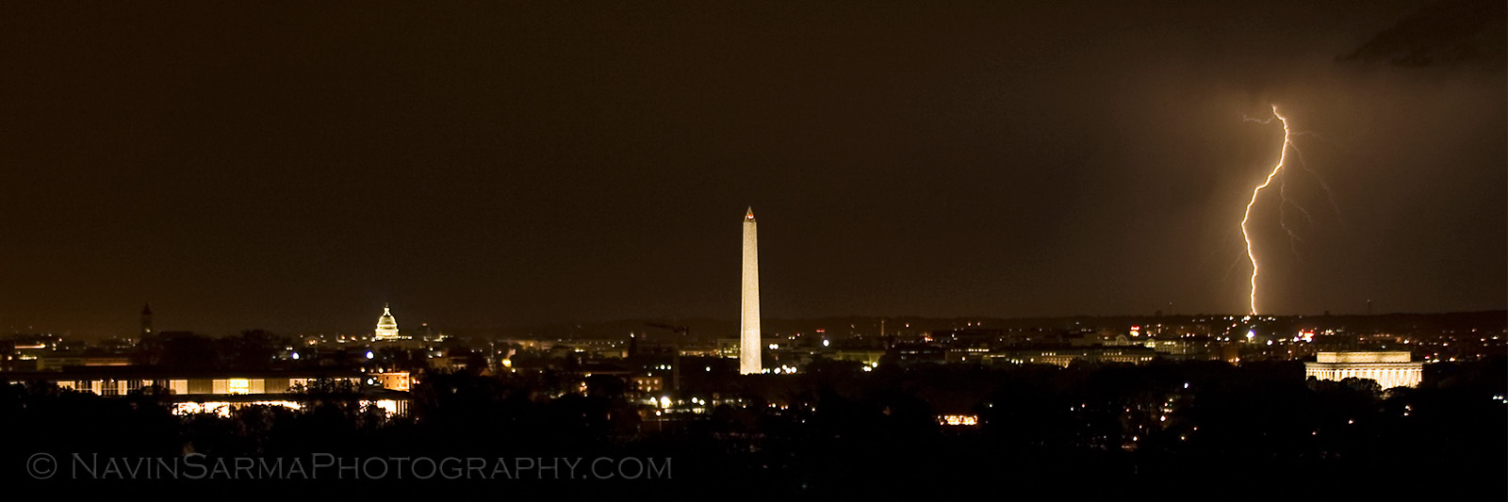
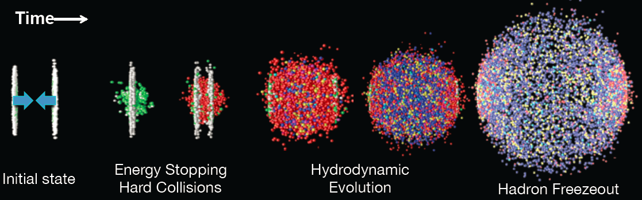




The Future Physics at RHIC
Positive Thinking!
Quark Matter Conference,
Washington DC (2012)
Jamie Nagle
University of Colorado
Jamie Nagle
University of Colorado

Slide 2
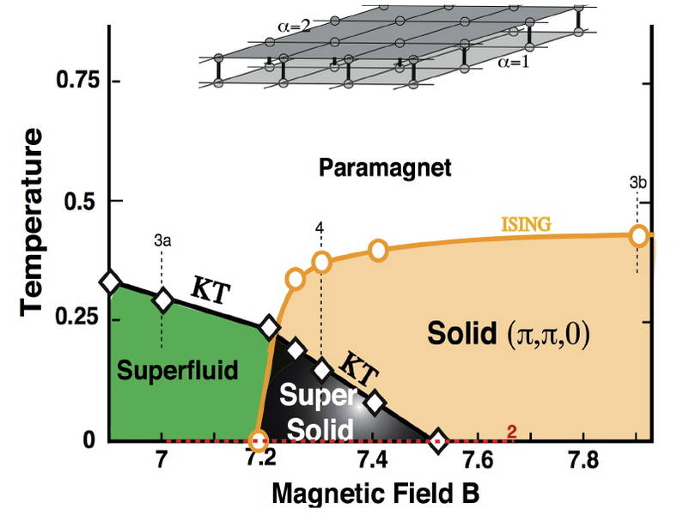
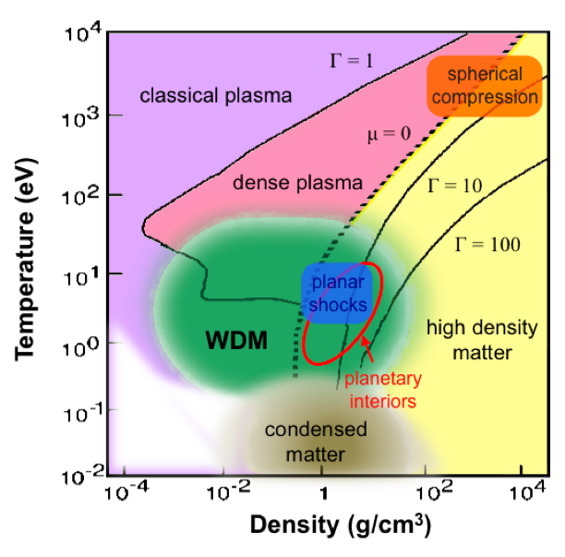
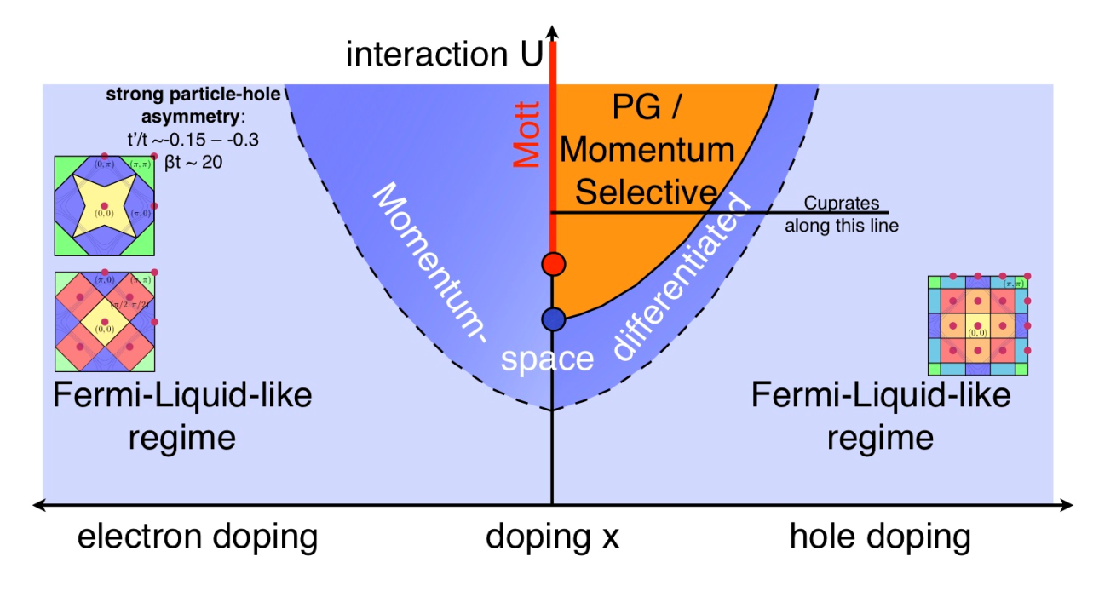
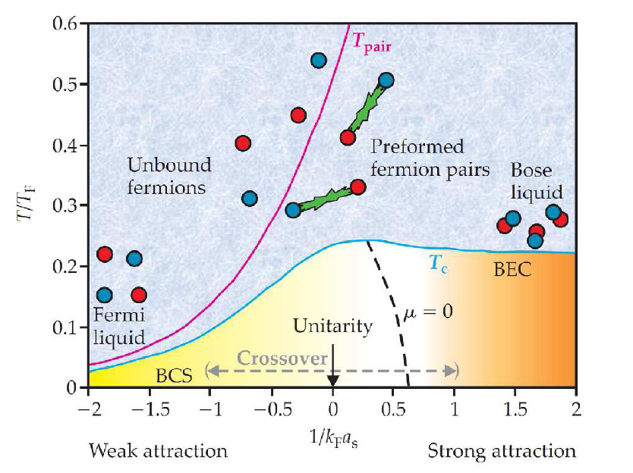
Electromagnetic Interaction → Very Rich Structures

Slide 3
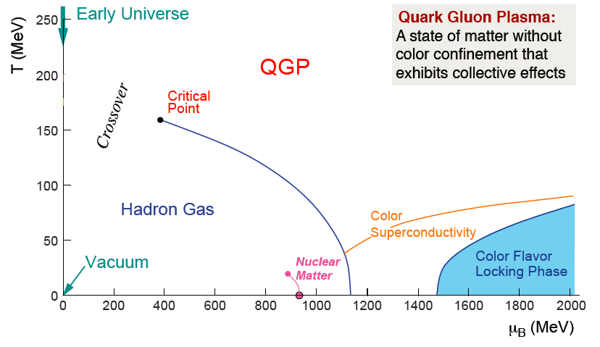
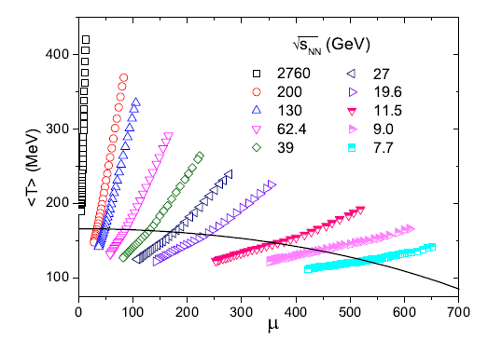
Nuclear Interaction → Very Rich Structures
Quark Gluon Plasma
Temperature [MeV]
Baryon Chemical Potential [MeV]
Laboratory tools (RHIC and LHC)
allow us to explore the richness of
QCD ‘condensed matter’ physics

Slide 4
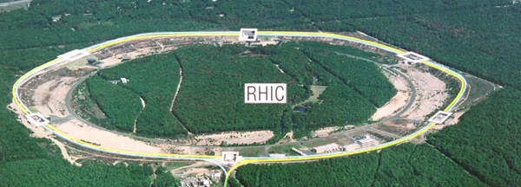
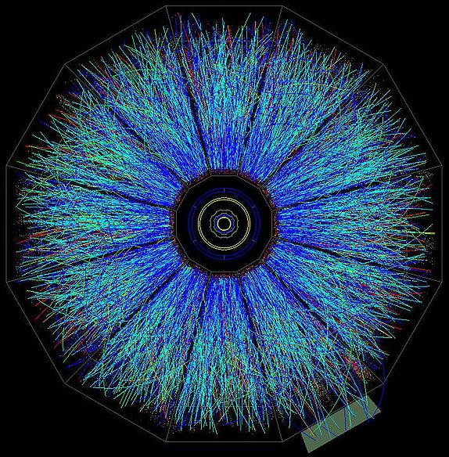
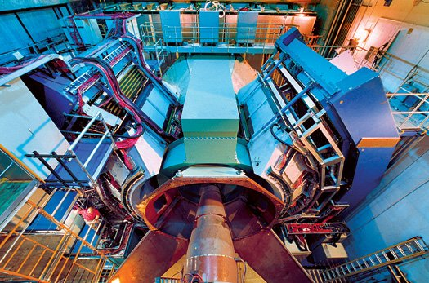
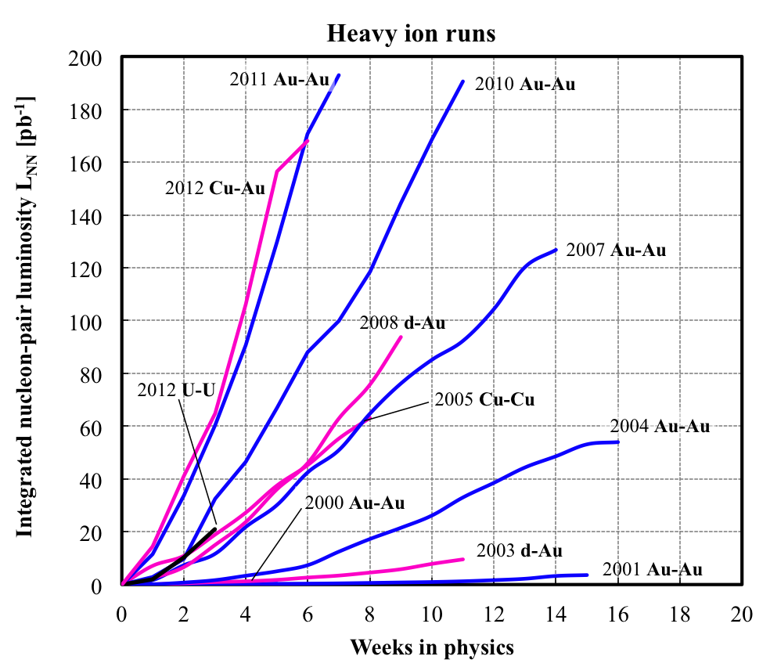
Laboratory Tool (RHIC)
RHIC – 7-200 GeV/nn
PHENIX
STAR
RHIC Machine Performance
3D stochastic cooling
L > 15 x RHIC design Au+Au
New EBIS Source provides
new geometries (U+U)
Great energy flexibility
Polarized p+p Program
Integrated Luminosity
Weeks in Physics

Slide 5
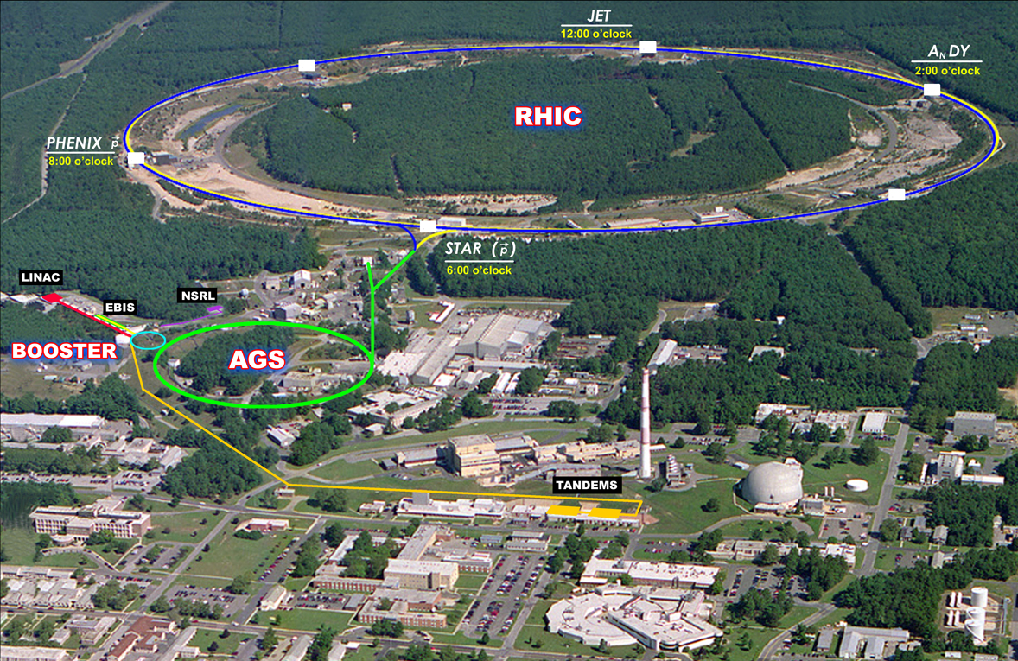
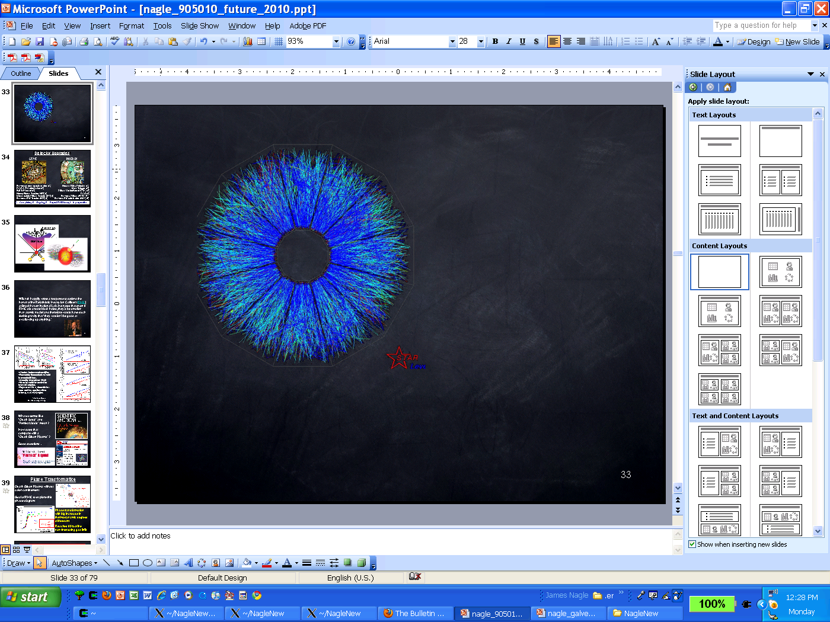
RHIC-II performance is here!
Unfortunate that because RHIC did it
3 years earlier and for 1/7 the cost, there are no fireworks…

Slide 6
Three key physics motivations for future physics
What is the nature of the QGP at μ_{B}>0?
Can we map the transition from plasma to hadron gas?
Is there a critical point in the phase diagram?
How does the QGP transition from
strong to weak coupling?
How do QGP properties change from T=170 – 400 MeV?
What is the nature of cold dense gluonic matter?
Do results from p(d)+A at RHIC and LHC give a consistent picture of gluonic matter?
* More speculative search for exotic phenomena…

Slide 7
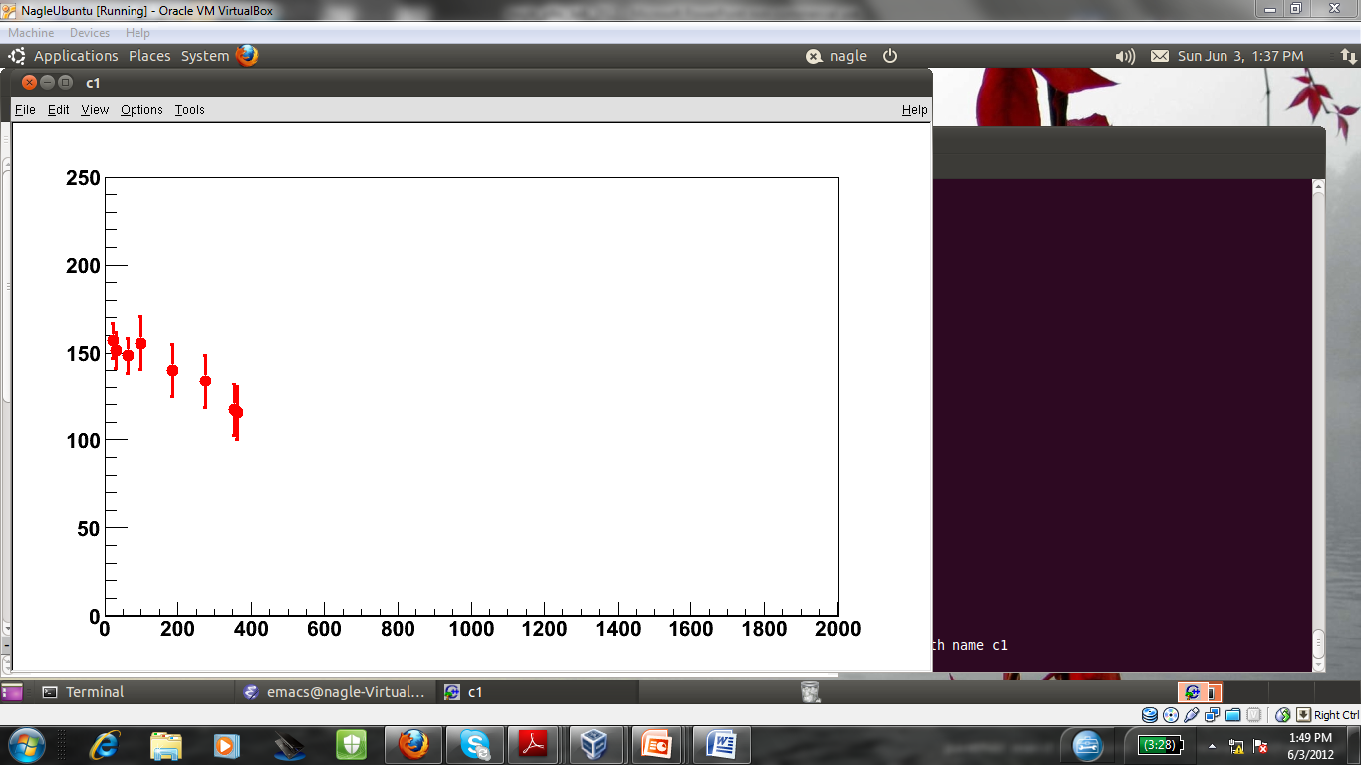
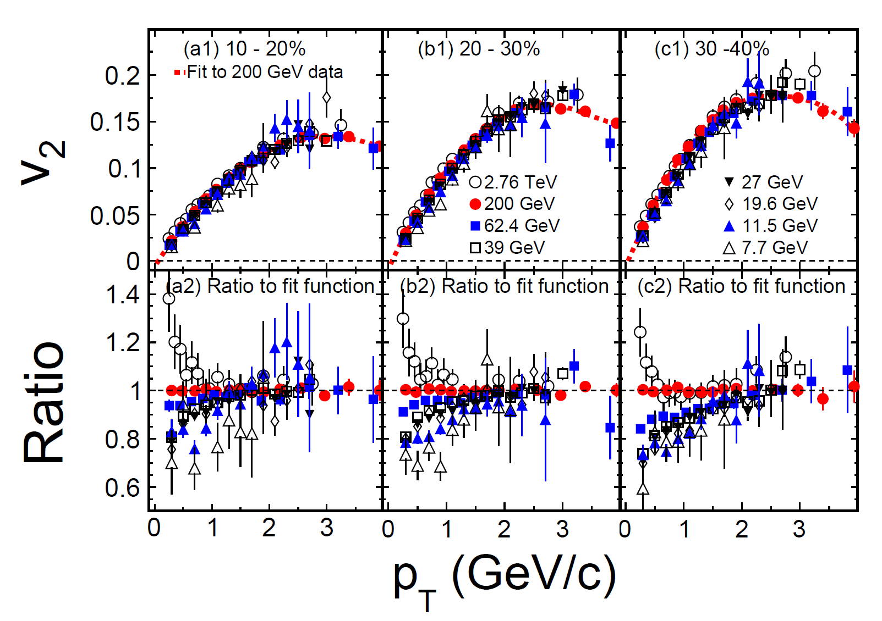
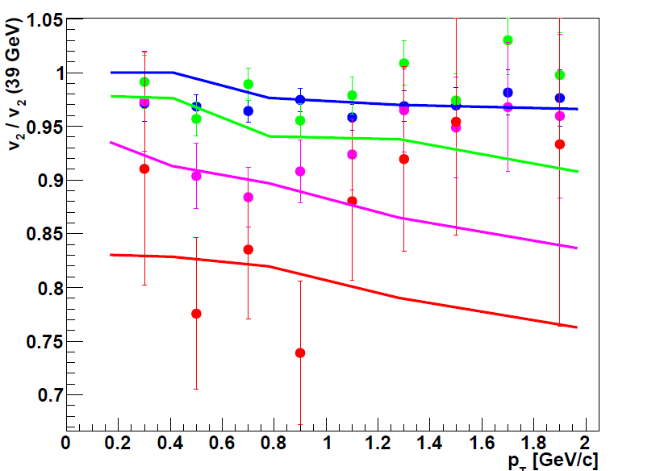
Nature of the QGP at μ_{B}>0?
RHIC first phase energy
scan complete
7.7, 11.5, 19.6, 27,
39, 62.4, 200 GeV
Does Perfect Fluidity Disappear?
T (MeV)
μ_{B} (MeV)
STAR: arXiv:1206.5528
v₂ / v₂ @39 GeV
27
19
11
7
Lines = Viscous (η/s=1/4π)
Shen, Heinz arXiv:1202.6620

Slide 8
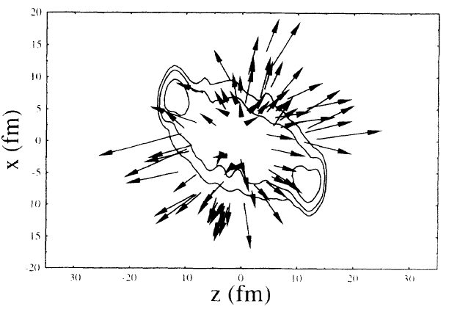
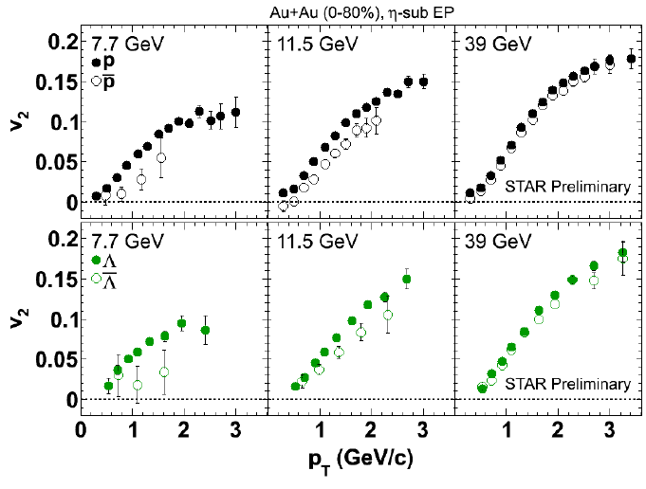
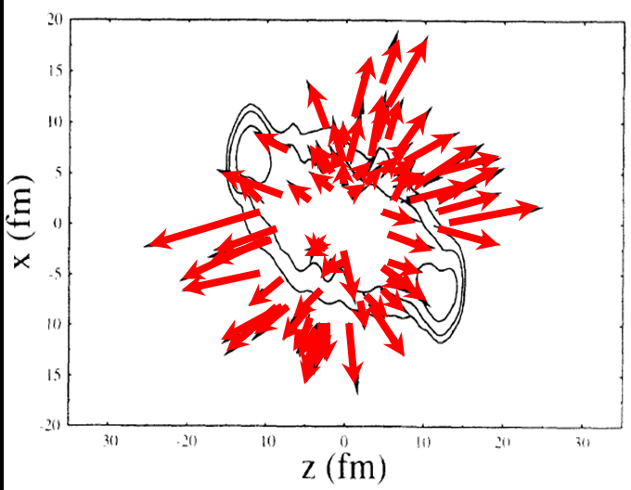
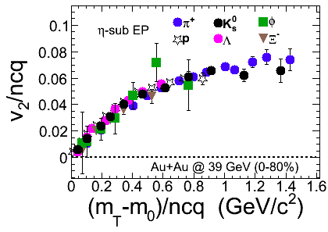
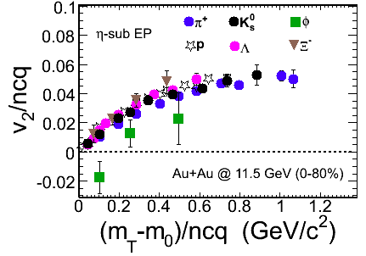
At lower energies, anti-proton anti-flow predicted
Anti-Flow
Flow
A. Jahns et al. (PRL 1994)
Higher energies, all hadrons reflect parton flow.
Lower energies, expect hadronic system,
φ and Ω with small cross section fall out of flow pattern.

Slide 9
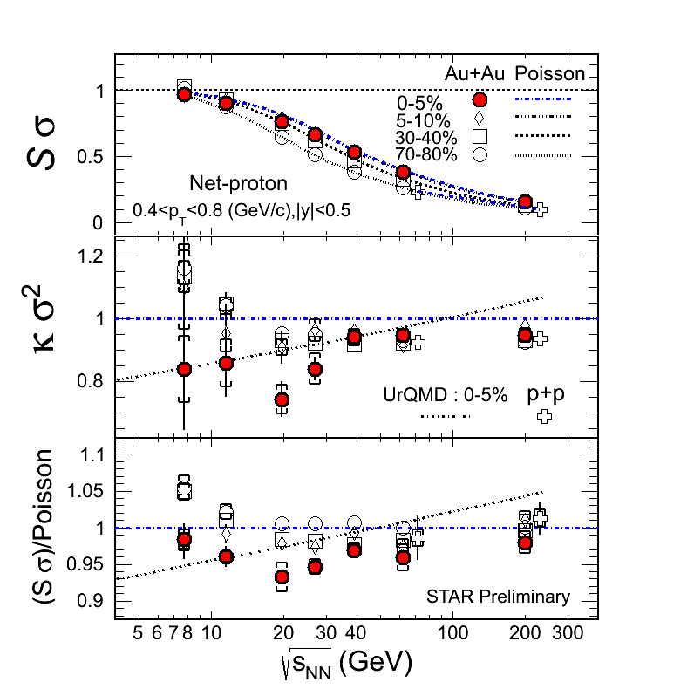
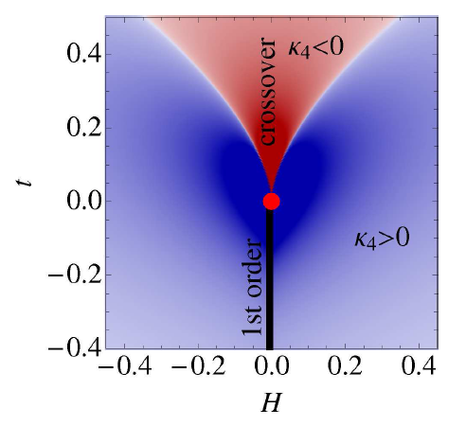
Critical Point Search
Net Proton Fluctuations
Examine fluctuations and their higher moments
Stephanov, PRL 107: 052301 (2011)
??
What does it mean that
some signals are seen and others are not?

Slide 10
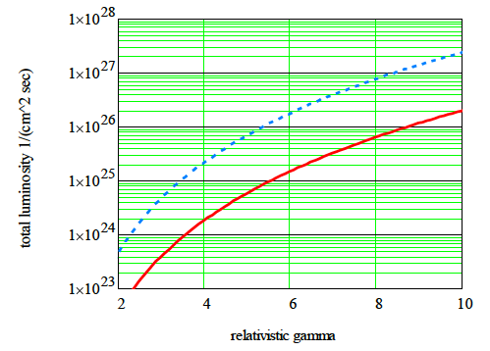
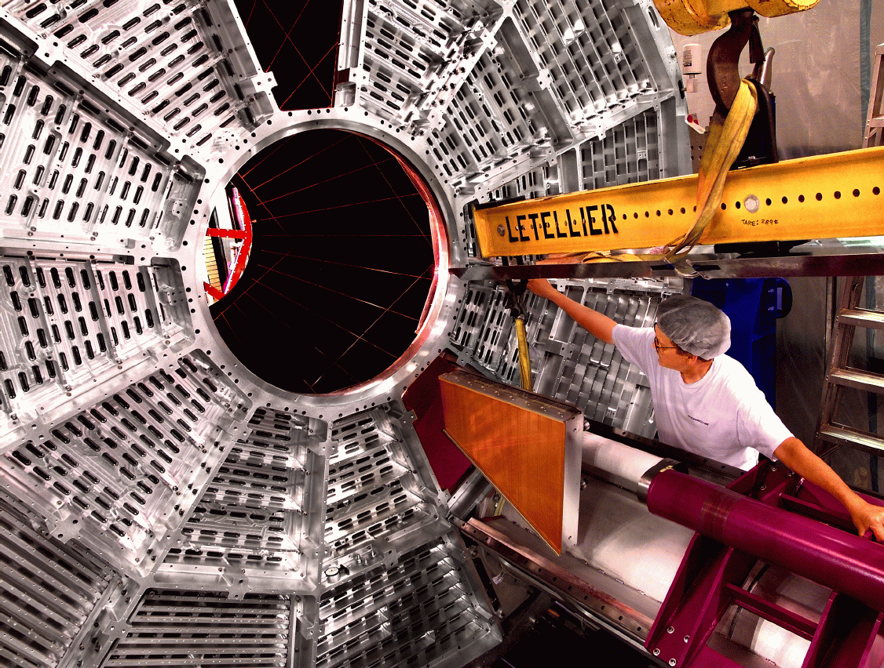
Must move from “Hints” → “Definitive Answers”
Beam Energy Scan (BES) Phase II
e-cooling for low energy
RHIC operation
Increased acceptance for
STAR and PHENIX
RHIC with cooling
and long bunches
RHIC w/o cooling
High brightness SRF electron gun or Fermilab Pelletron for 10x L
STAR Inner TPC Readout
Improved tracking and dE/dx PID
Extend η coverage 1.0-1.7

Slide 11
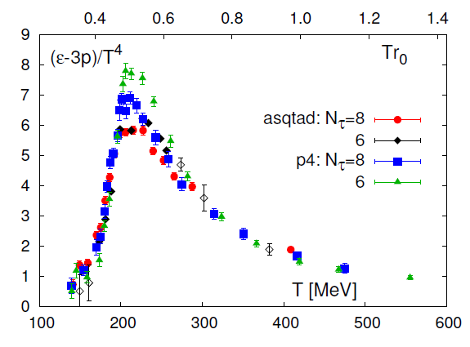
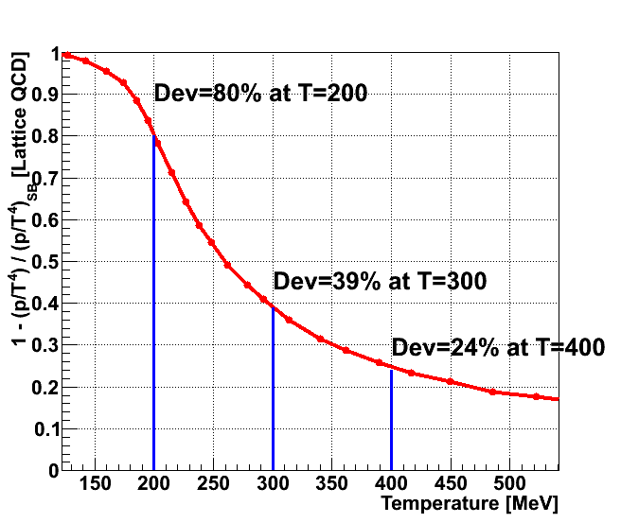
Transition from Strong to Weak Coupling?
What does Trace Anomaly tell us?
P/T⁴ deviation from SB?
Data from Phys. Rev. D80, 014504 (2009)
Some say no information on coupling
Caveats of AdS/CFT example
RHIC and LHC give a key lever arm in Temperature.
If the QGP properties are not different, why not?

Slide 12
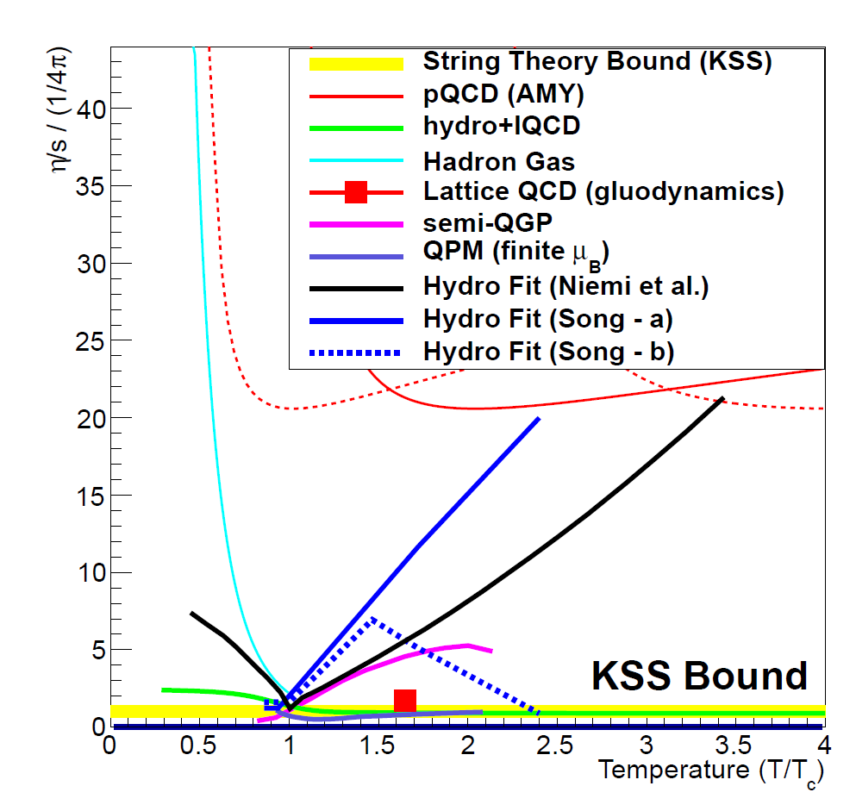
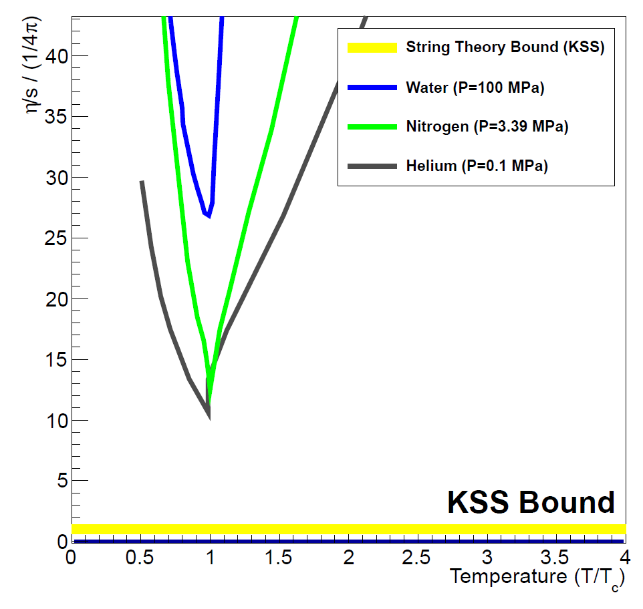
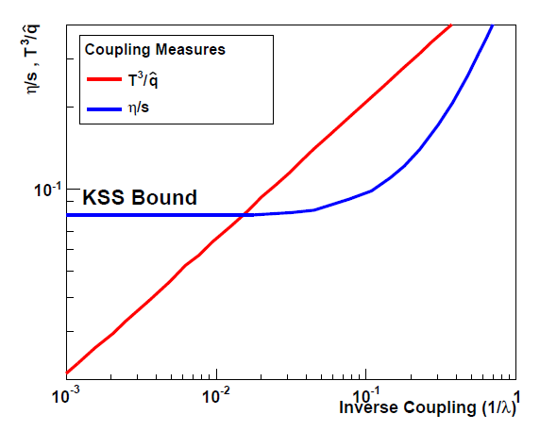
Coupling Measures
η/s
^
T³/q
“Small Shear Viscosity Implies Strong Jet Quenching”
A. Majumder, B. Muller, X.N. Wang, PRL (2007).
Measure both sides to check strong versus weak case.
?

Slide 13
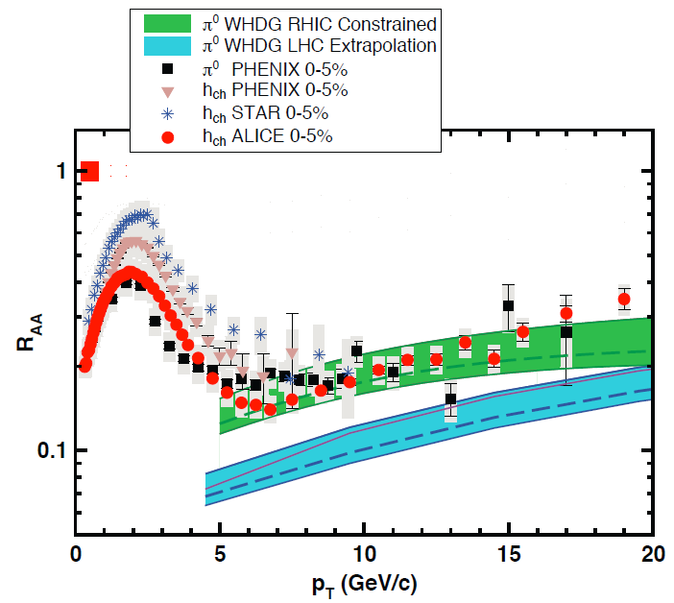
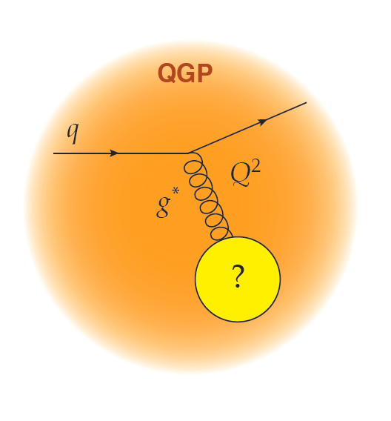
RHIC and LHC Jet Quenching
Collisional energy loss sensitive to mass m
of scatters.
Key to study as a
function of scale.
“The surprisingly transparent QGP at the LHC [compared to RHIC]”
Horowitz and Gyulassy, NPA (2011)

Slide 14
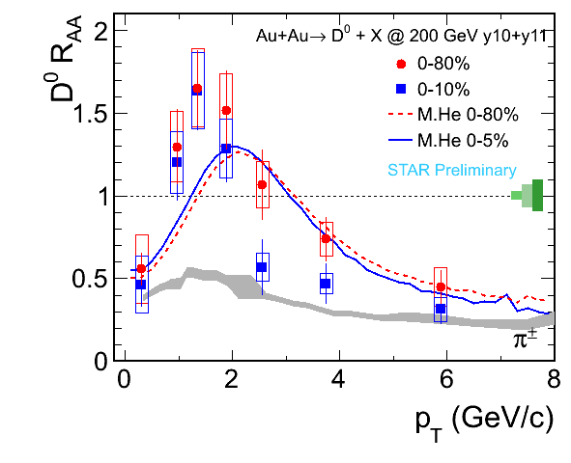
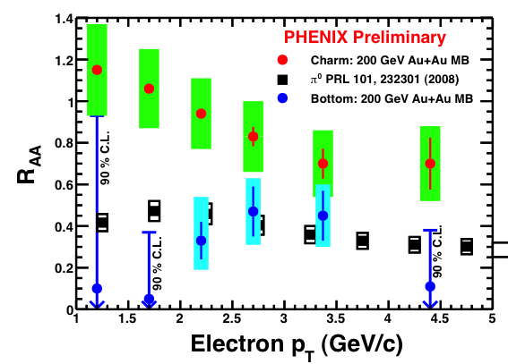
RHIC Heavy Flavor Upgrades (Now)
STAR TOF + DAQ1000
PHENIX VTX
Using FONLL shape as reference
Some say “jet quenching physics will be figured out soon, and so no need for more RHIC data?”
Answer: Surely you’re joking!
STAR Heavy Flavor Tracker (2014)
sPHENIX Proposal (tag c/b jets)

Slide 15

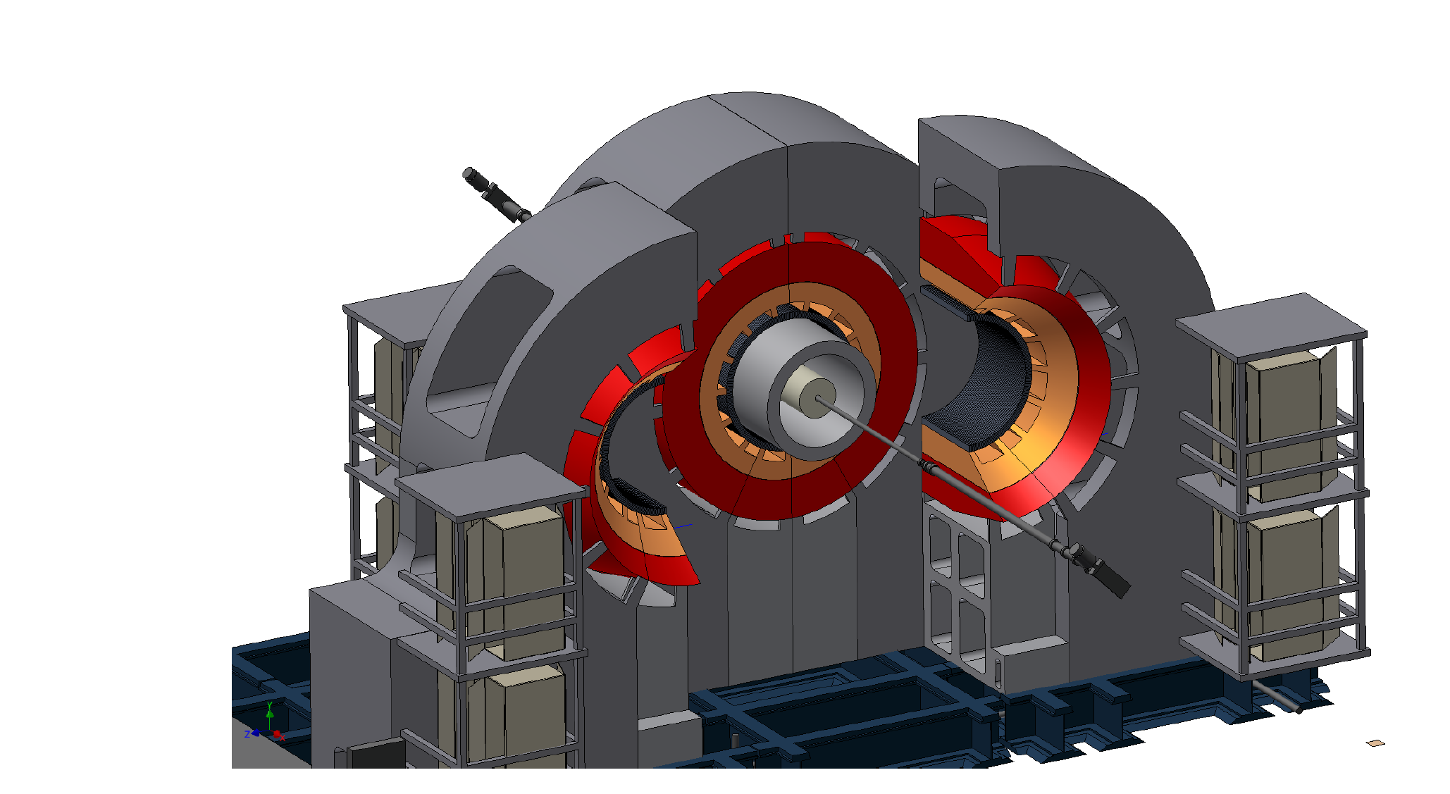
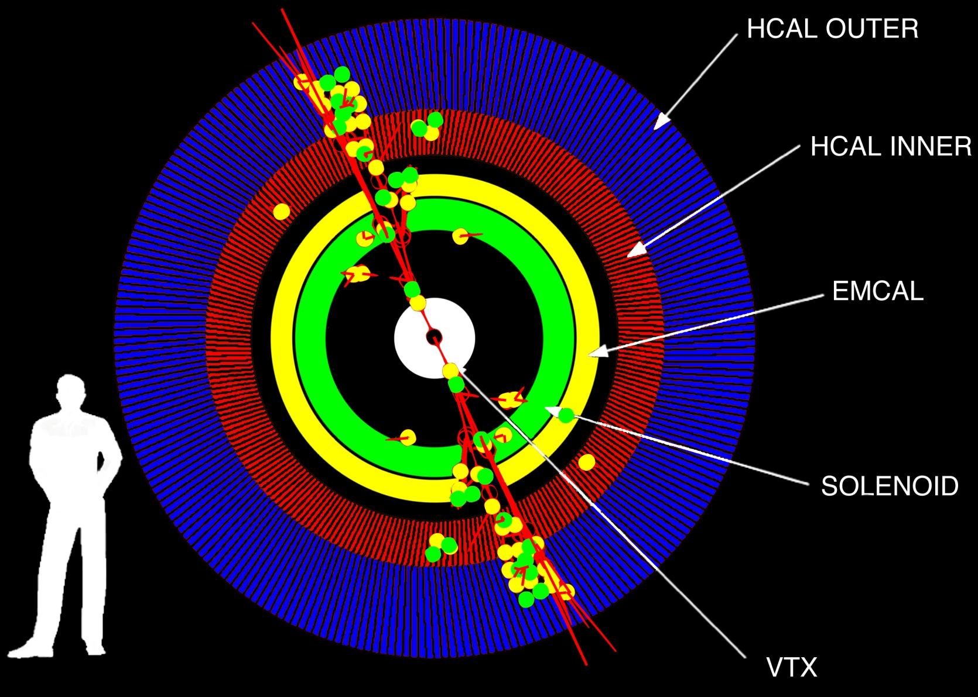
Proposal submitted to BNL (~$25M) for sPHENIX July 1, 2012
Details available at http://arxiv.org/abs/arXiv:1207.6378

Slide 16
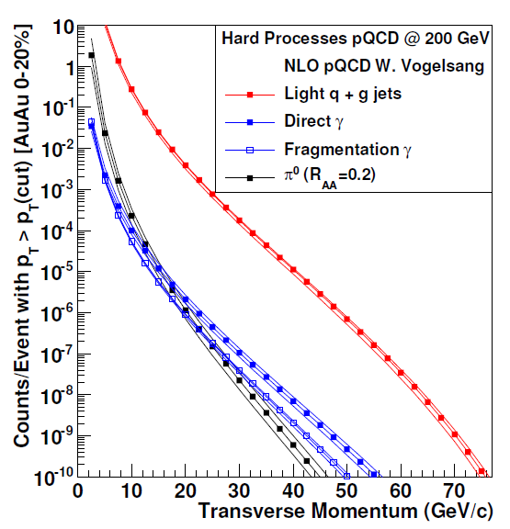
RHIC Jets, Dijets, γ-Jet
Sampling 50 billion Au+Au
events in one year
10⁷ jets > 20 GeV
80% are dijet events
10⁴ direct γ > 20 GeV
A+B
p+A (different nuclei)
U+U
Differential measures
For details on fake jet rates see: A. Hanks, A. Sickles et al., Phys. Rev. C 86, 024908 (2012)

Slide 17

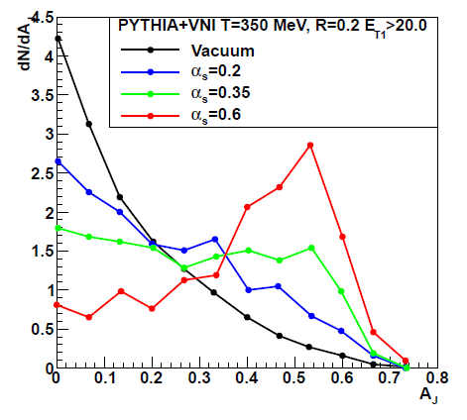
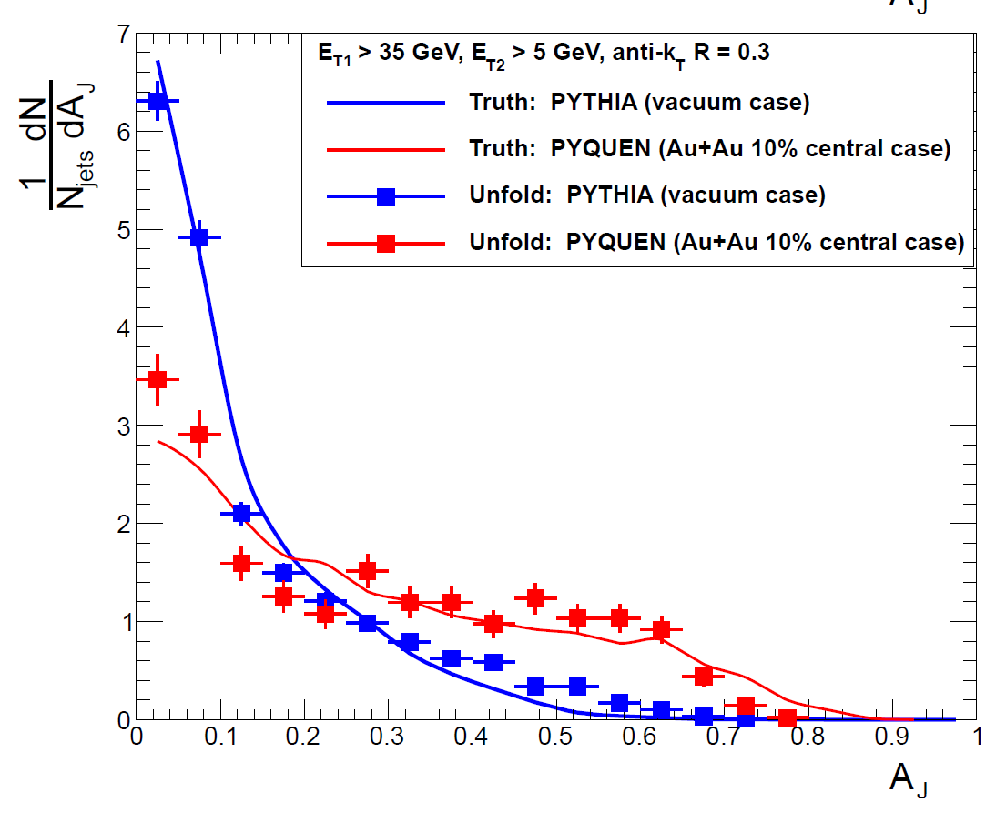
X.N. Wang taking the photo
Coleman-Smith Calculation
sPHENIX Simulation
No quench
Strong quench
Dijet Asymmetry
Dijet Asymmetry

Slide 18
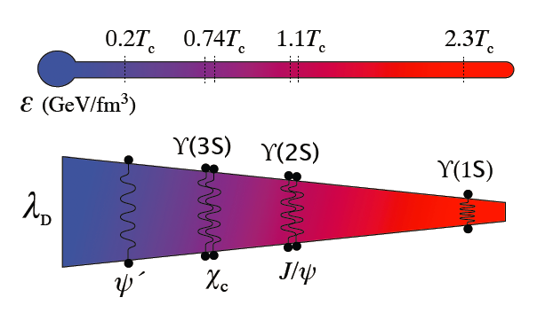
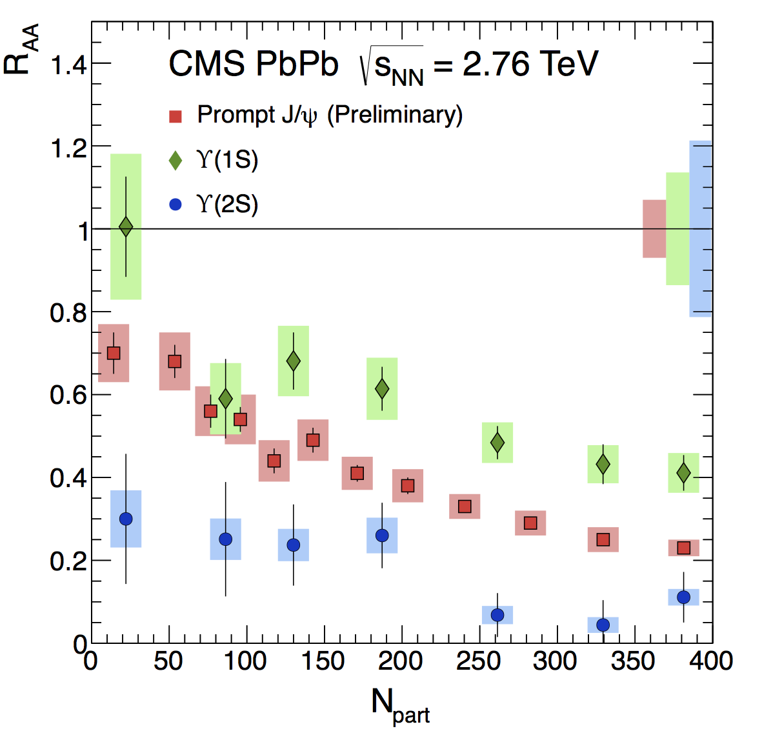
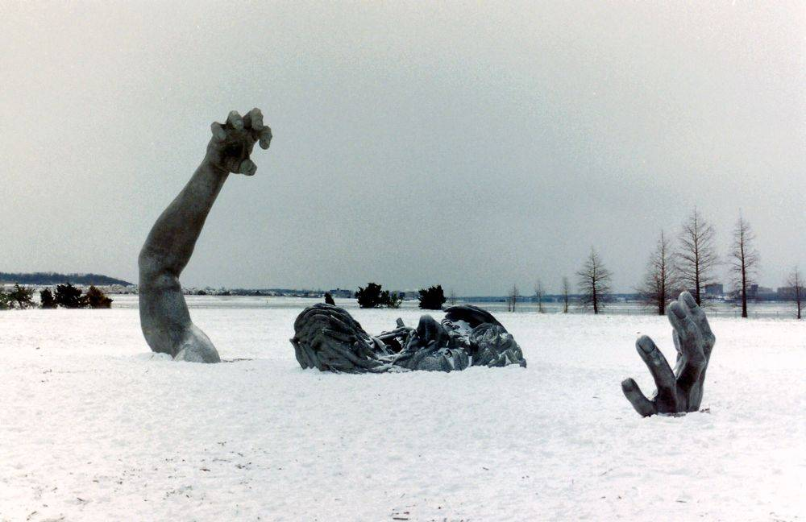
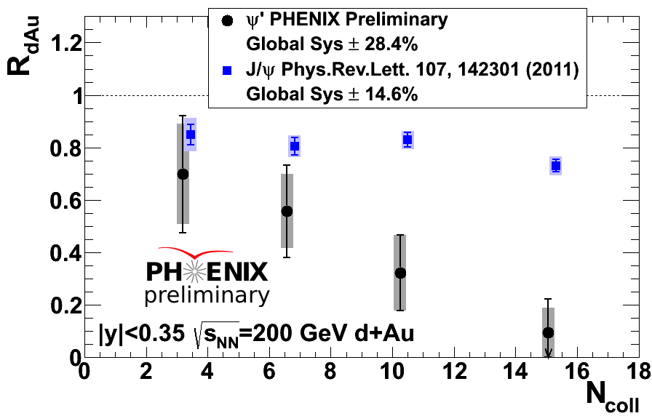



Quarkonia Thermometer
STAR and CMS data consistent with melting of Υ(2s,3s)
PHENIX d+Au
Know your
Baseline and Control
J/ψ
ψ’
N_{part}

Slide 19

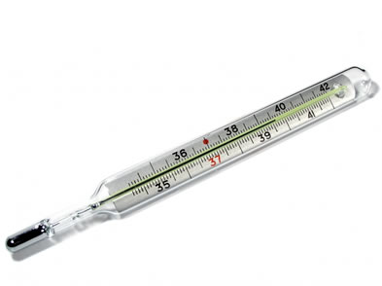
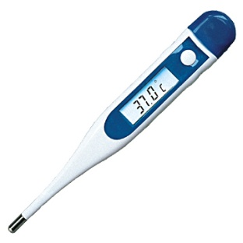
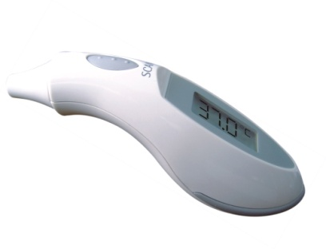

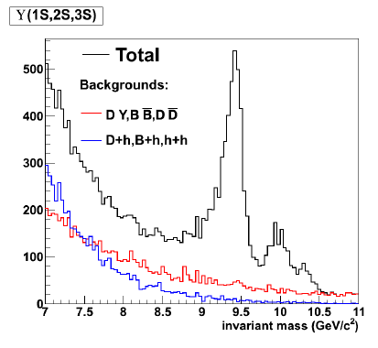
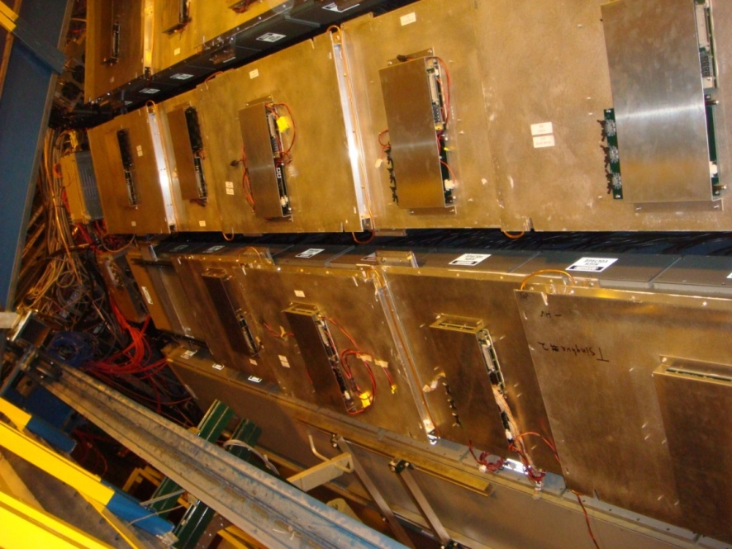
Thermometer Upgrade
And Calibration (RHIC & LHC)
STAR Muon Telescope Detector
Upsilon Measurement
Full physics in 2014
sPHENIX
Another 7x Acceptance

Slide 20
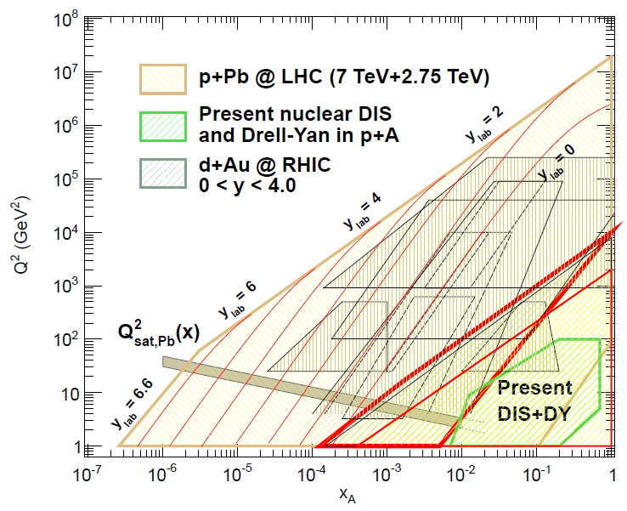
p + A and Gluon Saturation
Geometric
Dependence is Key
Test picture of factorization of nPDFs,
multi-parton interaction (MPI) contributions,
and high-x anti-shadowing / EMC effects at backward rapidity.
Stochastic Cooling at RHIC enables switch to p+A quickly.
Very exciting option for p+C, p+Si, p+Cu, p+Au all in one run!

Slide 21

Polarized p-A Insights
RHIC is a unique collider with spin polarized protons
Large transverse spin effects observed at forward rapidity (x_{F})
Exploiting the link between the TMD and CGC frameworks, one can learn about the saturation scale via transverse spin asymmetries!
http://arxiv.org/abs/arXiv:1106.1375

Slide 22



Forward Thinking
proton
nucleus
~ 6 GEM disks
Tracking: 2.5 < η < 4
Forward Calorimeter System (FCS)
FHC (E864)
Pb-Sc HCal
FHC (E864)
W-Powder EMCal
RICH/Threshold
Baryon/meson separation
Both designed for evolution into
Electron Ion Collider (EIC) detectors

Slide 23
Exciting science driven program for the next decade.
The key is convincing the right people of that.
Great RHIC Physics Ahead!
better than a talking bullfrog,
which is better than a Congressman.

Slide 24
Extra

Slide 25


Slide 26




Probing the Medium
When does the strongly coupled bulk (lower momentum IR)
transition to a weakly coupled probe (higher momentum UV)?

