Slide 1
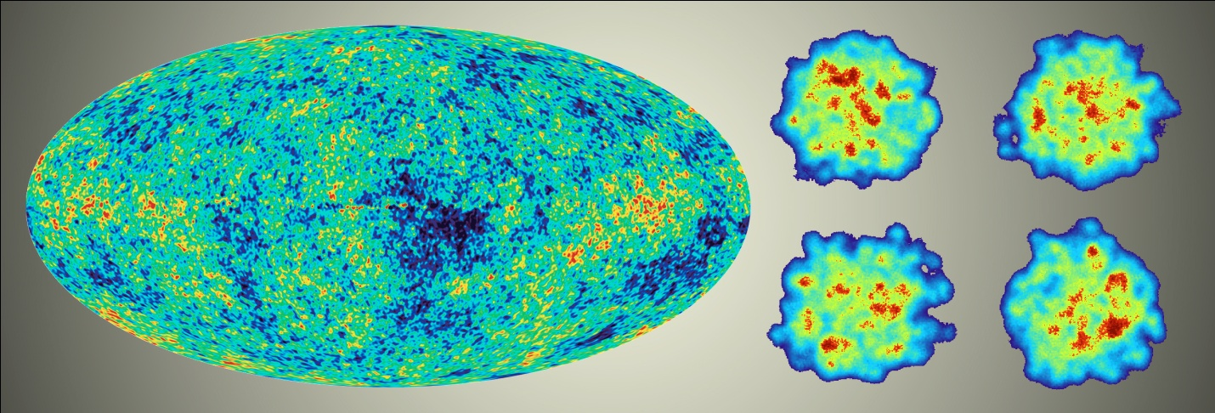
Science of the Quark-Gluon Plasma
What the Future Holds?
In different parallel funding universes

Slide 2
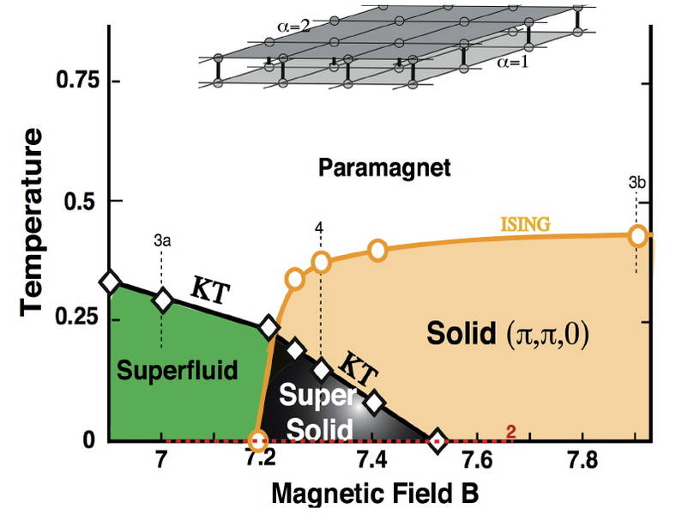
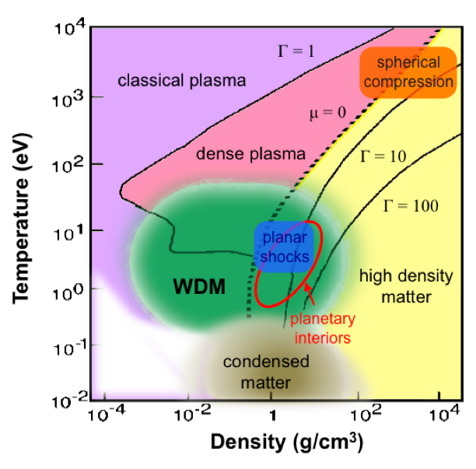
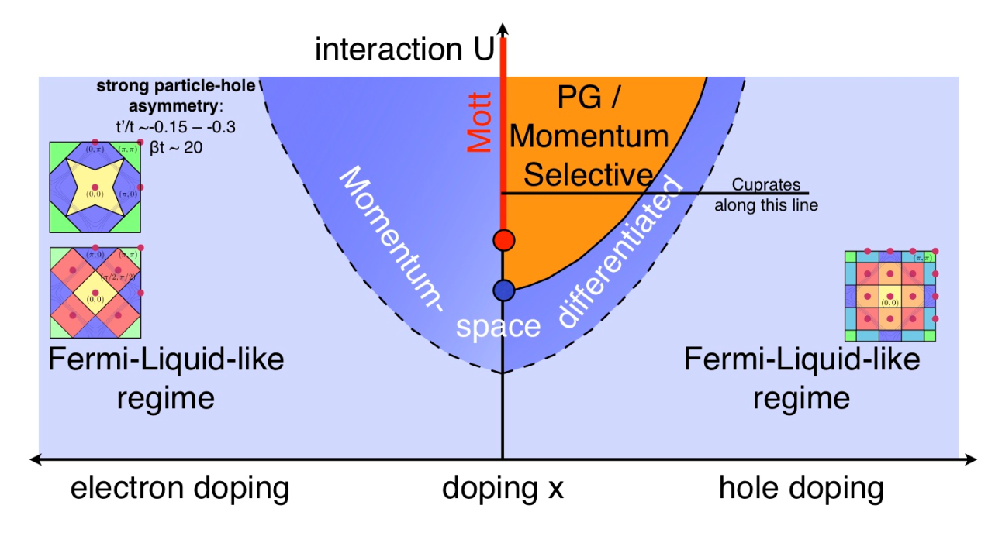
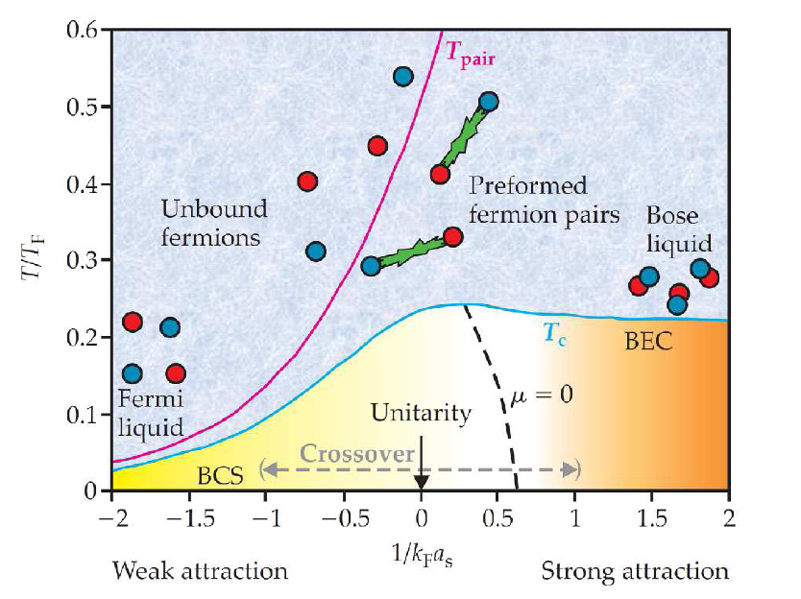
Electromagnetic Interaction → Very Rich Structures

Slide 3
Nuclear Interaction → Very Rich Structures
Laboratory tools (RHIC and LHC) allow us to explore the
richness of QCD ‘condensed matter’ physics
Only phase diagram directly connected to QCD Lagrangian

Slide 4
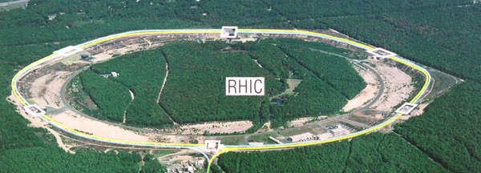
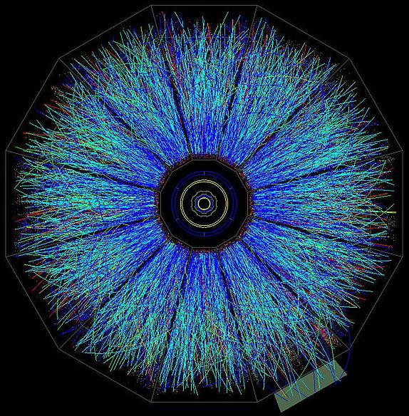
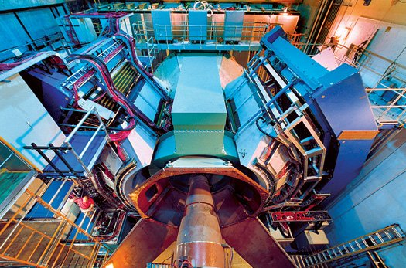
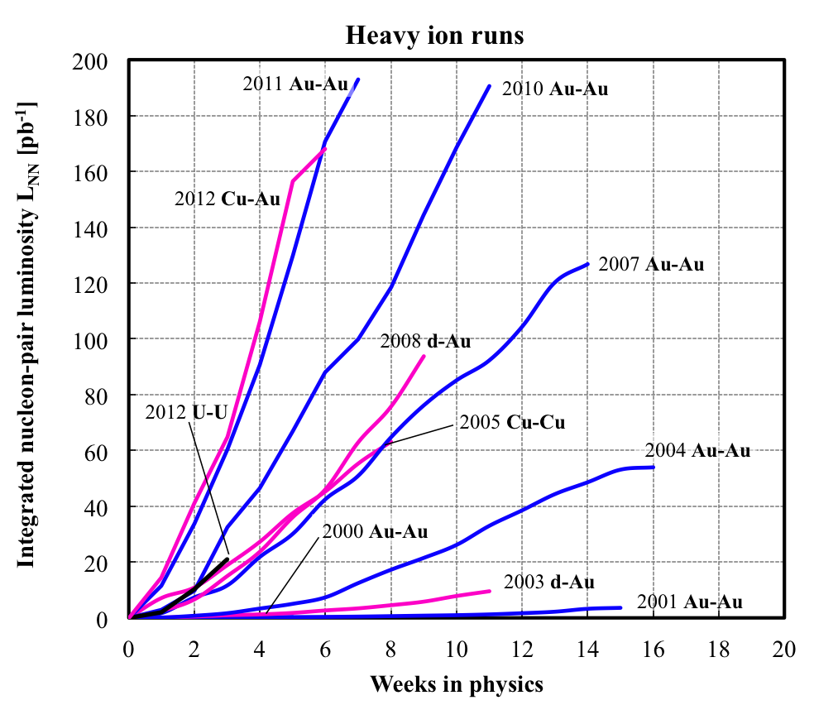
Laboratory Tool (RHIC)
RHIC – 7-200 GeV/nn
PHENIX
STAR
RHIC Machine Performance
3D stochastic cooling
L > 15 x RHIC design Au+Au
New EBIS Source provides
new geometries (U+U)
Great energy flexibility
Polarized p+p Program
Integrated Luminosity
Weeks in Physics

Slide 5
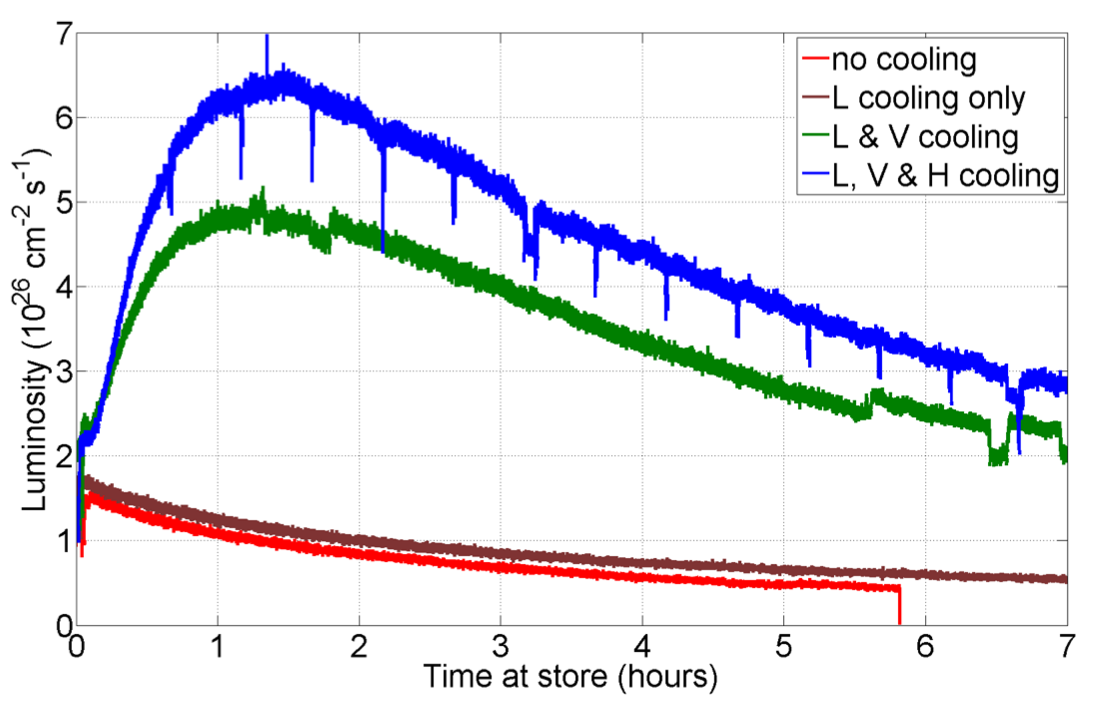
RHIC-II performance is here!
3 years earlier and for 1/7 the cost
2012 RHIC U-U run
National Academy Decadal Survey for Nuclear Physics (2012):
By capitalizing on strategic investments, including the ongoing upgrade of the continuous electron beam accelerator facility (CEBAF) at the Thomas Jefferson Accelerator Facility and the recently completed upgrade of the relativistic heavy ion collider (RHIC) at Brookhaven National Laboratory, as well as other upgrades to the research infrastructure, nuclear physicists will confront new opportunities to make fundamental discoveries and lay the groundwork for new applications.

Slide 6
2007 Long Range Plan (four recommendations) included
#4: “The experiments at the Relativistic Heavy Ion Collider have discovered a new state of matter at extreme temperature and density—a quark-gluon plasma that exhibits unexpected, almost perfect liquid dynamical behavior. We recommend implementation of the RHIC II luminosity upgrade, together with detector improvements, to determine the properties of this new state of matter.”
Significant contributor to rank was $100M cost.
2007 LRP: "New funding made available to our field will be used to revitalize the tools of our trade. The four recommendations of this Plan present a roadmap for new investment in facilities and the development of new experimental equipment that will allow us to continue to address the scientific challenges of our field into the future. These recommendations can be implemented in a staged approach over the course of the next decade. During this period, we must continue to operate effectively our existing flagship facilities to make optimal use of their capabilities."
Technical breakthrough of stochastic cooling allowed the #4 recommendation to be accomplished in 2012 (and ready for physics)… earlier than construction priorities #1, 2, 3.
One must incorporate this reality.

Slide 7
Three key physics motivations for future physics
What is the nature of the QGP at μ_{B}>0?
Can we map the transition from plasma to hadron gas?
Is there a critical point in the phase diagram?
How does the QGP transition from
strong to weak coupling?
How do QGP properties change from T=170 – 400 MeV?
New insights gained about other strong coupled systems?
What is the nature of cold dense gluonic matter?
What are parton distributions in nuclei and
at what scale do the gluons saturate?

Slide 8
Nature of the QGP at μ_{B}>0?
World’s Most Flexible Collider
RHIC first phase energy
scan almost complete
7.7, 11.5, 19.6, 27,
39, 62.4, 200 GeV
It is not yet known whether nuclear matter has a critical point, nor where it might lie in the phase diagram.
The experimental discovery of the critical point would represent a giant leap forward in our understanding of nuclear matter. It would provide a distinctive landmark in the mapping of its phase diagram.

Slide 9
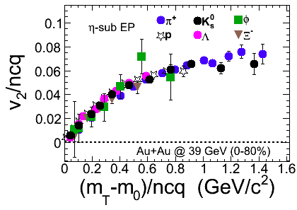
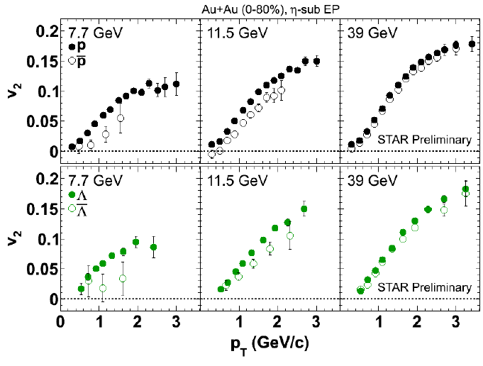
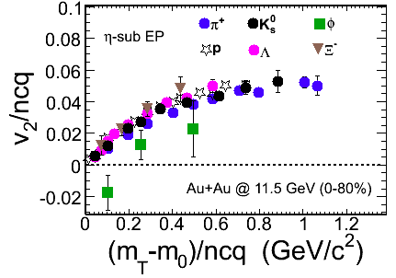
Partonic Flow Reflected by All Hadrons
Protons/Antiprotons
> 39 GeV
At the lower energies, dominance of hadronic interactions
< 12 GeV

Slide 10
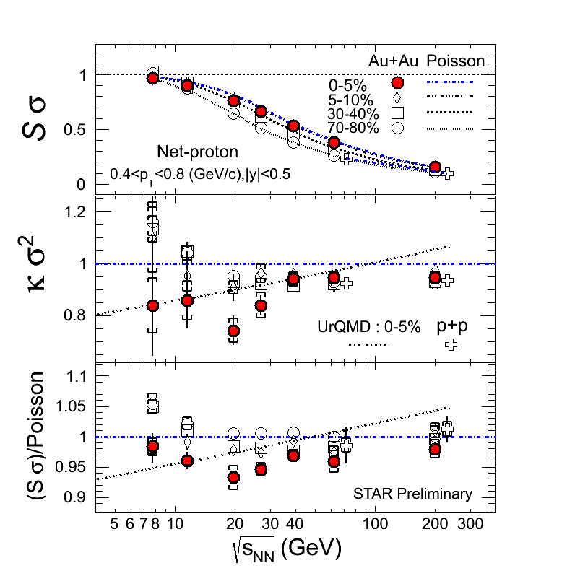
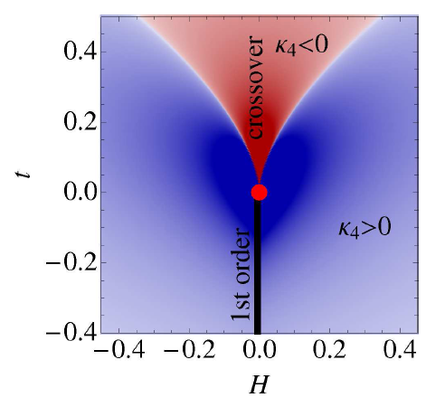
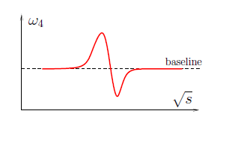
Critical Point Search
Examine fluctuations and their higher moments
Net Proton Fluctuations
??
Stephanov, PRL 107: 052301 (2011)

Slide 11
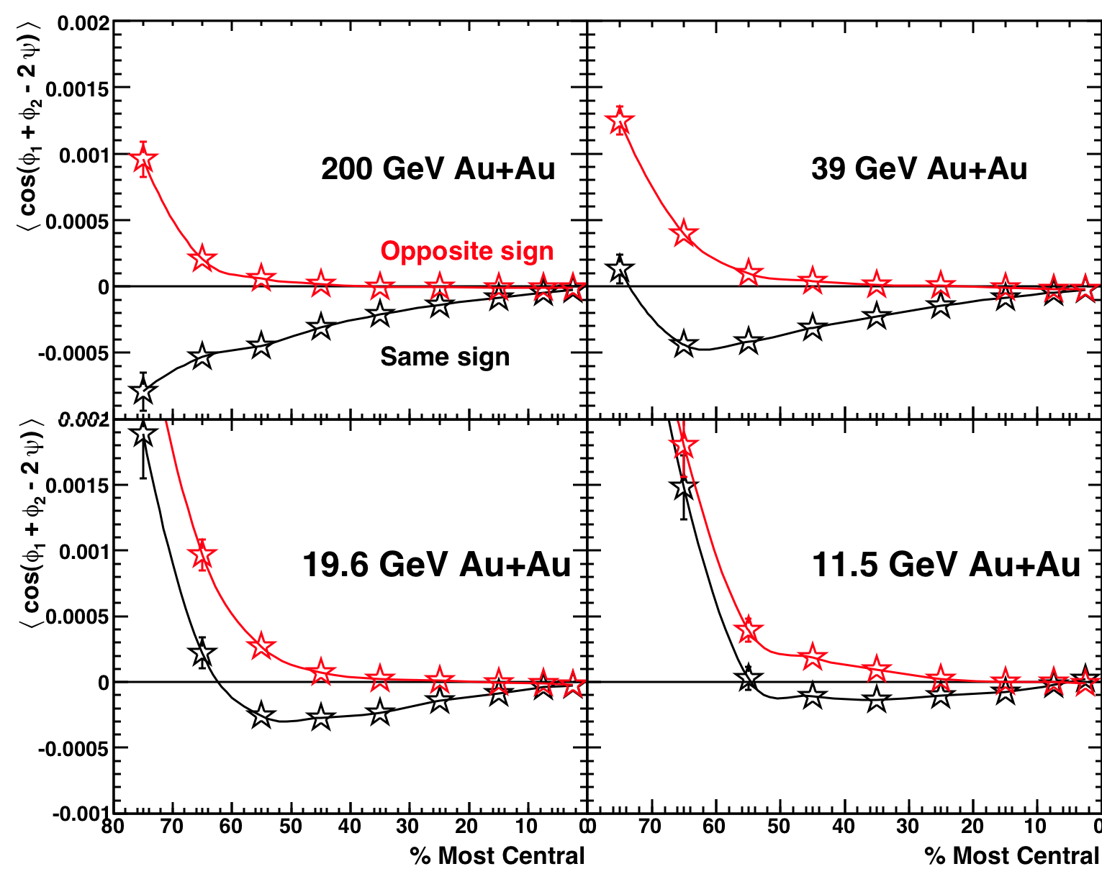
Quantum Fluctuations (Parity Violating Domains)
Predicted domains with deconfinement interact with magnetic field to produce observable effects
Chiral Magnetic Effect
Disappears at lower energy
B
STAR Preliminary
B
Control over both collision geometry and energy is unique to RHIC and relies upon its flexibility, putting the United States in the position to discover parity-violating domains. This makes RHIC the unique place for studying these quantum fluctuations, similar to those that may be responsible for the universe being made of matter today, instead of antimatter.

Slide 12
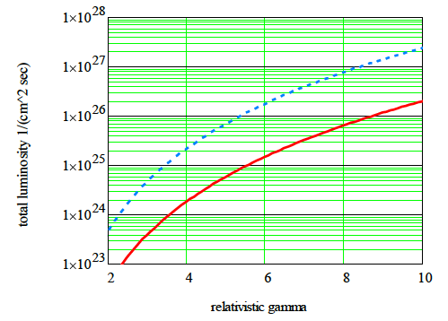
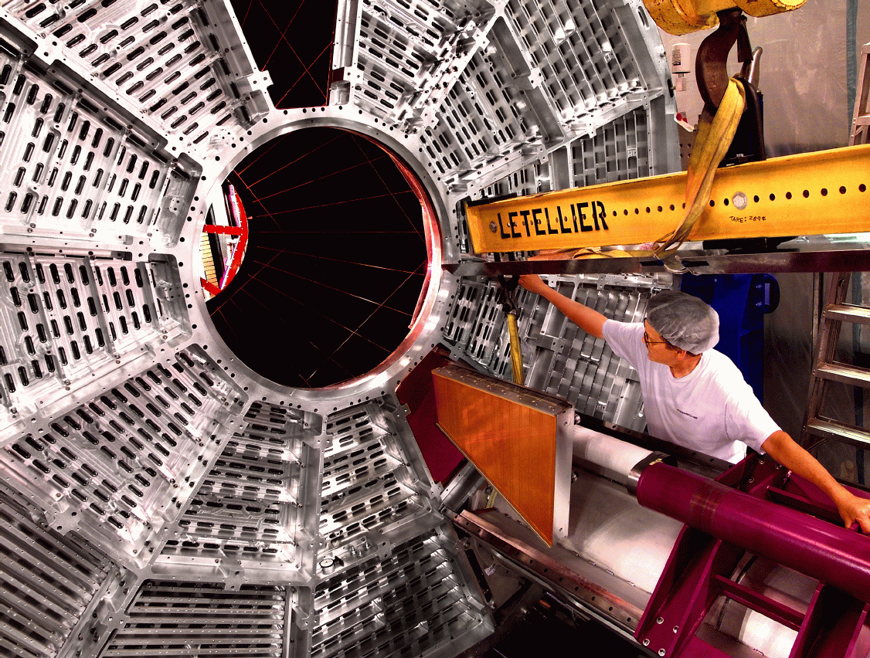
Must move from “Hints” → “Definitive Answers”
Beam Energy Scan (BES) Phase II
e-cooling for low energy
RHIC operation
Increased acceptance for
STAR and PHENIX
RHIC with cooling
and long bunches
RHIC w/o cooling
High brightness SRF electron gun
Phase I (2017) √s_{NN} = 5-9 GeV
Phase II (2018+)
[add 3 MeV booster cavity] √s_{NN} = 9-20 GeV
STAR Inner TPC Readout
Improved tracking and dE/dx PID
Extend η coverage 1.0-1.7

Slide 13
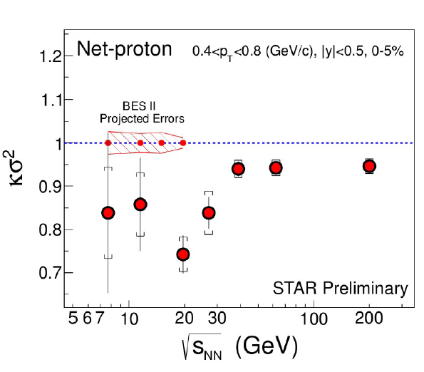
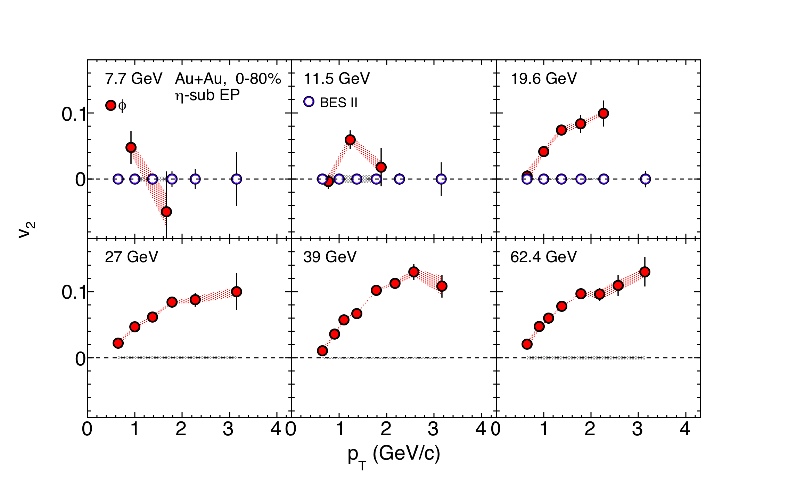
Physics Projections
70 weeks of current RHIC running required,
turns into 17 weeks with BES II
√S_{NN} (GeV) | 19.6 | 15 | 11.5 | 7.7
BES I (MEvts) | 36 | --- | 11.7 | 4.3
BES II (MEvts) | 400 | 100 | 120 | 80
φ flow (v₂) BES II Projected Uncertainties
BES II Projected Uncertainties

Slide 14
Completely unique RHIC discovery physics…
High impact, textbook ready
Made possible only through accelerator innovations
Beam Energy Scan Phase 2 starting in 2017
Turning RHIC off prior to 2017 simply terminates this program and the world loses this key physics.
If the deconfinement transition corresponds to collision energy > 11 GeV, no facility in the world will do this physics [see backup slides on NICA and FAIR programs]

Slide 15
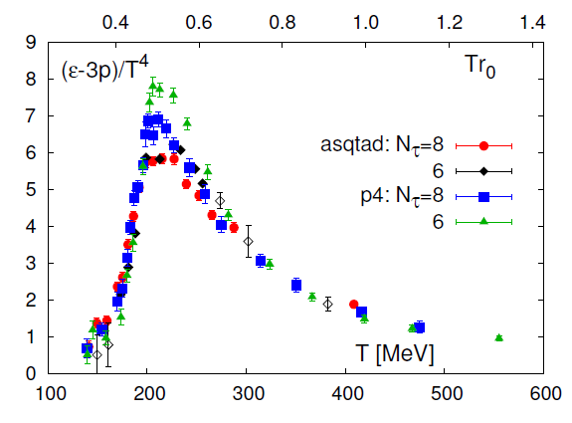
Transition from Strong to Weak Coupling
and Emergence of Quasiparticles?
Lattice tells us the character of QGP changes with T
RHIC and LHC give a key lever arm in Temperature

Slide 16
Strong Coupling and Fluidity
Need to understand how the most strongly coupled fluid emerges from an
asymptotically free theory?

Slide 17
RHIC
RHIC
RHIC
LHC
RHIC
RHIC
Collisions Map Out Temperature Evolution

Slide 18
Critical Questions
1. The LHC QGP evolves all the way from 420 → 170 MeV.
Can’t we disentangle everything from that?
Unfolding the full time evolution results in ambiguities that
can only be resolved with measurements at different
starting temperatures (many good worked examples).
Are we only trying to measure the coupling strength as a
function of temperature?
No, we are trying to disentangle the underlying mechanism
by which an asymptotically free theory makes a strongly
coupled liquid; how do quasiparticles at short length scales
disappear?

Slide 19
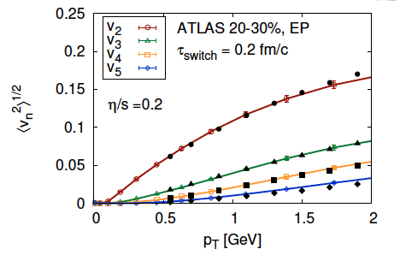
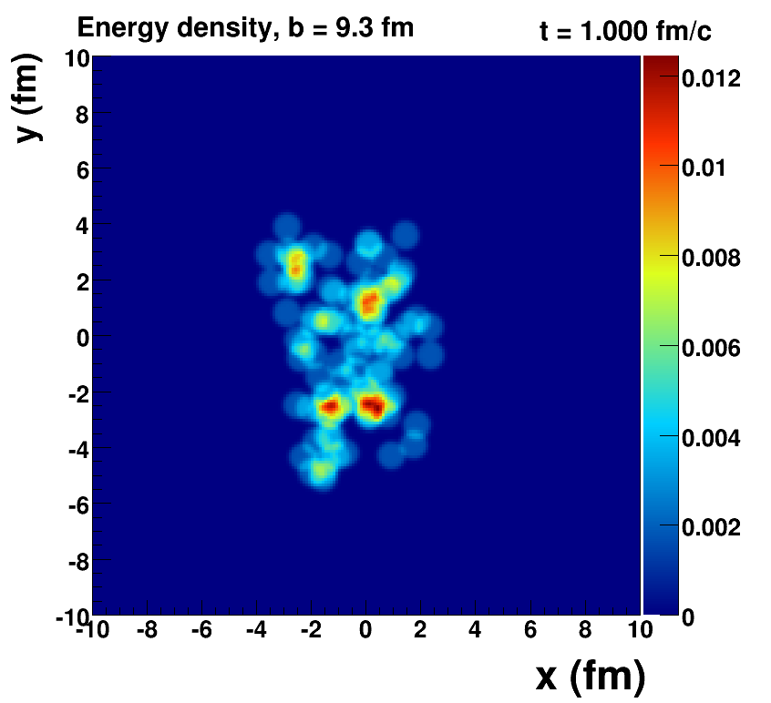
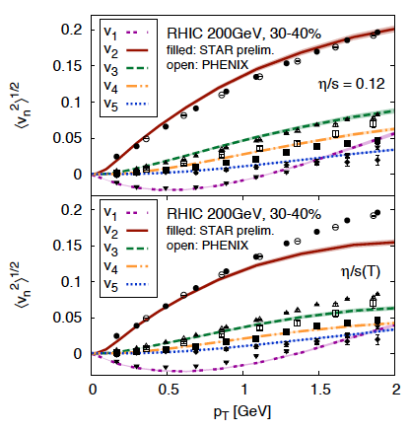
RHIC/LHC Interplay (Example)
Quantum Fluctuations
Survive Evolution!
Calculation from Bjoern Schenke
Steady increase of accuracy in quantities like the transport properties
of the QGP: Textbook Ready Physics

Slide 20
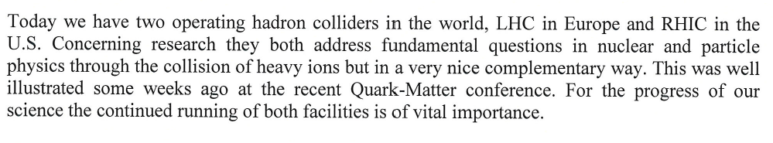

That is why there is very strong support for RHIC from the LHC community.
June 2012: Town Meeting of the European Strategy Group
Major Recommendations include “the complementarity of LHC and RHIC is an essential resource in efforts to quantify properties of the Quark-Gluon Plasma.”

Slide 21
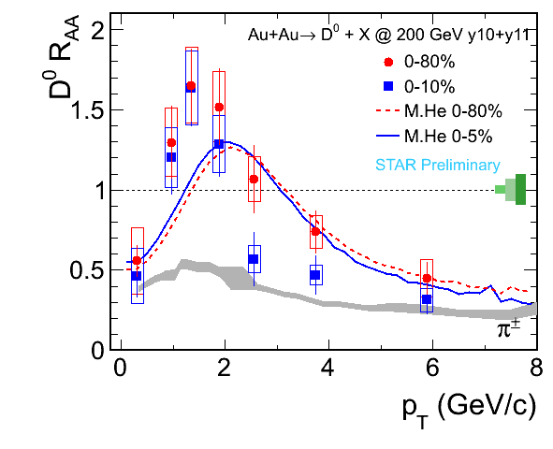
Is the QGP so strongly coupled it sweeps up very heavy charm, beauty quarks?
Very large suppression at the highest p_{T}
Blast from QGP pushed charm to higher p_{T}
Total surprise!
Perturbative QCD estimates predicted the opposite.
D⁰ and Λ_{c} key tests

Slide 22
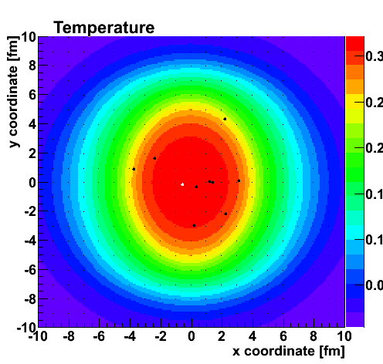
Heavy Quark Tracers
To match RHIC data, require strongest coupling near T_{c}!
Upgrade to ALICE to test T dependence further

Slide 23
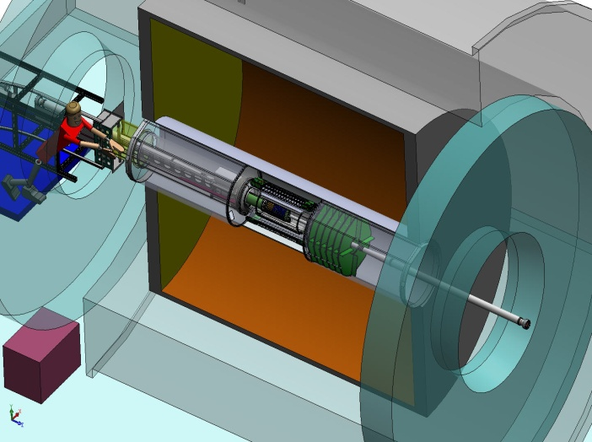
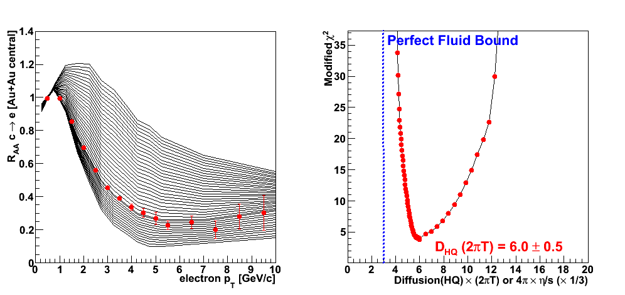
Silicon Upgrades and Investments
PHENIX
VTX (2011)
FVTX (2012)
STAR
HFT (2014)
Example RHIC precision measurement by 2016
Charm Suppression

Slide 24
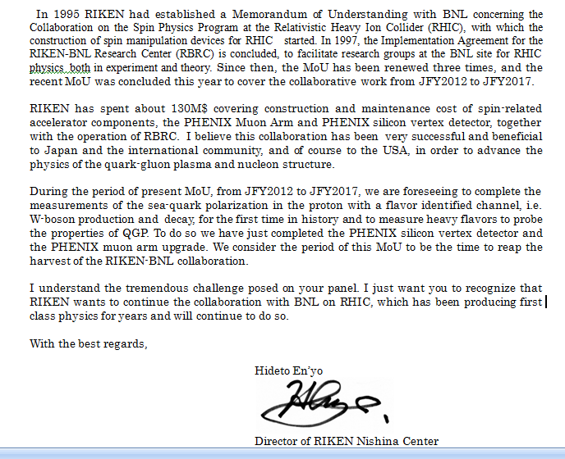
Letter from Director of RIKEN Nishina Center
“We consider the period of this MoU [JFY2012-2017] to be the time to reap the harvest of the RIKEN-BNL collaboration.”
Strong interest expressed in funding for sPHENIX

Slide 25
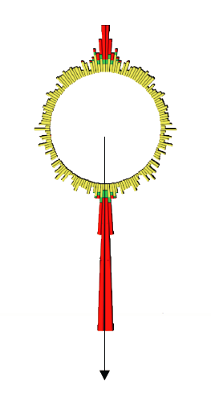
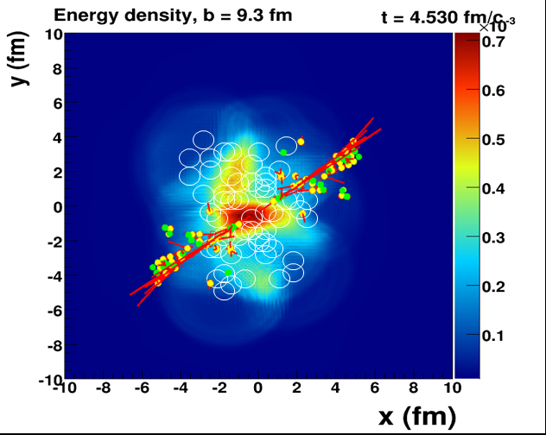

Penetrating Probes
When does the strongly coupled bulk (lower momentum IR)
transition to a weakly coupled probe (higher momentum UV)?

Slide 26
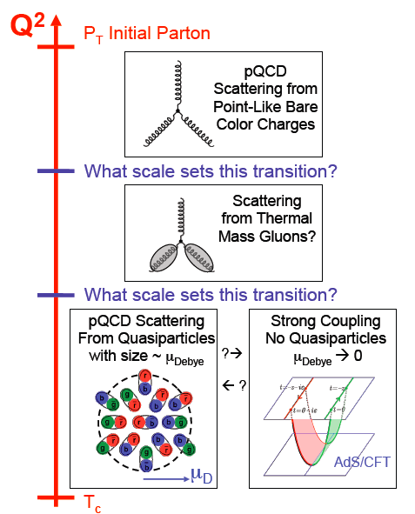
As high energy quarks or quark-antiquark pairs traverse the QGP, what do they see?
Do the highest energy
jets at LHC see
point-like color charges?
1/λ
Do the lowest energy jets at RHIC scatter from coherent fields or only excite sound waves?
26
26

Slide 27
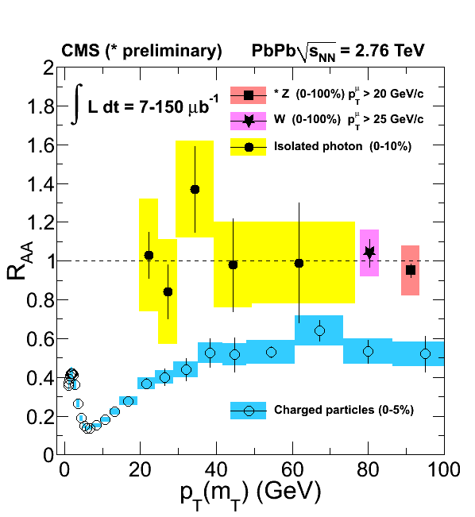
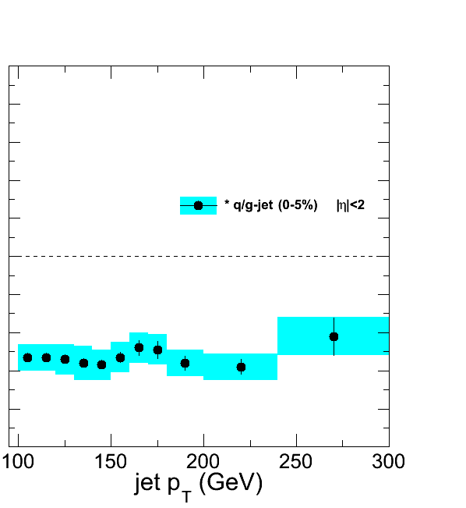
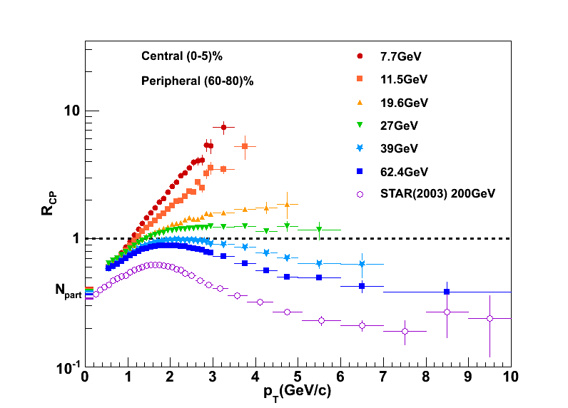
Jet Results to Date
RHIC critical lever arm in scale and temperature, and requires full jet probes and measurements of where the energy goes…

Slide 28
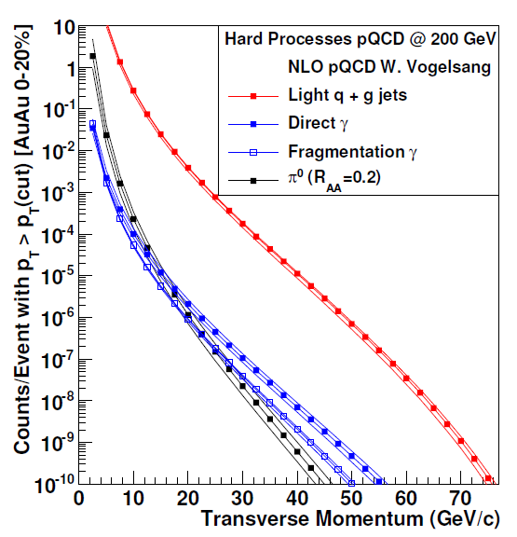

sPHENIX Upgrade: Jets, Dijets, γ-Jet
Sampling 50 billion Au+Au
events in one year
(can record 20 billion without selective triggers)
10⁷ jets > 20 GeV
10⁶ jets > 30 GeV
80% are dijet events
10⁴ direct γ > 20 GeV
A+B
p+A (different nuclei)
U+U
Differential measures
Jets Rates for Au+Au @ 100 GeV and Unique Flexibility of RHIC Enable Additional Lever Arm

Slide 29
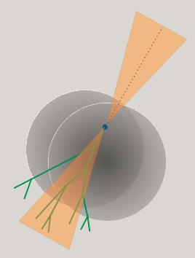
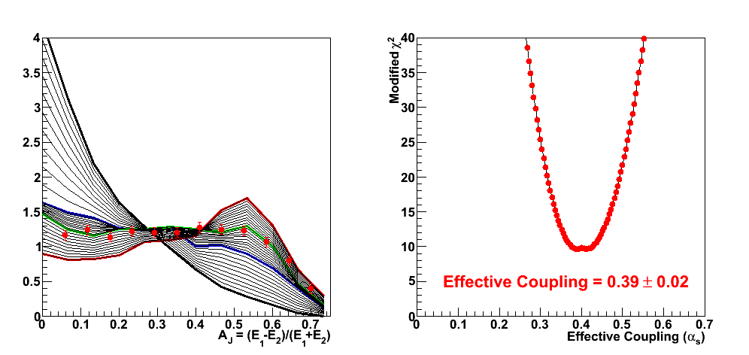
Dijet imbalance directly sensitive to effective coupling to QGP.
Comprehensive picture across scales and QGP temperatures spanned by RHIC and LHC needed.
Example RHIC precision measurement by 2019

Slide 30
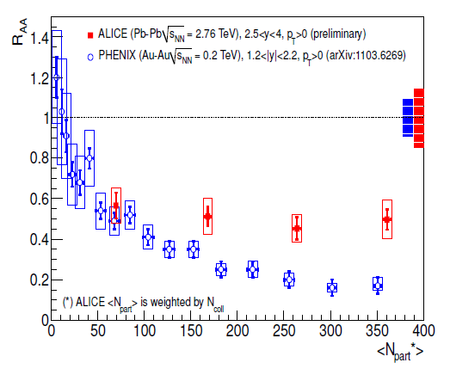
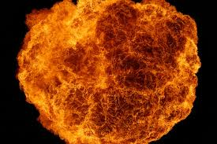
Quarkonia
Bound states of cc and bb can be Debye color screened in the QGP as one increases the temperature (melting)
J/ψ Suppression
Bizarre twist
Less suppression at LHC with higher temperature.
Quark deconfinement and charm recombination at LHC.
LHC
RHIC

Slide 31
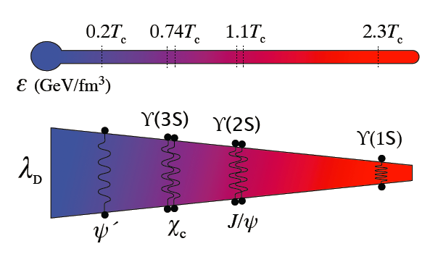
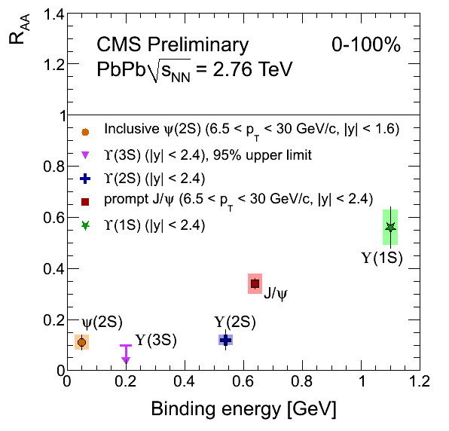
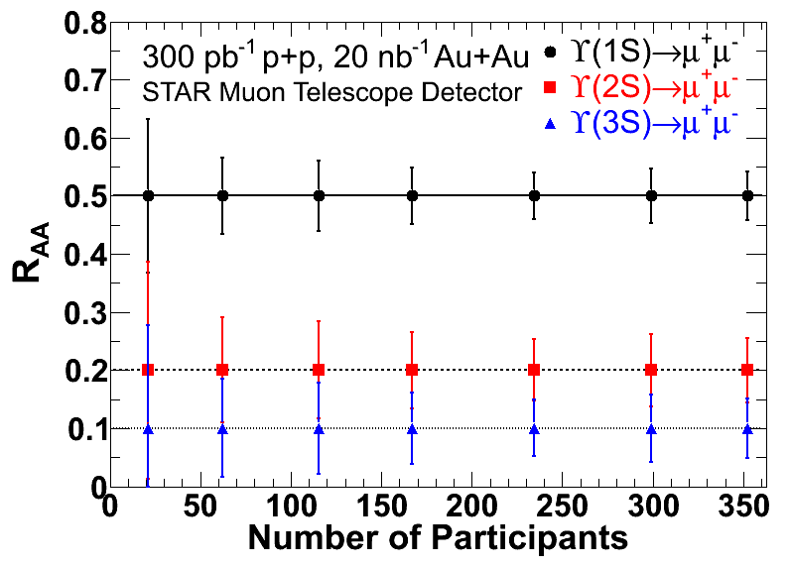
Quarkonia Thermometer
CMS observes expected melting pattern with binding energy
Requires RHIC p+A and A+A
for a complete picture and
to bracket the screening lengths
STAR MTD 2014 install.
sPHENIX 2018 install (7x stats)

Slide 32
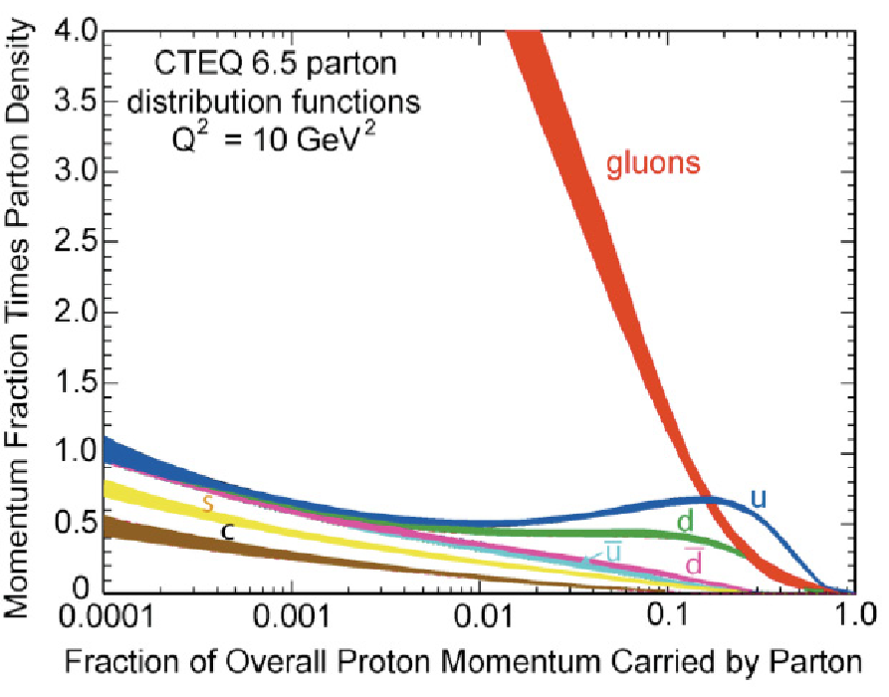
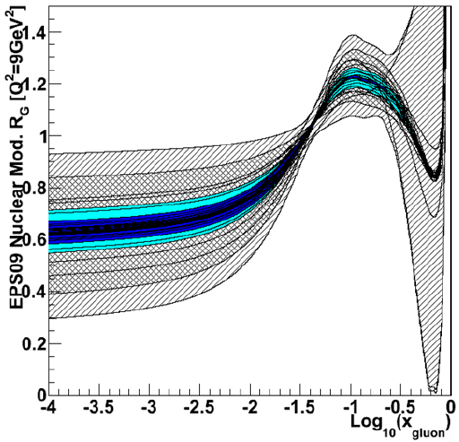
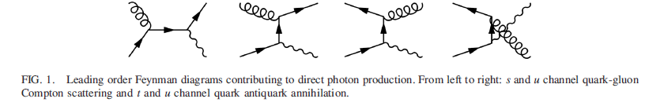
Cold Nuclear Matter and Gluon Saturation
Does gluon density saturate?
Precision via direct γ in 2016
MPC-EX
700nb⁻¹ p+Au
50pb⁻¹ p+p
Measured by 2016
90% C.L.
The nucleus is an amplifier of high gluon densities
Direct photon channel.
Key is connecting RHIC forward-y to LHC mid-y

Slide 33
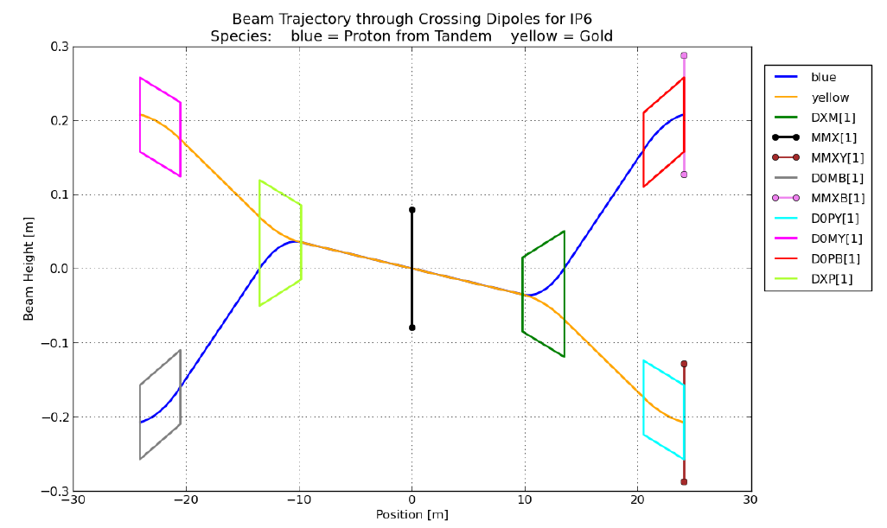
RHIC p+A
p+A (instead of only d+A) made possible by stochastic cooling
Issue is aperture of the DX magnets at IP6,8 (beams in collision).
CAD study by S. Tepikian
and D. Trbojevic
Stochastic Cooling at RHIC enables switch to p+A quickly.
Very exciting option for p+C, p+Si, p+Cu, p+Au all in one run!
Key for testing very interesting geometric dependencies observed in d+Au at RHIC.

Slide 34
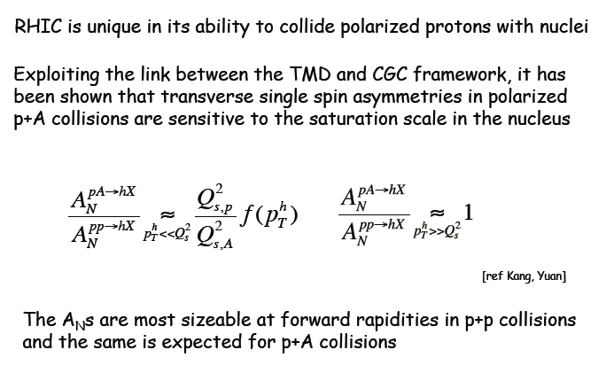
Polarized p-A Insights
RHIC is a unique collider with spin polarized protons
Large transverse spin effects observed at forward rapidity (x_{F})
p+p A_{N}(π) @ 62 GeV
Exploiting the link between the TMD and Gluon Saturation frameworks, one can learn about the saturation scale via transverse spin asymmetries!
http://arxiv.org/abs/arXiv:1106.1375

Slide 35


STAR/PHENIX Forward Upgrades
STAR Staged Approach:
Calorimeters: 2015-2017
GEM Trackers: ~2017
Cerenkov: 2018-2019
Extension of sPHENIX at forward angles
GEM based tracking
Diamond pixel for heavy flavor tagging
RICH based PID (π/K/p)
EM and hadronic calorimetry
Muon identification
Excellent transverse spin capabilities, and first stage EIC option

Slide 36


Connections, Impact, Public Visibility
2005 AIP Story of the Year
Viscosity/Entropy Density
QGP
String Theory Limit
In Search of Perfect Fluids
(May 2010)
Ultra-Hot QCD
Perfect Liquid
String Theory (AdS/CFT)
Holography
Cold Matter, Atomic Gases
Strongly Correlated Electrons

Slide 37


RHIC’s Most Important Products
Collaboration | Total # Refereed Papers | Total # Citations for Refereed Papers | # PRL’s | # Citations for 2005 White Paper | Position of 2005 White Paper Among Most Cited NP Papers 2001-12 | # Papers with >250 Citations
PHENIX | 126 | 13,292 | 57 | 1358 | 5 | 12
STAR | 160 | 14,434 | 54 | 1382 | 4 | 15
PHOBOS^{a)} | 39 | 4057 | 15 | 1049 | 7 | 1
BRAHMS^{b)} | 22 | 2649 | 10 | 1040 | 8 | 3
Total = | 347 | 34,432 | 136 | 4829 |  | 31
More than 40% of all-time top-cited Nuclear Theory arXiv papers are RHIC-related!
Cumulative Citations of RHIC Exp’ts
Plus >190 tenured faculty positions worldwide + 6 cover story articles +…
Thanks in part to vigorous foreign investment, e.g., $130M from RIKEN…

Slide 38
What Would be Lost if RHIC Were Terminated?
“Closing RHIC at this fertile time would leave unexploited a major fraction of the investments, both intellectual and financial, made by the United States in the science of quark-gluon plasma over the past decade and would be akin to abandoning superconductivity research just before the key measurements that let us look under the hood and see how a superconductor works, or abandoning the Hubble telescope just after seeing its first high quality images.”
“Because of the unique flexibility and capability of RHIC, key discoveries would go unmade. The United States would unilaterally cede leadership in a new field of science that it has led for its first decade and that it is poised to lead in the decade to come.”

Slide 39
What Would be Lost if RHIC Were Terminated?
The last operating U.S. collider, hence a critical attractor for talented accelerator scientists and cutting-edge R&D.
Unique polarized p+p access to nucleon spin structure.
The fantastic track record of RIKEN-BNL Research Center in funding outstanding Fellows and placing them in high-profile tenured positions.
Extremely strong foreign (esp. RIKEN) investment in U.S. facility.
Associated efforts will suffer collateral, possibly fatal, damage:
  Lattice QCD thermodynamics leadership
  Strong medical radioisotope production program @ BNL
  NASA Space Radiation studies @ BNL
  Accelerator physics offshoots, esp. in hadron radiotherapy
Cost-realizable path to a future EIC, taking advantage of ~$2B replacement cost (avoiding ~$1B D&D cost) of RHIC complex.
Home research base for >1000 domestic + foreign users.
~750 (direct, including research + indirect) FTE’s @ BNL.
  Risk of chunk of DOE ONP funding being siphoned off to other agencies or program offices
39

Slide 40

Summary
Hard to imagine working in a scientific world where the United States builds up great facilities and communities over 20+ years only to cede away the discoveries awaiting us.

Slide 41
The Following Set of Slides are a
very nice timeline presented at DNP Town Meeting
By Paul Sorensen

Slide 42

2013 | 2014 | 2015 | 2016 | 2017 | 2018 | 2019 | 2020 | 2021 | 2022
(F)VTX
Heavy Flavor Tracker & Muon Telescope Det.
sPHENIX & STAR/PHENIX Forward Detectors
eRHIC Constr.
FGT
Muon Piston Cal. Ext.
RHIC e-cooling & STAR Inner TPC Upgrade
Substantial Reduction in Uncertainties on Anti-quark Polarization from W+/W-
polarization of the u, u-bar, d, and d-bar quarks in the proton
500 GeV p+p 15 GeV A+A | 200 GeV A+A 200 GeV p+p | Au+Au, U+U, Cu+Au at 1-2 energies 200 GeV p+A, 500 GeV p+p | BESII 5-20 GeV Au+Au; 200 and 100 GeV Au+Au; 500 GeV p+p; 200 GeV (polarized) p+A

Slide 43




2013 | 2014 | 2015 | 2016 | 2017 | 2018 | 2019 | 2020 | 2021 | 2022
(F)VTX
Heavy Flavor Tracker & Muon Telescope Det.
sPHENIX & STAR/PHENIX Forward Detectors
eRHIC Constr.
FGT
Muon Piston Cal. Ext.
RHIC e-cooling & STAR Inner TPC Upgrade
Charm Flow
Screening of Upsilon States
charm quark diffusion, hadronization mechanism, screening lengths, and temperature of the plasma
500 GeV p+p 15 GeV A+A | 200 GeV A+A 200 GeV p+p | Au+Au, U+U, Cu+Au at 1-2 energies 200 GeV p+A, 500 GeV p+p | BESII 5-20 GeV Au+Au; 200 and 100 GeV Au+Au; 500 GeV p+p; 200 GeV (polarized) p+A

Slide 44
2013 | 2014 | 2015 | 2016 | 2017 | 2018 | 2019 | 2020 | 2021 | 2022
(F)VTX
Heavy Flavor Tracker & Muon Telescope Det.
sPHENIX & STAR/PHENIX Forward Detectors
eRHIC Constr.
FGT
Muon Piston Cal. Ext.
RHIC e-cooling & STAR Inner TPC Upgrade
Charm Suppression
Requires Reference Data: p+p; p+A
D_{HQ} 2πT = 3 (4π) η/s
charm quark diffusion; direct measure of coupling to the medium, complimentary to η/s from correlations data
500 GeV p+p 15 GeV A+A | 200 GeV A+A 200 GeV p+p | Au+Au, U+U, Cu+Au at 1-2 energies 200 GeV p+A, 500 GeV p+p | BESII 5-20 GeV Au+Au; 200 and 100 GeV Au+Au; 500 GeV p+p; 200 GeV (polarized) p+A

Slide 45




2013 | 2014 | 2015 | 2016 | 2017 | 2018 | 2019 | 2020 | 2021 | 2022
(F)VTX
Heavy Flavor Tracker & Muon Telescope Det.
sPHENIX & STAR/PHENIX Forward Detectors
eRHIC Constr.
FGT
Muon Piston Cal. Ext.
RHIC e-cooling & STAR Inner TPC Upgrade
Critical Fluctuations
Coupling of s Quarks to a QGP
s quark population
Mapping the phase diagram: critical point search, turning off the QGP, probing the transition region
500 GeV p+p 15 GeV A+A | 200 GeV A+A 200 GeV p+p | Au+Au, U+U, Cu+Au at 1-2 energies 200 GeV p+A, 500 GeV p+p | BESII 5-20 GeV Au+Au; 200 and 100 GeV Au+Au; 500 GeV p+p; 200 GeV (polarized) p+A

Slide 46

2013 | 2014 | 2015 | 2016 | 2017 | 2018 | 2019 | 2020 | 2021 | 2022
(F)VTX
Heavy Flavor Tracker & Muon Telescope Det.
sPHENIX & STAR/PHENIX Forward Detectors
eRHIC Constr.
FGT
Muon Piston Cal. Ext.
RHIC e-cooling & STAR Inner TPC Upgrade
Constrained by Multiple Measurements
◆
◆
◆
◆
Large energy range of RHIC to map temperature dependence of η/s, strong coupling, comparison to string theory lower bound
500 GeV p+p 15 GeV A+A | 200 GeV A+A 200 GeV p+p | Au+Au, U+U, Cu+Au at 1-2 energies 200 GeV p+A, 500 GeV p+p | BESII 5-20 GeV Au+Au; 200 and 100 GeV Au+Au; 500 GeV p+p; 200 GeV (polarized) p+A

Slide 47


2013 | 2014 | 2015 | 2016 | 2017 | 2018 | 2019 | 2020 | 2021 | 2022
(F)VTX
Heavy Flavor Tracker & Muon Telescope Det.
sPHENIX & STAR/PHENIX Forward Detectors
eRHIC Constr.
FGT
Muon Piston Cal. Ext.
RHIC e-cooling & STAR Inner TPC Upgrade
Dijet Energy Imbalance
Coupling to the Medium
Jet measurements: effective coupling in QGP, temperature dependence of transport properties
500 GeV p+p 15 GeV A+A | 200 GeV A+A 200 GeV p+p | Au+Au, U+U, Cu+Au at 1-2 energies 200 GeV p+A, 500 GeV p+p | BESII 5-20 GeV Au+Au; 200 and 100 GeV Au+Au; 500 GeV p+p; 200 GeV (polarized) p+A

Slide 48


2013 | 2014 | 2015 | 2016 | 2017 | 2018 | 2019 | 2020 | 2021 | 2022
(F)VTX
Heavy Flavor Tracker & Muon Telescope Det.
sPHENIX & STAR/PHENIX Forward Detectors
eRHIC Constr.
FGT
Muon Piston Cal. Ext.
RHIC e-cooling & STAR Inner TPC Upgrade
Gluon dynamics and probing the saturation boundary in the x-Q² QCD phase diagram
500 GeV p+p 15 GeV A+A | 200 GeV A+A 200 GeV p+p | Au+Au, U+U, Cu+Au at 1-2 energies 200 GeV p+A, 500 GeV p+p | BESII 5-20 GeV Au+Au; 200 and 100 GeV Au+Au; 500 GeV p+p; 200 GeV (polarized) p+A

Slide 49

2013 | 2014 | 2015 | 2016 | 2017 | 2018 | 2019 | 2020 | 2021 | 2022
(F)VTX
Heavy Flavor Tracker & Muon Telescope Det.
sPHENIX & STAR/PHENIX Forward Detectors
eRHIC Constr.
FGT
Muon Piston Cal. Ext.
RHIC e-cooling & STAR Inner TPC Upgrade
Testing QCD prediction of sign change in the Sivers function
500 GeV p+p 15 GeV A+A | 200 GeV A+A 200 GeV p+p | Au+Au, U+U, Cu+Au at 1-2 energies 200 GeV p+A, 500 GeV p+p | BESII 5-20 GeV Au+Au; 200 and 100 GeV Au+Au; 500 GeV p+p; 200 GeV (polarized) p+A

Slide 50


2013 | 2014 | 2015 | 2016 | 2017 | 2018 | 2019 | 2020 | 2021 | 2022↦
(F)VTX
Heavy Flavor Tracker & Muon Telescope Det.
sPHENIX & STAR/PHENIX Forward Detectors
eRHIC Constr.
FGT
Muon Piston Cal. Ext.
RHIC e-cooling & STAR Inner TPC Upgrade
q & g contributions to p spin
modifications of structure functions
spin physics, spatial distribution of quarks and gluons in nucleons and nuclei, non-linear regime of strong gluon fields
500 GeV p+p 15 GeV A+A | 200 GeV A+A 200 GeV p+p | Au+Au, U+U, Cu+Au at 1-2 energies 200 GeV p+A, 500 GeV p+p | BESII 5-20 GeV Au+Au; 200 and 100 GeV Au+Au; 500 GeV p+p; 200 GeV (polarized) p+A | e+A ↦

Slide 51
Slides on Capabilities of other Low Energy Heavy Ion Physics Projects

Slide 52




Super Proton Synchrotron (SPS)
Runn
+ Running now, that’s good
+ Energy range is good
- But fixed-target
- And light ions
Time Line: 2009-2015
Energy Range: √s_{NN} = 4.9 to 17.3 GeV μ_{B} = 0.560 to 0.230 GeV
BES I

Slide 53



Nuclotron based Ion Collider fAcility (NICA)
Time Line: Not yet funded. Plan is to submit documents by end of 2012. Operations could not begin before 2017 (probably much later)
Energy Range: √s_{NN} from 3.9 - 11 GeV for Au+Au; μ_{B} from 0.630 - 0.325 GeV.
+ Collider, that’good
+ High Luminosity expected
MPD simiar to STAR
Maybe as early as 2017
- (But probably later)
Energy is likely too low
Multi-Purpose Detector (MPD)

Slide 54


Facility for Antiproton and Ion Research (FAIR)
Time Line:
SIS-100 is funded and will be complete by 2018
SIS-300 will need additional funding (no time estimate)
Energy Range:
SIS-100: Au+Au @ 2.9 GeV
SIS-300: Au+Au from 2.7 to 8.2 GeV
μ_{B} from 0.730 to 0.410 GeV
Compressed Baryonic Matter (CBM)
TOF
ECAL
++ Very High Interaction Rate
Fixed target geometry
- No time estimate for SIS-300
  Probably after 2022
Even with SIS-300, the
energy is too low!
RICH
TRD
MVD
STS

Slide 55
Comparison of Facilities
Facility
Exp.:
Start:
Au+Au Energy:
Event Rate:
Physics:
RHIC BESII
STAR
2017
7.7– 19.6+
100 HZ
CP&OD
SPS
NA61
2009
4.9-17.3
100 HZ
CP&OD
NICA
MPD
>2017?
2.7 - 11
<10 kHz
OD&DHM
SIS-300
CBM
>2022?
2.7-8.2
<10 MHZ
OD&DHM
PHENIX
√s_{NN} (GeV)
At 8 GeV
CP = Critical Point
OD = Onset of Deconfinement
DHM = Dense Hadronic Matter
Fixed Target
Fixed Target
Lighter ion
collisions

Slide 56
EXTRAS

Slide 57
The most recent LRP (2007) contained four recommendations for investments for the future US nuclear science program, which are listed here in the order as given in the LRP.
We recommend completion of the 12 GeV Upgrade at Jefferson Lab. The Upgrade will enable new insights into the structure of the nucleon, the transition between the hadronic and quark/gluon descriptions of nuclei, and the nature of confinement.
We recommend construction of the Facility for Rare Isotope Beams, FRIB, a world-leading facility for the study of nuclear structure, reactions and astrophysics. Experiments with the new isotopes produced at FRIB will lead to a comprehensive description of nuclei, elucidate the origin of the elements in the cosmos, provide an understanding of matter in the crust of neutron stars, and establish the scientific foundation for innovative applications of nuclear science to society.
We recommend a targeted program of experiments to investigate neutrino properties and fundamental symmetries. These experiments aim to discover the nature of the neutrino, yet-unseen violations of time-reversal symmetry, and other key ingredients of the new standard model of fundamental interactions. Construction of a Deep Underground Science and Engineering Laboratory is vital to U.S. leadership in core aspects of this initiative.
The experiments at the Relativistic Heavy Ion Collider have discovered a new state of matter at extreme temperature and density—a quark-gluon plasma that exhibits unexpected, almost perfect liquid dynamical behavior. We recommend implementation of the RHIC II luminosity upgrade, together with detector improvements, to determine the properties of this new state of matter.

Slide 58
"The four recommendations of this Plan present a roadmap for new investment in facilities and the development of new experimental equipment that will allow us to continue to address the scientific challenges of our field into the future. These recommendations can be implemented in a staged approach over the course of the next decade. During this period, we must continue to operate effectively our existing flagship facilities to make optimal use of their
capabilities."
Operating the existing facilities and making optimal use of their capabilities is stated as an imperative in the long range plan. In my reading of this document, the prioritized list of new investments does not appear to supersede the imperative to make use of the existing facilities.

Slide 59

Timeline for RHIC’s Next Decade
Years | Beam Species and Energies | Science Goals | New Systems Commissioned
2013 |  | Sea antiquark and gluon polarization QCD critical point search | Electron lenses upgraded pol’d source STAR HFT
2014 | 200 GeV Au+Au and baseline data via 200 GeV p+p (needed for new det. subsystems) | Heavy flavor flow, energy loss, thermalization, etc. quarkonium studies | 56 MHz SRF full HFT STAR Muon Telescope Detector PHENIX Muon Piston Calorimeter Extension (MPC-EX)
2015-2017 |  | Extract η/s(T_{min}) + constrain initial quantum fluctuations further heavy flavor studies sphaleron tests @ μ_{B}≠0 gluon densities & saturation finish p+p W prod’n | Coherent Electron Cooling (CeC) test Low-energy electron cooling STAR inner TPC pad row upgrade
2018-2021 |  | x10 sens. increase to QCD critical point and deconfinement onset jet, di-jet, γ-jet quenching probes of E-loss mechanism color screening for different qq states transverse spin asyms. Drell-Yan & gluon saturation | sPHENIX forward physics upgrades

Slide 60
Timelines for Possible Projects
Low-energy cooling Accelerator Improvement Project:
Requires start of the project (engineering phase) at the end of 2012 with high priorities and resources from C-AD.
2012 – feasibility study
2013-2014 – engineering design, drawings, purchase orders, and
manufacturing for gun, magnets, power supplies, RF, etc.
2014-2015 – installation
2016 – commissioning of electron beam and transport; start cooling of ion beam – first 3-D electron cooling in a collider, expect some learning curve and optimization before luminosity improvement.
2017 – luminosity improvement in physics – Phase I
2018+ – luminosity improvements in physics – Phase II
Aggressive Critical Decision timeline for sPHENIX upgrade:
CD0 2QFY2013 allows R&D funds to be expended and PED funds to be requested (these are part of TPC)
CD1 1QFY2014 PED funds can be expended
CD 2/3 1QFY2015 A year of design brings the project to a CD2 review; CD3 approval allows procurement to begin on long lead time items like the solenoid
CD4 4QFY2018 3.5 years of construction (2Q2015-4QFY2018)
4QFY2019 Commissioning complete
60

Slide 61




Schedule Drivers: Technically Driven Project Timelines, Plus Running Period Lengths for Desired Uncertainties
E.g., low-energy electron cooling can be implemented in 2 phases:
Phase I (available for use in 2017)
√s_{NN} = 5-9 GeV (e-beam energy 0.9-2 MeV)
Phase II (2018+) [additional 3 MeV booster cavity]
√s_{NN} = 9-20 GeV (e-beam energy 2-5 MeV)
10 m
cooling section
electron
u-turn,
delay line
Beam dump
10 m cooling section
3 MeV booster
cavity needed for
2nd stage.
energy
correction
cavity
gun
Schematic of electron cooler in warm sector 3 based on CeC proof-of-principle layout, and using technology and/or components from R&D ERL + CeC PoP

Slide 62

BES II: Low Energy Cooling Projection
Cooling of bunches with nominal length (1-2 m rms)
(counteracting intra-beam scattering only and longer stores)
With Cooling
factor 3 (in average Luminosity)
x 1.5 (duty factor between stores,
assumes 6 minutes between fills)=4.5
Cooling provides improvement in both peak Luminosity and in length of store
No Cooling

Slide 63



RHIC Related Town Meetings
DC Town Meeting on Heavy Ions:
Held Saturday afternoon, after the conclusion of the Quark Matter Conference
Presentations by
Peter Jacobs – Tribble subcommittee charge
Steve Vigdor – The case for continuing RHIC operations
Peter Braun-Munzinger – Report on European Town Meeting
Stephan Bass – White-paper discussion
Followed by public comments
more than 80 attendees
more than 250 attendees
63

