Slide 1
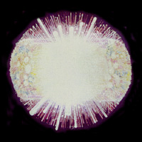
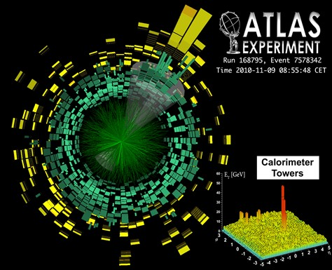
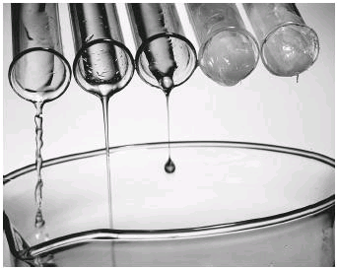

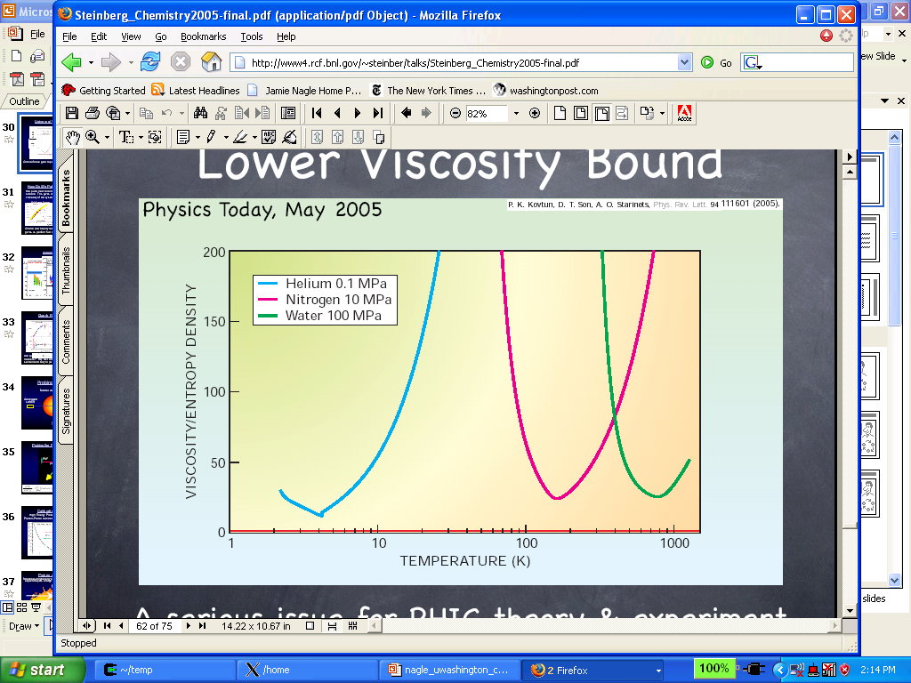
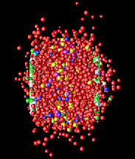


Mysteries of Deconfined
Quark-Gluon Matter
Niels Bohr Lecture
University of Copenhagen
June 15 2011
Jamie Nagle
Discovery Institute, NBI
University of Colorado

Slide 2
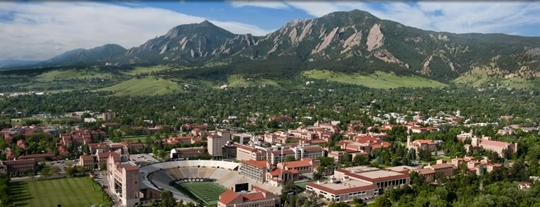

Normally in Boulder, Colorado
On sabbatical at the Discovery Institute at NBI, collaborating on the ALICE Experiment
Quark-Gluon Matter probed many different ways Highlight three key areas today from RHIC + LHC

Slide 3
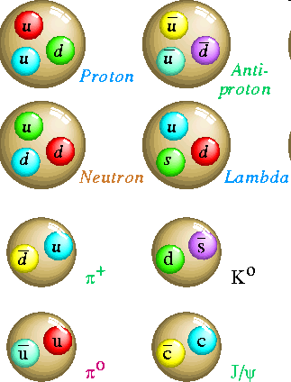
Quantum Chromodynamics
Hadrons are composite objects made of quarks and gluons
QCD is a “confining” gauge theory, with an effective potential:
V(r)
r
“Coulomb” “Confining”
Thus, no one has ever seen a free quark!

Slide 4
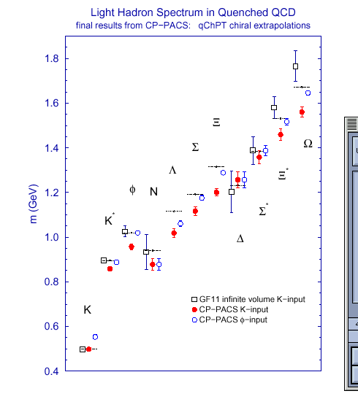
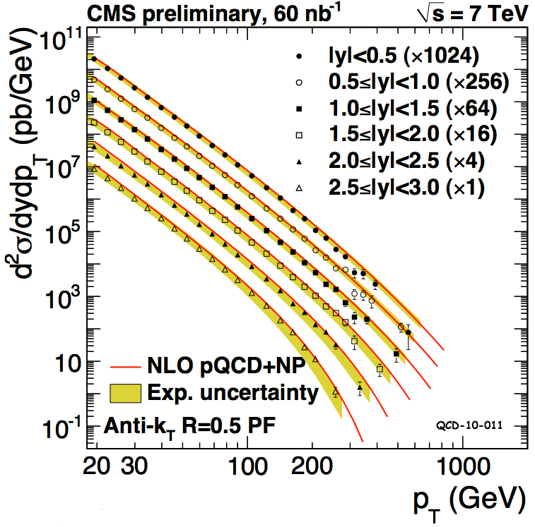
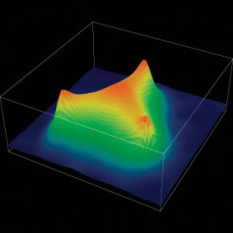
Strong evidence that QCD is the
correct theory of the strong interaction
Lattice QCD Calculations
Perturbative QCD Calculations
Jets
Ξ
Σ
Ω
Λ
Ξ*
Mass (GeV)
φ
N
Σ*
K*
Δ
K
And yet, much about the strongly interacting world not calculable from QCD Lagrangian

Slide 5
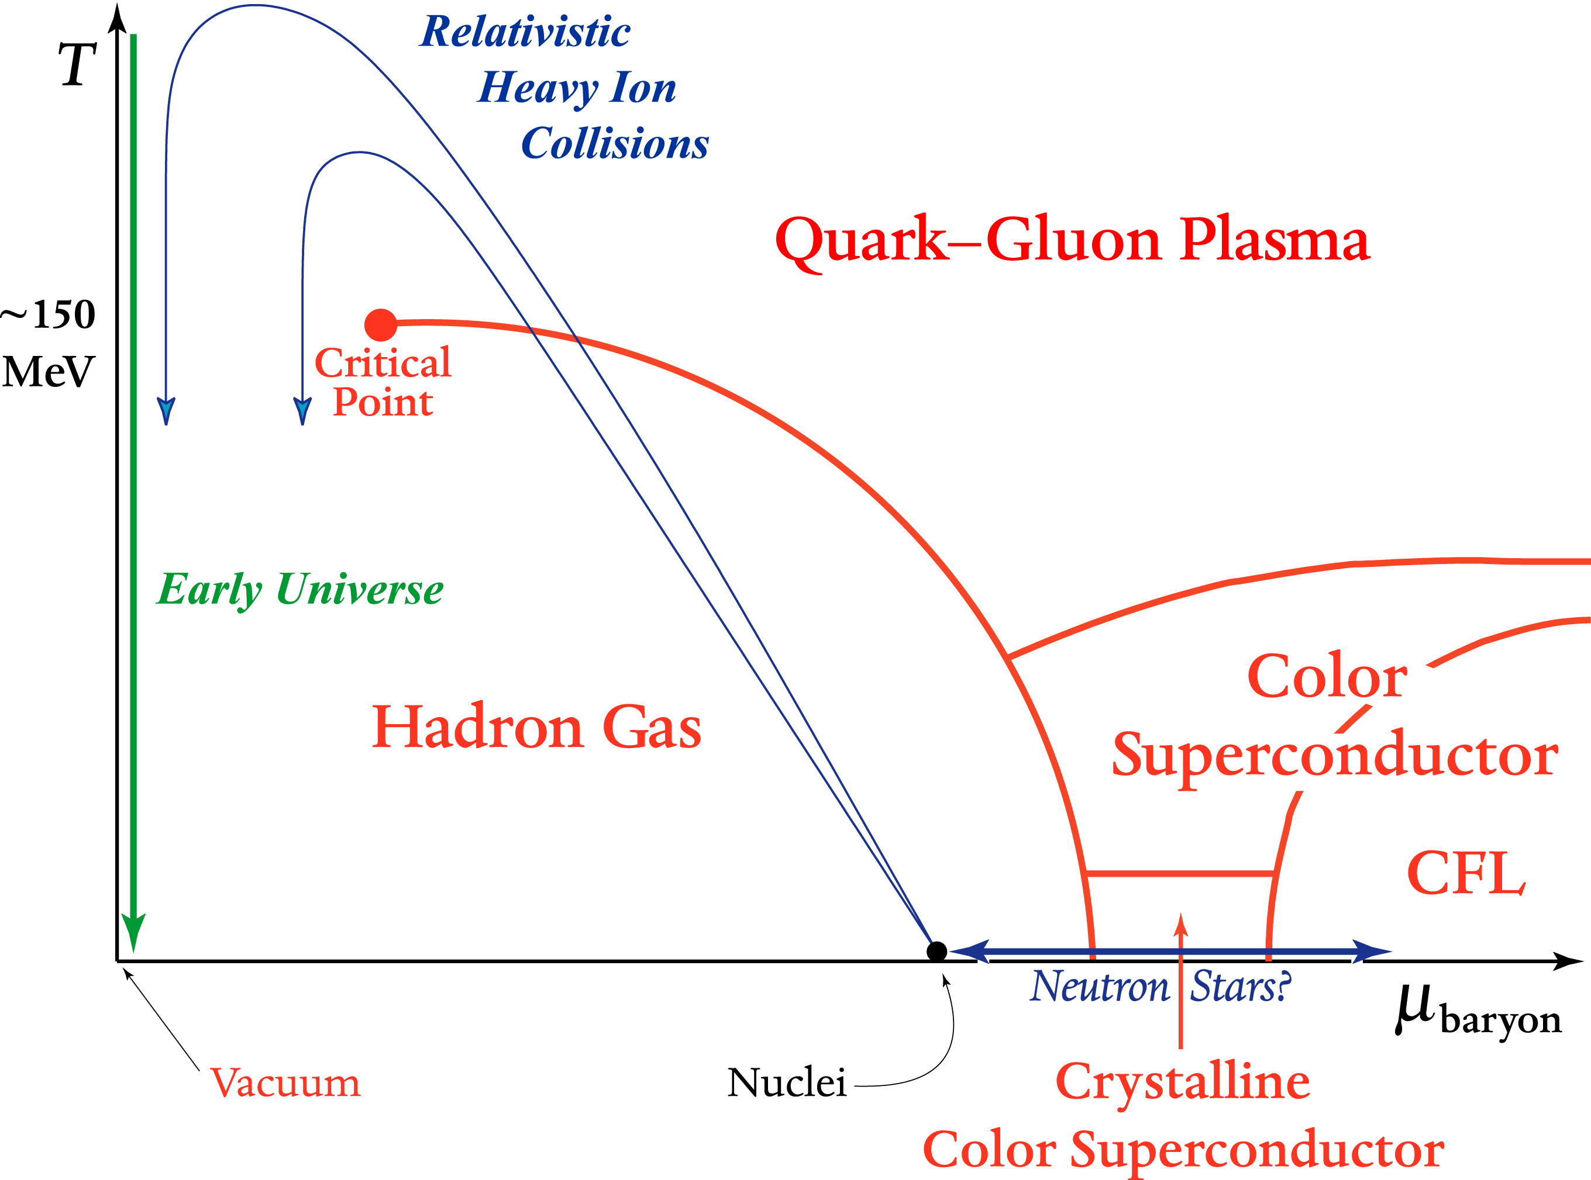
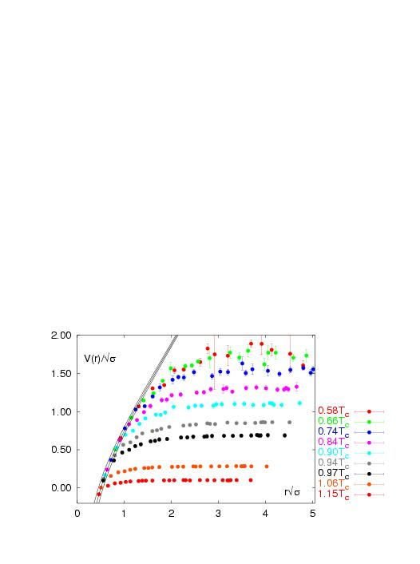
What about Hot QCD?
Quarks and Gluons deconfined → Quark-Gluon Plasma
V(r)
r
Lattice QCD
V(r)/√σ
Screening of long range confining potential at
high temperature or density
r√σ

Slide 6
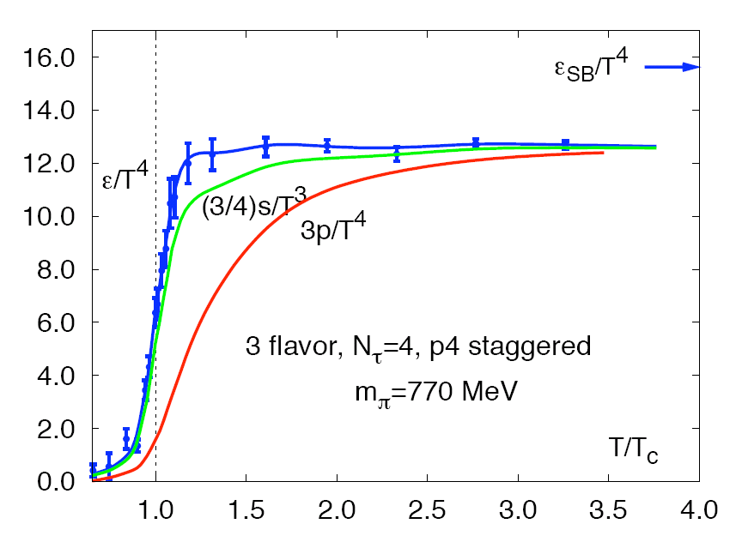
Energy density for “g” massless
degrees of freedom
Hadronic Matter (T ~ 200 MeV):
3 pions (π⁺, π⁻, π⁰) with spin=0
Quark-Gluon Plasma:
8 gluons;
2 quark flavors, anti-quarks, 2 spins, 3 colors
Lattice QCD
Degrees of Freedom increase by
factor 10!
Phase Transformation

Slide 7
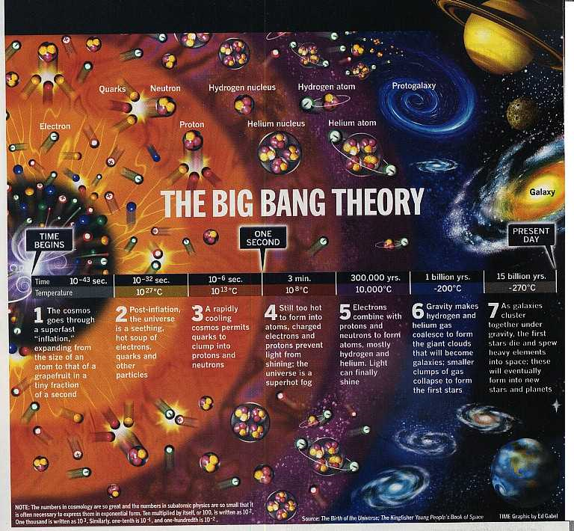

Very early in the universe, quarks and gluons were deconfined in this plasma state
As the universe cooled, they were confined and have remained that way since

Slide 8
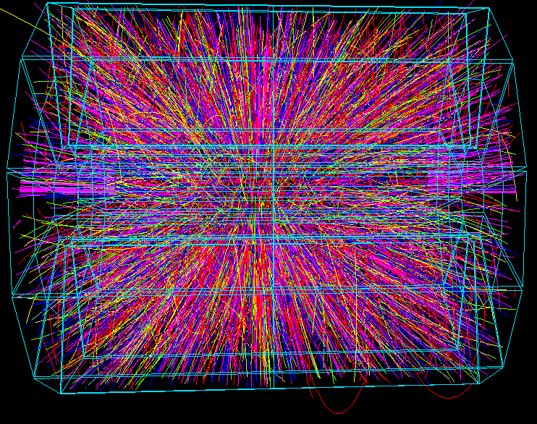
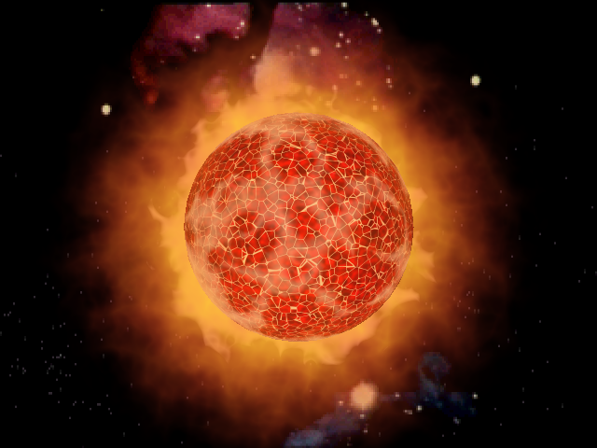
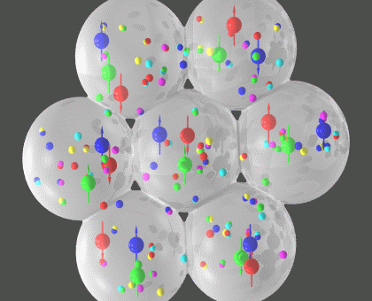
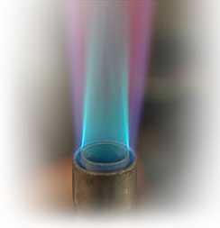
One trillion Kelvin !

Slide 9
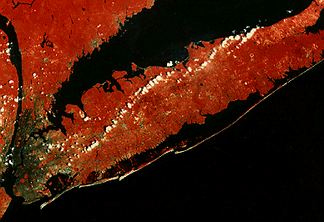
Relativistic Heavy Ion Collider
at Brookhaven National Laboratory
started program 2000
Colliding heavy nuclei at 99.995% the speed of light
Colliding heavy nuclei at 99.99997% the speed of light
Large Hadron Collider (LHC) at CERN just started heavy nuclei program in 2010

Slide 10
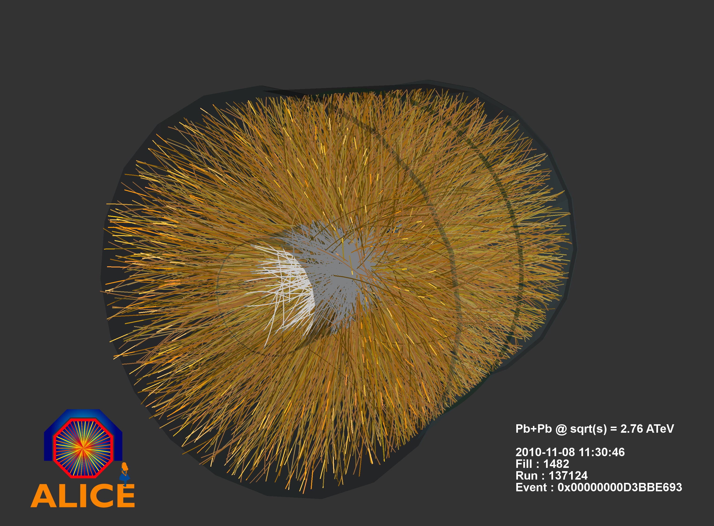
University of Copenhagen effort led by
Professors Gaardhøje, Bearden, Bøggild

Slide 11
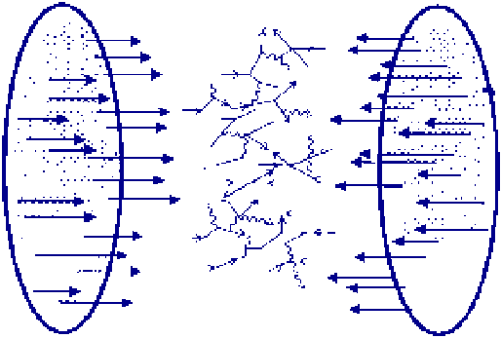
Heavy Ion Collisions
Thousands of virtual gluons, quarks, and antiquarks
from the nuclear wavefunctions
are made physical in the laboratory !
What is the nature of this ensemble of particles?

Slide 12
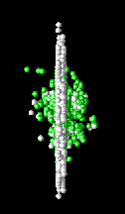

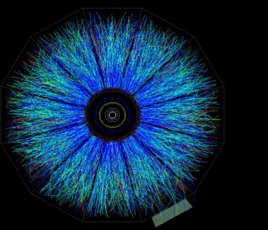
Time Evolution
0 fm/c
5 fm/c
10 fm/c
>15 fm/c
Diagram from Peter Steinberg

Slide 13
Ultimate Temperature
Hagedorn (1968) calculated a limiting temperature due to exponential increase in hadron levels
More energy only excites more states, no increase in temperature
Cannot exceed T_{H} ~ 170 MeV, except through change in Degrees of Freedom
W.A. Zajc

Slide 14
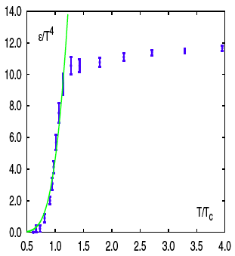
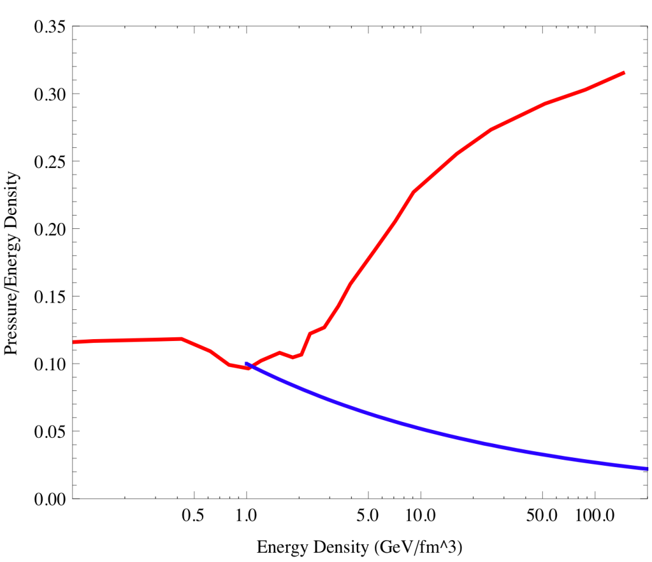
“Ultimate Temperature in the Early Universe”
K. Huang & S. Weinberg, Phys Rev Lett 25, 1970.
“…a veil, obscuring our view of the very beginning.”
Steven Weinberg, The First Three Minutes (1977)
ε/T⁴
Thermal QCD ”QGP” (Lattice)
Thermal QCD ”QGP” (Lattice)
Pressure / ε
Hadron Gas
P/ε ~ ε^{-2/7}
Hadron gas
Temperature/T_{c}
Energy Density ε (GeV/fm³)
Karsch, Redlich, Tawfik, Eur.Phys.J.C29:549-556 (2003).
A. Bazavov et al. (HotQCD),
arXiv:0903.4379 [hep-lat]
Slide from Paul Stankus

Slide 15
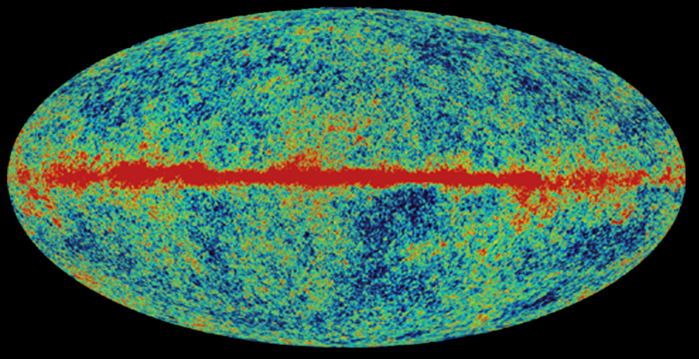
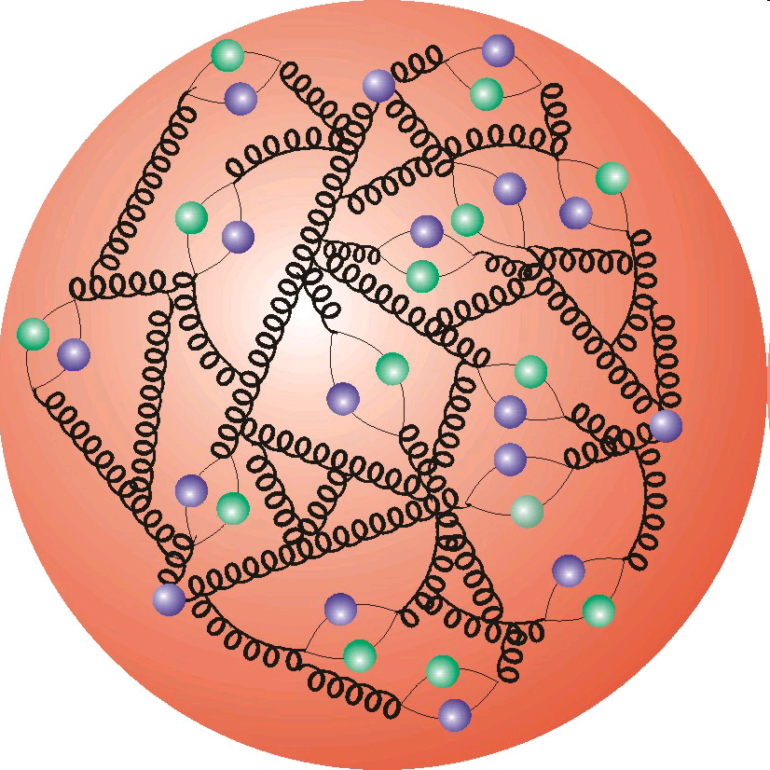
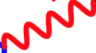
Information at Earlier Times?
Electromagnetic Radiation
Real and Virtual
Direct Photons

Slide 16
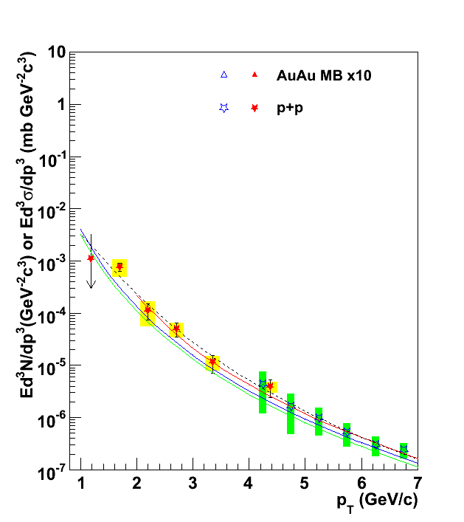
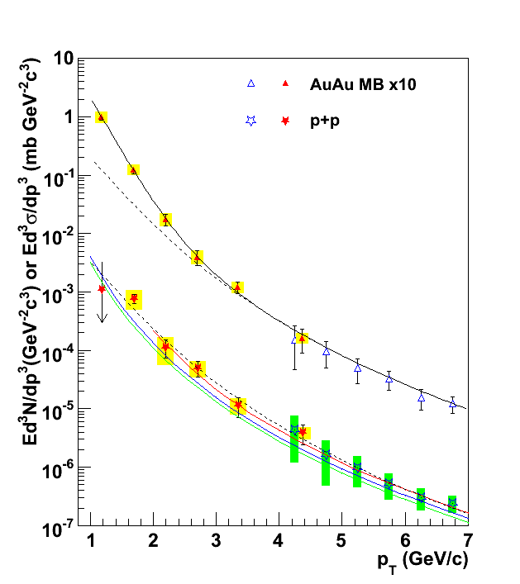
Hot Quark-Gluon Matter emits EM radiation
T_{AA} scaled pp + Exponential
Emission rate and distribution consistent with
equilibrated matter:
τ < 1 fm/c and
T > 2 x T_{c} !
QGP Shine
Gold-Gold
Direct Photons
T_{i} ≈ 340 MeV
Proton-Proton
Direct Photons
Fit to pp
First experimental observation of
T > Ultimate Temperature
NLO pQCD (W. Vogelsang)
PHENIX: Phys.Rev.Lett. 104 (2010) 132301

Slide 17
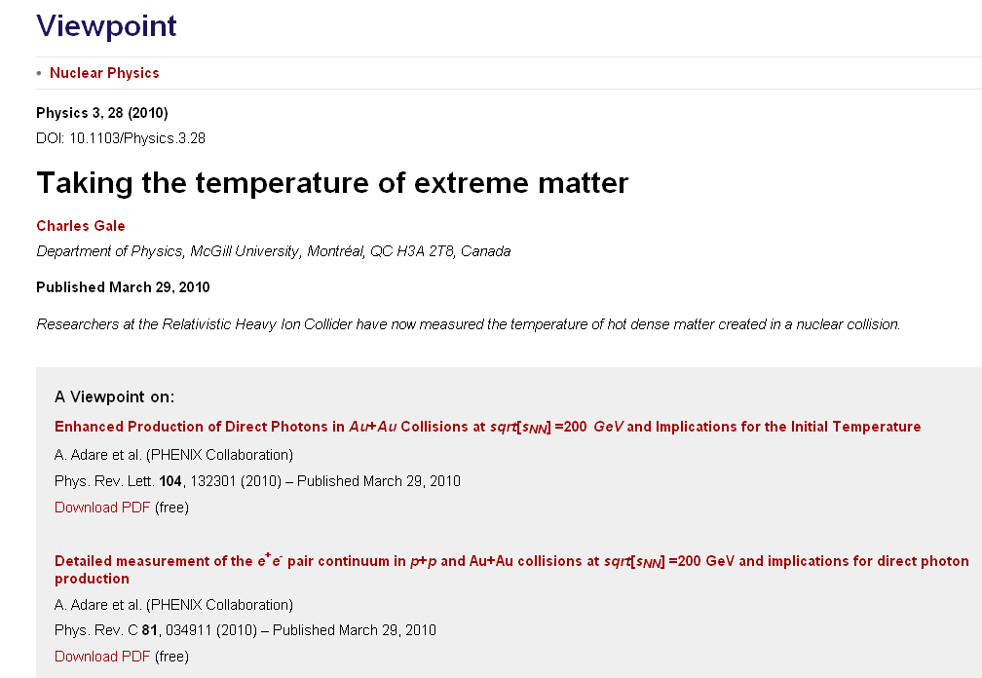
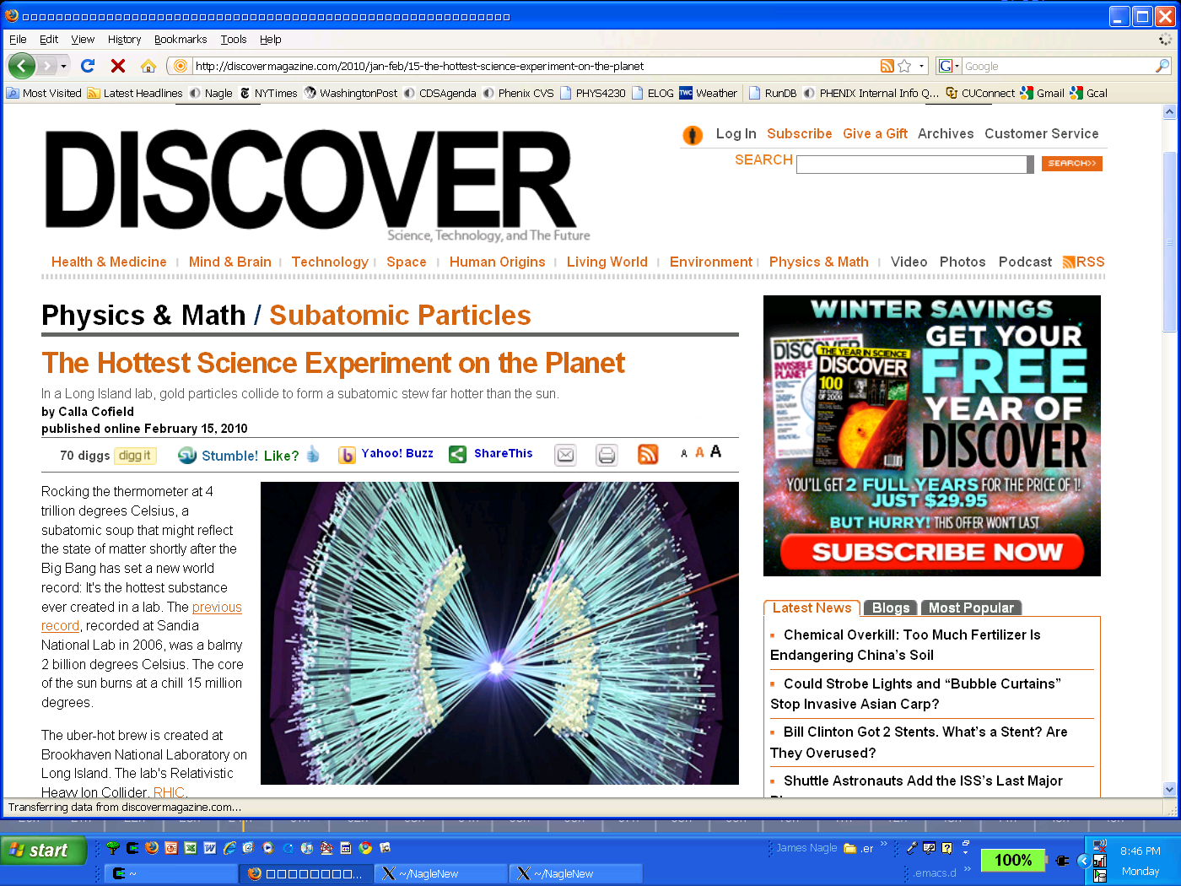

Slide 18
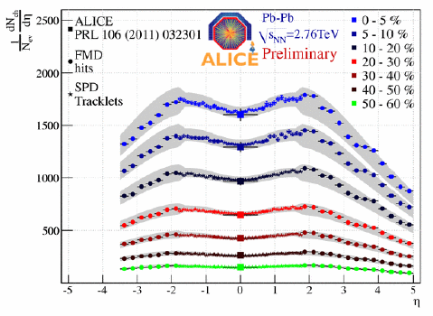
What about at the higher energy LHC?
Expectations of higher initial temperature, but no measurements yet….
Key measure of total charged particle production
208 x 2 nucleons collide → produce 17,000 charged particles
Enormous initial entropy production
Hans Dalsgaard – presented at
Quark Matter 2011 conference

Slide 19
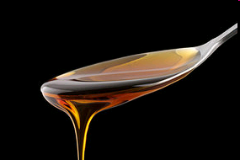
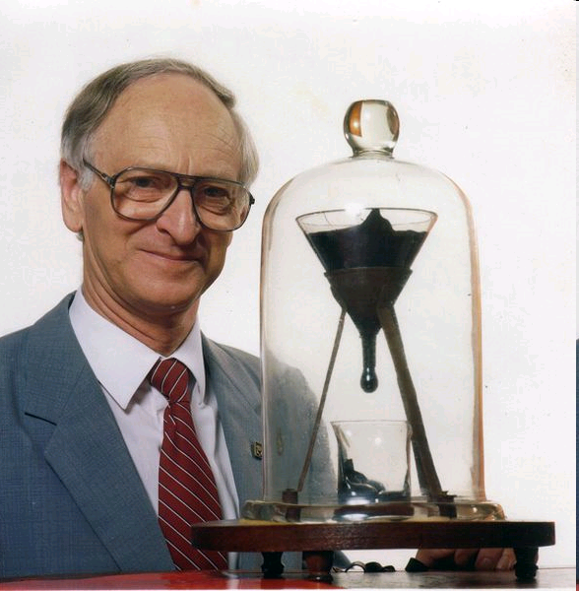
What is this Quark-Gluon Matter like?
Really it is like nothing else we have seen before….
What are properties like the viscosity?
(resistance to flow)
Pitch has viscosity approximately
230 billion times that of water.
Longest running experiment (1927-present)
8 drops so far, none ever seen fall!
http://en.wikipedia.org/wiki/Pitch_drop_experiment

Slide 20
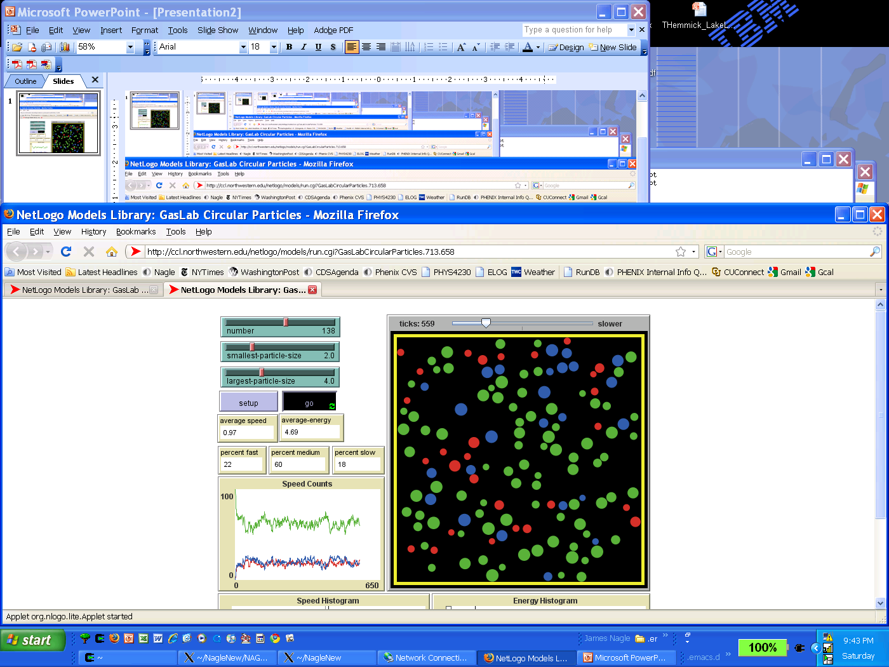
Quark
Gluon
Plasma
?
Viscosity Roadmap
Superfluidity Transition
Gas-Liquid Phase Transition
String Theory
Lowest Bound!

Slide 21
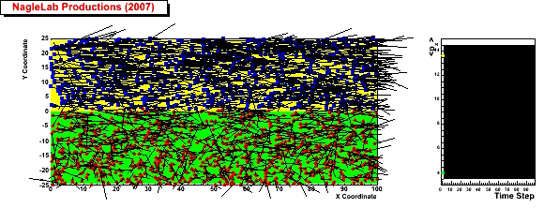
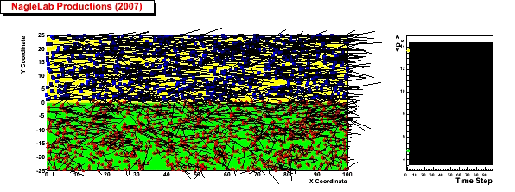
Viscosity Review
Honey – viscosity decreases at higher temperatures
viscosity increases with stronger coupling
Weak coupling (σ=0)
<p_{x}> top region
Inhibited
diffusion
↓
Small
viscosity
↓
Perfect fluid
<p_{x}> bottom region
Strong coupling (σ ↑)

Slide 22
How to Measure QGP Viscosity?
y
x
Lower Viscosity
↓
Less Dissipation
↓
More Flow
↓
Larger v₂
Density, Pressure
Low High
Pressure Gradient
Low
High
Yield(φ) = a (1 + 2 v₂ cos[2(φ−Ψ₂)])

Slide 23
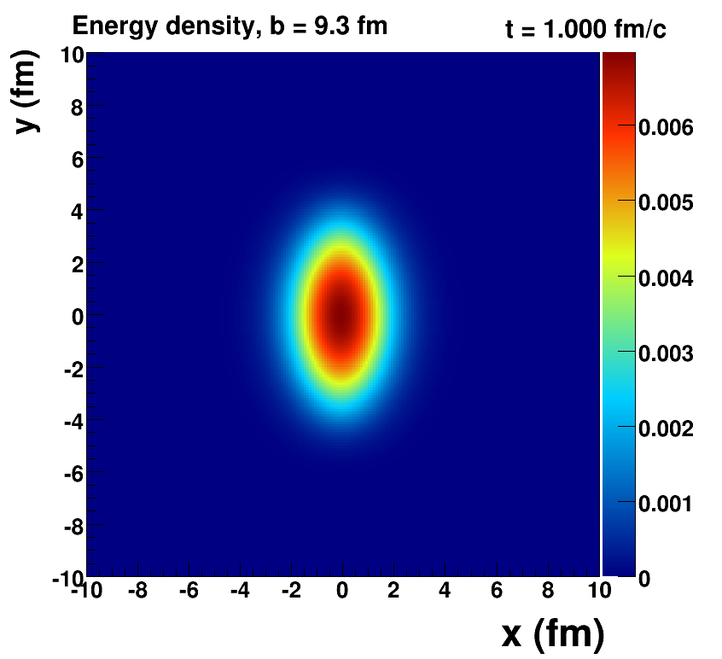
Hydrodynamic Simulation
Smooth Initial Conditions

Slide 24
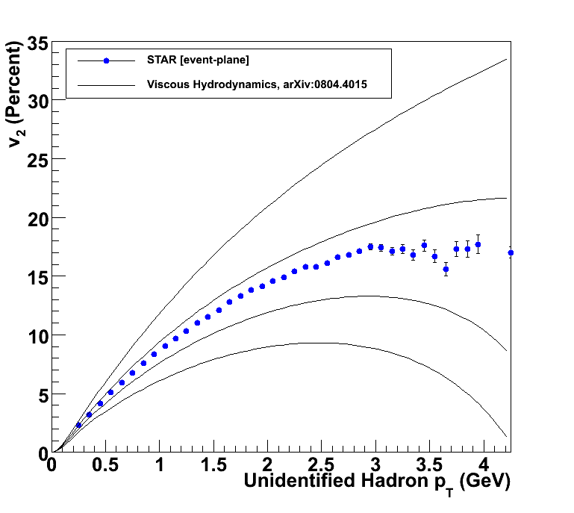
Confronting the Data
Three-dimensional relativistic viscous hydrodynamics to compare to bulk medium flow
η/s ~ 0
η/s = 1/4π
η/s = 2 x 1/4π
η/s = 3 x 1/4π
Very close to lower string theory bound
Recent work is shrinking uncertainties

Slide 25
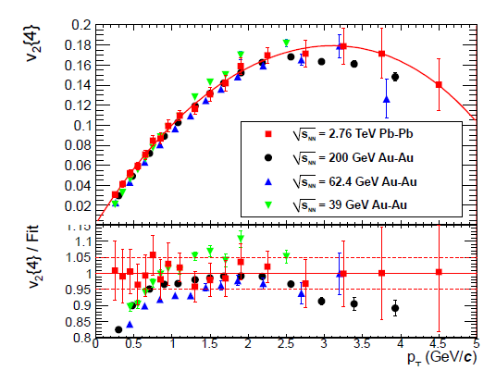
How does flow change with 14 x energy?
Wow!
What is required to get this remarkable agreement?
(JN, Beaden, Zajc, arXiv:1102.0680)
Equally low η/s or earliest time not so important…

Slide 26
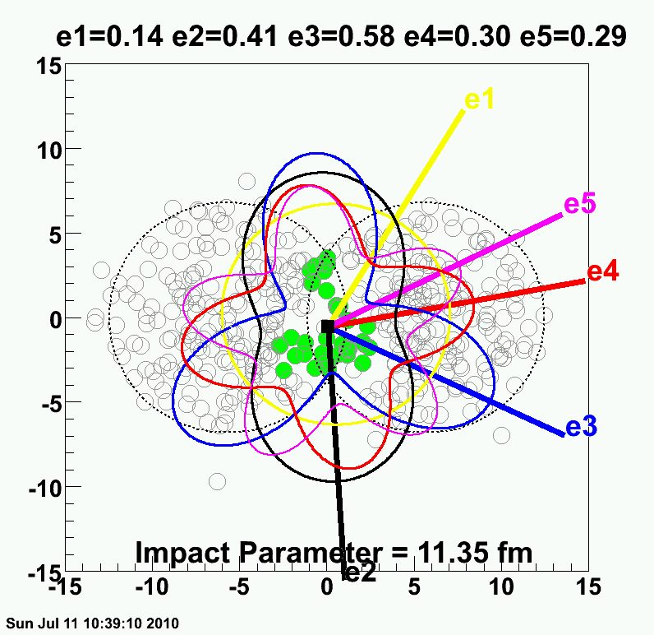
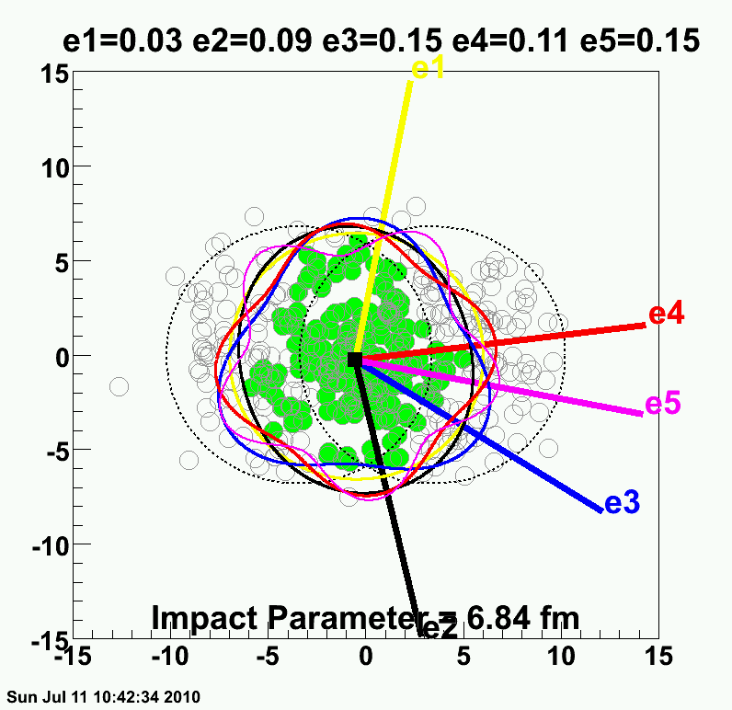
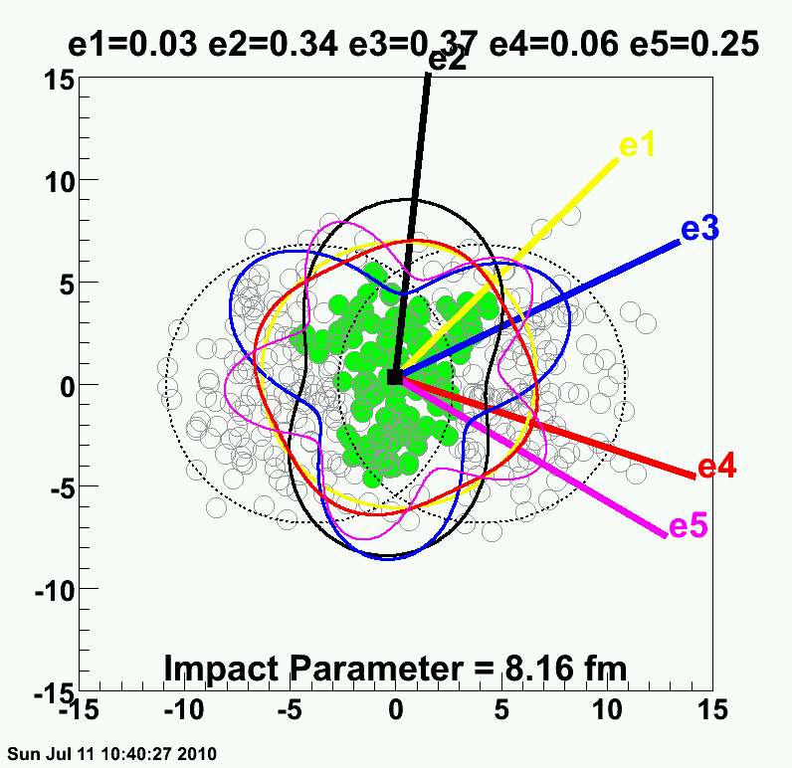
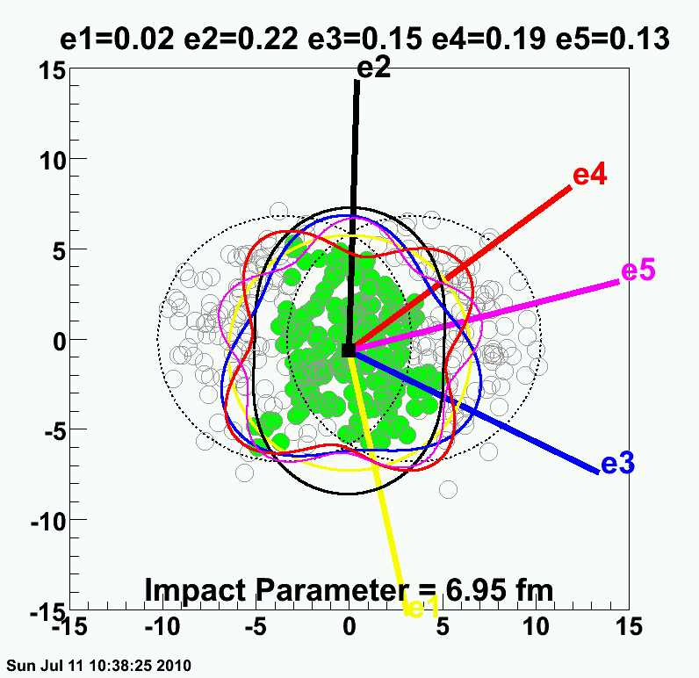
Reality = Lumpy Initial Conditions

Slide 27
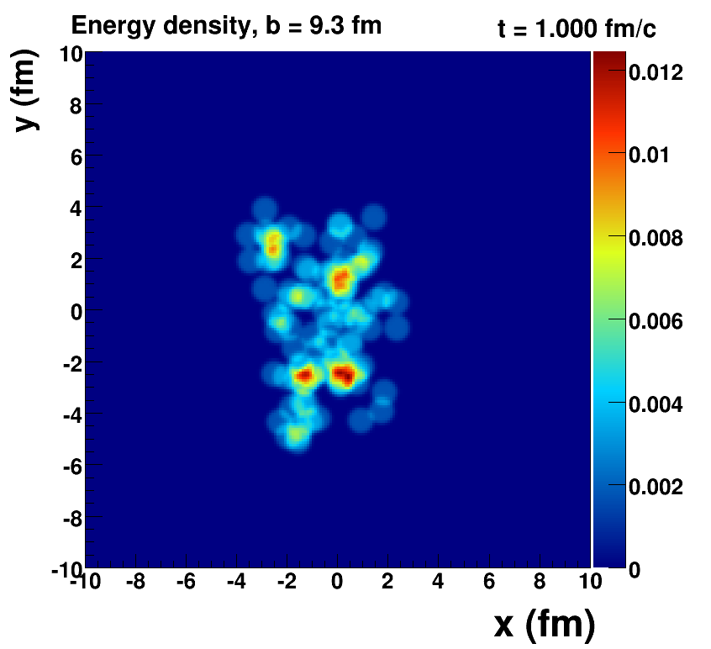
Romatschke=viscous hydrodynamics, McCumber=lumpy conditions + animation

Slide 28
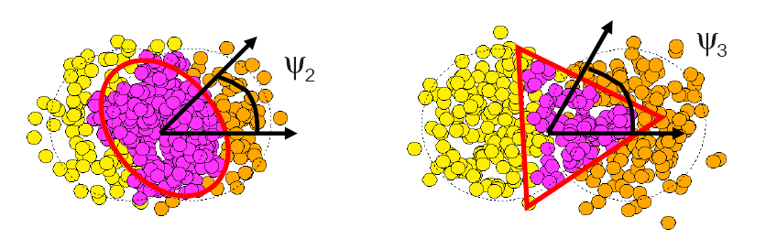
Fluctuations Dominate
Flow dictated by participating nucleon geometry
Yield(φ) = a (1 + 2 v₁ cos[(φ−Ψ₁)]
+ 2 v₂ cos[2(φ−Ψ₂]
+ 2 v₃ cos[3(φ−Ψ₃)]
+ 2 v₄ cos[4(φ−Ψ₄)]
+ 2 v₅ cos[5(φ−Ψ₅)]
+ 2 v₆ cos[6(φ−Ψ₆)]
+ …
B. Alver, G. Roland arXiv:1003.0194
P. Sorenson arXiv:1002.4878
Elliptic Flow
Triangular Flow
Quadrangular Flow
….

Slide 29
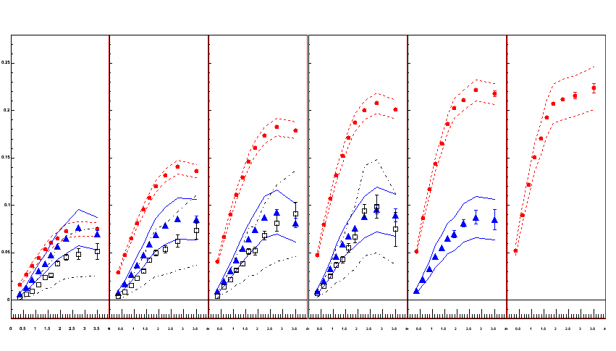
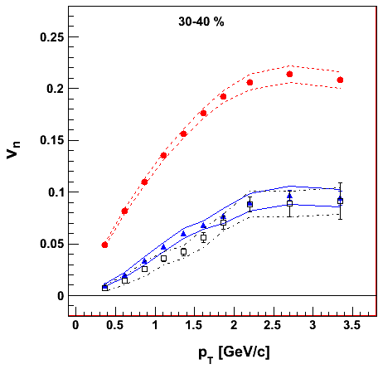
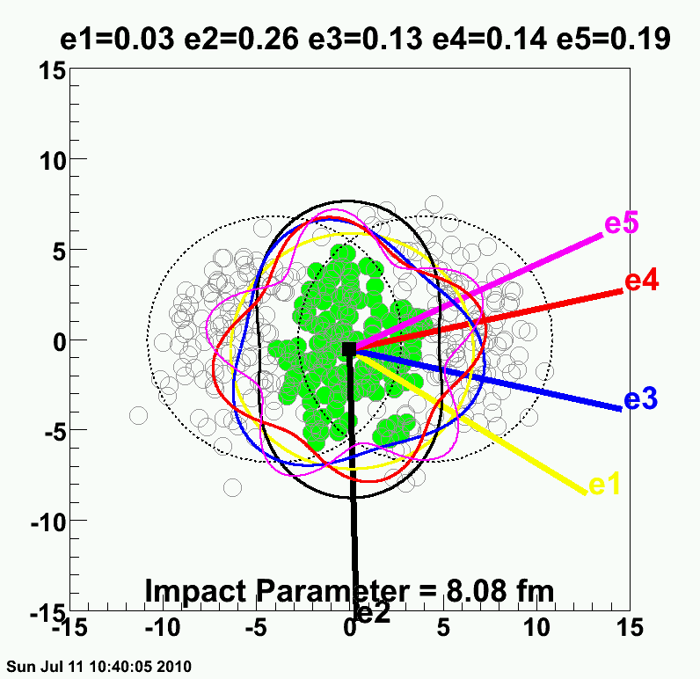
PHENIX Experiment
Systematic uncertainties defined by the variations with Φ_{n} from different Δη and different methods
v₂ {Φ₂ forw.η}
v₃ {Φ₃ forw.η}
v₄ {Φ₄ forw.η}
TT
v_{n} {EP}
Au+Au at 30-40% Central
200 GeV AuAu – 30-40% Central
PHENIX Preliminary
0.20
Elliptic
Triangular
0.10
0.0
Quadrangular
0.0
1.0
2.0
3.0
p_{T} (GeV/c)
ε₂ ≈ 2 x ε₃ ≈ 2 x ε₄
arXiv:1105.3928

Slide 30


PHENIX Experiment
v₂ {Φ₂ forw.η}
v₃ {Φ₃ forw.η}
v₄ {Φ₄ forw.η}
TT
v_{n} {EP}
Au+Au at 0-10% Central
200 GeV AuAu – 0-10% Central
PHENIX Preliminary
0.20
ε₂ ≈ ε₃ ≈ ε₄
0.10
How many moments are important? 5,6,7th
0.0
0.0
1.0
2.0
3.0
p_{T} (GeV/c)
arXiv:1105.3928

Slide 31




v₂, v₃, v₄, v₅, even v₆ !
STAR
ATLAS
Higher moments more sensitive to η/s and
simultaneous description should really pin the value down

Slide 32


Alternative Viscometer:
Put a pebble in the stream
and watch something out of equilibrium then equilibrate.
Charm Quark
Perfect Fluid?
Beauty Quark
“Does the Charm Flow at RHIC?”
At the time, many said this idea was “ridiculous”.

Slide 33


Heavy Quarks Flow with the Medium
Theory comparisons imply η/s = (1.3-2.0) x 1/4π
Electrons from D, B decays
PHENIX Upgrade for tagging charm and beauty via displaced vertex.
Taking data as I speak!
D_{HF} = 30/2πT
D_{HF} = 6/2πT
D_{HF} = 4/2πT
Suppression
Flow
Phys. Rev. C71, 034907, 2005.
Phys. Rev. C71, 064904, 2005.
Transverse Momentum

Slide 34
Probes of the Medium
Matter we want to study
Calibrated
Light Meter
Calibrated
LASER
Calibrated
Heat Source

Slide 35

Jet Probes
Jet = collimated spray of confined hadrons due to vacuum radiation of initial quark

Slide 36

Regular Jets Event Display

Slide 37

Quark Energy Loss in Medium
Jet Quenching
Expect medium induced gluon bremsstrahlung (“braking radiation”)…
Prediction for specific re-arrangement of energy in jets

Slide 38

pQCD calculations indicate:
→ mostly co-linear radiative gluon emission
→ angular broadening
→ most energy within the jet cone, just rearranged
What has been seen at the LHC?
70.0 GeV
205.1 GeV

Slide 39

Unmodified surface emitted jet
Substantially reduced opposite jet core energy, and yet no angular broadening.
Phys.Rev.Lett. 105 (2010) 252303

Slide 40

Unmodified surface emitted jet
CMS Experiment
Momentum balance recovered in < 2 GeV soft particles
Heating of Medium
- ? -

Slide 41


All this lost energy into p_{T} < 2 GeV particles…
Is it really like heating the bulk medium?
Two particle correlations for p_{T} < 4 GeV described almost perfectly via bulk flow decomposition!
A. Adare for ALICE at QM11

Slide 42

RHIC Perfect Fluid
LHC Perfect Fluid too
Ideal Gas
50 nanoseconds
T = 10 x T_{c}
Z. Fodor – Lattice 2007
400 nanoseconds
T = 4 x T_{c}
Early Universe
1.6 microseconds
T = 2 x T_{c}
6 microseconds
T_{c} = 170 MeV

Slide 43


Quark Gluon Plasma
Most Perfect Fluid
RHIC running now with high luminosity
Major detector upgrades discussed (e.g. sPHENIX)
Large Hadron Collider at CERN started with higher energies and thus temperatures x2-3 larger
Exciting challenge to understand these properties and uncover additional mysteries!

