Slide 1
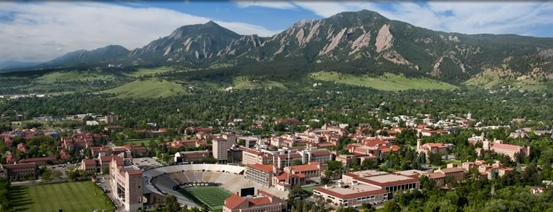



Heavy Ion Physics
and How I Learned to Love
Geometry Fluctuations
Jamie Nagle
Niels Bohr Institute, Copenhagen, Denmark
University of Colorado, Boulder, USA

Slide 2
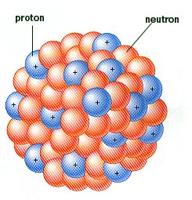
For heavy ion physicists, nuclei are simply our energy delivery system
Low energy structure and excitations are not important when we smash them apart
Fluctuations in
nucleon positions and modification in
parton distributions (nPDFs)
are important

Slide 3
Heavy Ion Collisions
RHIC energy 200 GeV x 197 = 39 TeV available
LHC energy 2.76 TeV x 208 = 574 TeV available

Slide 4
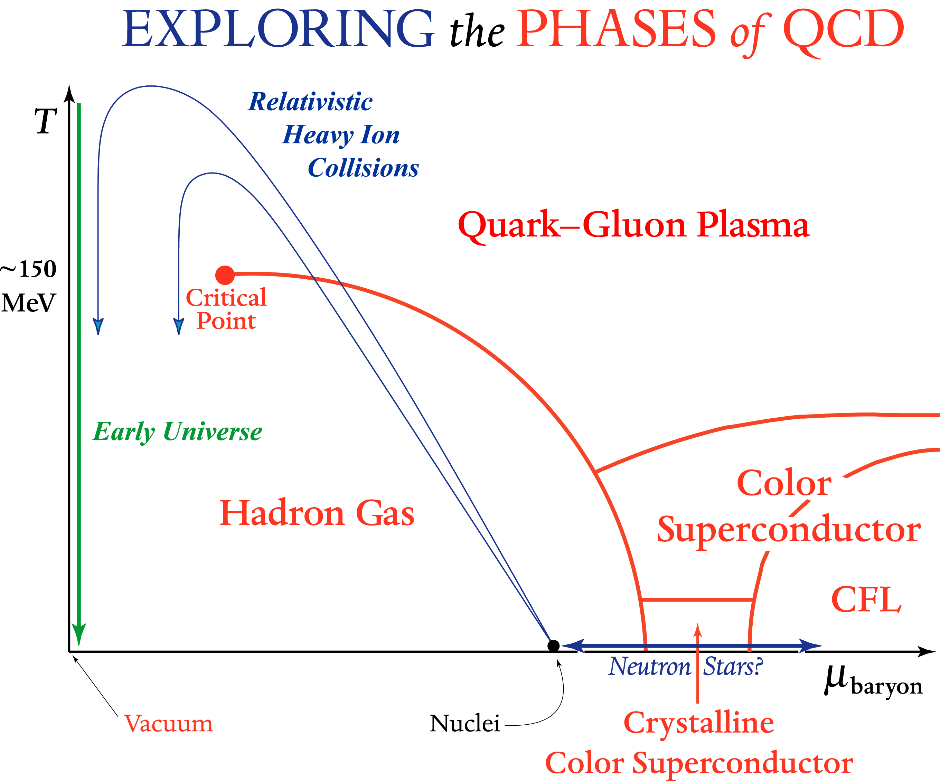
What are the Quark-Gluon Plasma Properties?

Slide 5
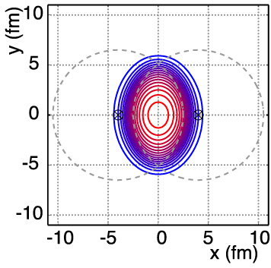
Simple Geometry Picture
v₂ = often called “elliptic flow”

Slide 6
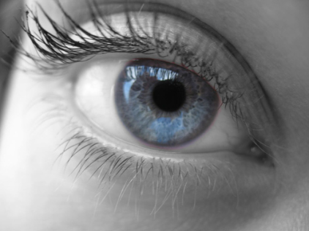
Large Elliptic Flow
Literally “seen” in first days at RHIC

Slide 7
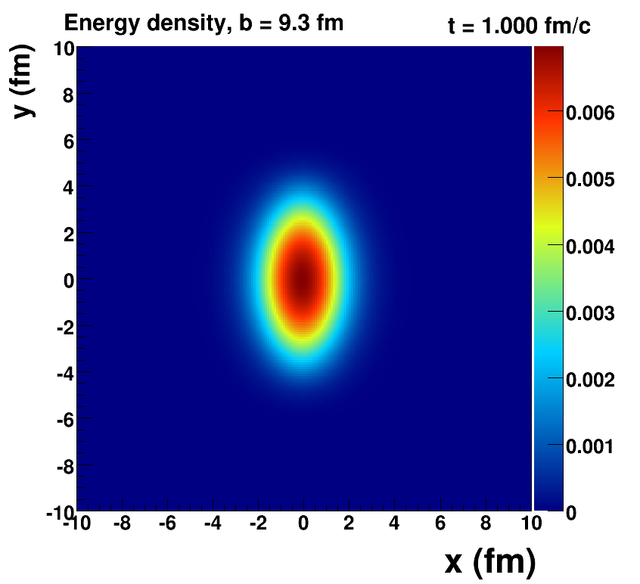
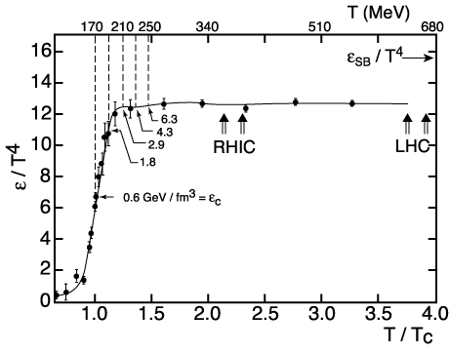
How Large is the Flow Really?
Assume early thermalization and run ideal hydrodynamics (i.e. no dissipation or zero shear + bulk viscosity)
Key Inputs:
Initial geometry
lQCD Equation of State

Slide 8
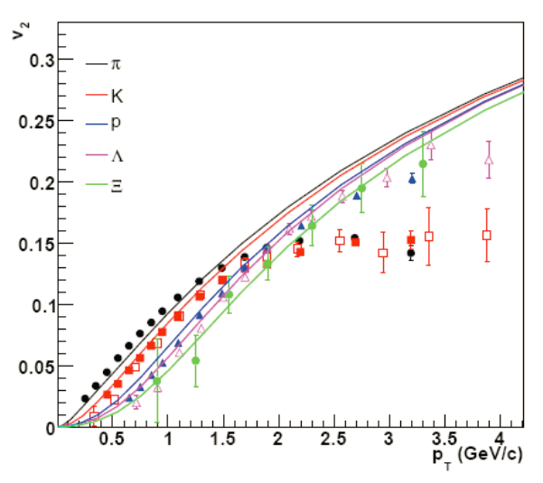
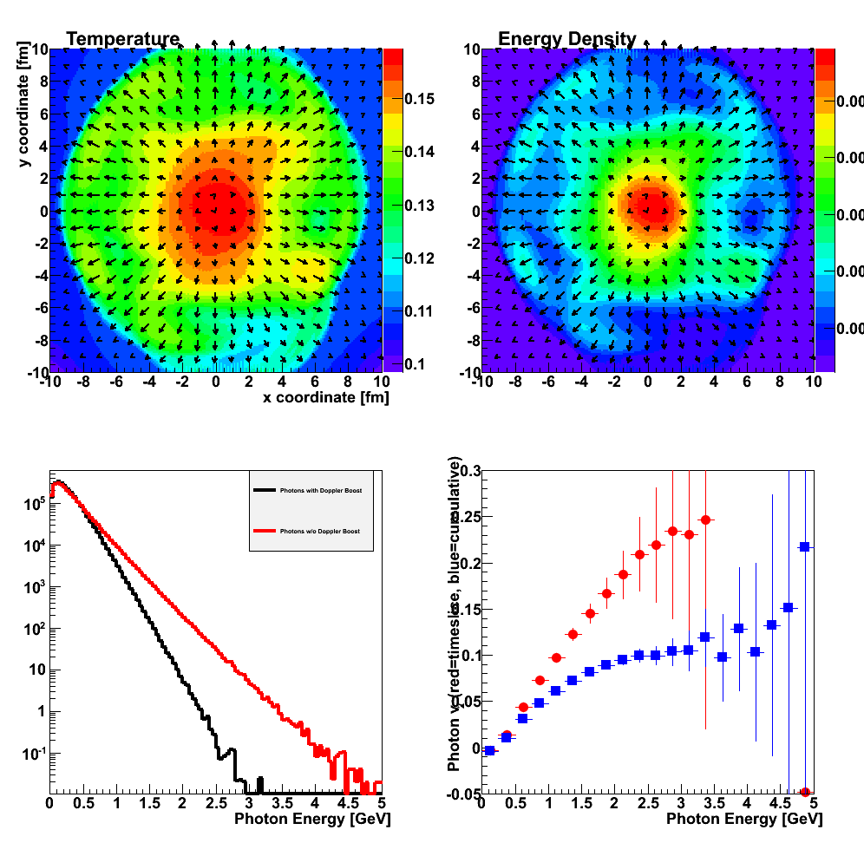
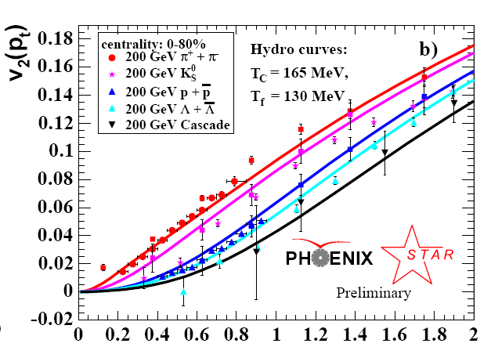
Fluid cells “freeze-out” below T_{f}
Isotropic hadrons in cell rest frame, then boosted
v₂
Temperature Profile + Velocity Vectors
v2
p_{T} (GeV)
Characteristic flow pattern observed for p_{T} < 2 GeV
Circa 2005: Quark-Gluon Plasma = Perfect Fluid

Slide 9
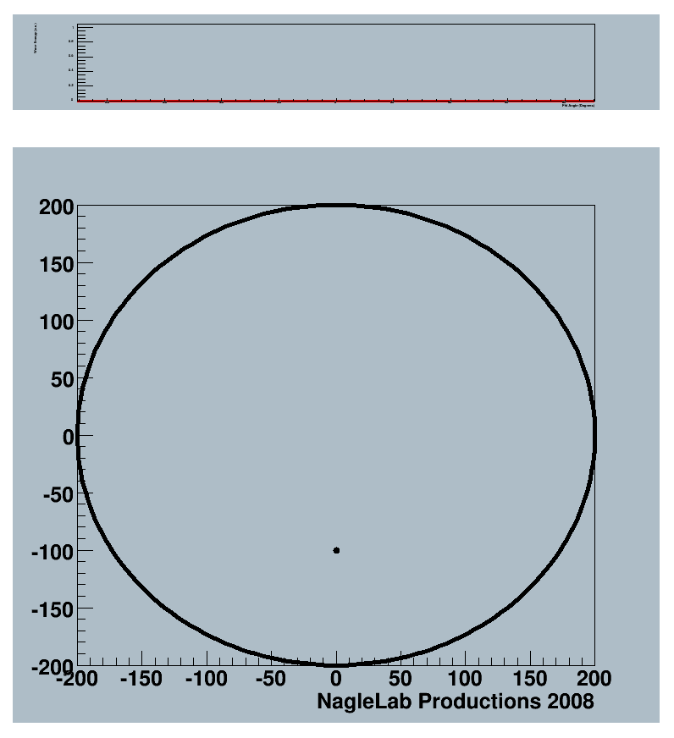
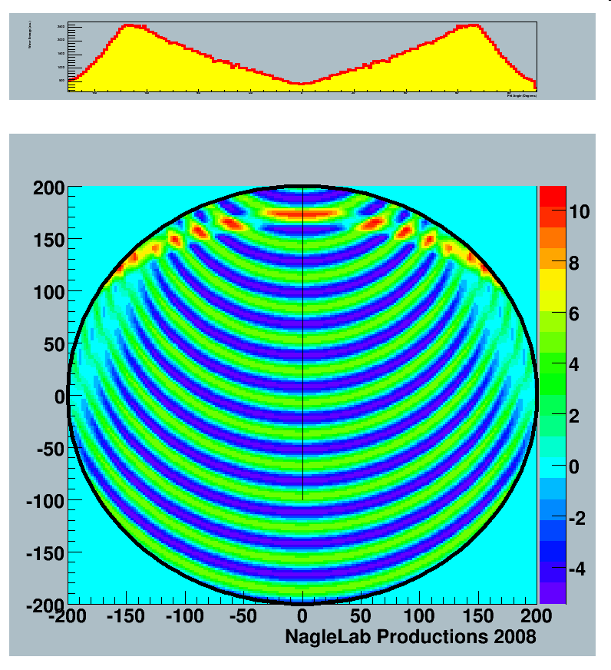
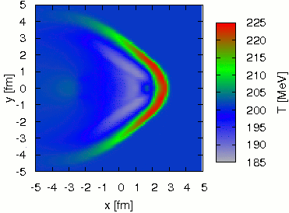
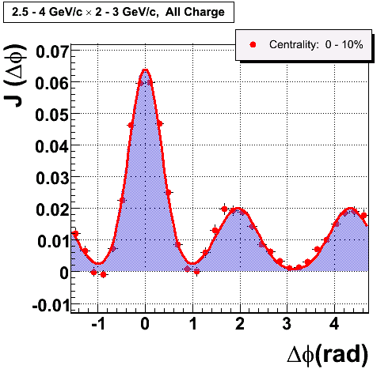
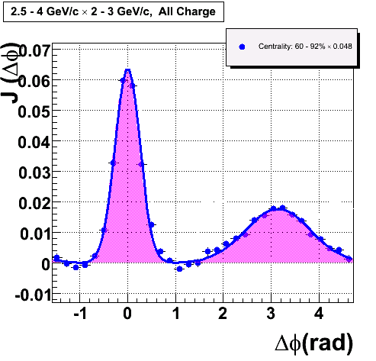
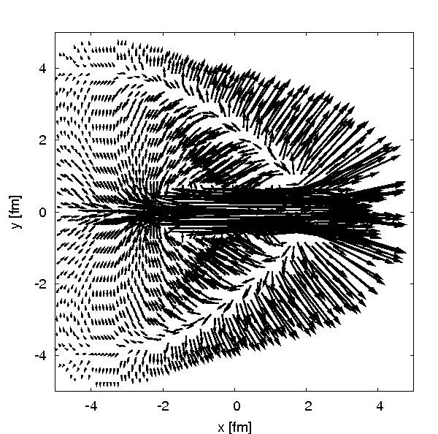
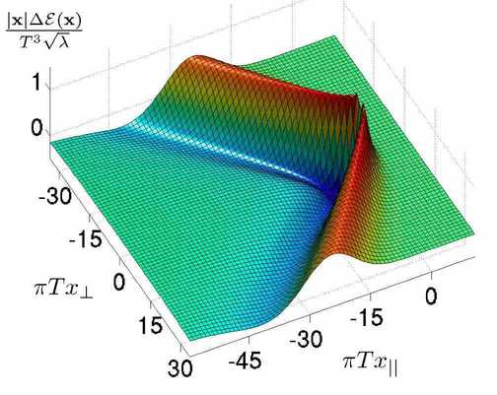
Perfect Fluid Response
Super-sonic quark traversing medium results in
shock wave response
Observed in the data?
φ = -90⁰
φ = +90⁰
Run 4 0.2 nb⁻¹
Central
AuAu
Peripheral
AuAu
Lots of theory papers!

Slide 10
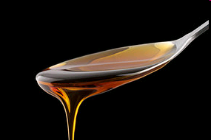
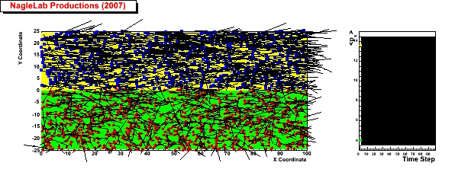
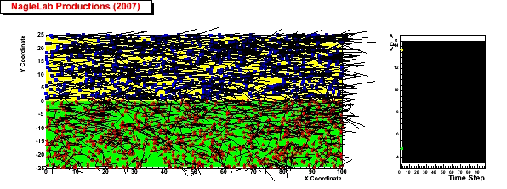
Viscosity Review
Honey – viscosity decreases at higher temperatures
viscosity increases with stronger coupling
Weak coupling (σ=0)
<p_{x}> top region
Inhibited
diffusion
↓
Small
viscosity
↓
Perfect fluid
<p_{x}> bottom region
Strong coupling (σ ↑)

Slide 11
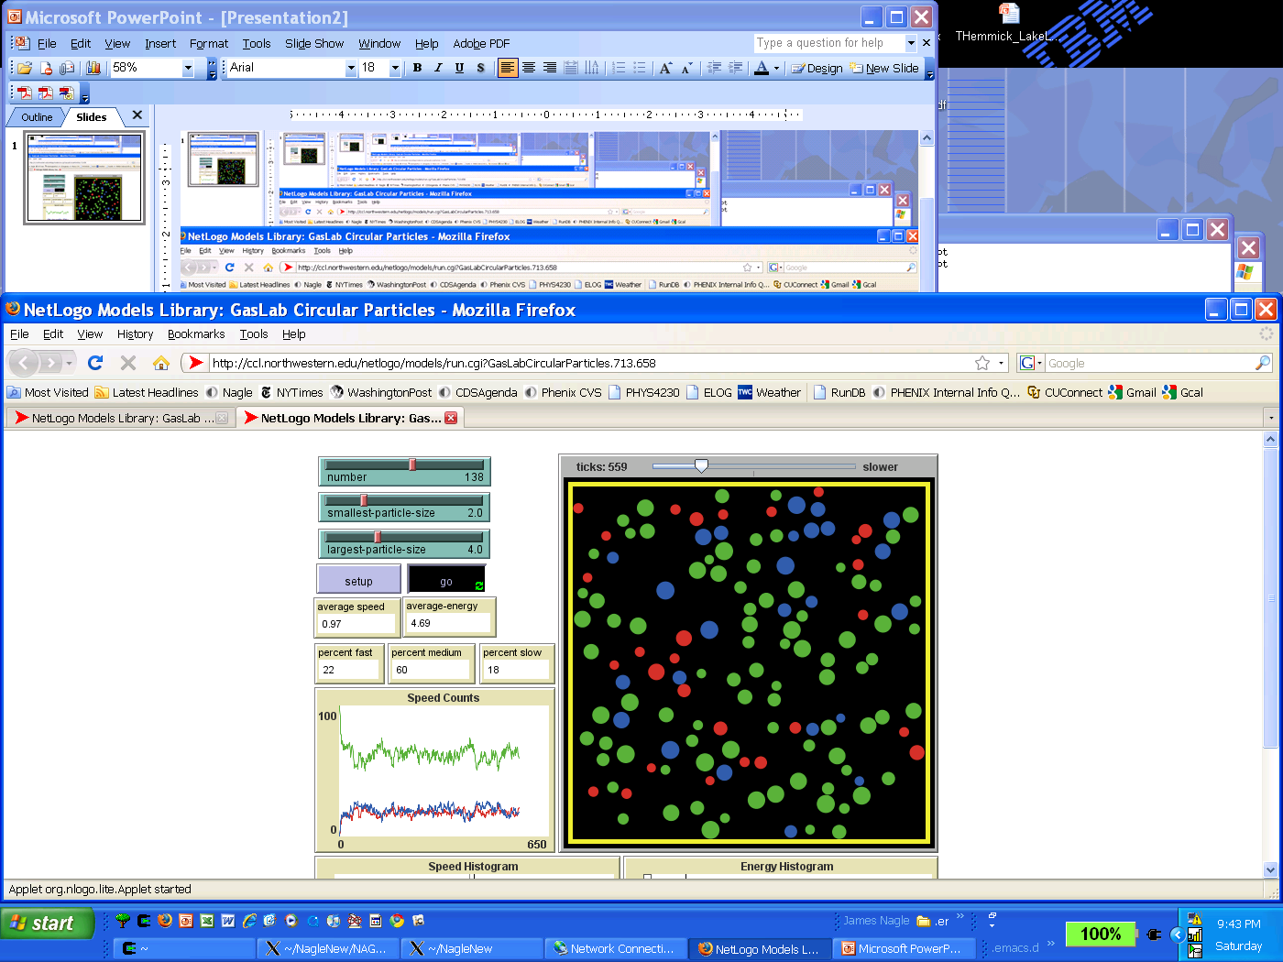
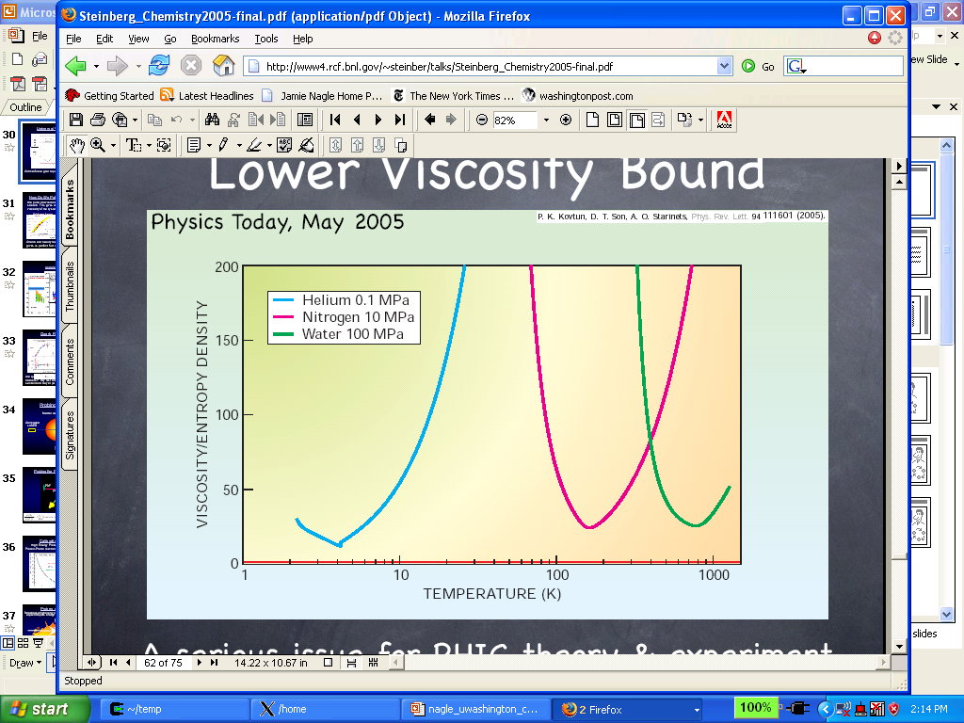
Quark
Gluon
Plasma
?
Viscosity Roadmap
String Theory
Lowest Bound!

Slide 12
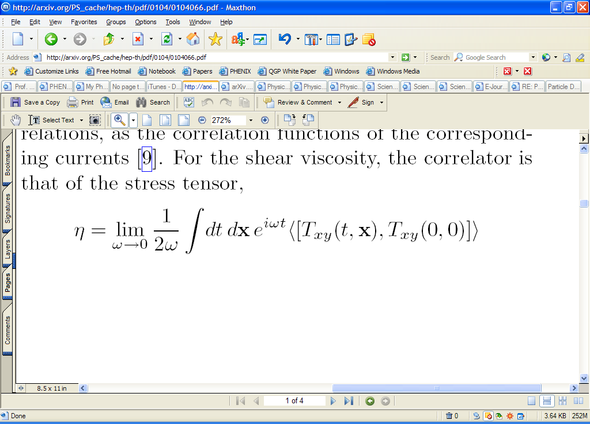
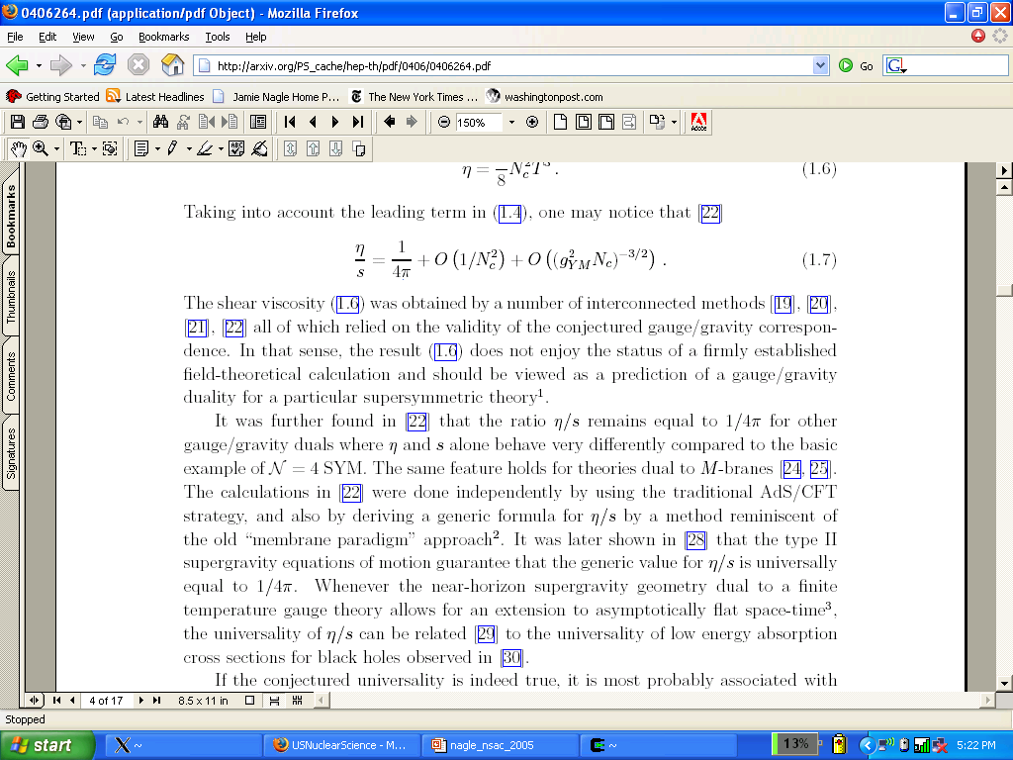
Calculating viscosity is very difficult in a strongly-coupled gauge theory
How about in String Theory (AdS/CFT)?
The Shear Viscosity of Strongly Coupled N=4 Supersymmetric Yang-Mills Plasma
G. Policasto, D.T. Son, A.O. Starinets, PRL 87: 081601 (2001). 600++ citations so far..
Superfluidity Transition
Gas-Liquid Phase Transition
String Theory
Lowest Bound!

Slide 13
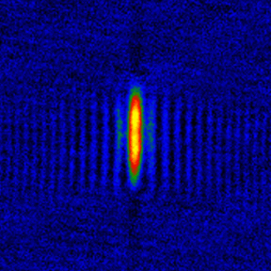
Connections / Impact
Strongly interacting Li atoms
Damping of breathing modes implies very low η/s
η/s ~ 7 x 1/4π
http://www.phy.duke.edu/research/photon/qoptics

Slide 14
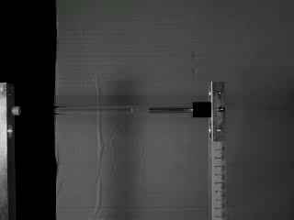
Connections / Impact
Fluid behavior with only repulsive interactions

Slide 15
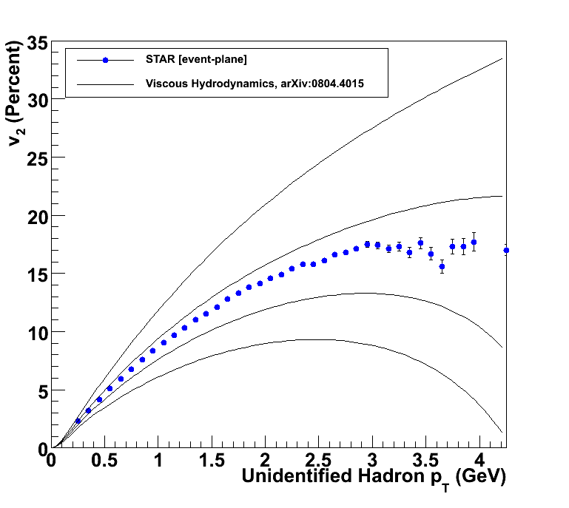
How to Quantify QGP η/s?
Relativistic viscous hydrodynamics compared to data
Luzum, Romatschke, Phys. Rev. C78, 034915 (2008)
η/s ~ 0
η/s = 1/4π
η/s = 2 x 1/4π
η/s = 3 x 1/4π

Slide 16
Very close to the bound!
What dominated these uncertainties a few years ago?
Different ways of measuring v₂ gave ±20% variations.
Now resolved that the methods have different sensitivities to “nonflow” and fluctuations.
For example Ollitrault, Poskanzer, Voloshin Phys. Rev. C80, 014904 (2009).
In ideal hydrodynamics v₂ α ε₂ (initial eccentricity)
Uncertainty on η/s from initial geometry was ~100%.
Other sources subdominant:
hadronization, EOS, pre-flow, …

Slide 17
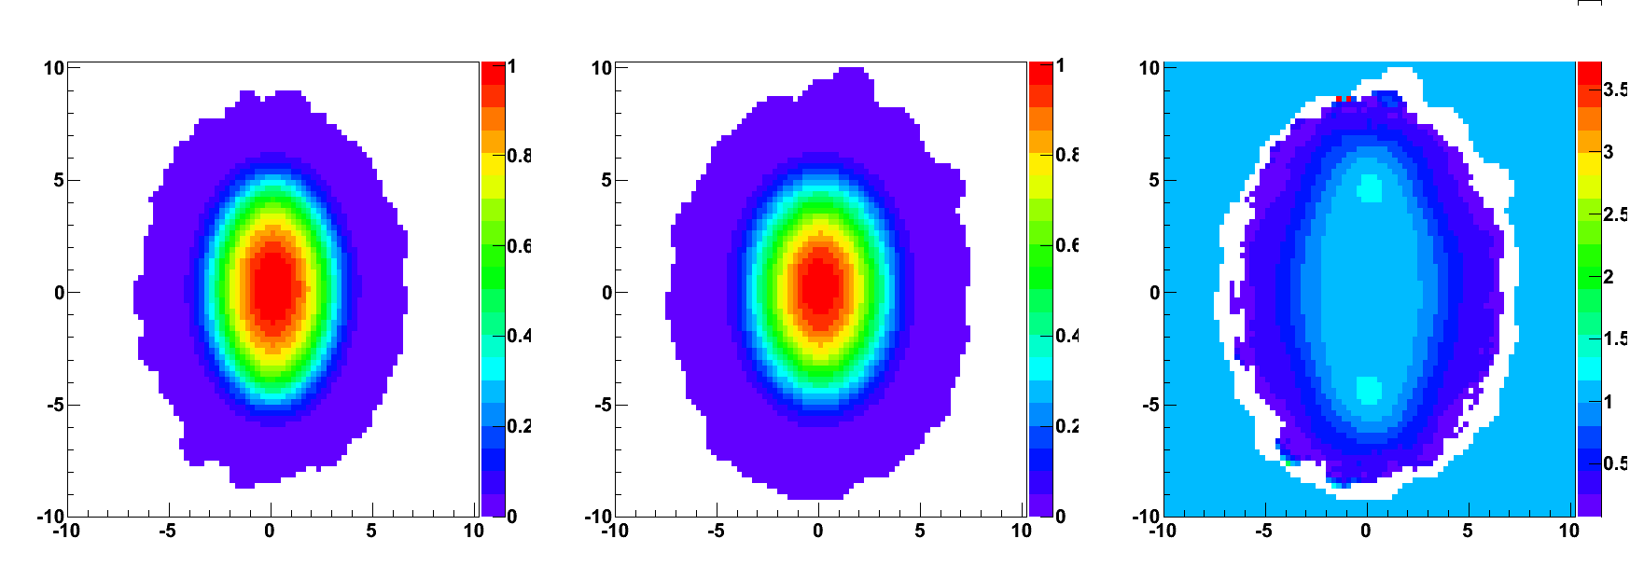
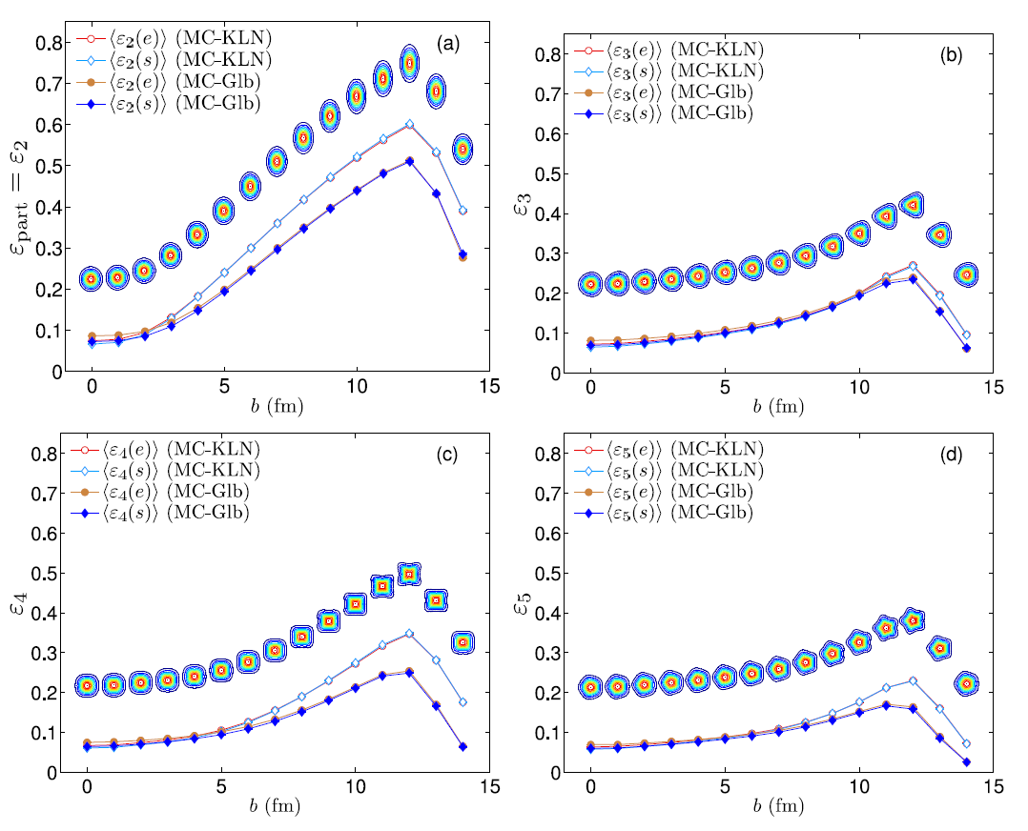
Initial Condition Uncertainty
Gluon Saturation (CGC)
Glauber
Ratio Saturation/Glauber
* Still working on full understanding (ratio normalized to 1.0 in the middle)
Elliptic Flow reasonably described by either:
Smaller initial eccentricity (Glauber) +
Less Dissipation (η/s≈1/4π)
Larger initial eccentricity (Gluon Satuation) +
    More Dissipation (η/s ≈ 2/4π)
Neither A nor B, and yet these give a range of uncertainty

Slide 18
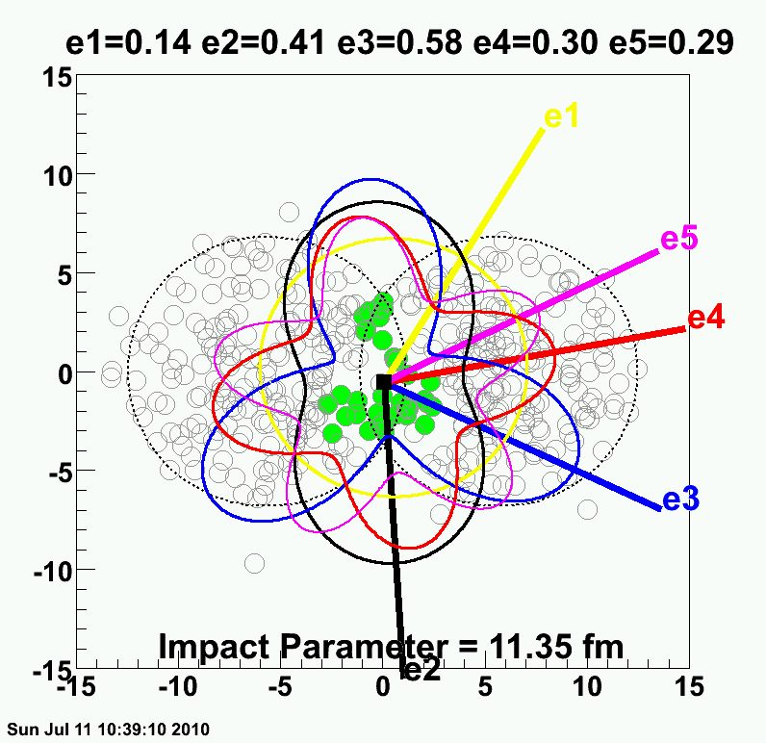
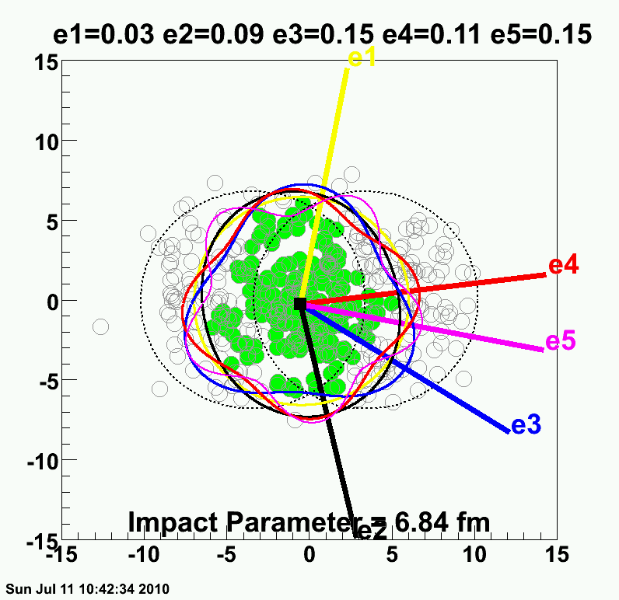
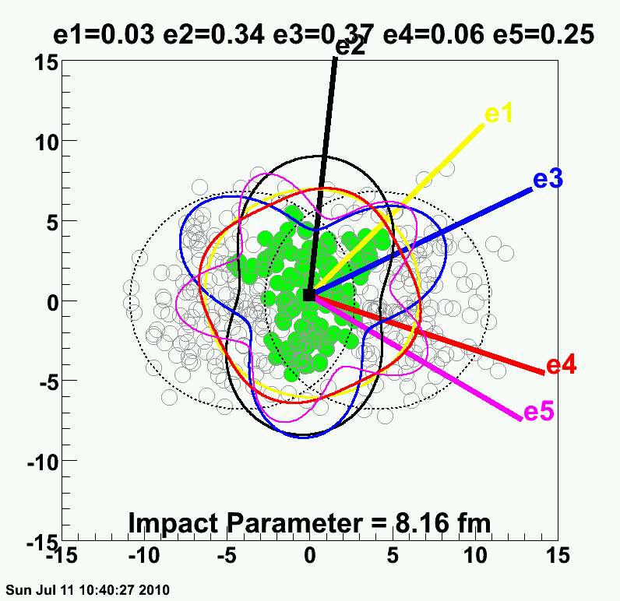
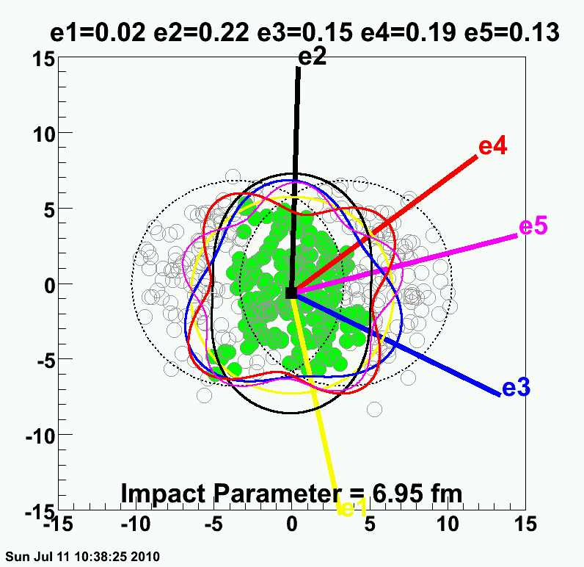
Realization → Lumpy Initial Conditions

Slide 19
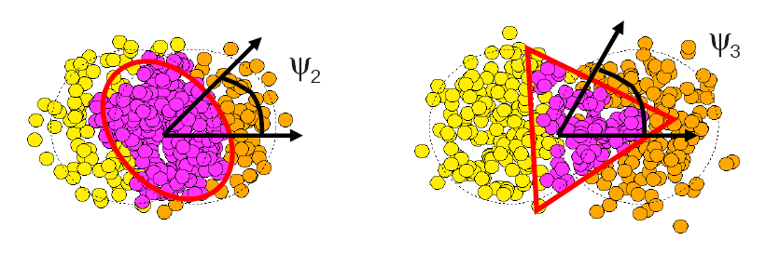
Fluctuations Dominate
σ(v₂)/v₂
Flow dictated by
nucleon geometry
σ_{v2}/v₂
σ_{ε2}/ε₂
B. Alver, G. Roland arXiv:1003.0194
P. Sorenson arXiv:1002.4878

Slide 20
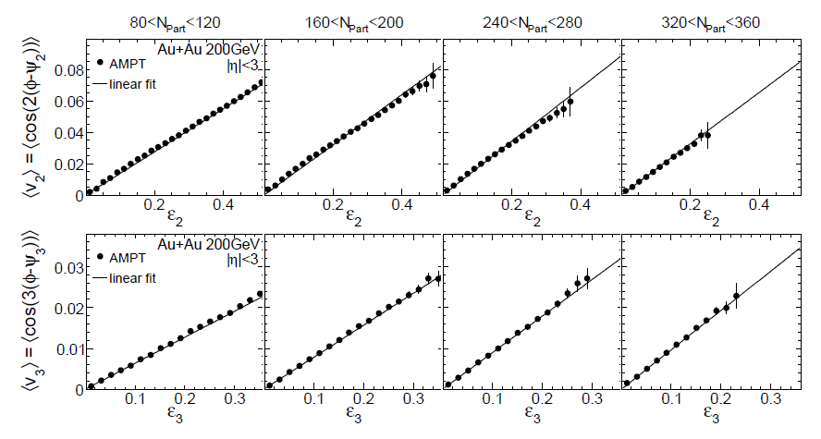
Spatial moments translate into
momentum anisotropy moments
v₂ vs ε₂
v₃ vs ε₃
v₃ is as irrefutable as v₂ from ε₂.
Now quantify implications.
Alver, Roland, arXiv:1003.0194v3

Slide 21
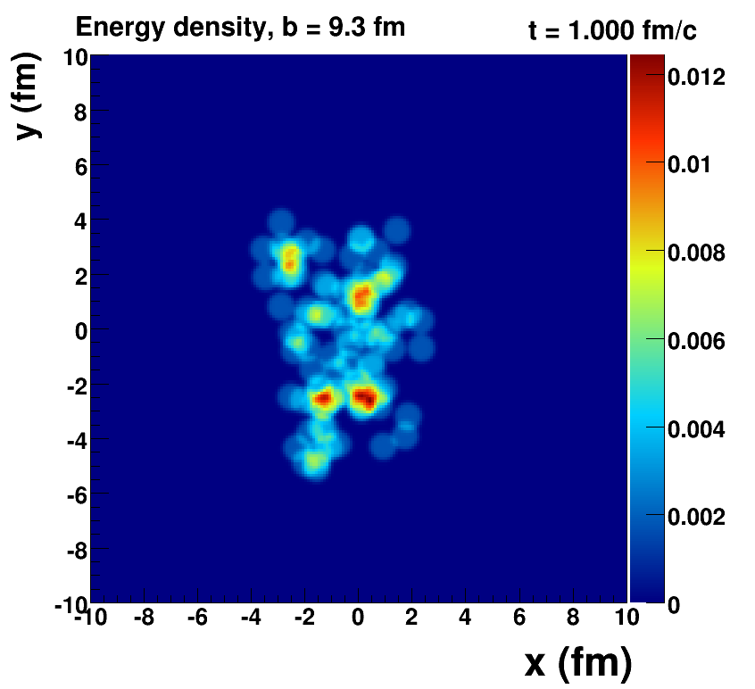
Romatschke=viscous hydrodynamics, McCumber=lumpy conditions + animation

Slide 22
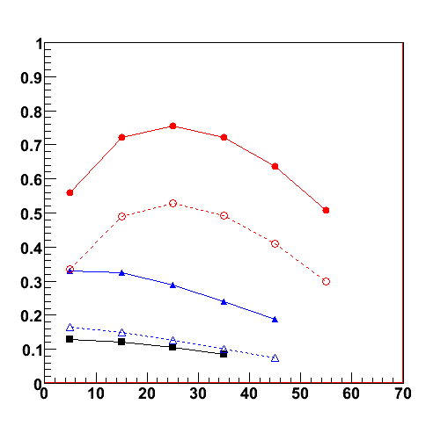
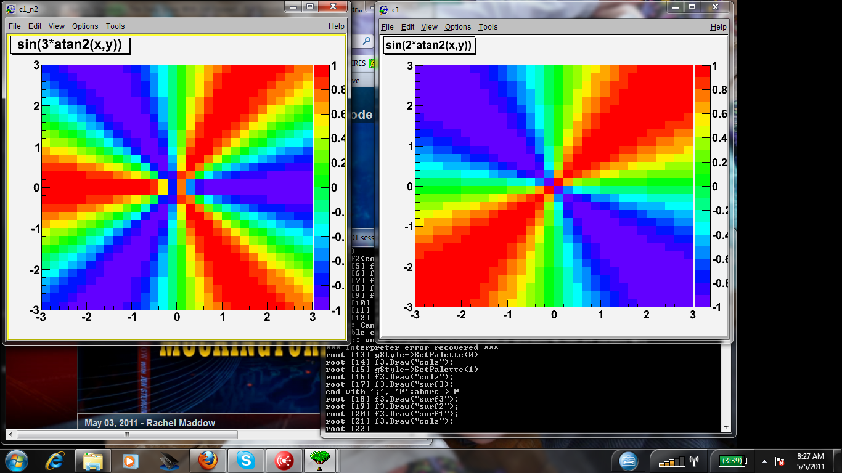
Measuring v₃
First, can detectors separated by Δη = 2 or even Δη = 6 measure event-by-event the 3rd order participant plane?
200 GeV Au+Au
PHENIX Preliminary
RXN |η| = 1.0-2.8
MPC |η| = 3.1-3.7
Answer = Yes
Now we can measure v₃ using the event plane method.
n=2 RXN
n=3 RXN
n=4 RXN
σ_{n} = <cos n(Φ_{n(meas.)} - Φ_{n(true)})>
n=2 MPC
n=3 MPC
n=2
n=3
n=4
centrality (%)
First presented at WWND11 by S. Esumi and J. Chen

Slide 23
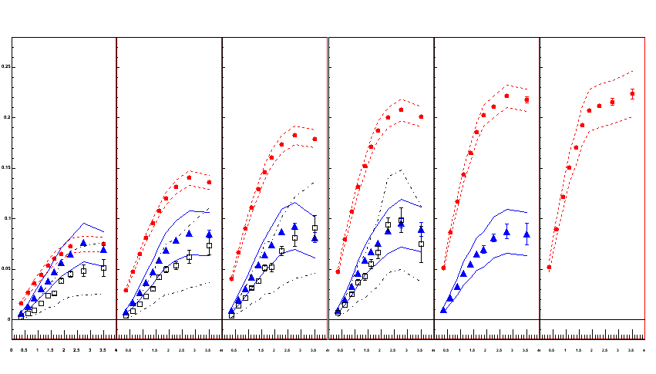
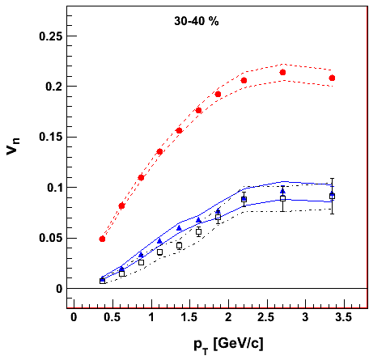
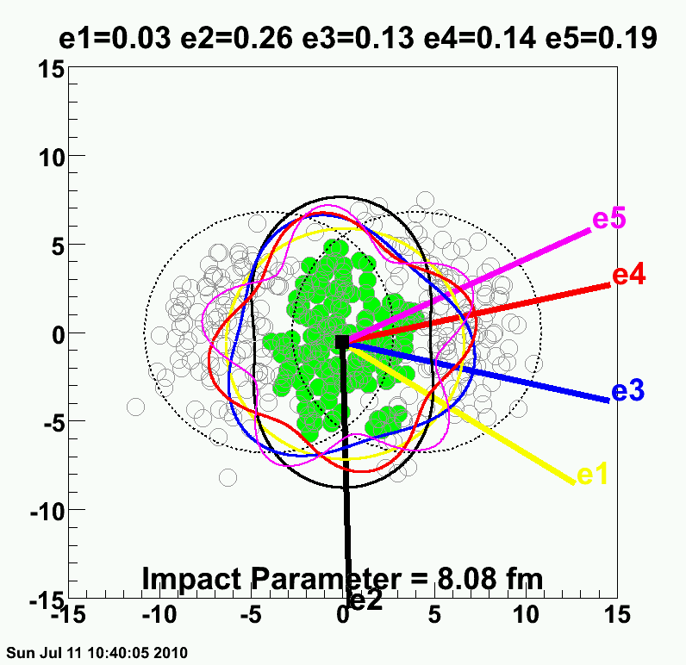
PHENIX Experiment
Systematic uncertainties defined by the variations with Φ_{n} from different Δη and from different methods.
v₂ {Φ₂ forw.η}
v₃ {Φ₃ forw.η}
v₄ {Φ₄ forw.η}
TT
v_{n} {EP}
Au+Au at 30-40% Central
200 GeV AuAu – 30-40% Central
PHENIX Preliminary
0.20
Elliptic
Triangular
0.10
0.0
Quadrangular
0.0
1.0
2.0
3.0
p_{T} (GeV/c)
ε₂ ≈ 2 x ε₃ ≈ 2 x ε₄

Slide 24
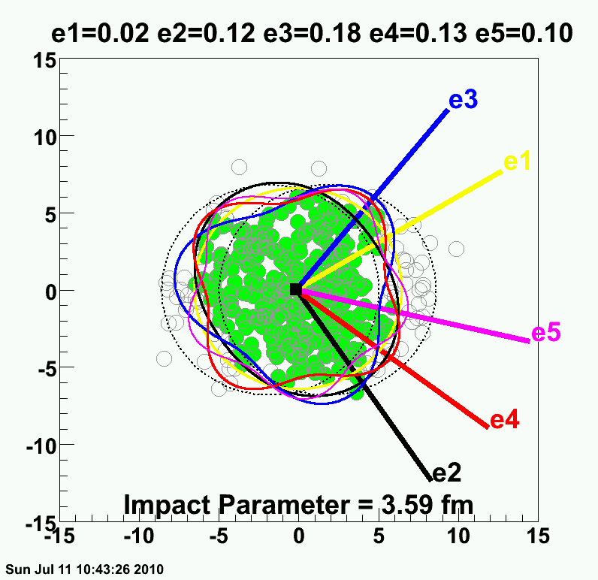
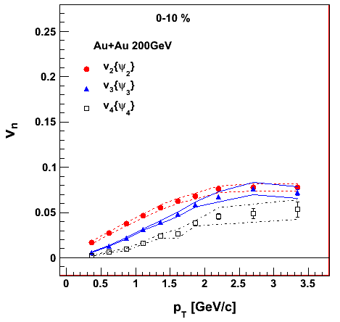
PHENIX Experiment
v₂ {Φ₂ forw.η}
v₃ {Φ₃ forw.η}
v₄ {Φ₄ forw.η}
TT
v_{n} {EP}
Au+Au at 0-10% Central
200 GeV AuAu – 0-10% Central
PHENIX Preliminary
0.20
ε₂ ≈ ε₃ ≈ ε₄
0.10
How many moments are important?
5,6,7th
0.0
0.0
1.0
2.0
3.0
p_{T} (GeV/c)

Slide 25
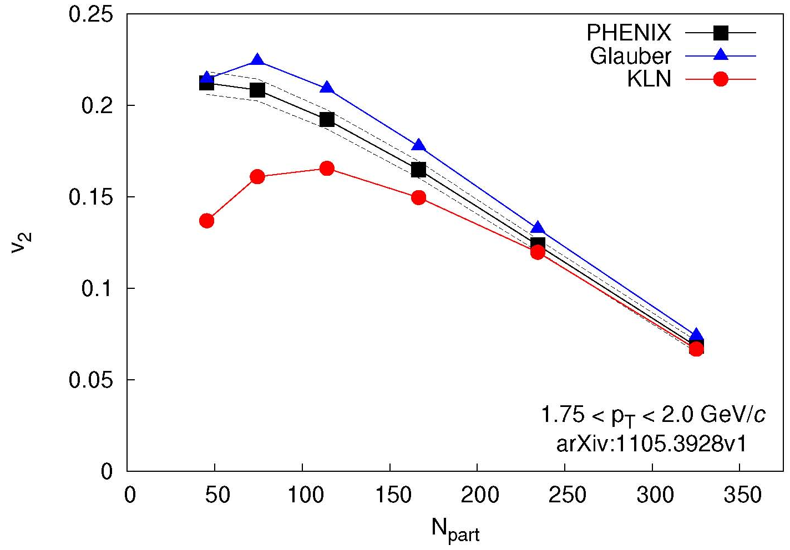
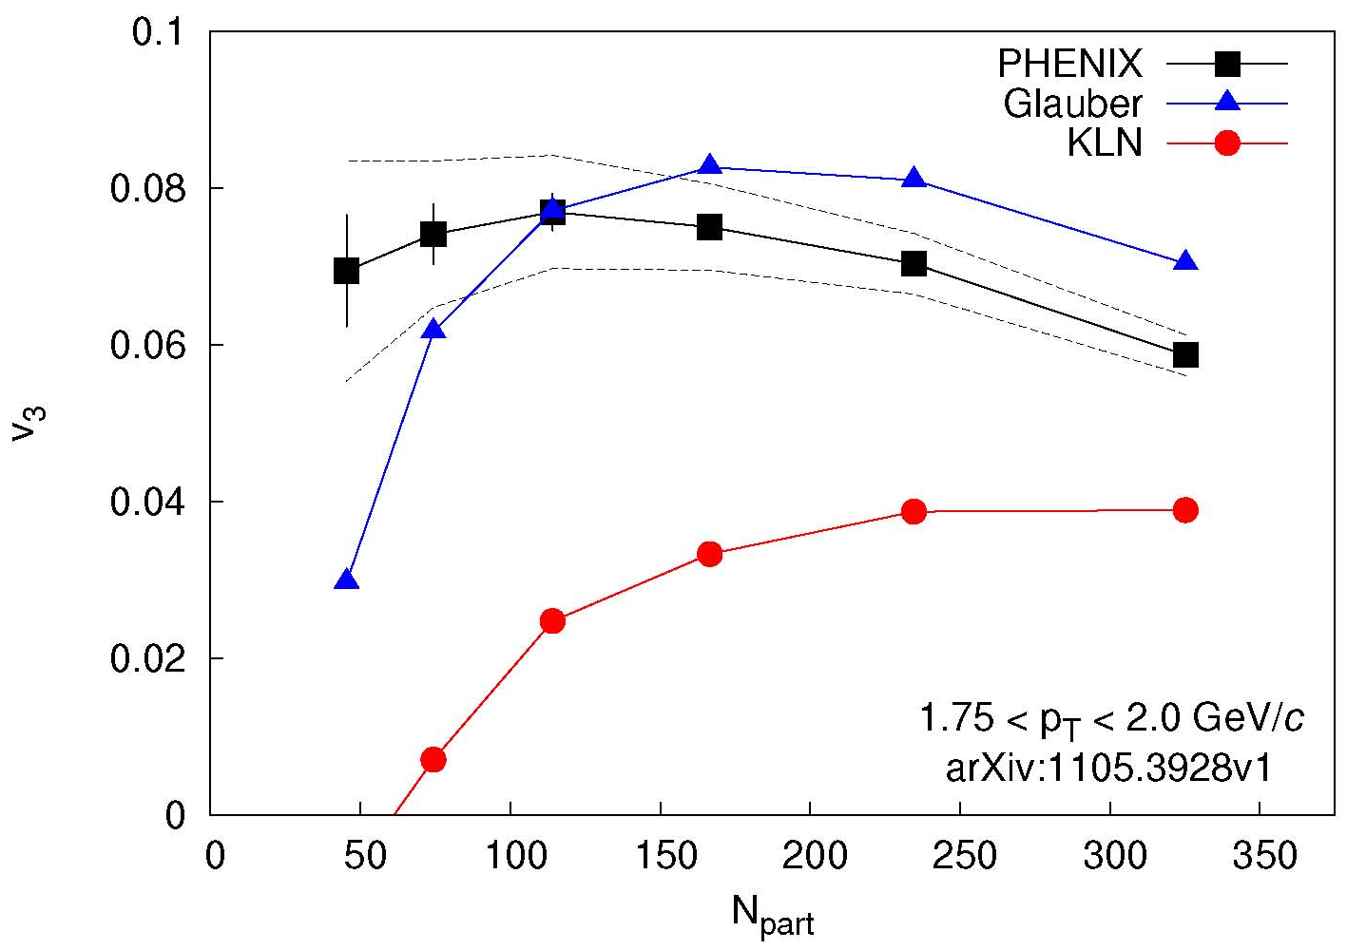
Initial Condition Constraints
Glauber and CGC similar spatial triangularity ε₃
Thus CGC with larger η/s gives smaller v₃
Real Prediction!
Qiu, Heinz, arXiv:1104.0650v2
Theory calculation:
Alver et al.
PRC82,034913
arXiv:1105.3928
arXiv:1105.3928
Theory calculation:
Alver et al.
PRC82,034913
v₂ described by Glauber and CGC
v₃ described only by Glauber
Needs theory calculation with full event-by-event fluctuations and confirmation at LHC energies.

Slide 26
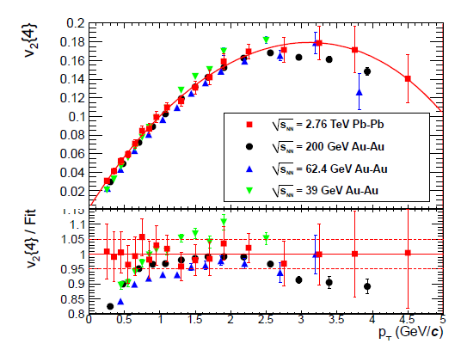
How does flow change with 14 x energy?
What is required to get this remarkable agreement?
JN, Bearden, Zajc, arXiv:1102.0680

Slide 27
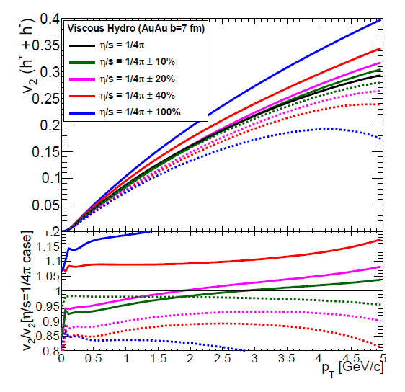
Change in η/s to change v₂ by 5%?
Δ(η/s) ~ 20% → Δv₂~ 5%
Δ(η/s) ~ 40% → Δv₂~10%
Δ(η/s) ~ 100% → Δv₂~25%
Always take ratios.
Low p_{T} turn out to be very sensitive
and where experiments have smallest uncertainties

Slide 28
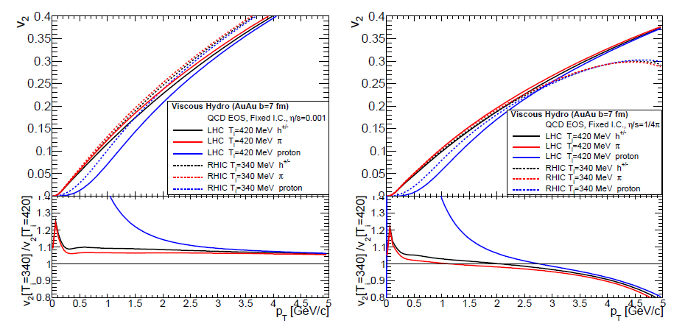
T_{i} = 420 MeV (LHC) versus T_{i} = 340 MeV (RHIC)?
Black = all hadrons
Very similar v₂(p_{T}) except larger viscous effects for p_{T} > 3 GeV/c
LHC = Solid
RHIC = Dash
Blue = protons
Large difference for v₂(p_{T}) due to larger radial boost at LHC temperatures.
Solid prediction.
Previously noted with ideal hydrodynamics by Kestin, Heinz
Ratio RHIC/LHC

Slide 29
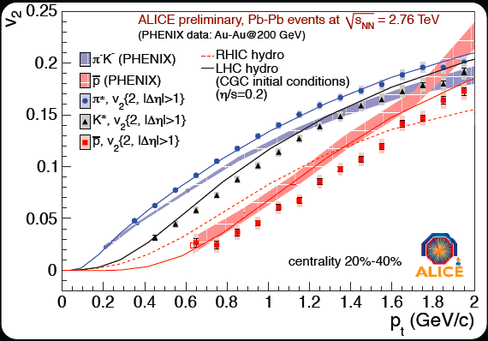
General Feature Confirmed in ALICE Data
v₂
Exact radial boost still not matching in detail
Try Hydro + Cascade afterburner

Slide 30
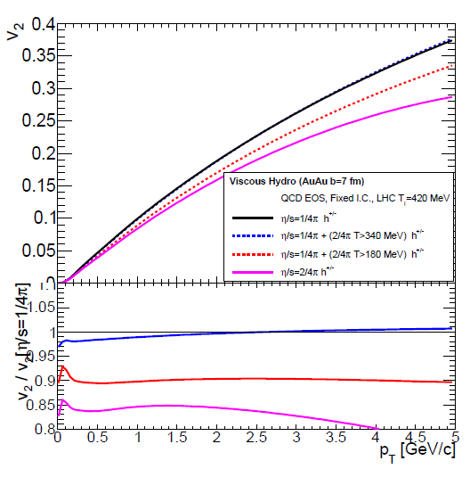
What if η/s is larger for T > 340 MeV?
(just the range sampled at the LHC in early times)?
Consider case I:
η/s = 1/4π (all T)
Consider case II:
η/s = 1/4π (T<340 MeV)
η/s = 2/4π (T>340 MeV)
No change in v₂(p_{T})!
Earliest LHC time has no big impact on η/s.
η/s
2/4π
1/4π
340
T
Ratio

Slide 31


Recent study of η/s (T) – arXiv:1101.2442
Conclusion that RHIC v₂ is dominated by η/s below T_{c} and LHC v₂ by η/s above T_{c} seems an unlikely fine tuning problem.
In fact, if one takes the ratios, the green-dash curve fails to describe the differences.
Factor 10 increase in η/s results in 15% reduction in v₂ at p_{T} = 2 GeV/c
Seems consistent with my finding that a factor of 2 for T>340 MeV has almost no effect.

Slide 32




Another Class of η/s Constraints
“Does the Charm Flow at RHIC?”
Flow of charm and beauty quarks may yet provide the best constraints. PHENIX Silicon Detector now operational.
10 Gigabit link Data Collection system
Colorado effort led by Mike McCumber

Slide 33







“Ridge” and “Shoulders”
Features in two-particle correlations that have generated a lot of excitement.
p-p 200 GeV
Two years ago (QM09)
I gave a talk with my prediction.
The “death” of the ridge and shoulders
(aka shock response)
π⁰

Slide 34

Re-Evaluation of Shock Response
Black points
PHENIX published with v₂ background modulation and ZYAM.
Red points
(NOT PHENIX OFFICIAL)
Use AMPT v₃/v₂ ratio and include v₂ and v₃ background modulation.
Calculation by A. Adare
PHENIX Au+Au 0-20% Central
Dominant ridge and shoulders will be gone.
Detailed careful analysis needs v₁ … v₅ and method checks.

Slide 35

LHC Results
“Ridge” and “Shoulders” seen at LHC as well…
ALICE: arXiv:1105.3865
Fourier Decomposition characterizes the distribution
Are the Fourier Coefficient just the higher order flow moments?

Slide 36

Tests and model comparisons can be done on Coefficients
If entire 2-particle correlation from bulk flow then:
Fourier Coefficient v_{nΔ}(p_{T1},p_{T2}) = v_{n}(p_{T1}) x v_{n}(p_{T2})
Deviations indicate important non-flow effects
(jets and medium response for example)

Slide 37





For p_{T} < 3-4 GeV/c,
everything looks like flow.
Jet energy absorbed completely into medium
Heating?

Slide 38



Thermal Photon Emission
T_{AA} scaled pp + Exponential
Gold-Gold
Direct Photons
Proton-Proton
Direct Photons
Specific prediction for flow (v₂) of thermal photons
Fit to pp
NLO pQCD (W. Vogelsang)
PHENIX: Phys.Rev.Lett. 104 (2010) 132301

Slide 39


Hydrodynamic Calculation
KZ Mendoza, M. McCumber, JN, P. Romatschke
Early Time
Middle Time
Late Time
Large Blue
Shift
No Boost

Slide 40
Hydrodynamic Calculation
KZ Mendoza, M. McCumber, JN, P. Romatschke
v₂ from late time steps
Early Time
Middle Time
Late Time
v₂ Cumulative
Large Blue
Shift
v₂ = 0
No Boost

Slide 41

Challenge of Direct Photon Flow
PHENIX Experiment: arXiv:1105.4126
Thermal Only
Thermal + Direct
Holopainen, Räsänen, Eskola , arXiv:1104.5371v1
Pre-equilibrium photons will have small v₂…
However, pre-equilibrium flow build-up could help.

Slide 42
Summary
Enormous progress in this area in the last one year
Dramatic reduction in η/s uncertainties around the corner
Exotic shock response and ridge features gone
Key is now to understand how localized energy is so quickly transformed into effective heating
(nicely related to jet quenching puzzle)
Major upgrades at RHIC planned.
Critical for complementing the studies at LHC and really measuring the full excitation function

Slide 43


PHENIX Decadal Plan
Major Upgrade Proposed Extending into EIC Era
We are interested in feedback, suggestions, involvement.
http://www.phenix.bnl.gov/phenix/WWW/docs/decadal/2010/phenix_decadal10_full_refs.pdf

