Slide 1
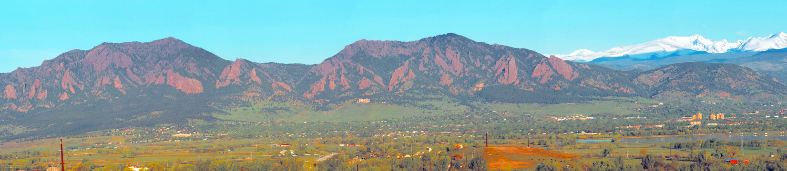



Geometry Rules:
Heavy Ion Physics of
Heavy Quarkonia and Harmonic Flow
Jamie Nagle
Niels Bohr Institute, Copenhagen, Denmark
University of Colorado, Boulder, USA

Slide 2
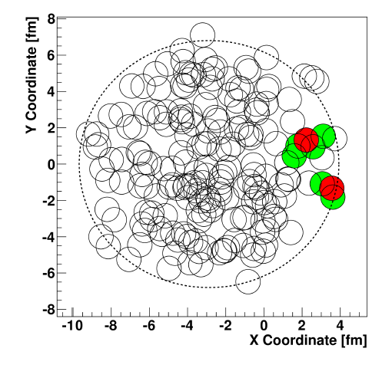
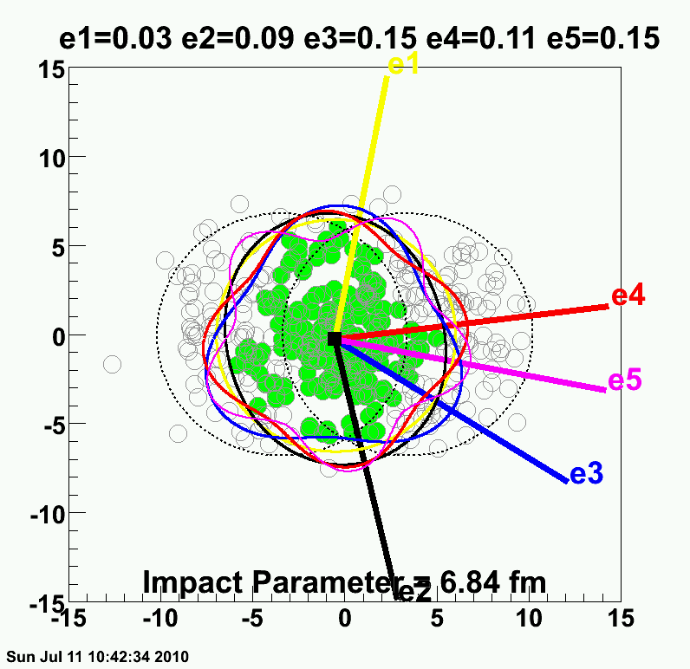
Focus on two topics in today’s talk…
1. Heavy Quarkonia (J/ψ) in p-p, d-Au, Au-Au
2. Harmonic Flow of the bulk QGP
Highlight how geometric dependencies
provide key insights…
d-Au
Au-Au

Slide 3
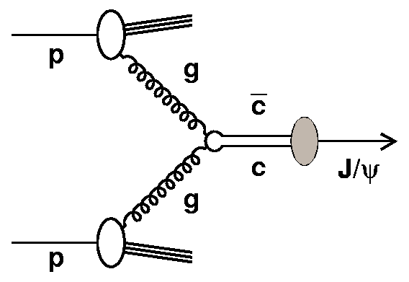
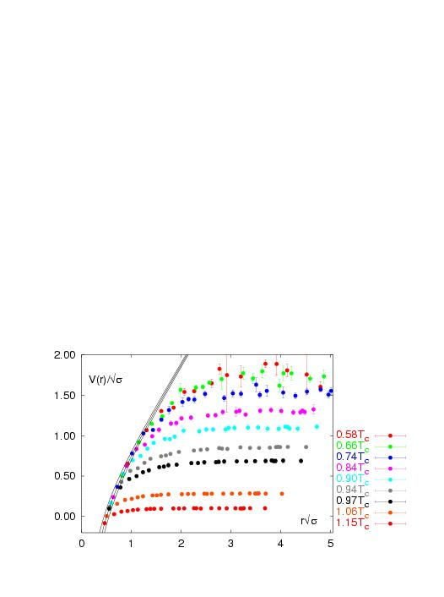
Heavy Quarkonia
J/ψ Production Mechanisms
Not understood and not addressed in this talk
see excellent review in arXiv:1010.5827
Time evolution into color neutral J/ψ state
(d-Au reactions are an excellent test)
Color screening in QGP
(Au-Au reactions are the test)
Highlight results from PHENIX Experiment
d-Au (Alex Linden-Levy) and
Au-Au (Matt Wysocki Ph.D. thesis) and
theory paper (JN, Frawley, Linden-Levy, Wysocki, arXiv:1011.4534)

Slide 4
J/ψ Modifications in p-A Reactions
gluon-gluon → c c
c c evolves to J/ψ on
a timescale of 0.3 fm/c
At RHIC energies, the J/ψ forms outside the Lorentz contracted nucleus
Simplest modifications
1. Shadowing nPDF changes initial charm pair production.
2. Breakup of charm pair
in nucleus
J/ψ
r_{T}
Longitudinal
thickness Λ(rT) dictates the physics

Slide 5
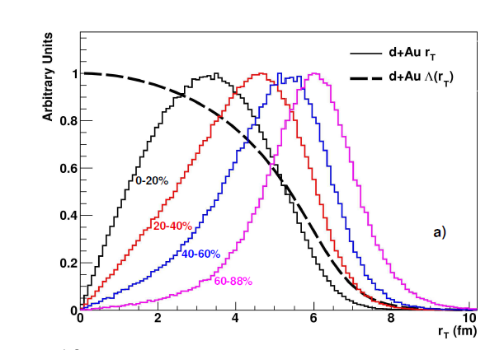
deuteron-Au collision
b = event
impact parameter
r_{T}(1,2,3)
PHENIX collected a high statistics d-Au @ 200 GeV data set in 2008.
Using multiplicity in Beam-Beam Counter (3.1 < η < 3.9) we select on d-Au centrality, then use Glauber MC to determine r_{T} distributions.
PHENIX arxiv:1010.1246v1
Λ(r_{T})

Slide 6
The nucleus is quite lumpy.
Longitudinal thickness varies event-to-event.
r_{T}(1)
Thus, calculate the thickness Λ(r_{T}) for each sampled charm pair production point by counting the
number of nucleons in a tube (Ntube).

Slide 7
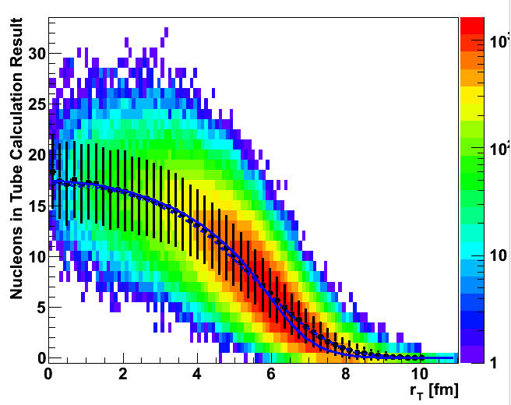
Glauber Monte Carlo
# in Tube
At the center of the nucleus, <Ntube> ≈ 18 and the rms ≈ 5.
Never believe any calculation with a smooth nucleus.

Slide 8
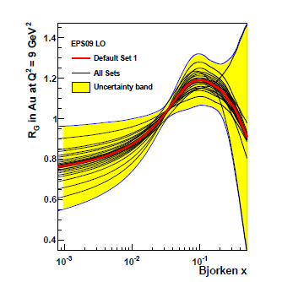
Nuclear Modified Parton Distribution Functions
Gluon Modification
EPS09 provides constrained nPDFs and with quantified uncertainties.
However, there is
no Λ(r_{T}) dependence
(only average modification)
Many calculations in the literature assume that the modification is linear in the thickness
What does that look like?

Slide 9
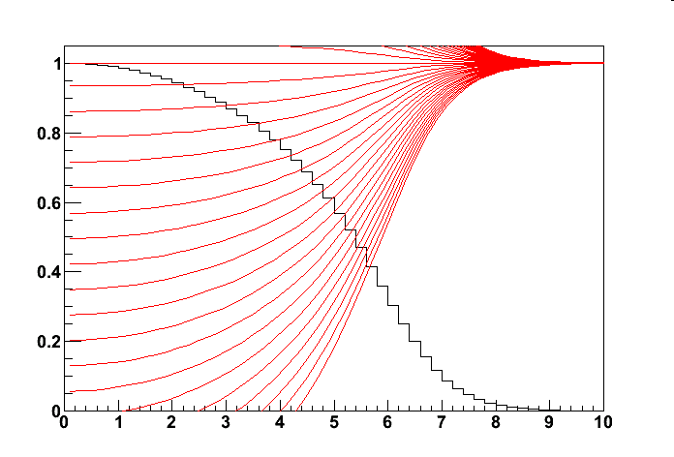
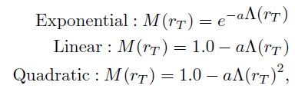
Geometric Mapping
Modification (M) linear in Λ(rT) for different average <M>
e.g. how many fewer low-x gluons
M
<M>=0.90
For <M> ≈ 0.35, one is forced to have a negative value at small r_{T}.
This is unphysical.
Also try other forms…
<M>=0.80
<M>=0.70
<M>=0.60
<M>=0.50
Λ(r_{T})
<M>=0.40
<M>=0.35
rT (fm)

Slide 10
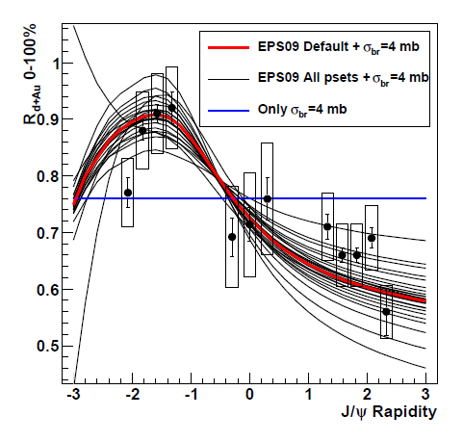
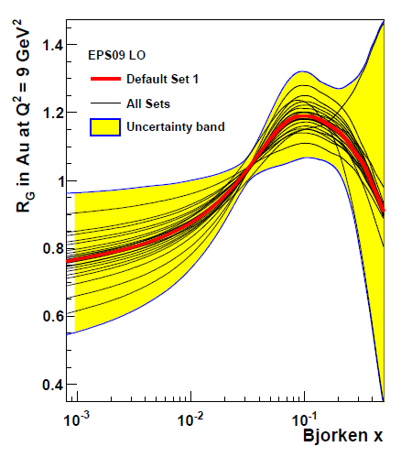
J/ψ Data Averaged Over All Geometries
PHENIX arxiv:1010.1246v1
We test all EPS09 nPDF variations and find reasonable agreement within uncertainties by including σ_{br}= 4 mb.
Rapidity dependence comes entirely from nPDF.

Slide 11
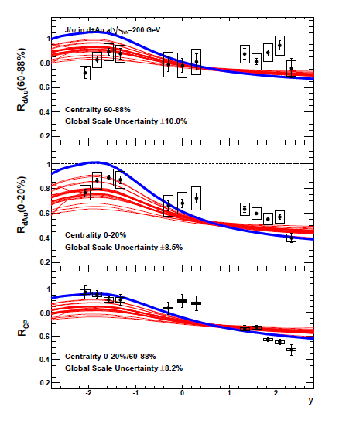
Peripheral dAu / pp
For each EPS09 nPDF set, fit the data including statistical and systematic uncertainties to find the best σ_{br}.
Central dAu / pp
Best fit EPS09 pset = 17 and σ_{br} = 3.2 mb. However, the fit is very poor (pvalue < 0.0001).
Central / Peripheral
Data cannot be described by any combination of EPS09 nPDF and σ_{br}!

Slide 12
Geometry Test
For each value of a and the distribution for Λ(r_{T}) one can calculate R_{dAu} for every centrality case.
For the Linear Case,
for any values of a,
there is a unique relationship between the average suppression (R_{dAu}) and the steepness versus centrality (R_{CP}).

Slide 13
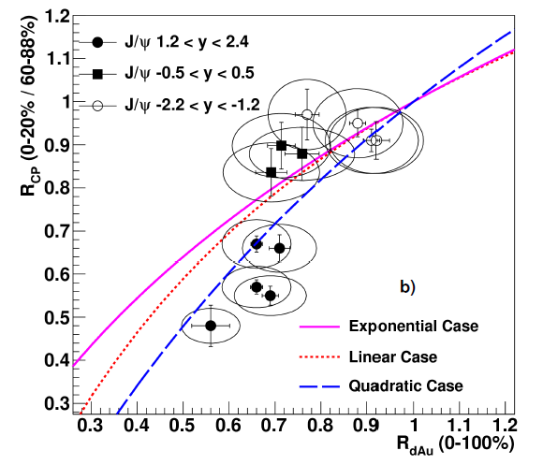
arXiv:1010.1246v1
Data driven proof that non-linear (in the thickness) physics effects must contribution to J/ψ modification.

Slide 14
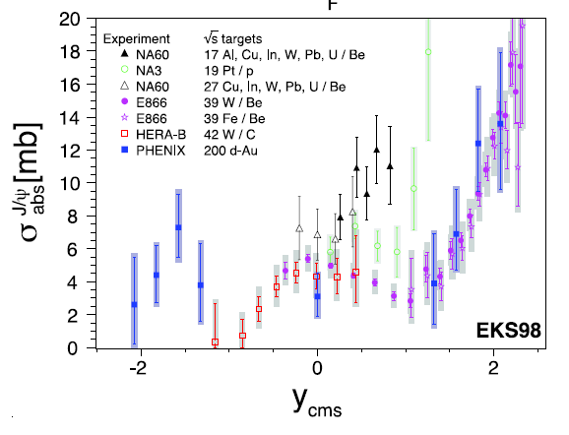
Initial State Parton Energy Loss
Energy loss of incoming gluon prior to hard scatter creating charm pair
J/ψ
Fit each rapidity point to a separate σ_{br} , yields rapid increase of σ_{br} at forward rapidity.
Initial state energy loss of
high x partons?
arXiv:1010.5827v3

Slide 15
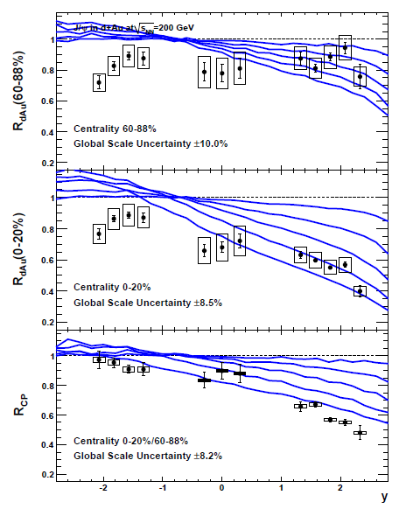
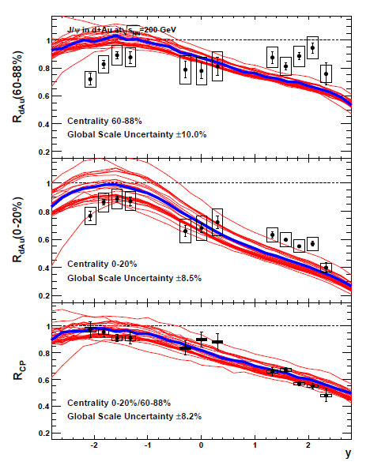
Initial parton energy loss in our calculation (ΔE α L or L²)
Only e-loss (ΔE α L)
Best fit e-loss, nPDF, σ_{br}

Slide 16
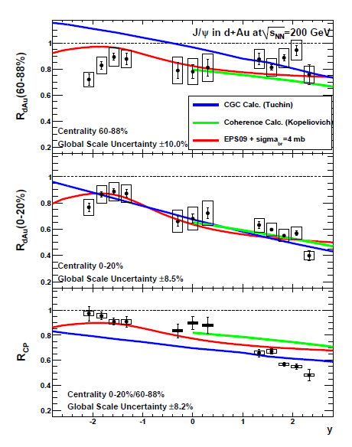
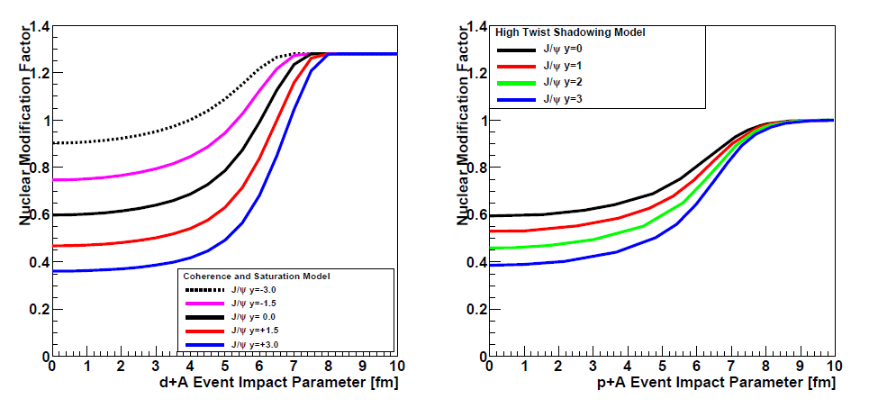
Coherence Calculations
Color Glass Condensate
K. Tuchin
Color Transparency
B. Kopeliovich et al.
arXiv:1008.4272
Gluon Saturation
But peripheral makes no physics sense.
Double gluon exchange diagrams

Slide 17
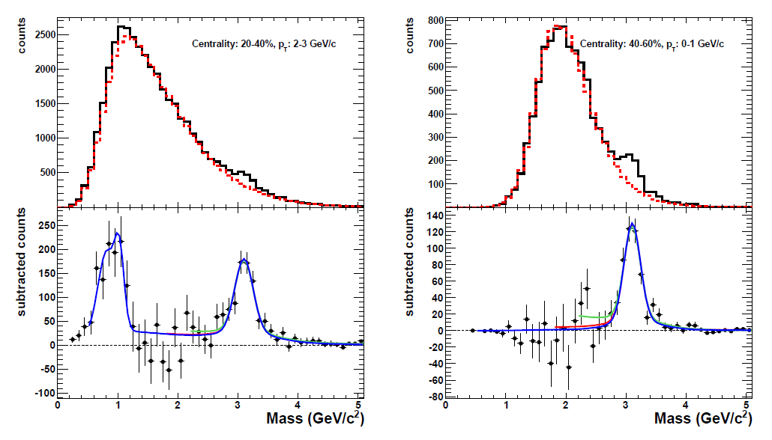
Gold-Gold Data (arXiv:1103.6269 and Wysocki Ph.D.)
J/ψ
J/ψ
Challenging analysis with low signal to background.
Over 3 billion Au+Au events recorded for analysis.

Slide 18
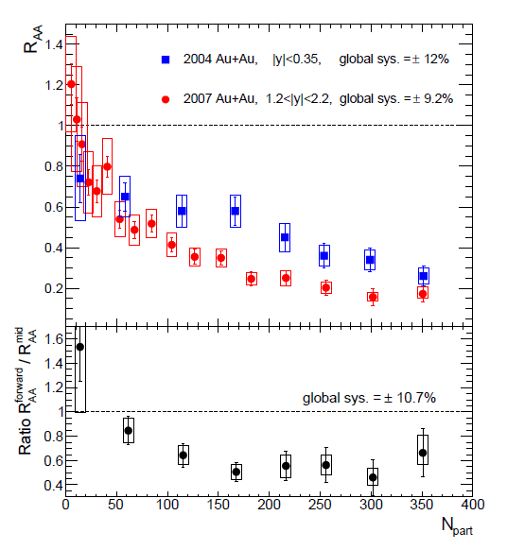
PHENIX Data
Very similar suppression at
CERN-SPS and RHIC at mid-rapidity.
New data confirms with precision the larger suppression at forward rapidity.
Is this just a cold nuclear matter effect?
NA50 Pb+Pb

Slide 19
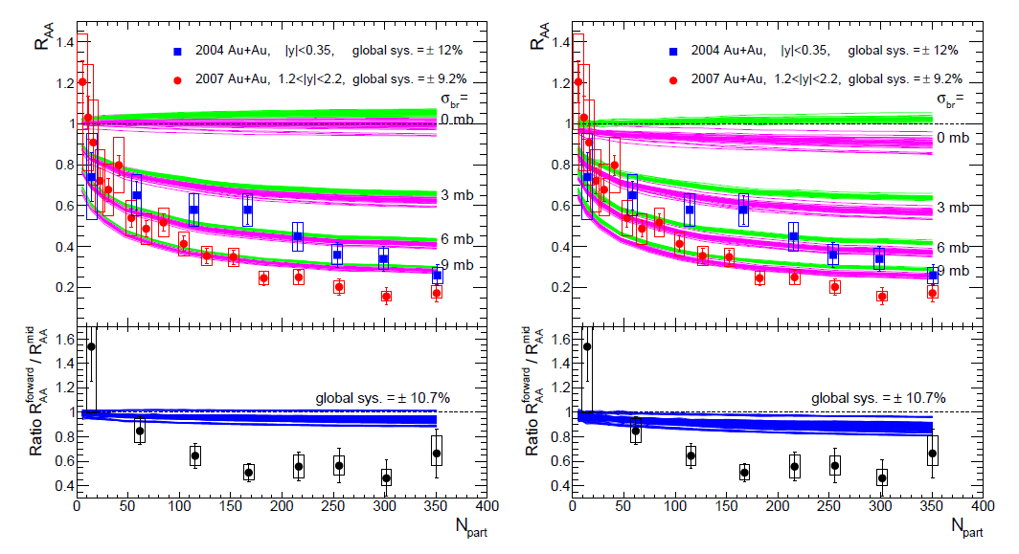
Extrapolate Cold Nuclear Matter Effects
We calculate with all EPS09 parameterizations and σ_{br}.
Almost no additional forward suppression – cancellation of low-x gluon (↓) and high-x gluon (↑).
Including energy loss matched to d-Au data does very little to change the picture.
Hot nuclear matters
(perhaps screening) effects are definitely important.

Slide 20
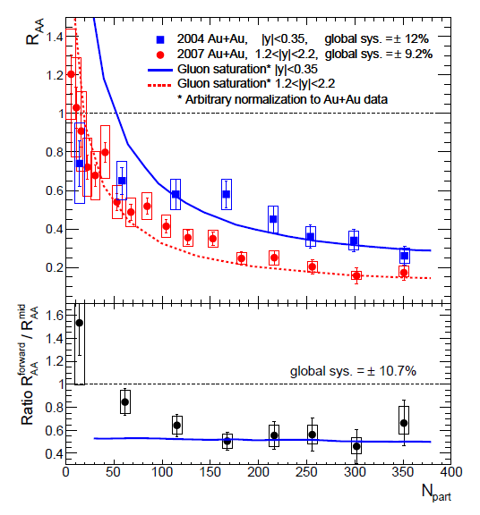
Gluon Saturation (Color Glass Condensate)
Appears to describe data and forward suppression.
However, arbitrary normalization to data.
New calculation from M. Nardi et al. indicate much smaller effect.
At Hard Probes 2010, she declared that there are definitely
final state effects.

Slide 21
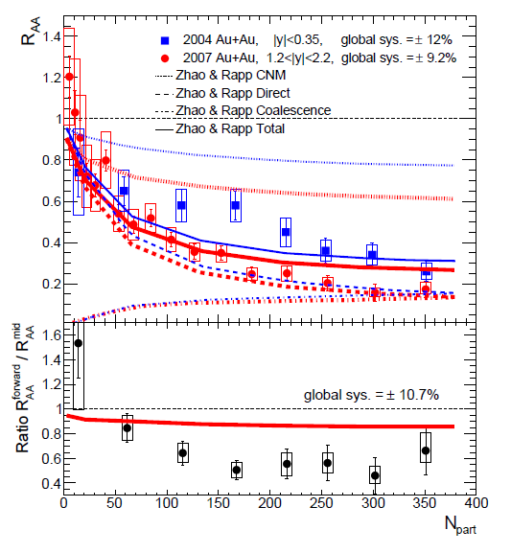
Charm Recombination
Similar R_{AA} as lower energies due to larger screening loss compensated by later recombination (?)
Less recombination at forward rapidity since lower ccbar density.
No effect, recombination of “diagonal pairs” dominates

Slide 22
Quarkonia Summary
Precision d-Au and Au-Au data sets
Non-linear physics is needed, perhaps e-loss or saturation
No complete description of d-Au data set
Au-Au indicates hot nuclear matter effect, and exact quantification remains elusive
206 citations for PHENIX PRL (2007), but no breakthrough
Near future data from lower energies 39 GeV, 62 GeV from PHENIX and LHC data may shed light…
Upgrades to push for even more forward measurements including Drell-Yan to disentangle effects.

Slide 23
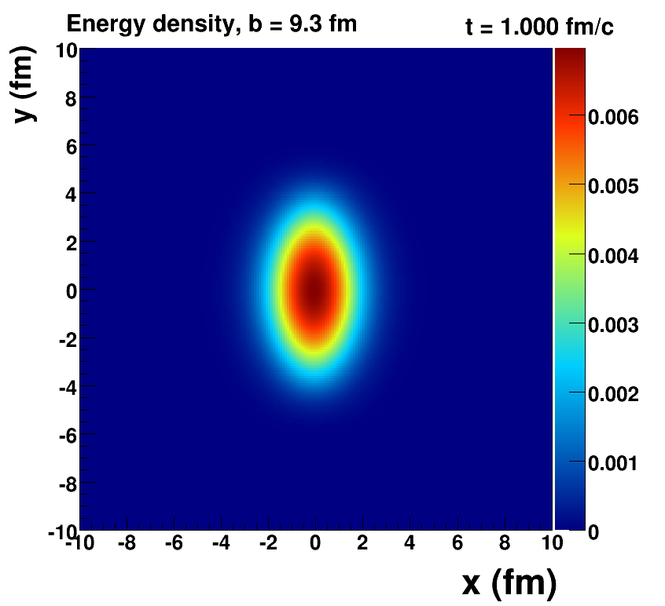
Harmonic Flow and Constraining QGP Properties
Our mental picture of heavy ion collisions has evolved…
Smooth initial conditions
Need to know initial geometric shape.
Initial Eccentricity ε₂ results in cos(2φ) flow called v₂.
Measured v₂ is sensitive to key QGP properties like the shear viscosity η/s.

Slide 24
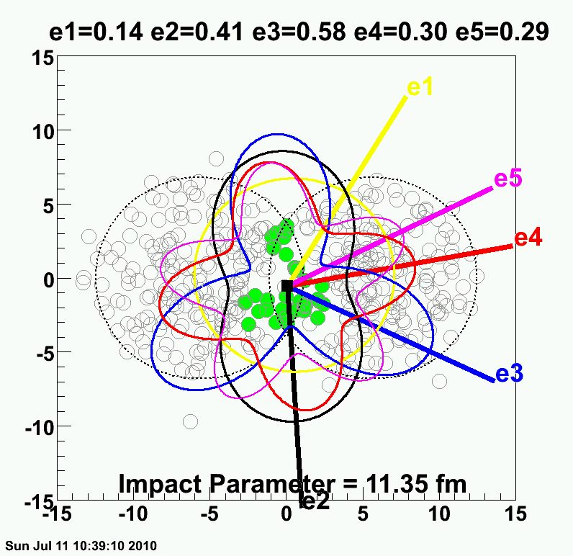
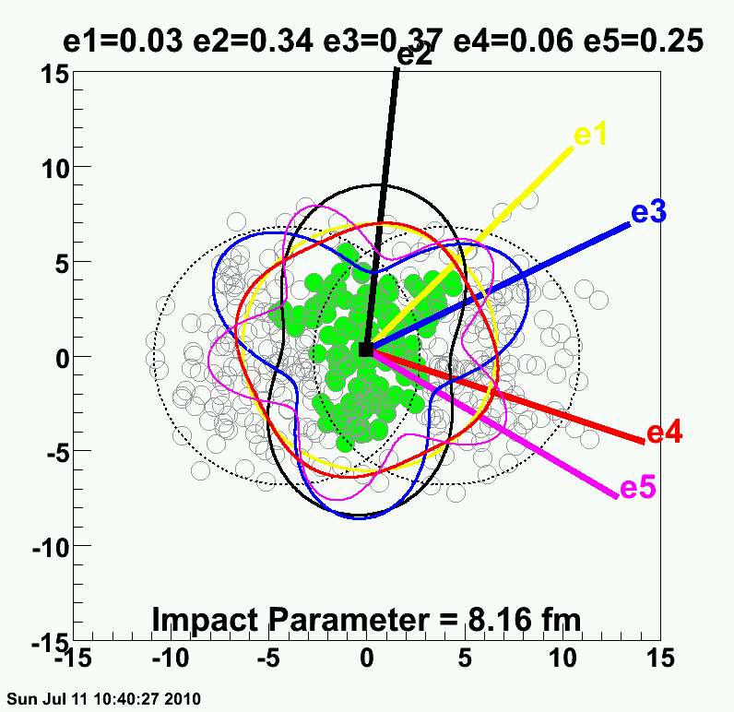
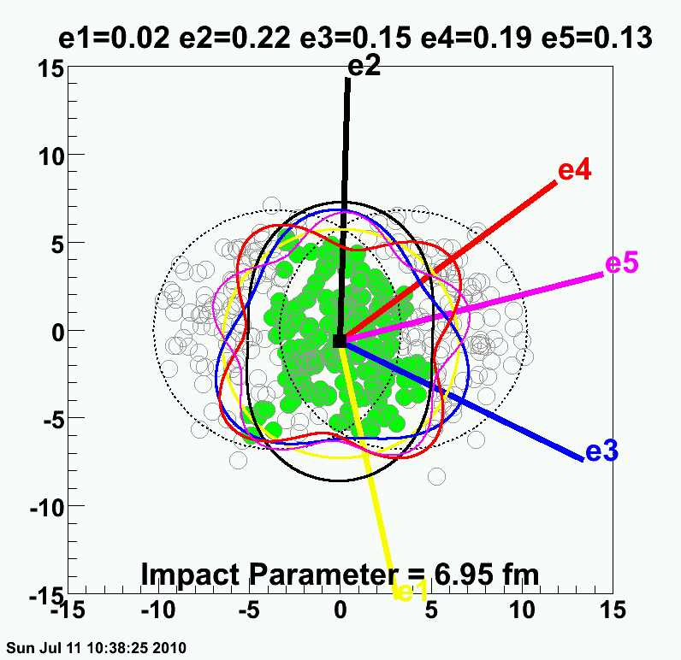
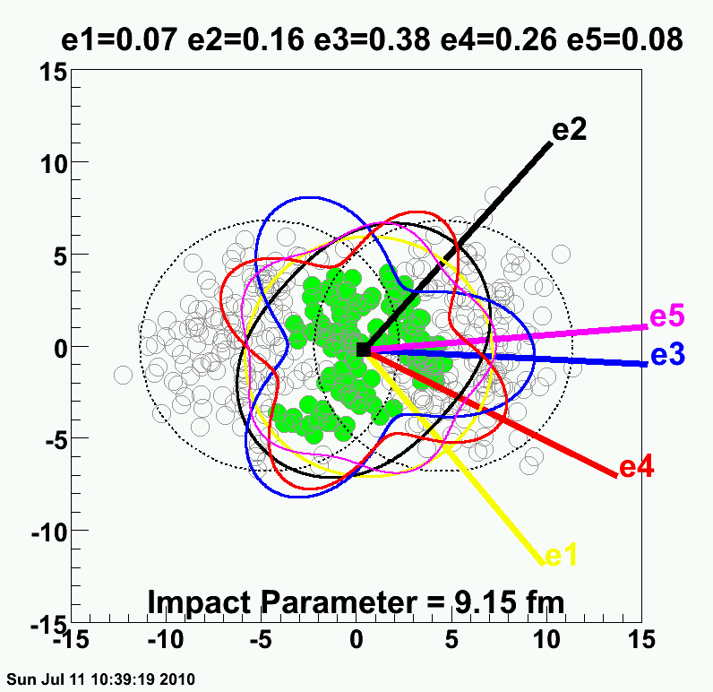
Reality = Lumpy Initial Conditions

Slide 25
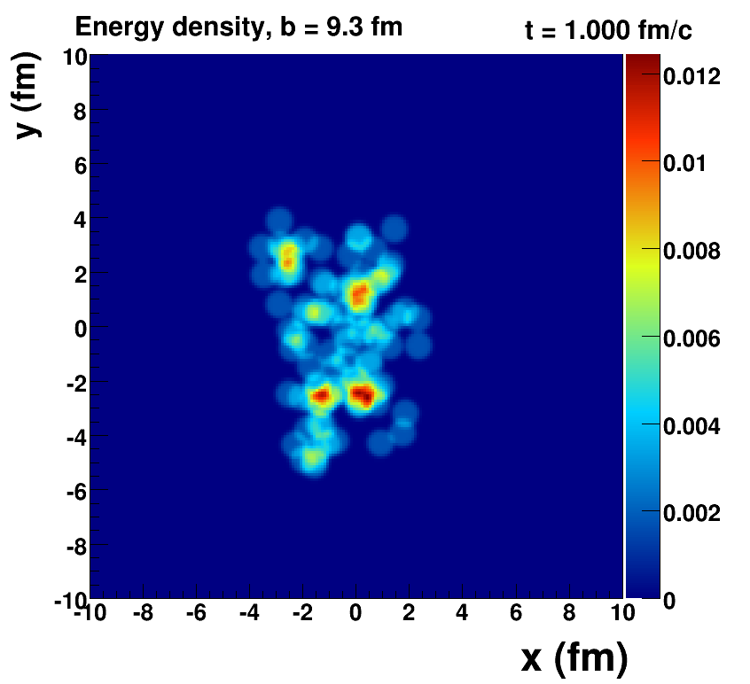
Romatschke=viscous hydrodynamics, McCumber=lumpy conditions + animation

Slide 26
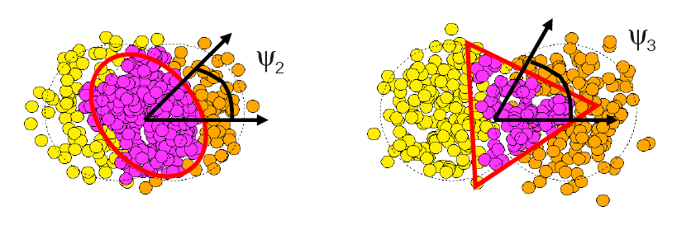
Fluctuations Dominate
σ(v₂)/v₂
Flow dictated by participating nucleon geometry
σ_{v2}/v₂
σ_{ε2}/ε₂
B. Alver, G. Roland arXiv:1003.0194
P. Sorenson arXiv:1002.4878

Slide 27
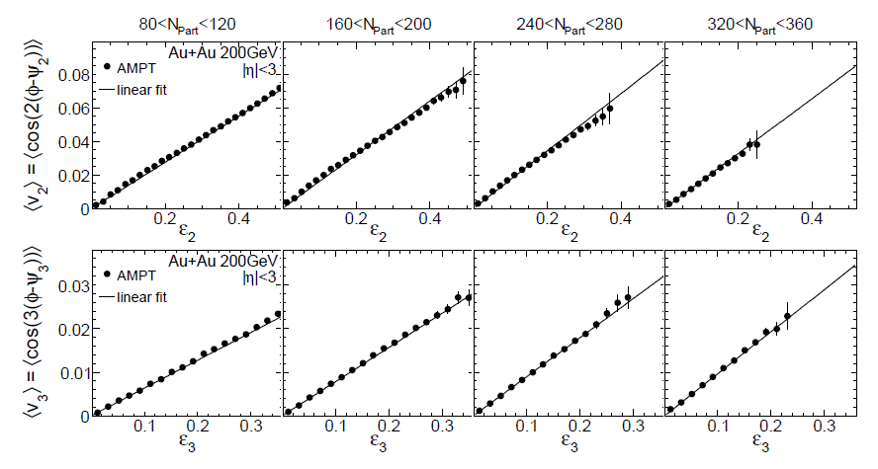
Spatial moments translate into
momentum anisotropy moments
v₂ vs ε₂
v₃ vs ε₃
v₃ is as irrefutable as v₂ from ε₂.
Now we must quantify the effects and implications.
Alver, Roland, arXiv:1003.0194v3

Slide 28
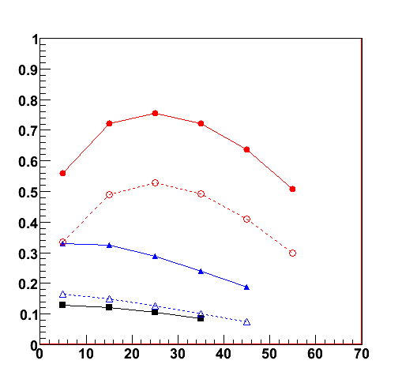
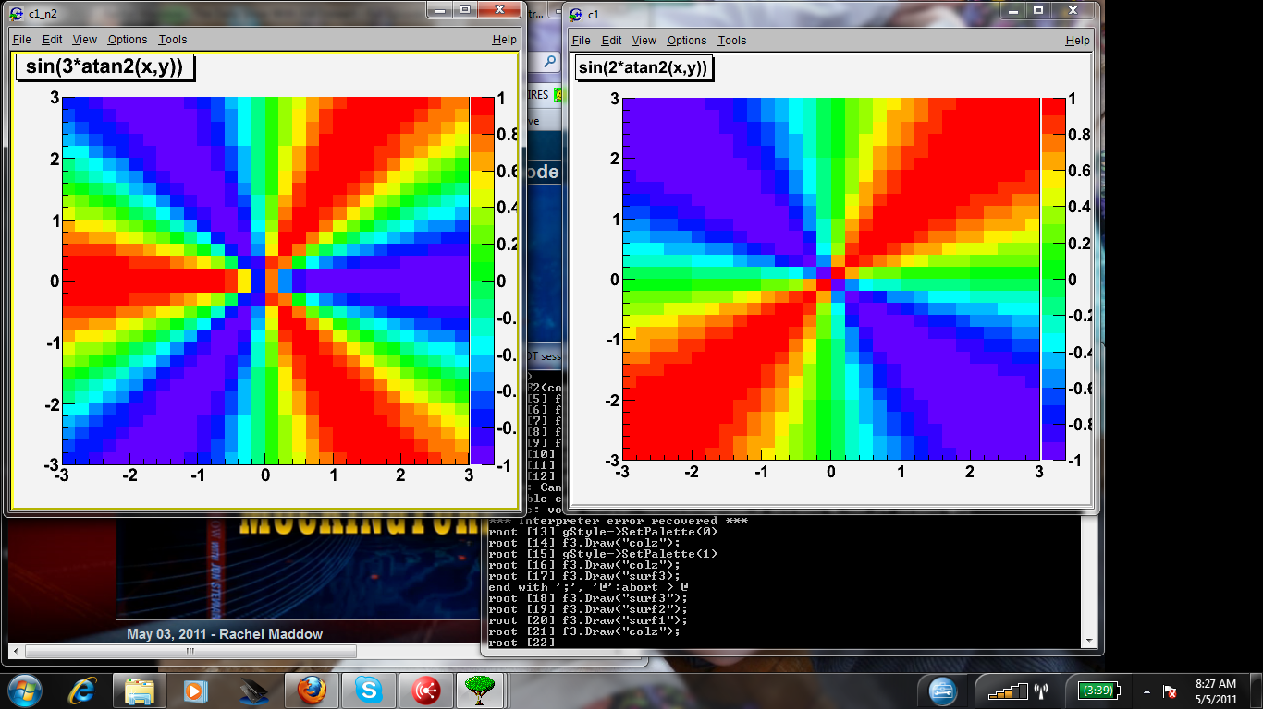
Measuring v₃
First, can detectors separated by Δη = 2 or even Δη = 6 measure event-by-event the 3rd order participant plane?
200 GeV Au+Au
PHENIX Preliminary
RXN |η| = 1.0-2.8
MPC |η| = 3.1-3.7
Answer = Yes
Now we can measure v₃ using the event plane method.
n=2 RXN
n=3 RXN
n=4 RXN
σ_{n} = <cos n(Φ_{n(meas.)} - Φ_{n(true)})>
n=2 MPC
n=3 MPC
n=2
n=3
n=4
centrality (%)
First presented at WWND11 by S. Esumi and J. Chen

Slide 29
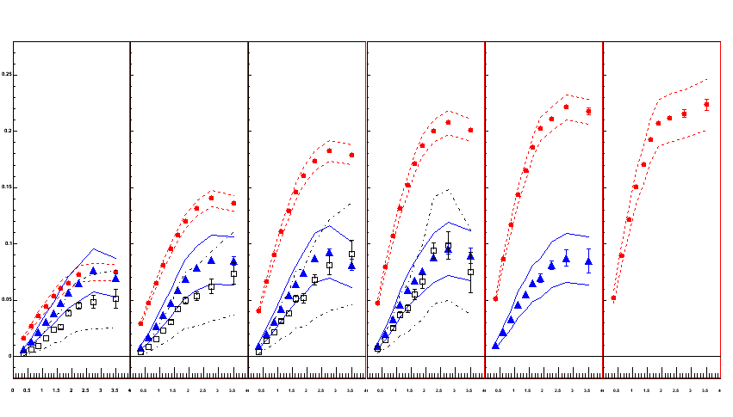
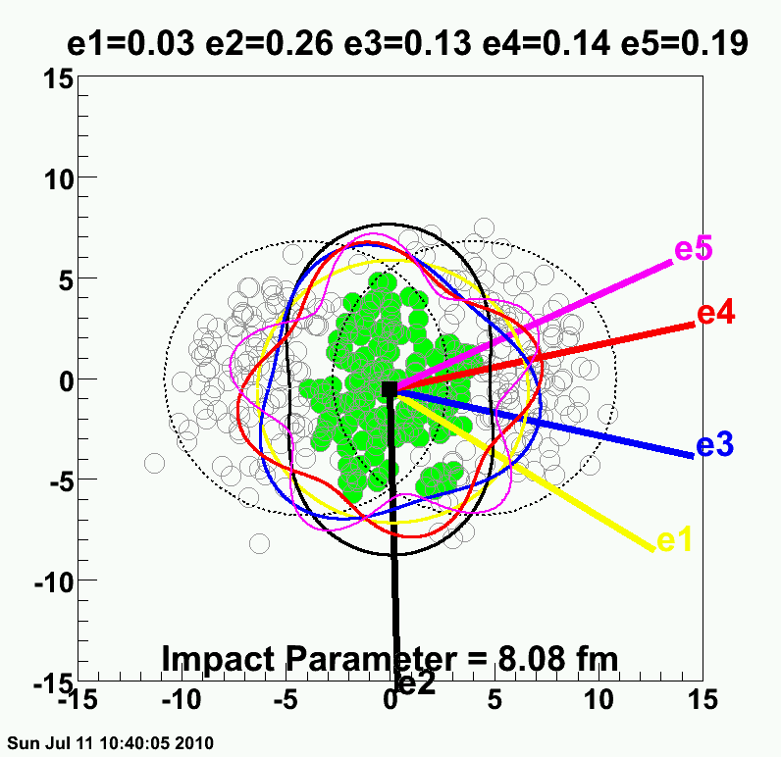
Systematic uncertainties defined by the variations with Φ_{n} from different Δη and from different methods.
v₂ {Φ₂ forw.η}
v₃ {Φ₃ forw.η}
v₄ {Φ₄ forw.η}
TT
v_{n} {EP}
200 GeV AuAu – 30-40% Central
PHENIX Preliminary
0.20
0.10
0.0
0.0
1.0
2.0
3.0
p_{T} (GeV/c)
ε₂ ≈ 2 x ε₃ ≈ 2 x ε₄

Slide 30
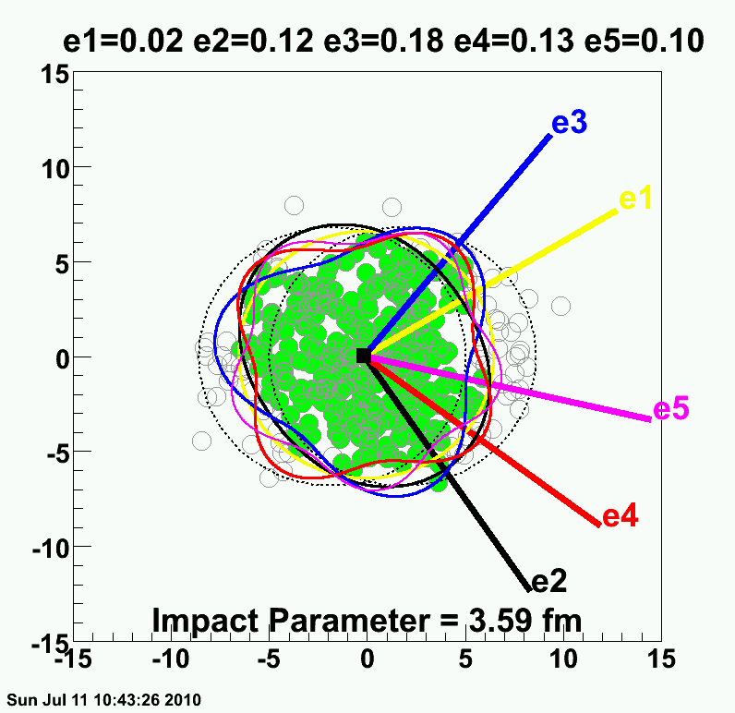
v₂ {Φ₂ forw.η}
v₃ {Φ₃ forw.η}
v₄ {Φ₄ forw.η}
TT
v_{n} {EP}
200 GeV AuAu – 0-10% Central
PHENIX Preliminary
0.20
ε₂ ≈ ε₃ ≈ ε₄
0.10
Forces the question of how many moments are important? 5,6,7th
Like white noise?
Also 1st moment!
0.0
0.0
1.0
2.0
3.0
p_{T} (GeV/c)

Slide 31
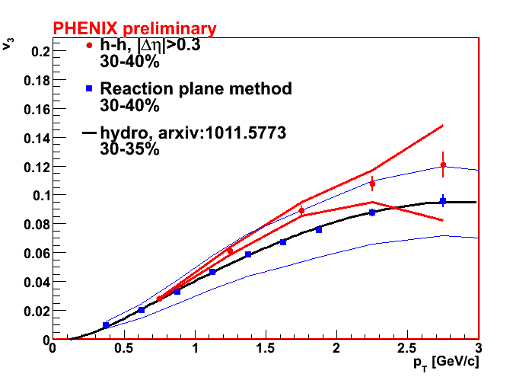
What do we Learn?
Alterative Fourier Method
Event PlaneMethod
Glauber initial condition
η/s = 1/4π
good agreement between data and theory!
Good agreement with viscous hydrodynamics calculations (ask Matt Luzum for calculation details)

Slide 32

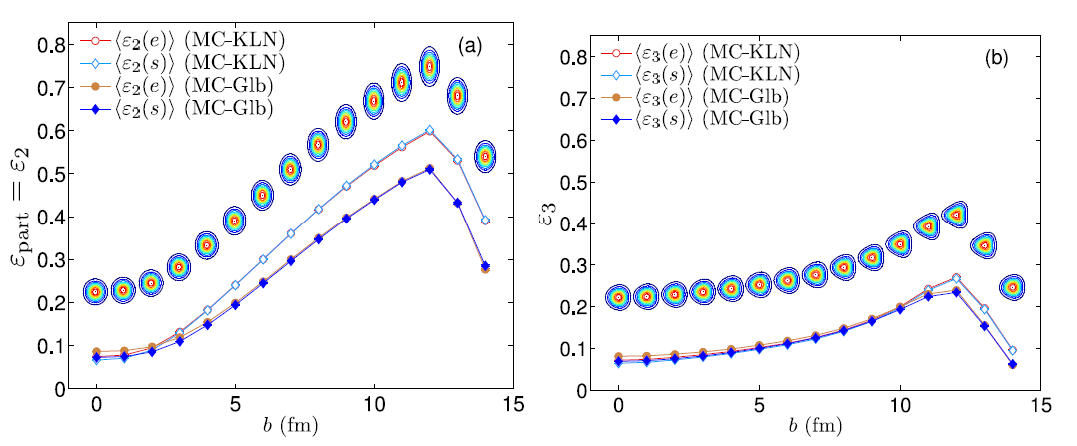
Key Point
Qiu, Heinz, arXiv:1104.0650v2
ε₁ vs. b
ε₂ vs. b
ε₃ vs. b
ε₄ vs. b
Color Glass Condensate versus Glauber results in different
ε₂ by ~ 20%. This is because gluon saturation reweights local entropy density – and thus different initial shape.
However, for ε₃, CGC and Glauber are nearly identical!
See also R. Lacey et al., arXiv:1009.5230v2

Slide 33
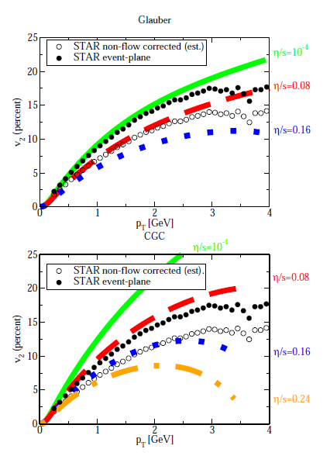
Why is this so important?
Glauber initial ε₂ requires
η/s ≈ 1/4π to match v₂ data
Color Glass Condensate initial ε₂ is larger by 20% and thus requires more dissipation to get the same flow and thus η/s ≈ 2/4π
This ambiguity has troubled the field for 3 years.
If both have the same ε₃
then CGC with η/s = 2/4π should give much lower v₃
Romatschke, Luzum

Slide 34
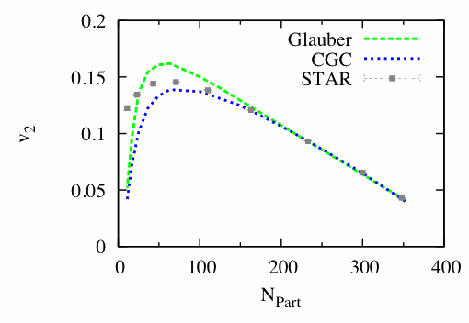
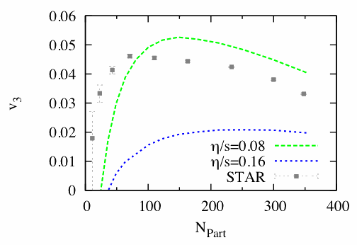
Further Proof
Luzum, arXiv: 1007.5469
v₂
v₃
STAR states in their paper that v₃ flow is not the explanation.
However, Luzum re-analyzes their correlations
to produce these figures (shown above).
Ask Matt….of course he is correct
“Thus, we conclude that the away-side double-peak structure is not an artifact of the ZYAM
flow subtraction procedure used in this analysis.”
STAR: arXiv:1010.0690v1

Slide 35
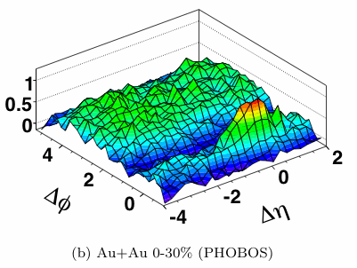
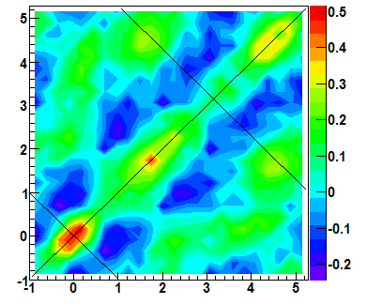
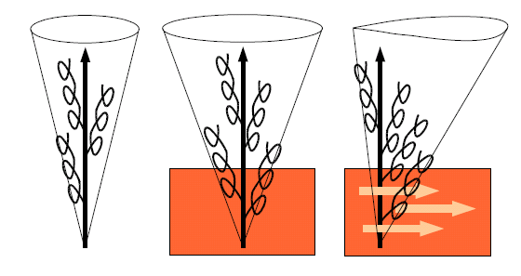

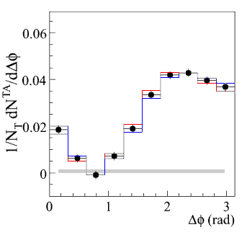
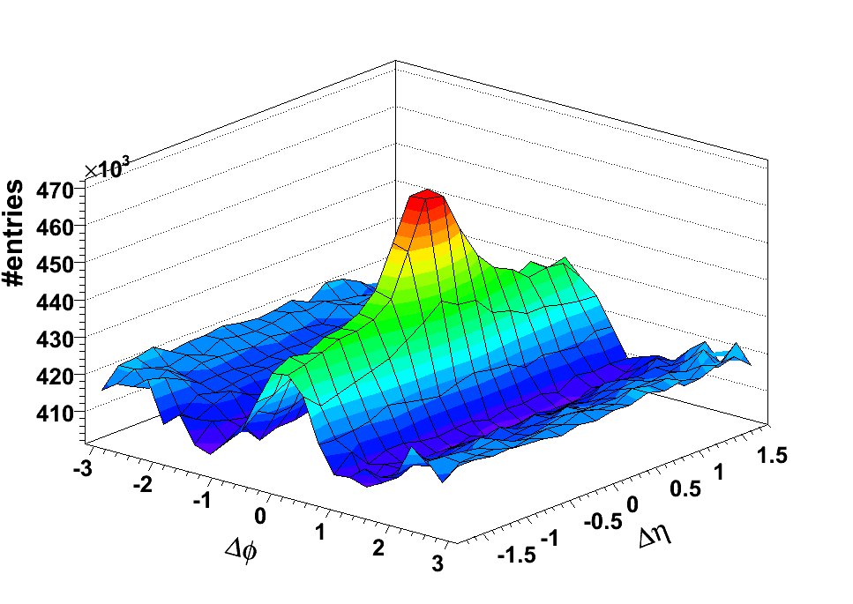
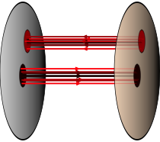
“Ridge” and “Shoulders”
Features in two-particle correlations that have generated a lot of excitement.
p-p 200 GeV
Two years ago (QM09)
I gave a talk with my prediction.
The “death” of the ridge and shoulders.
π⁰

Slide 36
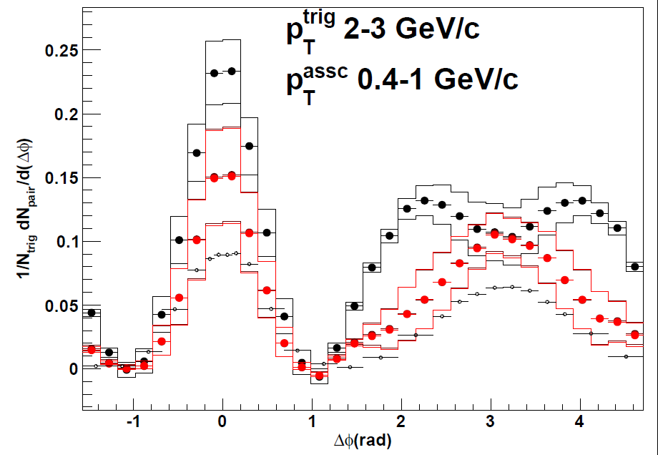
So what about the “Ridge” and “Shoulders”?
Black points
PHENIX published with v₂ background modulation and ZYAM.
Red points
(NOT PHENIX OFFICIAL)
Use AMPT v₃/v₂ ratio and include v₂ and v₃ background modulation.
Calculation by A. Adare
PHENIX Au+Au 0-20% Central
Dominant ridge and shoulders will be gone.
Detailed careful analysis needs v₁ … v₅ and method checks.

Slide 37
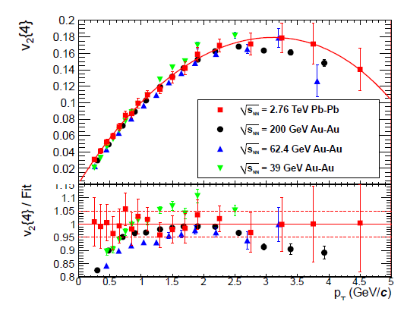
What if we crank up the energy?
Bill Zajc, Ian Bearden and I wondered what is required to get this remarkable agreement (arXiv:1102.0680).
Use Romatschke’s publicly available viscous hydro code…

Slide 38

Q1: How much does a constant η/s
need to change to get a 5% change in v₂?
Δ(η/s) ~ 20% → Δv₂~ 5%
Δ(η/s) ~ 40% → Δv₂~10%
Δ(η/s) ~ 100% → Δv₂~25%
Always take ratios.
What looks like little difference at low p_{T}, turns out to be very sensitive (and where experiments have the smallest uncertainties).

Slide 39

Q2: How does v₂ change for initial T = 420 MeV (LHC) and T = 340 MeV (RHIC)?
Black = all hadrons
Very similar v₂(p_{T}) except larger viscous effects for p_{T} > 3 GeV/c
LHC = Solid
RHIC = Dash
Blue = protons
Large difference for v₂(p_{T}) due to larger radial boost at LHC temperatures.
Solid prediction.
Previously noted with ideal hydrodynamics by Kestin, Heinz
Ratio RHIC/LHC

Slide 40

Q3: What if η/s is larger for T > 340 MeV
(just the range sampled at the LHC in early times)?
Consider case I:
η/s = 1/4π (all T)
Consider case II:
η/s = 1/4π (T<340 MeV)
η/s = 2/4π (T>340 MeV)
No change in v₂(p_{T})!
Earliest LHC time not effected by factor 2 change in η/s.
η/s
2/4π
1/4π
340
T
Ratio

Slide 41


Recent study of η/s (T) – arXiv:1101.2442
Conclusion that RHIC v₂ is dominated by η/s below T_{c} and LHC v₂ by η/s above T_{c} seems an unlikely fine tuning problem.
In fact, if one takes the ratios, the green-dash curve fails to describe the differences.
Factor 10 increase in η/s results in 15% reduction in v₂ at p_{T} = 2 GeV/c
Seems consistent with my finding that a factor of 2 for T>340 MeV has almost no effect.

Slide 42

Viscous Hydrodynamics + Hadron Cascade
Fixed η/s case for QGP
LHC needs larger QGP η/s to get the same v₂(p_{T}).
However, the η/s in the same T range at RHIC cannot be different.
Fine tuning problem again.
Song et al.,arXiv:1103.2380v2

Slide 43




Another Class of η/s Constraints
“Does the Charm Flow at RHIC?”
Flow of charm and beauty quarks may yet provide the best constraints. PHENIX Silicon Detector now operational.
10 Gigabit link Data Collection system
Colorado effort led by Mike McCumber

Slide 44


PHENIX Decadal Plan
Major Upgrade Proposed Extending into EIC Era
We are interested in feedback, suggestions, involvement.
http://www.phenix.bnl.gov/phenix/WWW/docs/decadal/2010/phenix_decadal10_full_refs.pdf

Slide 45
Summary:
Deviations from smooth geometry have major impact in all areas of heavy ion physics

Slide 46
EXTRAS

Slide 47



J. Uphoff, K. Zhou, O. Fochler, Z. Xu, C. Greiner
Cold nuclear matter effects linear in thickness….
Should confront dAu data…
Far too much J/ψ suppression.
Less suppression at forward rapidity.

Slide 48


Q4: If the initial ε₂ is Glauber, does that predict a change in v₂(p_{T}) as a function of colliding energy?
Glauber predicts a 5% change from RHIC (200 GeV) to LHC and a 10% change for RHIC (39 GeV).
Color Glass Condensate has an even smaller energy dependence.
That was puzzling to me since saturation effects should be larger for the lower-x partons at LHC.

