Slide 1
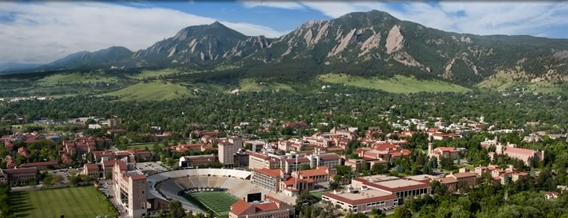

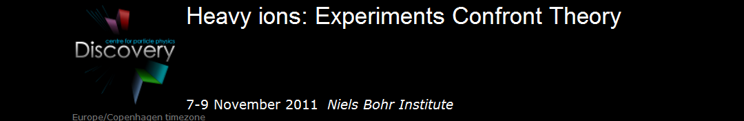
Geometry, Geometry, Geometry
Jamie Nagle
University of Colorado, Boulder, USA

Slide 2
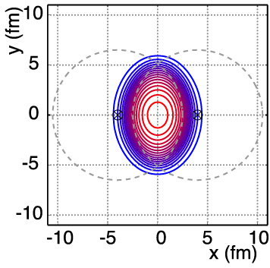
Simple Geometry
v₂ = “elliptic flow”

Slide 3
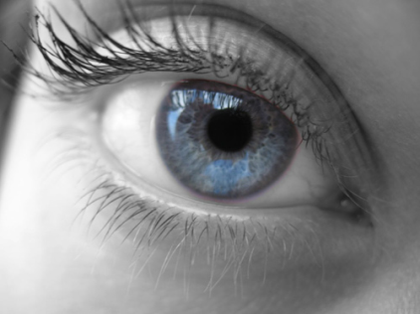
Large Elliptic Flow
Literally “seen” in first days at RHIC

Slide 4
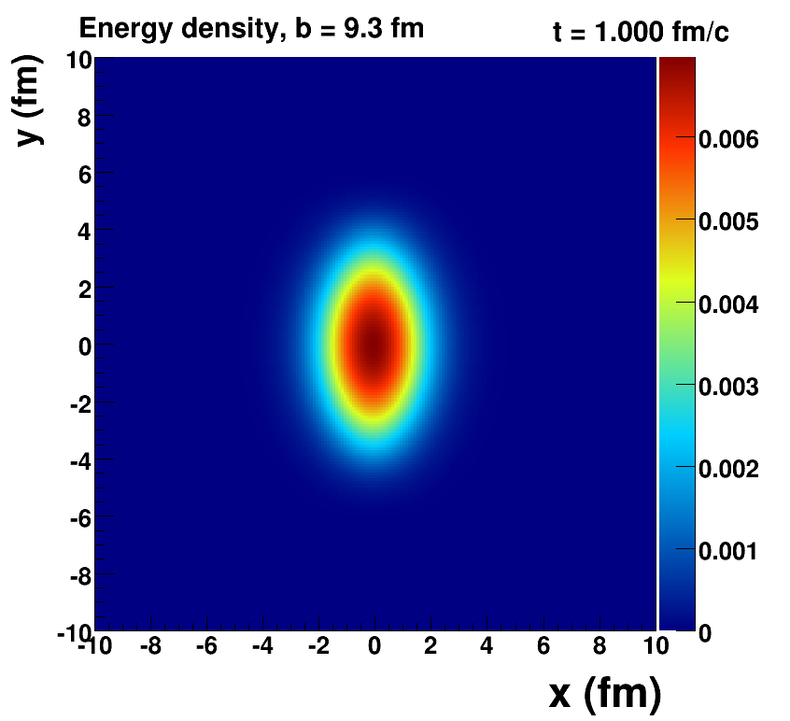
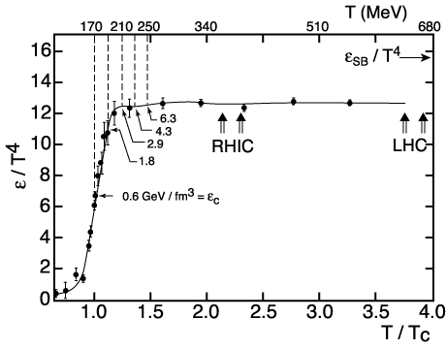
How Large is the Flow Really?
Assume early thermalization and run ideal hydrodynamics (i.e. no dissipation → zero shear + zero bulk viscosity)
Key Inputs:
Initial Geometry
lQCD Equation of State

Slide 5
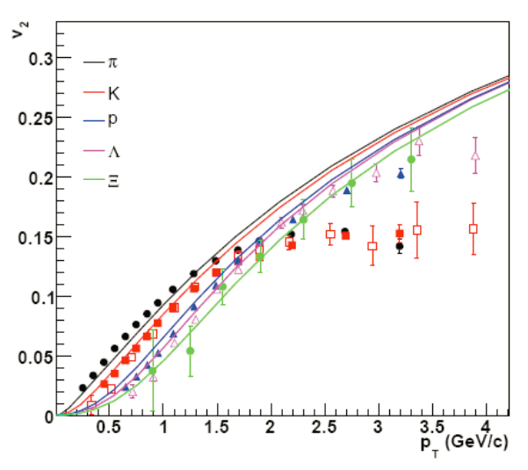
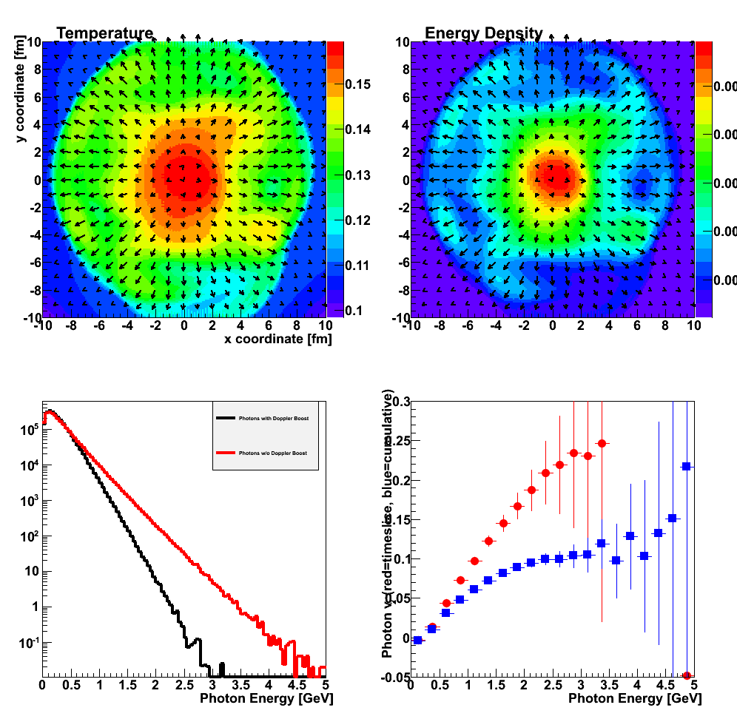
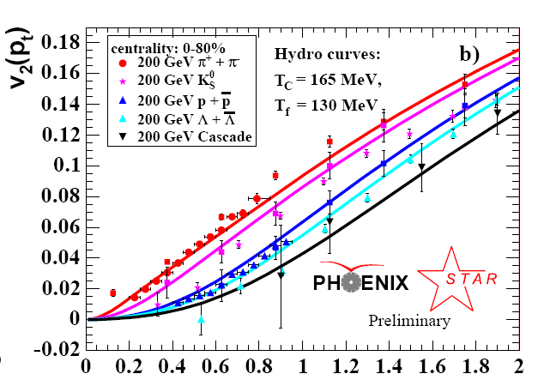
Fluid cells “freeze-out” below T_{f}
Isotropic hadrons in cell rest frame, then boosted
v₂
Temperature Profile + Velocity Vectors
v2
p_{T} (GeV)
Characteristic flow pattern observed for p_{T} < 2 GeV
Circa 2005: Quark-Gluon Plasma = Perfect Fluid

Slide 6
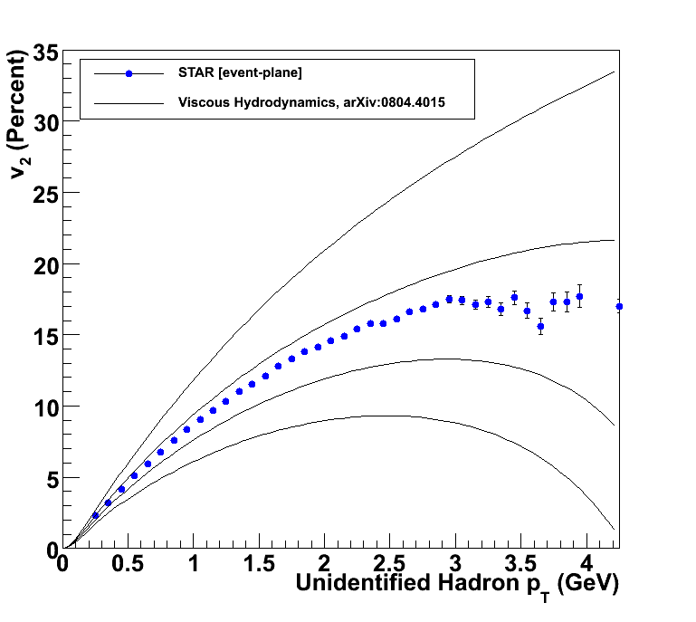
How to Quantify QGP η/s?
Relativistic viscous hydrodynamics compared to data
Luzum, Romatschke, Phys. Rev. C78, 034915 (2008)
η/s ~ 0
η/s = 1/4π
η/s = 2 x 1/4π
η/s = 3 x 1/4π

Slide 7
Very close to the bound!
What dominated these uncertainties a few years ago?
Different ways of measuring v₂ gave ±20% variations.
Now resolved that the methods have different sensitivities to “nonflow” and fluctuations.
For example Ollitrault, Poskanzer, Voloshin Phys. Rev. C80, 014904 (2009).
In ideal hydrodynamics v₂ α ε₂ (initial eccentricity)
Uncertainty on η/s from initial geometry was ~100%.
Other sources subdominant:
hadronization, EOS, pre-flow, … (worth re-examination)

Slide 8
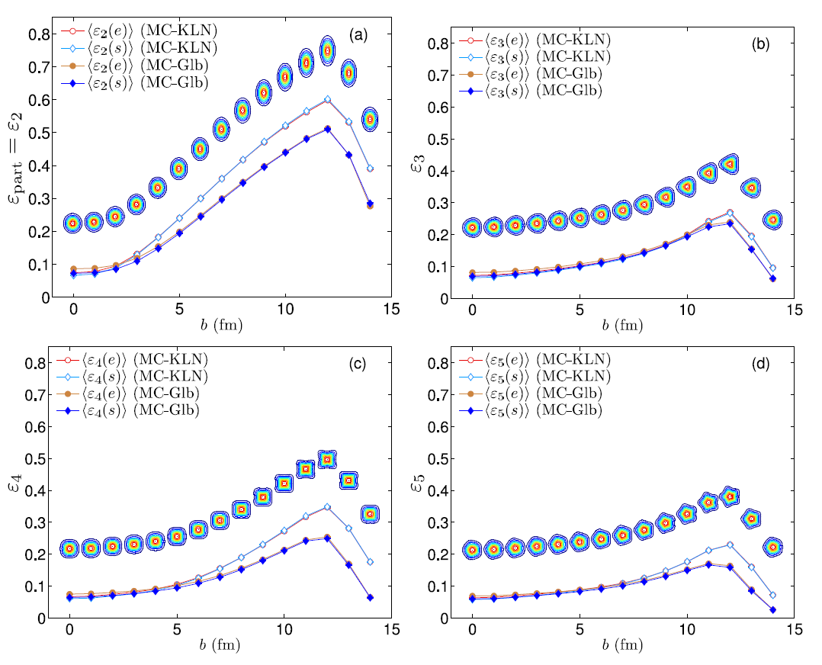
Initial Condition Uncertainty
Elliptic Flow reasonably described by either:
Smaller eccentricity (Glauber) + Less Dissipation (η/s≈1/4π)
Larger eccentricity (Gluon Saturation) + More Dissipation (η/s ≈ 2/4π)
Neither A nor B, and yet these give a range of uncertainty

Slide 9
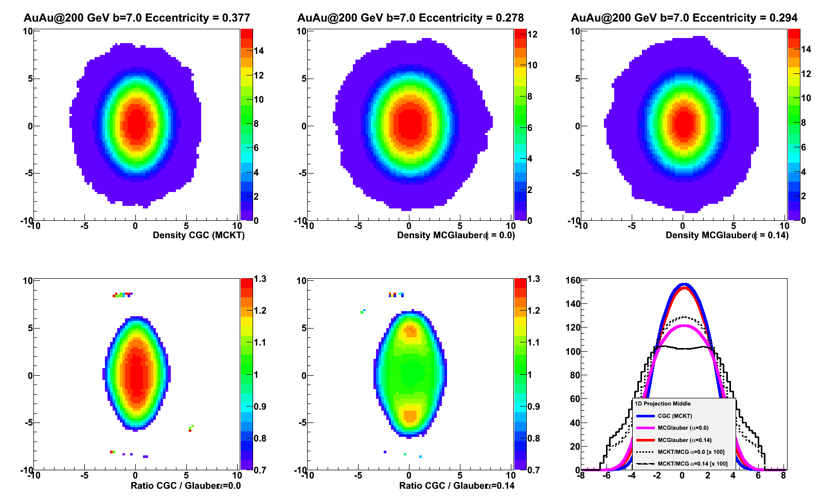

Examine b = 7 fm case
x = 0.0
x = 0.14
Just saying “Glauber” is not enough (different variants).
MC Glauber variations have 26 and 22% lower eccentricities
than MCKT (with saturation effects).

Slide 10
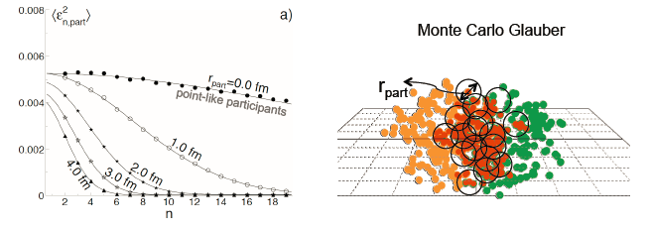
Spatial Moments Initial Smearing
Moscy and Sorensen
The initial smearing for the starting distribution suppresses the higher moments almost like a Gaussian drop off. Spatial smearing could be in initial state (e.g. size of nucleon) or during evolution.
Au-Au 30-40% Central
Point-like Smear (1 fm radius)
<ε₂> 0.359 0.346 -4%
<ε₃> 0.197 0.185 -6%
<ε₄> 0.197 0.179 -9%
For a 1 fm smearing this effect is
modest for the n=2,3,4 moments.

Slide 11
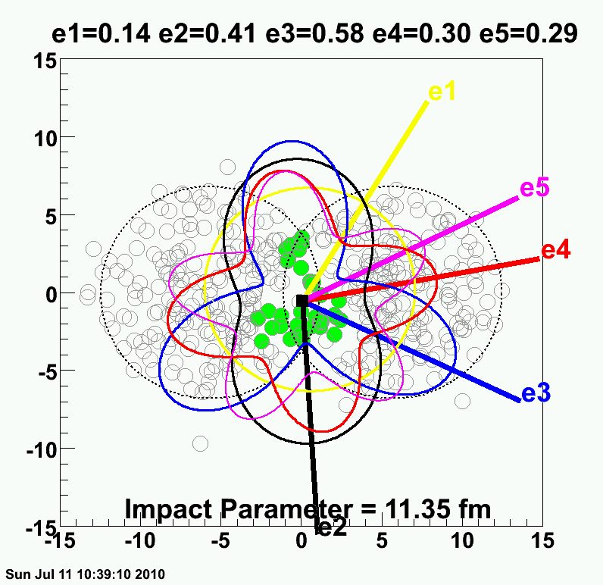
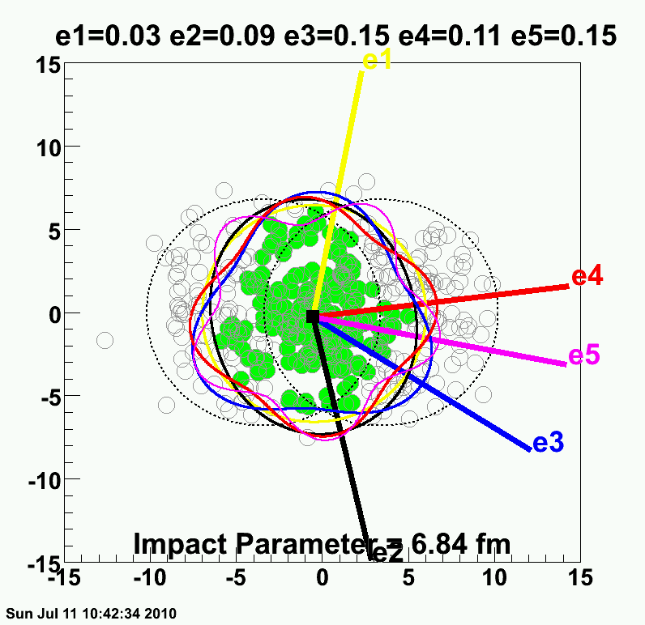
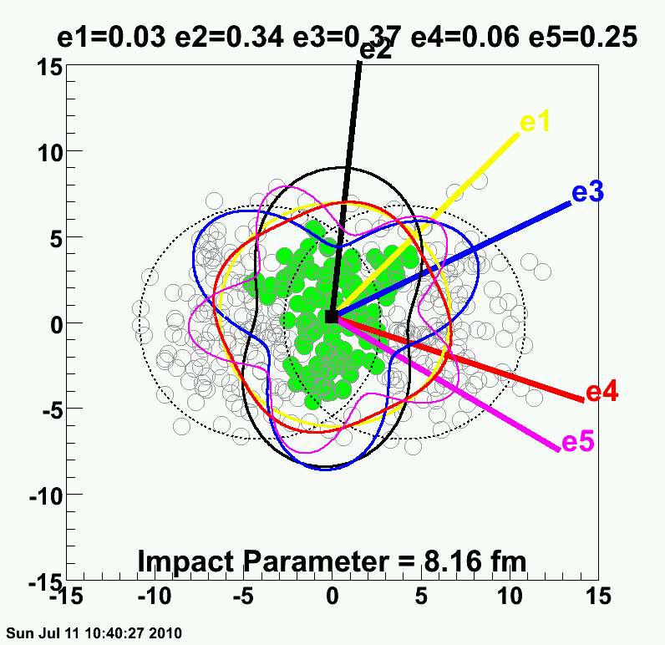
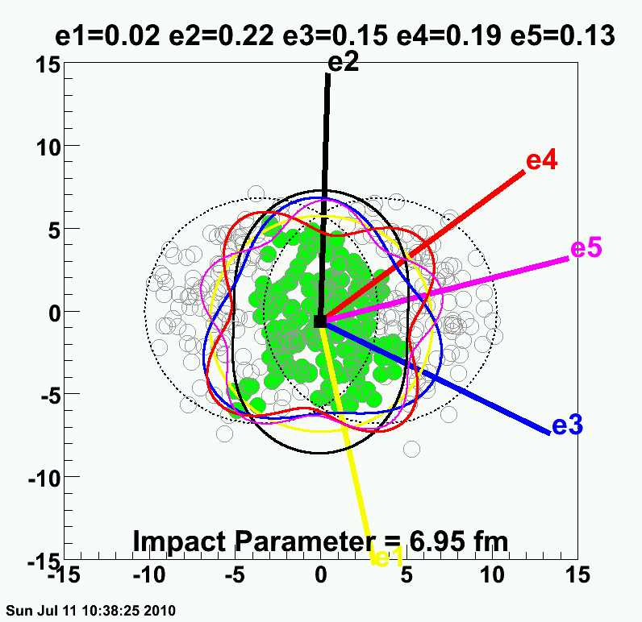
Realization → Lumpy Initial Conditions

Slide 12
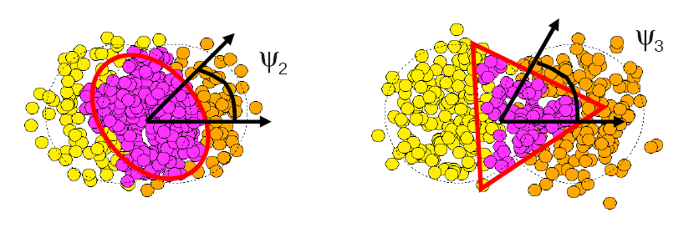
Fluctuations Dominate
σ(v₂)/v₂
Flow dictated by
nucleon geometry
σ_{v2}/v₂
σ_{ε2}/ε₂
B. Alver, G. Roland arXiv:1003.0194
P. Sorenson arXiv:1002.4878

Slide 13
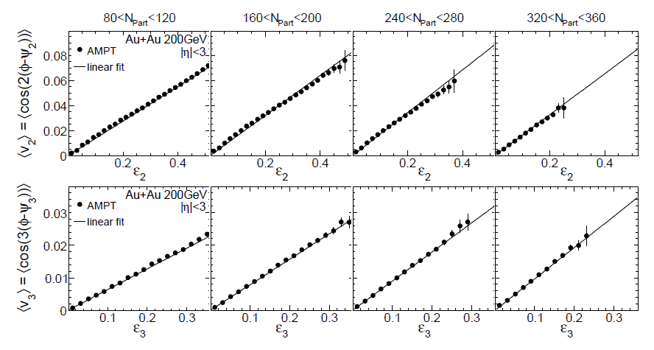
Spatial moments translate into
momentum anisotropy moments
v₂ vs ε₂
v₃ vs ε₃
v₃ is as irrefutable as v₂ from ε₂.
Now quantify implications.
Alver, Roland, arXiv:1003.0194v3

Slide 14
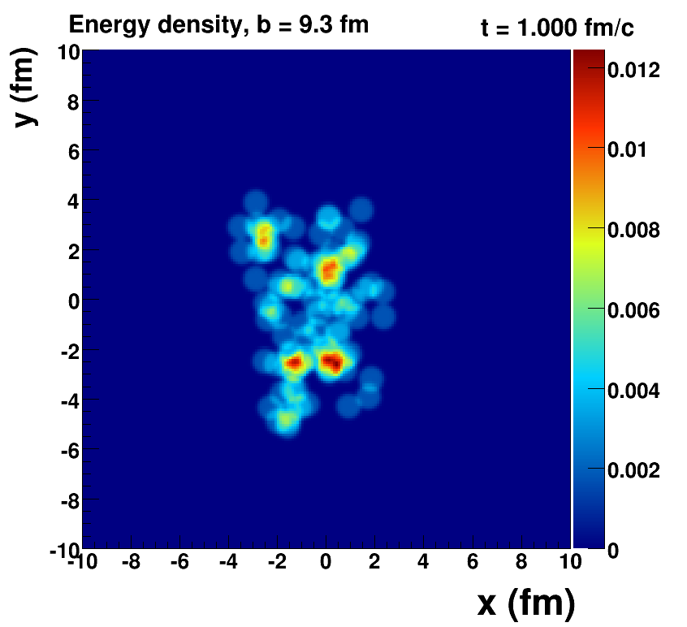
Romatschke=viscous hydrodynamics, McCumber=lumpy conditions + animation

Slide 15
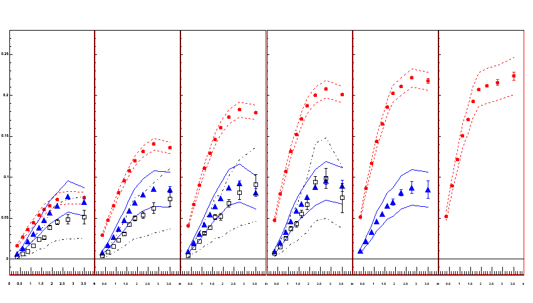
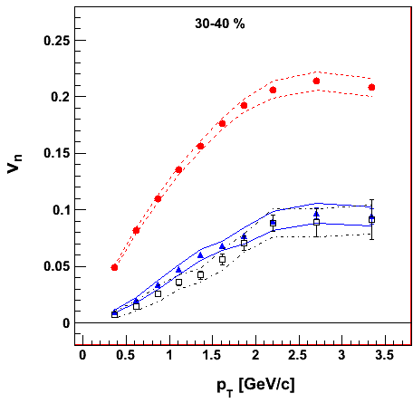
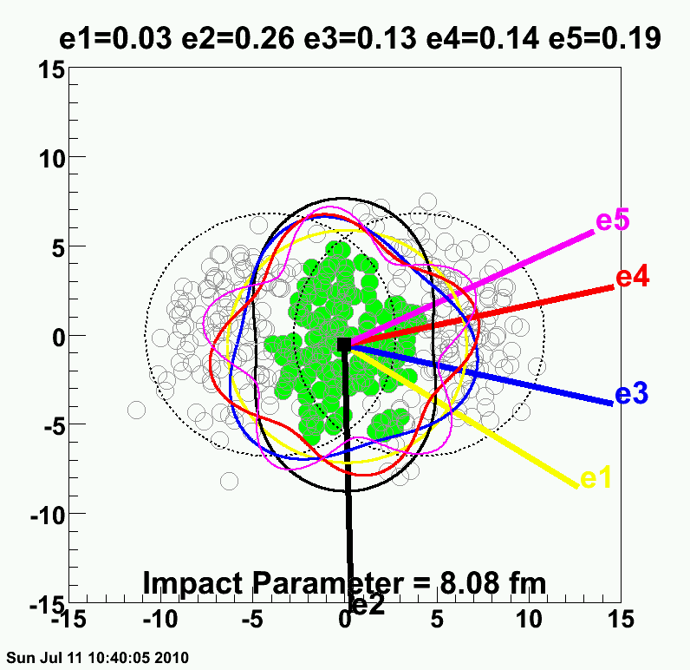
PHENIX Experiment
Systematic uncertainties defined by the variations with Φ_{n} from different Δη and from different methods.
v₂ {Φ₂ forw.η}
v₃ {Φ₃ forw.η}
v₄ {Φ₄ forw.η}
TT
v_{n} {EP}
Au+Au at 30-40% Central
200 GeV AuAu – 30-40% Central
PHENIX Preliminary
0.20
Elliptic
Triangular
0.10
0.0
Quadrangular
0.0
1.0
2.0
3.0
p_{T} (GeV/c)
ε₂ ≈ 2 x ε₃ ≈ 2 x ε₄

Slide 16
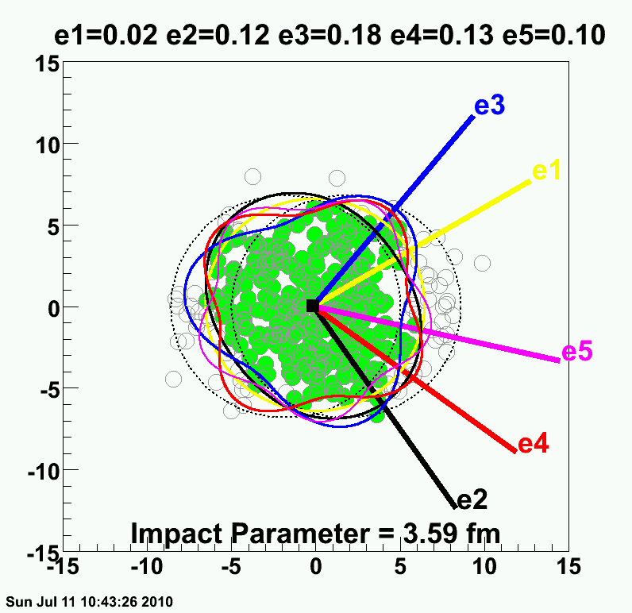
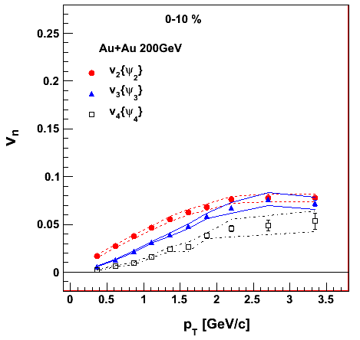
PHENIX Experiment
v₂ {Φ₂ forw.η}
v₃ {Φ₃ forw.η}
v₄ {Φ₄ forw.η}
TT
v_{n} {EP}
Au+Au at 0-10% Central
200 GeV AuAu – 0-10% Central
PHENIX Preliminary
0.20
ε₂ ≈ ε₃ ≈ ε₄
0.10
How many moments are important at RHIC?
5,6,7th
0.0
0.0
1.0
2.0
3.0
p_{T} (GeV/c)

Slide 17
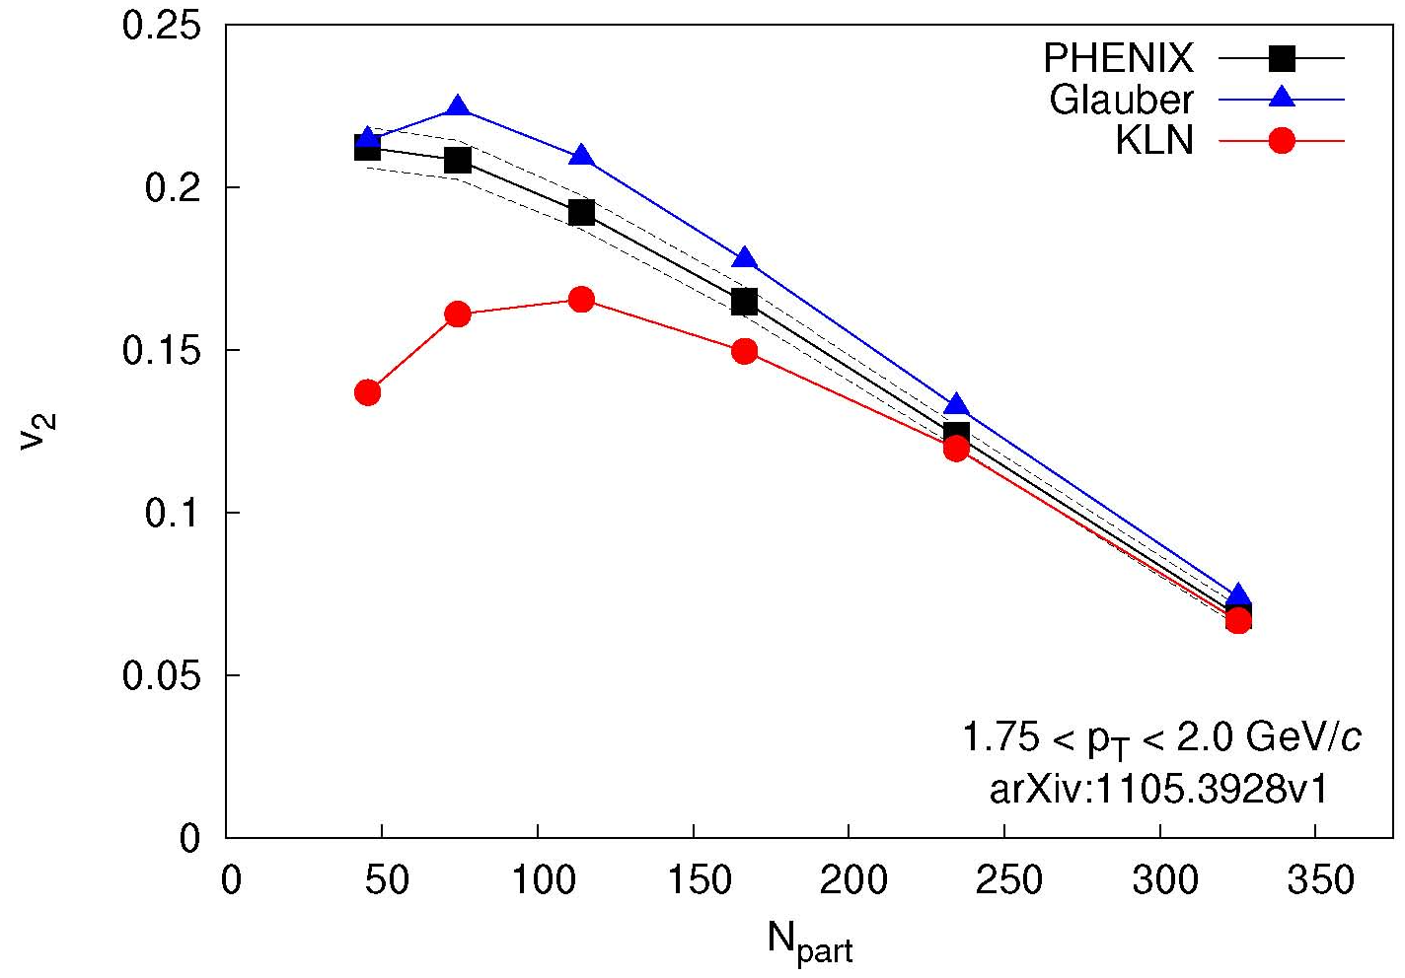
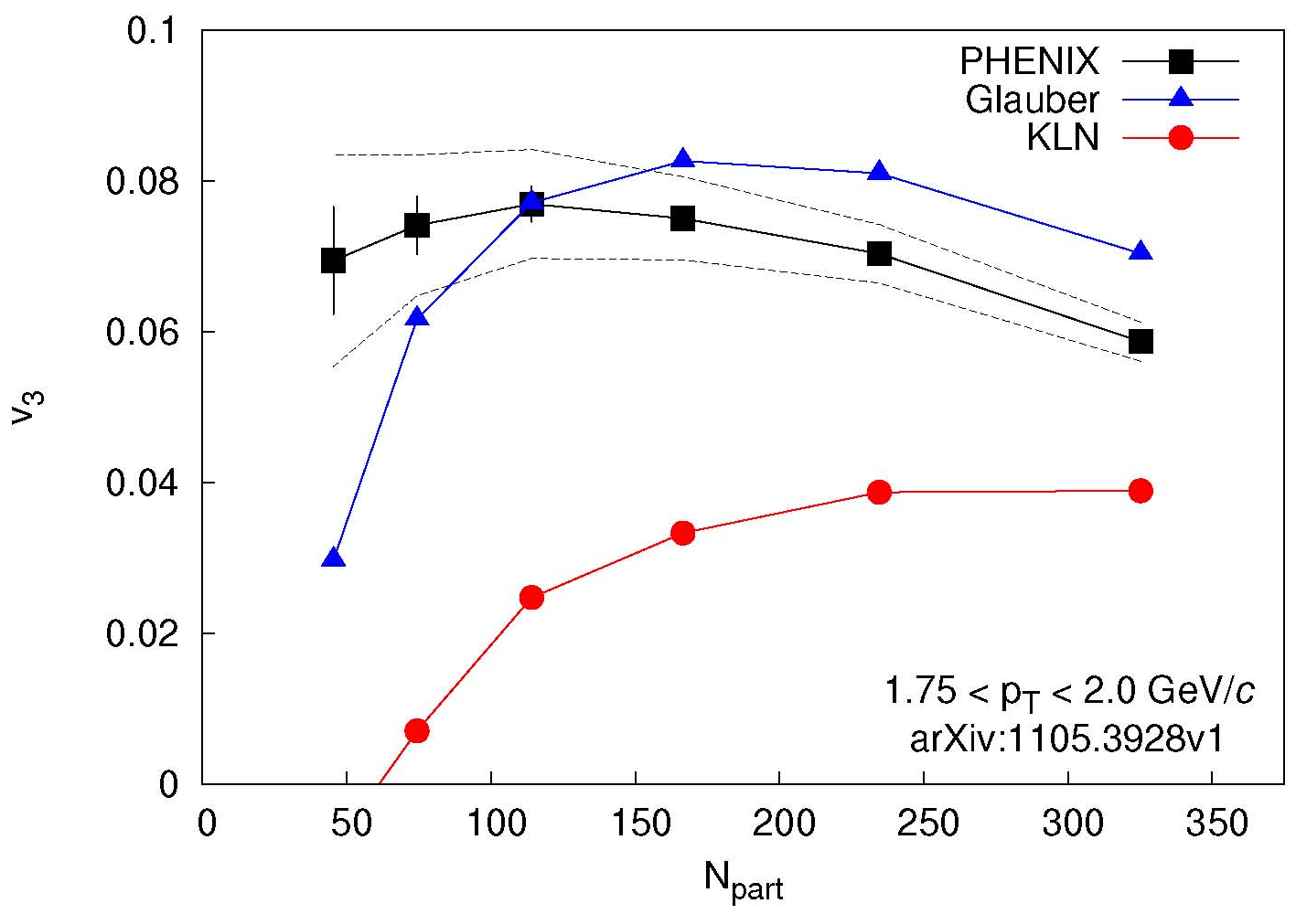
Initial Condition Constraints
Glauber and CGC similar spatial triangularity ε₃
Thus CGC with larger η/s gives smaller v₃
Real Prediction!
Qiu, Heinz, arXiv:1104.0650v2
Theory calculation:
Alver et al.
PRC82,034913
arXiv:1105.3928
arXiv:1105.3928
Theory calculation:
Alver et al.
PRC82,034913
v₂ described by Glauber and CGC
v₃ described only by Glauber
Needs theory calculation with full event-by-event fluctuations and confirmation at LHC energies.

Slide 18
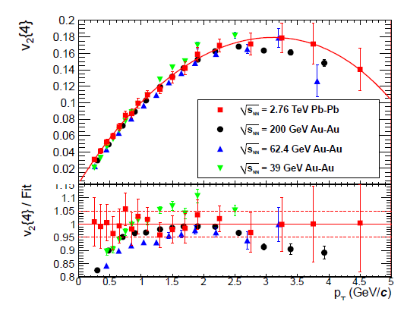
How does flow change with 14 x energy?
What is required to get this remarkable agreement?
JN, Bearden, Zajc, arXiv:1102.0680

Slide 19
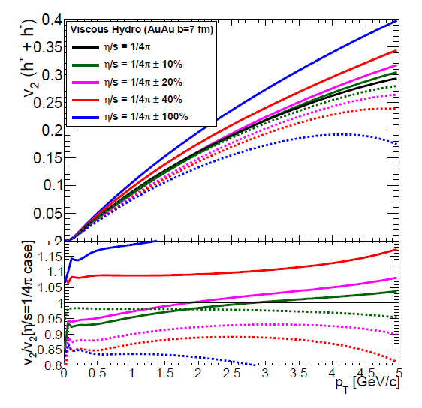
Change in η/s to change v₂ by 5%?
Δ(η/s) ~ 20% → Δv₂~ 5%
Δ(η/s) ~ 40% → Δv₂~10%
Δ(η/s) ~ 100% → Δv₂~25%
Always take ratios.
Low p_{T} turn out to be very sensitive
and where experiments have smallest uncertainties

Slide 20
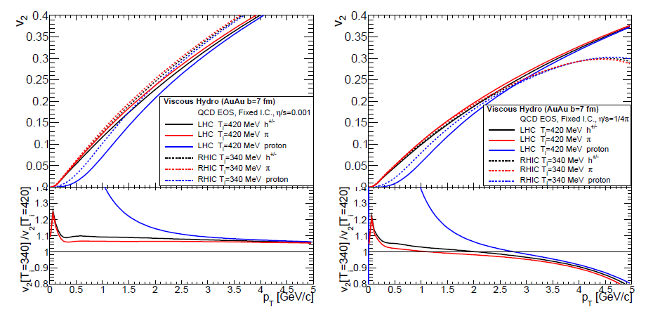
T_{i} = 420 MeV (LHC) versus T_{i} = 340 MeV (RHIC)?
Black = all hadrons
Very similar v₂(p_{T}) except larger viscous effects for p_{T} > 3 GeV/c
LHC = Solid
RHIC = Dash
Blue = protons
Large difference for v₂(p_{T}) due to larger radial boost at LHC temperatures.
Solid prediction.
Previously noted with ideal hydrodynamics by Kestin, Heinz
Ratio RHIC/LHC

Slide 21
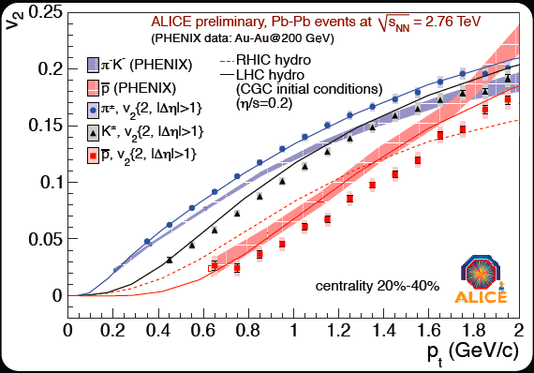
General Feature Confirmed in ALICE Data
v₂
Exact radial boost still not matching in detail
Try Hydro + Cascade afterburner

Slide 22
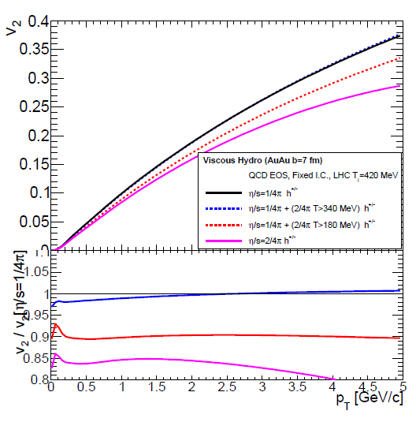
What if η/s is larger for T > 340 MeV?
(just the range sampled at the LHC in early times)?
Consider case I:
η/s = 1/4π (all T)
Consider case II:
η/s = 1/4π (T<340 MeV)
η/s = 2/4π (T>340 MeV)
No change in v₂(p_{T})!
Earliest LHC time has no big impact on η/s.
η/s
2/4π
1/4π
340
T
Ratio

Slide 23

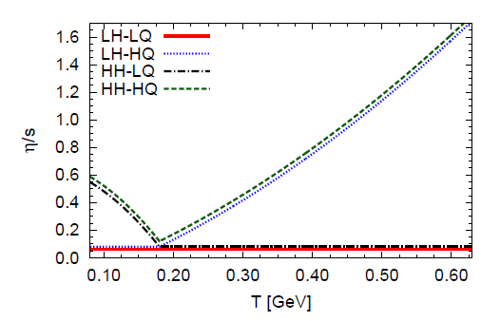
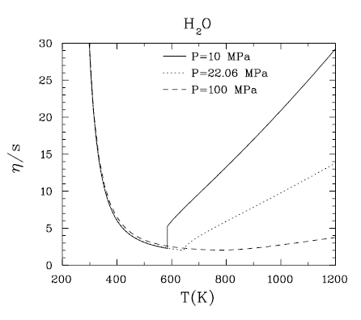
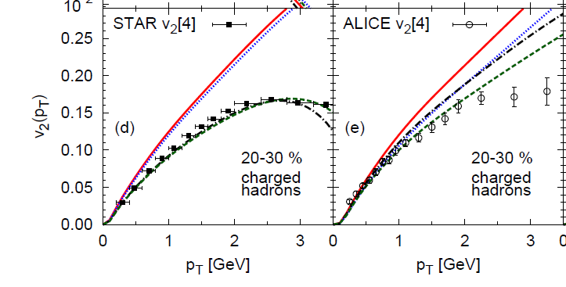
Recent study of η/s (T) – arXiv:1101.2442
Factor 10 increase in η/s results in 15% reduction in v₂ at p_{T} = 2 GeV/c
Seems consistent with my finding that a factor of 2 for T>340 MeV has almost no effect.
‘RHIC v₂ is dominated by η/s below T_{c} and
LHC v₂ by η/s above T_{c}‘
seems an unlikely fine tuning problem

Slide 24
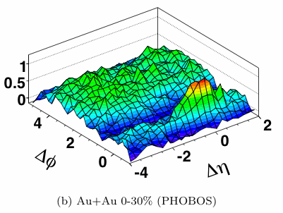
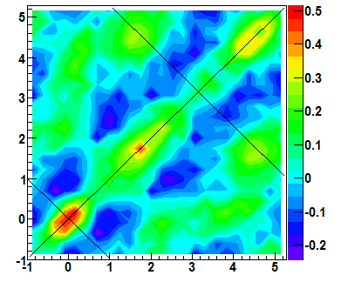
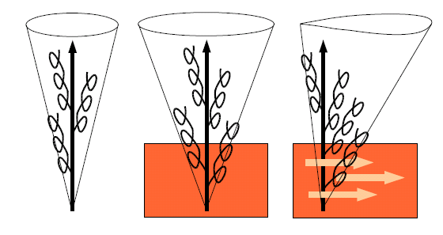

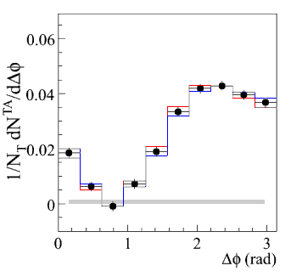
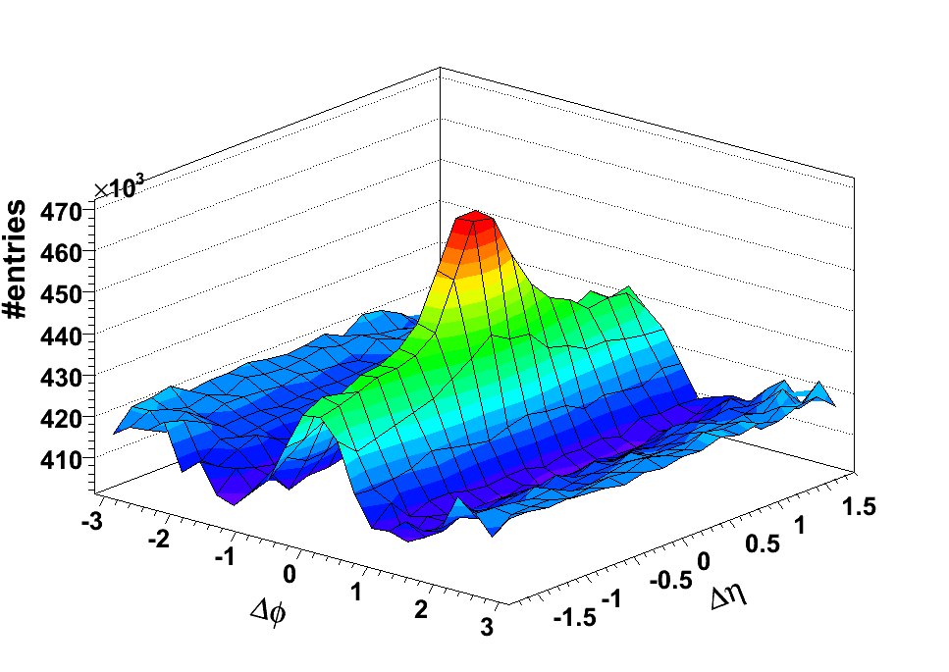
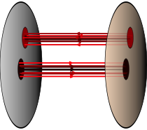
“Ridge” and “Shoulders”
Features in two-particle correlations that have generated a lot of excitement.
p-p 200 GeV
Two years ago (QM09)
I gave a talk with my prediction.
The “death” of the ridge and shoulders
(aka shock response)
π⁰

Slide 25
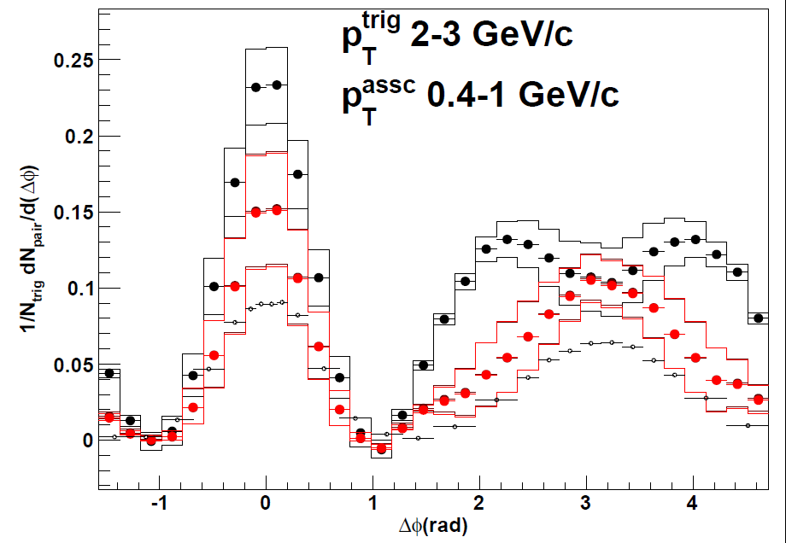
Re-Evaluation of Shock Response
Black points
PHENIX published with v₂ background modulation and ZYAM.
Red points
(NOT PHENIX OFFICIAL)
Use AMPT v₃/v₂ ratio and include v₂ and v₃ background modulation.
Calculation by A. Adare
PHENIX Au+Au 0-20% Central
Dominant ridge and shoulders will be gone.
Detailed careful analysis needs v₁ … v₅ and method checks.

Slide 26
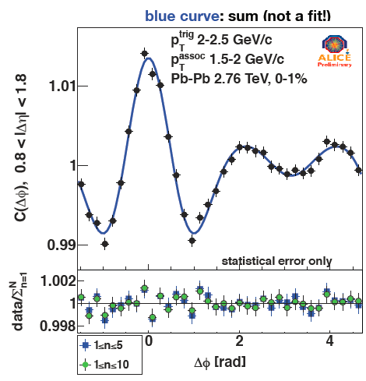
LHC Results
“Ridge” and “Shoulders” seen at LHC as well…
ALICE: arXiv:1105.3865
Fourier Decomposition characterizes the distribution
Are the Fourier Coefficient just the higher order flow moments?
Key Tests

Slide 27
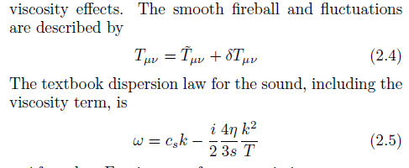

Sound Mode Commentary
Viscous Horizon: “Its verbal definition is that it separates the wavelengths of sound which are and are not dissipated by viscosity effects.” i.e. damped to “un-observably small magnitude” [Shuryak].
Smooth medium and fluctuations (δ)
Dispersion relation from shear viscosity
Damping of fluctuations depends on wavenumber (k), time (t), η/s and Temperature.
Need more formal definition of viscous horizon,
e.g. when wavelength mode damped by 1/e.
“Un-observably small” depends on experimental sensitivity.

Slide 28
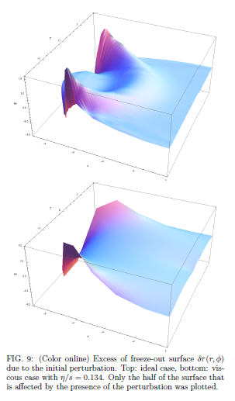
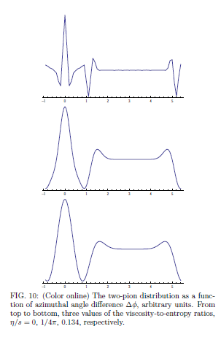
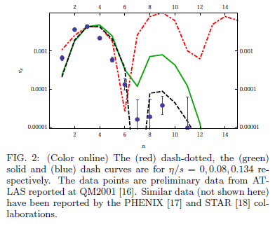

One then evolves with hydrodynamic equations this “hot spot”.
At the freeze-out surface, apply Cooper-Frye hadronization and calculate angular distribution of particles.
Finally, one decomposes the angular distribution into harmonics (n).
Structure due to detailed interaction of hot spot waves
with freeze-out surface and cut-off effects.
Needs double check on robustness of higher moment structures with realistic geometry.
Also, check of how lumpy medium
impacts propagation of state
(not small perturbations).

Slide 29
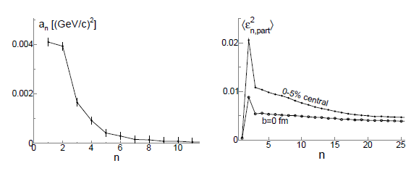
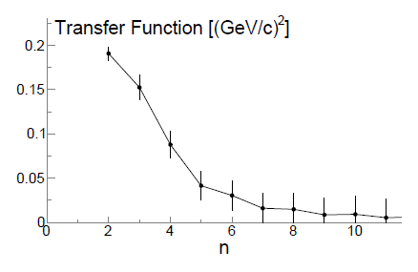
Mocsy, Sorensen use STAR published p_{T}-p_{T} and Δφ correlator (a_{n}) which in the limit of just number correlations ≈ v_{n}².
They argue that the transfer function goes to zero when
l(mean free path) ≈
λ (wavelength of the mode) = 2πR/n
They choose n=5 as the cut-off (viscous horizon) and <R> = 3 fm (average radial position of participants) and get l=3.5 fm.
They state plugging into kinetic formula gives η/s ~ 5 x 1/4π.
Lots of factors of 2
floating around
Really just a_{n}/<ε_{n}²>
http://arxiv.org/abs/arXiv:1008.3381 (Mocsy, Sorensen)

Slide 30
http://arxiv.org/abs/arXiv:1105.3782 (Lacey, Tananenko, Ajitanand, Alexander)
Shuryak’s damping equation by wavenumber (k)
They attempt to relate k to angular harmonic moment n
However, k is mode in radial direction and n is angular correlation for momentum vectors.
I believe this is simply incorrect.

Slide 31
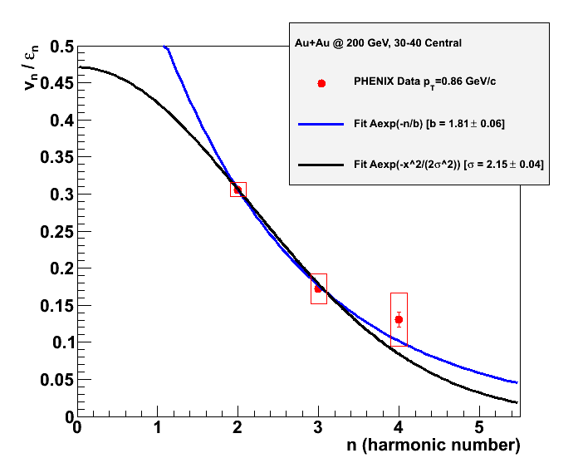
Interesting feature of larger damping for higher moments.
However, I believe full viscous hydrodynamics
needed to relate to η/s (no skipping steps).
Uncertainties on ε
not included!
Au+Au @200
30-40% Central
<ε₂> = 0.359
<ε₃> = 0.197
<ε₄> = 0.197

Slide 32



Thermal Photon Emission
T_{AA} scaled pp + Exponential
Gold-Gold
Direct Photons
Proton-Proton
Direct Photons
Specific prediction for flow (v₂) of thermal photons
Fit to pp
NLO pQCD (W. Vogelsang)
PHENIX: Phys.Rev.Lett. 104 (2010) 132301

Slide 33

Challenge of Direct Photon Flow
PHENIX Experiment: arXiv:1105.4126
Thermal Only
Thermal + Direct
Holopainen, Räsänen, Eskola , arXiv:1104.5371v1

Slide 34


Hydrodynamic Calculation
KZ Mendoza, M. McCumber, JN, P. Romatschke
Early Time
Middle Time
Late Time
Large Blue
Shift
No Boost

Slide 35
Hydrodynamic Calculation
KZ Mendoza, M. McCumber, JN, P. Romatschke
Early Time
Middle Time
Late Time
v₂ from late time steps
Large Blue
Shift
v₂ = 0
v₂ Cumulative
No Boost

Slide 36
Summary
Enormous progress in this area in the last one year
Dramatic reduction in η/s uncertainties around the corner
Exotic shock response and ridge features gone
Key is now to understand how localized energy is so quickly transformed into effective heating
(nicely related to jet quenching puzzle)
Major upgrades at RHIC planned.
Critical for complementing the studies at LHC and really measuring the full excitation function

Slide 37


PHENIX Decadal Plan
Major Upgrade Proposed Extending into EIC Era
We are interested in feedback, suggestions, involvement.
http://www.phenix.bnl.gov/phenix/WWW/docs/decadal/2010/phenix_decadal10_full_refs.pdf

Slide 38


Counts per 2.5 GeV bin in 50B AuAu Events
sPHENIX proposal for a hermetic EMCal/HCAL jet detector at RHIC
NLO pQCD (W. Vogelsang)
CTEQ6M5, DSS FF
pp @ 200 GeV |η|<1.0
q,g jets
Direct γ
Fragmentation γ
π⁰ (assume R_{AA} = 0.2)
π⁰
Photons
Jets

Slide 39
Extras

Slide 40


Measuring v₃
First, can detectors separated by Δη = 2 or even Δη = 6 measure event-by-event the 3rd order participant plane?
200 GeV Au+Au
PHENIX Preliminary
RXN |η| = 1.0-2.8
MPC |η| = 3.1-3.7
Answer = Yes
Now we can measure v₃ using the event plane method.
n=2 RXN
n=3 RXN
n=4 RXN
σ_{n} = <cos n(Φ_{n(meas.)} - Φ_{n(true)})>
n=2 MPC
n=3 MPC
n=2
n=3
n=4
centrality (%)
First presented at WWND11 by S. Esumi and J. Chen

Slide 41


Quark
Gluon
Plasma
?
Viscosity Roadmap
String Theory
Lowest Bound!

Slide 42

Tests and model comparisons can be done on Coefficients
If entire 2-particle correlation from bulk flow then:
Fourier Coefficient v_{nΔ}(p_{T1},p_{T2}) = v_{n}(p_{T1}) x v_{n}(p_{T2})
Deviations indicate important non-flow effects
(jets and medium response for example)

Slide 43





Slide 44


Ratio Density MCKT (Saturation) / Glauber
With the normalization, MCKT has a larger entropy density in the middle of the almond than both Glauber cases.

Slide 45






Perfect Fluid Response
Super-sonic quark traversing medium
results in shock wave response
Observed in the data?
φ = -90⁰
φ = +90⁰
Run 4 0.2 nb⁻¹
Central
AuAu
Lots of theory papers!

