Slide 1
Prospects of the sPHENIX Experiment at RHIC
The future of the Heavy Ion Physics at RHIC and a foundation for the Electron-Ion Collider
Ming Liu
Aug. 19-23, 2019
Yonsei University

Slide 2
US Nuclear Physics Long Range Plan (2015)
Nuclear matter under extreme condition
Nucleon structure with quarks and gluons and QCD dynamics

Slide 3

US Nuclear Physics Long Range Plan (2015) – sPHENIX – to understand Inner Workings of QGP

Slide 4
Outline
Physics motivation
sPHENIX detectors and physics highlights
Heavy Flavor physics and MVTX upgrade
A new Cold-QCD physics Opportunity
Outlook

Slide 5
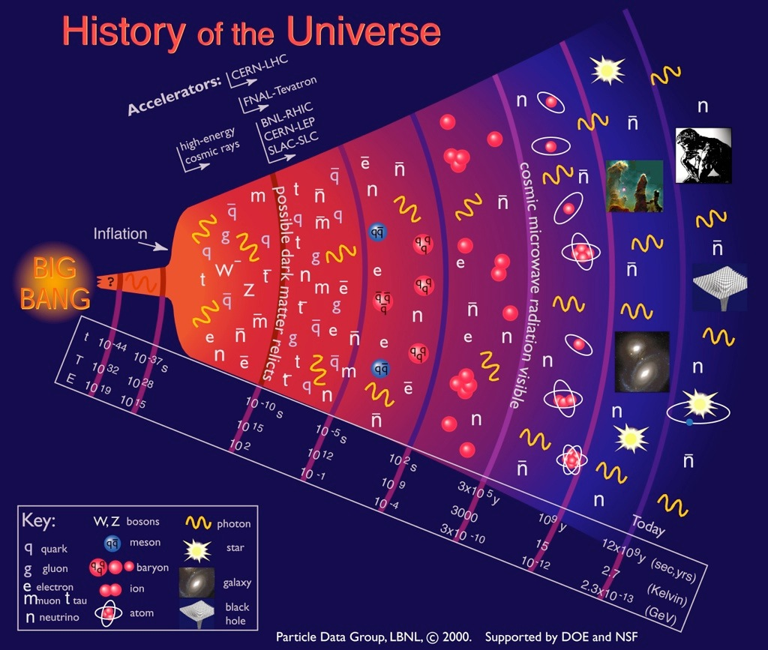
Quark-Gluon
Plasma (QGP)

Slide 6
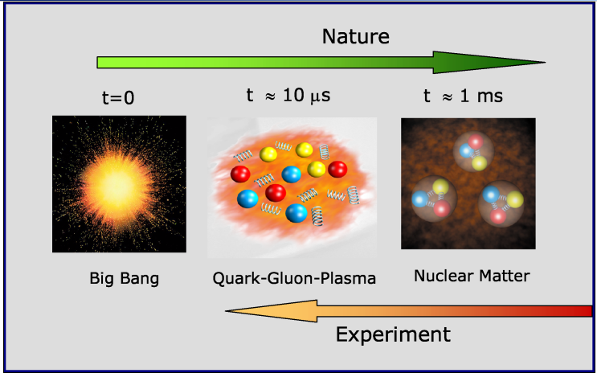
Quark Gluon Plasma and Heavy Ion Collisions
- recreate a state of matter in the early universe

Slide 7
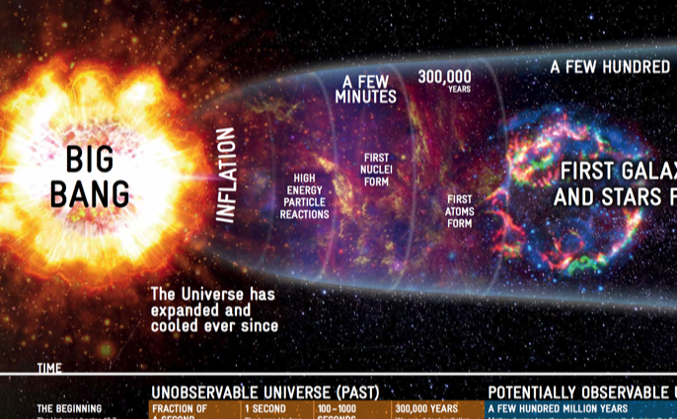

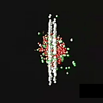
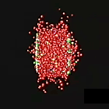
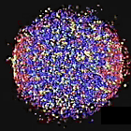
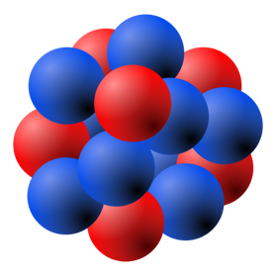


High Energy Heavy Ion Collisions
- Artists’ View
¹⁹⁷Au
¹⁹⁷Au
About to collide
Ion collision
Quarks and gluons freed
QGP formed
Relativistic Lorentz Contraction:
At RHIC (LHC):
¹⁹⁷Au

Slide 8
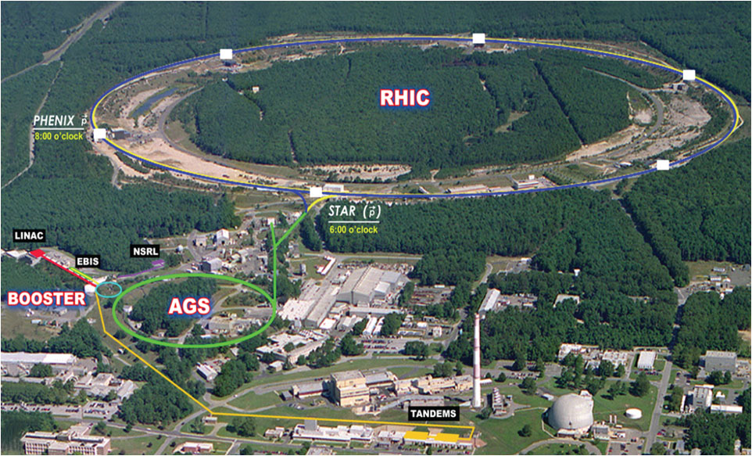
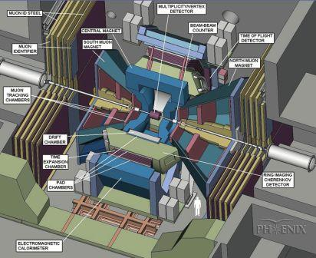

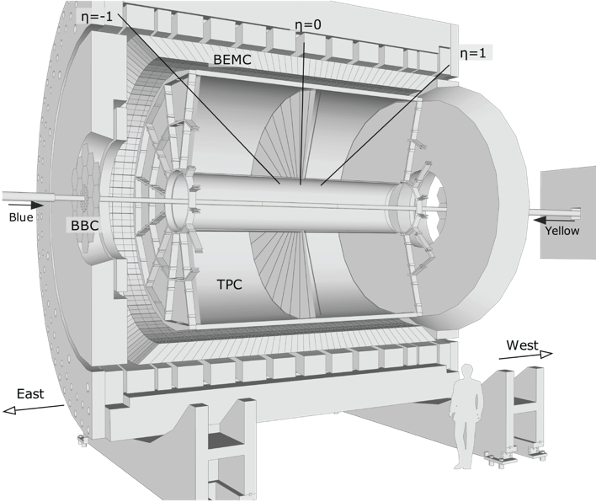
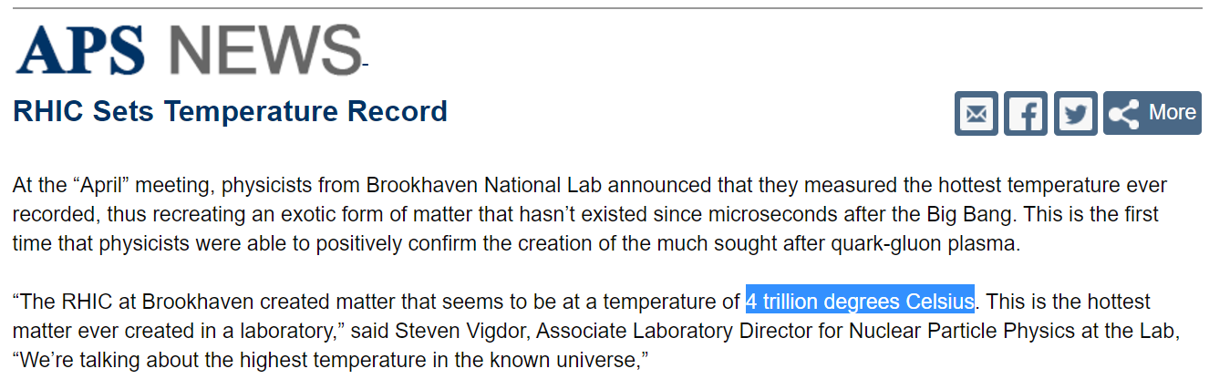
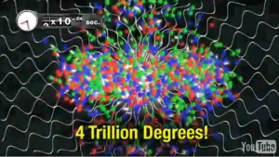
RHIC: Relativistic Heavy Ion Collider @BNL
Φ 1.2km
Mar, (2010)
The most versatile hadron collider in the world, and world’s first and only spin-polarized proton collider.
Discovery of Quark Gluon Plasma
Reached x40 of designed luminosity.
Two major experiments as of today
Pioneering High Energy Nuclear Interaction eXperiment (PHENIX) → sPHENIX
Solenoidal Tracker At RHIC (STAR, J. Zhang, Tue)
PHENIX, Phys. Rev. Lett. 104, 132301

Slide 9
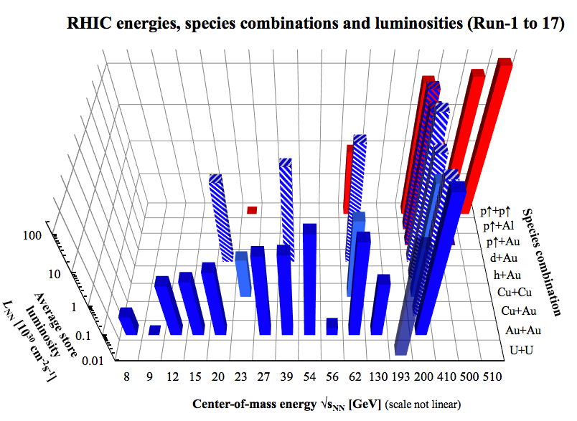
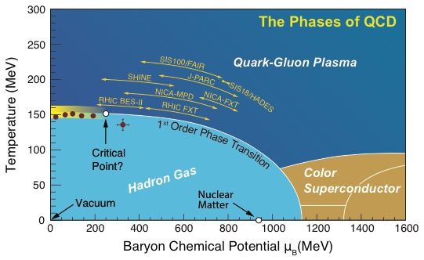
RHIC Delivers Whatever it Takes
The world’s most versatile facility for the exploration of the phases of QCD matter from high temperature to high baryon density.
Discovery of “perfect liquid” QGP
Discovery of jet quenching in QGP
Proton spin decomposition, quark & gluon
RHIC
Run18: (⁹⁶Zr⁴⁰⁺ + ⁹⁶Zr⁴⁰⁺) and (⁹⁶Ru⁴⁴⁺ + ⁹⁶Ru⁴⁴⁺)

Slide 10

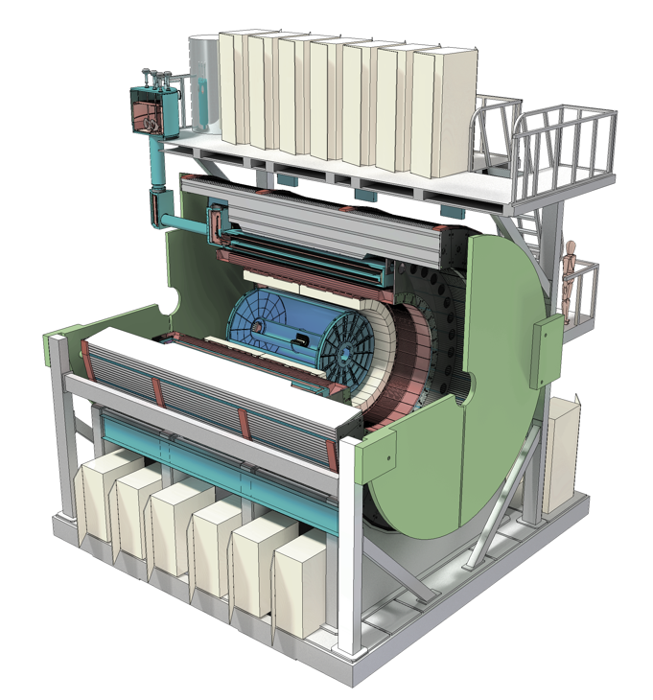
sPHENIX Upgrade the next Generation HI experiment at RHIC
Φ 1.2km

Slide 11
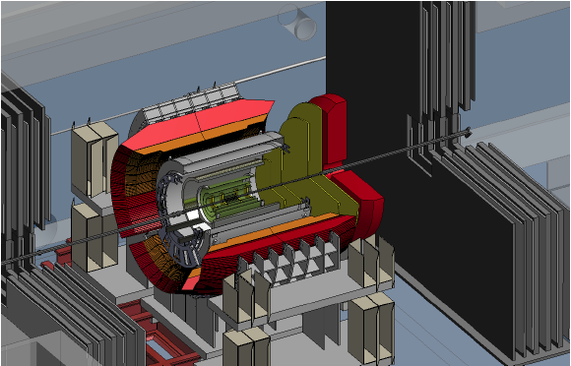
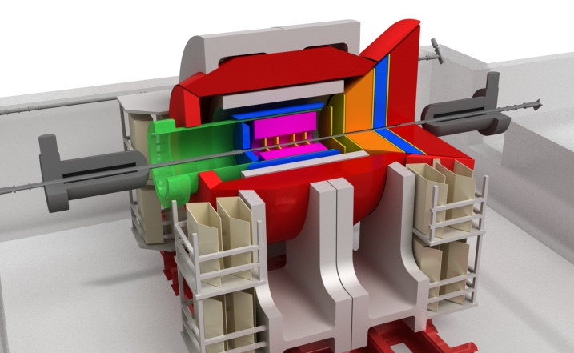
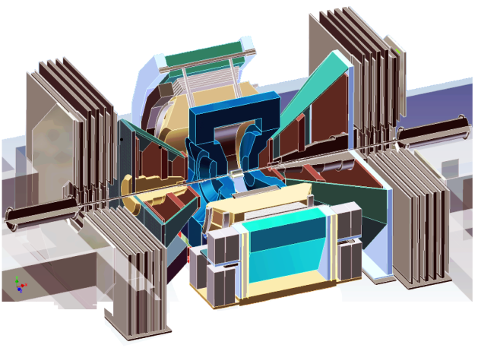
Evolution of the PHENIX Interaction Region
PHENIX experiment
An EIC detector
16y+ operation
Broad spectrum of physics (QGP, Hadron Physics, Dark Matter)
170+ physics papers with 24k citations
Last run in this form 2016
Comprehensive central upgrade base on BaBar magnet
Rich jet and beauty quarkonia physics program
→ nature of QGP
Possible forward tracking, and calorimeter → Spin, CNM
Path of PHENIX upgrade leads to a capable EIC detector
Large coverage of tracking, calorimetry and PID
Open for new collaboration/new ideas
arXiv:1501.06197 [nucl-ex]
arXiv:1402.1209 [nucl-ex]
2000-2016
2017→2022, CD-3@ 2019
~>2027
Time
RHIC: A+A, spin-polarized p+p, spin-polarized p+A
EIC: e+p, e+A

Slide 12
Complementarity: Why RHIC and LHC?

Slide 13
Probing the Inner Workings of QGP in sPHENIX

Slide 14
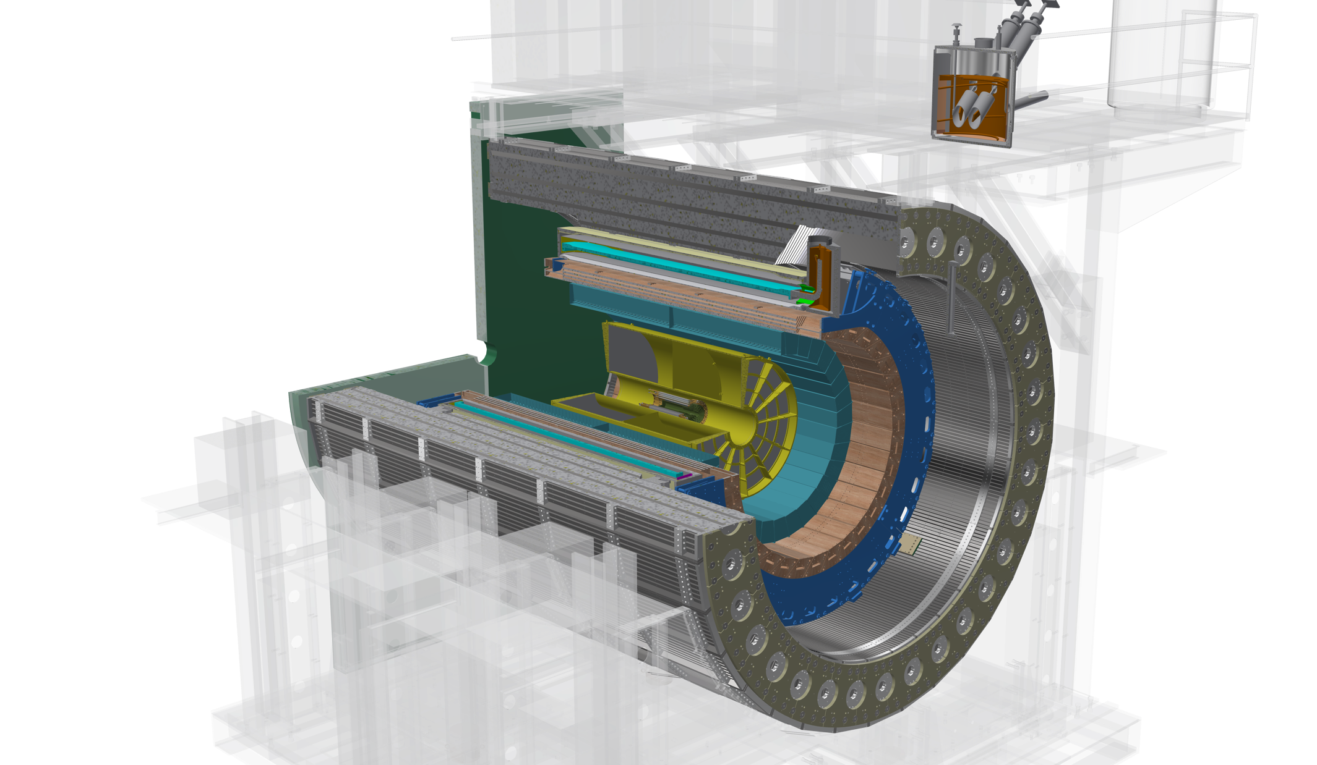
The sPHENIX Detectors
Outer HCal
SC Magnet
Inner HCal
EMCal
TPC
INTT
MVTX
Φ ~ 5m
15 kHz trigger
>10 GB/s data
Notes:
15kHz matched to collision rate.

Slide 15
sPHENIX Detector Sub-Systems

Slide 16
Detector Performance: Tracking and Jets

Slide 17
MVTX: Precision Vertex Detector for Heavy Quark Measurements

Slide 18
sPHENIX 3 Physics Pillars
Jets
Upsilons
Heavy Quarks

Slide 19
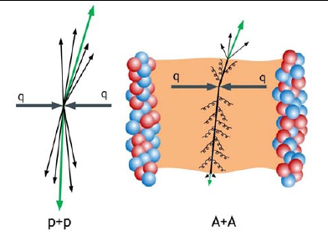
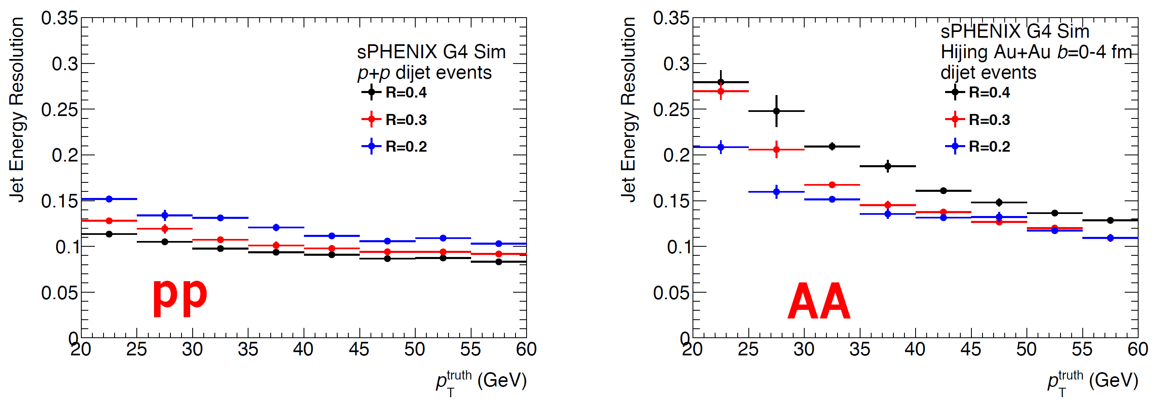
(I) Precision Calorimetry for Jets and Photons
Jet production in p+p and Au+Au
Excellent jet resolution in both p+p and A+A

Slide 20
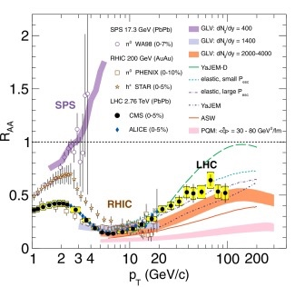
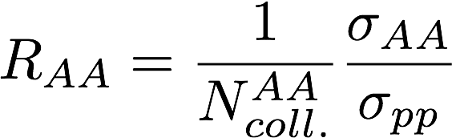
Jet Quenching Observed @RHIC and LHC
- Great progress in the last decade, but significant model dependence remains in the understanding of the physics of jet suppression and QGP properties at RHIC and LHC
- sPHENIX goals - understand the inner workings of QGP

Slide 21
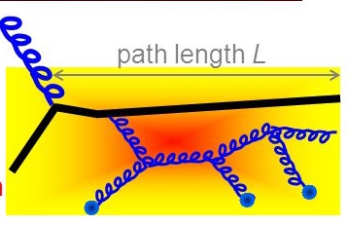
sPHENIX: Detail Study of the Path-length Dependence of Jet Suppression
Medium induced gluon radiation:
- BDMPS, GLV etc.

Slide 22
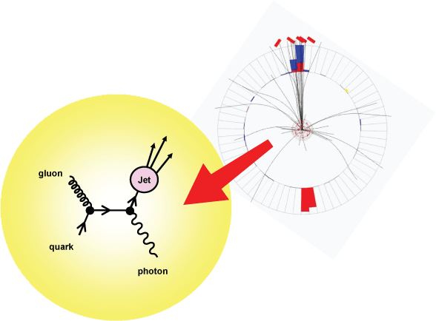
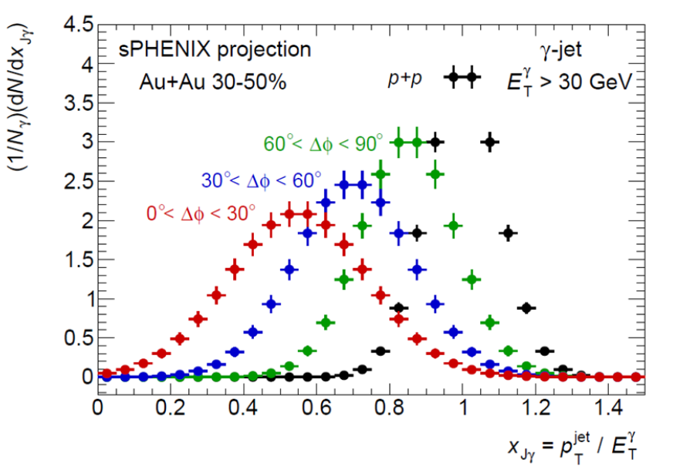
Direct Photon + Jet in Au+Au: Simulations
Jet - direct photon momentum imbalance

Slide 23
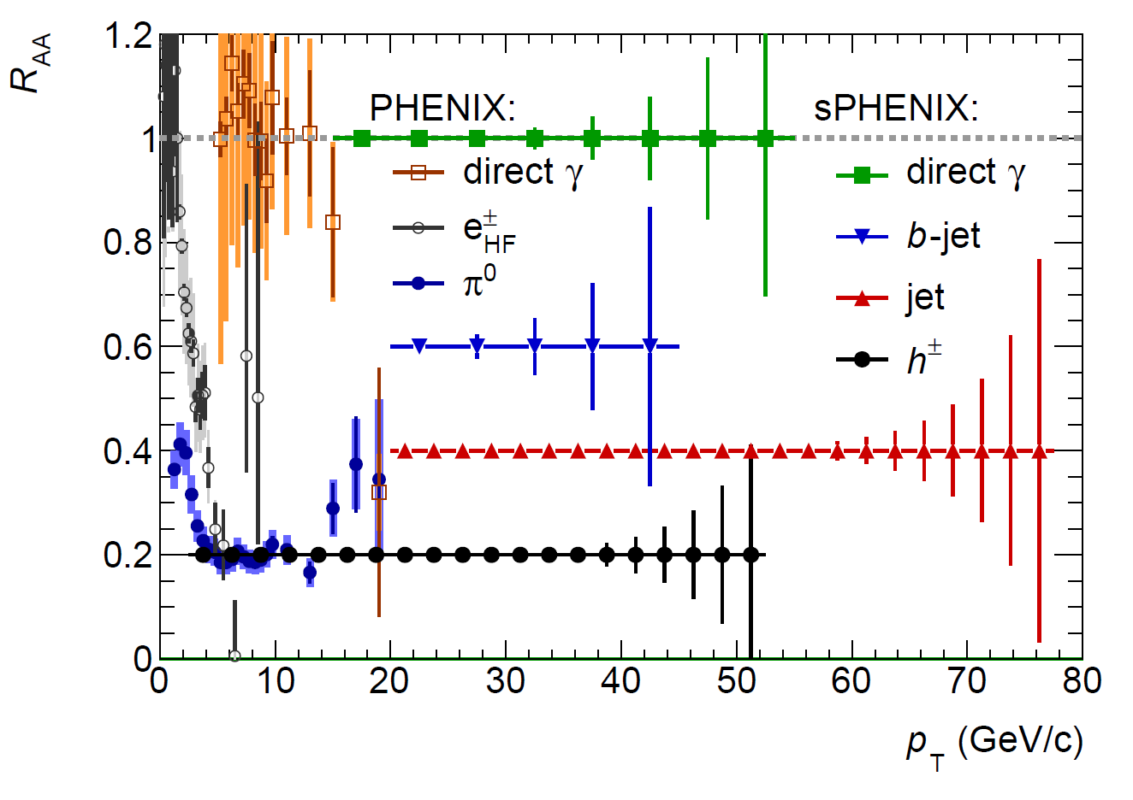
A Broad Physics Program with Jets @sPHENIX
Parton Mass and Flavor Dependence of Jet Suppression and more

Slide 24
sPHENIX 3 Physics Pillars
Jets
Upsilons
Heavy Quarks

Slide 25
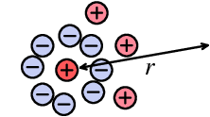
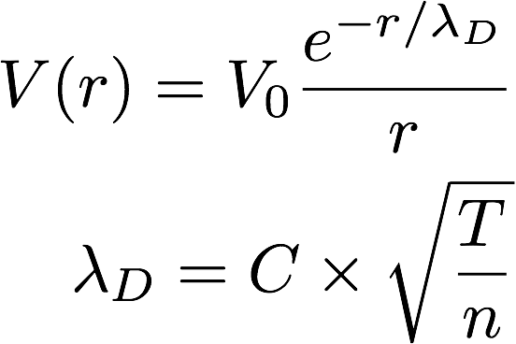
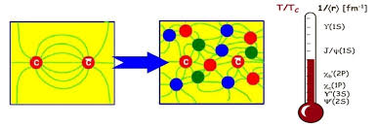
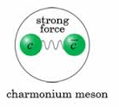
(II) Heavy Quarkonia and QGP Color Screening
Plasma Debye Length:
The shorter the r_{D},
the stronger the screening
effects

Slide 26
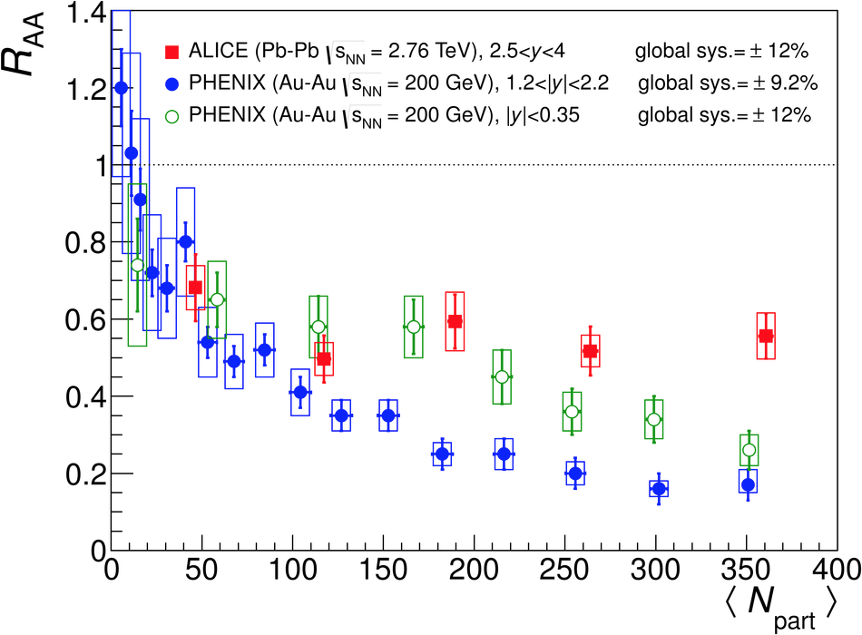
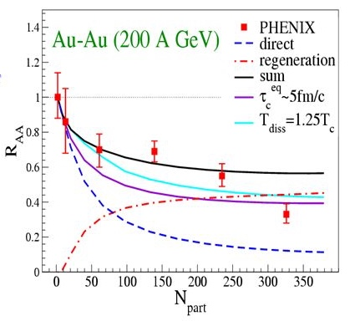
J/Psi Suppression Observed, w/ Surprises
QGP Suppression
  Color screening
  Breakup w/ “co-movers”
Regeneration
  Coalescence of many c-cbar pairs produced in A+A
Upsilons! – focus of sPHENIX
  Color screening
  Breakup w/ “co-movers”
  No regeneration
Zhuang et al.

Slide 27
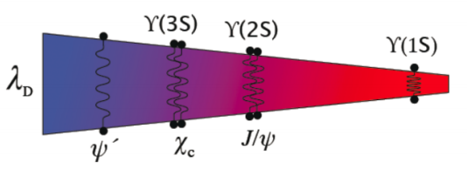
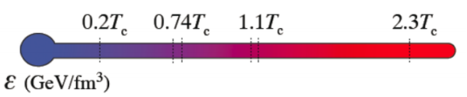
Upsilon Spectroscopy
ϒ(3s)-0.78fm
ϒ(2s) – 0.56fm
Courtesy from A. Mocsy
ϒ(1s) – 0.28fm
Thermometer of QGP via clean separation of three Upsilon states (M_{ee} < 100 MeV/c²)

Slide 28
sPHENIX 3 Physics Pillars
Jets
Upsilons
Heavy Quarks

Slide 29
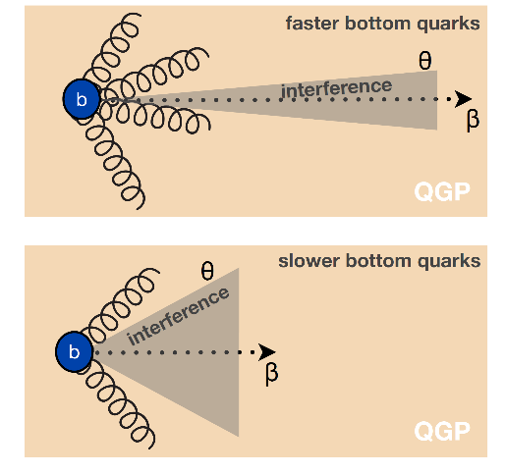
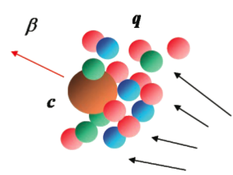
(III) Heavy Quarks - Unique Probe of QGP
Study mass dependence
  Jet quenching
  Flow – interaction with medium
Access QGP properties
Mass dependent
radiation dE/dx
m_{u} m_{d}
m_{s}
Λ_{QCD}
m_{c}
m_{b}
MeV
1
10
10²
10³
10⁴
T_{c}
T_{QGP}

Slide 30
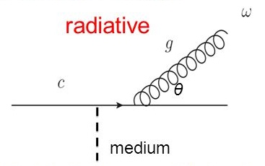
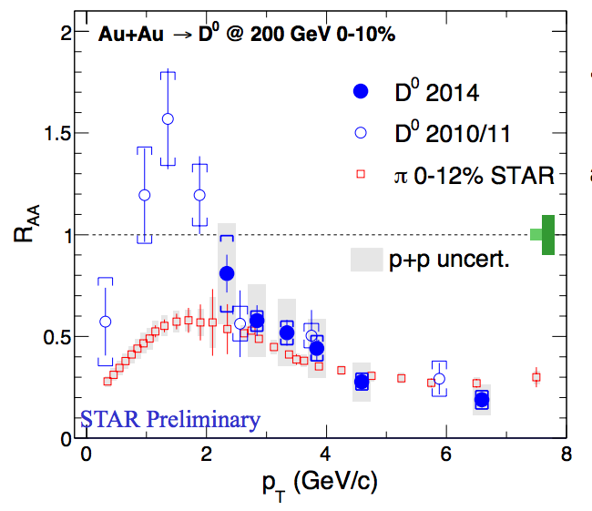
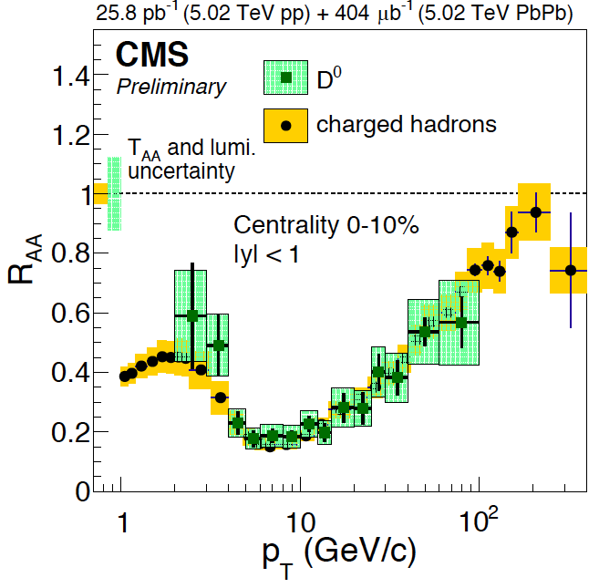
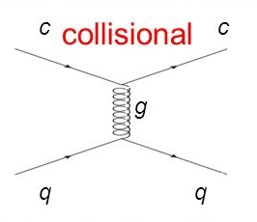
Recent Highlight I: Charm R_{AA} @RHIC and LHC
R_{AA} (D-meson) ~ R_{AA} (h) at high p_{T} ~> 4 GeV/c
significant suppression of charmed hadron R_{AA} in central A+A collisions
strong charm-medium interactions
mass effects?: expected important at low pT, dead-cone, collisional effects etc.

Slide 31
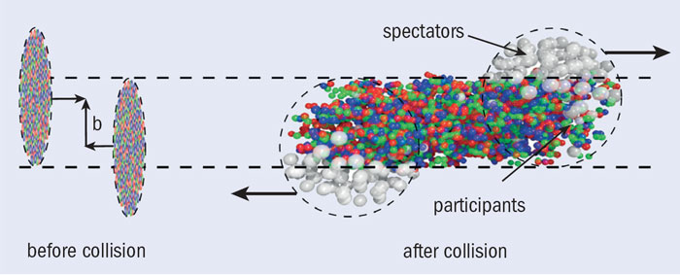
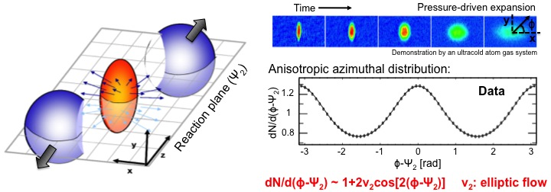
Particle “Flow” and QGP Medium Response
Anisotropic flow:
due to interactions w/ medium

Slide 32
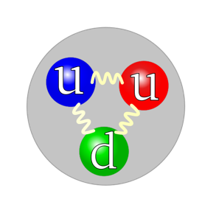
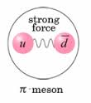
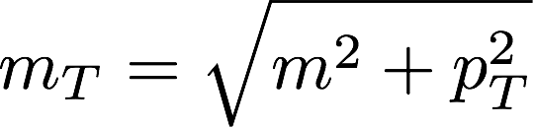
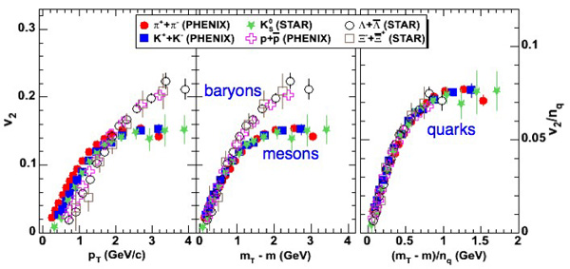
Universal Scaling of V₂ - Perfect QGP Liquid!?
Baryons: n_{q}=3
Mesons: n_{q}=2

Slide 33
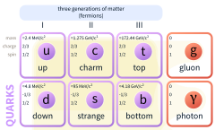
A Surprise from RHIC!
Charm quarks flow just as well as lighter quarks – “Perfect liquid”
Elliptic flow of D0 mesons (charm quarks)
m(u,d) = 2~5 MeV
M(s) = 100 MeV
M(c) = 1,300 MeV
M(b) = 4,200 MeV
M(t) = 175,000 MeV
- PDG 2014
PRL 118 (2017) 212301

Slide 34
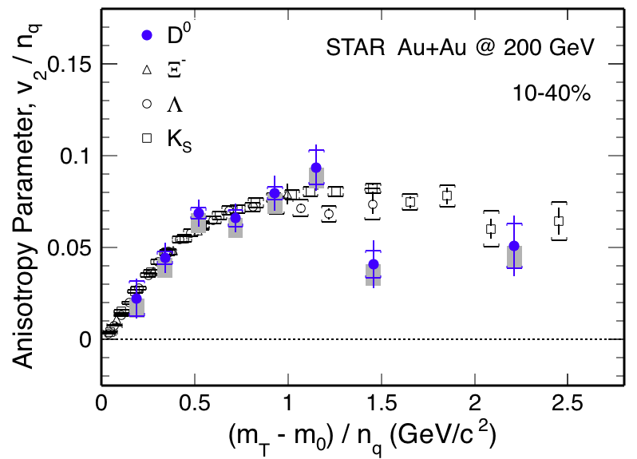
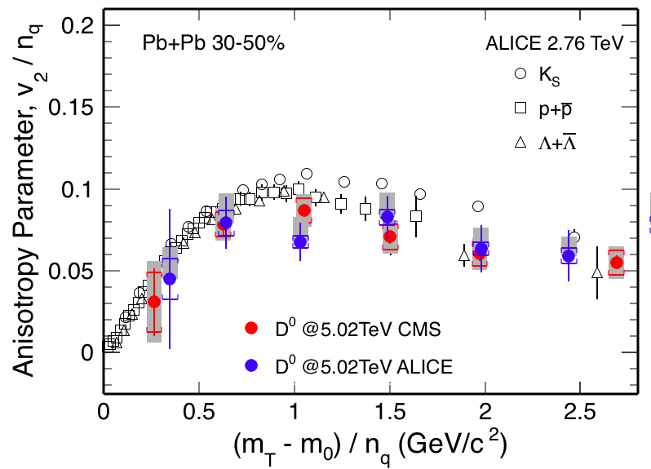
Recent Highlights II: Charm V₂ @RHIC and LHC
v₂ of D⁰ follows the same trend as light hadrons
  Charm quarks flow the same as light quarks
Strong coupling to medium at low pT?

Slide 35





How about the Much Heavier Beauty?
Highly desired:
precision measurements of
B @low-intermediate pT ~< 50GeV
R_{AA} (B->e) > R_{AA} (D->e, h) @low pT
B⁺ & b-jet ~ light hadrons & charm @high pT
STAR, QM17

Slide 36




MAPS-based VerTex detector: MVTX Upgrade
To enable B-hadron and b-jet physics in sPHENIX
ALICE ITS Upgrade:
Inner Barrel Tracker
sPHENIX Inner Tracking
Adapt ITS/IB
- Min. Risks
- Max. Phys.

Slide 37


Monolithic-Active-Pixel-Sensors (MAPS)
The next Generation State of the Art Pixel Tracker
Advantages of ALICE MAPS/ALPIDE:
  Very fine pitch (27x29 μm)
  High efficiency (>99%) and low noise (<10⁻⁶)
  Time resolution, as high as ~5 μs
  Ultra-thin/low mass, 50μm (~0.3% X₀)
  On-pixel digitization, low power dissipation
An ideal detector for QGP physics!
FPC
9 Chips
Cooling plate
A 9-chip MAPS stave, 1.5 x 27cm²
ALPIDE design
50 μm
28 μm

Slide 38

RHIC Multi-Year Plan: sPHENIX 2023-2027+
Evolving
Precision B-tagging w/ MVTX:
  Tracking resolution better than 50um @pT=1GeV
  High multiplicity HI collisions
  Low multiplicity but high rate p+p collisions
  High efficiency and high purity
B hadrons/pT<15GeV: O(1M)
b-jets/pT>15GeV: O(100K)

Slide 39


Physics Channels: Open Charm and Beauty
Hadron | Abundance | cτ (μm)
D⁰ | 61% | 123
D⁺ | 24% | 312
D_{s} | 8% | 150
Λ_{c} | 6% | 60
B⁺ | 40% | 491
B⁰ | 40% | 455
B_{s} | 10% | 453
Λ_{b} | 10% | 435
b-tagged jet and cor.
p_{T}>15 GeV
60%
0.5%
p_{T}<15 GeV
Exploring and more

Slide 40



Simulation: b-jet and B-meson Tagging
sPHENIX Geant4 display of p_{T}=30 GeV/c B⁺-hadron
Design to Simulation
MVTX and INTT _
_ MVTX Ladders modeled in details
MVTX sensors

Slide 41


Tracking Performance with Full GEANT
MVTX geometry modeled and digitized according to ALICE ITS/IB
Cluster resolution: ~5 µm
DCA_{2D ,} DCA_{z}<30 µm down to 1 GeV/c
DCA_rφ
DCA_z

Slide 42




B-jet tagging
Multi-tracks w/ large DCA
2nd vertex mass reco’d
CMS work-point, Phys. Rev. Lett. 113, 132301 (2014)

Slide 43



B-hadron Tagging
Impact parameter (DCA) method to tag non-prompt D⁰ from B-meson decays
Inclusive and exclusive channels possible

Slide 44


Charm Chemistry - Introduction
Charm baryon vs meson
Heavy quarks transport in
QGP and hadronic phase of the medium
Charm quark hadronization via coalescence

Slide 45




Reconstruction of $Λ_{c }$
$Λ_{c}$→K⁻pπ⁺
Daughters p_{T} > 0.6GeV
Daughters DCA < 50 µm
p DCA > 75 µm,
K DCA > 96 µm,
π DCA > 65 µm
Decay length Lc > 200 µm
DCA Lc < 100 µm
Hybrid PID
0-10%
2<p_{T}<3 GeV/c
Centrality | Running events |  | Scaled events
 | signal | Background
0-10% | 5B | 2B | 24B
10-20% | 3B | 1B | 24B
20-40% | 3B | 1B | 48B
40-60% | 3B | 1B | 48B
60-80% | 5B | 8B | 48B

Slide 46


B-meson projections
sPH-HF-2018-001 - MVTX Proposal
Bring high precision non-prompt-D suppression and flow to RHIC
Determine the bottom quark collectivity
→ clean access to D_{HQ} at RHIC energy
non-prompt D-meson and predictions for sPHENIX
Notes:
Exploring B->J/psi (and maybe B->e high pT) channels

Slide 47


b-jet projection
sPH-HF-2018-001 - MVTX Proposal
Bring inclusive b-jet suppression and v₂ to RHIC
Strong constraints on energy loss model of high energy probe in QGP
Inclusive b-jet R_{AA}
Inclusive b-jet v₂

Slide 48



Broader Heavy Flavor Program
sPH-HF-2018-001 - MVTX Proposal
HF-jet-jet, jet-HF-hadron, D-D correlations, HF jet substructure
Total b-cross section for Upsilon program and more decay chan.
Di-b-jet p_{T} balance
Exclusive B± in most central Au+Au
90%
67%

Slide 49
sPHENIX at Electron Ion Collider (EIC)

Slide 51
Forward sPHENIX Upgrade Opportunity
MVTX

Slide 52
A New Development of Cold QCD Physics
- toward the future Electron Ion Collider

Slide 53

Nucleon Structure and Parton Interaction
A very rich dynamic environment, NOT a point particle
  “3-D” tomography
  Probe scale-dependence, QCD evolution
Source of many novel strong interaction phenomena
Probe resolution:
$$λ \sim 1/Q$$
Low Q²
Large Q²

Slide 54
Origin of the Proton Spin

Slide 55


Three Decades of the Proton Spin Puzzle
Early expectation: large gluon polarization
 | Quark Spin | Gluon Spin
SLAC -> 2000 | E80 – E155
CERN ongoing | EMC, SMC, COMPASS
DESY ->2007 | HERMES
JLab ongoing | Hall A,B,C
RHIC ongoing | (BRAHMS), (PHENIX), STAR
Axial anomaly
Cheng & Li, PRL (1989)
EMC, 1980s
 | SIDIS/DIS
 | Polarized p+p

Slide 56
Gluon Polarization Study in sPHENIX
Jets, Charged hadrons and Direct Photons

Slide 57

“TMD” phenomena: The Challenge of “Too Large”
Large Transverse Single Spin Asymmetry (TSSA) in forward hadron production persists up to top RHIC energy.
Kane, Pumplin, Repko (1978)
A_{N} ~ O(10%)
Fermilab
E704 (1991)

Slide 58




Physics with Transversely Polarized p+p Collisions at RHIC

Slide 59
Probe the Underlying Physics via Hard Scatterings
TMD, Collinear Twist-3 Factorizations
(i) Sivers mechanism:
correlation proton spin & parton k_{T}
(ii) Collins mechanism: Transversity × spin-dep fragmentation
SIDIS:
S_{P}
Phys Rev D41 (1990) 83; 43 (1991) 261
S_{P}
Nucl Phys B396 (1993) 161
S_{q}
p
k_{T,q}
p
p
p
S_{q}
k_{T,π}
pp:
Collinear Twist-3 (RHIC):
quark-gluon/gluon-gluon correlation

Slide 60
Access Sivers and Collins with Jet and Hadron Azimuthal Distributions in Transversely Polarized p+p Collisions
Feng Yuan, PRL 100, 032003 (2008)
Umberto D’Alesio et al PRD 83 034021 (2011)
→ “Sivers-like” (Jet)
→ “Collins-like” (hadron)

Slide 61
Collins Asymmetry Observed
in Jet in p+p Collisions
Inclusive A_{N} = 0 at central rapidity
A_{N} at central rapidity: non-zero in jet!

Slide 62
Future at RHIC: PHENIX -> sPHENIX (-> EIC@RHIC)
PHENIX
Forward sPHENIX
Sign change in
Jet A_{N}?
PHENIX completed 2016
16y+ work
100+M$ investment
Comprehensive central upgrade based on BaBar magnet
fsPHENIX: forward tracking, HCal and muon ID
Key study of transverse spin
New collaboration/new ideas
Naïve direct mapping
from SIDIS Sivers (GPM)
- “u-quark jet” A_{N} >0
With process-dependence
from SIDIS Sivers (Twist-3)
- “u-quark jet” A_{N} < 0
~2000
2017→2022
~2027+
RHIC: A+A, polarized p+p, polarized p+A

Slide 63
Nuclear Parton Distributions: Forward sPHENIX
Expand QGP tomography
Spin physics
Nuclear PDF

Slide 64
sPHENIX Collaboration

Slide 65


Summary and Outlook
sPHENIX CD-0 granted Sept 2016; Construction 2018
1st data taking: Early 2023

Slide 66
Quark-Gluon
Plasma (QGP)

Slide 67





Slide 68
backup

Slide 69



Evolving sPHENIX Collaboration
~70 institutions from world wide & growing!
A new Chinese consortium joined sPHENIX,
led by Prof. H. Huang!
Santa Fe, NM, 12/2017

Slide 70

sPHENIX: a State of the Art Detector for Heavy Ion Physics at RHIC
CD-0/Science Case Sept 2016
Construction Phase Jul 2018 -22
Ready for Beam Jan 2023
Space preserve for
future Particle ID
MVTX
Detector

Slide 71





Super conducting magnet
1.4 Tesla magnet, Ф = 2.8 m, L = 3.8 m Previously used in BaBar @ SLAC
Moved to BNL in Feb 2015
Successful cold low field test in 2016
On-going full field test
Preparing full field test @ BNL

Slide 73
sPHENIX Projected R_{AA} Sensitivity
Open questions to be answered: energy loss mechanisms and QGP medium properties
B-Mesons
B-jets

Slide 74

sPHENIX Project Elliptical Flow v₂
Open questions to be answered: nature of quasi-particles, medium interactions and transportation
B-Mesons
B-jets

Slide 75





Heavy Quark Probes at RHIC
Uniqueness at RHIC
- dominated by pair creation, clean interpretation for experimental results
Pair Creation
PYTHIA6
LHC
RHIC
Flavor Excitation
Gluon Splitting
T. Sjostrand, EPJC17 (2000) 137

Slide 77


Toward a Unified Picture of Nucleon Structure
Momentum and Spatial Tomography
Some data, recent progress
Good data, long history
F(r,Q²)

Slide 78
Latest Pol NNPDFPol Global Fit
arXiv:1702.05077
-SI/DIS data
-RHIC data

Slide 79
RHIC Highlight (2): Flow
Phys. Rev. C 95 (2017) 034910
PHENIX Preliminary
Signatures of collective flow exist even in the smallest systems and at the lowest RHIC energies
PHENIX Preliminary

Slide 80






Jet Probes of QCD Structure
Bare Color Charges
Parton virtuality evolves quickly and is sensitive to the medium at the scale it probes
Thermal Mass Gluons
RHIC Jet Probes
LHC Jet Probes
QGP Influence
Structureless Fluid
- Unique critical microscope resolution range at RHIC
- Kinematic overlap between RHIC and LHC provides complementarity
80

Slide 81


Topic-1: Probe the Density
QGP and Jet Quenching
High density QGP medium created in
Heavy ion collisions:
~20x of normal nucleus

Slide 82

Jet Quenching Observed
QGP density > 10x normal nucleus

Slide 83


Jet Quenching @RHIC and LHC

Slide 84





Calorimeters beam tests
February 2014
Proof of principle
February 2016: η~0 prototype
February 2017: η~0.9 prototype
Electron
Energy resolution
arXiv:1704.01461
Pion
Energy resolution
arXiv:1704.01461
sPHENIX beam test data
sPHENIX beam test data

