Slide 1
This Week
My contact information:
Ming Liu,
Office at Yonsei: XXX
Email: ming@bnl.gov
Monday
  Introduction, Relativistic Heavy Ion Collisions
  The SM, theoretical foundation and experimental methods
Tuesday
  Selected topics of QGP study at RHIC
  Jet quenching, J/Psi screening effects in QGP, anti-matter production etc
Wednesday
  Novel phenomena in strong interactions, proton structure
  Proton spin puzzle etc.
Thursday
  Polarized fixed target experiment at Fermilab
  Dark Matter search at Fermilab
Friday
  Physics opportunity with sPHENIX at RHIC
  Monolithic-Active-Pixel-Sensor based Vertex Detector upgrade

Slide 2
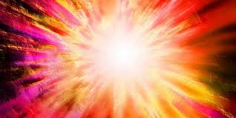
Recreate Early Universe in Laboratory
Ming Liu
Los Alamos National Laboratory

Slide 3
Outline
The Big Bang
  The early universe
“Little Bang” in Heavy Ion Collisions
  Recreate a droplet of the early universe
    Quark Gluon Plasma
    Matter and anti-matter
Dark Matter?
Outlook

Slide 4
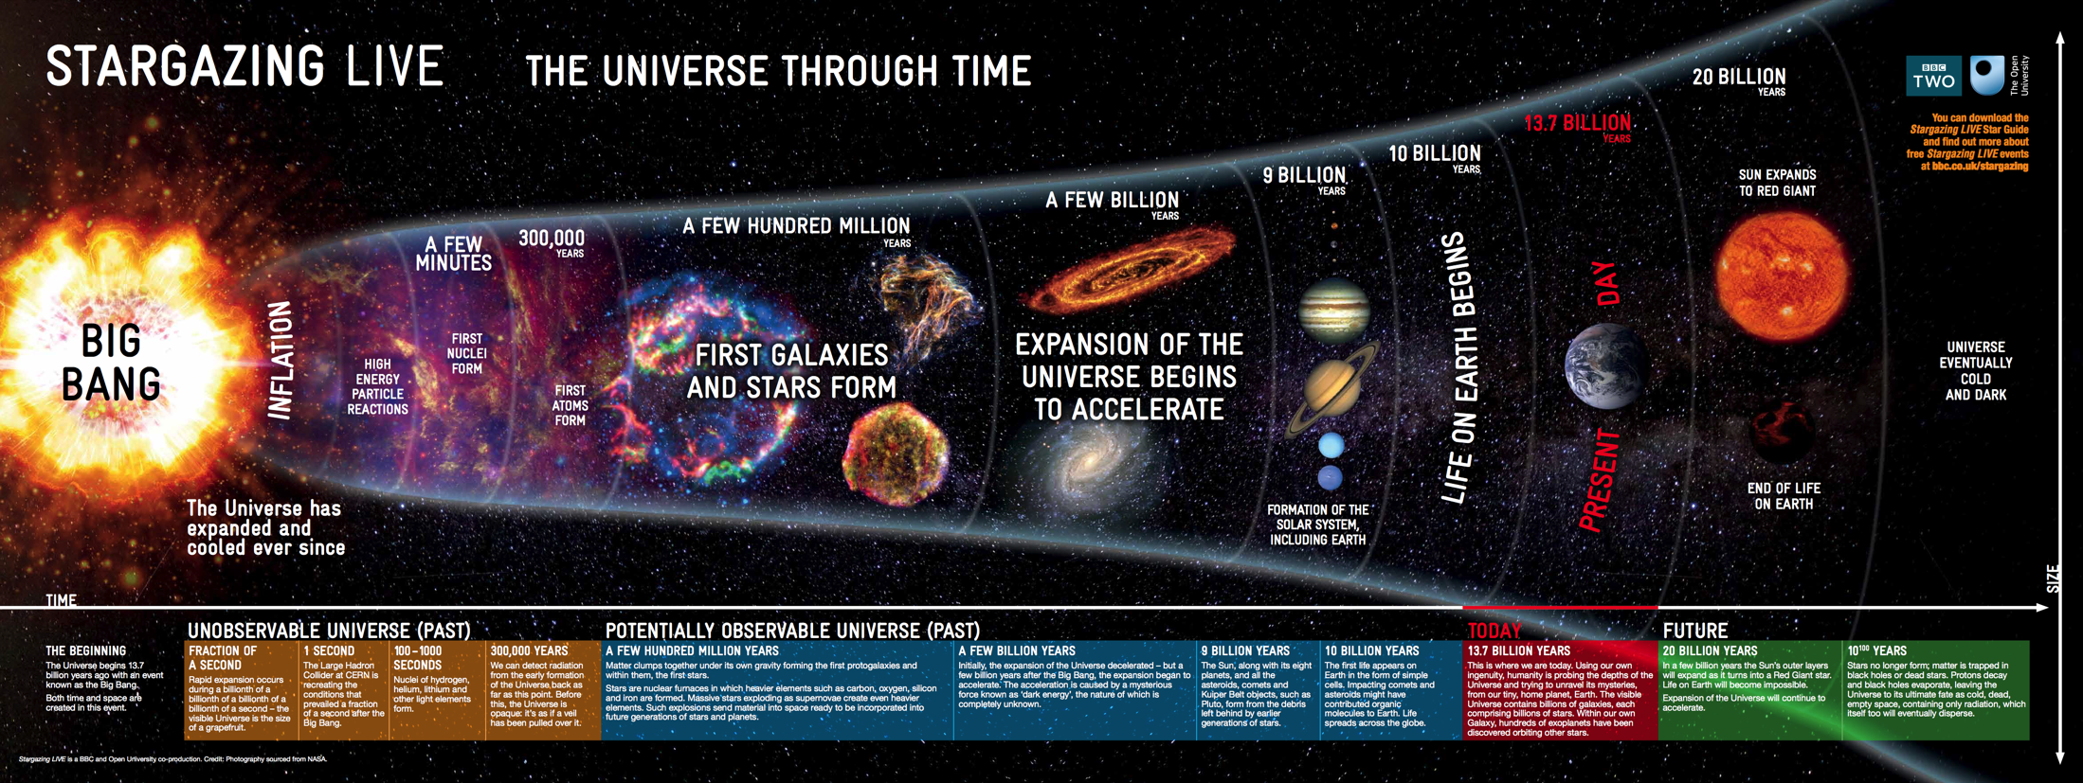
The Big Bang Model
Ref: Open University / BBC
Today, ~13.7 Billion years later

Slide 5
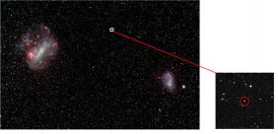

How Far Can Hubble See into the Past?
The oldest star observed, 13.2 Billon Years!
Speed of light
Correlation of distance vs redshift

Slide 6
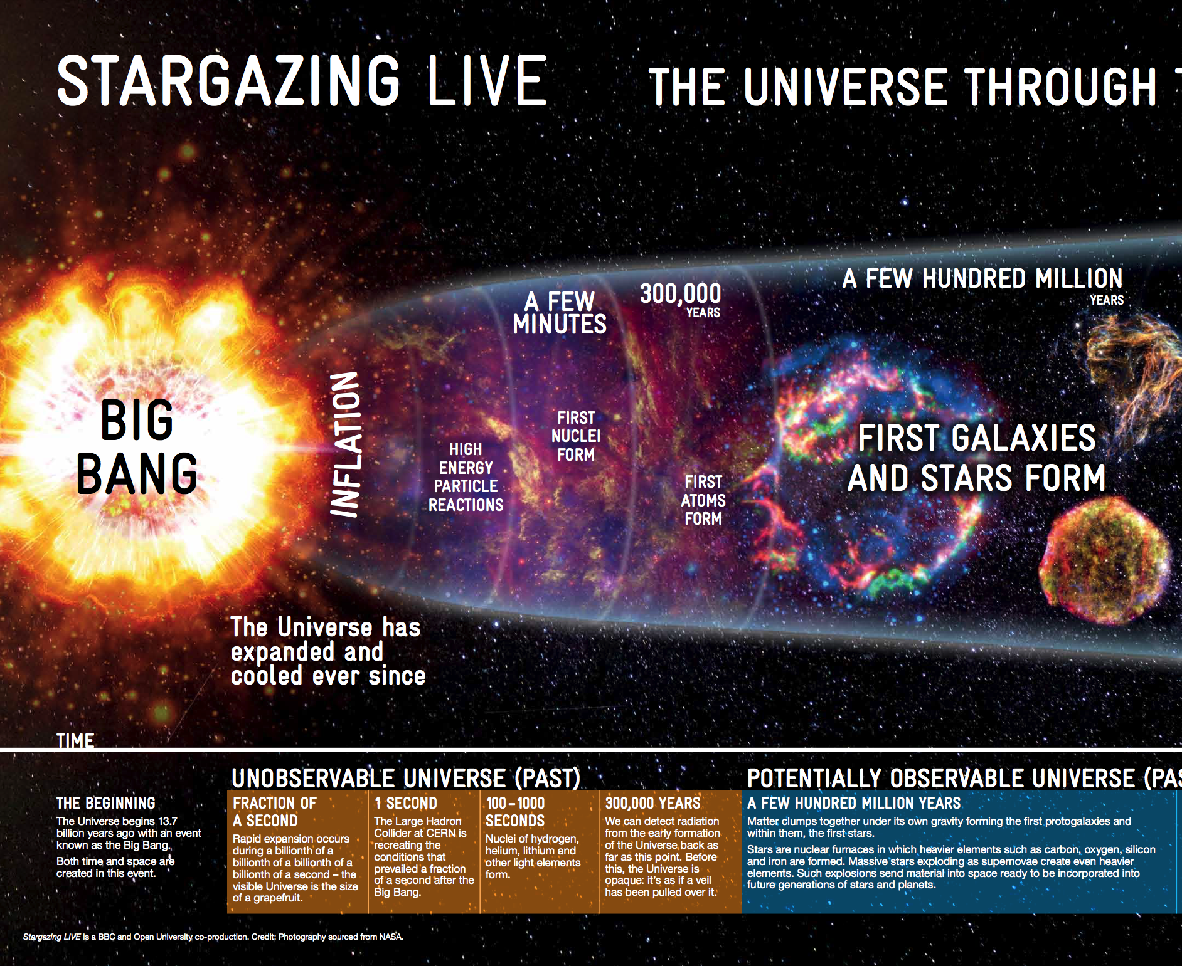
Unobservable Universe by Telescope
Consist of fundamental
particles

Slide 7
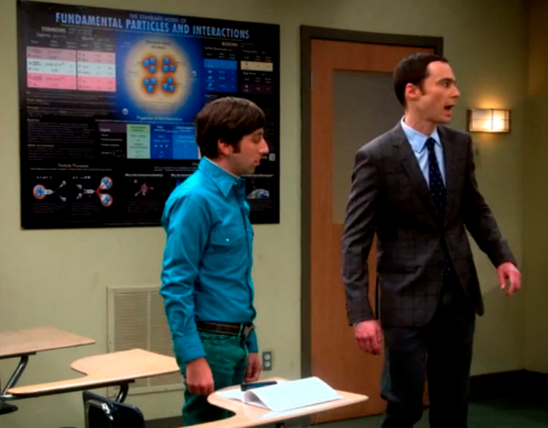
Some Basic Ideas and Concepts fundamental matter blocks and interactions
I know what to do
Fundamental particles and interactions
Scales of fundamental distance
Atom: ~1nm (10⁻⁸ m)
Nucleus: ~1fm (10⁻¹⁵ m)

Slide 8
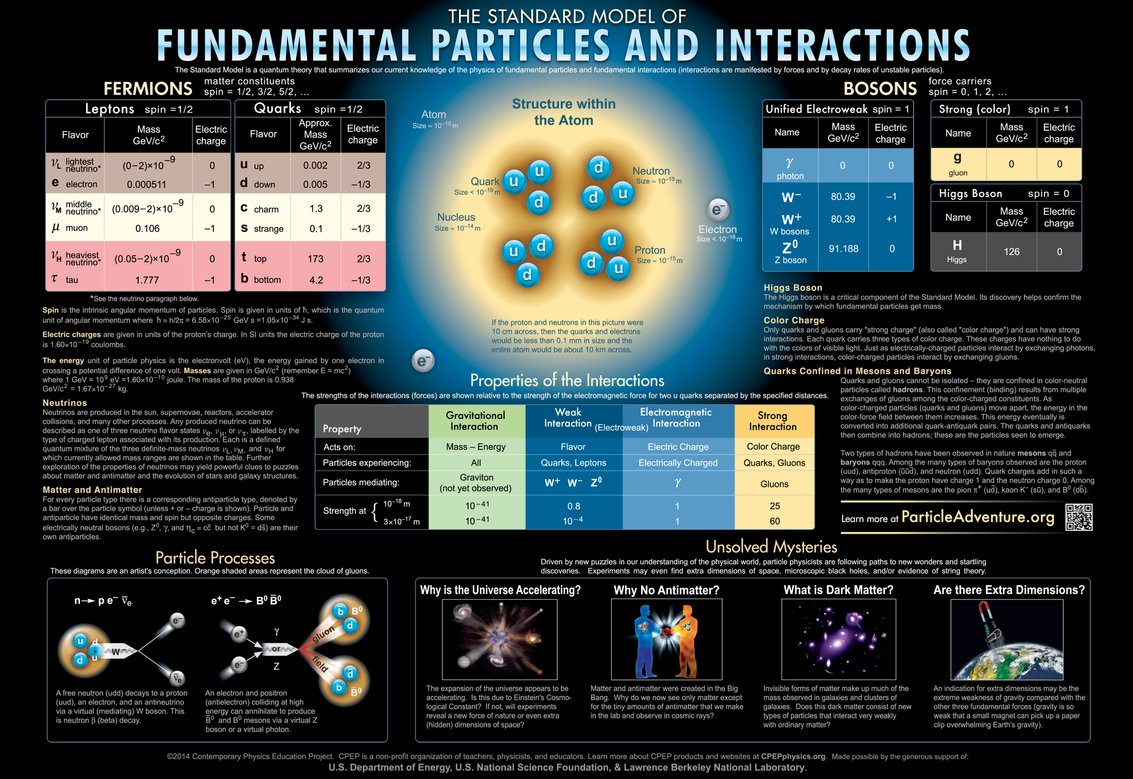

Slide 9
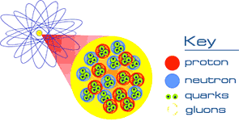
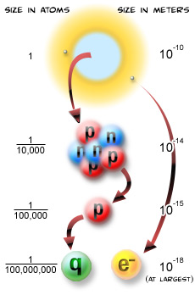
Fundamental Particles in the SM
Quarks
Gluons
Leptons
Photons
W, Z …

Slide 10
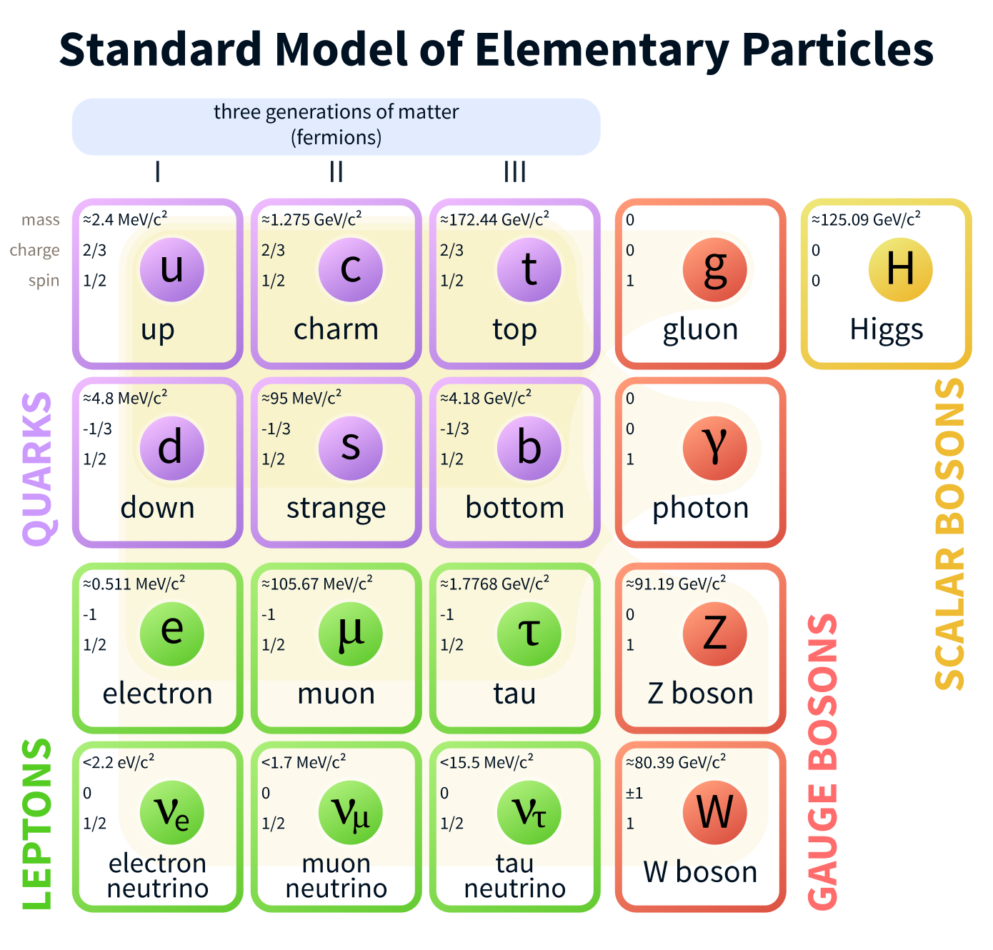
Most of our Universe
is made particles from the 1st group

Slide 11
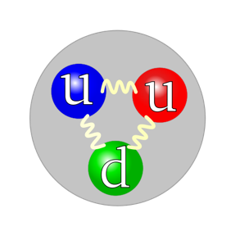
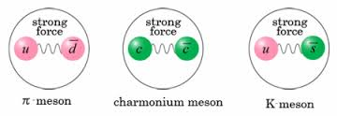
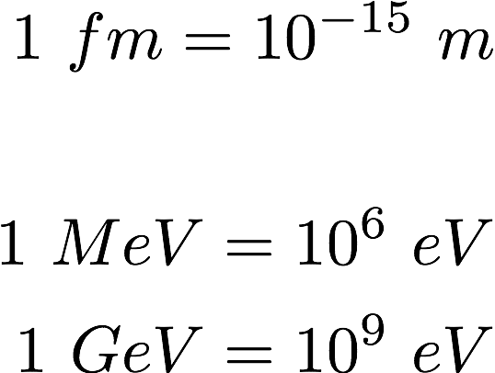
Examples of Subatomic Particles
Hadrons - strong interaction and electromagnetic force
  Made of 3 quarks
  Made of quark and anti-quark
Leptons – NO strong interaction, electromagnetic force
  Electrons
  Muons
  …
Proton mass = 1.67 x 10⁻²⁷ Kg
= 938 MeV
= 0.938 GeV
Radius = 0.87 x 10⁻¹⁵m
= 0.87 fm
Recent development: 4, 5+ quarks states claimed
Electron mass = 9.11 x 10⁻³¹ Kg
= 0.511 MeV
Radius < 10⁻¹⁸ m

Slide 12

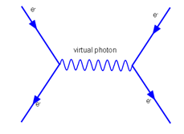
Force by Particle Exchange
Gauge Bosons: photon, W^{+/-},Z⁰,g
3 colors for strong interactions:
Red, Green, Blue

Slide 13
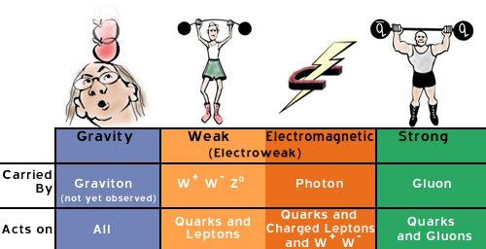
Interaction Strength of the 4 Forces
Nuclear force
Theory of the Strong Interaction:
QCD = Quantum Chromo Dynamics

Slide 14
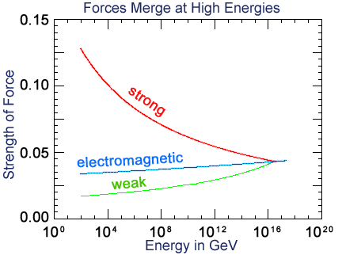
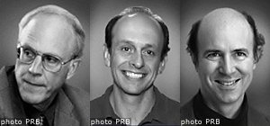
QCD Asymptotic Freedom and QGP in the Early Universe
D. Gross
H.D. Politzer
F. Wilczek
Nobel Prize 2004
Big Bang
QCD Asymptotic Freedom (1973)
"for the discovery of asymptotic freedom in the
theory of the strong interaction".
“In 1972 the early universe seemed hopelessly opaque…conditions of ultrahigh temperatures…produce a theoretically intractable mess. But asymptotic freedom renders ultrahigh temperatures friendly…”
Frank Wilczek, Nobel Lecture

Slide 15
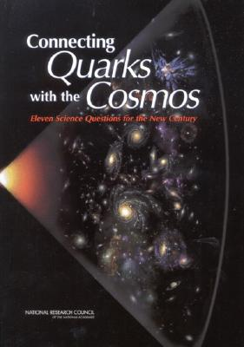
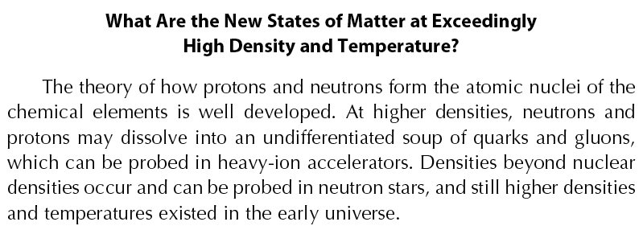
National Research Council Report (2003)
Eleven Science Questions for the New Century
Question #8:

Slide 16
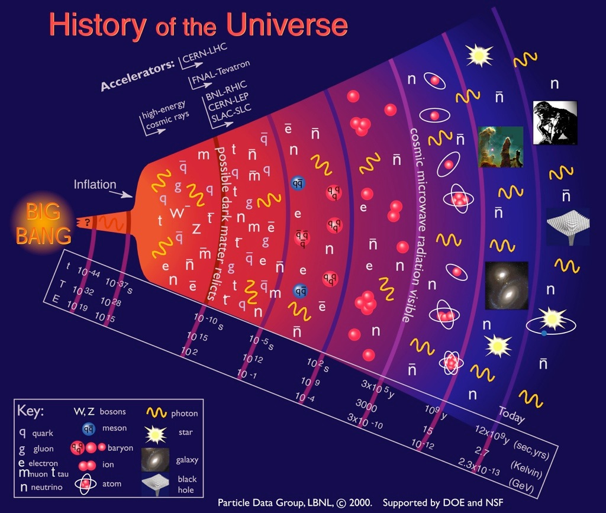
Fundamental particles and the evolution of the Universe
Quark-Gluon
Plasma (QGP)

Slide 17
Coffee Break

Slide 18
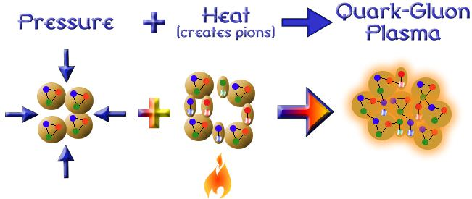
An Idea: Create Quark-Gluon Plasma in the Lab and Study the Evolution
Normal nuclear matter

Slide 19

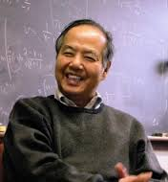
Our Approach: Heavy Ion Collision Creates a New State of Matter
Birth of Relativistic Heavy Ion Collider (RHIC) at BNL, 1983
T. D. Lee
Nobel Prize, 1957

Slide 20
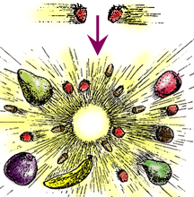
The Magic: E = mc²
Energy creates new matter

Slide 21
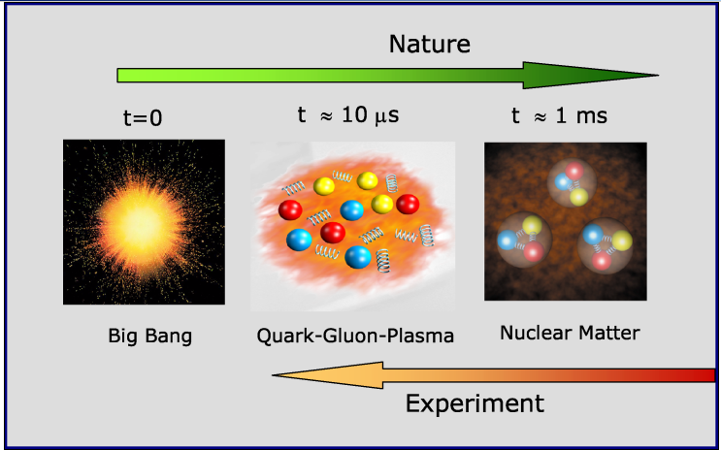
Recreate a state of the Early Universe: QGP

Slide 22
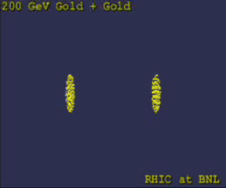
Computer Simulations: QGP at RHIC

Slide 23
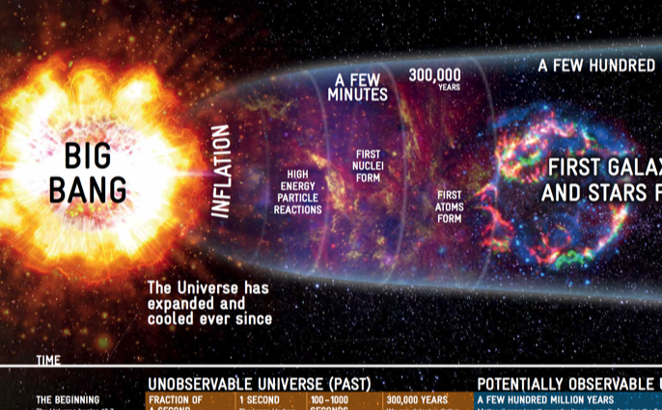

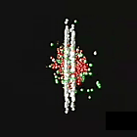
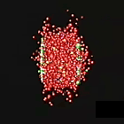
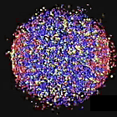
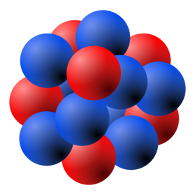


Heavy Ion Collisions
Artists’ View
¹⁹⁷Au
¹⁹⁷Au
About to collide
Ion collision
Quarks and gluons freed
QGP formed
Relativistic Lorentz Contraction:
At RHIC (LHC):
¹⁹⁷Au

Slide 24
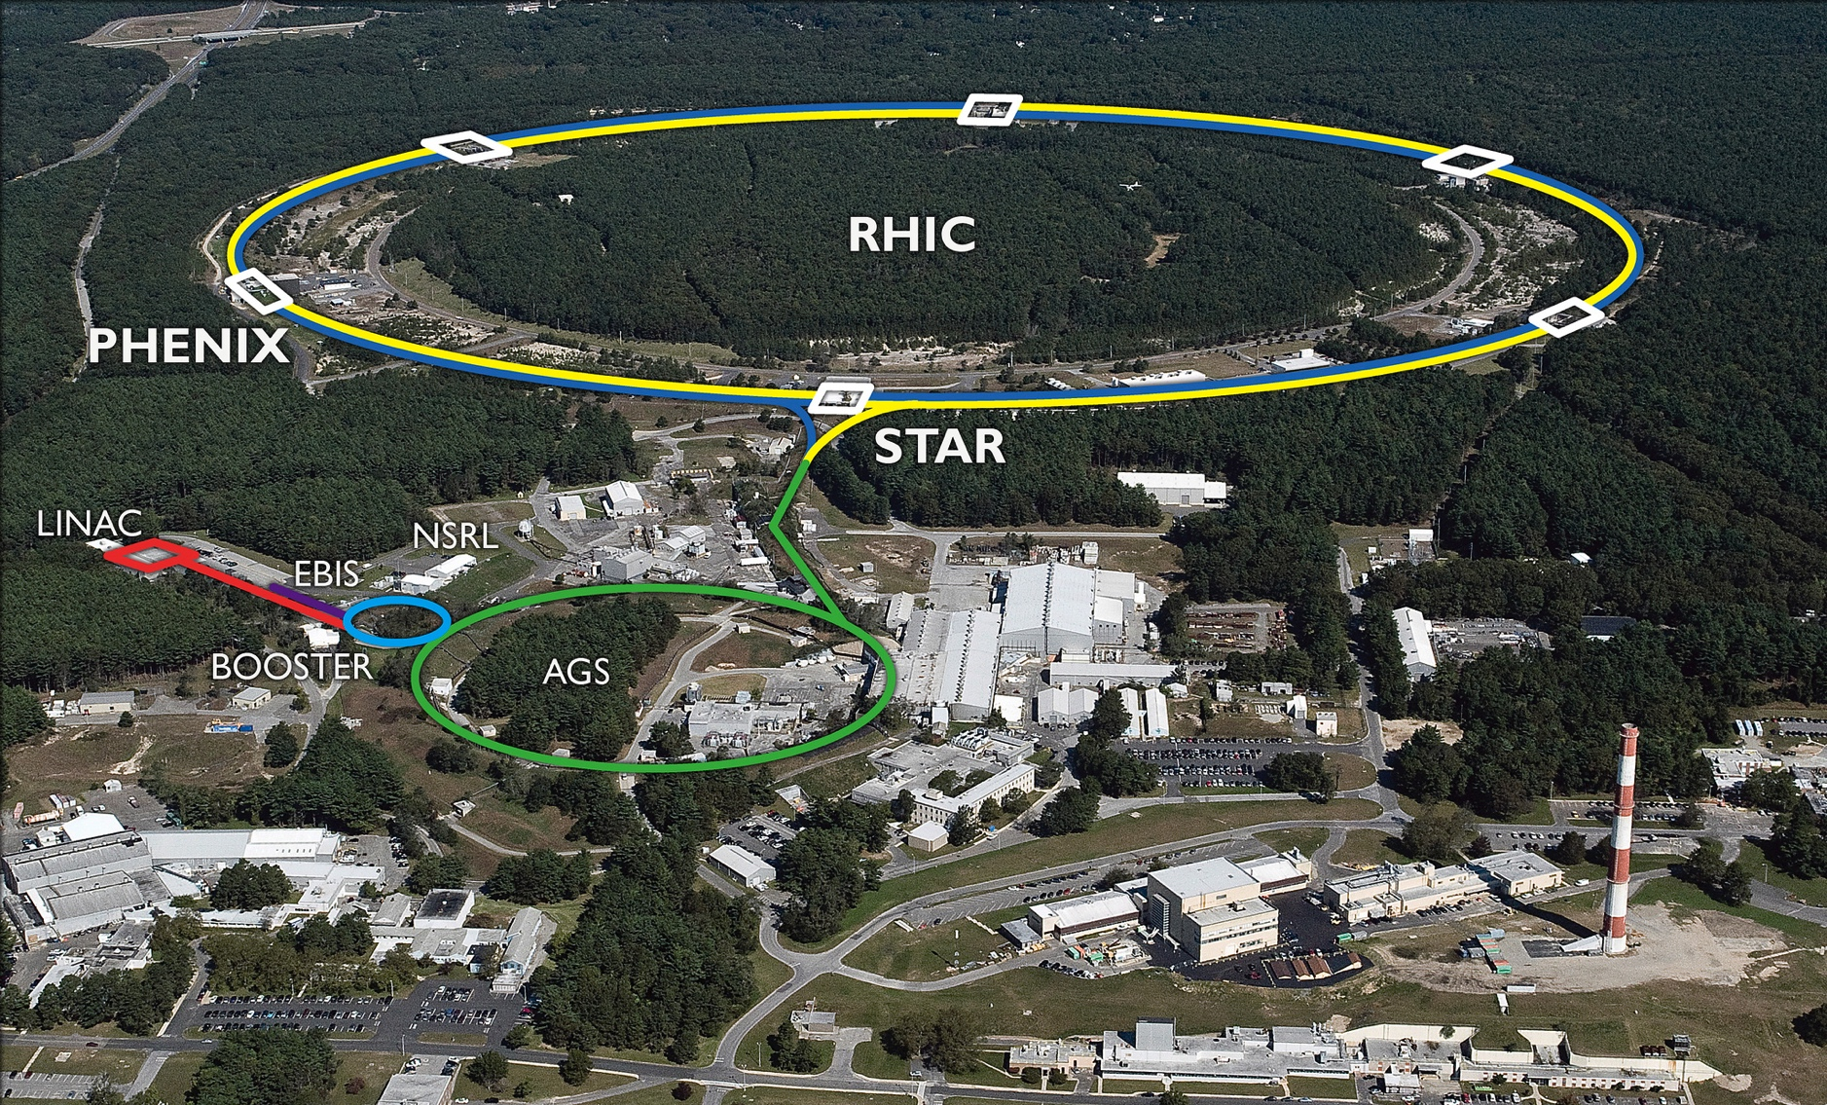

Relativistic Heavy Ion Collider
Brookhaven National Laboratory, Long Island, NY in operation since 2000
¹⁹⁷Au: E_total = 197 x 100 M_{p}
Au+Au collisions @200GeV Max.

Slide 25
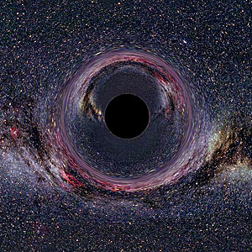
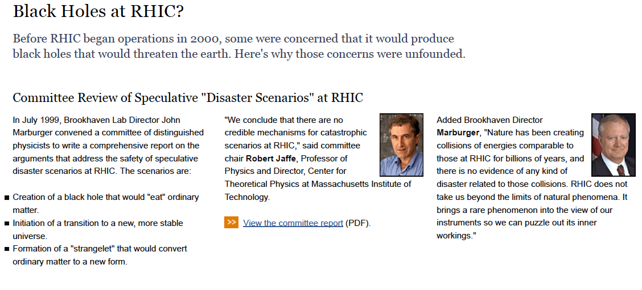
Black Holes at RHIC?
https://www.bnl.gov/rhic/docs/rhicreport.pdf

Slide 26
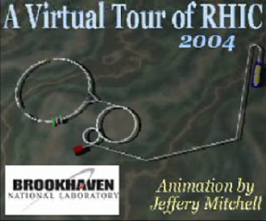

Slide 27
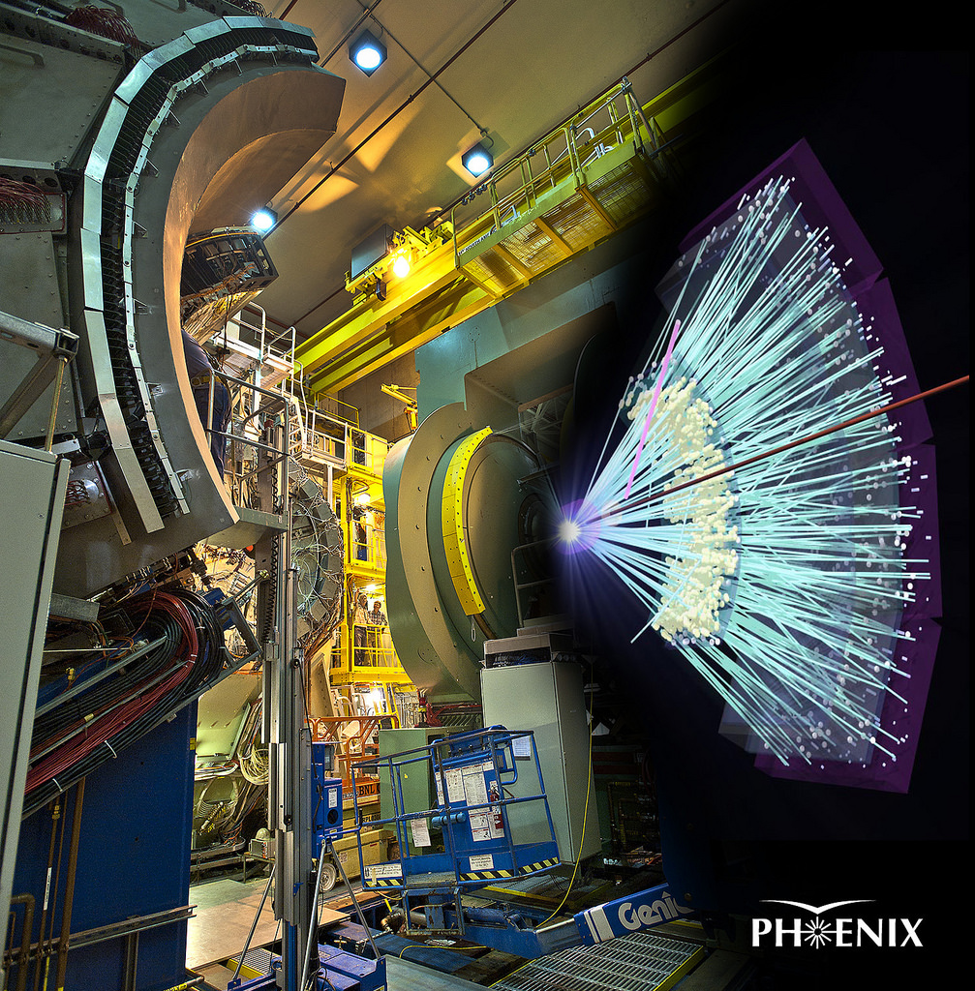
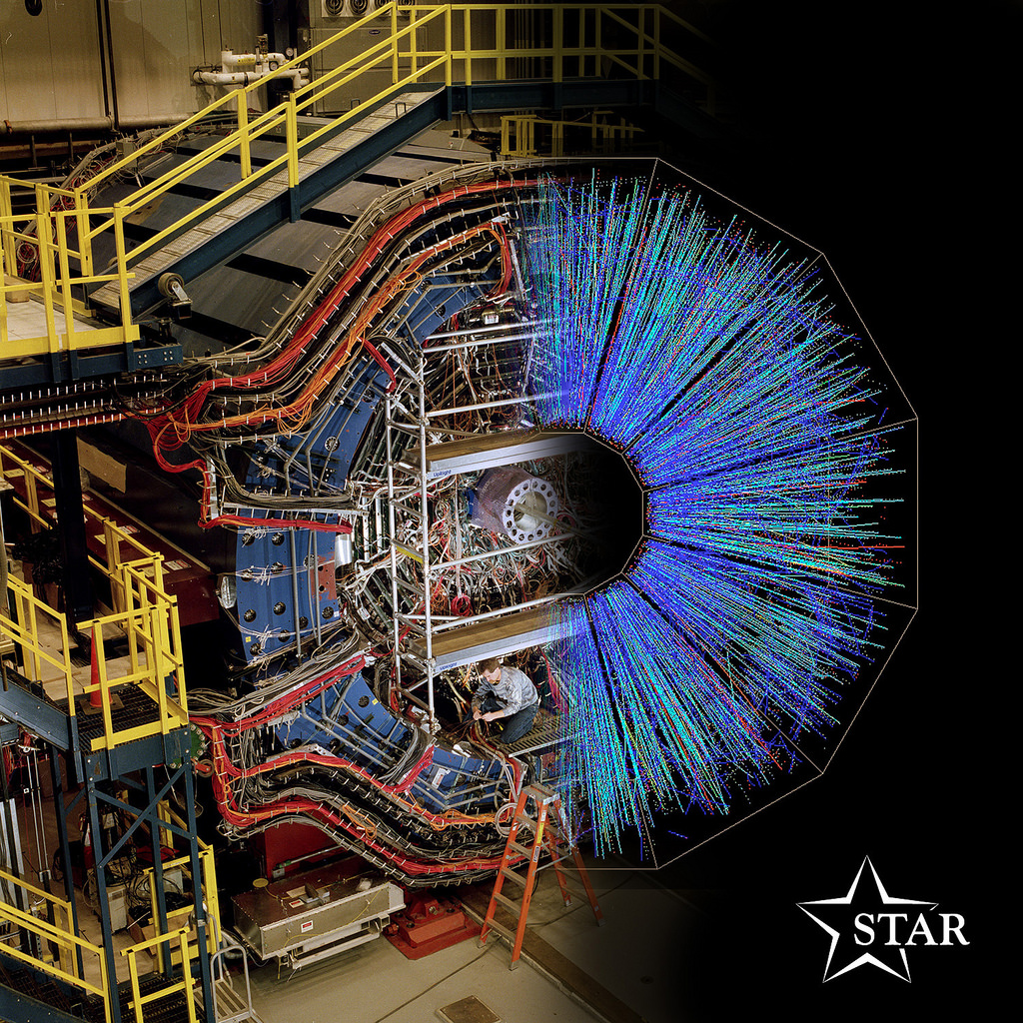
The Little Bang Realized at RHIC
QGP Created in Au+Au Collisions!

Slide 28
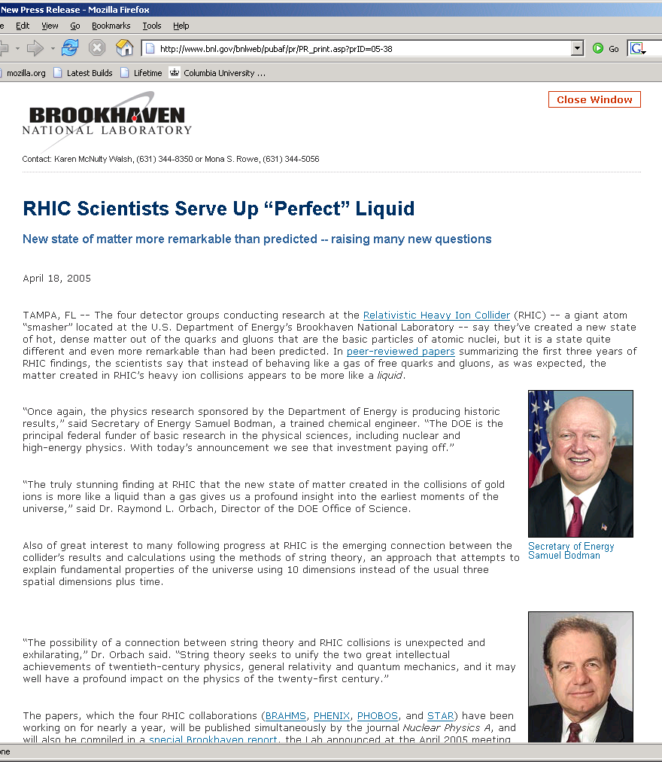
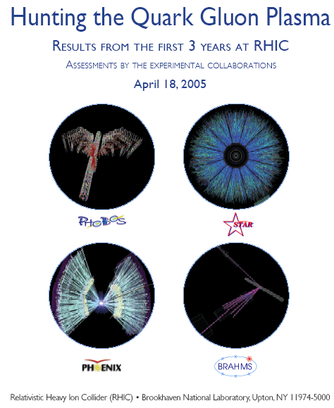
RHIC Success

Slide 29
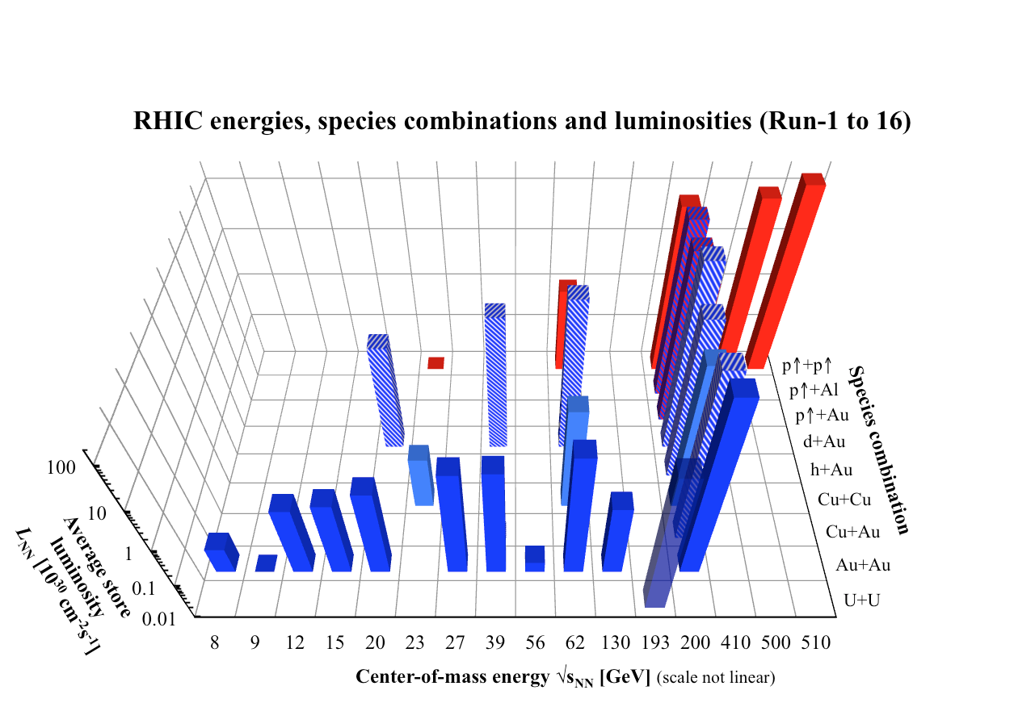
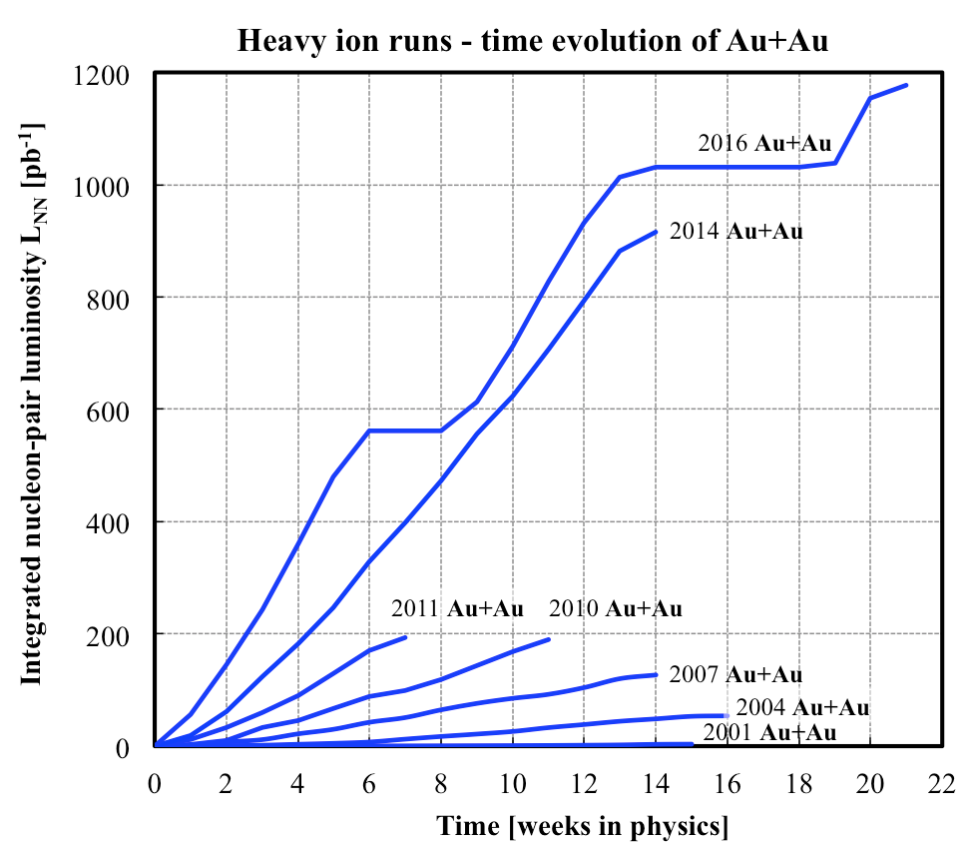
Very Rich Physics Program at RHIC
Operation: 2000 – 2020+

Slide 30
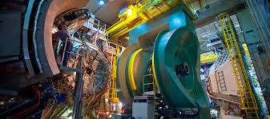
PHENIX Detectors at RHIC
Data taking: 2000-2016
A new detector “sPHENIX” under construction, physics 2023+
A large international collaboration, ~500 scientists from 13 countries

Slide 31
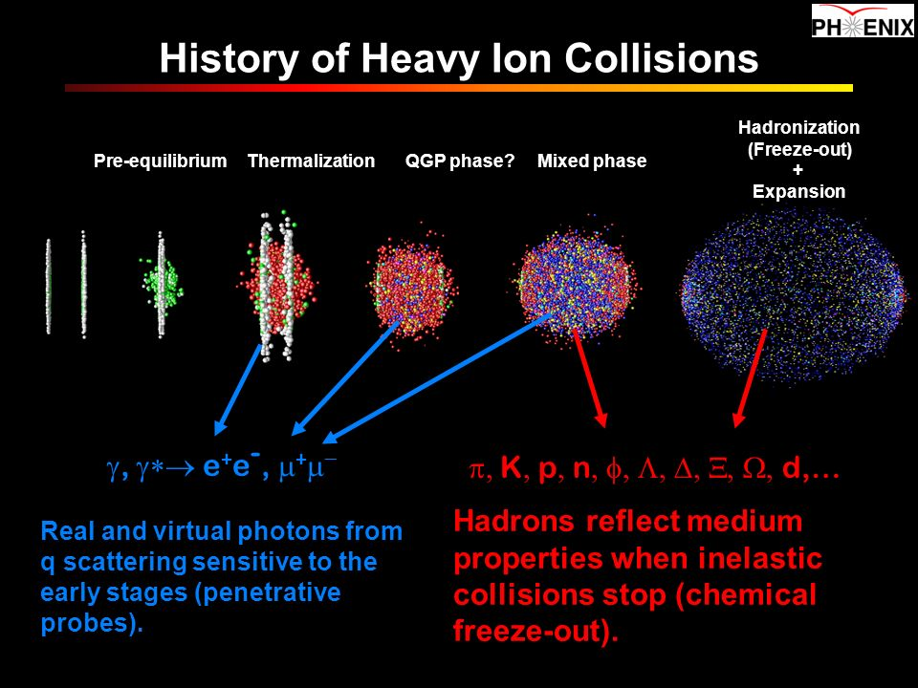
Particles Produced in Heavy Ion Collision

Slide 32
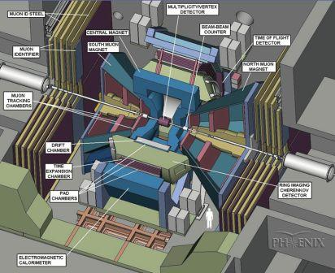
PHENIX: a State of the Art Particle Detector

Slide 33

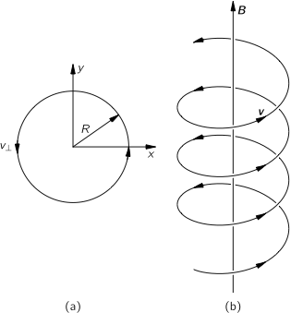
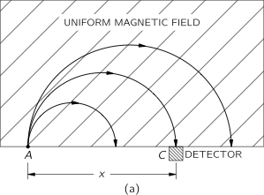
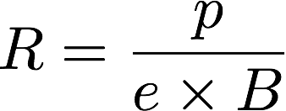

Tracking: Reconstruct and Measure High Energy Charged Particle Momentum

Slide 34
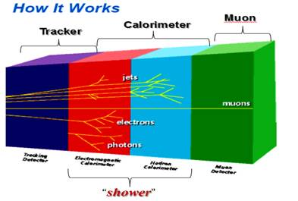
Calorimeter: Measure Particle’s Energy

Slide 35
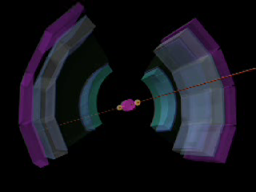
A Heavy Ion Collision inside the PHENIX

Slide 36
Day-2

Slide 37
Recreate a state of the Early Universe: QGP

Slide 38
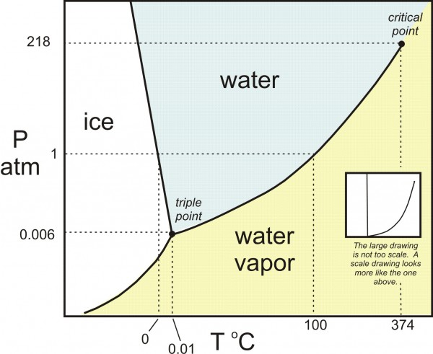
Study Matter Properties
Density
Temperature
Medium state
  Solid, liquid, gas, PLASMA ..
Other properties?

Slide 39
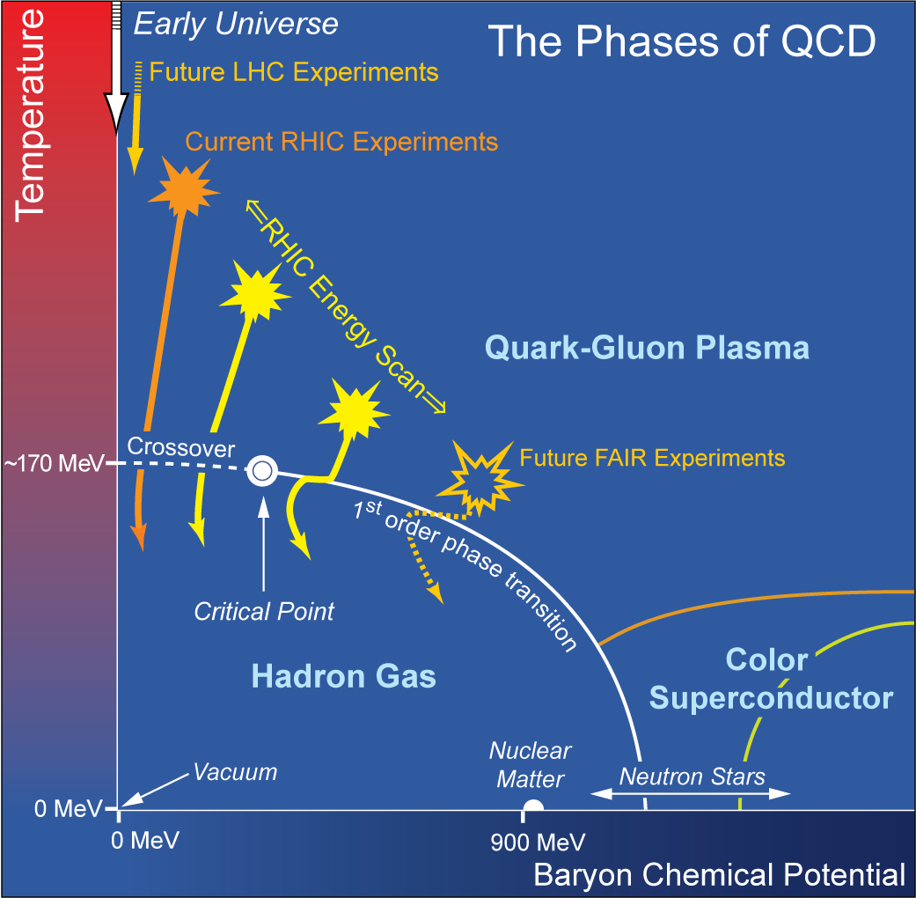
QCD Phase Diagram

Slide 40
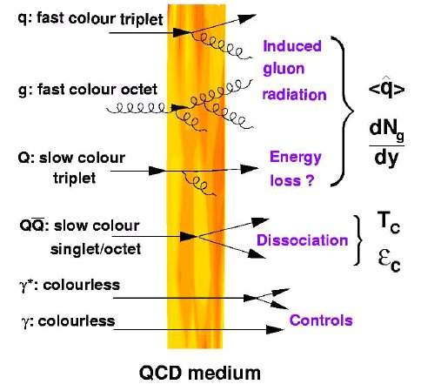

Topic-1: Probe the QGP Density with Jets
High density QGP medium created in
Heavy ion collisions:
~20x of normal nucleus

Slide 41


Nuclear Modification Factor: R_{AA}
AA
AA
If no “effects”:
R_{AA} = 1 at high-p_{T} where hard
scattering dominates
Suppression:
R_{AA} < 1 at high-p_{T}
AA

Slide 42



Jet Quenching Observed in QGP
QGP density > 10x normal nucleus

Slide 43


Topic-2: Is the QGP Hot?
QGP short lived in heavy ion collisions:
QGP lifetime ~ 10⁻²² sec.

Slide 44



A Text Book Example
Measure the Temperature of the Sun
Planck’s law of black-body radiation
The temperature of the Sun is determined
from fitting the spectrum of light emitted
T_{Sun} = 5,800 Kelvin

Slide 45

Electromagnetic Probes
(photon and lepton pairs)
e⁺
Photons and lepton pairs are cleanest probes of the dense matter formed at RHIC
These probes have little interaction with the matter so they carry information deep inside of the matter
  Temperature?
  Hadrons inside the matter
  Matter properties
e⁻
γ∗
γ

Slide 46





QGP: it is really HOT!
Direct photons
Di-electrons

Slide 47

Topic-3: Probe the Medium State

Slide 48


QGP Medium Behavior in non-Central Heavy Ion Collisions
Anisotropic flow

Slide 49

Quark Liquid!
baryons
mesons

Slide 50
Electromagnetic Plasma
Plasma is one of the four fundamental states of matter, and was first described by chemist Irving Langmuir^{[2]} in the 1920s.^{[3]} It consists of a gas of ions, atoms which have some of their orbital electrons removed, and free electrons. Plasma can be artificially generated by heating or subjecting a neutral gas to a strong electromagnetic field to the point where an ionized gaseous substance becomes increasingly electrically conductive, and long-range electromagnetic fields dominate the behaviour of the matter.
Plasma and ionized gases have properties and display behaviours unlike those of the other states

Slide 51


Examples of “Normal” Plasma

Slide 52


Debye Screening in Plasma

Slide 53


QGP “Color Charge” Screening
Plasma Debye Length:
The shorter the r_{D},
the stronger the screening
effects
Binding energy ~ a few 10² MeV, ~ QGP Temperatures

Slide 54

Quarkonia Productions in p+p at 200GeV
J/Psi -> di-muons

Slide 55

J/Psi Suppression Observed in Heavy Ion Collisions

Slide 56


QGP effects on Quarkonia
Regeneration – Compensating for Screening
larger gluon density at RHIC expected to give stronger suppression than SPS
but larger charm production at RHIC gives larger regeneration
forward rapidity lower than mid due to smaller open-charm density there
very sensitive to poorly known open-charm cross sections (FVTX will help here)
expect inherited flow from open charm
regeneration would be HUGE at the LHC!
Grandchamp, Rapp, Brown
PRL 92, 212301 (2004)
nucl-ex/0611020
Centrality (N_{part})
can the two compensating components (screening & regeneration) which may have diff. centrality dependences, give a flat forward/mid-rapidity R_{AA}?
Centrality (N_{part})

Slide 57





QGP Discovery @RHIC: 2004
QGP discovery announced in 2004 by RHIC experiments, confirmed later at LHC
Unambiguous evidence for phase transition from ordinary nuclear matter to QGP (T~175 MeV, ~10¹² degrees)
Exhibits strong collective behavior, has huge stopping power for color-charged particles (quarks, gluons – the fundamental constituents)
Fundamental discovery:
QGP is not a weakly interacting gas of quarks and gluons, but rather a strongly coupled near-perfect liquid!

Slide 58

QGP
QGP

Slide 59
Day-3

Slide 60


Why Antimatter ?
Why so few anti-matter?
Antimatter matters !

Slide 61


QGP and Anti-Matter
QGP: creates almost equal amount of particles and anti-particles …
anti-neutron, anti-proton …
Particles observed in Au+Au collisions at RHIC

Slide 62




Observation of the antimatter helium4 nucleus
nature
473, 353 (2011)

Slide 63

Anti-matter Particle Search

Slide 64


From alpha to anti-alpha
alpha = (ppnn)
1911 : Rutherford used α + gold to discover the nucleus;
2011 : RHIC used gold + gold to discover the anti-α.

Slide 65


Reduction Factor
Matter and anti-Matter Production @RHIC
Yield
473, 353 (2011)
Production rate reduces by a factor of 1.6x10³ (1.1x10³) for each additional antinucleon (nucleon) added to the antinucleus (nucleus).

Slide 66
Anti-Matter vs Matter Ratios

Slide 67
Global L hyperon polarization in nuclear collisions: evidence for the most vortical fluid
Nature, (2017)
arXiv:1701.06657
Lambda polarization:
J ~

Slide 68
Lambda Polarization in Au+Au Collisions

Slide 69





Dark Matter?
Galaxies’ rotation curve
Gravitational lensing (Hubble 2007)
F. Zwicky, ApJ 86 (1937) 217, V. Rubin et al, ApJ 238 (1980) 471
Planck: 2013
Notes:
It is widely accepted today that visible matter only account for 5% of matter and energy, with 25% dark matter .. With many compelling experimental obseravtions , how ever the nature of dark matter and dark energy remtain as the biggest scientific challenges for hunam being … sa they only interactio with SM particels very weakly .. Only shown in gravitaiton sectors ..

Slide 70

How Significant are the Results?

Slide 71
Dark Photon?

Slide 72

Outlook
Connecting Quarks with the Cosmos
Just start an exiting journey to understand the Biggest with the Smallest …

Slide 73

Enjoy Our Beautiful Universe!

Slide 75

“Dark Age” and the Universe
By NASA/WMAP Science Team - Original version: NASA; modified by Ryan Kaldari, Public Domain, https://commons.wikimedia.org/w/index.php?curid=11885244
Time in log scale

Slide 76
The Big Bang
Ref: Open University / BBC
Unobservable
Universe!
Being probed with telescopes
Dark Ages: 150-800 M Years
Today, ~13.7 Billion years later

Slide 77

“Telescopes”

Slide 78

A Collision Event

Slide 79


QM 1983 and RHIC
https://www.bnl.gov/rhic/news2/news.asp?a=6204&t=today
Recalling Quark Matter '83 and the Birth of RHIC

Slide 80


Au+Au Collision: Event Display
Beam View
Side View

Slide 81



