Slide 1
Dark Matter Search at Fermilab
Ming Liu
Aug 19 -23, 2019
Yonsei Lectures

Slide 2
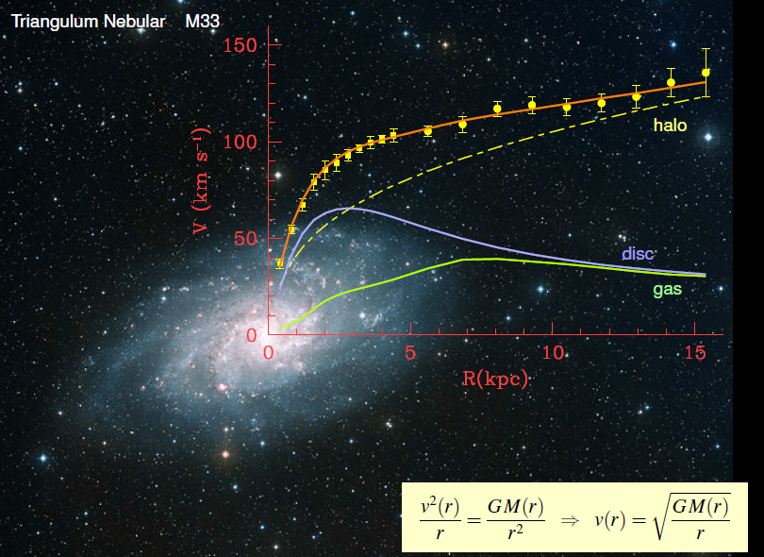
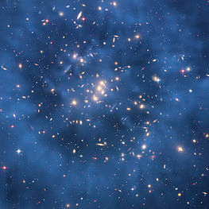
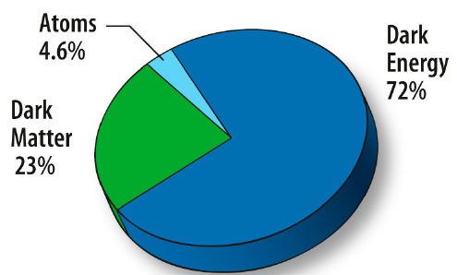
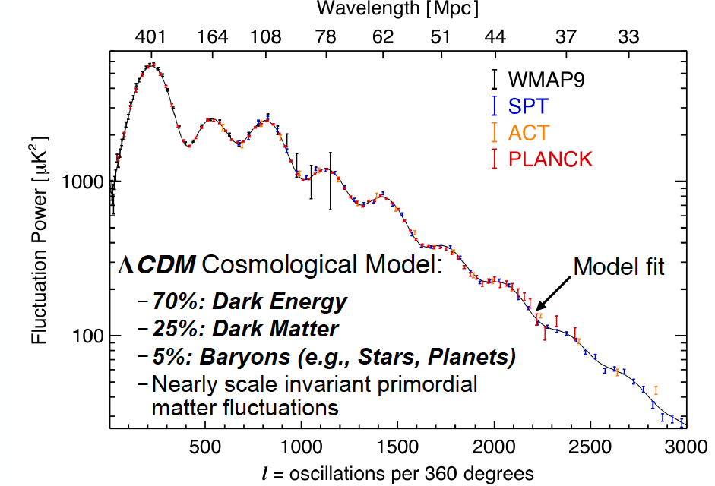
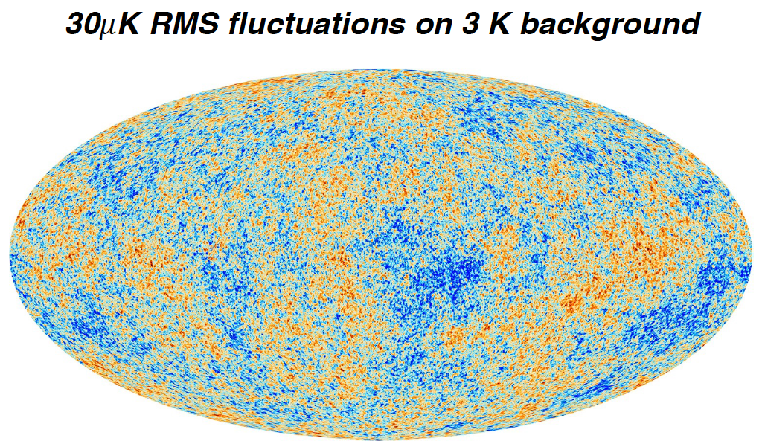
Dark Matter?
Galaxies’ rotation curve
Gravitational lensing (Hubble 2007)
F. Zwicky, ApJ 86 (1937) 217, V. Rubin et al, ApJ 238 (1980) 471
Planck: 2013
Benson’s talk @CIPANP 2015
6/22/15
2
Notes:
It is widely accepted today that visible matter only account for 5% of matter and energy, with 25% dark matter ..
2

Slide 3
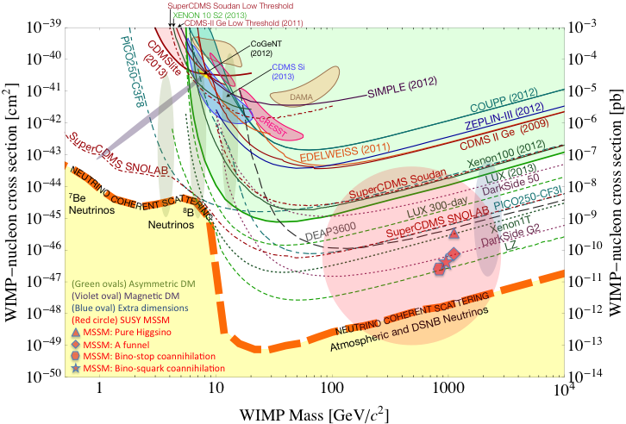
What Are the Dark Particles?
WIMP being excluded?
Recent anomalies observed by satellite and terrestrial experiments have motivated dark matter models introducing a new dark sector
“Sub-GeV” low mass weakly-interacting dark particles become very interesting!
Mass: O(MeV ~ GeV)
In particular, high-intensity colliders (B-factories) and fixed target experiments (Fermilab, JLab, LHC) offer an ideal environment to probe these new ideas.
Montgomery’s talk at CIPANP2015
“a vision of nuclear and particle physics”
- Imaginable space for these experiments is rapidly disappearing
- the “natural” theory space is also disappearing.
- I like to think that Dark Matter is on solid ground, maybe not!!!
6/22/15
3
Notes:
What are the DM? WIMP is considered one of the primary candidates of DM …
3

Slide 4
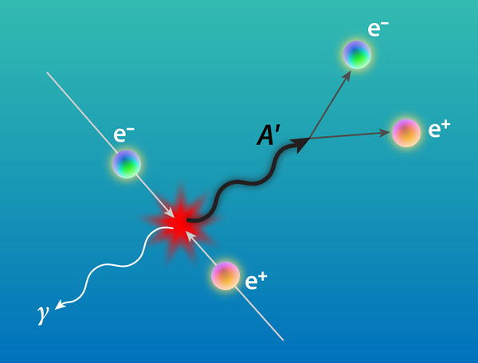




Accelerator Based Direct Search for Dark Photons
B-factories, RHIC, LHC, Jlab, BES-III etc
B. Holdom, Phys. Lett. B 166 (1986) 196
J. D. Bjorken et al, arXiv:0906.0580
l
A’
“Kinetic Mixing”
l
7/22/15
4

Slide 5
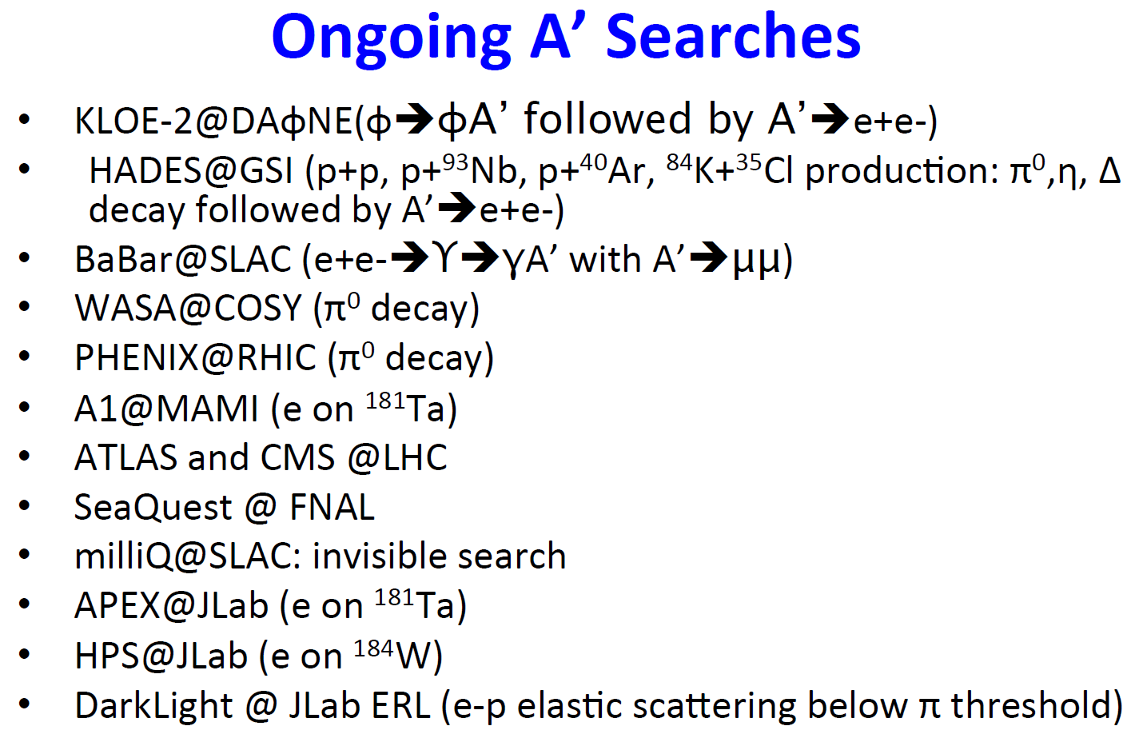
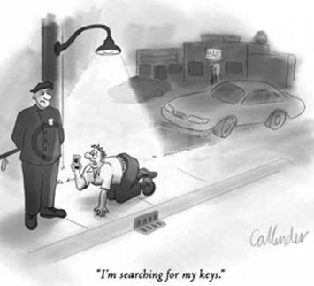
Very Active Field
Courtesy: R. Milner at the Fundamental Interactions Town Meeting, Chicago, Sept. 28-29, 2014
7/22/15

Slide 6
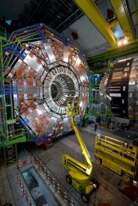
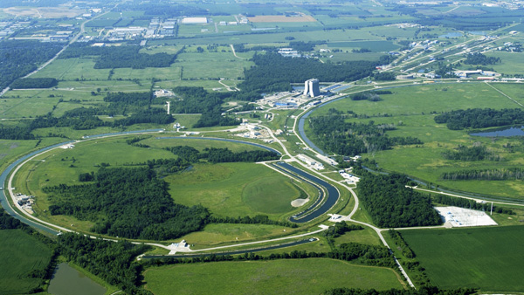
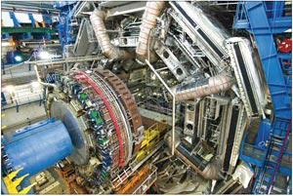
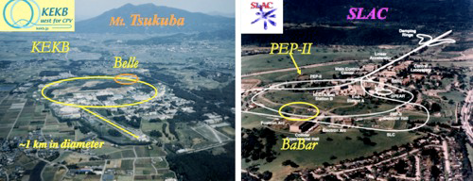
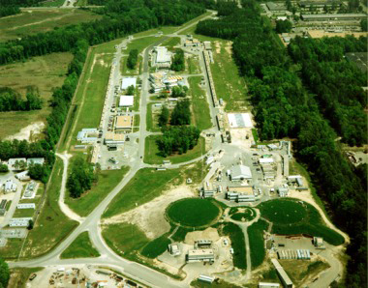
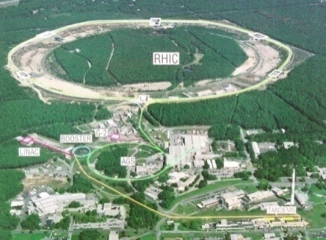
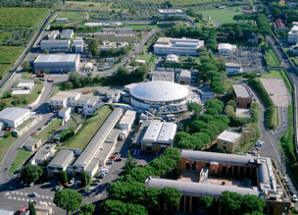
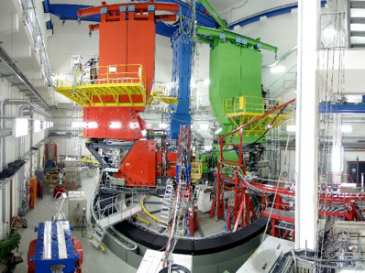
The search is on …
7/22/15
Ming Liu, A New Dark Photon/Higgs Search @Fermilab
6

Slide 7
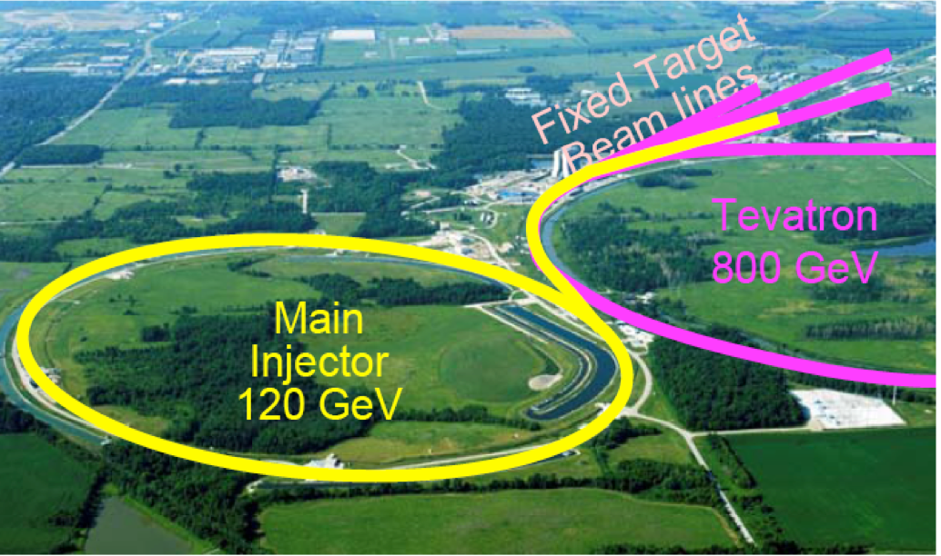
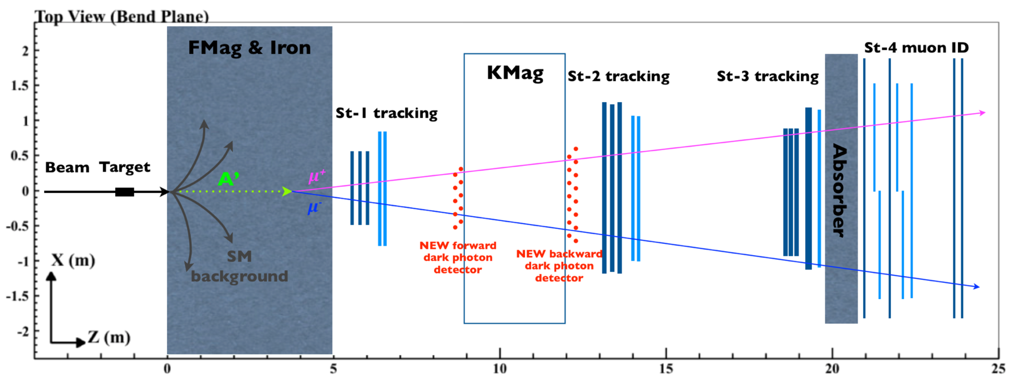
A Direct Search for Dark Photon and Dark Higgs Particles with the SeaQuest Spectrometer in Beam Dump Mode
at Fermilab
E-1067/DarkQuest Collaboration

Slide 8

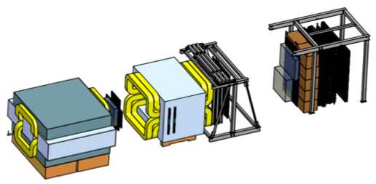
Intensity Frontier at Fermilab: 120 GeV Beam
World’s highest intensity high energy proton beam:
“beam dump mode” @SeaQuest/E906
35,000 fb⁻¹ (in 2 years of parasitic runs)
LHC-II: 300 fb⁻¹ (~2025), achieved 25fb⁻¹ in Run-I
B-factory@KEK: 50,000 fb⁻¹ (~2023)
Absorber wall and proportional
tube based Muon ID
Spectrometer magnet
Δpt = 0.4 GeV
Focusing magnet
and solid iron dump
Δpt = 2.9 GeV
Beam
120 GeV proton from Main Injector
19ns RF, 4s spill, 0.5×10¹³ protons per spill
25 m
Target system
Liquid H and D
Solid C, Fe, W
- Capture most beam in beam dump mode: p+Fe collisions!
- Parasitic run mode possible with other experiments, E1039/E1027
6/22/15
8

Slide 9
Direct Productions of Dark Photons and Dark Higgs in p+Fe at Fermilab
Photon portal: “vector”
Higgs portal: “scalar”
θ = μ v/m_{h}²
6/22/15
9

Slide 10
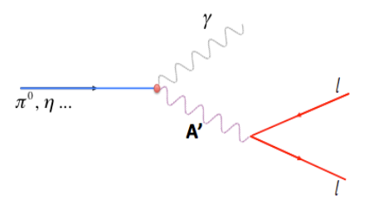
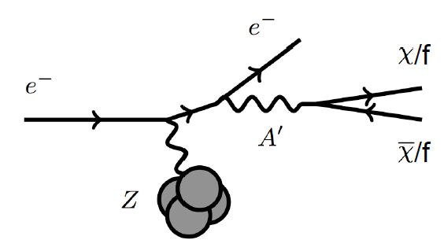
Dark Photon Search in Dimuon Channel
at SeaQuest in Beam Dump Mode (p+Fe)
Drell-Yan like
π⁰, η, … decay
Bremsstrahlung
(DM)
MiniBooNE
Beam-dump
(DM)
p
l⁺
p
l⁻
6/22/15
10

Slide 11
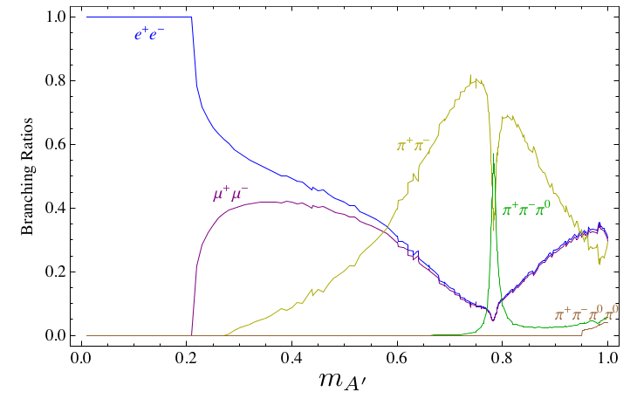
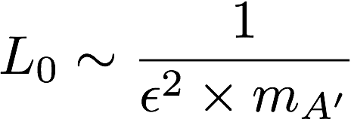
Dark Photon Decay Modes
“Minimal” Decay:
Dark photon is the lightest in the dark sector;
  SM final state particles only
Long proper decay length: L₀ ~ O(1m)
D. Curtin, et al, arXiv: 1312.4992
“General” Decay:
Decay into other dark particles,
dominant channel if allowed
  Dark -> Dark
  Dark -> SM particles
(GeV)
6/22/15
11

Slide 12
Experimental Measurements
Dark photon trigger upgrade
  A new trigger for events with displaced down-stream dimuons
Unique signals
  Displaced dimuon decay vertex for long-lived particles
  Invariant mass peak in dimuon mass spectrum
Beam time
  Run parasitically with E1039 (2017-2019)
-- 2.5%
-- 6.0%
Dimuon mass resolution
6/22/15
Dark Photons & Dark Higgs Search @Fermilab
12
Z (meter)

Slide 13
A New High-Granularity Displayed Dimuon Vertex Trigger
High rejection power, very low rate, << 1 kHz(E906 DAQ limit)
Y-Plane Trigger:
A quadrant panel: 40 x 40 cm², 1cm thinck
  40 x 1cm x 40 cm scintillating strips, SiPM readout
- Straight line projection, 30cm Z-vertex resolution
- Displaced z-vertex, mostly low mass < 3GeV
Coincident with St-4 Hodos(muons)
Quadrant-based triggers: 4 x V1495
Y-channels per quadrant:
- 1x V1495
40(St1) + 40(St2) + 8x2 (St4-Y1,2) = 96
96+64 = 160 possible
  72+72+16 = 160 (possible)
  (2NIM=RFCLK+ComSTOP )
St1
St2
Z
Coincident Z-vtx
window matched@L2
E906 Run2
E906 Run2
Dimuon Z-vertex (cm)
6/22/15
13

Slide 14
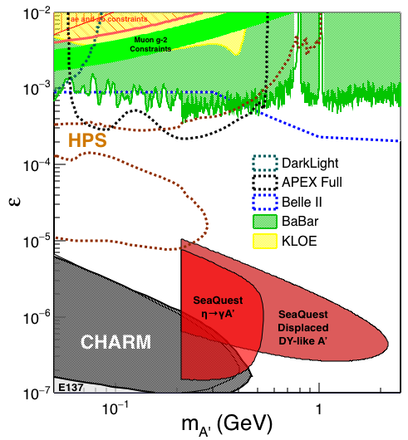
Search Mode (1): Long-lived Dark Photons
Reconstructed dimuons with downstream Z-vertex:
3m < Z-vertex < 6m
Low trigger rate, << 1kHz
SM background free
Dimuon mass peak
- 5x10¹² ppp ( current E906)
200 days
1.4 x 10¹⁸ POT (recorded)
4 events contours (2-sigma)
2-sigma (95%) exclusion plots
Excellent coverage of uncharted region!
6/22/15
14

Slide 15


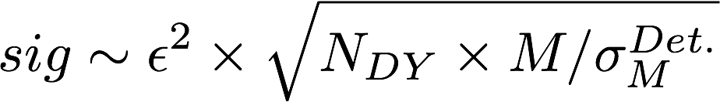
Search Mode (2): “Prompt” Dark Photons vs Drell-Yan
Z-vertx < 3m
Expected Drell-Yan like signal and backgrounds:
Excluded phi
resonance region
Dark photon
signal
Drell-Yan Background
Work in progress
Further optimization possible
6/22/15
15

Slide 16
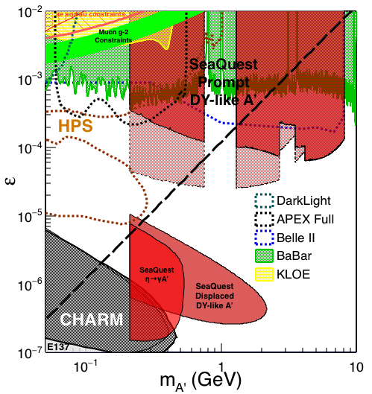
Dark Photon Sensitivity: Summary
POT:1.4x10¹⁸ (parasitic w/ E1039)
Signals considered:
Drell-Yan like
Eta decays
Bremsstralung
Covers a wide range of unexplored parameter phase space
Displaced dimuons
- Minimal SM background
Prompt dimuons
- Excellent coverage over BELLE-II
projection
- Possible dedicated runs later to fully
restore mass < 3GeV (Phase-II)
Phase-II with upgrades
Access below 200MeV with di-electrons
( add EMCal)
(2017?)
(2016?)
(~2023)
6/22/15
16

Slide 17
Dark Higgs Search at SeaQuest
Y. Zhang et al, arXiv:1502.06983
θ = μ v/m_{h}²
D. Curtin et al arXiv:1312.4992
e⁺e⁻
Phase-I:
High-mass: μ⁺μ⁻ and hadrons
Advantage of using hadron beams
with muon probes over electrons
Phase-II:
Low-mass: e⁺e⁻, <200MeV possible
μ⁺μ⁻
6/22/15
17

Slide 18
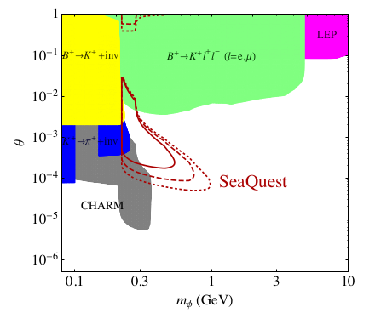
SeaQuest Dark Higgs Sensitivity
POT:1.4x10¹⁸ (Phase-I)
Dimuons with downstream displaced decay vertices
Limited sensitivity to “prompt” large mixing case due to small cross-section
Dark Higgs or dark photons?
  Dimuon kinematic and angular distributions
Phase-II
  Dedicated high luminosity runs optimized for low mass acceptance, mass<3GeV
Y. Zhang (2015)
6/22/15
18

Slide 19
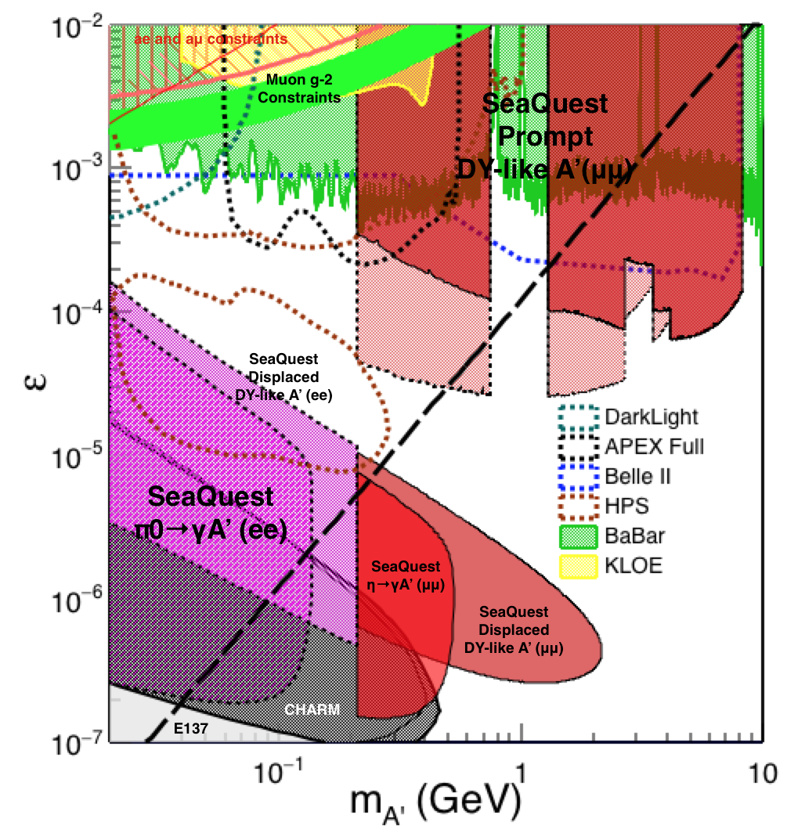
Phase-II: Full Coverage (2020+)
with future detector “EMCal/HCal” upgrades
Projection: POT 1.4 x 10¹⁸
Detector upgrades
  EMCal: e^{+/-}
  HCal: π^{+/-}
  Recycle from other experiments, RHIC/JLab etc.
DAQ upgrade
  100 kHz
Timeline of dedicated runs
  2019+
Detector configuration
  Access low mass region with optimized Fmag settting
6/22/15
19

Slide 20
Summary and Outlook
Phase-I (2017-2019+)
  Great discovery potential!
  Add a new displayed vertex trigger
  Early parasitic data taking 2017-2019+
  POT 1.4 x10¹⁸
Phase-II (2020+)
  Possible detector upgrade later, add electrons and hadrons
  A new dedicated dark matter program at Intensity Frontier!
Dark Higgs
sarch
Preparation Phase-I (parasitic runs)
Phase-II
2015
2016
2017
2018
2019
2020+
6/22/15
20

Slide 21
A latest reference:
https://arxiv.org/abs/1908.07525
The High-Energy Frontier of the Intensity Frontier: Closing the Dark Photon, Inelastic Dark Matter, and Muon g-2 Windows
Yu-Dai Tsai, Patrick deNiverville, Ming Xiong Liu
(Submitted on 20 Aug 2019)
We study hidden sector and long-lived particles at past (CHARM and NuCal), present (NA62 and SeaQuest/DarkQuest), and future (LongQuest) experiments that are at the high-energy frontier of the intensity frontier. We focus on exploring the minimal vector portal and variere-lifetime particles (VLP). VLP models have mostly been devised to explain experimental anomalies while avoiding existing constraints, and we demonstrate that proton fixed-target experiments provide one of the most powerful probes for the sub-GeV to few GeV mass range of the VLP models, using inelastic dark matter (iDM) as an example. We consider an iDM model with small mass splitting that yields the observed dark matter (DM) relic abundance, and a scenario with a sizable mass splitting that can also explain the muon g−2 anomaly. We set strong limits based on the CHARM and NuCal experiments, which come close to excluding iDM as full-abundance thermal DM candidates in the MeV to GeV mass range, for the mass arrangements and small mass splittings we consider. We also study the future projections based on NA62 and SeaQuest/DarkQuest, and update the constraints of the minimal dark photon parameter space. We found that NuCal sets the only existing constraint in ϵ∼10−8−10−4 regime reaching ∼ 800 MeV in dark photon mass due to the resonant enhancement of the proton bremsstrahlung production. Finally, we propose LongQuest, a three-stage thorough retool of the SeaQuest experiment with short (≲ 5 m), medium (∼ 5 m), and long baseline (≳ 35 m) tracking stations/detectors, as a multi-purpose machine to explore dark sector particles with a wide range of couplings to the standard model sector.

Slide 22
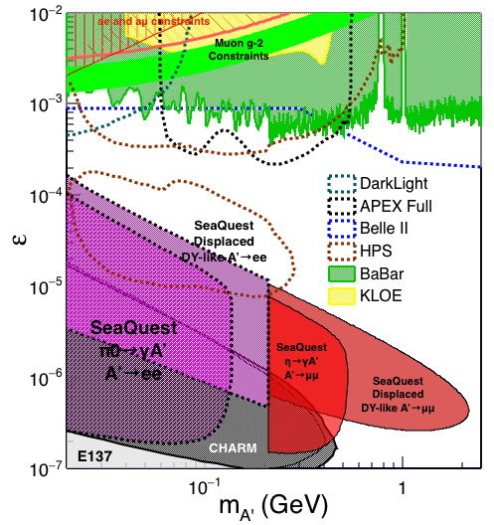
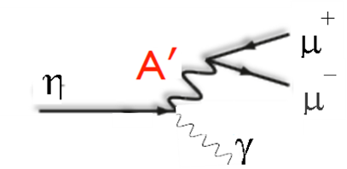
Phase-II: Access Low Mass Region with e⁺e⁻
with future detector “EMCal” upgrades
S. Gardner, R. Holt et al
6/22/15
Dark Photons & Dark Higgs Search @Fermilab
22

