Slide 1
Feynman Diagram Challenge

Slide 2
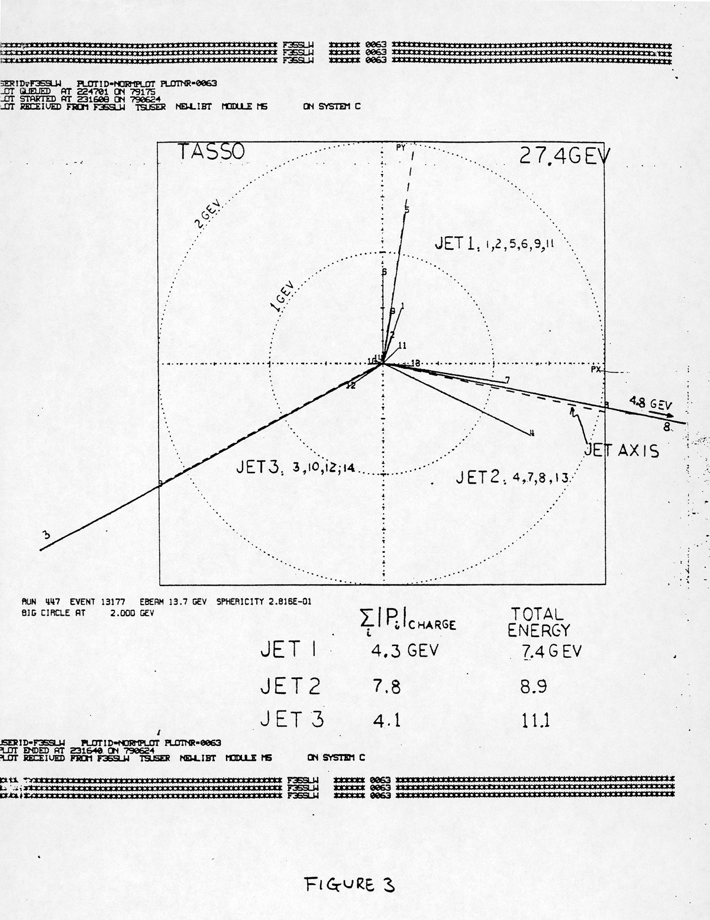
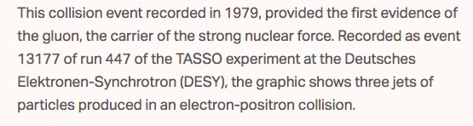
Discovery of the Gluon
First observed 3-jet event, Center of Mass Energy = 27.4GeV

Slide 3
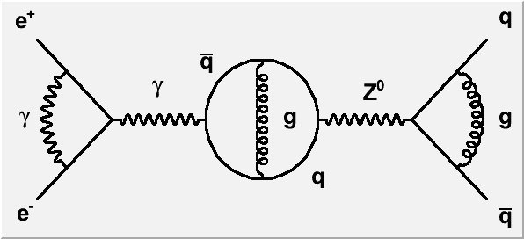

Slide 4
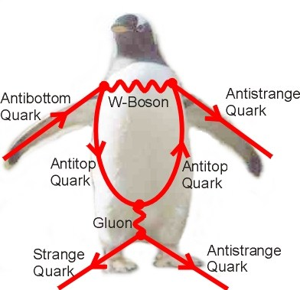
Feynman Diagram Challenge

Slide 5
The Proton & Neutron Structure and Novel QCD Phenomena
Ming Liu
Aug. 19-23, 2019

Slide 7
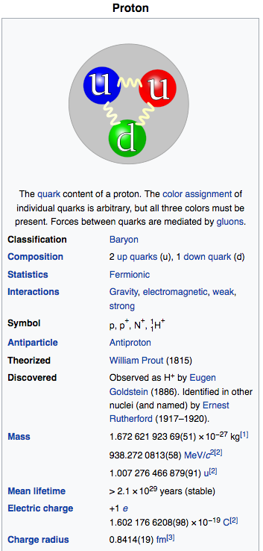
What Do We Know about the Proton and the Neutron?
P: uud
N: udd
https://en.wikipedia.org/wiki/Proton

Slide 8
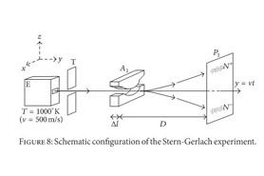
1943 Nobel Prize: Otto Stern
… for his discovery of the magnetic moment of the proton
  (Stern‐Gerlach Experiment)
For a point particle:
Measured:

Slide 9
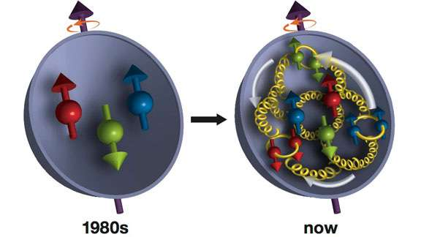
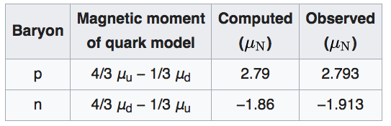
The Proton Spin and Quarks
Proton is NOT a point particle,
  2 up-quark, pointing up
  1 down-quark, pointing down
Mass_up = 1/3 Mass_proton
Mass_down = 1/3 Mass_proton

Slide 10
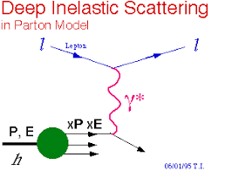
1990 Nobel Prize
“partons” later identified as “quarks”
… for their discovery of parton structure of the nucleon via
Deep-Inelastic-Scattering (DIS) at SLAC (1968)

Slide 11
Proton Structure: Quarks and Gluons

Slide 12
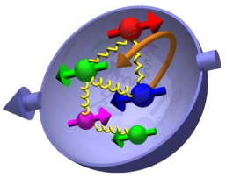
The Proton Spin “Crisis” (1988)
~ till 1980s

Slide 13
Origin of the Proton Spin

Slide 14
Probe the Proton Spin with DIS
Mostly sensitive to the charged quark distributions
Not sensitive to the gluon distribution

Slide 15
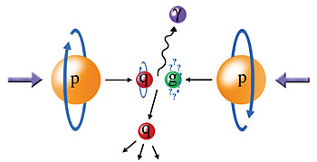
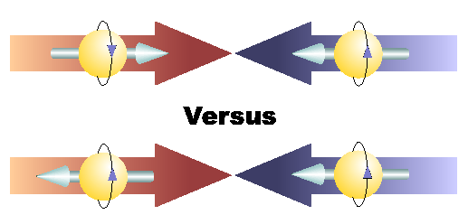
Physics with Longitudinally
Polarized p+p Collisions
A_{LL} = (N⁺⁺ - N⁺⁻)/(N⁺⁺ + N⁺⁻)

Slide 16
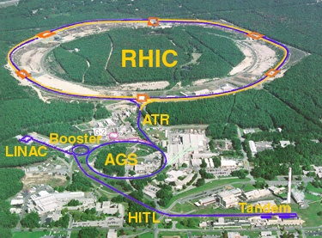
Polarized Proton Collider at RHIC
Absolute Polarimeter (H↑ jet)
RHIC pC Polarimeters
PHOBOS
polarized p+p collisions
62 ≤ √s ≤ 500 GeV
Siberian Snakes
BRAHMS
Siberian Snakes
PHENIX
STAR
Spin Rotators
(longitudinal polarization)
Spin Rotators
(longitudinal polarization)
Pol. H⁻ Source
LINAC
BOOSTER
Helical Partial Siberian Snake
200 MeV Polarimeter
AGS
AGS pC Polarimeter
Strong AGS Snake

Slide 17
This allows us to use QCD to calculate some high energy interaction processes perturbatively

Slide 18
Perturbative QCD (pQCD) a new theoretical tool to study strong interaction phenomena

Slide 19
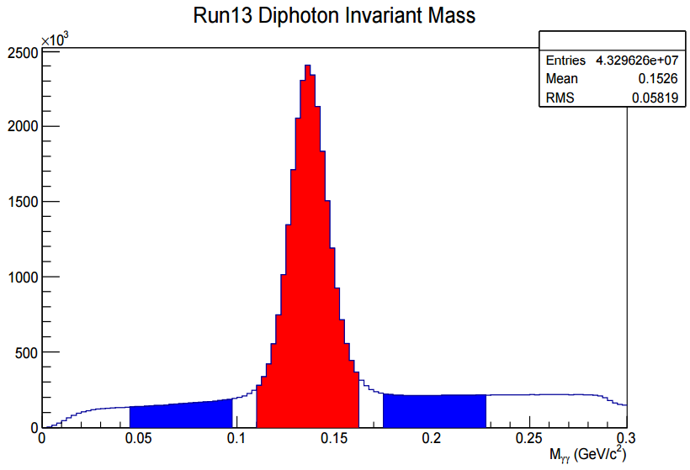
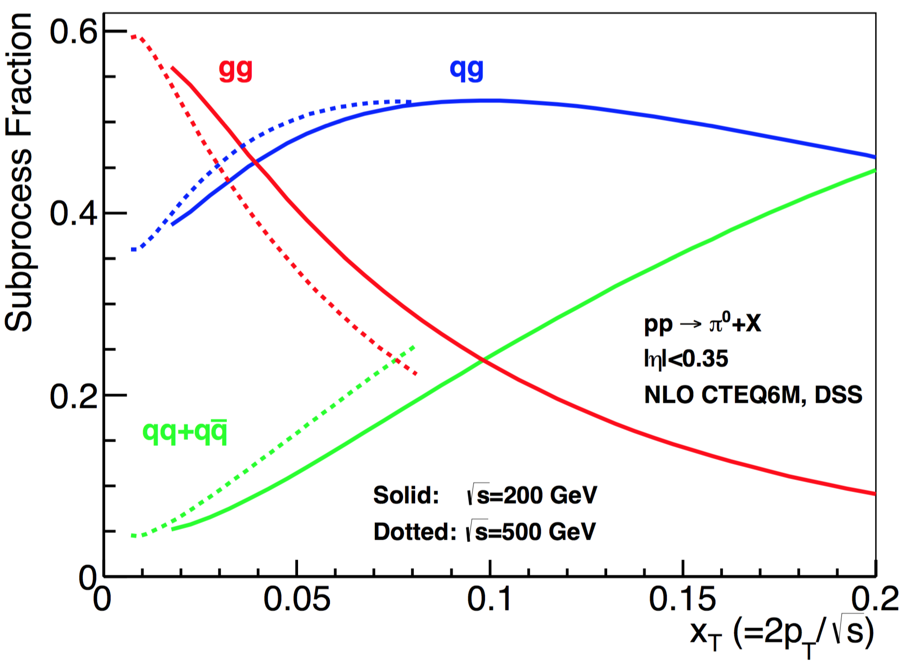
Gluon Polarization and 𝜋⁰ (or jet)A_{LL}
A_{LL}=(N⁺⁺-N⁺⁻)/(N⁺⁺+N⁺⁻)
    -- Parton distribution functions
    -- Partonic hard scattering rates
    -- Fragmentation functions
DIS
?
pQCD
e+e-
Relative fractions
Di-photon mass: 𝜋⁰ peak

Slide 20
First Hint of Non-zero Gluon Polarization from RHIC
PHENIX and STAR A_{LL} data
@ Q² = 10 GeV²
PRL 113, 012001 (2014), DSSV
Run 2009
p+p@200GeV

Slide 21
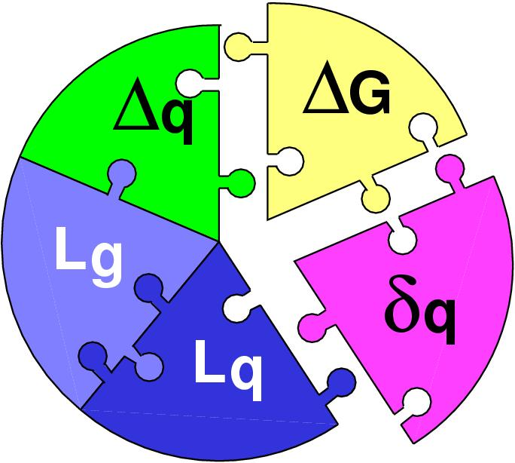
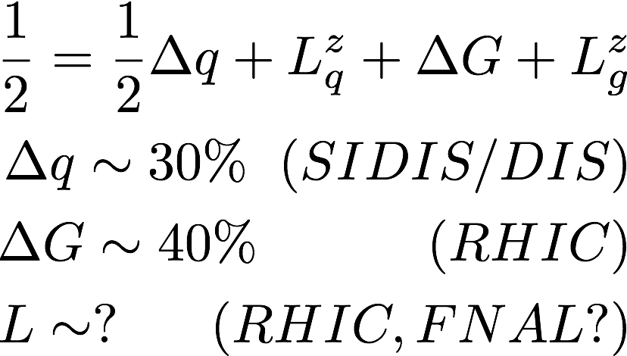
Three Decades of the Proton Spin Puzzle
Early expectation: large gluon polarization
 | Quark Spin | Gluon Spin
SLAC -> 2000 | E80 – E155
CERN ongoing | EMC, SMC, COMPASS
DESY ->2007 | HERMES
JLab ongoing | Hall A,B,C
RHIC ongoing | (BRAHMS), (PHENIX), STAR
Axial anomaly
Cheng & Li, PRL (1989)
EMC, 1980s
 | SIDIS/DIS
 | Polarized p+p

Slide 22
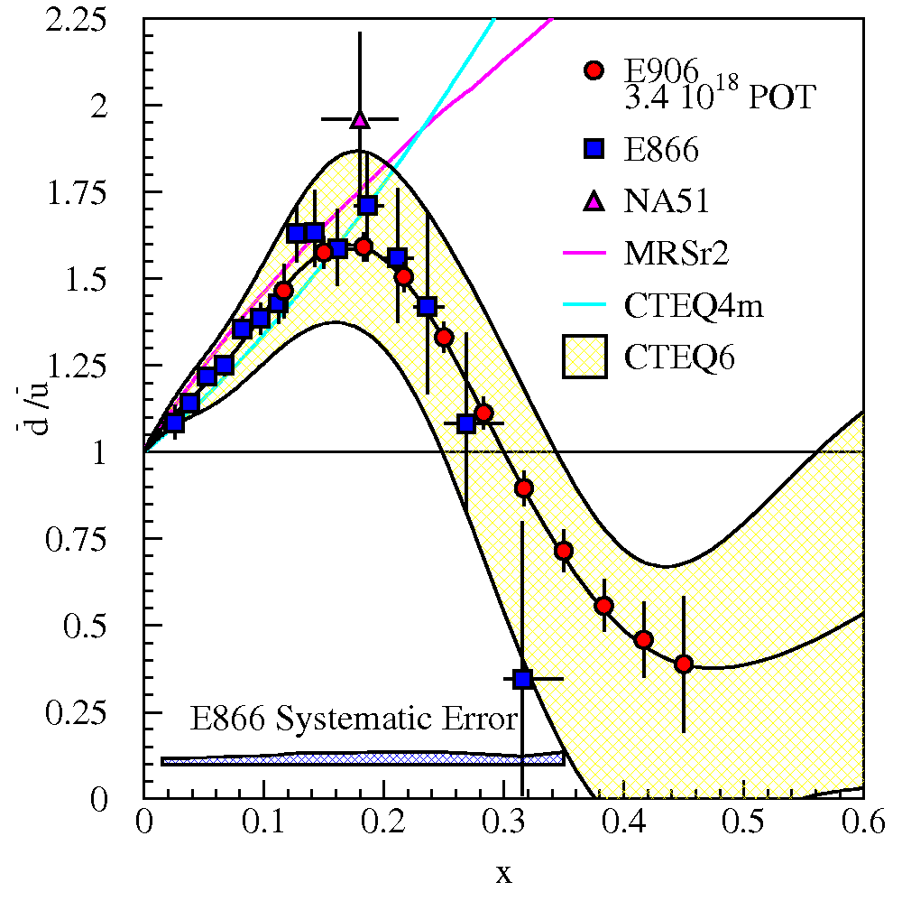
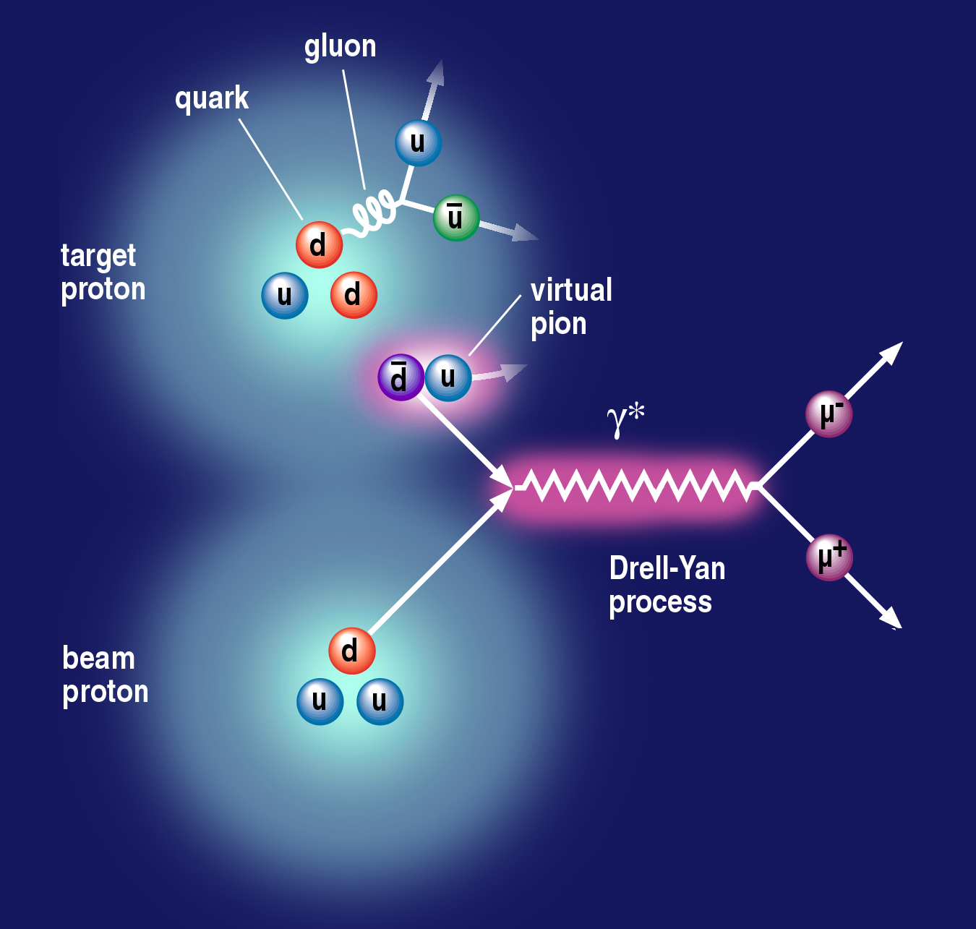
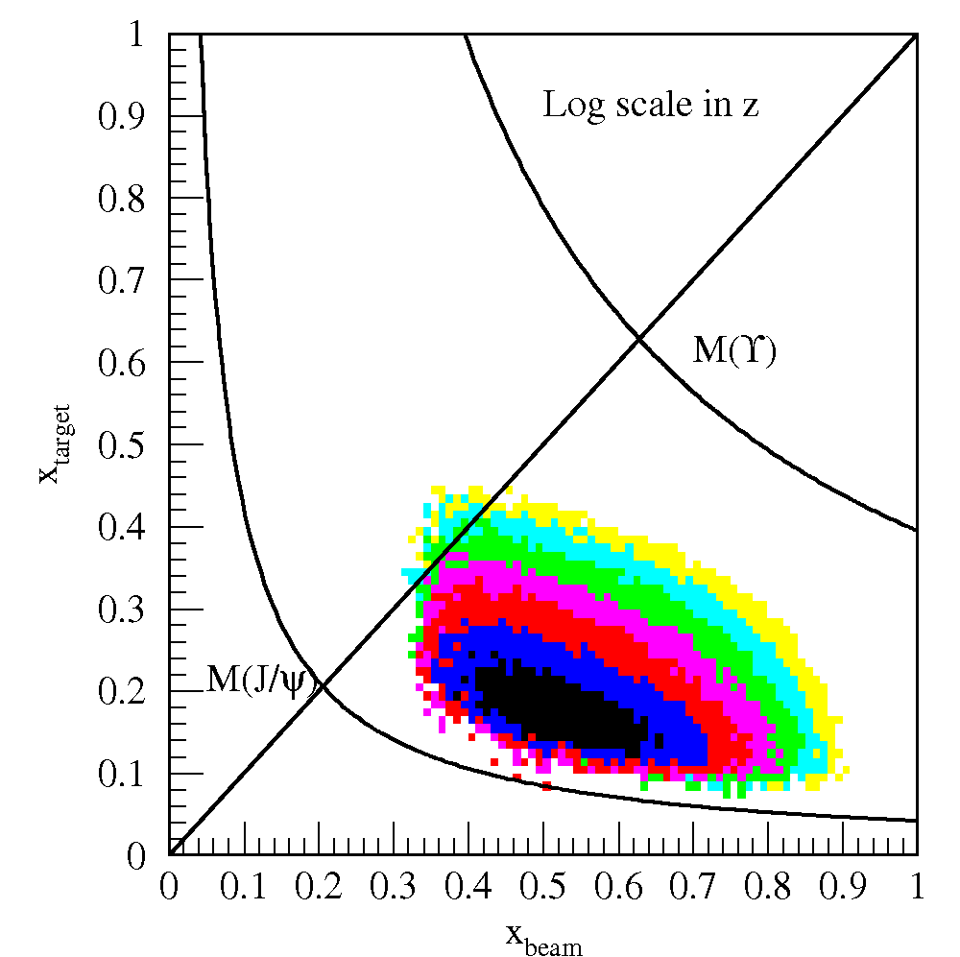
Rich Nucleon 3-D Structure and Orbital Angular Motion
Sea-quark flavor asymmetry
Sea-quark orbital angular motion
x = 0.0 ~ 0.3
Related to proton spin puzzle
  - OAM?
dbar/ubar asymmetry
6/13/13
22
E906 Spect.
Monte Carlo
E906 Spect.
Monte Carlo
E906 Spect.
Monte Carlo

Slide 23
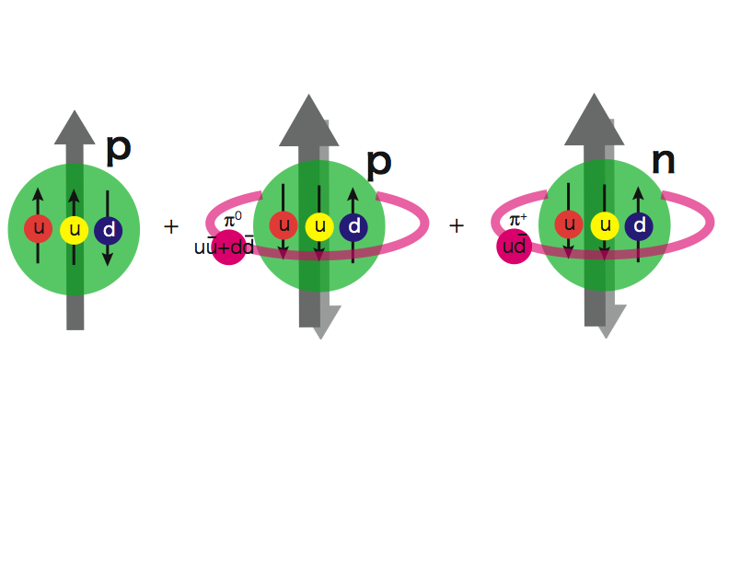
The Physics: Sea Quarks
Sea-quark flavor asymmetry
Sea-quark orbital angular motion
Proton spin puzzle
L = 0
L = 1
Spin Crisis?
10/24/2014
Ming Liu, Spin2014
23
E906 Spect.
Monte Carlo
E906 Spect.
Monte Carlo
E906 Spect.
Monte Carlo

Slide 24
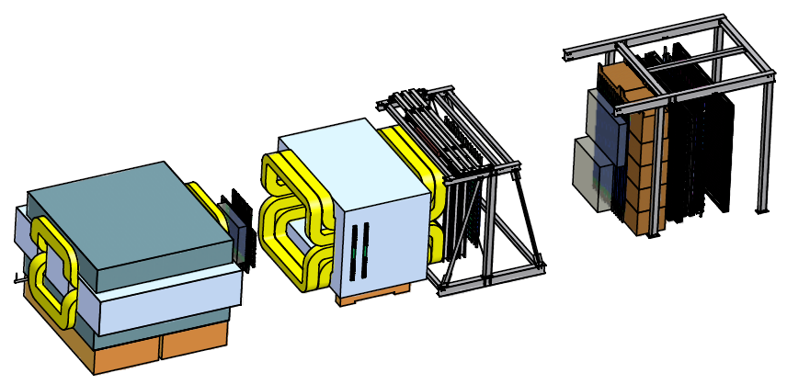
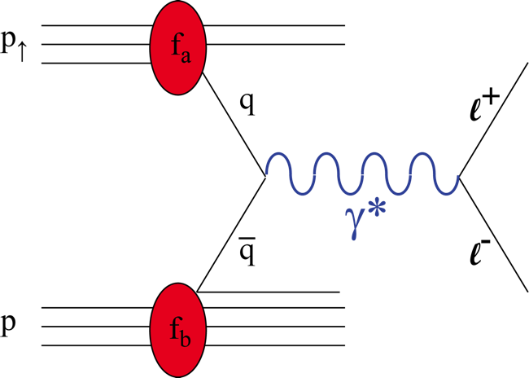
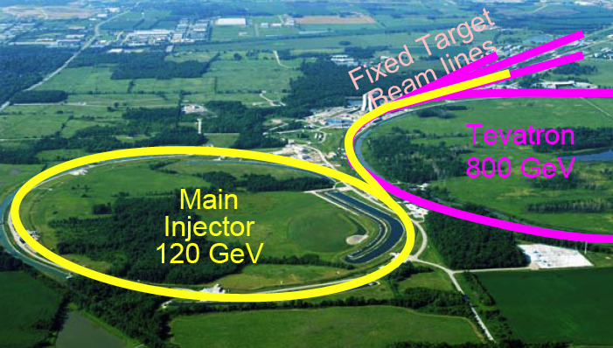
E1039 Experiment @Fermilab
Take advantage of the current E906 Drell-Yan Exp. @Fermilab,
Develop a new polarized hadron physics Program
p
A New Polarized Target
4.9m
p
Drell-Yan Transverse Single Spin Asymmetry Study at Fermilab:
Polarized Target Drell-Yan, E1039 (LOI submitted 2013)
  Polarized proton (NH₃) target, design & construction at LANL
Polarized 120 GeV proton beam from the Fermilab’s Main Injector, E-1027
24

Slide 25
backup

Slide 26
Surprise-I: Proton Spin Puzzle
Early expectation: large gluon polarization

Slide 27
Surprise-I: Proton Spin Puzzle
Early expectation: large gluon polarization
Axial anomaly
Cheng&Li, PRL 1989

Slide 30
Proton Structure: Quarks and Gluons

Slide 32
Novel Transverse Spin Phenomena

Slide 33
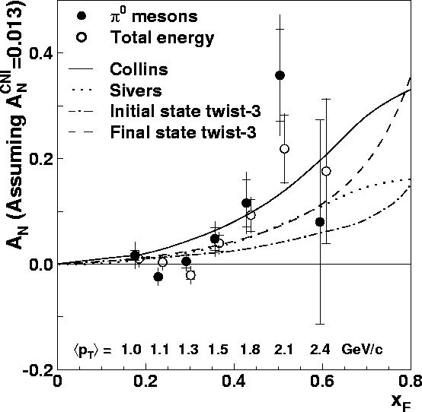
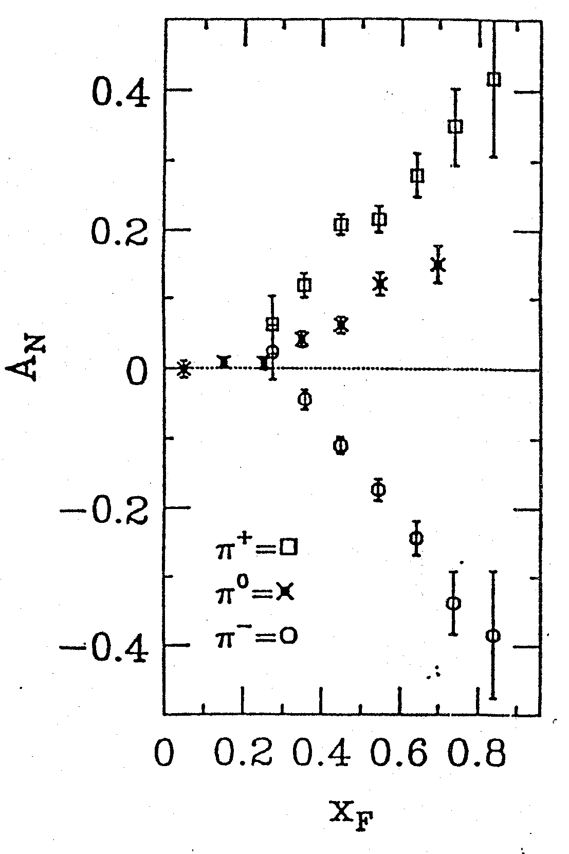
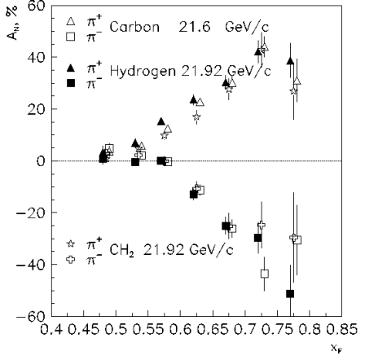
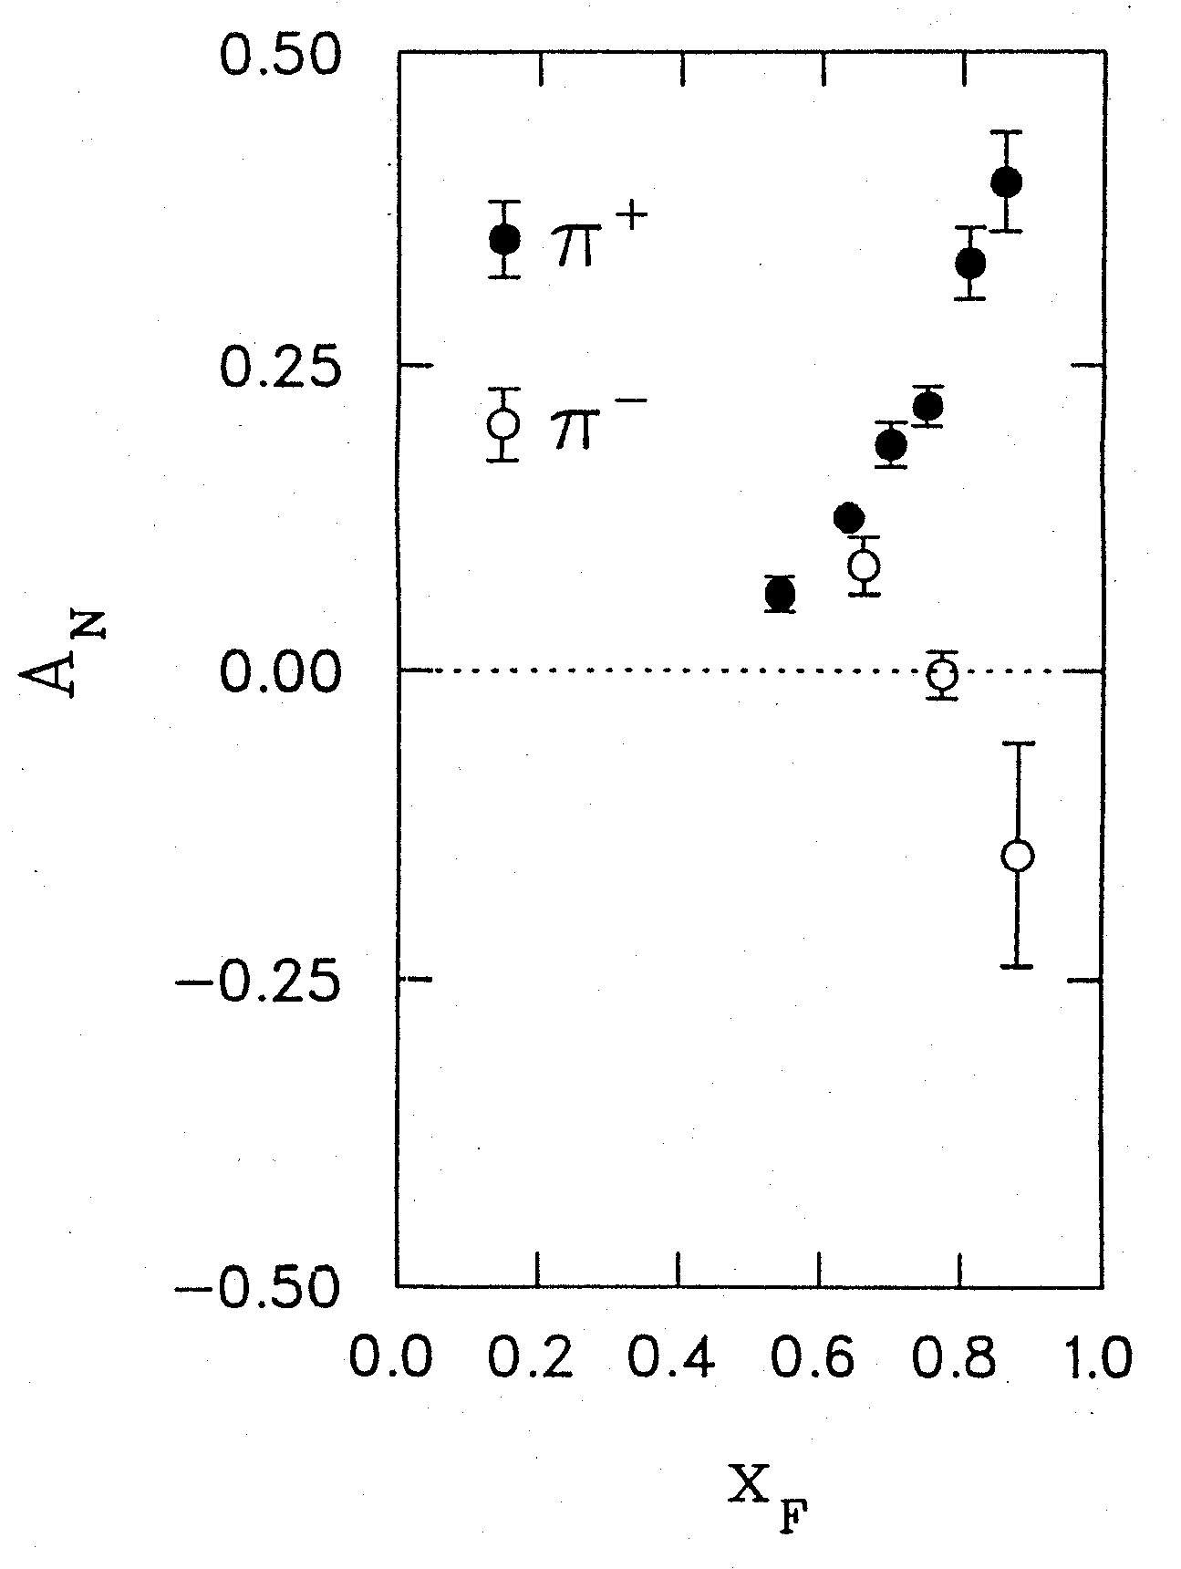
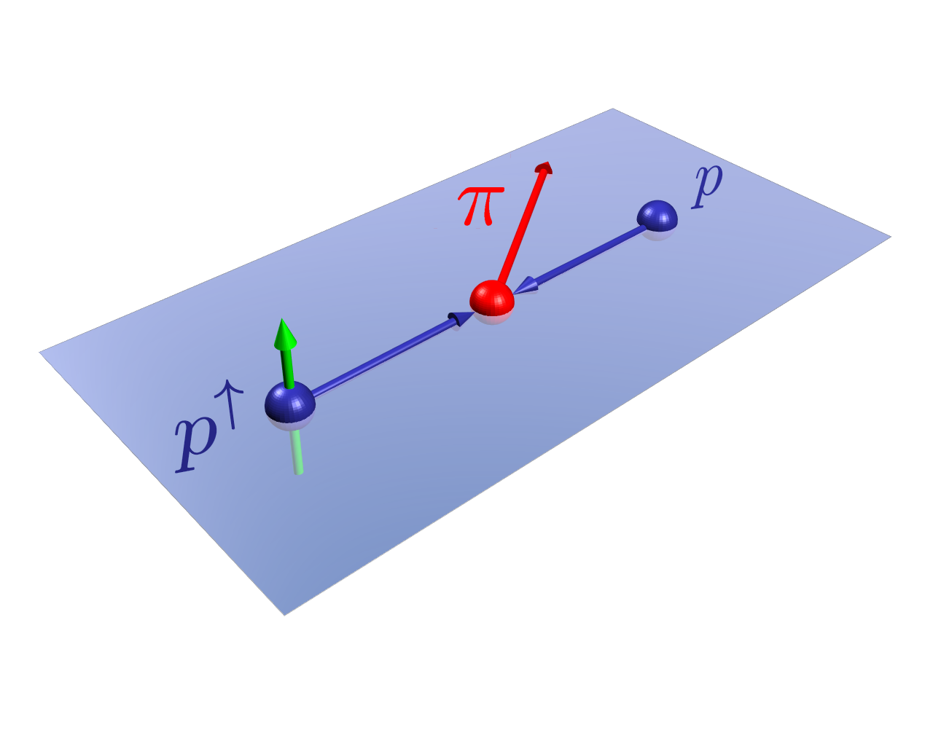
Surprise-II: Very Large TSSA
RHIC 200 GeV CMS
Large Transverse Single Spin Asymmetry (SSA) in forward hadron production persists up to RHIC energy.
FNAL 200 GeV beam
AGS 22 GeV beam
ZGS 12 GeV beam
PRL (2004)
PLB261, 201 (1991)
PLB264, 462 (1991)
PRD65, 092008 (2002)
PRL36, 929 (1976)
Sivers, Collins, Twist-3 ….
Non-Perturbative cross section
Perturbative cross section
Notes:
33

Slide 34
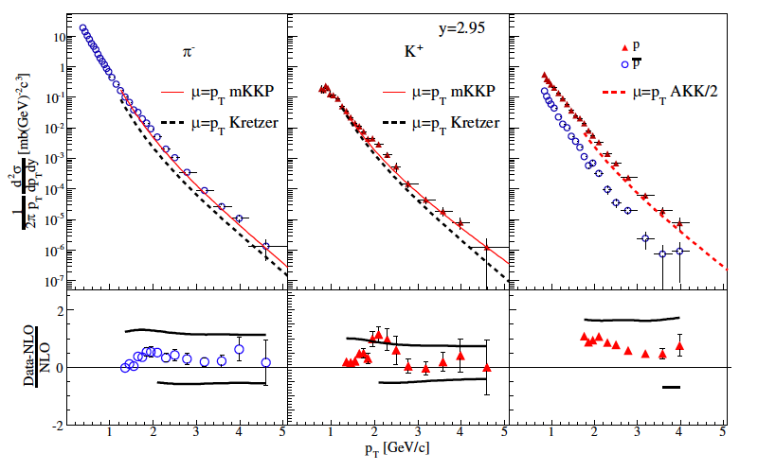
NLO pQCD and Forward Hadron Production at RHIC
BRAHMS

Slide 35
Study the Physics via Hard Scatterings at RHIC
(i) Sivers mechanism:
correlation between proton spin & parton k_{T}
(ii) Collins mechanism: Transversity × spin-dep fragmentation
S_{P}
Phys Rev D41 (1990) 83; 43 (1991) 261
S_{P}
Nucl Phys B396 (1993) 161
S_{q}
p
k_{T,q}
p
p
p
S_{q}
k_{T,π}
Collinear Twist-3: quark-gluon/gluon-gluon correlation
Expectation: at large p_{T}, A_{N} ~ 1/Q ~1/p_{T}
Notes:
35

Slide 36
Hadron TSSA in Twist-3 Framework
Qiu & Sterman PRD 59 (1998)
1st term: twsit-3 correlation functions, “Sivers”
2nd term: twist-2 transversity * twist-3 from unpol beam
3rd term: twist-2 transversity * twist-3 FF, “Collins”
It is generally believed the 2nd term is small (Yuji Koike), thus neglected.
However, more effort is needed for rigorous test of this approach.
10/13/14
Ming Liu, Spinfest2014
36

Slide 37
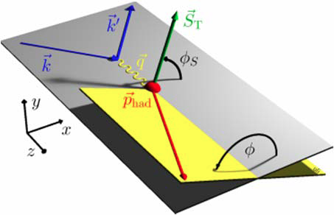
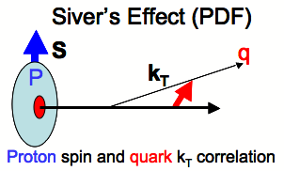
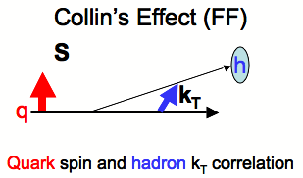
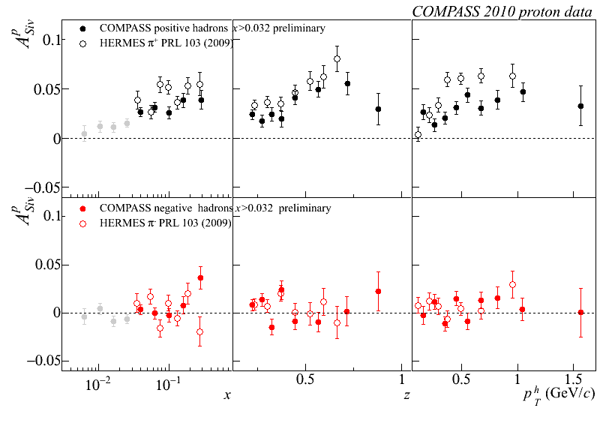
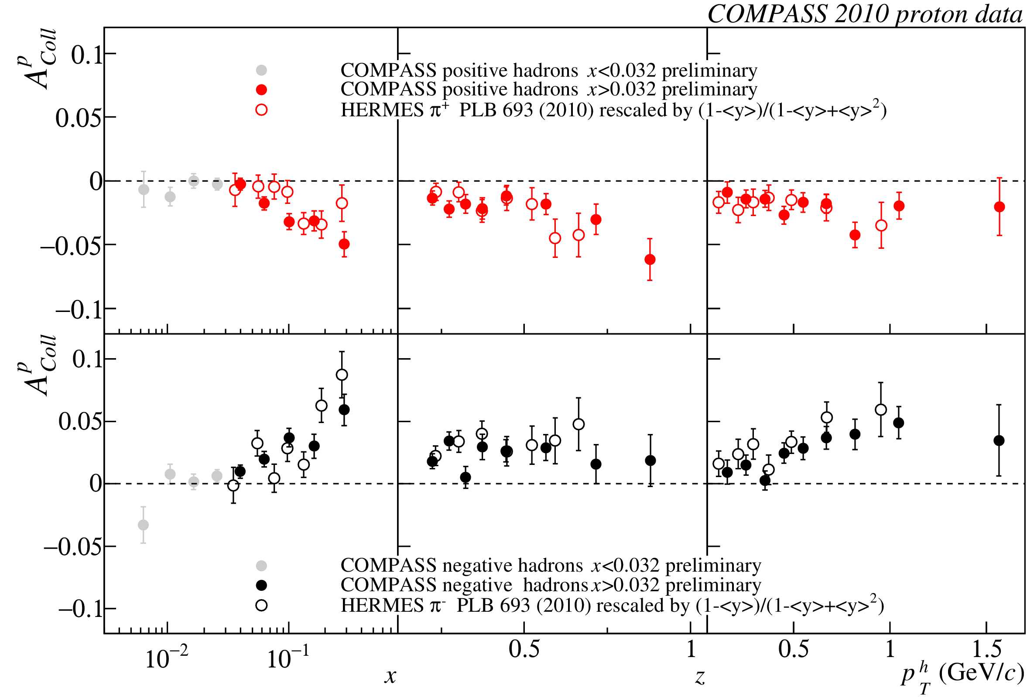
Sivers vs Collins Mechanisms
Significant Asymmetries Observed in SIDIS
Sivers
  <sin(Φ–Φ_{s})>
Collins
  <sing(Φ+Φ_{s}))>
10/16/14
Ming X. Liu @QCD-N12
37

Slide 39
The Physics: Sea Quarks
Sea-quark flavor asymmetry
Sea-quark orbital angular motion and Sivers function at x = 0.0 ~ 0.4
Proton spin puzzle
dbar/ubar asymmetry
L = 0
L = 1
X=0.0~0.4
Spin Crisis?
10/24/2014
Ming Liu, Spin2014
39
E906 Spect.
Monte Carlo
E906 Spect.
Monte Carlo
E906 Spect.
Monte Carlo

Slide 41
High Energy Electron-Proton Scattering

Slide 42
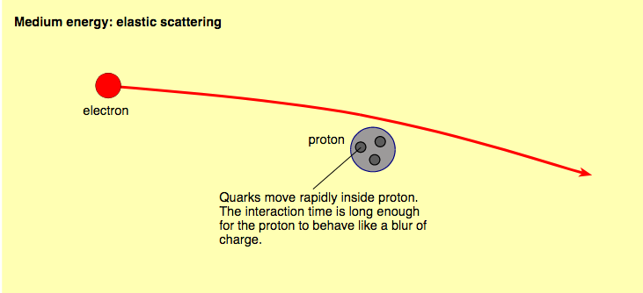
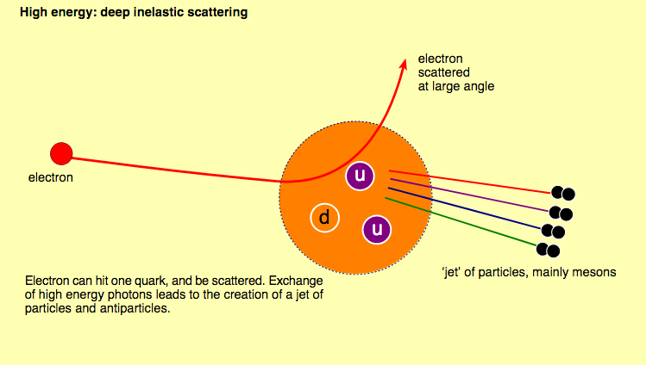
Total cross section ~ sum of “point-like” particle interactions

