Slide 1
A Brief Introduction to Particle Physics
Ming Xiong Liu
Los Alamos National Laboratory
Aug. 18-23, 2019

Slide 2

- What is the world made of?
Where do we come from?
Where do we go?

Slide 3
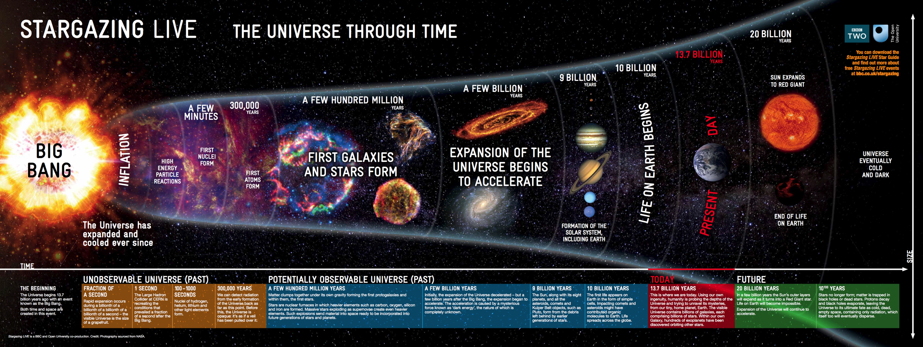
Ref: Open University / BBC
Unobservable
Universe!
Being probed with telescopes
Dark Ages: 150-800 M Years
Today, ~13.7 Billion years later

Slide 4
A Brief Introduction to Particle Physics
How to think like a physicist?
Theoretical foundation
  The Standard Model
    Quarks and Leptons
    QCD, the theory of strong interaction
  Feynman Diagrams
  Discovery of J/Psi
Experimental Methods
  Particle accelerators
  Particle detectors
Reference books:
Halzen & Martin: “Quarks & Leptons”
Perkins: “Introduction to High Energy Physics”
Particle Data Group: “Review of Particle Physics”

Slide 5
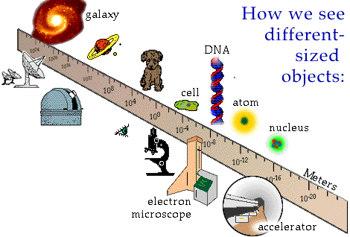
How Do We See the World?

Slide 6
A Note about the “Natural Units”
Remember,
E=mc²
Proton mass = 938 MeV

Slide 7
Atoms and Fundamental Particles
Atoms were postulated long ago by the Greek philosopher Democritus, and until the beginning of the 20th century, atoms were thought to be the fundamental indivisible building blocks of all forms of matter.
Protons, neutrons and electrons came to be regarded as the fundamental particles of nature when we learned in the 1900's through the experiments of Rutherford and others that atoms consist of mostly empty space with electrons surrounding a dense central nucleus made up of protons and neutrons.
With accelerators reaching higher ad higher energies, through a long series of experimental and theoretical studies in 1960s and 1970s, it was established quarks and leptons are the fundamental blocks of matter.

Slide 8
The Standard Model of Particle Physics
Particle physicists now believe they can describe the behavior of all known subatomic particles within a single theoretical framework called the Standard Model - incorporating quarks and leptons and their interactions through:
the strong force
weak force
electromagnetic forces.
Gravity is the one force not described by the Standard Model yet.

Slide 9
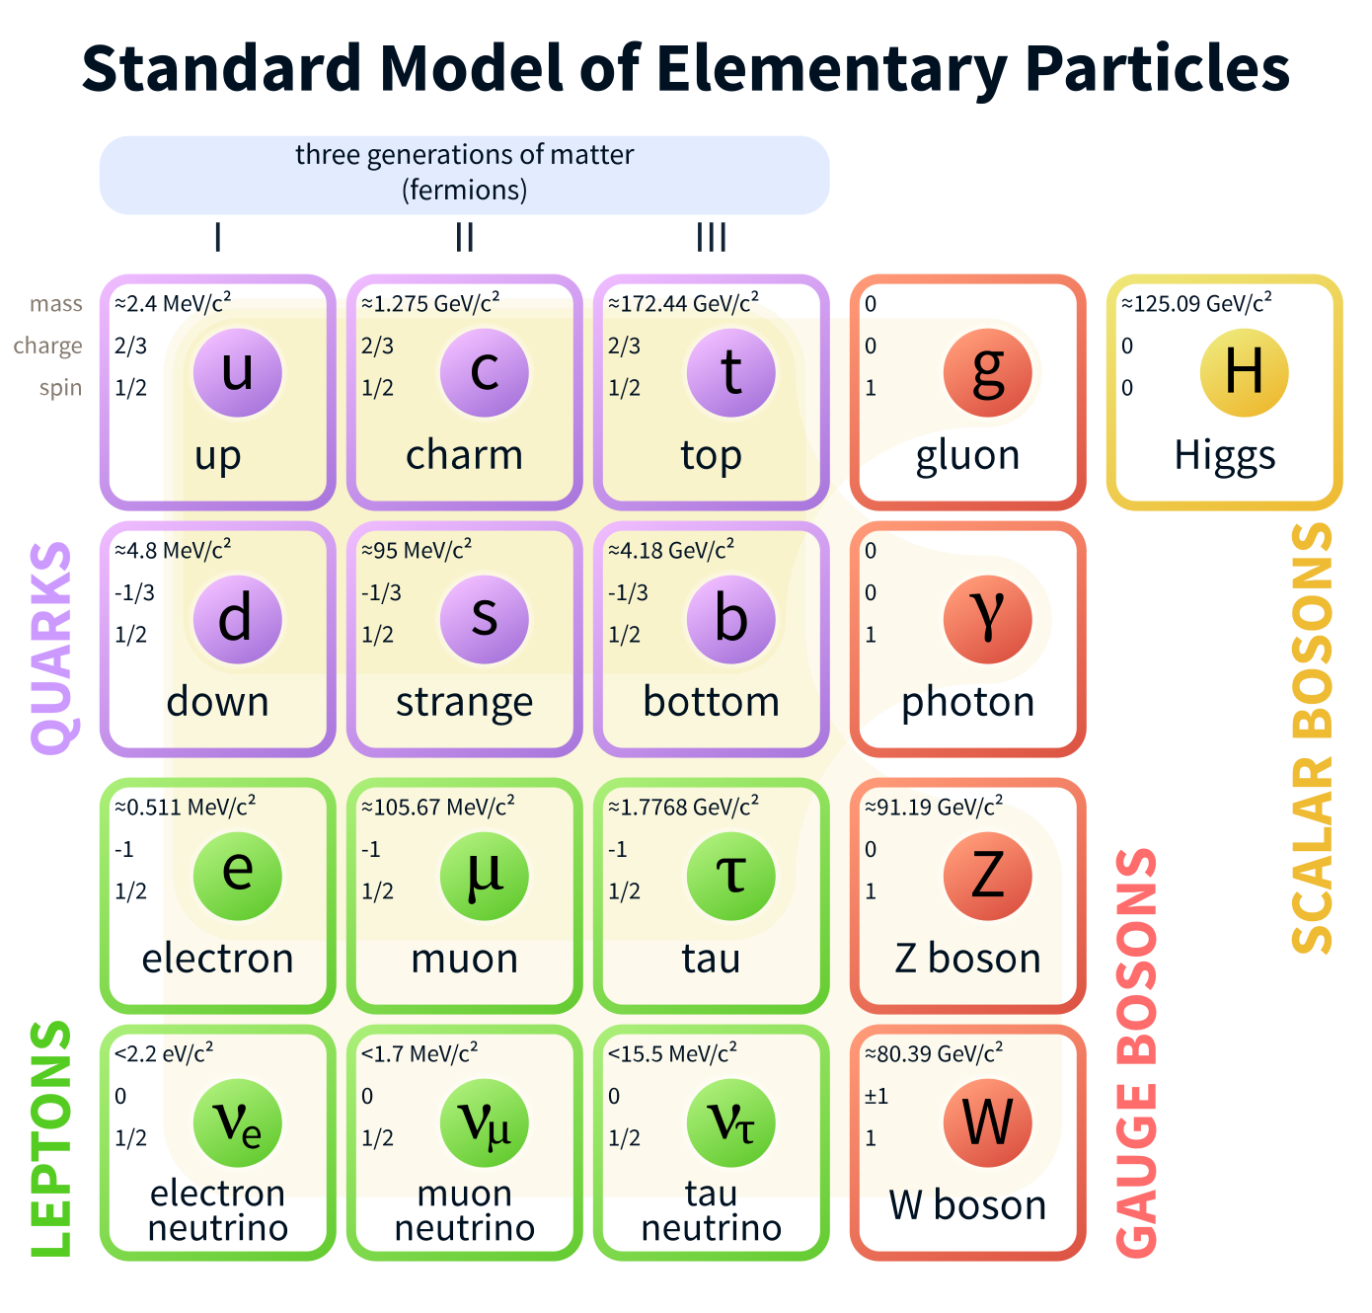

Slide 10
Leptons – “light particles”
Leptons are electrons, muons and taus and associated neutrinos
  They don’t interact strongly with other particles
  They have intrinsic spin of ½, fermions
  Charges are either -1 or 0
  All have anti-particles
3 distinct families
  Electron and electron-neutrino
  Muon and muon-neutrino
  Tau and tau-neutrino
Electrons and muons interact with matter
mostly through their electric charge;

Slide 11
The Quark Model of Hadrons
Higgs: 2012 @CERN
Baryons: 3 quarks
Mesons: 2 quarks
Hadrons with 4, 5+ quarks are expected,
and recently claimed from LHC and other experiments

Slide 12

Force by Particle Exchange
Gauge Bosons: photon (EM), W/Z (weak), g(strong), Graviton?

Slide 13

Particle Interactions: EM and Gravity
Our everyday world is controlled by gravity and electromagnetism
The strong force binds quarks together and holds nucleons (protons & neutrons) in nuclei.
The weak force is responsible for the radioactive decay of unstable nuclei and for interactions of neutrinos and other leptons with matter.
Gravity, Electromagnetic forces via massless particles (Graviton and photon)
Where G, $α$ are fundamental coupling constants

Slide 14
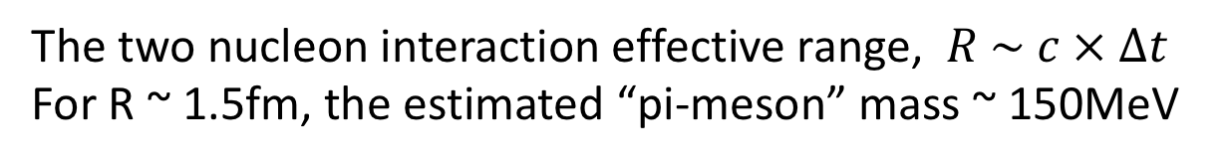
Yukawa Potential and Short Range Interaction
Yukawa
In 1935, Yukawa proposed a new particle, a pi-meson, as a carrier for strong nuclear interaction
Two nucleons interact by
exchanging massive pions,
The two nucleon interaction effective range, $R \sim c × ∆t$
For R ~ 1.5fm, the estimated “pi-meson” mass ~ 150MeV

Slide 15
Relative Strength of 4 Fundamental Interactions

Slide 16
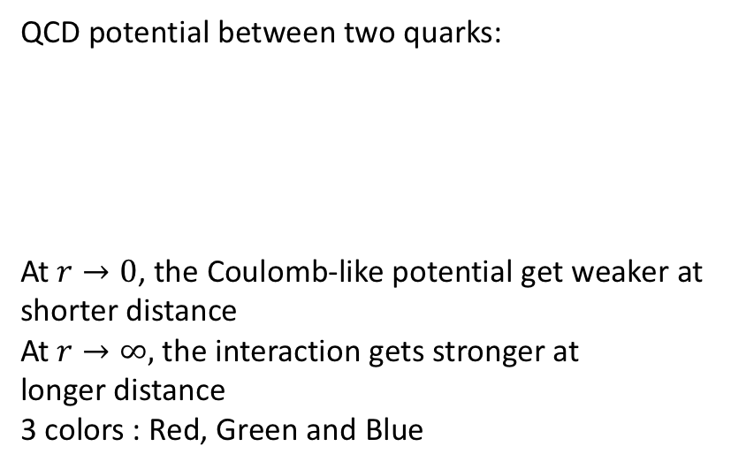
The Theory of Strong Interaction:
Quantum Chromo Dynamics (QCD)
QCD potential between two quarks:
At $r→0$, the Coulomb-like potential get weaker at
shorter distance
At $r→∞,$ the interaction gets stronger at
longer distance
3 colors : Red, Green and Blue

Slide 17
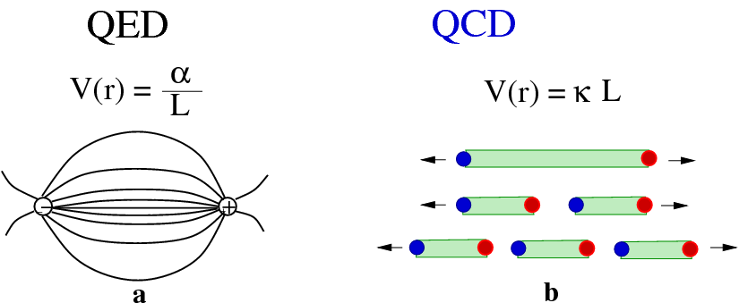
QCD vs QED at Large Distance: QCD Confinement

Slide 18
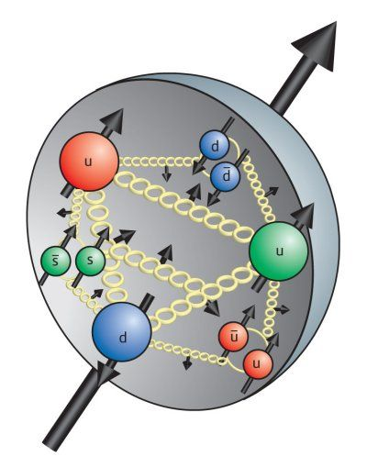
Color Confinement – Hadrons are Color Neutral
No free quarks seen – “color neutral” hadrons
Gluon self-interaction
Very rich hadron structure, novel QCD phenomena
More discussions on this topic later this week
Proton internal structure:
spin and parton(quarks and gluons) distributions

Slide 19
Deconfinement of Quarks and Gluons
At early Universe, with very high Temperature and Density, existed asymptotically free quarks and gluons:
  Quark-Gluon-Plasma (QGP)
Recently confirmed QGP experimentally at RHIC and LHC
More discussions on this topic later this week

Slide 20
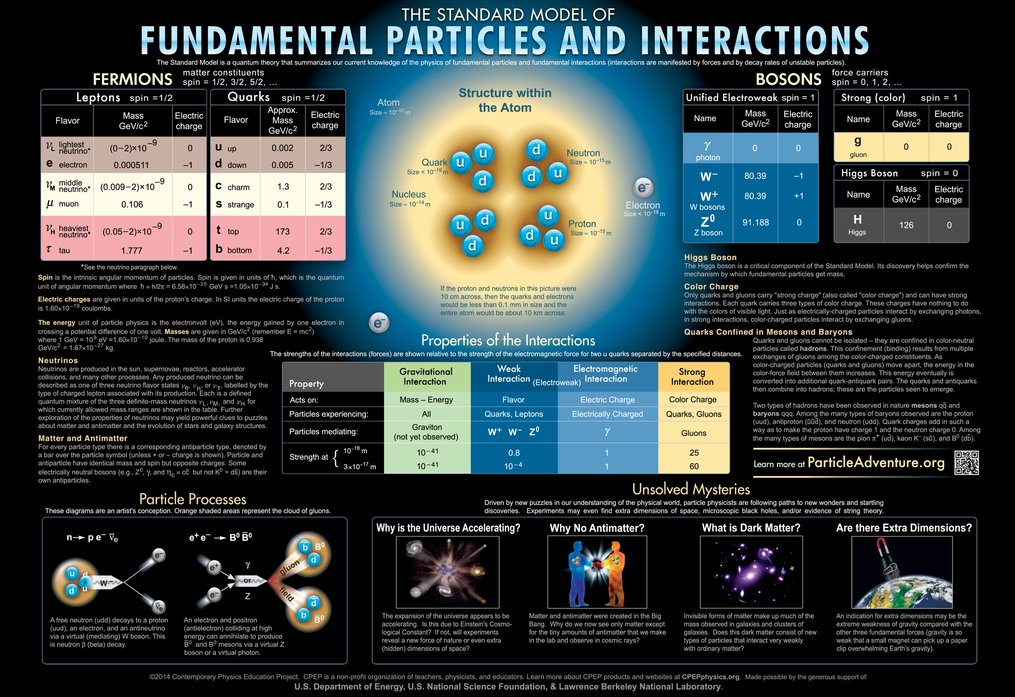

Slide 21
Feynman Diagram
A very powerful and intuitive theoretical tool
Feynman diagrams are graphical ways to represent exchange forces, originally developed by Feynman for QED
A spacetime diagrams, ct vs x, with the time axis points upward and the space axis to the right.

Slide 22
Feynman Diagrams
– EM, Strong and Weak interactions
a particle (quark or lepton) absorbs/emits a Gauge boson (photon, gluon, W/Z)

Slide 23
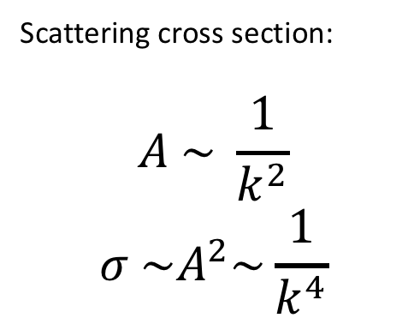
Feynman Diagram – Two Particle Interactions
- Only lines entering or leaving the diagram represent observable particles.
- The vertical direction indicates the progress of time upward, but the horizontal spacing does not give the distance between the particles.
Here two electrons enter, exchange a photon, and then exit.
Scattering cross section:
$$A \sim \frac{1}{k^{2}}$$
$$σ \sim A^{2}\sim \frac{1}{k^{4}}$$

Slide 24
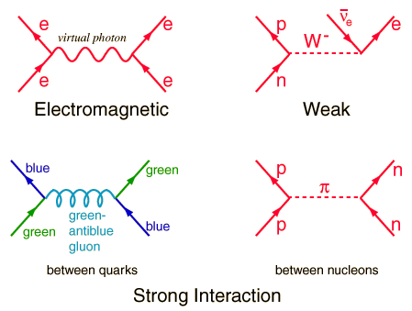




Feynman Diagram – More Examples
$$e+e→e+e$$
$$n→p+e+v$$
$$q+q→q+q$$
$$p+n→p+n$$

Slide 25
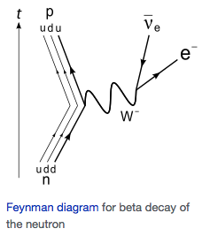

An Example:
Free Neutron Decay: Lifetime ~ 15min (900s)
Neutron: Mass = 939.57 MeV
Proton: Mass = 938.28 MeV
Electron: Mass = 0.51 MeV
M(n) – M(p) – M(e) = 0.78 MeV
Flavor Changing Weak Interactions: d - > u + W

Slide 26
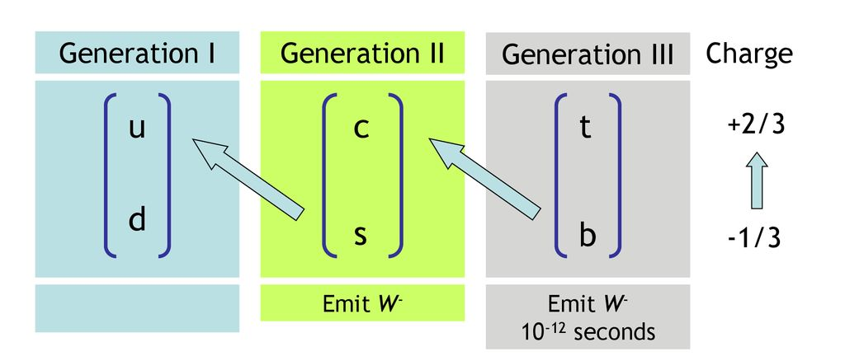
Quarks and Weak Interactions
Quark mass states

Slide 27
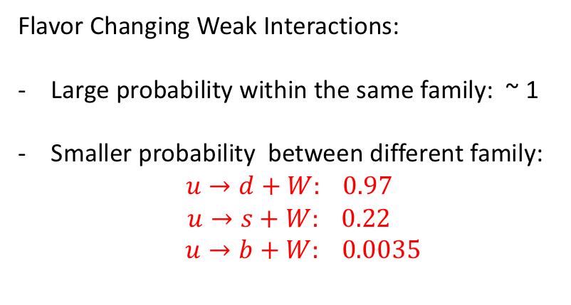
Cabibbo–Kobayashi–Maskawa (CKM) Matrix
Flavor Changing Weak Interactions:
Large probability within the same family: ~ 1
Smaller probability between different family:
$$u→d+W: 0.97$$
$$u→s+W: 0.22$$
$u→b+W: 0.0035$
Prob. ~ 1
Quarks belong to 3 “families”, (u,d) (c,s) and (t,b)

Slide 28
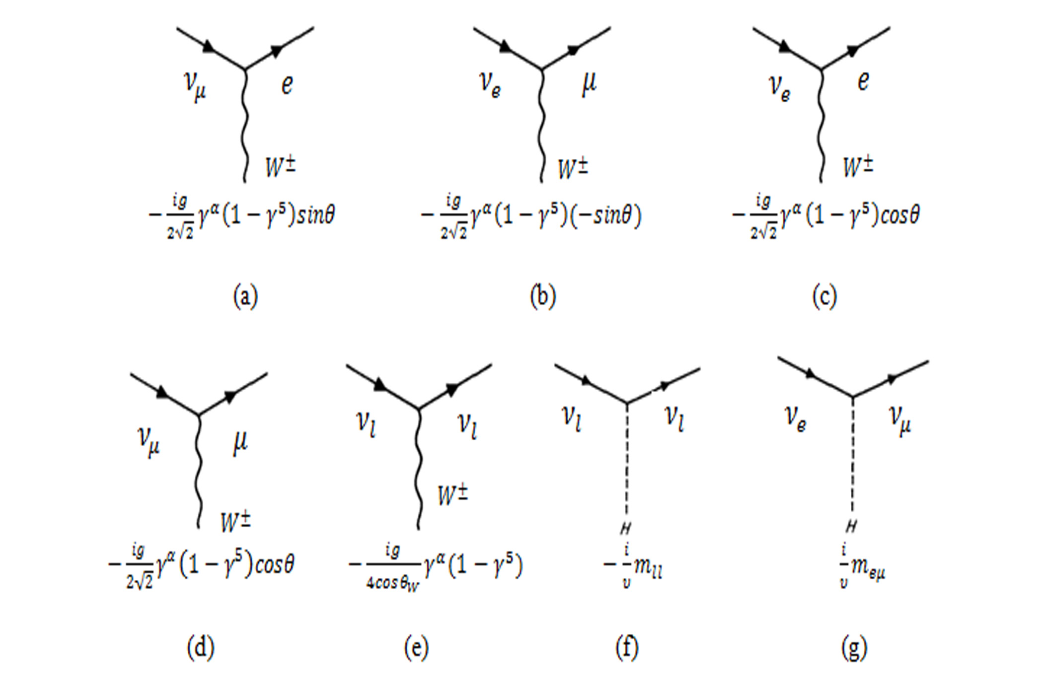
3 Lepton Families and Neutrino Mixing

Slide 29
Success of the SM

Slide 30
Discovery of the Quarks at SLAC in Deep-Inelastic-Scattering (DIS)
With accelerators reaching higher ad higher energies, through a long series of experimental and theoretical
studies in 1960s and 1970s, it was established quarks and leptons are the fundamental blocks of matter.

Slide 31
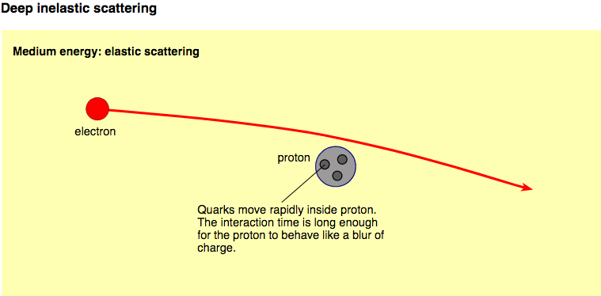
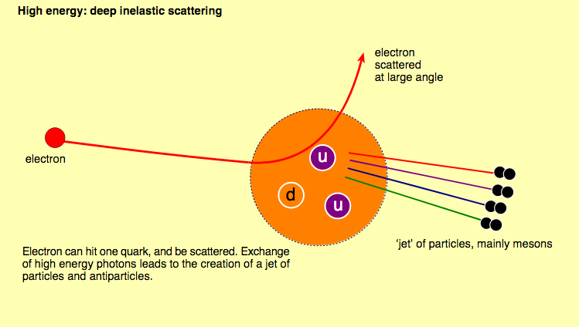
Total cross section ~ sum of “point-like” particle interactions

Slide 32
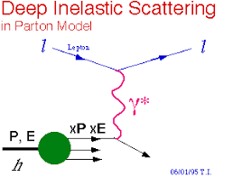
1990 Nobel Prize
… for their discovery of parton structure of the nucleon via
Deep-Inelastic-Scattering (DIS) at SLAC (1968)

Slide 33
Test of the Standard Model – Quark Color
The hadron to muon production ratio: R
For high energy , 1 < E < 4 GeV,
(u, d, s) are possible:
R=Nc {[2/3]^2 + [1/3]^2 + [1/3]^2 }
= Nc {6/9} ~ 2

Slide 34
R from PPG: Confirmed Nc = 3
HW: calculate R for high energy, E > 10GeV

Slide 35
Success of the SM - Discovery of Charm Quark
In 1960s, Gell-Mann’s quark model contains 3 types of quarks: u,d,s
In early 70s, very long life-time (low decay rate) observed in K_L:

Slide 36
A 4th Quark (Charm) Needed to Cancel the Amplitude from the 1st process
Glashow, Illiopolus and Maiani proposed the existiance of the 4th quark, Charm (c)
Decay amplitude:
A = {A(s) + A(c)} ~ 0
Charm quark was discovered in 1974 at BNL and SLAC

Slide 37
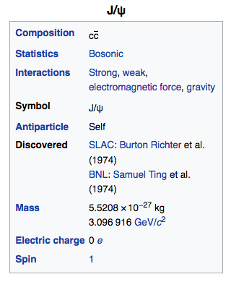
Discovery of J/Psi in 1974
“November J/Psi Revolution”
BNL
SLAC
J/Psi is a particle made of charm and anti-charm quarks – a Charmonium;
This discovery was very decisive in our understanding as well as formulating the picture regarding the basic constituents of nature.
More discussions on using J/Psi for QGP study later this week

Slide 38
Modern High Energy Nuclear and Particle Physics Experiments
Throughout the history of Physics, experimental discoveries and theoretical ideas and explanations have moved forward together
Accelerators
  Relativistic Heavy Ion Collider at Brookhaven National Laboratory in New York, USA (RHIC)
Detectors
  PHENIX and STAR experiments at RHIC

Slide 39

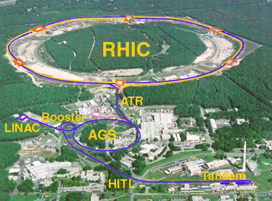
The Relativistic Heavy Ion Collider
at Brookhaven National Laboratory
R-HI
New state of matter
QGP
De-confinement
…
polarized proton
Nucleon Spin Structure
Spin Fragmentation
pQCD
…
RHIC is a QCD lab
BRAHMS
PHENIX
STAR

Slide 40
Phots from LHC
RHIC
FERMILAb

Slide 41
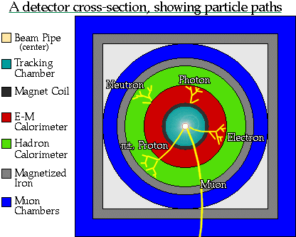
A Typical Collider Detector Model

Slide 42

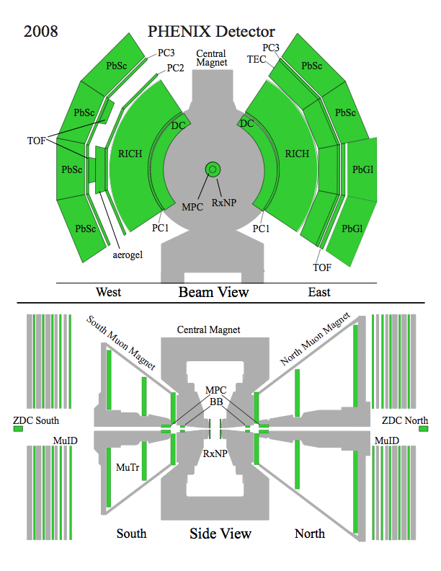
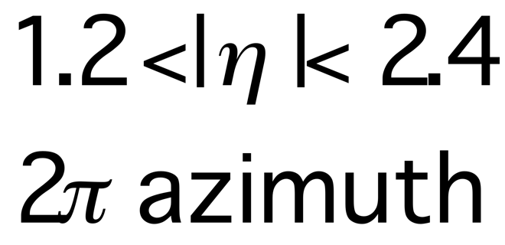
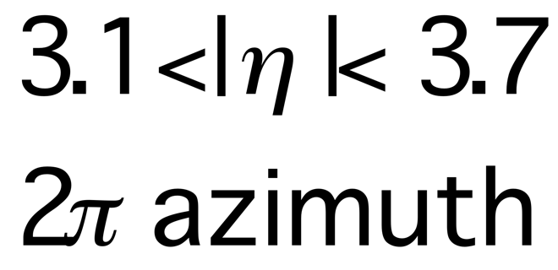
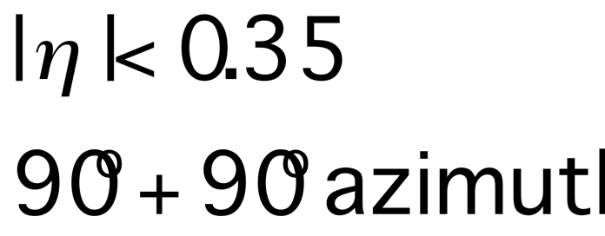
The PHENIX detector
Philosophy:
  High rate capability to measure rare probes,
  limited acceptance.
2 central spectrometers
  Track charged particles and detect electromagnetic processes
2 forward muon spectrometers
  Identify and track muons
2 forward calorimeters (as of 2007!)
  Measure forward pions
Relative Luminosity
  Beam-Beam Counter (BBC)
  Zero-Degree Calorimeter (ZDC)

Slide 43
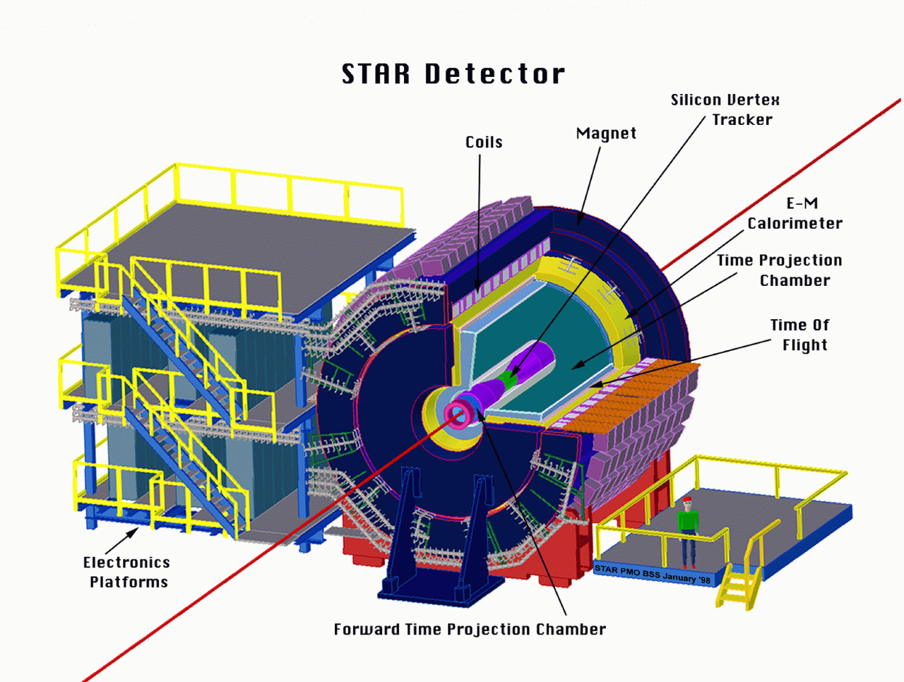
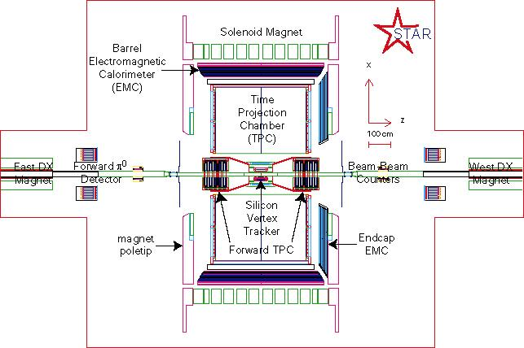
The STAR Detectors
PHOBOS
BRAHMS &PP2PP
PHENIX
RHIC
1.2 km
STAR
Time Projection Chamber |η|<1.6
Forward TPC 2.5<|η|<4.0
Silicon Vertex Tracker |η|<1
Barrel EMC |η|<1
Endcap EMC 1.0< η <2.0
Forward Pion Detector 3.3<|η|<4.1

Slide 44
Summary
The Standard Model of Particle Physics – very successful
  6 quarks and 6 leptons
  Interact through exchange of gauge bosons
Feynman diagram
  very intuitive graphic representation of interactions
Success of the SM
High energy experiment
  RHIC
  PHENIX and STAR experiments

Slide 45
Back up

Slide 46
The Nature of Our Universe
We believe the Universe started from a Big Bang
All of the known matter in the Universe today is made up of quarks and leptons described in the SM.

Slide 47
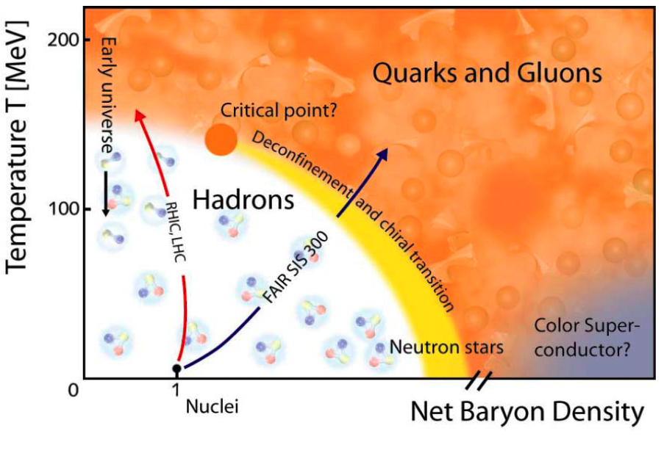
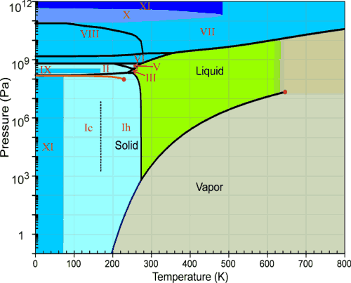

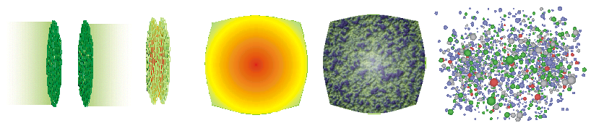
Phase Diagram
Phase diagram of water
Phase diagram of nuclear matter

Slide 48
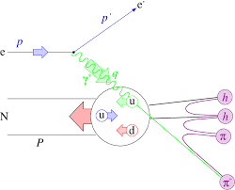
Experimental Methods: Accelerators
E = mc²

Slide 49
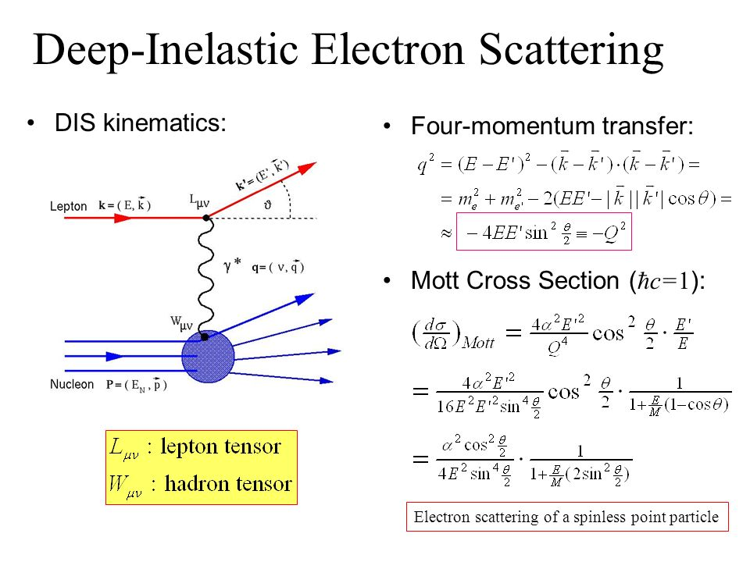

Slide 50
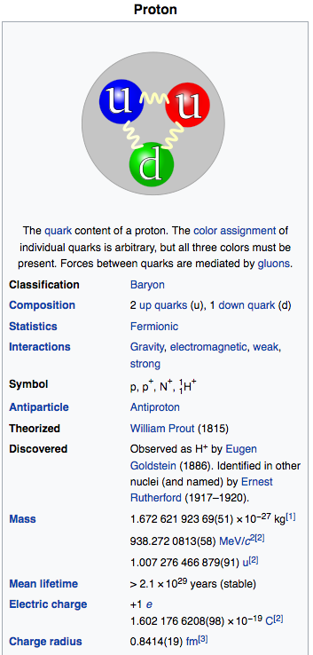
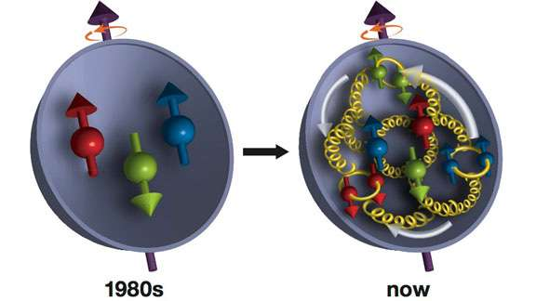
The Proton and Quarks
https://en.wikipedia.org/wiki/Proton
Proton is NOT a point particle, it has internal structure!
  2 up-quarks and 1 down quark
  Charge = 2x(2/3)e + 1x(-1/3)e = +1e
  Spin = 2 x (1/2) + 1x(-1/2) = +1/2
~ till 1980s

Slide 51
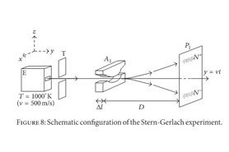
1943 Nobel Prize: Otto Stern
… for his discovery of the magnetic moment of the proton
  (Stern‐Gerlach Experiment)
Homework:
what is the $μ_{p}$ for proton, 1) if it is an elementary particle? 2)if each quark (uud) has 1/3 of the proton mass?

Slide 52
Proton Structure: Quarks and Gluons
Proton:
Quarks (u,u,d),
Spin = ½
Charge = +1

Slide 53
High Energy Electron-Proton Scattering

Slide 54
Total cross section ~ sum of “point-like” particle interactions

Slide 55
Test of the Standard Model - Colors
The hadron to muon production ratio: R
For high energy , E > 2GeV,
(u, d, s) are possible:
R=Nc {[2/3]^2 + [1/3]^2 + [1/3]^2 }
= Nc {5/9}

