Slide 1

Open Heavy Flavor Physics with the sPHENIX MVTX Detector at RHIC
Ming X. Liu
Los Alamos National Laboratory
for the sPHENIX Collaboration
WWND 2019, CO

Slide 2
Outline
Science
MAPS-based VeTex detector (MVTX)
Physics prospects

Slide 3
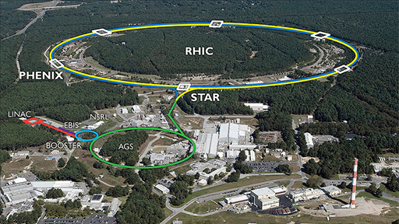


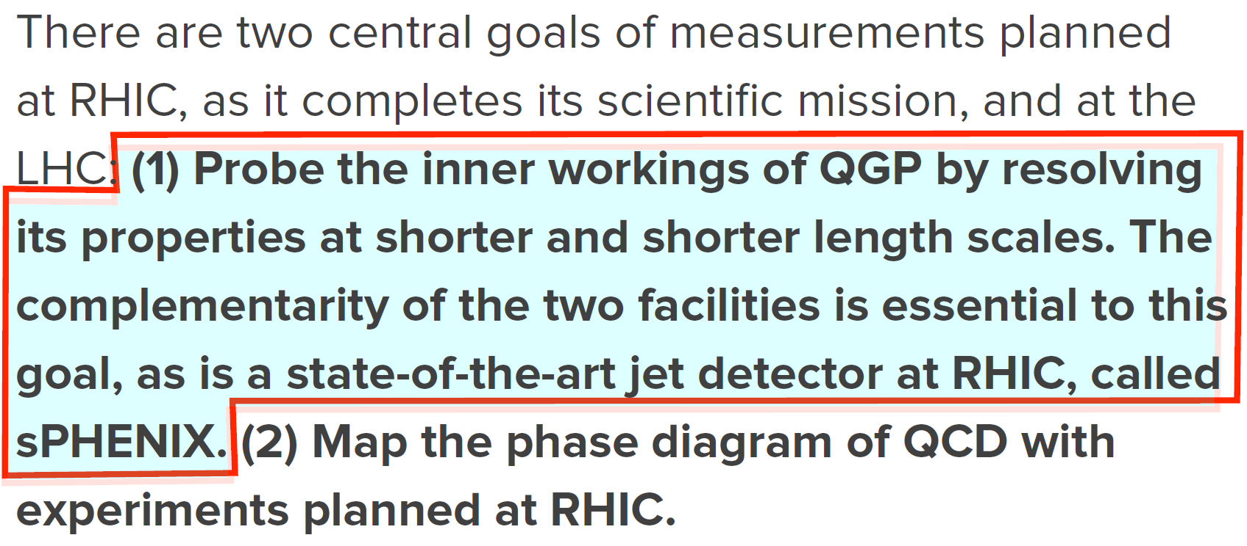
The Scientific Mission at RHIC

Slide 4
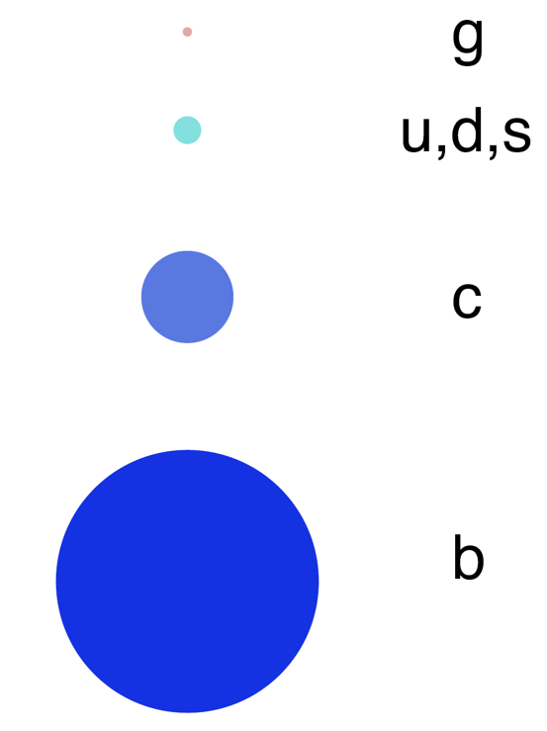
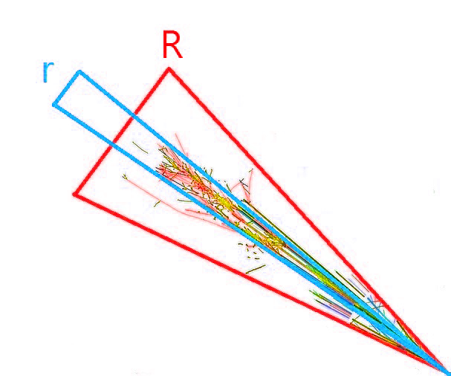
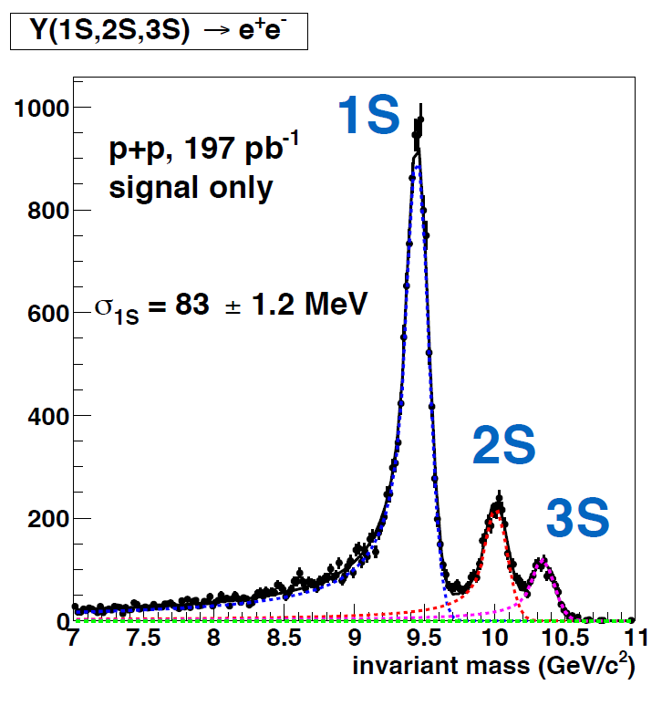
Three Physics Pillars
Jet cor. & substructure
Upsilon spectroscopy
Size of the probe
Parton energy loss & cor.
mass dependent
ϒ(3s)-0.78fm
ϒ(2s) – 0.56fm
ϒ(1s) – 0.28fm
Justin Frantz, Monday
sPHENIX jet physics
This talk : HF program

Slide 5
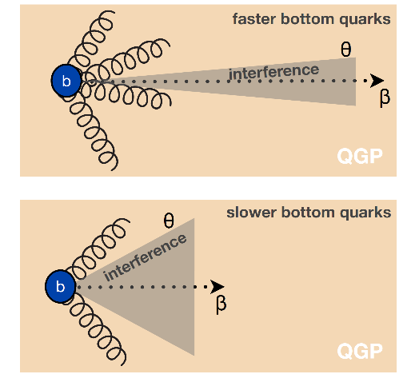
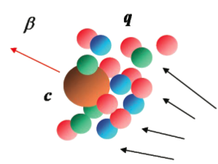
Heavy Quarks - Unique Probe of QGP
Study mass dependence in
  Jet quenching and dE/dx
  Flow – interaction with medium
Access QGP properties
m_{u} m_{d}
m_{s}
Λ_{QCD}
m_{c}
m_{b}
MeV
1
10
10²
10³
10⁴
T_{c}
T_{QGP}

Slide 6
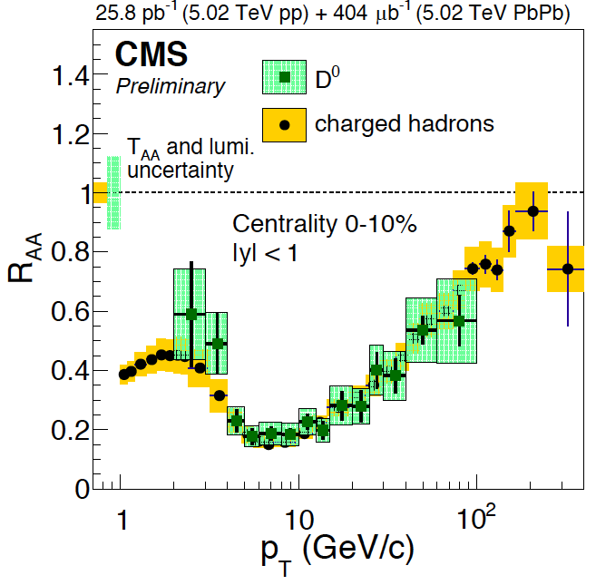
Charm R_{AA}
R_{AA} (D-meson) ~ R_{AA} (h) at high p_{T} ~> 4 GeV/c
significant suppression of charmed hadron R_{AA} in central A+A collisions
strong charm-medium interactions
mass effect expected important at low pT, dead-cone effects etc.
STAR: arXiv:1812.10224

Slide 7
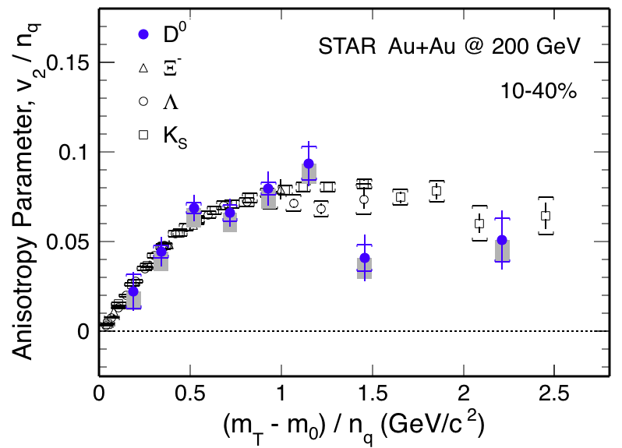
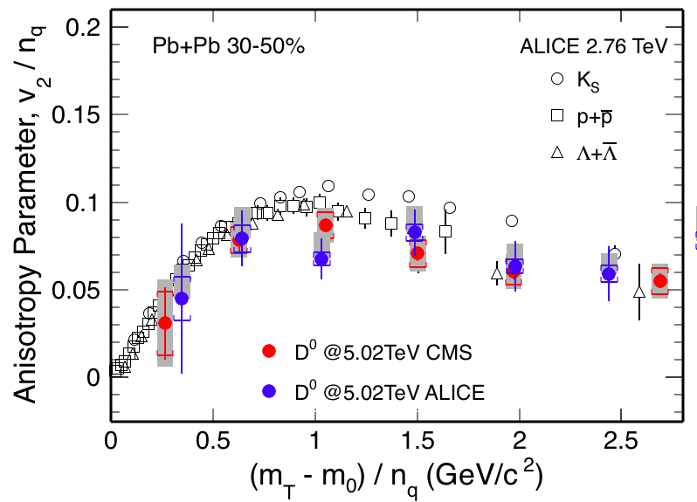
Charm V₂
v2 of D⁰ follows the same trend as light hadrons
Charm quarks flow the same as light quarks
Strong coupling to medium at low pT

Slide 8
Direct Flow of Charm at RHIC
Singha, WWND19

Slide 9
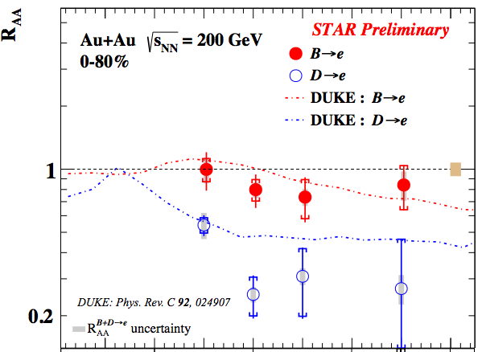
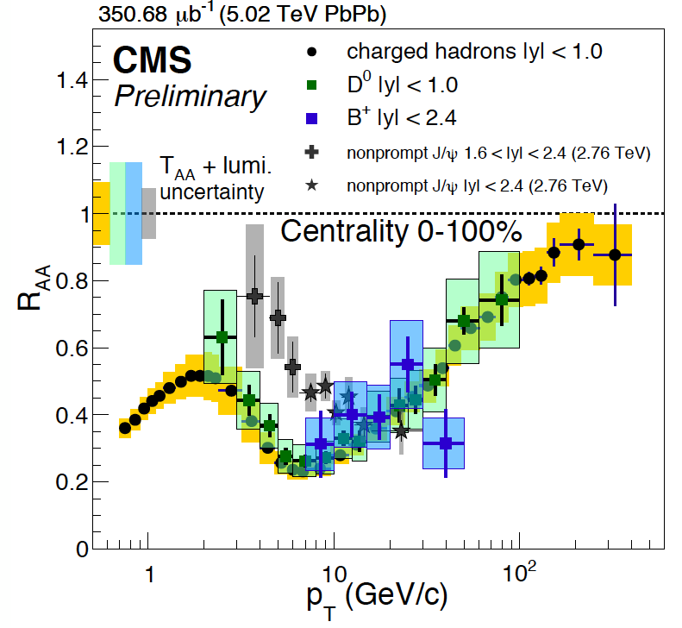
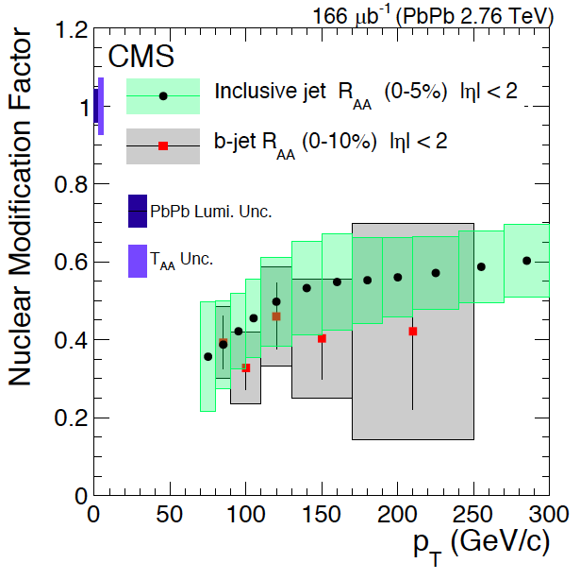

Beauty?
Highly desired:
precision measurements of
B @low p_{T} ~< 50GeV
R_{AA} (B->e) > RAA (D->e, h) @low p_{T}
B⁺ & b-jet ~ light hadrons & charm @high p_{T}
STAR, QM17

Slide 10
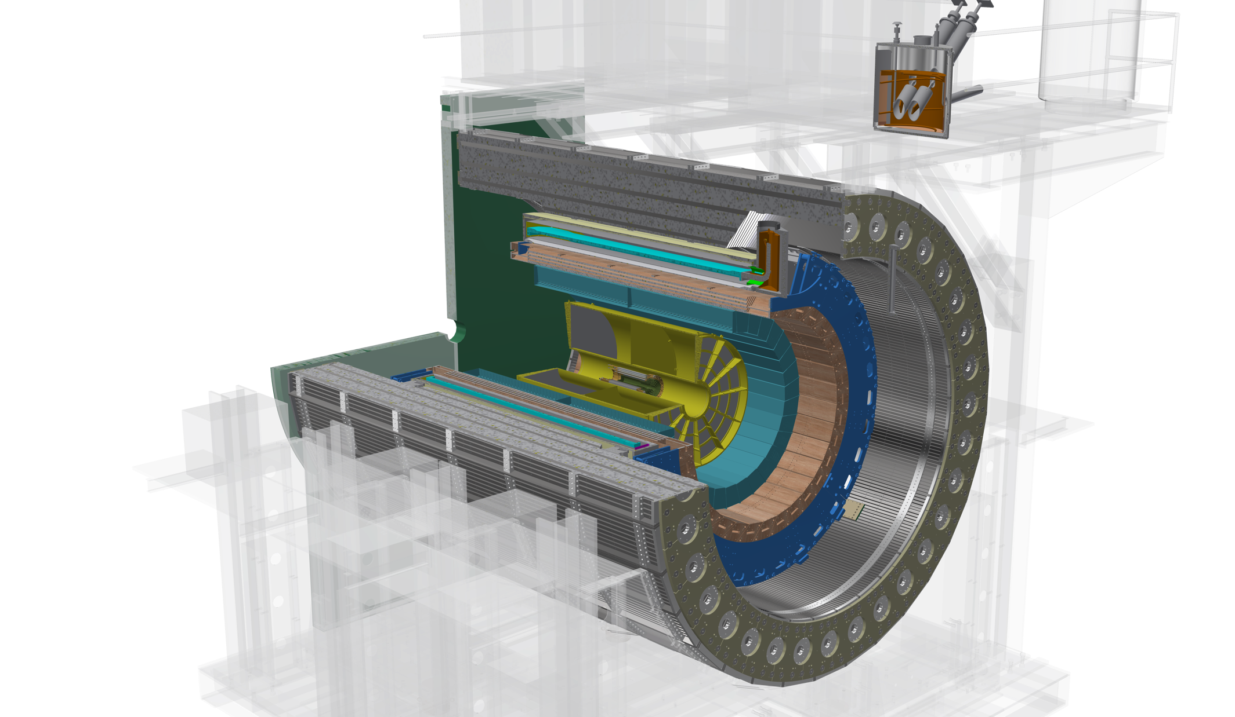
The sPHENIX Detectors
Outer HCal
SC Magnet
Inner HCal
EMCal
TPC
INTT
MVTX
Φ ~ 5m
15 kHz trigger
>10 GB/s data
Baseline detectors: HCal/EMCal/TPC
Parallel Activities “upgrade”
MAPS-based Vertex Detector (MVTX)
Intermediate Silicon Strip Tracker (INTT)
Notes:
15kHz matched to collision rate.

Slide 11
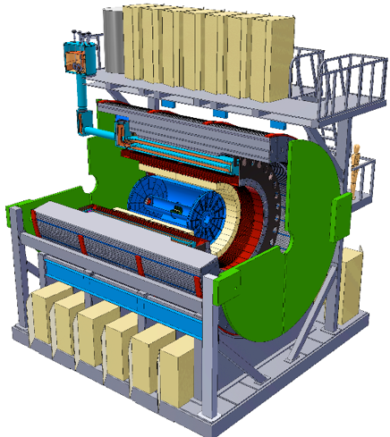

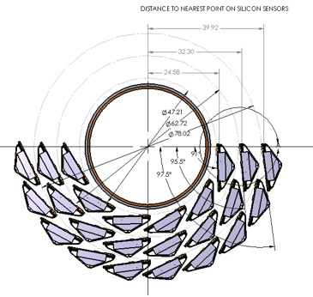
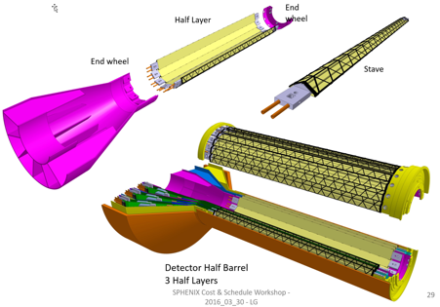
sPHENIX MVTX Detector Design
Adapts ALICE ITS/IB design, modifications to fit sPHENIX environment:
-Sensors:
Use ALICE ALPIDE sensors and the identical ITS/IB design of the active part
-Readout:
A hybrid design using ALICE frontend Readout Unit(RU) and ATLAS upgrade backend PCIe based FELIX boards for sPHENIX
-Mechanics:
Modified mechanical frame design for sPHENIX
ALICE ITS Upgrade:
Inner Barrel Tracker
Adapt ITS/IB design
- Min. Risks
- Max. Phys.
Modified MVTX detector
layout for sPEHINX
R = 2.5/3.5/4 cm
Z = 27 cm

Slide 12
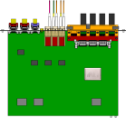

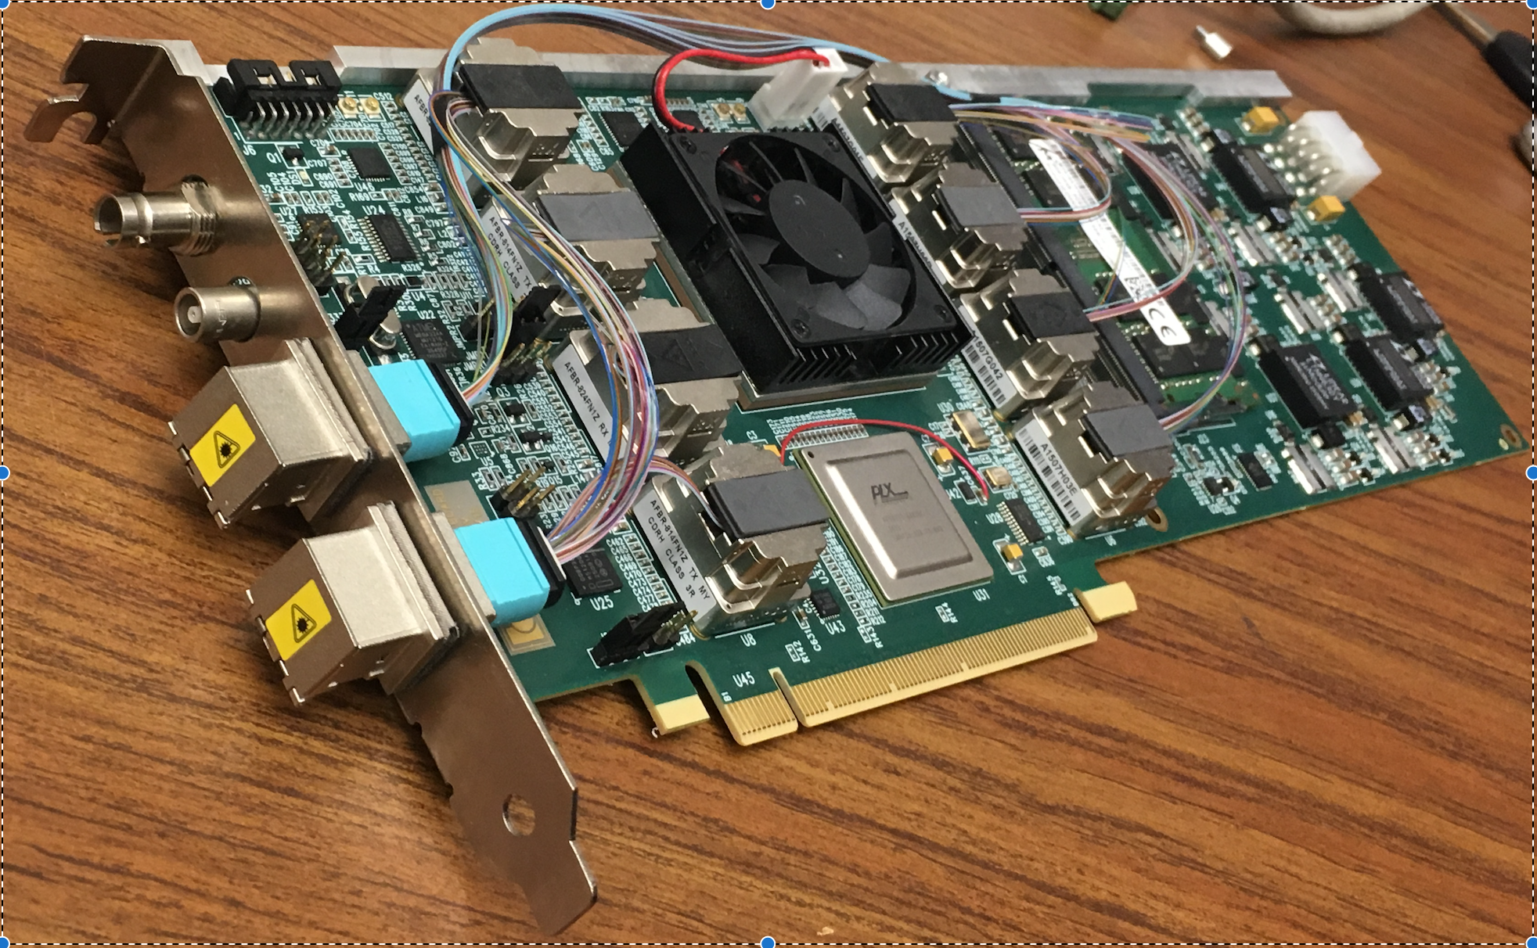
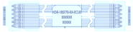
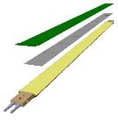

MVTX Electronics, Power and Controls
CAN bus
DCS
5-10 m
Trigger & Clock
Readout Unit
Front End
GBT Optical Links
9-sensor Stave
9 Data (1.2Gbps)
1 Clock, 1 Control/Trigger
Control
Data (9.6 Gb/s max)
Trigger
Samtec Twinax “FireFly”
FELIX
Back End
FPC
Power
Alpide Sensors
Filtering Capacitors
Power
regulators
Power supplies
Cold Plate
Regulated Power
Power Board
Interaction Region
Experimental Hall
Counting House
MVTX Detector Electronics consists of three parts
Sensor-Stave (9 ALPIDE chips) | Front End-Readout Unit |Back End-FELIX
(------- ALICE/ITS Hardware --------)
(- ATLAS Hardware -)

Slide 13
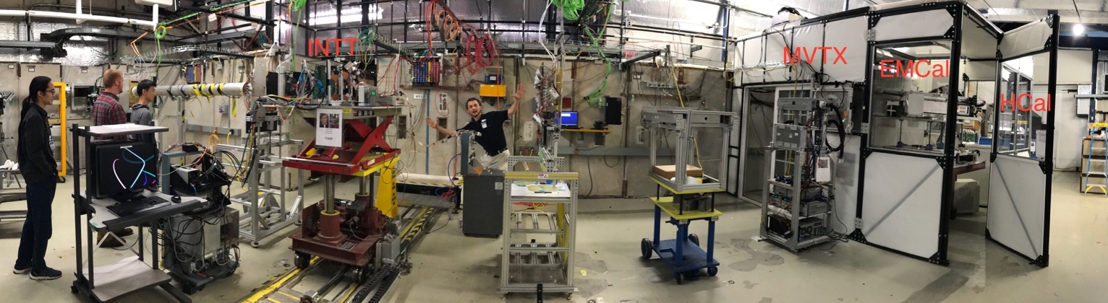
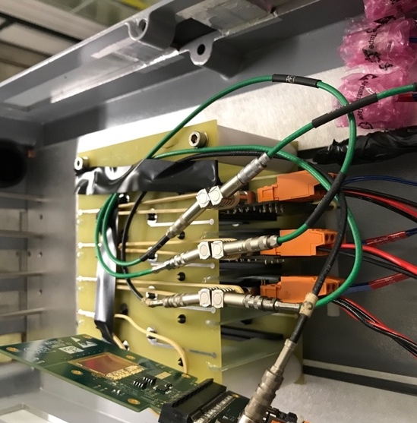
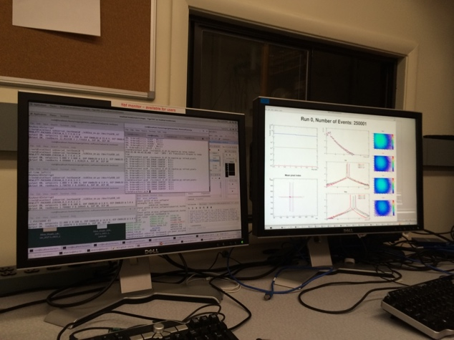
MVTX R&D Highlights
2018 test beam @Fermilab
INTT
MVTX EMCal HCal
Feb-July 2018 FermiLab Test beam facility, test of each sPHENIX detector subsystem
4x MVTX sensor in beam sPHENIX DAQ
MVTX Hit Spatial Resolution: < 5 um

Slide 14
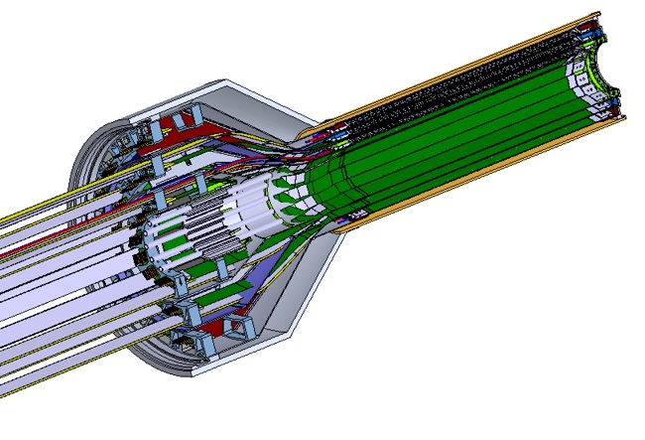
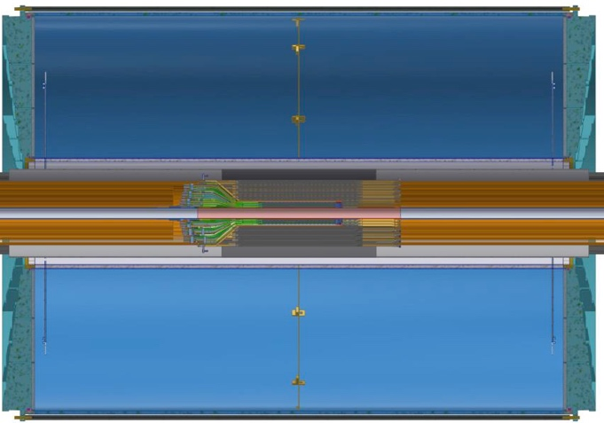

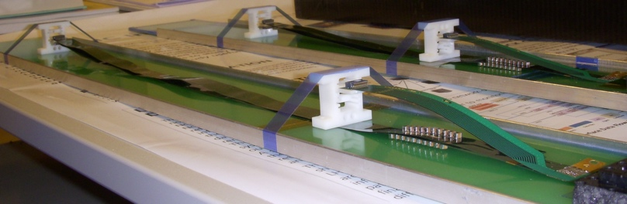
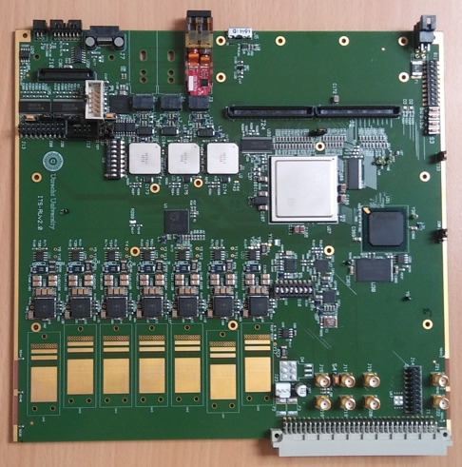
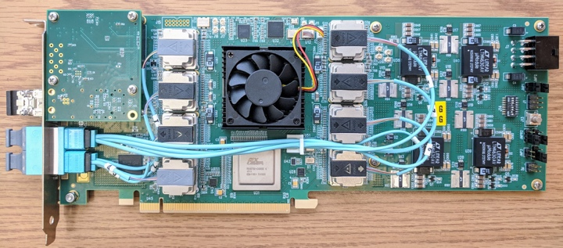
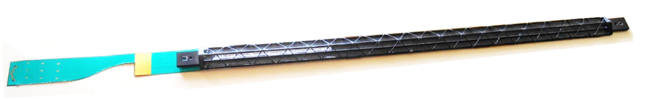
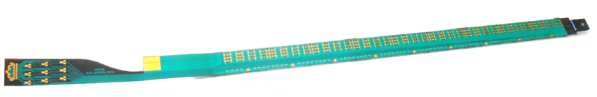
MVTX Production Status
Stave & RU: starts soon following ALICE ITS production at CERN
  84 Staves: 3-layer + spares (full inner 2-layer + 20%); 60 RUs: 48 + 25% spares
Back-end DAQ: sPHENIX production of ATLAS FELIX cards at BNL
Active length
~ 30 cm
Diameter
~ 8 cm
Sensor tested with sPHENIX extension
Readout Unit v2
Data Assembly Module (FELIX v2)
In close coordination with
R&D and production for
ALICE/ATLAS Phase-I upgrade
Notes:
48 staves + 100% spares
30-um-pitch, 200 M pixel, 0.3% X0/layer, 4-10 us integration time

Slide 15
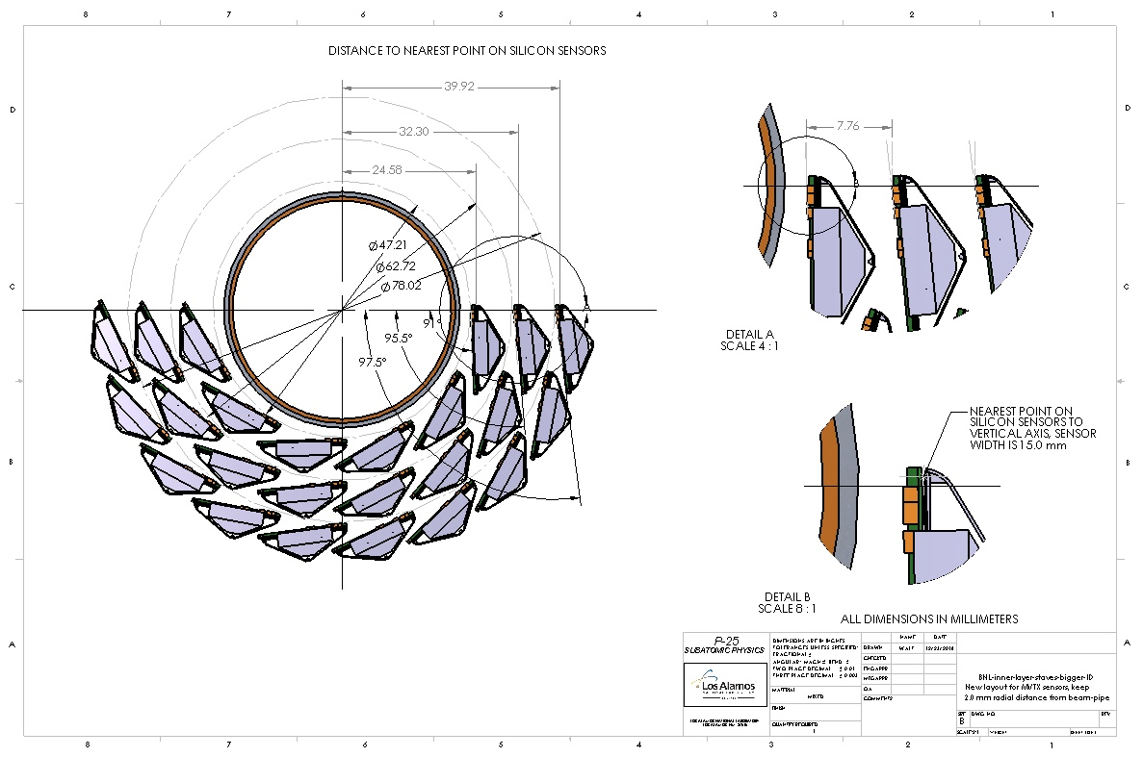
New MVTX Stave Configuration

Slide 16
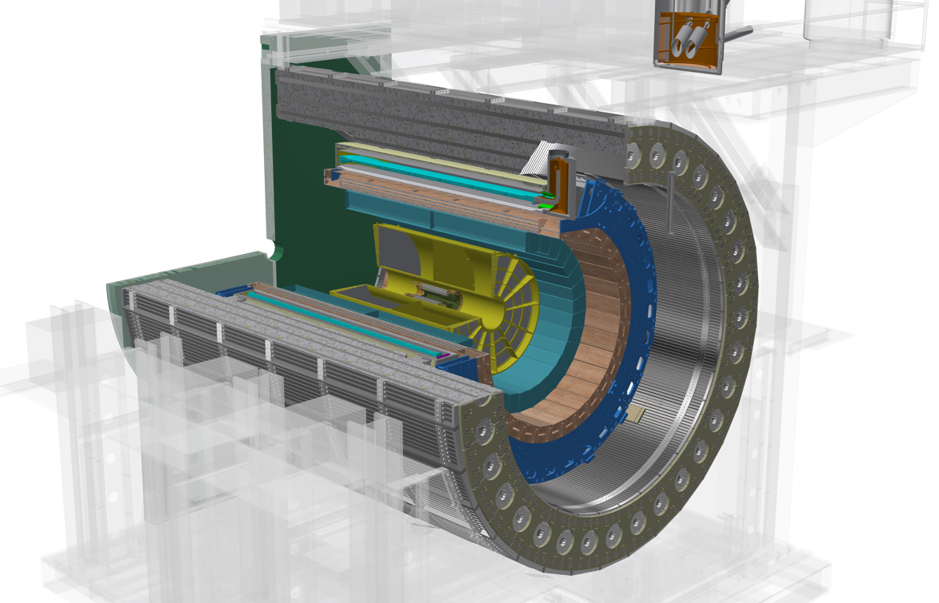

sPHENIX Tracking Detectors
See also calorimeters – Justin Frantz
MVTX
Diameter ~ 1.6 m
INTT
TPC
Inner tracker: |eta|<1
MVTX: MAPS pixel sensors (3-layer)
  Modified ALICE ITS IB staves
  integrated into sPHENIX
  Precision vertexing
INTT: strip silicon sensors (2-layer)
  Pattern recognition, timing
Outer tracker: |eta|<1
TPC: gateless and continuous readout
  Provide momentum measurement
δp/p < 2% for p_{T}<10 GeV/c

Slide 17
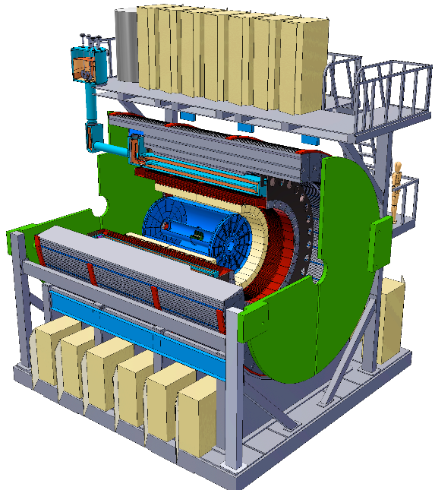
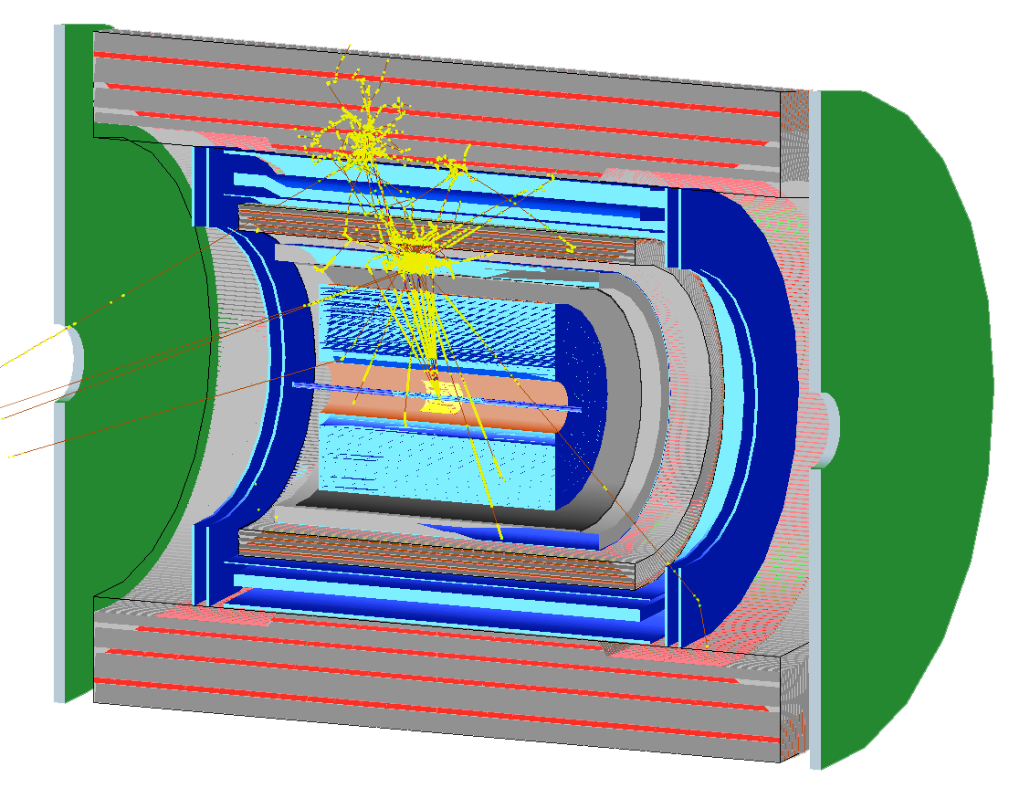
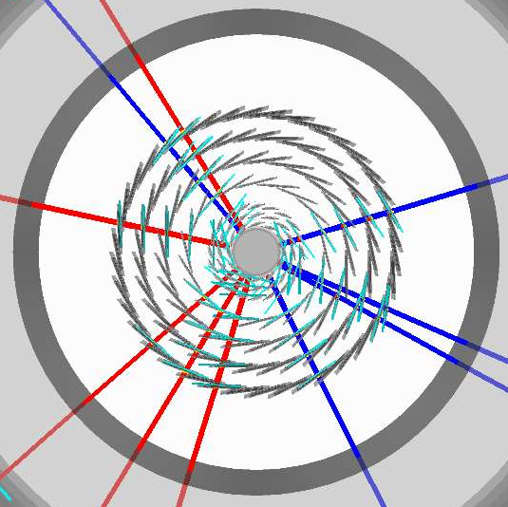
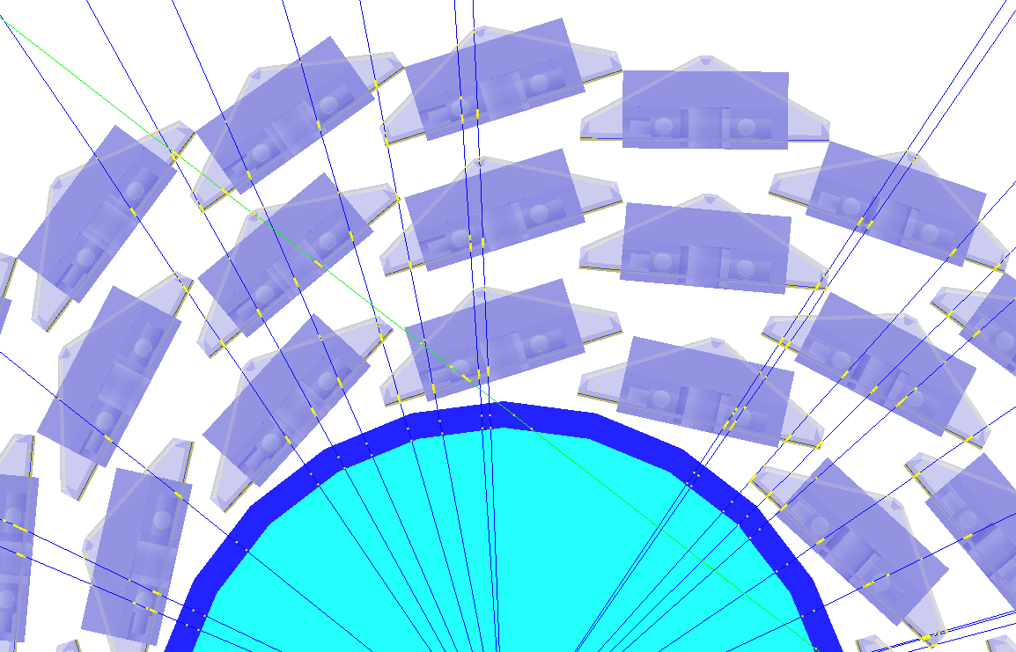
Simulation for b-jet and B-meson
sPHENIX Geant4 display of p_{T}=30 GeV/c B⁺-hadron
Design to Simulation
MVTX and INTT _
_ MVTX Ladders modeled in details
MVTX sensors
New design: 2-layer INTT (was 4)

Slide 18
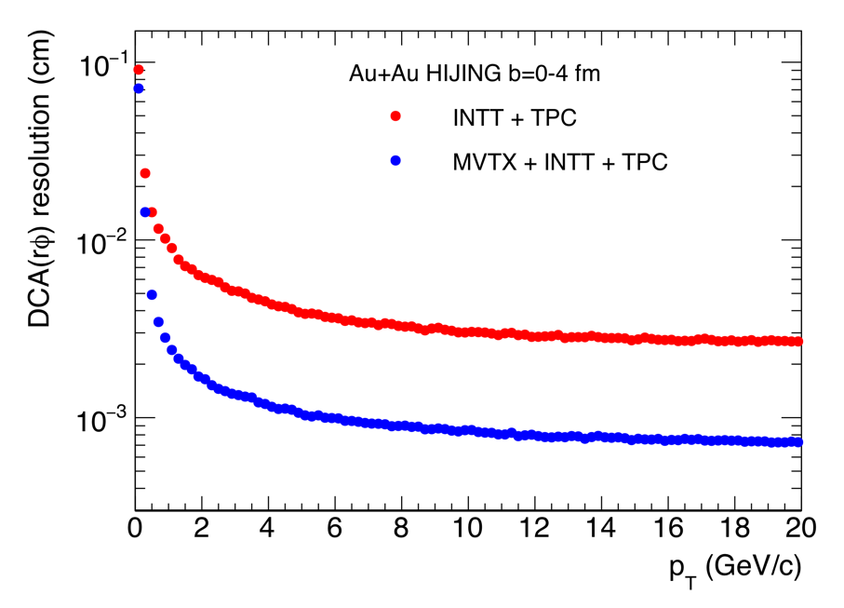
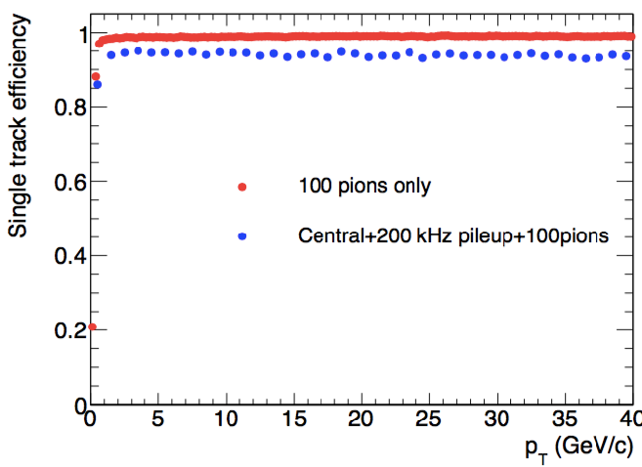
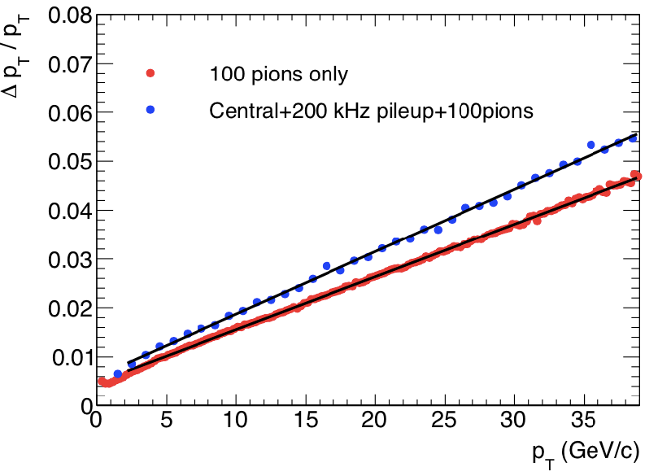
Tracking Performance
MVTX geometry modeled and digitized according to ALICE ITS/IB
Cluster resolution: ~5 µm
DCA_{2D ,} DCA_{z}<30 µm down to 1 GeV/c
Robust tracking at top projected RHIC collision rate
DCA_rφ

Slide 19
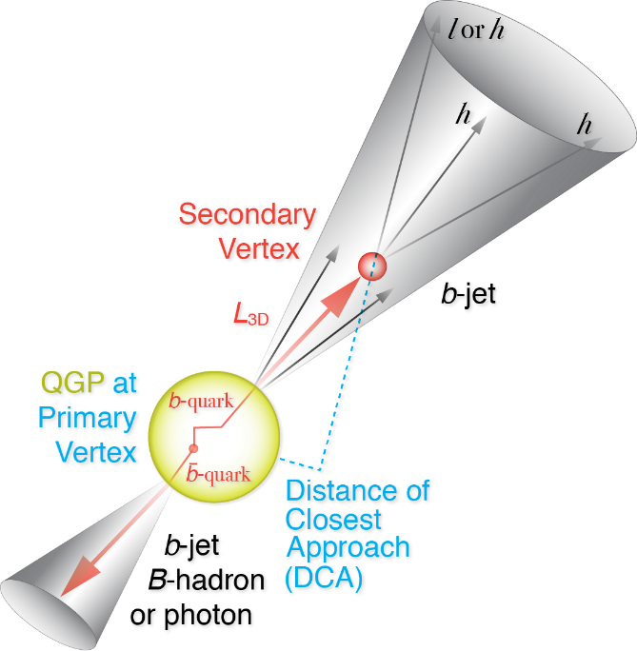
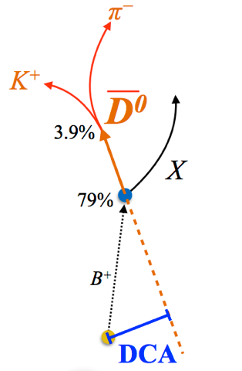
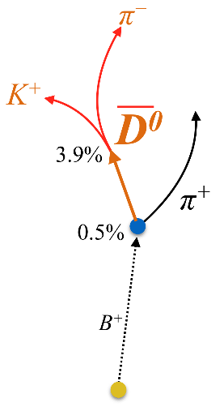
Open Charm & Beauty Production
Hadron | Abundance | cτ (μm)
D⁰ | 61% | 123
D⁺ | 24% | 312
D_{s} | 8% | 150
Λ_{c} | 6% | 60
B⁺ | 40% | 491
B⁰ | 40% | 455
B_{s} | 10% | 453
Λ_{b} | 10% | 435
b-tagged jet and cor.
p_{T}>15 GeV
60%
0.5%
p_{T}<15 GeV
Exploring and more

Slide 20
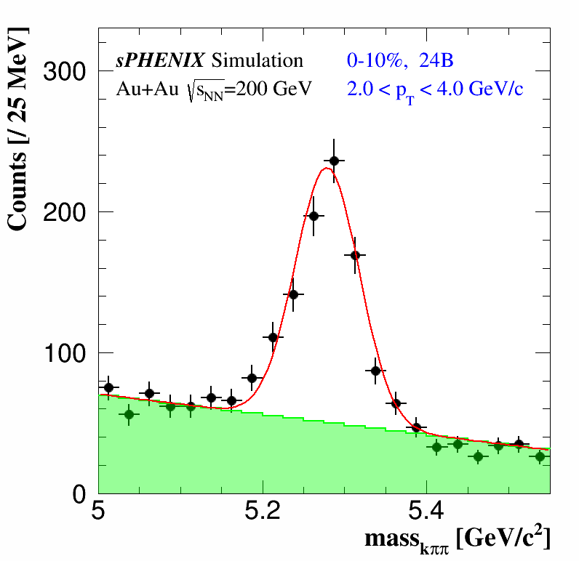
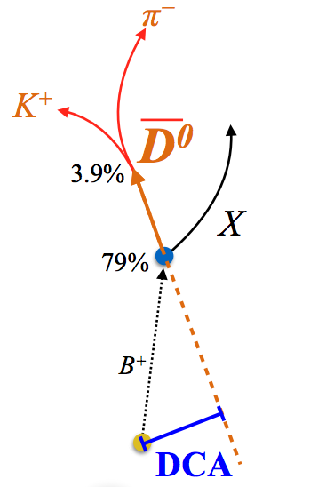
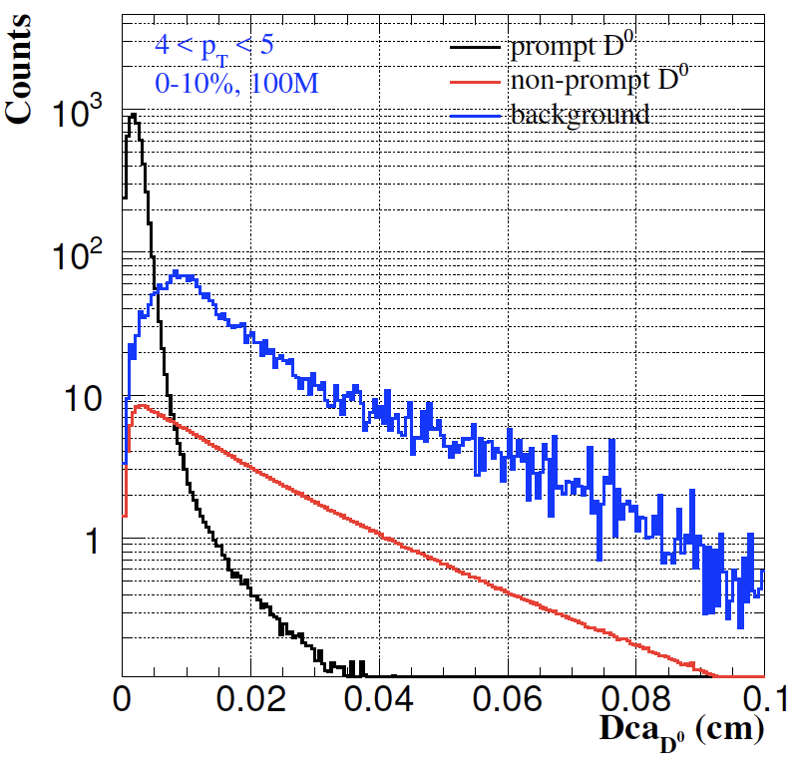
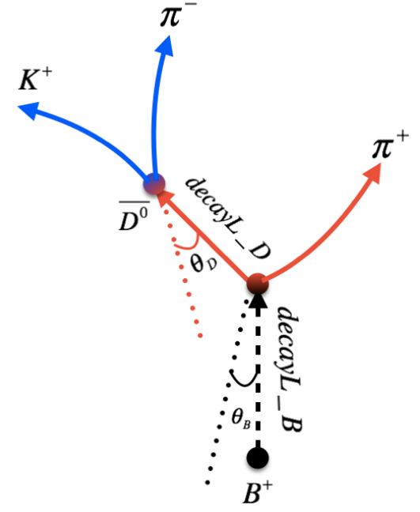
B-hadron Tagging
Impact parameter (DCA) method to tag non-prompt D⁰ from B-meson decays
Inclusive and exclusive channels possible

Slide 21
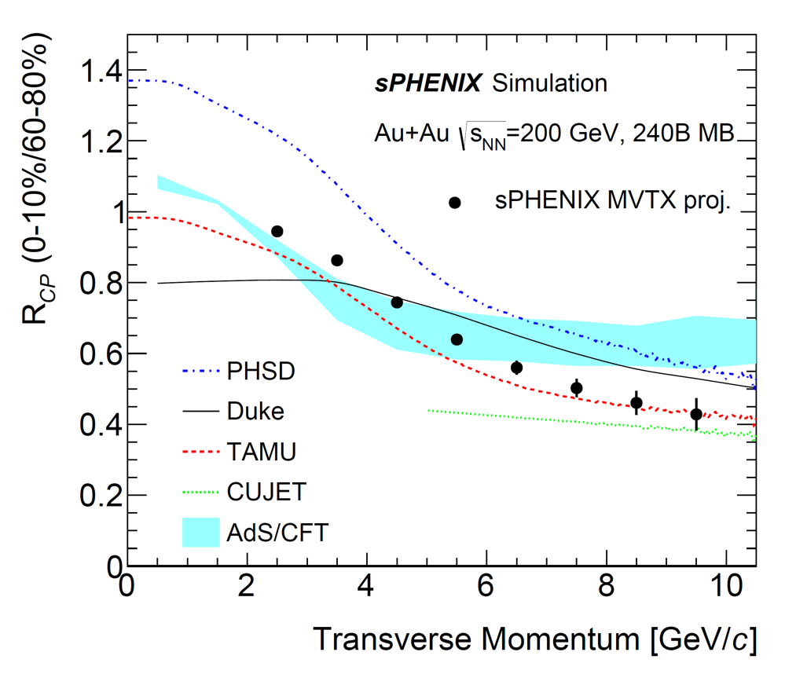
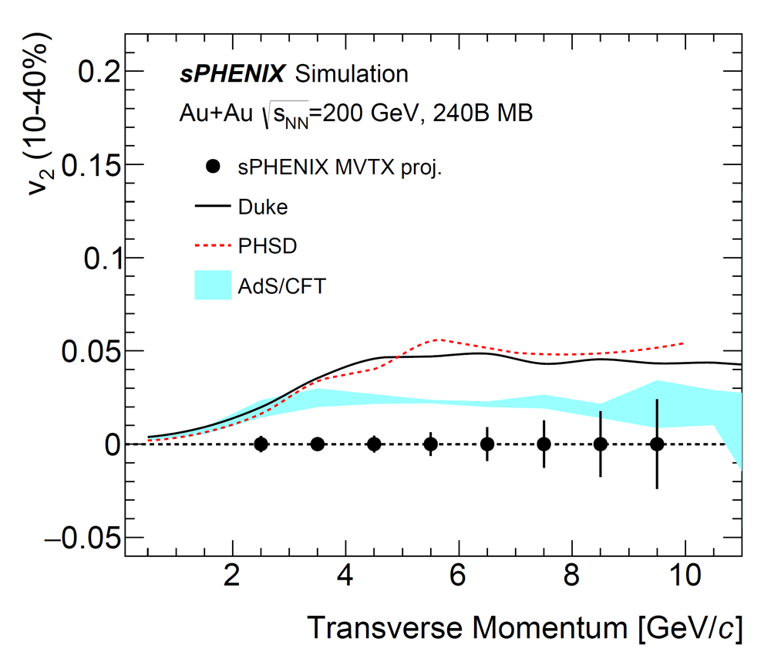
B-meson Projections
sPH-HF-2018-001 - MVTX Proposal
High precision non-prompt-D suppression and flow at RHIC
Determine the bottom quark collectivity
→ clean access to D_{HQ} at RHIC energy
A+A: non-prompt D-meson and predictions for sPHENIX
Notes:
Exploring B->J/psi (and maybe B->e high pT) channels

Slide 22
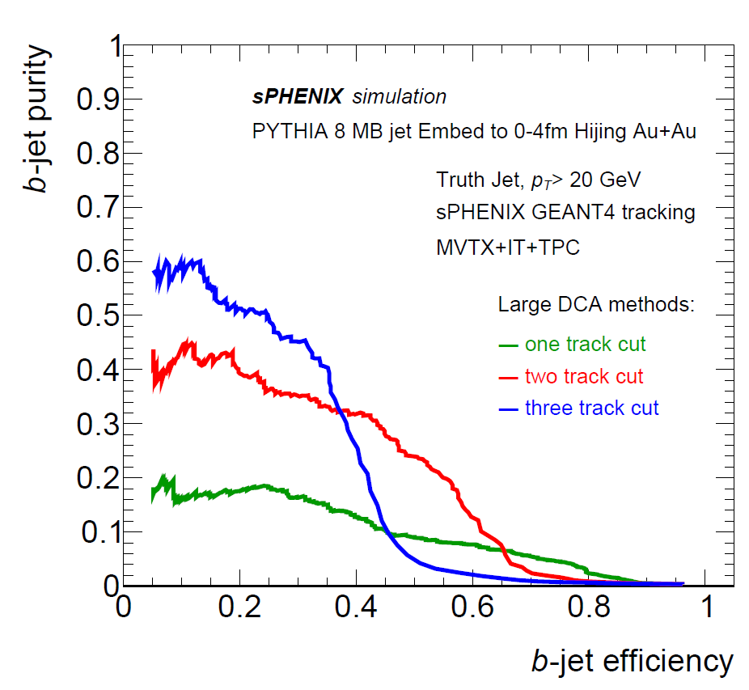


B-jet Tagging
Multi-tracks w/ large DCA
2nd vertex mass reco’d

Slide 23


b-jet Projections
sPH-HF-2018-001 - MVTX Proposal
High precision inclusive b-jet suppression and v₂ at RHIC
Strong constraints on energy loss models in QGP
A+A: Inclusive b-jet R_{AA}
Inclusive b-jet v₂

Slide 24



A Broad HF Physics Program
sPH-HF-2018-001 - MVTX Proposal
HF di-jet/hadron correlations, HF jet substructures
HF baryons, chemistry and hadronization
Total b-cross section for Upsilon baseline reference
A great opportunity for new ideas and new measurements
Di-b-jet p_{T} balance
Exclusive B± in most central Au+Au
90%
67%

Slide 25

sPHENIX Status and Plan
MVTX funded

Slide 26
A Rapidly Growing Collaboration

Slide 27





Summary and Outlook
sPHENIX is the next generation flagship heavy ion physics experiment in the US (NSAC LRP2015)
  Jets & Upsilons
  B hadron and b-jet physics enabled by MVTX
MVTX will complete QGP heavy flavor physics at RHIC
  Unambiguous determination of key parameters of QGP through precision study of open HF productions
MVTX on track for day-1 physics in 2023
  Production begins now
  Strong community support, ALICE, ATLAS, BNL, LANL et al
Complement & extend current and future RHIC and LHC QGP programs
sPHENIX Three Physics Pillars
Jets
Upsilons
B
D

Slide 28
backup

Slide 30


RHIC Multi-Year Plan: sPHENIX 2022-2026+
Evolving
Precision vertexing for B-tagging:
  Tracking resolution better than 50um @pT=1GeV
  High multiplicity HI collisions
  Low multiplicity but high rate p+p collisions
  High efficiency and high purity
B hadrons/pT<15GeV: O(1M)
b-jets/pT>15GeV: O(100K)

Slide 31






Recent Achievements on Bottom
LHC 2.76 TeV
RHIC 200 GeV
R_{AA}(J/ψ_{B}) > R_{AA}(D)
R_{AA}(e_{B}) > R_{AA}(e_{D+B})
R_{AA}(e_{B}) > R_{AA}(e_{D})

Slide 32
Latest Design: 3-layer MVTX + 2-layer INTT

Slide 33
sPHENIX vs LHC Projections
sPHENIX
projections

Slide 34

sPHENIX vs ALICE Specifications
 | ALICE (Run3) | sPHENIX
Pb+Pb / Au+Au | 100 kHz (50kHz) | 200 kHz
p+p | 400 kHz (200kHz) | 13 MHz
“Trigger” | C.R. (>50 kHz) | 15 kHz
Event size, dN/dη: sPHENIX = 1/3 ALICE (pp), 1/5 ALICE(AA)
sPHENIX
ALICE

Slide 35


Monolithic-Active-Pixel-Sensors (MAPS)
The next Generation State of the Art Pixel Tracker
FPC
Advantages of ALICE MAPS/ALPIDE:
  Very fine pitch (27x29 μm)
  High efficiency (>99%) and low noise (<10⁻⁶)
  Fast readout, ~5 μS
  Ultra-thin/low mass, 50μm (~0.3% X₀)
  On-pixel digitization, low power dissipation
An ideal detector for QGP b-jet physics!
9 Chips
Cooling plate
A 9-chip MAPS stave, 1.5 x 27cm²
ALPIDE design
50 μm
28 μm

