Slide 1
J/Psi Production and Asymmetry in Polarized p+p Collisions at RHIC
Ming Liu
Los Alamos National Laboratory
(for the PHENIX Collaboration)

Slide 2
Outline
The challenge:
  J/Psi production mechanisms in p+p
J/Psi spin asymmetry:
  New understanding of QCD process

Slide 3
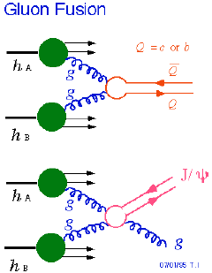
J/Psi & QCD
J/Psi is considered one of the simplest hadrons
  Charm and anti-charm “atom”
  Non-relativistic movement of charm quarks, wave functions
  Clean signature: di-lepton decay channel
Produced through “hard” scattering in p+p
  pQCD applicable: NRQCD
An excellent test ground for our understanding of QCD processes
@RHIC, LHC

Slide 4
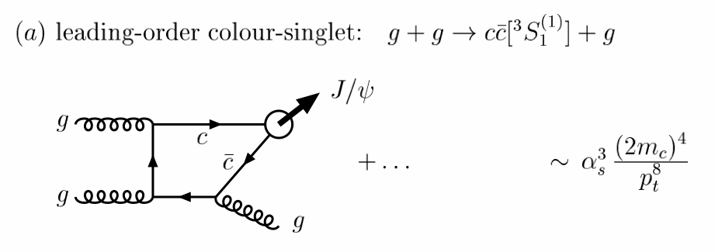
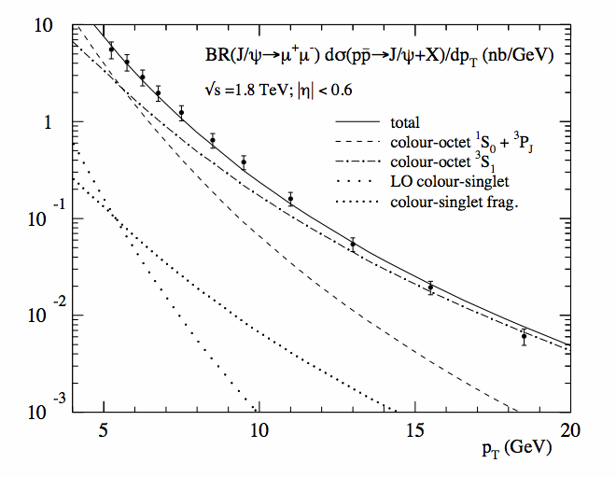
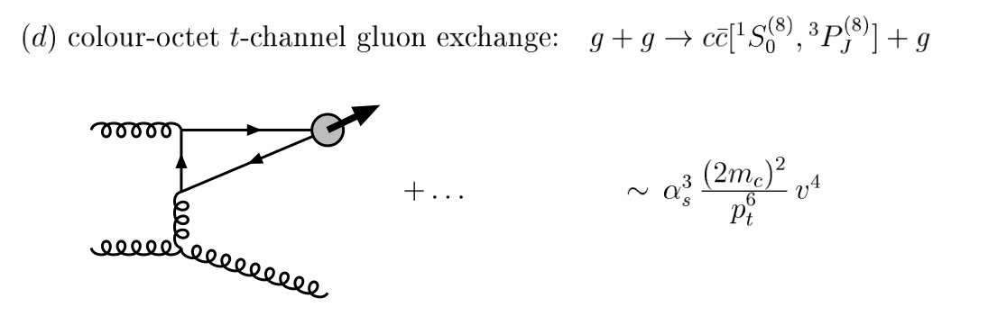
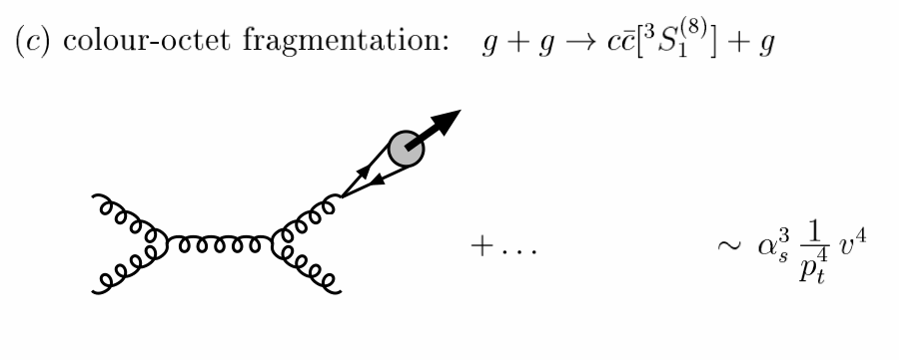
J/ψ Production in p+p Collisions
NRQCD @high pT:
Fixed the relative contributions from Data (CDF)
Prog.Part.Nucl.Phys.47:141-201,2001

Slide 5
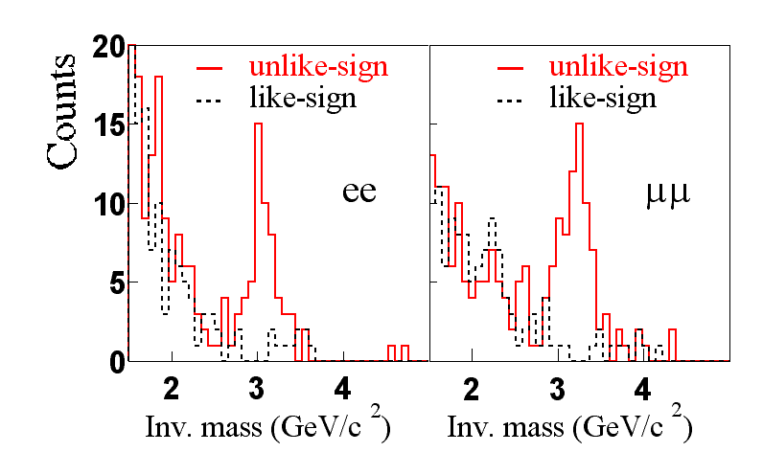
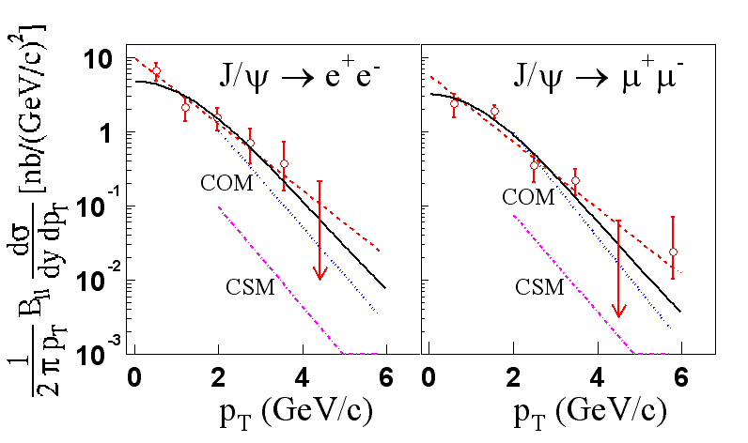
The First J/Psi Measurement @RHIC
NRQCD and J/ψ Cross Section
PHENIX, PRL 92, 051802 (2004)
Theoretical predictions of J/Ψ production at RHIC are in good agreement with the PHENIX data: COM process dominant
  PRD 68 (2003) 034003 G. Nayak, M. Liu, F. Cooper
  PRL 93 (2004) 171801 F. Cooper, M. Liu, G. Nayak

Slide 6
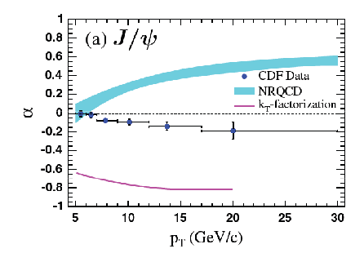
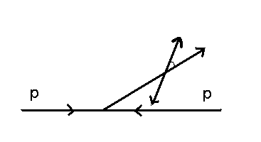
A Challenge to NRQCD: J/ψ Polarization
CDF Run-II
α= +1: transversely polarized
α= -1: longitudinally polarized
α= 0: no polarization
μ⁺
J/ψ
θ*
μ⁻
NRQCD failed badly on J/Psi polarization in pp
- HI connection: what happens in AA?
Notes:
Measurement of J/psi polarization will be a crucial test for the color octet model since it predicts large transverse polarization at high pT.
Experimentally, we measure decay angle distribution at the CM system of the J/psi. This is an expected distribution when we assume unpolarized J/psi.
Sensitivity of alpha is 0.02 for pT is over 2GeV/c J/psi, and 0.1 for pT is over 5GeV/c J/psi.

Slide 7
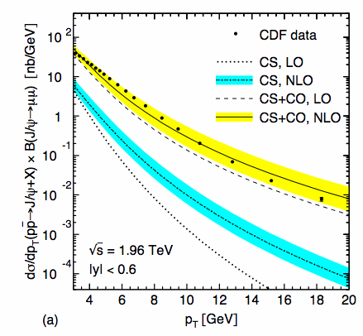
J/Psi pT Distr. and NRQCD Fit
J/Psi pT distr. in CO and CS @LO NRQCD
  COM
  CSM
NLO corrections sizable
  change the pT shapes
  Higher order contributions unknown
  Hard to separate CO and CS contributions from pT fit alone
    Y. Ma et al., PRL 106, 042002 (2011)
    M. Buternschoen et al. PRL 106, 022003,(2011)
Production mechanism – an open question.
  Any other new observables?
PLR 106, 022003,(2011)

Slide 8
A Possible New Observable to Study J/Psi Production Mechanisms
J/Psi Transverse Spin Asymmetry

Slide 9
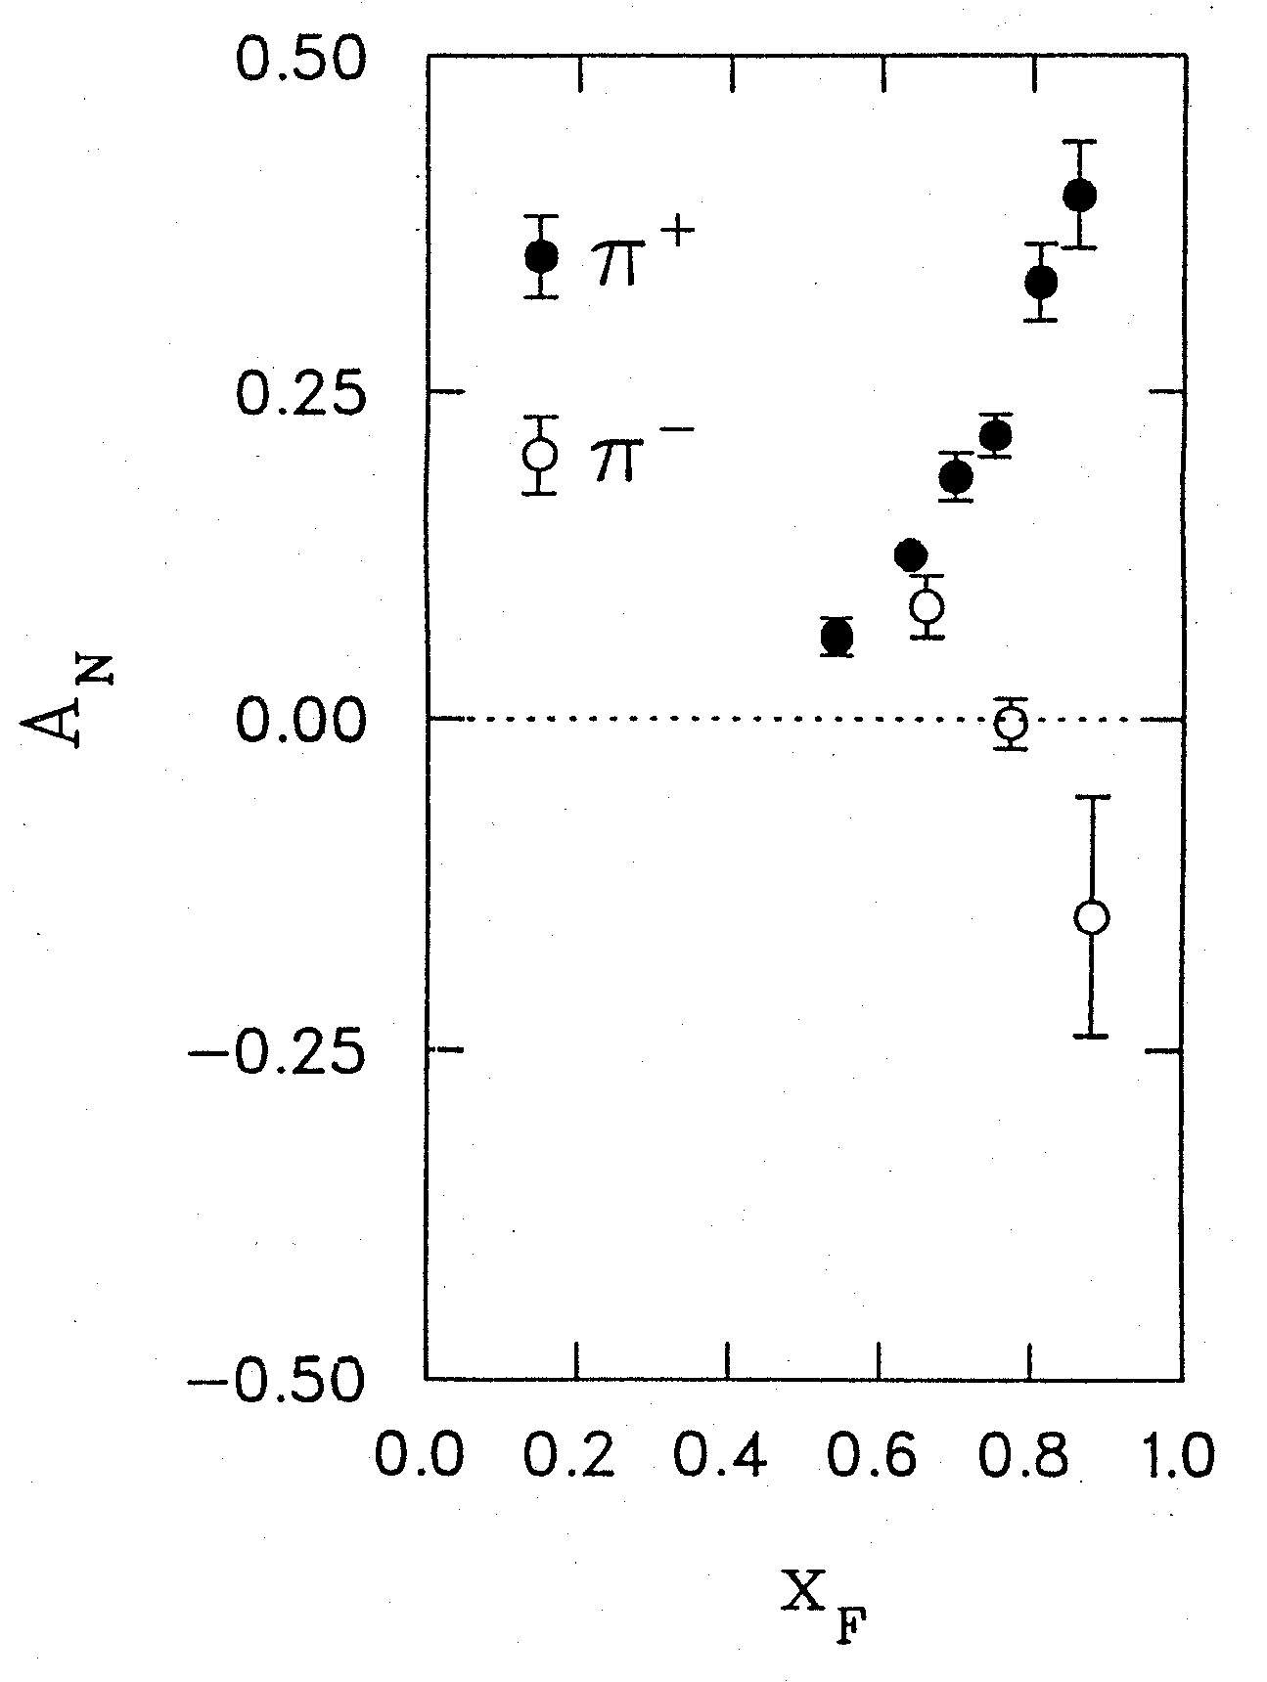
A Puzzle in Spin Physics
A. Vossen’s talk on Mon.
Transverse Single Spin Asymmetries A_{N}
Left
Argonne ZGS, p_{beam} = 12 GeV/c
Right
Theory Expectation:
Small asymmetries at high energies
(Kane, Pumplin, Repko, PRL 41, 1689–1692 (1978) )
A_{N}
A_{N} ~ O(10⁻⁴) theory
Experiments:
ZGS, AGS, FERMILAB to RHIC
A_{N} ~ O(10⁻¹) observed
W.H. Dragoset et al., PRL36, 929 (1976)

Slide 10
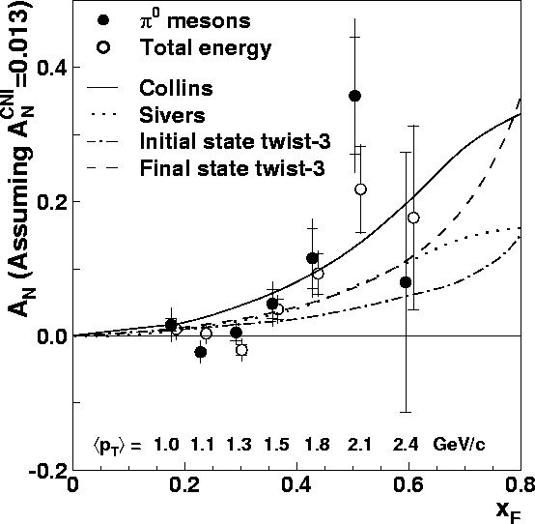
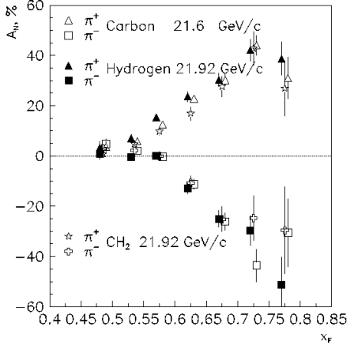
Transverse SSA’s : π^{0,±} from low to high energies
RHIC 10,000 GeV beam
FNAL 200 GeV beam
AGS 22 GeV beam
ZGS 12 GeV beam
PRL (2004)
PLB261, 201 (1991)
PLB264, 462 (1991)
PRD65, 092008 (2002)
PRL36, 929 (1976)
Non-Perturbative cross section
Perturbative cross section

Slide 11
Possible Mechanisms for large A_{N} …
Sivers mechanism: Correlation between nucleon spin and parton k_{T}
Collins mechanism: Transversity (quark polarization) * spin-dependent fragmentation
Phys Rev D41 (1990) 83; 43 (1991) 261
Nucl Phys B396 (1993) 161
S_{P}
S_{P}
S_{q}
p
k_{T,q}
p
p
p
S_{q}
k_{T,π}
Orbital Angular Momentum?
Quark’s Sivers and Collins functions well measured from polarized DIS
Gluon’s Sivers poorly known; no Collins effect due to zero tranversity

Slide 12
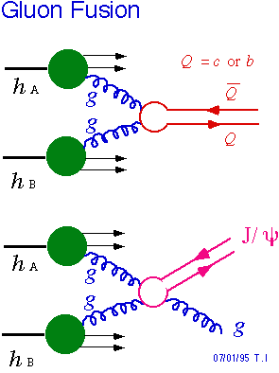
Heavy Flavor TSSA and Gluon’s Sivers Function
Heavy flavor production dominated by gluon gluon fusion at RHIC energy
Pythia 6.1 simulation (LO) @200GeV
Gluon has zero transversity
  Minimize Collins’ effects
Sensitive to the poorly known gluon Sivers functions
  corresponding to the twist-3 tri-gluon correlation functions in the collinear approach
Sensitive to J/ψ production mechanisms if gluon’s Sivers function is non-zero

Slide 13
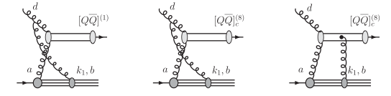
A new Theoretical Development about J/Psi TSSA
  J/ψ TSSA is sensitive to the production mechanisms
  Assuming a non-zero gluon sivers function, In pp scattering, TSSA vanishes if the pair are produced in a color-octet model but survives in the color-singlet model
  Feng Yuan, Phys. Rev D78, 014024(2008)
One color-singlet diagram
— no cancellation, asymmetry generated by the initial state interaction
Two color-octet diagrams
— cancellation between initial and final state interactions, no asymmetry
Let’s measure it!

Slide 14
RHIC Polarized Proton Collider
Absolute Polarimeter (H jet)
RHIC pC Polarimeters
Siberian Snakes
PHOBOS
BRAHMS & PP2PP
Siberian Snakes
Spin Flipper
STAR
PHENIX
Spin Rotators
Partial Snake
Helical Partial
Snake
Energy: up to 500GeV
Pol: 70%
Polarized Source
Strong Snake
LINAC
AGS
200 MeV Polarimeter
BOOSTER
Rf Dipole
AGS Internal Polarimeter
AGS pC Polarimeter
14

Slide 15
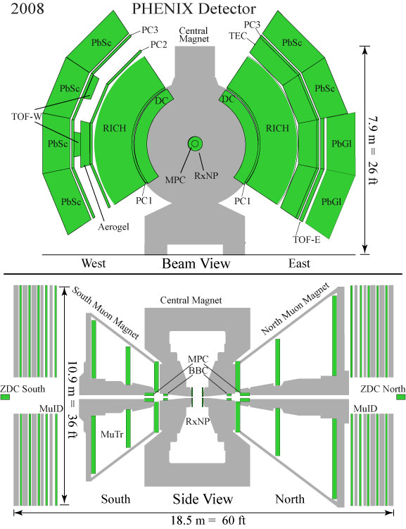
PHENIX Detectors
Central Arm |η| < 0.35
  Drift Chamber (DC)
  PbGl and PbSc
  Ring Imaging Cherenkov Detector (RICH)
  Pad Chambers (PC)
  Time Expansion Chamber (TEC)
Global Detectors (Luminosity,Trigger)
  BBC
  ZDC
Muon Arms 1.2 < |η| < 2.4
  Muon tracker (MuTr)
  Muon Identifier (MuID)
e⁺
e⁻
μ⁺
μ⁻
Year | √s [GeV] | Recorded L | Pol [%] | FOM (P²L)
2006 (Run 6) | 200 | 2.7 pb⁻¹ | 51 | 700 nb⁻¹
2008 (Run 8) | 200 | 5.2 pb⁻¹ | 46 | 1100 nb⁻¹

Slide 16
Transverse p + p Runs in 2006 and 2008
y
x
y
x
2006
2008
z
z
South
North
South
North
Blue
Blue
Yellow
Yellow
Define Left:
Right:
Beam Polarization: 2006: 0.53 ± 0.02 (syst.) (clockwise – Blue)
0.52 ± 0.02 (syst.) (counterclockwise – Yellow)
2008: 0.48 ± 0.02 (syst.) (clockwise)
0.41 ± 0.02 (syst.) (counterclockwise)
Left
Right

Slide 17
Asymmetry Measurements
TSSA
Final asymmetry
If both beams are polarized

Slide 18
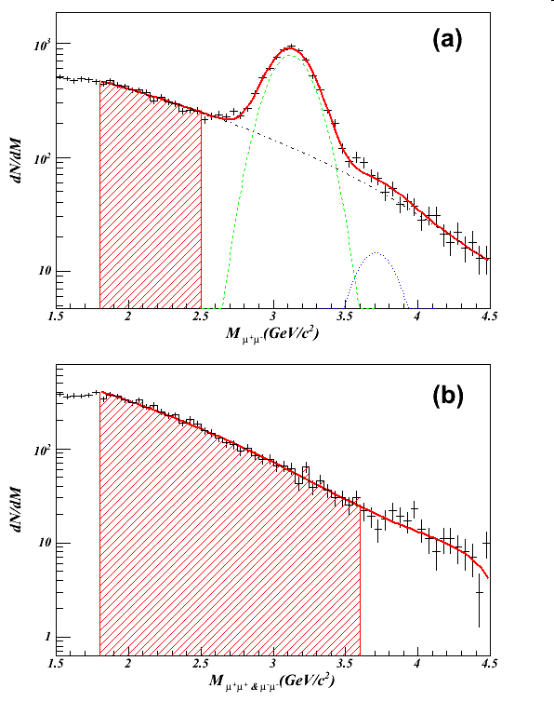
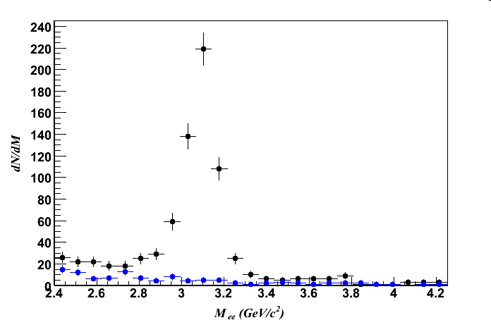
J/ψ Measurements in the Muon and Central Arms
In Muon Arm
A_{N}^{Incl}: oppositely-charged muon pairs in the
invariant mass range ±2σ around J/ψ mass.
A_{N}^{BG}: oppositely-charged muon pairs in the
invariant mass range 1.8 (2.0 run8) < m <2.5
along with charged pairs of the same sign in
invariant mass range 1.8 (2.0 run8) < m < 3.6
In Central Arm
BG subtraction: 2*sqrt{N_{e+e+}N_{e-e-}}
Remaining continuum background
Is small, not enough statistics
Assuming: A_{N}^{BG}=0

Slide 19
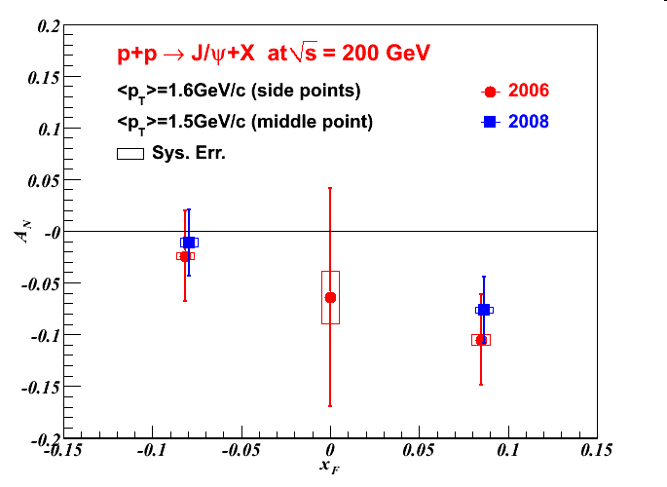
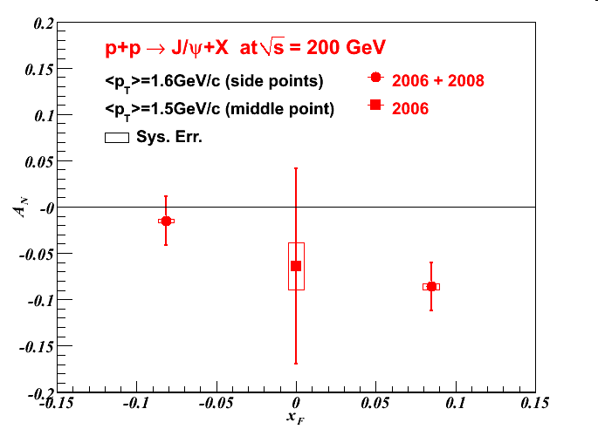
J/ψ A_{N} vs x_{F}
PHENIX PRD 82, 112008 (2010)
Asymmetries were obtained as a function of J/Psi Feynman-x,
with a value of -0.086 ± 0.026 (stat.) ± 0.003 (sys.) in the forward region.
Suggests possible non-zero tri-gluon correlation functions (gluon Sivers functions) in transversely polarized protons.
Possible significant Color Singlet channel contribution?
More theoretical and experimental investigations are needed!

Slide 20
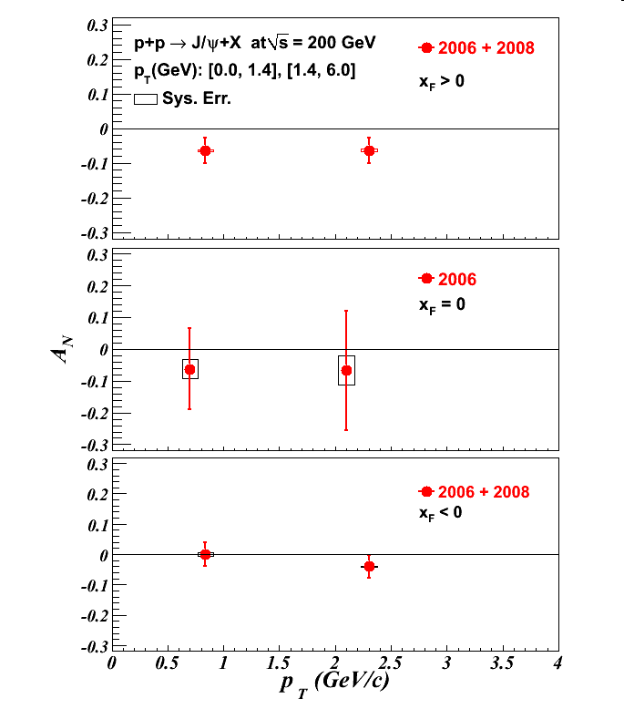
Results: A_{N} vs p_{T}

Slide 21
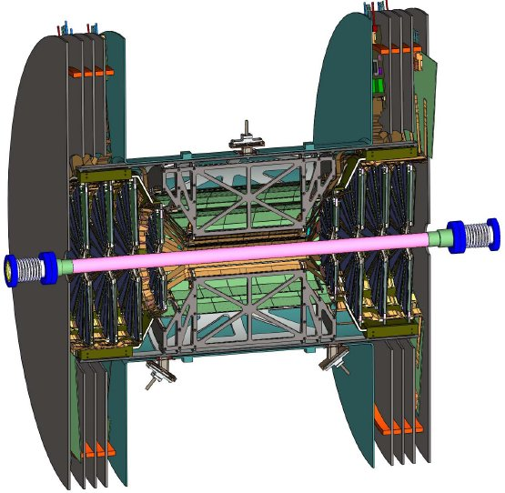
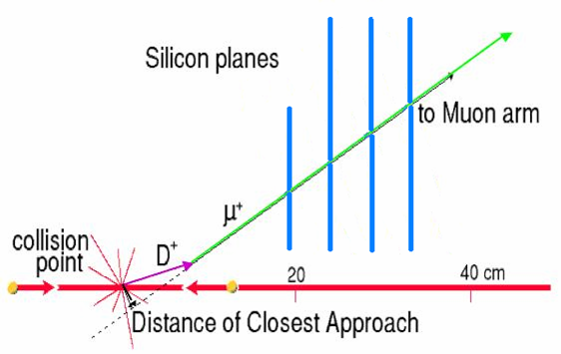
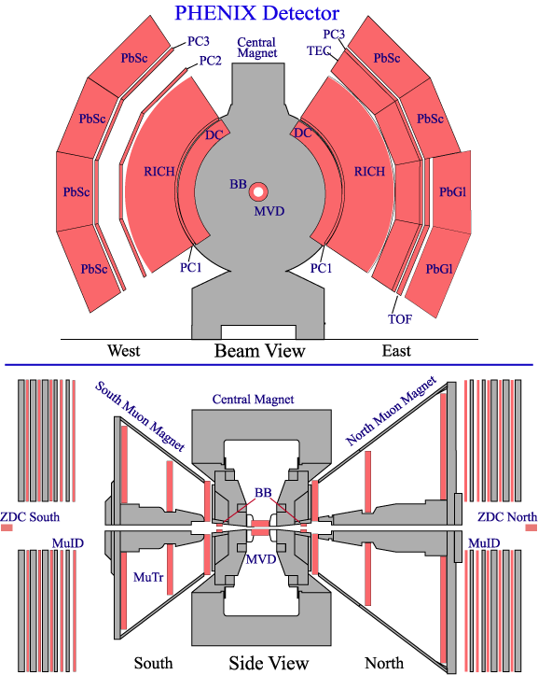
Future Prospects
PHENIX Forward Silicon VTX Upgrades: by 2011
Precision Charm/Beauty Measurements
B→J/ψ, Drell-Yan, ψ’
Drell-Yan
prompt
π→μ

Slide 22
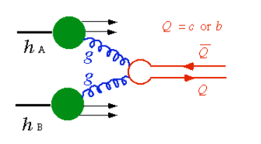
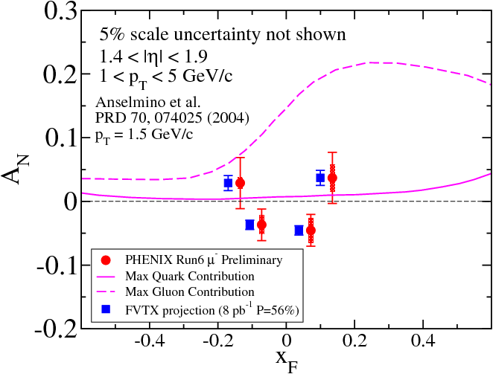
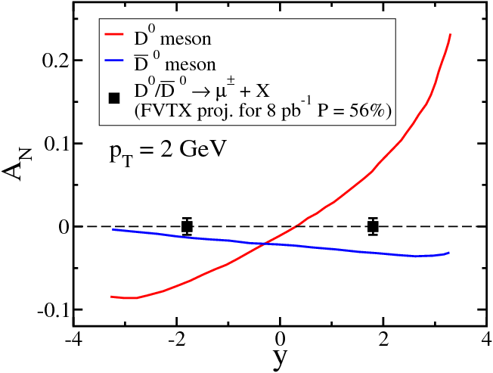
Charm SSA to Probe Gluon Sivers Distribution
D meson Single-Spin Asymmetry:
Production dominated by gluon-gluon fusion
Sensitive to gluon Sivers distribution
  PHENIX-2006 data ruled out the max. gluon Sivers
  Much improved results expected with VTX detectors
Kang, Qiu, Yuan, Vogelsang, Phys. Rev. D 78,114013(2008)

Slide 23
Summary and Outlook
First measurements of TSSA in J/Psi production in p+p collisions at RHIC
  In the forward direction, 3.3σ effect observed
  A_{N} = -0.086 ± 0.026 (stat.) ± 0.003 (sys.)
  Possible none-zero Gluon Sivers (or Twist-3 funcs)
  Suggesting possible significant Color Singlet contribution at RHIC
Much improved results expected in near future
  Future high luminosity runs
  FVTX upgrade:
    Psi’, DY asymmetry possible
    Open charm to constrain gluon’s Sivers (or Twist-3)functions
Active theoretical work ongoing for better understanding of J/psi production mechanisms.

Slide 24
backup

Slide 25
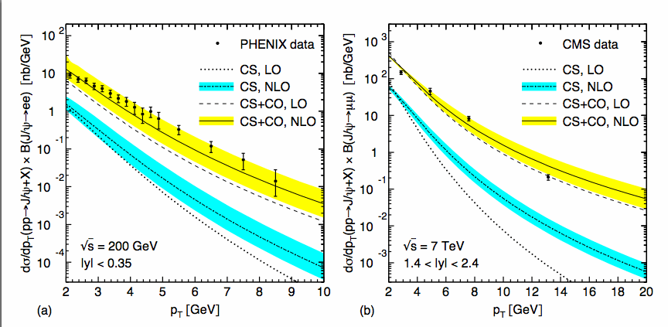
NRQCD @NLO

Slide 26
Theoretical Models of TSSA (I)
1. Transverse momentum dependent (TMD) function approach
-- Quark transversity distributions and Collins spin dependant fragmentation function
-- Sivers quark-distribution
Correlation between proton-spin and quark transverse momentum
Assuming TMD factorization….
TMD factorization is not valid for process involving more than two hadrons.
T.Rogers, P Mulders, PRD81, 094006(2010)
26

Slide 27
Theoretical Models of TSSA (II)
2. Collinear factorization approach
Twist-3 factorization works at Q >>Λ_{QCD},
-- Twist-3 quark-gluon correlation function T_{F}
-- Two independent tri-gluon correlation functions
represent integrated spin dependence of the partons transverse motion
k┴ is integrated
are related to the k┴ integrated moment of the corresponding quark/gluon Sivers function

Slide 28
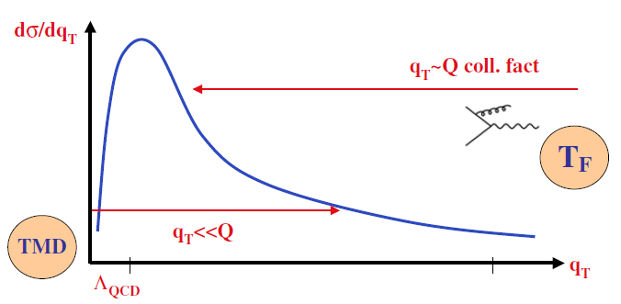
TMDs and Collinear Twist-3 Functions
For DY process, when Q~q_{T}>>Λ_{QCD}, TMDs can be calculated in pQCD and expressed in terms of twist-3 functions.
Ji, Qiu, Vogelsang and Yuan
PRL 97, 082002 (2006)
PRL 97, 082002 (2006)
PRL 97, 082002 (2006)
PRL 97, 082002 (2006)
In the overlap region both approaches give the same physics
Case study: Drell-yan

Slide 29
Effective Luminosity:
Run6: S: 1.63pb⁻¹ , N: 1.75pb⁻¹,
Run8: S: 4.30pb⁻¹, N: 4.33pb⁻¹
Fill-by-fill analysis
Asymmetry measured fill by fill
Fix mass range to extract the number of J/Ψ (2σ)
Track/Event Selection
Rapidity range: 1.2 < |y| < 2.2
Event vertex cut: < 35cm
J/ψ P_{T} range : 0 - 6 GeV/c
Muon Track p_{Z} cut: 1.4 < |p_{Z}|< 20

Slide 30
Effective Luminosity
Run6: 1.36pb⁻¹
Rapidity range:
|η|< 0.35
Too small statistics in central arm to calculate
asymmetry for each store.
It require: R_{i} =<R>, f_{i} = <f>, P_{i} = <P> for all i
Stabilize relative luminosities method:
Several bunches of colliding protons are removed from the analysis so that the relative luminosity within each store is brought as close to unity as possible.
BG subtraction:
Remaining continuum background
Is small, not enough statistics
Assuming: A_{N}^{BG}=0

