Slide 1
Study QGP with sPHENIX Upgrade at the Relativistic Heavy Ion Collider
Ming X. Liu
Los Alamos National Laboratory
01/08/2018

Slide 2
Outline
Physics motivation
sPHENIX proposal
Heavy Flavor physics and MVTX upgrade
Outlook

Slide 3
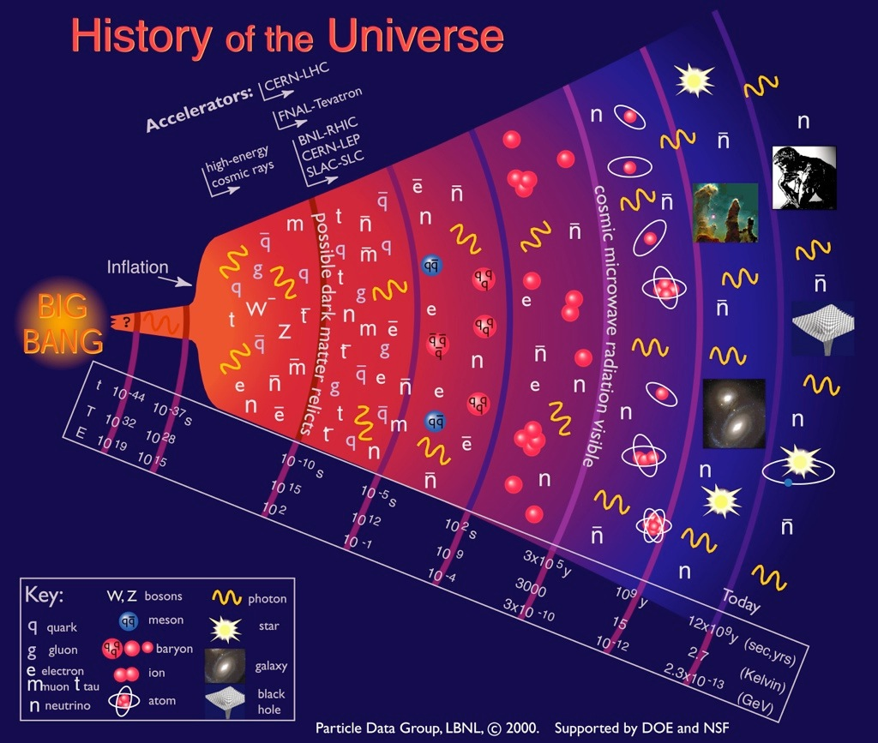
Quark-Gluon
Plasma (QGP)

Slide 4
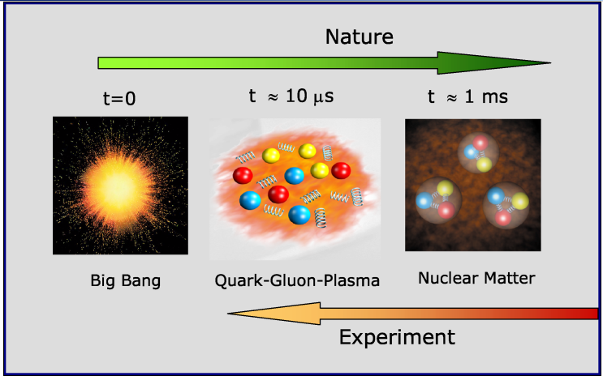
Quark Gluon Plasma and Heavy Ion Collisions

Slide 5
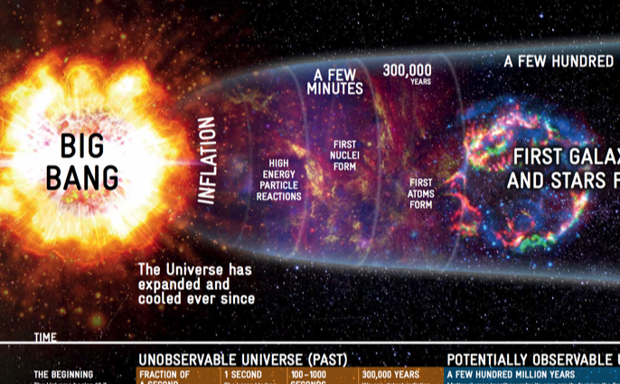

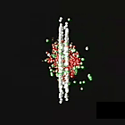
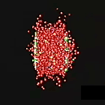
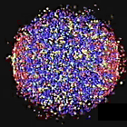
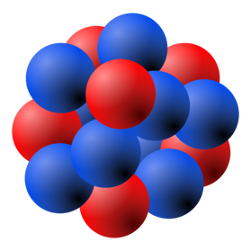


Heavy Ion Collisions
- Artists’ View
¹⁹⁷Au
¹⁹⁷Au
About to collide
Ion collision
Quarks and gluons freed
QGP formed
Relativistic Lorentz Contraction:
At RHIC (LHC):
¹⁹⁷Au

Slide 6
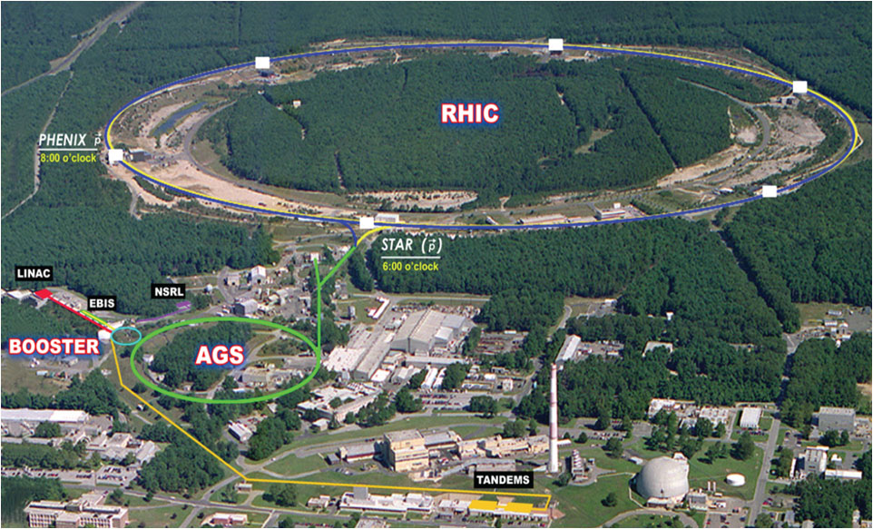
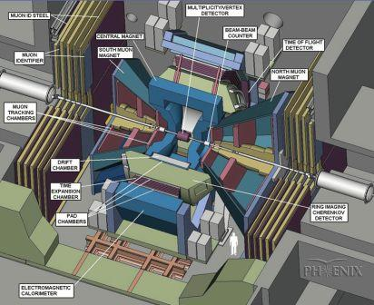

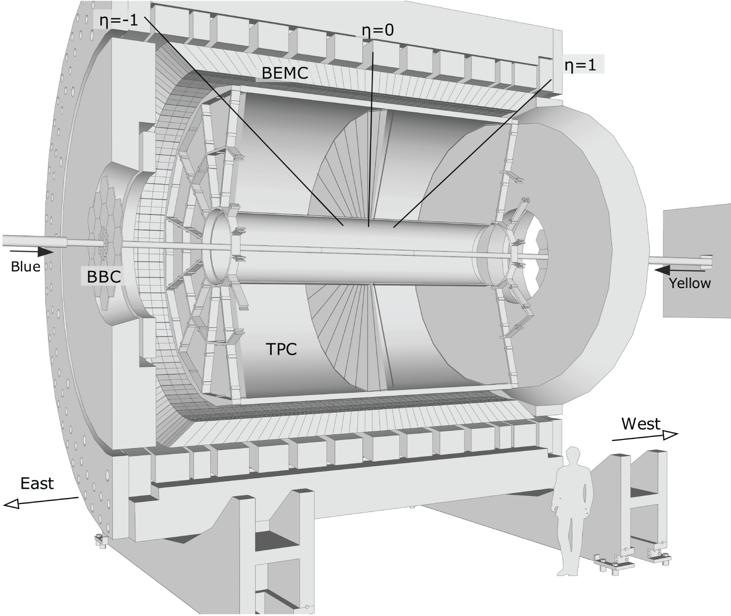
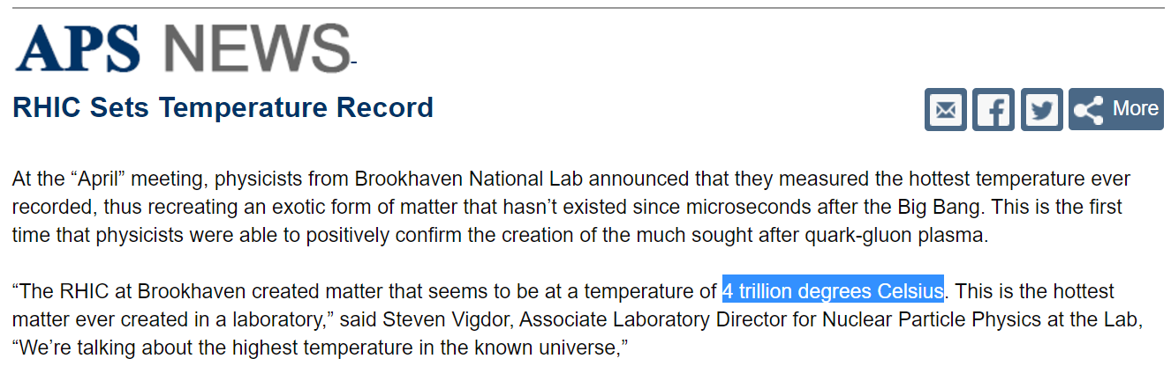
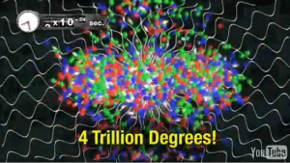
RHIC: Relativistic Heavy Ion Collider @BNL
Φ 1.2km
Mar, (2010)
The most versatile hadron collider in the world, and world’s first and only spin-polarized proton collider.
Discovery of Quark Gluon Plasma
Reached x40 of designed luminosity.
Two major experiments as of today
Pioneering High Energy Nuclear Interaction eXperiment (PHENIX) → sPHENIX
Solenoidal Tracker At RHIC (STAR, J. Zhang, Tue)
PHENIX, Phys. Rev. Lett. 104, 132301

Slide 7
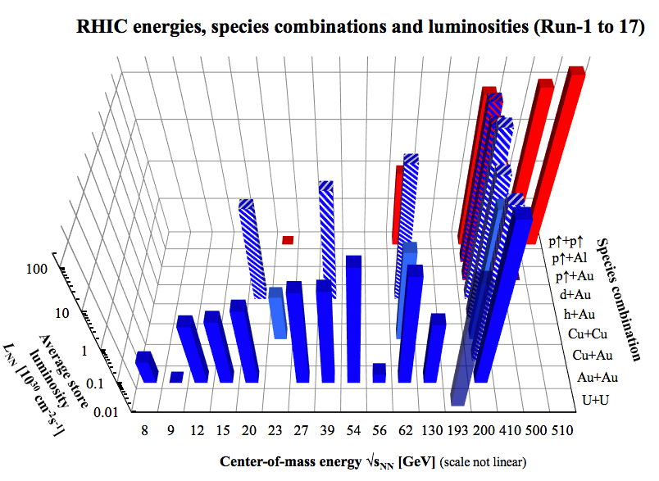
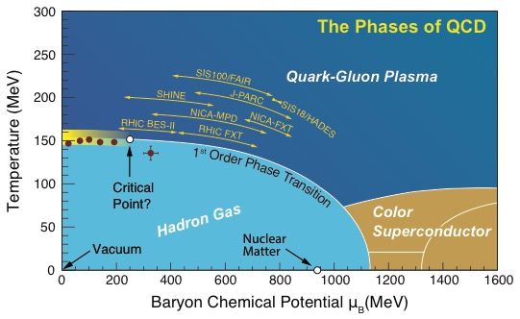
RHIC Delivers Whatever it Takes
The world’s most versatile facility for the exploration of the phases of QCD matter from high temperature to high baryon density.
Discovery of “perfect liquid” QGP
Discovery of jet quenching in QGP
Proton spin decomposition, quark & gluon
RHIC
Run18 in preparation: (⁹⁶Zr⁴⁰⁺ + ⁹⁶Zr⁴⁰⁺) and (⁹⁶Ru⁴⁴⁺ + ⁹⁶Ru⁴⁴⁺)

Slide 8
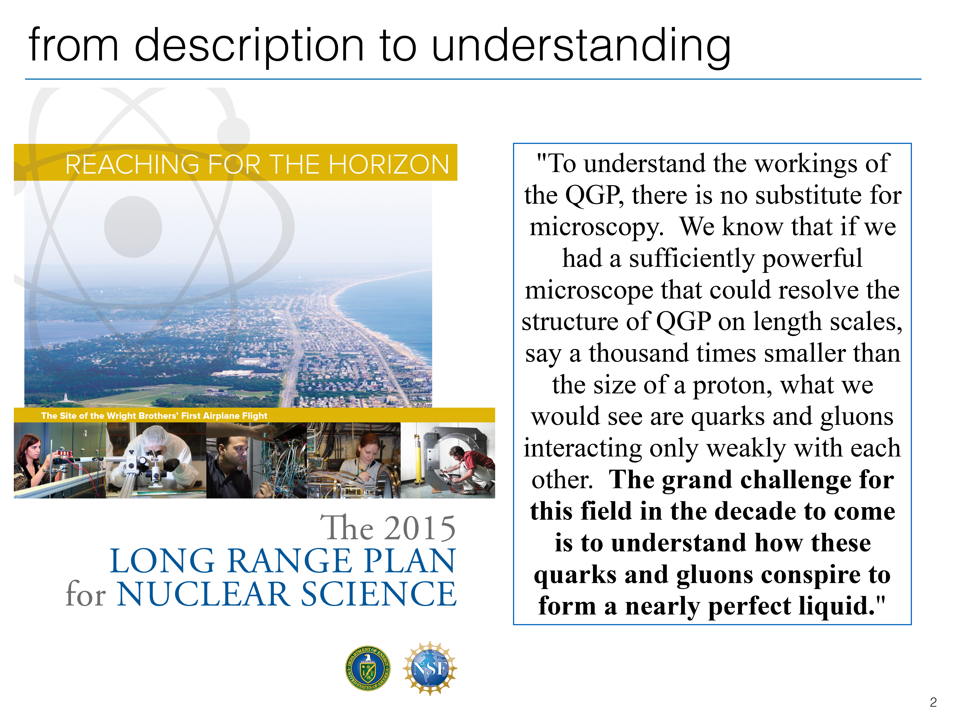
Next Step: Understand Inner Workings of QGP

Slide 9

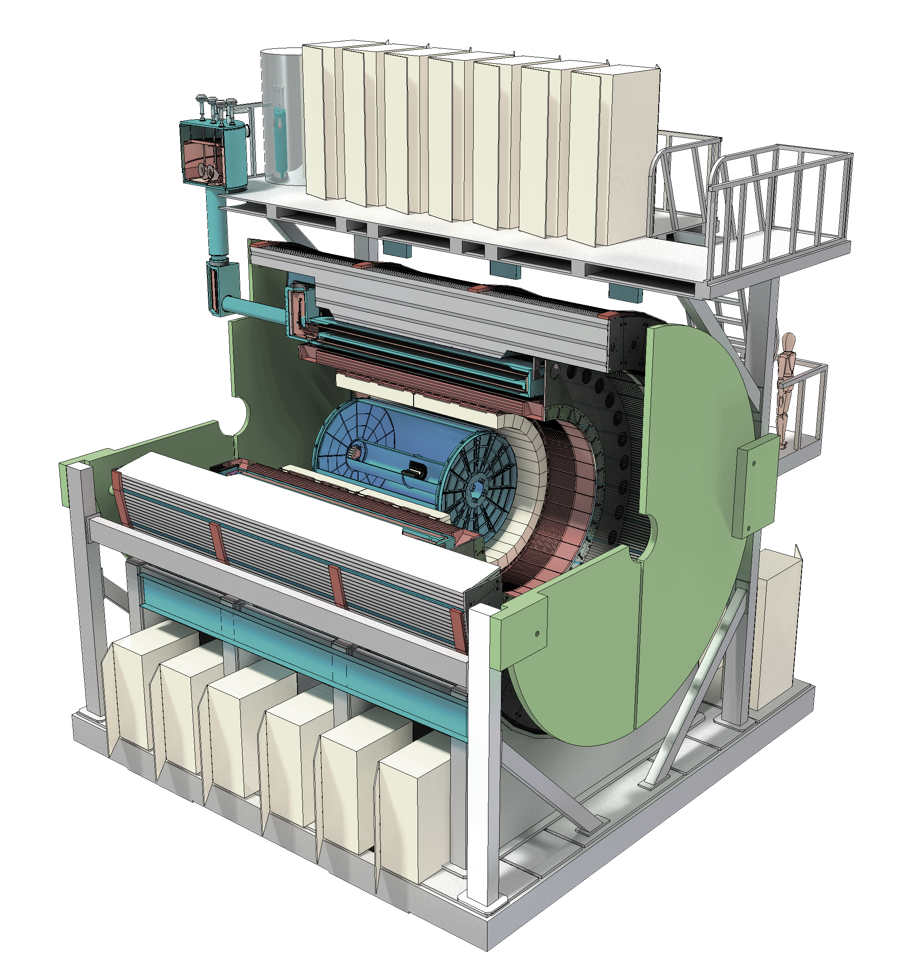
sPHENIX Upgrade the next Generation HI experiment at RHIC
Φ 1.2km

Slide 10
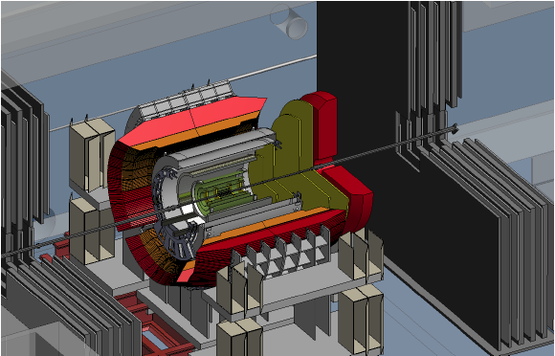
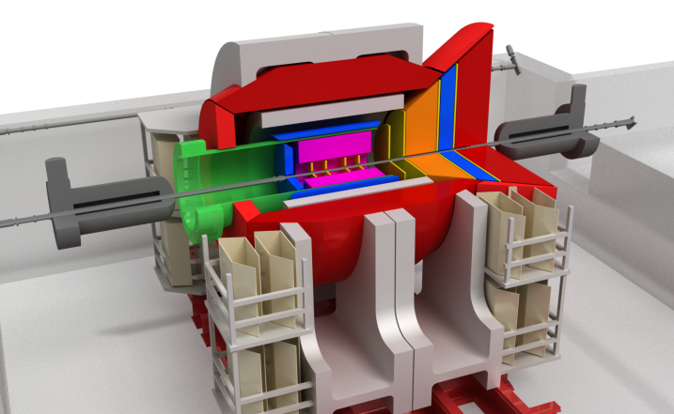
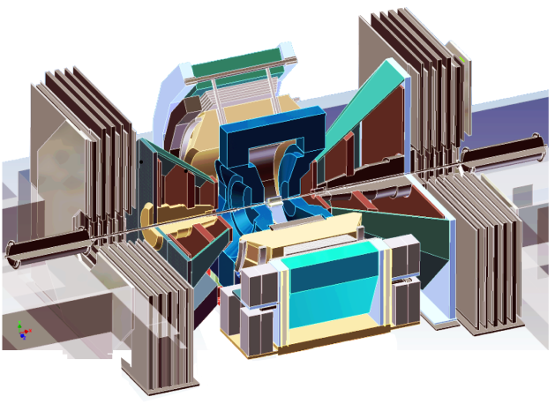
Evolution of the PHENIX Interaction Region
PHENIX experiment
An EIC detector
16y+ operation
Broad spectrum of physics (QGP, Hadron Physics, Dark Matter)
170+ physics papers with 24k citations
Last run in this form 2016
Comprehensive central upgrade base on BaBar magnet
Rich jet and beauty quarkonia physics program
→ nature of QGP
Possible forward tracking, and calorimeter → Spin, CNM
Path of PHENIX upgrade leads to a capable EIC detector
Large coverage of tracking, calorimetry and PID
Open for new collaboration/new ideas
arXiv:1501.06197 [nucl-ex]
arXiv:1402.1209 [nucl-ex]
2000-2016
2017→2022, CD-0@ 2016
>2025
Time
RHIC: A+A, spin-polarized p+p, spin-polarized p+A
EIC: e+p, e+A

Slide 11
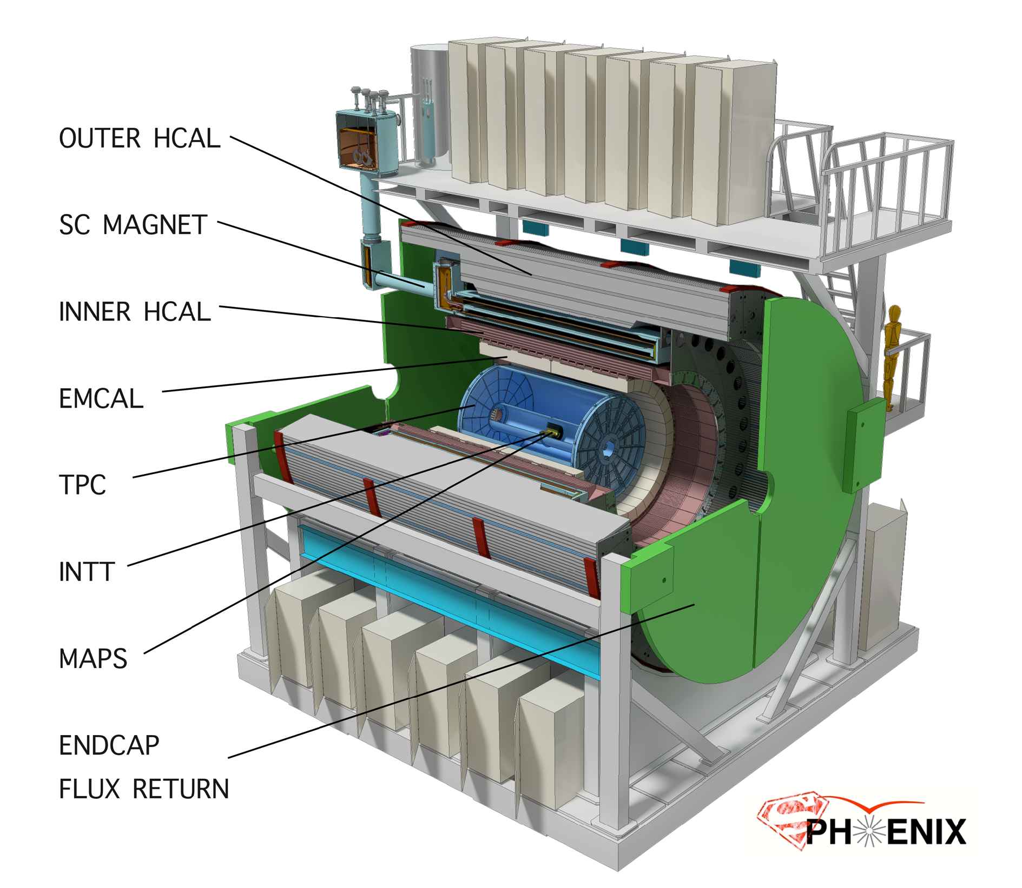
High speed, 15 kHz trigger
Large acceptance, |eta| < 1
Space preserve for
future Particle ID
MVTX
Detector
CD-0 Sept 2016
Construction Phase Jul 2018
Ready for Beam Jan 2022

Slide 12
sPHENIX 3 Physics Pillars
Jets
Heavy Quarks
Upsilons

Slide 13
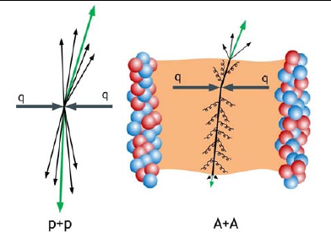
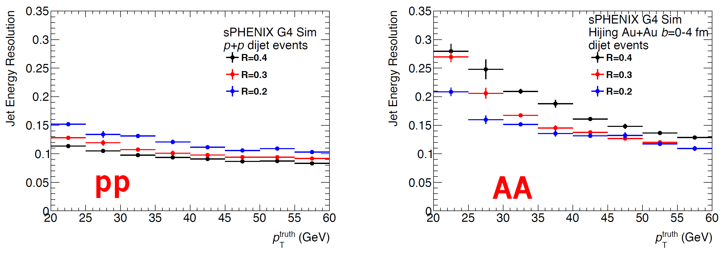
(I) Precision Calorimetry for Jets and Photons
Jet production in p+p and Au+Au
Excellent jet resolution in both p+p and A+A

Slide 14
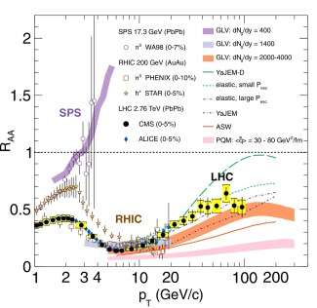
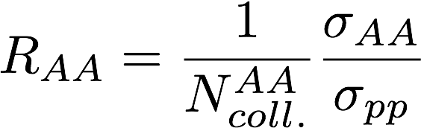
Jet Quenching Observed @RHIC and LHC
- Great progress in the last decade, but significant model dependence remains in the understanding of the physics of jet suppression and QGP properties at RHIC and LHC
- sPHENIX goals - understand the inner workings of QGP

Slide 15
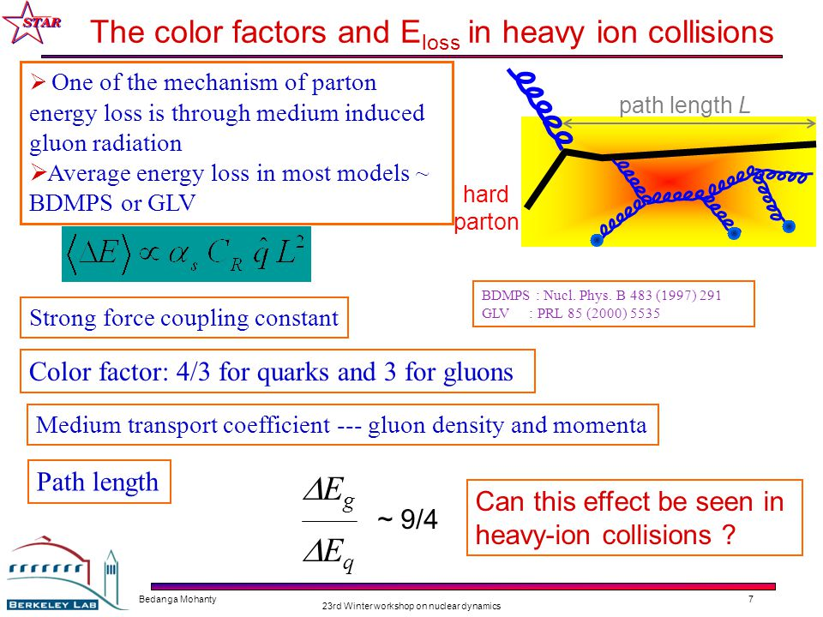
sPHENIX: Detail Study of the Path-length Dependence of Jet Suppression
Medium induced gluon radiation:
- BDMPS, GLV etc.

Slide 16
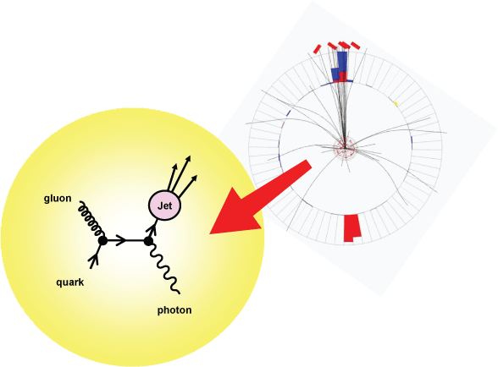
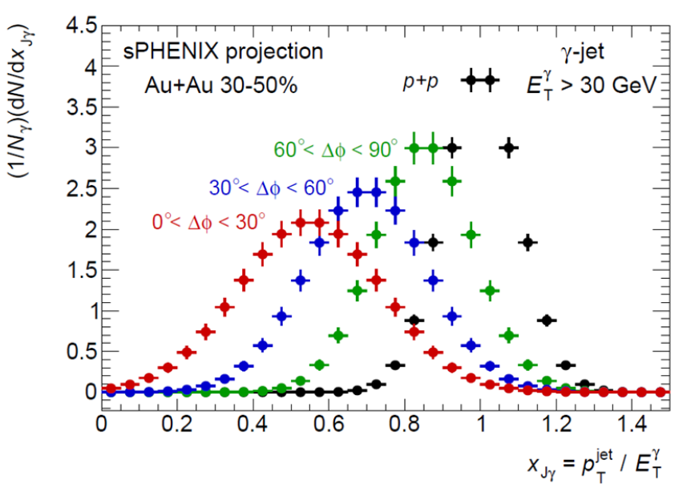
Direct Photon + Jet in Au+Au: Simulations
Jet - direct photon momentum imbalance

Slide 17
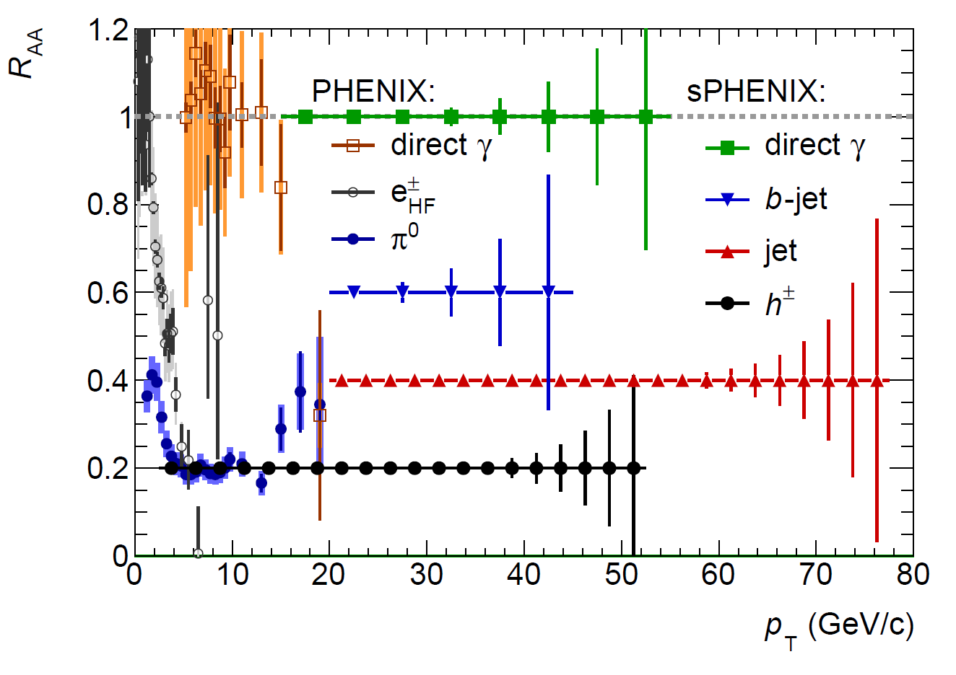
A Broad Physics Program with Jets @sPHENIX
Parton Mass and Flavor Dependence of Jet Suppression and more

Slide 18
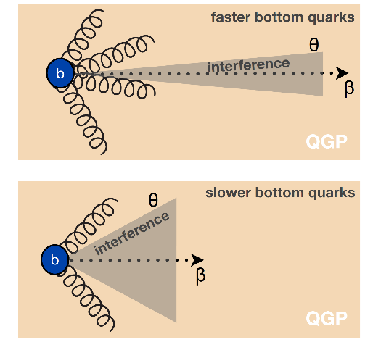
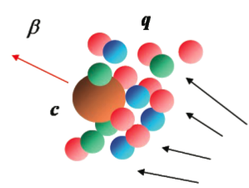
(II) Heavy Quarks - Unique Probe of QGP
Study mass dependence
  Jet quenching
  Flow – interaction with medium
Access QGP properties
Mass dep.
radiation dE/dx
m_{u} m_{d}
m_{s}
Λ_{QCD}
m_{c}
m_{b}
MeV
1
10
10²
10³
10⁴
T_{c}
T_{QGP}

Slide 19
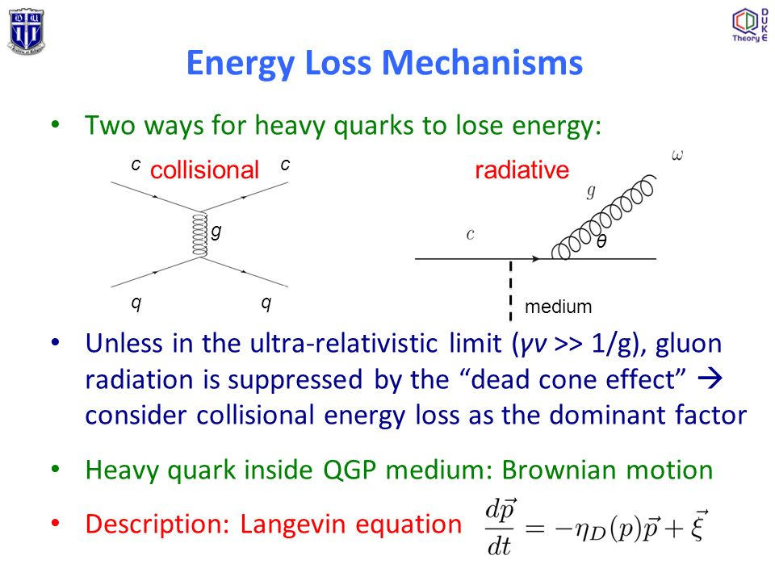
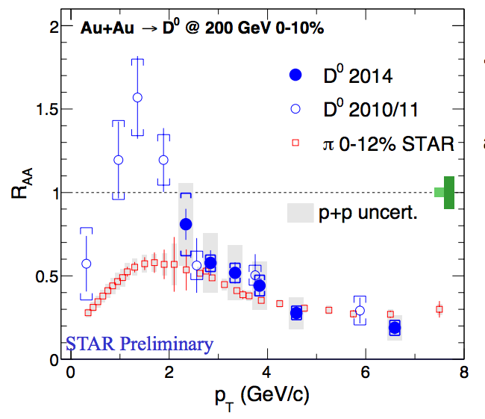
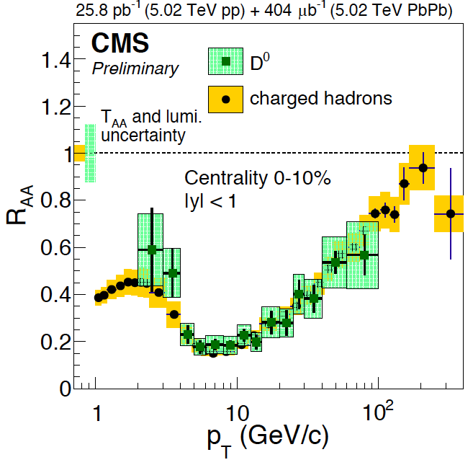
Recent Highlight I: Charm R_{AA} @RHIC and LHC
R_{AA} (D-meson) ~ R_{AA} (h) at high p_{T} ~> 4 GeV/c
significant suppression of charmed hadron R_{AA} in central A+A collisions
strong charm-medium interactions
mass effects?: expected important at low pT, dead-cone, collisional effects etc.

Slide 20
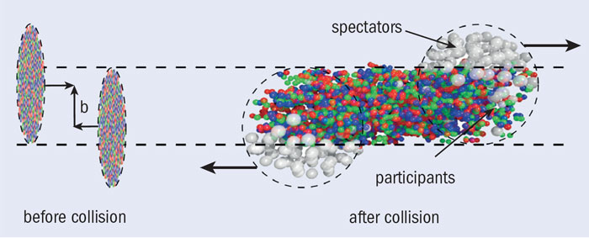
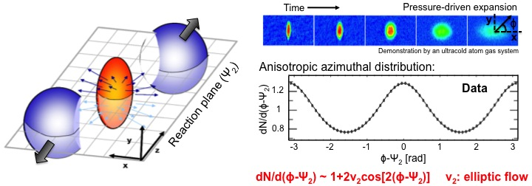
Particle “Flow” and QGP Medium Response
Anisotropic flow:
due to interactions w/ medium

Slide 21
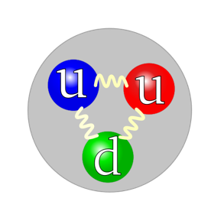
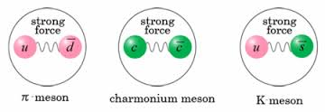
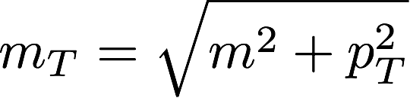
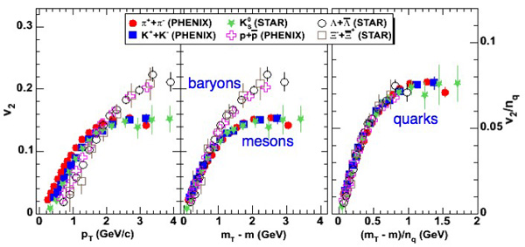
Universal Scaling of V₂ - Perfect QGP Liquid!?
Baryons: n_{q}=3
Mesons: n_{q}=2

Slide 22
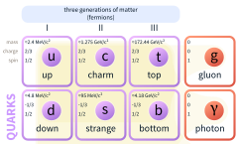
A Surprise from RHIC!
Charm quarks flow just as well as lighter quarks – “Perfect liquid”
Elliptic flow of D0 mesons (charm quarks)
m(u,d) = 2~5 MeV
M(s) = 100 MeV
M(c) = 1,300 MeV
M(b) = 4,200 MeV
M(t) = 175,000 MeV
- PDG 2014
PRL 118 (2017) 212301

Slide 23
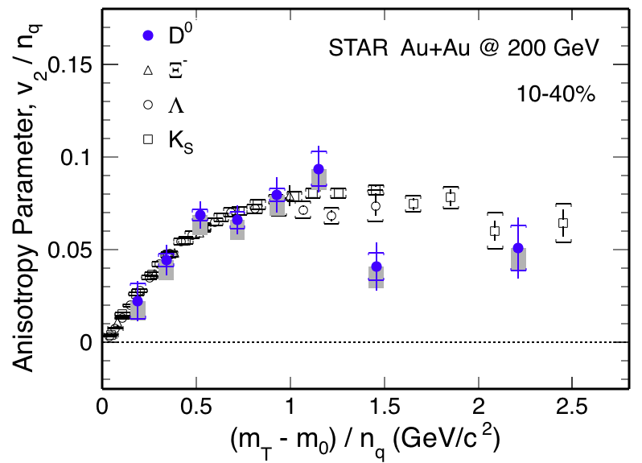
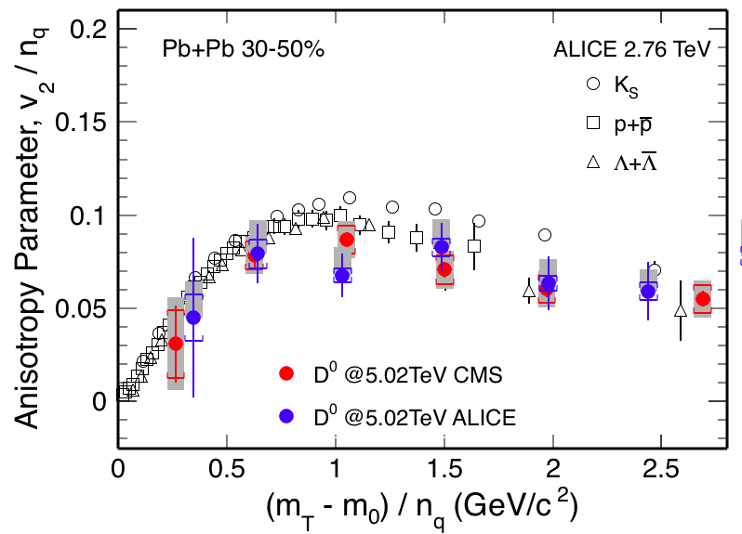
Recent Highlights II: Charm V₂ @RHIC and LHC
v₂ of D⁰ follows the same trend as light hadrons
  Charm quarks flow the same as light quarks
Strong coupling to medium at low pT?

Slide 24

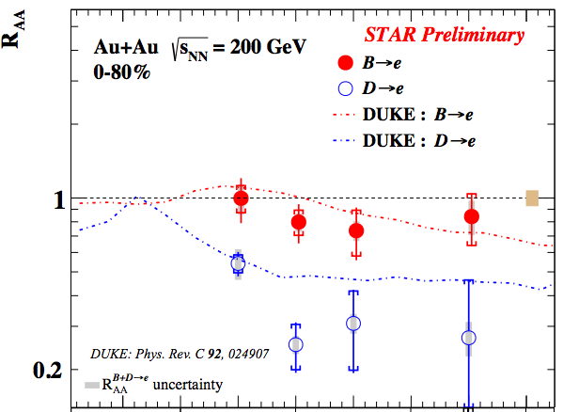
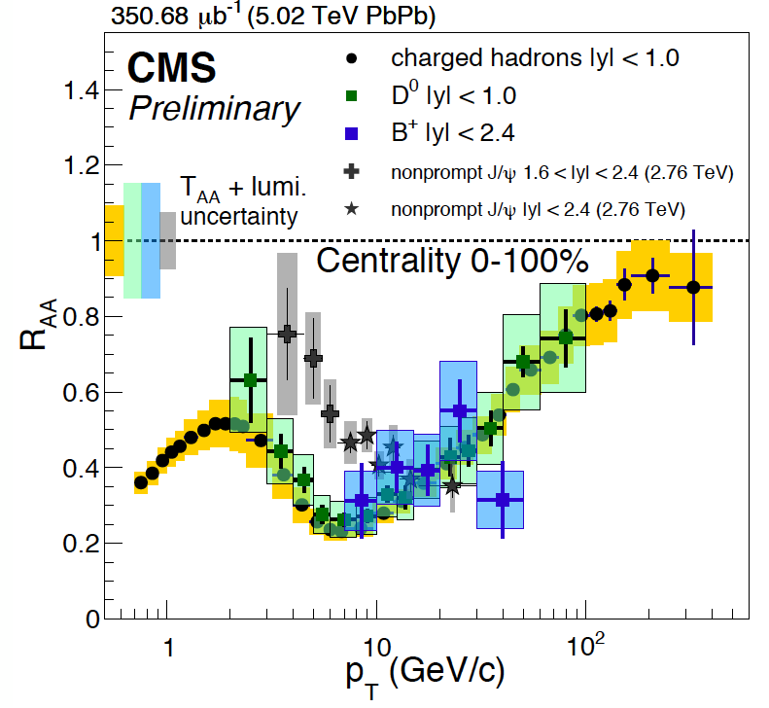
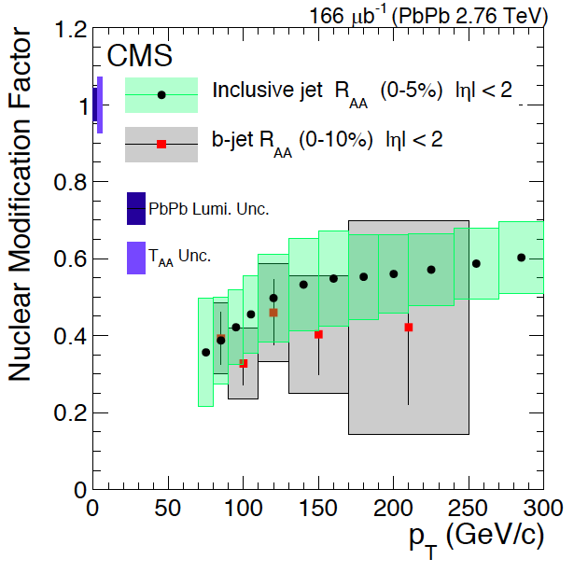

How about the much heavier Beauty?
Highly desired:
precision measurements of
B @low-intermediate pT ~< 50GeV
R_{AA} (B->e) > R_{AA} (D->e, h) @low pT
B⁺ & b-jet ~ light hadrons & charm @high pT
STAR, QM17

Slide 25
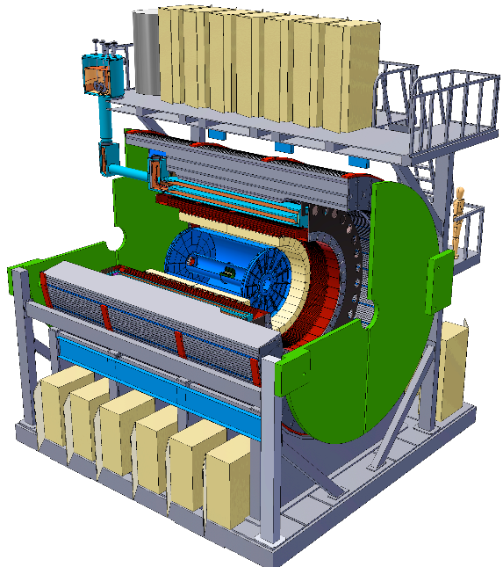

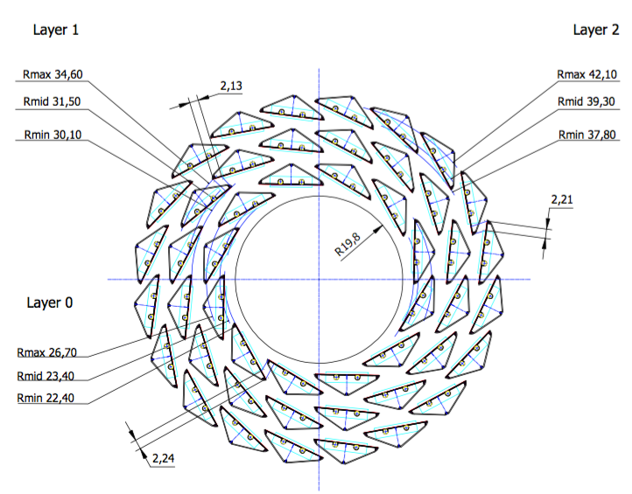
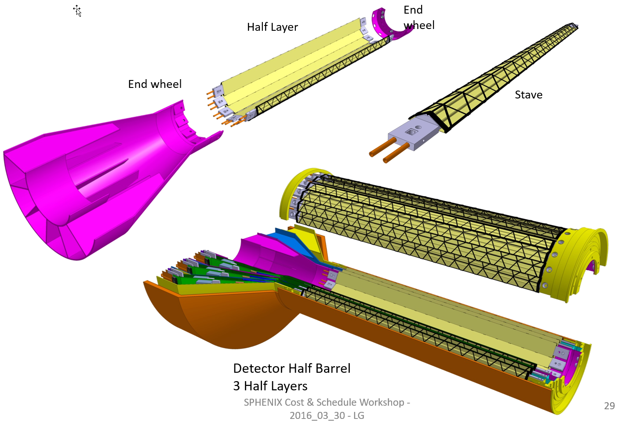
MAPS-based VerTex detector: MVTX Upgrade
To enable B-hadron and b-jet physics in sPHENIX
ALICE ITS Upgrade:
Inner Barrel Tracker
sPHENIX Inner Tracking
Adapt ITS/IB
- Min. Risks
- Max. Phys.

Slide 26


Monolithic-Active-Pixel-Sensors (MAPS)
The next Generation State of the Art Pixel Tracker
Advantages of ALICE MAPS/ALPIDE:
  Very fine pitch (28x28 μm)
  High efficiency (>99%) and low noise (<10⁻⁶)
  Time resolution, as high as ~5 μs
  Ultra-thin/low mass, 50μm (~0.3% X₀)
  On-pixel digitization, low power dissipation
An ideal detector for QGP physics!
FPC
9 Chips
Cooling plate
A 9-chip MAPS stave, 1.5 x 27cm²
ALPIDE design
50 μm
28 μm

Slide 27
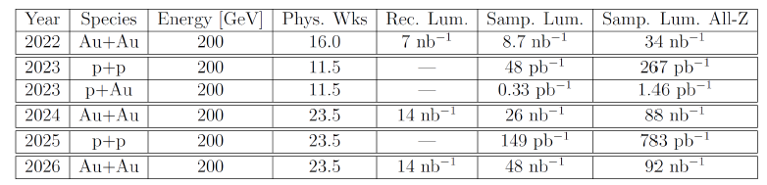
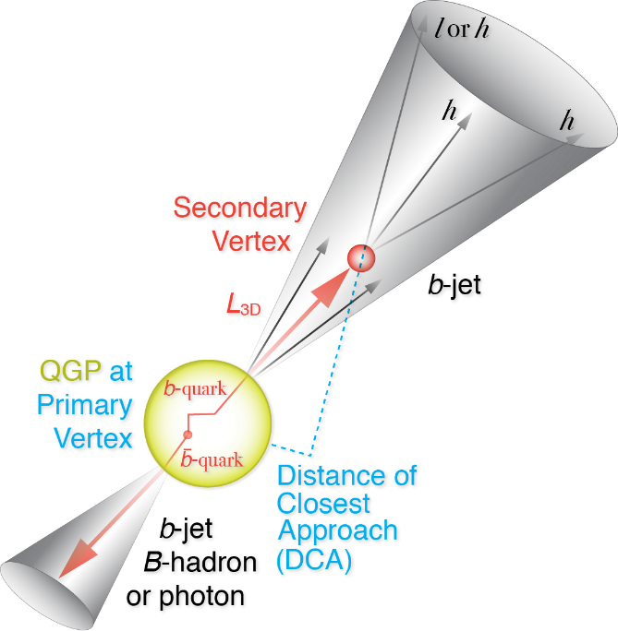
RHIC Multi-Year Plan: sPHENIX 2022-2026+
Evolving
Precision B-tagging w/ MVTX:
  Tracking resolution better than 50um @pT=1GeV
  High multiplicity HI collisions
  Low multiplicity but high rate p+p collisions
  High efficiency and high purity
B hadrons/pT<15GeV: O(1M)
b-jets/pT>15GeV: O(100K)

Slide 28


Physics Channels: Open Charm and Beauty
Hadron | Abundance | cτ (μm)
D⁰ | 61% | 123
D⁺ | 24% | 312
D_{s} | 8% | 150
Λ_{c} | 6% | 60
B⁺ | 40% | 491
B⁰ | 40% | 455
B_{s} | 10% | 453
Λ_{b} | 10% | 435
b-tagged jet and cor.
p_{T}>15 GeV
60%
0.5%
p_{T}<15 GeV
Exploring and more

Slide 29



Simulation: b-jet and B-meson Tagging
sPHENIX Geant4 display of p_{T}=30 GeV/c B⁺-hadron
Design to Simulation
MVTX and INTT _
_ MVTX Ladders modeled in details
MVTX sensors

Slide 30


Tracking Performance with Full GEANT
MVTX geometry modeled and digitized according to ALICE ITS/IB
Cluster resolution: ~5 µm
DCA_{2D ,} DCA_{z}<30 µm down to 1 GeV/c
DCA_rφ
DCA_z

Slide 31



B-jet tagging
Multi-tracks w/ large DCA
2nd vertex mass reco’d
CMS work-point, Phys. Rev. Lett. 113, 132301 (2014)

Slide 32



B-hadron Tagging
Impact parameter (DCA) method to tag non-prompt D⁰ from B-meson decays
Inclusive and exclusive channels possible

Slide 33
sPHENIX Projected R_{AA} Sensitivity
Open questions to be answered: energy loss mechanisms and QGP medium properties
B-Mesons
B-jets

Slide 34

sPHENIX Project Elliptical Flow v₂
Open questions to be answered: nature of quasi-particles, medium interactions and transportation
B-Mesons
B-jets

Slide 35



(III) Heavy Quarkonia and QGP Color Screening
Plasma Debye Length:
The shorter the r_{D},
the stronger the screening
effects

Slide 36


J/Psi Suppression Observed, w/ Surprises
QGP Suppression
  Color screening
  Breakup w/ “co-movers”
Regeneration
  Coalescence of many c-cbar pairs produced in A+A
Upsilons! – focus of sPHENIX
  Color screening
  Breakup w/ “co-movers”
  No regeneration
Zhuang et al.

Slide 37

Upsilon Spectroscopy
ϒ(3s)-0.78fm
ϒ(2s) – 0.56fm
Courtesy from A. Mocsy
ϒ(1s) – 0.28fm
Thermometer of QGP via clean separation of three Upsilon states (M_{ee} < 100 MeV/c²)

Slide 39


Summary and Outlook
- sPHENIX CD-0 granted Sept 2016; In preparation for CD-1, May 2018
- 1st data taking: Early 2023

Slide 40



Evolving sPHENIX Collaboration
~70 institutions from world wide & growing!
A new Chinese consortium joined sPHENIX,
led by Prof. H. Huang!
Santa Fe, NM, 12/2017

Slide 41
backup

Slide 42
RHIC Highlight (2): Flow
Phys. Rev. C 95 (2017) 034910
PHENIX Preliminary
Signatures of collective flow exist even in the smallest systems and at the lowest RHIC energies
PHENIX Preliminary

Slide 43






Jet Probes of QCD Structure
Bare Color Charges
Parton virtuality evolves quickly and is sensitive to the medium at the scale it probes
Thermal Mass Gluons
RHIC Jet Probes
LHC Jet Probes
QGP Influence
Structureless Fluid
- Unique critical microscope resolution range at RHIC
- Kinematic overlap between RHIC and LHC provides complementarity
43

Slide 45





Heavy Quark Probes at RHIC
Uniqueness at RHIC
- dominated by pair creation, clean interpretation for experimental results
Pair Creation
PYTHIA6
LHC
RHIC
Flavor Excitation
Gluon Splitting
T. Sjostrand, EPJC17 (2000) 137

Slide 46


Topic-1: Probe the Density
QGP and Jet Quenching
High density QGP medium created in
Heavy ion collisions:
~20x of normal nucleus

Slide 47

Jet Quenching Observed
QGP density > 10x normal nucleus

Slide 48


Jet Quenching @RHIC and LHC

Slide 49



Detector highlights
Radius (cm)
|η|<1.1
B_{z} = 1.4 T
EMCal SPACAL module

Slide 50





Calorimeters beam tests
February 2014
Proof of principle
February 2016: η~0 prototype
February 2017: η~0.9 prototype
Electron
Energy resolution
arXiv:1704.01461
Pion
Energy resolution
arXiv:1704.01461
sPHENIX beam test data
sPHENIX beam test data

Slide 51





Super conducting magnet
1.4 Tesla magnet, Ф = 2.8 m, L = 3.8 m Previously used in BaBar @ SLAC
Moved to BNL in Feb 2015
Successful cold low field test in 2016
On-going full field test
Preparing full field test @ BNL

Slide 52
Sheet 1, section view of sPHENIX inner detector assembly (inside the superconducting solenoid magnet), the ALICE service barrel has been modified – shortened, see later sheets for detail

Slide 53

sPHERNIX cross-section view, including envelope for services; TPC and INTT, the following 2 slides detail views -
TPC services (one end)
INTT services, (one –end)

