Slide 1
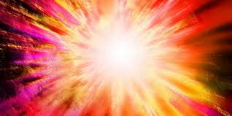
Recreate Early Universe in Laboratory
Olan Kruse Physics Lecture at Texas A&M at Kingsville
Ming Liu
Los Alamos National Laboratory

Slide 2
Outline
The Big Bang
  The early universe
“Little Bang” in Heavy Ion Collisions
  Quark Gluon Plasma
  Matter and anti-matter
Dark Matter?
Outlook

Slide 3
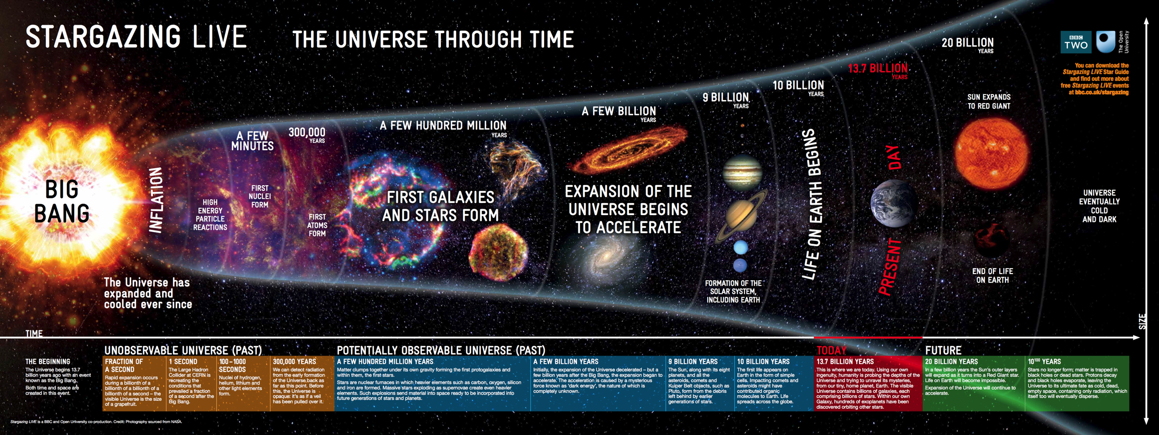
The Big Bang
Ref: Open University / BBC
Unobservable
Universe!
Being probed with telescopes
Dark Ages: 150-800 M Years
Today

Slide 4

“Dark Age” and the Universe
By NASA/WMAP Science Team - Original version: NASA; modified by Ryan Kaldari, Public Domain, https://commons.wikimedia.org/w/index.php?curid=11885244
Time in log scale

Slide 5
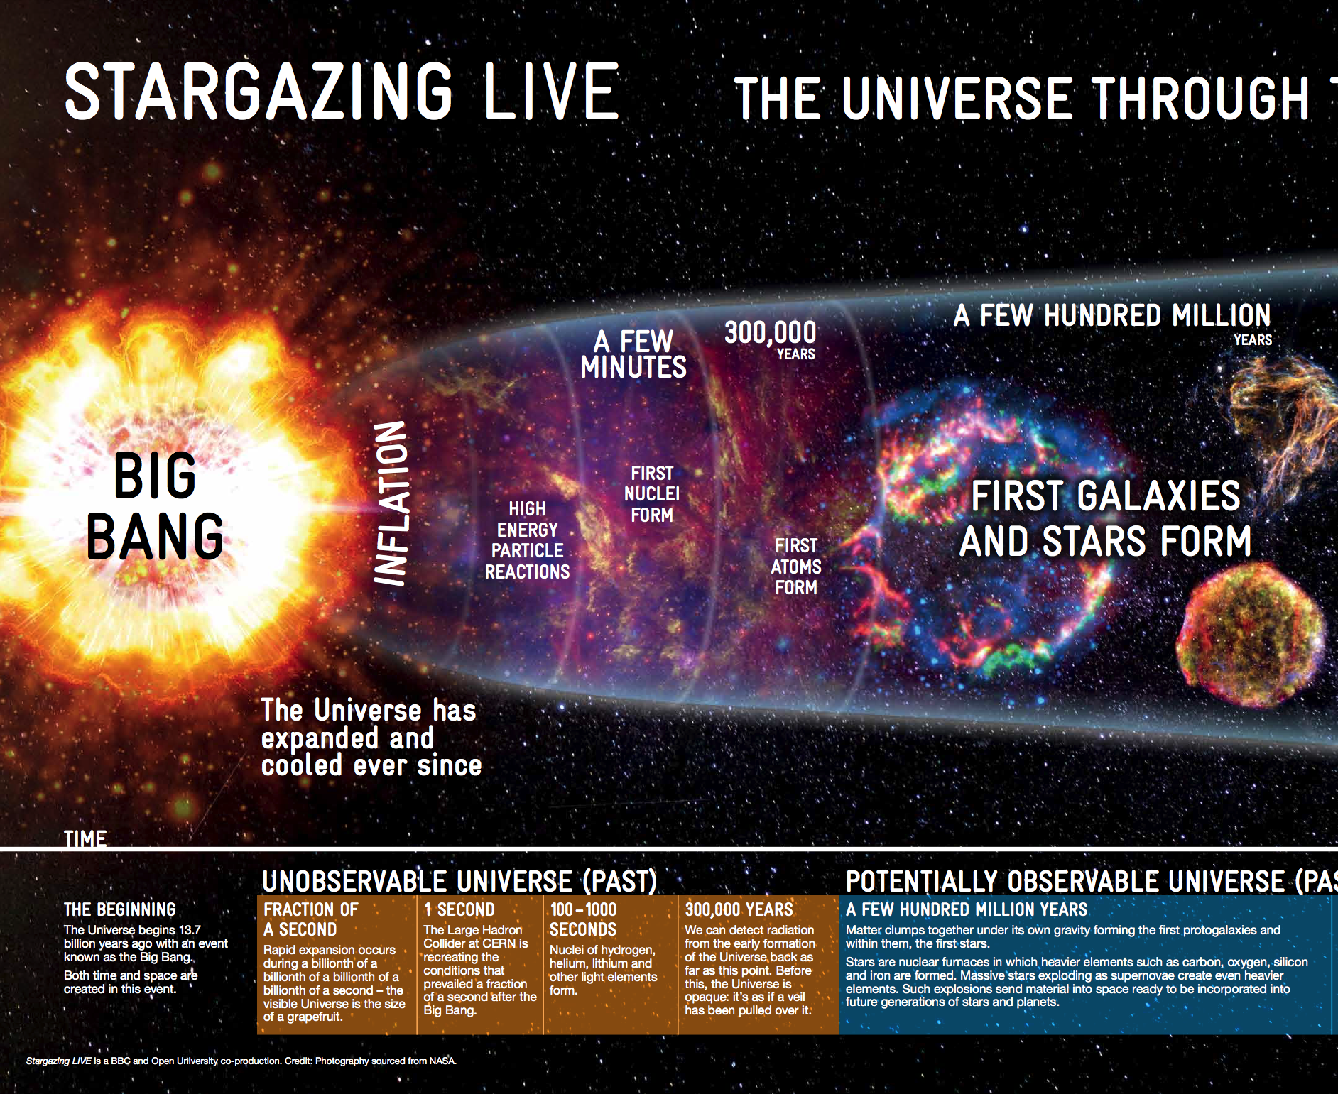
Consist of fundamental
particles

Slide 6
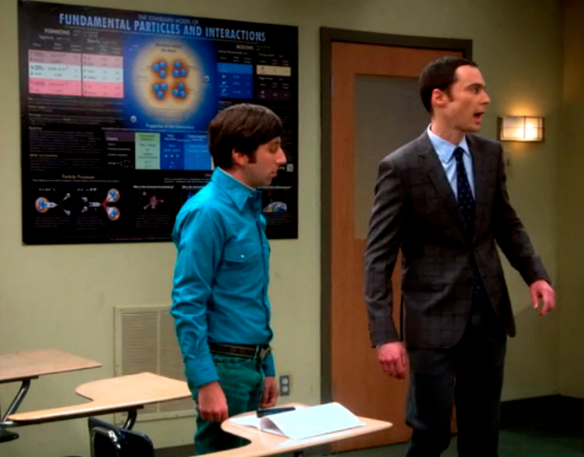
Some Basic Ideas and Concepts fundamental matter blocks and interactions
Fundamental particles and interactions
Scales of fundamental distance
Atom: ~1nm (10⁻⁸ m)
Nucleus: ~1fm (10⁻¹⁵ m)

Slide 7
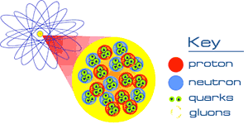
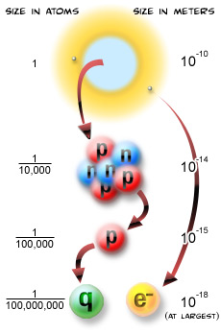
Fundamental Particles
Quarks
Gluons
Leptons
Photons
…

Slide 8
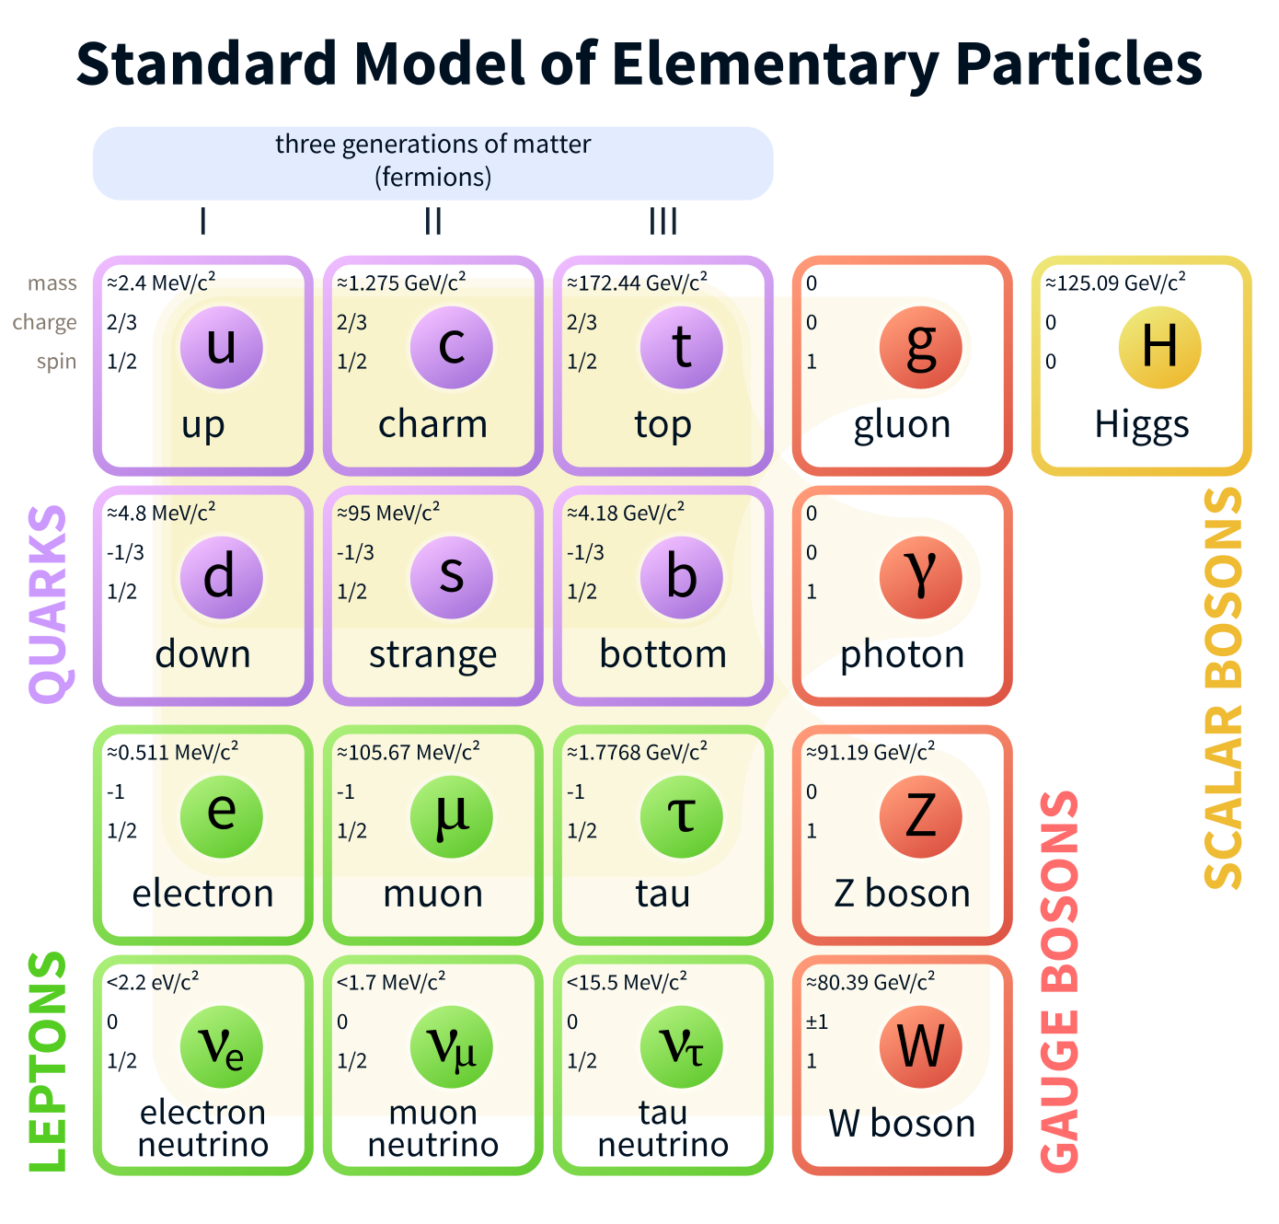

Slide 9

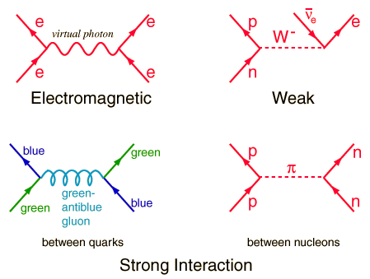
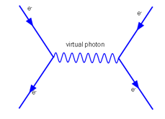
Force by Particle Exchange

Slide 10
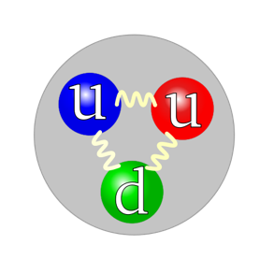
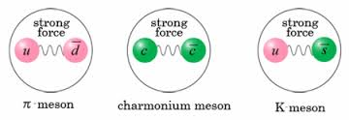
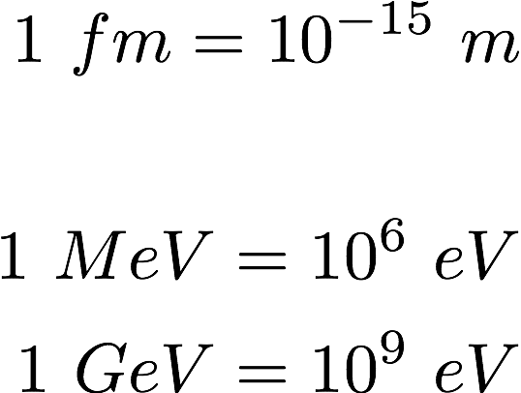
Examples of Subatomic Particles
Hadrons - strong interaction and electromagnetic force
  Made of 3 quarks
  Made of quark and anti-quark
Leptons – NO strong interaction, electromagnetic force
  Electrons
  Muons
  …
Proton mass = 1.67 x 10⁻²⁷ Kg
= 938 MeV
= 0.938 GeV
Radius = 0.87 x 10⁻¹⁵m
= 0.87 fm
Electron mass = 9.11 x 10⁻³¹ Kg
= 0.511 MeV
Radius < 10⁻¹⁸ m

Slide 11
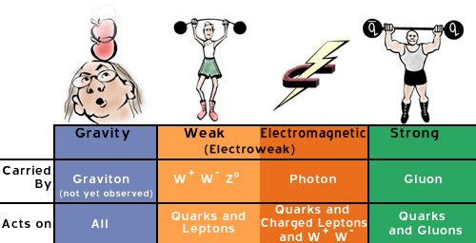
Interaction Strength
Nuclear force
Strong Interaction: QCD = Quantum Chromo Dynamics
very hard to do computation with QCD

Slide 12
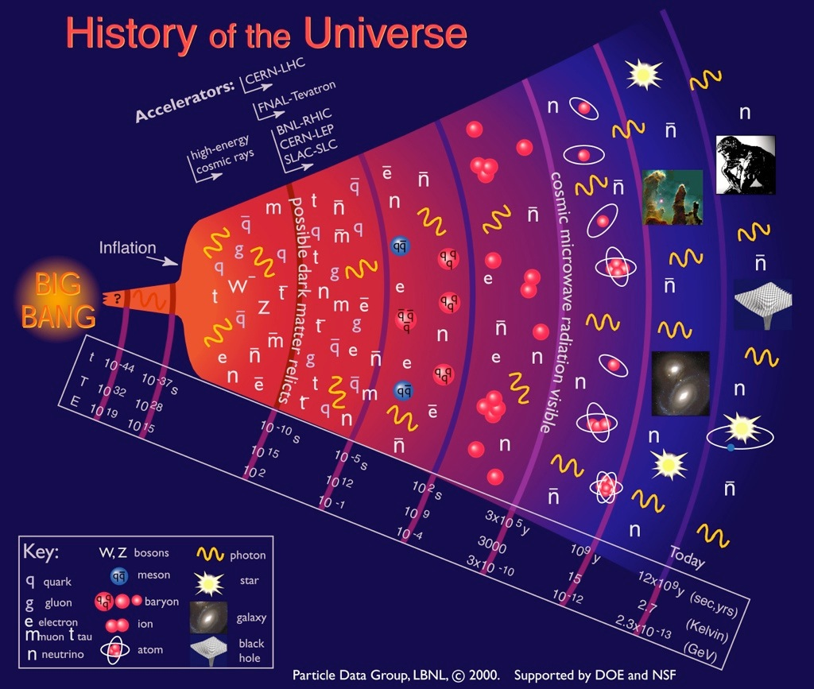
Quark-Gluon
Plasma (QGP)

Slide 13
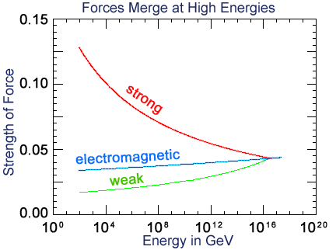
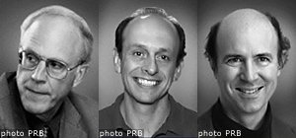
QCD Asymptotic Freedom and QGP
D. Gross
H.D. Politzer
F. Wilczek
Nobel Prize 2004
Big Bang
QCD Asymptotic Freedom (1973)
"for the discovery of asymptotic freedom in the
theory of the strong interaction".
“In 1972 the early universe seemed hopelessly opaque…conditions of ultrahigh temperatures…produce a theoretically intractable mess. But asymptotic freedom renders ultrahigh temperatures friendly…”
Frank Wilczek, Nobel Lecture

Slide 14
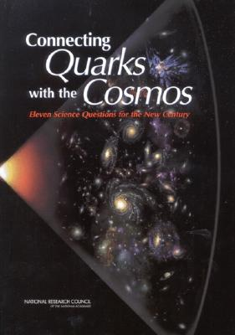
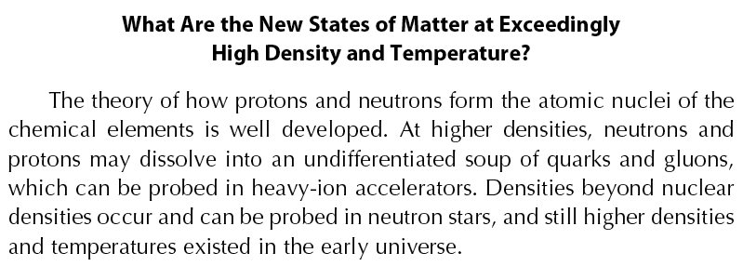
National Research Council Report (2003)
Eleven Science Questions for the New Century
Question 8:

Slide 15
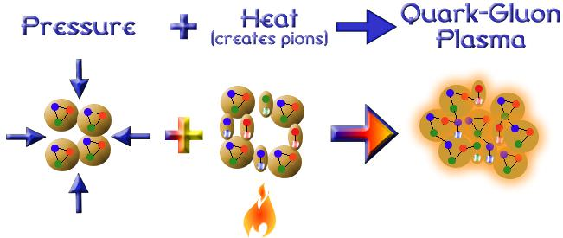
An Idea: Create Quark-Gluon Plasma
Normal nuclear matter

Slide 16

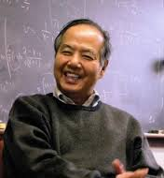
Heavy Ion Collision Creates a New State of Matter
T. D. Lee
Nobel Prize, 1957
Birth of RHIC 1983

Slide 17
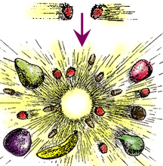
The Magic: E = mc²

Slide 18
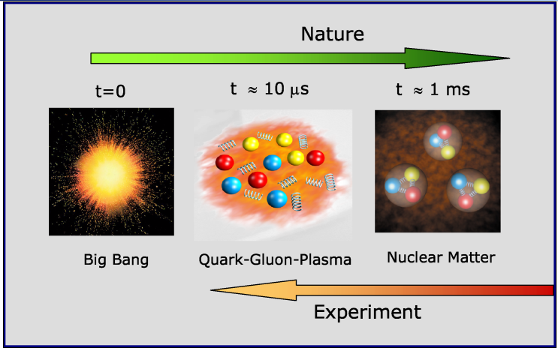
Recreate a state of the Early Universe

Slide 19
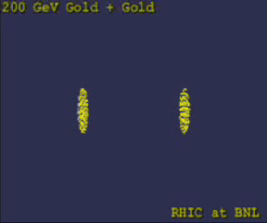
Computer Simulations

Slide 20
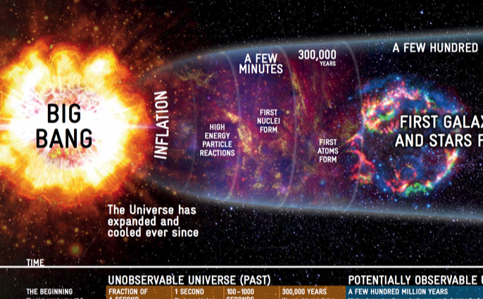

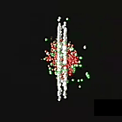
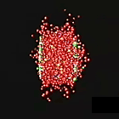
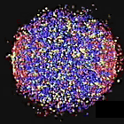
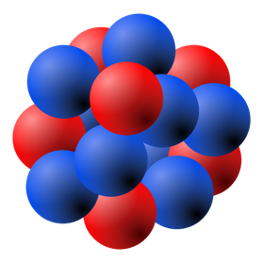


Heavy Ion Collisions
Artists’ View
¹⁹⁷Au
¹⁹⁷Au
About to collide
Ion collision
Quarks and gluons freed
QGP formed
Relativistic Lorentz Contraction:
At RHIC (LHC):
¹⁹⁷Au

Slide 21
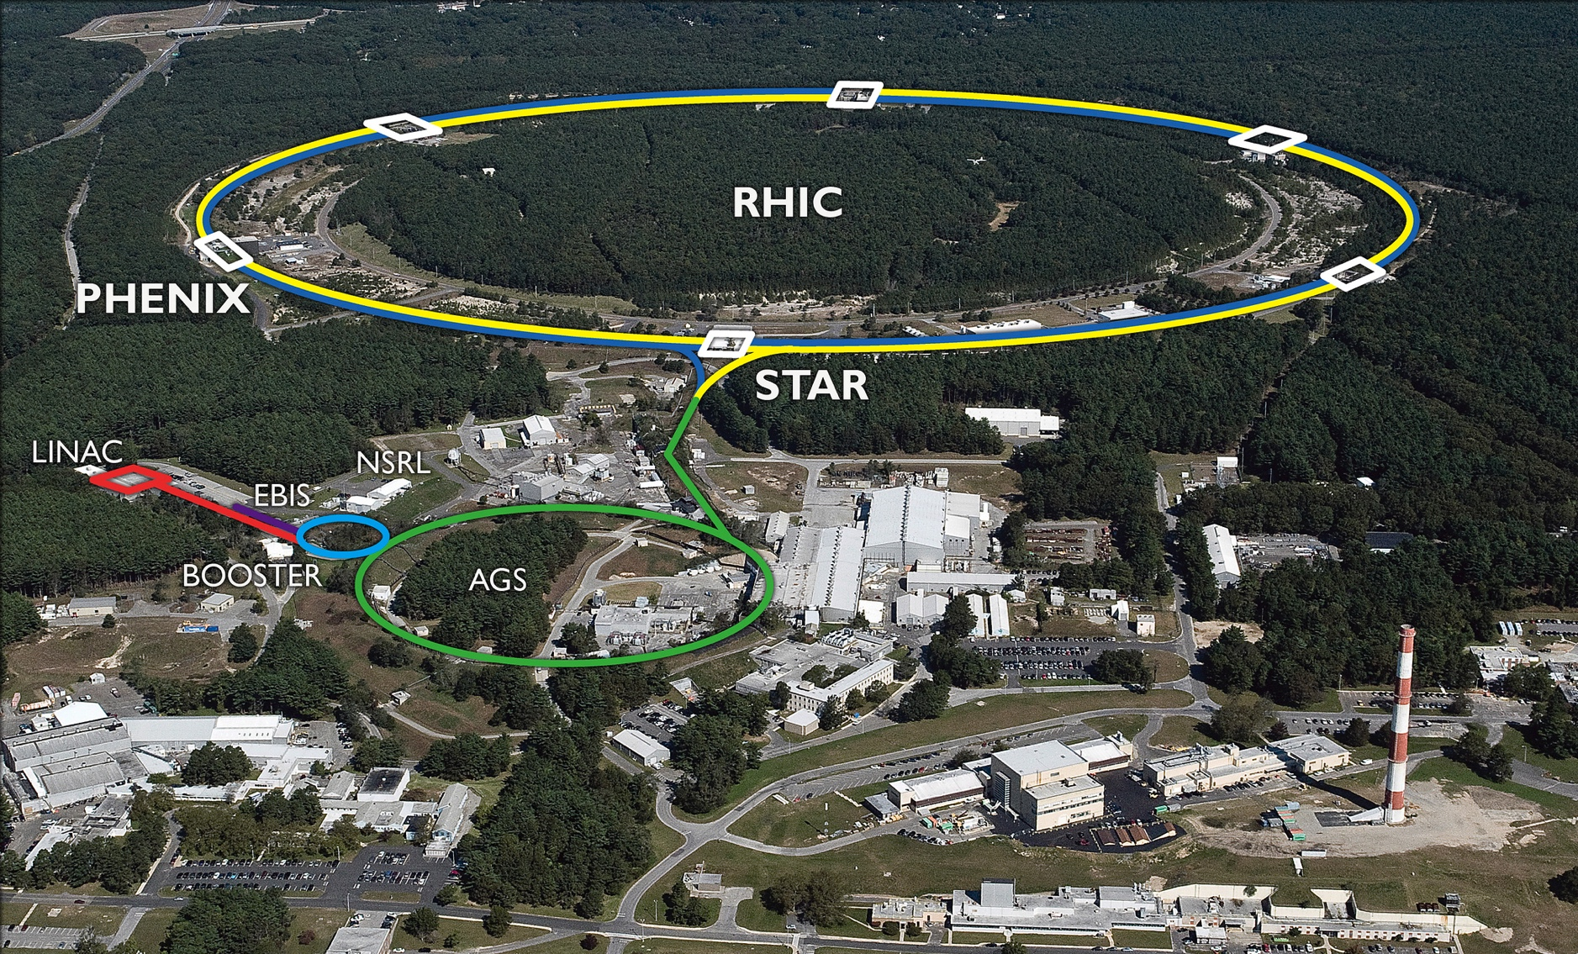

Relativistic Heavy Ion Collider
@BNL, Long Island, NY
¹⁹⁷Au: E_total = 197 x 100 M_{p}
Au+Au collisions @200GeV Max.

Slide 22
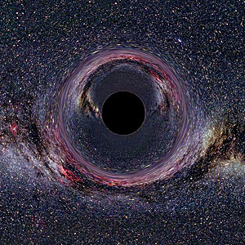
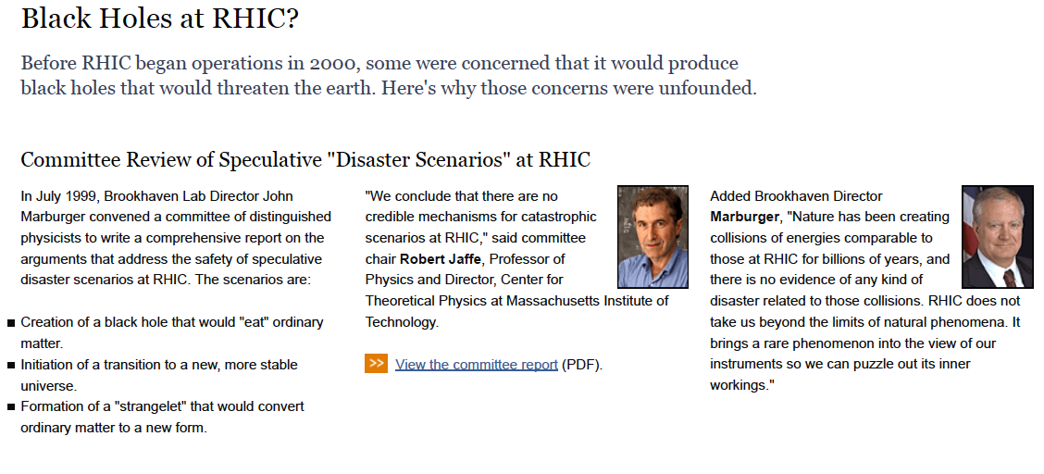
Black Holes?
https://www.bnl.gov/rhic/docs/rhicreport.pdf

Slide 23
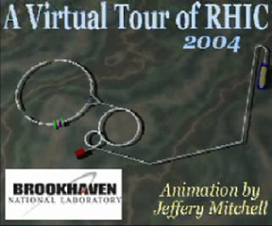

Slide 24
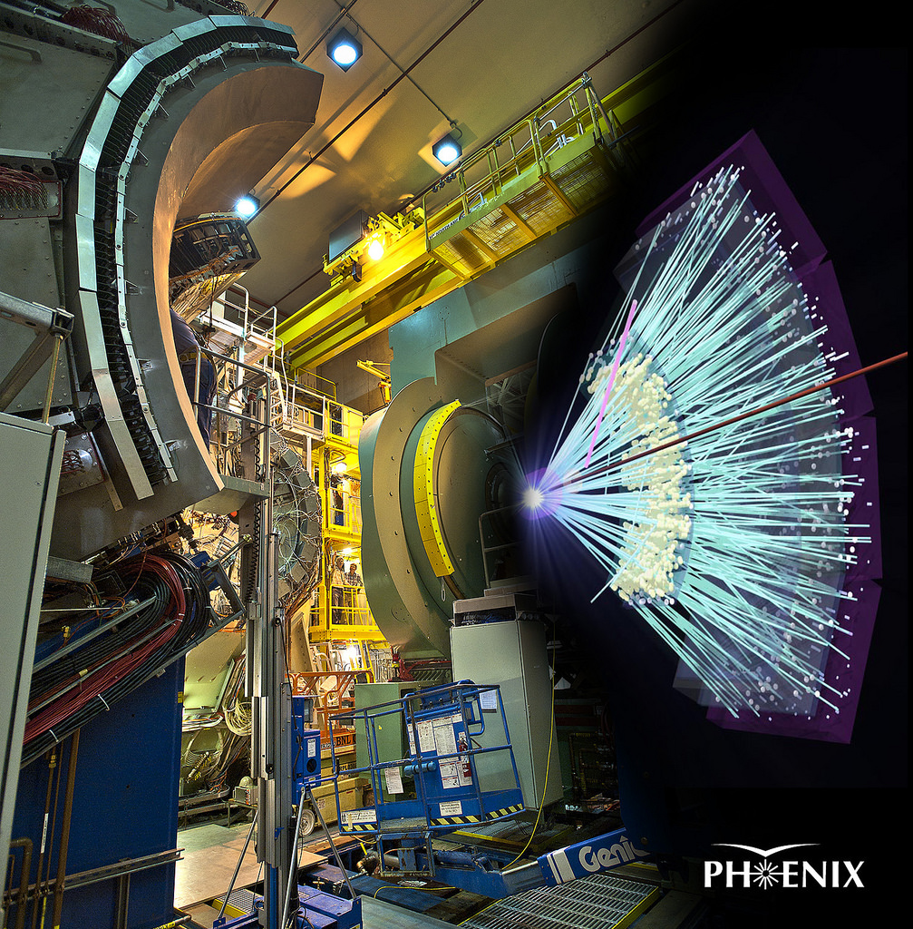
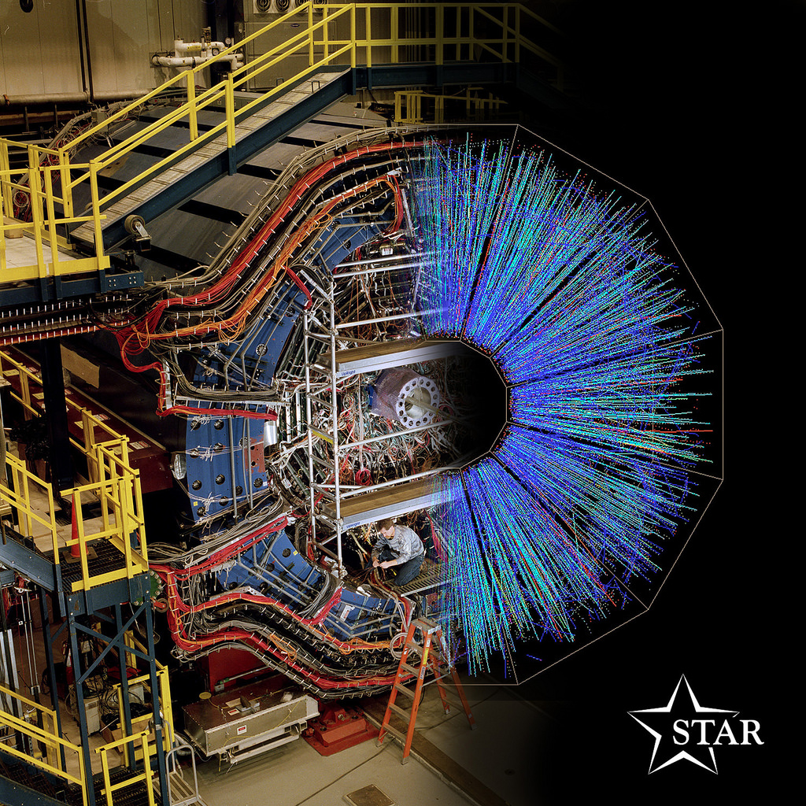
The Little Bang at RHIC
QGP Created in Au+Au Collisions!

Slide 25
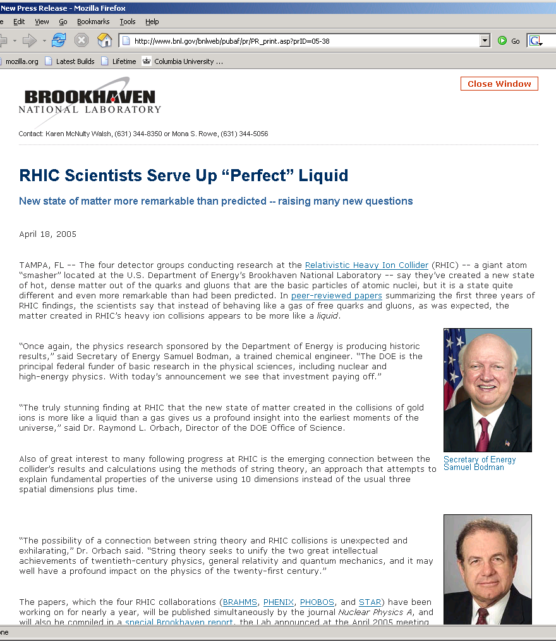
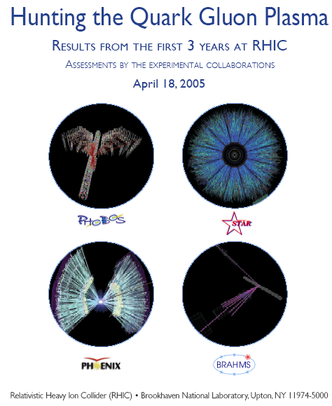
RHIC Success

Slide 26
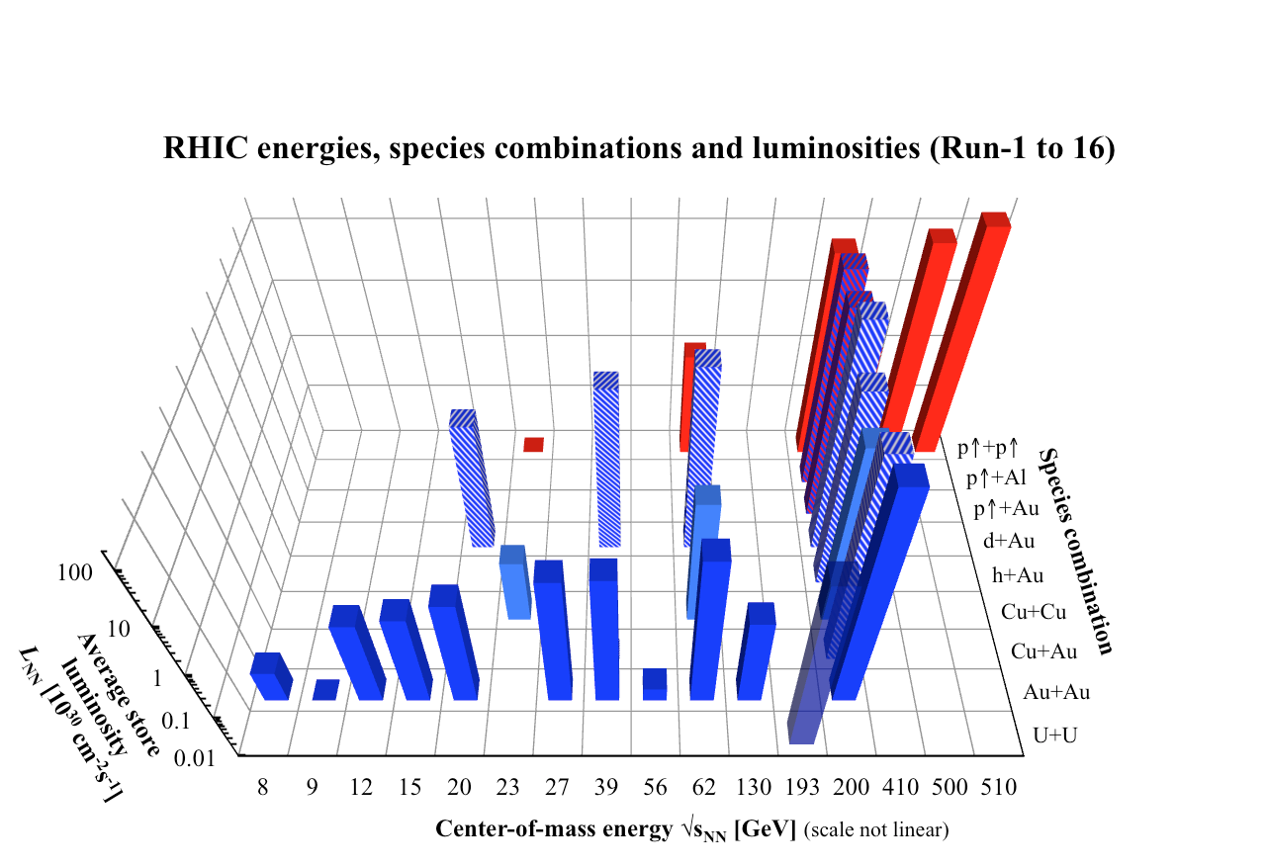
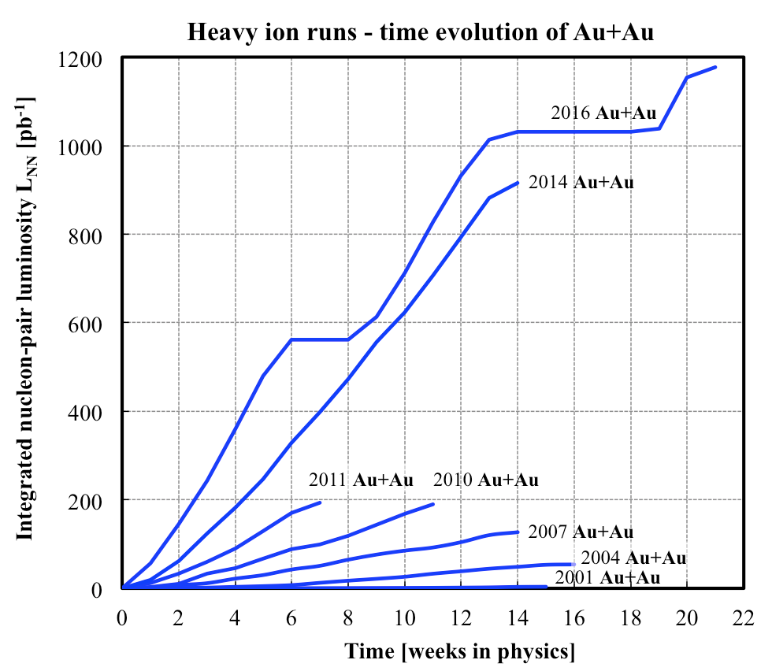
History of RHIC Heavy Ion Operation
Very Rich Physics Program at RHIC

Slide 27
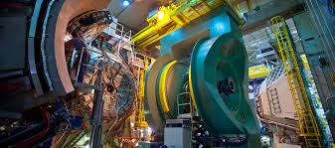
PHENIX Detectors at RHIC
A large international collaboration, ~500 scientists from 13 countries

Slide 28
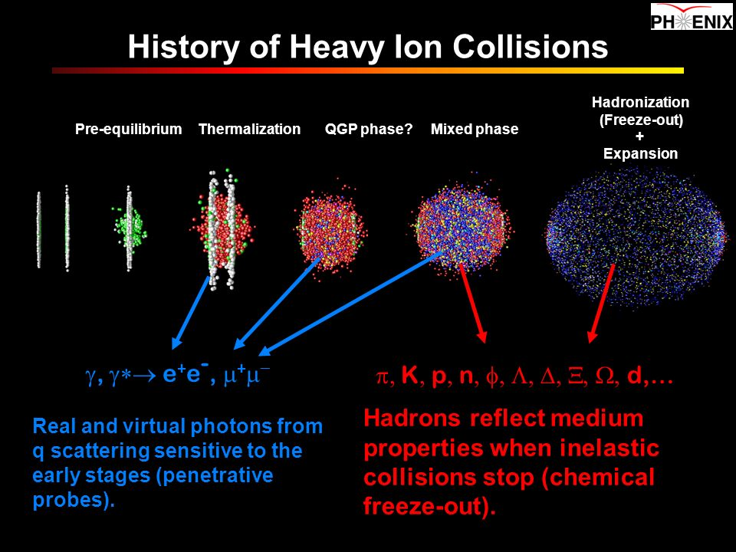

Slide 29
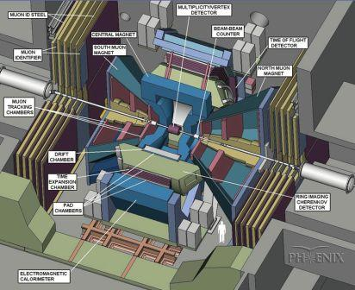
A State of the Art Particle Detector

Slide 30

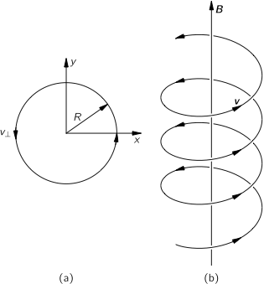
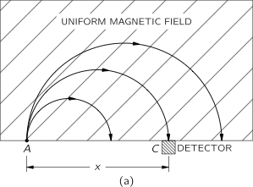
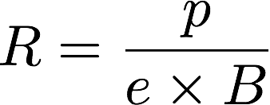

Measure Charged Particles

Slide 31
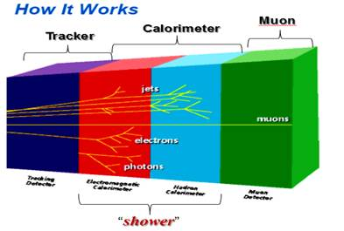
Particle’s Energy with Calorimeters

Slide 32
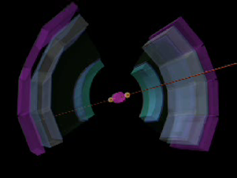
PHENIX Detectors

Slide 33
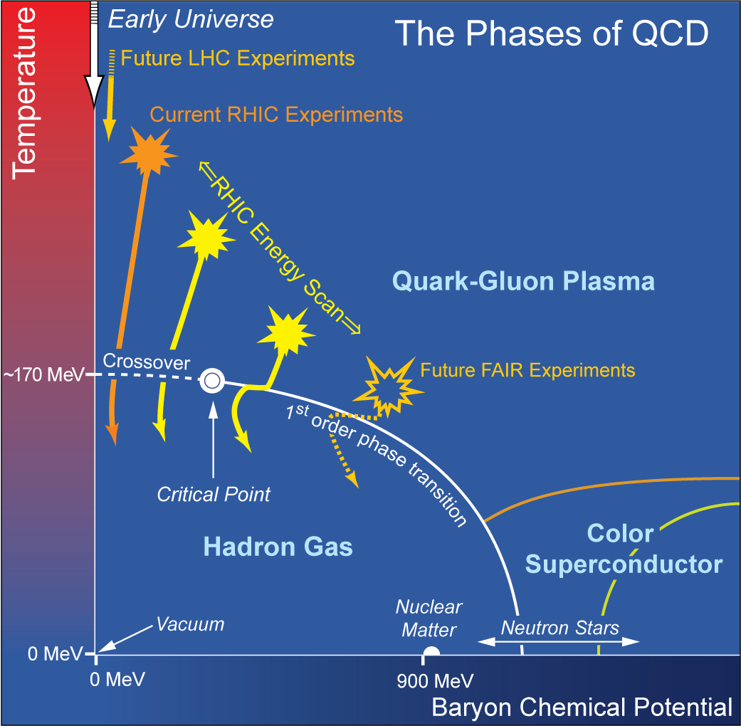
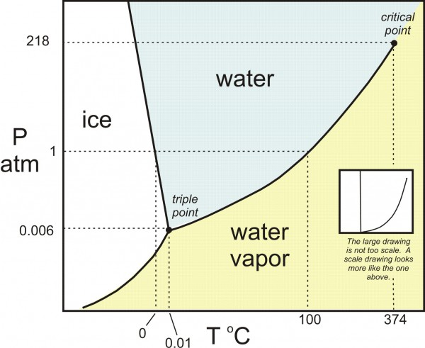
Study QGP Properties
Density
Temperature
Medium
  Solid, liquid, gas, Plasma..

Slide 34
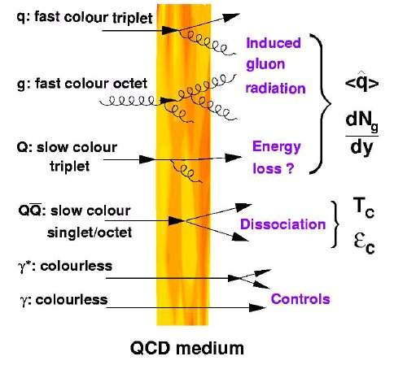
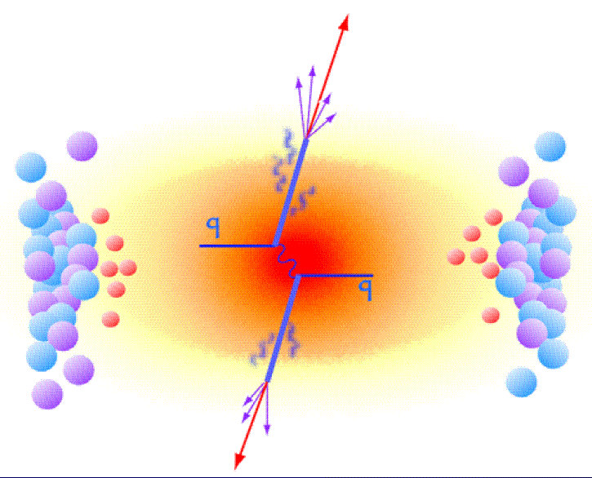
Topic-1: Probe the Density
QGP and Jet Quenching
High density QGP medium created in
Heavy ion collisions:
~20x of normal nucleus

Slide 35



Jet Quenching Observed
QGP density > 10x normal nucleus

Slide 36


Topic-2: Is the QGP Hot?
Short lived in heavy ion collisions:
~ 10⁻²² sec.

Slide 37



A Text Book Example
Measure the Temperature of the Sun
Planck’s law of black-body radiation
The temperature of the Sun is determined
from fitting the spectrum of light emitted
T_{Sun} = 5,800 Kelvin
= 10,000 F

Slide 38





QGP: it is really HOT!

Slide 39

Topic-3: Probe the Medium

Slide 40


QGP Medium Behavior
Anisotropic flow

Slide 41

Quark Liquid!
baryons
mesons

Slide 42



QGP Color Screening
Plasma Debye Length:
The shorter the r_{D},
the stronger the screening
effects

Slide 43

J/Psi Suppression Observed

Slide 44





QGP Discovery @RHIC: 2004
QGP discovery announced in 2004 by RHIC experiments, confirmed later at LHC
Unambiguous evidence for phase transition from ordinary nuclear matter to QGP (T~175 MeV, ~10¹² degrees)
Exhibits strong collective behavior, has huge stopping power for color-charged particles (quarks, gluons – the fundamental constituents)
Fundamental discovery:
QGP is not a weakly interacting gas of quarks and gluons, but rather a strongly coupled near-perfect liquid!

Slide 45


Slide 46


Why Antimatter ?
Why so few anti-matter?
Antimatter matters !

Slide 47


QGP and Anti-Matter
QGP: creates almost equal amount of particles and anti-particles …
anti-neutron, anti-proton …
Particles observed in Au+Ai collisions at RHIC

Slide 48




Observation of the antimatter helium4 nucleus
nature
473, 353 (2011)

Slide 49

Anti-matter Particle Search

Slide 50


From alpha to anti-alpha
alpha = (ppnn)
1911 : Rutherford used α + gold to discover the nucleus;
2011 : RHIC used gold + gold to discover the anti-α.

Slide 51


Reduction Factor
Matter and anti-Matter Production @RHIC
Yield
473, 353 (2011)
Production rate reduces by a factor of 1.6x10³ (1.1x10³) for each additional antinucleon (nucleon) added to the antinucleus (nucleus).

Slide 52





Dark Matter?
Galaxies’ rotation curve
Gravitational lensing (Hubble 2007)
F. Zwicky, ApJ 86 (1937) 217, V. Rubin et al, ApJ 238 (1980) 471
Planck: 2013
Notes:
It is widely accepted today that visible matter only account for 5% of matter and energy, with 25% dark matter .. With many compelling experimental obseravtions , how ever the nature of dark matter and dark energy remtain as the biggest scientific challenges for hunam being … sa they only interactio with SM particels very weakly .. Only shown in gravitaiton sectors ..

Slide 53

How Significant are the Results?

Slide 54


Outlook
Connecting Quarks with the Cosmos
Just start an exiting journey to understand the Biggest with the Smallest …

Slide 55

Enjoy Our Universe!

Slide 57


Slide 58

“Telescopes”

Slide 59

A Collision Event

Slide 60


QM 1983 and RHIC
https://www.bnl.gov/rhic/news2/news.asp?a=6204&t=today
Recalling Quark Matter '83 and the Birth of RHIC

Slide 61


Au+Au Collision: Event Display
Beam View
Side View

