Slide 1
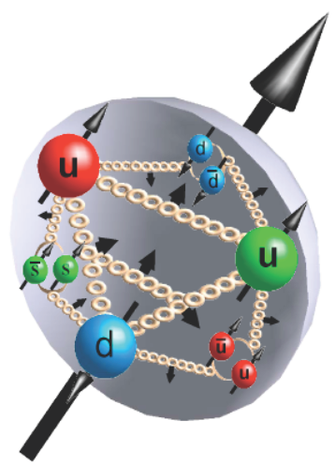
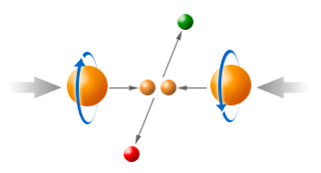
Highlights from RHIC Spin Program
Ming Xiong Liu
Los Alamos National Lab
- Longitudinal spin program
- Transverse spin program

Slide 2

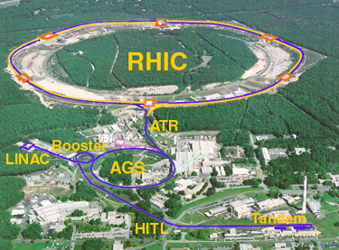
The Relativistic Heavy Ion Collider
at Brookhaven National Laboratory
R-HI
New state of matter
QGP
De-confinement
…
polarized proton
Nucleon Spin Structure
Spin Fragmentation
pQCD
…
RHIC is a QCD lab
BRAHMS
PHENIX
STAR

Slide 3
Highest Energy Polarized Proton Collider @RHIC
Absolute Polarimeter (H jet)
RHIC pC Polarimeters
Siberian Snakes
PHOBOS
BRAHMS
Siberian Snakes
Spin Flipper
STAR & pp2pp
PHENIX
Spin Rotators
Partial Snake
Helical Partial
Snake
Energy: up to 500GeV
Pol: 70%
Polarized Source
Strong Snake
LINAC
AGS
200 MeV Polarimeter
BOOSTER
Rf Dipole
AGS Internal Polarimeter
AGS pC Polarimeter

Slide 4
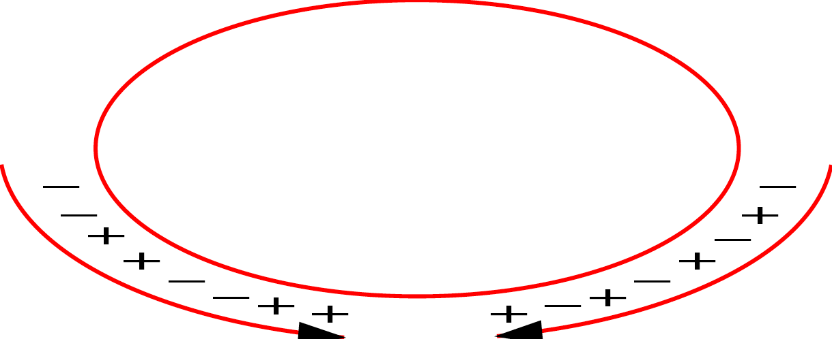
Experimental Observables
Asymmetries
  PHENIX and STAR: all
  BRAHMS: transverse beams only
Notes:
For polarized interactoins, we have 4 basic asymmetry measurements, depend on polarization:

Slide 5

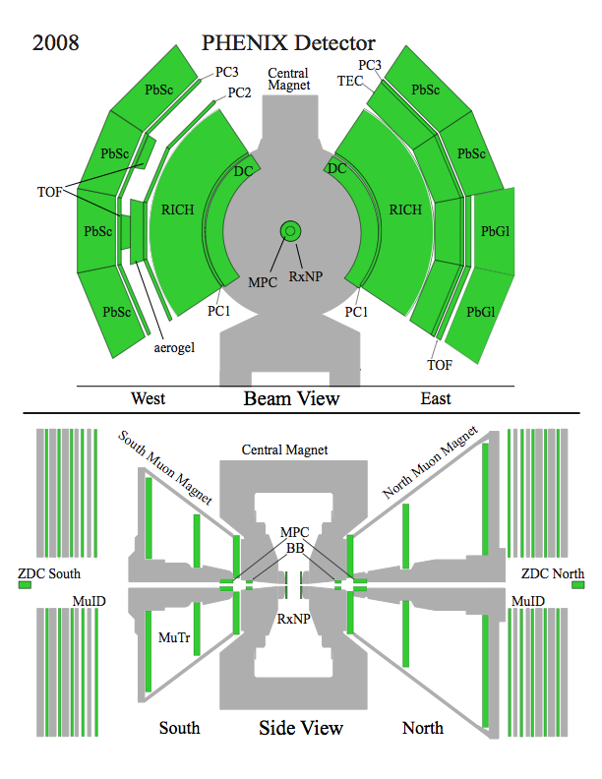
The PHENIX Detectors
Philosophy:
  High rate capability to measure rare probes,
  limited acceptance.
2 central spectrometers
  Track charged particles and detect electromagnetic processes
2 forward muon spectrometers
  Identify and track muons
2 forward calorimeters (as of 2007!)
  Measure forward pions
Relative Luminosity
  Beam-Beam Counter (BBC)
  Zero-Degree Calorimeter (ZDC)

Slide 6
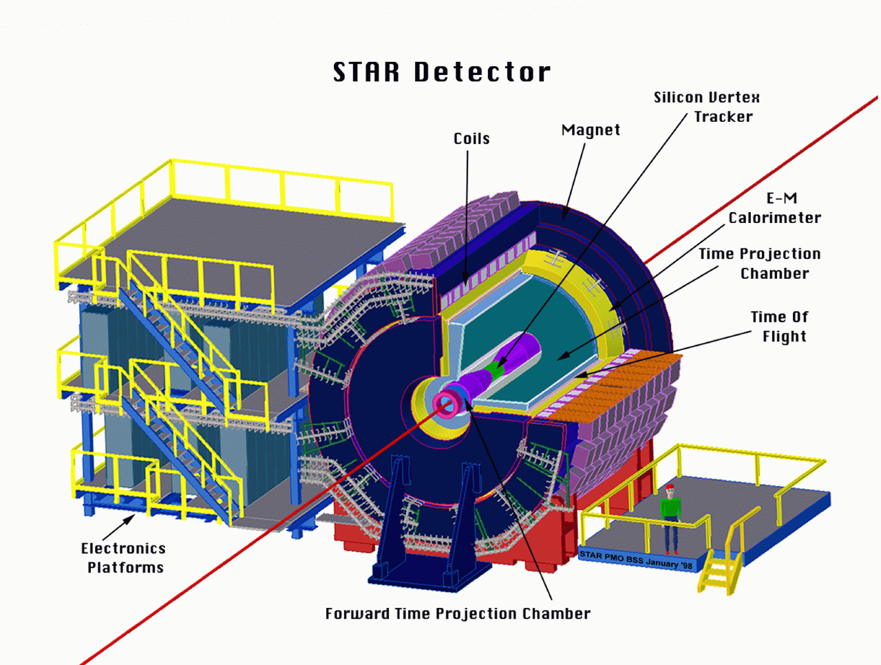
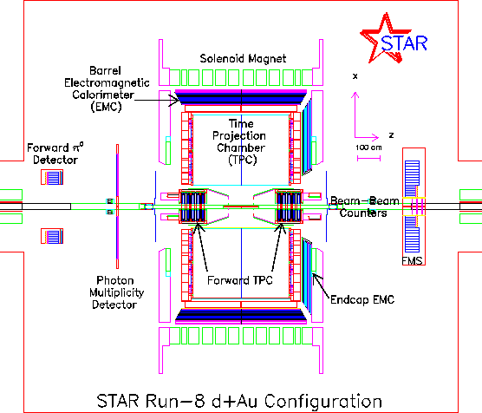
The STAR Detectors
PHOBOS
BRAHMS &PP2PP
PHENIX
RHIC
1.2 km
STAR
Time Projection Chamber |η|<1.6
Forward TPC 2.5<|η|<4.0
Silicon Vertex Tracker |η|<1
Barrel EMC |η|<1
Endcap EMC 1.0< η <2.0
Forward Pion Detector 3.3<|η|<4.1
Forward Meson Spectr. 2.5 < η < 4

Slide 7
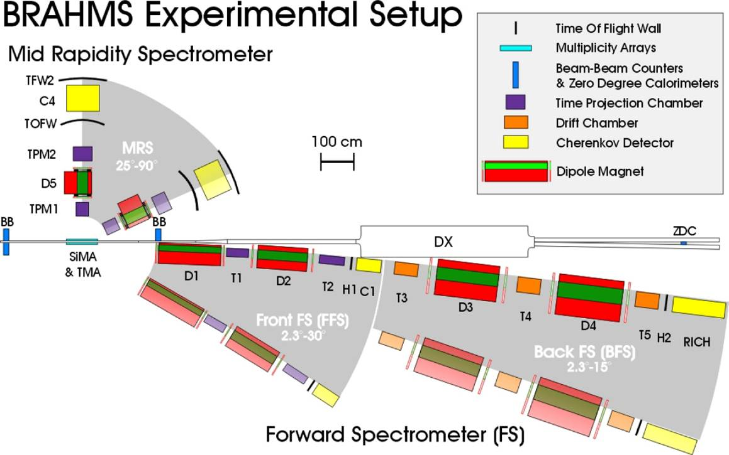
14

Slide 8
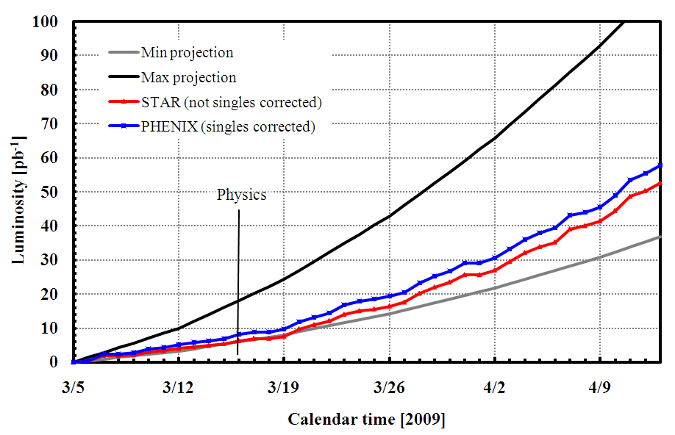
RHIC Spin Run History
Pol L(pb^-1) Results
2002 15% 0.15 first pol. pp collisions!
2003 30% 1.6 pi^0, photon cross section,
A_LL(pi^0)
2004 40% 3.0 absolute beam polarization
with polarized H jet
2005 50% 13 large gluon pol. ruled out
(P^4 x L = 0.8)
2006 60% 46 first long spin run
(P^4 x L = 6)
2007 --- --- no spin running
50% 20 (short) run
500GeV/200GeV first W measurements
Run9 500 GeV

Slide 9
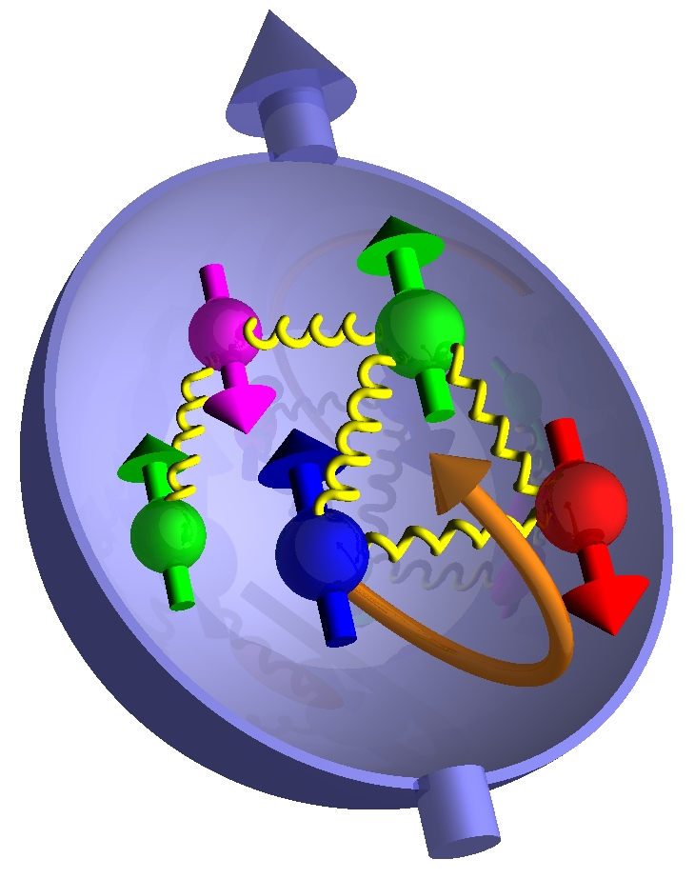
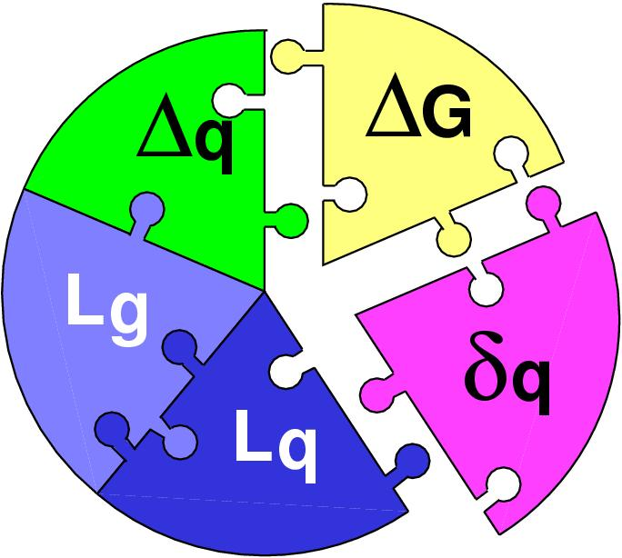
Part I: Longitudinal Spin Physics Program
The proton is viewed as being a “bag” of
bound quarks and gluons interacting via QCD
Spins + orbital angular momentum need
to give the observed spin 1/2 of proton
Fairly well measured
only ~30% of spin
Beginning to be measured
at RHIC
A future challenge
Notes:
Proton is a bag of bound quarks and gluons under strictures of QCD
Proton is spin 1/2 object so pieces must come together -> written as “sum rule”
Delta-q is measured, delta-G is not

Slide 10
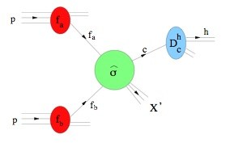
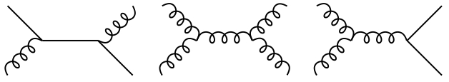
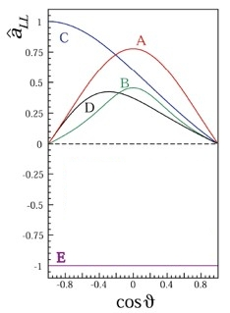
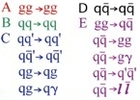
Δg and Polarized p+p Collisions
+
+
+
…
The LO result for a_{LL}
is nonzero for
all subprocesses
Notes:
P+p collision in factorized pQCD where you have pdfs for initial state, hard partonic cs for scattering, and FFs for final state.
Write ALL as convolution of polarized pieces, hard partonic helcity asymmetry
ALL has roughly three pieces

Slide 11
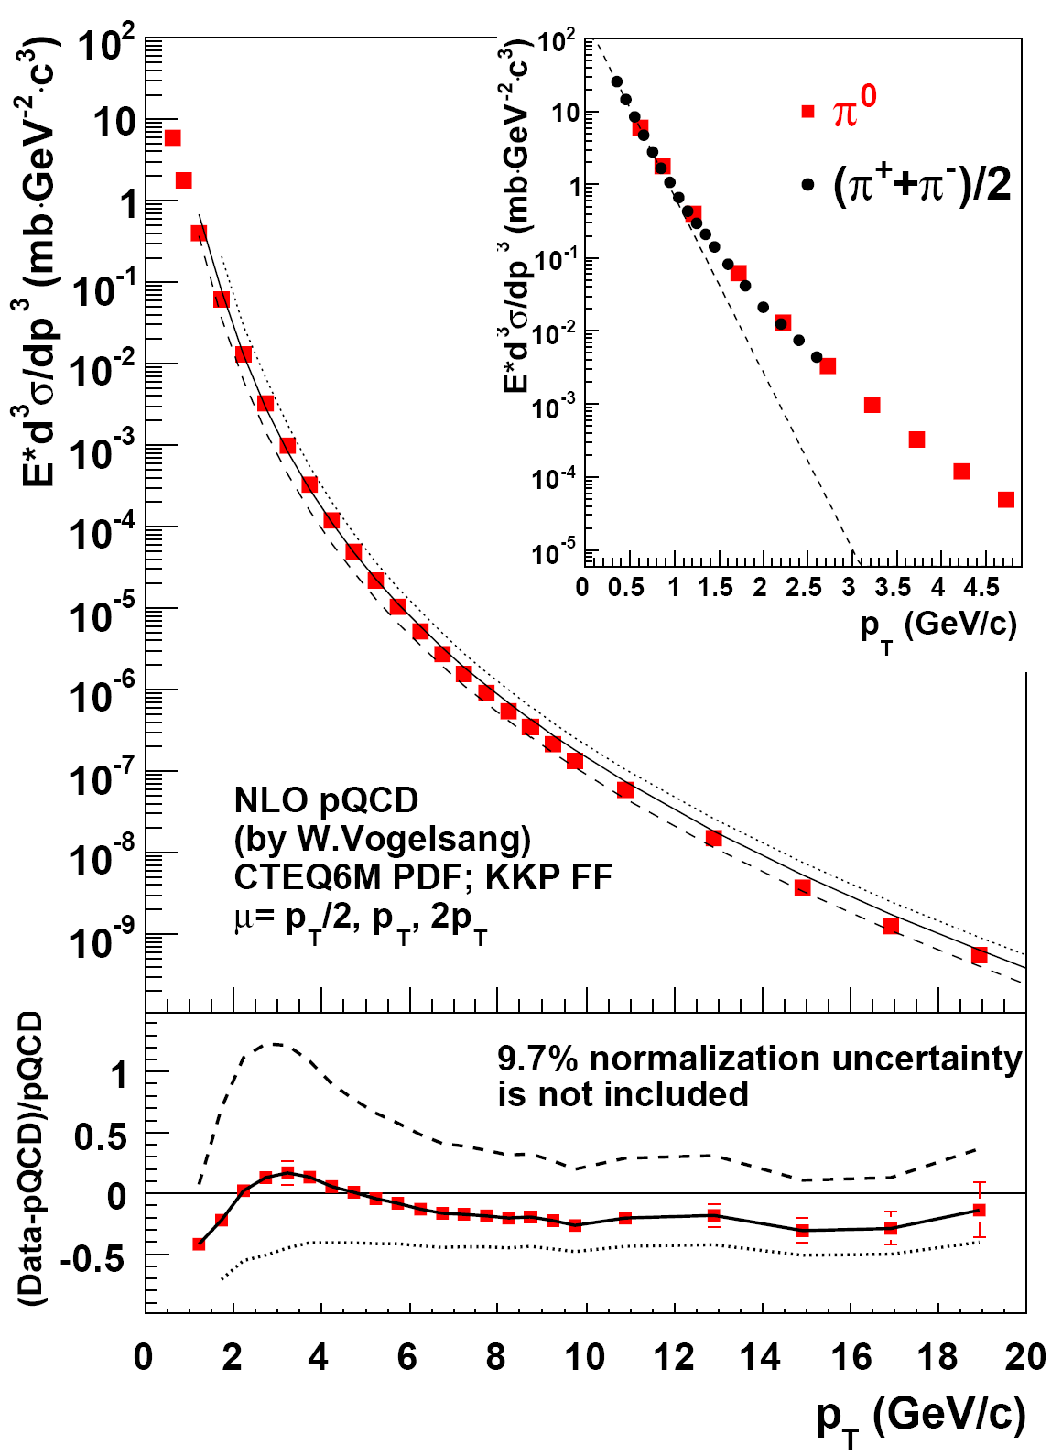
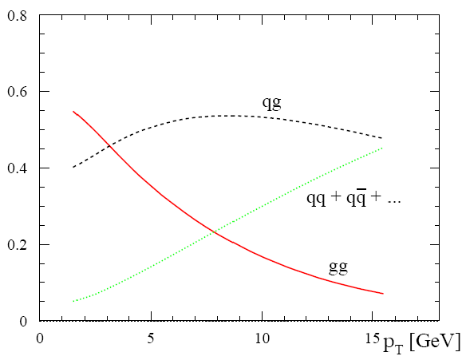
Pion production and NLO pQCD
* NLO QCD Calculation Cross-sections consistent with Data
  --- CTEQ6M pdf
  --- KKP and Kretzer Fragmentation Fcns
* Necessary Confirmation that pQCD can be used successfully at RHIC to extract spin dependent pdf’s

Slide 12
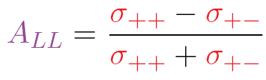
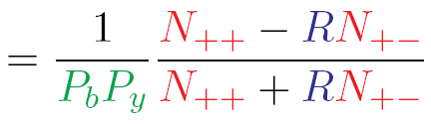




Measuring A_{LL}
+ - = Opposite helicity =
+
++ = Same helicity
=
+
Helicity Dependent Particle Yields (N)
  π⁰, π⁺, π⁻, γ, η, etc
Polarization (P)
Relative Luminosity (R=L₊₊/L₊₋)

Slide 13



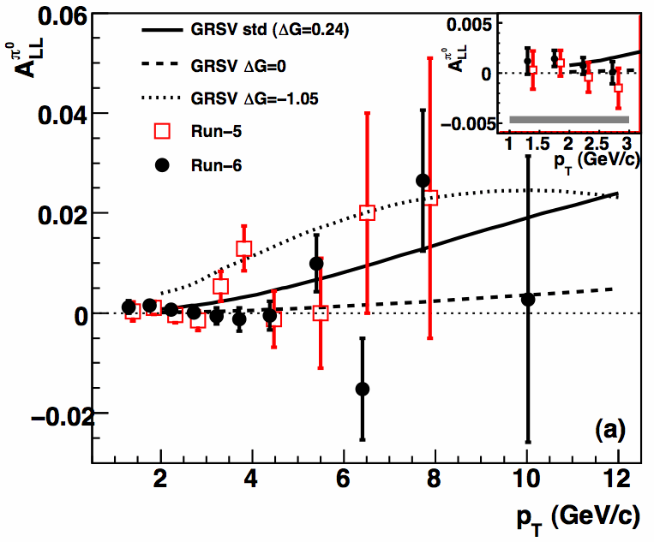

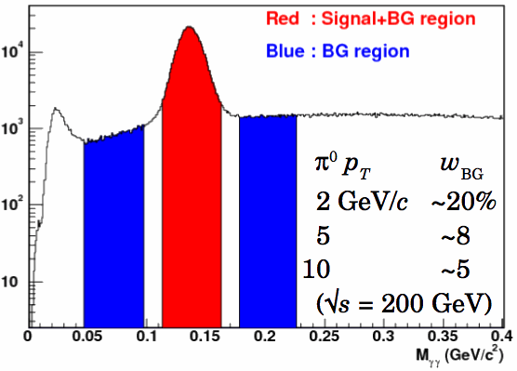
Neutral Pion A_{LL}
Hard Scattering Process
π⁰
Large cross section + finely segmented EMCal + high p_{T} photon trigger → large statistics
|η|<0.35
2005: PRD 76, 051106
2006: PRL 103, 012003
ΔG²
ΔGΔq
Δq²

Slide 14
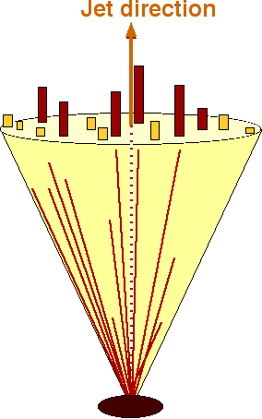
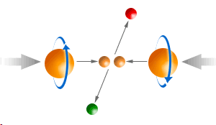
Jet reconstruction in STAR
Data jets MC jets
Midpoint cone algorithm
(Adapted from Tevatron II - hep-ex/0005012)
Seed energy = 0.5 GeV
Cone radius in η-φ
  R=0.4 with 0.2 < η < 0.8 (till 2005)
  R=0.7 with -0.7 < η < 0.9 (since ‘06)
Splitting/merging fraction f=0.5
Detector
GEANT
Particle
PYTHIA
Use PYTHIA + GEANT to quantify detector response

Slide 15
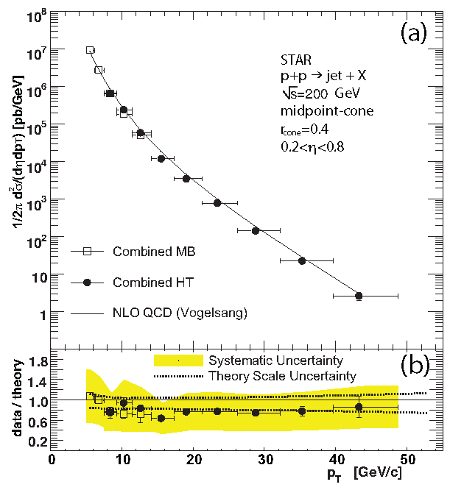
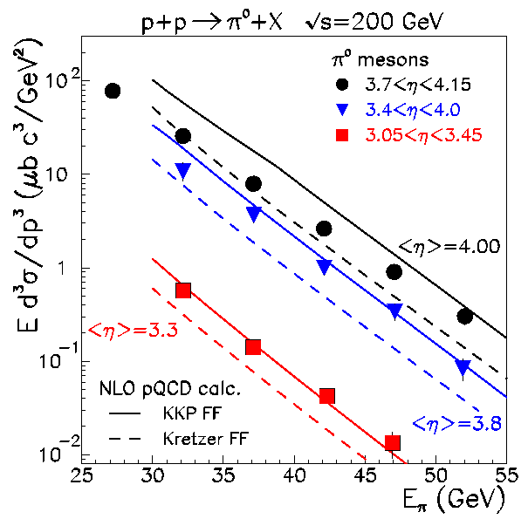
Essential benchmark – unpolarized cross sections
STAR
PRL 97, 252001
STAR
PRL 97, 152302
Mid-rapidity jet cross section is consistent with NLO pQCD over 7 orders of magnitude
Forward rapidity π⁰ cross section also consistent with NLO pQCD
Many other examples
pQCD works over a very broad kinematic range at RHIC energies

Slide 16
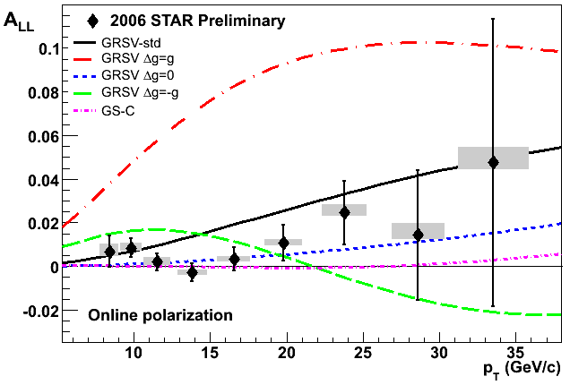
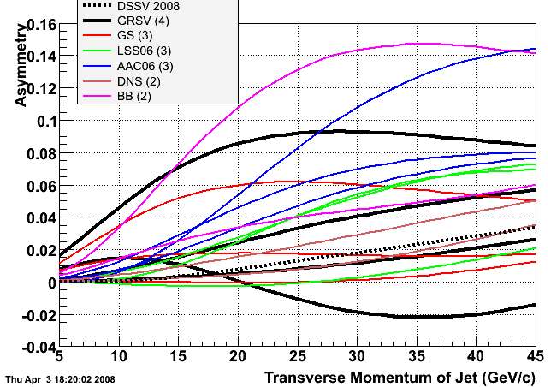
STAR inclusive jet A_{LL} from Run 6
STAR
200 GeV
-0.7 < η < 0.9
Run 6 inclusive jet A_{LL} results exclude many polarized parton fits that include large gluon polarizations

Slide 17
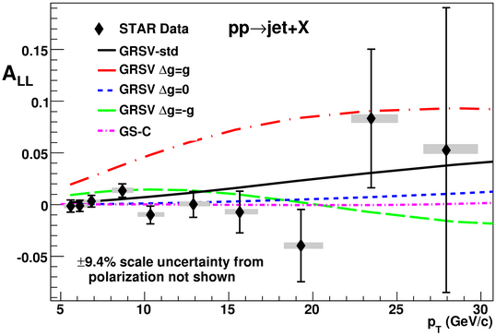
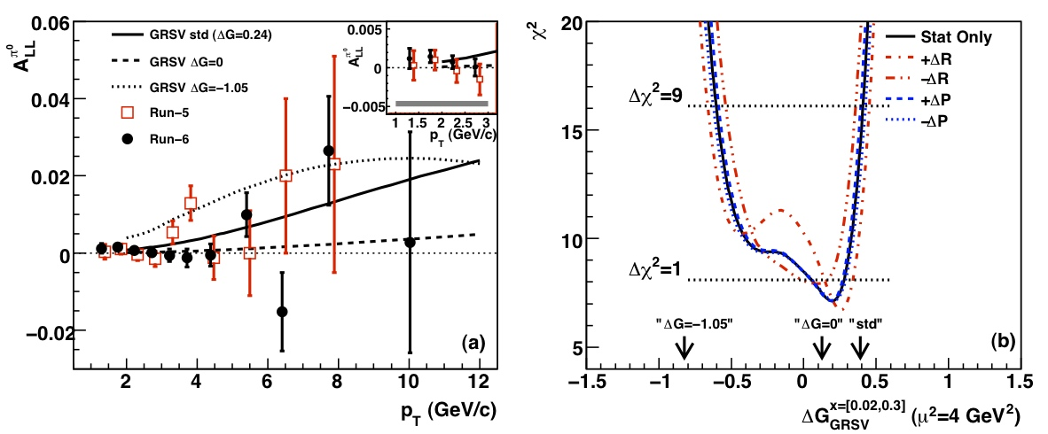
RHIC data and Δg
STAR, PRL 100 232003 (2008)
PHENIX pi0
STAR inclusive jets
PHENIX, PRL 103 012003 (2009)

Slide 18
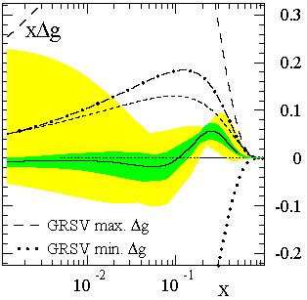
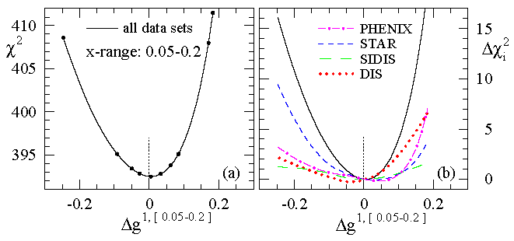
Impact of RHIC-Spin Program on Δg
Prior to RHIC-Spin Program, Δg = 1~2 expected at scale of 1GeV
  Restored consistency between data and quark model predictions
Major impact of program
  such large values of Δg seem to be excluded
DSSV 08
RHIC constraints
χ² distribution as Δg is varied w/in x-range constrained by
the RHIC data.
It is interesting to note that the best fit has
a zero-crossing at x ≈ 0.1.

Slide 19
Future New Probes @RHIC: Δg
Polarized hadron collisions
  double longitudinal spin asymmetry
  leading-order gluon interactions
    direct-photon production
    heavy-flavor production
    Other channels (light hadrons etc.)
proton beam
proton beam
→ or ←
→ or ←
gluon
gluon
heavy flavor
photon
gluon
→ or ←
→ or ←
proton beam
proton beam

Slide 20
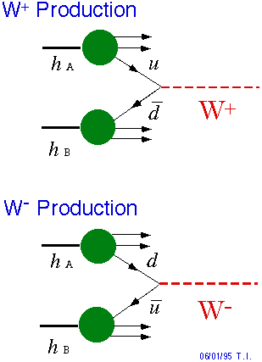
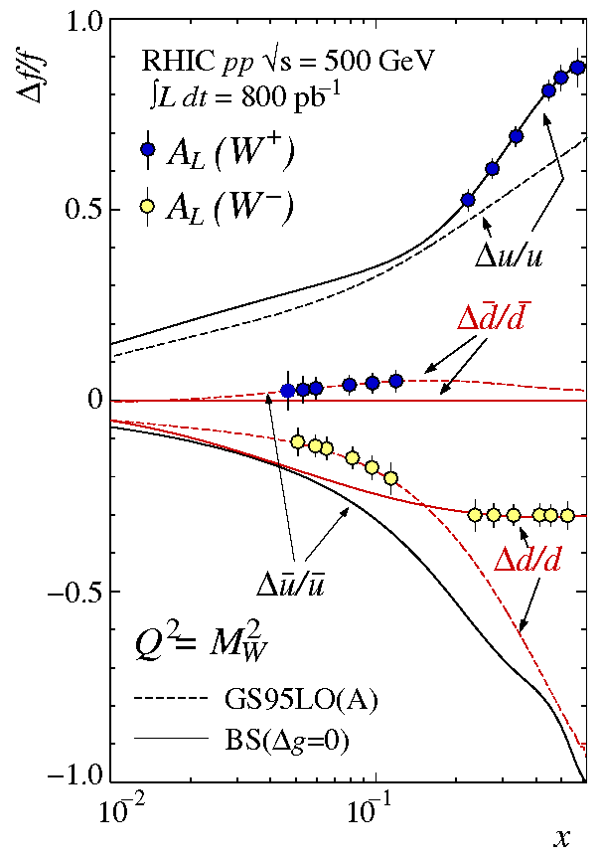
Latest News: W± Production and A_{L} @500GeV
μ⁺
Bunce G. et al, hep-ph/0007218
ν
μ⁻
ν
Notes:
Forward moving W+ measures du/u
Backward moving W+ measure dd/d
The magnitude of parton level PV asymmetry is large ~1
…

Slide 21
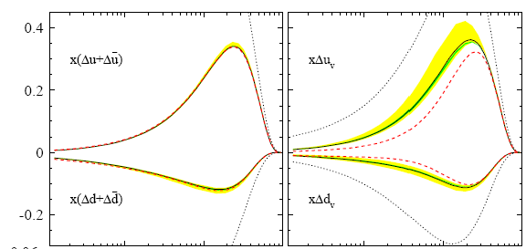
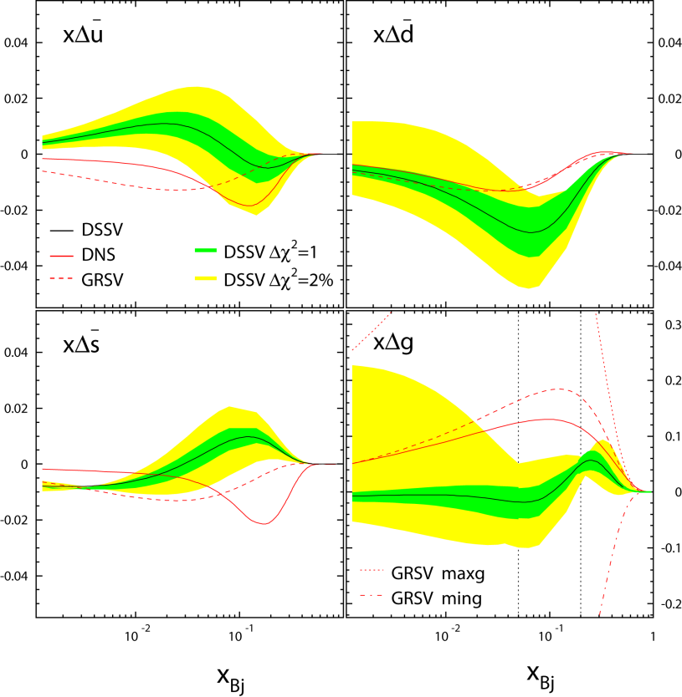
Polarized Parton Distributions
DIS:
  Valence quark distributions well determined
  Flavor separated sea quark distributions are not accessible
SIDIS:
  Can access in semi-inclusive DIS
  Rely on fragmentation functions
p+p:
  Accessible through parity violating W production
de Florian et al., PRL101, 072001 (2008)

Slide 22
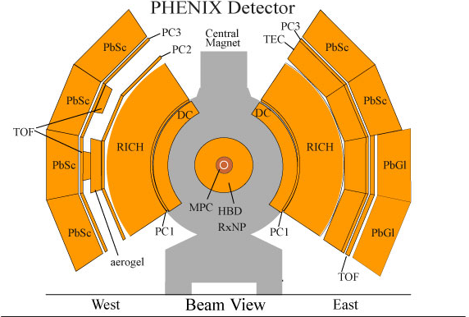
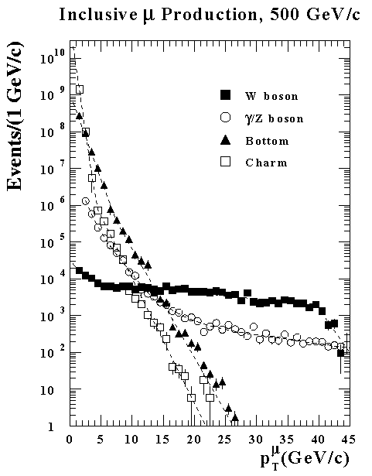
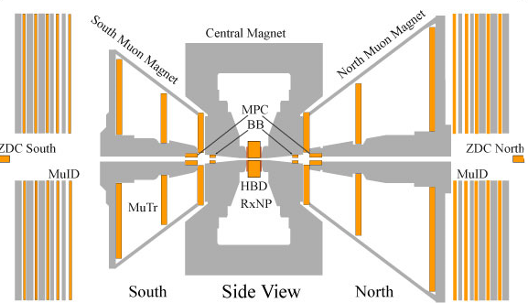
Two ways to get W^{+/-}->l^{+/-}+v in PHENIX
Central Rapidity: |η|<0.35
  Measure electron in the central arms EMCal
  Determine charge sign from tracking
Forward/Backward: 1.2<η<2.4
  Measure muon in muon arms
  W dominates muon signal above 20 GeV
  For measurement, we require:
    Ability to trigger on high momentum μ
    Hadron background reduction
  Upgrading PHENIX for this purpose
e^{+/-}
Muon p_{T} spectra in the Muon Arms
(2000 [1/pb], from PYTHIA5.7)
μ ±
Present trigger threshold
W

Slide 23
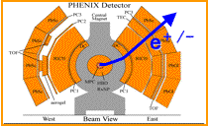
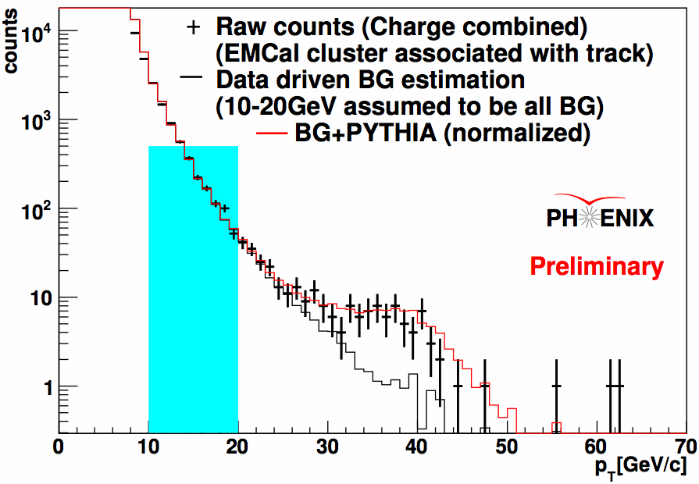
First Results (W^{+/-}→e^{+/-})
Run9 was first 500 GeV run
  P=40%, L=~10 pb⁻¹
  First measurement of W→e for |η|<0.35
EMCal:
  High energy trigger
    Reduces hadron contamination
DC/PC
  Charge sign determination
Background
  γ conversions and hadrons.
  Normalized to yield in p_{T}=10-20 GeV

Slide 24
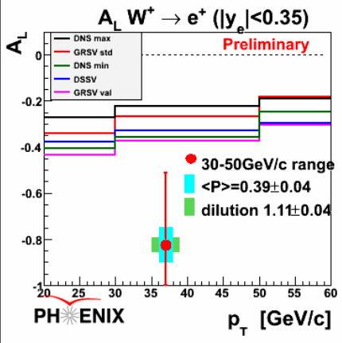
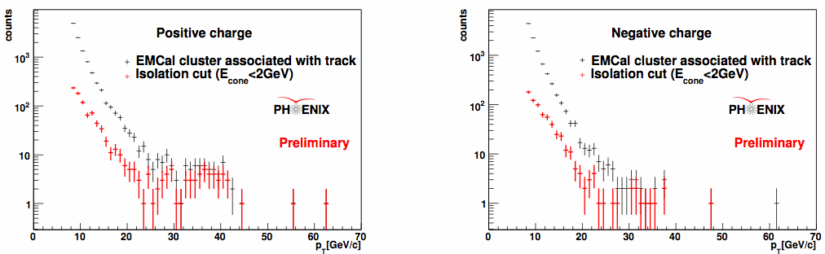
Measuring A_{L}
For asymmetry, use additional isolation cut
  Background reduced
Non-zero asymmetry found
Agrees within large statistical uncertainty
Not corrected for Z, DY
In future, VTX will allow better background determination

Slide 25
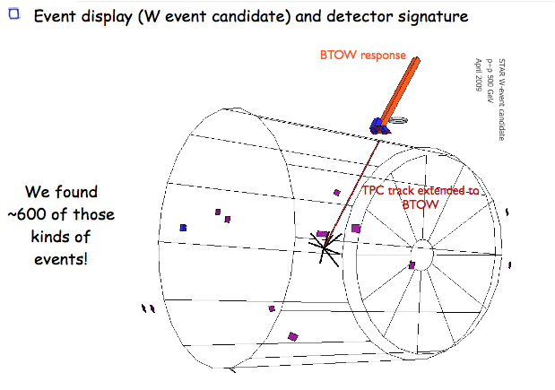
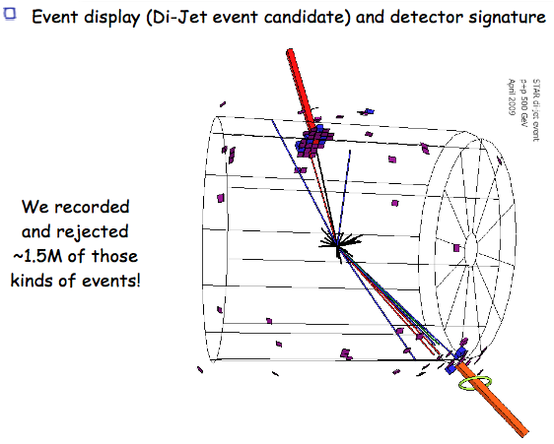
STAR W^{+/-} -> e^{+/-} +v Measurements
W->e+ν signal event
QCD background event

Slide 26
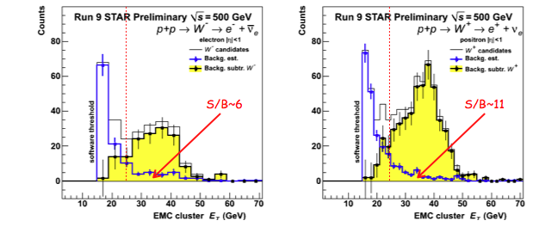
STAR W^{+/-} Results
High pT electrons

Slide 27
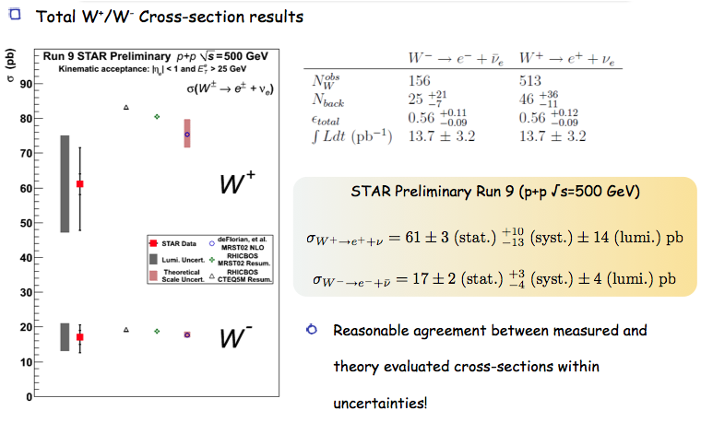
W^{+/-} Cross Sections

Slide 28
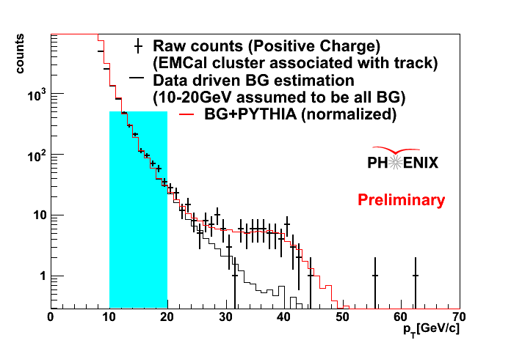
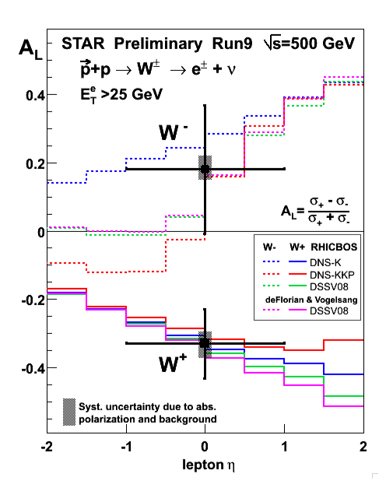
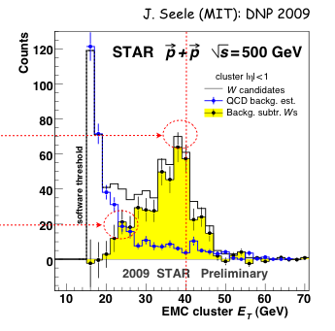
Mini Summary
First W± Measurements from Run9 500 pp!

Slide 29
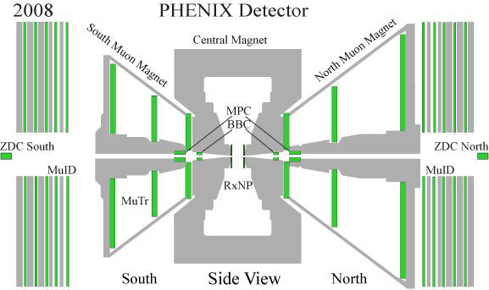
W^{+/-}→μ^{+/−}
Trigger upgrade:
  MuTrig
    Uses fraction of signal in Muon Tracker
    Tested in Run10
  RPC 3
    Fast timing
    North commisioned in Run10
    South will be installed this summer
Background Reduction
  Absorber
    Reduce background hadrons by order of magnitude
    Will be installed in both arms this summer

Slide 30




(DOE Milestone HP8, 2013)

Slide 31




Part II: Transverse Spin Physics Program
RHIC 20,000 GeV beam
Large Transverse Single Spin Asymmetry (SSA) in forward meson production persists up to RHIC energy.
FNAL 200 GeV beam
AGS 22 GeV beam
ZGS 12 GeV beam
PRL (2004)
PLB261, 201 (1991)
PLB264, 462 (1991)
PRD65, 092008 (2002)
PRL36, 929 (1976)
Non-Perturbative cross section
Perturbative cross section

Slide 32
Possible Mechanisms …
Sivers mechanism: Correlation between nucleon spin and parton k_{T}
Collins mechanism: Transversity (quark polarization) * asymmetry in the jet fragmentation
Phys Rev D41 (1990) 83; 43 (1991) 261
Nucl Phys B396 (1993) 161
S_{P}
S_{P}
S_{q}
p
k_{T,q}
p
p
p
S_{q}
k_{T,π}
Orbital Angular Momentum?

Slide 33

Theory: K_{T} vs Collinear Factorization
f_{a}
h
Tran. Mom. Dep. Funs
  Sivers Fun
  Collins Fun
Twist-3 collinear
  Quark-gluon correl.
  Gluon-gluon correl.
q
FF_{q}
σ
f_{b}
X’
A_{N}
TMD
Collinear/Twist-3
pT

Slide 34



4
STAR
Forward π⁰ Single Spin Asymmetry(SSA)
At √s=200GeV, π⁰ cross-section measured by STAR FPD is consistent with the NLO pQCD calculation. Results at <η>=3.3 and <η>=3.8 have been included in the DSS global pion fragmentation function analysis. (Phys.Rev.D75(2007) 114010)
Phys.Rev.Lett.101:222001,2008
Black Points: Phys.Rev.Lett.101:222001,2008
34
From Spin2008 talk by J.Drachenberg,
arXiv:0901.2763

Slide 35


5
STAR
p_{T} Dependence of A_{N}
For Fixed X_{F}, the asymmetry A_{N} does not fall with p_{T} as predicted by models
and perhaps expected on very general grounds.
NLO PQCD does describe
the size and shape of this
forward π⁰ cross section.
Model calculations (Sivers,
Collins or twist-3) can explain
the X_{F} dependence of A_{N}.
X Flat or increasing dependence
of A_{N} on p_{T} is very difficult
to understand within any of
these frameworks!
Phys.Rev.Lett.101:222001,2008
Notes:
35

Slide 36



17
STAR
Latest Run 8 REsults: p_{T}-dependence of π⁰ A_{N}
Large solid angle of FMS allows simultaneous mapping of x_{F} vs p_{T} with greater statistics
Run3+5+6
Run8
F.o.M. was smaller in run8 than in run6
→ More statistics needed
Black: Phys.Rev.Lett.101:222001,2008
Blue: From Spin2008 talk by J.Drachenberg,
arXiv:0901.2763

Slide 37

A_{N} P_{T} Dependence Remains as a Challenge
A_{N} vs p_{T}
A_{N} vs x_{F}
Run8

Slide 38

6
Pattern from Previous Transverse SSA Measurements of Forward Pion / Eta Production with High Energy Polarized Proton / Antiproton Beams
STAR
Majority valence quark in polarized proton.
  for proton
  for antiproton.
Minority valence quark
  for proton
  for antiproton.
Pion containing only majority quarks: large positive AN.
Pion containing only minority quarks: large negative A_{N}.
Pion containing both majority and minority quarks: intermediate positive A_{N}.

Slide 39


New Channels: Heavy Quark
D meson A_{N}
Production dominated by gluon-gluon fusion at RHIC energy
Gluon transversity zero
→Asymmetry cannot originate from Transversity x Collins
Sensitive to gluon Sivers effect (poorly constrained by pol DIS)
Theoretical prediction:
p↑p→DX
Anselmino et al, Phys. Rev. D 70, 074025 (2004)

Slide 40

Theoretical Models: J/Psi SSA can be measured @RHIC/PHENIX!
Singlet vs Octet channels
F. Yuan (2008)

Slide 41


Latest Results of Heavy Quark SSA
Probing Gluon’s Sivers Asymmetry
D->μ⁻
J/Psi A_{N} sensitivity, expect results spin2010
Gluon’s Sivers fun was not constrained well by DIS data
PHENIX Charm data exclude the maximum gluon Sivers Fun (Anselmino et al, 06)
Much improved results expected soon (Run6+Run8)

Slide 42


Future Opportunity
Vertex Detectors (2011-2012)
Large acceptance precision tracking
  Drell-Yan
  Heavy quarks
  Jets
Forward Calorimeter(2012-2013?)
Proposed PHENIX Upgrade ( 1 < eta < 3 )
  A_{N} π⁰, Direct γ, γ-Jet
  Collins-type measurements

Slide 43

Attractive vs Repulsive “Sivers” Effects
Unique Prediction of Gauge Theory !
DIS: attractive
Drell-Yan: repulsive

Slide 44


Critical Role of VTX/FVTX for Drell-Yan
Tracking muons with MuTr+FVTX
  Prompt muons from DY
  Displaced tracks from π/K and heavy quark decays
Drell Yan
DCA < 1 σ cut:
Increase DY/bb ~ 5
ϒ-states
J/Ψ
Drell Yan
charm
beauty
charm
beauty
DY: 4 GeV < M < 9 GeV; B-background: use FVTX
combinatorial background

Slide 45

Future Transverse Spin Physics: A_{N} (Drell-Yan ->μ⁺μ⁻)
“Transverse-Spin Drell-Yan Physics at RHIC” (http://spin.riken.bnl.gov/rsc/write-up/dy_final.pdf)
Important test at RHIC of recent fundamental QCD predictions for the Sivers effect, demonstrating… attractive vs repulsive color charge forces
HERMES
Sivers Amplitude
0.1 0.2 0.3 x

Slide 46


Charm SSA to Probe Gluon Sivers Distribution
D meson Single-Spin Asymmetry:
Production dominated by gluon-gluon fusion
Sensitive to gluon Sivers distribution
  PHENIX-2006 data ruled out the max. gluon Sivers
  Much improved results expected (Run2006+2008)
Kang, Qiu, Yuan, Vogelsang, Phys. Rev. D 78,114013(2008)

Slide 47



Transverse Physics
W^{+/-} & Z⁰ SSA @500GeV ?
Kang & Qiu PRL 103, 172001 (2009)
Latest theoretical progress
  Test time-reversal universality of Sivers functions with W/Z
  Expect large asymmetry (from DIS fit)
Flavor-identified Sivers Funs
Expected Statistics @1fb⁻¹ 500GeV
  W^{+/-} →μ^{+/-} ~20K
  Z⁰ -> μ⁺μ⁻ ~ 1K
W^{+/-}
Z⁰
Kang & Qiu arX 0912.1319
47

Slide 48

Renaissance of Transverse Spin Physics
Recent experimental observation of non-Zero Sivers and Collins effects
  HERMES, 05,09; COMPASS, 05,09 ; BELLE 06
Very active/rapid theoretical progress
  Spin-dependent TMD
    Sivers 90; Colllins 93; Brodsky-Hwang-Schmidt, 02
  Twist-3 quark-gluon correlations (coll.) in DIS
    Efremov-Teryaev, 82, 84; Qiu-Sterman, 91,98
  Twist-3 tri-gluon correlations in p+p
    Kang-Qiu-Vogelsang-Yuan 08
  Unified picture of TMD and Twist-3
    Ji-Qiu-Vogelsang-Yuan 06; Yuan-Zhou, 09
Opportunity for new study of QCD dynamics
  Sivers Funs in DIS & DY
  Flavor Dep. Sivers Fun & OAM
  quark-gluon and tri-gluon correlation
Future direction @RHIC-SPIN?
  Large SSA observed at forward rapidity @RHIC
  Open charm and beauty
  Drell-Yan and Vector mesons
  Light hadrons at forward rapidity
A_{N}
TMD
Collinear/Twist-3
pT
48

Slide 49
The Forward S-PHENIX Spectrometer (2016+x)
(Courtesy E. Aschenauer)
o Acceptance: -1 < η < 4 and -2.4 < η < -1.2
o Full jet capability: electromagnetic + hadronic calorimetery
o Heavy flavor tagging, PID for : 1 < η < 4
o W-physics: a) reconstruct missing mass, b) access to hadronic final states
o Opportunity to improve relative luminosity measurement ➔ access to asymmetries < 10⁻³
HCAL
145cm
North Muon
Arm
H
C
A
L
68cm
E
M
C
A
L
EMCAL
RICH
Silicon Tracker
IP
Forward
Silicon Tracker
49

Slide 50
Summary and Outlook
Spin puzzle
  Gluon polarization
    Large Δg ruled out
    New probes, direct-photon, open charm …
    Larger x-range in the future
Sea quark polarization
  First W asymmetry observed
  Much improved results in the future
Transverse spin physics
  Large SSAs observed at RHIC
  New study of QCD dynamics
    Charm SSA
    Drell-Yan SSA
RHIC constraints

Slide 51
backup

Slide 52
RHIC/PHENIX Spin Run History and Prospect
RHIC-RUN Pol(%) L(pb⁻¹) Results
15% 0.15 first pol p+p run@RHIC! Transverse
30% 0.35 π⁰ cross section, A_{LL}(π⁰)
40% 0.12 Pol H-Jet, absolute beam polarization
50% 3.5 A_{LL}(π⁰) ruled out large Δg, GRSV-Max-Like
60% 7.5 first dedicated long spin run
2.7 Transverse run
2007 -- -- NO spin run
2008 45% 5.2 short run for HI baseline pp physics
2009 35% 14 first 500GeV run!
55% 16 200GeV
Goals
800pb⁻¹@500GeV
300pb⁻¹@200GeV
300pb⁻¹@500GeV
70pb⁻¹@200GeV
CAD Delivered Run9@500GeV
CAD(10.2009): From Run9 experience, reduced the “enhanced” design goals: P=70%, L = 3 × 10³¹ cm⁻²s⁻¹ (or ≈ 7.5 pb⁻¹/week) at √s = 200 GeV
12-week Run Delivered: 90pb⁻¹
PHENIX(ε=1/3) = 30pb⁻¹
With hardware upgrade, expect to achieve: 18~83 pb⁻¹/week@500GeV
12-week Run Delivered: 220~1000pb⁻¹
PHENIX(ε=1/2) = 100~500pb⁻¹
52

Slide 53








Charged Pion A_{LL}
Use RICH (|η|<0.35) to identify pions with p_{T}>4.7 GeV
  Cross section in this region is dominated by qg scattering
Favored/Disfavored FF → different qg contributions for π⁺, π⁰, π⁻ due to sign of Δu and Δd
→ access sign of ΔG
π⁺
π⁻

Slide 54






Direct photon and η A_{LL}
η
  (|η|<0.35)
  Analysis similar to π⁰
  Fractional subprocess differ somewhat
  Independent confirmation of ΔG
Direct Photon
  |η|<0.35
  Quark-gluon compton scattering process dominates (~80%)
  Limited statistics, but unique access to ΔG
R. Bennett

Slide 55

Daniel de Florian, RSC’09

Slide 56


16
STAR
Preliminary Run8 FMS π⁰ A_{N}
Azimuthal Angle Dependence of A_{N}
A_{N} vs. xF
→ Consistent with previous measurements
STAR Preliminary
stat.errors only
Estimate σ_{tot.} ≤ 1.2 σ_{stat.}
From SPIN08 talk by N. Poljack, arXiv:0901.2828

Slide 57

Sivers Asymmetries in Drell Yan
(IV) Sensitivities with S-PHENIX
A_{UT} prediciton
from Feng Yuan
and Werner Vogelsang
based on Hermes
data.
Acceptance assumed to
be 2.5 < η < 4 . Backgrounds
assumed to be identical to
background in PHENIX
muon arms for Drell-Yan.
Presently the S-PHENIX
forward acceptance is
assumed to be 1 < η < 4

Slide 58

Color Flow in Twist-3
Kang @this workshop

Slide 59



Generalized Parton Model
Assume TMD factorization
Anselmino et al.
TMD factorization breakdown… a failure or an opportunity?
Mulders, Xiao..
@this workshop

Slide 60

Gamberg, Kang
@this workshop
Generalizing GPM… with modified hard cross sections (gluonic-pole cross sections)
PRL 99 (2007) A. Bacchetta et al,
PRD 72 (2005) A. Bacchetta, C.J. Bomhof, P.J.Mulders, F.Pijlman

Slide 61

Heavy Quark TSSA (I)
Twist-3 quark-gluon correlation
Different color factors for charm and anti-charm
F. Yuan and J. Zhou PLB 668 (2008) 216-220
Initial state
Charm
Anti-charm

Slide 62


JPARC p+p
GSI: p+pbar

Slide 63

Heavy Quark SSA (II)
Twist-3 tri-gluon correlation
Consequence of different color factors for charm and anti-charm
Kang, Spin2008

