Slide 1
TSSA in Heavy Quark Production
Ming X. Liu
Los Alamos National Lab
BNL/RBRC Summer Spin Workshop 07/2010
A new Experimental Test of color dynamics in hard scattering
Color flow, DIS and DY
Open charm TSSA
J/Psi TSSA
Experimental prospects: PHENIX@RHIC and other new Exp’s
An experimentalist’s point of view

Slide 2
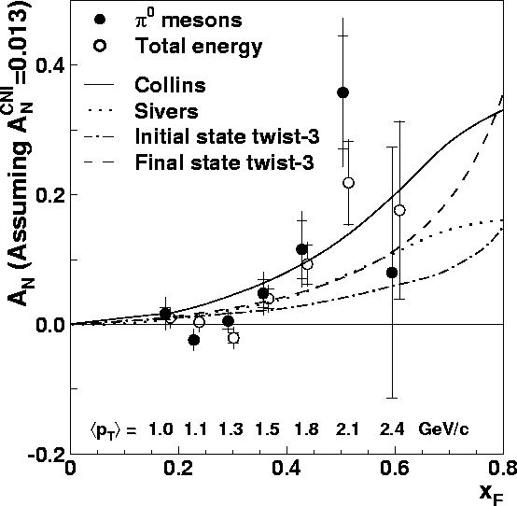
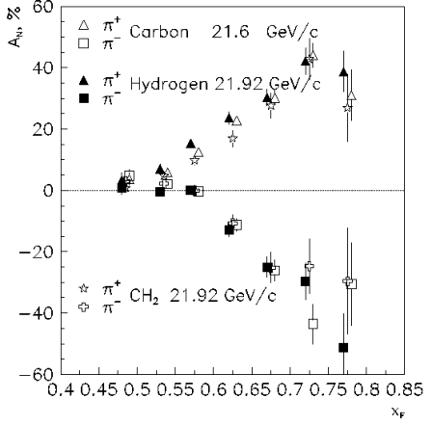
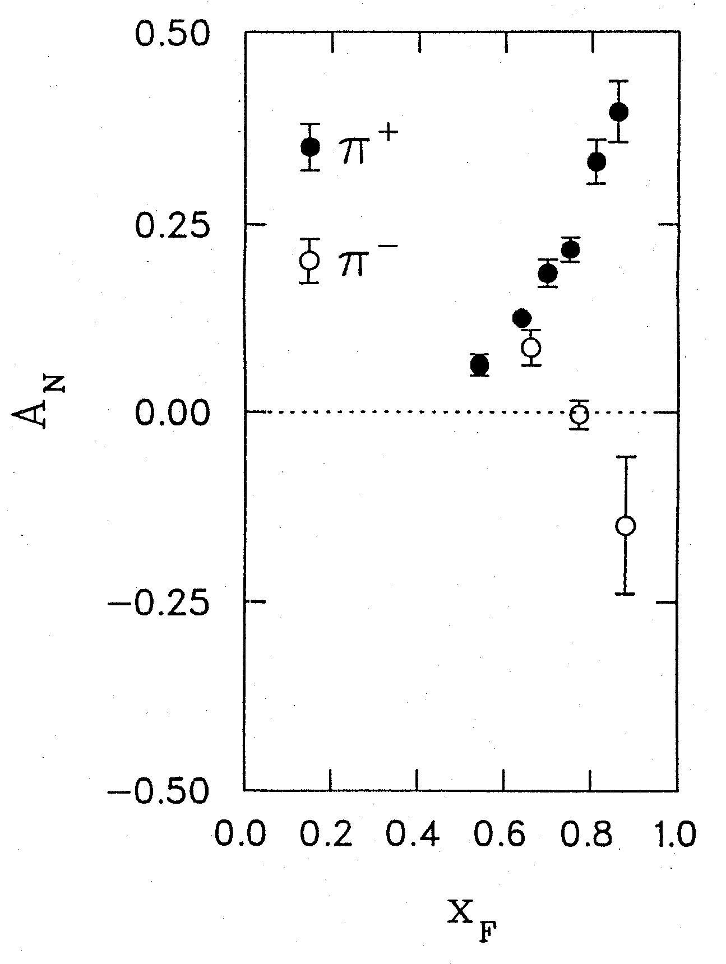
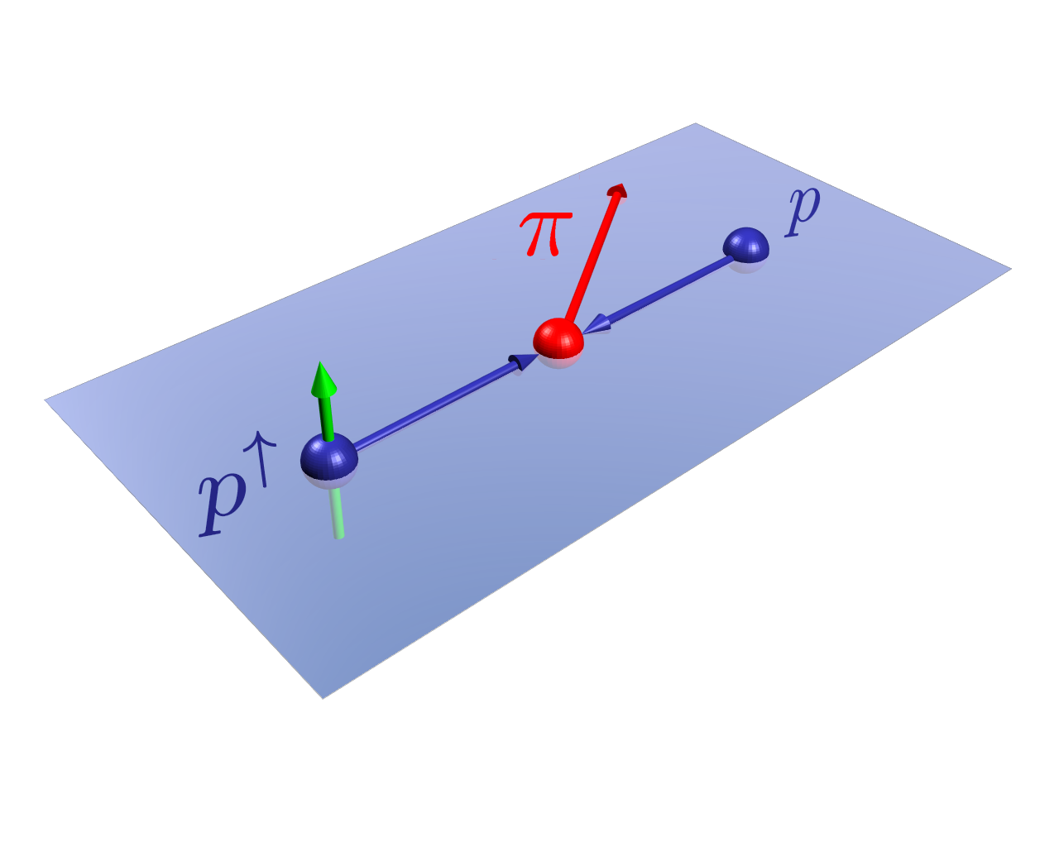
The Challenge of “Too Large”
- do we understand this?
RHIC 20,000 GeV beam
Large Transverse Single Spin Asymmetry (SSA) in forward meson production persists up to RHIC energy.
FNAL 200 GeV beam
AGS 22 GeV beam
ZGS 12 GeV beam
PRL (2004)
PLB261, 201 (1991)
PLB264, 462 (1991)
PRD65, 092008 (2002)
PRL36, 929 (1976)
Non-Perturbative cross section
Perturbative cross section

Slide 3
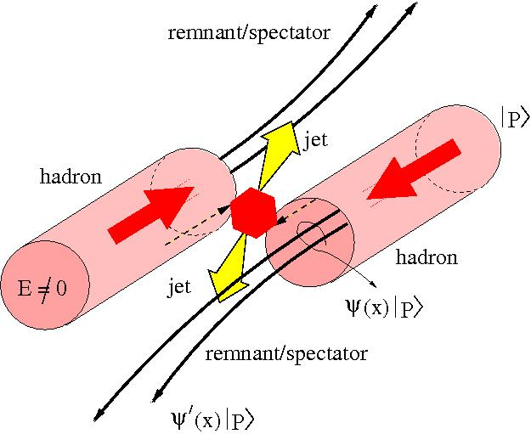
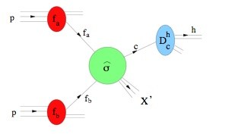
Color Interaction and TSSA
Do we understand the underlying physics?
  the Sivers asymmetry, for example
What can we learn more from future data?
  DY, charm, direct-photon…
We are colliding hadrons, not partons!

Slide 4
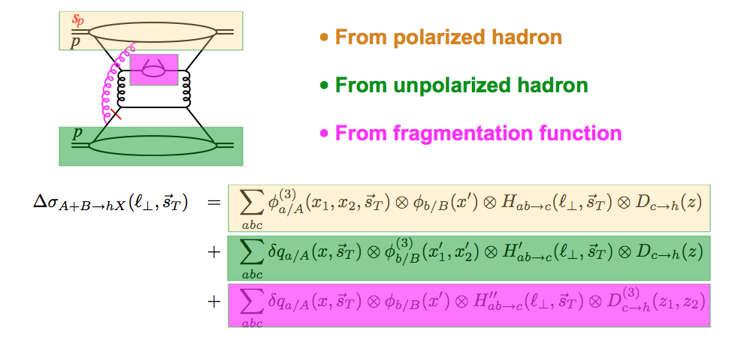
Color Flow in Twist-3
Kang @this workshop

Slide 5
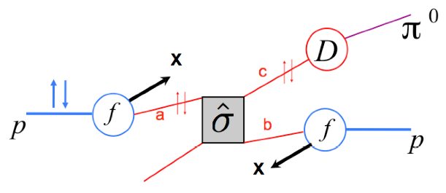
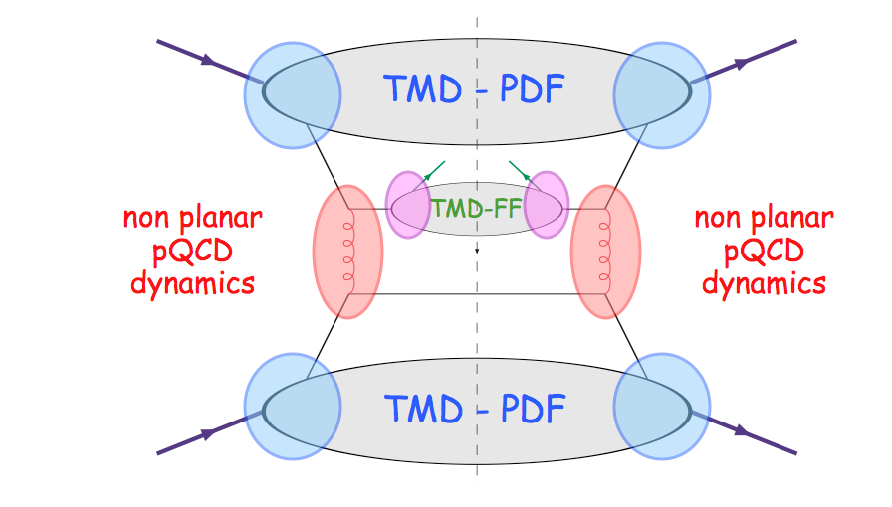
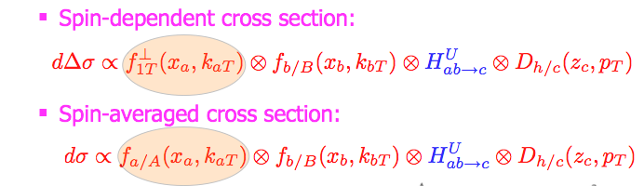
Generalized Parton Model
Assume TMD factorization
Anselmino et al.
TMD factorization breakdown… a failure or an opportunity?
Mulders, Xiao..
@this workshop

Slide 6
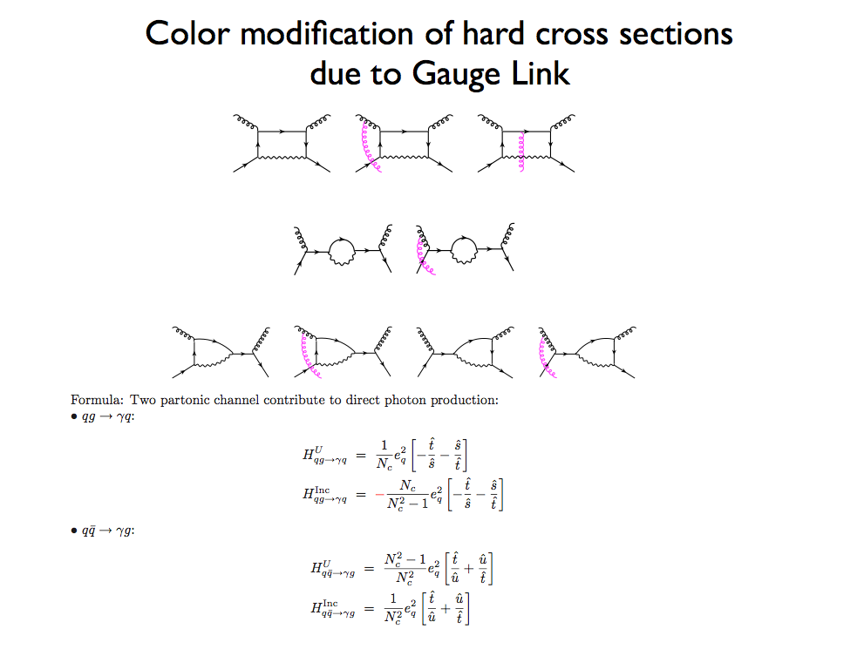
Gamberg, Kang
@this workshop
Generalizing GPM… with modified hard cross sections (gluonic-pole cross sections)
PRL 99 (2007) A. Bacchetta et al,
PRD 72 (2005) A. Bacchetta, C.J. Bomhof, P.J.Mulders, F.Pijlman

Slide 7
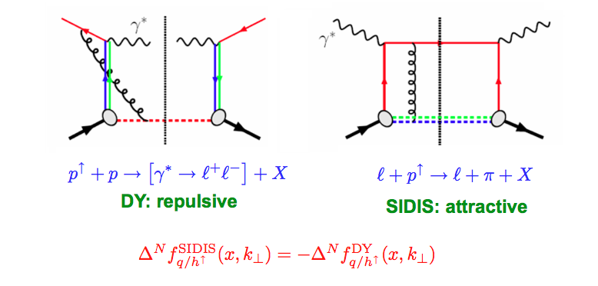
Color Flow in DY and DIS
The sign change – a new fundamental test of color gauge formalism
Charm TSSA could provides a new independent experimental test
Collins ‘02
Twist-3: sign change from gluonic-pole in hard parts
In the overlapped region – consistent description
Ji, Qiu, Vogelsang, Yuan ‘06
Bacchetta, Boer, Diehl, Mulders ‘08

Slide 8
Charm and anti-Charm TSSA and Color Flow
Quark and antiquark could have different color flow structure in hard scattering
Experimentally Charm and anti-Charm can be cleanly identified,
A_{N}(charm) provide new insight to the underlying physics of TSSA
  Directly test the different color coupling for quark and anti-quark
A new experimental test of the color coupling
to quark vs antiquark in hard scatterings!

Slide 9
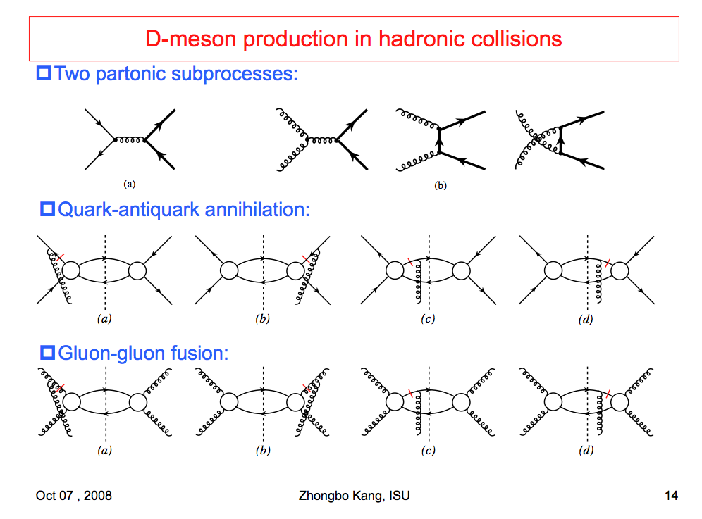
TSSA in Heavy Quark Production at LO
Kang, Qiu, Vogelsang, Yuan, PRD 2008

Slide 10
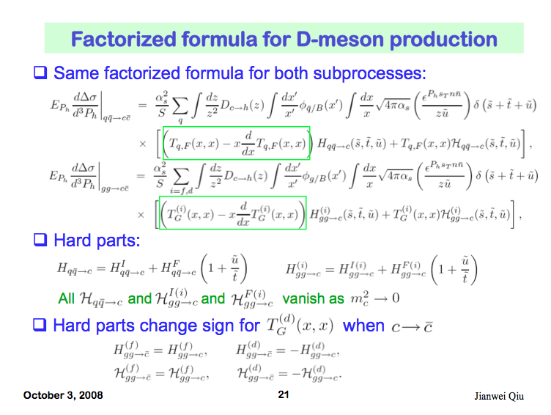
Charm TSSA in Twist-3 Approach

Slide 11
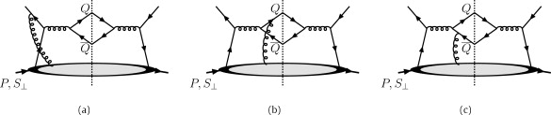
Heavy Quark TSSA (I)
Twist-3 quark-gluon correlation
Different color factors for charm and anti-charm
F. Yuan and J. Zhou PLB 668 (2008) 216-220
Initial state
Charm
Anti-charm

Slide 12
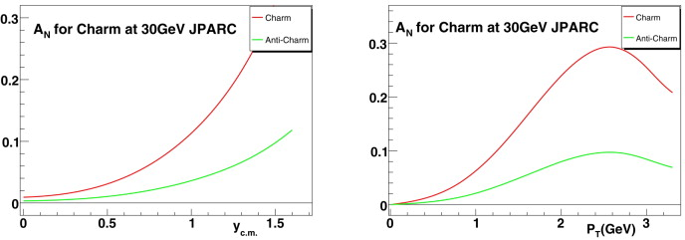
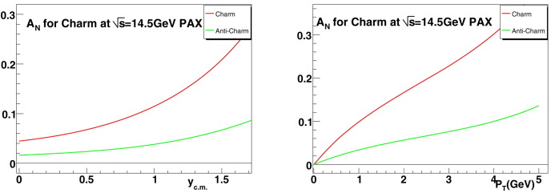
JPARC p+p
GSI: p+pbar

Slide 13
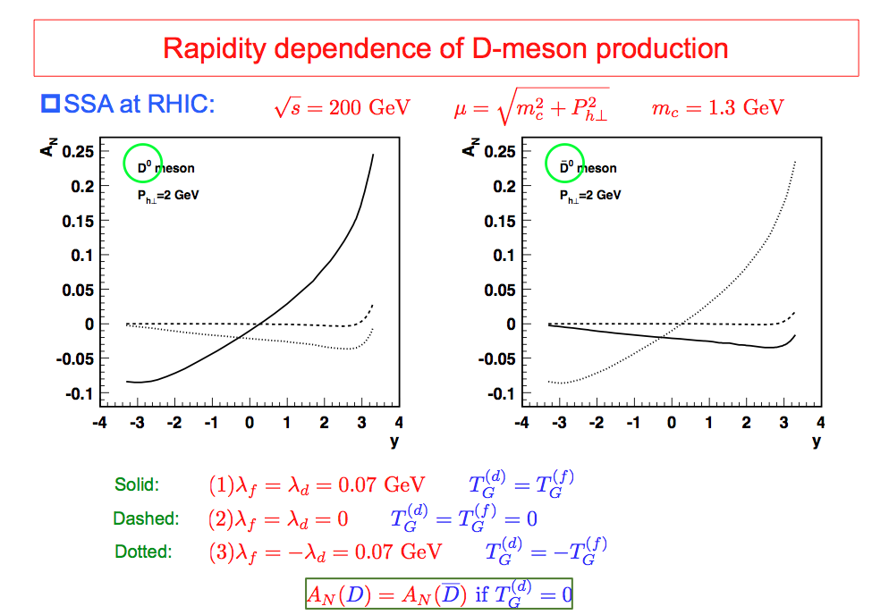
Heavy Quark SSA (II)
Twist-3 tri-gluon correlation
Consequence of different color factors for charm and anti-charm
Kang, Spin2008

Slide 14
Experimentally Test Color Flow via Open Heavy Quark TSSA
- mini summary
Current understanding of TSSA based on the color gauge invariant QCD formalism
  Twist-3, GPM …
The different color charge will generate the process dependent asymmetry/correlation funcs
The process dependence of TSSA can be tested experimentally
  DY vs DIS
  Charm (quark) vs anti-charm (anti-quark)
  Other processes ..

Slide 15
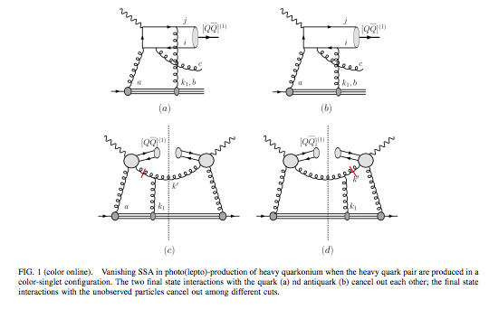
J/Psi TSSA: e+p (I) important for future EIC
TSSA is closely related to J/Psi production mechanisms
F. Yuan PRD 70, 074025

Slide 16
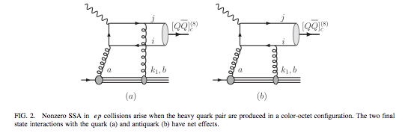
J/Psi SSA: e+p (II)
Color octet channel

Slide 17
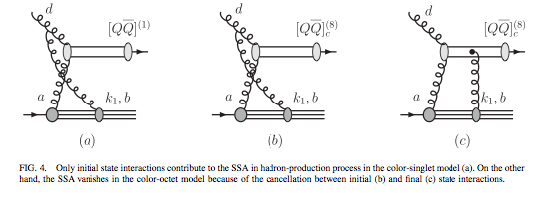
J/Psi SSA: p+p (III)
@RHIC/PHENIX!
Singlet vs Octet channels

Slide 18
Experimental Prospects
RHIC – PHENIX @high energy
Other facilities @lower energy
  Jlab-12?
  JPARC ?
  GSI/FAIR?
  Fermilab?
  EIC?
work in progress

Slide 19
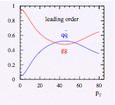
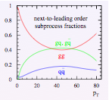
Charm Production p+p @200GeV
At low pT, g+g dominates
LO
NLO

Slide 20

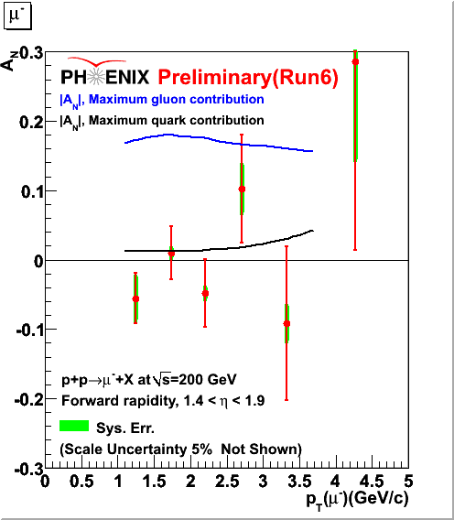
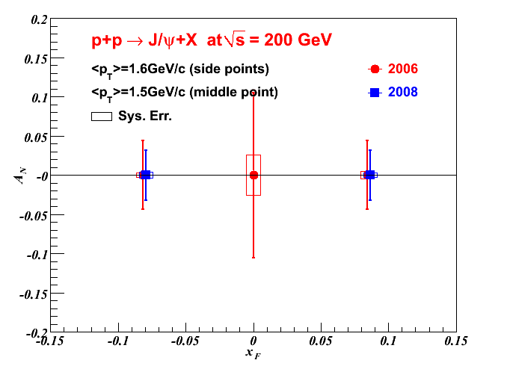
Latest Results of Heavy Quark SSA
Probing Gluon’s Sivers Asymmetry
D->μ⁻
J/Psi A_{N} sensitivity, expect results spin2010
Gluon’s Sivers fun was not constrained well by DIS data
PHENIX Charm data exclude the maximum gluon Sivers Fun (Anselmino et al, 06)
Much improved results expected soon (Run6+Run8)

Slide 21
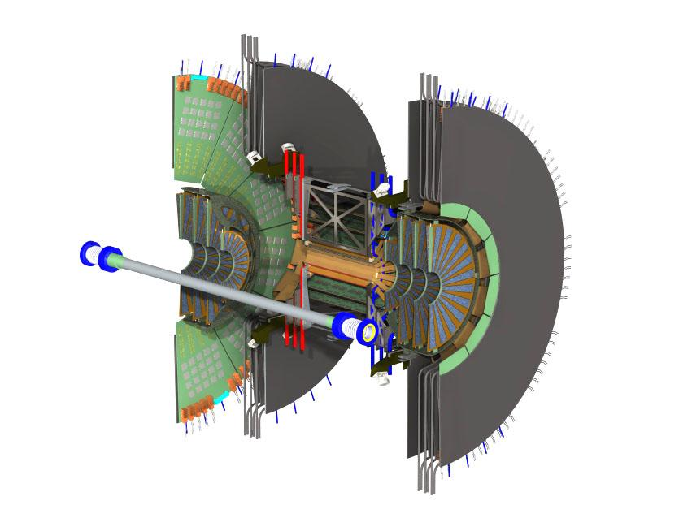
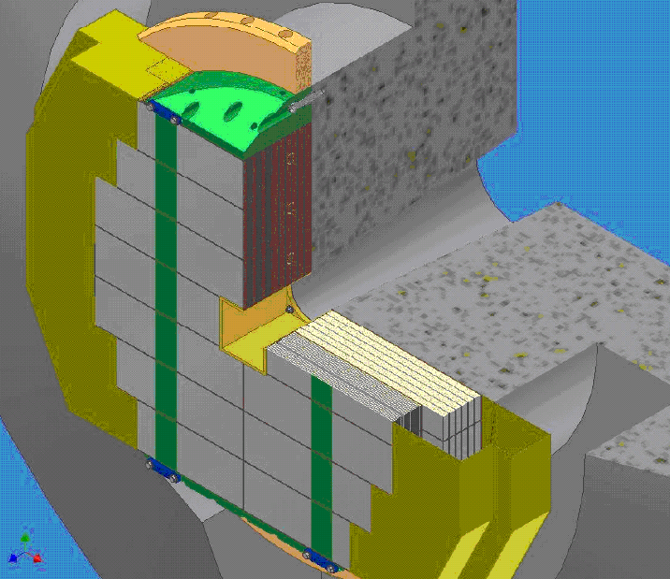
Future Opportunity
Vertex Detectors (2011-2012)
Large acceptance precision tracking
  Drell-Yan
  Heavy quarks
  Jets
Forward Calorimeter(2012-2013?)
Proposed PHENIX Upgrade ( 1 < eta < 3 )
  A_{N} π⁰, Direct γ, γ-Jet
  Collins-type measurements

Slide 22
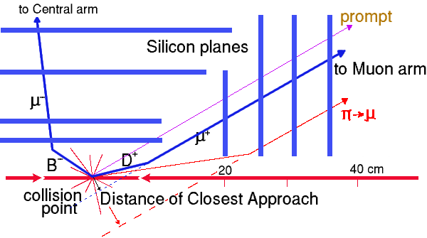
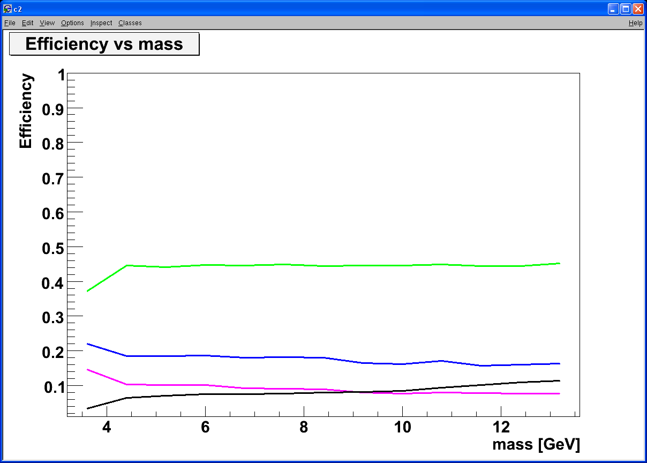
Critical Role of VTX/FVTX for Drell-Yan and Open Charm
Tracking muons with MuTr+FVTX
  Prompt muons from DY
  Displaced tracks from π/K and heavy quark decays
Drell Yan
DCA < 1 σ cut:
Increase DY/bb ~ 5
ϒ-states
J/Ψ
Drell Yan
charm
beauty
charm
beauty
DY: 4 GeV < M < 9 GeV; B-background: use FVTX
combinatorial background

Slide 23
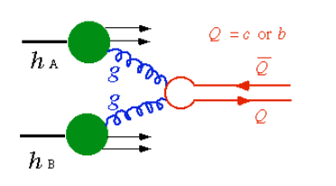
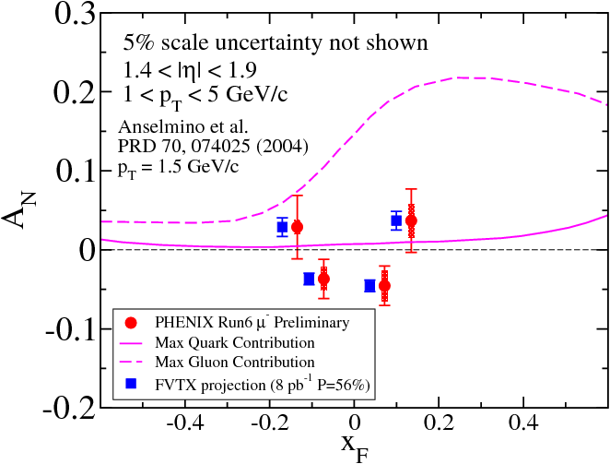
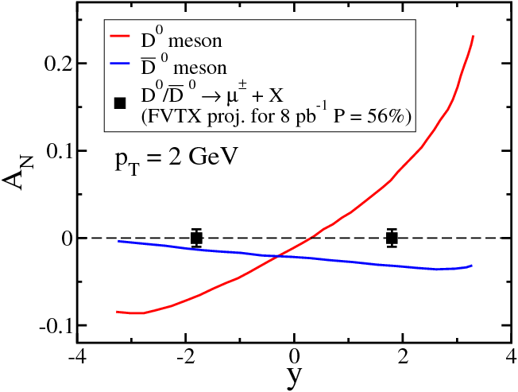
Charm SSA to Probe Gluon Sivers Distribution
D meson Single-Spin Asymmetry:
Production dominated by gluon-gluon fusion
Sensitive to gluon Sivers distribution
  PHENIX-2006 data ruled out the max. gluon Sivers
  Much improved results expected with VTX detectors
Kang, Qiu, Yuan, Vogelsang, Phys. Rev. D 78,114013(2008)

Slide 24
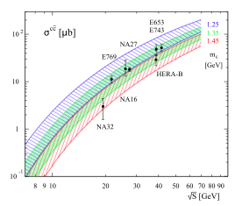
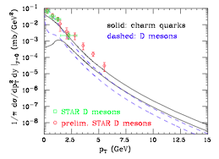
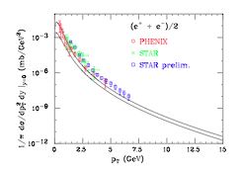
More on Open Charm Production
Fixed targets
Collider mode @RHIC
EPJ C 52, 987 (2007) J. Riedl, A. Schafer, M. Stratmann
PRL 95, 122001 (2005) M. Cacciari, P. Nason, R. Vogt

Slide 25
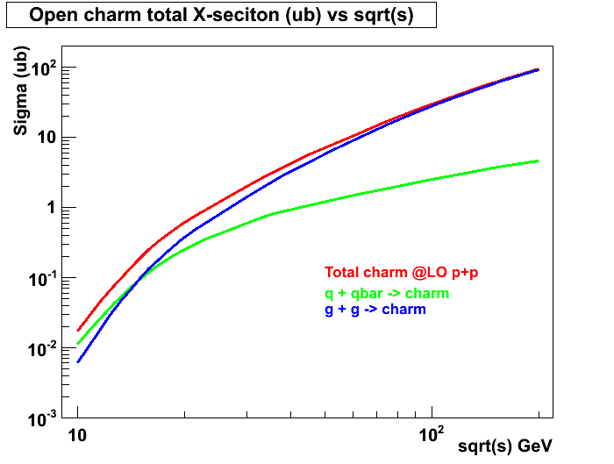
Open Charm Production in p+p with PYTHIA (LO)
RHIC 62GeV
E906
JAPRC

Slide 26
A few Observations and Comments
Twist-3 and Generalized TMD Parton Model
  Color gauge approach
Quark sector: some knowledge
  Quark Sivers and Collins functions
  Twist-3 quark-gluon correlation functions
Gluon sector: largely unknown
  Gluon Sivers function(s)??
  Twist-3 tri-gluon correlation functions
What is the next experimental step?
  Heavy quark probe!
  Directly access the color charge coupling to quark and anti-quark
It is all about the color flow in hard scattering
  TSSA @RHIC-SPIN
  p/d+A @RHIC Xiao @ this workshop!
  Jlab-12, EIC…

Slide 27
Summary and Outlook
Experimental confirmation (or disproval) of color flow in hard scattering is a critical step toward understanding the mechanisms of SSA
Color charge dependence is originated from the Gauge formulism. Experimental study of SSA in charm and anti-charm is as important as the test of sign change in DY SSA.
Future experimental prospects – exciting opportunity!
  RHIC, high energy
  Low energy fixed target
  Jlab-12
  EIC

