Slide 1
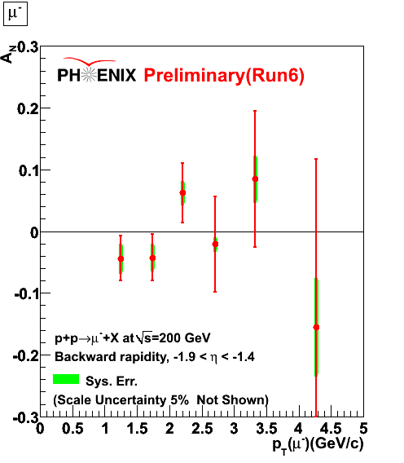
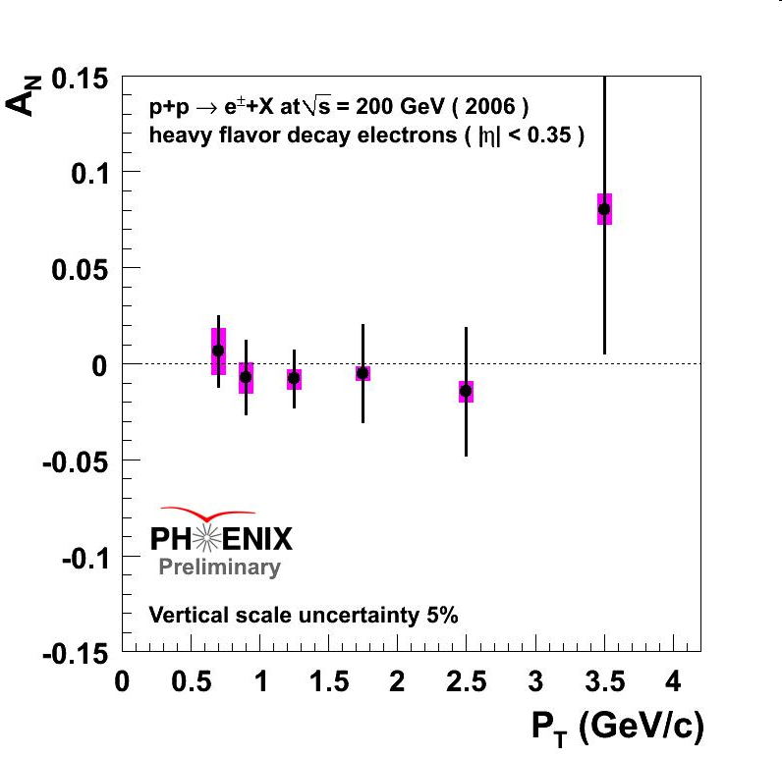
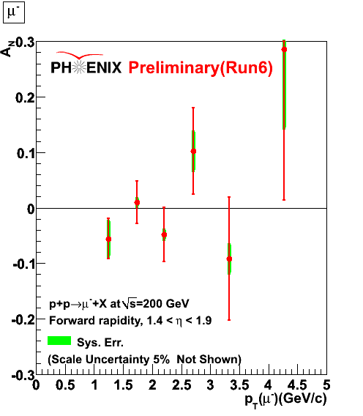
Phenix Heavy Quark A_N
A_N vs pT(e, muon) for different eta ranges
-1.9<η<-1.4
-0.35<η<+0.35
1.4<η<1.9

Slide 2
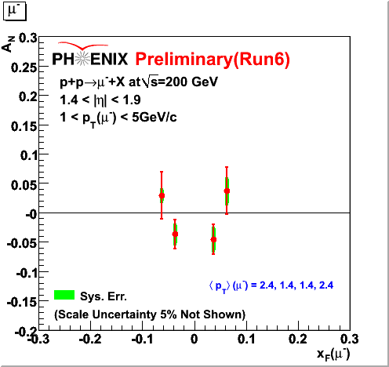
Heavy Quark A_N
AN vs xF

Slide 3
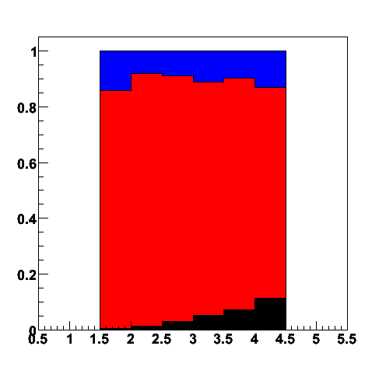
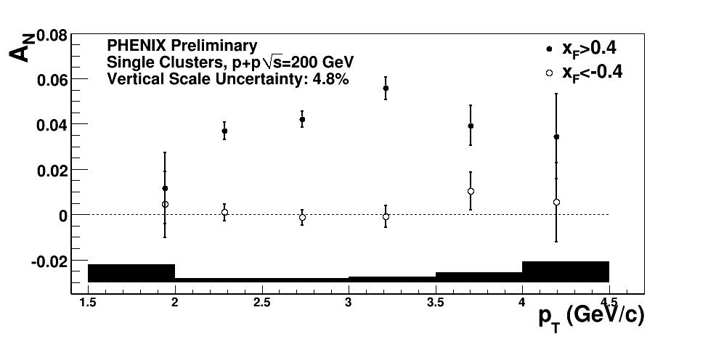
Forward inclusive EM cluster (mostly pi0 decays) A_N
200GeV p+p
Decay photon π⁰ Direct photon

Slide 4
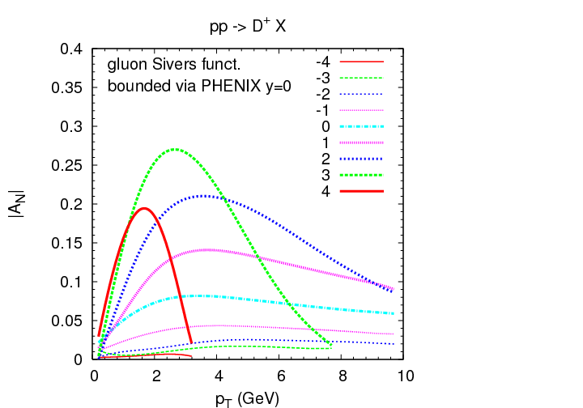
Model Calculations
Anselmino et al, PRD 70,074025
TMD

Slide 5
Forward J/Psi A_N
Final results will be available very soon..

