Slide 1
Nucleon-Structure Physics by Proton-Proton Collisions
Ming X. Liu
Los Alamos National Laboratory
QNP 2018
Tsukuba, Japan

Slide 2
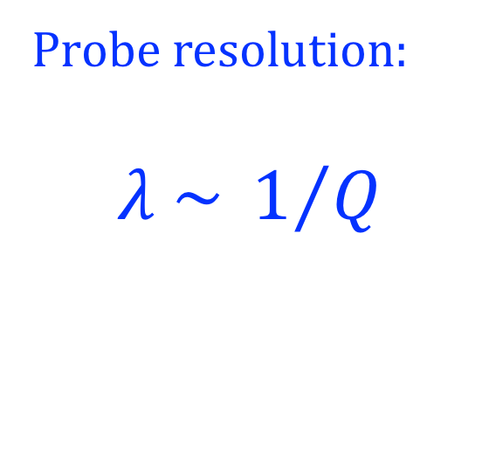
Nucleon Structure and Parton Interaction
A very rich dynamic environment, NOT a point particle
  “3-D” tomography
  Probe scale-dependence, QCD evolution
Source of many novel strong interaction phenomena
Probe resolution:
$$λ \sim 1/Q$$
Low Q²
Large Q²

Slide 3
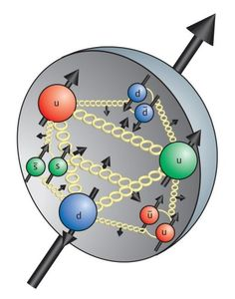
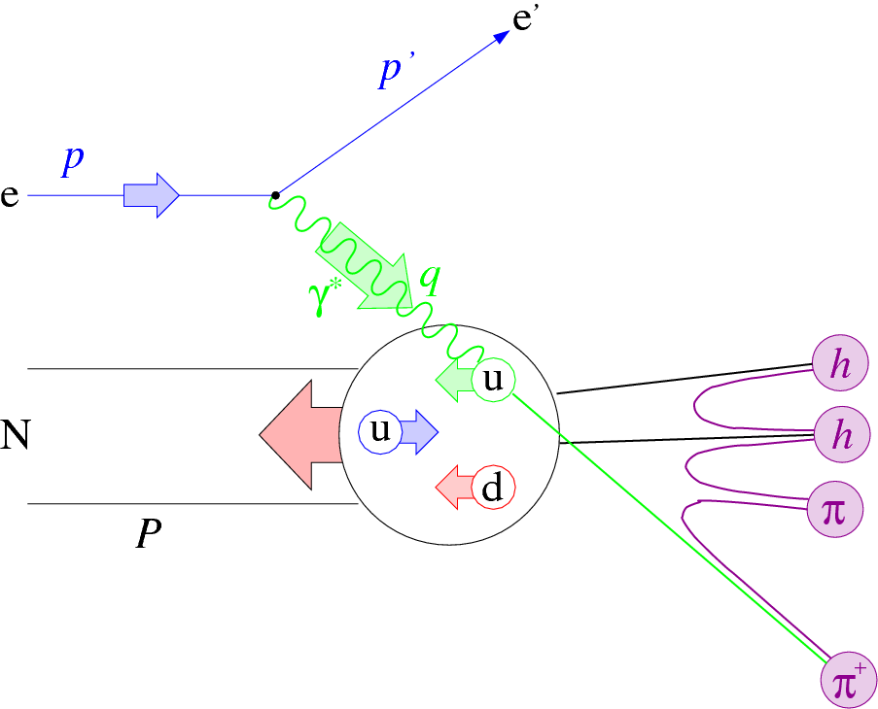
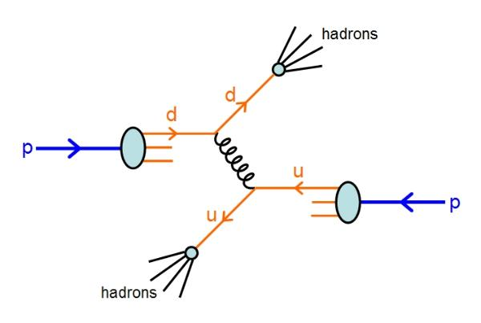
Physics of Nucleon Parton Structures
How hadrons formed and interact at fundamental level
  Space and momentum distributions of quarks and gluons
  Scale Q² QCD evolution etc.
  Parton correlations, spin degree of freedom etc.
Tools
  Lepton probes – DIS
    HERMIES, COMPASS, HERA, EIC…
  Hadron probes – proton, pion/Kaon beams
    RHIC, Fermilab, CERN, NIKA …
  Lattice QCD, pQCD …
DIS

Slide 4
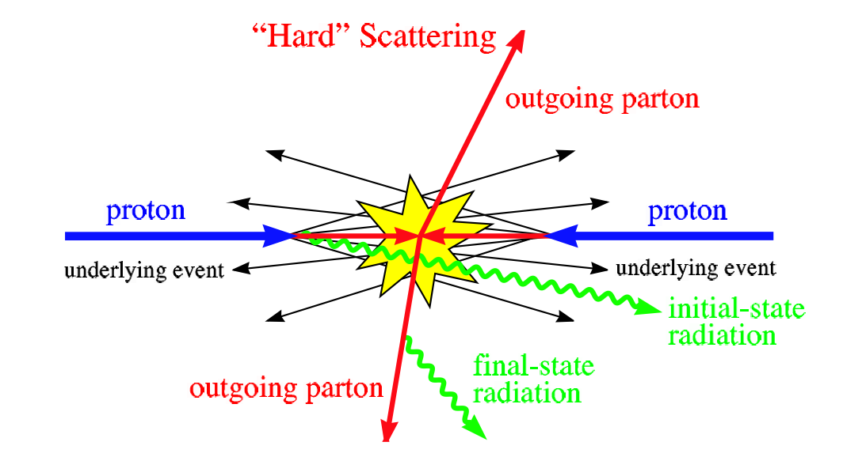
Study Nucleon Structures in Hadronic Collisions
Very complex p-p collisions could be simplified for hard-scattering processes, pQCD applicable

Slide 5
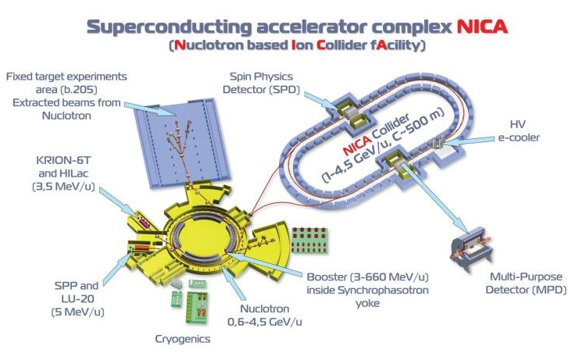

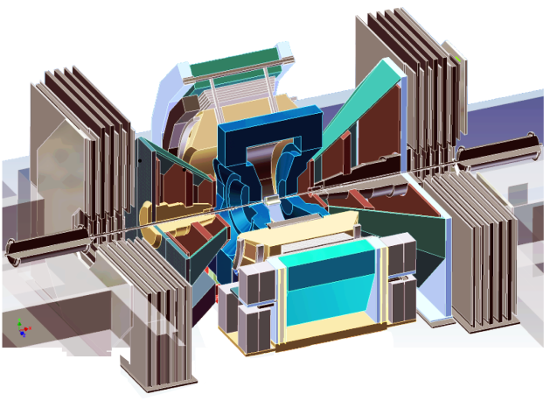
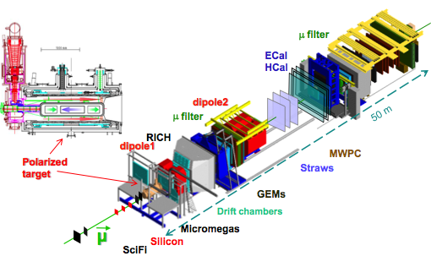


Selected Recent Highlights
Alexey Guskov, Fri.
Proton spin puzzle
  RHIC –PHENIX, STAR
  “Longitudinal spin phenomena”
Transvers spin challenge
  RHIC/PHENIX, STAR
  CERN/COMPASS
  Fermilab/SeaQuest
  “Transverse spin phenomena”
Itaru Nakagawa, Fri.
Ken Barish, Fri.
Kei Nagai &
Yoshiyuki Miyachi, Wed.
Marcia Quaresma, Wed.
SeaQuest

Slide 6
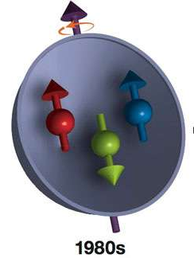
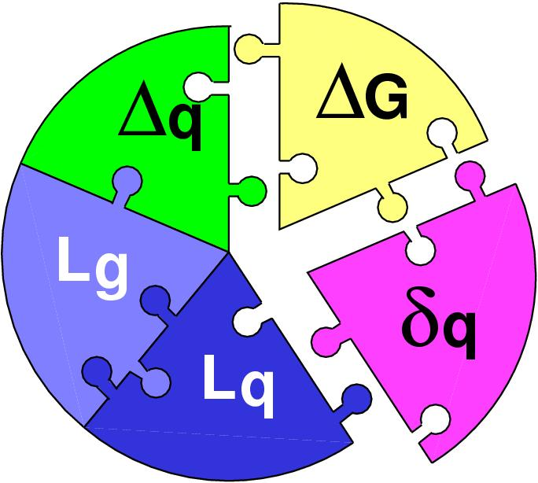
Proton Spin Puzzle: the Challenge of “Too Small”
“Spin Crisis”: EMC (1987)
Quark contribution “small”
 | Quark Spin | Gluon Spin
SLAC -> 2000 | E80 – E155
CERN ongoing | EMC, SMC, COMPASS
DESY ->2007 | HERMES
JLab ongoing | Hall A,B,C
RHIC ongoing | (BRAHMS), (PHENIX), STAR
Early expectation:
Possible large gluon polarization,
Axial anomaly, Cheng & Li, PRL (1989)
Led to very active spin physics program in 90’s
Development of RHIC-Spin program
Today:
 | SIDIS/DIS
 | Polarized p+p

Slide 7
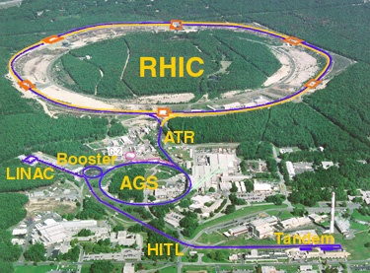
The World First High-Energy Polarized Proton Collider at Relativistic Heavy Ion Collider
Absolute Polarimeter (H↑ jet)
RHIC pC Polarimeters
PHOBOS
Siberian Snakes
BRAHMS
Polarized p+p collisions
62 ≤ √s ≤ 510 GeV
Siberian Snakes
RHIC-Spin
Program:
2000-2017+
PHENIX
STAR
Spin Rotators
(longitudinal polarization)
Spin Rotators
(longitudinal polarization)
Pol. H⁻ Source
LINAC
BOOSTER
Helical Partial Siberian Snake
200 MeV Polarimeter
AGS
AGS pC Polarimeter
Strong AGS Snake

Slide 8
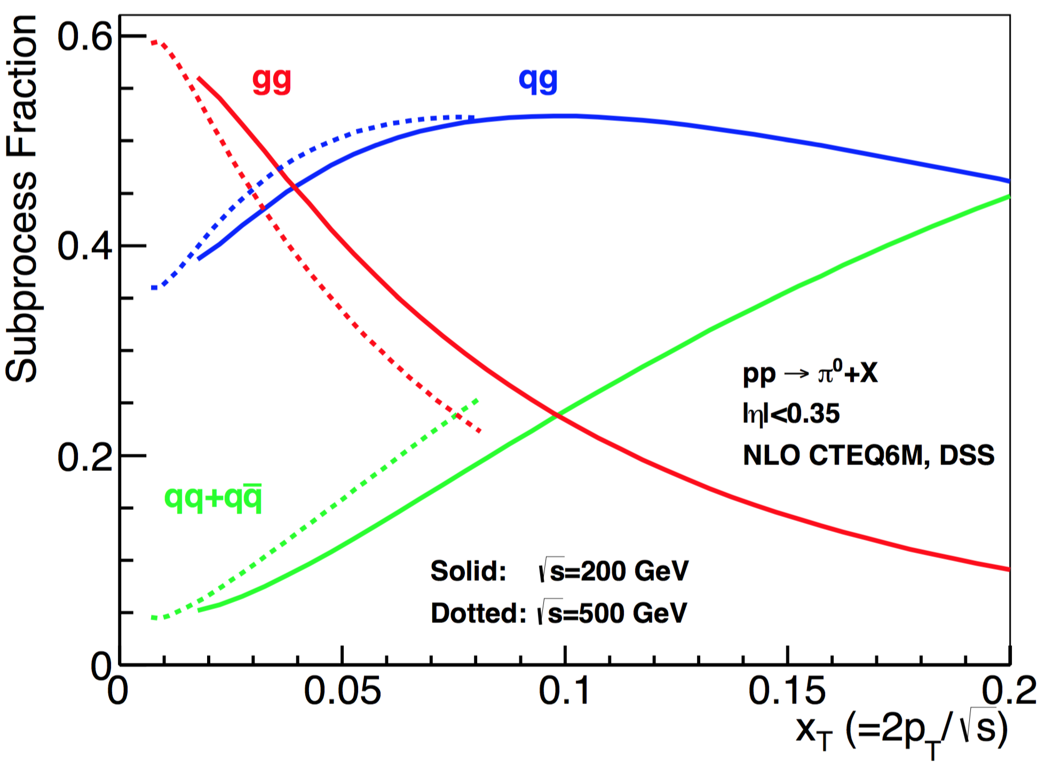
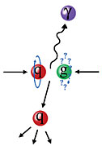
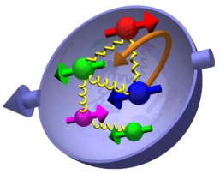
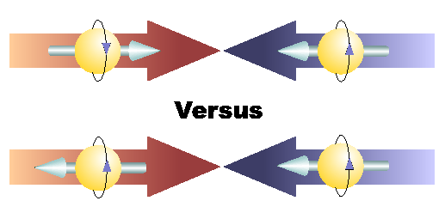
Study Gluon Polarization at RHIC
Relative fractions
A_{LL}=(N⁺⁺-N⁺⁻)/(N⁺⁺+N⁺⁻)

Slide 9
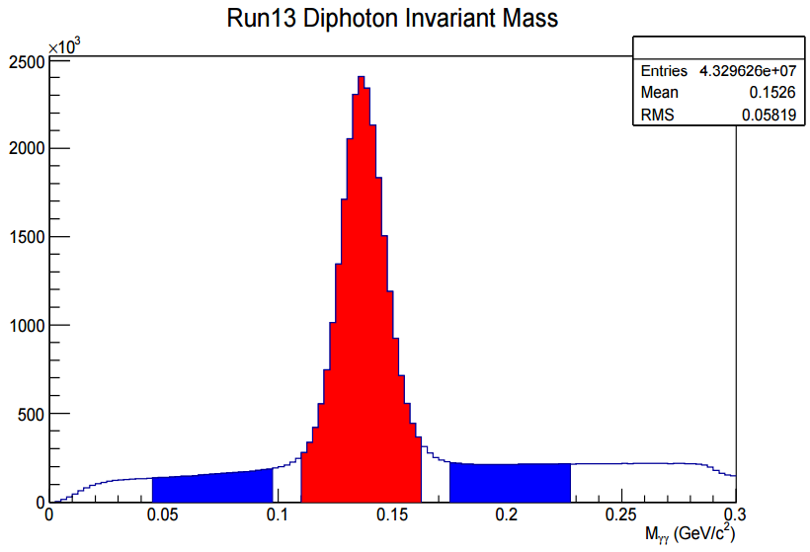
First Hints of Non-zero Gluon Polarization from RHIC
STAR: PRL 115, 092002 (2015)
I. Nakagawa;
K. Barish’s talks
Jet
PRL 113, 012001 (2014), DSSV
PHENIX: PRD 90, 012007 (2014)
p+p@200GeV
pi0

Slide 10
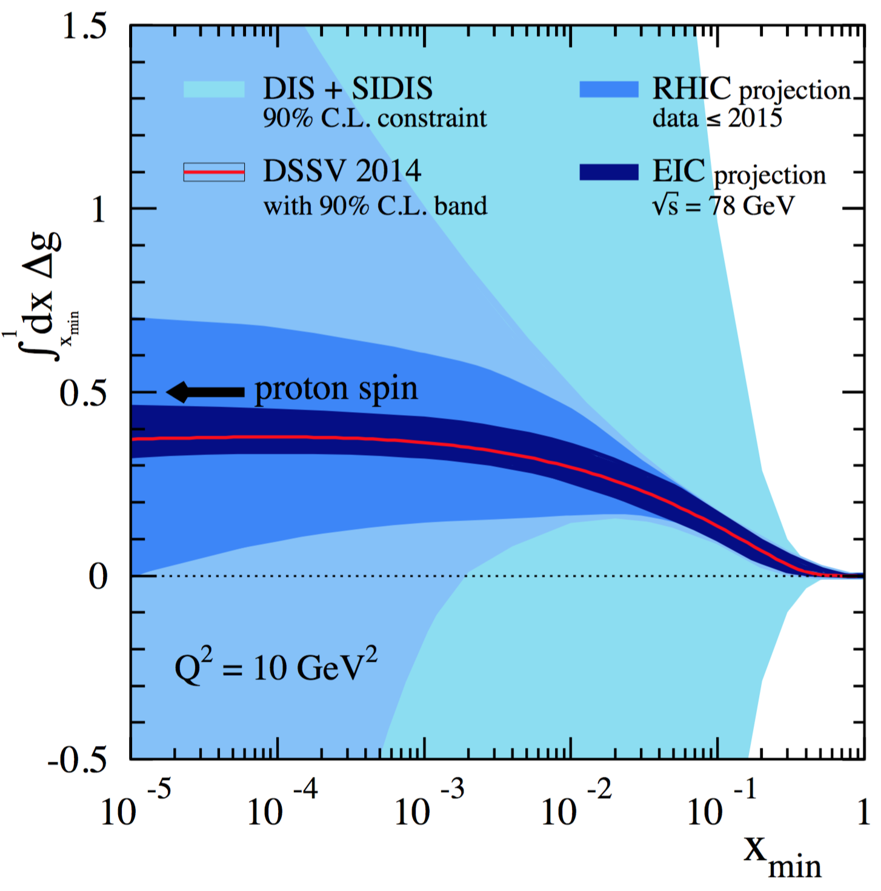
Near Future: Projected Gluon Polarization Measurements
Favors positive gluon polarization
  PHENIX/STAR data:
  62-510GeV 𝜋⁰ A_{LL}
  200/510GeV (di)jets A_{LL}
  and more …
EIC future, 2027+
“RHIC Cold QCD Plan for 2017-2023”, arXiv:1602.03922
NNPDF: PRL 115, 092002 (2015)

Slide 11
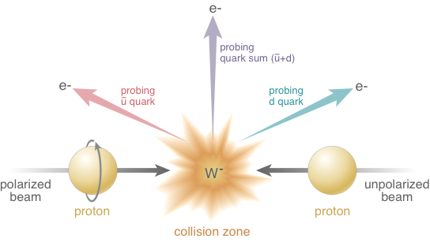
Electroweak Probes for (anti)Quarks at High Energy at RHIC
“left-hand coupling”

Slide 12


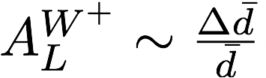
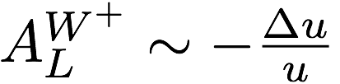
First Measurements of Flavor Identified Sea-Quark Polarization
RHIC has unique access to flavor identified sea-quarks via real W^{+/-}
STAR: PRL 113, 072301 (2014)
Sea quarks
Valence quarks
arXiv:1406.7122

Slide 13
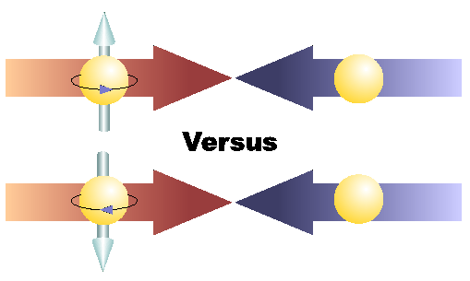
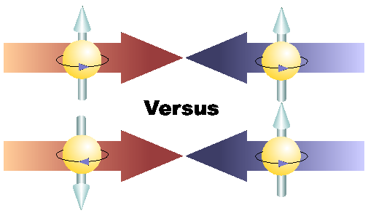
Physics with Transversely Polarized p+p Collisions at RHIC

Slide 14
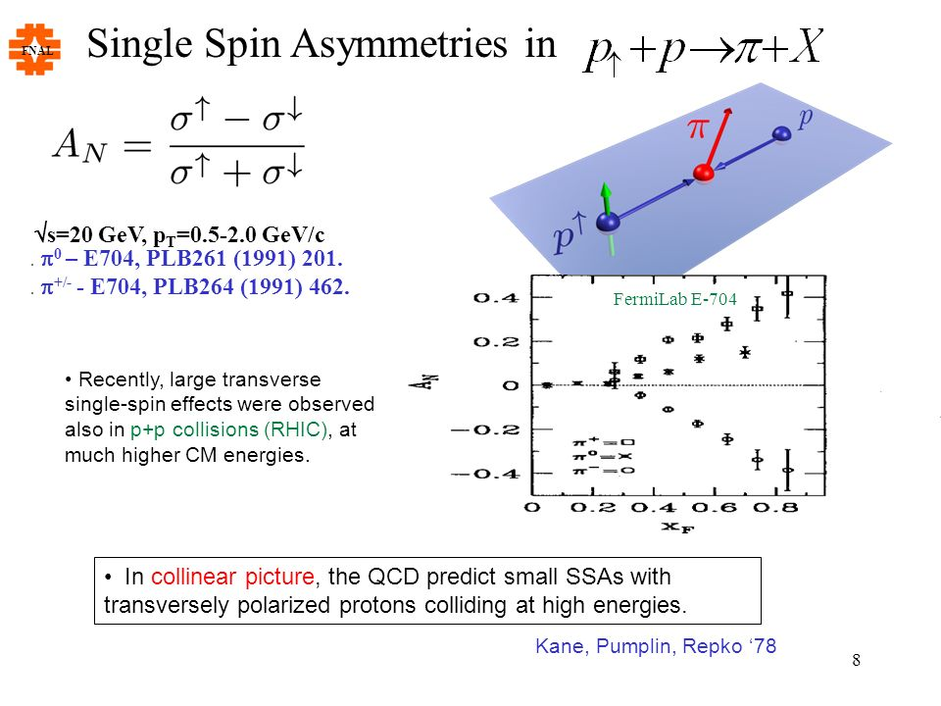
“TMD” phenomena: The Challenge of “Too Large”
Large Transverse Single Spin Asymmetry (TSSA) in forward hadron production persists up to top RHIC energy.
Kane, Pumplin, Repko (1978)
A_{N} ~ O(10%)
Fermilab
E704 (1991)

Slide 15
Probe the Underlying Physics via Hard Scatterings
TMD, Collinear Twist-3 Factorizations
(i) Sivers mechanism:
correlation proton spin & parton k_{T}
(ii) Collins mechanism: Transversity × spin-dep fragmentation
SIDIS:
S_{P}
Phys Rev D41 (1990) 83; 43 (1991) 261
S_{P}
Nucl Phys B396 (1993) 161
S_{q}
p
k_{T,q}
p
p
p
S_{q}
k_{T,π}
pp:
Collinear Twist-3 (RHIC):
quark-gluon/gluon-gluon correlation

Slide 16
Access Sivers and Collins with Jet and Hadron Azimuthal Distributions in Transversely Polarized p+p Collisions
Feng Yuan, PRL 100, 032003 (2008)
Umberto D’Alesio et al PRD 83 034021 (2011)
→ “Sivers-like” (Jet)
→ “Collins-like” (hadron)

Slide 17
Collins Asymmetry Observed
in Jet in p+p Collisions
Inclusive A_{N} = 0 at central rapidity
A_{N} at central rapidity: non-zero in jet!

Slide 18
Sivers Asymmetry – Initial State
Non-universality, process dependent
K. Barish’s Talk
Sign change prediction, QCD factorization
Can be tested in Drell-Yan and W/Z in p+p
First hint of sign change from RHIC
More data, 350pb⁻¹, from 2017 run
PRL 116, 132301 (2016)

Slide 19
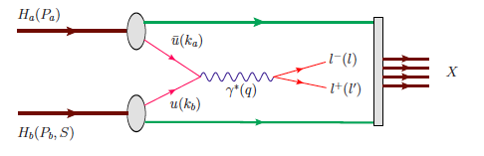
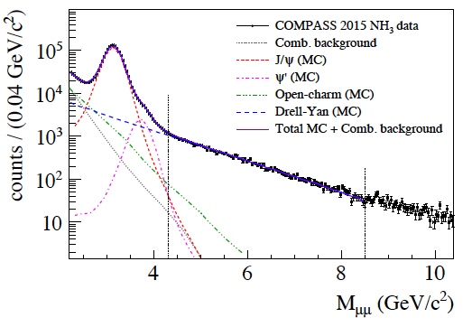
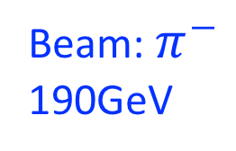
Drell-Yan A_{N} from COMPASS Polarized Target
Beam: $π^{−}$
190GeV
M. Quaresma’s talk
Polarized
Proton target
- J/ψ (NH₃) ~1.5M
- HM DY (NH₃) ~35K

Slide 20
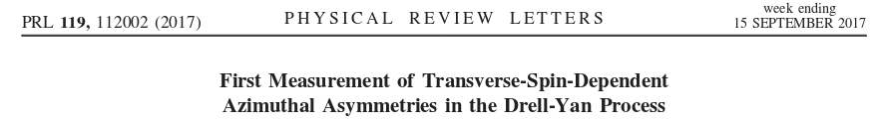
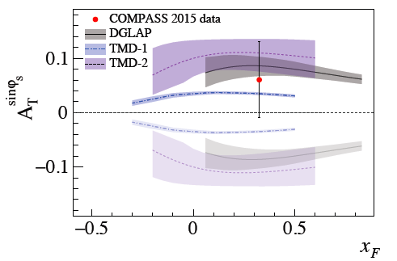
COMPASS Drell-Yan Run 2015 Results
Sign change
NO Sign change
Expectation from 2018 polarized Drell-Yan run:
Verification of the sign change by reducing of the error by a factor of ~1.5.

Slide 21
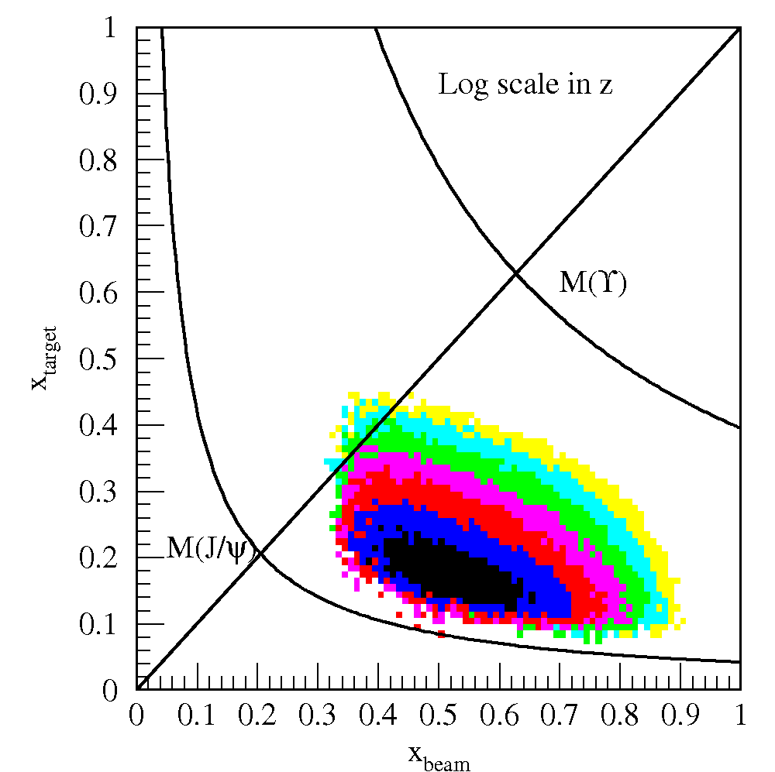
Fermilab SeaQuest Fixed Target Drell-Yan
SeaQuest
SeaQuest
acceptance
120 GeV
Kinematically favors sea-quarks
from target – a sea quark lab!

Slide 22
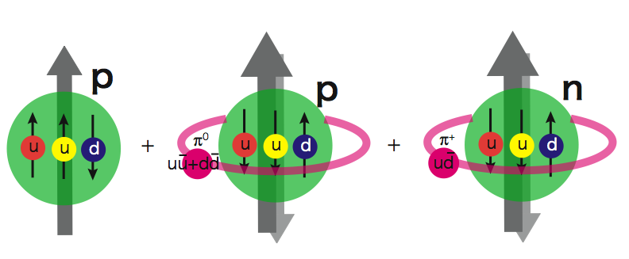
Flavor Asymmetry of Sea Quarks at Intermediate x
Kei Nagai’s talk
Proton vs “Neutron” targets:
This could lead to a very interesting physics …
|p> = a|p₀> + b|p₀ + pi⁰> + c|n+pi⁺> + …

Slide 23
SeaQuest/E1039 Projected Drell-Yan A_{N}
Y. Miyachi’s talk
Sea quark Sivers:
Pion cloud model:

Slide 24
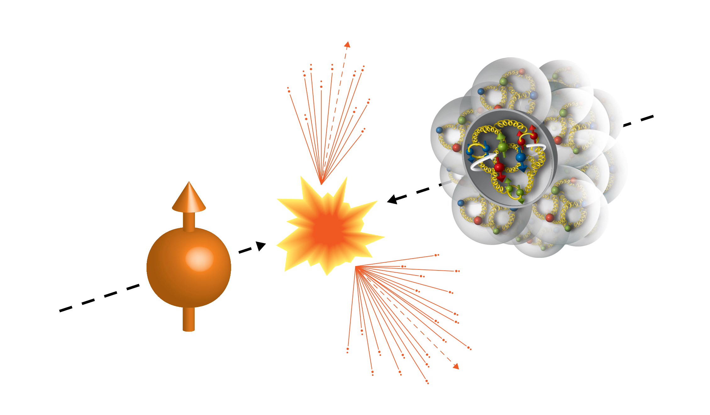
First Transversely Polarized p+A collisions at RHIC
Run15 (2015)
100GeV/nucleon
Au, Al
100GeV
 | # of proton | # of neutron
p | 1 | 0
Al | 13 | 14
Au | 79 | 118
Transversely Polarized Proton

Slide 25
Run15 p+Au: a Surprise!
I. Nakagawa’s talk
Unexpected large pAu and pAl asymmetries observed compared to that of pp
[PRL 120 (2018) 022001]
A
BBC Veto
𝛾*
𝜋⁺
p
↑
n
A
BBC
BBC Tag
?
↑
n
p
BBC

Slide 26
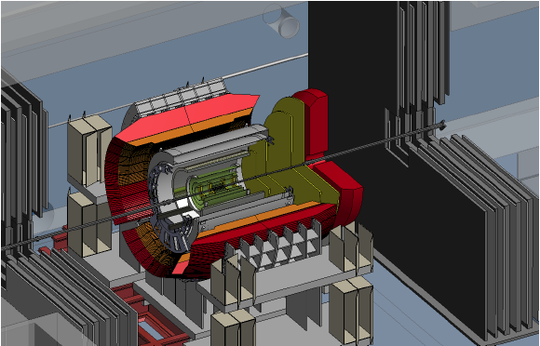
Future at RHIC: PHENIX -> sPHENIX (-> EIC@RHIC)
PHENIX
Forward sPHENIX
Sign change in
Jet A_{N}?
PHENIX completed 2016
16y+ work
100+M$ investment
Comprehensive central upgrade based on BaBar magnet
fsPHENIX: forward tracking, HCal and muon ID
Key study of transverse spin
New collaboration/new ideas
Naïve direct mapping
from SIDIS Sivers (GPM)
- “u-quark jet” A_{N} >0
With process-dependence
from SIDIS Sivers (Twist-3)
- “u-quark jet” A_{N} < 0
~2000
2017→2020
~2025+
RHIC: A+A, polarized p+p, polarized p+A

Slide 27
STAR Forward Upgrade Proposal
To access small-x gluons
To install a Forward Calorimeter System (FCS)
in early 2020s:
EMCal
Hcal
Tracking, charge separation

Slide 28
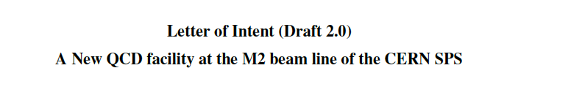
Other Future Facilities
A New QCD Facility at M2 beam line of the SPS CERN (to be submitted in January 2019)
SPD @NIKA
http://arxiv.org/abs/1808.00848
COMPASS-Like

Slide 29
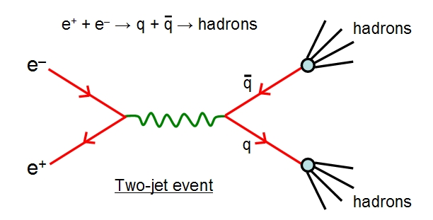
Summary
Proton(hadron) collisions have provided:
  Very rich & active nucleon structure physics program
    RHIC, Fermilab, COMPASS …
  Unique electroweak probes at high energy @RHIC
  Independent test of the universality of QCD description of strong phenomena in pp and DIS
Will continue playing a key role in exploring the fundamental nature of nucleon structure and strong interactions
  Complementary to future EIC program

Slide 30
backup

Slide 31


Toward a Unified Picture of Nucleon Structure
Momentum and Spatial Tomography
Some data, recent progress
Good data, long history
F(r,Q²)

Slide 32
Latest Pol NNPDFPol Global Fit
arXiv:1702.05077
-SI/DIS data
-RHIC data

Slide 33
RHIC pp500GeV: W^{+/-} A_{N}
A_{N}(W⁺) ~
A_{N}(W⁻) ~
RHIC data:
A mix of valence and sea quark Sivers
Quark flavor identified
High Q²
Statistically limited, ~0(10%)
Possible large dbar Sivers contributions
E1039:
- low Q²
- Good statistics, ~O(1%)

