Slide 1
Nucleon-Structure Physics by Proton-Proton Collisions
Ming X. Liu
Los Alamos National Laboratory
QNP2018
Tsukuba, Japan

Slide 2
Nucleon Structure and Interaction
A very rich dynamic environment, NOT a point particle
  3-D
  scale-dependent
Primary source of our knowledge about QCD and strong interaction phenomena

Slide 3
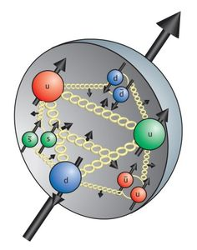
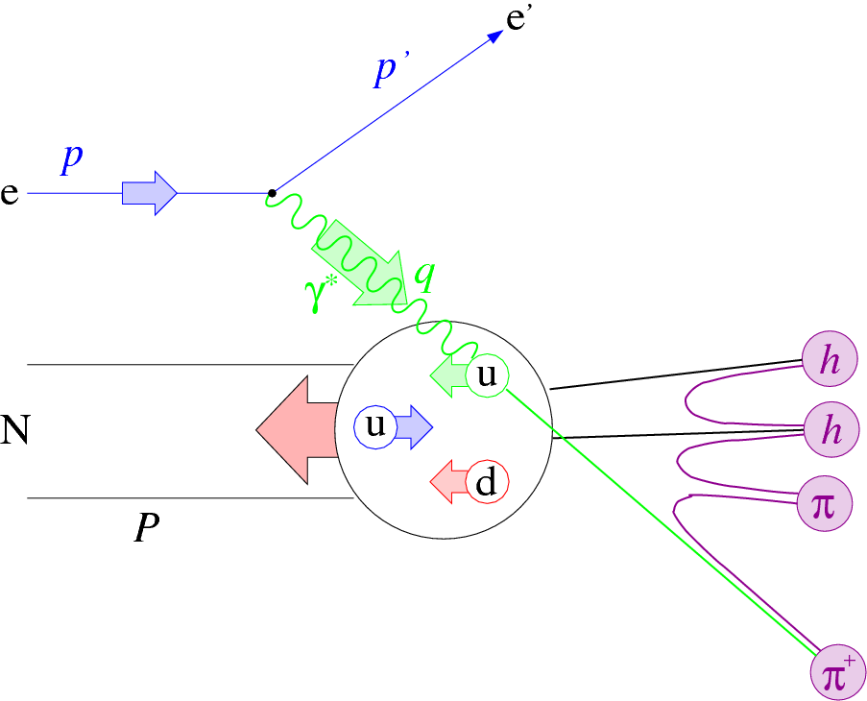
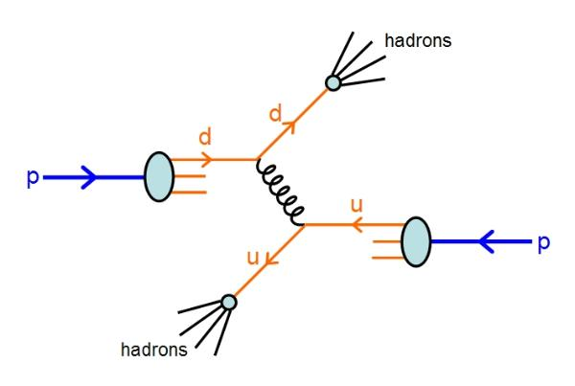
Physics of Nucleon Structures
How hadrons formed and interact from the fundamental quarks and gluons?
  Space and momentum distributions of quarks and gluons
  Spin degree of freedom
  Probe scale dependence, Q2
Our tools
  Lepton probes - electrons, muons, neutrinos …
    DIS experiments, HERMIES, COMPASS, EIC…
  Hadron probes - proton, pion/Kaon…
    RHIC, Fernilab, COMPASS …
  Lattice QCD, pQCD …

Slide 4
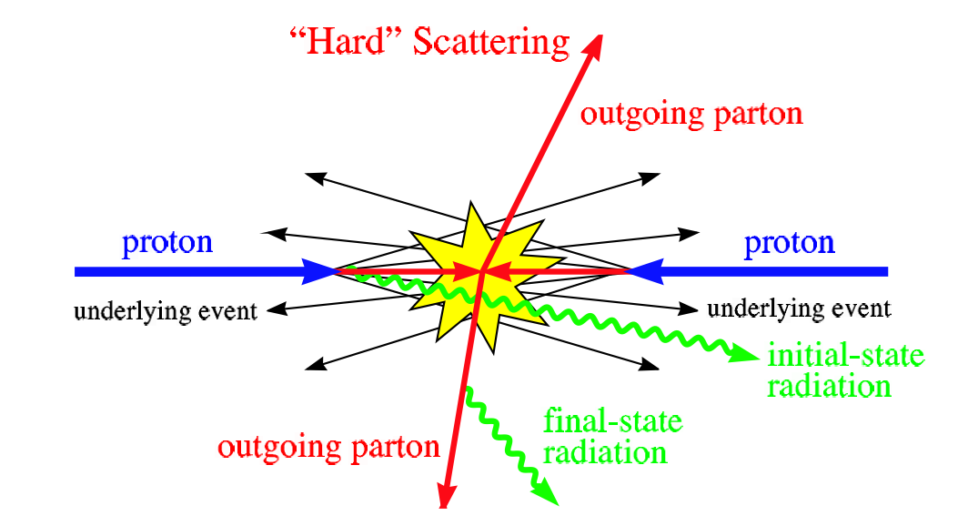
Study Nucleon Structure in Hadron Collisions
Very massy p-p collisions could be simplified for hard-scattering processes, pQCD applicable

Slide 5
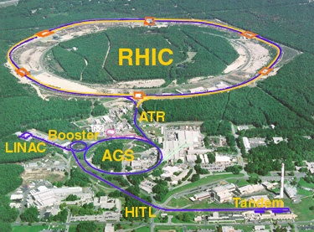


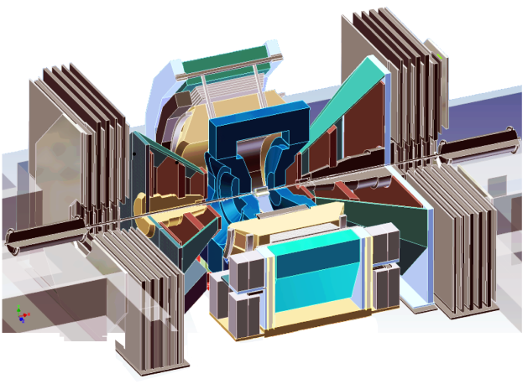
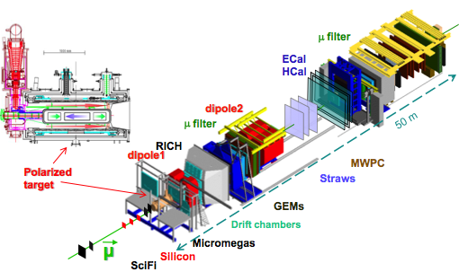


Selected Recent Highlights
Spin puzzle
  RHIC – STAR, PHENIX
TMD phenomena
  RHIC/STAR, PHENIX
  CERN/COMPASS
  Fermilab/SeaQuest
SeaQuest

Slide 6
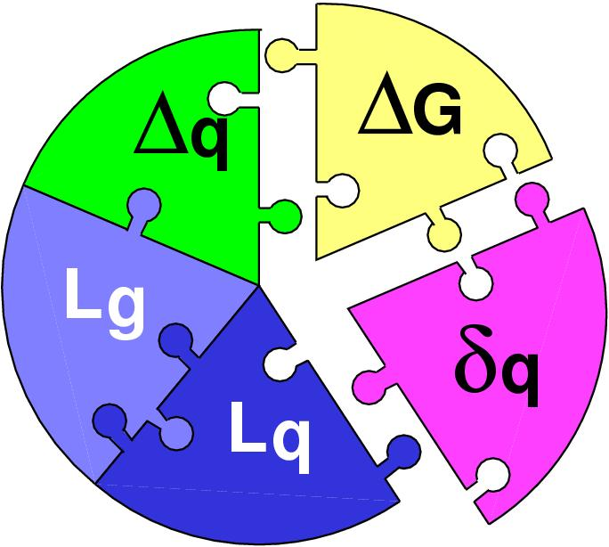
Part-I: Challenge of “Too Large”
Three Decades of the Proton Spin Puzzle
Spin Crisis: EMC, 1987
 | Quark Spin | Gluon Spin
SLAC -> 2000 | E80 – E155
CERN ongoing | EMC, SMC, COMPASS
DESY ->2007 | HERMES
JLab ongoing | Hall A,B,C
RHIC ongoing | (BRAHMS), (PHENIX), STAR
Early expectation:
Large gluon polarization,
Axial anomaly, Cheng & Li, PRL (1989)
Development of RHIC-Spin program in 90’s
Today:
 | SIDIS/DIS
 | Polarized p+p

Slide 7
World First High-Energy Polarized Proton Collider at RHIC
Absolute Polarimeter (H↑ jet)
RHIC pC Polarimeters
PHOBOS
polarized p+p collisions
62 ≤ √s ≤ 500 GeV
Siberian Snakes
BRAHMS
Siberian Snakes
PHENIX
STAR
Spin Rotators
(longitudinal polarization)
Spin Rotators
(longitudinal polarization)
Pol. H⁻ Source
LINAC
BOOSTER
Helical Partial Siberian Snake
200 MeV Polarimeter
AGS
AGS pC Polarimeter
Strong AGS Snake

Slide 8
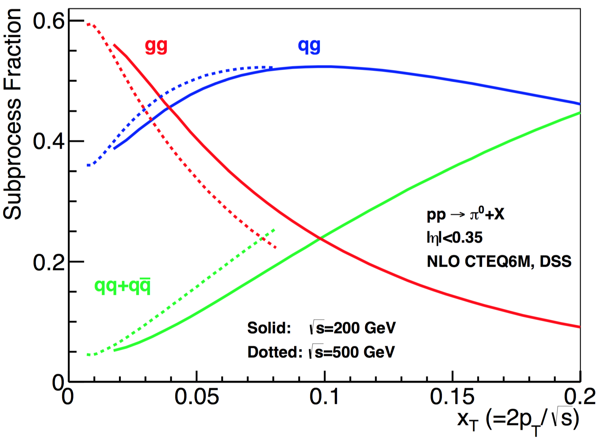
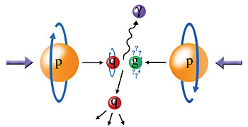
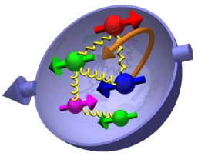
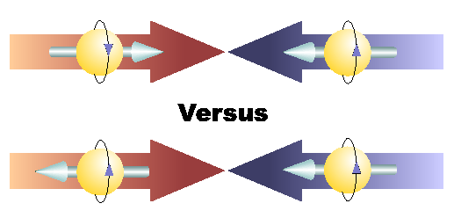
Study Gluon Polarization at RHIC
Relative fractions
A_{LL}=(N⁺⁺-N⁺⁻)/(N⁺⁺+N⁺⁻)

Slide 9
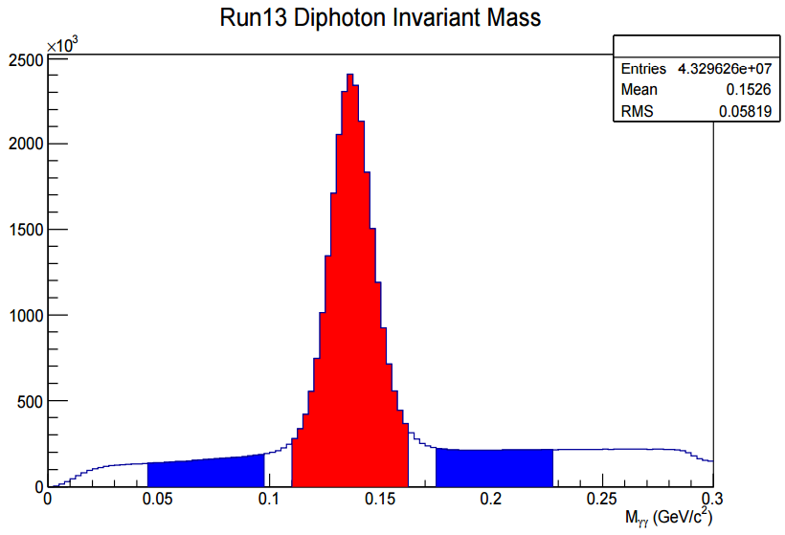
First Hint of Non-zero Gluon Polarization from RHIC 2009 Data Set
STAR: PRL 115, 092002 (2015)
@ Q² = 10 GeV²
PRL 113, 012001 (2014), DSSV
Run 2009
p+p@200GeV
PHENIX: PRD 90, 012007 (2014)

Slide 10
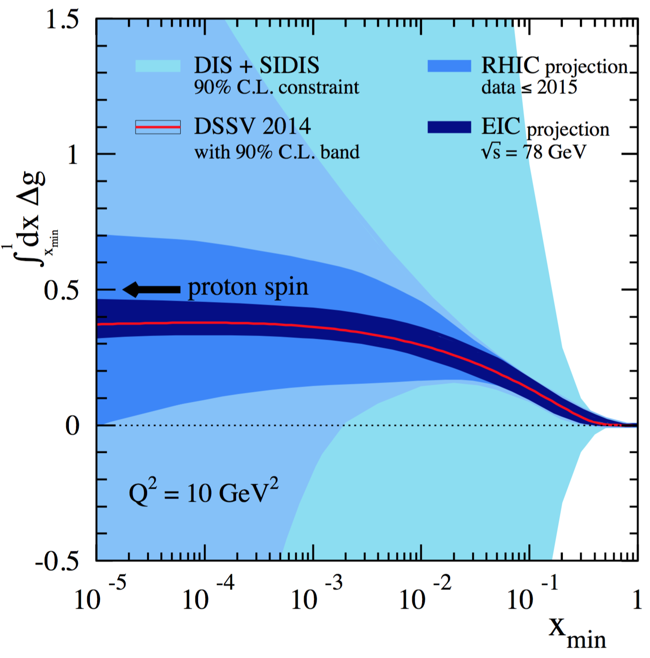
Projected Impact of RHIC data on Gluon Polarization
Favors positive gluon polarization
  PHENIX/STAR data:
  62GeV 𝜋⁰ A_{LL}
  200GeV 𝜋⁰ A_{LL}
  510GeV 𝜋⁰ A_{LL}
  200/510GeV (di)jets A_{LL}
  Statistically limited but could be improved in the future high luminosity program:
  200/510GeV charged hadron A_{LL}
  200/510GeV HF A_{LL}
  200/510GeV 𝐽/𝜓 A_{LL}
EIC future, 2027+
“RHIC Cold QCD Plan for 2017-2023”, arXiv:1602.03922
PRL 115, 092002 (2015)

Slide 11
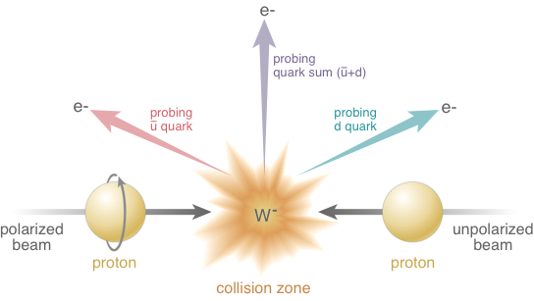
Electroweak Probe for Sea Quarks at High Energy at RHIC

Slide 12


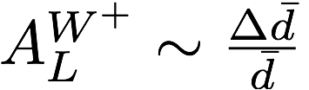
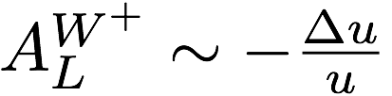
First Direct Measurements of Flavor Identified Sea Quark Polarization
RHIC has unique access to flavor identified sea-quarks via real W^{+/-}
STAR: PRL 113, 072301 (2014)
Sea quarks
Valence quarks
arXiv:1406.7122

Slide 13
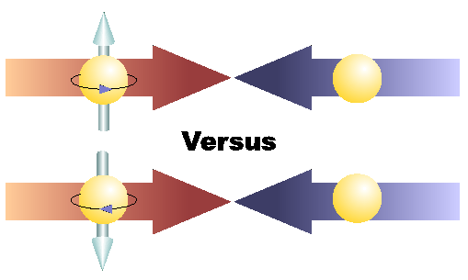
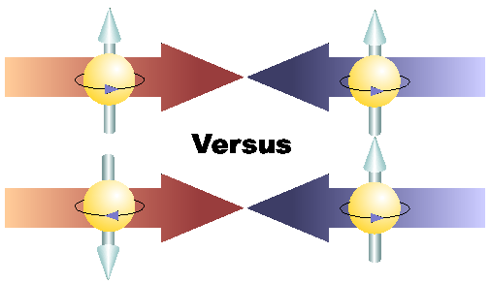
Physics with Transversely Polarized p+p Collisions at RHIC

Slide 14
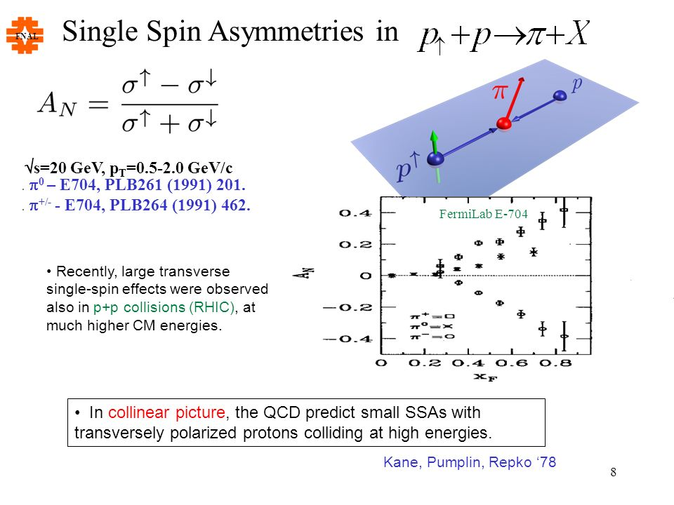
Part-II: The Challenge of “Too Large”
Large Transverse Single Spin Asymmetry (TSSA) in forward hadron production persists up to RHIC energy.
Kane, Pumplin, Repko (1978)
A_{N} ~ O(10%)
Fermilab
E704 (1991)

Slide 15
Probe the Underlying Physics via Hard Scatterings
TMD vs Collinear Twist-3 Factorizations
(i) Sivers mechanism:
correlation proton spin & parton k_{T}
(ii) Collins mechanism: Transversity × spin-dep fragmentation
S_{P}
Phys Rev D41 (1990) 83; 43 (1991) 261
S_{P}
Nucl Phys B396 (1993) 161
S_{q}
p
k_{T,q}
p
p
p
S_{q}
k_{T,π}
Collinear Twist-3 (RHIC):
quark-gluon/gluon-gluon correlation

Slide 16
Access Sivers and Collins with Jet and Hadron Azimuthal Distributions in Transversely Polarized p+p Collisions
Feng Yuan, PRL 100, 032003 (2008)
Umberto D’Alesio et al PRD 83 034021 (2011)
Experimental variables:
Jet P_{j,} xF
Hadron P_{h} , PID
Beam polarization
→ “Sivers-like”
→ “Collins-like”

Slide 17
Collins Asymmetry in Jet
Inclusive A_{N} = 0 at central rapidity
A_{N} at central rapidity: non-zero in jet!

Slide 18
Sivers Asymmetry
- non-Universality, process dependent
Sign change prediction
Drell-Yan and W/Z in p+p

Slide 19
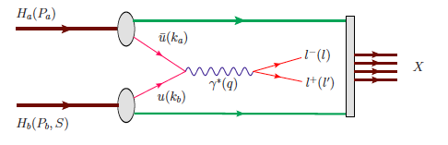
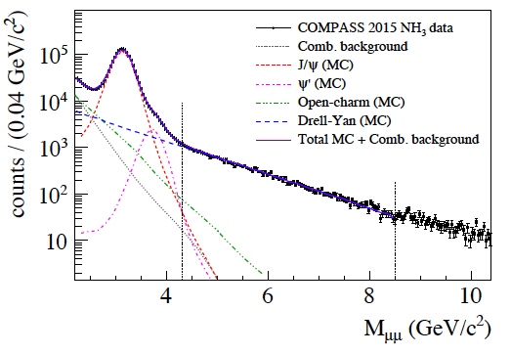
Drell-Yan from COMPASS Polarized Target
Beam: pi-
Polarized
Proton target
- J/ψ (NH₃) ~ 1.5M
- HM DY (NH₃) ~40K

Slide 20
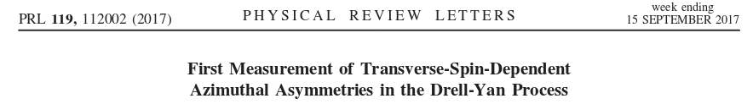
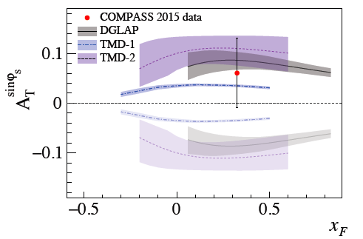
COMPASS Drell-Yan Run 2015 results
Sign change
NO Sign change
Expectation from 2018 polarized Drell-Yan run:
Unambiguous verification of the Sivers asymmetry sign change by reducing of the statistical error on Sivers TSA by a factor of ~2.

Slide 21
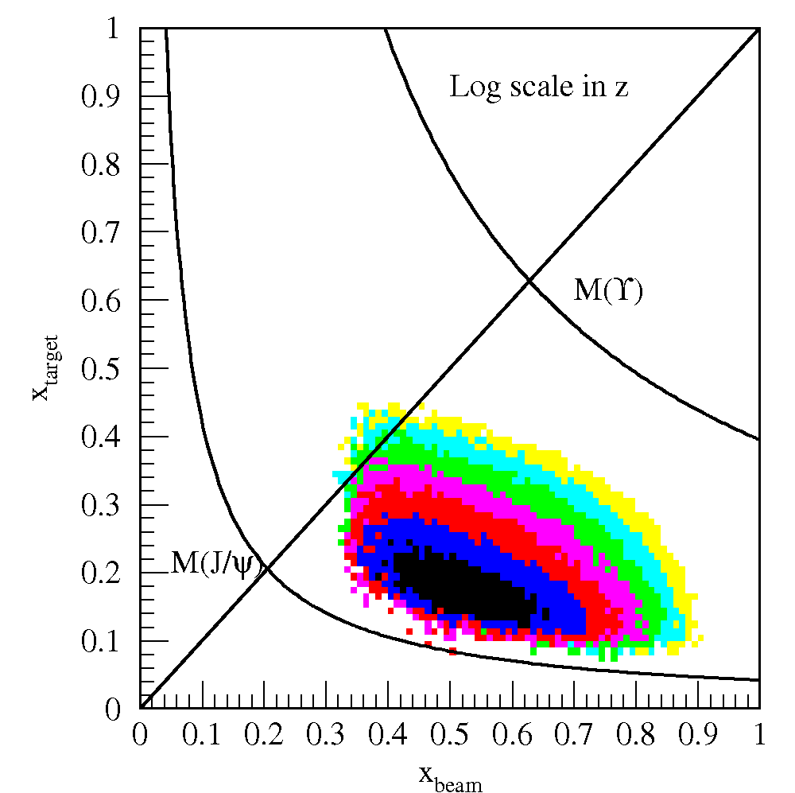
Drell-Yan @SeaQuest Fixed Target
SeaQuest
SeaQuest
acceptance
Kinematically favors sea-quarks
from target – a sea quark lab!

Slide 22
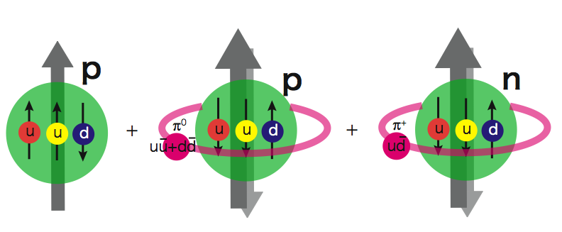
Flavor Asymmetry of Sea Quarks at Intermediate x
Proton vs “Neutron” targets:
This could lead to a very interesting physics …
|p> = a|p₀> + b|p₀ + pi⁰> + c|n+pi⁺> + …

Slide 23
Projected Drell-Yan A_{N}
SeaQuest: p+NH₃
Sea quarks
COMPASS
Sea quark
Sivers
Valence quarks

Slide 24
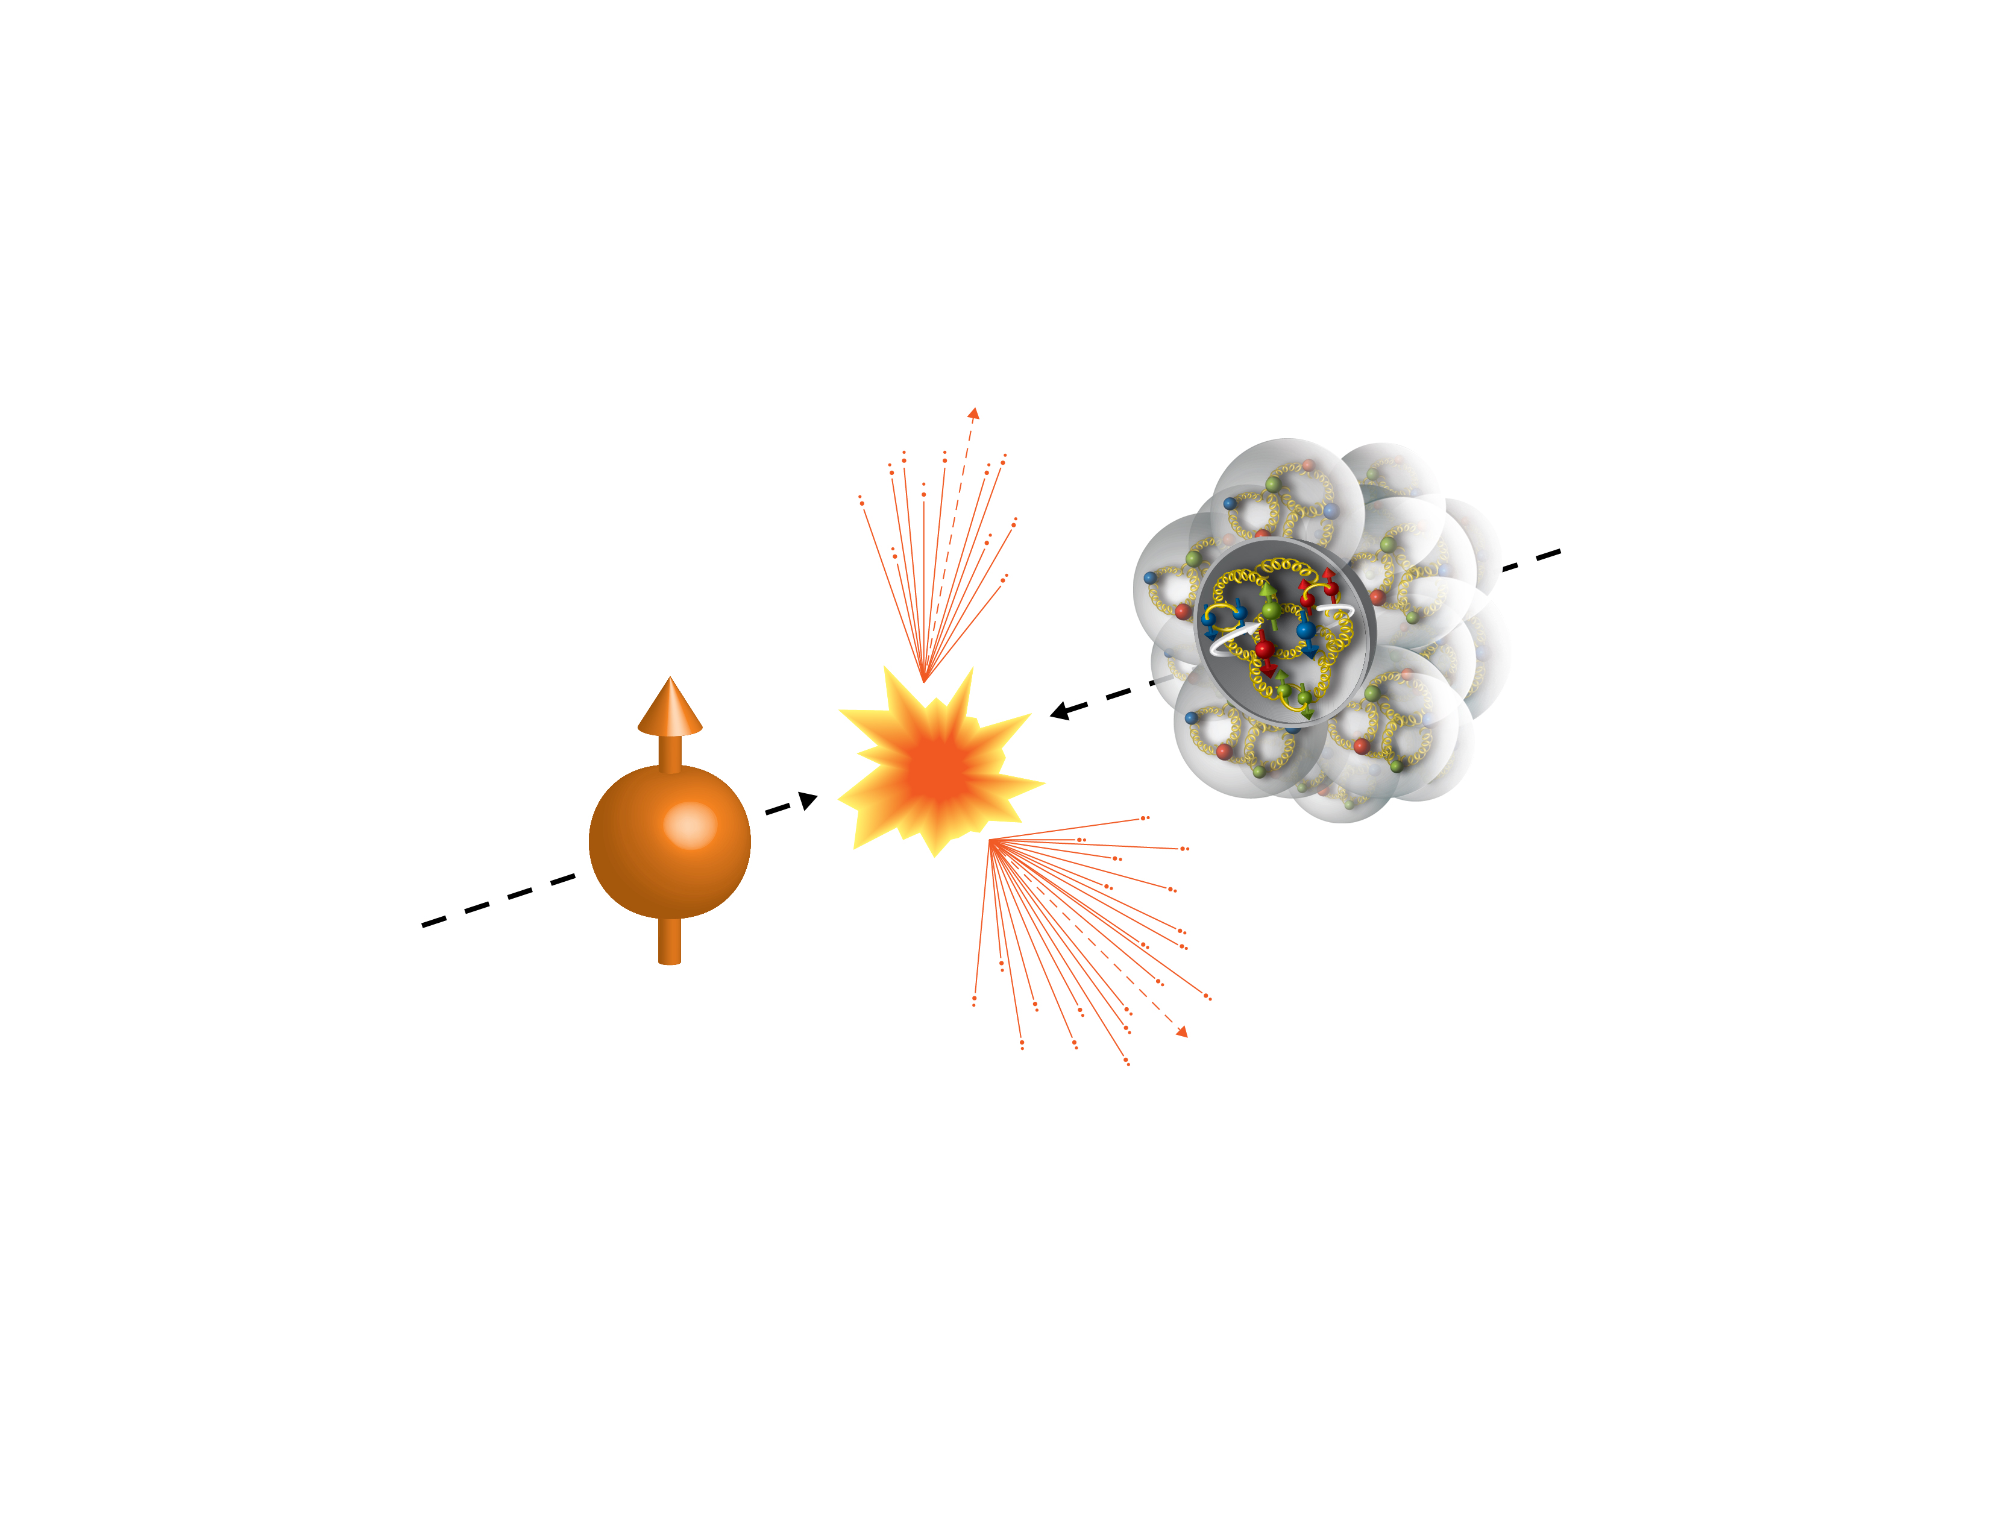
First Polarized p+A at RHIC
Run15 (2015)
100GeV/nucleon
Au, Al
100GeV
Polarized Proton
 | # of proton | # of neutron
p | 1 | 0
Al | 13 | 14
Au | 79 | 118

Slide 25
Run15 p+Au: a Surprise!
Itaru Nakagawa’s
talk, July 13
Unexpected pAu and pAl asymmetries observed compared to that of pp
[PRL 120 (2018) 022001]
A
BBC Veto
𝛾*
𝜋⁺
p
↑
n
A
BBC
BBC Tag
?
↑
n
p
BBC

Slide 26
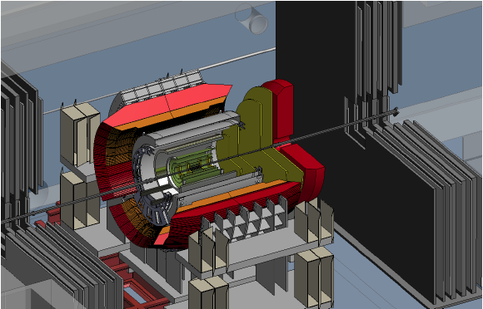
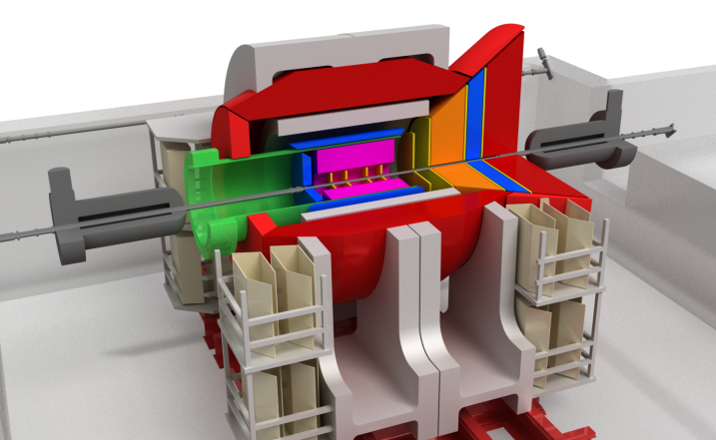
Future: PHENIX -> sPHENIX -> EIC@RHIC
Current PHENIX
f/sPHENIX
An EIC detector
PHENIX completed 2016
16y+ work
100+M$ investment
130+ published papers to date
Comprehensive central upgrade based on BaBar magnet
fsPHENIX: forward tracking, HCal and muon ID
Key study of transverse spin
New collaboration/new ideas
Path of sPHENIX upgrade leads to a capable EIC detector
Large coverage of tracking, calorimetry and PID
New collaboration/new ideas
~2000
2017→2020
~2025
Time
RHIC: A+A, polarized p+p, polarized p+A
eRHIC: e+p, e+A

Slide 27
fsPHENIX Projected Jet Sivers Asymmetries
Test the universality of QCD description of TSSA: pp vs SIDIS
Naïve direct mapping
from SIDIS Sivers (GPM)
- “u-quark jet” A_{N} >0
Sivers, SIDIS fit
With process-dep
from SIDIS Sivers (Twist-3)
- “u-quark jet” A_{N} < 0

Slide 28
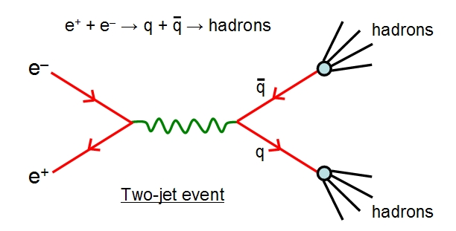
Summary
QCD has been very successful in consistently interpreting and predicting high energy phenomena in
  DIS
  p+p
  Unified partonic picture of nucleon structures
Proton/Hadron collisions
  Versatile physics program
  Access broad (x,Q²) range
Will continue playing a key role in exploring the fundamental nature of nucleon structure
  We need all three experimental tools to complete the program
    p+p
    DIS
    e⁺e⁻
Complementary test and validation of QCD description of hard processes

Slide 30
RHIC pp500GeV: W^{+/-} A_{N}
Anselmino et al 2016
A_{N}(W⁺) ~
A_{N}(W⁻) ~
RHIC data:
A mix of valence and sea quark Sivers
Quark flavor identified
High Q²
Statistically limited, ~0(10%)
Possible large dbar Sivers contributions
E1039:
- low Q²
- Good statistics, ~O(1%)

Slide 31

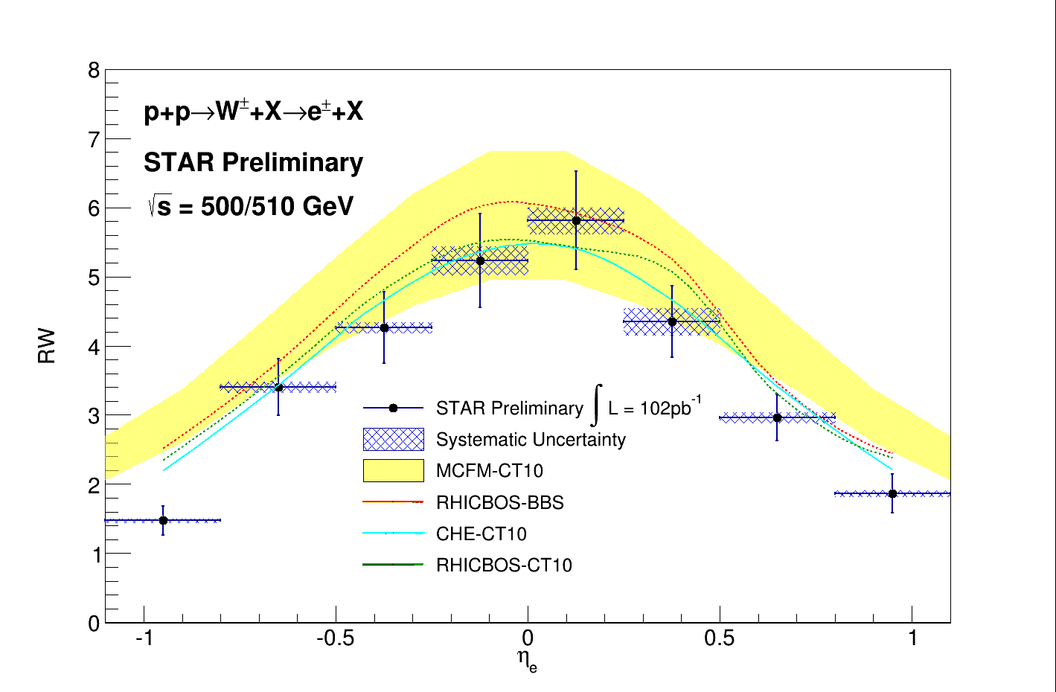

Unpolarized Sea Quark Distributions
Sea quark flavor asymmetry and
pion cloud model
SeaQuest/E906 @Fermilab
0.1 < x < 0.3

Slide 32
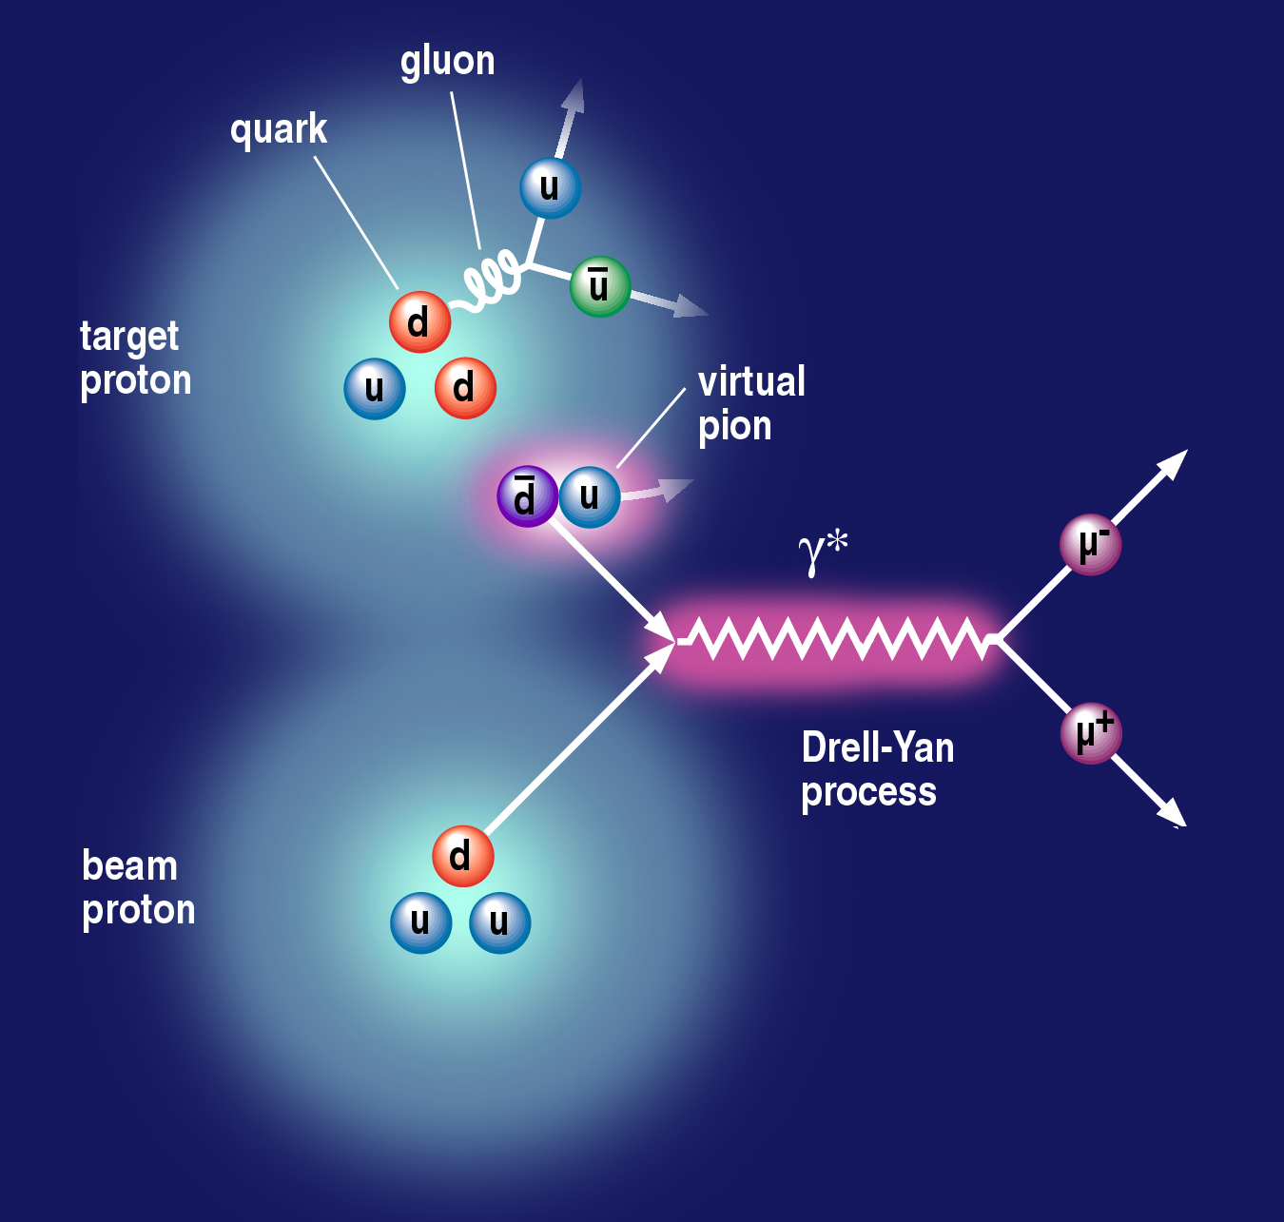
Sea Quark Flavor Asymmetry and OAM
Pion cloud and
Drell-Yan process
Pion cloud model
Sea-quark flavor asymmetry
Sea-quark orbital angular motion
Expect large Sivers function at x = 0.0 ~ 0.4
|p> = a|p₀> + b|p₀ + pi⁰> + c|n+pi⁺> + …
proton
neutron
L_{Z} = 1
E906 Spect.
Monte Carlo
E906 Spect.
Monte Carlo
E906 Spect.
Monte Carlo

Slide 33
Drell-Yan Sivers Asymmetries w/ QCD Evolution
Kang et al, 1401.5078
COMPASS
Valence quark
Sivers
SeaQuest: p+NH₃
COMPASS
Sea quark
Sivers

Slide 34
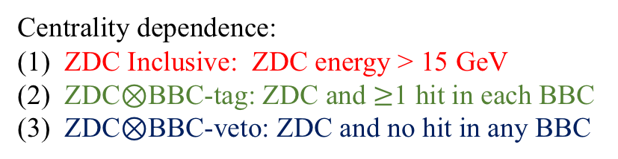
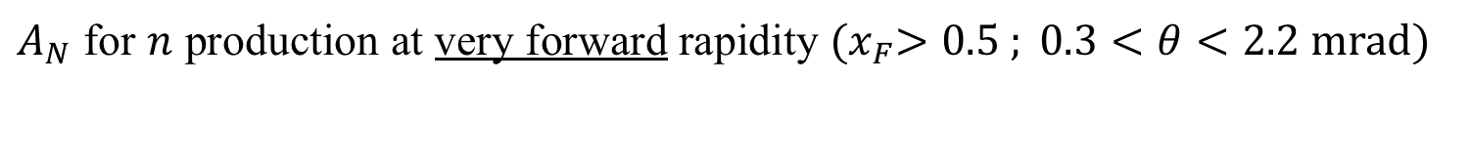
$A_{N}$ for $n$ production at very forward rapidity ${(x}_{F}>0.5 ; 0.3<θ<2.2 mrad)$
Centrality dependence:
ZDC Inclusive: ZDC energy > 15 GeV
ZDC$⊗$BBC-tag: ZDC and $≥$1 hit in each BBC
ZDC$⊗$BBC-veto: ZDC and no hit in any BBC
[PRL 120 (2018) 022001]
Collisions with small impact parameter (BBC-tag) show a negative asymmetry with a moderate nuclear dependence.
Collisions with a large impact parameter (BBC-veto) show a strong nuclear dependence, indicating the importance of ultra-peripheral collisions.
Mitsuka [PRC 95 (2017) 044908] has shown that in a UPC the photon flux from the unpolarized nucleus can interact with the polarized proton to produce such asymmetries.

Slide 35
Fixed target expriments – COMPASS DY and SeaQuest dbar/ubar and E1039

Slide 36
Near Future Oppotunities
RHIC
CERN
Fermilab

Slide 37
Latest W^{+/-} A_{L} from STAR and PHENIX
arXiv:1702.05077
arXiv:1804.04181

Slide 38
sPHENIX at RHIC
Large acceptance, high rate next generation experiment at RHIC
  QGP and Cold QCD physics with,
    Jets
    Heavy quarkonia
    Open heavy flavor
  Study p+p, p+A and Au+Au collisions at top energy 200GeV
    Central barrel: |eta|<1, 2pi coverage
      EMCal & HCal
      MVTX/INTT/TPC
    Forward upgrade being developed
    DAQ rate: 15kHz
Project Status
  Granted DOE CD-0, 10/2016
  CD-1 reviewed, 8/2018
  Construction: 2018-2022
  Day-1 physics, ~1/2023

Slide 39
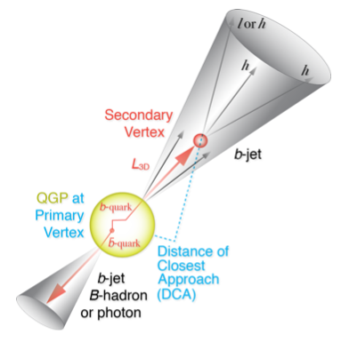
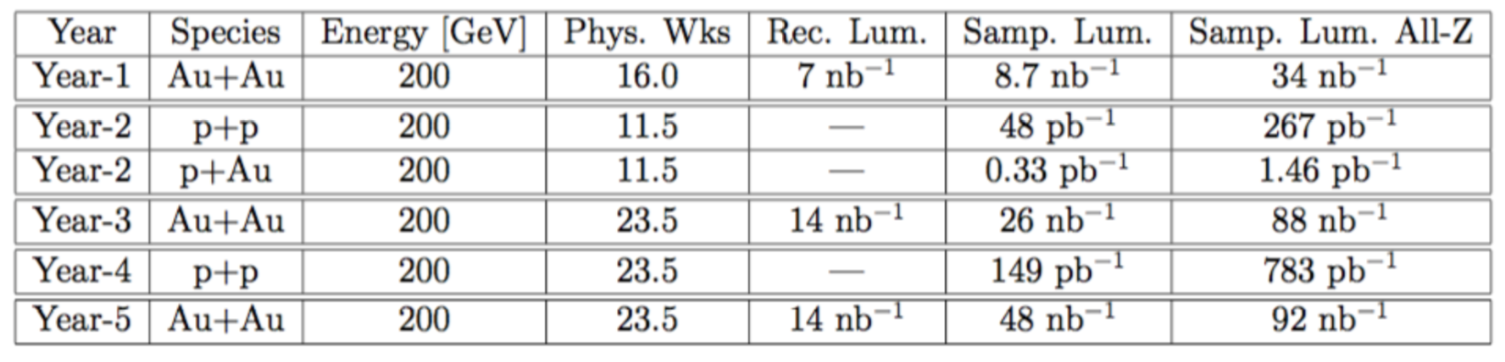
RHIC Multi-Year Plan: sPHENIX 2023-2027+
(Cold QCD plan under development now)
Jets, hadrons and heavy flavor and more
RHIC 2015 pp200
Recorded lumi ~50pb⁻¹

Slide 40
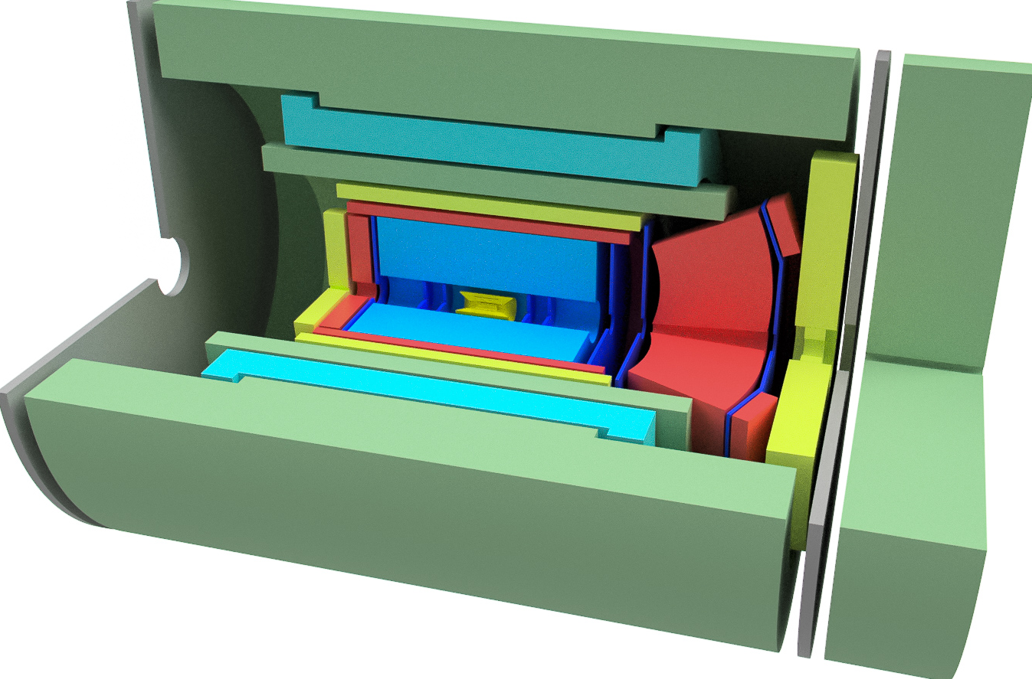
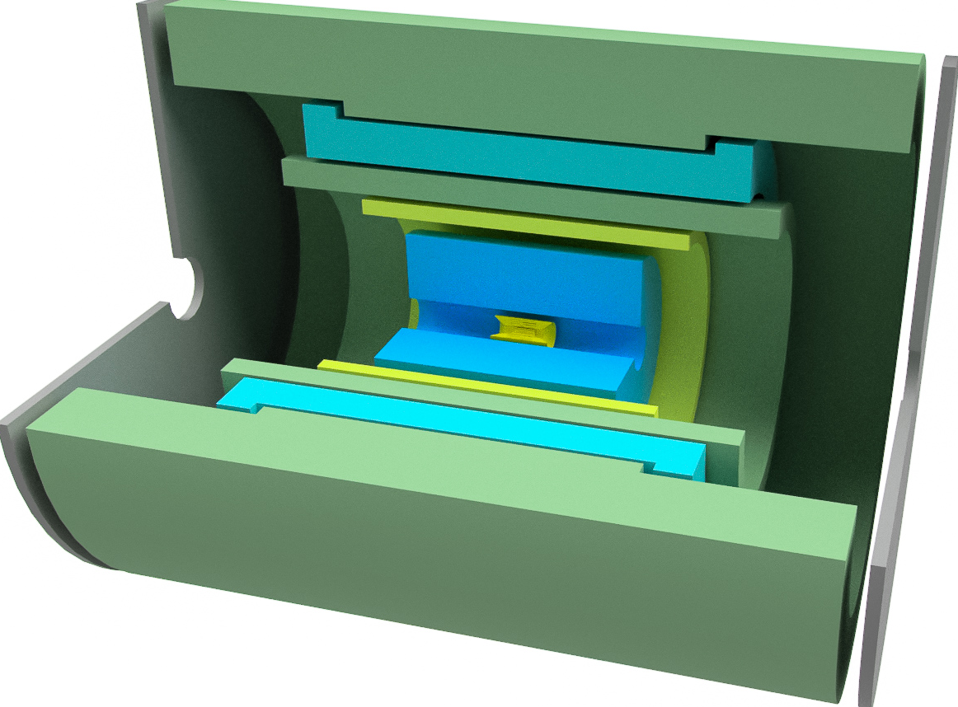
Detector components, sPHENIX and EIC detector
sPHENIX
  HCal/Flux return
  Solenoid
  Central EMCal
  Silicon strip tracking
  TPC
  MVTX
EIC detector
  HCal/Flux return
  Solenoid
  Extended Central EMCal
  Central hadron PID
  TPC
  MAPS
  Forward and backward tracking
  Forward and backward hadron PID
  Backward crystal EMCal
  Forward EMCal
  Forward HCal

Slide 41
Significant impact expected for inclusive DIS measurements
2014 LOI: arXiv:1402.1209
EPPS16 Nuclear PDFs: EPJ C77, 163 (2017)
xΔg(x)
Q² = 10 GeV²
Will update using pseudodata for EIC detector based on sPHENIX, taking into account expected detector performance based on GEANT studies
x

Slide 42
Proposed STAR Forward Upgrade
Access small-x Gluons
To install a Forward Calorimeter System (FCS)
in early 2020s:
EMCal
Hcal
Tracking, charge separation
Di-jet in the forward region (2.8<eta<3.7)
Access gluon polarization at low x:
X ~ 5x10^-3 (central + forward)
X~ <1x 10^-3 (forward - forward)

Slide 43
Summary and Outlook
First evidence of non-zero gluon polarization
  PHENIX: pi0 A_{LL}
  STAR: 200/510GeV inclusive jets and di-jet A_{LL}
First direct measurements of sea-quark polarization with W^{+/-}
  PHENIX: W->e, mu
  START: W->e
Cold QCD plan being developed
  Exciting long-term polarized pp/pA 2020+
    sPHENIX
    STAR/Forward upgrade proposal
EIC future 2025+

Slide 44
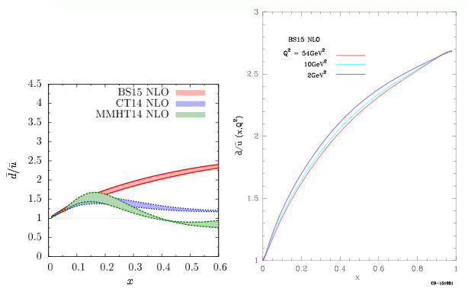
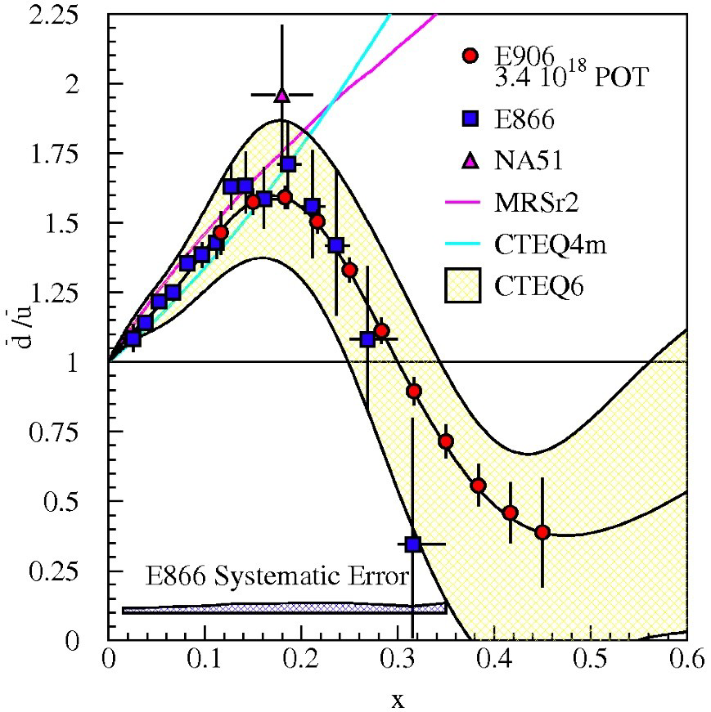
Unpolarized Sea Quark Distributions
C. Bourrely and J. Soffer (2013)
0.1 < x < 0.3
projected

Slide 45


Toward a Unified Picture of Nucleon Structure
Momentum and Spatial Tomography
Some data, recent progress
Good data, long history
F(r,Q²)

Slide 46
backup

Slide 47
Outline
Physics questions
  Novel QCD phenomena
  Polarized structure
Uniqueness of high energy hadrons collisions
  Broad (x,Q2) range
  High energy, open up more channels,
    like real weak probes W+/-
  Complementary to DIS, cross-check the consistency of the QCD description
    Sign change in TSSA in Drell-Yan and SIDIS
Selected recent highlights from hadron beam facilities
  RHIC
  CERN/COMPASS
  Fermilab/SeaQuest
  LHC?
Future opportunities

Slide 48
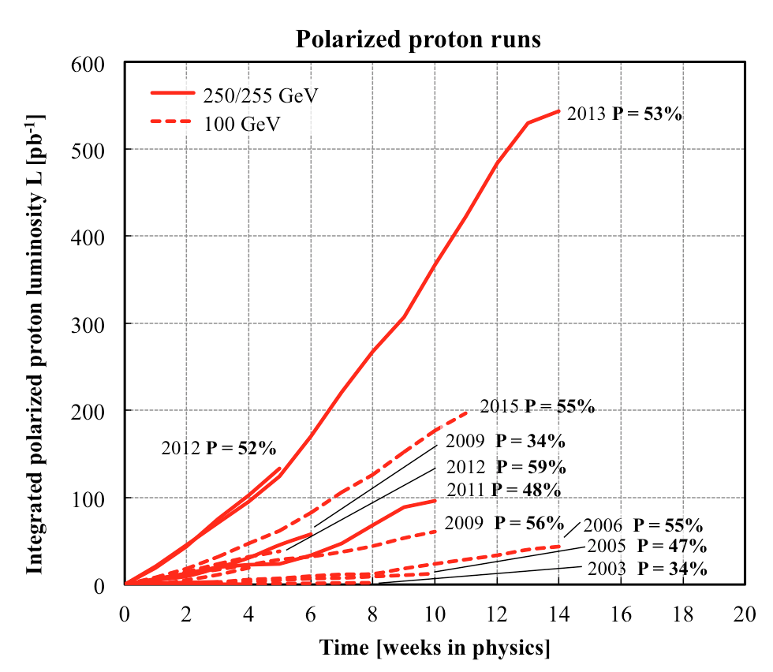
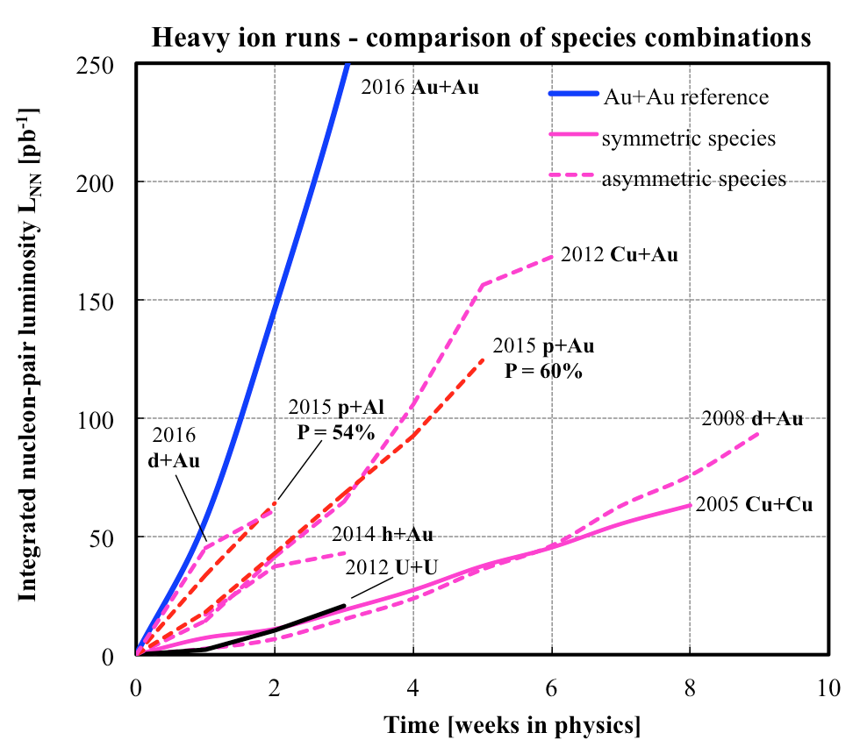
History of RHIC Spin Runs
RHIC is capable of delivering the polarized p+p/A for precision spin physics
A very challenging task to deliver polarized p+p, excellent performance from 2012+
Outstanding Heavy Ion machine performance from the beginning
Polarized p+p, p+Au and p+Al
10/13/14
Notes:
Our physics analysis efforts are closely tied to the RHIC beams operations
Took “BNL” 10 years to reach the mechine performanvec goals ..
48

Slide 49
Work Wide Collins – (x, Q²)

Slide 50
Physics case for an Electron-Ion Collider
How are the quarks and gluons, and their spins, distributed in space and momentum inside the nucleon? How do the nucleon properties emerge from them and their interactions?
How do color-charged quarks and gluons, and colorless jets, interact with a nuclear medium? How do the confined hadronic states emerge from these quarks and gluons? How do the quark-gluon interactions create nuclear binding?
How does a dense nuclear environment affect the quarks and gluons, their correlations and their interactions? What happens to the gluon density in nuclei? Does it saturate at high energy, giving rise to a gluonic matter with universal properties, in all nuclei, even the proton?
EPJ A52, 268 (2016)

Slide 51
The eRHIC facility
}
Electrons
Protons
Deuterium, ³He
Nuclei up to Uranium
Spin
Polarized!
E_{e} 5-18 GeV
E_{p} up to 275 GeV
E_{A} up to 110 GeV/n
√s = 29 -140 GeV
Lep = 10³³ - 10³⁴ cm⁻²s⁻¹
Notes:
Wide range in nuclei useable.
HERA: √s = 318 GeV -> more than twice that of EIC, BUT: Only electrons polarized, L ~ 100-1000 times less than EIC.
Integrated Luminosity:
10³³ cm⁻²s⁻¹ -> 10 fb⁻¹ / year integrated
10³⁴ cm⁻²s⁻¹ -> 100 fb⁻¹ / year integrated

Slide 52
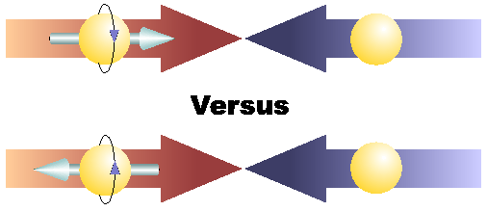
Physics with Longitudinally
Polarized p+p Collisions

Slide 53
Latest Pol NNPDFPol Global Fit
arXiv:1702.05077
-SI/DIS data
-RHIC data

Slide 54
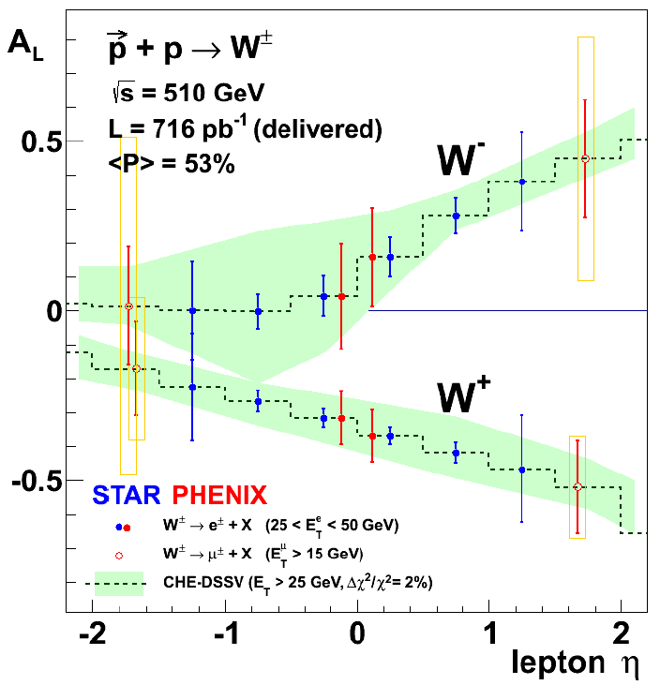
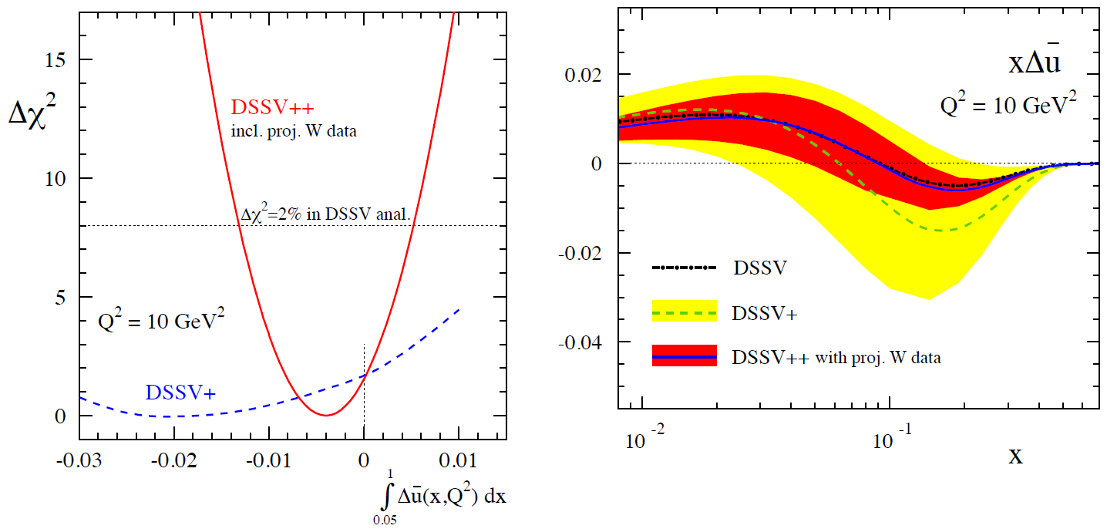
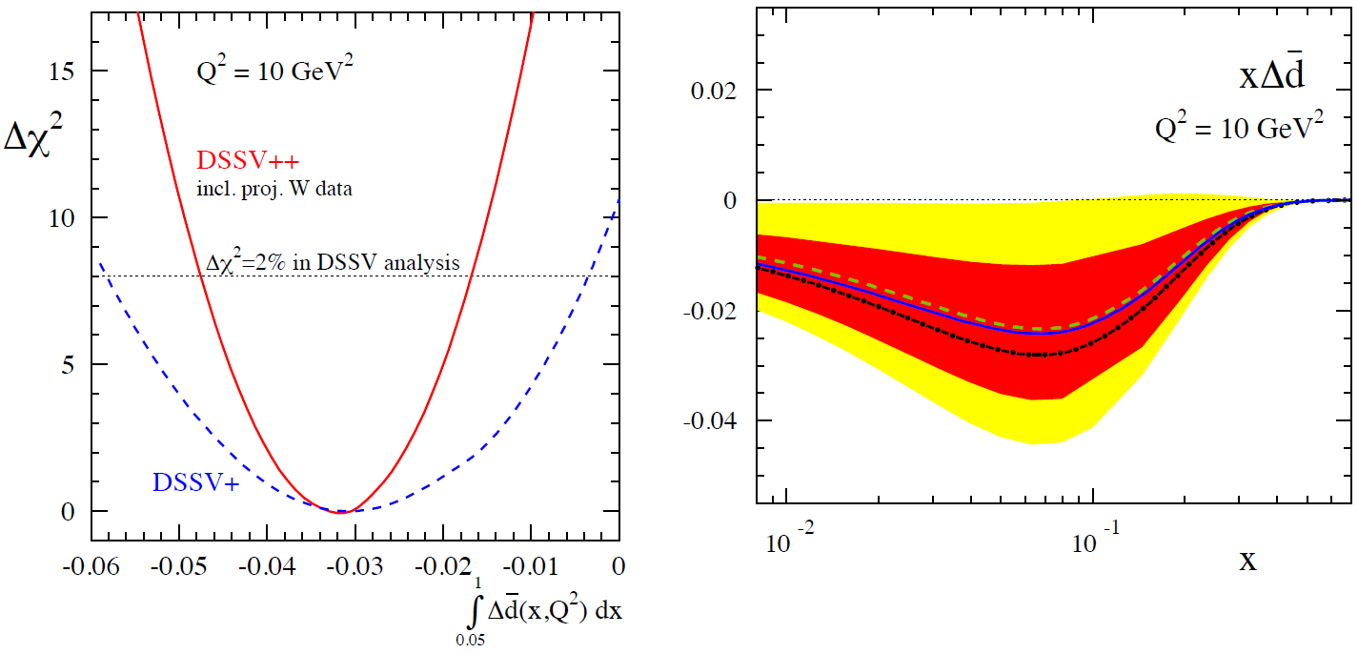
Projected RHIC 𝑊± → 𝑙± data Impact on Sea Quark Polarization Determination
Expect significant improvement of flavor identified sea quark distributions
The RHIC Spin Program, arXiv: 1501.01220

Slide 55
Relative contributions
RHIC Spin Program, arXiv:1501.01220

Slide 56
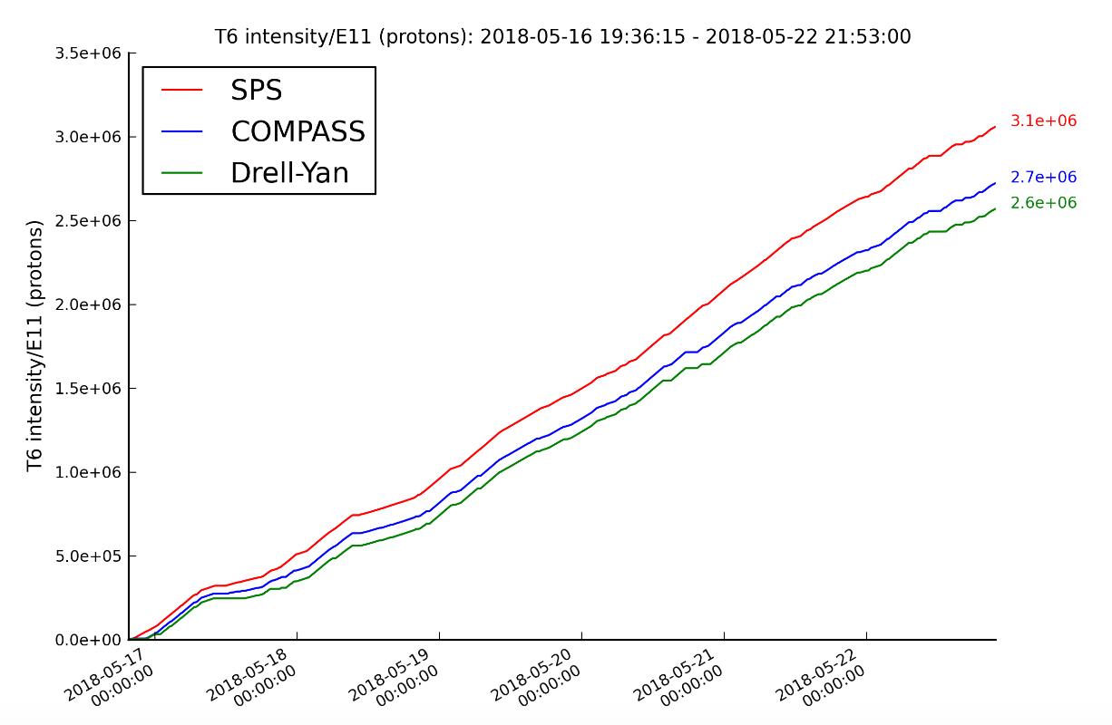
2018 COMPASS Polarised Drell-Yan Run
One of the main goals of the polarised Drell-Yan program at COMPASS is the unambiguous verification of the Sivers asymmetry sign change by reducing of the statistical error on Sivers TSA by a factor of ~2.
Improvements with respect to 2015 data taking:
Beam telescope (additional SciFi station, 11 planes vs 8 in 2015)
CEDARS: fast MAPMT and new read out chain – high rate capable system
Polarised Target – new field rotation procedure + extensive commissioning period
Better tuned trigger system
New radiation protection (additional wrt 2015)
Current status of the data taking:
- Better performance of the PT system
compared to 2015 (longer relaxation time)
Significantly higher statistics wrt 2015
First preliminary results are expected
by summer 2019

Slide 57
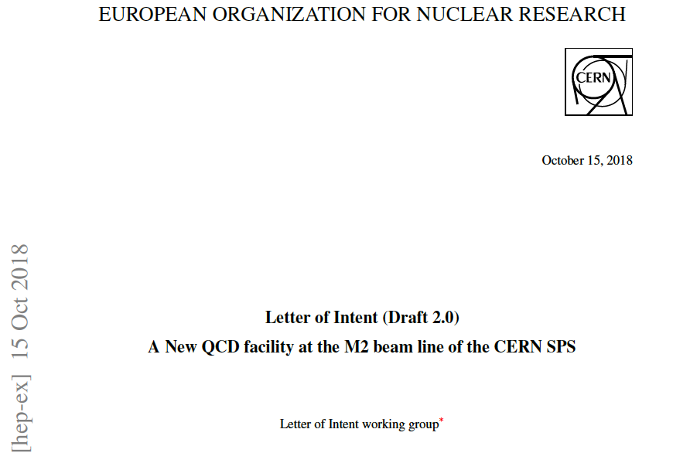
A New QCD Facility at M2 beam line of the SPS CERN (to be submitted in January 2019)
A New QCD Facility at M2 beam line LoI is under preparation now. The goal is to bring together new Collaboration enthusiastic about opportunities of doing physics at CERN with conventional and newly designed RF separated kaon and antiproton beams. The total duration of the program reaches 10 years of running with hadron and muon beams.
http://arxiv.org/abs/1808.00848

Slide 58
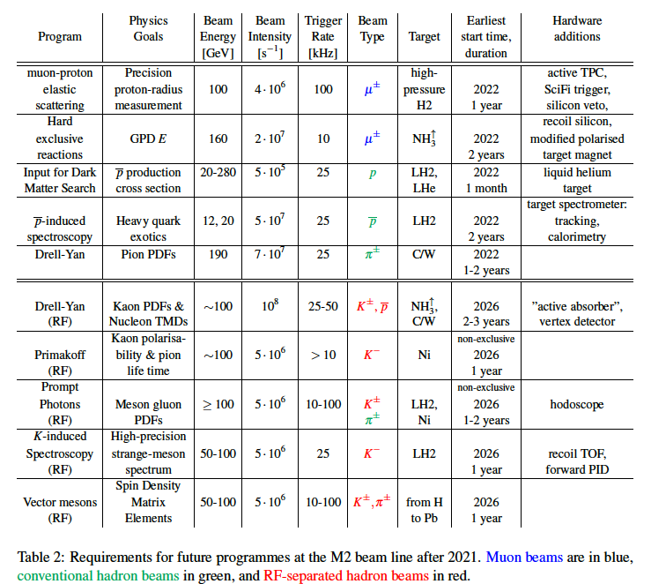
A NQF@M2 beam line of the SPS CERN

Slide 59
Two stages program:
First stage (shorter term) – existing extracted beams
Second stage (longer term) – RF-separated extracted kaon and antiproton beams
Shorter term 2021/22 ÷~ 2026 (N.B. 2019-20 and 2024-25 – LS2 and LS3) :
a.) Standard muon beam:
- 1. DVCS with trans. polarised proton target
- 2. Proton radius measurement in elastic muon proton scattering
b.) Standard hadron beam:
- 1. Unpolarised DY with various targets
- 2. Absolute cross-section measurements p + He -> pbar X
- 3. Hadron spectroscopy with antiproton
Longer term (New RF-separated beam will be ready ≥ 2026 ):
- 1. Hadron spectroscopy
- 2. Drell-Yan physics
- 3. Primakoff with kaon beam
- 4. Direct Photons with kaon

Slide 60
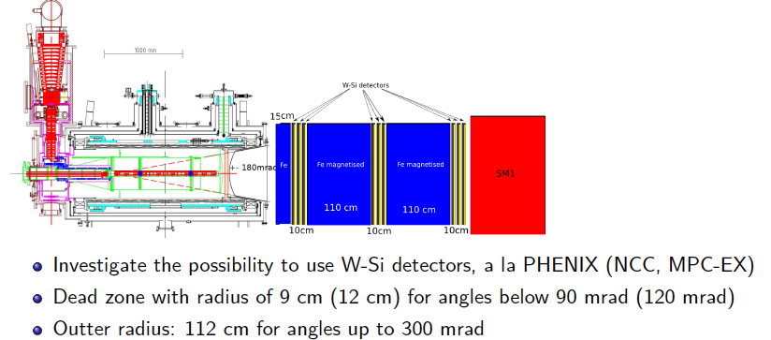

QCD facility – future fixed target experiment at M2
Spectrometer upgrades for Drell-Yan measurements with RF-separated beam

Slide 61
The Challenge of “Too Small”
 | Quark Spin | Gluon Spin
SLAC -> 2000 | E80 – E155
CERN ongoing | EMC, SMC, COMPASS
DESY ->2007 | HERMES
JLab ongoing | Hall A,B,C
RHIC ongoing | (BRAHMS), (PHENIX), STAR
Proton spin puzzle
Axial anomaly
Cheng & Li, PRL (1989)
“Spin Crisis”, EMC 1987
 | SIDIS/DIS
 | Polarized p+p
Development of RHIC-Spin program in 90’s

Slide 62

Gluon Polarization and 𝜋⁰ (or jet)A_{LL}
A_{LL}=(N⁺⁺-N⁺⁻)/(N⁺⁺+N⁺⁻)
    -- Parton distribution functions
    -- Partonic hard scattering rates
    -- Fragmentation functions
DIS
?
pQCD
e+e-
Relative fractions
Di-photon mass: 𝜋⁰ peak

Slide 63
First Precision Measurements of Longitudinal Double-Spin Asymmetry A_{LL} from 2009 RHIC Run
STAR: PRL 115, 092002 (2015)
PHENIX: PRD 90, 012007 (2014)
PRL 115, 092002 (2015)

Slide 64
Projected Drell-Yan TSSA from SeaQuest Polarized Fixed Target E0139

Slide 65





Do We Understand the Physics?
RHIC 200 GeV CMS
Large Transverse Single Spin Asymmetry (TSSA) in forward hadron production persists up to RHIC energy.
FNAL 200 GeV beam
AGS 22 GeV beam
ZGS 12 GeV beam
PRL (2004)
PLB261, 201 (1991)
PLB264, 462 (1991)
PRD65, 092008 (2002)
PRL36, 929 (1976)
Sivers, Collins, Twist-3 ….
Non-Perturbative cross section
Perturbative cross section

Slide 66
Hadron TSSA in Twist-3 Framework
Qiu & Sterman PRD 59 (1998)
1st term: twsit-3 correlation functions, “Sivers”
2nd term: twist-2 transversity * twist-3 from unpol beam (expected small)
3rd term: twist-2 transversity * twist-3 FF, “Collins”
Need new direct measurements of Sivers and Collins TSSA in p+p!
Forward sPHENIX Upgrade Proposal
66

Slide 67


Large TSSA observed at Forward-Rapidity: π⁰ and η
Production well described by pQCD
A_{N} is independent of collision energy
  xF scaling?
Similar for Pion and eta
  No mass dependence?
x₁
Valance quark effect ?
arXiv:1406.3541
x₁>>x₂
x₂

