Slide 1
Nucleon-Structure Physics by Proton-Proton Collisions
Ming X. Liu
Los Alamos National Laboratory
QNP2018
Tsukuba, Japan

Slide 2
Nucleon Structure and Interaction
A very rich dynamic environment, NOT a point particle
  3-D
  scale-dependent
Primary source of our knowledge about QCD and strong interaction phenomena

Slide 3
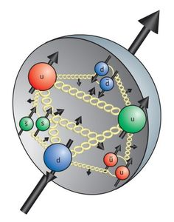
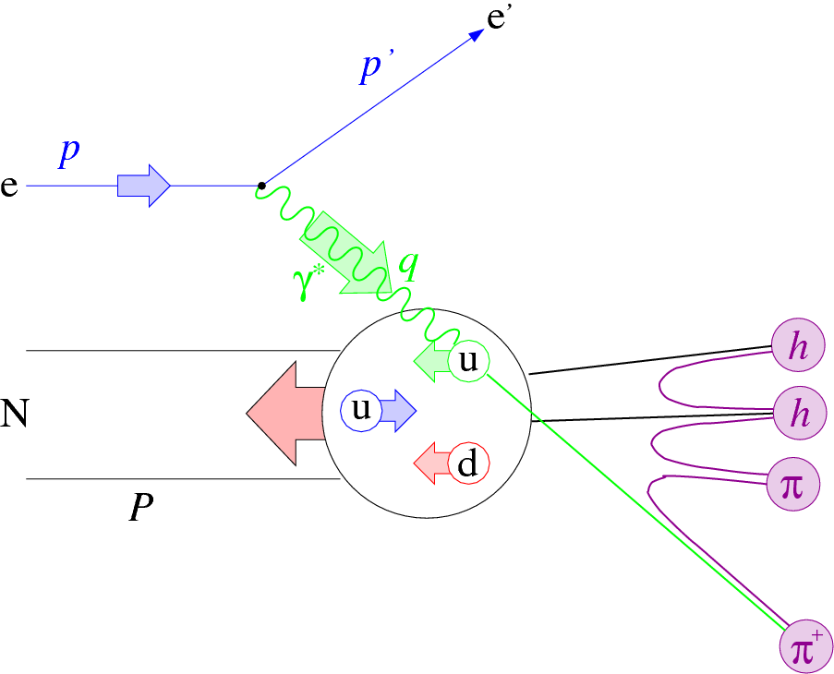
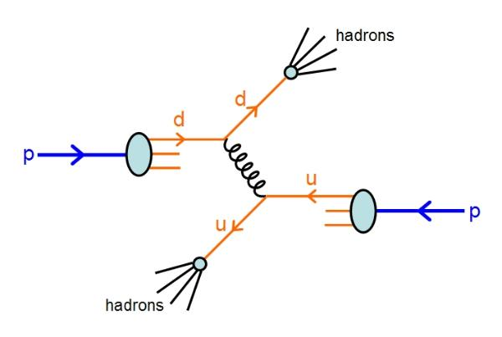
Physics of Nucleon Structures
How hadrons formed and interact from the fundamental quarks and gluons?
  Space and momentum distributions of quarks and gluons
  Spin degree of freedom
  Probe scale dependence, Q2
Our tools
  Lepton probes - electrons, muons, neutrinos …
    DIS experiments, HERMIES, COMPASS, EIC…
  Hadron probes - proton, pion/Kaon…
    RHIC, Fernilab, COMPASS …
  Lattice QCD, pQCD …

Slide 4
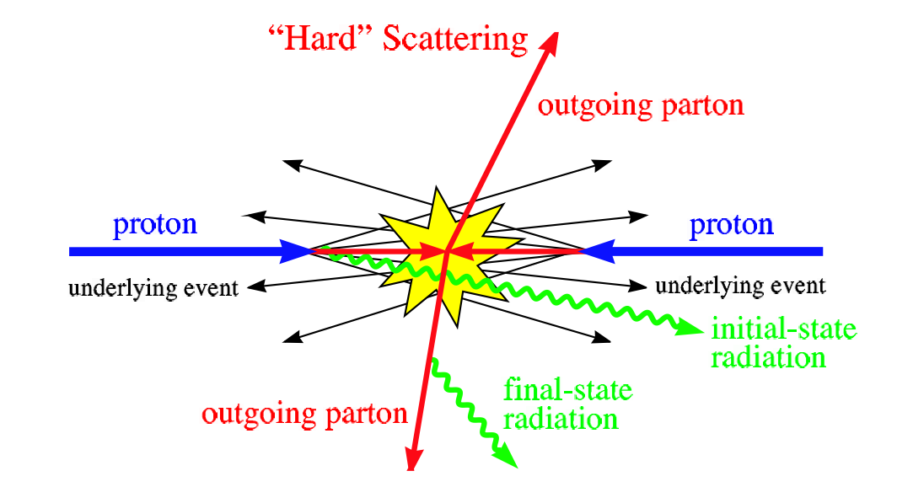
Study Nucleon Structure in Hadron Collisions
Very massy p-p collisions could be simplified for hard-scattering processes, pQCD applicable

Slide 5
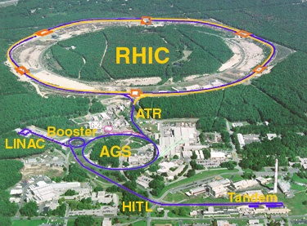


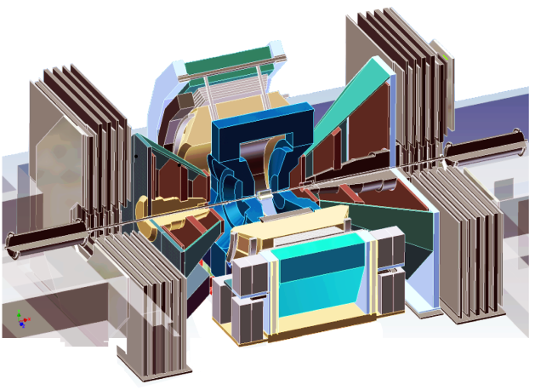
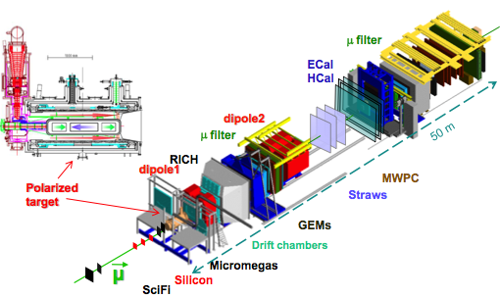


Selected Recent Highlights
Spin puzzle
  RHIC – STAR, PHENIX
TMD phenomena
  RHIC/STAR, PHENIX
  CERN/COMPASS
  Fermilab/SeaQuest
SeaQuest

Slide 6
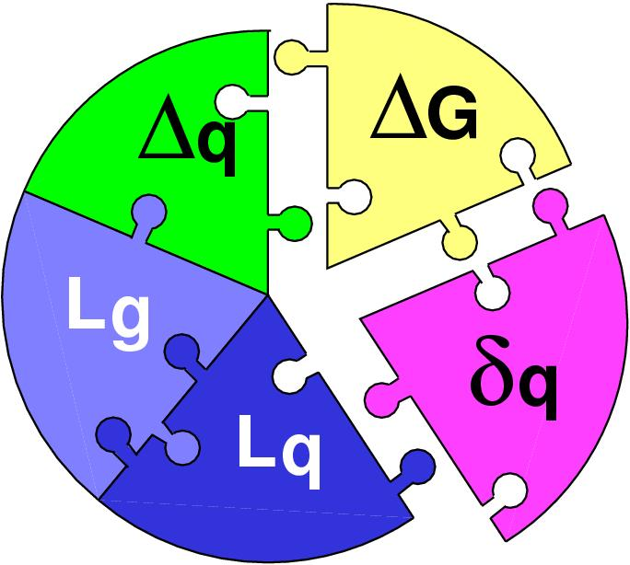
Part-I: Challenge of “Too Large”
Three Decades of the Proton Spin Puzzle
Spin Crisis: EMC, 1987
 | Quark Spin | Gluon Spin
SLAC -> 2000 | E80 – E155
CERN ongoing | EMC, SMC, COMPASS
DESY ->2007 | HERMES
JLab ongoing | Hall A,B,C
RHIC ongoing | (BRAHMS), (PHENIX), STAR
Early expectation:
Large gluon polarization,
Axial anomaly, Cheng & Li, PRL (1989)
Development of RHIC-Spin program in 90’s
Today:
 | SIDIS/DIS
 | Polarized p+p

Slide 7
World First High-Energy Polarized Proton Collider at RHIC
Absolute Polarimeter (H↑ jet)
RHIC pC Polarimeters
PHOBOS
polarized p+p collisions
62 ≤ √s ≤ 500 GeV
Siberian Snakes
BRAHMS
Siberian Snakes
PHENIX
STAR
Spin Rotators
(longitudinal polarization)
Spin Rotators
(longitudinal polarization)
Pol. H⁻ Source
LINAC
BOOSTER
Helical Partial Siberian Snake
200 MeV Polarimeter
AGS
AGS pC Polarimeter
Strong AGS Snake

Slide 8
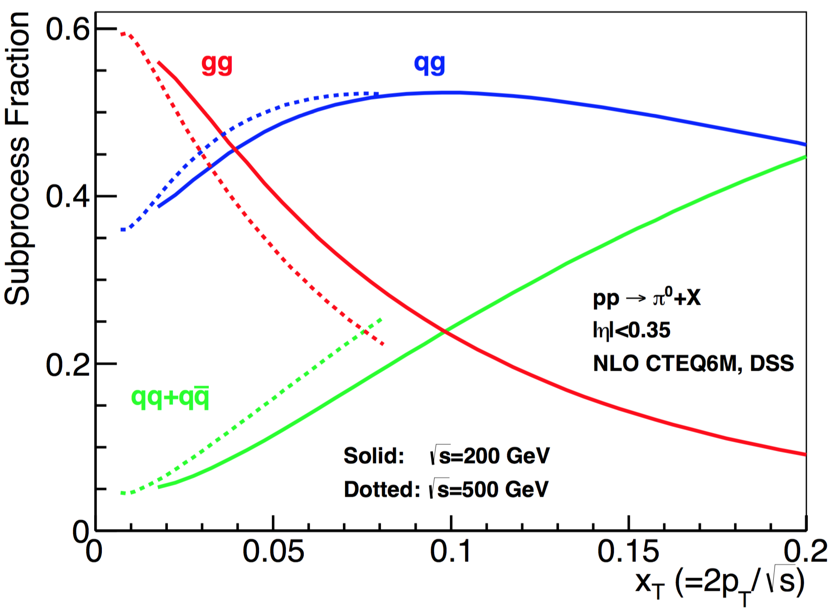
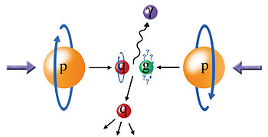
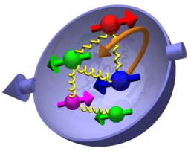
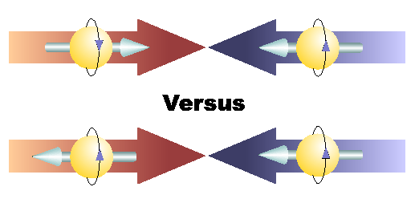
Study Gluon Polarization at RHIC
Relative fractions
A_{LL}=(N⁺⁺-N⁺⁻)/(N⁺⁺+N⁺⁻)

Slide 9
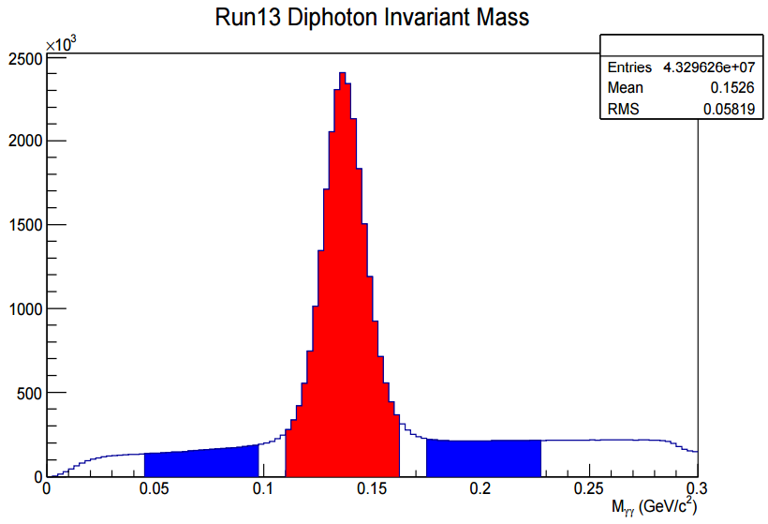
First Hint of Non-zero Gluon Polarization from RHIC 2009 Data Set
STAR: PRL 115, 092002 (2015)
@ Q² = 10 GeV²
PRL 113, 012001 (2014), DSSV
Run 2009
p+p@200GeV
PHENIX: PRD 90, 012007 (2014)

Slide 10
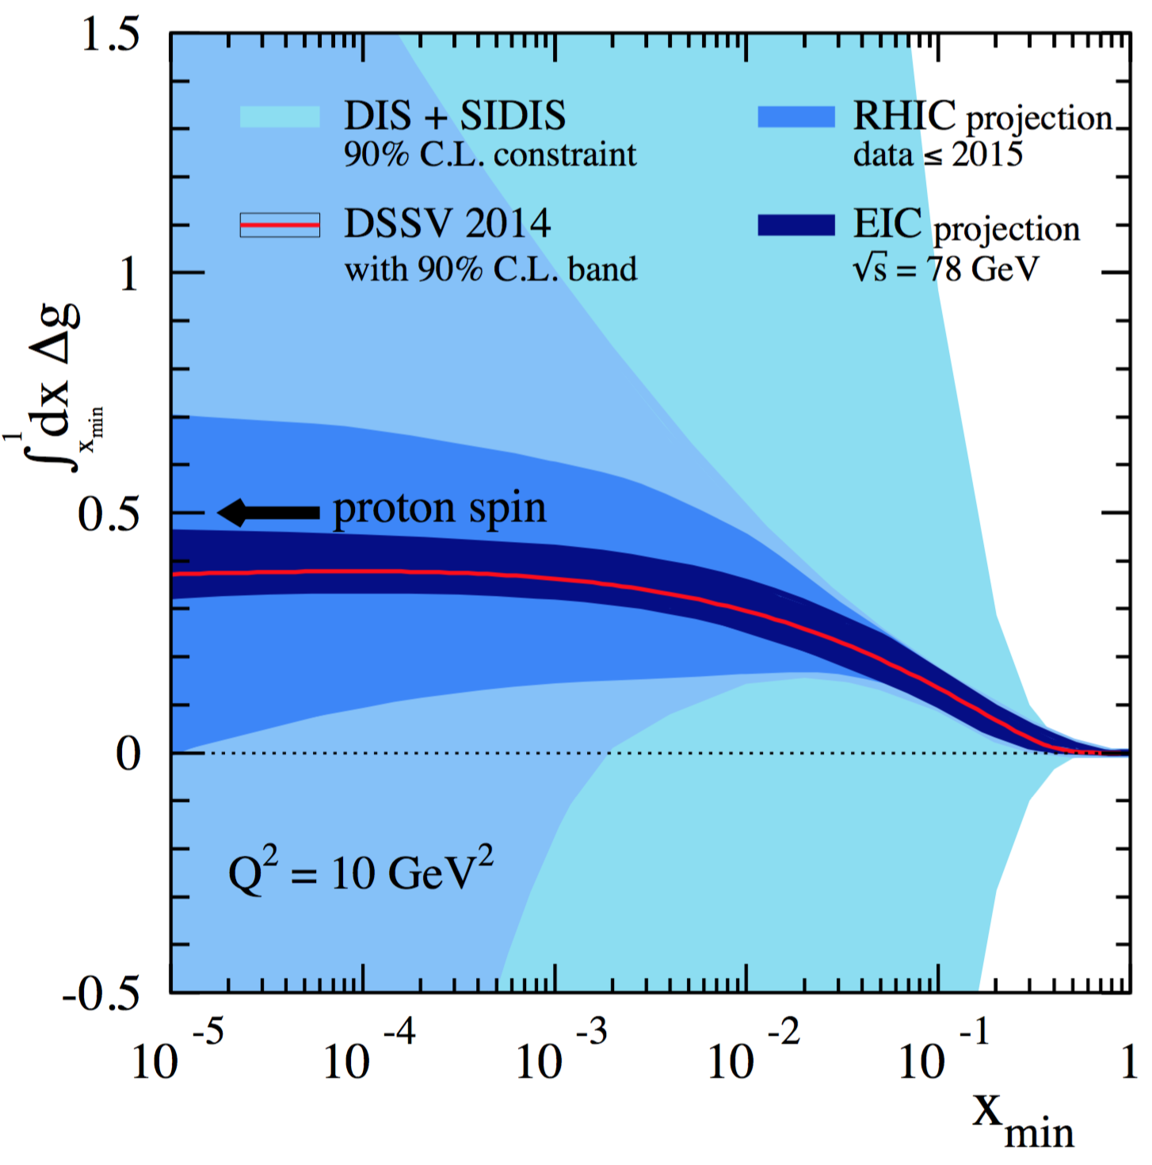
Projected Impact of RHIC data on Gluon Polarization
Favors positive gluon polarization
  PHENIX/STAR data:
  62GeV 𝜋⁰ A_{LL}
  200GeV 𝜋⁰ A_{LL}
  510GeV 𝜋⁰ A_{LL}
  200/510GeV (di)jets A_{LL}
  Statistically limited but could be improved in the future high luminosity program:
  200/510GeV charged hadron A_{LL}
  200/510GeV HF A_{LL}
  200/510GeV 𝐽/𝜓 A_{LL}
EIC future, 2027+
“RHIC Cold QCD Plan for 2017-2023”, arXiv:1602.03922
PRL 115, 092002 (2015)

Slide 11
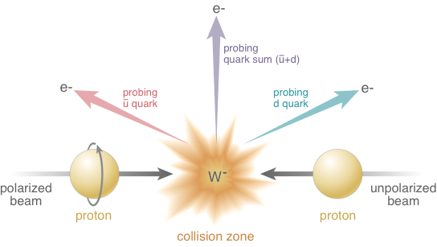
Electroweak Probe for Sea Quarks at High Energy at RHIC

Slide 12


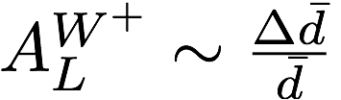
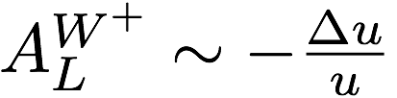
First Direct Measurements of Flavor Identified Sea Quark Polarization
RHIC has unique access to flavor identified sea-quarks via real W^{+/-}
STAR: PRL 113, 072301 (2014)
Sea quarks
Valence quarks
arXiv:1406.7122

Slide 13
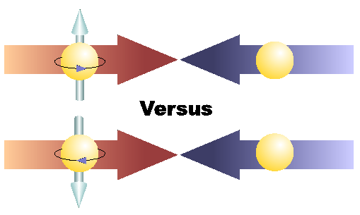
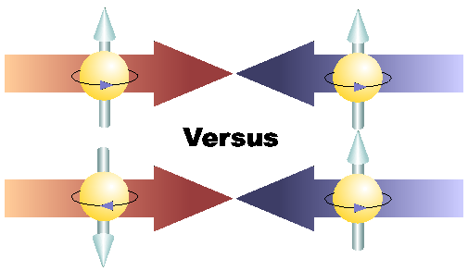
Physics with Transversely Polarized p+p Collisions at RHIC

Slide 14
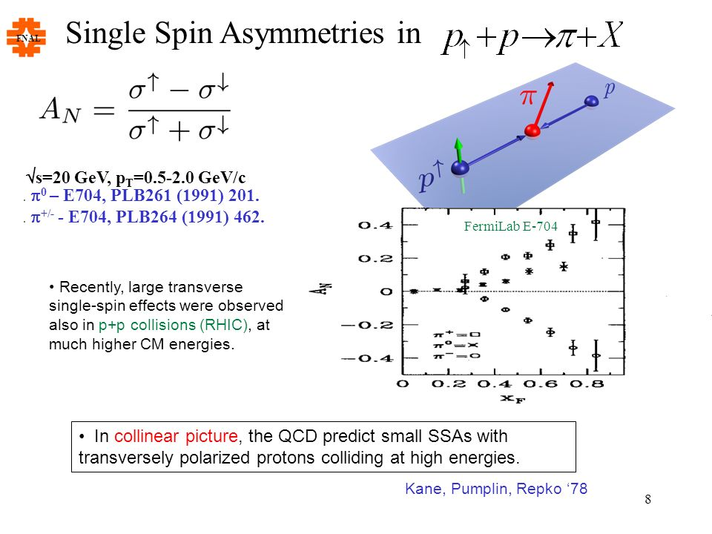
Part-II: The Challenge of “Too Large”
Large Transverse Single Spin Asymmetry (TSSA) in forward hadron production persists up to RHIC energy.
Kane, Pumplin, Repko (1978)
A_{N} ~ O(10%)
Fermilab
E704 (1991)

Slide 15
Probe the Underlying Physics via Hard Scatterings
TMD vs Collinear Twist-3 Factorizations
(i) Sivers mechanism:
correlation proton spin & parton k_{T}
(ii) Collins mechanism: Transversity × spin-dep fragmentation
S_{P}
Phys Rev D41 (1990) 83; 43 (1991) 261
S_{P}
Nucl Phys B396 (1993) 161
S_{q}
p
k_{T,q}
p
p
p
S_{q}
k_{T,π}
Collinear Twist-3 (RHIC):
quark-gluon/gluon-gluon correlation

Slide 16
Access Sivers and Collins with Jet and Hadron Azimuthal Distributions in Transversely Polarized p+p Collisions
Feng Yuan, PRL 100, 032003 (2008)
Umberto D’Alesio et al PRD 83 034021 (2011)
Experimental variables:
Jet P_{j,} xF
Hadron P_{h} , PID
Beam polarization
→ “Sivers-like”
→ “Collins-like”

Slide 17
Collins Asymmetry in Jet
Inclusive A_{N} = 0 at central rapidity
A_{N} at central rapidity: non-zero in jet!

Slide 18
Sivers Asymmetry
- non-Universality, process dependent
Sign change prediction
Drell-Yan and W/Z in p+p

Slide 19
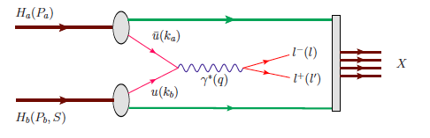
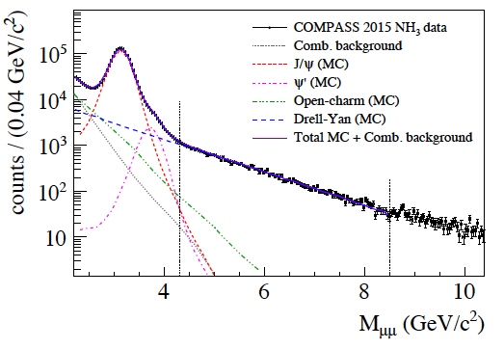
Drell-Yan from COMPASS Polarized Target
Beam: pi-
Polarized
Proton target
- J/ψ (NH₃) ~ 1.5M
- HM DY (NH₃) ~40K

Slide 20
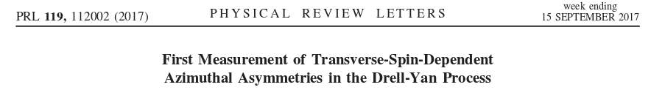
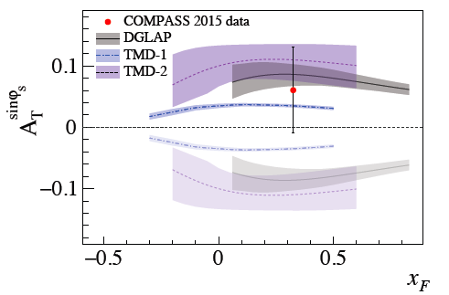
COMPASS Drell-Yan Run 2015 results
Sign change
NO Sign change
Expectation from 2018 polarized Drell-Yan run:
Unambiguous verification of the Sivers asymmetry sign change by reducing of the statistical error on Sivers TSA by a factor of ~2.

Slide 21
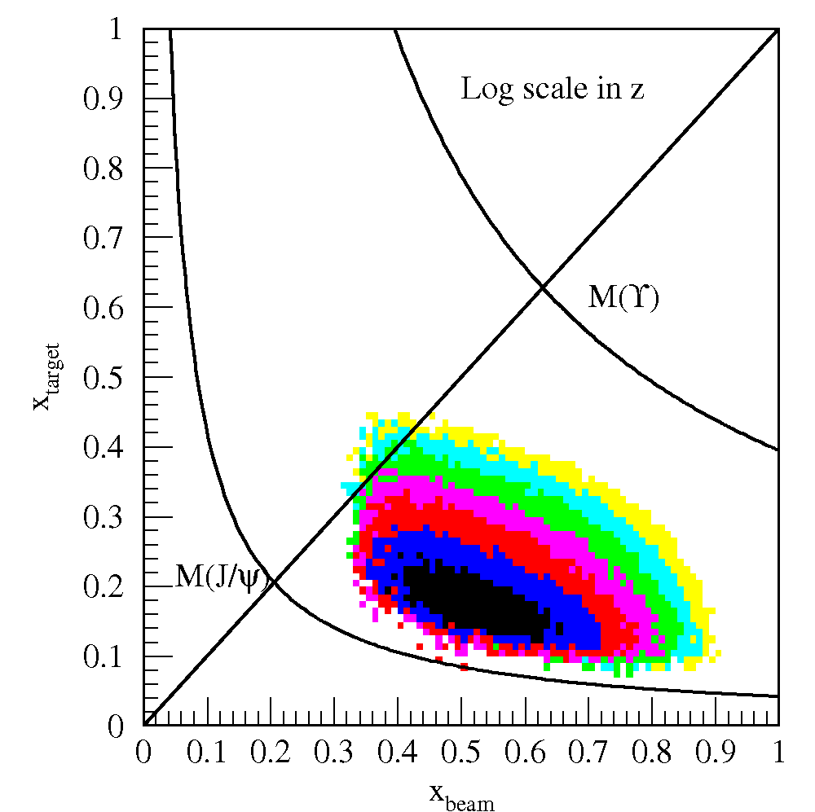
Drell-Yan @SeaQuest Fixed Target
SeaQuest
SeaQuest
acceptance
Kinematically favors sea-quarks
from target – a sea quark lab!

Slide 22
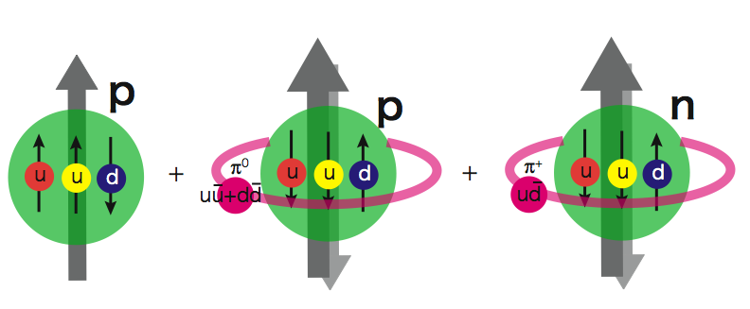
Flavor Asymmetry of Sea Quarks at Intermediate x
Proton vs “Neutron” targets:
This could lead to a very interesting physics …
|p> = a|p₀> + b|p₀ + pi⁰> + c|n+pi⁺> + …

Slide 23
Projected Drell-Yan A_{N}
SeaQuest: p+NH₃
Sea quarks
COMPASS
Sea quark
Sivers
Valence quarks

Slide 24
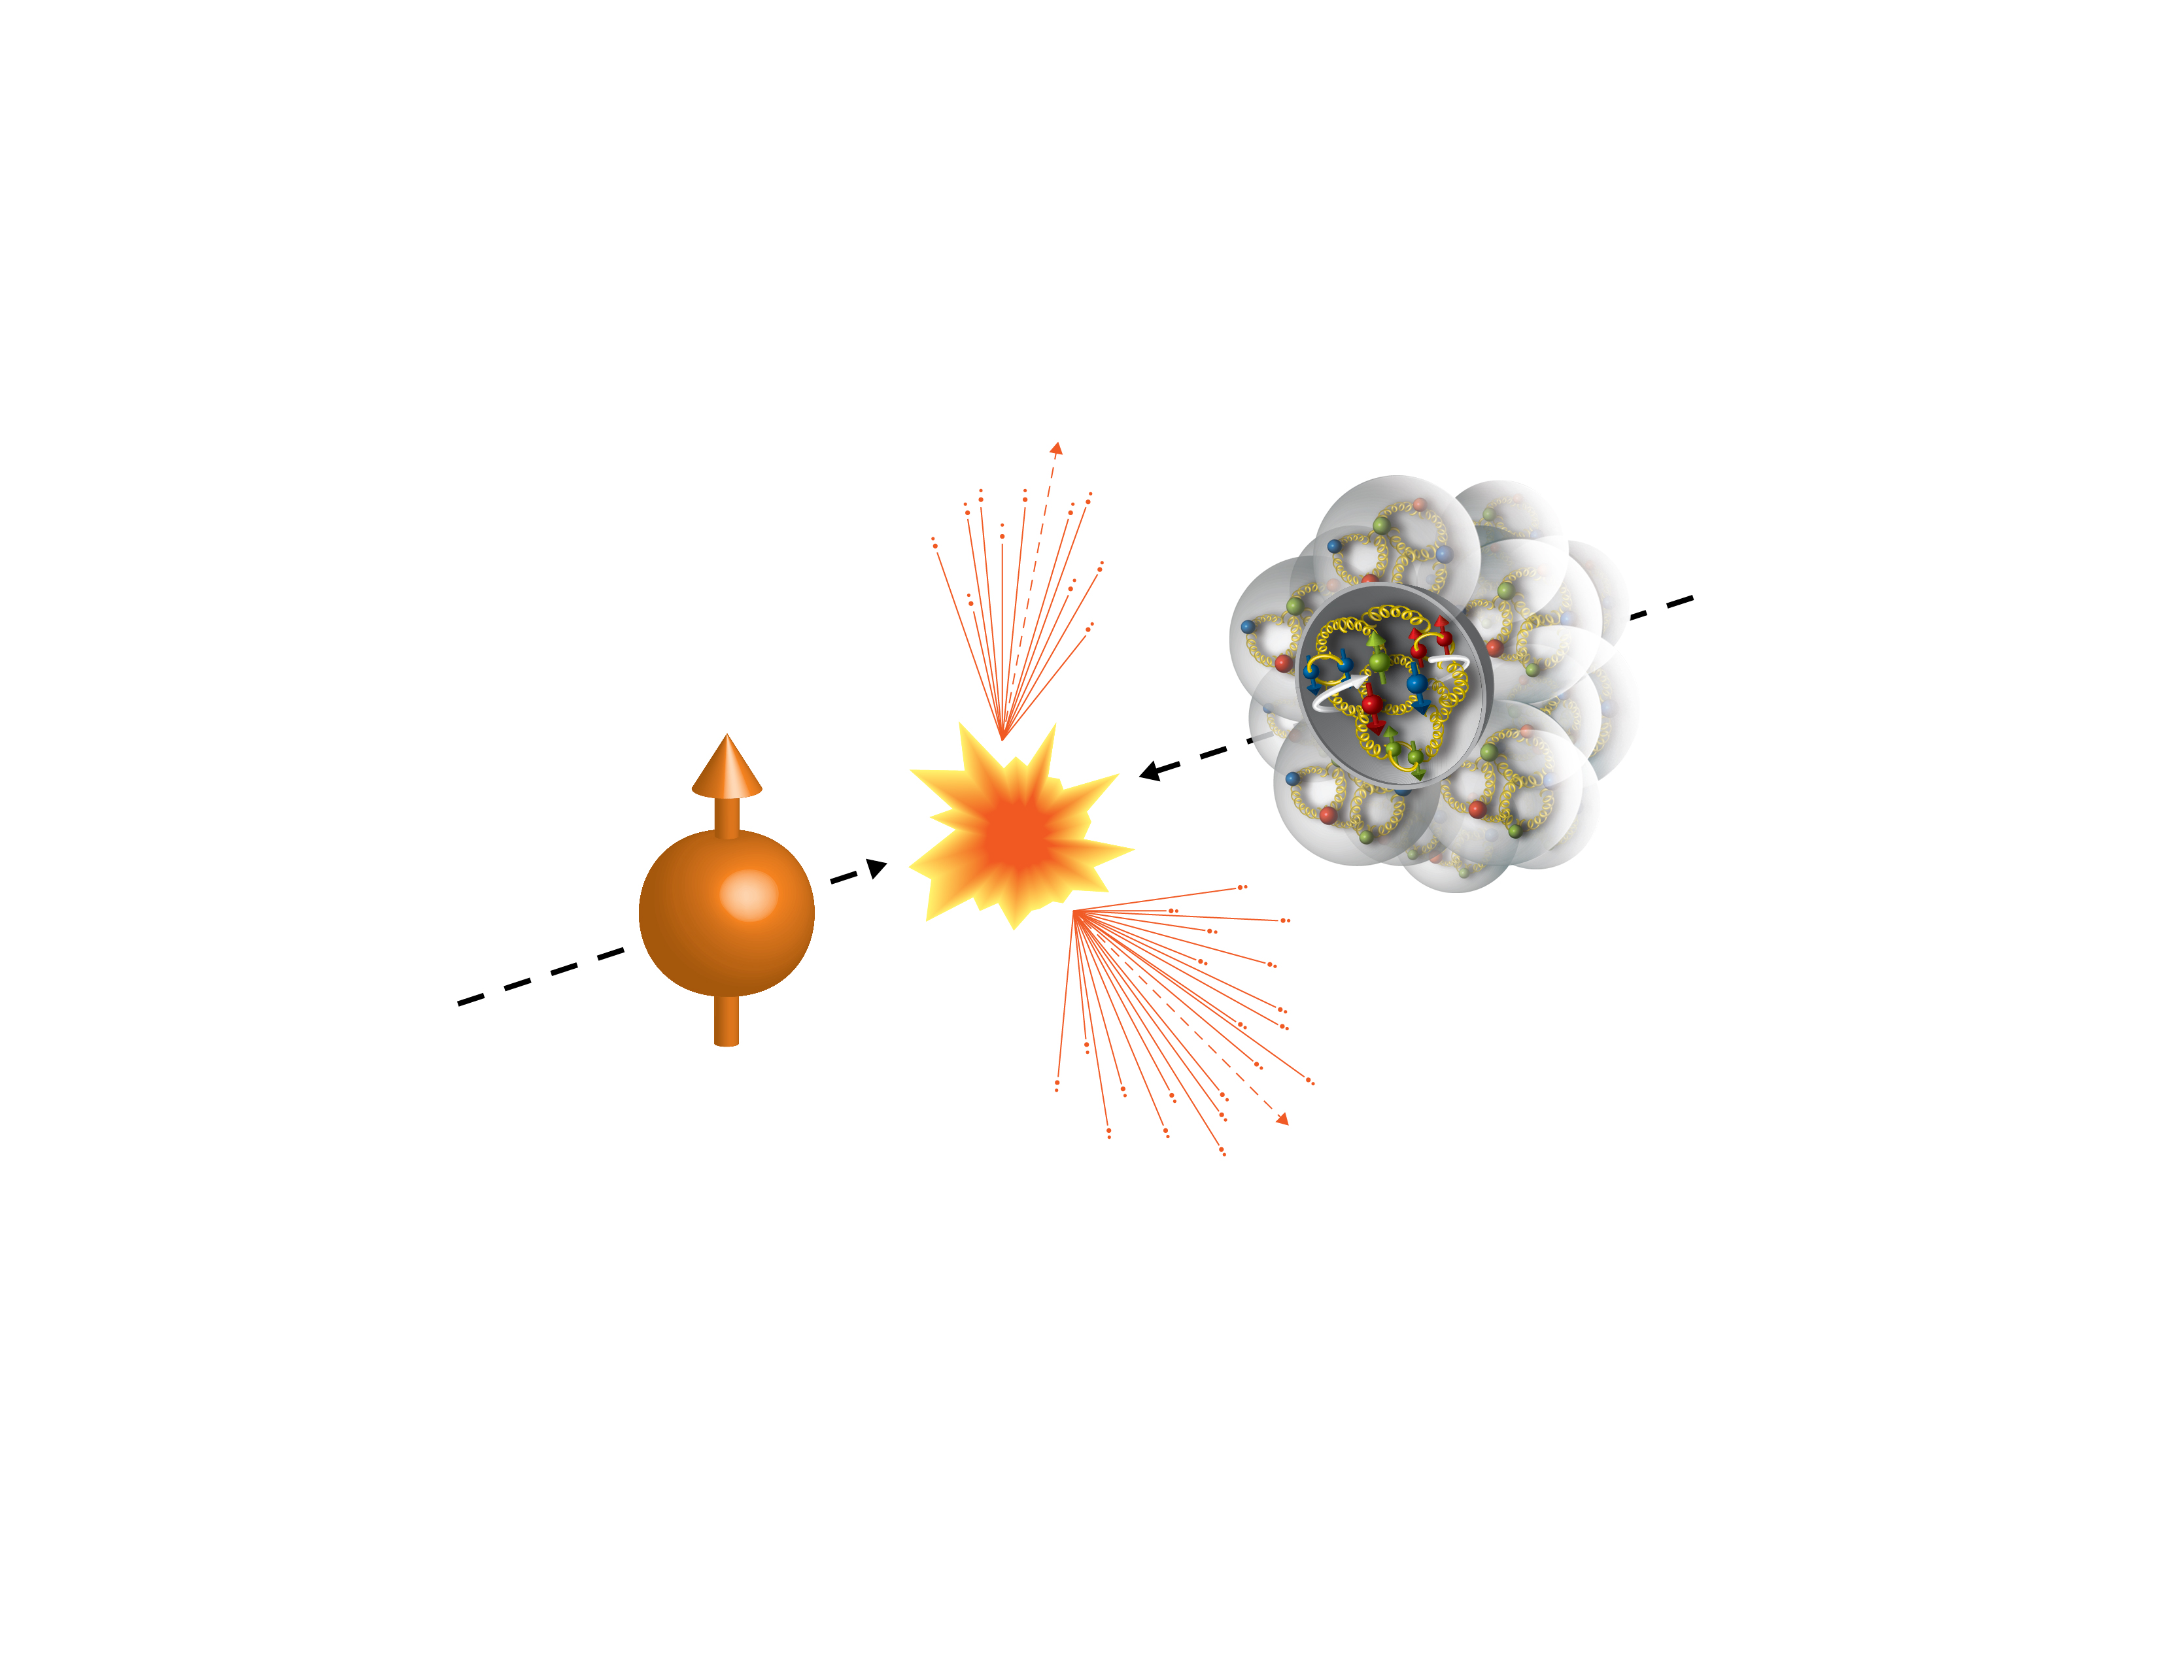
First Polarized p+A at RHIC
Run15 (2015)
100GeV/nucleon
Au, Al
100GeV
Polarized Proton
 | # of proton | # of neutron
p | 1 | 0
Al | 13 | 14
Au | 79 | 118

Slide 25
Run15 p+Au: a Surprise!
Unexpected pAu and pAl asymmetries observed compared to that of pp
[PRL 120 (2018) 022001]
A
BBC Veto
𝛾*
𝜋⁺
p
↑
n
A
BBC
BBC Tag
?
↑
n
p
BBC

Slide 26
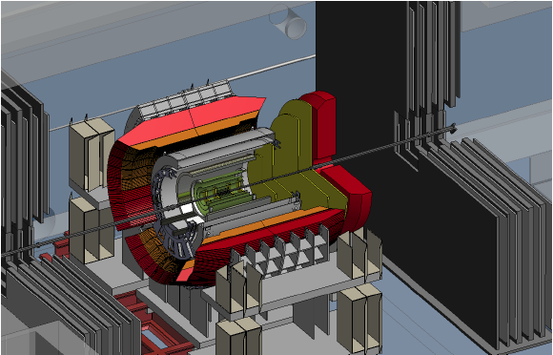
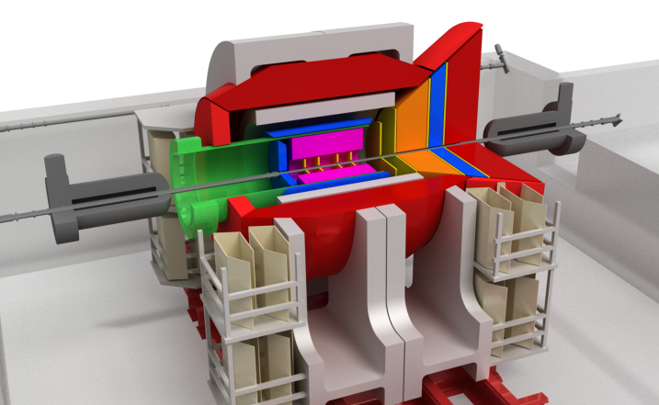
Future at RHIC: PHENIX -> sPHENIX -> EIC@RHIC
Current PHENIX
Forward sPHENIX
An EIC detector
PHENIX completed 2016
16y+ work
100+M$ investment
130+ published papers to date
Comprehensive central upgrade based on BaBar magnet
fsPHENIX: forward tracking, HCal and muon ID
Key study of transverse spin
New collaboration/new ideas
Path of sPHENIX upgrade leads to a capable EIC detector
Large coverage of tracking, calorimetry and PID
New collaboration/new ideas
~2000
2017→2020
~2025
Time
RHIC: A+A, polarized p+p, polarized p+A
eRHIC: e+p, e+A

Slide 27
Forward sPHENIX Projected Jet Sivers Asymmetries
Test the universality of QCD description of TSSA: pp vs SIDIS
Naïve direct mapping
from SIDIS Sivers (GPM)
- “u-quark jet” A_{N} >0
Sivers, SIDIS fit
With process-dep
from SIDIS Sivers (Twist-3)
- “u-quark jet” A_{N} < 0

Slide 28
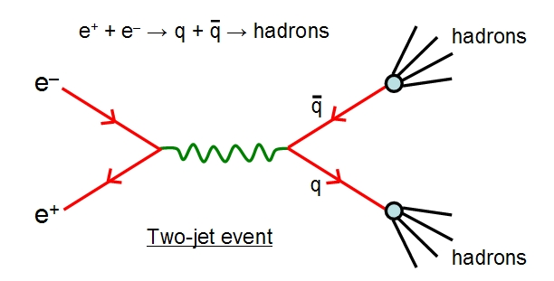
Summary
QCD has been very successful in consistently interpreting and predicting high energy phenomena in
  DIS vs p+p
  Unified partonic description of nucleon structures and interactions
Proton/Hadron collisions
  Versatile physics program
  Access a broad (x,Q²) range
Will continue playing a key role in exploring the fundamental nature of nucleon structure and strong interactions
  Need all three experimental tools to complete the program
    p+p, DIS, e⁺e⁻
Complementary test and validation of QCD description of hard processes

Slide 29
backup

Slide 30
RHIC pp500GeV: W^{+/-} A_{N}
Anselmino et al 2016
A_{N}(W⁺) ~
A_{N}(W⁻) ~
RHIC data:
A mix of valence and sea quark Sivers
Quark flavor identified
High Q²
Statistically limited, ~0(10%)
Possible large dbar Sivers contributions
E1039:
- low Q²
- Good statistics, ~O(1%)

Slide 31

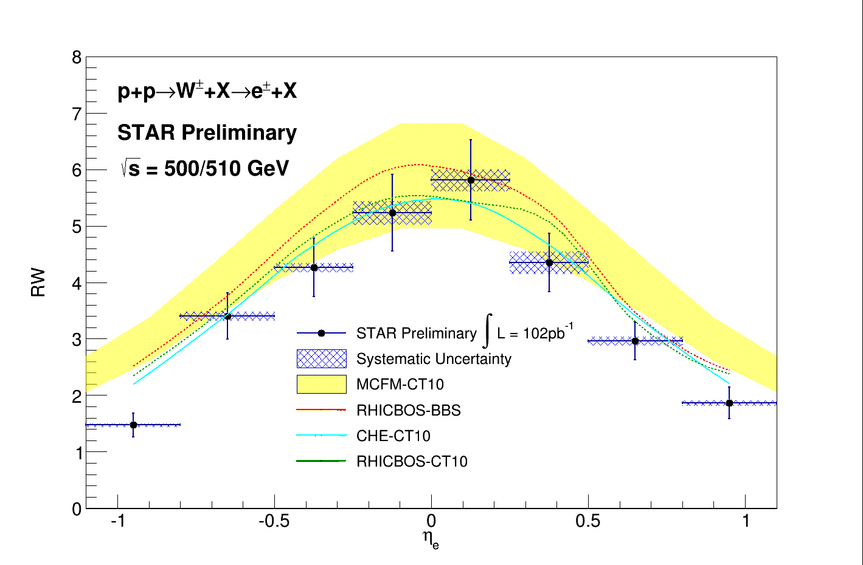

Unpolarized Sea Quark Distributions
Sea quark flavor asymmetry and
pion cloud model
SeaQuest/E906 @Fermilab
0.1 < x < 0.3

Slide 32
Drell-Yan Sivers Asymmetries w/ QCD Evolution
Kang et al, 1401.5078
COMPASS
Valence quark
Sivers
SeaQuest: p+NH₃
COMPASS
Sea quark
Sivers

Slide 33
Latest W^{+/-} A_{L} from STAR and PHENIX
arXiv:1702.05077
arXiv:1804.04181

Slide 34
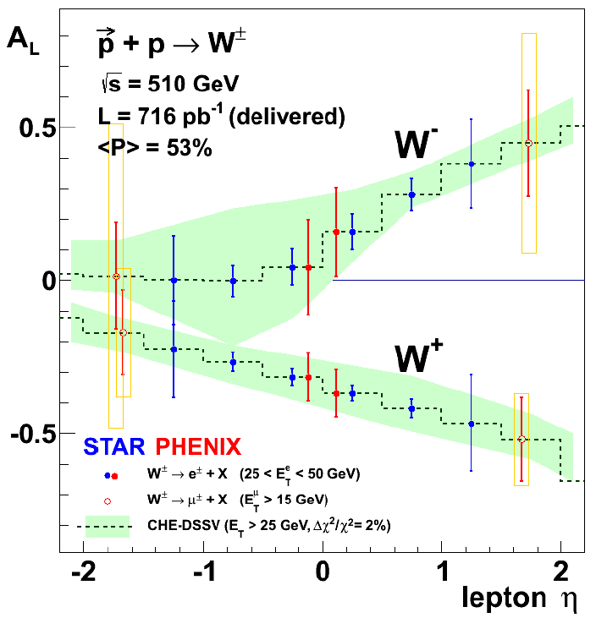
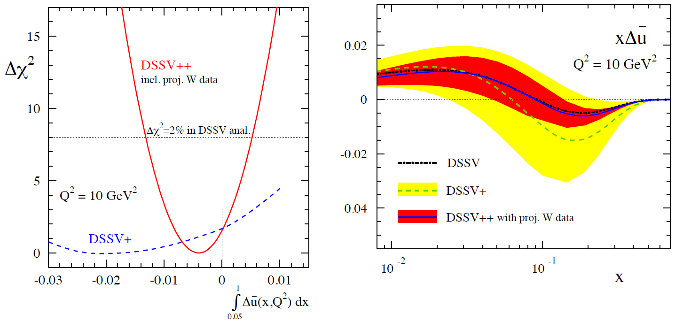
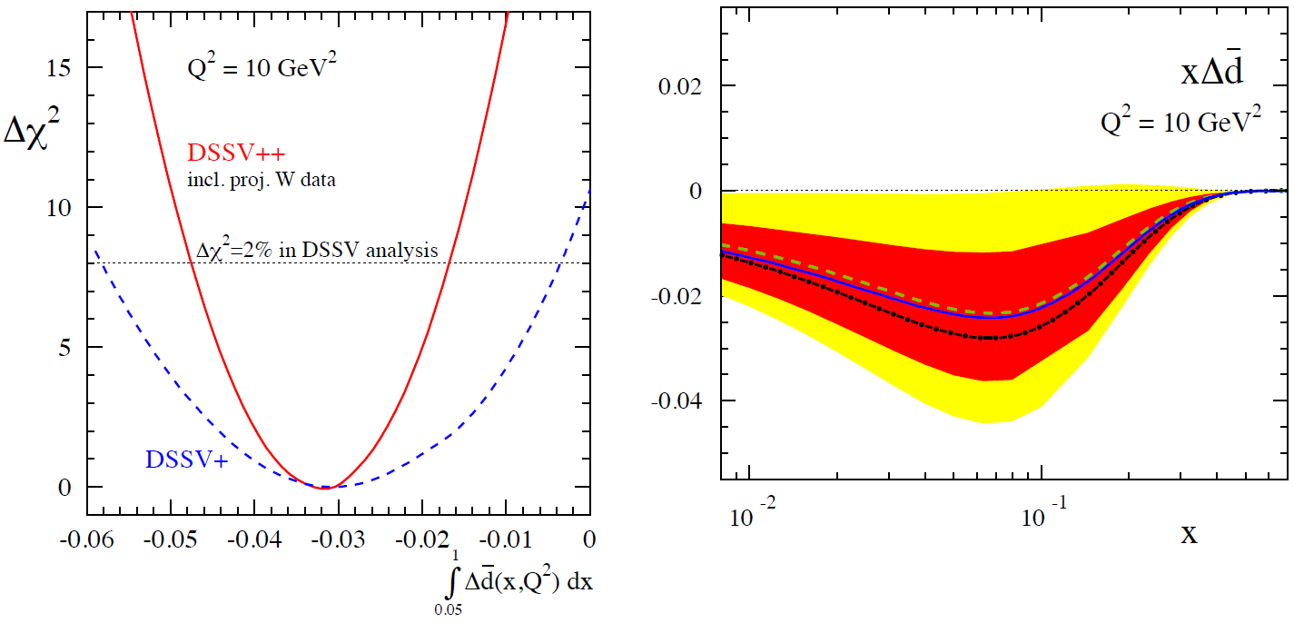
Projected RHIC 𝑊± → 𝑙± data Impact on Sea Quark Polarization Determination
Expect significant improvement of flavor identified sea quark distributions
The RHIC Spin Program, arXiv: 1501.01220

Slide 35
sPHENIX at RHIC
Large acceptance, high rate next generation experiment at RHIC
  QGP and Cold QCD physics with,
    Jets
    Heavy quarkonia
    Open heavy flavor
  Study p+p, p+A and Au+Au collisions at top energy 200GeV
    Central barrel: |eta|<1, 2pi coverage
      EMCal & HCal
      MVTX/INTT/TPC
    Forward upgrade being developed
    DAQ rate: 15kHz
Project Status
  Granted DOE CD-0, 10/2016
  CD-1 reviewed, 8/2018
  Construction: 2018-2022
  Day-1 physics, ~1/2023

Slide 36
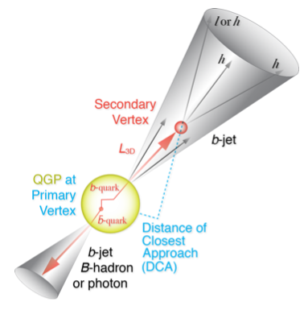
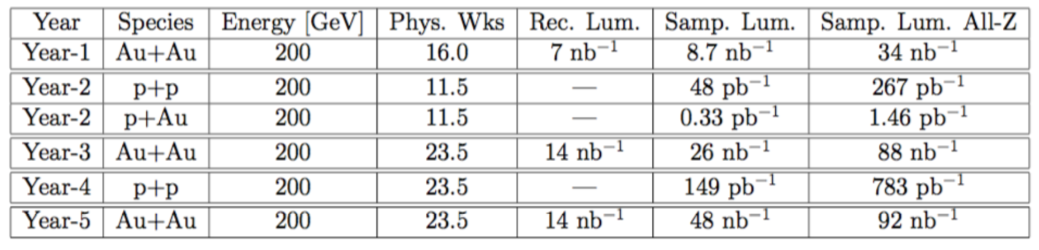
RHIC Multi-Year Plan: sPHENIX 2023-2027+
(Cold QCD plan under development now)
Jets, hadrons and heavy flavor and more
RHIC 2015 pp200
Recorded lumi ~50pb⁻¹

Slide 37
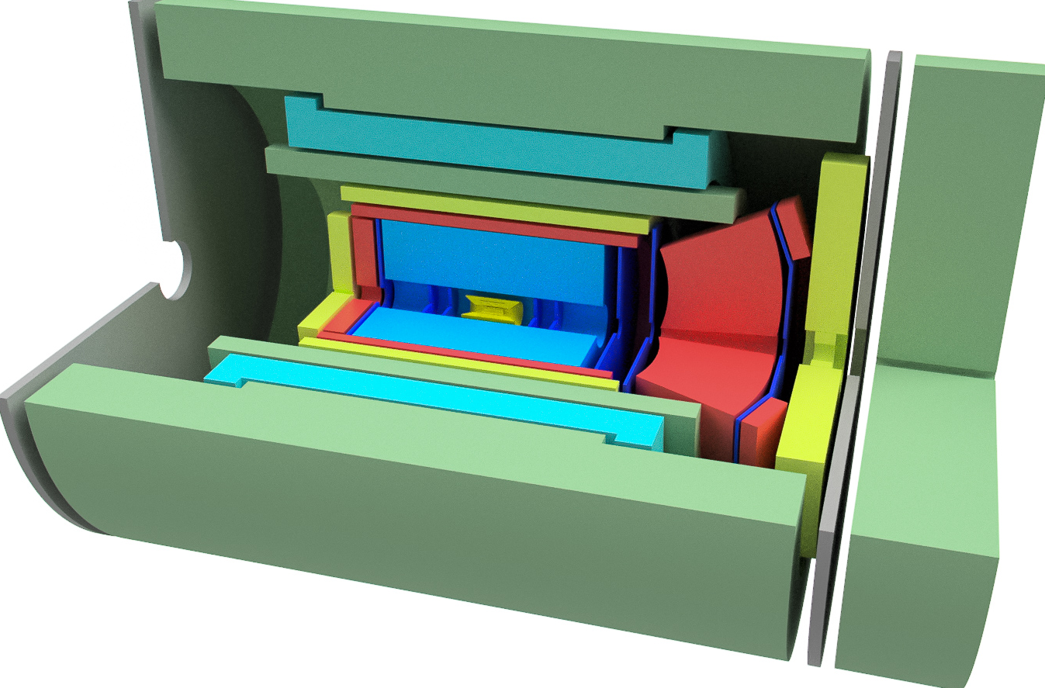
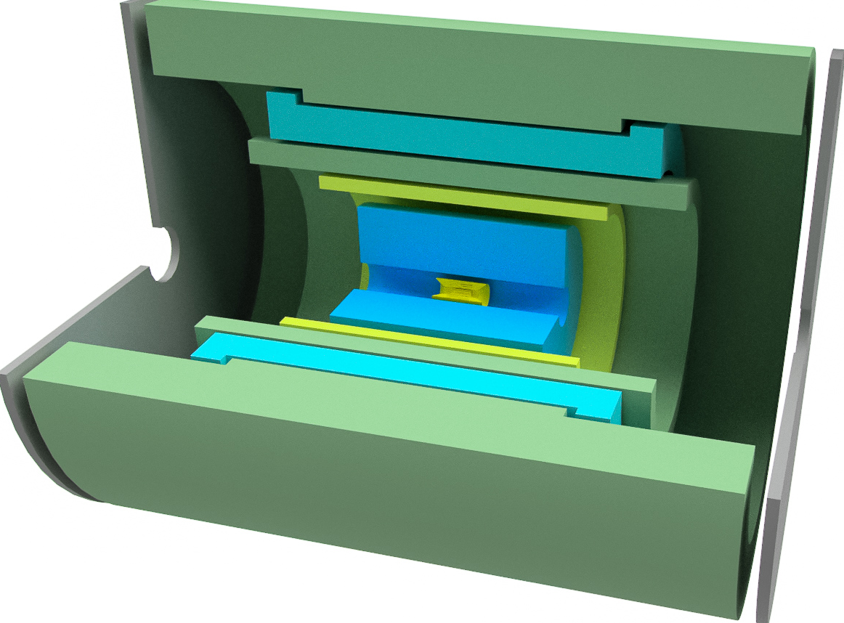
Detector components, sPHENIX and EIC detector
sPHENIX
  HCal/Flux return
  Solenoid
  Central EMCal
  Silicon strip tracking
  TPC
  MVTX
EIC detector
  HCal/Flux return
  Solenoid
  Extended Central EMCal
  Central hadron PID
  TPC
  MAPS
  Forward and backward tracking
  Forward and backward hadron PID
  Backward crystal EMCal
  Forward EMCal
  Forward HCal

Slide 38
Proposed STAR Forward Upgrade
Access small-x Gluons
To install a Forward Calorimeter System (FCS)
in early 2020s:
EMCal
Hcal
Tracking, charge separation
Di-jet in the forward region (2.8<eta<3.7)
Access gluon polarization at low x:
X ~ 5x10^-3 (central + forward)
X~ <1x 10^-3 (forward - forward)

Slide 39


Toward a Unified Picture of Nucleon Structure
Momentum and Spatial Tomography
Some data, recent progress
Good data, long history
F(r,Q²)

Slide 40
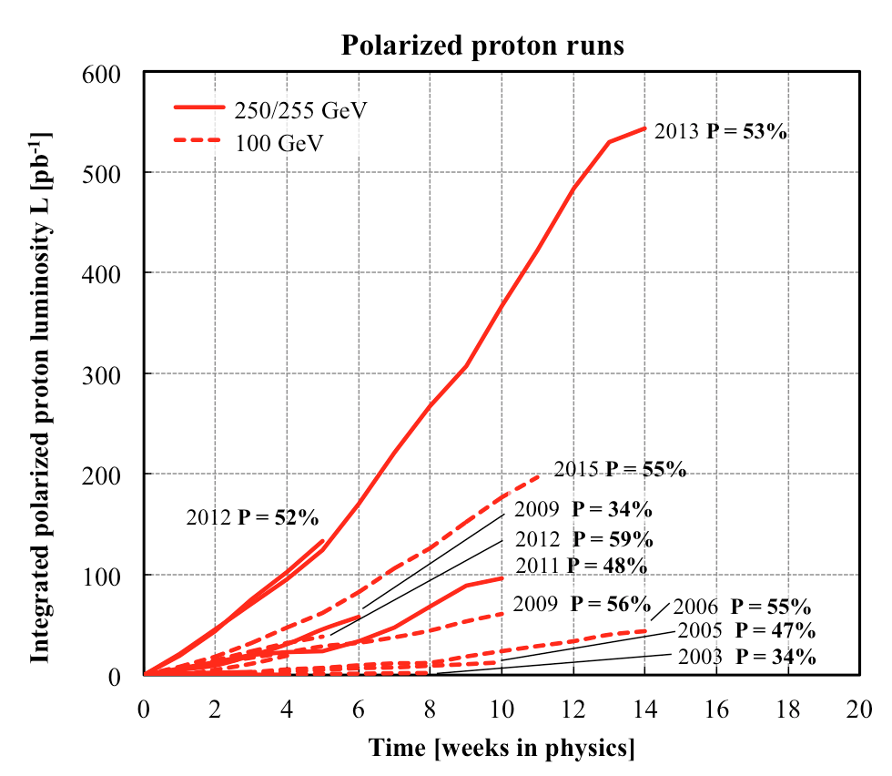
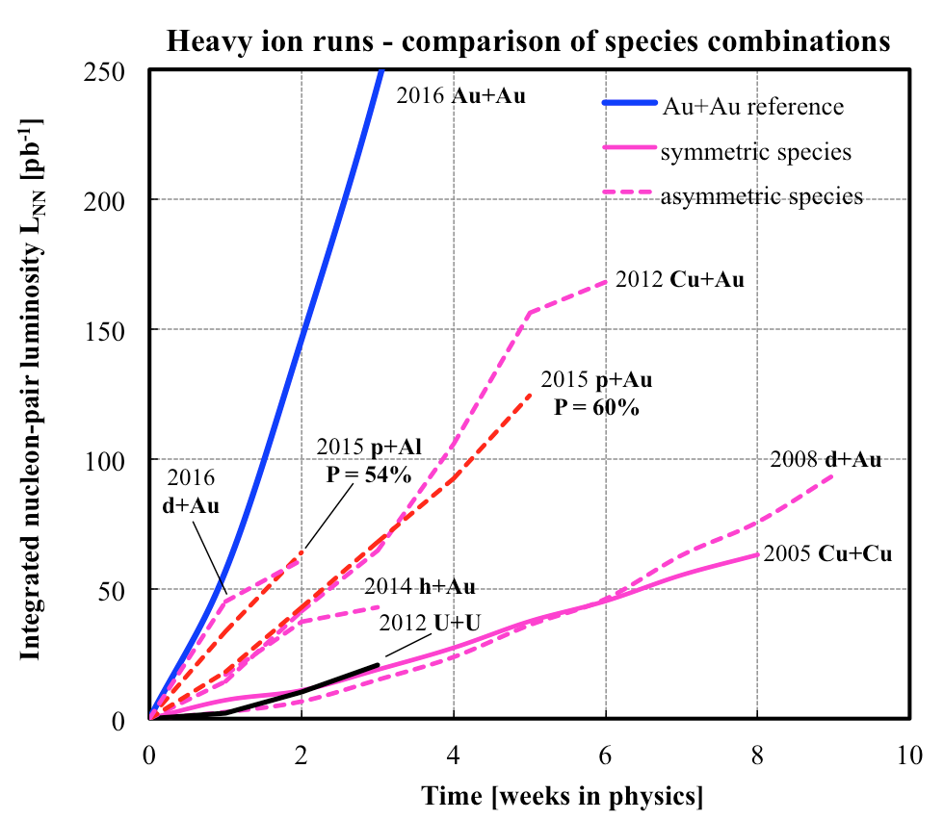
History of RHIC Spin Runs
RHIC is capable of delivering the polarized p+p/A for precision spin physics
A very challenging task to deliver polarized p+p, excellent performance from 2012+
Outstanding Heavy Ion machine performance from the beginning
Polarized p+p, p+Au and p+Al
10/13/14
Notes:
Our physics analysis efforts are closely tied to the RHIC beams operations
Took “BNL” 10 years to reach the mechine performanvec goals ..
40

Slide 41
Work Wide Collins – (x, Q²)

Slide 42
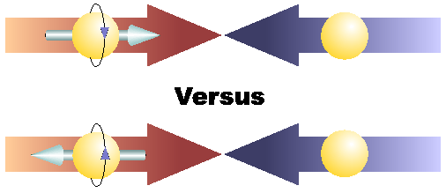
Physics with Longitudinally
Polarized p+p Collisions

Slide 43
Latest Pol NNPDFPol Global Fit
arXiv:1702.05077
-SI/DIS data
-RHIC data

Slide 44
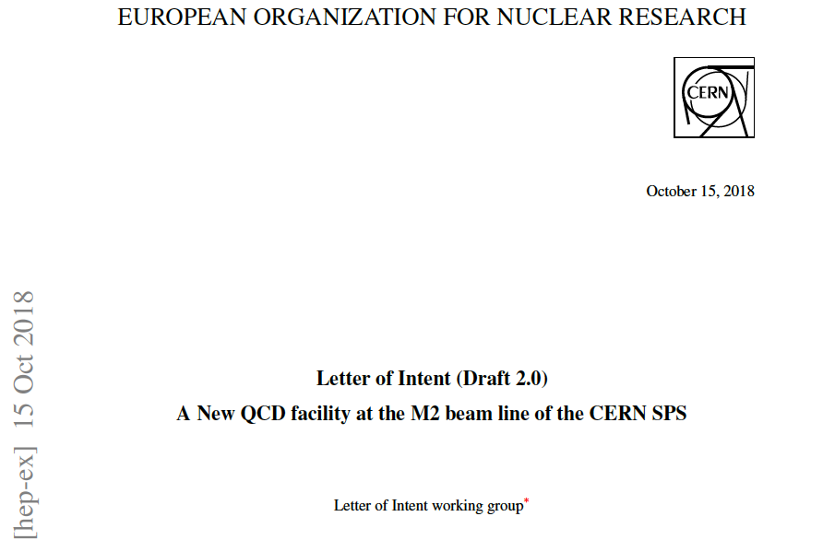
A New QCD Facility at M2 beam line of the SPS CERN (to be submitted in January 2019)
A New QCD Facility at M2 beam line LoI is under preparation now. The goal is to bring together new Collaboration enthusiastic about opportunities of doing physics at CERN with conventional and newly designed RF separated kaon and antiproton beams. The total duration of the program reaches 10 years of running with hadron and muon beams.
http://arxiv.org/abs/1808.00848

Slide 45
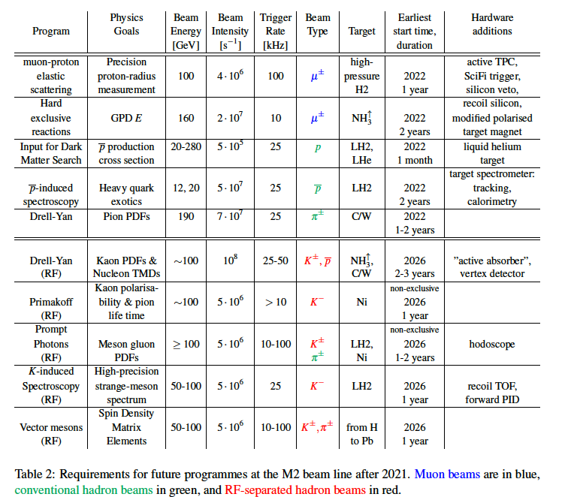
A NQF@M2 beam line of the SPS CERN

Slide 46
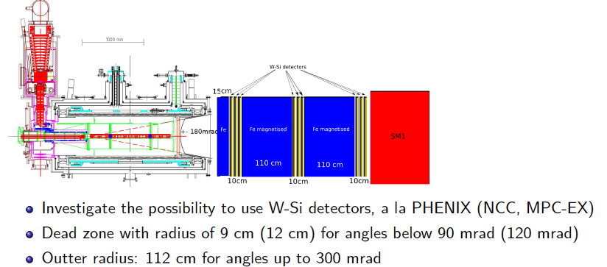
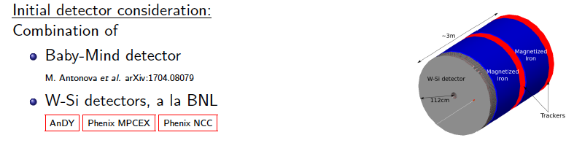
QCD facility – future fixed target experiment at M2
Spectrometer upgrades for Drell-Yan measurements with RF-separated beam

Slide 47
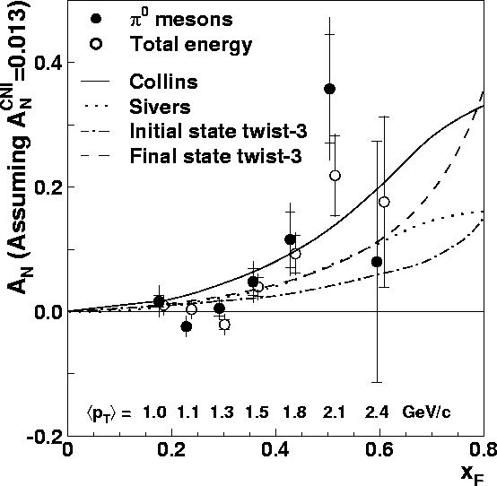
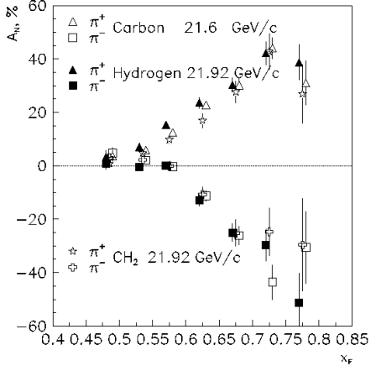
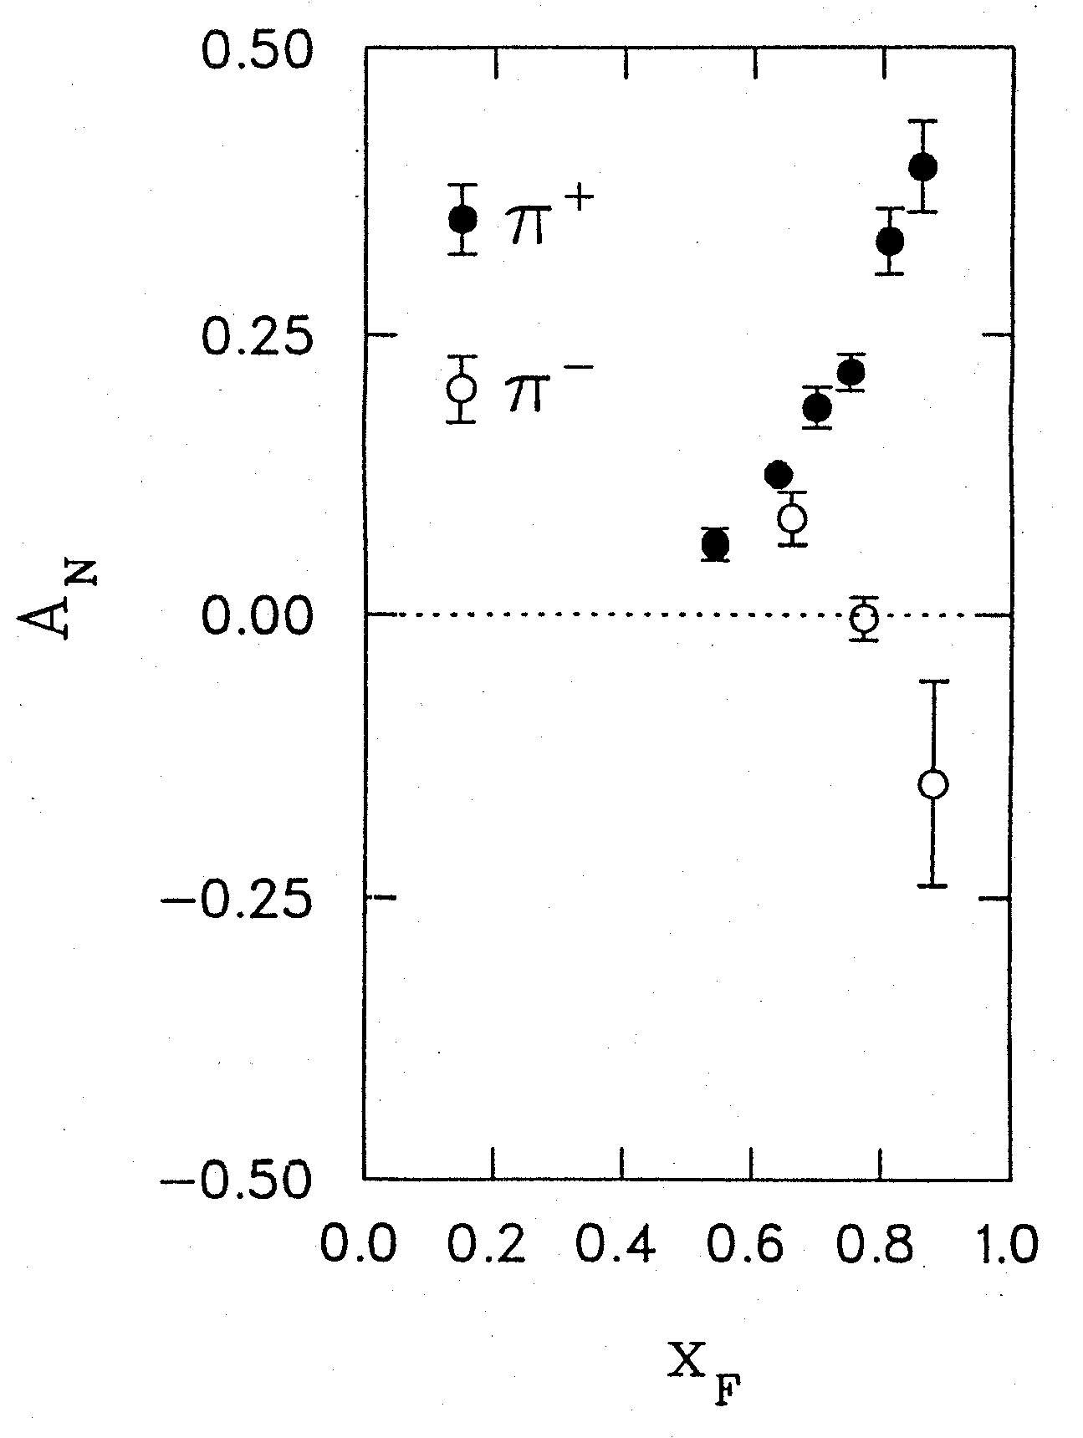
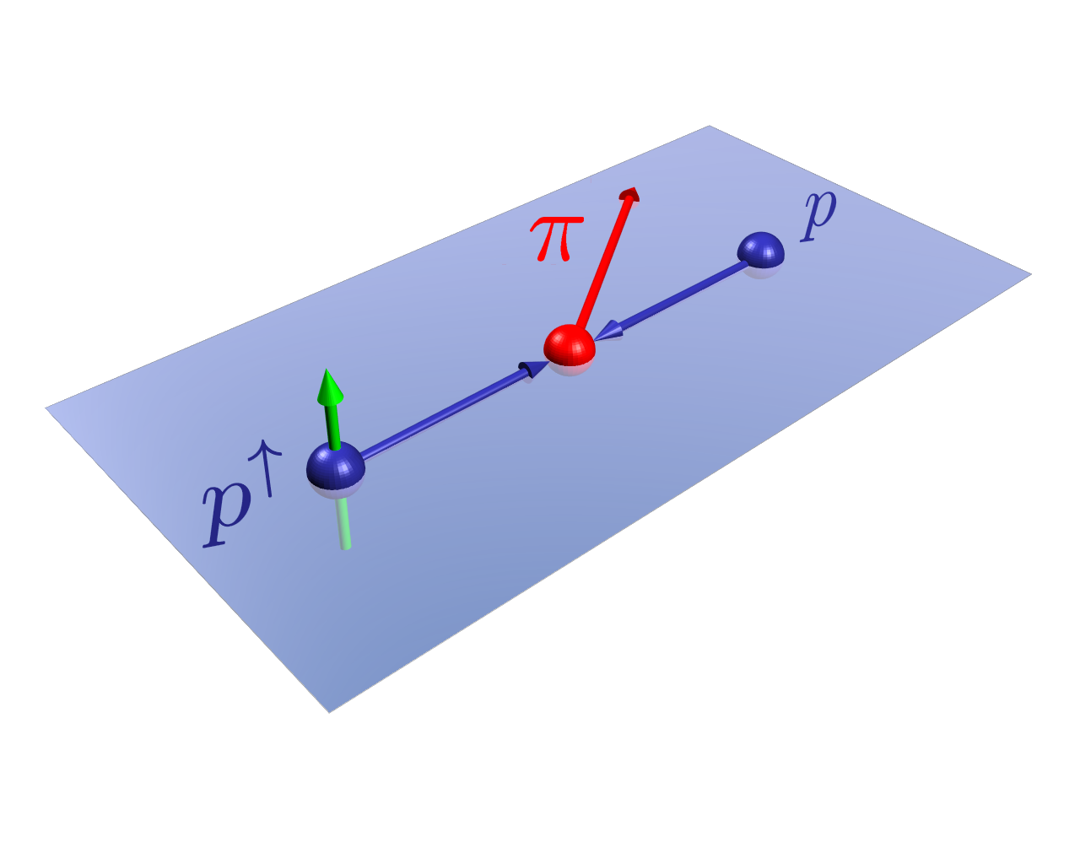
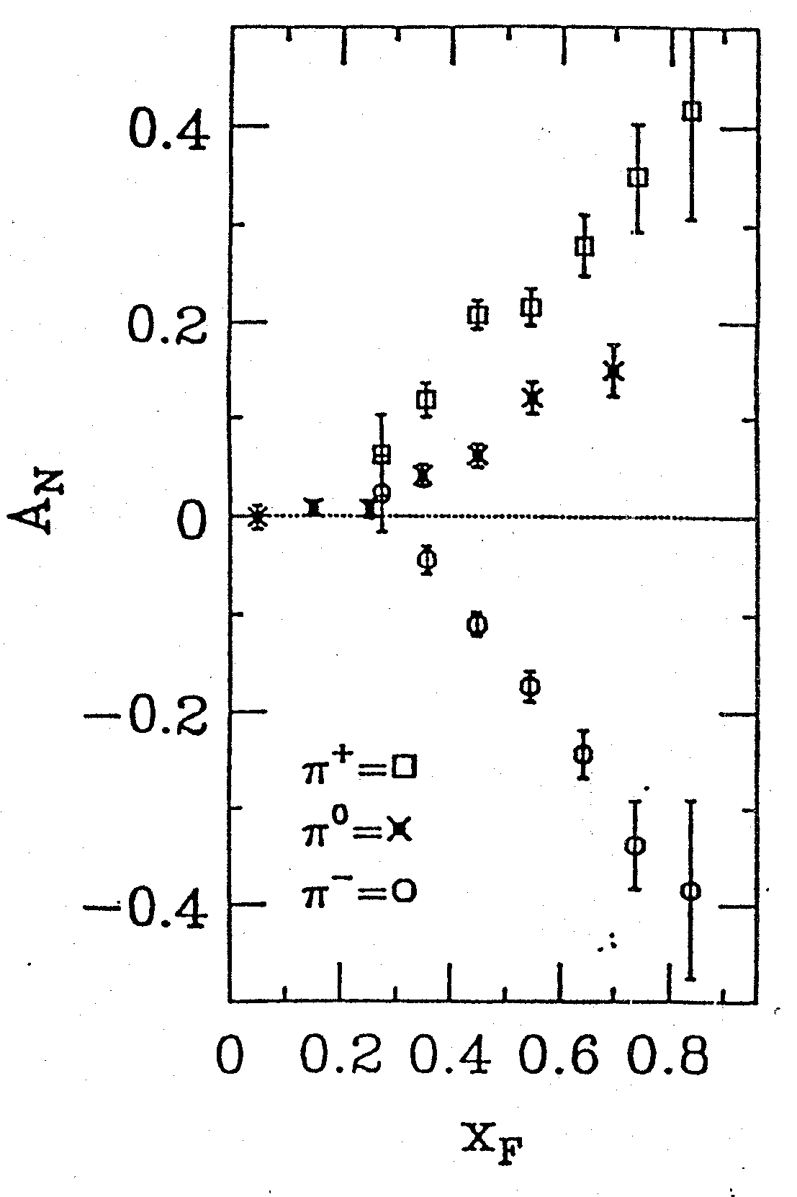
Do We Understand the Physics?
RHIC 200 GeV CMS
Large Transverse Single Spin Asymmetry (TSSA) in forward hadron production persists up to RHIC energy.
FNAL 200 GeV beam
AGS 22 GeV beam
ZGS 12 GeV beam
PRL (2004)
PLB261, 201 (1991)
PLB264, 462 (1991)
PRD65, 092008 (2002)
PRL36, 929 (1976)
Sivers, Collins, Twist-3 ….
Non-Perturbative cross section
Perturbative cross section

Slide 48
Hadron TSSA in Twist-3 Framework
Qiu & Sterman PRD 59 (1998)
1st term: twsit-3 correlation functions, “Sivers”
2nd term: twist-2 transversity * twist-3 from unpol beam (expected small)
3rd term: twist-2 transversity * twist-3 FF, “Collins”
Need new direct measurements of Sivers and Collins TSSA in p+p!
Forward sPHENIX Upgrade Proposal
48

