Slide 1
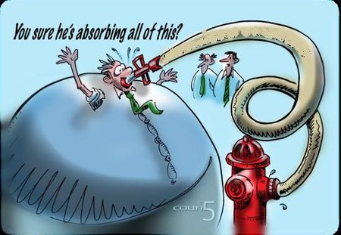
QM2012 Highlights
RHIC
  d+A
  Cu+Au
LHC
  Jets
  Heavy flavor
Future @RHIC
  Polarized p+A in forward

Slide 2
d+A

Slide 3
Initial state by hadronic probes
Jets are reconstructed in d+Au up to 40 GeV/c

Slide 4
CNM and nPDF

Slide 5
ψ’ is strongly suppressed in dAu
Hard to explain by models!
  See talks by Wyoscki (Mon) and McGlinchey(Tue)
Factor of ~5!

Slide 6
Cu+Au

Slide 7
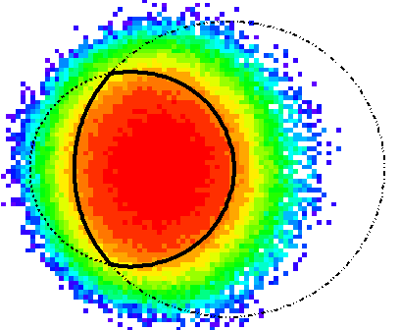

Asymmetric Cu+Au collisions
Asymmetric coordinate space leads to asymmetric density profile and pressure gradient
Defining Au-spectator going side as Ψ₁
Coordinate space asymmetry
Momentum space?
Cu
Au
Cu
x
p_{x}
Ψ_{1,SMD}

Slide 8
v₁ and v₂ in totally new trend
Sizable negative v₁ is in opposite sign, and magnitude of v₂ is larger, compared to AMPT model

Slide 9
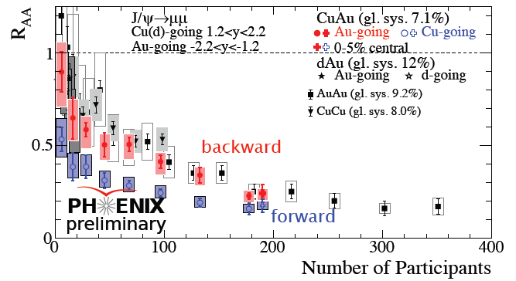
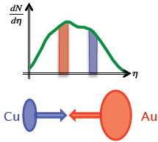
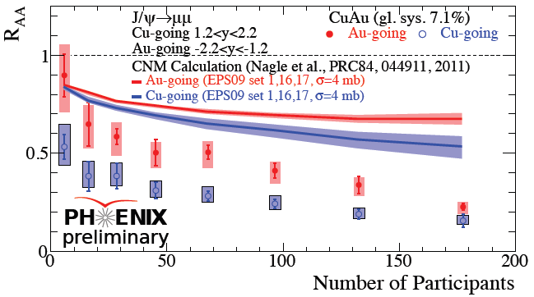
J/ψ results in 200 GeV Cu+Au
PHENIX: Hollis, Rosati, Sakaguchi
In Cu+Au collisions,
R_{AA}(Au-going) > R_{AA}(Cu-going),
qualitatively described by CNM
but not quantitatively.
Additional suppression
suggests hot, dense medium
effect
Notes:
9

Slide 10
QGP or Geometry Scaling
V2 (3) vs pT

Slide 11
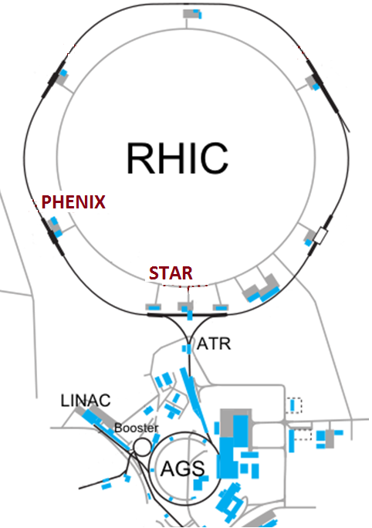
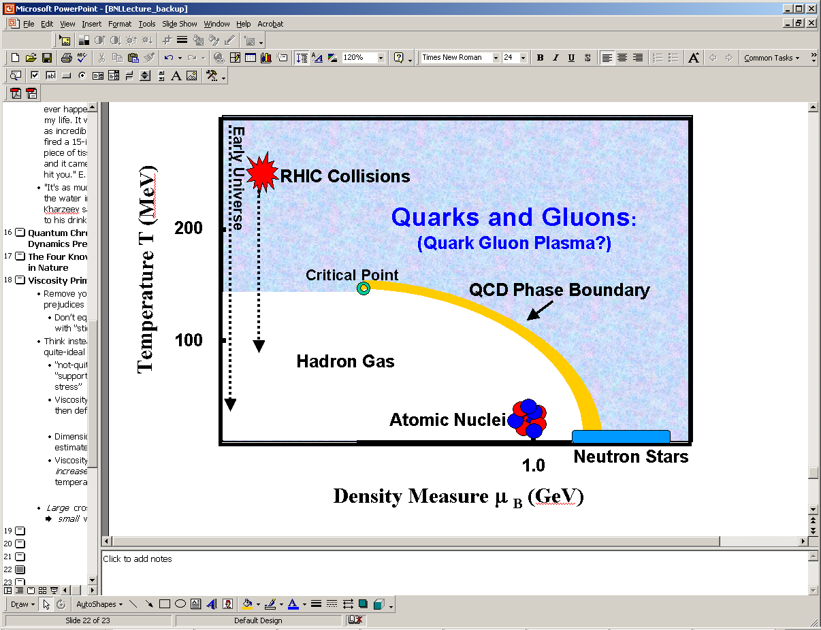

The Physics Motivation
Use the flexibility of RHIC to carry out detailed energy and species scans with the point of determining:
The evolution from partonic to hadronic matter through the QCD crossover region - QGP transition
Location, if any, of a critical point on the QCD phase diagram
Baryon Chemical Potential μ_{B} (GeV)

Slide 12
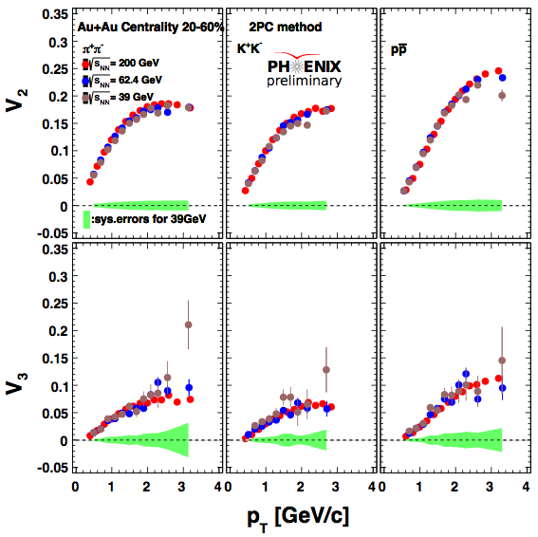
Flow v2, v3

Slide 13
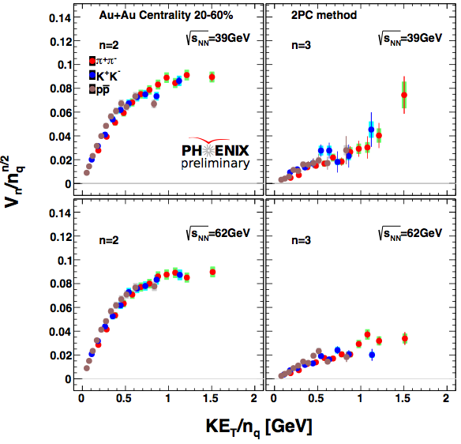
NCQ scaling of v2, v3

Slide 14
Jet and Heavy Quark in AA

Slide 15
The measurements presented at QM2012
Experiment | Heavy flavor | Quarkonia | Electroweak
PHENIX | μ: 1.2<|y|<2.2 e: |y|<0.35 | J/ψ, ϒ→μμ J/ψ, ϒ→ee | γ, di-electron
STAR | e, D: |y|<1 | J/ψ, ϒ→ee | di-electron
ALICE | μ: 2.5<|y|<4 e,D: |y|<0.9 B→J/ψX→eeX | J/ψ→ μμ J/ψ→ ee | γ
ATLAS | μ: |y|<1.05, p_{T}>4 GeV/c |  | γ: |y|<1.3, E_{T} (45-200 GeV) W→μν: |η^{μ}|<2.7,p_{T}(μ)>7 GeV/c Z→µµ (ee): |y|<2.7 (|y|<2.5)
CMS | B→J/ψX→μμX | J/ψ→μμ: |y|<2.4, p_{T}>6.5 GeV/c ϒ→μμ |y|<2.4 | γ: |y|<1.44, E_{T} (20-80 GeV) W→μν: |η^{μ}|<2.1,p_{T}(μ)>25 GeV/c Z→μμ: |y|<2.1
Notes:
15

Slide 16
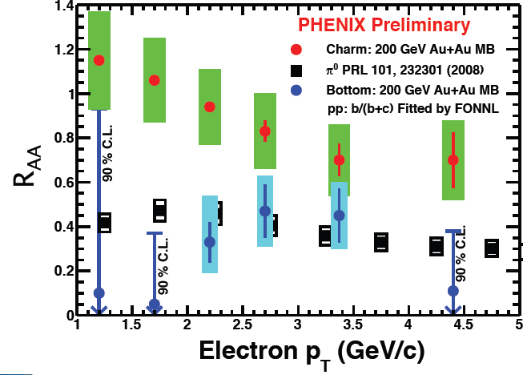
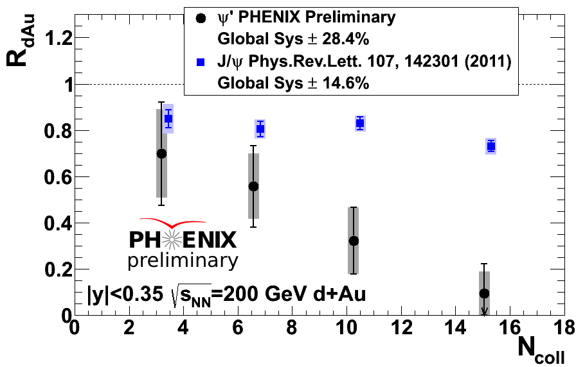
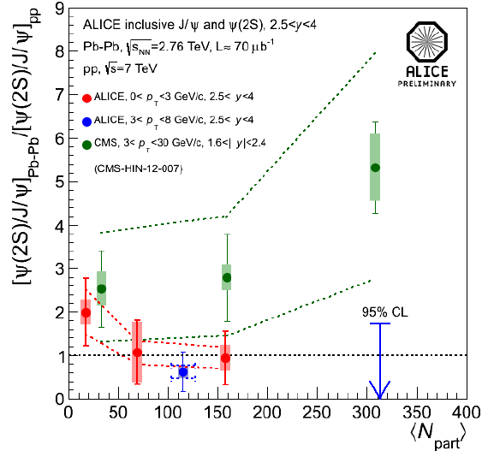
Surprising results at QM2012
PHENIX: McGlinchey, Nouicer, Rosati, Sakaguchi, Wysocki
PHENIX: R_{AA}(b→e) < R_{AA} (c→e)
at p_{T}=1-5 GeV/c in 200 GeV Au+Au
PHENIX: R_{dAu}(ψ’) < R_{dAu}(J/ψ) by a factor of 5 in most central d+Au
CMS: At 1.6<|y|<2.4, 3<p_{T}<30 GeV, ψ(2S) less suppressed than J/ψ in central Pb+Pb, not confirmed by ALICE with 2.5<|y|<4, 3<p_{T}<8 GeV.
CMS: Mironov, Moon, Roland; ALICE: Arnaldi, Safarik, Scomparin
Notes:
16

Slide 17
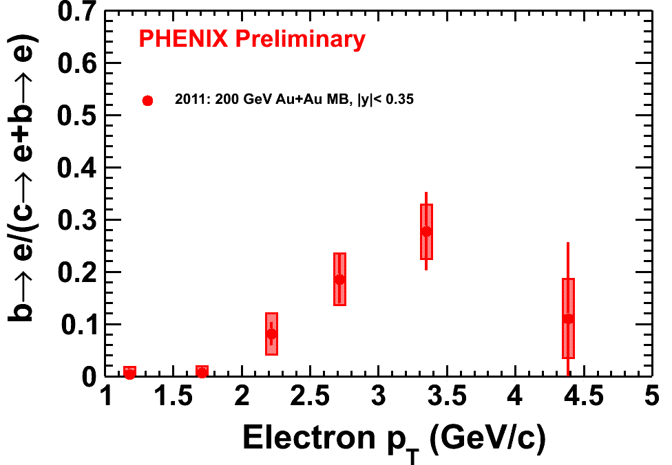
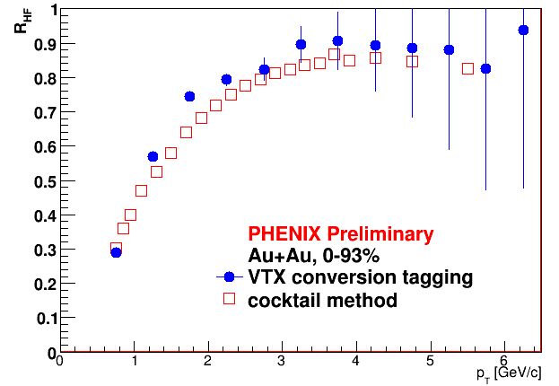
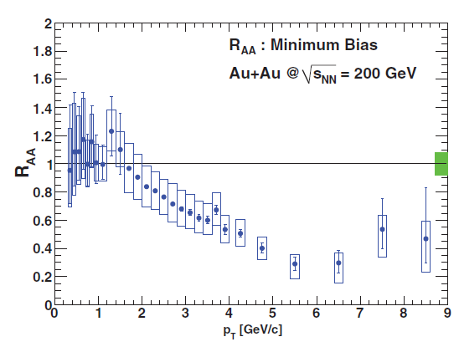
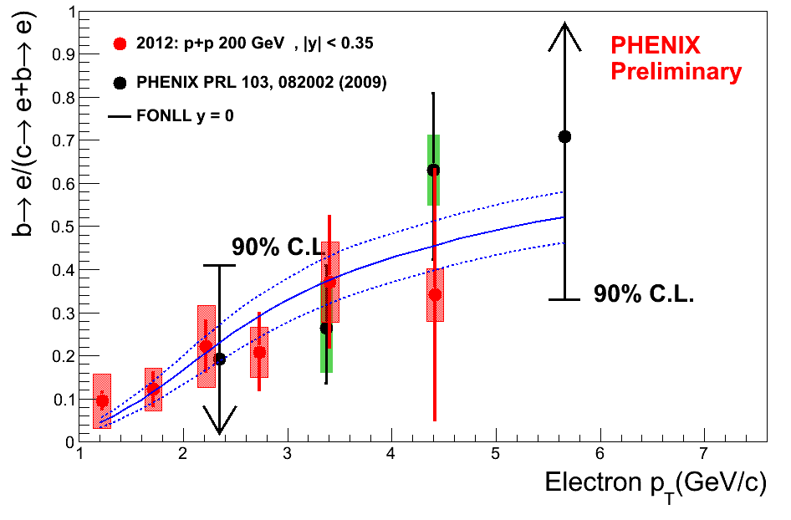
R_{AA} of Bottom Extraction
90% heavy flavor e
Photonic BG is small
after conversion VETO
x
R_{AA} (b→e) =

Slide 18
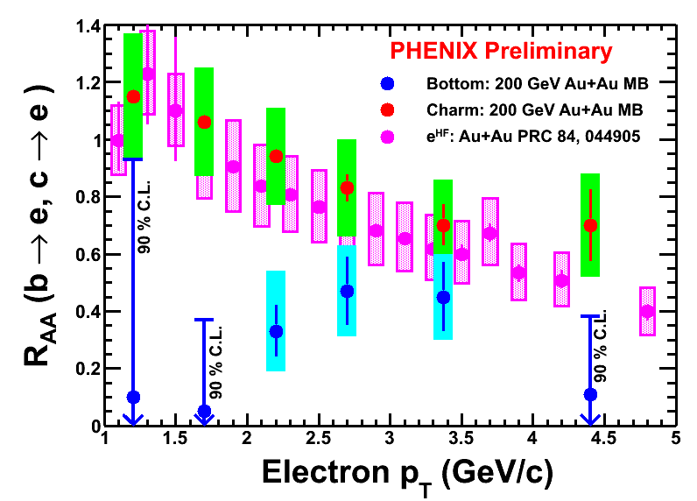
Surprises from PEHNIX ..of Bottom and Charm Separately
R_{AA} of Bottom, Charm and published e^{HF} in Au+Au MB
Au+Au centrality: Min-Bias

Slide 19
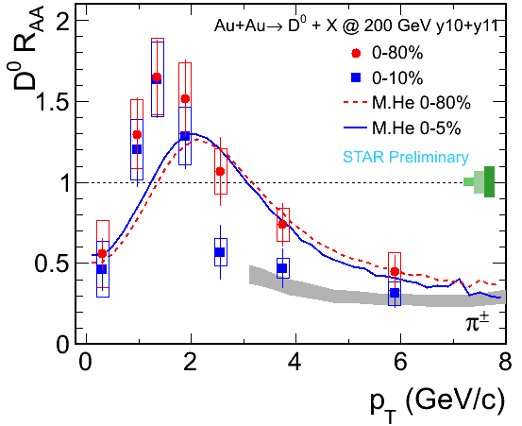
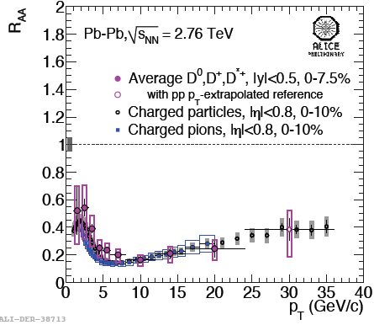
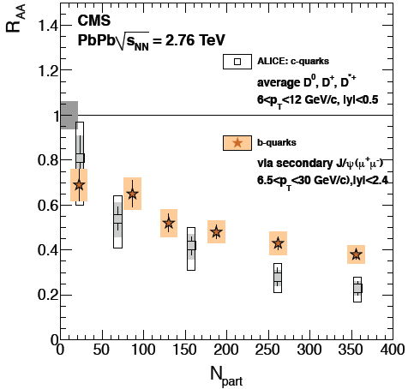
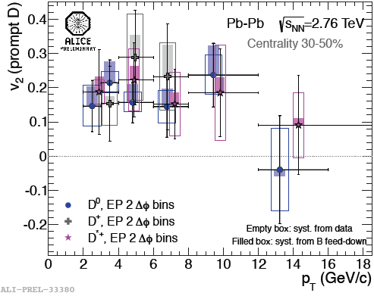
Open heavy flavor results in A+A
Significant charmed hadron, B hadron suppression observed. R_{AA}(D)~R_{AA}(π) ≤R_{AA}(B→J/ψ)
D meson flows (High precision measurements of electron, muon R_{AA} and v₂ also reported by ALICE, ATLAS, and STAR)
Need more precise measurements to study color charge and/or flavor dependence of energy loss
STAR: Dong, Tlusty, Xie
ALICE: Caffarri, Grelli, Safarik, Valle; CMS: Mironov, Jo
Notes:
19

Slide 20
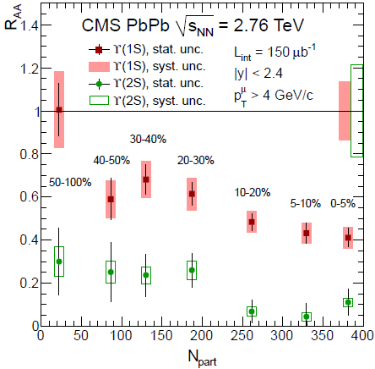
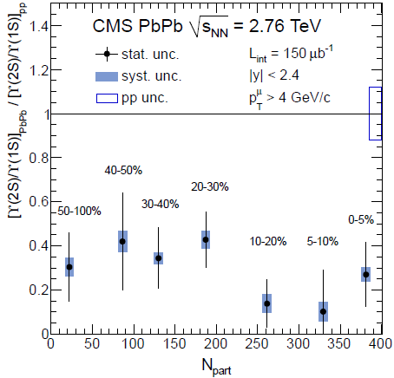
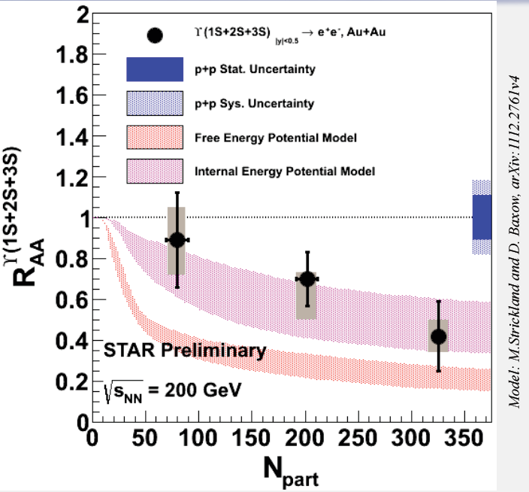
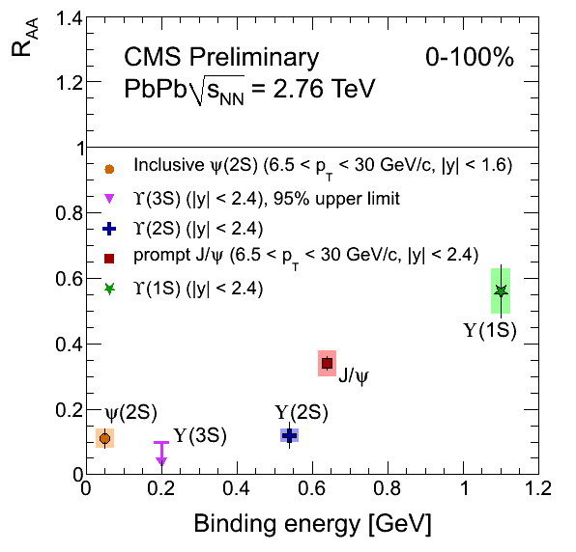
ϒ results in A+A
STAR: Dong, Trzeciak, Xie
CMS: arXiv: 1208.2826, Mironov, Rangel, Roland
ϒ(1s) suppression magnitude consistent with excited states suppression.
ϒ(2S) strongly suppressed, ϒ(3S) completely melted.
Now is the perfect time to study color screening features of hot, dense
medium in light of RHIC and LHC precise quarkonium measurements.
Notes:
20

Slide 21
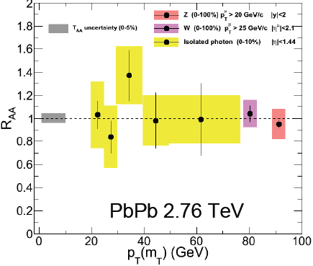
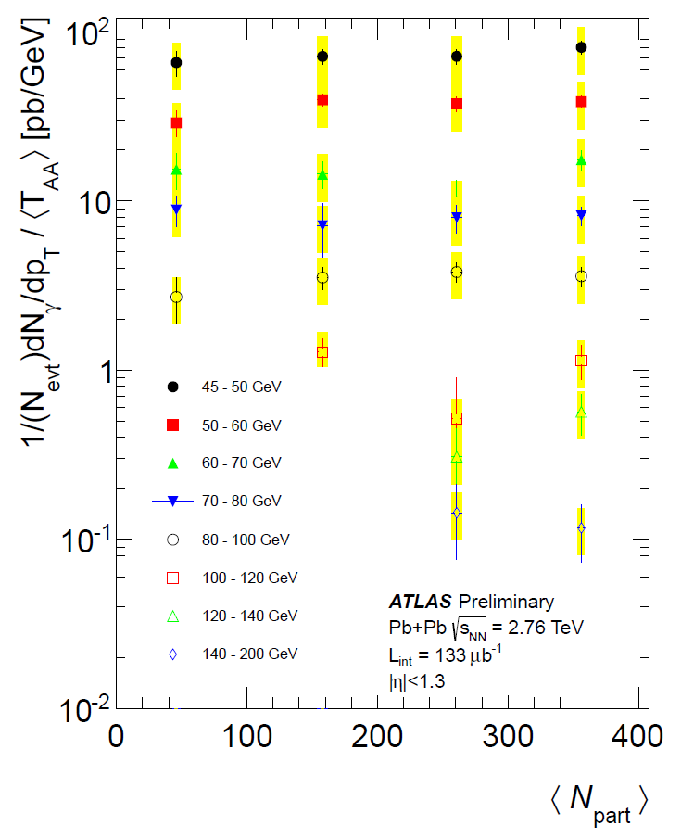
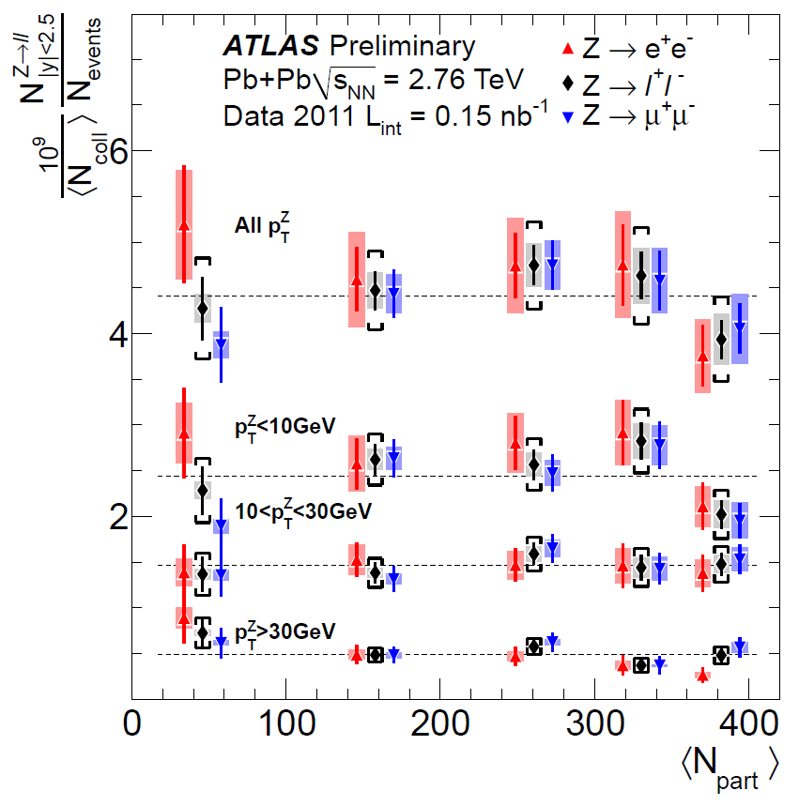
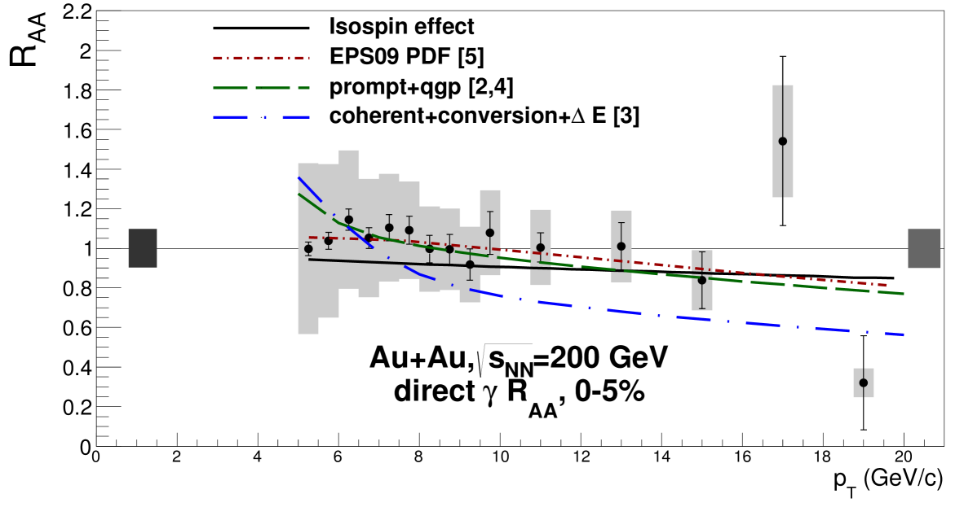
Electro-weak probes
CMS: Benhabib, Cassagnac, Roland, Stephans
ATLAS: Dolejsi, Grabowska-Bold, Steinberg, Wosiek
W, Z and high energy γ production in
heavy ion collisions:
consistent with number of binary
scaling.
Initial nuclear wave function effect is not
significant wrt. uncertainties
PHENIX: arXiv:1205.5759, Tserruya

Slide 22
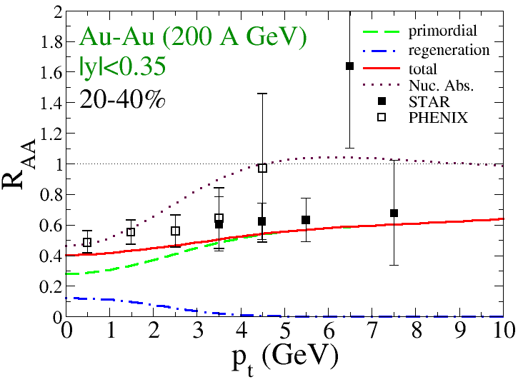
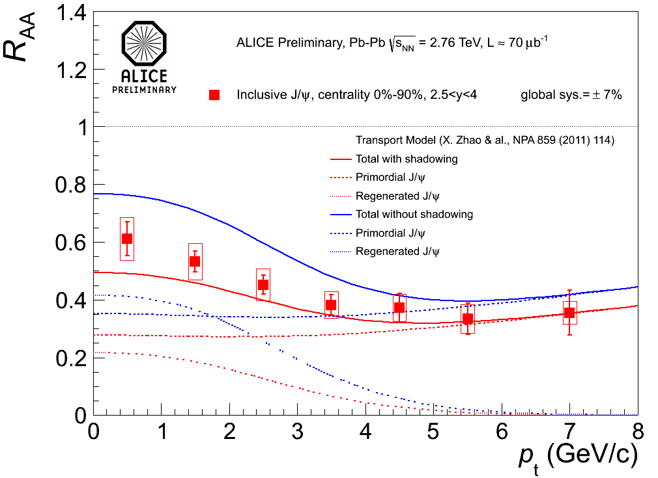
P_{T} spectrum at RHIC: contributions from supression, regen., and CNM absorption
P_{T} spectrum at LHC: contributions from supression, regen., and CNM absorption.
Regeneration causes the low momentum bump
Consistency between new lattice results and SBS

Slide 23
R_{AA}: B->J/Psi

Slide 24
B->J/Psi

Slide 25
Future Direction and New Opportunity at RHIC

Slide 26
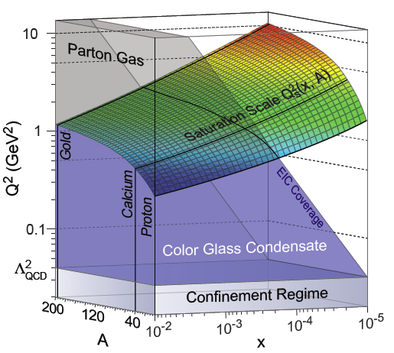
Forward Polarized p+A Physics at RHIC
Large TSSA at forward rapidity – large x effect
Gluon saturation/CGC at forward rapidity in d+A – small x effect
+

Slide 27
Polarized p+A

Slide 28
model

Slide 29
modle

