Slide 1
Highlights from RHIC
Ming X. Liu
LANL
    Latest News from Quark Matter 2009

Slide 2

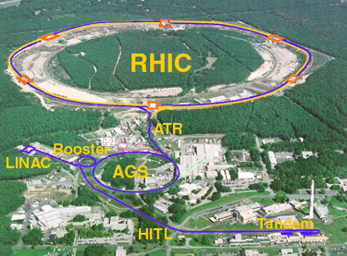
The Relativistic Heavy Ion Collider
at Brookhaven National Laboratory
R-HI
New state of matter
QGP
De-confinement
…
polarized proton
Nucleon Spin Structure
Spin Fragmentation
pQCD
…
RHIC is a QCD lab
BRAHMS
PHENIX
STAR

Slide 3

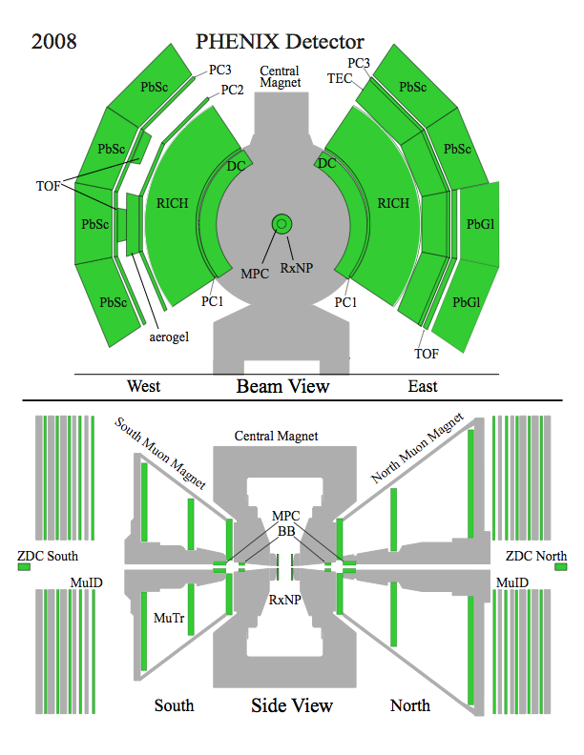
The PHENIX detector
Philosophy:
  High rate capability to measure rare probes,
  limited acceptance.
2 central spectrometers
  Track charged particles and detect electromagnetic processes
2 forward muon spectrometers
  Identify and track muons
2 forward calorimeters (as of 2007!)
  Measure forward pions
Relative Luminosity
  Beam-Beam Counter (BBC)
  Zero-Degree Calorimeter (ZDC)

Slide 4
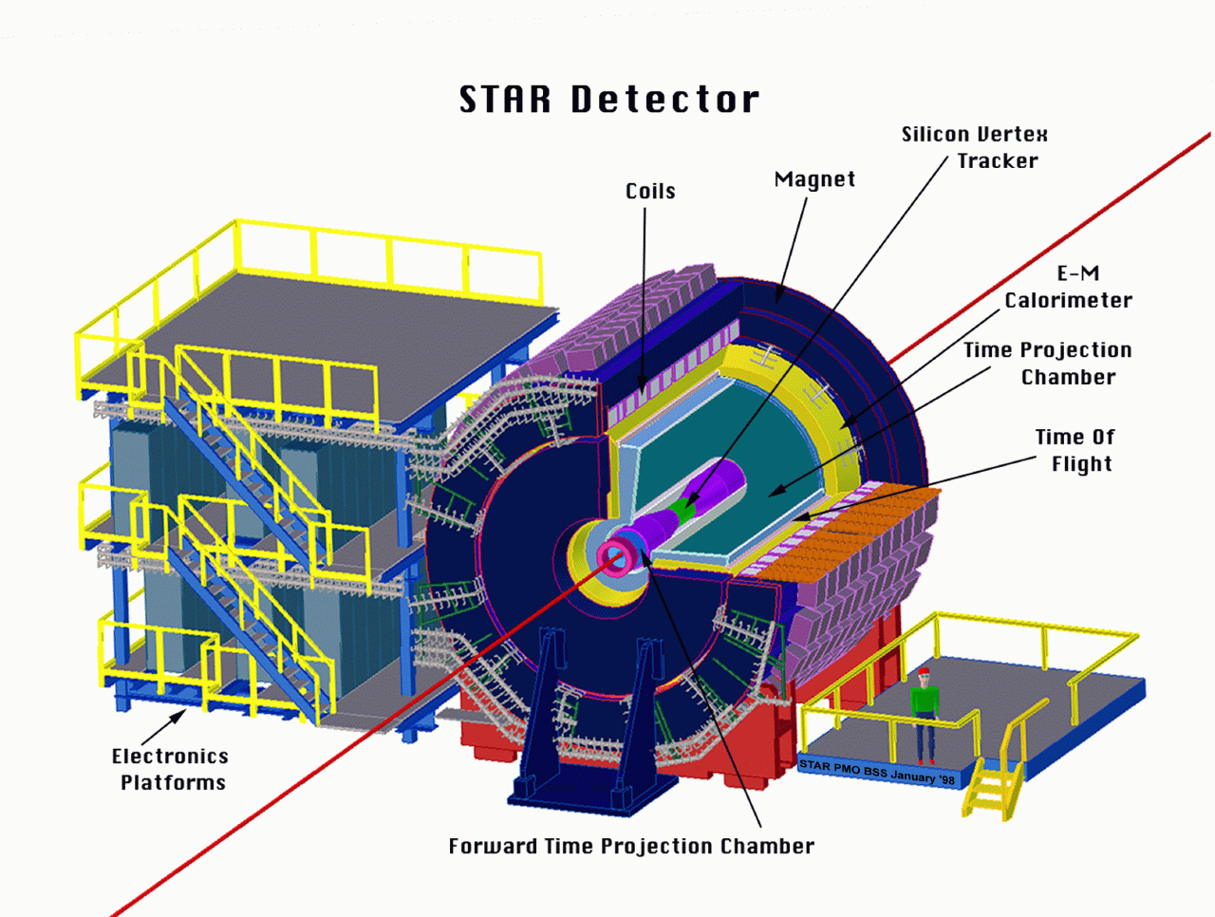
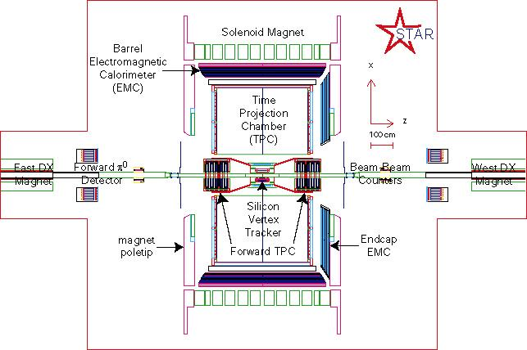
The STAR Detectors
PHOBOS
BRAHMS &PP2PP
PHENIX
RHIC
1.2 km
STAR
Time Projection Chamber |η|<1.6
Forward TPC 2.5<|η|<4.0
Silicon Vertex Tracker |η|<1
Barrel EMC |η|<1
Endcap EMC 1.0< η <2.0
Forward Pion Detector 3.3<|η|<4.1

Slide 5
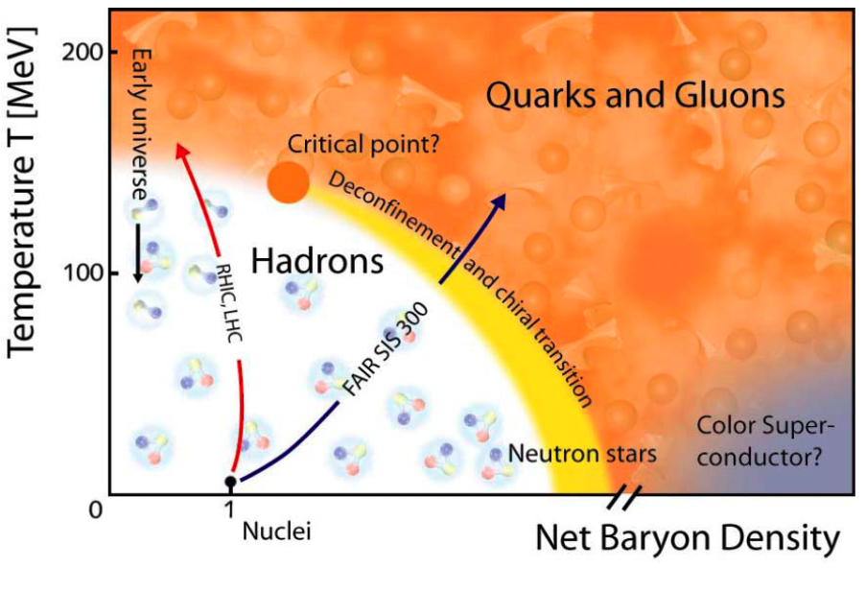
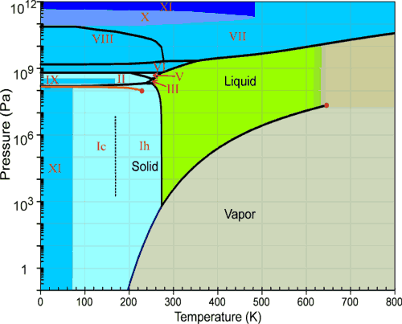

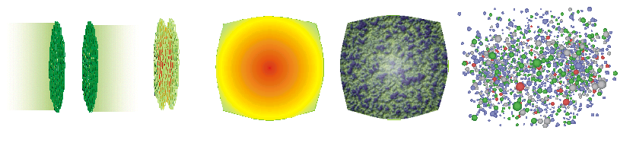
Phase Diagram
Phase diagram of water
Phase diagram of nuclear matter

Slide 6
Selected Topics on Heavy Ion Physics
QGP Bulk Property and Soft Physics
  Parton Collective Motion and “Perfect Liquid”
  Blackbody Thermal photons
Medium Interaction and Hard Probes
  Jet energy loss
  Direct photons
QGP Screening and Heavy Quarkonia Produciton
  J/Psi
  Upsilon

Slide 7
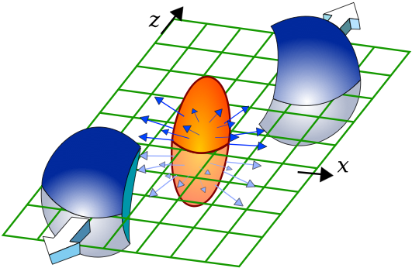

Elliptic flow and scaling properties

Slide 8
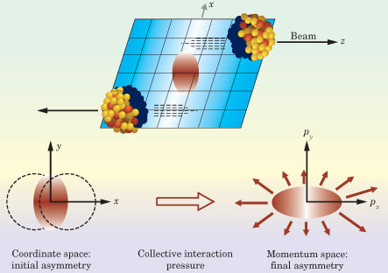
Reaction Plane in AuAu Collisions

Slide 9
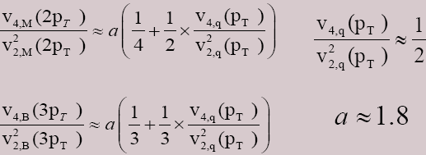
What is Flow?
out-of-plane
y
initial state of non-central collision
  large asymmetric pressure gradients
  → hydrodynamic flow of partons
  control parameters: ε_{s}, η, c_{s}
Au nucleus
in-plane
translates into
  final state momentum anisotropy
hydrodynamic flow exhibits scaling properties which can be validated (or invalidated), e.g.:
Au nucleus
x
z
→ v₄/v₂2 ≈ 0.9

Slide 10

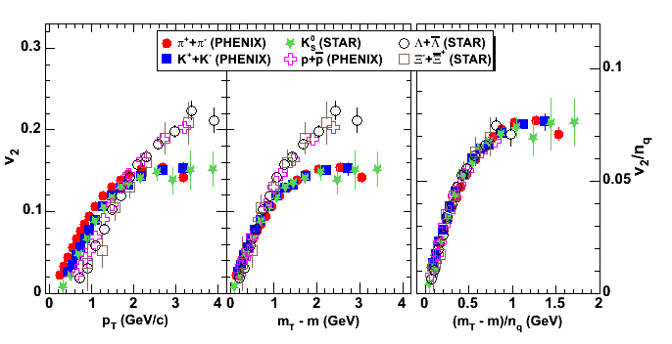
Quark number + KE_{T} scaling (AuAu 200 GeV)
PRL. 98, 162301 (2007)
Transverse kinetic energy: KE_{T} ≈ m_{T} - m, where m_{T}² = p_{T}² + m²
v₂(p_{T}) /n_{quark} vs. KE_{T}/n_{quark} becomes one curve independent of particle species.

Slide 11
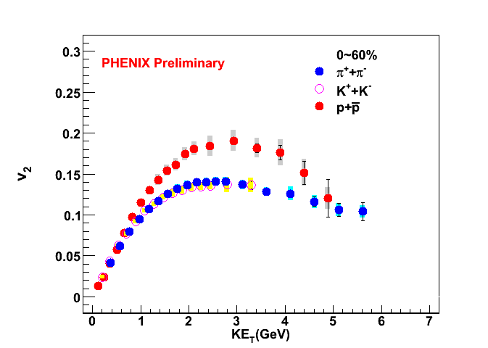
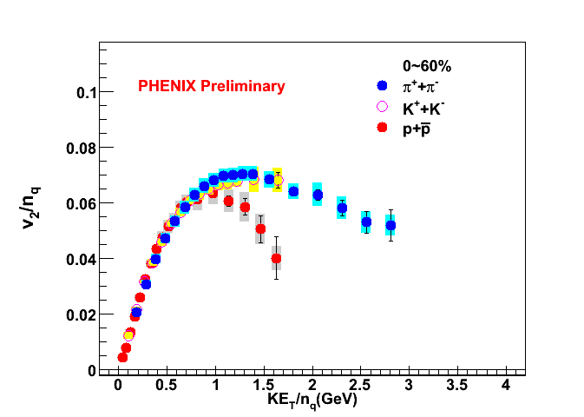
KE_{T} and NCQ scaling
Parton Collective Motion
KE_{T} scaling works for baryons and mesons separately at moderate p_{T}
At low p_{T} KE_{T}/n_{q} scaling suggests flow established at partonic level; breaks down at KE_{T}/n_{q}>1 GeV
At p_{T}/n_{q}~1.5 GeV/c², PID v₂ start to deviate from NQ scaling, in particular for protons.

Slide 12
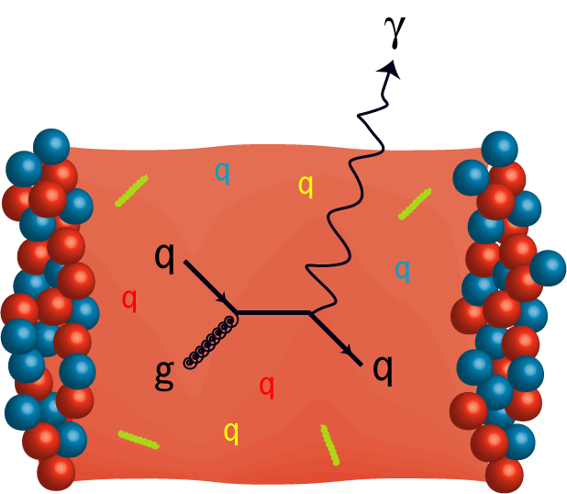
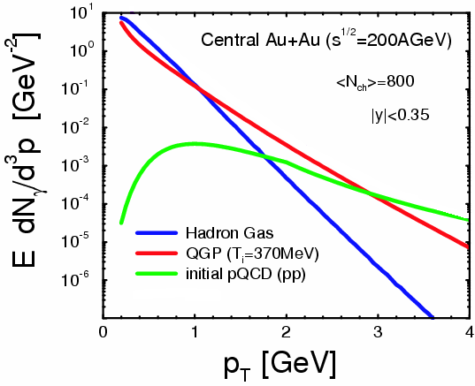
Thermal Radiation and Direct photon
  Photons emitted from every stage of collisions
    Carry the thermodynamic information about the matter when they are generated.
    Low pT region (1~3 GeV/c)
      Thermal radiation from QGP
    Intermediate pT region (3~5 GeV/c)
      jet-medium interactions
        jet-photon conversion
        in-medium bremsstrahlung
  Nuclear matter/PDF effects may enhance/decrease photon yield at low pT.
    Cronin effect, nuclear shadowing
  Measurement of direct photon is very challenging due to a large background from hadron decays.
S.Turbide et al PRC 69 014903

Slide 13
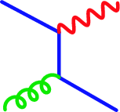
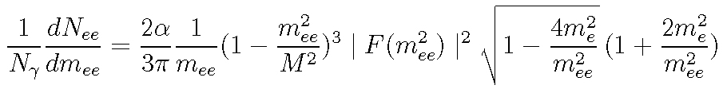
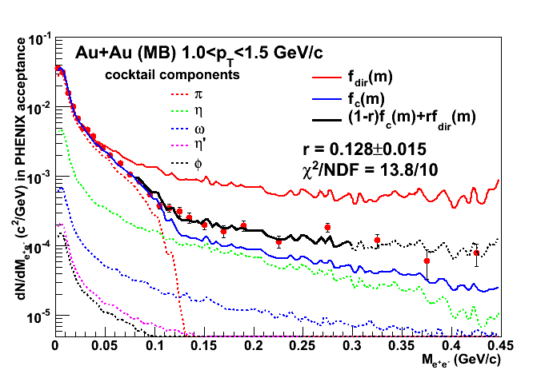
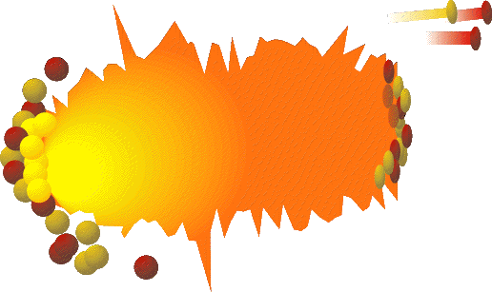
Direct γ in AuAu via Internal Conversion
e⁺
γ∗
e⁻
Kroll Wada PR98(1955) 1355
PHENIX NPA774(2006)403
q
g
q
e⁺
e⁻
= Kroll-Wada
γ∗
γ
Eliminating the π⁰ background by going to 0.2<m_{ee}<0.3 GeV enables direct γ signal to be measured for 1<p_{T} <3 GeV/c in Au+Au. It is exponential, does that mean it is thermal. We must see whether p-p direct γ turns over as p_{T} →0 as in Drell-Yan or exponential like for π⁰

Slide 14
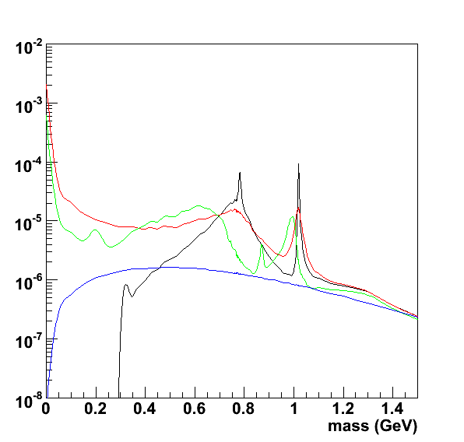
Theory Prediction of Dilepton Emission
at y=0, pt=1.025 GeV/c
Theory calculation by Ralf Rapp
Usually the dilepton emission is measured and compared as dN/dptdM
The mass spectrum at low pT is distorted by the virtual photon→ee decay factor 1/M, which causes a steep rise near M=0
qq annihilaiton contribution is negligible in the low mass region due to the m**2 factor of the EM correlator
In the caluculation, partonic photon emission process
q+g→q+γ→qee is not included
Vaccuum EM correlator
Hadronic Many Body theory
Dropping Mass Scenario
q+q annihilaiton (HTL improved)
(q+g→q+γ→qee not shown)

Slide 15
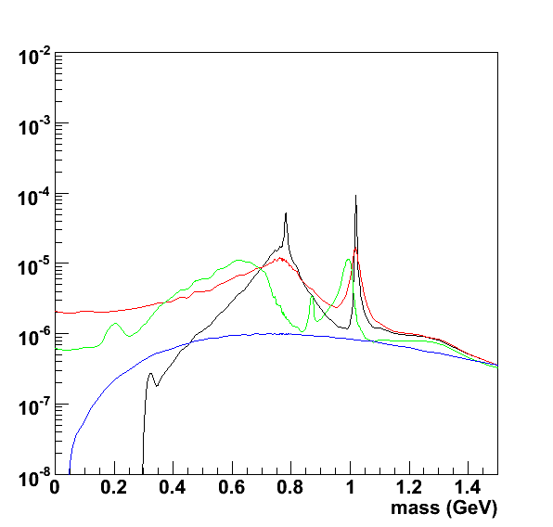
Virtual photon emission rate
at y=0, pt=1.025 GeV/c
The same calculation, but shown as the virtual photon emission rate.
The steep raise at M=0 is gone, and the virtual photon emission rate is more directly related to the underlying EM correlator.
When extrapolated to M=0, the real photon emission rate is determined.
q+g→q+γ* is not shown; it is similar size as HMBT at this pT
Vaccuum EM correlator
Hadronic Many Body theory
Dropping Mass Scenario
q+q annihilaiton (HTL improved)
(q+g→q+γ→qee not shown)

Slide 16
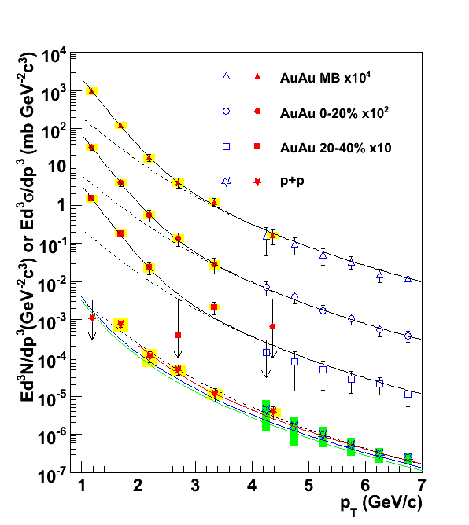
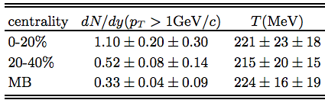
Evidence of Thermal Radiation?
p+p
First measurement in 1-3GeV/c
Consistent with NLO pQCD
Serves as a crucial reference
arXiv: 0804.4168
Au+Au
Significant excess over binary-scaled p+p result for pT<3GeV/c.
Inverse slope of exponential fit is related to temperature of matter
Inverse slope
Exponential part
Binary-scaled p+p result

Slide 17
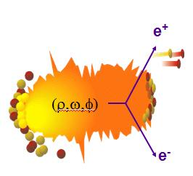
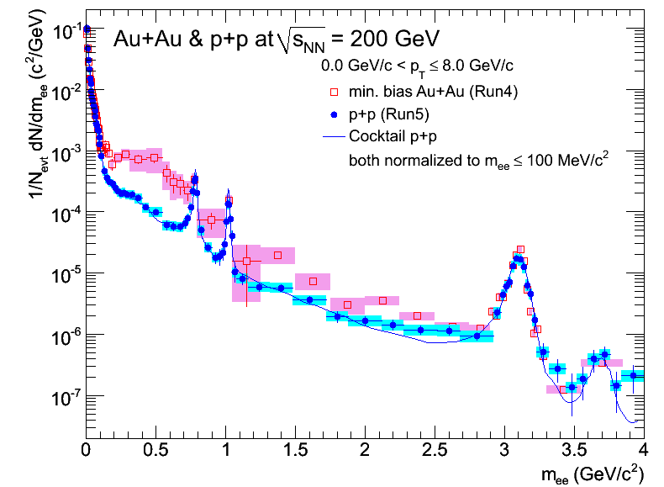

PHENIX Low Mass Dielectrons
p+p NORMALIZED TO m_{ee}<100 MeV
low mass
ω
AuAu
φ
pp and AuAu normalized to p⁰ Dalitz region (~ same # of particles)
p+p: agree with the expected background from hadron decays
Au+Au: large Enhancement in 0.15-0.75 GeV/c²
intermediate mass
J/ψ
pp
ψ’
PLB670,313 (2009)
arXiv:0706.3034

Slide 18
What Have We Learned about the Bulk Properties?
  What is the ultimate say on partonic collectivity for the matter ?
    Yes. Case Closed. (A. Tang, QM2009)
  What is the limit of NQ scaling of V₂?
    NQ Scaling studied works in lower energy, smaller system and at forward region. Signs of deviation from NQ scaling has been observed at large pt in AuAu collisions at 200 GeV.
  - In Au+Au collisions, significant excess of direct photon over binary-scaled p+p result is seen, is this thermal radiation?
      - Nuclear matter effect to direct photon yield should be evaluated in order to extract net signal of thermal photons.
      Run8 d+Au result is promising and will come in near future

Slide 19
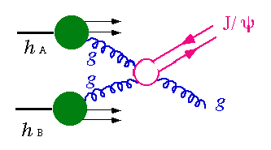
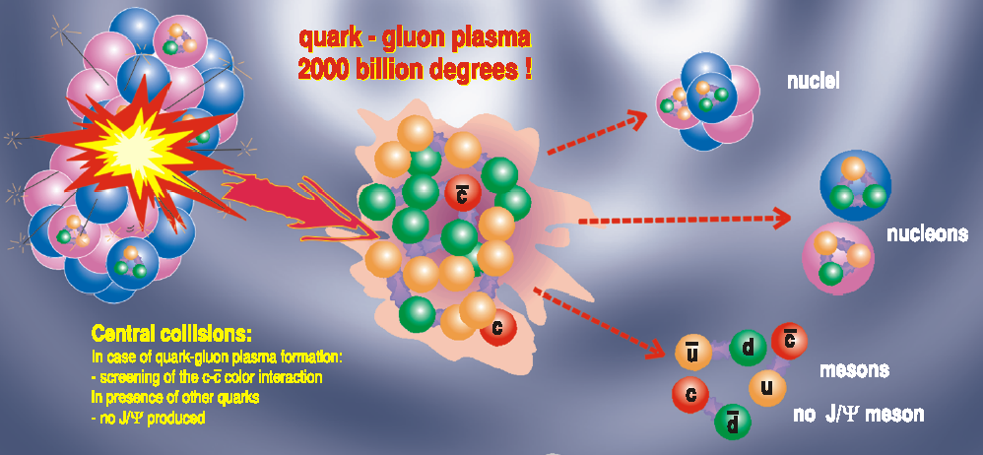
The Hard Probes
Hard scattering & Jet
  Multiple scattering
  Energy loss
  Jet suppression
  Leading particle
Heavy Quarkonium
  Debye screening
  J/Psi suppression
partonic energy loss

Slide 20
Energy loss from single particles

Slide 21
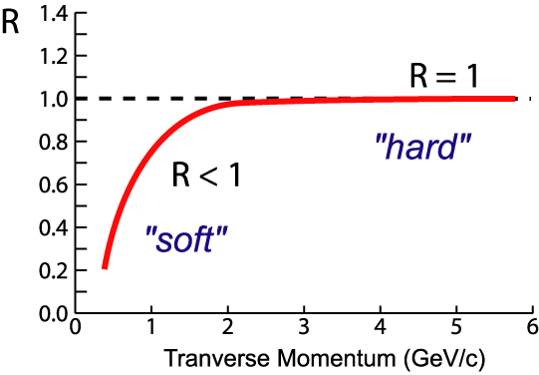
Nuclear Modification Factor: R_{AA}
AA
AA
If no “effects”:
R_{AA} = 1 at high-p_{T} where hard
scattering dominates
Suppression:
R_{AA} < 1 at high-p_{T}
AA

Slide 22
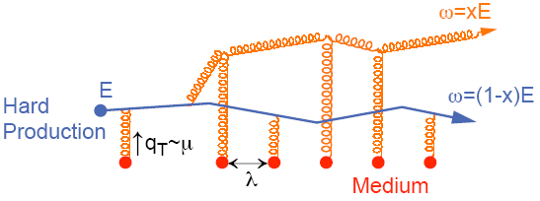
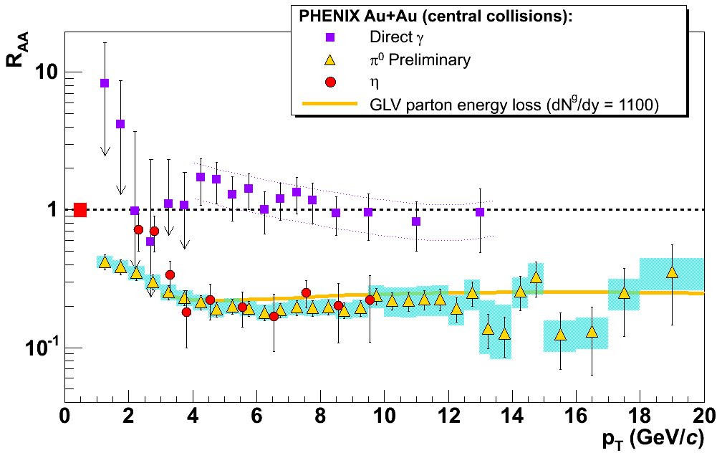
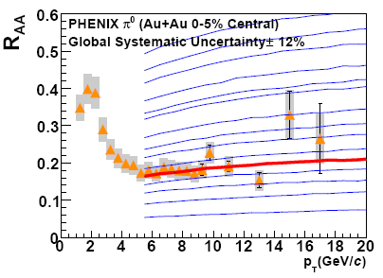
Jet Quenching at RHIC
Energy loss of partons from hard scattering through re-scattering in the hot & dense medium
  nuclear modification factor R_{AA} << 1 at high p_{T}
  Access medium properties through statistical analysis
    example: transport coefficient in PQM model
A. Adare et al., PRC 77(2008)064907
PQM
Huge opacity of the medium
→

Slide 23


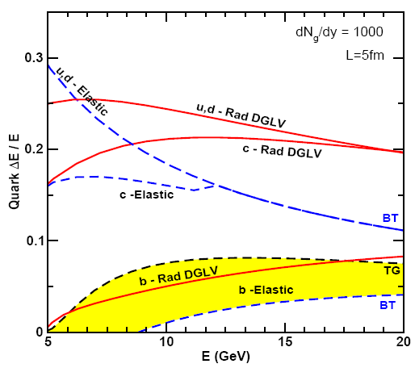
Other Mechanisms of Energy-loss:
Radiation
due to scattering
Elastic collision,
energy re-distribution
Many calcs on relative importance
Probe via high-pt heavy-quarks
smaller energy loss after elastic collision
gluon radiation also reduced
  interference during radiation
  dead-cone effect
S.Wicks, W. Horowitz, M. Djordjevic M. Gyulassy (WHDG) nucl-th/0512076

Slide 24
e± R_{AA}: a Challenge for Models
Wicks et al., NPA 784(2007)426
Testing ground for various parton energy loss (ΔE) models
  radiative ΔE only
    Djordjevic et al., PLB 632(2006)81
    Armesto et al., PLB 637(2006)362)
  collisional ΔE included
    Wicks et al., NPA 784(2007)426
    van Hees & Rapp, PRC 73(2006)034913)
Alternative approaches to interpret the suppression
  collisional dissociation of heavy mesons (charm and bottom!)
    Adil & Vitev, PLB 649(2007)139
  contribution from baryon enhancement
    Sorensen & Dong, PRC 74(2006)024902
Adil & Vitev, PLB 649(2007)139

Slide 25
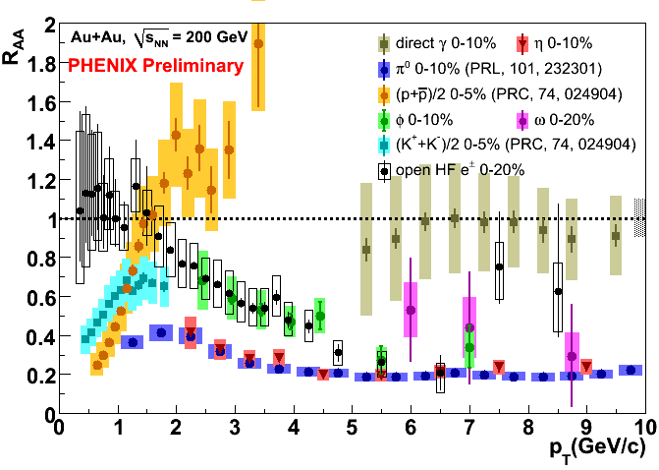
Sample of R_{AA} in PHENIX

Slide 26
Energy loss and two particle correlation

Slide 27
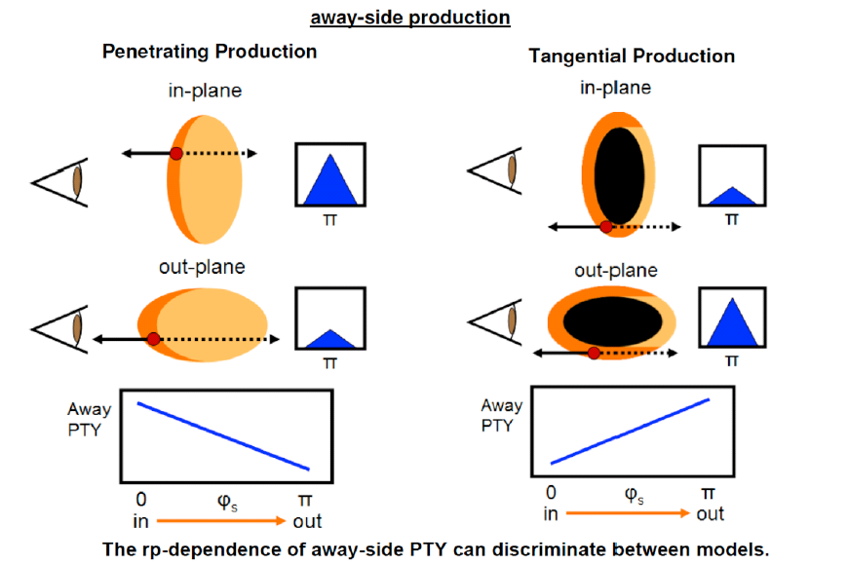
How Opaque is the medium?
At high partner p_{T} (>3 GeV/c), there is little medium response in awayside
Awayside jet: Surface emission or punch through?

Slide 28
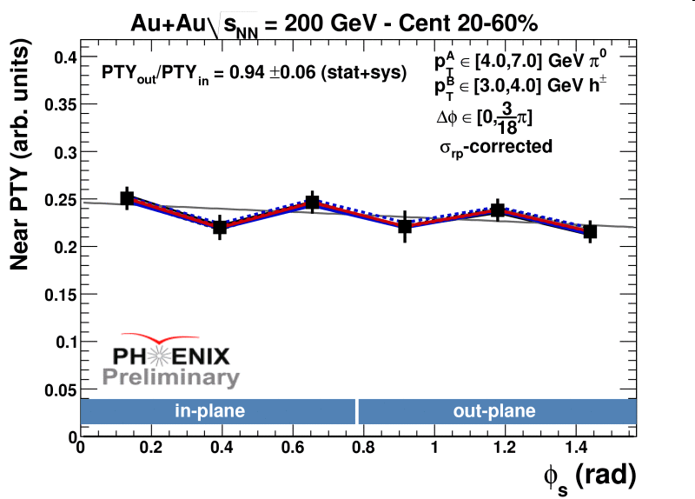
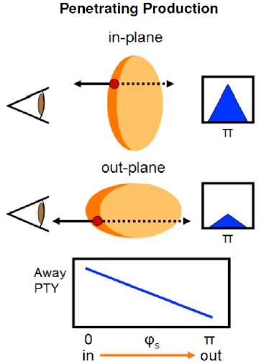
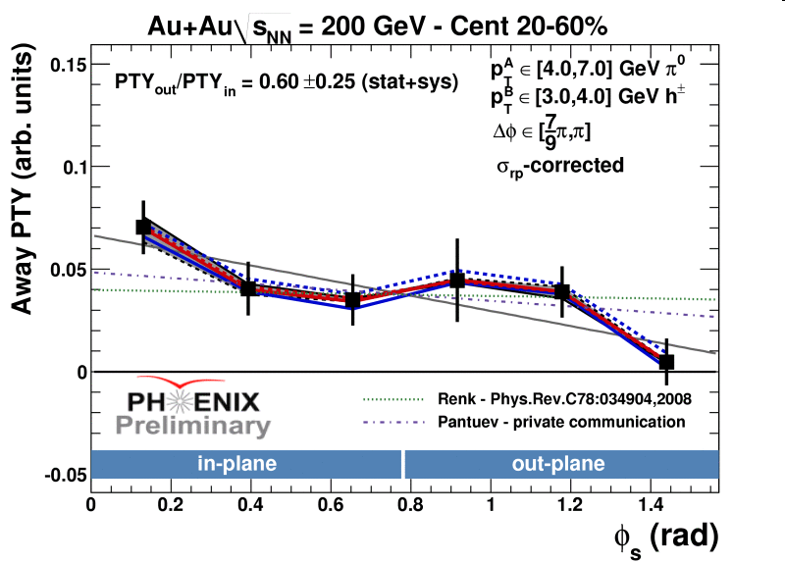
Near/Away Side Particle Yield vs φ_{s} (π⁰-h)

Slide 29
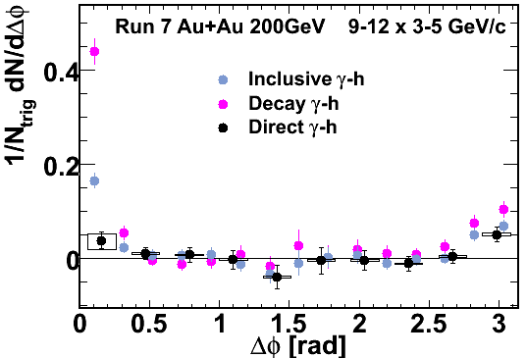
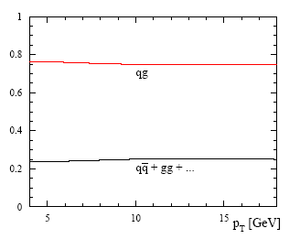
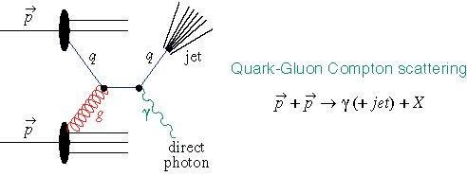
A Better Probe: Direct γ-jet
γ not affected by strong interaction ⇒ no surface bias, can probe the entire geometry
well calibrated, E_{γ} ~ E_{jet}

Slide 30
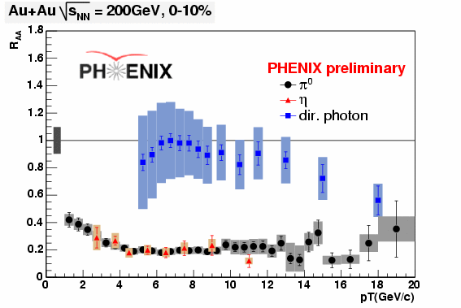
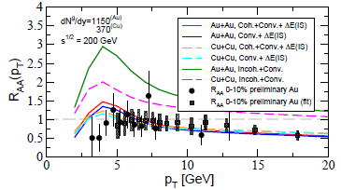
No Suppression in Direct Photons
Isospin, Cronin, shadowing, dE/dx
Vitev, nucl-th/0810.3194v1
(data all PHENIX preliminary)
Au+Au photons have some modification at high p_{T}, but may be just CNM effects – i.e. Cronin & neutron vs proton (isospin/charge) effects

Slide 31

γ-jet Correlations
γ
q
g
q
?
p+p
Au+Au

Slide 32
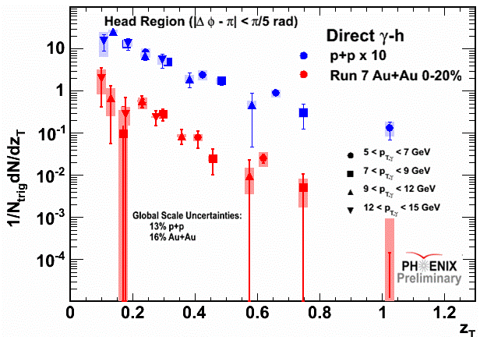
Fragmentation function in p+p and Au+Au
p+p slope:
6.89 ± 0.64
Au+Au slope:
9.49 ± 1.37

Slide 33
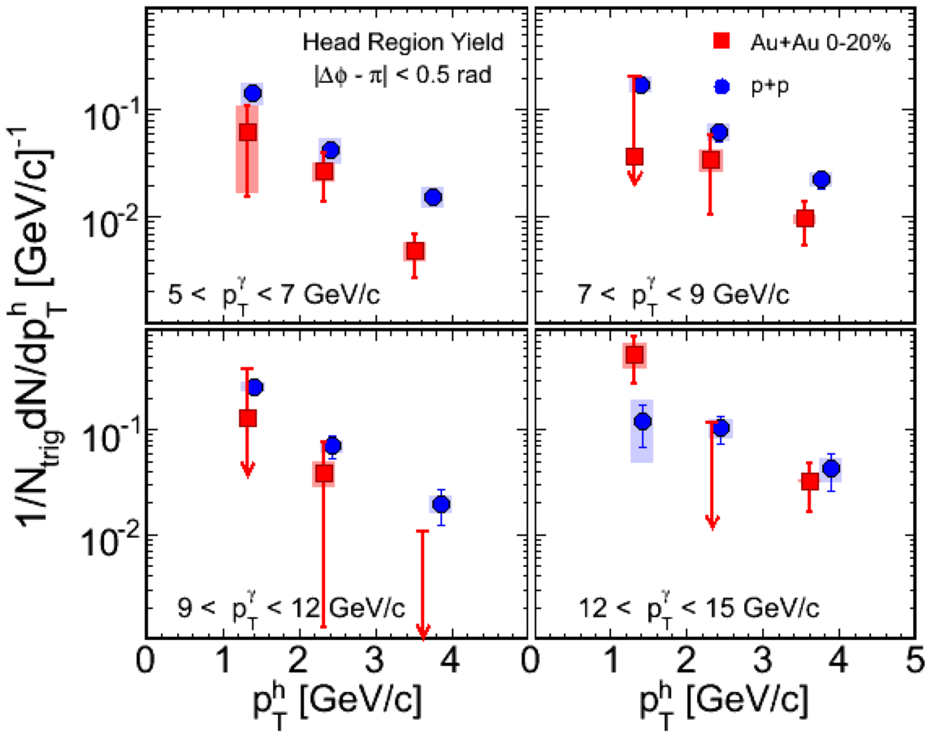
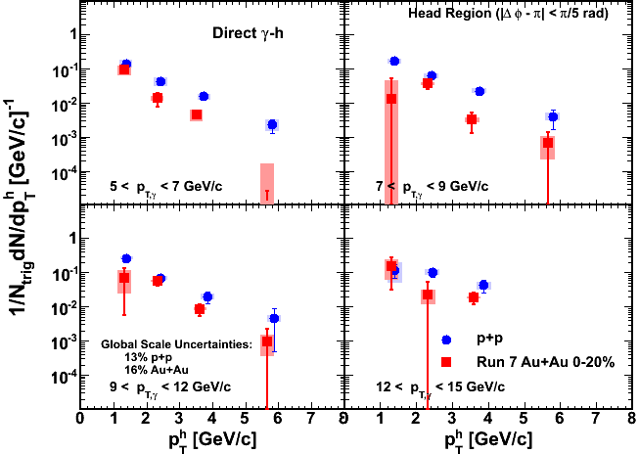
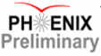

Away Side Jet Suppression
arXiv:0903.3399
Fragmentation function:

Slide 34
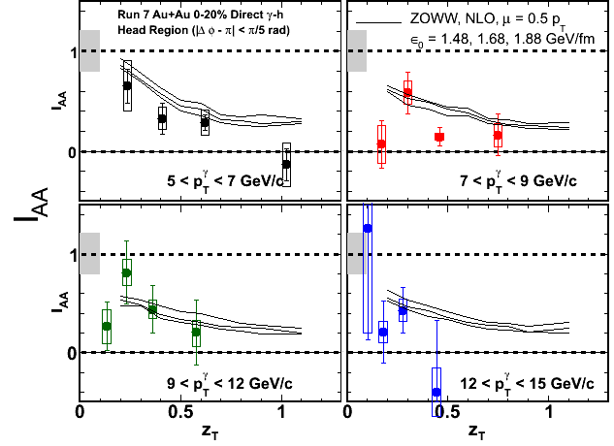
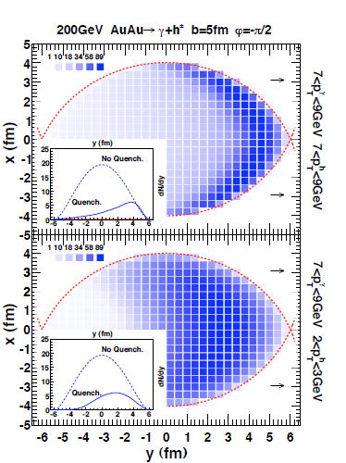
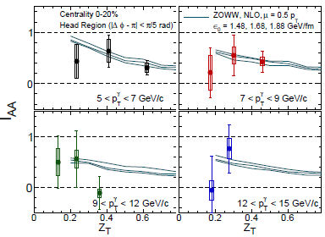
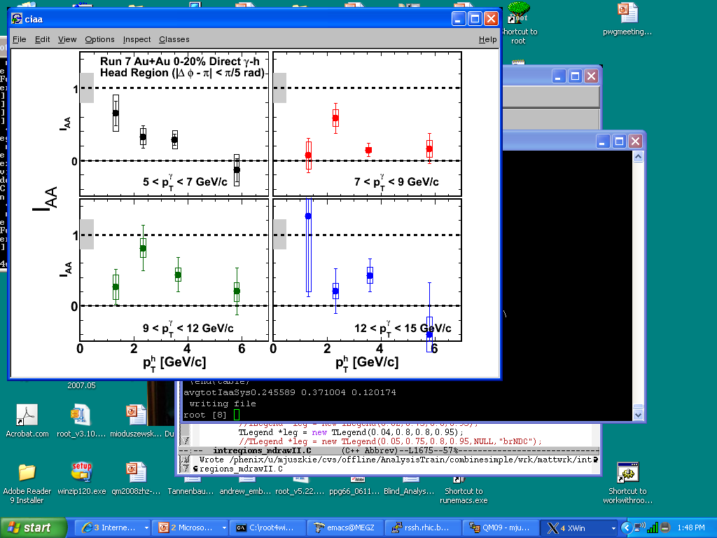
Surface emission?
Modification at low z_{T} and suppression at high z_{T}
arXiv:0902.4000v1
High zT
low zT

Slide 35
Heavy Quarkonia

Slide 36


Deconfinement and Quarkonia
For the hot-dense medium (QGP) created in A+A collisions at RHIC:
Large quark energy loss in the medium implies high densities
Flow scales with number of quarks – partonic flow
Is there deconfinement? → look for Quarkonia screening
Debye screening predicted to destroy J/ψ’s in a sQGP with other states “melting” at different temperatures due to different sizes or binding energies.
Mocsy, WWND08
RHIC: T/T_{C} ~ 1.9 or higher
Different lattice calculations do not agree on whether the J/ψ is screened or not – measurements will have to tell!
Satz, hep-ph/0512217

Slide 37


The RHIC J/ψ “puzzle”
Suppression doesn’t increase with local density
  R_{AA} (RHIC, |y|<0.35) ≈ R_{AA} (SPS)
  R_{AA} (|y|<0.35) > R_{AA} (1.2<|y|<2.2)
Possible candidates
  Regeneration compensating for strong suppression
  Temperature both at RHIC & SPS not sufficient to melt J/ψ, only excited states melt
  Gluon saturation models predict stronger charm production at mid rapidity
PRL 98, 232301 (2007)
Global error = 7%
Global error = 12%
E. Scomparin (proc. QM06) : nucl-ex/0703030

Slide 38


QGP effects on Quarkonia
Regeneration – Compensating for Screening
larger gluon density at RHIC expected to give stronger suppression than SPS
but larger charm production at RHIC gives larger regeneration
forward rapidity lower than mid due to smaller open-charm density there
very sensitive to poorly known open-charm cross sections (FVTX will help here)
expect inherited flow from open charm
regeneration would be HUGE at the LHC!
Grandchamp, Rapp, Brown
PRL 92, 212301 (2004)
nucl-ex/0611020
Centrality (N_{part})
can the two compensating components (screening & regeneration) which may have diff. centrality dependences, give a flat forward/mid-rapidity R_{AA}?
Centrality (N_{part})

Slide 39
Experimental Approaches to Solve the Puzzle
Higher energies (LHC)
  Regeneration => Spectacular increase in R_{AA}
  Sequential melting => Onset at start of J/ψ melting
Higher masses (ψ’, Υ(1S,2S,3S))
  Better understanding of sequential melting
Other observables
  Momentum dependence
  Rapidity dependence
  Elliptic flow
Better CNM constraints

Slide 40


Momentum Dependence
In Au+Au (left) and central Cu+Cu (right)
  Momentum distribution is rather flat up to 5 GeV/c

Slide 41

J/ψ Elliptic Flow
J/ψ flow : possible test of regeneration
  Electrons from open c and b semileptonic decays show nonzero elliptic flow
  J/ψ regenerated from c quarks should inherit their flow
Run 4 Final : PRL 98, 172301 (2007)
c & b (+ J/ψ)
Main criticisms
  Flow is seen at NA50 and NA60 where net charm yield is not that high
    Indication of other causes that induce J/ψ flow
But then...
  Absence of J/ψ elliptic flow would weigh against regeneration models which all predict substantial flow
Notes:
Have to explain rapidly what elliptic flow is, add backup on it and add a paper on upgrades especially vtx…

Slide 42

J/ψ Elliptic Flow
p_{T} integrated v₂ = (-10±10)% @ |y|<0.35 and (-9.3 ± 9.2)% @ -1.2<|y|<1.2
Bar : stat. + uncorrelated syst. errors
Band : correlated syst. errors
Probability of positive v₂ from p_{T} integrated values ≈ 15%, and 8% if two rapidities are combined

Slide 43



Quarkonia Production & Suppression – Upsilons in p+p
Cross section follows world trend
Baseline for Au+Au

Slide 44



Quarkonia – Upsilons Suppressed in Au+Au
Au+Au
 | p+p | Au+Au
N[8.5,11.5] | 10.5(+3.7/-3.6) | 11.7(+4.7/-4.6)
N_{J/Ψ} | 2653 ±70±345 | 4166 ±442(+187/-304)
R_{AA}(J/Ψ) | --- | 0.425 ±0.025±0.072
R_{AuAu} [8.5,11.5] < 0.64 at 90% C.L.

Slide 45

Summary

Slide 46
backup

Slide 47
Should ϒ’s be Suppressed?
ϒ’s long touted as a standard candle for quarkonia melting
but what should we really expect?
 | R_{AuAu}(y=0)
J/Ψ | 0.425 ± 0.025 ± 0.072
M_{e+e-}= [8.5,11.5 GeV] | < 0.64 at 90% C.L.
σ_{abs} of ϒ probably ~1/2 of that for J/Ψ – E772 (PRL 64, 2479 (1990))
  E772 ϒ nuclear dependence corresponds to R_{AuAu} = 0.81
Lattice expectations in Au+Au - ϒ_{2S+3S} suppressed: R_{AuAu} = 0.73
absorption x lattice ~ 0.73 x 0.81 ~ 0.60 ??? – but need serious theory estimate instead of this naïve speculation!
  e.g. Grandchamp et al. hep-ph/0507314
Other considerations:
ϒ in anti-shadowing region (for mid-rapidity)
CDF: 50% of ϒ from χ_{b} for p_{T}>8 GeV/c - but less (25%?) at our p_{T}
  PRL84 (2000) 2094, hep-ex/9910025

Slide 48


NQ Scaling, MSH and Large p_{t}
π
p
Preliminary
See talk by M. Shimomura
See talk by S. Shi
At p_{T}/n_{q}~1.5 GeV/c², PID v₂ start to deviate from NQ scaling, in particular for protons.

Slide 49




η/s measurements
need observables that are sensitive to shear stress
damping ~ η/s
flow
fluctuations
heavy quark motion
R. Lacey et al.: PRL 98:092301, 2007
S. Gavin and M. Abdel-Aziz:
PRL 97:162302, 2006
p_{T}fluctuations STAR
v₂ PHENIX
& STAR
A. Adare et al.: PRL 98:092301, 2007
top RHIC energy
  η/s close to conjectured minimum 1/4π

Slide 50

Virtual photon method
Any source of real γ can emit γ* with very low mass.
Convert direct γ* fraction to real direct photon yield
Kroll-Wada formula
S : Process dependent factor
Dalitz decays
  Obviously S = 0 at M_{ee} > M_{hadron}
γ* decay
  If pT²>>M_{ee}²
Possible to separate hadron decay components from real signal in the proper mass window.

Slide 51
Electromagentic probes (photon and lepton pairs)
e⁺
Photons and lepton pairs are cleanest probes of the dense matter formed at RHIC
These probes have little interaction with the matter so they carry information deep inside of the matter
  Temperature?
  Hadrons inside the matter
  Matter properties
e⁻
γ∗
γ

Slide 52






What we can learn from lepton pair emission
Emission rate of dilepton per volume
e.g. Rapp, Wambach Adv.Nucl.Phys 25 (2000)
γ∗→ee
decay
EM correlator
Medium property
Boltzmann factor
temperature
Medium modification of meson
Chiral restoration
Hadronic contribution
Vector Meson Dominance
q
q
qq annihilation
Thermal radiation from
partonic phase (QGP)
From emission rate of dilepton, the medium effect on the EM correlator as well as
temperature of the medium can be decoded.

