Slide 1
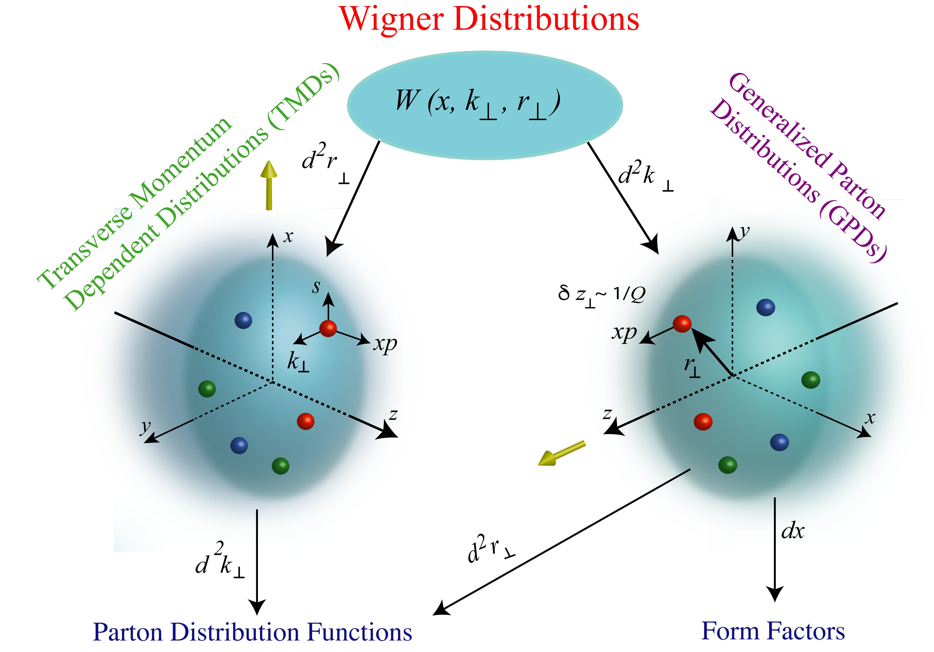
Probing Sea Quark TMD with Drell-Yan at SpinQuest/E0139 at Fermilab
Ming Liu
Los Alamos National Laboratory
For the SpinQuest/E1039 Collaboration
QCD Evolution 2019, May 13-17
Argonne National Laboratory

Slide 2
Outline
SpinQuest/E1039 experiment at Fermilab
  E1039 polarized NH₃/ND₃ targets
  Follow up of SeaQuest/E906 unpolarized target program
Novel physics of sea quarks at x = 0.1 - 0.4
  Flavor asymmetry
  Sivers & OAM
Other opportunities
  Parasitic E1067 dark photon search, 2016 - 2021+
  Future E1027 polarized beam possibility, 2021+
  TMD physics complementary to the future EIC program
A serials of follow up experiments:
SeaQuest, SpinQuest, DarkQuest …

Slide 3
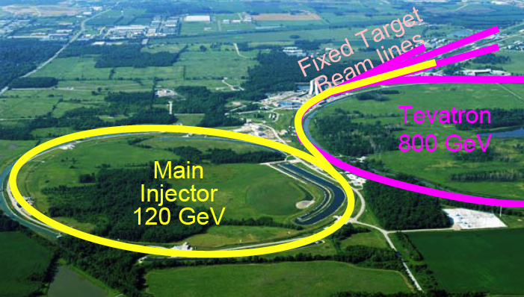
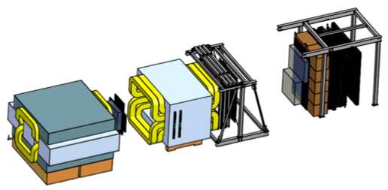
Fermilab High Intensity Frontier

Slide 4
SpinQuest Dimuon Spectrometer
120 GeV protons from the Main Injector
4s beam spill very 60 sec
19ns RF, ~10s K protons per RF bucket
5x10¹² Proton On Target (POT) per spill
Total integrated POT for E1039 (2-year):
1.4x10¹⁸ POT
Year 2015
Beam
120 GeV proton from Main Injector
19ns RF, 4s spill, 0.5×10¹³ protons per spill
SeaQuest Dimuon Tracking Top View
E906 unpolarized targets: 2012-2017
¹H, ²D, ¹²C, ⁵⁶Fe, ¹⁸⁴W
E1039 polarized targets: 2019 – 2021+
Polarized protons (NH₃)
Polarized neutrons (ND₃)
E1027 polarized beam

Slide 5
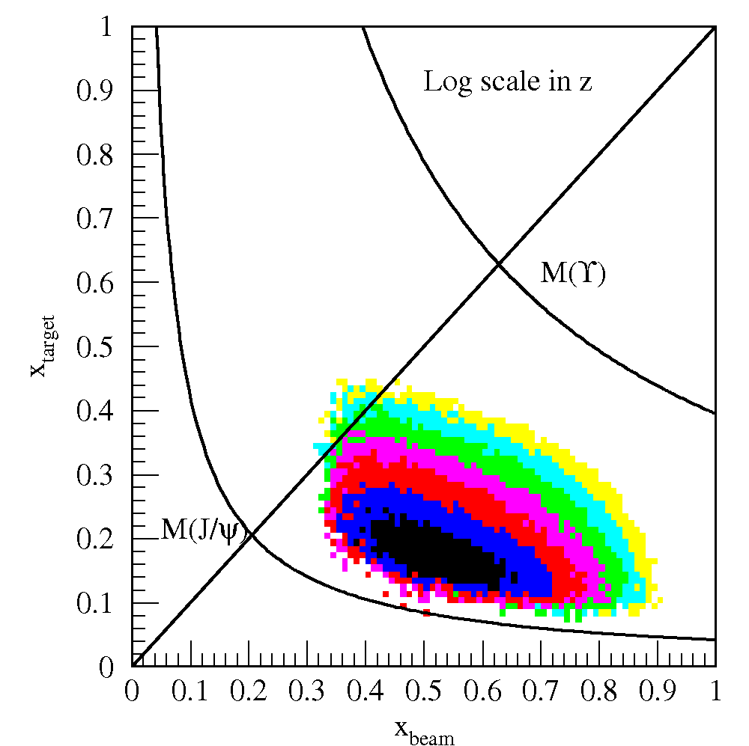
Drell-Yan @SeaQuest – a Sea Quark Laboratory
SeaQuest
acceptance
Fixed target kinematics favors sea-quarks
from target – a sea quark lab!

Slide 6
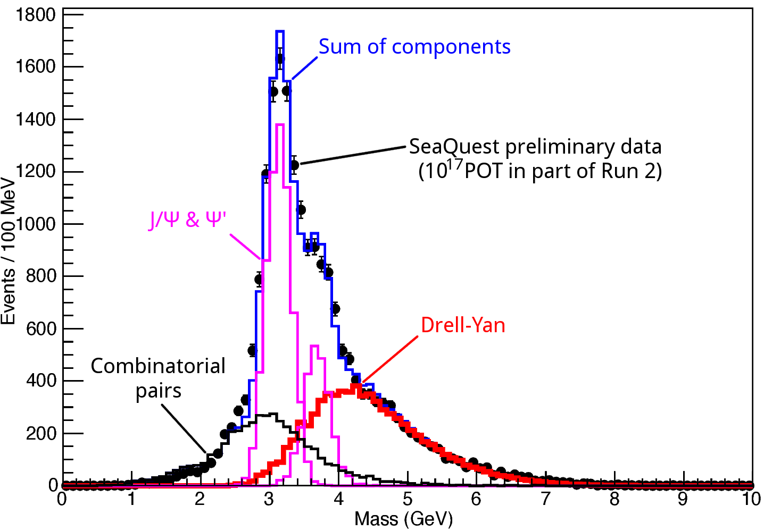
Dimuon Mass from SeaQuest/E906

Slide 7
E906 Unpolarized Physics Program
Thin targets: ~10% interaction length
  Liquid H/D
  Solid C, Fe, W
Physics
  Sea quark flavor asymmetry, dbar/ubar
  Quark energy loss in p+A collisions, dE/dx
  TMD and more …
Experimental runs – 6 years
  2012 – commissioning
  2017 – completed

Slide 8
Flavor Asymmetry of Sea Quarks at Intermediate x
Proton vs “Neutron” targets:
This could lead to a very interesting physics …
J. C. Peng et al (FNAL E866/NuSea), PRD 58, 092004 (1998)

Slide 9
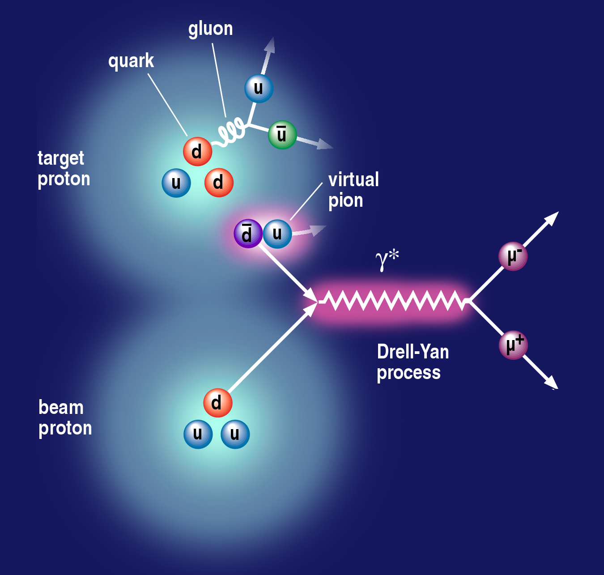
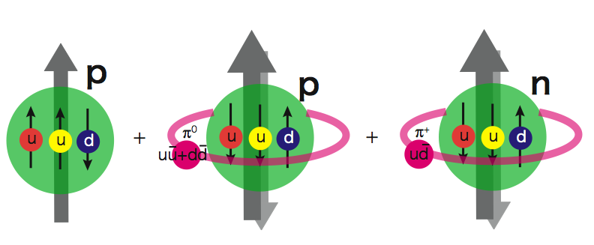
Sea Quark Flavor Asymmetry and OAM
Pion cloud and
Drell-Yan process
Pion cloud model
Sea-quark flavor asymmetry
Sea-quark orbital angular motion
Expect large Sivers function at x = 0.1 - 0.4
|p> = a₁|p₀> + a₂|p₀ + pi⁰> + a₃|n+pi⁺> + …
proton
neutron
L_{Z} = 1
E906 Spect.
Monte Carlo
E906 Spect.
Monte Carlo
E906 Spect.
Monte Carlo

Slide 10
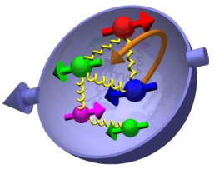
Nucleon 3-D Structure and Sivers Function
(x, k_{T})

Slide 11
Sivers Functions from Global Fits
Sea Quark Sivers poorly constrained, SIDIS not sensitive to sea quarks at large x
1612.06413, M. Anselmino et al
Sea quarks

Slide 12
RHIC pp500GeV: W^{+/-} A_{N}
Anselmino et al 2016
A_{N}(W⁺) ~
A_{N}(W⁻) ~
RHIC data:
A mix of valence and sea quark Sivers
Quark flavor identified
High Q²
Statistically limited, ~0(10%)
Hints of sizable sea-quark Sivers contributions
E1039:
- low Q²
- high statistics, ~O(1%)

Slide 13
Polarized NH₃ Target Developed for DY Sivers

Slide 14
Dynamic Nuclear Polarization: Pol. ~90%
With DNP,
Pol. ~ 90%
W/o DNP, at thermal
equilibrium:
- T = 1K
- B = 5T
Proton target polarization:
P_{i} = 0.5%
V_{p}=213MHz

Slide 15
Projected SpinQuest Target and Beam Performance

Slide 16

Projected Drell-Yan Transverse Single Spin Asymmetry

Slide 17
Drell-Yan Sivers Asymmetries w/ QCD Evolution
Kang et al, 1401.5078
COMPASS
Valence-quark
Sivers
SpinQuest: p+NH₃
COMPASS
Sea-quark
Sivers

Slide 18
E1039 Status & Plan
DOE approval, March 2018
E906 decommissioned 6/2018
Polarized target to be installed by fall of 2019
E1039 commissioning starts in late 2019
Run for 2+ years, 2019-2021+
Spectrometer
NH₃
Target
120GeV
beam

Slide 19
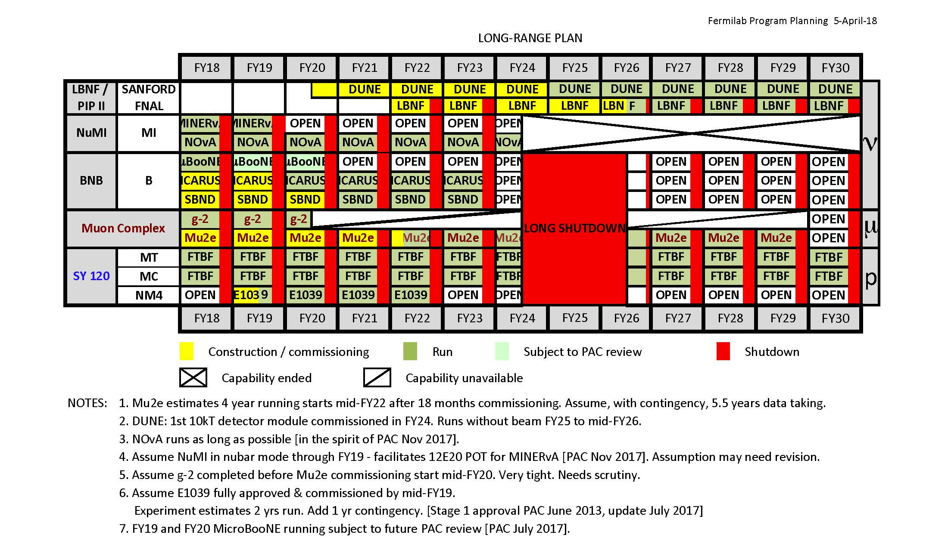
Fermilab Long Range Plan
E1039
Opportunity for new programs at SeaQuest after E1039

Slide 20
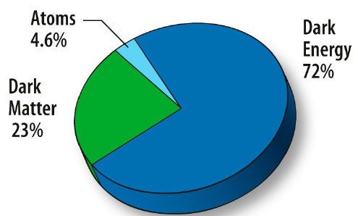
Physics Beyond E1039 Polarized DY A_{N}
Dark sector physics search – DarkQuest
  Parasitic run with E1039: 2019 – 2021+
  A new proposal for a dedicated run after E1039
Physics with polarized beams – E1027
  Polarize the Main Injector 120GeV beam
  Valence quark Sivers
    Test QCD dynamics in DY vs DIS
  TMD physics

Slide 21
Dark Photons and Dark Higgs Search at SpinQuest/DarkQuest
Photon portal: “vector”
Higgs portal: “scalar”
θ = μ v/m_{h}²
Advantage of hadronic collisions

Slide 22
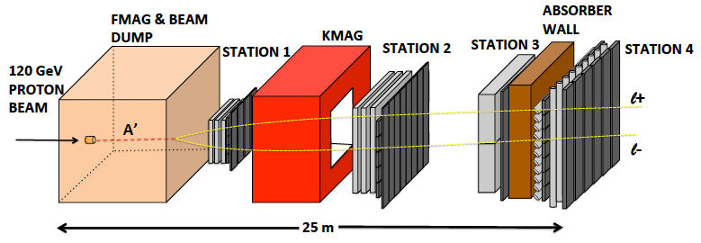
Dark Sector Physics Search at DarkQuest
2019 ~ 2021: parasitic run for DM search
2021+: a proposal for a long term DM program after E1039; parasitic TMD physics?
Add tracking detectors close to “target” to improve mass resolution
Add EMCal, PID
e^{+/-}, h^{+/-} , π^{+/-}

Slide 23
Dark Photon Search at DarkQuest with Future Projections

Slide 24
Spin physics Program with Polarized Main Injector – E1027
Access both polarized valence and sea quarks
Fermilab PAC stage-1 approved
Complementary to the future EIC TMD Physics
Test QCD processes in DY vs DIS
over a broad range of kinematics

Slide 25
TMDs probed via DY at Fermilab
E906, E1039, E1027
E1039, E1027
E1027
→COMPASS, RHIC, EIC/SpinQuest for sea quarks

Slide 26
Summary and Outlook
Experiments | Run Time | Collision Types | Physics
E906 | 2012-2017 | p + targets (H, D, C, Fe, W) | - dbar/ubar asymmetry - quark dE/dx
E1039 | 2018 – 2021+ | p + pol. targets (NH₃, ND₃) | Sea-quark Sivers, TMDs
E1067(para.) DarkQuest | 2017-2021+(para.) 2021+ (dedicated) | p + any targets | dark photon, dark Higgs, ALP …
E1027 | 202x | Pol. p-beam + | quark Sivers TMD, spin

Slide 27
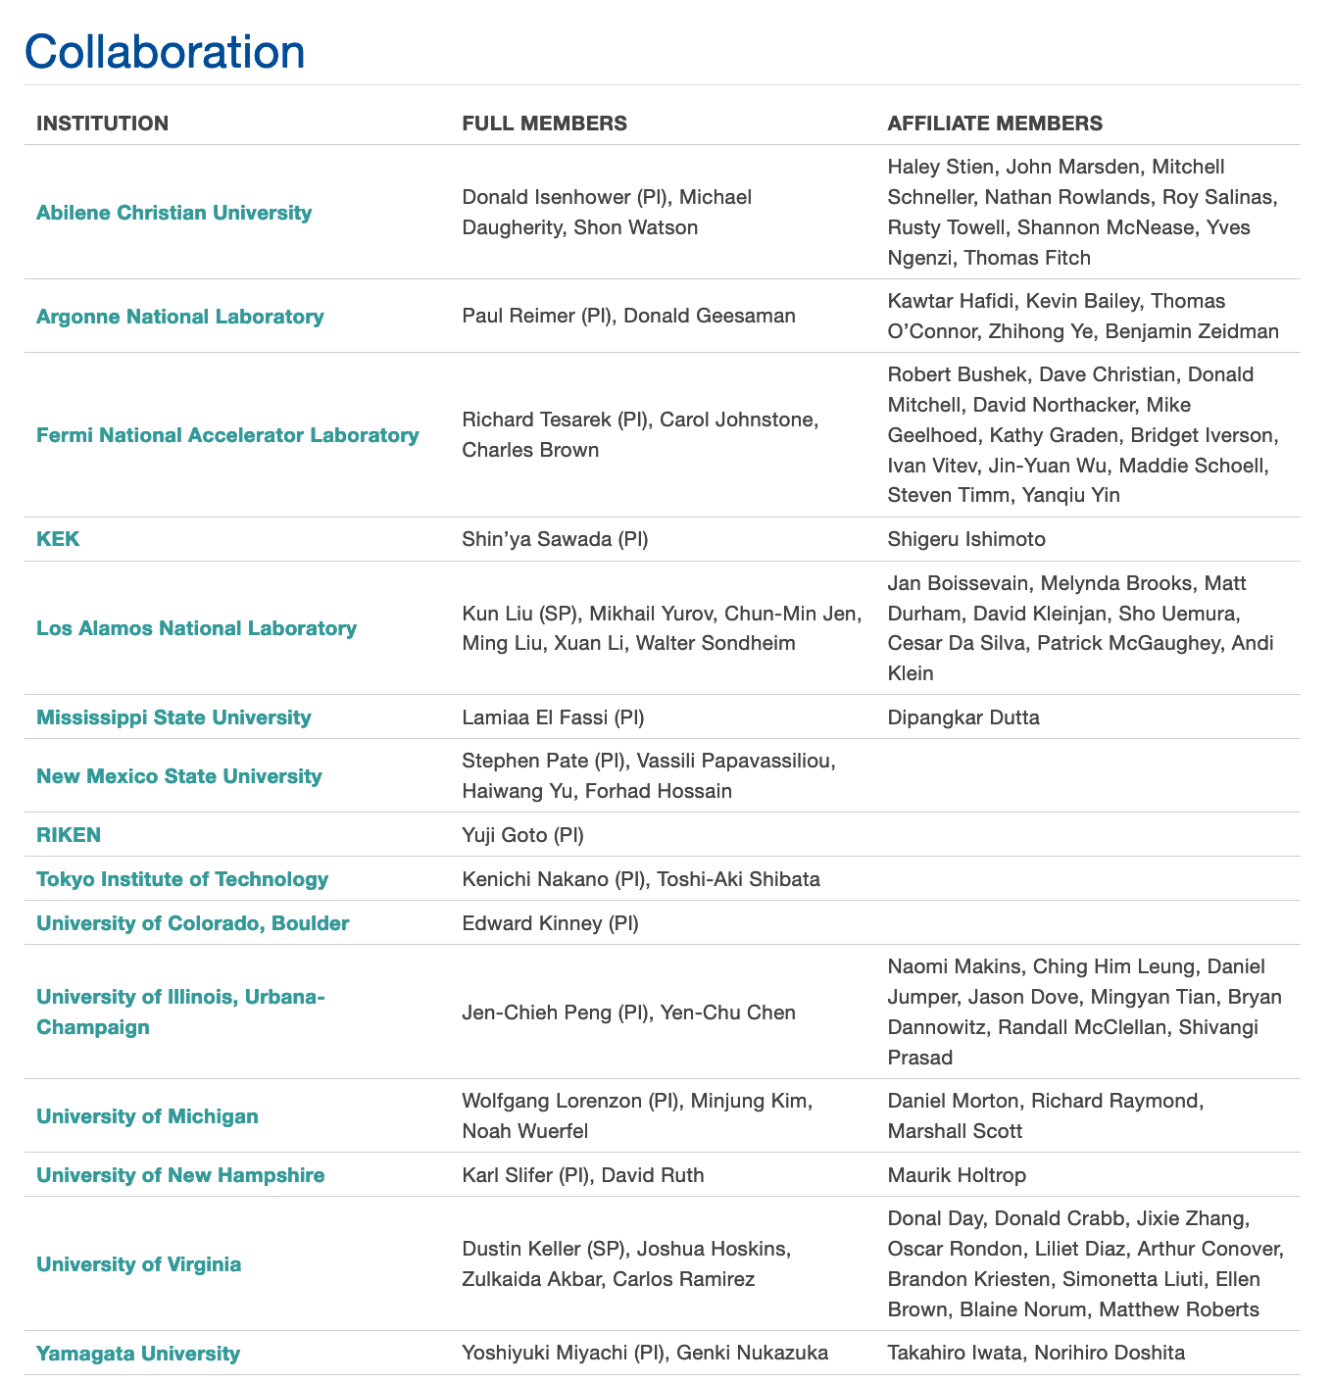
SpinQuest/E1039 Collaboration
A relatively small collaboration, great opportunities for new comers to contribute and lead major detector and physics efforts

Slide 28
backup

Slide 29
SpinQuest Experimental Hall
Beam
Target area
F-Mag
K-Mag
Muon-ID

Slide 30
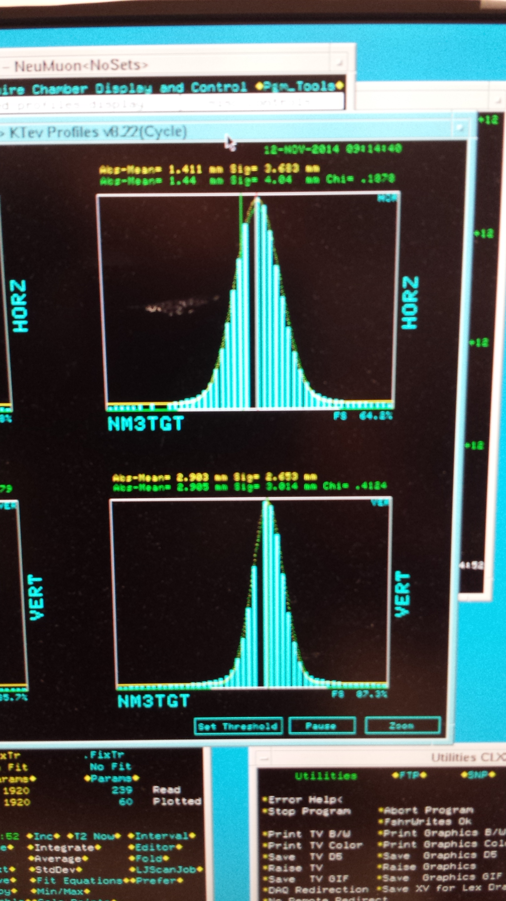

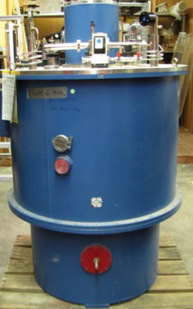
New Beam Collimator and Target
Target cross section: 18 x 28 mm²
E906 beam profile:
SigX = 4.0mm
SigY = 3.0mm
Beam cross section:
Need be well contained within
4 sigma, required by dR< 2x10⁻⁴
sigX = 18/2/4 = 2.2 mm
sigY = 28/2/4 = 3.5 mm
Beam jitter: dX=dY ~ 1mm
1 sig = 0.68269
2 sig = 0.95450
3 sig = 0.99730
4 sig = 0.99994
Beam collimator
120GeV
beam

Slide 31
Target and Beam Dump Event Separation target at upstream: Z=-3.5m
Trigger optimization possible!

Slide 32
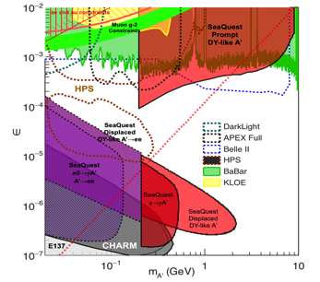
Projected Dark Sector Physics Search Sensitivity
Dark photon search
Dark Higgs search
1x
5x
25x

