Slide 1

Prospects of the sPHENIX Cold-QCD Physics Program at RHIC
Ming X. Liu
Los Alamos National Laboratory
(for the sPHENIX Collaboration)
The 11th Circum-Pan-Pacific Symposium on High Energy Spin Physics
August 27-30, 2019, Miyazaki, Japan

Slide 2
Outline
sPHENIX physics and detectors
  Quark-Gluon-Plasma
A new Cold-QCD physics opportunity
  Nucleon spin, TMD
  Small-x, nuclear PDF
  Forward upgrade
Outlook
  Forward upgrade
  EIC

Slide 3

US Nuclear Physics Long Range Plan (2015) sPHENIX – to understand “Inner Workings of QGP”

Slide 4
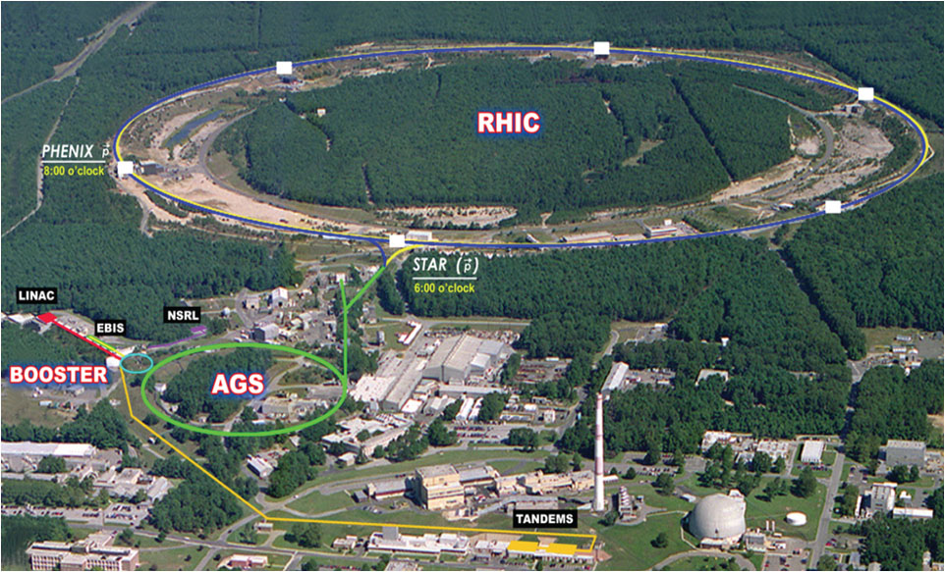
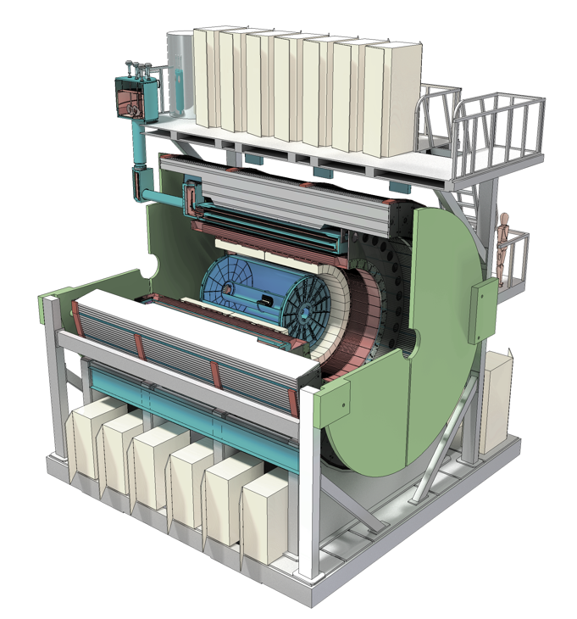


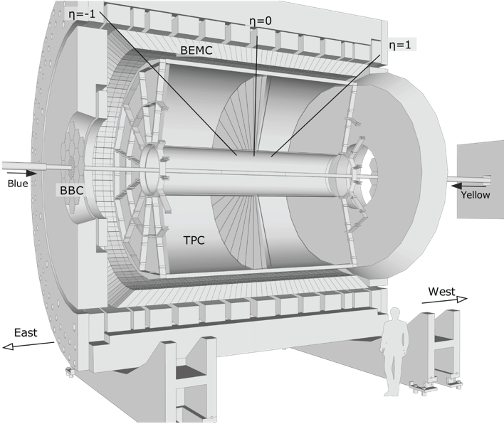
sPHENIX Upgrade at RHIC the next generation Heavy Ion Physics experiment in the US
Φ 1.2km

Slide 5
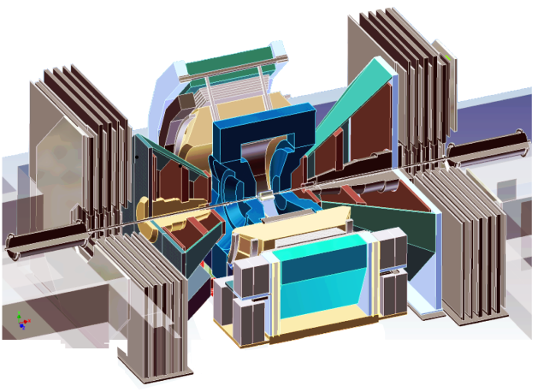
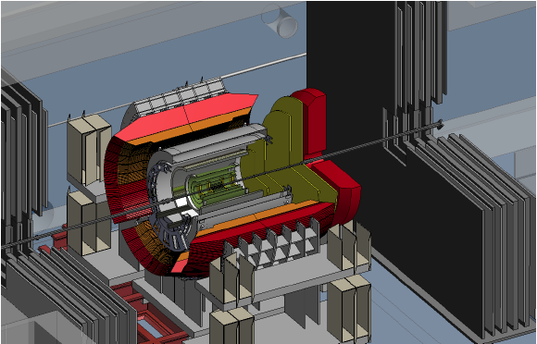
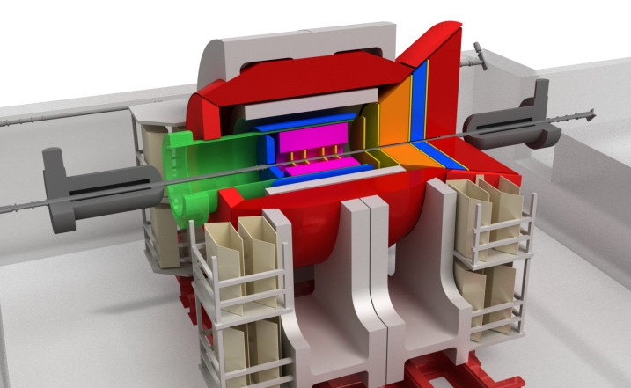
Evolution of the PHENIX Interaction Region at RHIC
PHENIX experiment
An EIC detector
16y+ operation
Broad spectrum of physics
(QGP, Hadron Physics, Dark Matter)
170+ physics papers with 24k citations
Last run in this form 2016
Comprehensive central upgrade base on BaBar magnet
Jet, heavy flavor and beauty quarkonia physics program
→ nature of QGP
Possible forward tracking and calorimeter upgrade → Spin, CNM
Path of PHENIX upgrade leads to a capable EIC detector
Large coverage of tracking, calorimetry and PID
Open for new collaboration/new ideas
arXiv:1501.06197 [nucl-ex]
arXiv:1402.1209 [nucl-ex]
2000-2016
2017→2022; Physics: 2023+
>2025+
Time
RHIC: A+A, spin-polarized p+p, spin-polarized p+A
EIC: e+p, e+A

Slide 6
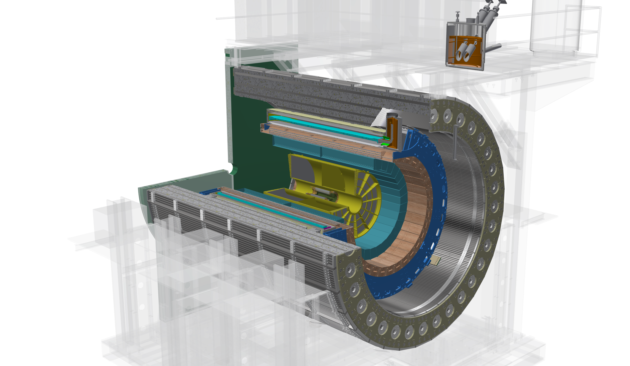
The sPHENIX Detectors
Outer HCal
SC Magnet
(Inner Hcal)
EMCal
TPC
INTT
MVTX
Φ ~ 5m
|eta| < 1.1
B: 1.4 T
15 kHz trigger
>10 GB/s data
Notes:
15kHz matched to collision rate.

Slide 7
Probing the Inner Workings of QGP in sPHENIX
- Key Capabilities

Slide 8
sPHENIX Detector Sub-Systems

Slide 9
Detector Performance: Tracking and Jets
GEANT simulations verified with test beam data

Slide 10
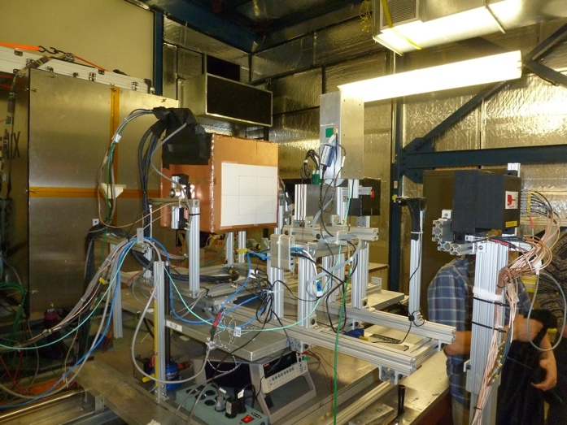
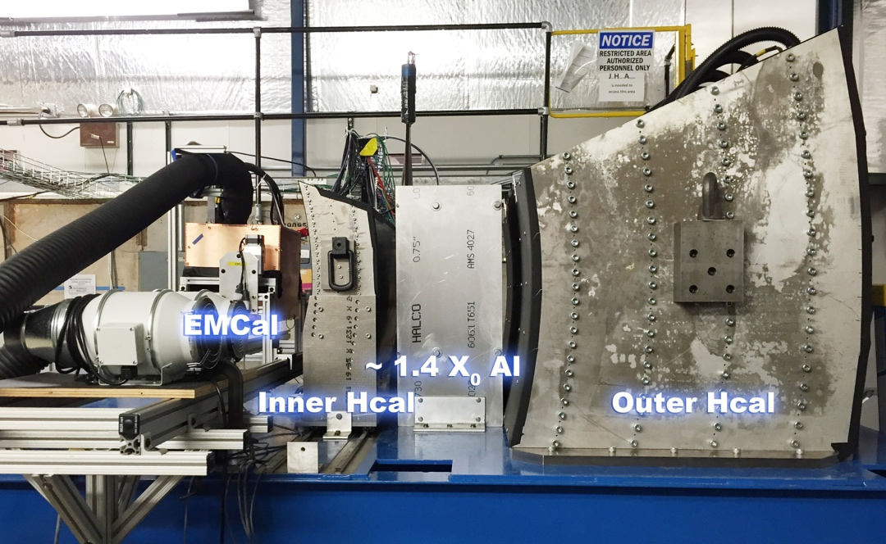
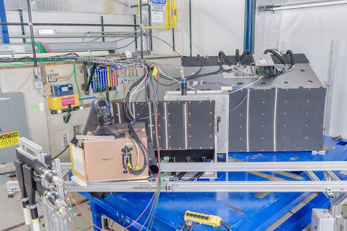
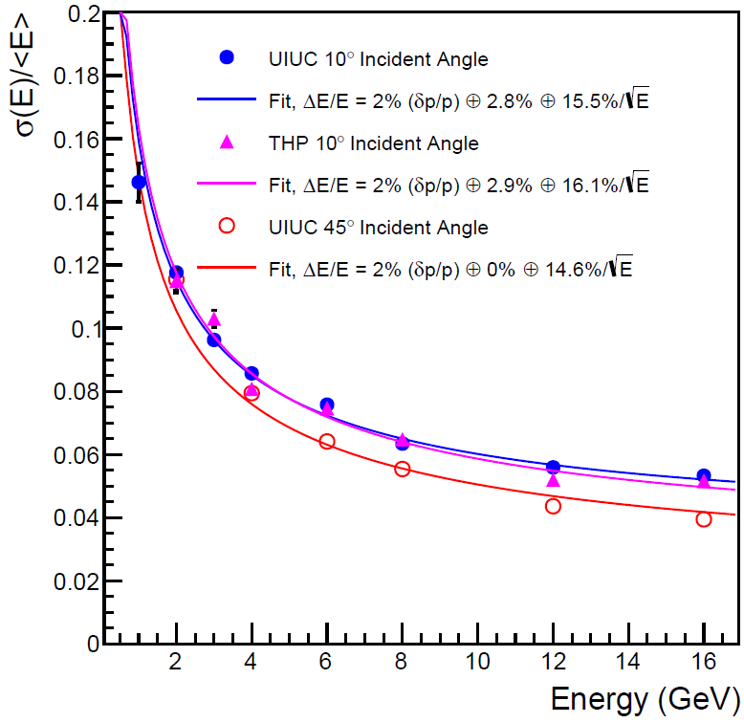
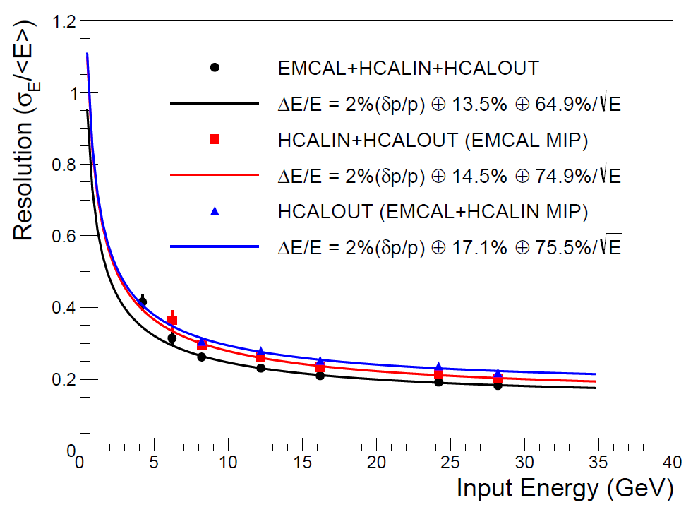
Calorimeters Beam Tests
February 2014
Proof of principle
February 2016: η~0 prototype
February 2017: η~0.9 prototype
Electron
Energy resolution
arXiv:1704.01461
Pion
Energy resolution
arXiv:1704.01461
sPHENIX beam test data
sPHENIX beam test data

Slide 11
Monolithic-Active-Pixel-Sensor based Precision Vertex Detector
-- for Open Heavy Quark Measurements

Slide 12
Evolving sPHENIX Run Plan
Champaign -2, Champaign-1

Slide 13
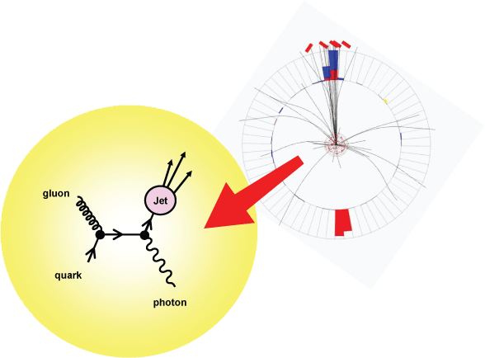
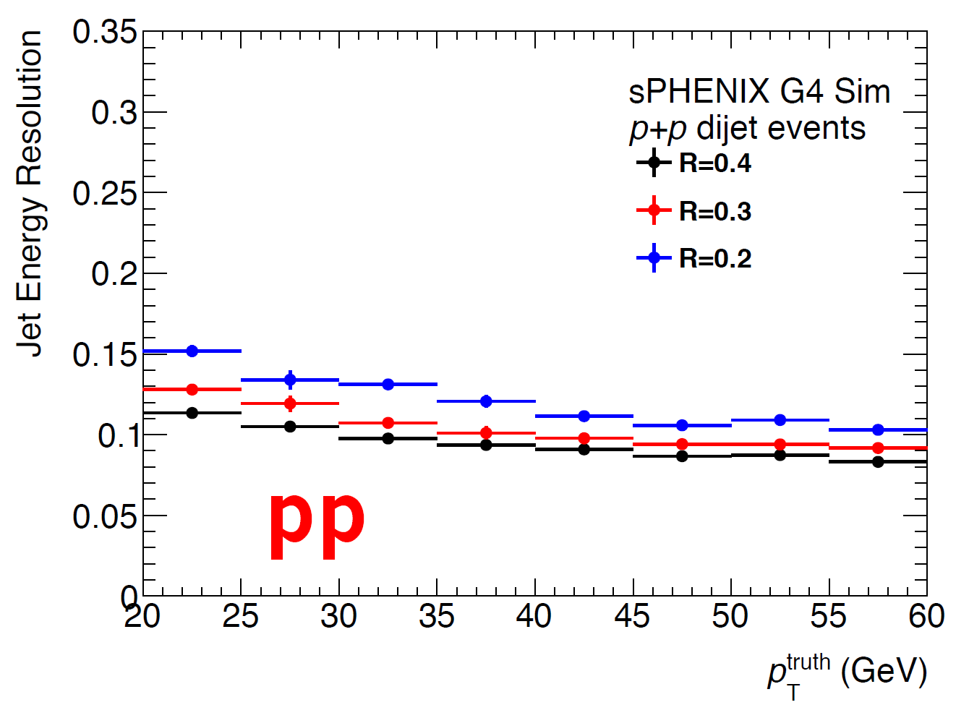
Precision Calorimetry for Jets and Photons
Jets by EMCal+HCal
Excellent jet resolution in both p+p and A+A
Photons by EMCal

Slide 14
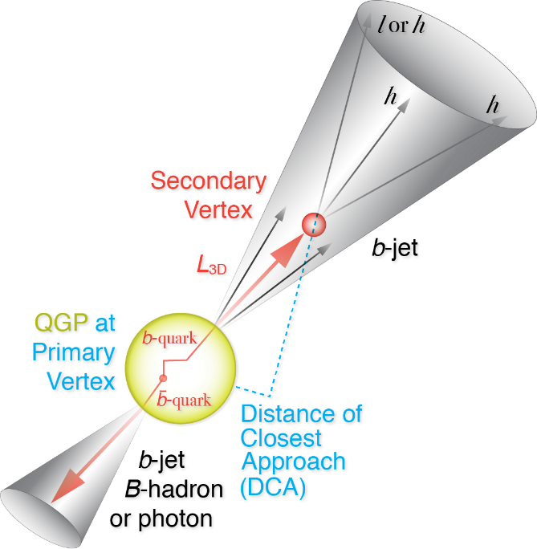
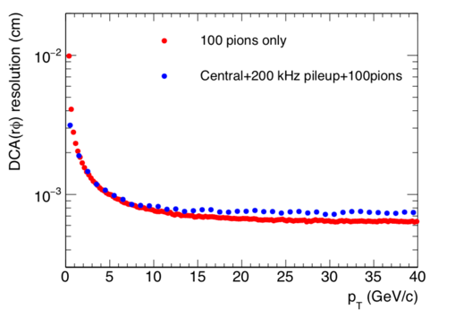
Precision Vertex and Open HF Observables
Precision vertex tracker + high rate capability
→ Precision open charm and bottom over wide scales
10um
Notes:
D_s plot … ?
Shanshan - A multi-scale approach is required for the full picture

Slide 15
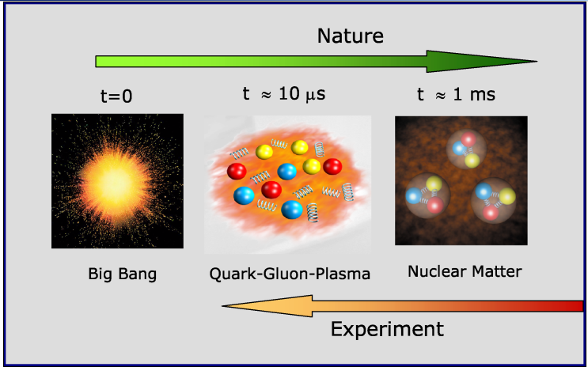
A Broad Physics Program with sPHENIX
Nuclear matter under extreme condition, “QGP”
Nucleon and nuclear structures, QCD evolution, “Cold QCD”
“Hot” QGP physics
“Cold” QCD physics

Slide 16
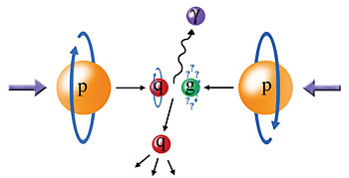
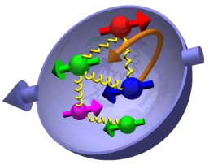
Gluon Polarization

Slide 17
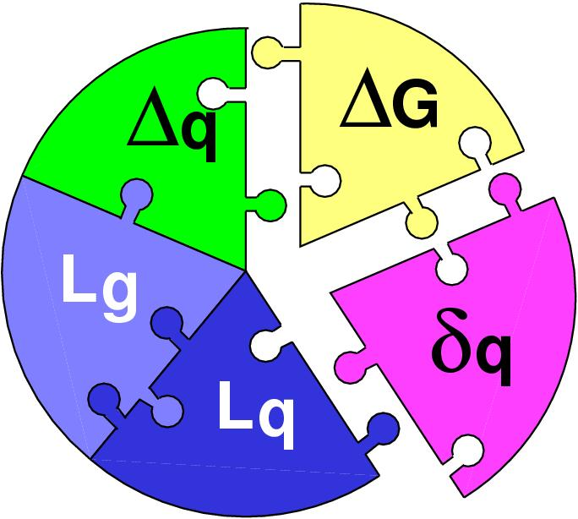
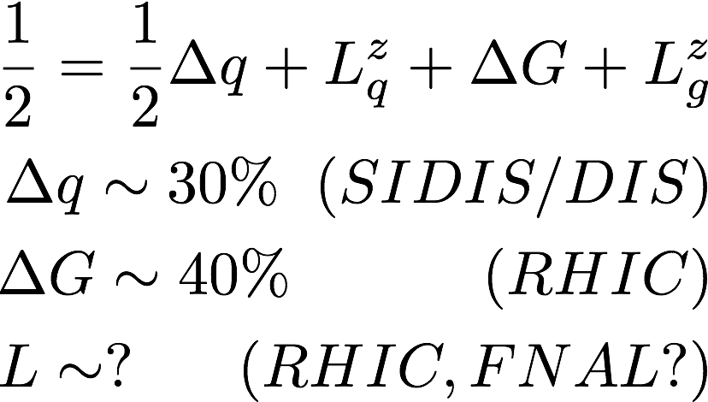
Three Decades of the Proton Spin Puzzle
Early expectation: large gluon polarization
 | Quark Spin | Gluon Spin
SLAC -> 2000 | (E80 – E155)
CERN ongoing | (EMC), (SMC), COMPASS
DESY ->2007 | (HERMES)
JLab ongoing | Hall A,B,C
RHIC ongoing | (BRAHMS), (PHENIX), STAR
Axial anomaly
Cheng & Li, PRL (1989)
EMC, 1980s
 | SIDIS/DIS
 | Polarized p+p
/hadrons

Slide 18
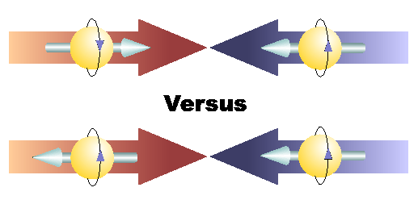
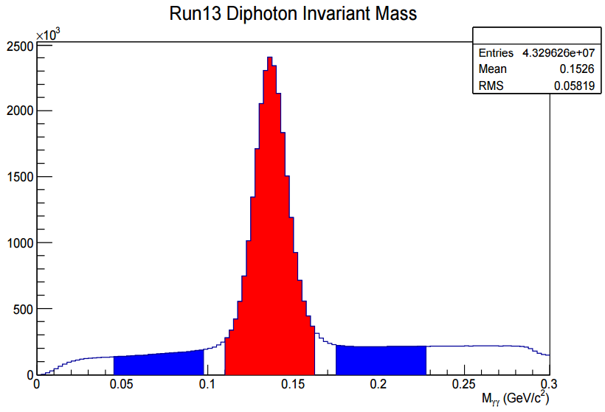
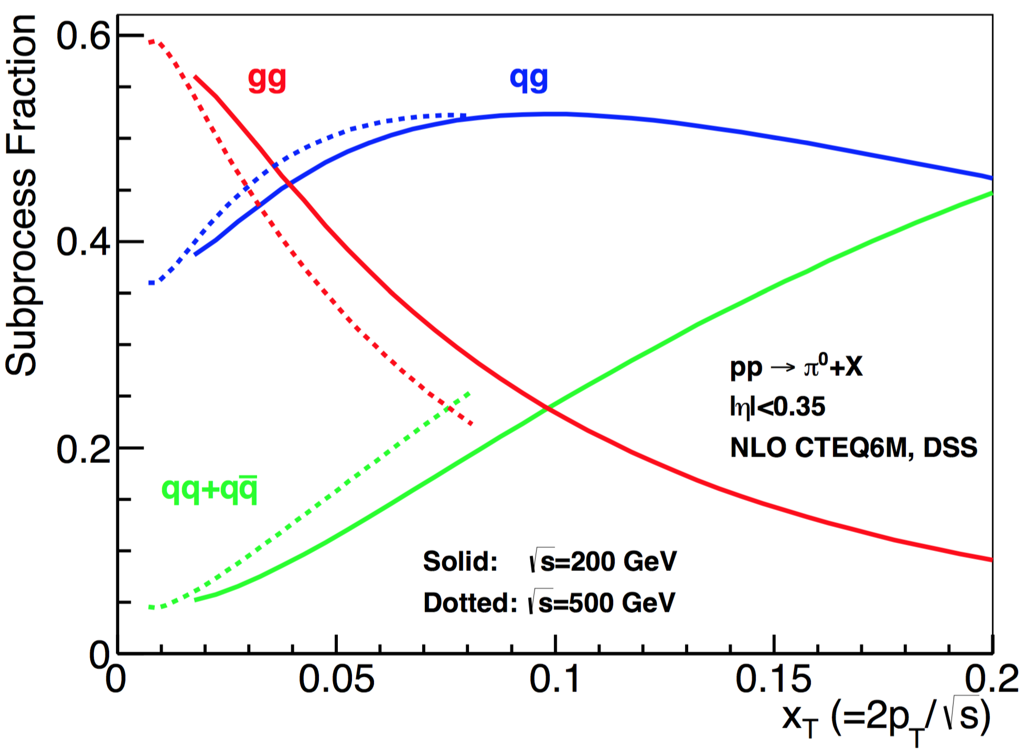

Gluon Polarization and 𝜋⁰ (or jet)A_{LL}
A_{LL}=(N⁺⁺-N⁺⁻)/(N⁺⁺+N⁺⁻)
    -- Parton distribution functions
    -- Partonic hard scattering rates
    -- Fragmentation functions
DIS
?
pQCD
e+e-
Relative fractions
Di-photon mass: 𝜋⁰ peak

Slide 19
First Hint of Non-zero Gluon Polarization from RHIC
PHENIX and STAR A_{LL} data
STAR: PRL 115, 092002 (2015)
@ Q² = 10 GeV²
PRL 113, 012001 (2014), DSSV
PHENIX: PRD 90, 012007 (2014)
Run 2009
p+p@200GeV

Slide 20

RHIC Multi-Year Plan: sPHENIX 2023-2027+
(Cold QCD plan under development now)
Jets, hadrons, direct photons and more
Study gluon polarization
Ref: RHIC 2015 pp200
Recorded lumi ~50pb⁻¹

Slide 21
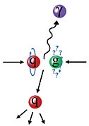
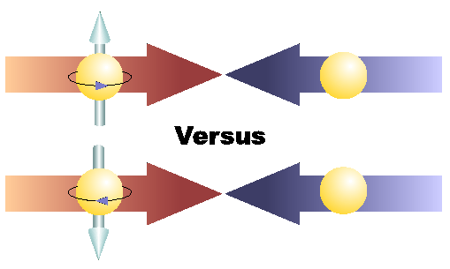
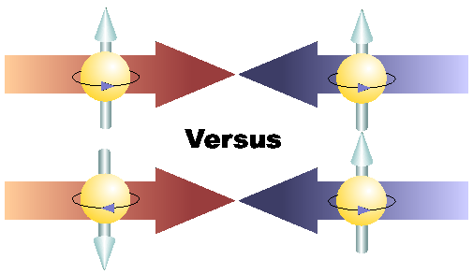
Physics with Transversely Polarized p+p Collisions at RHIC

Slide 22
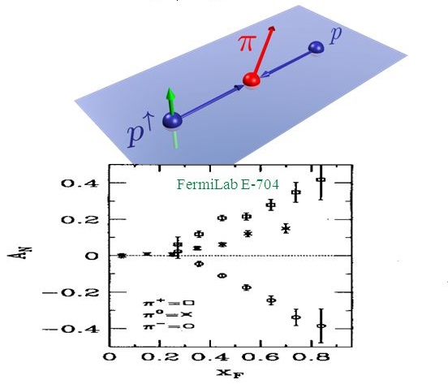
“TMD” phenomena: The Challenge of “Too Large”
Large Transverse Single Spin Asymmetry (TSSA) in forward hadron production persists up to top RHIC energy
Kane, Pumplin, Repko (1978)
A_{N} ~ O(10%)
Fermilab
E704 (1991)

Slide 23
Probe the Underlying Physics via Hard Scatterings
TMD, Collinear Twist-3 Factorizations
(i) Sivers mechanism:
correlation proton spin & parton k_{T}
(ii) Collins mechanism: Transversity × spin-dep fragmentation
SIDIS:
S_{P}
Phys Rev D41 (1990) 83; 43 (1991) 261
S_{P}
Nucl Phys B396 (1993) 161
S_{q}
p
k_{T,q}
p
p
p
S_{q}
k_{T,π}
pp:
Collinear Twist-3 (RHIC): quark-gluon/gluon-gluon correlations

Slide 24
Collins-Like Asymmetry Observed
in Jet in p+p Collisions
Inclusive hadron A_{N} = 0 at central rapidity
Projections for sPHENIX in progress;
-> Inclusive single hadron TSSA in p+p seems
mostly from Twist-3 Collins function
None-zero “Collins-like” TSSA at central rapidity in jet!

Slide 25
Probe Gluon TMD with D⁰
Charm is unique probe of gluon TMD
D⁰_AN→ Tri-gluon correlation
PHENIX, DOI:10.1103/PhysRevD.95.112001
sPHENIX projection

Slide 26
Forward Upgrade Proposal
Forward upgrade will bring in new physics capability – TMD, small-x physics etc.
sPHENIX Barrel Detectors:
MVTX, INTT, TPC
EMCal, HCal
sPHENIX Forward Upgrade
EMCal, Hcal, Tracking

Slide 27
Access Sivers and Collins with Jet and Hadron Azimuthal Distributions in Transversely Polarized p+p Collisions
Feng Yuan, PRL 100, 032003 (2008)
Umberto D’Alesio et al PRD 83 034021 (2011)
→ “Sivers-like” (Jet)
→ “Collins-like” (hadron)

Slide 28
Precision Charged Tagged Jet TSSA
Naïve direct mapping
from SIDIS Sivers (GPM)
- “u-quark jet” A_{N} >0
With process-dependence
from SIDIS Sivers (Twist-3)
- “u-quark jet” A_{N} < 0

Slide 29
Drell-Yan in the Forward Rapidity: p+A

Slide 30
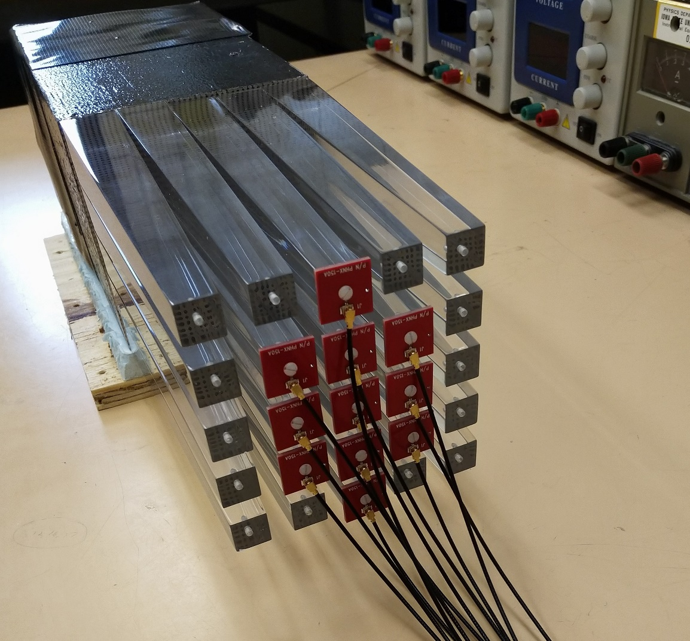
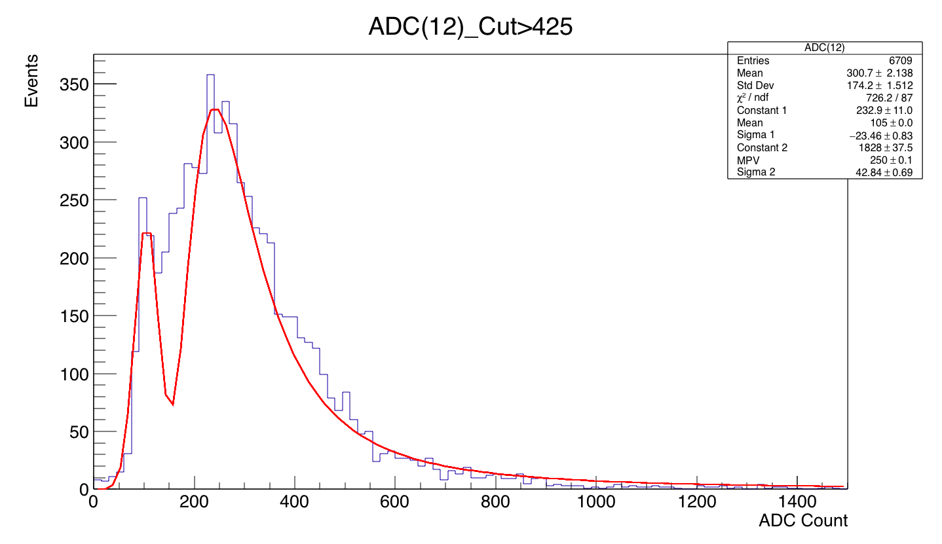
Forward EMCal R&D
- Recycled Modules from AGS/E864
Use the existing E864 HCal modules for high density and
high granularity EMCal
- Compensating SPACAL design: 10x10x117 cm³
- X0=7.8mm, RM=2cm
- 5x5 light guide array for 10x10 cm² modules => 2x2 cm²
- 117 cm long => 7 cuts for 16 cm long modules (20 X0)
Cosmic Ray Landau plus Pedestal
(fit to Gaussian + Landau)

Slide 31
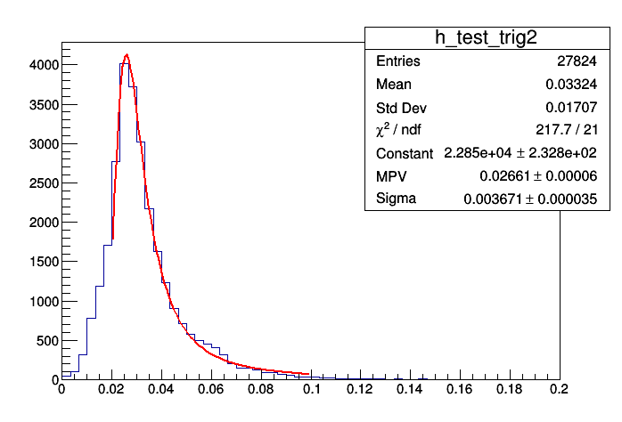
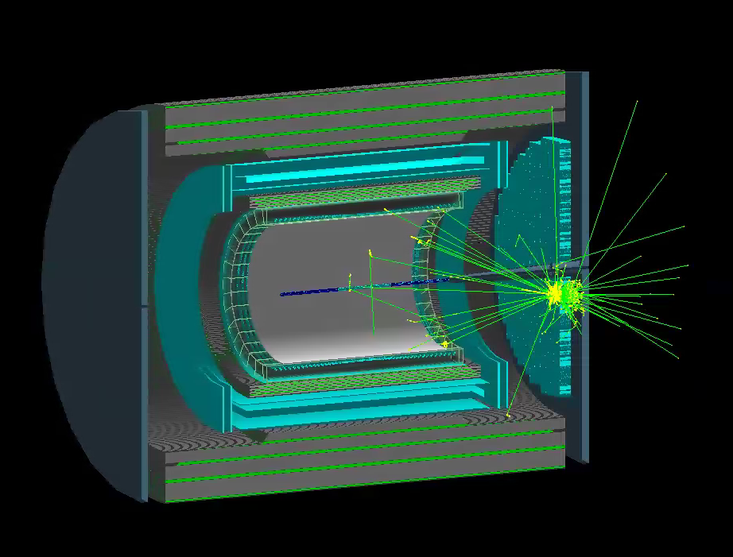
Forward EMCal Simulations and Calibration
Cosmics energy response determined with vertical muons down into fEMC stack in standard G4 setup (3% sampling):
Full simulation setup exists in G4:
30 GeV photon
shower in G4
deposited energy (GeV)
MPV is 26.6 MeV
~3 pixels/0.0266 GeV =
113 SiPM pixels/GeV
NIM A 406 (1998) 227-258:
136 +/- 5 p.e. /GeV
(BCF-10, cosmics)
217 +/- 68 p.e. /GeV
(BCF-12, laser)

Slide 32
Forward Hadronic Calorimeter R&D
Essential for forward jet reconstruction, hadron energy measurement, and triggering
Collaboration with UCLA group for STAR upgrade and EIC detector R&D

Slide 33
HCal Prototype Test Beam Results

Slide 34
sPHENIX at Electron Ion Collider (EIC)
A Day-1 EIC Detector based on sPHENIX

Slide 35
Summary and Outlook
A great opportunity for new collaborators to join the sPHENIX experiment!
Baseline detectors
Forward upgrade
An EIC detector

Slide 36
The Growing sPHENIX Collaboration

Slide 38
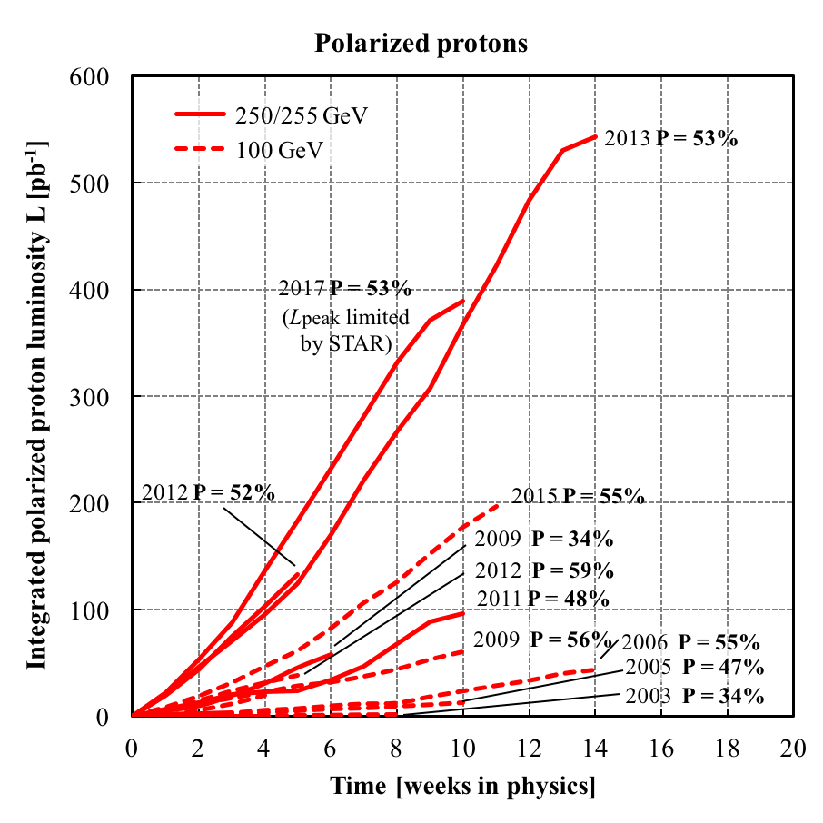
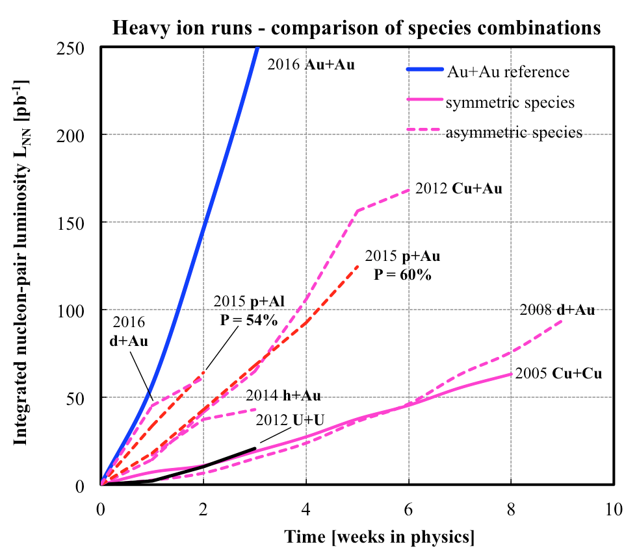
History of RHIC Runs
RHIC is capable of delivering the polarized p+p/A for precision spin, CNM physics
A very challenging task to deliver polarized p+p, excellent performance from 2012+
Longitudinally and transversely polarized p+p,
Transversely polarized p+Au and p+Al, in 2015
10/13/14
Notes:
Our physics analysis efforts are closely tied to the RHIC beams operations
Took “BNL” 10 years to reach the mechine performanvec goals ..
38

Slide 39
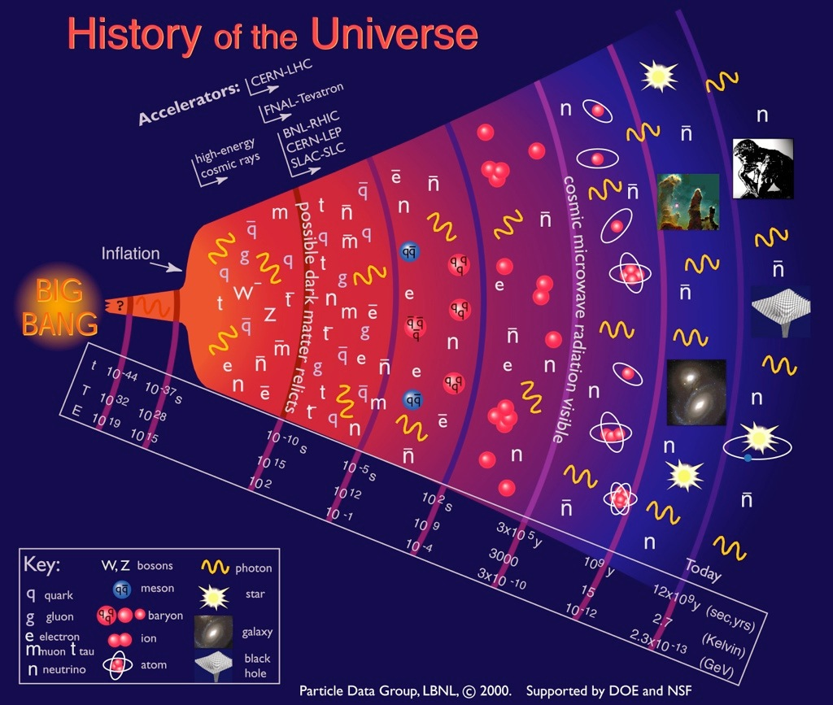
Quark-Gluon
Plasma (QGP)

Slide 40
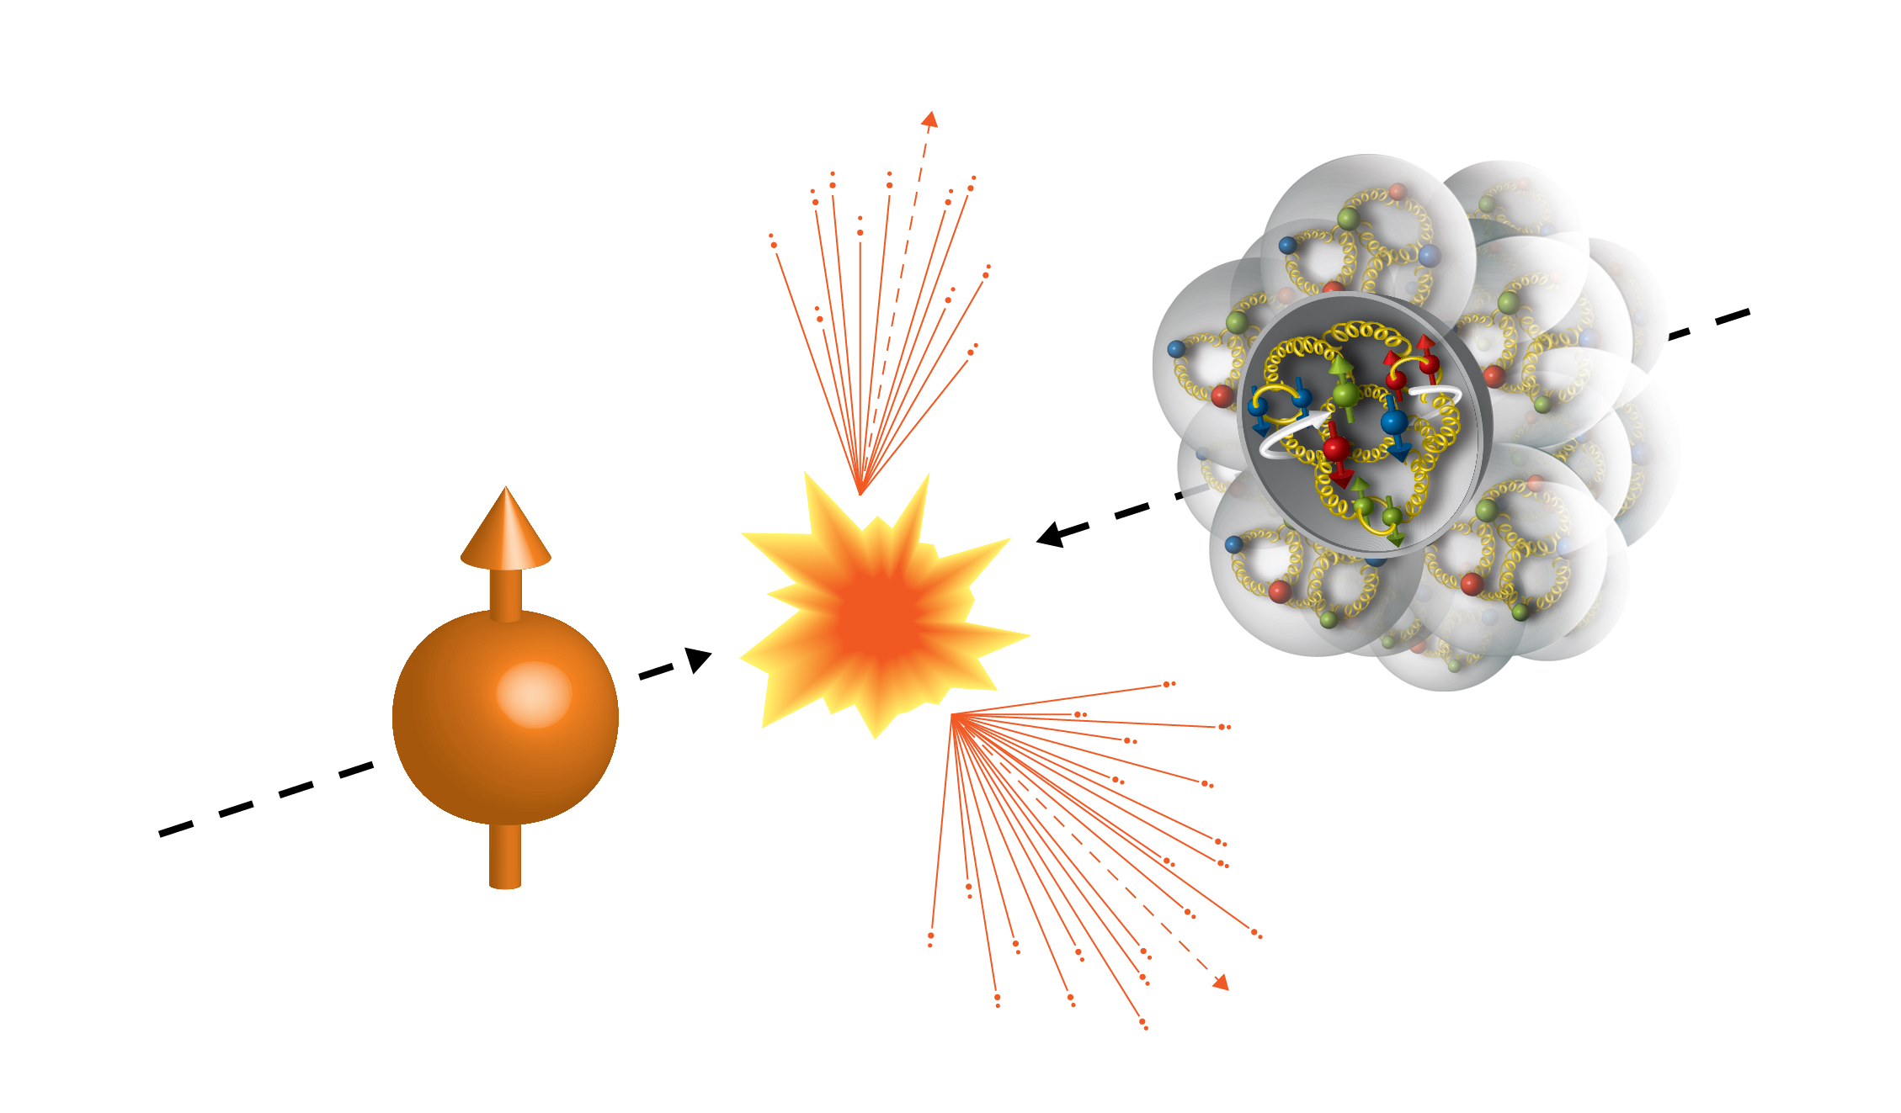
First Transversely Polarized p+A collisions at RHIC
Run15 (2015)
100GeV/nucleon
Au, Al
100GeV
 | # of proton | # of neutron
p | 1 | 0
Al | 13 | 14
Au | 79 | 118
Transversely Polarized Proton

Slide 41
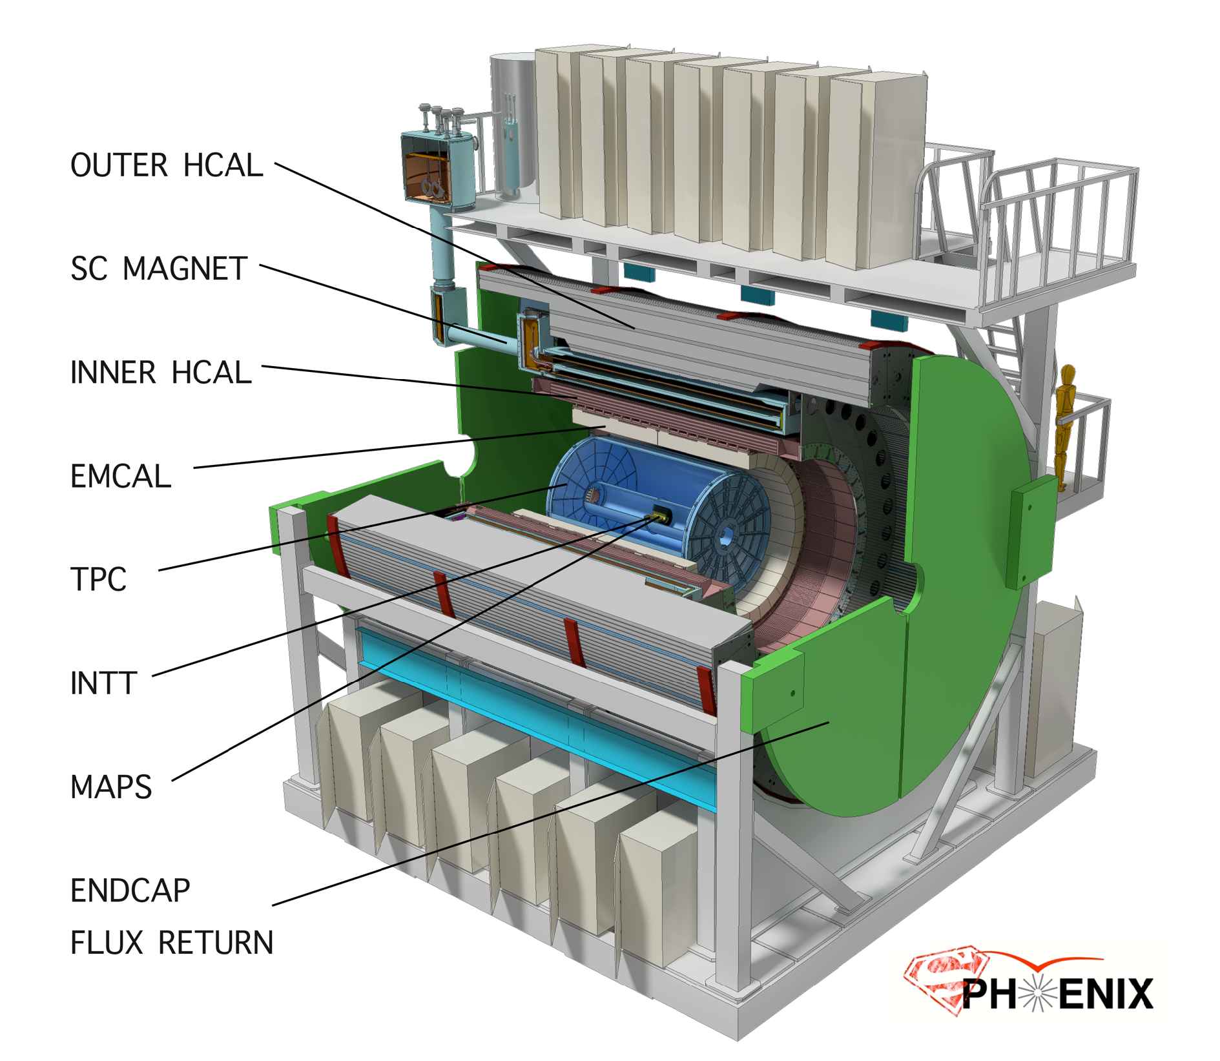
sPHENIX: a State of the Art Detector for Heavy Ion Physics at RHIC
CD-0/Science Case Sept 2016
Construction Phase Jul 2018 -22
Ready for Beam Jan 2023
Space preserve for
future Particle ID
MVTX

Slide 42
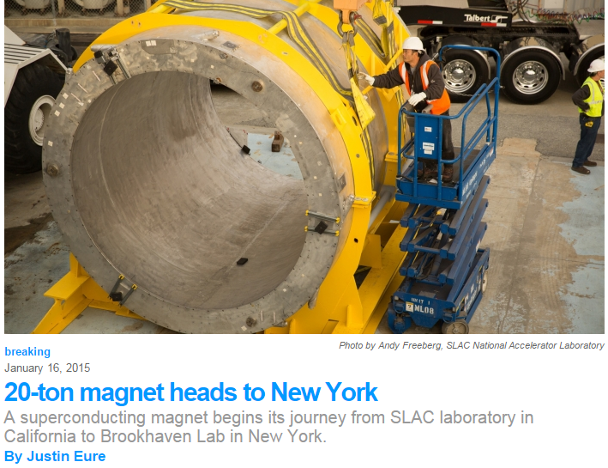
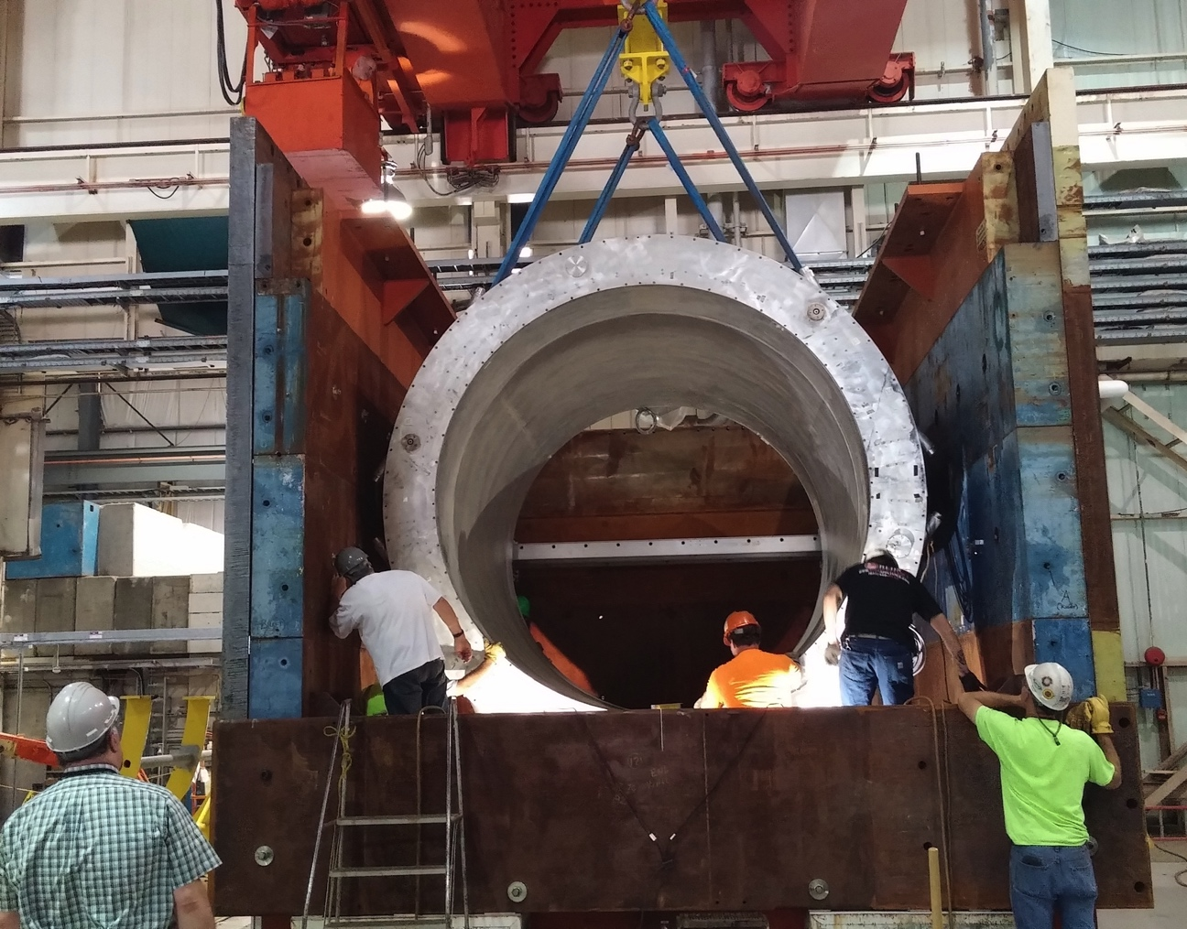

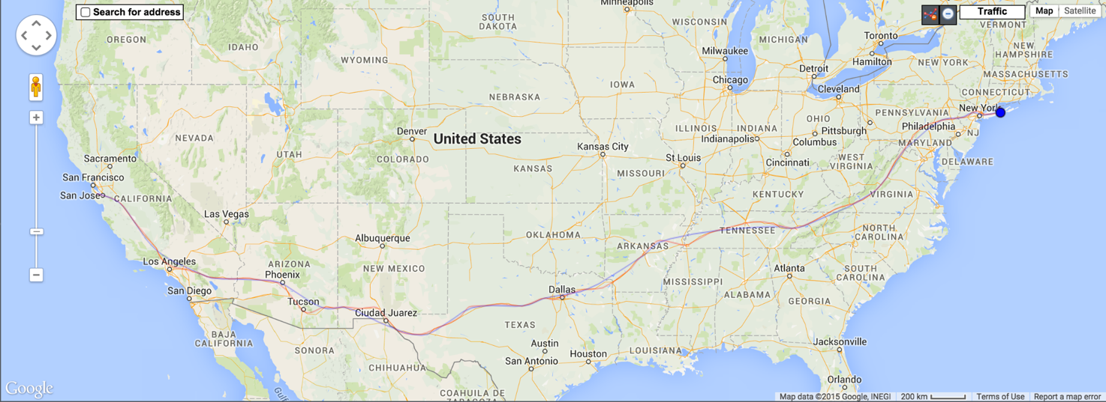

Super conducting magnet
1.4 Tesla magnet, Ф = 2.8 m, L = 3.8 m Previously used in BaBar @ SLAC
Moved to BNL in Feb 2015
Successful cold low field test in 2016
Full field test in 2018
Preparing full field test @ BNL

Slide 43
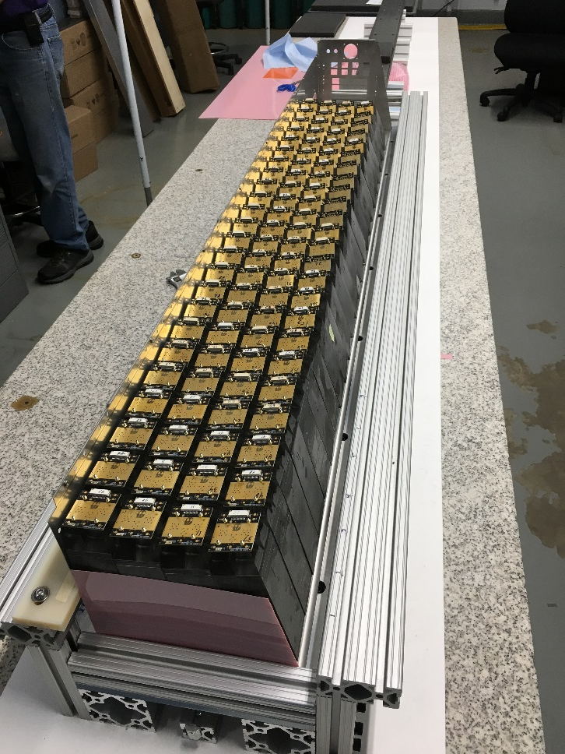
Assembly of EMCal Sector 0
Sector 0 cooling system
Sector 0 assembly continues to make good progress at BNL.
Fit-up of the Sector electronics cooling system underway
Sector 1 block construction ongoing at UIUC
Assembly of Sector 0 at BNL

Slide 44
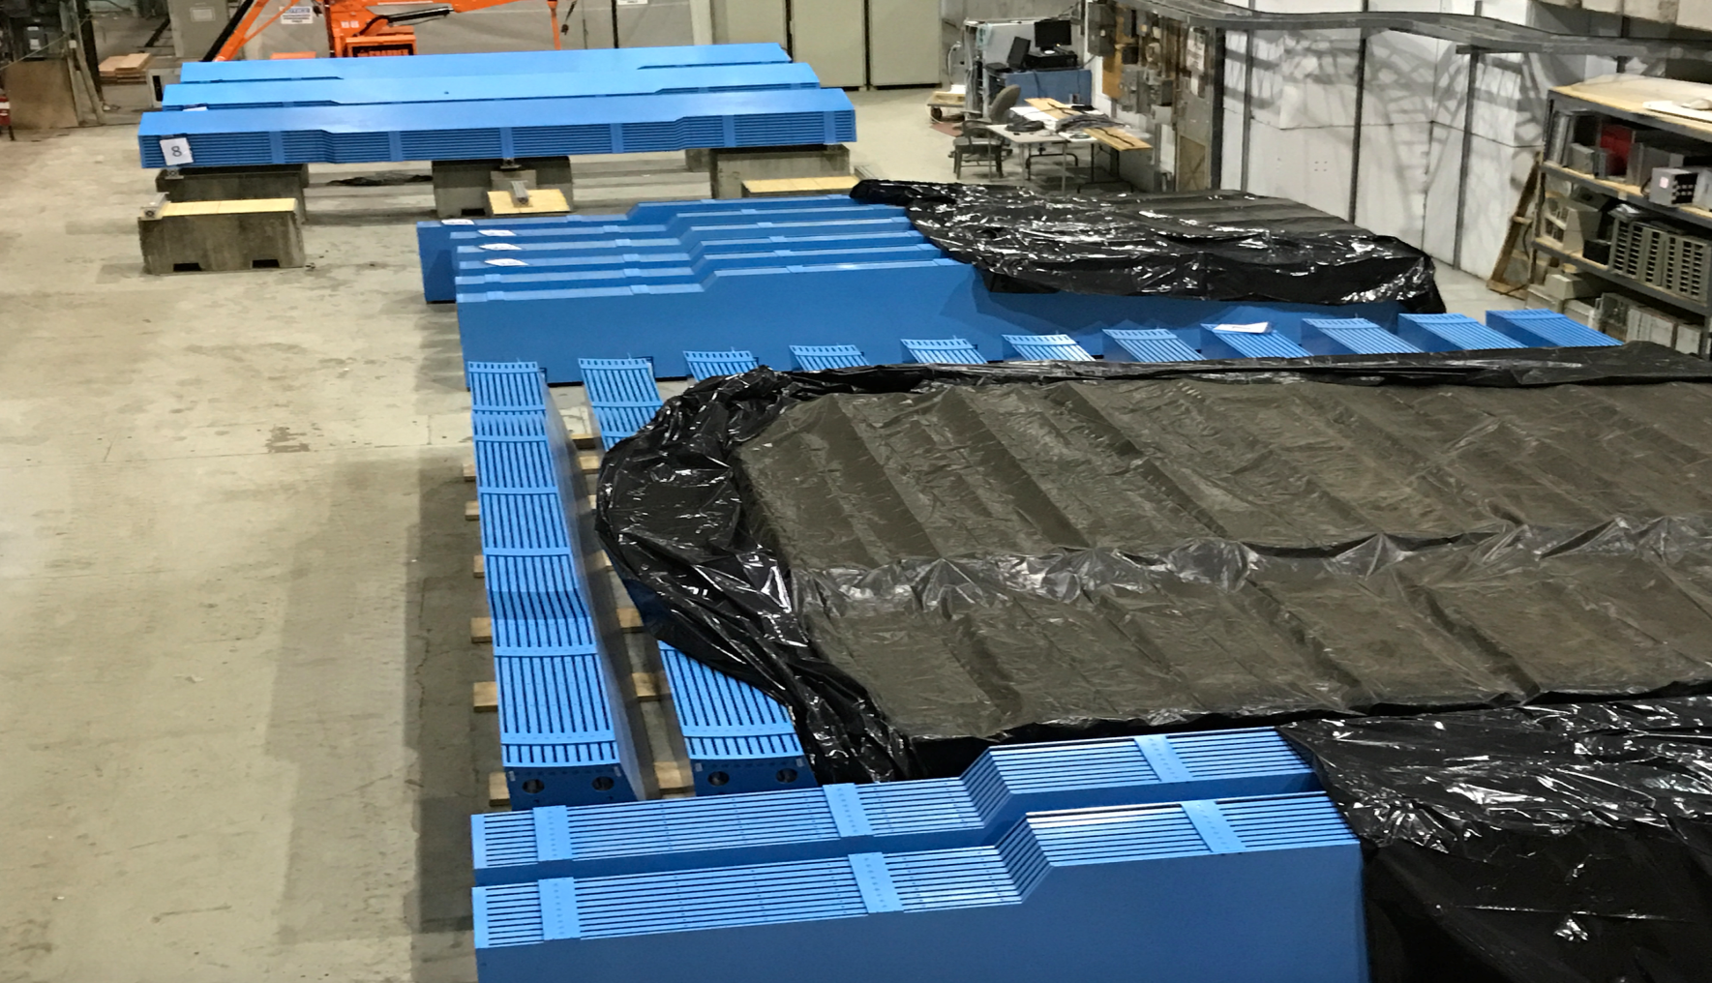
All 32 Barrel Magnet Steel Sectors at BNL

Slide 45
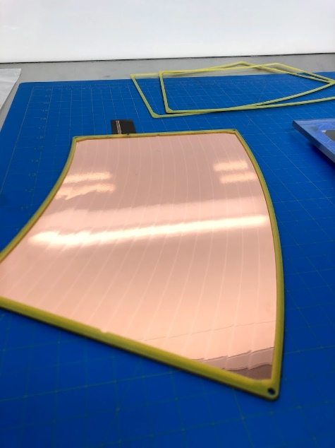
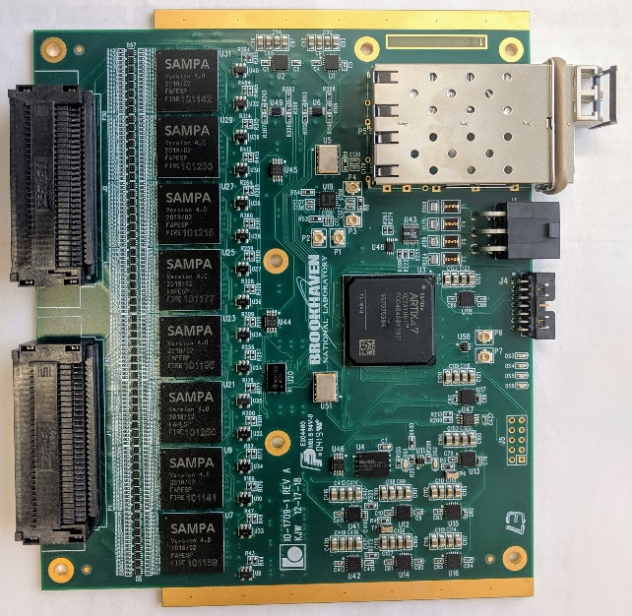
TPC Preproduction Components
Left: TPC R2 module four-layer GEM stack used in the test beam. Right: Preproduction TPC FEE cards carrying eight SAMPA version 4 chips, an Artix-7 FPGA, and double SFP+ links.

Slide 46
sPHENIX 3 Physics Pillars
Jets
Upsilons
Heavy Quarks

Slide 47
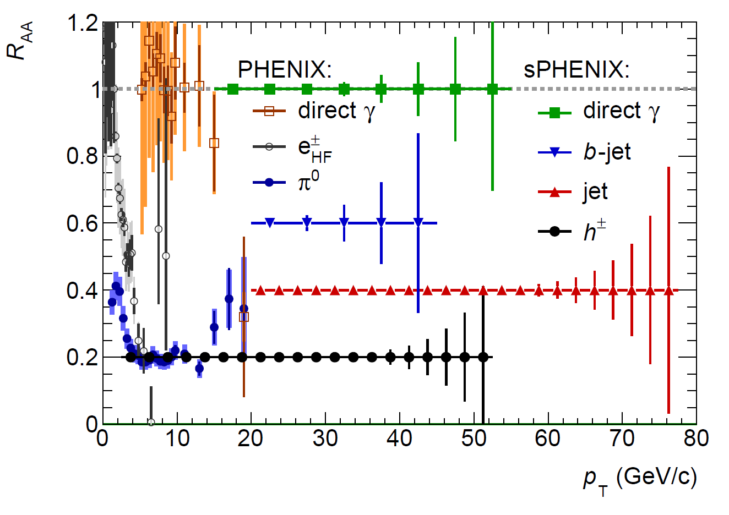
A Broad Physics Program with Jets @sPHENIX
Parton Mass and Flavor Dependence of Jet Suppression and more

Slide 48
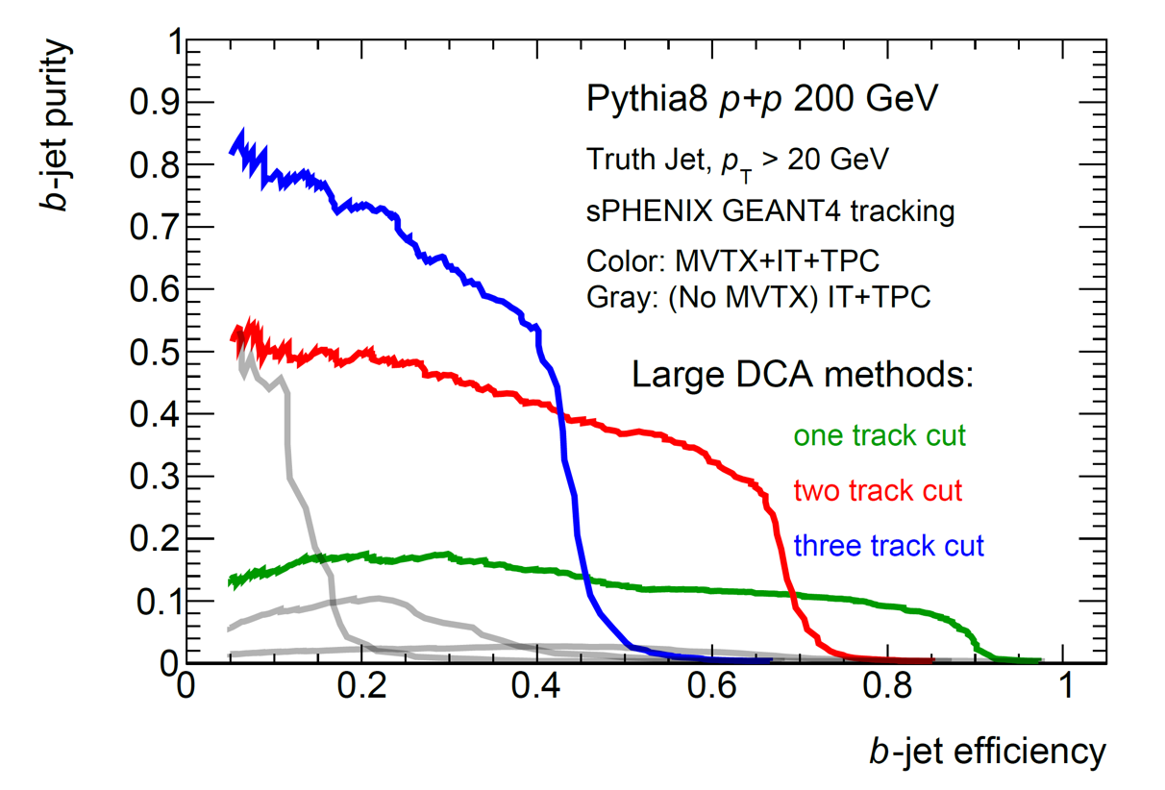
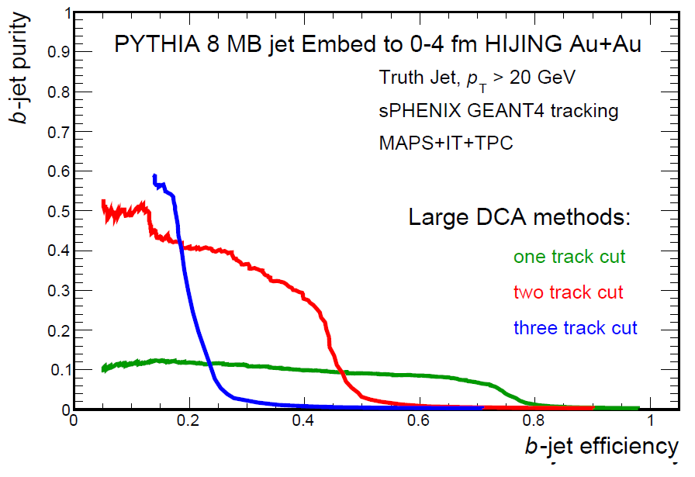
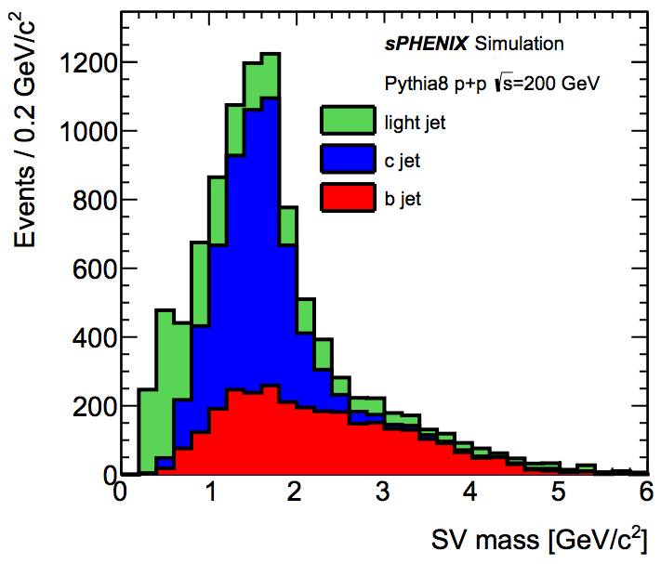

B-jet tagging
Multi-tracks w/ large DCA
2nd vertex mass reco’d
CMS work-point, Phys. Rev. Lett. 113, 132301 (2014)

Slide 49


Toward a Unified Picture of Nucleon Structure
Momentum and Spatial Tomography
Some data, recent progress
Good data, long history
F(r,Q²)

