Slide 1
Latest Development in High Energy Nuclear Physics at RHIC
Ming Xiong Liu
Los Alamos National Laboratory

Slide 2
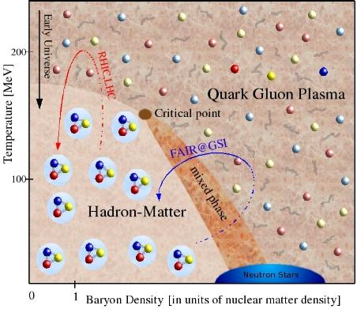
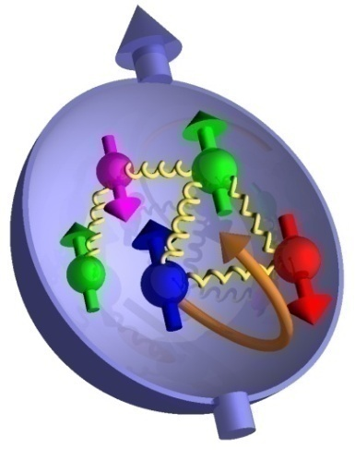
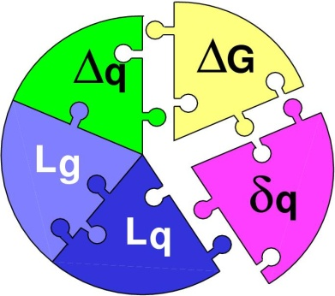
Outline
Physics of Quark Gluon Plasma
  Highlights from RHIC and LHC
  Parton energy loss in QGP
  RHIC, LHC, FNAL etc.
Spin Physics
  Polarized Nucleon structure
  Novel QCD phenomena and Spin Asymmetry
  RHIC-spin, pol-DIS
Future Prospects
  Super-PHENIX and Super-STAR
  eRHIC

Slide 3

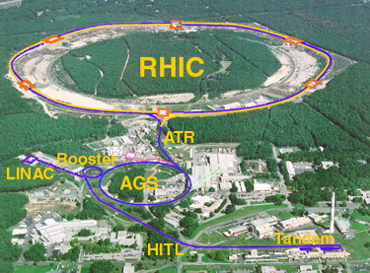
The Relativistic Heavy Ion Collider
at Brookhaven National Laboratory
RHIC’s First Decade: A discovery Machine
HI
New state of matter
QGP
De-confinement
…
polarized proton
Nucleon Spin Structure
Spin Fragmentation
pQCD
…
RHIC is a QCD Lab
BRAHMS
PHENIX
STAR

Slide 4
Highest Energy Polarized Proton Collider @RHIC
Absolute Polarimeter (H jet)
RHIC pC Polarimeters
Siberian Snakes
PHOBOS
BRAHMS
Siberian Snakes
Spin Flipper
STAR & pp2pp
PHENIX
Spin Rotators
Partial Snake
Helical Partial
Snake
Energy: up to 500GeV
Pol: 70%
Polarized Source
Strong Snake
LINAC
AGS
200 MeV Polarimeter
BOOSTER
Rf Dipole
AGS Internal Polarimeter
AGS pC Polarimeter

Slide 5
RHIC History
First Au+Au run: 2000
First polarized p+p run: 2003

Slide 6
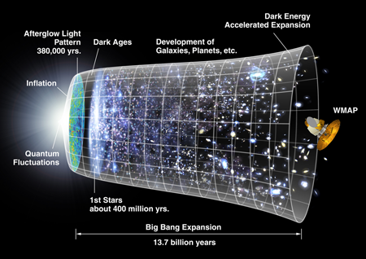
The Big Bang

Slide 7
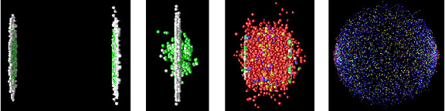
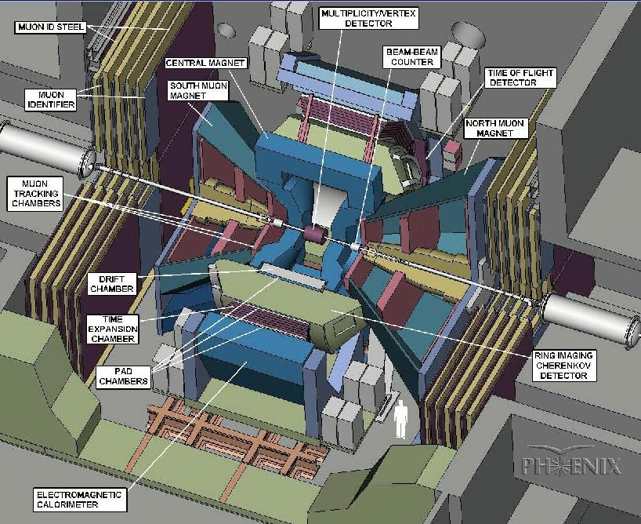
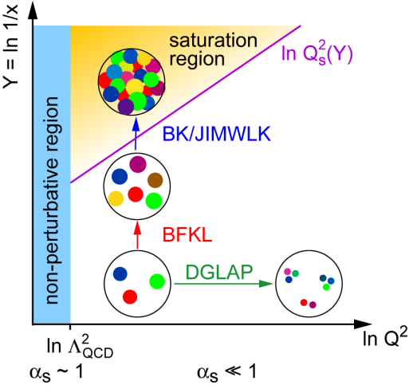
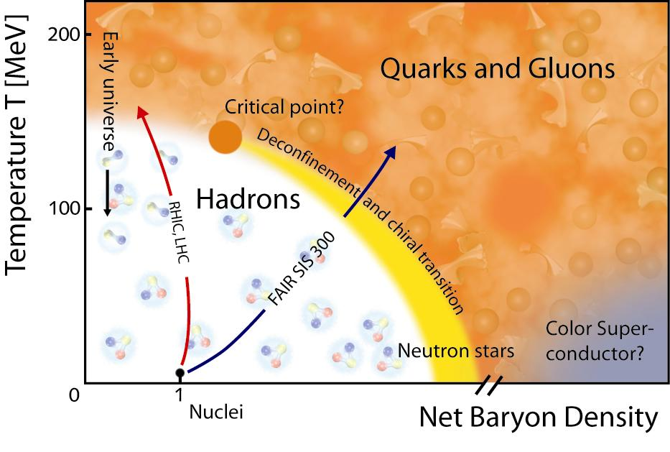
The Goals of Little Bang: QGP Physics
- Understand the Properties of QGP
- Explore the QCD phase diagram
Before collision
Initial state
CNM effects
QGP
Hadron gas
Hadrons detected
Heavy Ion Collision – Time Evolution
Time (fm/c)
1 10
- Gluon saturation
- Parton shadowing
- CNM Parton energy loss

Slide 8
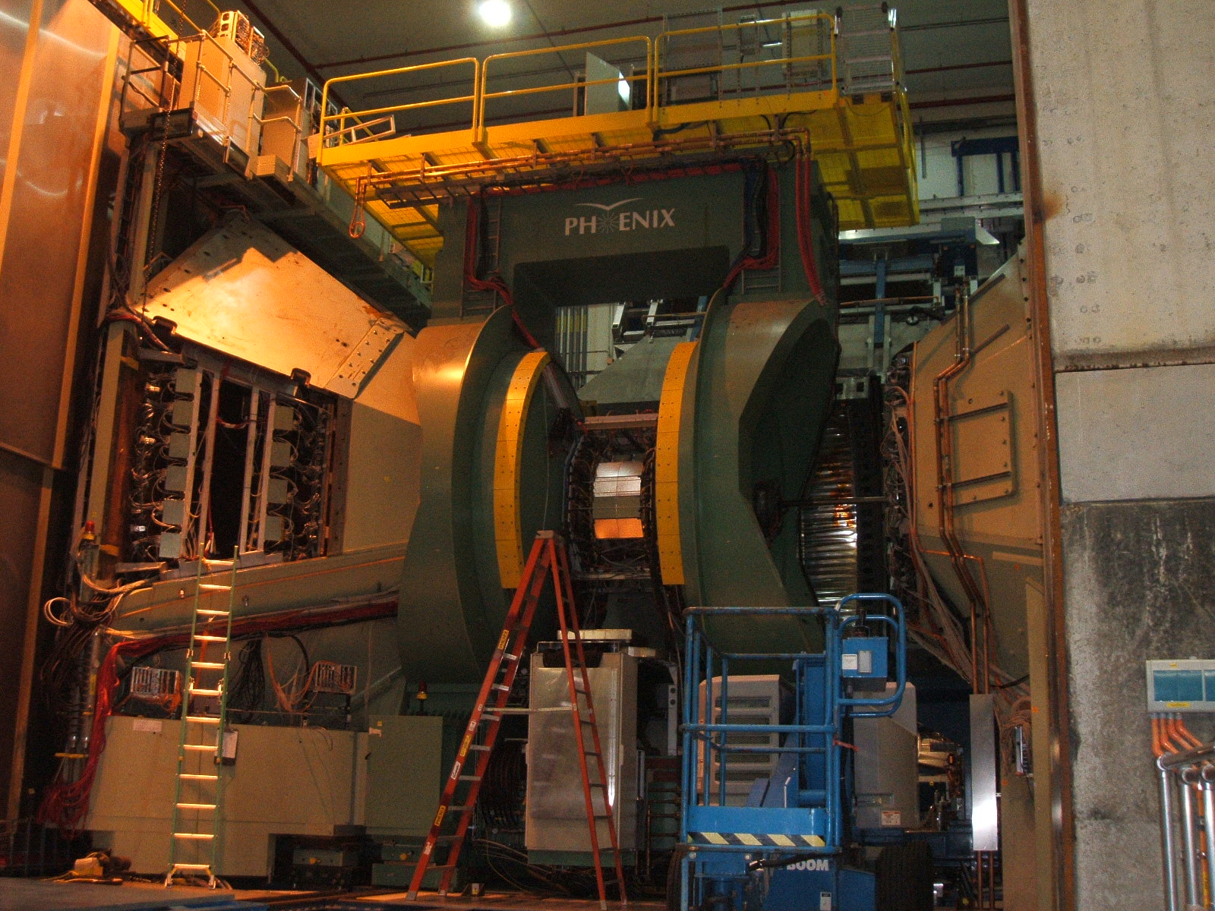
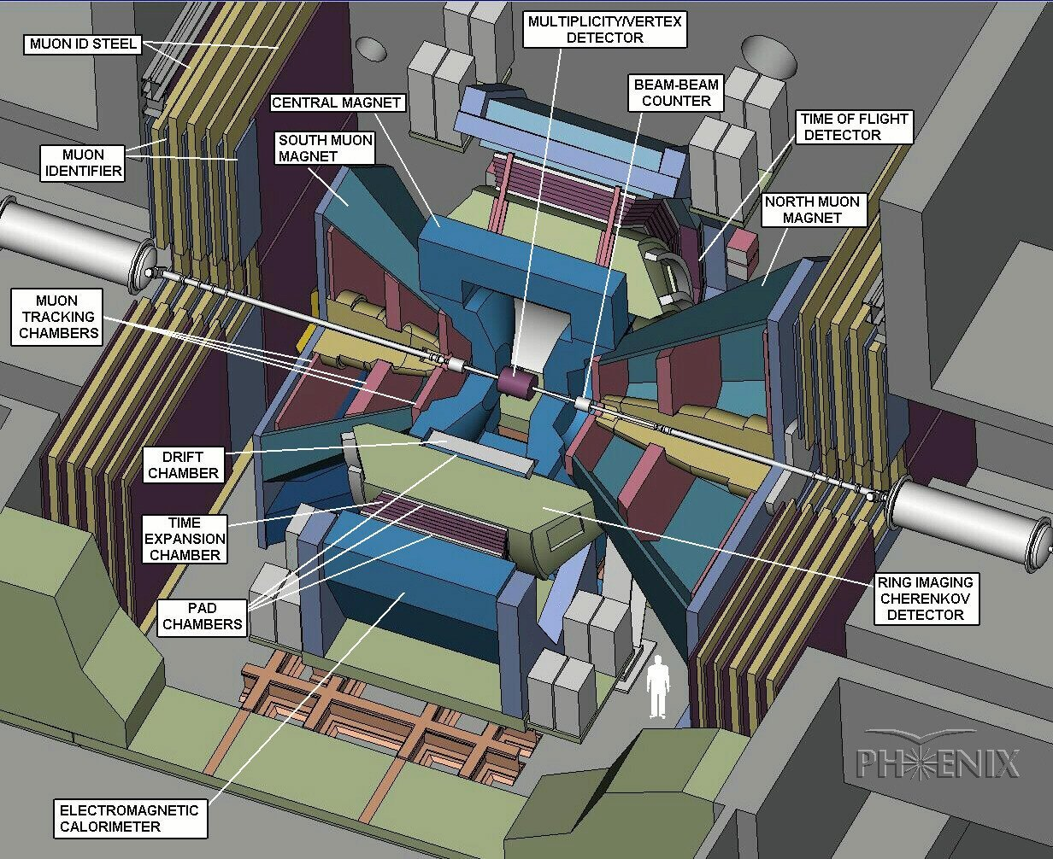
Rapidity Coverage : 1.2 < η < 2.2(4)

Slide 9

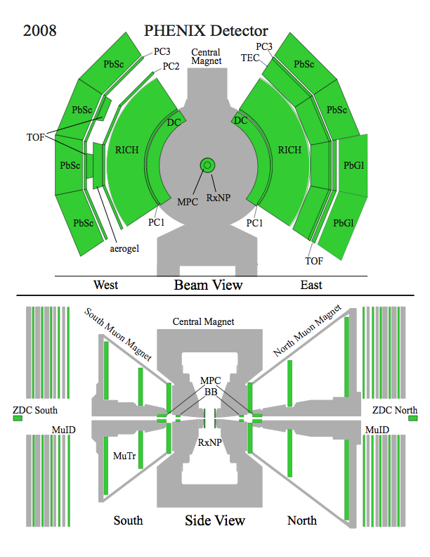
The PHENIX Detectors
Philosophy:
  High rate capability to measure rare probes,
  limited acceptance.
2 central spectrometers
  Track charged particles and detect electromagnetic processes
2 forward muon spectrometers
  Identify and track muons
2 forward calorimeters (as of 2007!)
  Measure forward pions
Relative Luminosity
  Beam-Beam Counter (BBC)
  Zero-Degree Calorimeter (ZDC)

Slide 10
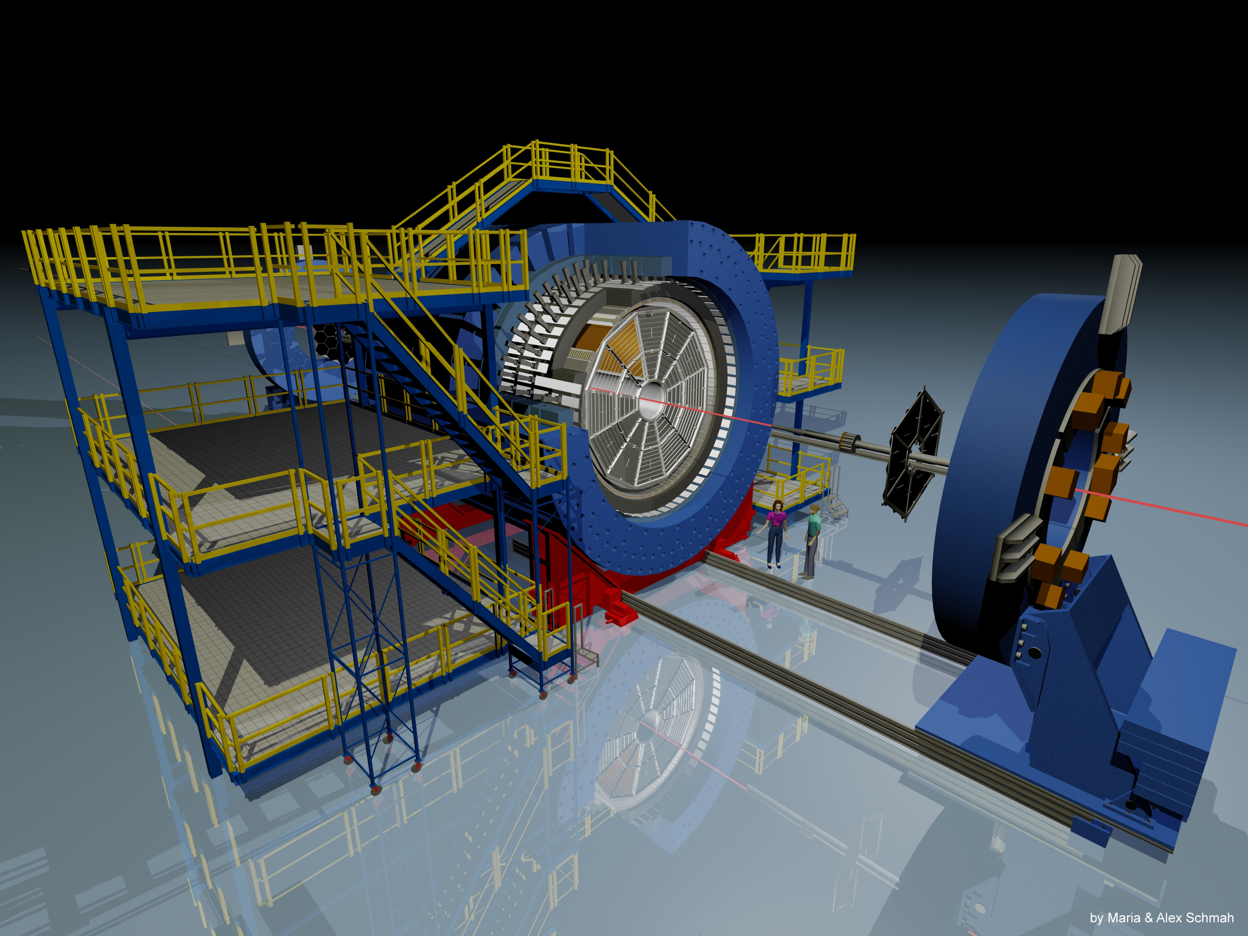
STAR Detector Setup and Key Components for This Search
Tim of Flight Barrel (TOF)
Tim Projection Chamber (TPC)
Computing device : High Level Trigger (HLT)

Slide 11
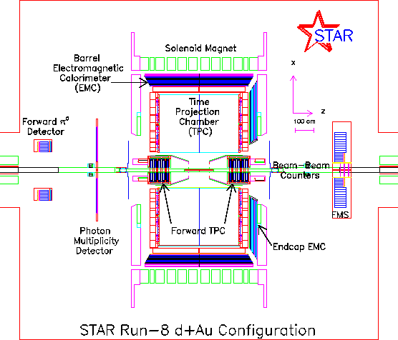
The STAR Detectors
PHOBOS
BRAHMS &PP2PP
PHENIX
RHIC
1.2 km
STAR

Slide 12
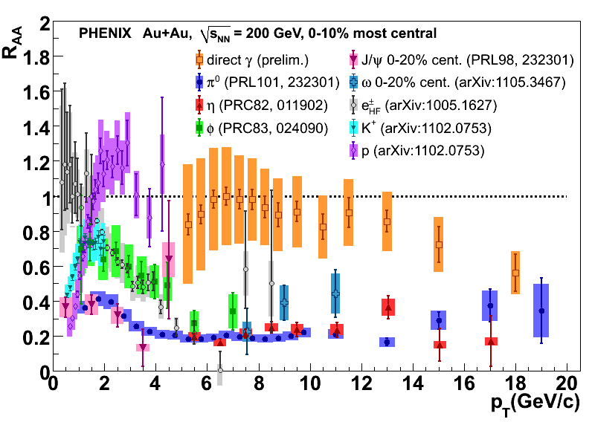
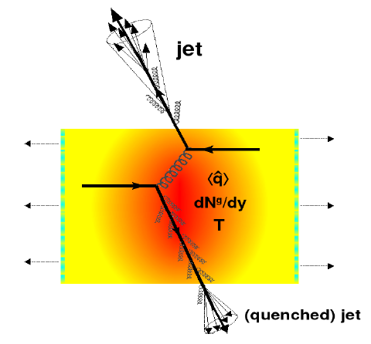
Parton Energy Loss and Hadron Suppression
High density QGP is created in Au+Au collisions at RHIC
❖

Slide 13
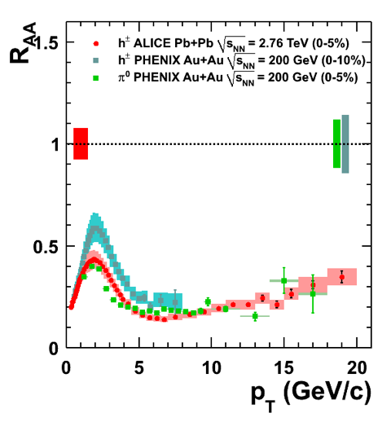
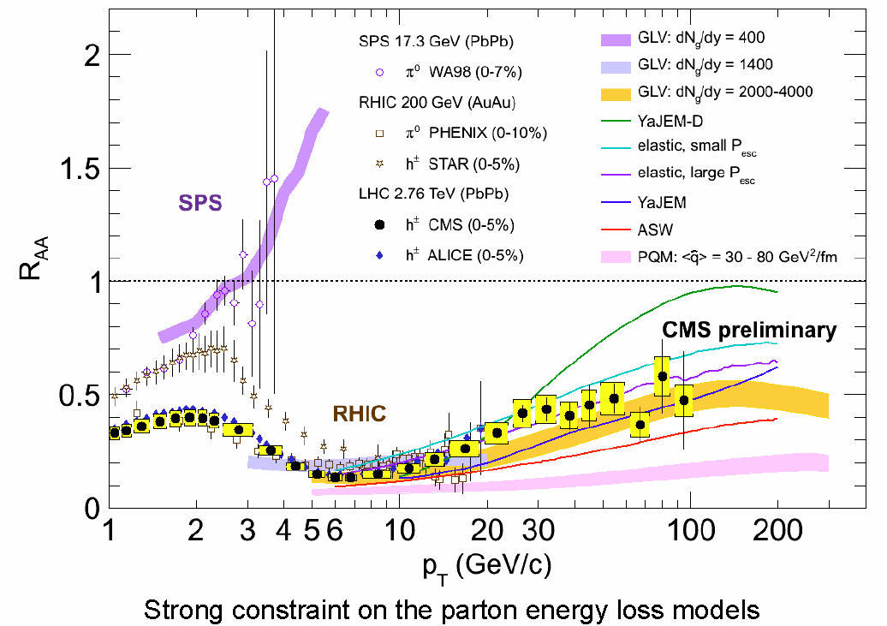
Single Hadron R_{AA}
RHIC (200GeV) vs LHC(2.76 TeV)
0-5% ALICE with 0-5% PHENIX Centrality
Minimum RAA is ~0.1 at pT~6 GeV/c; stronger suppression than RHIC (RAA~0.2)
Rise to RAA ~ 0.5 at pT~30-40 GeV/c and stay constant (?)
sPHENIX can measure pi0 and jets up to 40 GeV where RAA saturate.

Slide 14
Di-hadron correlations
Back-to-back dihadrons
h

Slide 15
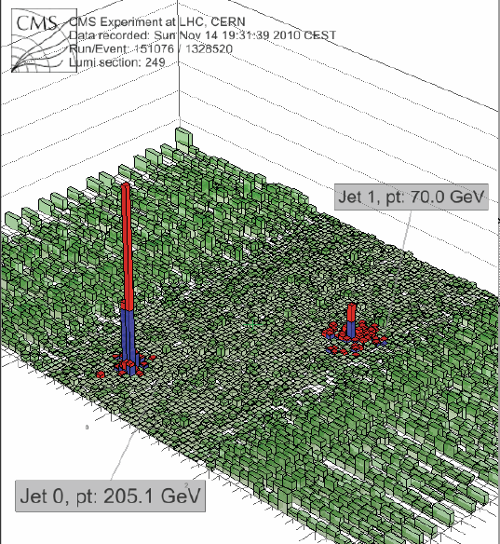
New Development
Full Jet Measurements @LHC
High energy back-to-back jets in Pb+Pb Collisions

Slide 16
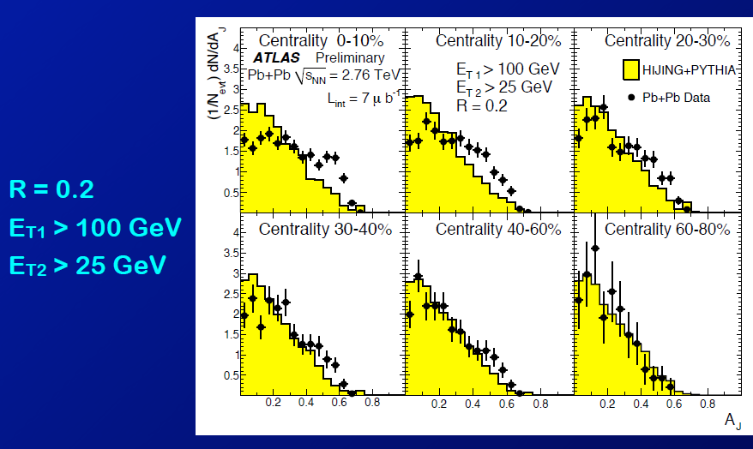
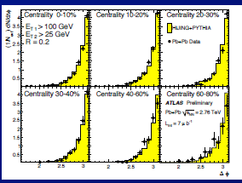
Di-Jet Correlations
Large Jet energy asymmetry but No significant change in correlation
h
Large jet energy asymmetry
Little change in di-jet angle correlation Δφ

Slide 17
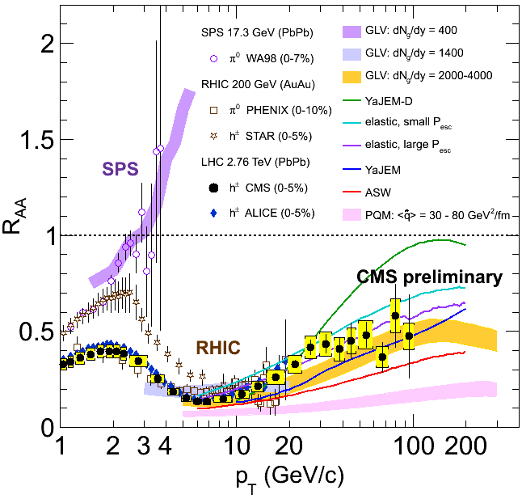
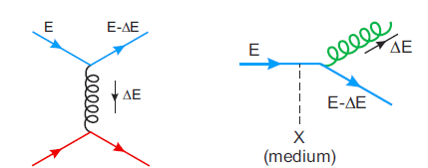

Outstanding Questions in Heavy Ion Physics
Jet Quenching and QGP Properties
Various parton energy loss mechanisms
  Radiative energy loss
    e.g. DGLV, BDMPS, AMY …
  Collisional energy loss
Theoretical quenching factor
- much model dependent!

Slide 18

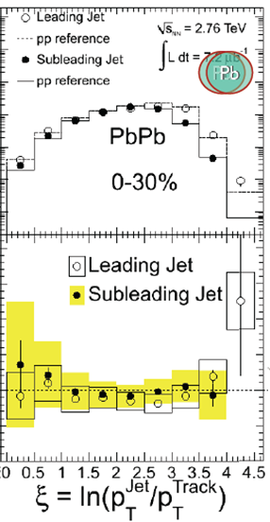
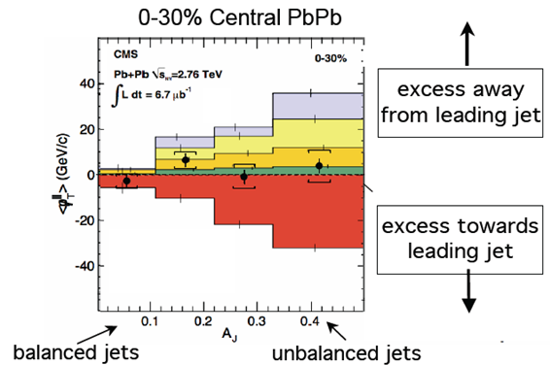

Jet measurements at LHC
New Development in QGP Physics
CMS
ALTAS
Large jet energy asymmetry
Lost energy goes to low pT particles
Little change in di-jet angle correlation Δφ
Jet shape is not modified

Slide 19
LHC jets results from QM11
Very surprising results
R_{AA} ~ 0.5 and independent of pT (for pT>50 GeV)
Large jet asymmetry A_{J} is seen
Path length dependence of energy loss seems to be very steep
ΔE ~ l³ as AdS/CFT predict? (and PHENIX derived in high pt v2?)
Or it is even steeper? (No analysis yet)
Little modification of jet fragmentation
Little modification of di-jet angular correlation
Lost energy goes to low pT particles at large angle (i.e. bulk)
→ It is as if parton only lose energy in QGP and the lost energy is quickly dissipated in the medium. (heat up the medium)
Perturbative energy loss model is severely challenged (if not completely excluded)

Slide 20
What LHC data tells us at RHIC
The answer depends on to whom you ask, but my lessons are
  Direct measurement of jets is very important at RHIC
  Hadronic calorimeter is the key at ATLAS/CMS
  Large coverage in y is essential
  Jets can be measured in heavy ion collision with calorimeter
  Jet is little modified
  → jet template in p+p can be used for reconstruction
  Energy loss in the medium can be measured directly
  → strong constraint on the initial conditions and medium properties

Slide 21
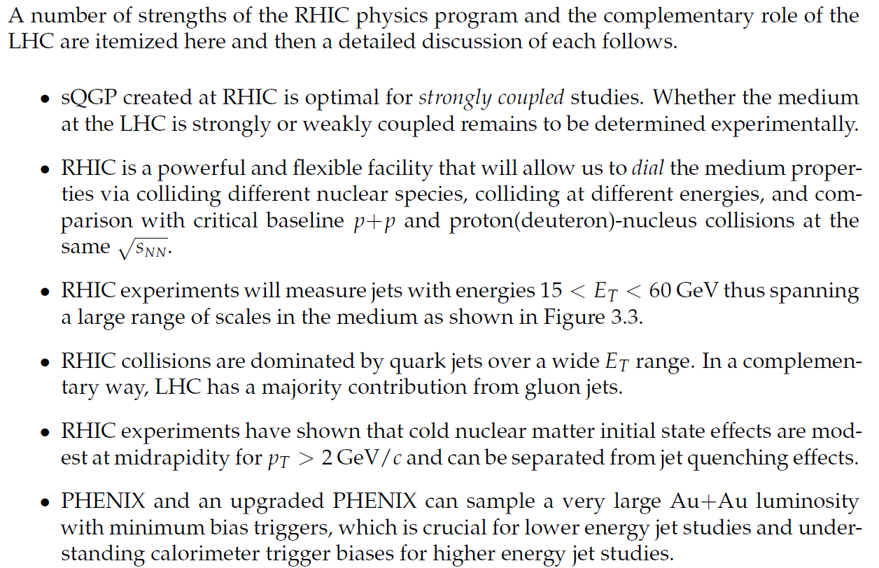
Complementarities of RHIC and LHC
Detailed comparison of ΔE(ε,path length) between LHC and RHIC

Slide 22
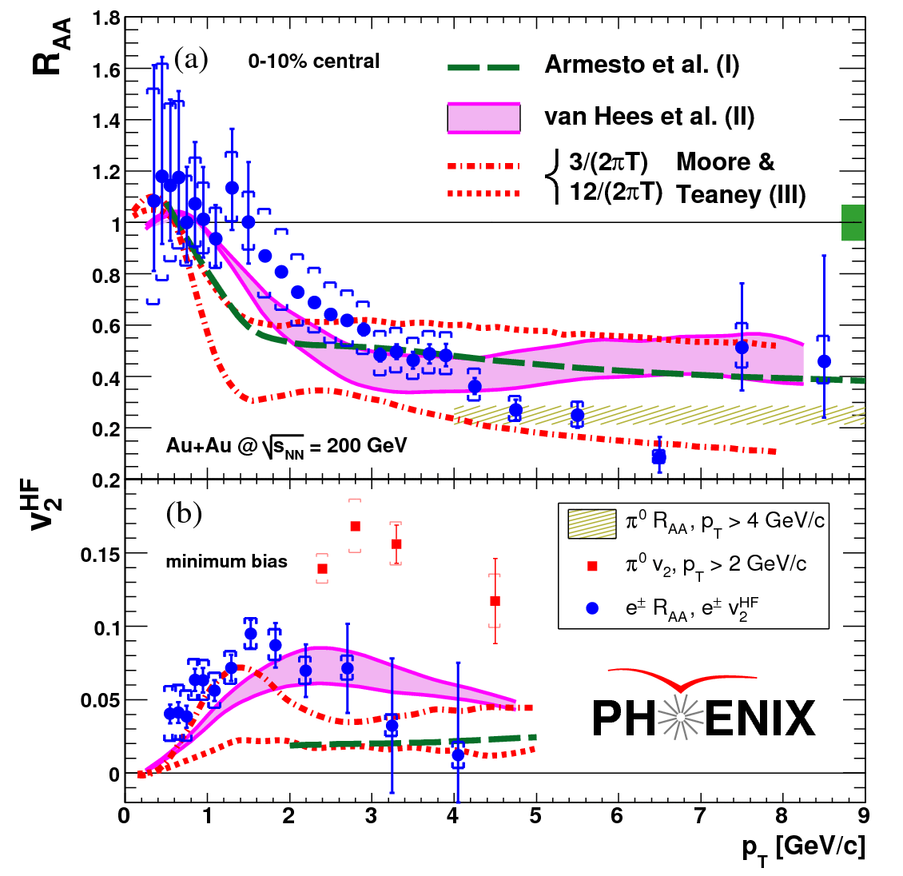
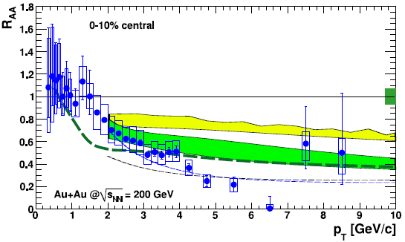
Probing the sQGP with Heavy Quarks
PRL 98, 172301 (2007)
Contrast heavy with light quarks & separate charm and beauty
Mechanisms of parton energy loss
radiative and/or collisional energy loss
path length dependence
modification of correlations of particle pairs
collision-energy dependence
Coupling to the medium
flow and η/s of the hydrodynamic system
fragmentation in the medium
contrasting transverse and longitudinal expansion via comparisons between mid and forward-rapidity
non-photonic electrons
BDMPS D+B dE/dx
radiative dE/dx
+collisional
DGLV charm dE/dx

Slide 23
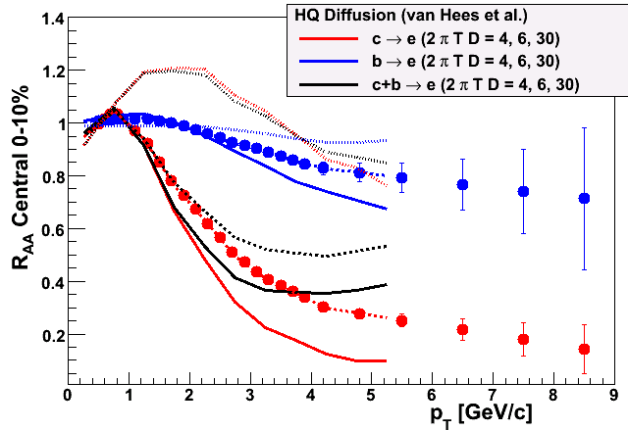
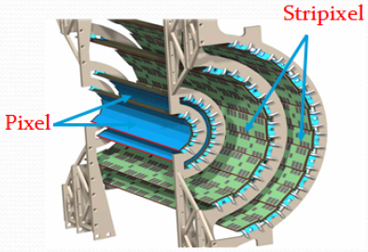
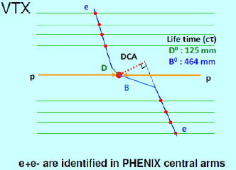
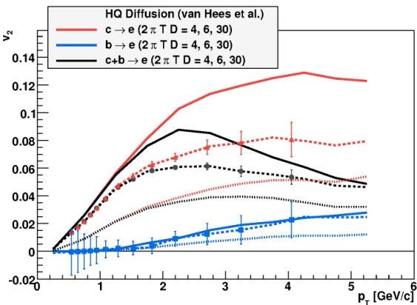
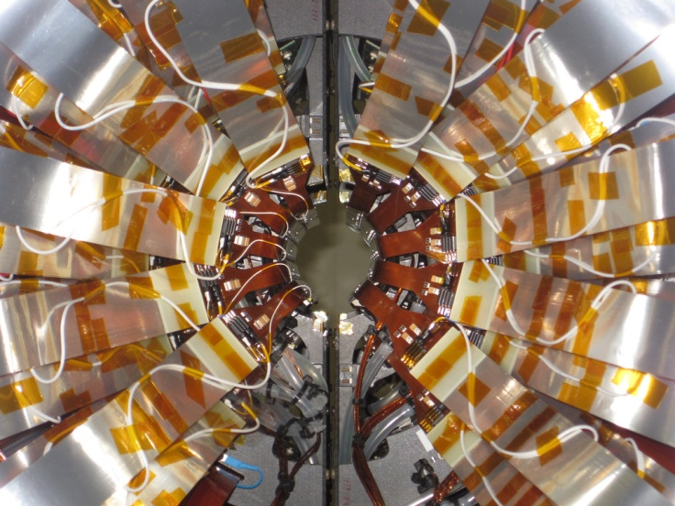
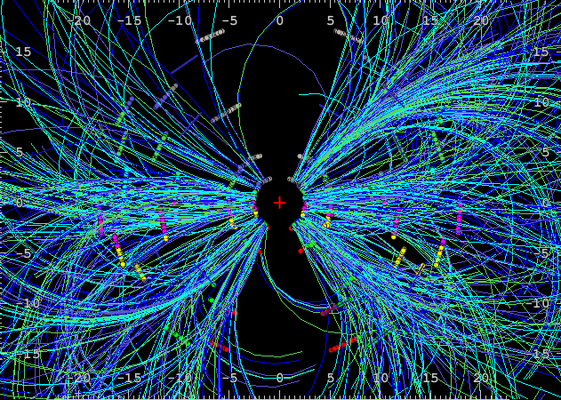
Probing the sQGP with Heavy Quarks
Silicon VerTeX Detector (VTX)
Running in Run11
Improved charm, beauty & quarkonia
for 4.3 nb⁻¹ (Au+Au), 14.8 pb⁻¹ (p+p)
Simulation
beauty
charm
50 μm DCA resolution
end view of VTX
Au+Au event
v₂
Simulation
charm
beauty

Slide 24
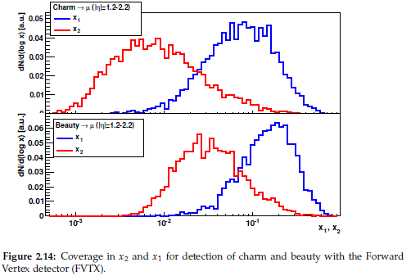
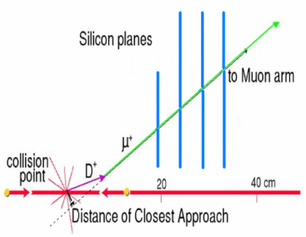
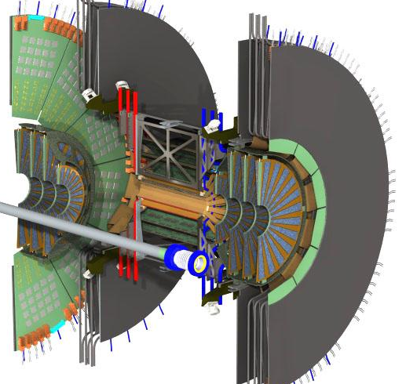
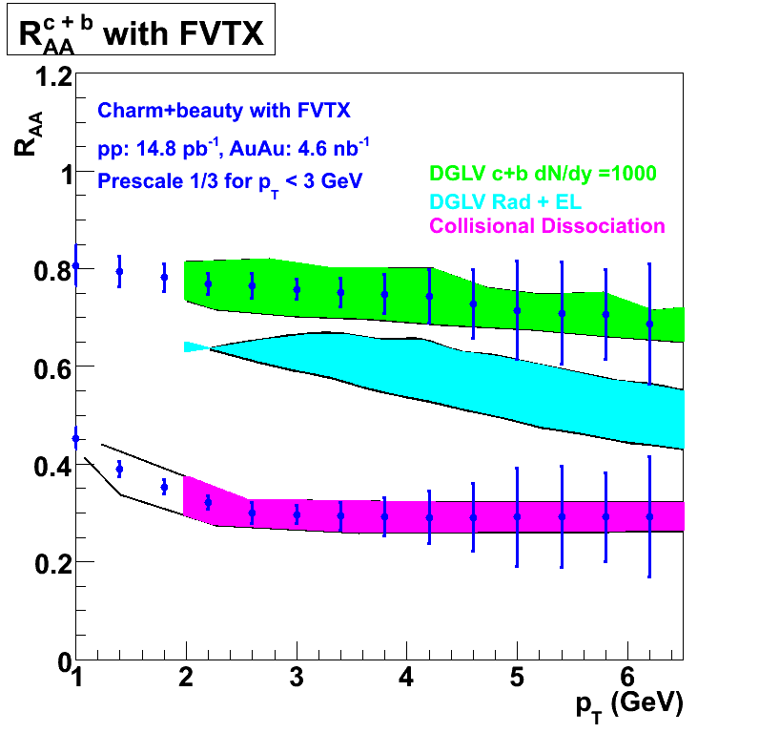
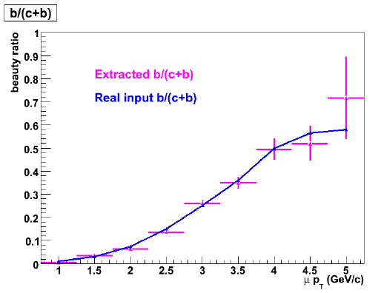
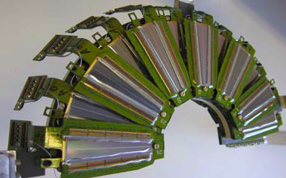
Probing the sQGP with Heavy Quarks
Forward VerTeX Detector (FVTX)
Installation for Run12
Improved forward charm, beauty
& quarkonia
FVTX c,b x-coverage
x₂
prompt
x₁
charm
1.2< η <2.2
π→μ
x₂
x₁
beauty
1.2< η <2.2
10⁻³ 10⁻² 10⁻¹
x₁, x₂
Simulation
radiative
Simulation
collisional
p_{T} (GeV/c)

Slide 25
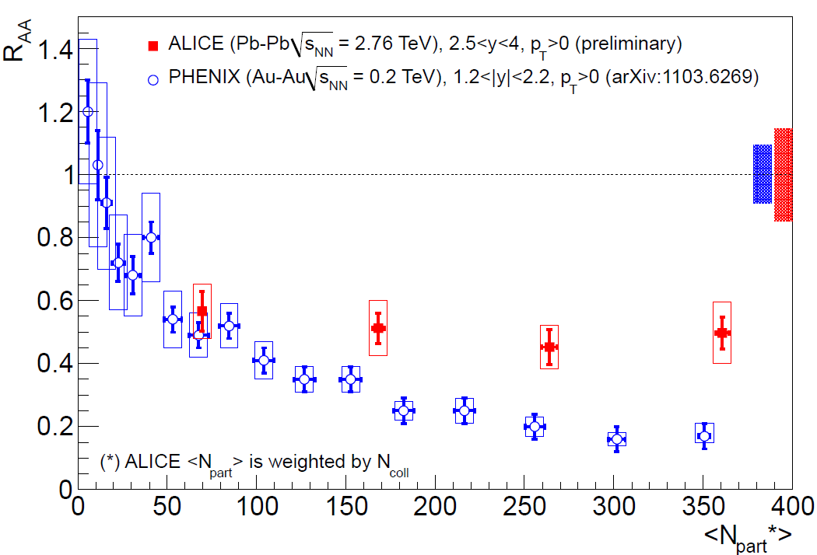
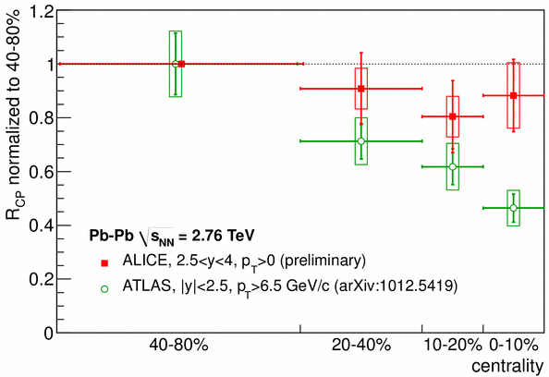
J/Ψ suppression (puzzle)
R_{CP}
R_{AA}
Phenix μμ
ATLAS
Surprisingly (?) : less suppression than RHIC !
R_{CP}(Alice/Atlas): suppression stronger at high p_{T} ??
More data; 1 more slide on the J/Psi puzzle
Add 62 GeV; CMS data; it is puzzle
Central is suppressed at LHC
Need high statistics and large y range of J/Psi measurement

Slide 26
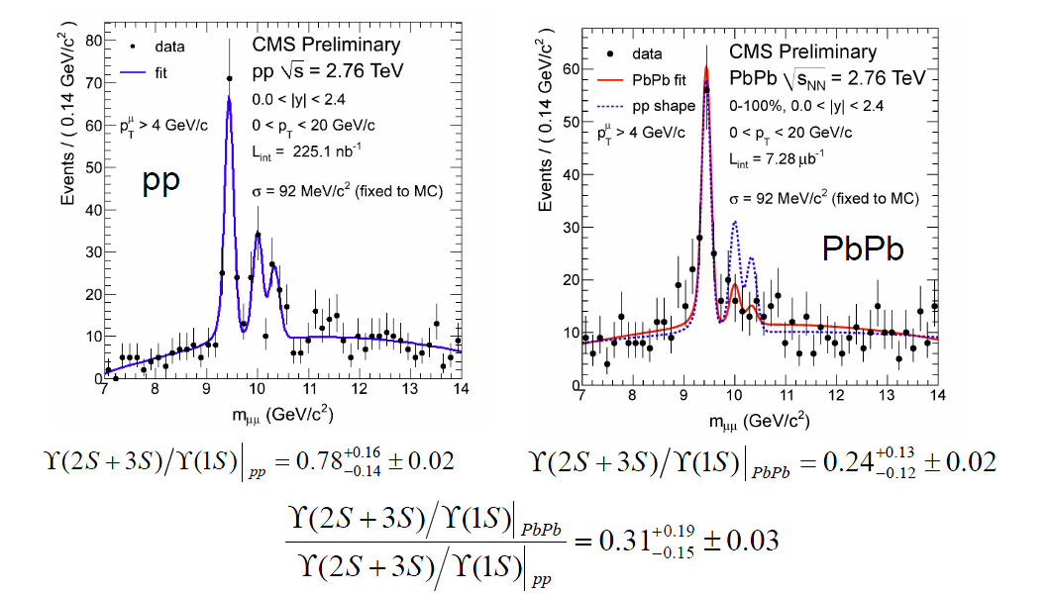
CMS sees Suppression of Y(2S,3S)
The data show that the 2s/3s are reduced as compared to the 1s.
Large acceptance Y measurement at RHIC is important
1S/2S/3S need to be separated

Slide 27
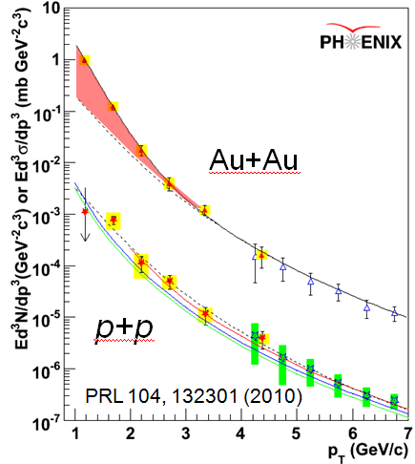
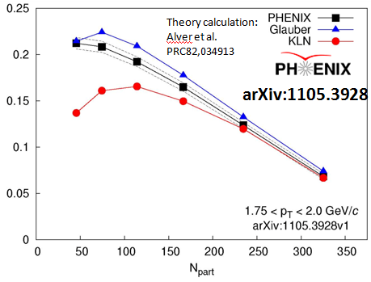
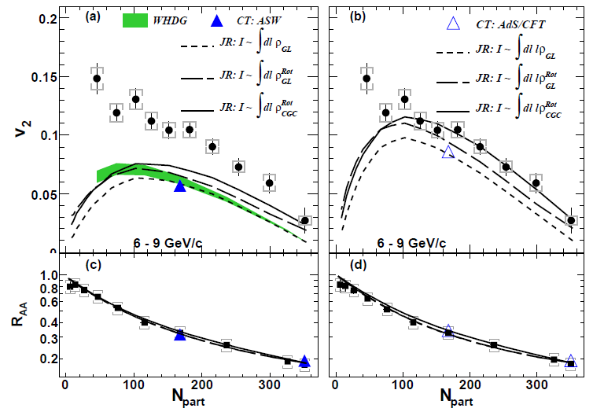
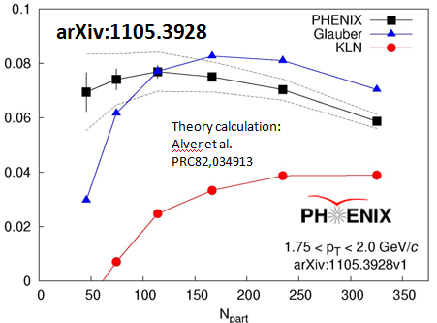
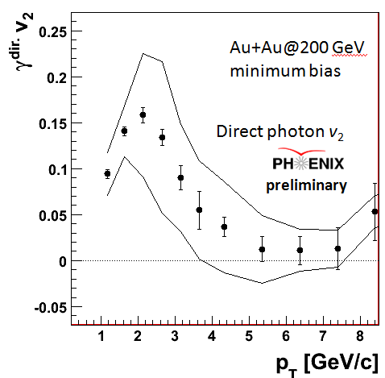
Current understanding: QGP
Thermal photons
T_{i} =300-600 MeV
v₂ and v₃ (and v_{n})
Glauber initial state and η/s~1/4π favored
RAA and v₂ at high pT
ΔE ~ (path length)³
favored
V₂
PRL105,142301
V₃
a

Slide 28
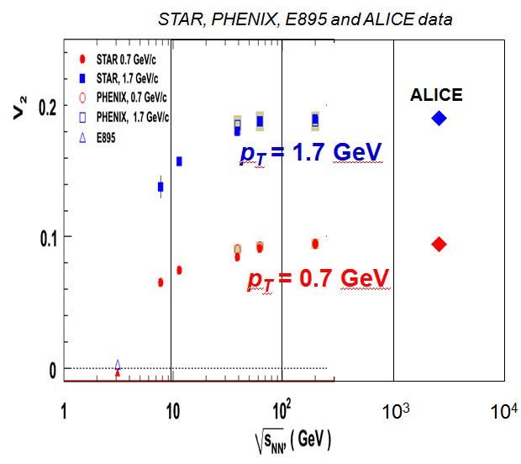
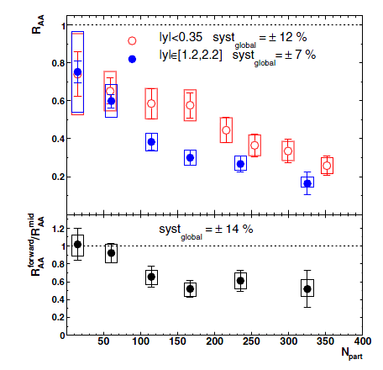




Current Understanding: QGP (2)
J/ψ suppression
Debye screening?
Puzzle remains
Detailed study of CNM effect on J/ψ
V₂ saturates for s^{1/2} >39 GeV
Di-hadron suppression at small x
gluon saturation?
Stronger suppression with s^{1/2}

Slide 29



Heavy quark R_{AA} and v₂ with VTX & FVTX
Probe sQGP at RHIC with heavy quark
High statistics and wide kinematic coverage
Very competitive with LHC

Slide 30

J/ψ R_{AA} at LHC
P. Pillot, QM 2011
T. Dahms, QM 2011
Similar trend at LHC

Slide 31

Production and Dynamics : J/ψ Flow
STAR Preliminary
Phys. Rev. Lett. 99 (2007) 112301
Phys. Rev. Lett. 93, 252301 (2004)
Conistent with zero considering errors.

Slide 32


Outstanding Questions in QGP Physics
LHC ~ RHIC!
Parton dE/dx & QGP properties
  (NSAC DM10, 12)
  Radiation & collisional dE/dX
    Light vs heavy quarks
  CNM effects
QGP color screening & heavy quarkonia “melting”
  (NSAC DM5)
  Color screening & recombination
  CNM effects
h
Jet suppression
J/Psi suppression
Achieved QGP Densities
LHC
RHIC

Slide 33


Study of parton-medium interaction
In QED, a rich structure of energy loss is well understood and quantitatively calculated.
Energy loss in QCD matter can have richer structure. How can we quantitatively study it?
How parton-medium interaction depends on the scale

Slide 34




New Geometries – U+U & Cu+Au
Tip-Tip
U
U
Early time dynamics & thermalization
varying the eccentricity for flow studies
and path length for suppression studies
Body-Body
U
U
U. Heinz
s₀
U+U simulation
U+U energy density (65% larger than Au+Au for tip-tip)
Au+Au energy density
0.2%
ε₀
0.04%
N_{part}
U+U collisions:
higher energy density (top 0.2% tip-to-tip)
1st we need initial data to understand how to disentangle the geometry
Cu+Au collisions:
Cu buried inside Au for most central collisions – minimize periphery (top 3%)
Eccentricity w/o left-right symmetry for non-central collisions
Uranium θ Angle (deg)
Cu buried in Au

Slide 35

Cold Nuclear Matter (CNM) and Low-x Partons in Nuclei
Traditional shadowing or gluon saturation
Initial-state quark or gluon energy loss
low x
anti-shadowing
R_{G} in Au
shadowing
high x
Dissociation of J/ψ or
CNM effects are difficult to disentangle experimentally – multiple probes, types & energies of collisions, wide kinematic coverage, are key
  closed vs. open-heavy – isolates initial-state effects
  other probes of shadowing & gluon saturation – forward hadrons, etc.
  Drell-Yan to constrain parton energy loss in CNM
And strong theoretical analysis
Need a rational/reliable baseline for sQGP studies
Need to understand the early thermalization & formation of the sQGP

Slide 36

The Intensity Frontier
17 kW at 8 GeV
for neutrinos
Soudan
MiniBooNE
SciBooNE
MINOS
Tevatron Collider
250 kW at 120 GeV
for neutrinos
36
Young-Kee Kim: Ten Year Plan (Science and Resources), PAC Meeting 2009-03-05

Slide 37

Determine and Calibrate dE/dx with DY in p+A
(Drell-Yan Process)
Known initial state nuclear parton density;
Minimal final-state interactions of the detected particles.
E906: No shadowing correction at moderate X_{t}
q, g
DY
euterium
Energy loss reduces x_{b} and x_{F} in nuclei versus proton (x_{F} = x_{b}-x_{t})
Possible sea-quark shadowing effects

Slide 38
Sea Quark Shadowing and Nuclear PDFs
E906
E866

Slide 39
Quark Energy Loss in Cold Nuclear Medium
Drell-Yan @E866
- Drell-Yan Suppression ~20% in p+W
<dE/dx> strongly depends on shadowing correction
x_{t} ~ 10⁻² @ 800GeV p+A
(PRL 86 (2001) 4483)
800GeV p + A
5<M<6 GeV
7<M<8 GeV

Slide 40


E906 Acceptance and Dimuon Mass Distributions
x_{t}
E_{beam}120 GeV:
No shadowing
correction
since x_{t} = 0.1~0.4
Acceptance
E906 Spect.
Monte Carlo
20~30% effect @xF~0.6!
x_{b}
Dimuon mass
EKS shadowing
DY
J/ψ
X_{b}

Slide 41



Experimental Sensitivity to Quark Energy Loss
Quark energy loss only I. Vitev et al
Shortest radiation length in nature X₀ = 1 x 10⁻¹³ m
Clearly distinguish between leading models for L dependence of E-loss
Benchmark dE/dx models

Slide 42

Expected Detector Performance
Reasonable J/Psi and Drell-Yan separation
  Drell-Yan: M>4GeV
Improved tracking to separate tracks from target and beam dump
Rec’d primary vtx
from Kun Liu
μ
E906 Bend Plane View
120 GeV
protons
Drift
Chambers
Muon ID

Slide 43




Process Dependence of Parton Energy Loss
E-loss in three cases
Academic case
(probably inapplicable)‏
Initial-state E loss:
DY process
Final-state E loss:
SDIS, QGP
I. Vitev, PRC 75(2007)064906.

Slide 44
Nuclear Physics Milestones: QGP

Slide 45

PHENIX RUN PLAN (2011-2015)
PHENIX Decadal Plan
Longitudinal spin@ 500 GeV
W program
350/pb for W→μ
130/pb for W→e
ΔG at small x
Transverse spin@200 GeV
50/pb for muon arms
17/pb with VTX
A_{N} of various processes
Exploratory of Drell Yan
A_{N} : Sivers sign change
Spin @ 62 GeV
ΔG at high x
Transverse spin

Slide 46
PHENIX RUN PLAN (2011-2015)
Heavy quark physics with VTX is the main thrust of PHENIX Heavy Ion physics plan in 2011 - 2015
Heavy quark energy loss
Heavy quark flow
CNM on Heavy Quark
Plus
Spin Physics with VTX in p+p collisions
Charm A_{N,} A_{LL}
Bottom A_{N} A_{LL}
photon jet A_{N}, A_{LL}
di-jet A_{N}, A_{LL}

Slide 47
Outstanding Questions in QGP Physics
LHC ~ RHIC!
Parton dE/dx & QGP properties
  Radiation & collisional dE/dX
    Light vs heavy quarks
  CNM effects
QGP color screening & heavy quarkonia “melting”
  Color screening & recombination
  CNM effects
h
Jet suppression
J/Psi suppression
Achieved QGP Densities
LHC
RHIC

Slide 48
Mysteries in heavy ion physics
Energy loss mechanism
  @ LHC 40 GeV jets opposing 100 GeV jets look “normal”
  no broadening or decorrelation
  no evidence for collinear radiation from the parton
  @ RHIC low energy jets appear to show medium effects
  but, “jet” is defined differently
  c & b to probe role of collisional energy loss VTX, FVTX
  quantify path length dependence U+U, Cu+Au
J/ψ suppression and color screening
  amazingly similar from √s=17-200 GeV; but initial states differ
not SO different at LHC
  Other states y & √s dependence (e.g. ψ’) FVTX, statistics
  d+Au for initial state; 130 GeV Au+Au eventually?

Slide 49
spin

Slide 50
DIS Structure Function Measurement

Slide 51


Probing the Helicity Structure of the Nucleon
Study difference in particle production rates for same-helicity vs. opposite-helicity proton collisions
DIS
?
pQCD
e+e-
NLO sub-process in π production
    -- Parton distribution functions
    -- Partonic hard scattering rates
    -- Fragmentation functions
W. Vogelsang
Notes:
51
Let me now show you some highlights from the helicity program at RHIC.

Slide 52





Experimental Observables
Asymmetries
  PHENIX and STAR: all
  BRAHMS: transverse beams only
Notes:
For polarized interactoins, we have 4 basic asymmetry measurements, depend on polarization:

Slide 53

History

Slide 54


Part I: Longitudinal Spin Physics Program
The proton is viewed as being a “bag” of
bound quarks and gluons interacting via QCD
Spins + orbital angular momentum need
to give the observed spin 1/2 of proton
Fairly well measured
only ~30% of spin
Beginning to be measured
at RHIC
A future challenge
Notes:
Proton is a bag of bound quarks and gluons under strictures of QCD
Proton is spin 1/2 object so pieces must come together -> written as “sum rule”
Delta-q is measured, delta-G is not

Slide 55




Δg and Polarized p+p Collisions
+
+
+
…
The LO result for a_{LL}
is nonzero for
all subprocesses
Notes:
P+p collision in factorized pQCD where you have pdfs for initial state, hard partonic cs for scattering, and FFs for final state.
Write ALL as convolution of polarized pieces, hard partonic helcity asymmetry
ALL has roughly three pieces

Slide 56





Current Understanding: Spin
Gluon contribution to the proton spin is not large
Measurement of anti-quark spin with the
W boson started
Transverse spin physics: A_{N} at large xF

Slide 57


Future New Probes @RHIC: Δg
Polarized hadron collisions
  double longitudinal spin asymmetry
  leading-order gluon interactions
    direct-photon production
    heavy-flavor production
    Other channels (light hadrons etc.)
proton beam
proton beam
→ or ←
→ or ←
gluon
gluon
heavy flavor
photon
gluon
→ or ←
→ or ←
proton beam
proton beam

Slide 58


W± Production and A_{L} @500GeV
μ⁺
Bunce G. et al, hep-ph/0007218
ν
μ⁻
ν
Notes:
Forward moving W+ measures du/u
Backward moving W+ measure dd/d
The magnitude of parton level PV asymmetry is large ~1
…

Slide 59



First W± Measurements from Run9 500 pp!

Slide 60





Part II: Transverse Spin Physics Program
RHIC 20,000 GeV beam
Large Transverse Single Spin Asymmetry (SSA) in forward meson production persists up to RHIC energy.
FNAL 200 GeV beam
AGS 22 GeV beam
ZGS 12 GeV beam
PRL (2004)
PLB261, 201 (1991)
PLB264, 462 (1991)
PRD65, 092008 (2002)
PRL36, 929 (1976)
Non-Perturbative cross section
Perturbative cross section

Slide 61
Single Transverse Spin Asymmetries in pp Collisions
A_{N} difference in cross-section between particles produced to the left and right
Left
(Preliminary)
Right
Features:
Forward non-zero asymmetries.
Asymmetries consistent over an order of magnitude in sqrt(s).
Several theoretical frameworks to explain the results.

Slide 62

Theory: K_{T} vs Collinear Factorization
f_{a}
h
Tran. Mom. Dep. Funs
  Sivers Fun
  Collins Fun
Twist-3 collinear
  Quark-gluon correl.
  Gluon-gluon correl.
q
FF_{q}
σ
f_{b}
X’
A_{N}
TMD
Collinear/Twist-3
pT

Slide 63


A_{N} P_{T} Dependence Remains as a Challenge
A_{N} vs p_{T}
A_{N} vs x_{F}
Run8

Slide 64



Charm SSA to Probe Gluon Sivers Distribution
D meson Single-Spin Asymmetry:
Production dominated by gluon-gluon fusion
Sensitive to gluon Sivers distribution
  PHENIX-2006 data ruled out the max. gluon Sivers
  Much improved results expected (Run2006+2008)
Kang, Qiu, Yuan, Vogelsang, Phys. Rev. D 78,114013(2008)

Slide 65




Transverse Spin
Drell-Yan
E866/NuSea
Measurement of Drell-Yan in PHENIX at forward rapidity with dimuons - enabled by rejection of backgrounds with FVTX (starting in 2012)
200 GeV p+p (8 pb⁻¹)
FVTX efficiencies with DCA cut
Drell Yan
Efficiency
DCA < 2 σ - Increase DY/bb ~ 3
charm
bottom
combinatorial background

Slide 66

Future Transverse Spin Physics: A_{N} (Drell-Yan ->μ⁺μ⁻)
“Transverse-Spin Drell-Yan Physics at RHIC” (http://spin.riken.bnl.gov/rsc/write-up/dy_final.pdf)
Important test at RHIC of recent fundamental QCD predictions for the Sivers effect, demonstrating… attractive vs repulsive color charge forces
HERMES
Sivers Amplitude
0.1 0.2 0.3 x

Slide 67

Summary and Outlook
Spin puzzle
  Gluon polarization
    Large Δg ruled out
    New probes, direct-photon, open charm …
    Larger x-range in the future
Sea quark polarization
  First W asymmetry observed
  Much improved results in the future
Transverse spin physics
  Large SSAs observed at RHIC
  New study of QCD dynamics
    Charm SSA
    Drell-Yan SSA
RHIC constraints

Slide 68


sqrt(s)=500 GeV @ RHIC
μ±
Parity Violation Asymmetry
Clean flavor separation
w/o fragmentation uncertainty

Slide 69


Projected Errors for A_{L}
P=0.55 assumed
Run11 + Run12 + Run13
Integrated Luminosity = 300 pb⁻¹
Run11 Goal 50pb⁻¹
Goal

Slide 70
Spin Physics Milestones
Year | # | Milestone
2013 | HP8 | Measure flavor-identified q and‾q contributions to the spin of the proton via the longitudinal-spin asymmetry of W production.
2013 | HP12 | Determine if gluons have appreciable polarization over any range of momentum fraction between 1 and 30% of the momentum of a polarized proton.
2015 | HP13 | Test unique QCD predictions for relations between single-transverse spin phenomena in p-p scattering and those observed in deep-inelastic lepton scattering.

Slide 71


Slide 72




Spin Physics with sPHENIX
A_{N} of DY at forward rapdity
γ-jet transverse spin moment
A_{LL} of Direct γ

Slide 73

Theory prediction for Drell-Yan process
New development
SIDIS and RHIC pion production do not overlap in momentum fraction (x)
Attempts to describe both results in a sign “mismatch” conclusion (Kang, Qiu, Vogelsang, Yuan PRD83 (2011) 094001
Combined analysis of SIDIS and RHIC pion production leads to the conclusion that the u-quark Sivers function has a node at x~0.4
A. Prokudin, Z.B. Kang “Opportunities for Drell-Yan Physics at RHIC” workshop (May, 2011)
Essential to test Dell-Yan
process in this region

Slide 74
Forward Physics Objectives
Transverse spin phenomena
  Kinematics high x_{f}, high rapidity |η| > 2
  Drell-Yan test QCD prediction for Sivers btwn SIDIS and DY
  Separate Sivers and Collins and do a flavor separation for the PDFs
    p⁰-jet, γ – jet, IFF for identified hadrons,
    jet A_{N}, direct photon
Longitudinal spin phenomena
  high rapidity |η| > 2 → extend x coverage for ΔG and Δq
Drell-Yan in dAu
  Measure quark distributions in nuclei
  Possible access to quark saturation
EIC physics
  Measure polarized and unpolarized inclusive structure functions in ep / eA (F₂, F_{L}, F₃, g₁, g_{2,} g₅)
  “Diffractive physics” (DVCS, etc.)

Slide 75

Requirements for e+e- DY at RHIC
http://spin.riken.bnl.gov/rsc/write-up/dy_final.pdf
High luminosity ~>150/pb (similar to W program)
Prefer 500GeV over 200GeV
Forward (eta ~ 4) detector
Sizable A_{N} at high x_{F}
Less charm & bottom backgrounds
Less QCD backgrounds
Good background (e/h and gamma/e) separation
Is charge sign discrimination required for like-sign pair subtraction?
PHENIX Muon Arm
Eta = 1-2
DY
Charm Bottom
DY : ~7 x 10⁻⁵ mb
@ 500GeV
Hadronic : ~30mb
10⁶

Slide 76

RHIC/PHENIX Upgrade and Physics
PHENIX Decadal Plan

Slide 77


RHIC Physics Focus
1) At 200 GeV top energy
- Study medium properties, EoS
- pQCD in hot and dense medium
2) RHIC beam energy scan
- Search for critical point
- Chiral symmetry restoration
Polarized spin program
- Study proton intrinsic properties
- Novel QCD spin dynamics
Forward program
- Study low-x properties, search for CGC
- Study elastic (inelastic) processes (pp2pp)
- Investigate gluonic exchanges

Slide 78
NEW questions due to RHIC discoveries
Compelling goals for 2015 - 2020
Address with ion collisions
  Are quarks strongly coupled to the QGP at all scales?
Are there quasiparticles at any scale?
Mechanisms for parton-QGP interaction?
and QGP response?
Is there a relevant screening length in the QGP?
How is rapid equilibration achieved?
What is the structure of cold nuclei at small-x?
Polarized proton running to answer
Internal landscape of nucleons: Spin? parton correlations
Color Interactions in QCD via Drell Yan
What governs hadronization?

Slide 79
Physics menu for 2015+
Study of interaction between parton and sQGP medium
  Direct measurement of Jets and their modification
Study of mass dependence of medium-parton interaction
  High statistic measurement of charm and bottom in Au+Au
  Measurement of c and b jets
Study of color screening in the medium
  High PtのJ/ψ（>10 GeV/c)
  Upsilon
Probe of initial condition
  Direct photon v2
High density QCD at small x
  Forward Physics
ePHENIX
  eA and ep when eRHIC beam come to PHENIX IR

Slide 81



Slide 82


Slide 83
eRHIC Physics
eA (5 GeV e x 130A GeV HI to 30 GeV x 130AGeV )
Saturation Physics, CGC
eRHIC proved deep inside the saturation region
Gluon density G(x,Q²,b) in nuclei
b: impact parameter. 3D picture of PDF
Parton fragmentation in nuclei
hadron formation and energy loss in Cold Nuclear matter
ep (5 GeV e x 325 GeV p to 30 GeV e x 325 GeV p)
Polarized PDF
ΔG(x), Δu(x), Δd(x) at small x
Parton Angular Momentum distribution
GPD, DVCS
TMD
q(x,kT,Q²) from SIDIS and charm production

Slide 84

Let the Search Continues

Slide 85
Mysteries in heavy ion physics
Energy loss mechanism
  @ LHC 40 GeV jets opposing 100 GeV jets look “normal”
  no broadening or decorrelation
  no evidence for collinear radiation from the parton
  @ RHIC low energy jets appear to show medium effects
  but, “jet” is defined different
  c&b to probe role of collisional energy loss VTX, FVTX
  quantify path length dependence U+U, Cu+Au
J/ψ suppression and color screening
  amazingly similar from √s=17-200 GeV; but initial states differ
not SO different at LHC
  Other states y& √s dependence (e.g. ψ’)FVTX, statistics
  d+Au for initial state; 130 GeVAu+Au eventually?
NSAC milestone DM11, 12
NSAC milestone DM5
B. Jacak BUP12 presentation June 6, 2011

Slide 86
NEW questions due to RHIC discoveries
Compelling goals for 2015 - 2020
Address with ion collisions
  Are quarks strongly coupled to the QGP at all scales?
Are there quasiparticles at any scale?
Mechanisms for parton-QGP interaction?
and QGP response?
Is there a relevant screening length in the QGP?
How is rapid equilibration achieved?
What is the structure of cold nuclei at small-x?
Polarized proton running to answer
Internal landscape of nucleons: Spin? parton correlations
Color Interactions in QCD via Drell Yan
What governs hadronization?

Slide 87
Physics menu for 2015+
Study of interaction between parton and sQGP medium
  Direct measurement of Jets and their modification
Study of mass dependence of medium-parton interaction
  High statistic measurement of charm and bottom in Au+Au
  Measurement of c and b jets
Study of color screening in the medium
  High PtのJ/ψ（>10 GeV/c)
  Upsilon
Probe of initial condition
  Direct photon v2
High density QCD at small x
  Forward Physics
ePHENIX
  eA and ep when eRHIC beam come to PHENIX IR

Slide 88
eRHIC Physics
eA (5 GeV e x 130A GeV HI to 30 GeV x 130AGeV )
Saturation Physics, CGC
eRHIC proved deep inside the saturation region
Gluon density G(x,Q²,b) in nuclei
b: impact parameter. 3D picture of PDF
Parton fragmentation in nuclei
hadron formation and energy loss in Cold Nuclear matter
ep (5 GeV e x 325 GeV p to 30 GeV e x 325 GeV p)
Polarized PDF
ΔG(x), Δu(x), Δd(x) at small x
Parton Angular Momentum distribution
GPD, DVCS
TMD
q(x,kT,Q²) from SIDIS and charm production

Slide 89



Parton Saturation
At eRHIC, saturation should be achieved
5 (30) x130 GeV → s^{1/2} = 51 (125) GeV
Hera (e+p) didn’t reach the saturation regime
α_{s}~1 α_{s} << 1
At Small x, saturation must set in when gluons start overlapping

Slide 90
Summary
Mid-term (2011 – 2015+ )
Harvest physics from PHENIX upgrades and RHIC performance increase
W measurements at 500 GeV
VTX & FVTX → Heavy quark physics in Heavy ion and Spin
Beyond 2015 +
Expand physics reach further by a large scale upgrade
Compact Jet detector
characterize energy loss mechanism
characterize property of QGP
Large acceptance J/psi and Y
study Debye screening of QGP
Forward detector
  Large y coverage to study QGP
  CNM
  First eRHIC detector to study gluon saturation efects

Slide 91

8 Leading Twist Parton Distributions:
Today Transversity and Sivers Distribution Functions
Mulders & Tangerman, NPB 461 (1996) 197
Unpolarized
Boer-Mulders
Transversity
Polarized target
Sivers
Polarized beam and target

Slide 92
8 Leading Twist Parton Distributions:
Some Rules on Nomenclature
proton
proton with long. spin
proton with trans. spin
quark
quark + long. spin
quark with trans. spin
Quark momentum dis.
unpolarized quark in unpolarized proton
longitudinally polarized quark in
longitudinally polarized proton
Quark helicity dis.
Transversity dis.
transversely polarized quark in
transversely polarized proton
Sivers function
quark with transverse momentum in
transversely polarized proton
Boer-Mulders function
quark with transverse momentum and
transverse momentum in unpol. proton

Slide 93
8 Leading Twist Parton Distributions:
Some Rules on Nomenclature
proton
proton with long. spin
proton with trans. spin
quark
quark + long. spin
quark with trans. spin
Quark momentum dis.
Intrinisic k⊥ dependence
⊥: yes
: no
Quark helicity dis.
f⊥_{1T}
Transversity dis.
Sivers function
quark spin
f: unpolarized
g: longitudinal
h: transverse
nucleon polarization
L: longitudinal
T: transverse
: unpolarized
Boer-Mulders function

Slide 94

World Map of QCD Facilities

Slide 95




The PHENIX Decadal Plan 2011-2020
Cesar, Christine’s Talks
~ 2018
Leitch (d+Au), Aidala (spin), van Hecke
MPC-EX?

