Slide 1
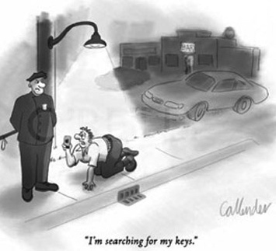
Dark Photon/Higgs Search in the SeaQuest/E1067 Experiment at Fermilab
Ming Liu
Los Alamos National Lab
Light Dark World 2017, Pittsburgh, PA

Slide 2
Outline
Dark sector physics @SeaQuest/E1067
  Mass: MeV ~ GeV
Detector upgrade @SeaQuest/E1067
  DAQ & dark photon trigger
  First run in 2017
Future plan
  Phase I: 2017 - 2020
    Parasitic run with E1039(polarized Drell-Yan)
    Electron/hadron ID w/ EMCal upgrade
  Phase II: 2020 -2025+
    Dedicated dark photon program @Fermilab

Slide 3

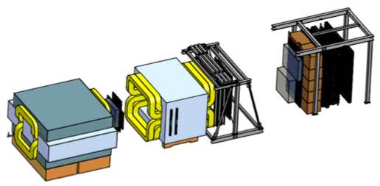
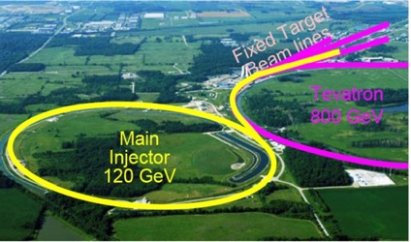
SeaQuest at the Intensity Frontier at Fermilab
High intensity proton beam: “beam dump mode” @SeaQuest/E1067
35K fb⁻¹ (in a 2-year parasitic run, 1.4x10¹⁸ POT @5% beam)
LHC-II: 300 fb⁻¹ (~2025), achieved 25fb⁻¹ in Run-I
Absorber wall and proportional
tube based Muon ID
Spectrometer magnet
Δpt = 0.4 GeV
Focusing magnet
and solid iron dump
Δpt = 2.9 GeV
Beam
120 GeV proton from Main Injector
19ns RF, 4s spill, 0.5×10¹³ protons per spill
25 m
Target system
Liquid H and D
Solid C, Fe, W
SeaQuest
- Beam dump mode: p+Fe collisions! Target ~ 10%λ_{I}
- Parasitic run mode possible with other experiments, E906/E1039

Slide 4
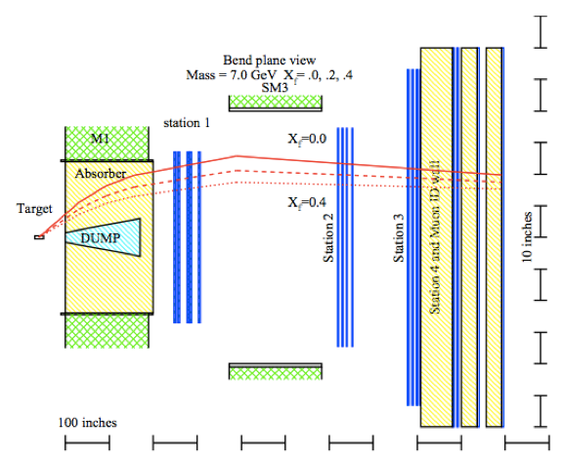
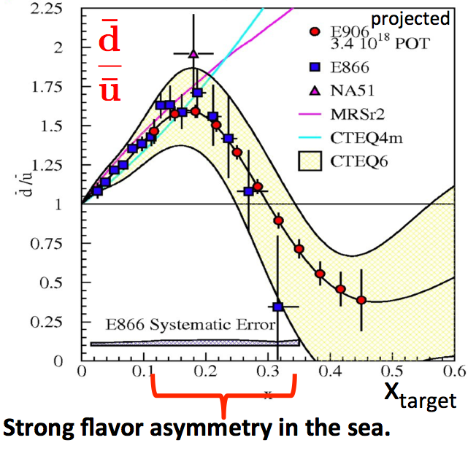
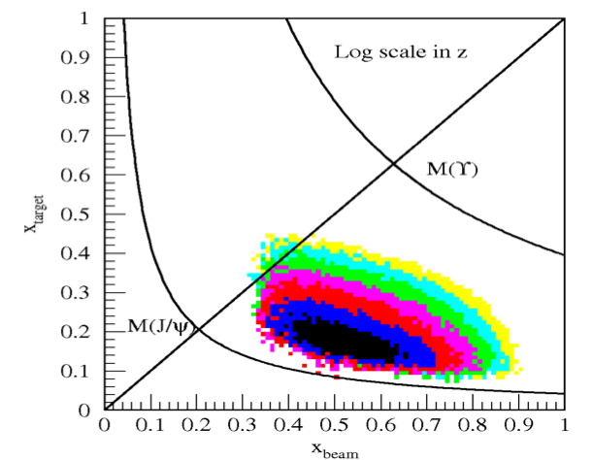
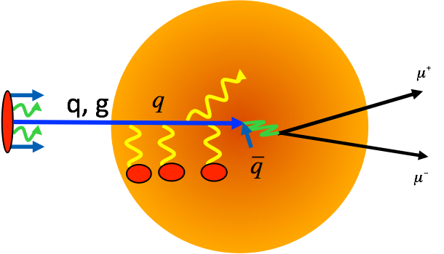
SeaQuest: Nuclear Physics with Drell-Yan
DOE/NP Programs 2012-2017(E906), 2017-2020(E1039)
Drell-Yan
Acceptance
Quark Energy Loss dE/dx in pA

Slide 5
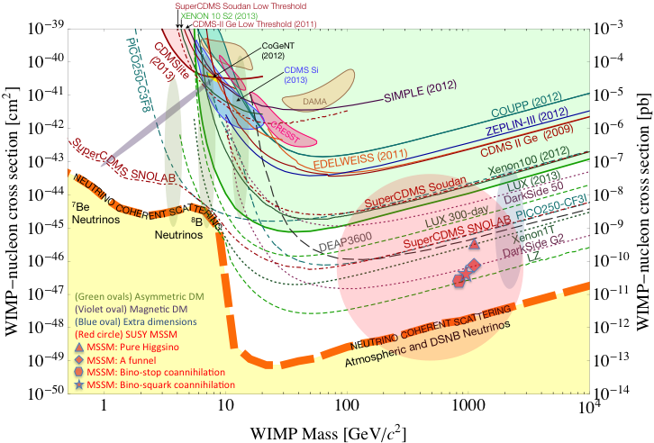
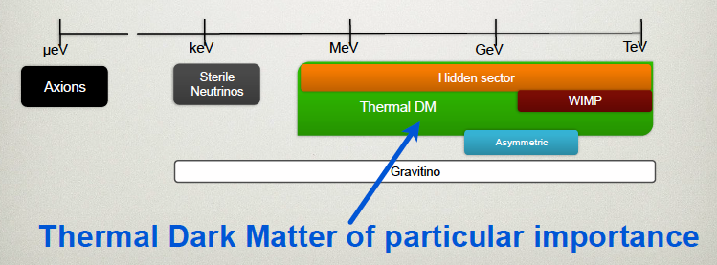
Dark Sector Physics @SeaQuest
Current and near future high-intensity colliders and fixed target experiments offer an ideal environment to probe dark sector physics in MeV ~ GeV
P. Schuster et al.
WIMP Search

Slide 6
A Great Opportunity
Dark Photons and Dark Higgs Search at SeaQuest
Photon portal: “vector”
Higgs portal: “scalar”
θ = μ v/m_{h}²

Slide 7
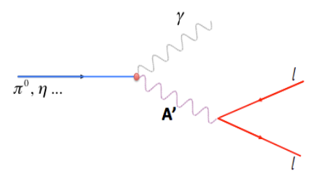
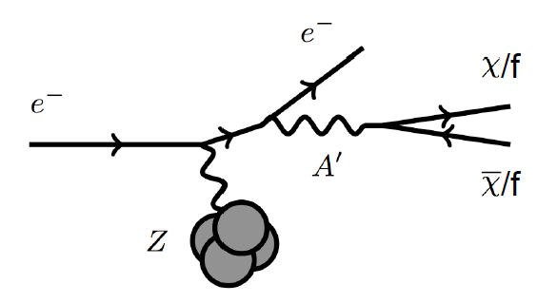
Dark Photon Detection in Dilepton Channel
Drell-Yan like
π⁰, η, … decay
Bremsstrahlung
(DM)
MiniBooNE
Beam-dump
(DM)
p
l⁺
p
l⁻
~ Fixed target w/
electron beams

Slide 8
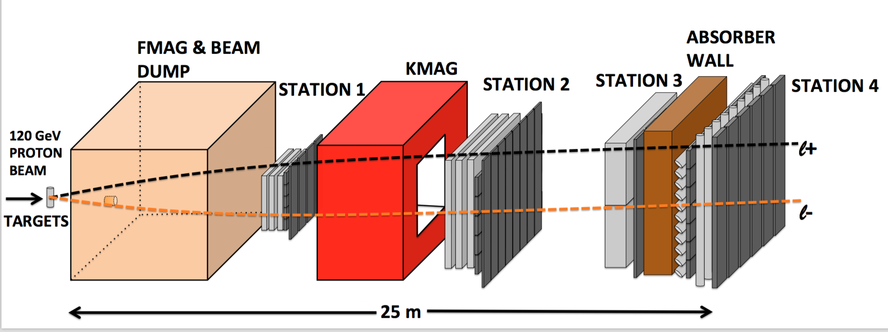
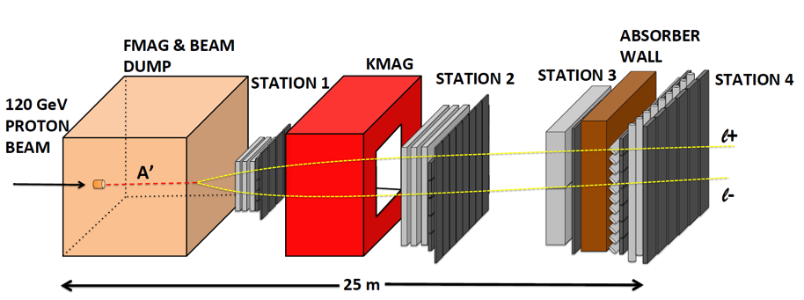
A target Drell-Yan event
A beam-dump dark photon event --- parasitic run possible!

Slide 9
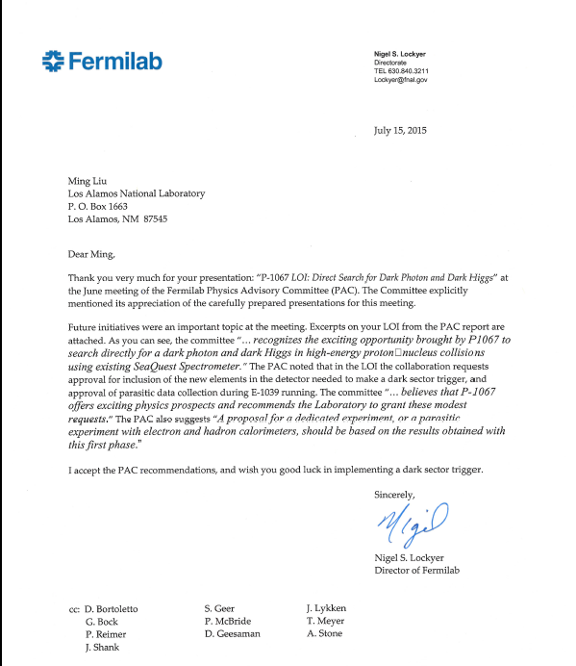
A heart-full endorsement
from Fermilab Director and PAC
July 15, 2015!
A New experiment! SeaQuest/E-1067
LANL LDRD support:
- FY16-18
- $1M to implement
the trigger/DAQ upgrade and theory development
Goals:
Trigger installed, 2017
Physics run, 2017-20
Preliminary results 2018!

Slide 10
LANL LDRD: Detector Upgrades and Expected Signals
Dark photon trigger upgrade
  Add a fine-granularity scintillating strip based trigger/tracking to tag dimuons from the same decay Z-vertex
  A new trigger for events with displaced down-stream dimuons
Unique signals
  Displaced dimuon decay vertex for long-lived particles
  Invariant mass peak in dimuon mass spectrum
  Mostly from beam dump (target ~10% λ_{I}.)
Planned beam time
  Run parasitically with E906/E1039 (2017-2020)
  Possible dedicated runs later with further upgrade (e^{+/-}, h^{+/-})
-- 2.5%
-- 6.0%
Dimuon mass resolution
Z (meter)

Slide 11
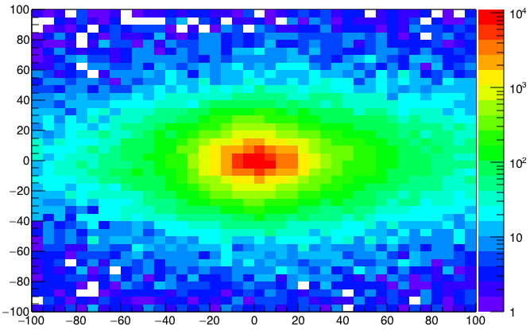
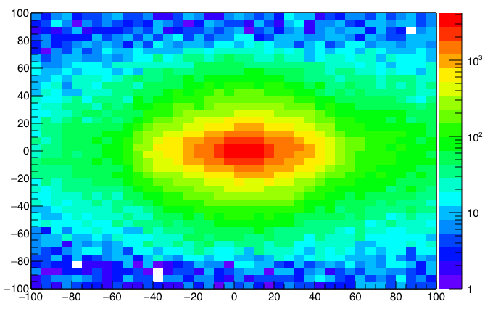
A New High-Granularity Displayed Dark Photon/Higgs Dimuon Vertex Trigger
High rejection power, low rate, < 1 kHz (previous E906 DAQ limit)
Y-Plane (non-bending) Trigger:
A quadrant panel: 80cm x 80cm (100cmx100cm @ST-2)
  ST1: 1cm x 1cm x 80 cm scintillating strips, SiPM readout
  ST2: 2cm x 2 cm x 100 cm strips
- Straight line projection, σ_{Z} ~30cm
Displaced z-vertex, mostly low mass < 3GeV
Y
Dimuon Z-vertex (cm)
ST1
X
St1
St2
Z
Coincident Z-vtx
Matched @Lvl-2
Z1=9m
Z1=12m
ST2

Slide 12
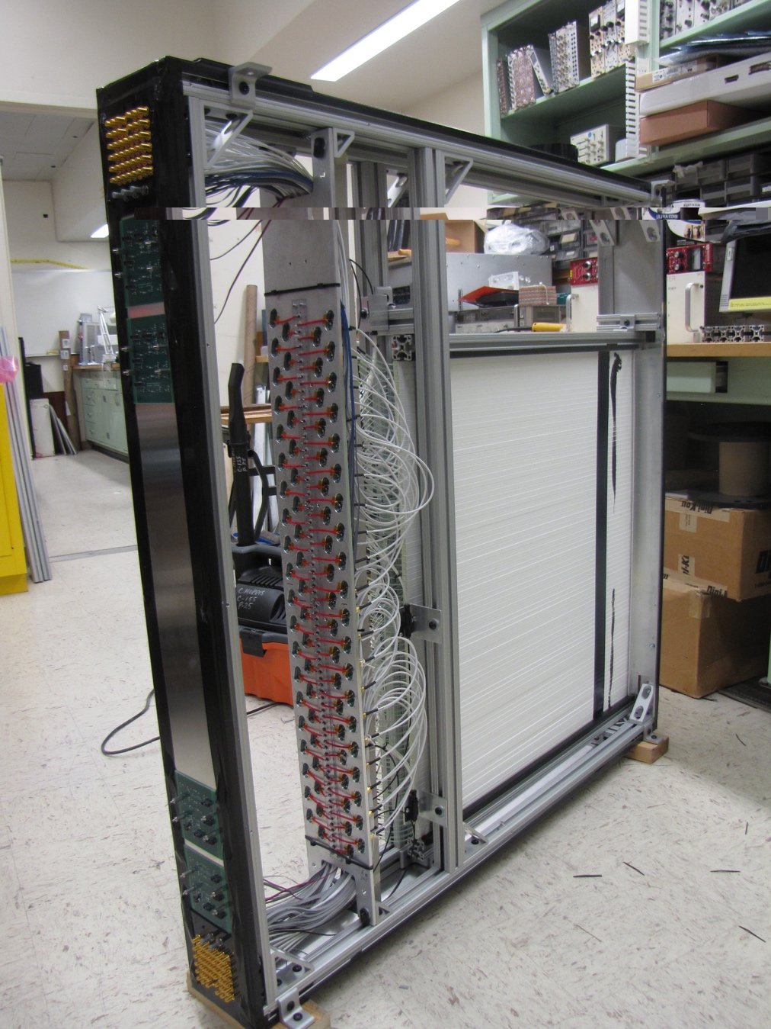
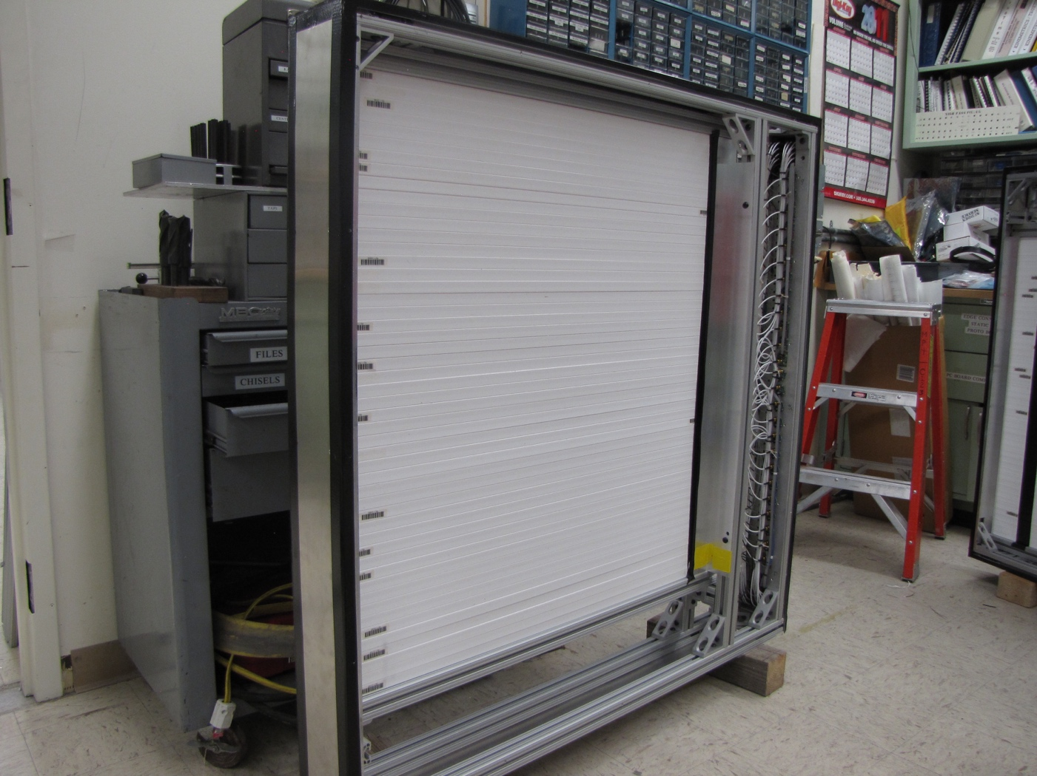
Completed modules, 8 of them in total!
Station-1: 80 x 80 cm², 80 channels
Station-2: 100 x 100 cm², 50 channels

Slide 13
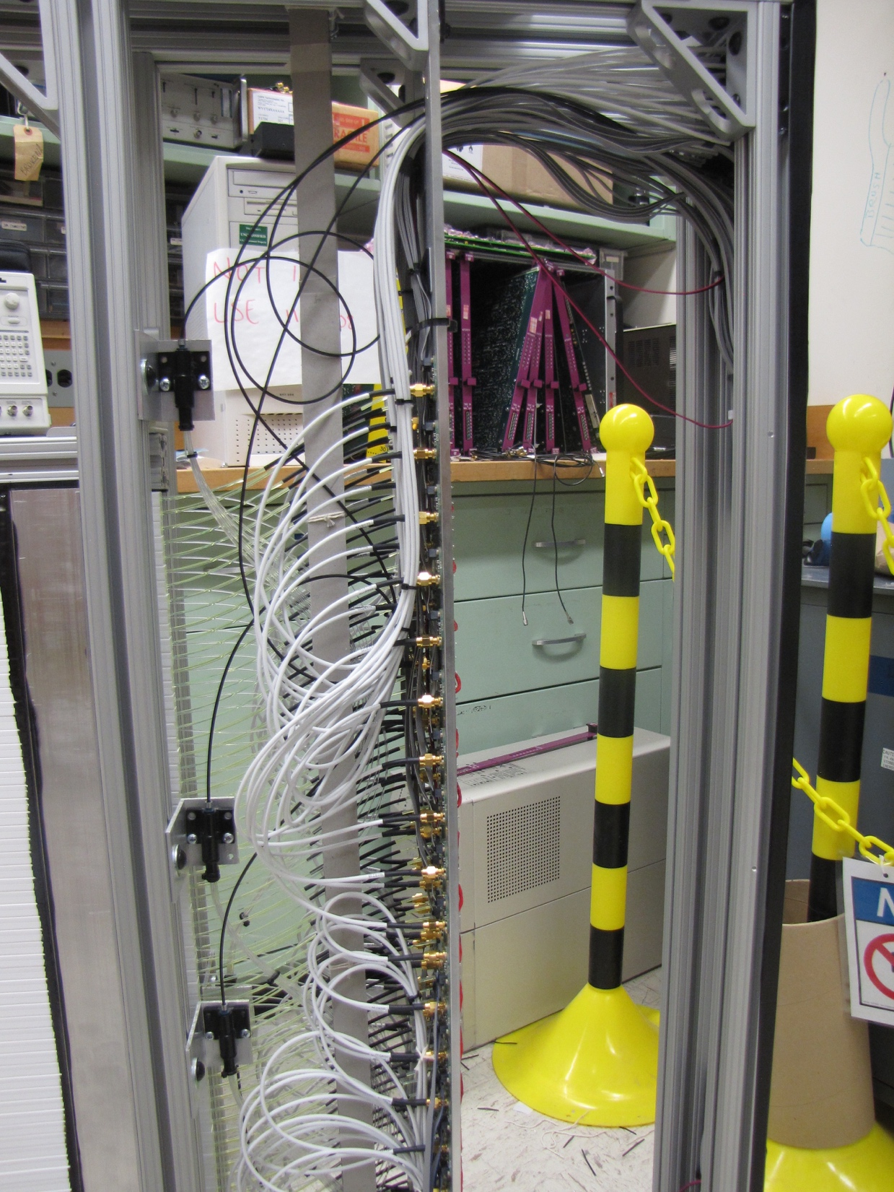
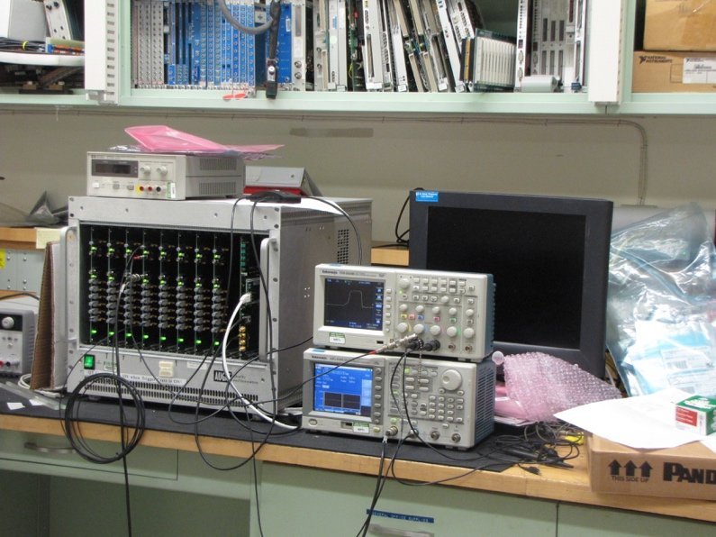
Optical Calibration, LV/HV Power Distribution and Controls Systems
Optical pulse generator
designed/built at LANL

Slide 14
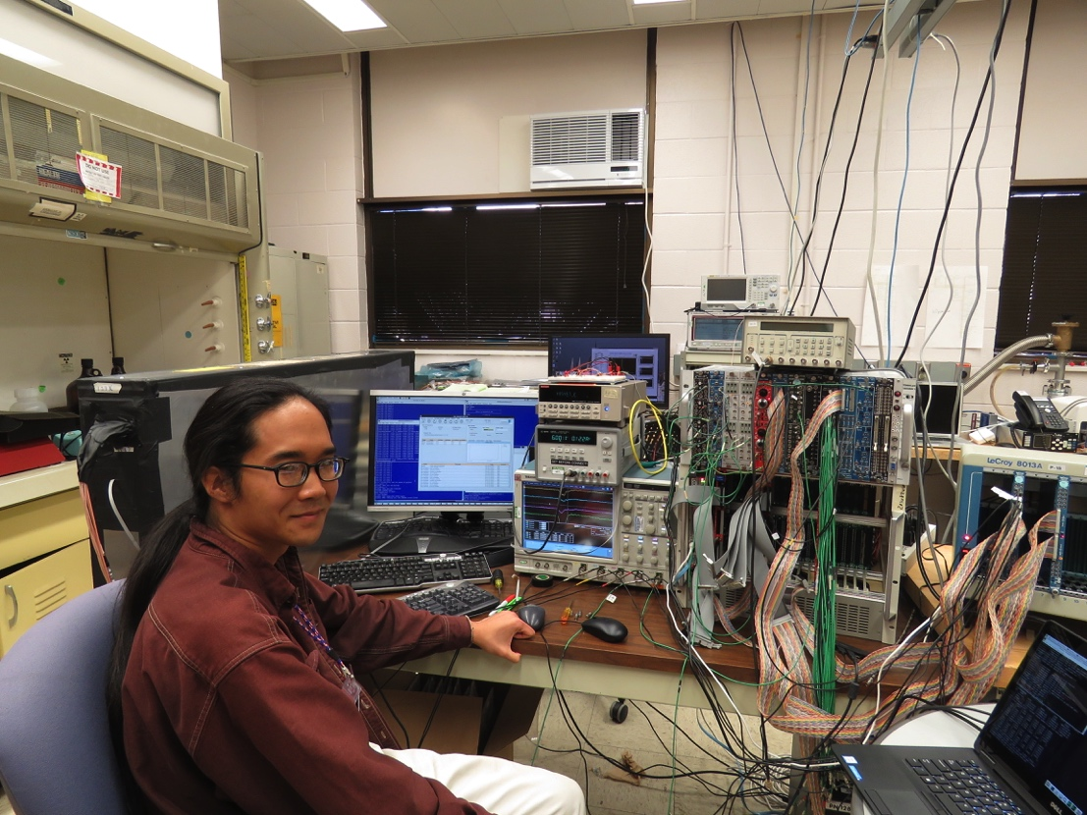
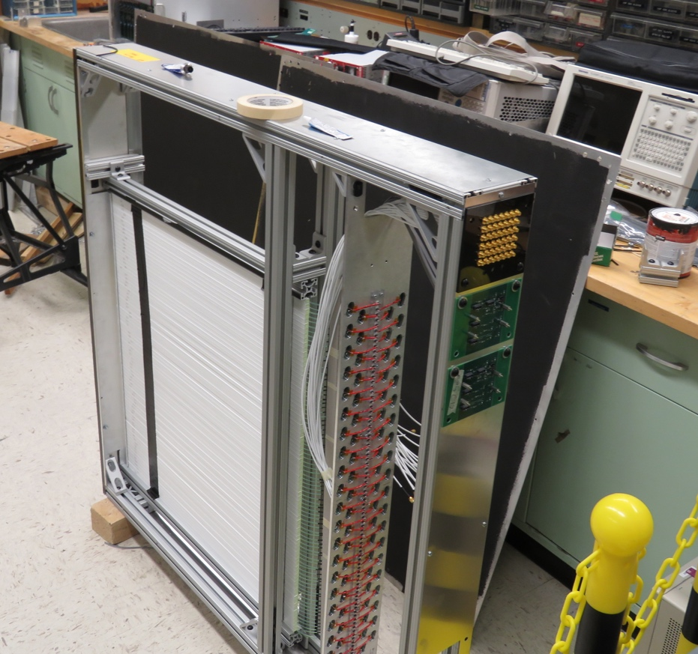
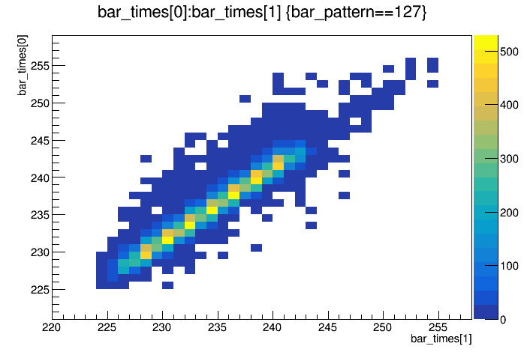
Trigger, DAQ R&D and Cosmic Test @LANL
Trigger & DAQ hardware and firmware designed and tested at LANL, in collaboration with Fermilab Engineers
Readout from a full module for cosmic test
  Full SiPM readout
  V1495 trigger logic + TDC read out
  E906 upgraded DAQ and firmware
Timing resolution, < 1.5nS (19nS RF)
Detector eff. > 96%
TDC_1
TDC_2

Slide 15
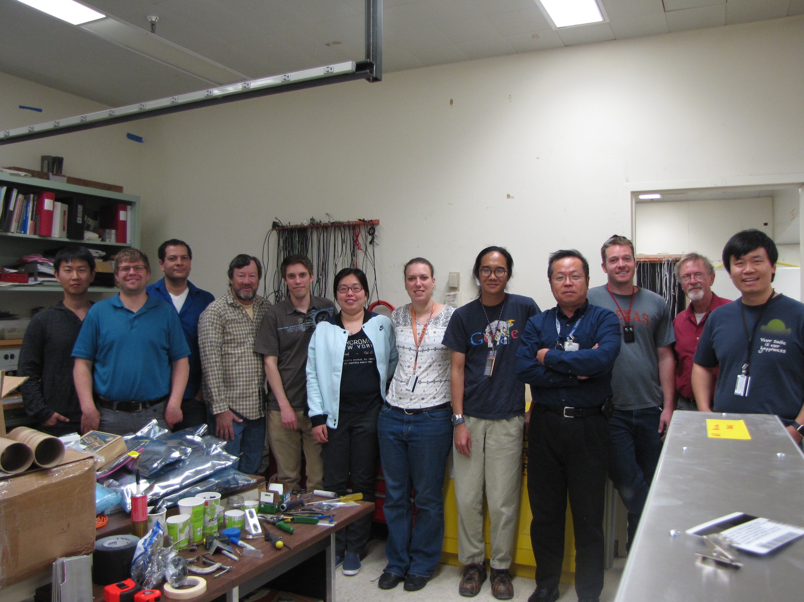
Trigger detectors shipped to Fermilab for installation 4/3/2017

Slide 16
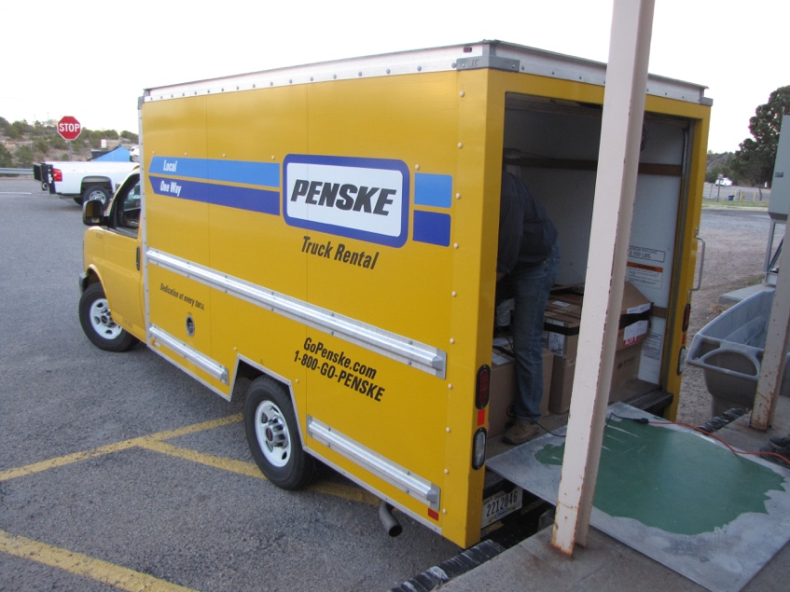
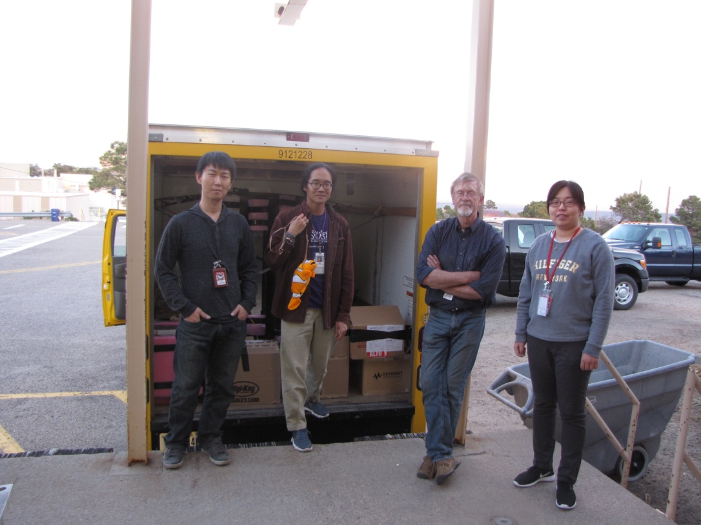
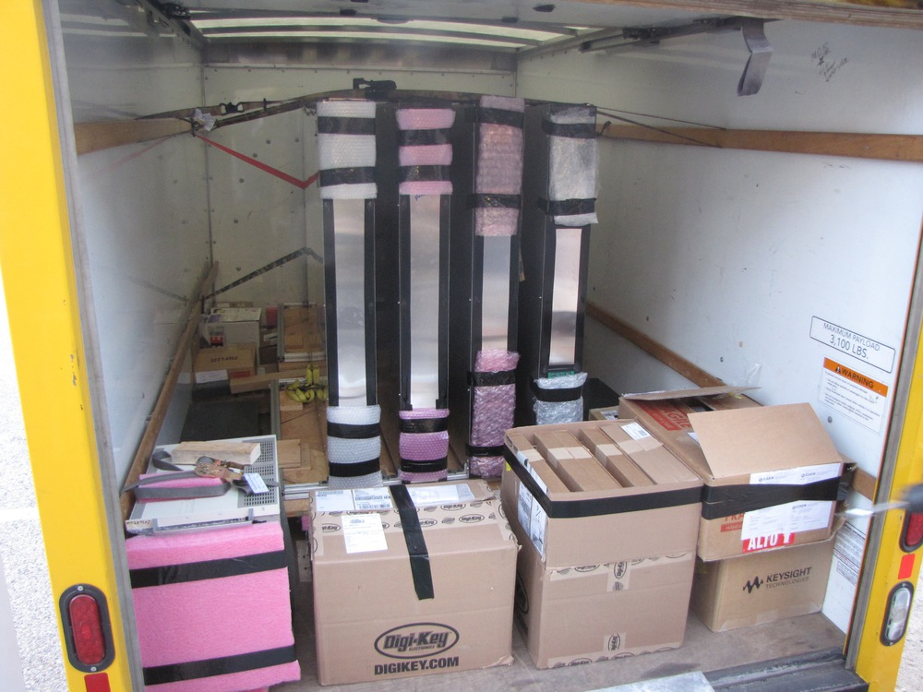
All Trigger Detectors Designed and Built at LANL, Truck loaded to Fermilab on 4/3/2017
Eight trigger detector modules
Electronics and Power supplies

Slide 17
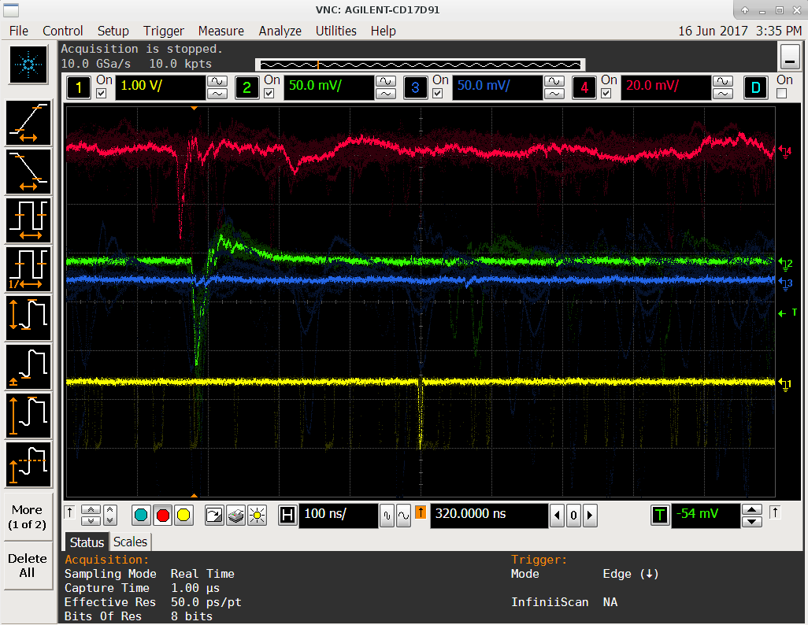
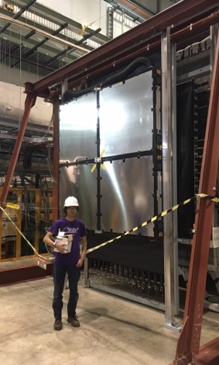
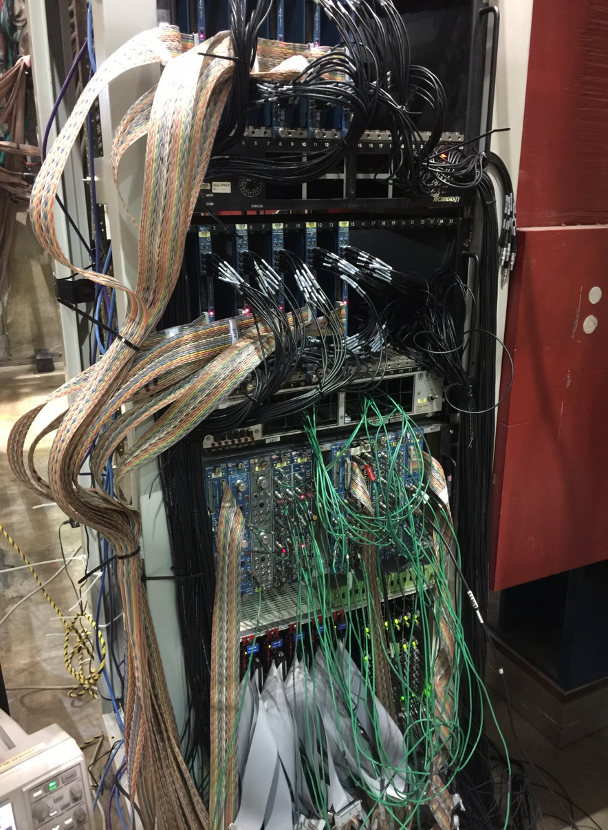
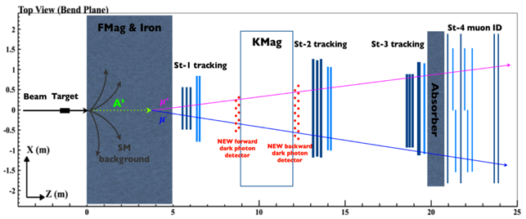
Dark Photon/Higgs Trigger Upgrade Completed in Summer 2017
Took Production Data with E906!
Station-2 Trigger Plane
LVL-1 + LVL-2
Trigger &
Calibration
Systems

Slide 18



Search Mode (2): “Prompt” Dark Photons vs Drell-Yan
Bump hunt at Z-vertx < 3m
Expected Drell-Yan like signal and backgrounds:
Excluded phi
resonance region
Dark photon
signal
Drell-Yan Background
Work in progress:
- optimization …,
- understand BG ...

Slide 19
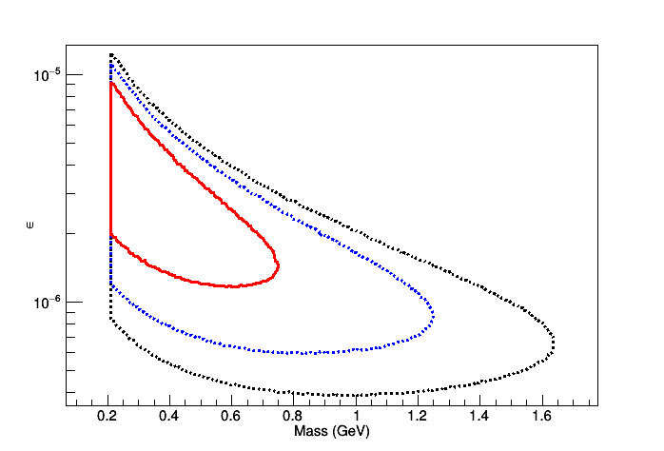
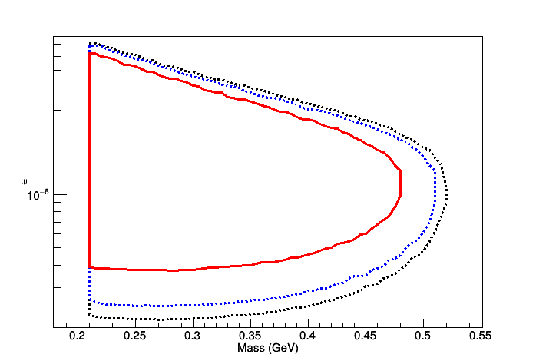
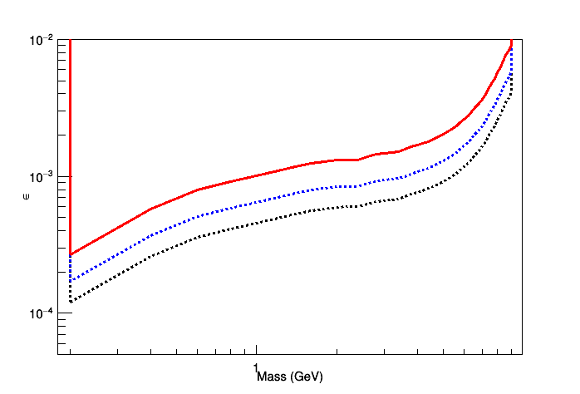
2017 Data Analysis in Progress
Projections of 2017 Data Sensitivity and Prospects of 2018 parasitic run
Projected sensitivity contours of displaced DY-like (left), η-decayed (middle), and prompt DY-like dark photon.
The dashed black curve stands for 4 months of data, blue dashed curve stands for 1 month of data,
and red curve shows 5 days of existing data.

Slide 20
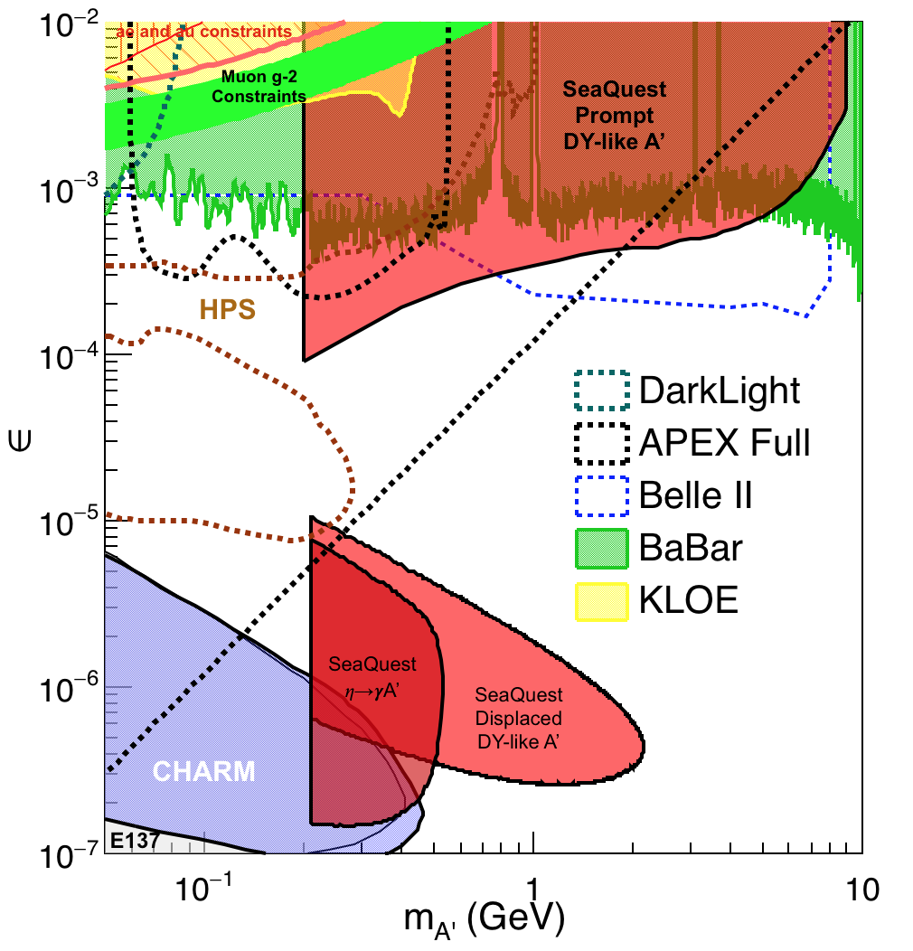
Phase-I Expectation: Dark Photons
(parasitic run w/ E1039)
Signals considered:
Drell-Yan like
Eta decays
Bremsstralung
Covers a wide range of unexplored parameter phase space
Displaced dimuons
- Minimal SM background
Prompt dimuons
- Good coverage
- Possible dedicated runs later to fully
restore mass < 3GeV (Phase-II)
EMcal upgrade (a new proposal)
Access below 200MeV with di-electrons
Work in progress!

Slide 21
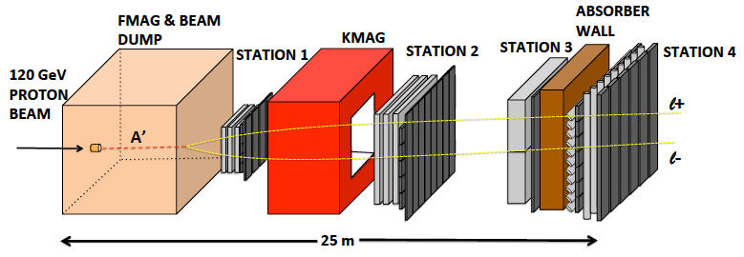

E-1067 Future Upgrade Opportunity
EMCal
Add tracking detectors close to “target” to improve mass resolution
Add EMCal, PID
e^{+/-}, h^{+/-} , π^{+/-}

Slide 22
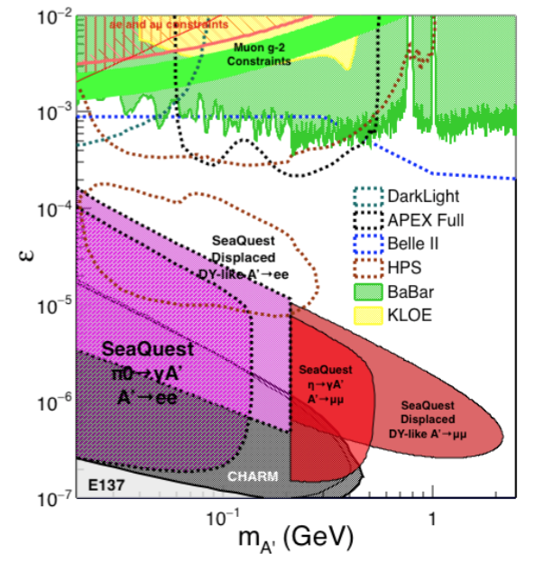
Phase-I: Displaced Low Mass Dark Photons with EMCal upgrades
Projection: POT 1.4 x 10¹⁸
Detector upgrades
  EMCal: e^{+/-}
  HCal: π^{+/-}
  Recycle from other experiments, PHENIX/RHIC etc.
Timeline of dedicated runs
  2020+
Detector configuration
  Access low mass region with optimized Fmag settting

Slide 23
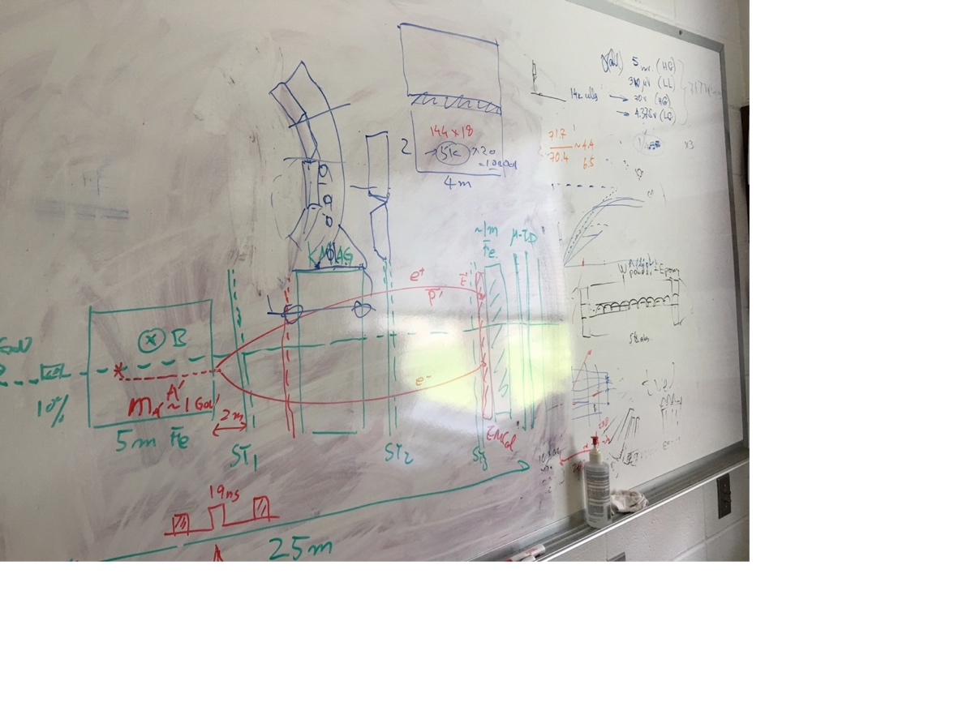
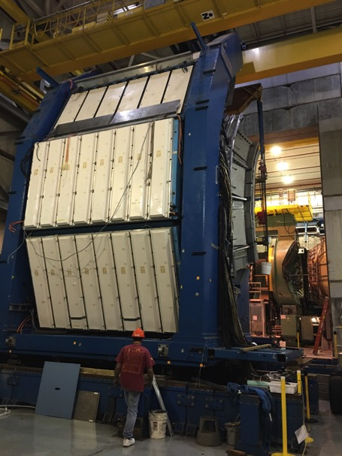
EMCal from PHENIX/RHIC
2 EMCal sectors are available from PHENIX experiment at RHIC, ~April of 2018
  One sector:
    2m x 4m, 18 (3x6)super modules
    Super module = 36 modules; Module = 4 towers
    36 x 4 x 18 = 2592 channels
    Could gang 2x2 (or 3x3) into one ADC/TDC readout
- dE/E = 8.1%/sqrt(E) + 2.1%
- dT < 200 ps
- Excellent e/pi separation

Slide 24
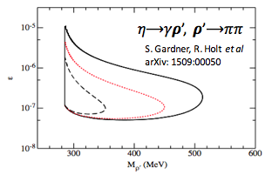
EMCal Upgrade: More Physics
2 sectors (4×4 m² coverage) PHENIX EMCal are available, need readout eletronics for SeaQuest
With EMCal installed, we will also be able to access:
  dark 𝝆 decays to 𝛑𝛑
  enhanced dark higgs sensitivity
Potential bonus of better background rejection on trigger level (studies underway).

Slide 25
Dark Higgs
Y. Zhang et al, arXiv:1502.06983
θ = μ v/m_{h}²
arXiv:1312.4992
e⁺e⁻
Phase-I:
High-mass: μ⁺μ⁻ and hadrons
Advantage of using hadron beams
with muon probes over electrons
Phase-II:
Low-mass: e⁺e⁻, <200MeV possible
High-mass: hadrons, (5x)
Electron ID
upgrade!
μ⁺μ⁻

Slide 26
Projected Dark Higgs Sensitivity
POT:1.4x10¹⁸ (Phase-I)
Y. Zhang (2015)
Dimuons with downstream displaced decay vertices
Limited sensitivity to “prompt” large mixing case due to small cross-section
Dark Higgs or dark photons?
  Dimuon kinematic and angular distributions
Phase-II
  Dedicated high luminosity runs optimized for low mass acceptance, mass<3GeV
POT:4x10²⁰

Slide 27
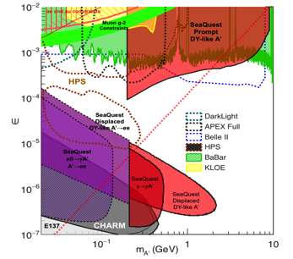
SeaQuest/E1067 Summary and Outlook
2017
  Successfully completed Trigger and DAQ Upgrade
  Successfully took production data parasitically with E906
  Data analysis in progress
  Ready for full data taking with E1039
2018
  Take more data parasitically with Polarized Drell-Yan experiment E1039
  First preliminary search results
Fermilab dark sector physics program @Seaquest/E1067:
Phase-I (2017-2020)
  Great discovery potential!
  Parasitic data taking with E906/E1039, 2017-2020
  POT 1.4 x10¹⁸ or more
  Possible detector upgrade, add electron and hadron capability
Phase-II (2020-2025+)
  A dedicated dark sector physics program at Intensity Frontier!
Dark Higgs
search
Preparation Phase-I (parasitic runs)
Phase-II
2015
2016
2017
2018
2019
2020+

Slide 28

Come to Join us!

Slide 29
backup

Slide 30
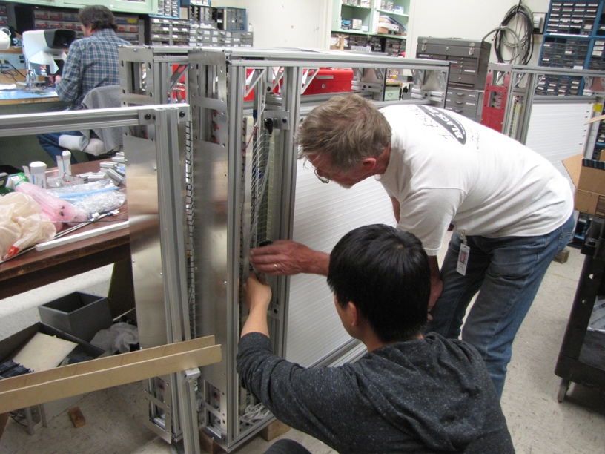
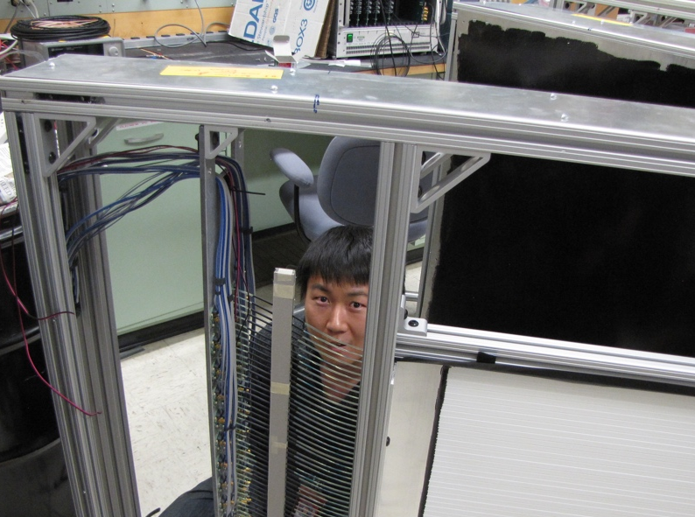
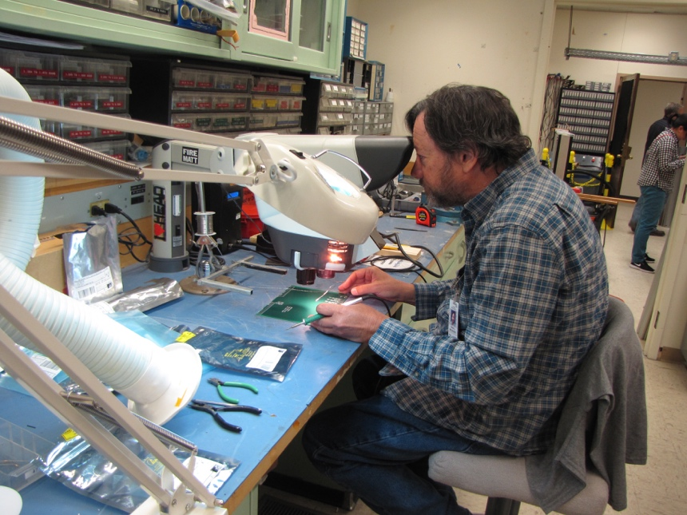
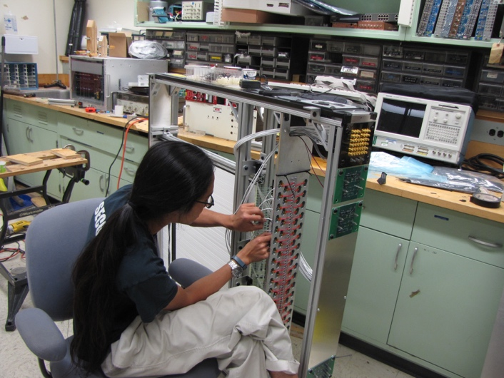
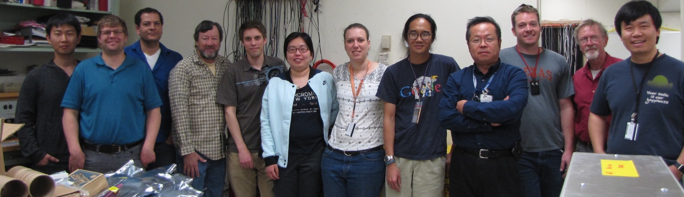
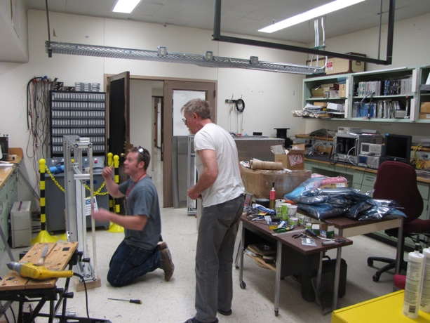
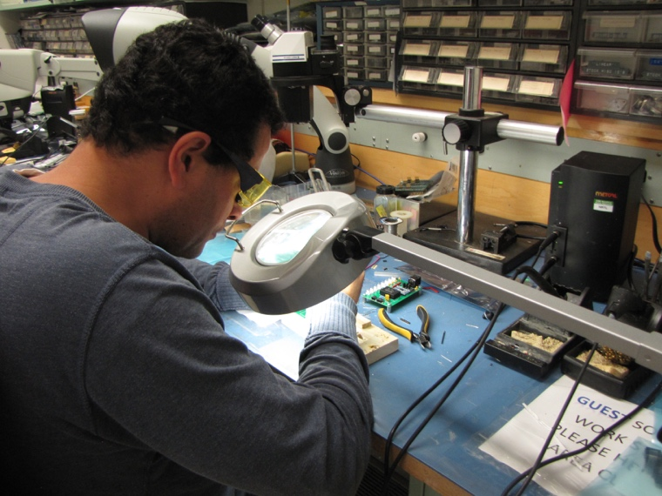
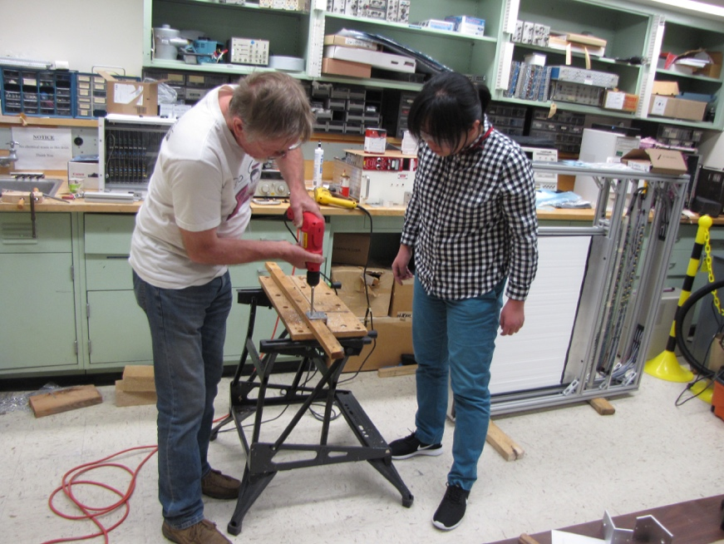
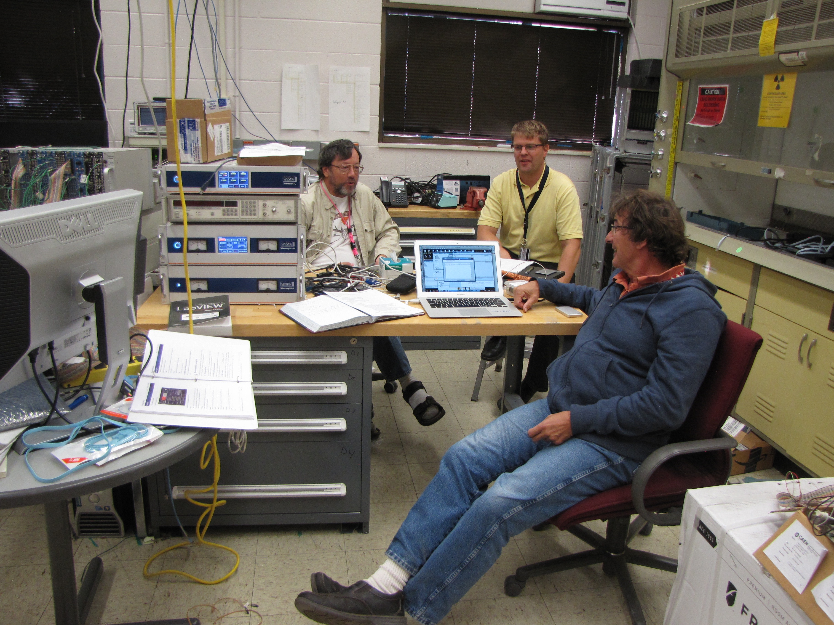
Very Successful Team Work!

Slide 31

Comparison with SHiP Proposal
120 GeV@FNAL: 2017 -2019
1.4x10¹⁸ POT or more, future dedicated runs
400 GeV@SPS: 2025 -2030
4x10²⁰ POT
POT:4x10²⁰

Slide 32
Low Mass Prompt Dimuon Trigger Rate Study
Current E906 setup
Proposed 2-layer trigger upgrade (10x improvement)
Additional Y-trigger after ST-3 absorber, and also using existing E906 X-Plane trigger
(additional ~2x improvement)
DAQ upgrade completed
  Previous E906 DAQ 1kHz
  Now 10+ kHz
  Can take all dark photon events of interest
4s spill, 60s cycle
Expected (Prompt) Low mass dimuon trigger performance
time

Slide 33



Event selection and reconstruction
Invariant mass spectrum for FY 2015 data
30% of anticipated data
Data agrees well with Monte Carlo (spectrometer works as expected)
Data with Mass > 4.2 GeV are mostly dimuons coming from the Drell-Yan process
E906 preliminary
J/ψ Monte Carlo
ψ’ Monte Carlo
Drell-Yan Monte Carlo
Random Background
Combined MC and bg

Slide 34



Beyond Exclusive Channels possible missing pT measurements being explored
Chien-Yi Chen, 2017

Slide 35

Side View of the Proposed Experimental Setup
F Mag
K Mag
LDRD:
St-1 trigger plane, 160 x 160 cm
Made of 4 1cm x 1cm x 80cm
scintillator planes
St-2 trigger plane, 200 cm x 200 cm
Made of 4 2cm x 2cm x 100cm
scintillator planes

