Slide 1
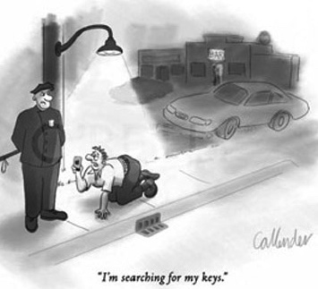
Dark Photon/Higgs Search in the SeaQuest/E1067 Experiment at Fermilab
Ming Liu
Los Alamos National Lab
Light Dark World International Forum 2017
Pittsburgh, PA

Slide 2
Outline
Dark sector physics @SeaQuest/E1067
  Experimental setup
Detector upgrade @SeaQuest/E1067
  Commissioning run in 2017
Future plan and opportunity
  Phase I: 2017 - 2020
    Parasitic run with E1039(polarized Drell-Yan)
    Electron/hadron ID w/ EMCal upgrade
  Phase II: 2020 -2025+
    Dedicated dark photon program @Fermilab
You inputs to further develop the program

Slide 3
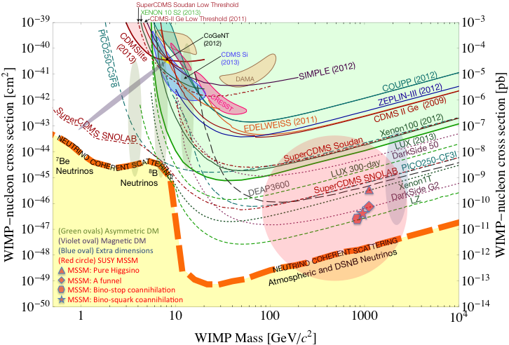
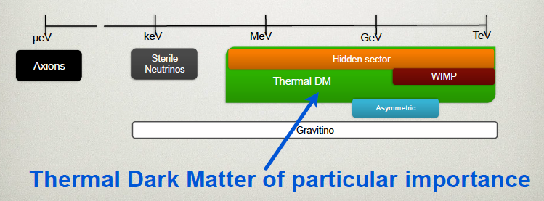
Dark Sector Physics at Low Mass
Current and near future high-intensity colliders and fixed target experiments offer an ideal environment to probe dark sector physics,
in O(MeV) ~ O(GeV), SeaQuest@Fermilab
P. Schuster et al.
WIMP Search

Slide 4

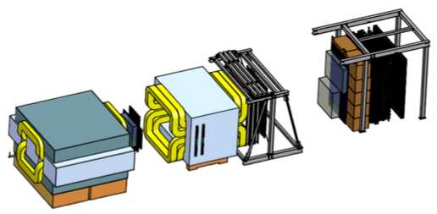
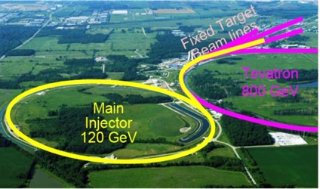
SeaQuest Dimuon Experiment at the Intensity Frontier at Fermilab
High intensity proton beam: “beam dump mode” @SeaQuest/E1067
35K fb⁻¹ (in a 2-year parasitic run, 1.4x10¹⁸ POT @7% beam)
LHC-II: 300 fb⁻¹ (~2025), achieved 25fb⁻¹ in Run-I
Absorber wall and proportional
tube based Muon ID
Spectrometer magnet
Δpt = 0.4 GeV
Focusing magnet
and solid iron dump
Δpt = 2.9 GeV
Beam
120 GeV proton from Main Injector
19ns RF, 4s spill, 0.5×10¹³ protons per spill
25 m
Target system
Liquid H and D
Solid C, Fe, W
SeaQuest
- Beam dump mode: p+Fe collisions! Target ~ 10%λ_{I}
- Parasitic run mode possible with other experiments, E906/E1039

Slide 5
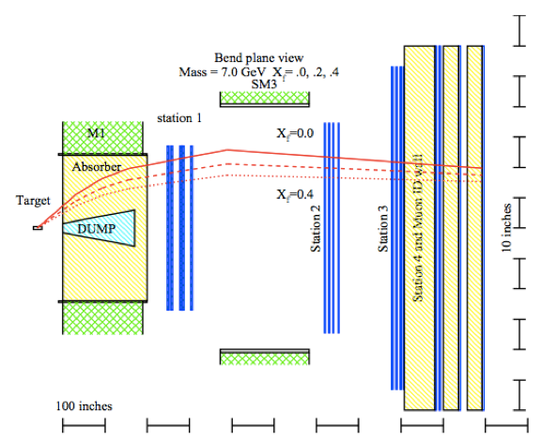
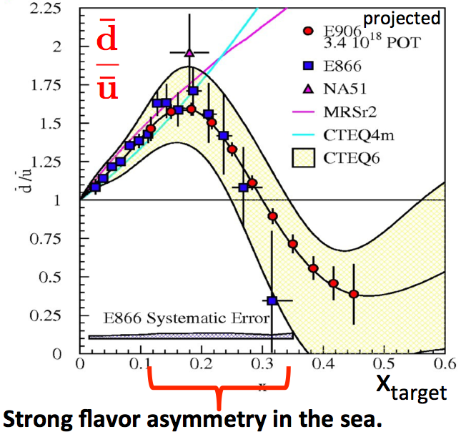
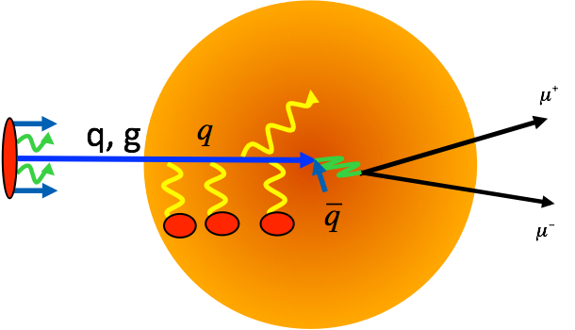
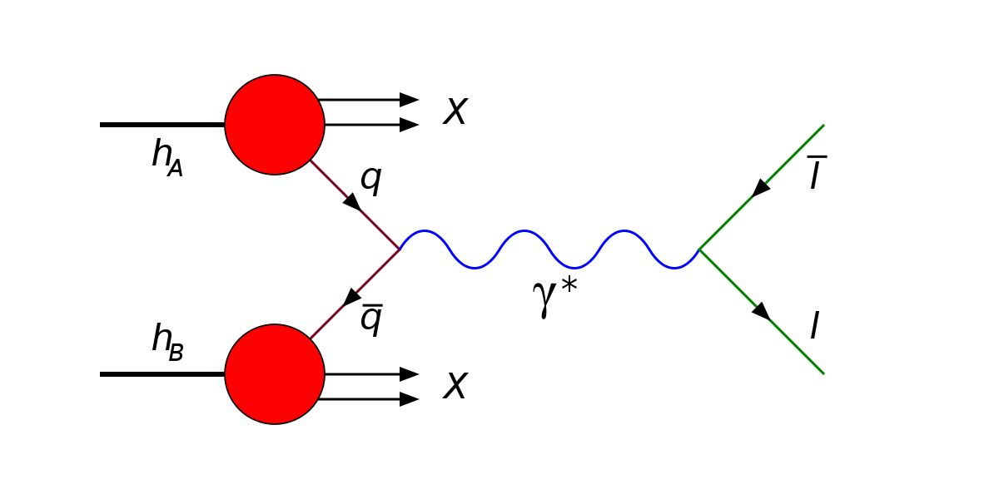
SeaQuest: Nuclear Physics with Drell-Yan
DOE/Nuclear Physics Programs: 2008-2017(E906), 2017-2020(E1039)
High mass Drell-Yan:
4<M<8 GeV
Quark Energy Loss dE/dx in p+A collisions

Slide 6
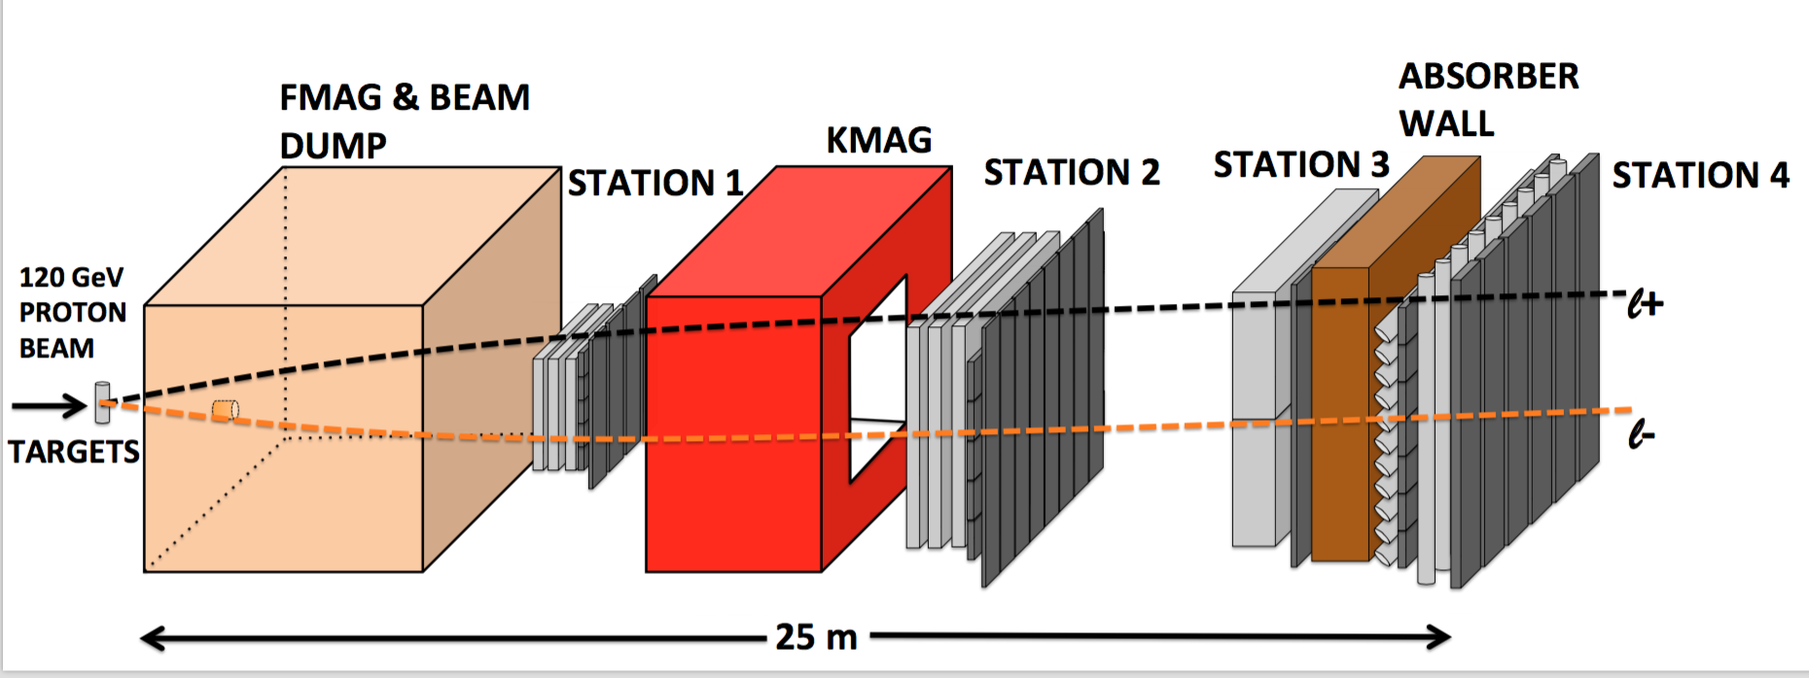
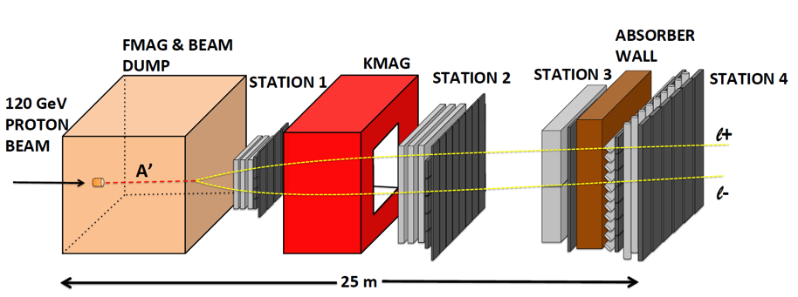
A target Drell-Yan event
E906
A beam-dump dark photon event --- parasitic run possible!
A new idea
developed
in ~2014

Slide 7
A Great Opportunity
Dark Photons and Dark Higgs Search at SeaQuest
Photon portal: “vector”
Higgs portal: “scalar”
A great advantage
for proton beam!
θ = μ v/m_{h}²

Slide 8
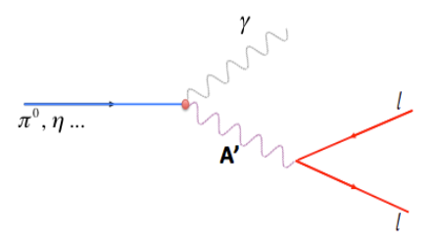
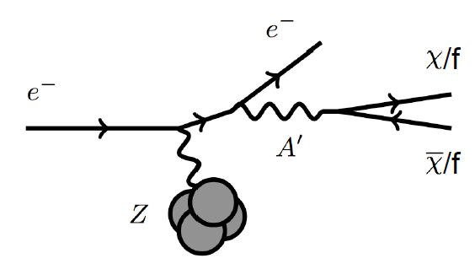
Dark Photon Detection in the Dilepton Channel
Drell-Yan like
π⁰, η, … decay
Bremsstrahlung
(DM)
(DM)
p
l⁺
p
l⁻

Slide 9
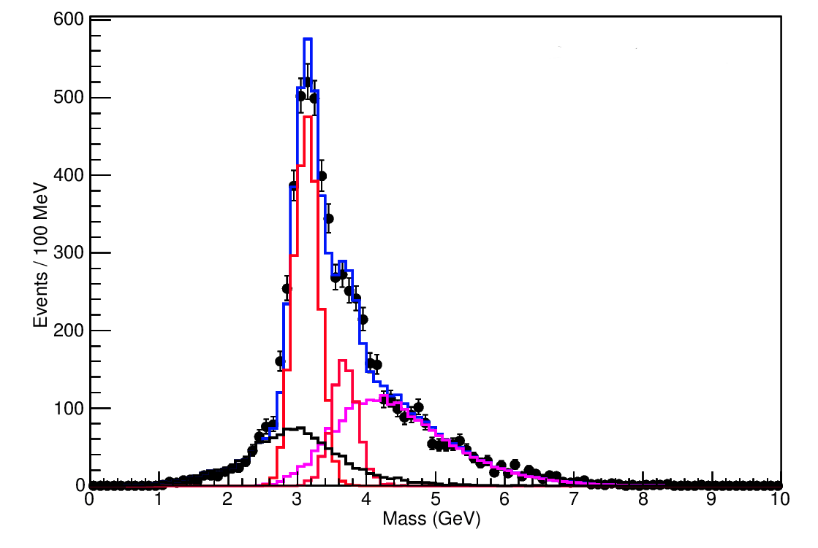

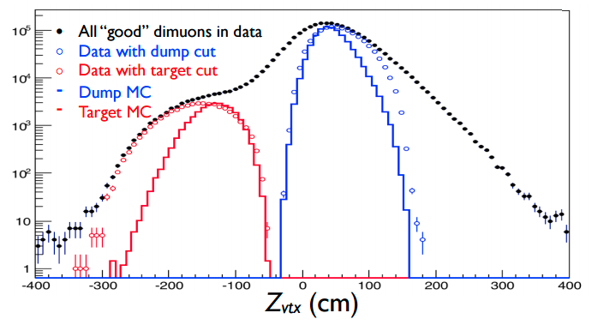
Upgrades Required for Dark Sector Search
Events collected in SeaQuest/E906
Invariant mass spectrum from 2015 data
Data agrees well with Monte Carlo (spectrometer works as expected)
Data with Mass > 4.2 GeV are mostly dimuons coming from the Drell-Yan process
For Dark Photon Search:
1)DAQ upgrade required to collect low mass dimuons
2)Trigger upgrade for displaced/long-lived particles
E906 preliminary
J/ψ Monte Carlo
ψ’ Monte Carlo
Drell-Yan Monte Carlo
Random Background
Combined MC and bg

Slide 10
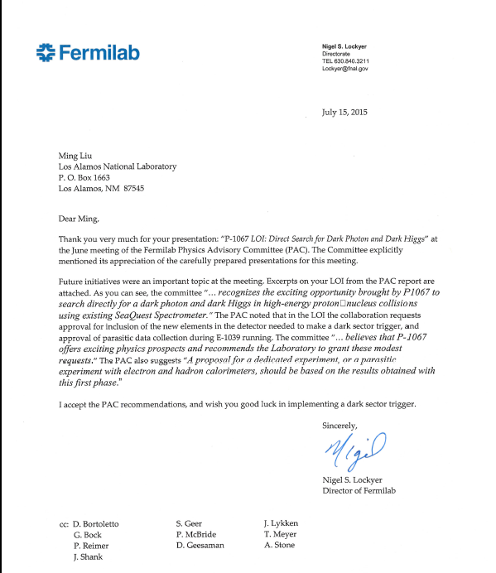
A heart-full endorsement
from Fermilab Director and PAC
July 15, 2015!
A New experiment! SeaQuest/E-1067
Generous LANL LDRD support:
- 2016-2018
- $1M to implement
the trigger/DAQ upgrade and theory development
Goals:
Trigger installed, 2017
Physics run, 2017-20
Preliminary results 2018!

Slide 11
Detector Upgrades and Expected Signals
Dark photon trigger upgrade
  A fine-granularity trigger/tracking to tag dimuons from the same decay Z-vertex
  A new trigger for events with displaced down-stream dimuons
Unique signals
  Displaced dimuon decay vertex for long-lived particles
  Invariant mass peak in dimuon mass spectrum
Planned beam time
  Run parasitically with E906/E1039 (2017-2020)
  Possible dedicated runs later with further upgrade (e^{+/-}, h^{+/-})
-- 2.5%
-- 6.0%
Dimuon mass resolution
Z (meter)

Slide 12
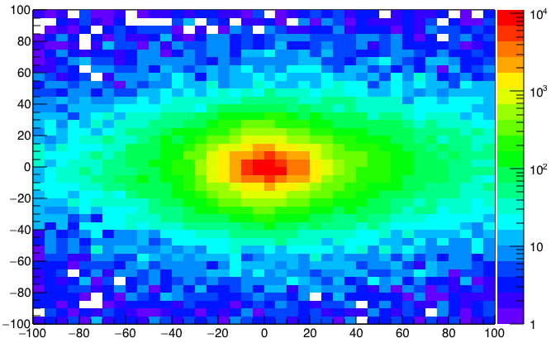
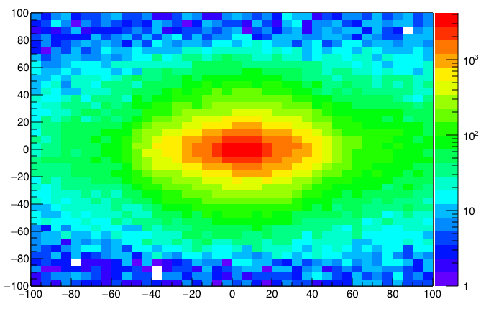
A New High-Granularity Displayed Dark Photon/Higgs Dimuon Vertex Trigger
High rejection power, low rate, < 1 kHz (previous E906 DAQ limit)
Y-Plane (non-bending) Trigger:
A quadrant panel: 80cm x 80cm (100cmx100cm @ST-2)
  ST1: 1cm x 1cm x 80 cm scintillating strips, SiPM readout
  ST2: 2cm x 2 cm x 100 cm strips
- Straight line projection, σ_{Z} ~30cm
Displaced z-vertex, mostly low mass < 3GeV
Y
Dimuon Z-vertex (cm)
ST1
X
St1
St2
Z
Coincident Z-vtx
Matched @Lvl-2
Z1=9m
Z1=12m
ST2

Slide 13
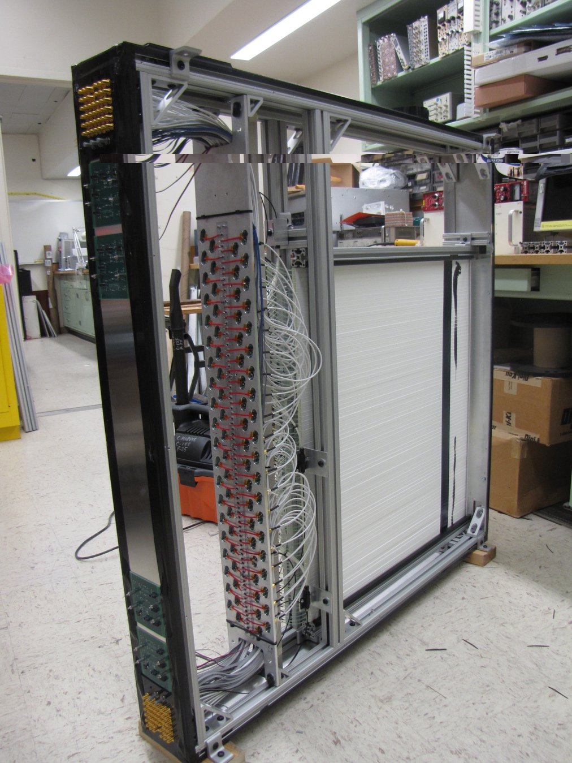
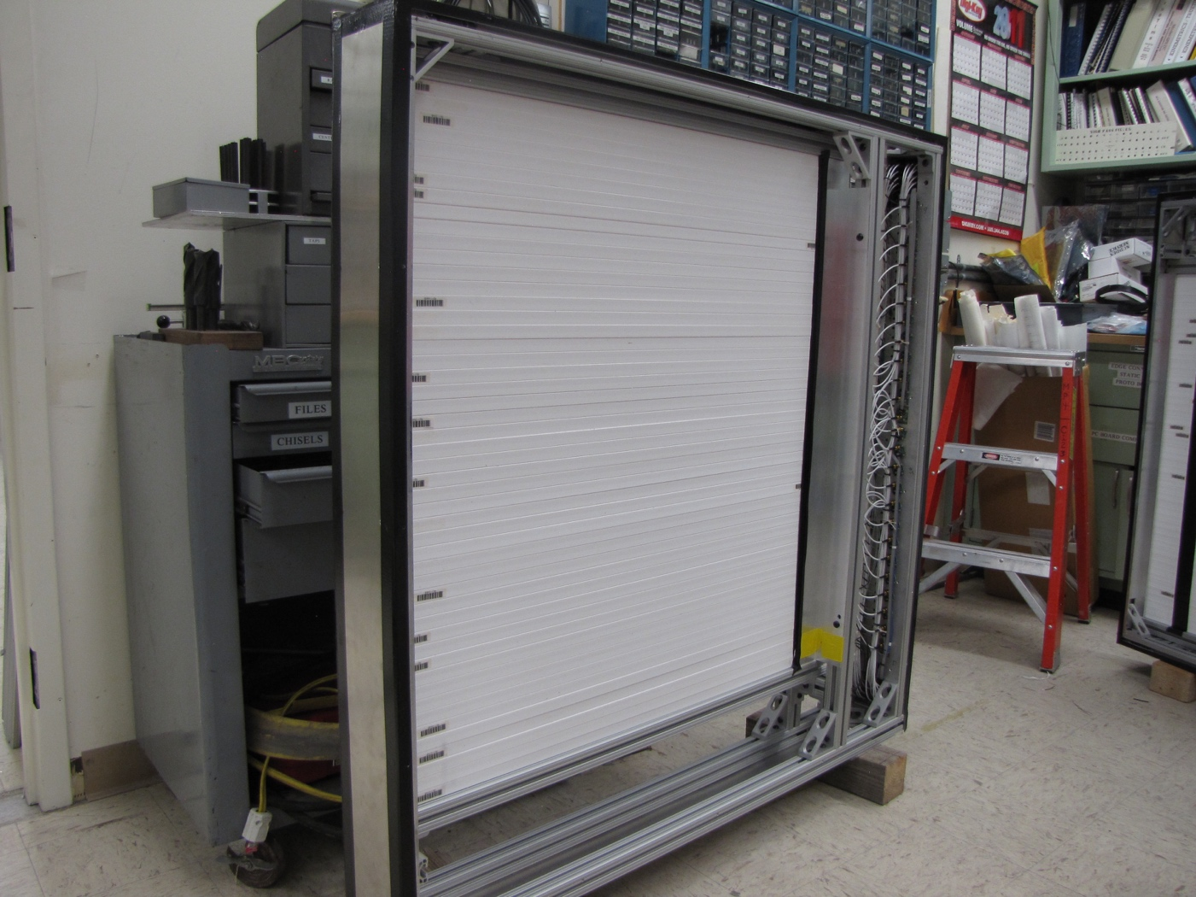
Completed modules, 8 of them in total
Station-1: 1cm scintillators, 80 x 80 cm²,
Station-2: 2cm scintillators, 100 x 100 cm²

Slide 14
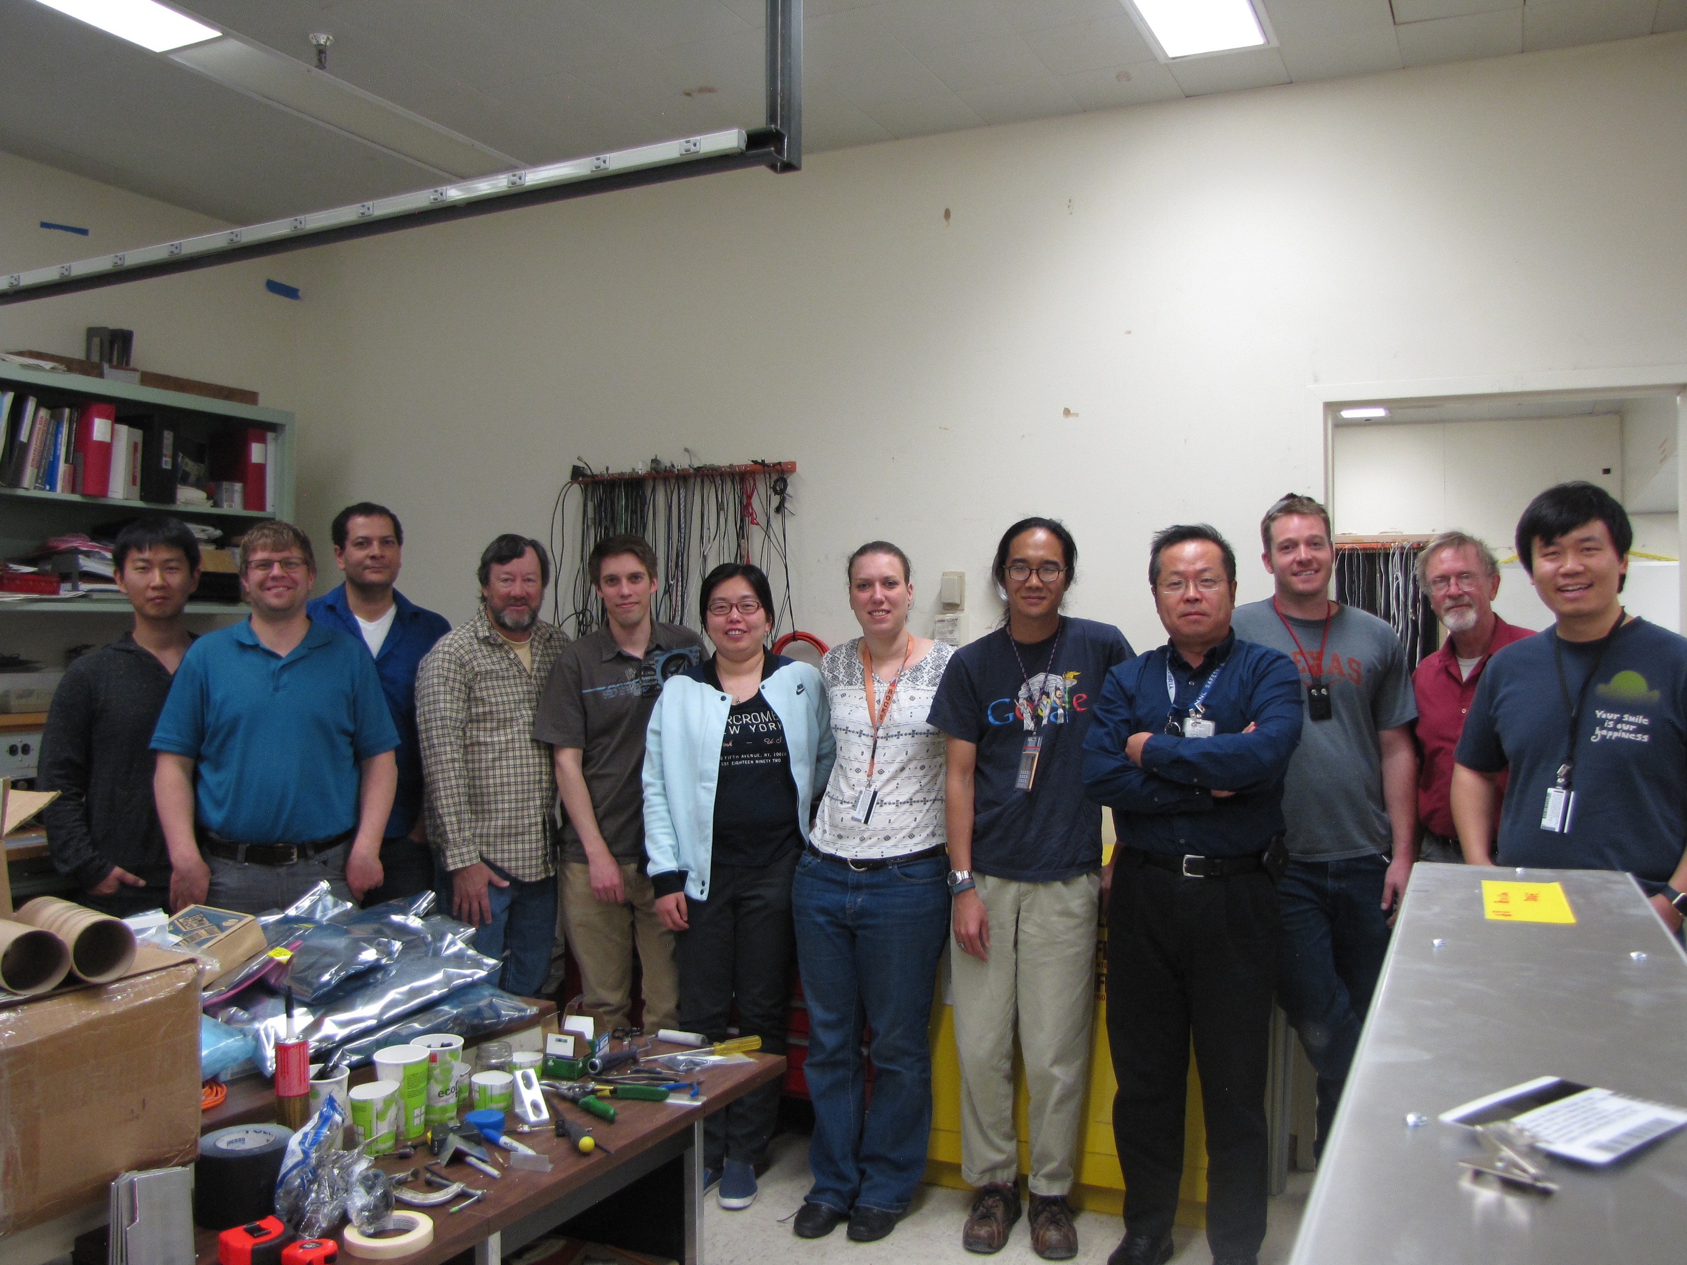
Trigger detectors shipped to Fermilab for installation 4/3/2017

Slide 15
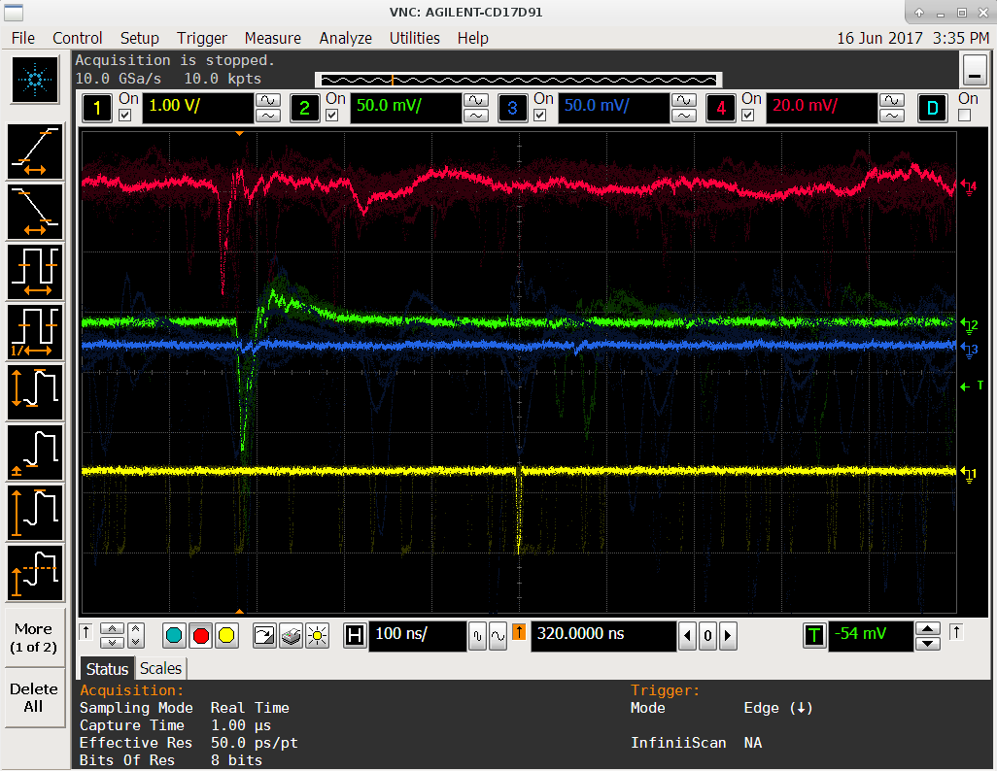
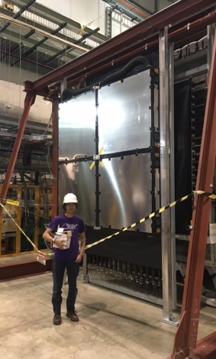
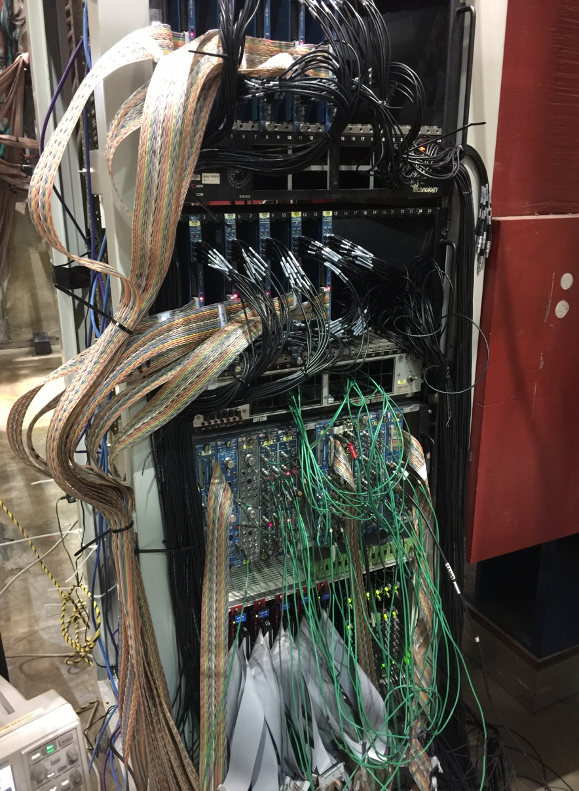
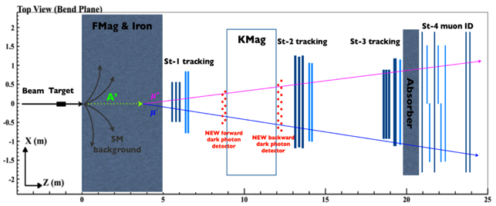
Dark Photon/Higgs Trigger Upgrade Completed in Summer 2017
Successfully took 1-week of production data with E906!
Station-2 Trigger Plane
LVL-1 + LVL-2
Trigger &
Calibration
Systems

Slide 16
DAQ Upgrade Completed in Early 2017
Take advantage of beam structure: 4 sec/ 60 sec.
Locally store data during collisions
  10x DAQ improvement
New DAQ boards
4sec, 56sec to others
Time

Slide 17
Trigger Detector Performance from 2017 Run
Hit rate vs Channel
Station-1
Station-2
Hit occupancy
Performed as expected

Slide 18

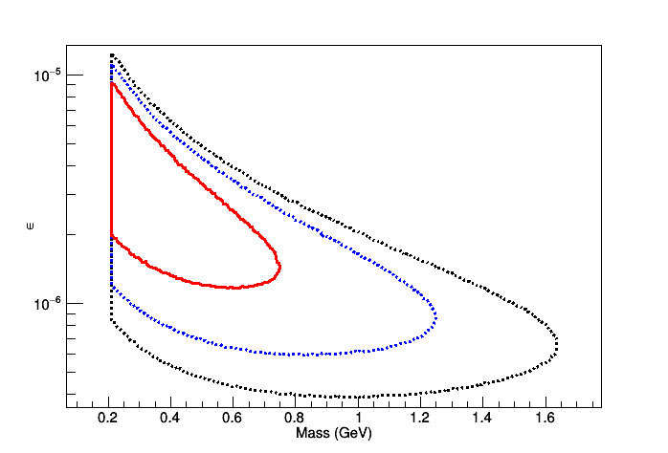
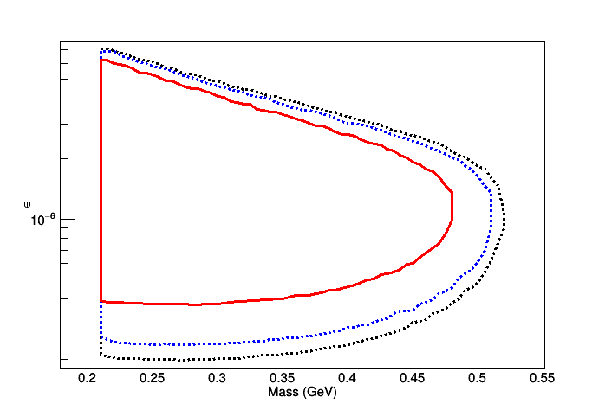
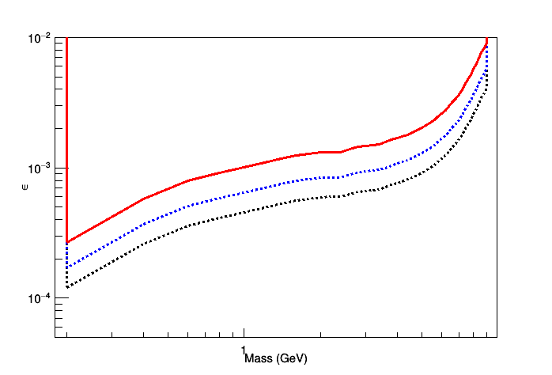
Expectations from 2017 data … Preliminary results ~2018
Displaced Dark Photon
Eta decays
Prompt Drell-Yan Like
1-week
1-month
4-month
Expectation from 2018 run:
The dashed black curve stands for 4 months of data, blue dashed curve stands for 1 month of data,
and red curve shows 5 days of existing data.
Polarized target
installation/E1039
2017
2018
2019
2020

Slide 19
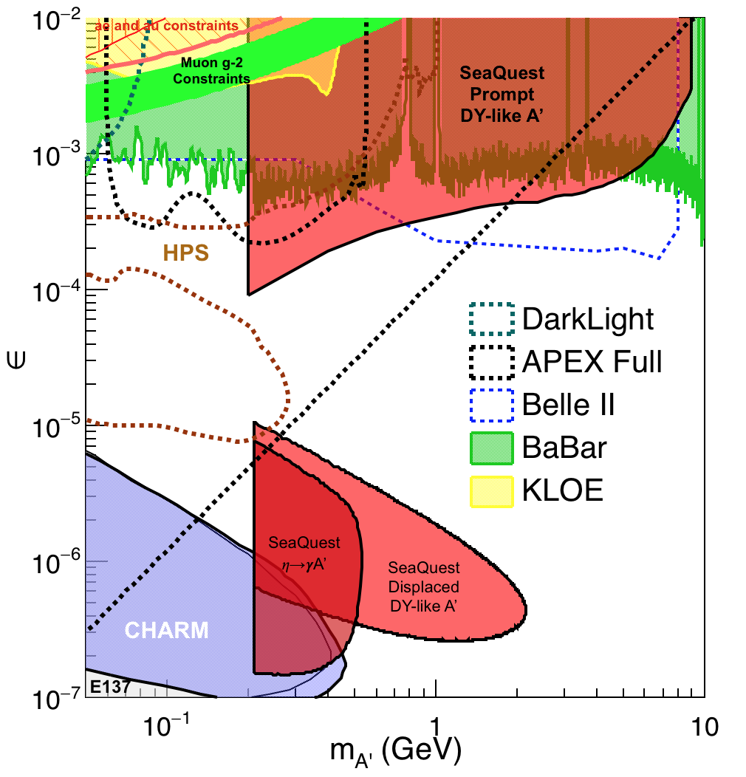
Full Projections - Dark Photons
(parasitic run w/ E1039: 2018-2020)
Signals considered:
Drell-Yan like
Eta decays
Bremsstralung
Covers a wide range of unexplored parameter phase space
Displaced dimuons
- Minimal SM background
Prompt dimuons
- Good coverage
- Possible dedicated runs later to fully
restore mass < 3GeV (Phase-II)
Possible EMcal upgrade (a new proposal)
Access below 200MeV with di-electrons
Work in progress!

Slide 20
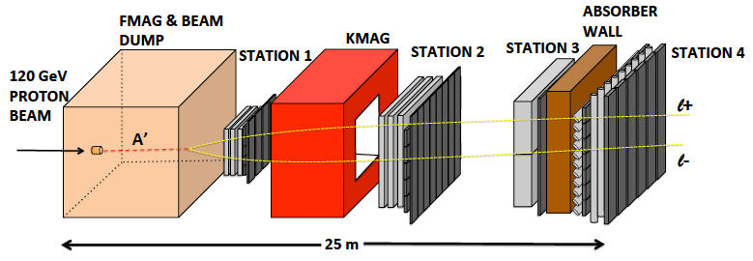

SeaQuest/E-1067 Upgrade Opportunity
EMCal
Add tracking detectors close to “target” to improve mass resolution
Add EMCal, PID
e^{+/-}, h^{+/-} , π^{+/-}

Slide 21
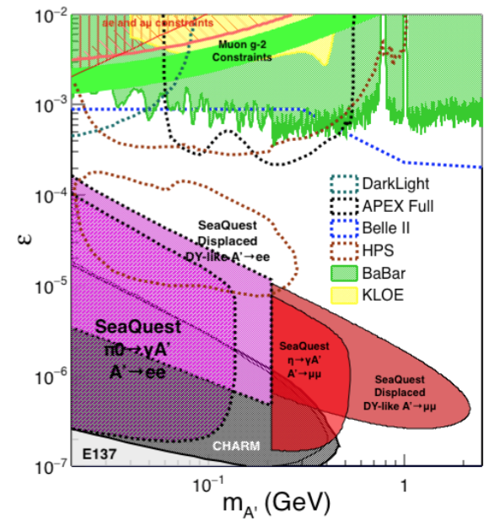
Displaced Low Mass Dark Photons with EMCal upgrades
Projection: POT 1.4 x 10¹⁸
Detector upgrades
  EMCal: e^{+/-}
  HCal: π^{+/-}
  Recycle from other experiments, PHENIX/RHIC etc.
Timeline of dedicated runs
  2020+
Detector configuration
  Access low mass region with optimized FMag settting

Slide 22
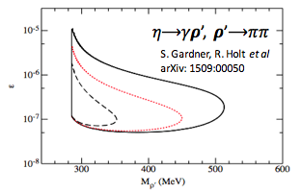
EMCal Upgrade: More Physics
EMCal opens up:
  dark 𝝆 decays to 𝛑𝛑
  enhanced dark higgs sensitivity
  SIMP, “dark QCD-like” etc.
Potential bonus of better background rejection on trigger level (studies underway).

Slide 23
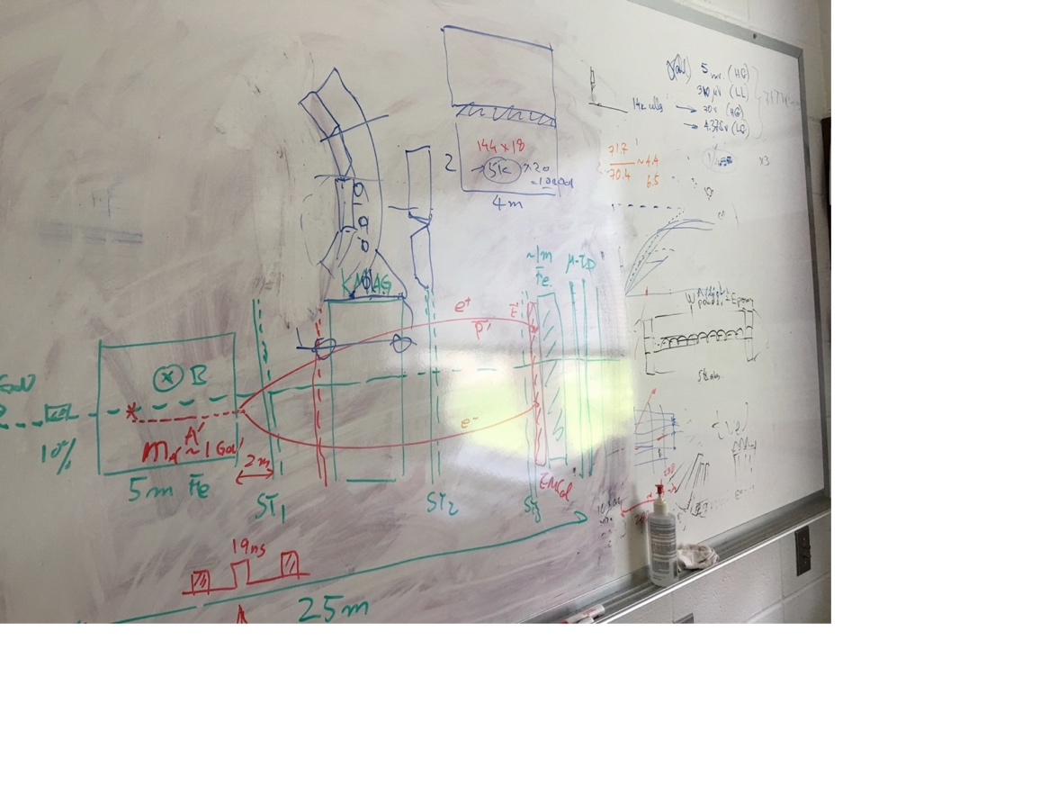
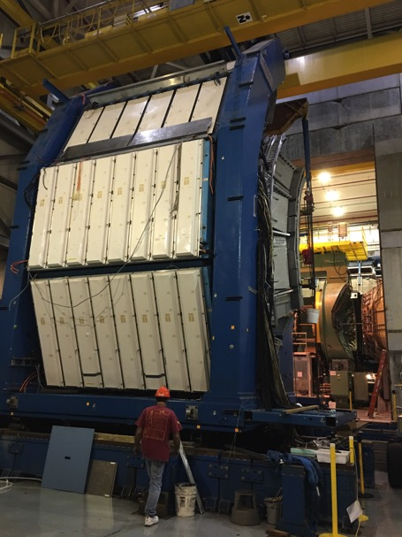
EMCal Identified & DOE Approved!
Two EMCal sectors are available from PHENIX experiment at RHIC, ~April of 2018
- dE/E = 8.1%/sqrt(E) + 2.1%
- dT < 200 ps
- Excellent e/pi separation
PHENIX @RHIC

Slide 24
Dark Higgs!
Y. Zhang et al, arXiv:1502.06983
θ = μ v/m_{h}²
arXiv:1312.4992
e⁺e⁻
Phase-I:
High-mass: μ⁺μ⁻ and hadrons
Advantage of using hadron beams
with muon probes over electrons
Phase-II:
Low-mass: e⁺e⁻, <200MeV possible
High-mass: hadrons, (5x)
Electron ID
upgrade!
μ⁺μ⁻

Slide 25
Projected Dark Higgs Sensitivity
POT:1.4x10¹⁸ (Phase-I)
Y. Zhang (2015)
Dimuons with downstream displaced decay vertices
Limited sensitivity to “prompt” large mixing case due to small cross-section
Dark Higgs or dark photons?
  Dimuon kinematic and angular distributions
POT:4x10²⁰

Slide 26
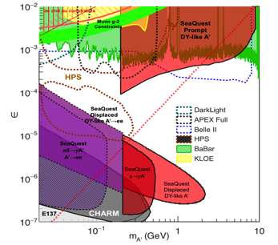
SeaQuest/E1067 Summary and Outlook
2017
  Successfully completed Trigger and DAQ Upgrade
  Successfully took production data parasitically with E906
  Data analysis in progress
  Ready for full data taking with E1039
2018
  Take more data parasitically with Polarized Drell-Yan experiment E1039
  First preliminary search results
Fermilab dark sector physics program @Seaquest/E1067:
Phase-I (2017-2020)
  Great discovery potential!
  Parasitic data taking with E906/E1039, 2017-2020
  POT 1.4 x10¹⁸ or more
  Possible detector upgrade, add electron and hadron capability
Phase-II (2020-2025+)
  A dedicated dark sector physics program at Intensity Frontier!
Dark Higgs
search
Preparation Phase-I (parasitic runs)
Phase-II
2015
2016
2017
2018
2019
2020+

Slide 27
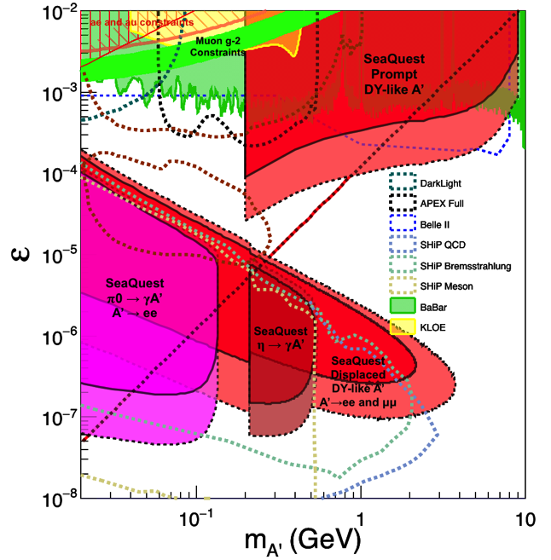
Comparison with SHiP Proposal
120 GeV@FNAL: 2018 -2020
1.4x10¹⁸ POT or more, future dedicated runs
Phase-II: 2020-2025+, POT: 4x10²⁰
400 GeV@SPS: 2025 -2030
4x10²⁰ POT
POT:4x10²⁰

Slide 28

Come to Join Us!

Slide 29
backup

Slide 30

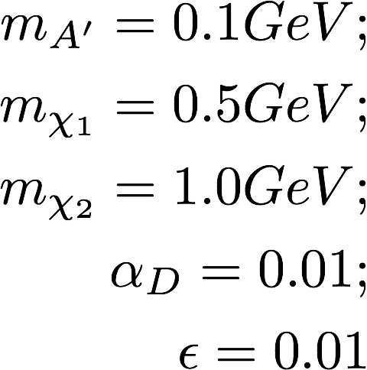
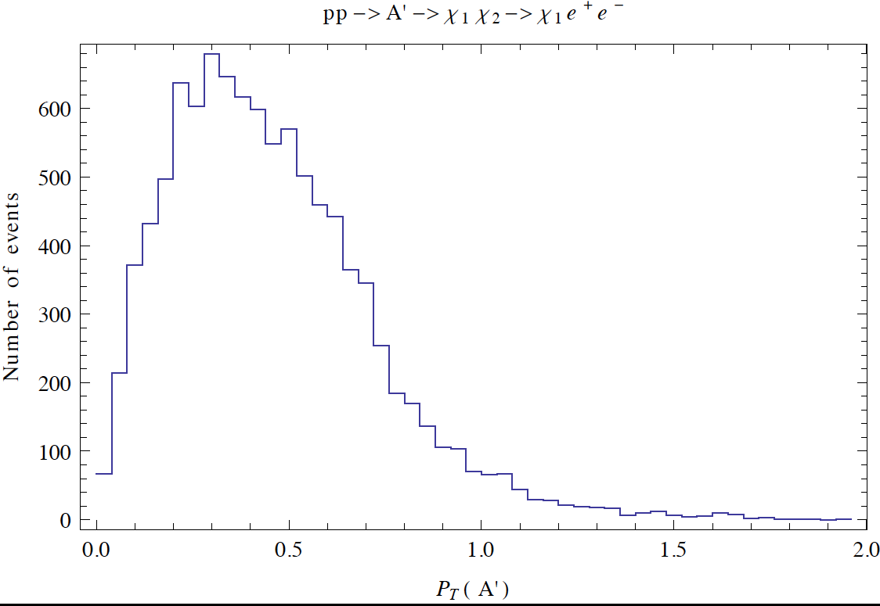
Beyond Exclusive Channels possible missing pT measurements being explored
Chien-Yi Chen, 2017

Slide 31
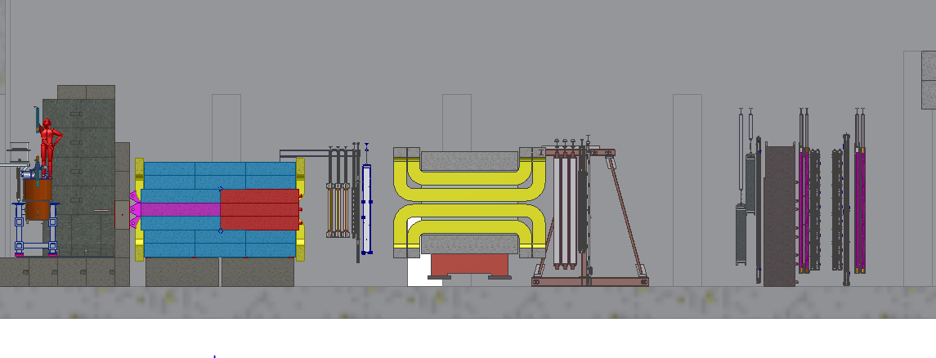
Side View of the Upgraded SeaQuest Experiment
F Mag
K Mag
ST-1
ST-2
ST-3
ST-4
St-1 trigger plane, 160 x 160 cm
Made of 4 1cm x 1cm x 80cm
scintillator planes
St-2 trigger plane, 200 cm x 200 cm
Made of 4 2cm x 2cm x 100cm
scintillator planes

Slide 32
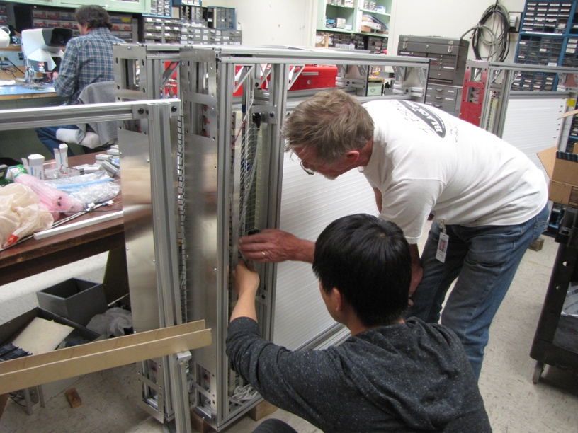
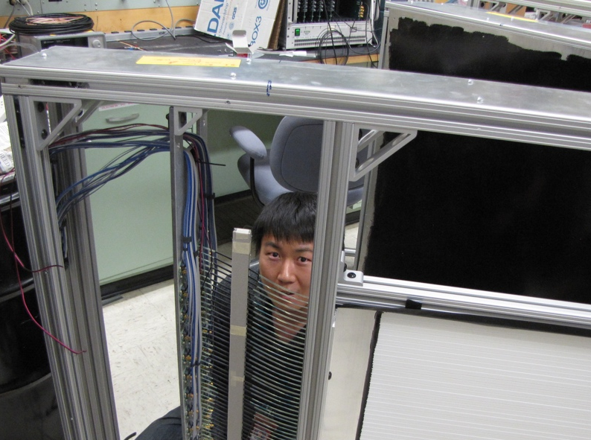
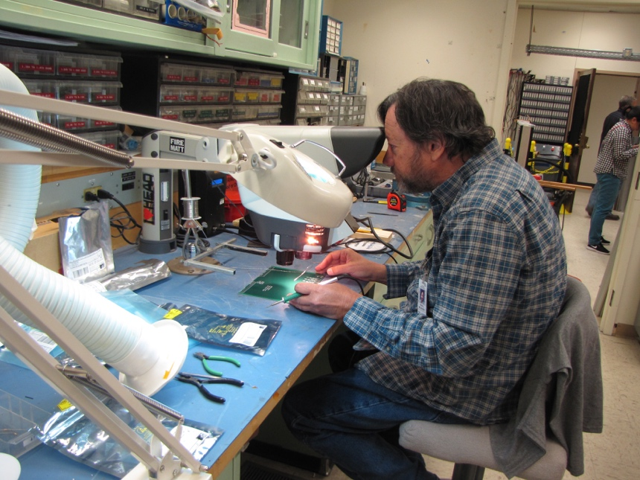
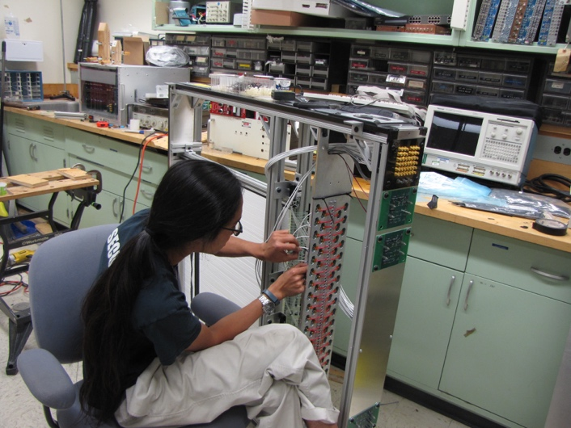
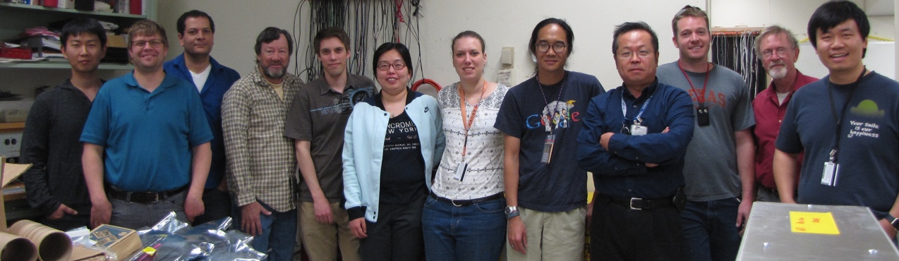
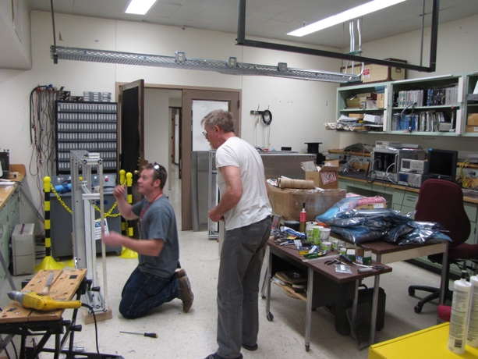
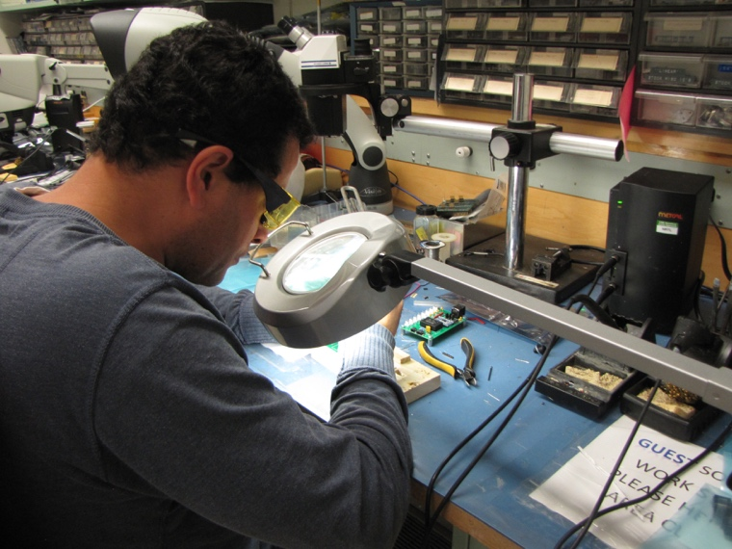
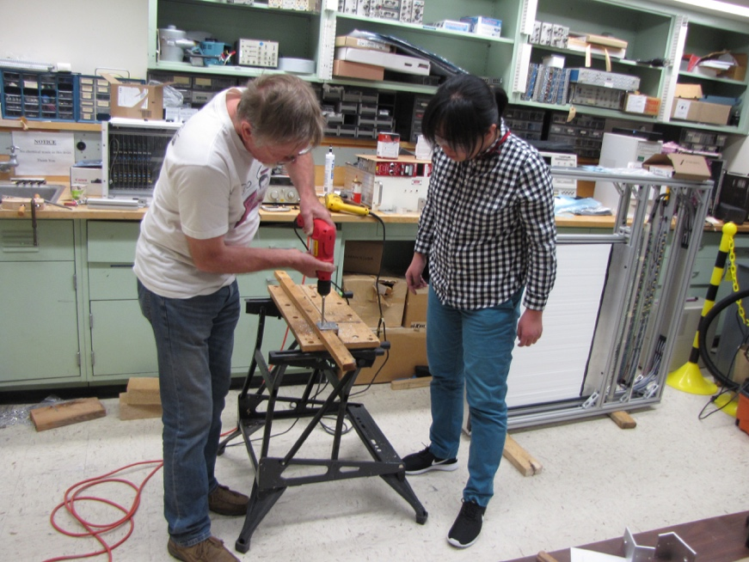
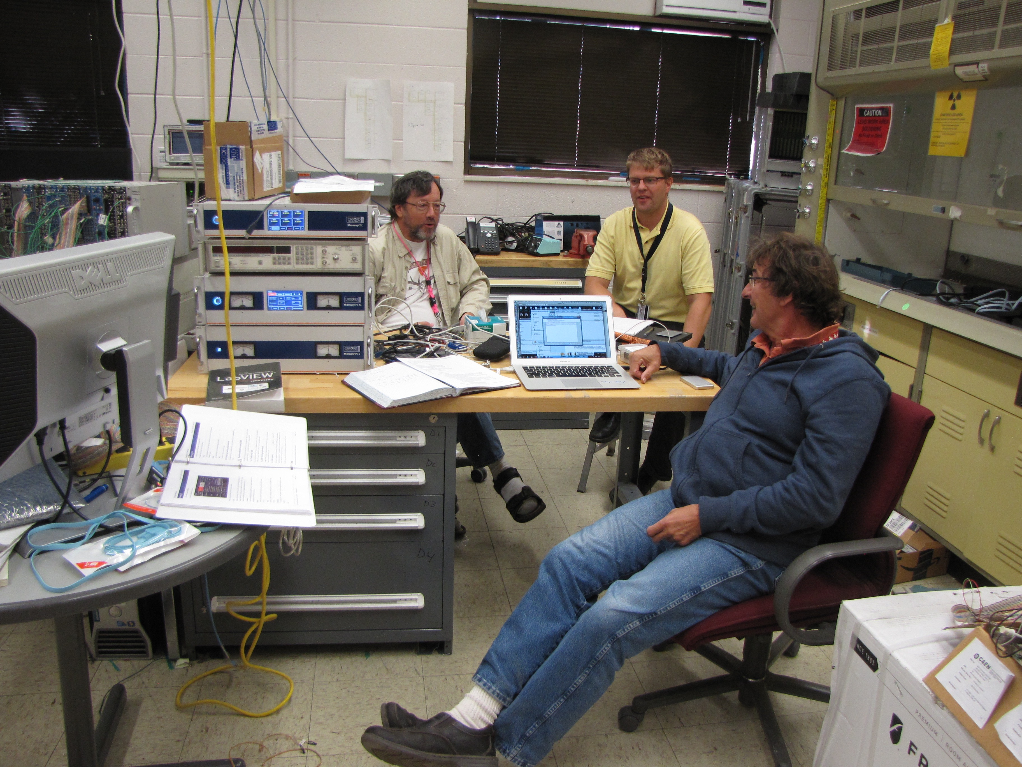
Very Successful Team Work!

Slide 33
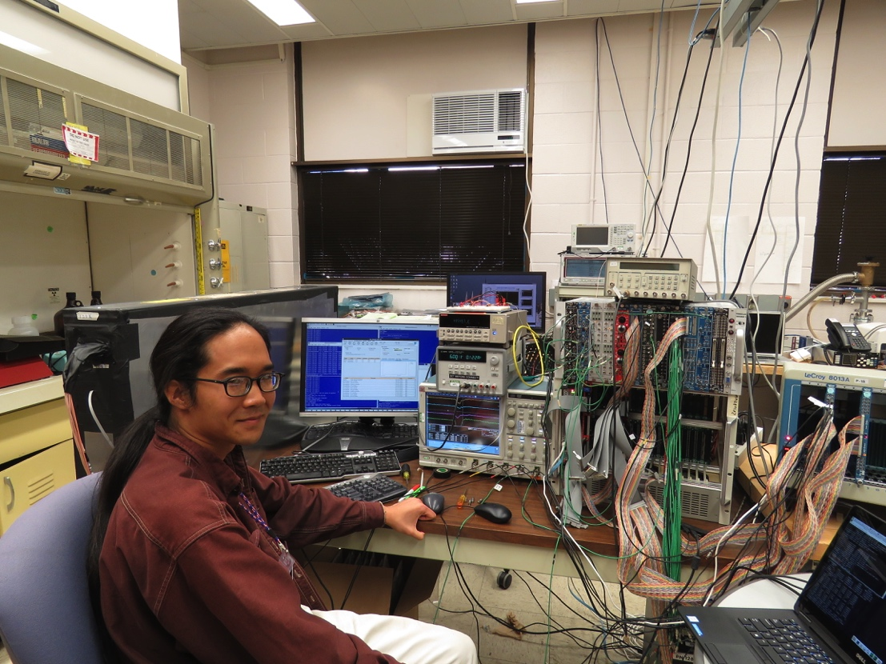
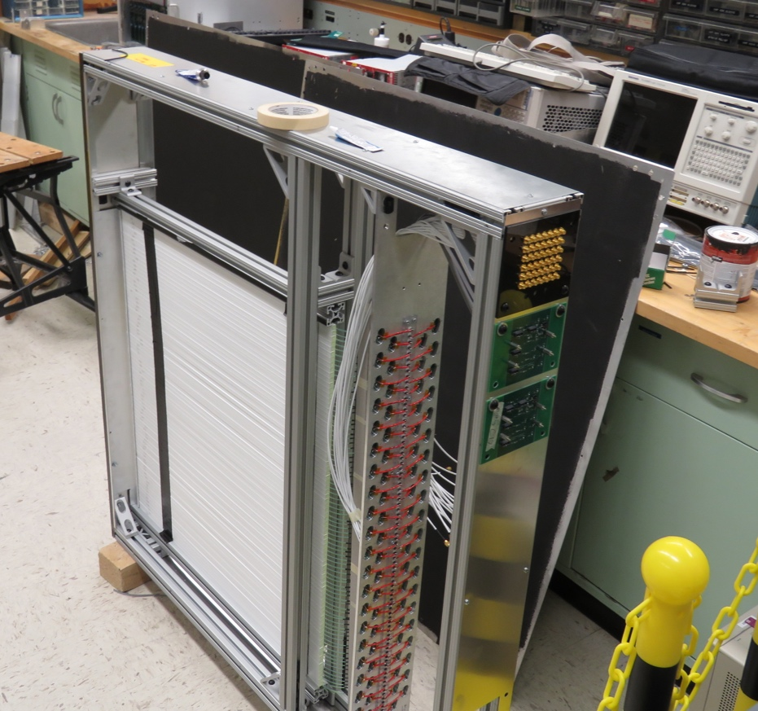

Trigger, DAQ R&D and Final Cosmic Test @LANL in 2017
Trigger & DAQ hardware and firmware designed and tested at LANL, in collaboration with Fermilab Engineers
Readout from a full module for cosmic test
  Full SiPM readout and Trigger
  E906 upgraded DAQ and firmware
Timing resolution, < 1.5nS (19nS RF)
Detector eff. > 96%
TDC_1
TDC_2

Slide 34



All Trigger Detectors Designed and Built at LANL, Truck loaded to Fermilab on 4/3/2017
Eight trigger detector modules
Electronics and Power supplies

Slide 35
New trigger rate: ~5%DAQ
Down stream view
Parasitic run OK!

Slide 36




Trigger Scintillator Size Optimization
Single Muon Z-Vertex Resolution
σ_{Z} (cm)
Forward: 1cm
Backward: 1cm
Forward: 1cm
Backward: 2cm
Sigma_Z ~ 30cm
σ_{Z} (cm)
Forward: 1cm
Backward: 1cm
Forward: 1cm
Backward: 2cm
Forward: 2cm
Backward: 2cm
E906
Current
E906
σ_{Z} (cm)
Open. Angl.

Slide 37



Search Mode (2): “Prompt” Dark Photons vs Drell-Yan
Bump hunt at Z-vertx < 3m
Expected Drell-Yan like signal and backgrounds:
Excluded phi
resonance region
Dark photon
signal
Drell-Yan Background
Work in progress:
- optimization …,
- understand BG ...

Slide 38
Low Mass Prompt Dimuon Trigger Rate Study
Current E906 setup
Proposed 2-layer trigger upgrade (10x improvement)
Additional Y-trigger after ST-3 absorber, and also using existing E906 X-Plane trigger
(additional ~2x improvement)
DAQ upgrade completed
  Previous E906 DAQ 1kHz
  Now 10+ kHz
  Can take all dark photon events of interest
4s spill, 60s cycle
Expected (Prompt) Low mass dimuon trigger performance
time

Slide 39
Displaced Dark Photon Trigger Logic
DAQ/Data stream
Trigger fired: Q1 & Q3 & VTX
Q1 (LVL1)
DAQ Trigger
LVL2
(vtxZ matching)
Q2 (LVL1)
VTX
TS
(12 inputs total)
(1-free bit available)
Q3 (LVL1)
DP Trigger
1-bit
Q4 (LVL1)
4 x 16-bit from 4 V1495 boards
(2 x 32LVDS cables)
V1495
Per quadrant Q(1-4): 80(ST1) + 50 (ST2) + 2x8(ST4-Y1/2) = 146, FANOUT ST4 Hodo

