Slide 1
A New Fundamental Test of QCD with Drell-Yan Measurements in Polarized p+p Collisions
P-25:
Ming Liu (PI), Xiaodong Jiang (co-PI),
Patrick McGaughey, Mike Leitch, PD
T-2:
Terry Goldman (co-PI), Ivan Vitev, PD

Slide 2
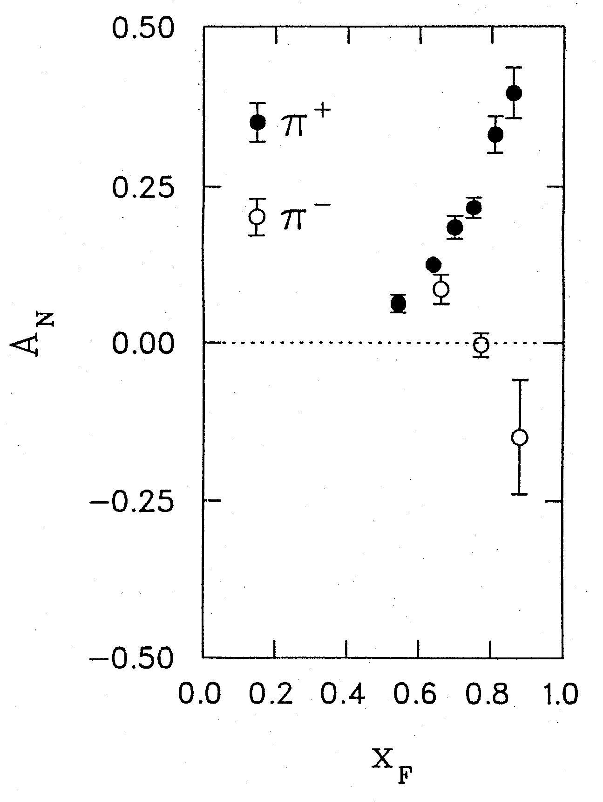
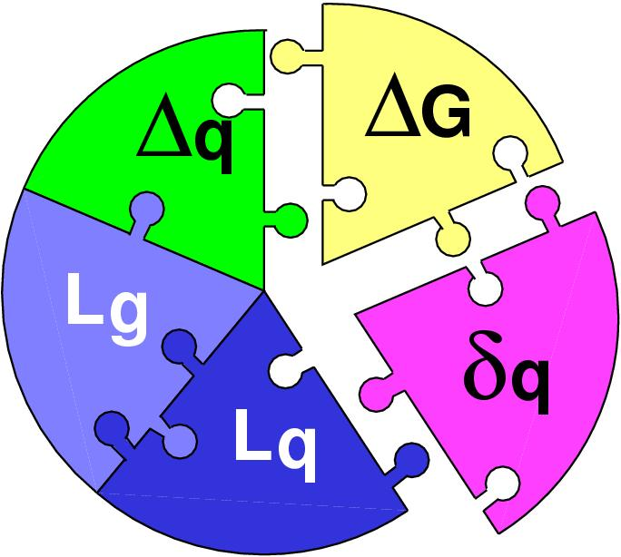
Two Outstanding Problems in Spin Physics
QCD and Strong Interactions
The challenge of “too small” aka “Proton Spin Crisis” (1988)
The challenge of “too large” spin asymmetry (1976)
Left
Right
A_{N} ~ 0.1
(~10⁻⁴ expected)
Note: Possible connection between ΔL and A_{N}, and a solution to the “spin crisis”

Slide 3
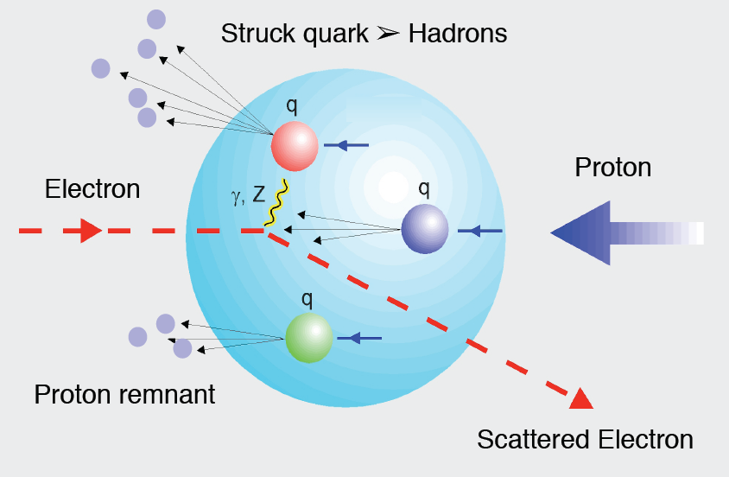
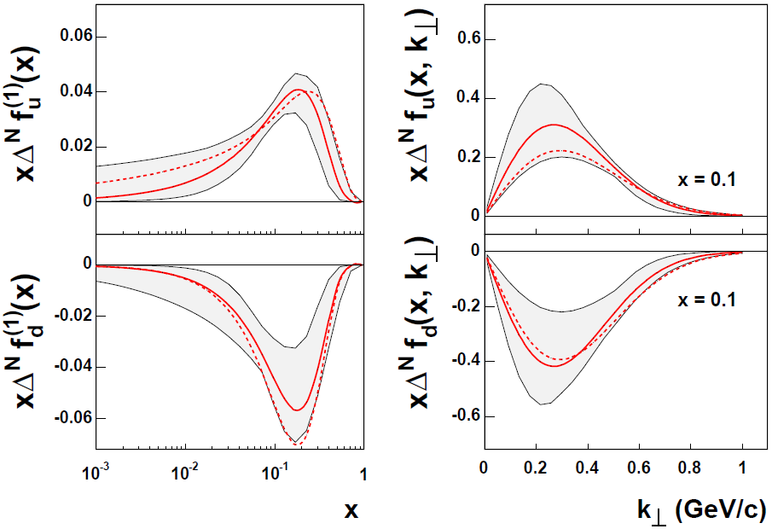
Possible Mechanisms for Large A_{N}
Sivers mechanism: Correlation between nucleon spin and parton transverse motion k_{T}
First Measurements of non-Zero Sivers Asymmetry from Polarized Semi-Inclusive Deep Inelastic Scatterings
Phys Rev D41 (1990) 83; 43 (1991) 261
Orbital Angular Momentum?
S_{P}
Max @ x~0.2
p
k_{T,q}
Extracted u,d quark Sivers distribution functions, EPJ (2009)
p
only ~30% of spin
A future challenge
Beginning to be measured at RHIC

Slide 4
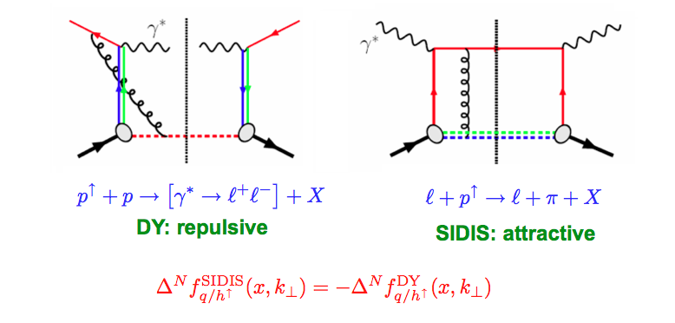
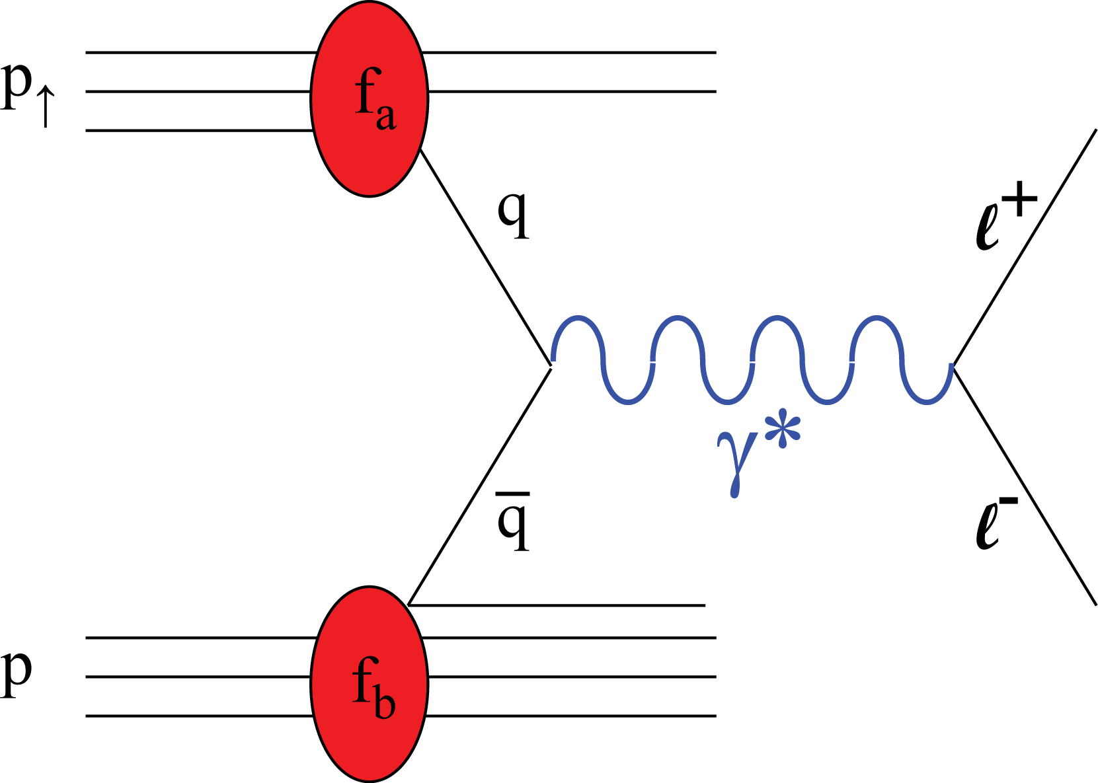
Critical Test of Fundamental QCD Predictions
The predicted sign change – a new fundamental test of color gauge formalism and factorization DOE milestone HP13
Possible outcomes:
  If confirmed:
  first major trumph of QCD in hadron spin physics: validation of color gauge formalism and QCD factorization
  If confirmed the sign change, but not the magnitude:
  major flaws in our current understanding of QCD processes
  If no sign change:
  fundamental flaws in our understating of QCD and it applicability to strong interaction phenomena, could lead to a new theoretical breakthrough

Slide 5
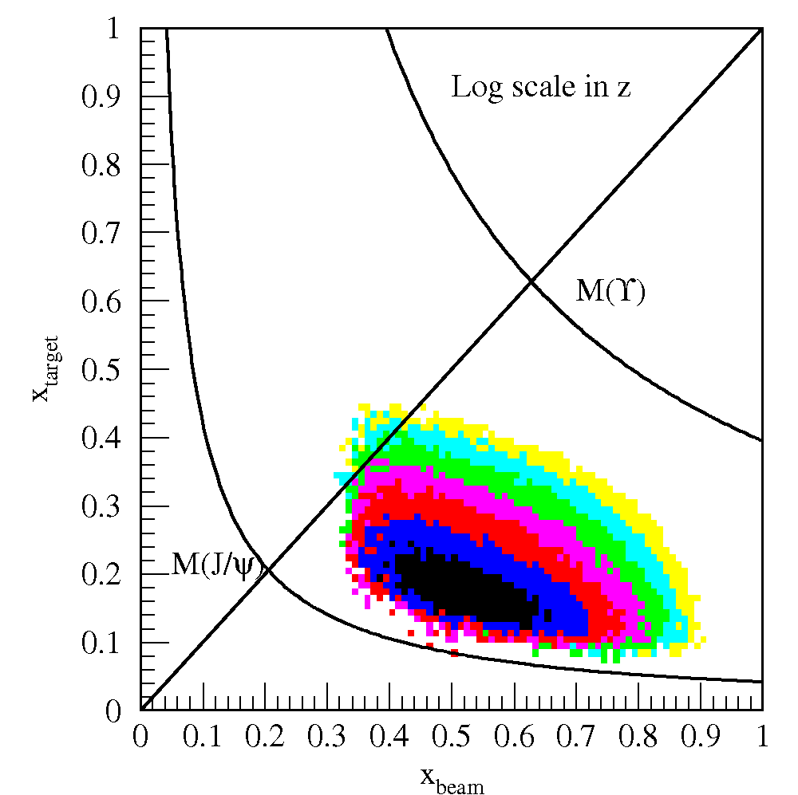
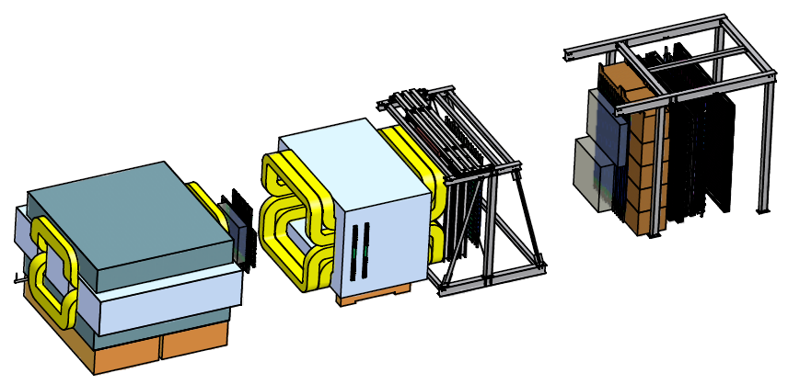
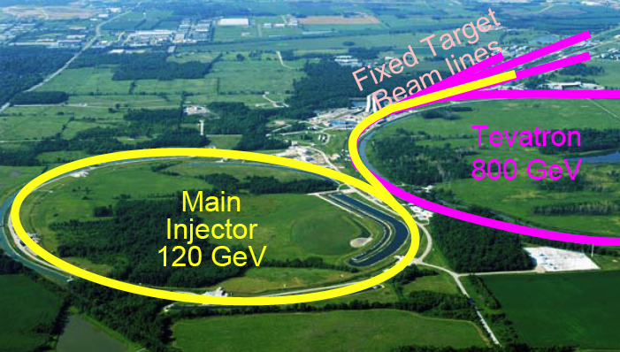
Our Proposal: Pol. Drell-Yan at Fermilab
X_{Target}
4.9m
X_{Beam}
Target
E906 Experiment
Advantage of the proposed experiment
First Pol. DY, never done before
Build upon LANL’s years investment in DY experiments, including the latest E906
Requires a polarized targets
  Based on technology similar to SLAC/J-Lab targets
The best opportunity is @Fermilab
  High intensity proton beam
  Right time
  Best kinematic range
    X_{Target} = 0.1 ~ 0.3
    Maximum spin asymmetry observed in pol. DIS
First study of sea-quark angular motion
  Not possible in other proposed Exp’s

Slide 6
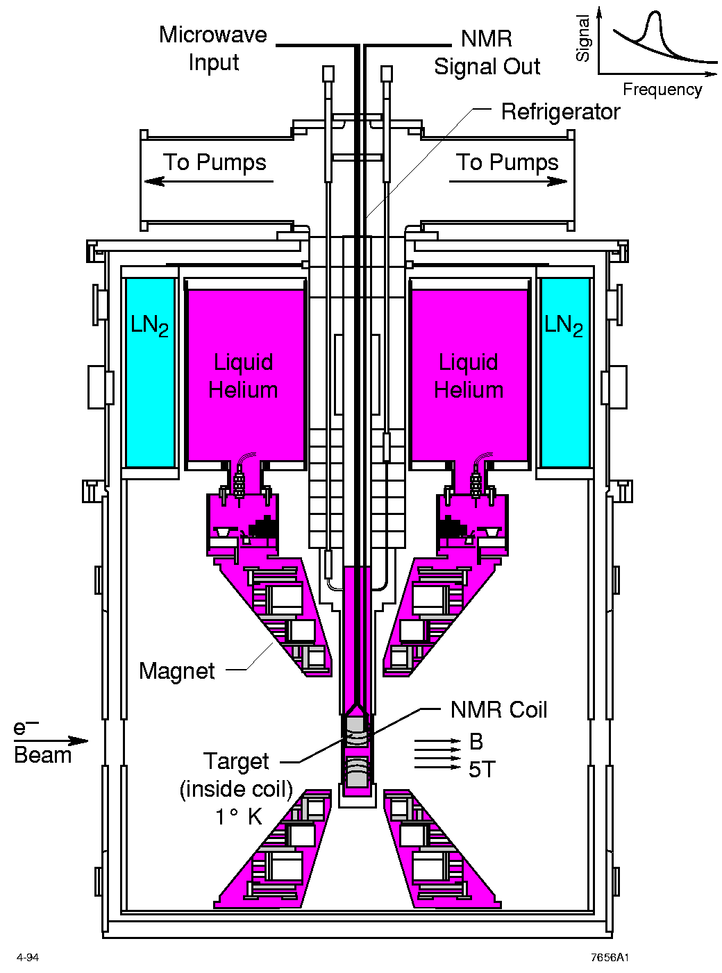
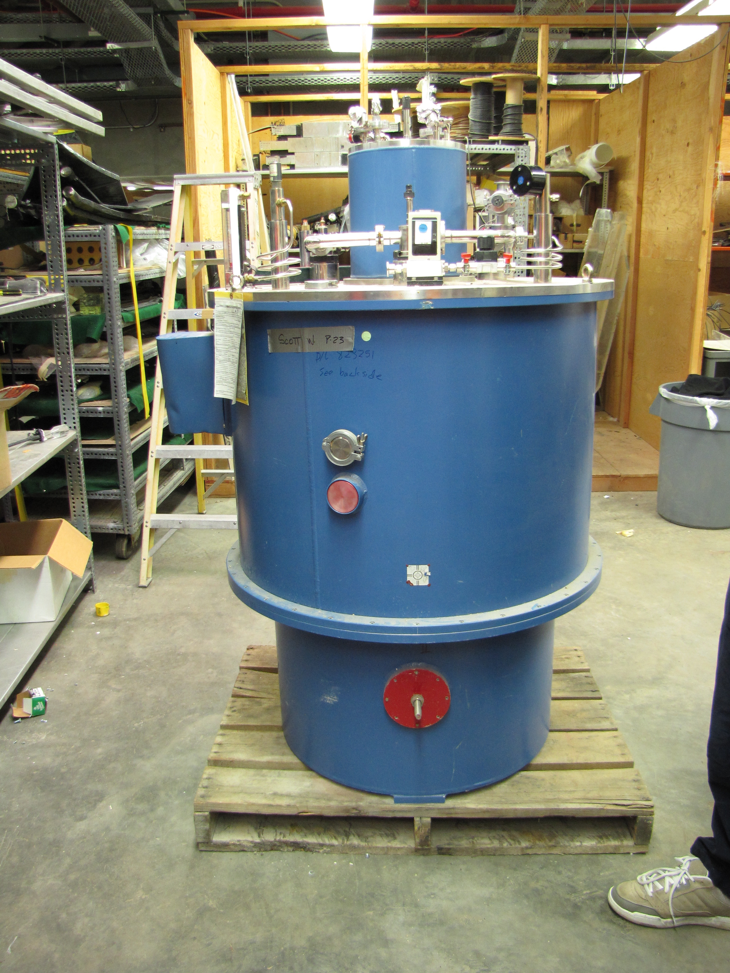
Polarized Target
Used for longitudinal polarization experiments a LANL
  LANL expertise and apparatus readily available
  As plan-B
Last visit in the storage area Nov. 2010
  Ming Liu, Xiaodong Jiang, Don Crabb and Seppo Penttila

Slide 7
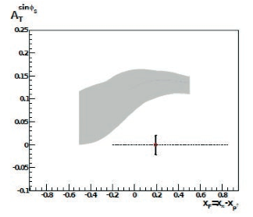
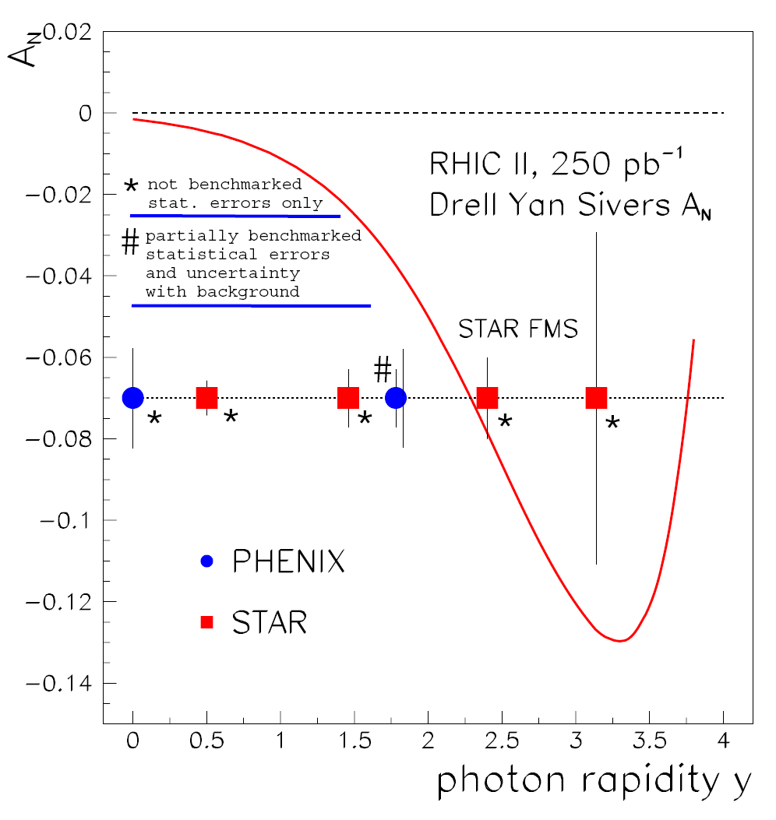
The Best Opportunity is at Fermilab
Expected DY A_{N} Sensitivity
Fully working detectors
  After E906
Polarized target & high luminosity
  Proved technology SLAC/J-Lab
Optimal kinematic range
  Significant spin asymmetry observed
Compared with other proposals:
RHIC & COMPASS:
  single point
  luminosity limited
  further in future
Other proposals: GSI, Dubna, JPARC…
  very far in the future
RHIC@BNL, 2016+
COMPASS@CERN,2014+

Slide 8
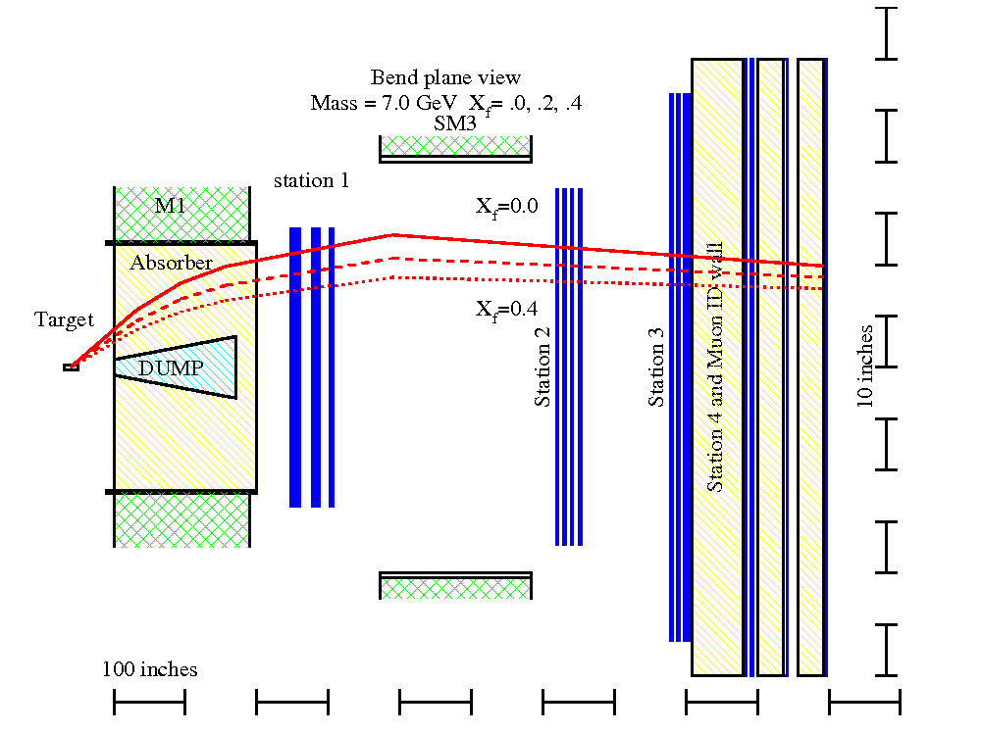
Scope of the Proposed Work
Experimental work
  Develop a polarized proton target for a high intensity Drell-Yan dimuon experiment
  A new polarized Drell-Yan dimuon experiment at Fermilab, after the completion of E906 unpolarized DY experiment
  Ming (50%), Xiaodong (50%), Pat (25%), Mike (25%), PD(100%)
  External collaborators: Don Crabb (UVA), Jian-Ping Chen(JLab)
Theoretical work
  NLO calculation of spin asymmetry for all Drell-Yan production mechanisms
  Terry (50%), Ivan (25%), PD (100%)
Expected results
  The world first measurement of transverse single spin asymmetry (TSSA) A_{N} in Drell-Yan production in p+p collisions
  The first test of the predicted sign change in TSSA in Drell-Yan production

Slide 9
Cost and Schedule
The First Polarized Drell-Yan Experiment at
  FY-12:
    Polarized target and theory development
    proposal to Fermilab to run polarized Drell-Yan after E906 dimuon Drell-Yan experiment
  FY-13:
    Fermilab approve the polarized DY experiment
    complete polarized target, ready for installation
    theoretical predictions published,9 month
  FY-13: first run, preliminary results of A_{N}
4FTE
  Target ~$1M
FY-11/run FY-12/shutdown FY-13/last run
E906
FY-12, 13 /Target Development. FY-14/first run/results, DOE
Polarized Drell-Yan Exp.

Slide 10
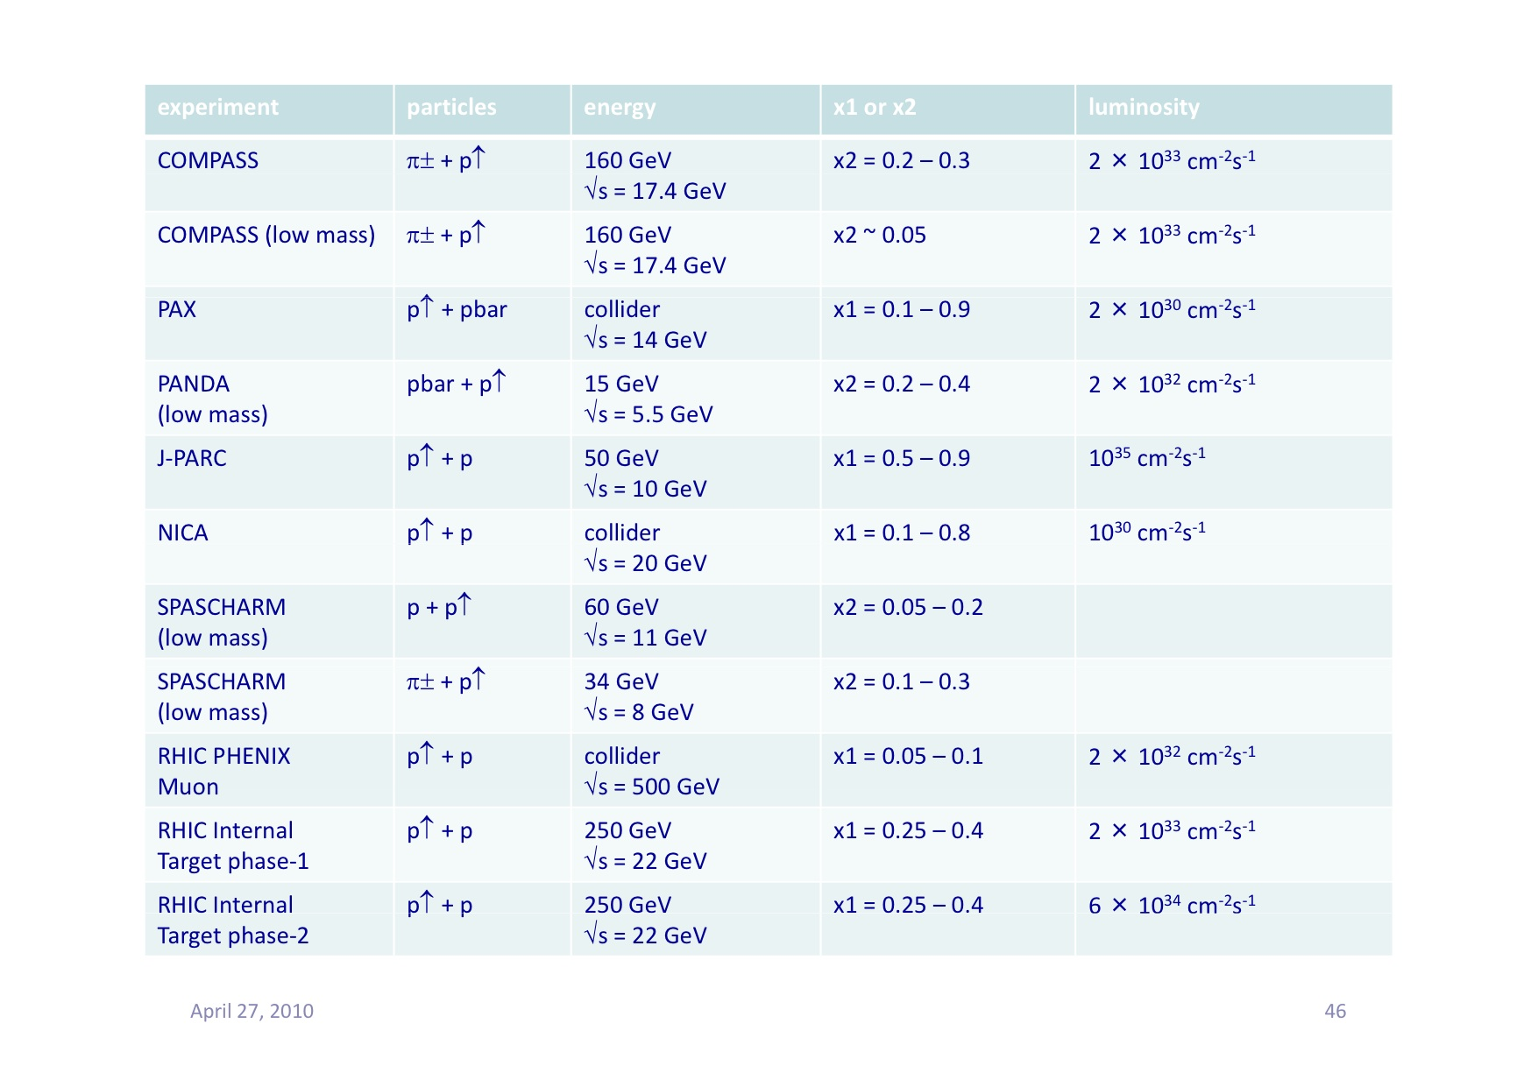
Proposed Future Polarized DY Exp’s
A worldwide competition
2016+
2014+
GSI, under
construction
Need Accl.
upgrade
Proposed to
build
2016+
2016+
Polarized DY Dimuon Exp. at Fermilab Main Injector: 120GeV
2014!

Slide 11
Summary
Exciting Science with Polarized Drell-Yan Experiment
  The Holy Grail for spin physics program
  A novel fundamental test of QCD never done before
Very Active Worldwide Competition
  Santa Fe polarized Drell-Yan workshop by LANL (11/2010)
  One of the main goals of DOE NP long range plan for next 10 years
    DOE milestone (HP13)
  CERN Drell-Yan workshop (04/2010) and many others
Why LANL
  Major player in spin physics program at RHIC, J-Lab
  Already a major player in E906
  Long history of Drell-Yan physics at LANL
    25+ years experience leading DY experiments at Fermilab
  Stratigic partnership with Fermilab (LANL-Fermilab MOU)
    Intensity frontier (Drell-Yan, neutrino oscillation experiments)
Why Now - The Best Opportunity
  A new DY experiment with polarized target possible after E906
  The best kinematic coverage and physics sensitivity among all existing and near future experiments, including RHIC at BNL and COMPASS at CERN

Slide 12
backup

Slide 13
Importance of Drell-Yan Tra. S..SA
Test the fundamental prediction of sign change in DY TSSA compared to DIS based on our understanding of the origin of TSSA
  Test of gauge formulism
  Test of QCD factorization
Help to resolve the proton spin puzzle?
    One expect the observation of Sivers Asymmetry signals the existence of partonic orbital angular momentum
only ~30% of spin
Beginning to be measured at RHIC
A future challenge

Slide 14
Complimentality between DIS and Drell-Yan
DIS
Drell-Yan
Polarized DIS
Polarized DY NOT yet!
McGaughey, Moss, Peng,
Ann.Rev.Nucl. Part. Sci. 49 (1999) 217
Both DIS and Drell-Yan process are tools to probe the quark and antiquark structure in hadrons (factorization, universality)
14

Slide 15
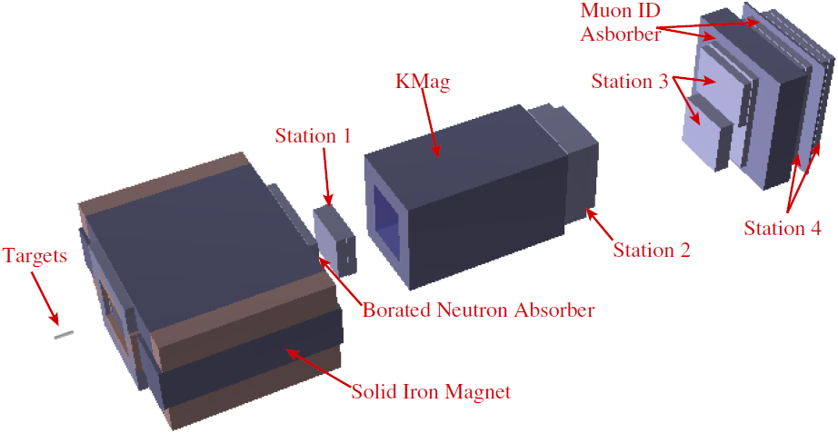
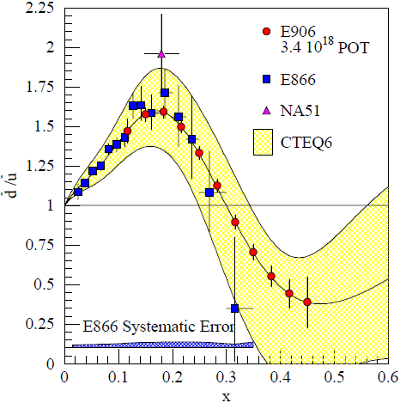
Drell-Yan experiment
Fermilab E906/SeaQuest
  Dimuon spectrometer
  Main injector beam E_{beam} = 120 GeV
  Higher-x region: x = 0.1 – 0.45
  Beam time: 2010 – 2013
Momentum
analysis
Focusing magnet
Hadron absorber
Beam dump
Notes:
This is their experimental apparatus to detect dimuon from Drell-Yan process.
The first magnet, solid iron magnet is a focusing magnet and also have a function of hadron absorber and beam dump.
The second magnet is momentum-analysis magnet. There are 4-stations of chambers, station 1, 2, 3, and 4, and the station 4 is also work for muon identification.
The beam time is from 2010 to 2013.

Slide 16
UVA/J-Lab/SLAC Polarized proton/deuteron target
D. Crabb MENU10
Polarized NH₃/ND₃ targets
Dynamical Nuclear Polarization
Operate at 5 T and 1 K. Pol ~ B/T
Used with high beam intensities – up to ~100 nA
Large capacity pumps
Polarizations:
  p > 90%,
  d ~ 50%
Able to handle high luminosity
  up to ~ 10³⁵ (Hall C)
~ 10³⁴ (Hall B)

Slide 17

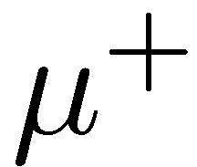

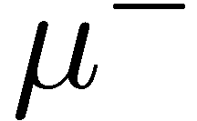
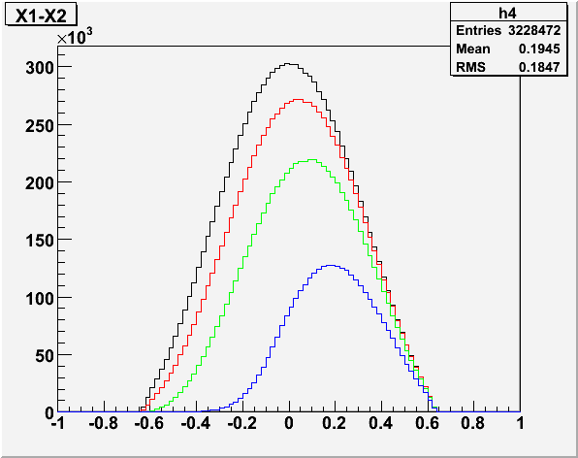
E906 Parameters @Fermilab
Beam energy = 120GeV
Beam structure and profile:
  2x10¹² protons/sec, for 5 sec/per min
  Beam size: σ_{x}< 10mm and σ_{y}< 5mm,
  Two years’ total = 7x10¹⁸, 15% efficiency
Magnet: 8.4 T*m
  pT kick ~ 2.5GeV
Absorber: 15 λ_{I}, beam dump 30λ_{I}
  Energy loss = 3.5GeV, E906 cut: p > 15GeV
  Multiple scattering 170/p mr
  Mass resolution = 240MeV @J/Psi
Targets: < 15% λ_{I}
  50.8cm liquid hydrogen and deuterium
  ¹²C, ⁵⁶Fe, W
4<M<8 GeV
  P_{1,2} > 0, 5, 10, 20 GeV
  N = 5.3, 4.7, 3.5, 1.6 M dimuons
  50M DY, m>2GeV, sqrt(s)= 15 GeV
  (L=900 fb⁻¹ or 3.5x10¹⁶ pp)
Muons:
P_{1,2} > 0,
5,
10,
20
x_{F} = x_{Beam} - x_{Target}

Slide 18
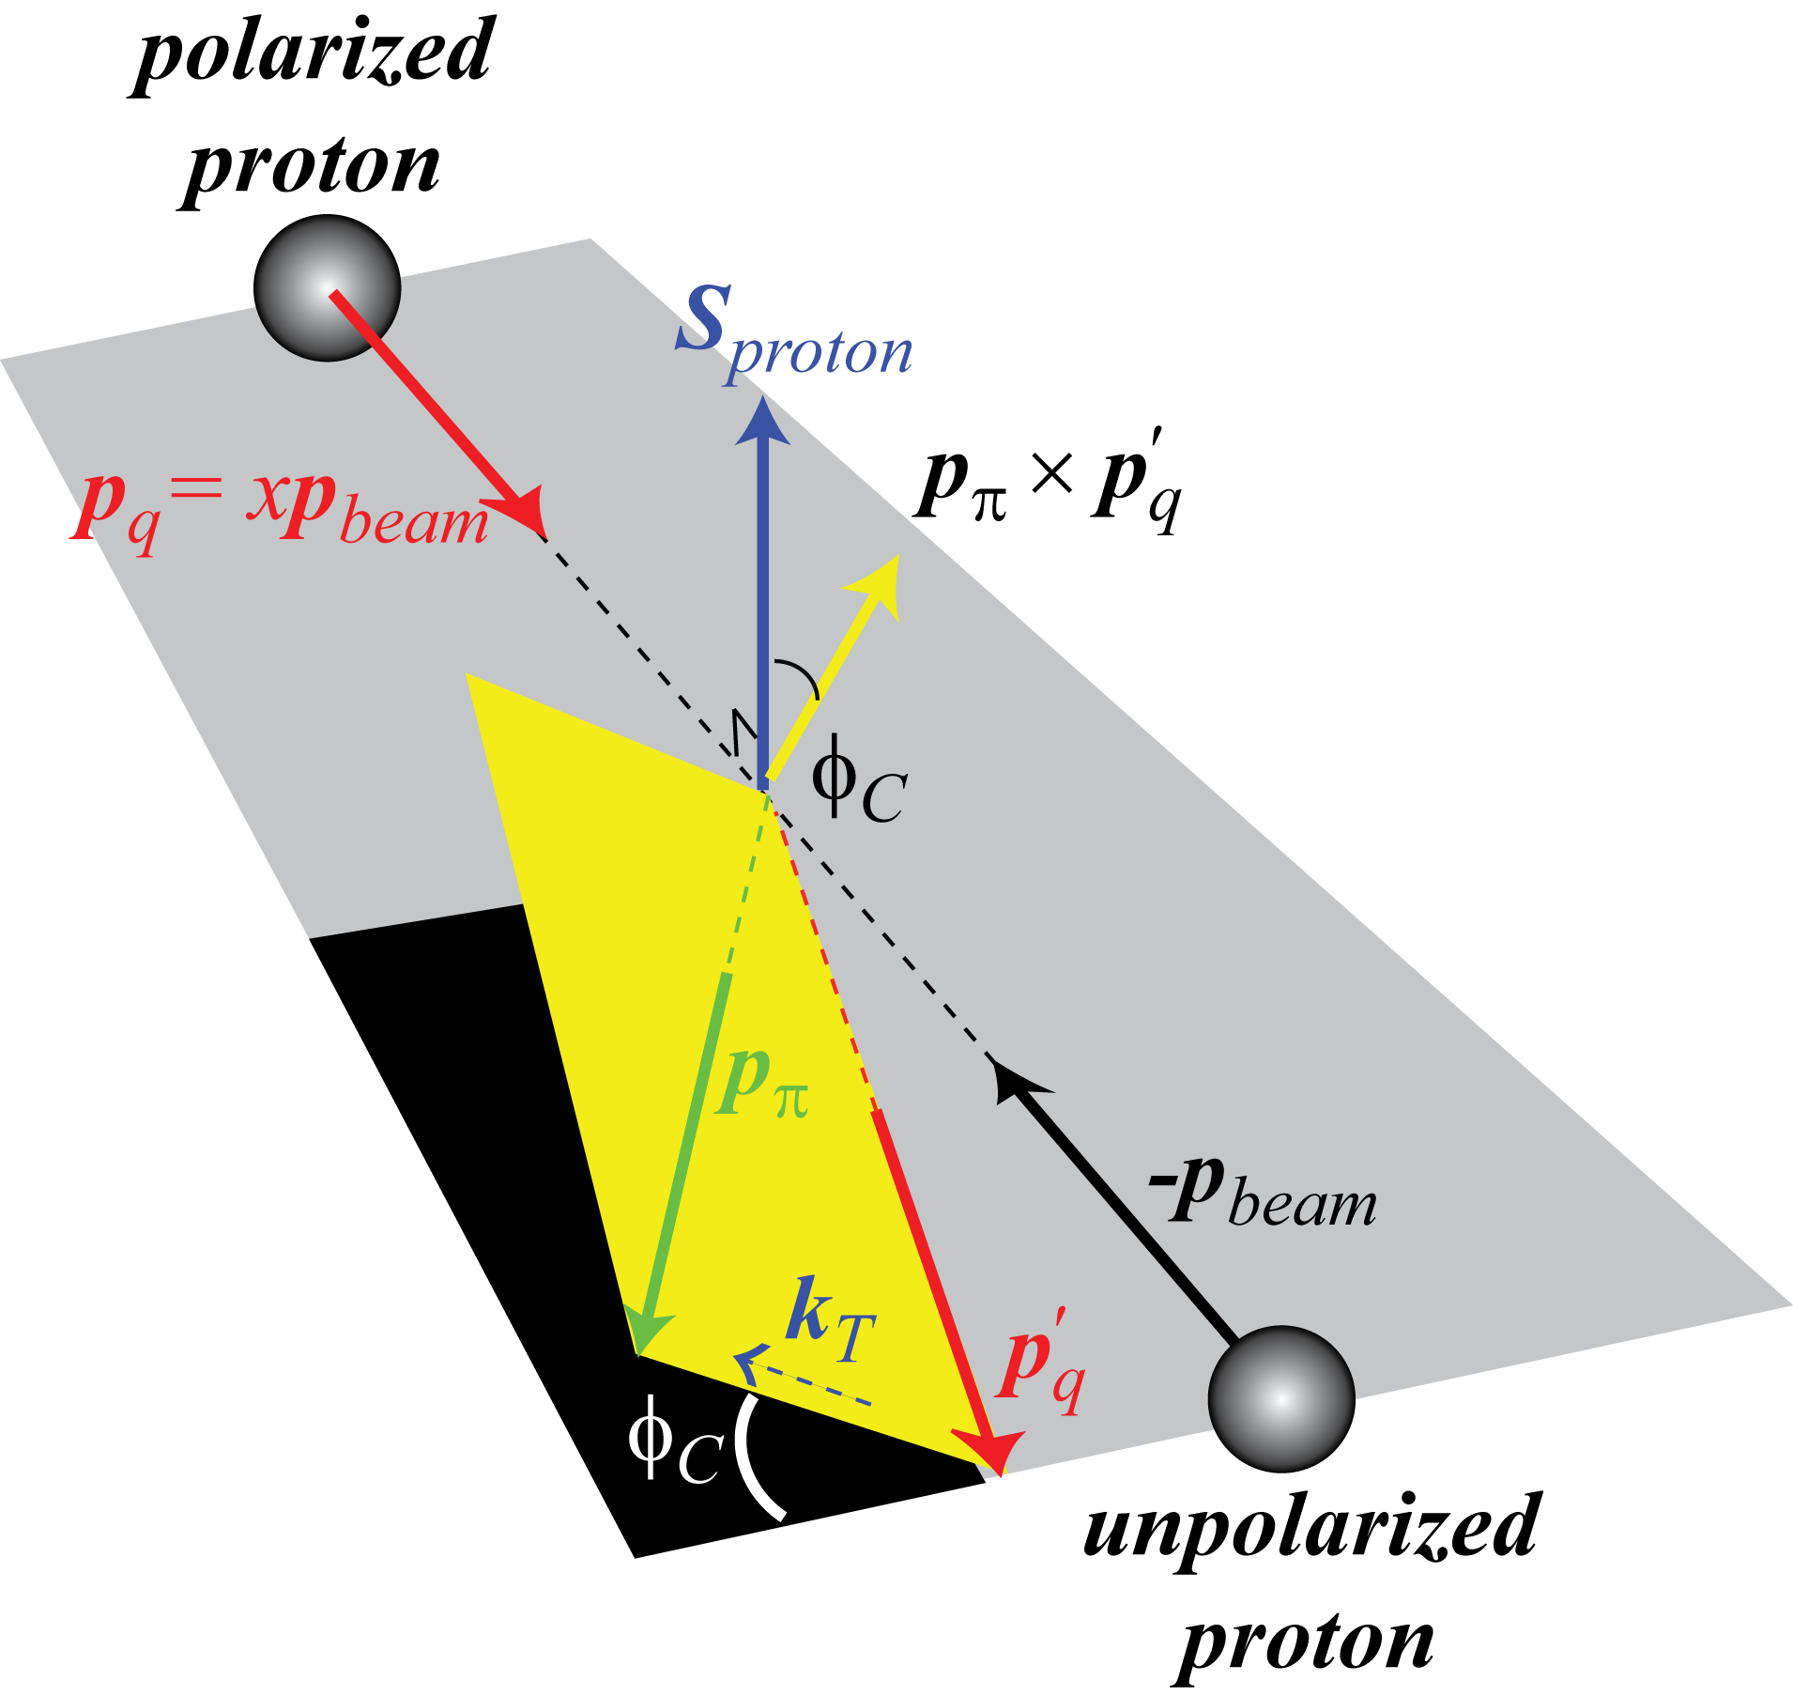
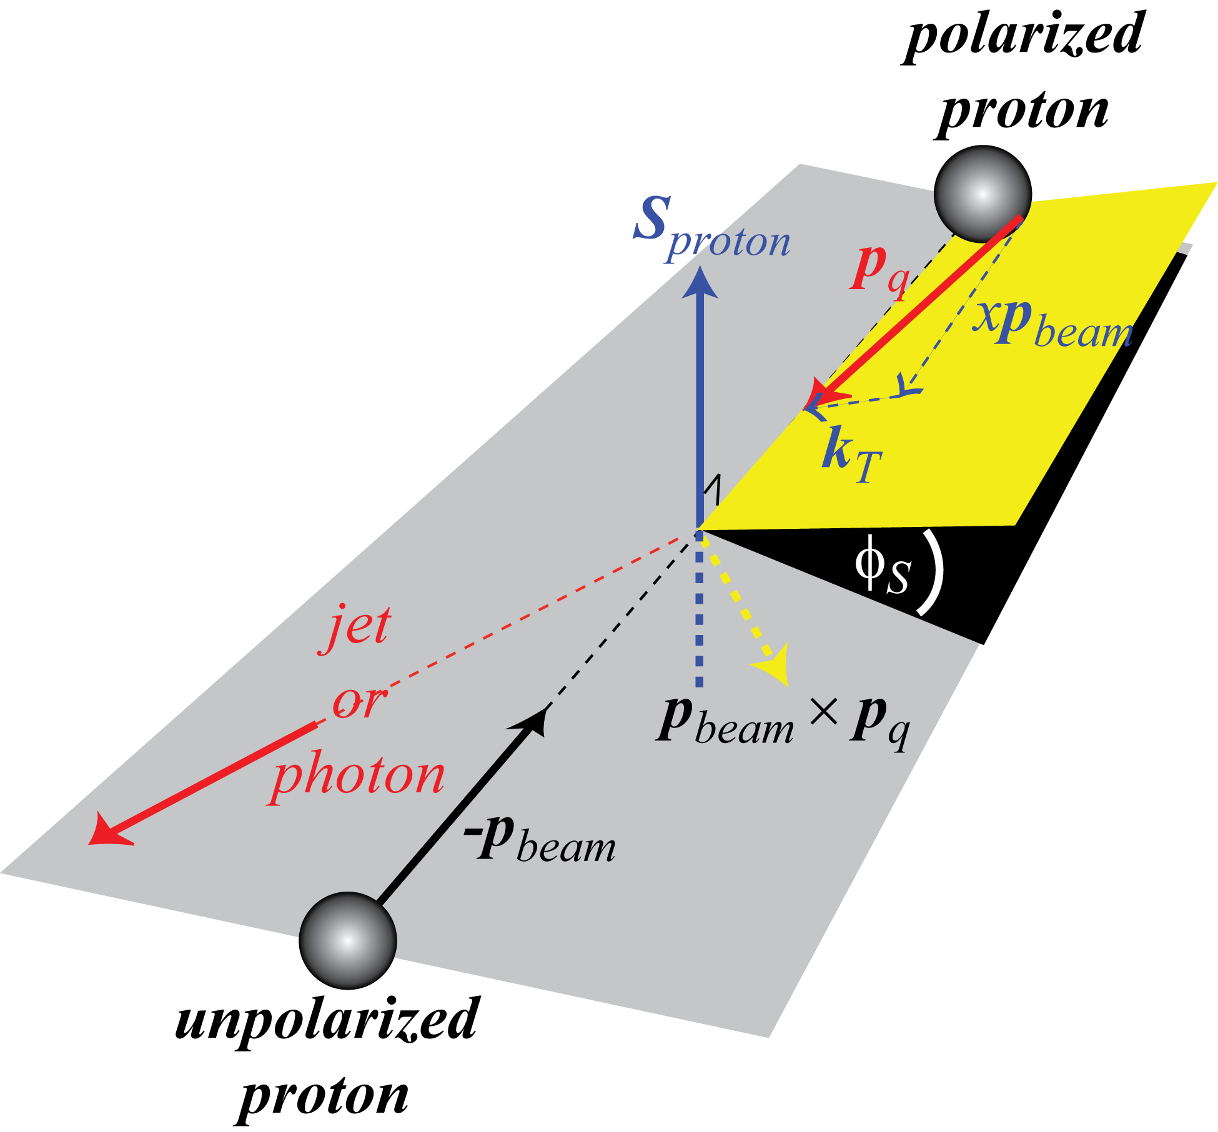
Two of the Explanations for Large Transverse SSA
Collins mechanism requires transverse quark polarization and spin-dependent fragmentation
Nucl Phys B396 (1993) 161
Sivers mechanism
requires spin-correlated transverse momentum in the proton (orbital motion). SSA is present for jet or γ
Phys. Rev. D42 (1990) 83.

