Slide 1
Mini-fsPHENIX?
sPHENIX in good progress
  Possible CD1 review early 2016?
  Babar magnet installation ~2018
Mini-fsPHENIX?
  2 < eta < 4
  AnDY’s HCal (3 m^2)
    Les (BNL) and Hank(LBNL) interested in f/sPHENIX
  Magnetic field return
    Small forward tracking? (FGT?)
  Physics run with sPHENIX

Slide 2
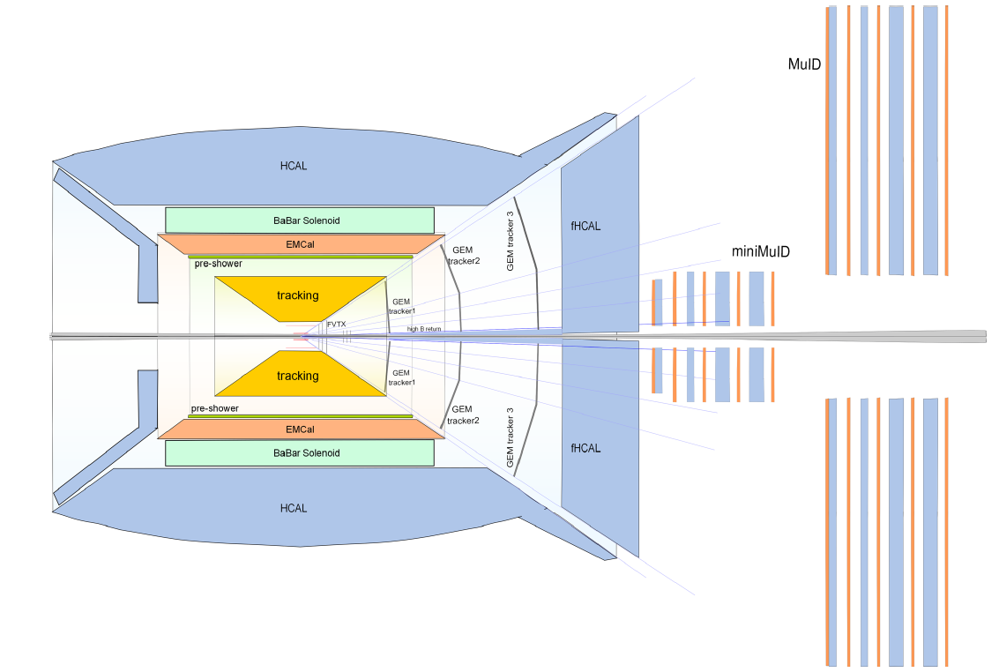
Mini-fsPHENIX
Hcal + GEM tracker: 2 <eta < 4
GEM inner tracker?
Magnetic field return/end cap

Slide 3
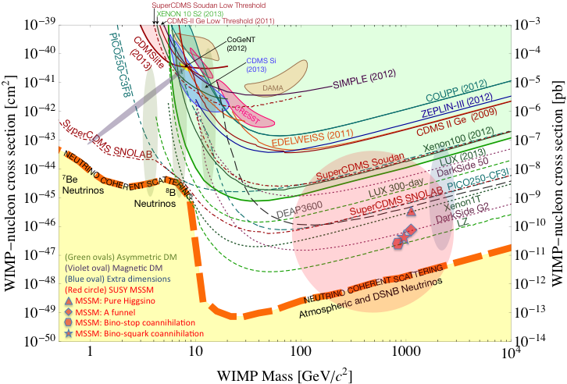
Dark Matter
Experiments
Xenon100
LUX(2013), LUX(300)
Darkside 50
DEAP3600(kg) – SNOLAB
  Lar, pulse shape
SuperCDMS (Soudan)
LZ Constr. SURF
  LXe, 7 tonnes
Darkside G2 LNGS
  ULAr, 3.8 tonnes (active)
Xenon 1T, LNGS
  LXe, 1tonne
Super CDMS (SNOLAB)
Imaginable space for these experiments is rapidly disappearing
the “natural theory space is also disappearing.
I like to think that Dark Matter is on solid ground, maybe not!!!

Slide 4
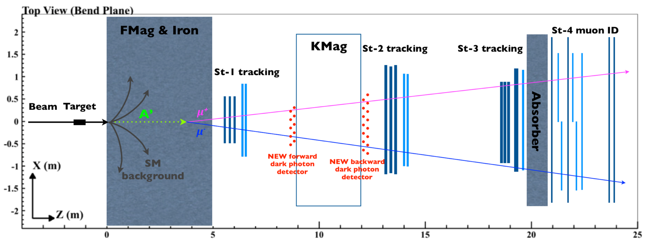
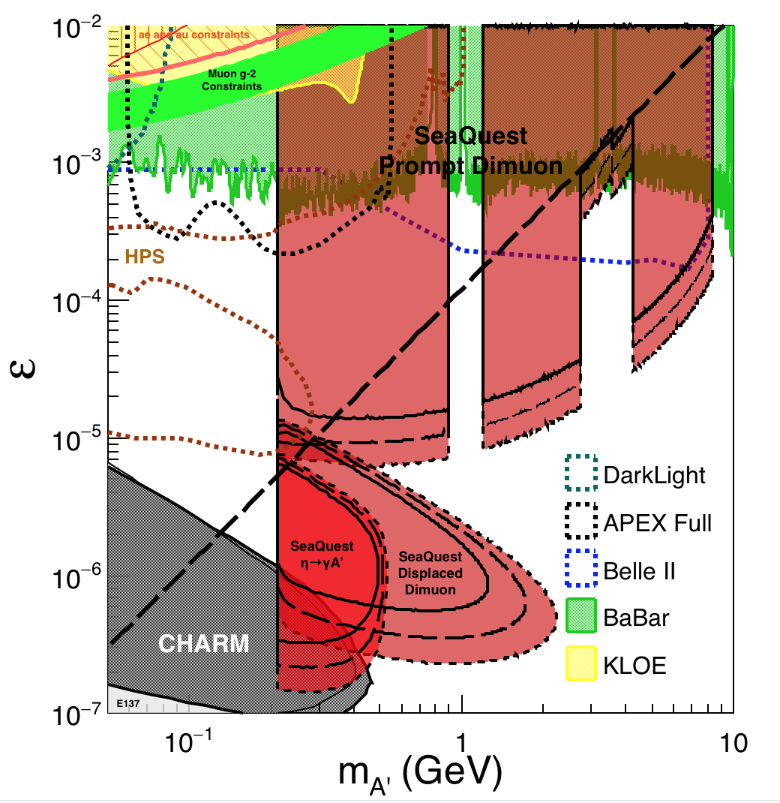
Summary and Outlook
Great discovery potential!
LOI submitted to Fermilab
Early data taking 2017-2019
Possible upgrade later

Slide 5
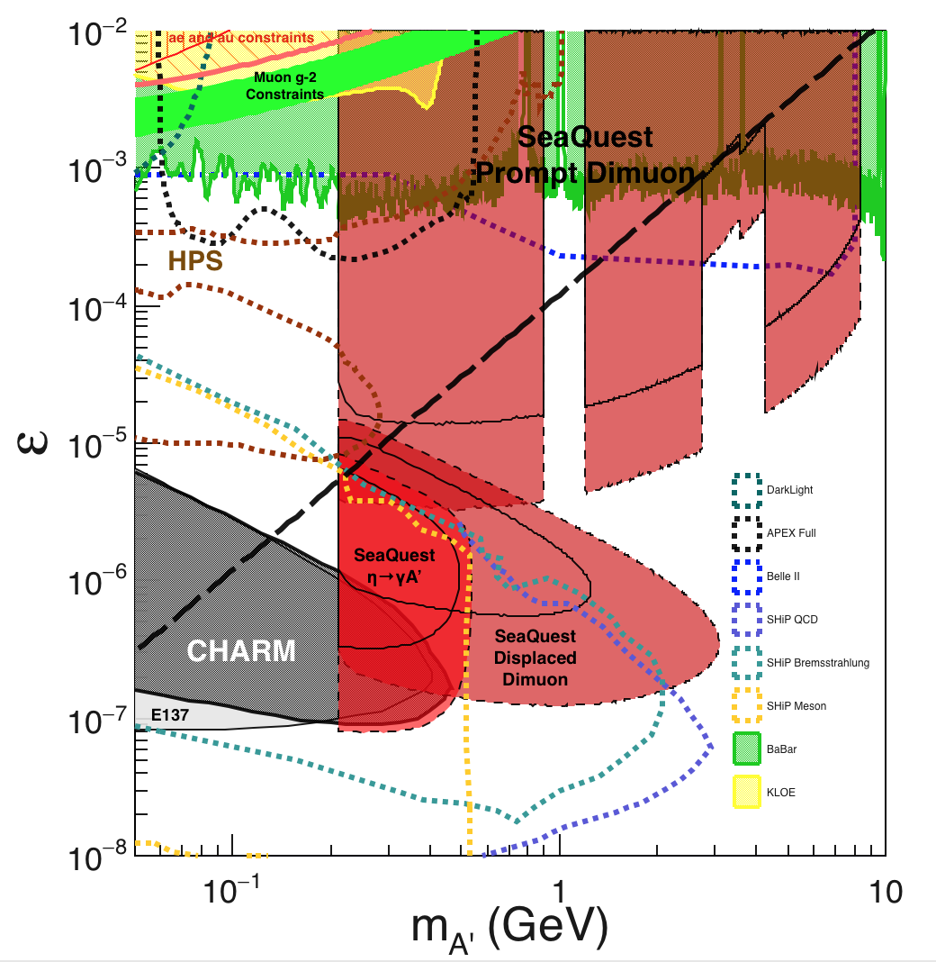
Comparison with SHiP Proposal
120 GeV@FNAL: 2017 -2019
1.4x10¹⁸ POT, future runs possible
400 GeV@SPS: 2025 -2030
4x10²⁰ POT

Slide 6
Drell-Yan Asymmetry
Use beam-dump events as reference, R(phi)
Use target events as signal, S(phi)
Asymmetry(phi) = S(phi)/Ref(Phi)

Slide 7
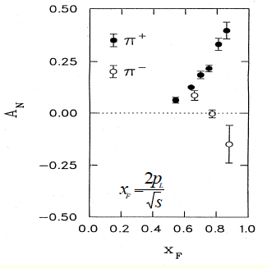
Confirm positive signals from charged h+/-
Target @ Z= -350cm
Decay muons from charged pi+/- and K+/-
Confirm positive signal from mu+ and mu-
Asy (phi) = S(phi)/Ref(phi)
Need to rum full MC to simulate
  Single mu+/- from pi/K decays
  Kinematics and single muon trigger optimization
  Improve DAQ from 1kHz -> 10(100)kHz

Slide 8
Summer work
Install telescopes
  Check rates
  Coverage
DAQ upgrade
  1kHz -> 10kHz (100kHz?)
Single muon triggers
  Large x₂, or low momentum muons, pZ
  New trigger map

