Slide 1
sPHENIX
Opportunities and Challenges
Ming Liu

Slide 2
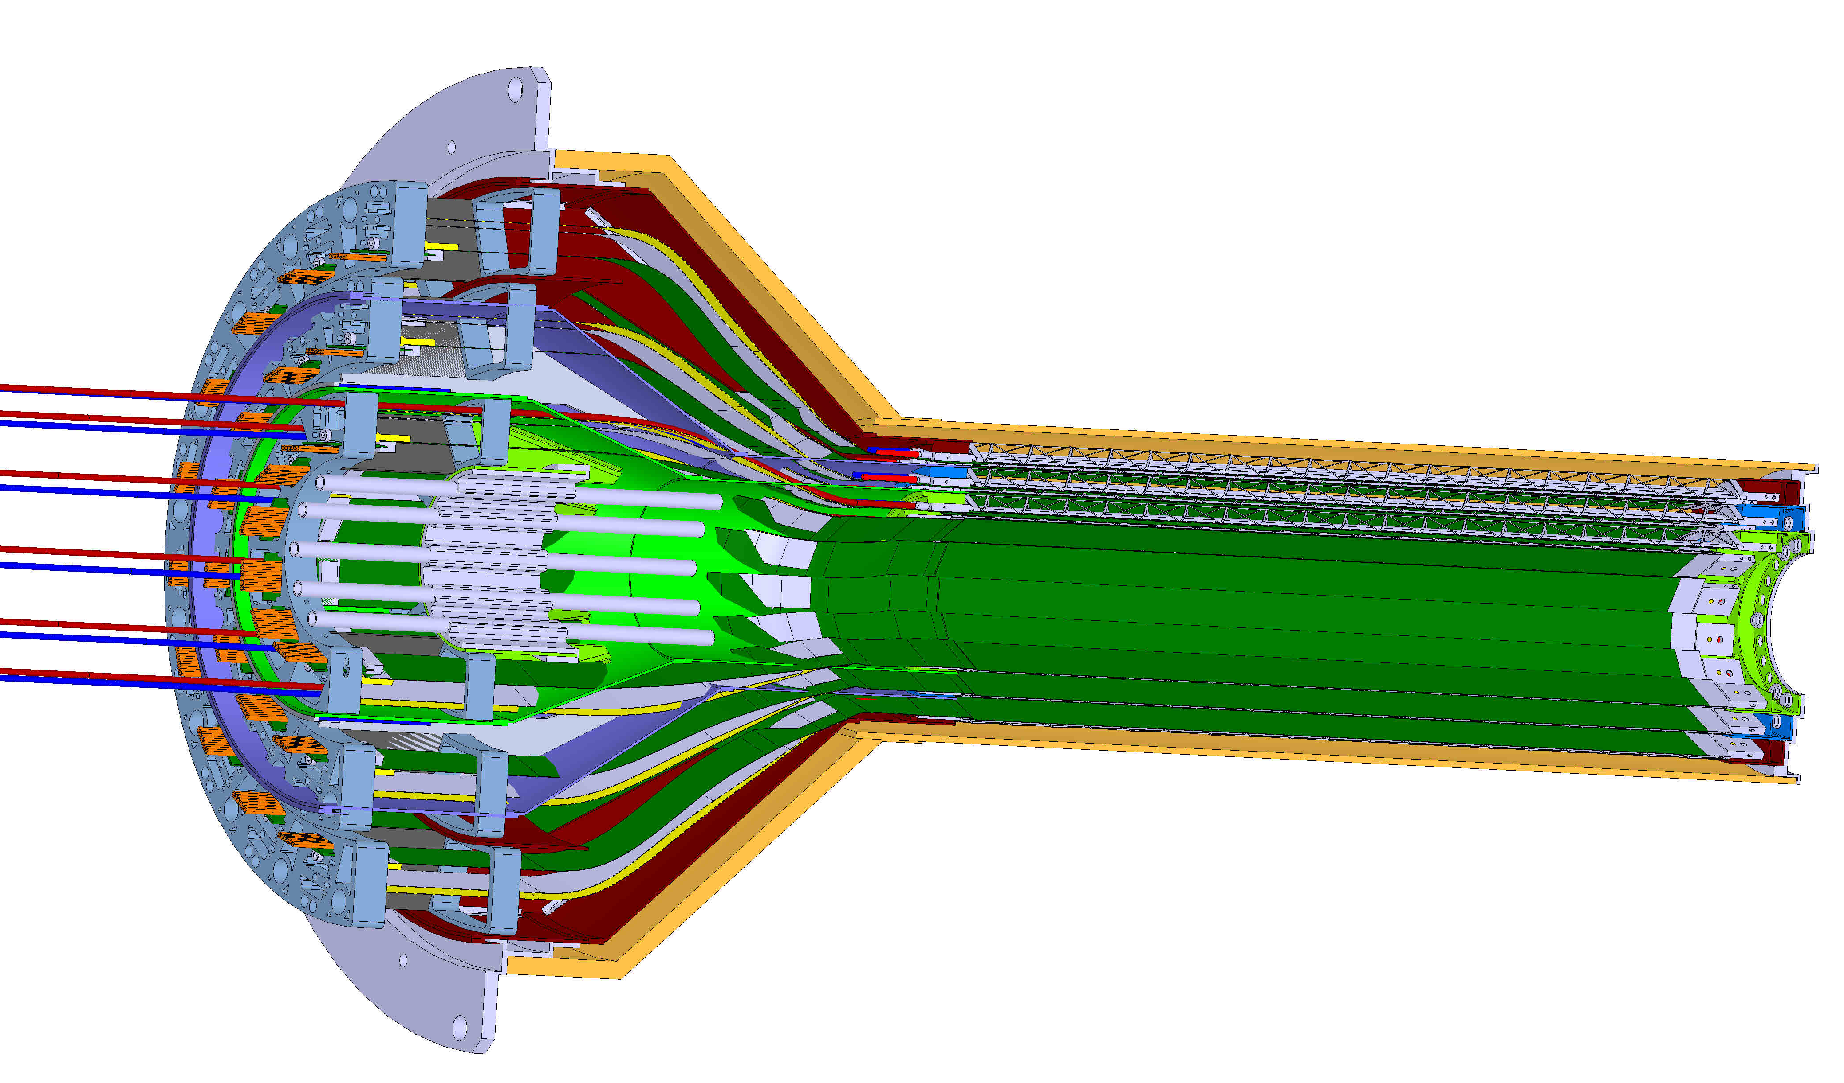

sPHENIX MVTX Detector
Service cone: signal, power, cooling
and mechanical support
CYSS: Cylindrical Shell Structure
End-Wheel
3-layer sensor barrel
- 48 staves, 432 chips
Figure for ALICE ITS/IB design
(slightly modified mechanically for sPHENIX)
MVTX
parameters
MVTX RUs, PUs & other services

Slide 3
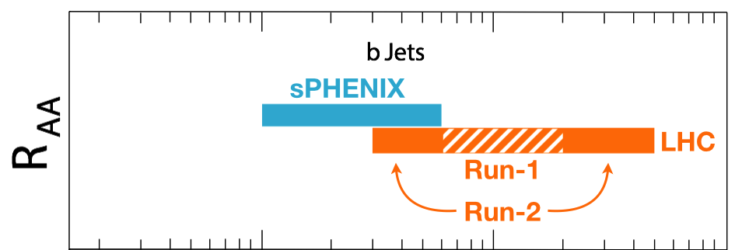
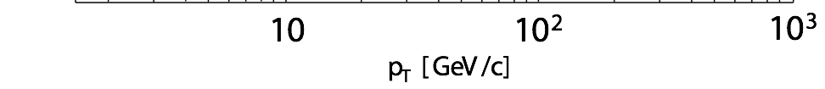
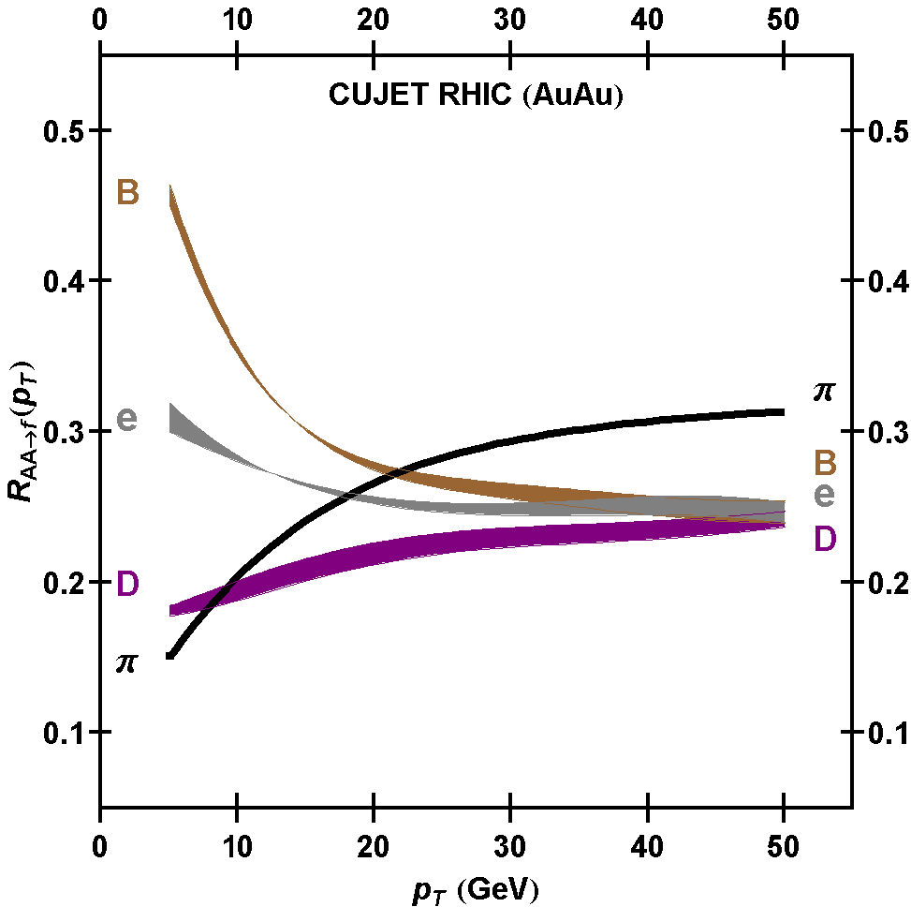
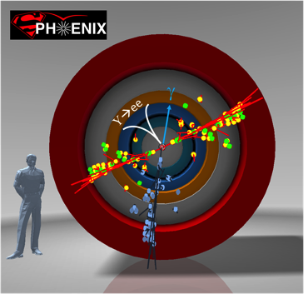
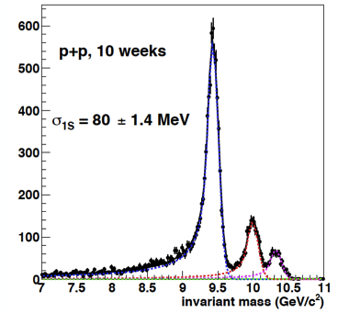
Exciting Science Enabled by MVTX @sPHENIX
– LANL’s major long term NP program
complement & extend current and future RHIC and LHC QGP programs
sPHENIX is the next flagship heavy ion physics experiment in the US (NSAC LRP2015)
  Jets
  Upsilons
  B-jets and B hadrons
MVTX will complete QGP heavy flavor physics
  Precision study of the “inner workings of QGP”(LRP15)
  Unambiguous determination of key parameters of QGP properties and interactions
sPHENIX 3 Physics Pillars
http://arxiv.org/pdf/1501.06197v1.pdf
Jets
Upsilons
PRL 108 (2012) 022301
B
D

Slide 4
sPHENIX 5-Year Run Plan: 2023 – 2027+
sPH-TRG-2018-001
Projected sPHENIX integrated luminosities after 5-year operation
  AuAu: Lum. = 214 nb⁻¹ , Max collision rate ~200kHz
  pp+pAu: Lum. = 1340 pb⁻¹ , Max collision rate ~13MHz
sPHENIX Trigger limit: <=15kHz
  AuAu: mostly MB w/ |Z| < 10cm
  p+p/A: high pT jet trigger, upsilons
A new proposal:
develop displaced tracker triggers for open heavy flavor in pp/pA
based on MVTX + INTT
- RU continues readout + trigger boards(FELIX based?)

Slide 5
Scope of the MVTX Project
MAPS Staves & Electronics
  Readout Integration R&D (LANL LDRD)
    Frontend: ALICE/ITS, RU
    Backend: ATLAS FELIX
    Reprogram RU & FELIX for sPHENIX
  Production:
    84 ALICE/ITS-IB staves from CERN
      Acceptance test @LBNL
      48+spares(36)
    58 ALICE/ITS-RU from CERN
      Acceptance test @UT-Austin, 48+spares(10)
    sPHENIX production, 8 ATLAS/FELIX
      Acceptance test @LANL
    Final detector assembly in US
      LBNL and BNL
  Ancillary systems, “adopt” ALICE system
Mechanics & Cooling
  Changes to ALICE/ITS inner tracker mechanical structures,
    End Wheels
    Cylindrical structure shells
    Detector half barrels
    Detector and Service half barrels
  Mechanical Integration,
    Conceptual design by LANL LDRD
    Prototype by sPHENIX R&D, MIT/LANL
    Design integration frames
    Composite structures, LBNL
    Installation tooling etc.
  Adopt ALICE cooling plant design
    Modifications to fit sPHENIX
    Much smaller heat load than ALICE ITS

Slide 6
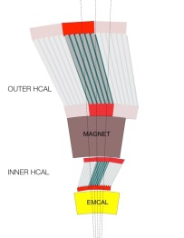
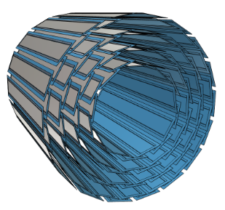
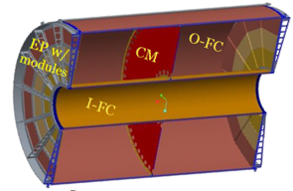
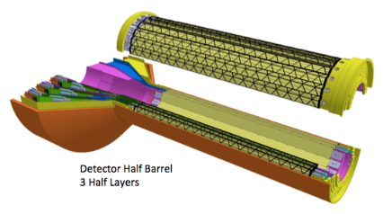
sPHENIX DAQ Architecture and MVTX Readout
Event Builder
FEM
DCM
DCM2
DCM
DCM
DCM
DCM
Network
Switch
Buffer Box
FEM
DCM
SEB
ATP
DCM
DCM
DCM2
DCM
DCM
ATP
DCM
Buffer Box
FEM
DCM
SEB
ATP
DCM
DCM
DCM
DCM2
ATP
Buffer Box
Calorimeters,
INTT, MBD
DCM
SEB
To the
RACF/HPSS
DCM
DCM
ATP
ATP
Buffer Box
FEE
ATP
DCM
DCM
FELIX
EBDC
ATP
TPC
MVTX
DCM
Buffer Box
FEE
ATP
DCM
DCM
FELIX
EBDC
ATP
Buffer Box
DCM
FEE
ATP
DCM
FELIX
EBDC
DCM
ATP
Buffer Box
DCM
Rack Room
SEB Sub-Event Buffer
EBDC Event Buffer and Data Compressor
ATP Assembles events and compresses data
Buffer Box Data interim storage before sending data to the computing center

Slide 7
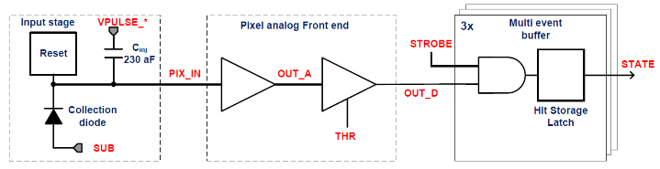
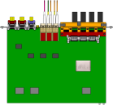

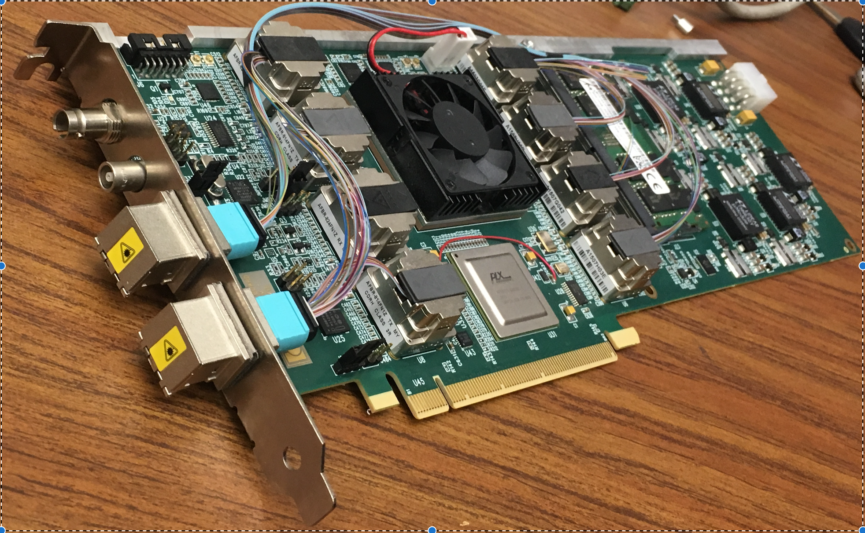
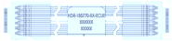
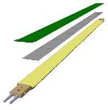

MVTX Readout, Power and Controls
a key LDRD deliverable:
Demonstrate the full readout and control
chain w/ “final” RU and FELIX
CAN bus
DCS
Trigger & Clock
Readout Unit
Front End
GBT Optical Links
one pixel
9 Data (1.2Gbps)
1 Clock, 1 Control/Trigger
Control
Data (9.6 Gb/s max)
Trigger
9-sensor Stave
Samtec Twinax “FireFly”
FELIX
Back End
FPC
Power
ATLAS Front-End Link eXchange (FELIX):
sPHENIX Data Aggregation Module(DAM)
Alpide Sensors
Power
Filtering Capacitors
regulators
Power supplies
Cold Plate
Regulated Power
ALPIDE pixel:
Shaping
Digitization
Zero-suppression
3x buffer
Power Board
Interaction Region
Experimental Hall
Counting House
MVTX Detector Electronics consists of three parts
Sensor-Stave (9 ALPIDE chips) | Front End-Readout Unit | Back End-FELIX/DAM

Slide 8
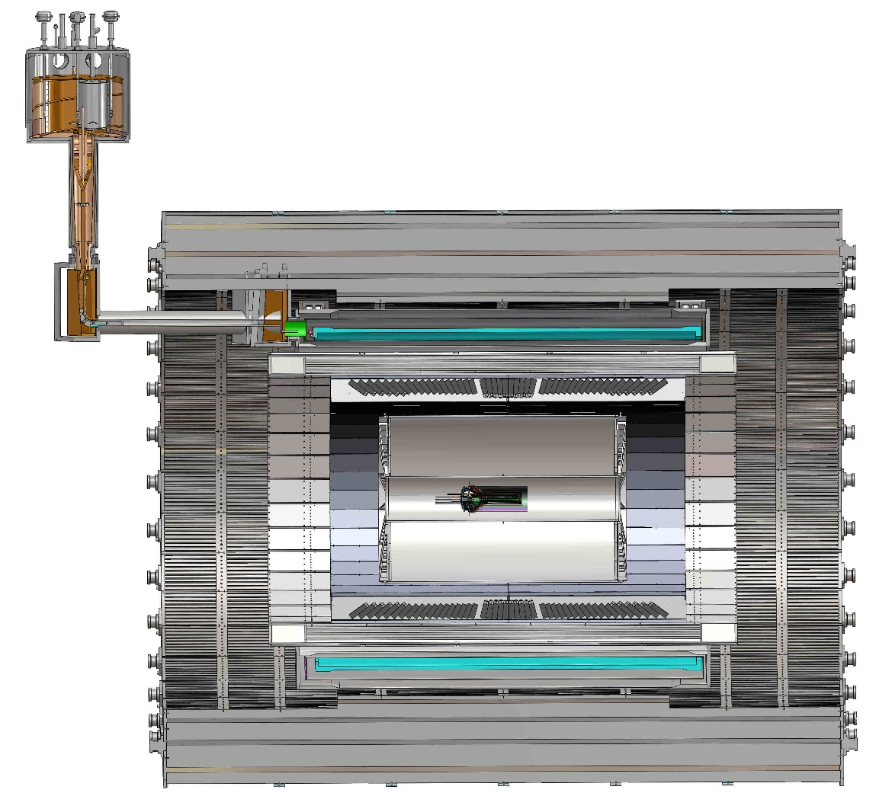
sPHENIX Mechanical System Integration
MVTX, INTT and TPC/HCal
  MVTX/INTT detector designs modified
  Global interface being developed
  Office of System Integration
TPC
TPC
INTT
MVTX
R= 209.6cm
L = 350.0 cm

Slide 9
MVTX Schedules and Milestones
sPHENIX: CD1/3a CD2
Installation
1st collisions
CY-2018 | 2019 | 2020 | 2021 | 2022 | 2023
MVTX
ALICE IB stave done;
Facilities available for
sPHENIX production;
A window of opportunity:
Low technical risk
Cost saving
Stave & RU
production
FELIX
production
Detector mechanics design & production, global interface to sPHENIX
End Wheels
CYSS
Service barrel
design & production
Ready for beam;
sPHENIX day-1 run
Barrel Assembly & Testing @LBNL
Install half barrels
@sPHENIX IR
Half barrel #1
Half barrel #2
Half barrels
arrive @BNL
Power system
production
MVTX installation & commissioning @BNL
RU, FELIX, PS, cables etc.

Slide 10
Key MVTX Physics Deliverables:~2027
“B meson and b-jet modification”
Heavy quarks – unique probe of QGP w/ new scales, m_{c}, m_{b}
  Study mass dependence
    Jet quenching & energy loss
    Flow – interaction with medium
  Access QGP properties
    Parton density, coupling, transport coefficients, viscosity etc.
“B meson and b-jet flow”
m_{u} m_{d}
m_{s}
Λ_{QCD}
m_{c}
m_{b}
MeV
1
10
10²
T_{c}
T_{QGP}
10³
10⁴
Note: B-hadron trigger desired for p+p/A, new physics capability
R_{AA} vs R_{CP} ; v2 in p+p/A etc.

Slide 11
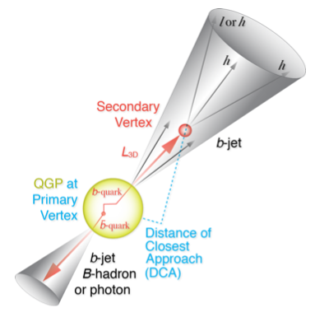
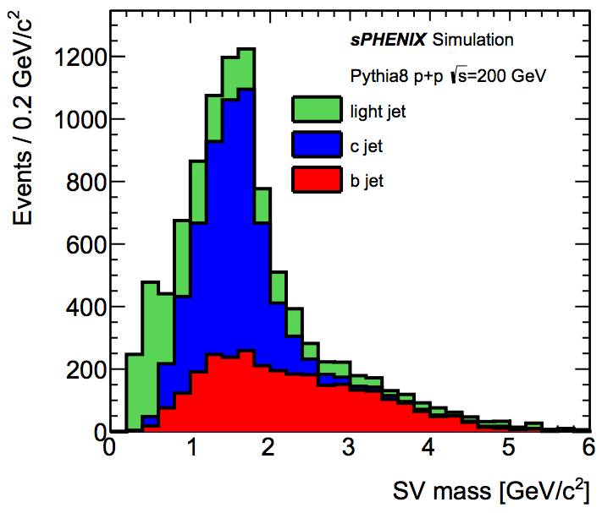
Analysis/Simulation Efforts: B-tagging
2019 – 2023+
Further improve the b-tagging (B-hadrons and b-jets) in p+p/A and A+A
Control of B-tagging methods’ systematics
- DCA vs 2nd vtx mass

Slide 12
Beyond the Baseline sPHENIX: f/sPHENIX and EIC
sPHENIX cold QCD – new TMD physics
  Spin physics with f/sPHENIX
  p+A and p+p,
  Forward tracking detector R&D (aim for EIC/eRHIC)
EIC/eRHIC physics program after sPHENIX, 2027+
  EIC project:
    Site selection: ~2019
    CD-0 ~2019
  LANL EIC program – 2019+
    Define physics focus - TMD, saturation etc.
    Detector R&D

Slide 13
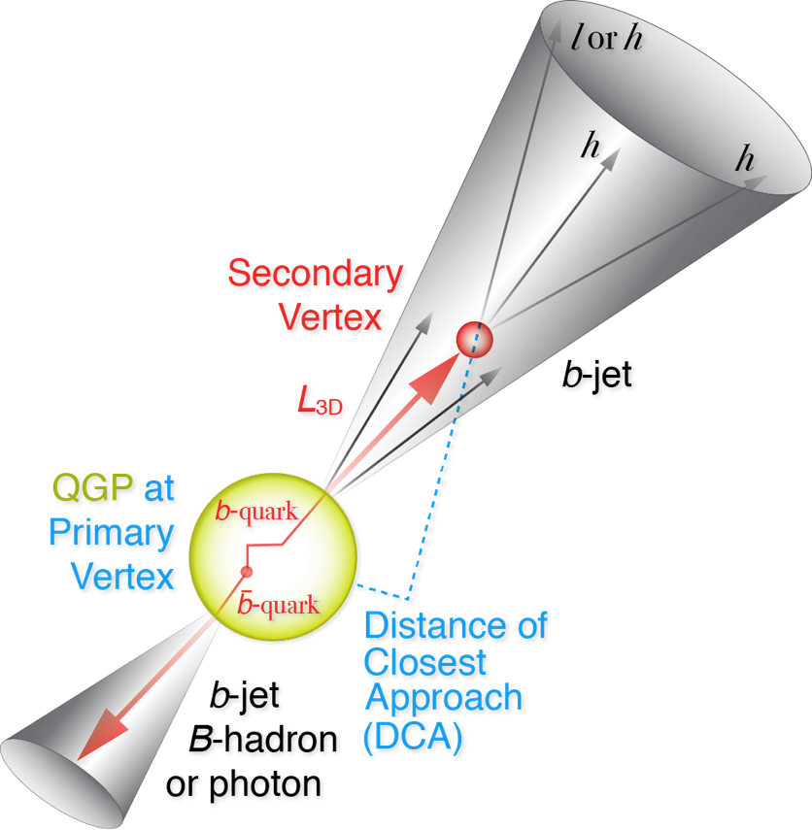
Open HF Trigger for p+p/A: based on DCA & High Multiplicity
https://www.phenix.bnl.gov/WWW/publish/mxliu/sPHENIX/HF-Trigger/sPHENIX-HF-Trigger-Study-042018.pptx
3+4+5 RU -> 1 FELIX/Trigger in continuous readout mode,
ALPIDE readout: ~<5uS,
APLIDE->RU timing:
rising time above threshold ~1 uS
Strobe length = 0.1uS
Readout time = hits N_x per region x 80bits @1.2Gbps = 0.1xN_x uS <~ 2uS
Readout frame gap ~ 50nS
Direct passthrough data from RU to FELIX/Trigger board: @1.2Gbps, a few ~0.1uS
Total delay @Trigger board: ~3uS
  Can we get INTT hits?
B-Trigger decision to be made at trigger board: 4~5uS
  Some kind of lookup table for DCA,
  possibly for multiple tracks, N>=2
Very high multiplicity sum for fast trigger (INTT?), most ~1% central event
B
- Beam center
DCA_XY

Slide 14
Summary: sPHENIX/MVTX Efforts at RHIC
LDRD: FY19, (FTE= 1 staff + 1.5PD)
  Sensor and readout R&D
  Telescope & cooling
  Transition into sPHENIX program
  Open HF trigger R&D for p+p and p+A
sPHENIX MVTX detector construction: FY2019 - 2023
  3+ staff / 3+ postdoc
  Electronics and mechanical integration
  Detector installation and commissioning
  Physics and detector simulations
  Develop open HF trigger
sPHENIX operation & physics analysis: 2023 – 2027+
  3.5+ staff/3+ postdocs
  MVTX operation and maintenance
  Physics analysis and publication
  Future f/sPHENIX & EIC program development
Engineering support:
0.5FTE electronics
0.2FTE mechanical
Engineering support:
0.5 FTE mechanical
0.5 FTE electronics
Engineering support:
0.2FTE mechanical
0.2FTE electronics

Slide 15
Backup slides

Slide 16
sPHENIX MVTX Group: Institution Roles
Growing number of institutions
  Major institutions lead key tasks

Slide 17
Stave and RU Production QA Plan
Staves
Purchase 84 staves from ALICE/CERN
  48 + 28(spares for 2 inner layers) + 8 spares
  Production following the completion of ALICE ITS/IB
  Starting ~Oct. 2018, will last 6-12 months
  Fully tested at CERN before shipping to US
    All Gold/Silver staves (same as ALICE IB)
    A LANL postdoc (Dr. Yasser Morales) oversees production QA at CERN
Acceptance QA at LBNL
  Full test and QA
    Electrical
    Mechanical
  Detector assembly at LBNL
Readout Units
Purchase 58 RUs from ALICE/CERN
  48 + 10 spares(20%)
  To be part of ALICE production
    Cost saving
    Minimize technical risks
  Initial test at CERN
Acceptance QA at UT-Austin
  Full test
  LANL as the 2nd test site

Slide 18
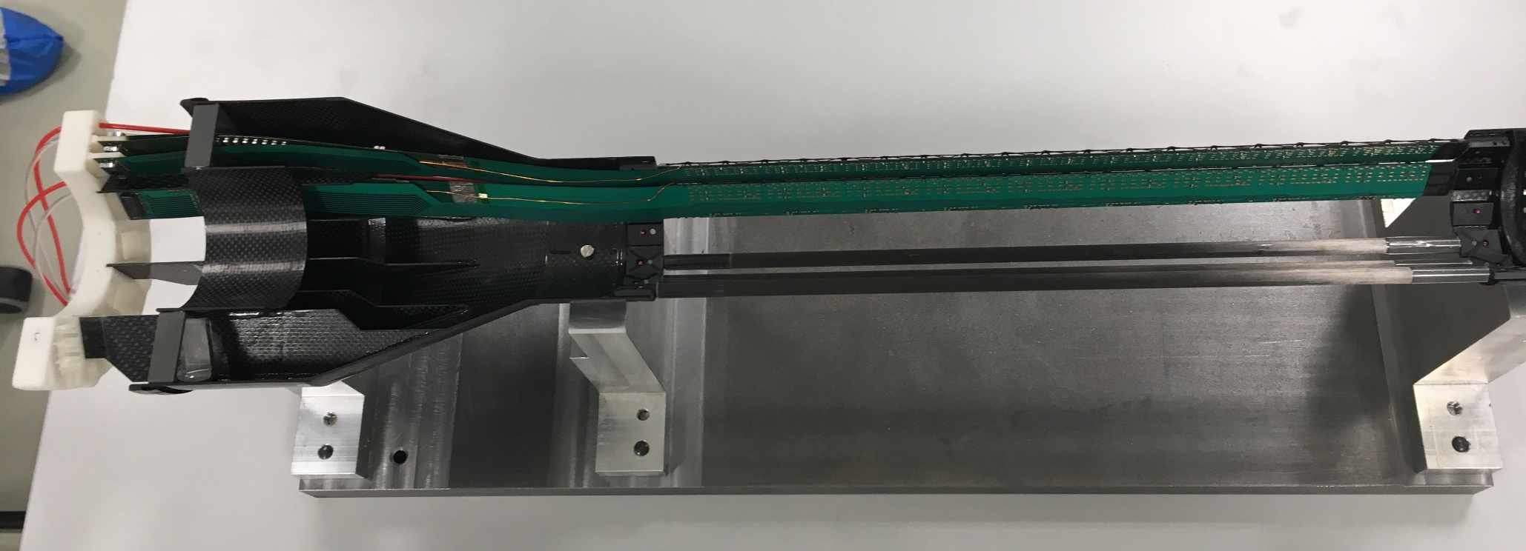
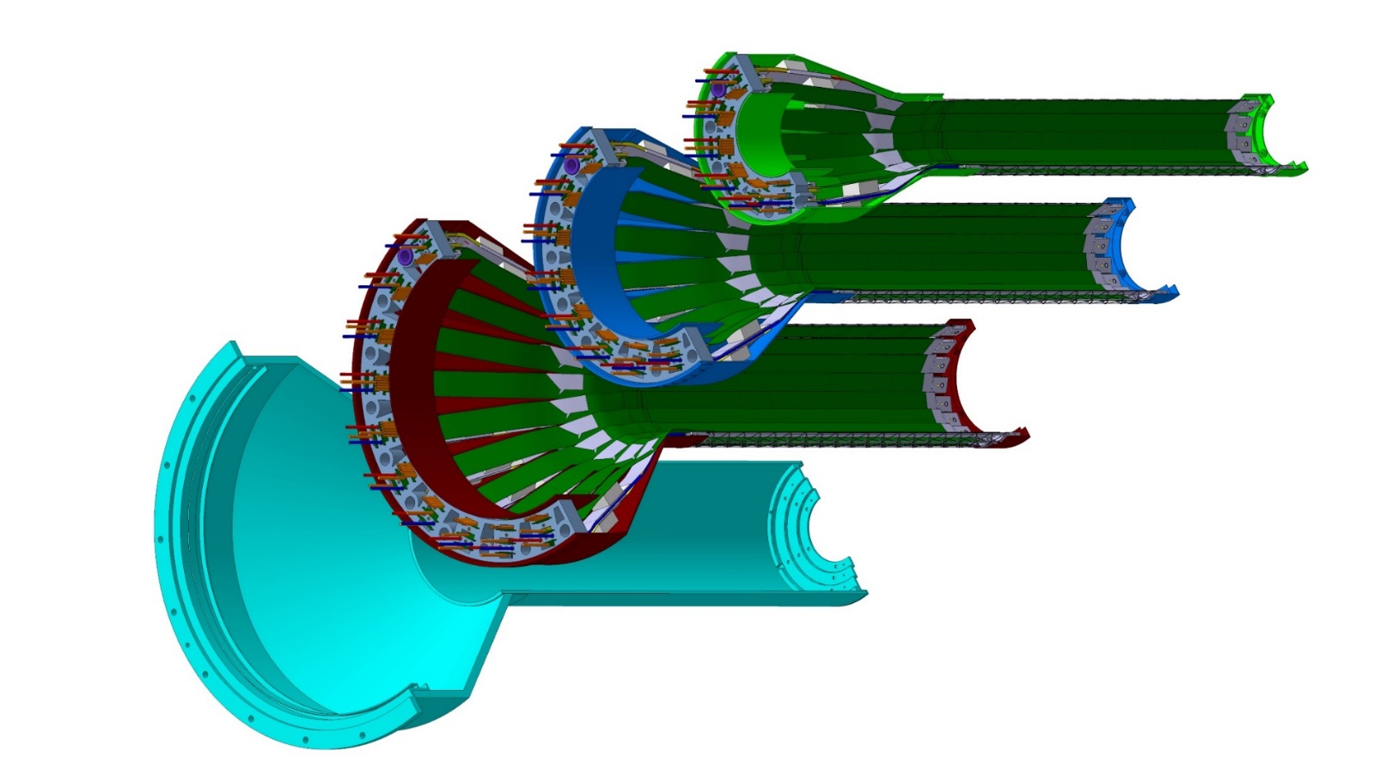
Detector Assembly Plan at LBNL
staves
Precision positioning and installation of staves on end-wheels
ALICE 1st half inner layer being assembled
6/2018@CERN
Layer 0
Layer 1
Follow ALICE IB assembly procedures to build half-detectors for MVTX
QA records in DB, travelers
Modified jigs for MVTX
Layer 2
IB CYSS

Slide 19
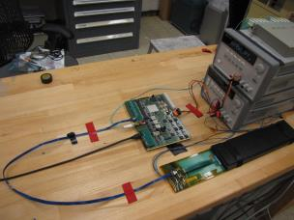
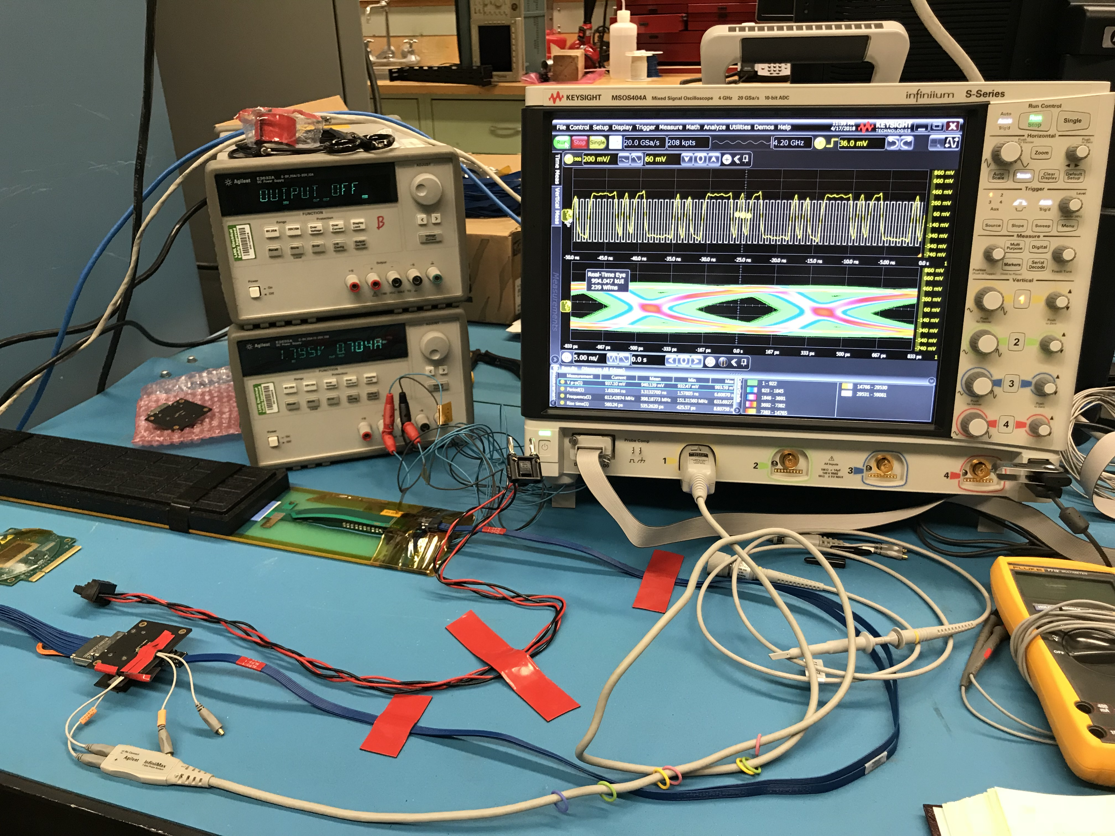
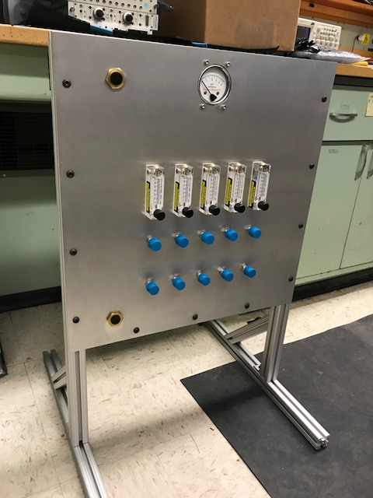
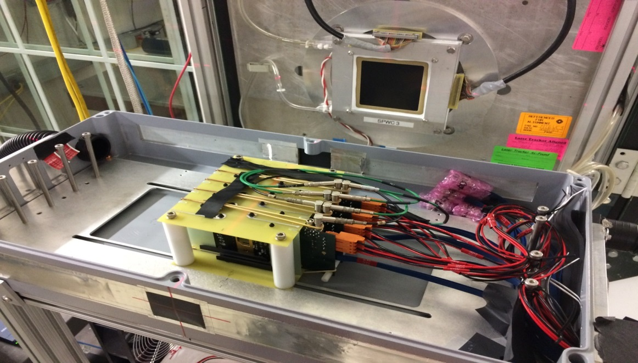
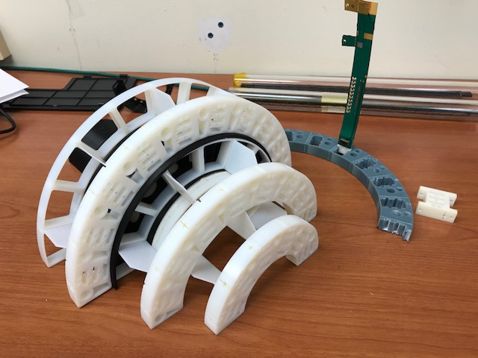
LANL LDRD Activity Highlights
MAPS evaluation
Readout integration
4-sensor telescope
Test beam at Fermilab
Mechanical & cooling
Readout R&D
Signal integrity & cables
RU
Cooling system
prototype
stave
4-ALPIDE Telescope;
5m-long SamTec cables
Service cone R&D
Sensor source test
FPC power extension R&D

Slide 20
sPHENIX LDRD Manpower in general for FY19
Ming
  0.3, overall, readout & integration
Cesar
  0.1, slow control, stave production
Walt/Chris
  0.2, mechanical
AlexT.
  0.5, readout
Sho
  0.5, readout & controls
Yasser
  1.0, stave production, offline simulation
Hubert
  0.1, mechanical mockup
Xuan
  0.1, ALPIDE evaluation
AlexW
  0.5, testing & simulation
Mark
  0.2, readout
T-2/CCS etc.
  Theory modeling
Exp. FTEs & Budget:
  Staff: 1.0
  PD/Students: 2.0
  Engineer/contractor: 0.5
  Budget: $1054K, w/ $330K for M&S

Slide 21
B-hadron trigger: pp and pA
https://www.phenix.bnl.gov/WWW/publish/mxliu/sPHENIX/HF-Trigger/sPHENIX-HF-Trigger-Study-042018.pptx
- STAR can’t do it, no trigger
sPHENIX, needs HF trigger for full D/B reconstruction
Track-based trigger MVTX+INTT+TPC, B-hadron measurements
Very high event multiplicity ~ <1%

Slide 22
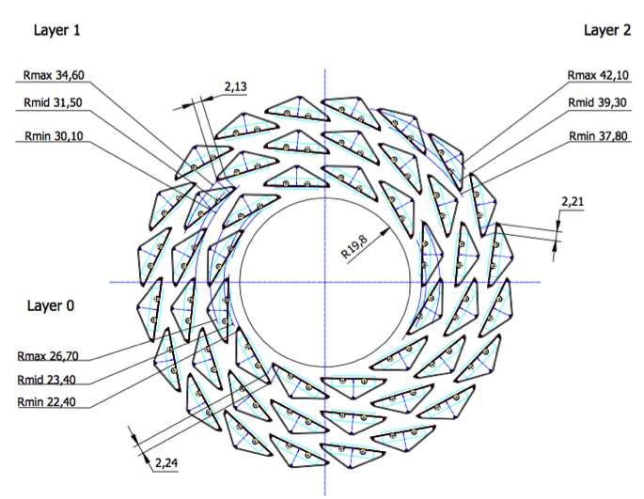
Quadrant based trigger logic:
3+4+5 RUs feed 1 FELIX/Trigger baord
sPHENIX Inner Tracking
Offline B-tagging

Slide 23
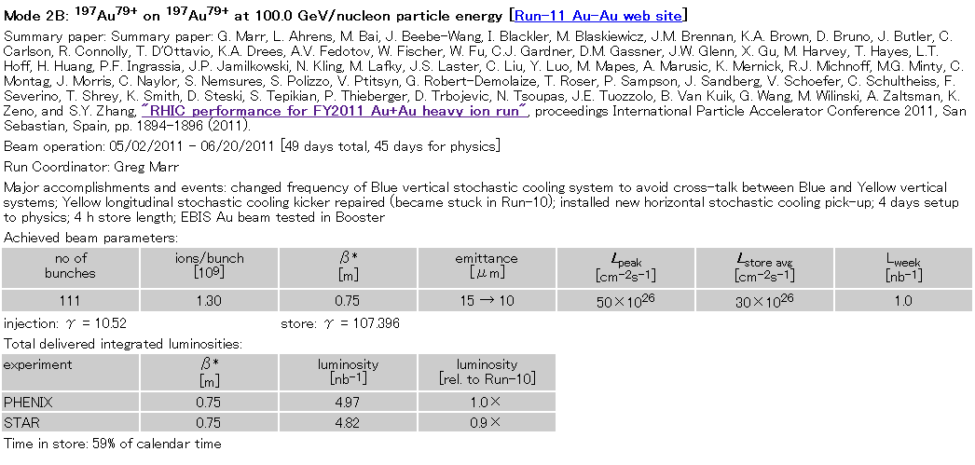
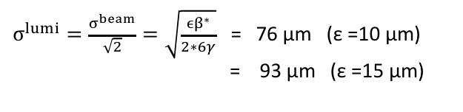
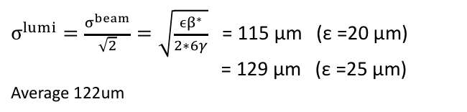
Expected beam spot size
obtained parameters from CAD’s web page:
http://www.rhichome.bnl.gov/RHIC/Runs/
definition of emittance
ε = (βγ) * (6σ^2)/β*
(βγ) : relativistic factors
σ : RMS beam size
β* : amplitude function
ε :95% normalized emittance
RUN11 AuAu 200GeV
RUN12 pp 200GeV
β* = 0.75 m (PHENIX)
β* = 0.85 m (PHENIX)
$σ^{lumi}=\frac{σ^{beam}}{\sqrt{2}}=\sqrt{\frac{ϵβ^{∗}}{2∗6γ}}$= 76 μm (ε =10 μm)
= 93 μm (ε =15 μm)
$σ^{lumi}=\frac{σ^{beam}}{\sqrt{2}}=\sqrt{\frac{ϵβ^{∗}}{2∗6γ}}$= 115 μm (ε =20 μm)
= 129 μm (ε =25 μm)
Average 122um
ASANO 2012/07/17
will check vernier scan result

