Slide 1
Goals and Plan of the Day
Current program status
  PHENIX operation ends 7/2016
  E906 operation ends 9/2016
  No on-going experiments beyond 9/2016
New proposals
  E1039: Fermilab approved, pending DOE ME support
    LDRD/DR ends 9/2016
  E1067: Fermilab approved, parasitic run with E1039
    Possible run with extended E906?
  sPHENIX: 2019+ Construction, 2022-2023+ data taking
  EIC detector R&D
Produce a priority list of vision plans
  Plan-A
  Plan-B …
Impacts
  Future hirings, staff and postdocs
  New LDRDs
  New experiments/programs
Revist the plans in 6-12 months?
  sPHENIX progress
    Tracking options
    f/sPHENIX possibility
  EIC progress
    NAS EIC science assesement ~1 year from now
Boundary conditions
  Complete PHENIX and E906 analyses and publications
    PHENIX HI: 1.5 FTE + 3 PD (3 topics)
    PHENIX Spin: 0.5 FTE + 1 PD (1 topics)
    E906 HI: 0.5FTE + 1 PD (1 topics)
  Current Funding and FTEs
    DOE support: 5 FTE + 3.5 PD
    LDRD/DR: 1.5 FTE + 1 PD
    LDRD/ER: 0.5 FTE + 0.5PD
  NP LRP2015 priorities
  P5 2014 priorities
Short presentations and possible timelines
  5+5’ from each
  Develop vision plans based on science inputs
Vote for long term vision plans
  Optimistic case, Plan-A
  Backup, Plan-B
Develop execution plans
  FTEs
  Timeline
  Additional funding

Slide 2
LANL HI and ME Future Programs: the Big Picture
Presented at 2013 DOE NP HI/ME Reviews
2013
2018
2023
2028
FVTX+MUON @RHIC
HI/CNM: heavy quark dE/dx, color screening,
small-x gluon saturation with D, B, J/Psi, Psi’, Upsilons and Drell-Yan
Spin: sea-quark/gluon polarization, transverse spin physics via W, Drell-Yan, D,B, J/Psi etc.
sPHENIX R&D
Forward sPHENIX
ePHENIX/EIC
HI/CNM: QGP property and CNM with Jets, J/Psi, HQ, DY
Spin: Transverse spin physics with DY, jet, D, B and identified hadrons
E906@Fermilab Pol. Target Drell-Yan
HI/CNM: quark dE/dX
Spin: Polarized target Drell-Yan by LANL LDRD
Other facilities: JLab12/FNAL/LHC/JPARC
HI/CNM: A+A,p+A,e+A, small-x CGC physics, dE/dx
Spin: e+p, e+³He, polarized SIDIS

Slide 3
Longer Term Future @RHIC
Presented at 2013 DOE NP HI/ME Reviews
FVTX + Muon
Forward s/ePHENIX
Forward ePHENIX
Notes:
For the longer term , here I see how our effort fit within the RHIC long term plan … do we lead the RHIC effort and direction? Yes!
Here I see how LANL could lead the longer term physics program at RHIC …

Slide 4
2015 NP LRP Recommendations
The progress achieved under the guidance of the 2007 Long Range Plan has reinforced U.S. world leadership in nuclear science. The highest priority in this 2015 Plan is to capitalize on the investments made.
We recommend the timely development and deployment of a U.S.-led ton-scale neutrinoless double beta decay experiment.
We recommend a high-energy high-luminosity polarized EIC as the highest priority for new facility construction following the completion of FRIB.
We recommend increasing investment in small-scale and mid-scale projects and initiatives that enable forefront research at universities and laboratories.

Slide 5
2015 Long Range Plan for Nuclear Science
Tim Hallman, EIC Users Mtg 01/2015
RECOMMENDATION I
The progress achieved under the guidance of the 2007 Long Range Plan has reinforced U.S. world leadership in nuclear science. The highest priority in this 2015 Plan is to capitalize on the investments made.
With the imminent completion of the CEBAF 12-GeV Upgrade, its forefront program of using electrons to unfold the quark and gluon structure of hadrons and nuclei and to probe the Standard Model must be realized.
Expeditiously completing the Facility for Rare Isotope Beams (FRIB) construction is essential. Initiating its scientific program will revolutionize our understanding of nuclei and their role in the cosmos
The targeted program of fundamental symmetries and neutrino research that opens new doors to physics beyond the Standard Model must be sustained
The upgraded RHIC facility provides unique capabilities that must be utilized to explore the properties and phases of quark and gluon matter in the high temperatures of the early universe and to explore the spin structure of the proton.

Slide 6
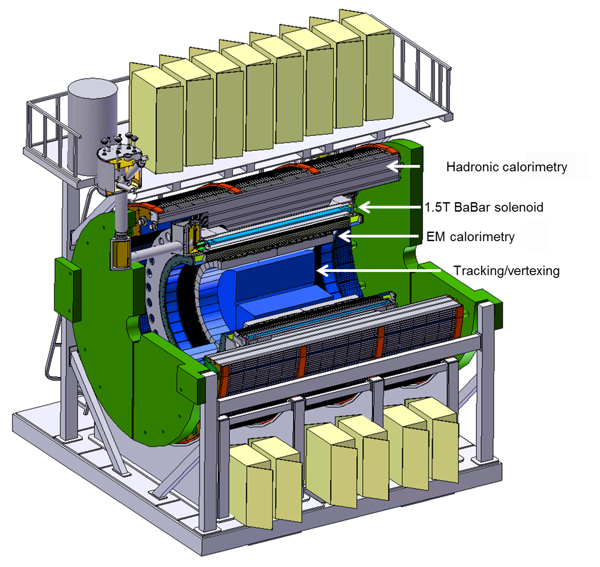
The SPHENIX Upgrade
sPHENIX is a proposed high-rate detector with a full program of light and heavy-flavor jets, direct photons, upsilons, and correlations to investigate the underlying dynamics of the QGP.
Successfully passed DOE Review of science case in April 2015.
Preparing for Technical Review.
In times of fiscal constraints, BNL proposes to implement a future MIE from within base funding, by limiting operations to one detector and periodically not operating facility, while simultaneously upgrading.
New Collaboration formed in 12/2015

Slide 7
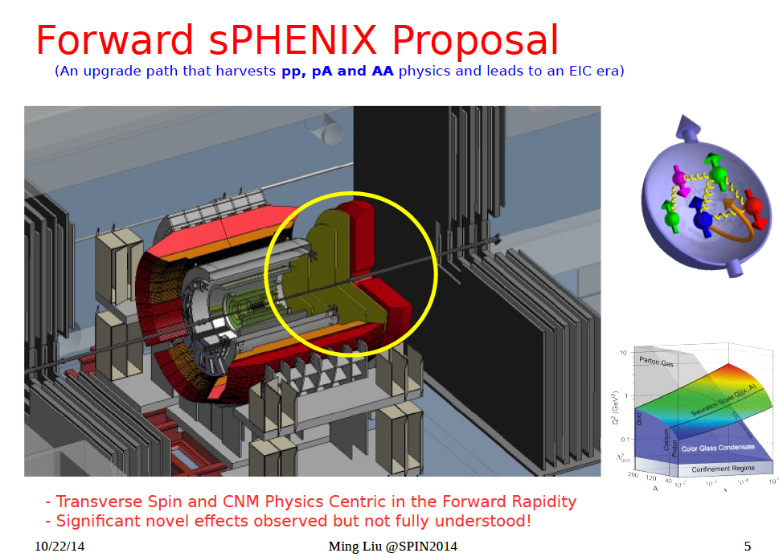

Slide 8
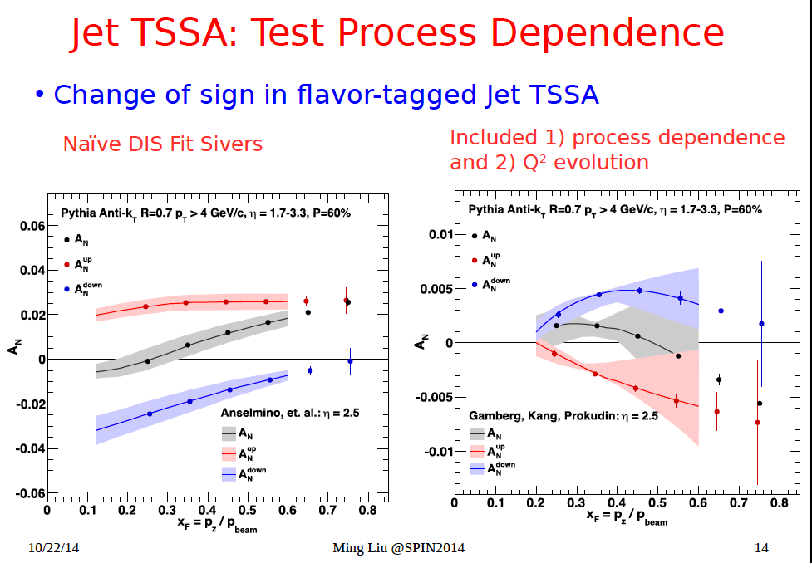

Slide 9
2015 Long Range Plan for Nuclear Science
RECOMMENDATION III
Gluons, the carriers of the strong force, bind the quarks together inside nucleons and nuclei and generate nearly all of the visible mass in the universe. Despite their importance, fundamental questions remain about the role of gluons in nucleons and nuclei. These questions can only be answered with a powerful new electron ion collider (EIC), providing unprecedented precision and versatility. The realization of this instrument is enabled by recent advances in accelerator technology.
We recommend a high-energy high-luminosity polarized EIC as the highest priority for new facility construction following the completion of FRIB.
Tim Hallman, EIC Users Mtg 01/2015

Slide 10
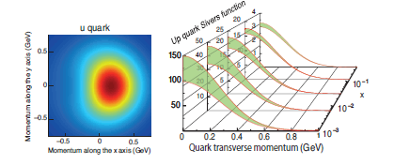
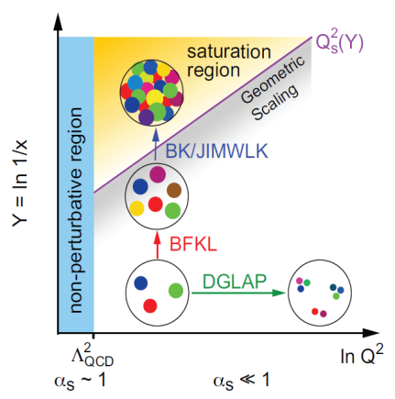
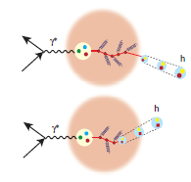
The Science Questions for the EIC as laid out by the community
Don Geessaman
EIC User Mtg 1/2016
How are the sea quarks and gluons, and their spins, distributed in space and momentum inside the nucleon? How are these quark and gluon distributions correlated with overall nucleon properties, such as spin direction? What is the role of the orbital motion of sea quarks and gluons in building the nucleon spin?
Where does the saturation of gluon densities set in? Is there a simple boundary that separates this region from that of more dilute quark-gluon matter? If so, how do the distributions of quarks and gluons change as one crosses the boundary. Does this saturation produce matter of universal properties in the nucleon and all nuclei viewed at nearly the speed of light?
How does the nuclear environment affect the distribution of quarks and gluons and their interactions in nuclei? How does the transverse spatial distribution of gluons compare to that in the nucleon? How does nuclear matter respond to a fast moving color charge passing through it? Is this response different for light and heavy quarks?
Quark propagation

Slide 11
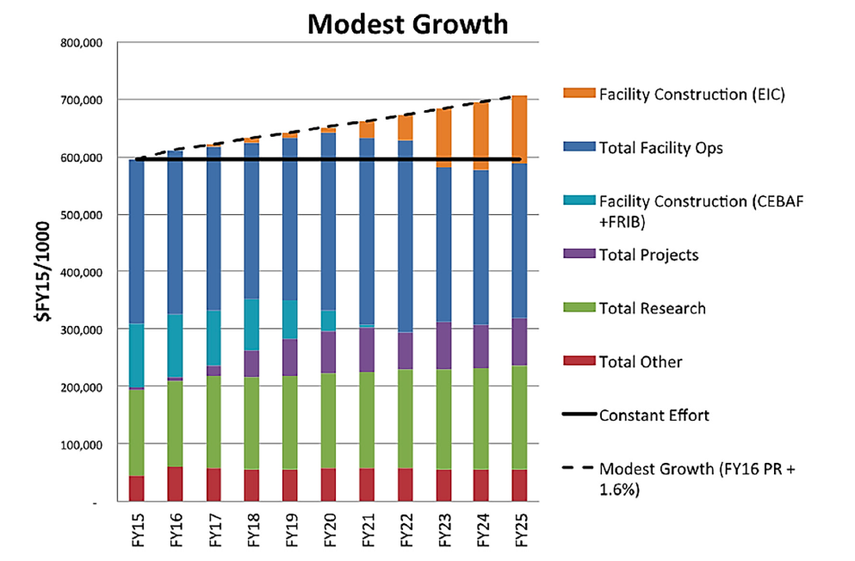
DOE Budget Projections
This is comparable to NP budget growth from 2007 to 2015

Slide 12
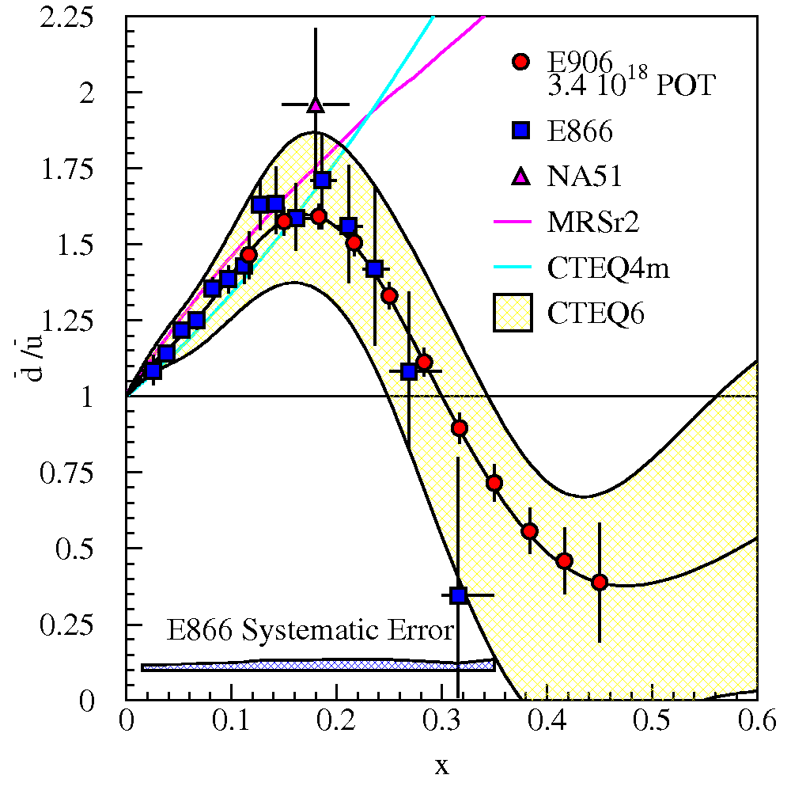
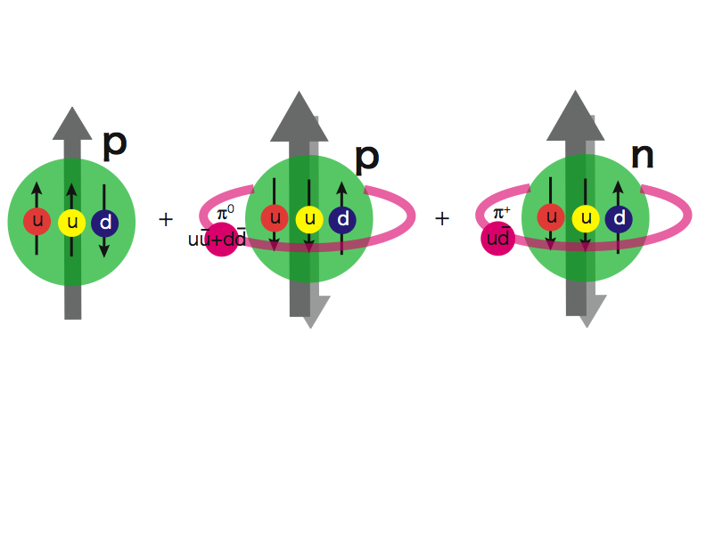
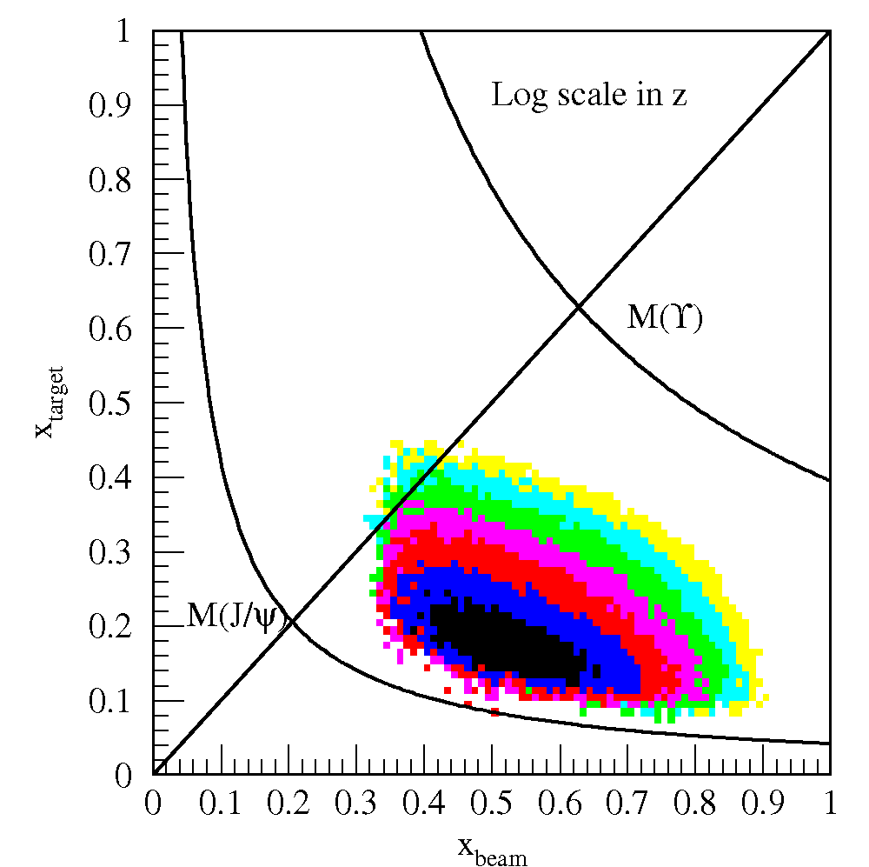
First Study of Sea-quark’s Sivers Asymmetry and OAM with a polarized proton target at E906@Fermilab
LDRD/DR FY13-16
The first precise measurements of sea-quark Sivers distributions
@ x = 0.0~0.3 where significant Sivers asymmetry observed in pol. SIDIS; and also expect OAM effect from pion-cloud
A new probe to study the origins of sea-quark flavor asymmetry
E906 Spect.
Monte Carlo
Notes:
This is a continouation of E906, studying the same phenomea and nucleon structure with different probes!

Slide 13
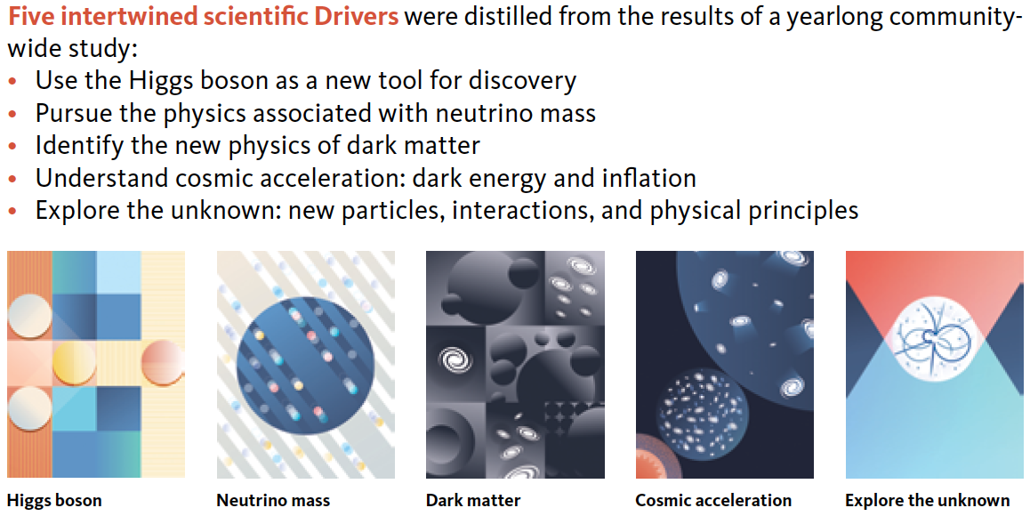
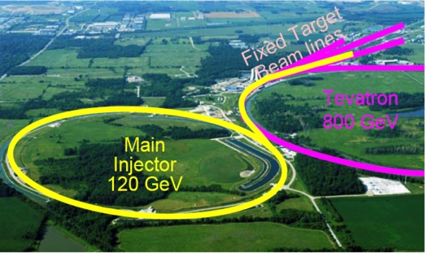
2014 US P-5 Report
Great Opportunities at the Fermilab Intensity Frontier!!!
Notes:
P5 reprot highted the 5 sciecne driver …
We respond to the call of P5 report and identified a new opportunity to explore key physics at Femirlab intensity frontier

Slide 14
Backup slides

Slide 15

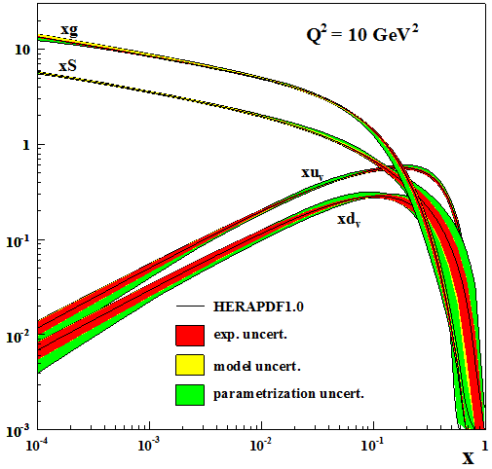
The Long Term Future of QCD:
Understanding the Glue That Binds Us All
T. Hallman
Proton (and nuclei) and black holes are the only fully relativistic (high enough energy density to excite the vacuum) stable bound systems in the universe. Protons can be studied in the laboratory.
Protons are fundamental to the visible universe (including us) and their properties are dominated by emergent phenomena of the self-coupling strong force that generates high density gluon fields:
  The mass of the proton (and the visible universe)
  The spin of the proton
  The dynamics of quarks and gluons in nucleons and nuclei
  The formation of hadrons from quarks and gluons
The study of the high density gluon field that is at
the center of it all requires a high energy, high
luminosity, polarized Electron Ion Collider
The 2013 NSAC Subcommittee on Future Facilities identified the physics program for an Electron-Ion Collider as absolutely central to the nuclear science program of the next decade.

Slide 16
2015 Long Range Plan for Nuclear Science
Tim Hallman, EIC Users Mtg 01/2015
RECOMMENDATION II
The excess of matter over antimatter in the universe is one of the most compelling mysteries in all of science. The observation of neutrinoless double beta decay in nuclei would immediately demonstrate that neutrinos are their own antiparticles and would have profound implications for our understanding of the matter-antimatter mystery.
We recommend the timely development and deployment of a U.S.-led ton-scale neutrinoless double beta decay experiment.

Slide 17
2015 Long Range Plan for Nuclear Science
Tim Hallman, EIC Users Mtg 01/2015
RECOMMENDATION IV
We recommend increasing investment in small-scale and mid-scale projects and initiatives that enable forefront research at universities and laboratories.
Innovative research and initiatives in instrumentation, computation, and theory play a major role in U.S. leadership in nuclear science and are crucial to capitalize on recent investments. The NSF competitive instrumentation funding mechanisms, such as the Major Research Instrumentation (MRI) program and the Mathematical & Physical Sciences mid-scale research initiative, are essential to enable university researchers to respond nimbly to opportunities for scientific discovery. Similarly, DOE-supported research and development (R&D) and Major Items of Equipment (MIE) at universities and national laboratories are vital to maximize the potential for discovery as opportunities emerge.
These NSF funding mechanisms are an essential component to ensure that NSF-supported scientists have the resources to lead significant initiatives. These programs are competitive across all fields, and an increase in the funds available in these funding mechanisms would benefit all of science, not just nuclear physics.
With both funding agencies, small- and mid-scale projects are important elements in increasing the agility of the field to react to new ideas and technological advances.

Slide 18
Nuclear Physics’ Five Subprograms
Tim Hallman, 11/2015 @Fermilab
Medium Energy (TJNAF 12 GeV CEBAF Upgrade)
  Studies the force which binds quarks and gluons in protons and neutrons
  Searches for unexpected evidence of parity violation
  Studies the origin of the spin structure of the proton
Heavy Ion (RHIC and Heavy Ion Research at the Large Hadron Collider)
  Investigates the properties of new states of matter with ∼100 times higher energy density than “normal” nuclear matter
Low Energy (ATLAS, FRIB and fundamental symmetries)
  Studies nuclear structure and nuclear astrophysics
  Investigates the properties of neutrons, and whether the neutrino is its own anti-particle (neutrino-less double beta decay experiment)
Theory
  Explores all three scientific thrusts of nuclear physics
  Encompasses the Nuclear Data Program
Isotope Development and Production for Research and Applications
  Produces, processes, and distributes isotopes in short supply for applications and research
  Research and development for new isotope production

Slide 19
MY 5+5 talk

Slide 20
Physics Topics
Science at PHENIX/RHIC
  Test sign change of DY, A_N, DY run15 pp + p+Au
    DOE Milestone HP13
  First determination of gluon Sivers functions over forward charm and anti-charm, QCD dynamics and gluon OAM
  Small-x gluon saturation forward DY and open heavy quarks, R_pAu
  Heavy quark energy loss in QGP and CNM via Heavy flavor R_AA from run12 Cu+Au, run14 Au+Au
sPHENIX/fsPHENIX
  Heavy quark and QGP interaction
    Small pT B-mesion
    B-jet in HI
  Forward physics
    TSSA
    CGC
EIC
  TSSA
  CGC
  Test QCD universality in pp/DIS
LHC-b
  Small-x physics
  Do CGC before EIC, and possibly better coverage in x and Q^2!
Science at Fermilab
  Quark energy loss and shadowing effects in p+A
    DOE milestone HD05
Future science
  Dark photon and dark Higgs search
    P5 discovery science HEP
    2017-2019 phase-I
    2020-2015+ phase-II with upgrade (recycle PHENIX EMCal+ RICH etc)
  Sea-quark Sivers function, connection to dbar/ubar

Slide 21
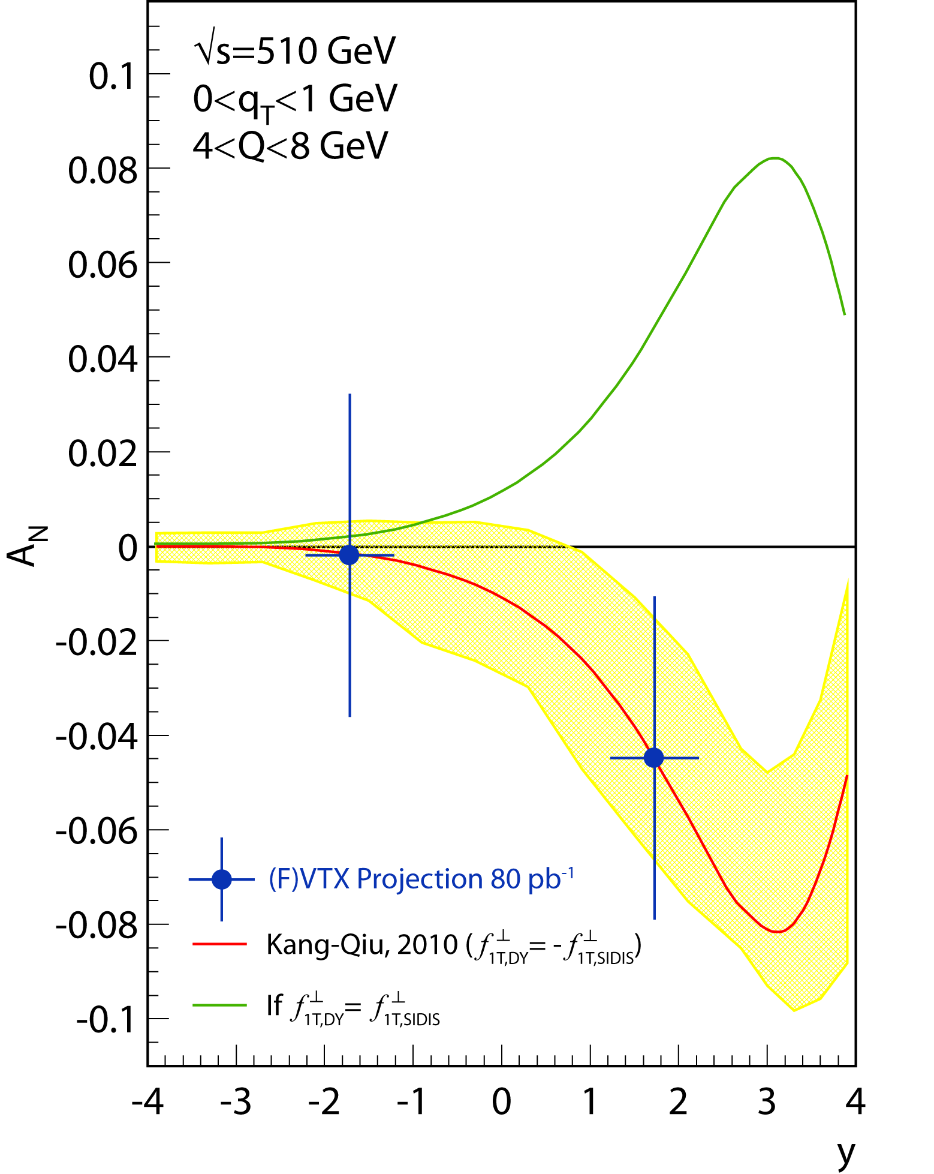
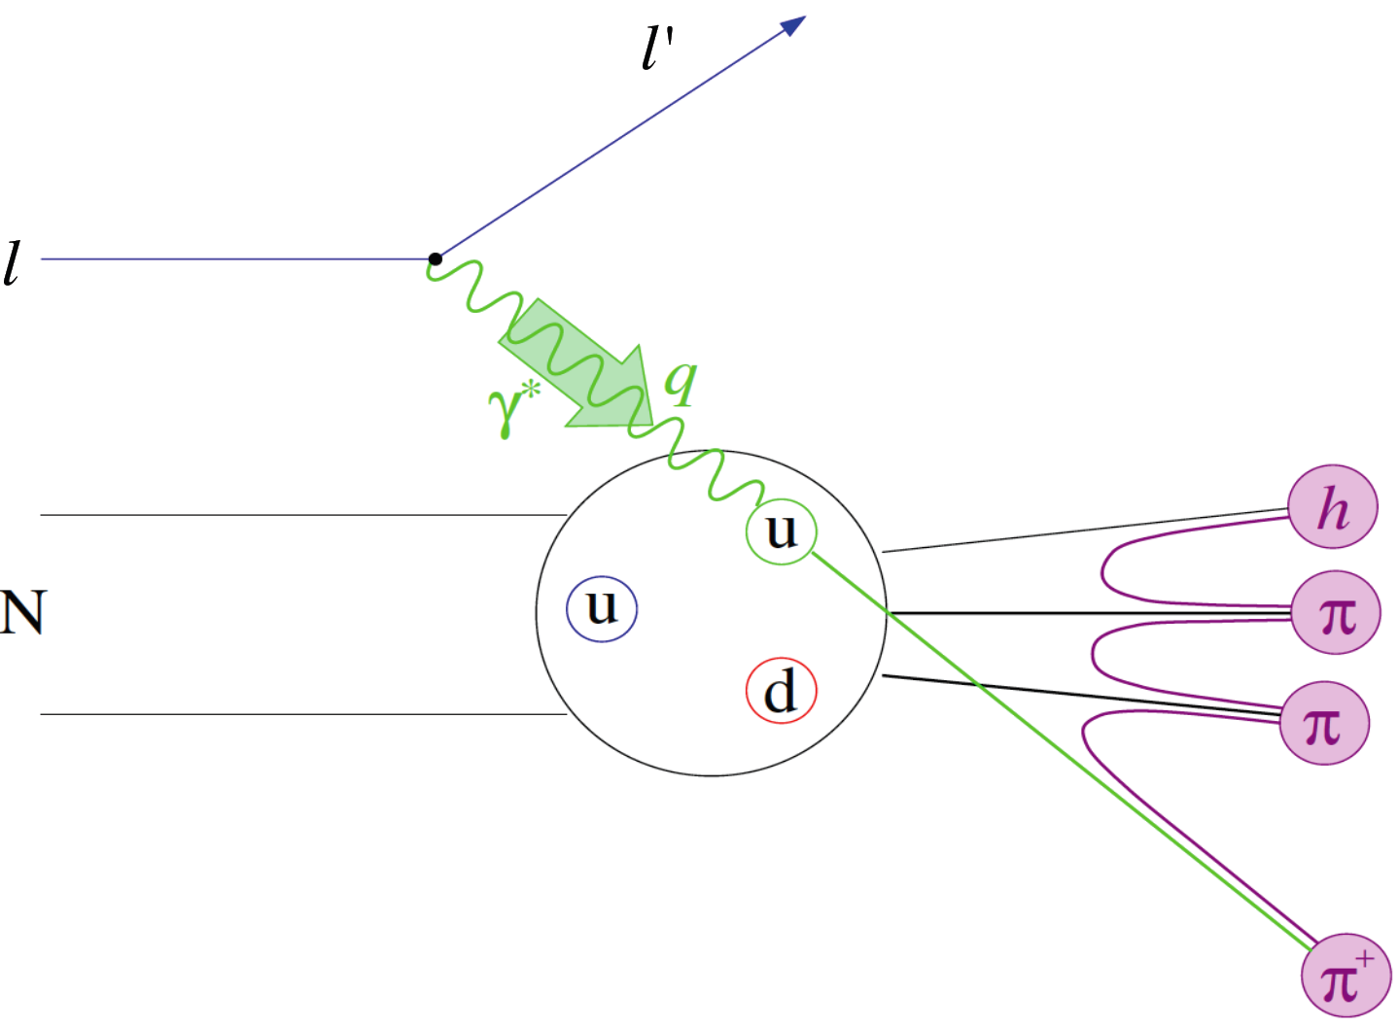
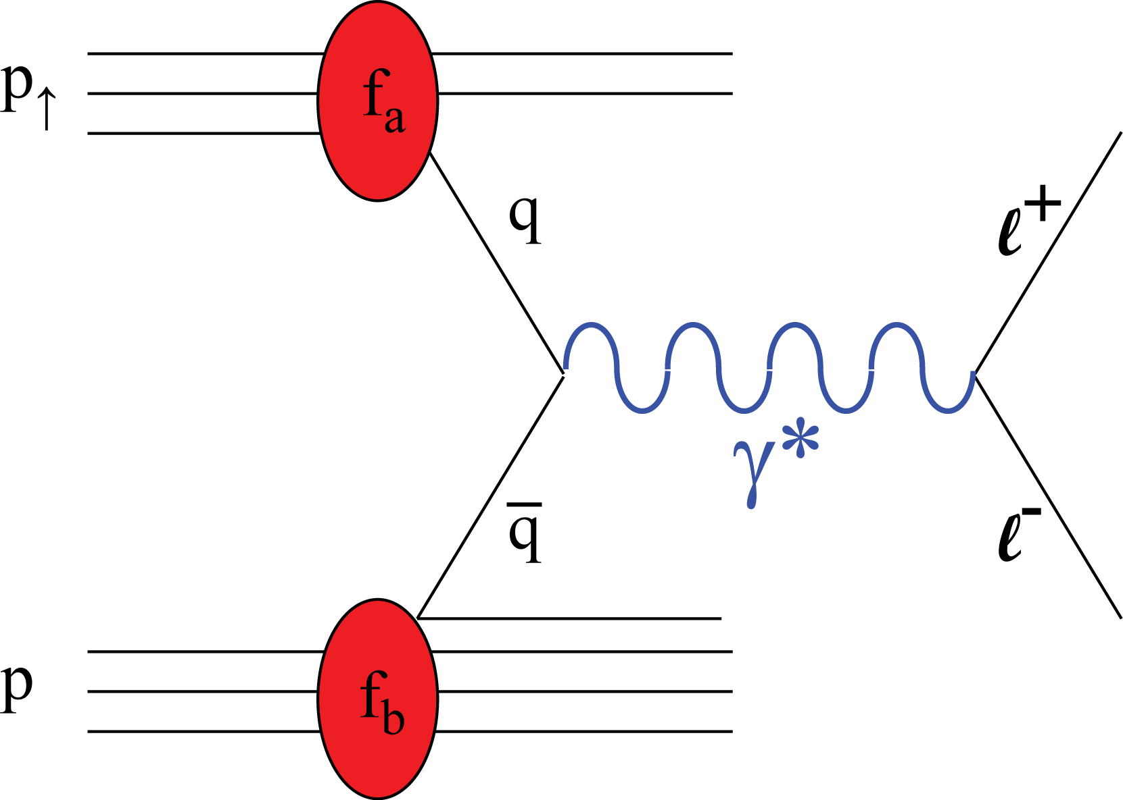
LANL-Led Future Forward Dimuon Drell-Yan A_{N} Study fundamentally important test of QCD factorization and gauge-link
Drell-Yan A_{N} accesses quark Sivers effect (f_{1T}⊥) in proton
f_{1T}⊥ expected to reverse in sign from SIDIS to DY meas.
RHIC 1-year running projection
DOE milestone HP13
~2016
Semi-inclusive DIS (SIDIS)
Drell-Yan
Notes:
Show this is DOE milestone HP 13

Slide 22
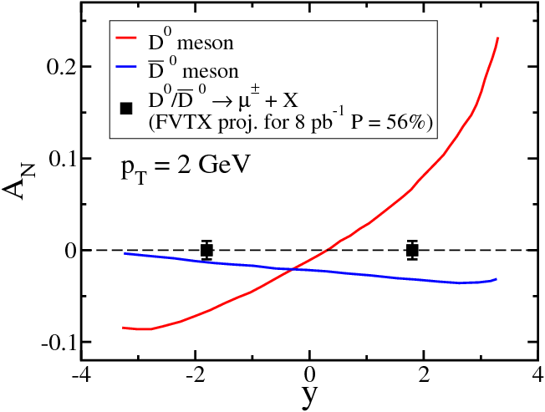
LANL Led First Measurements of Open Charm TSSA in p+p
Unique opportunity to study gluon Sivers distributions at RHIC
D hadron Trans. Single Spin Asymmetry:
Production dominated by gluon-gluon fusion
Sensitive to gluon Sivers distribution
- PHENIX (06+08) μ⁻ only data ruled out the max. gluon Sivers
- Much improved results expected with FVTX detectors, both muon+ and muon-
NEW: due to different color charges, charm and anti-charm could have different TSSAs, a new test of QCD gauge-link formalism
Gluon Sivers largely unknown
Kang, Qiu, Yuan, Vogelsang, (2008), Y. Koiek et al (2011)
2015
FVTX is critical for
μ⁺ and μ⁻ identification
~2015
μ⁺
μ⁻
Notes:
This is the first direct access to the gluon’s Sivers asymmetry … led by LANL group
Further developed a new program to test QCD formulisims

Slide 23
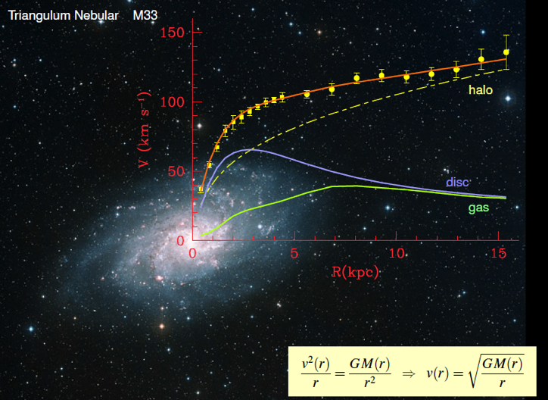
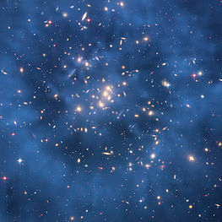
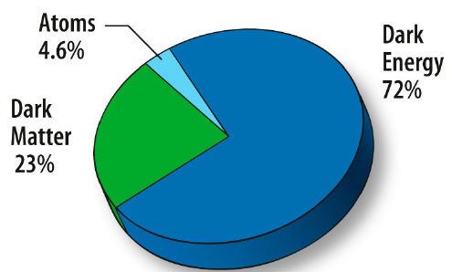
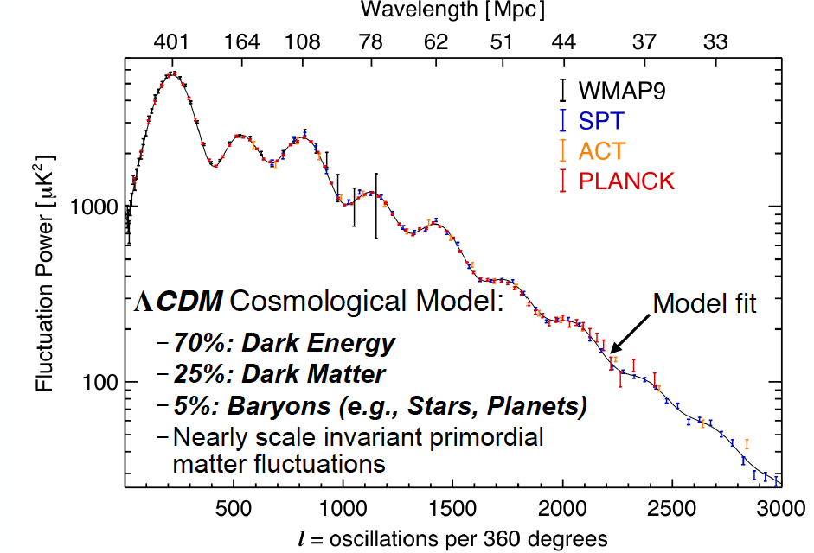
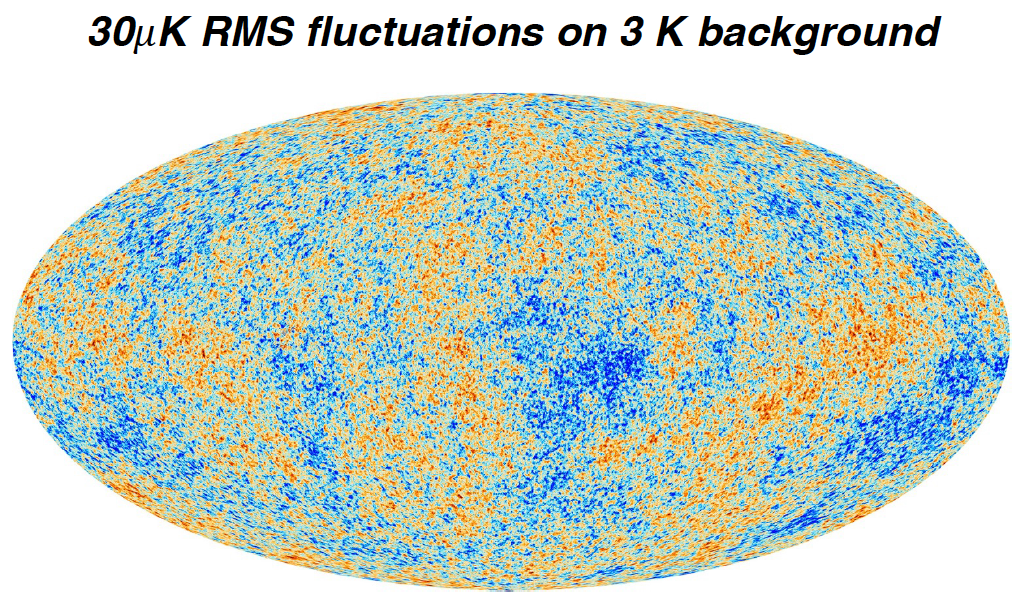
Dark Matter?
Galaxies’ rotation curve
Gravitational lensing (Hubble 2007)
F. Zwicky, ApJ 86 (1937) 217, V. Rubin et al, ApJ 238 (1980) 471
Planck: 2013
Benson’s talk @CIPANP 2015
Notes:
It is widely accepted today that visible matter only account for 5% of matter and energy, with 25% dark matter .. With many compelling experimental obseravtions , how ever the nature of dark matter and dark energy remtain as the biggest scientific challenges for hunam being … sa they only interactio with SM particels very weakly .. Only shown in gravitaiton sectors ..

Slide 24
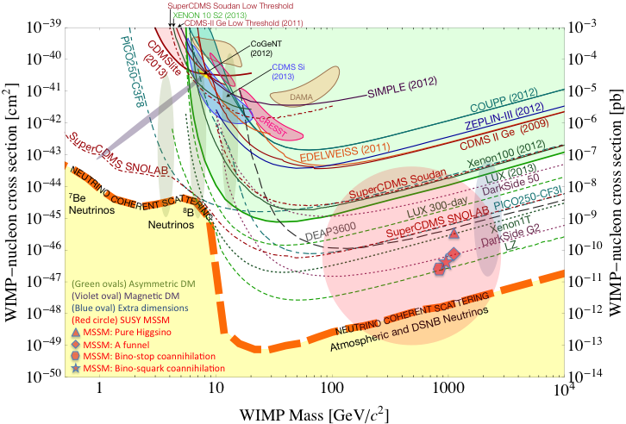
Direct Search for WIMP
Montgomery’s talk at CIPANP2015
“a vision of nuclear and particle physics”
WIMP being excluded?
Recent anomalies observed by satellite and terrestrial experiments have motivated dark matter models introducing a new “dark sector”
There are “portals” between the dark sector and the SM.
  “vector portal”: dark photon
  “scalar portal”: dark Higgs
  …
“Sub-GeV” low mass weakly-interacting dark particles become very interesting!
Mass: O(MeV ~ GeV)
In particular, high-intensity colliders (B-factories) and fixed target experiments (Fermilab, JLab, LHC etc.) offer an ideal environment to probe these new ideas.
- Imaginable space for these experiments is rapidly disappearing
- the “natural” theory space is also disappearing.
- I like to think that Dark Matter is on solid ground, maybe not!!!
Notes:
What are the DM? WIMP is considered one of the primary candidates of DM …

Slide 25

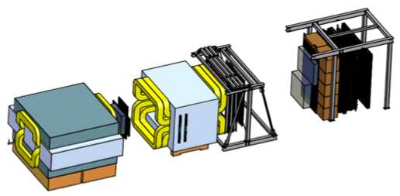

Intensity Frontier at Fermilab: 120 GeV Beam
World’s highest intensity high energy proton beam:
“beam dump mode” @E-1067
35,000 fb⁻¹ (in 2 years of parasitic runs)
LHC-II: 300 fb⁻¹ (~2025), achieved 25fb⁻¹ in Run-I
B-factory@KEK: 50,000 fb⁻¹ (~2023)
Absorber wall and proportional
tube based Muon ID
Spectrometer magnet
Δpt = 0.4 GeV
Focusing magnet
and solid iron dump
Δpt = 2.9 GeV
Beam
120 GeV proton from Main Injector
19ns RF, 4s spill, 0.5×10¹³ protons per spill
25 m
Target system
Liquid H and D
Solid C, Fe, W
- Capture most beam in beam dump mode: p+Fe collisions!
- Parasitic run mode possible with other experiments, E906/E1039

Slide 26
Dark Photons and Dark Higgs Productions in p+Fe Collisions at Fermilab
Photon portal: “vector”
Higgs portal: “scalar”
θ = μ v/m_{h}²

Slide 27
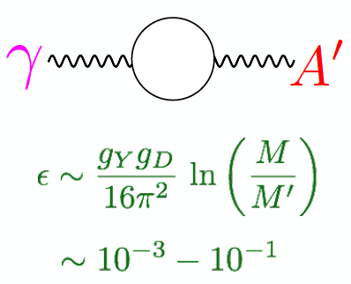
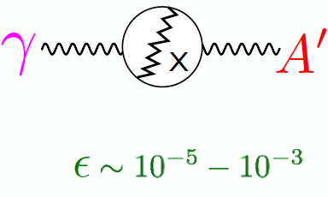
Expectations from GUT
After EWSB, there is a coupling ε between the dark photon and the photon (also the Z, less important at low energies).
Theoretical prejudice for a mass scale
m_{A}’ ~ √ε m_{EW} ~ (MeV – GeV)
e.g. Arkani-Hamed & Weiner;
Cheung, Ruderman, Wang, Yavin;
Morrissey, Poland, Zurek;
Essig, Schuster, Toro;

Slide 28
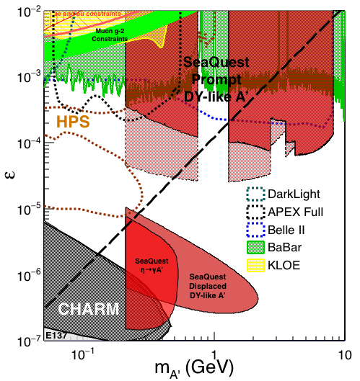

Summary: Phase-I Dark Photon Sensitivity
POT:1.4x10¹⁸ (parasitic w/ E1039)
Signals considered:
Drell-Yan like
Eta decays
Bremsstralung
Covers a wide range of unexplored parameter phase space
Displaced dimuons
- Minimal SM background
Prompt dimuons
- Excellent coverage over BELLE-II
projection
- Possible dedicated runs later to fully
restore mass < 3GeV (Phase-II)
Phase-II with upgrades
Access below 200MeV with di-electrons
( add EMCal)
(2017?)
(2016?)
(~2023)

Slide 29
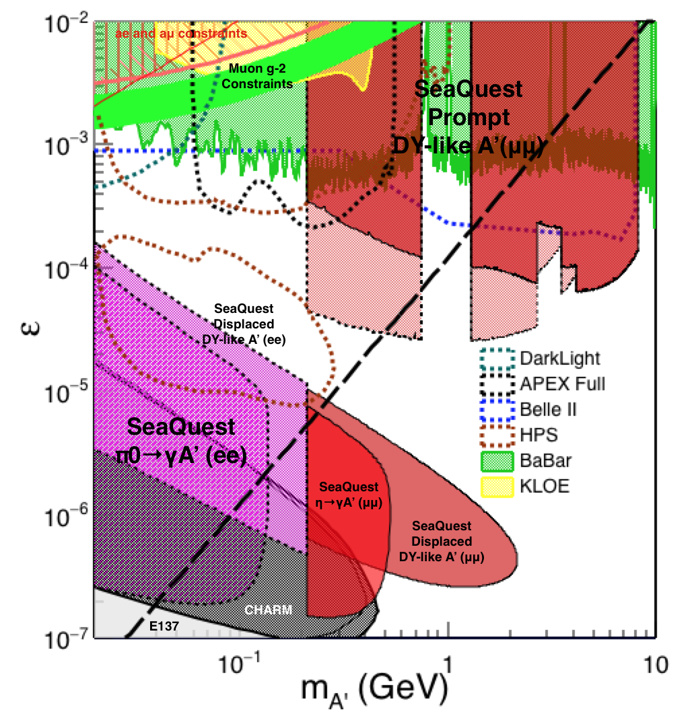
Phase-II: Full Coverage with future detector “EMCal/HCal” upgrades
Projection: POT 1.4 x 10¹⁸
Detector upgrades
  EMCal: e^{+/-}
  HCal: π^{+/-}
  Recycle from other experiments, RHIC/JLab etc.
DAQ upgrade
  100 kHz
Timeline of dedicated runs
  2019+
Detector configuration
  Access low mass region with optimized Fmag settting

Slide 30
Fermilab Upgrade
Recycle PHENIX EMCal + RICH for dark photon and dark Higgs search
  Access low mass range below dimuon 200MeV.
Need to arrange decommissioning and shipment of EMCal + RICH

Slide 31
2014 US P-5 Report
Great Opportunities at the Fermilab Intensity Frontier!!!
Notes:
P5 reprot highted the 5 sciecne driver …
We respond to the call of P5 report and identified a new opportunity to explore key physics at Femirlab intensity frontier

Slide 32
E-1067 Dark Higgs Sensitivity
POT:1.4x10¹⁸ (Phase-I)
Y. Zhang (2015)
Dimuons with downstream displaced decay vertices
Limited sensitivity to “prompt” large mixing case due to small cross-section
Dark Higgs or dark photons?
  Dimuon kinematic and angular distributions
Phase-II
  Dedicated high luminosity runs optimized for low mass acceptance, mass<3GeV
1x
5x
25x

Slide 33
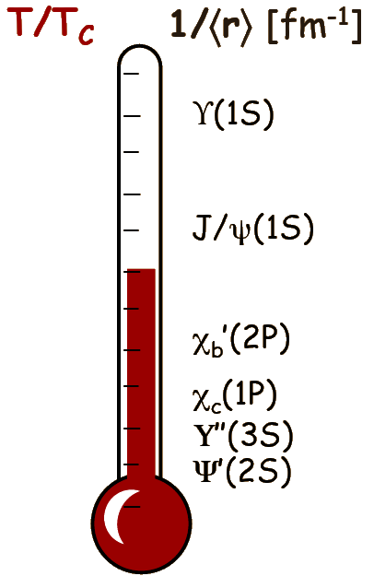
Beyond J/Psi Measurements: Upsilon, Chi_c etc.
Further explore the QGP color screening effects with other heavy quakonia
First dimuon Upsilons in Au+Au
Phys. Rev. C 87, 044909 (2013)
Upsilon
Upsilon
First dimuon Chi_c in d+Au
d+Au
Expect much improved mass resolution and S/B with FVTX
J/Psi, Psi’, Chi_c and Upsilons in p+p, p+A, A+A; see Melynda’s talk
Notes:
33
One expect the color screening effects would be strongly dependent on the heavy quark-antiquark biding energy, thus more “melting” for loosely bounded system like Chi_c, less for upsilons.
one need to systemtically study the whole heavy quarkonia family to clearly isolate the QGP screening effects
Here we show the work-in-progress of other heavy quarkonia production
QGP temperature, color screening length, QGP density etc
The latest FVTX will allow us to do J/Psi Psi’ separation etc

Slide 34
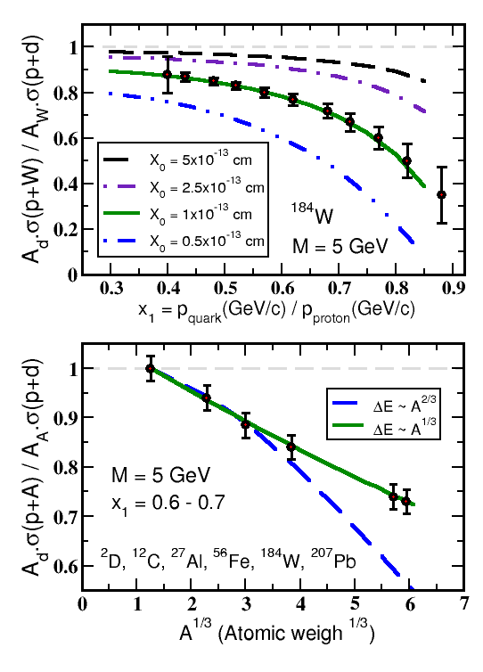
E906 Drell-Yan Provides Unique Sensitivity to Quark Energy Loss
Initiated with a LANL LDRD 2008-2010, $750K
E906 Kinematics eliminates uncertainties
Clearly distinguish between leading models for L dependence of E-loss (5σ)
Previous LANL led E866 d+W @Fermilab
  Shadowing vs dE/dx
PRL 86 (2001) 4483
I. Vitev & B.W. Zhang
Quark energy loss only @E906
q, g
Dominated by dE/dx effect
Minimal shadowing
No final state interactions

Slide 35
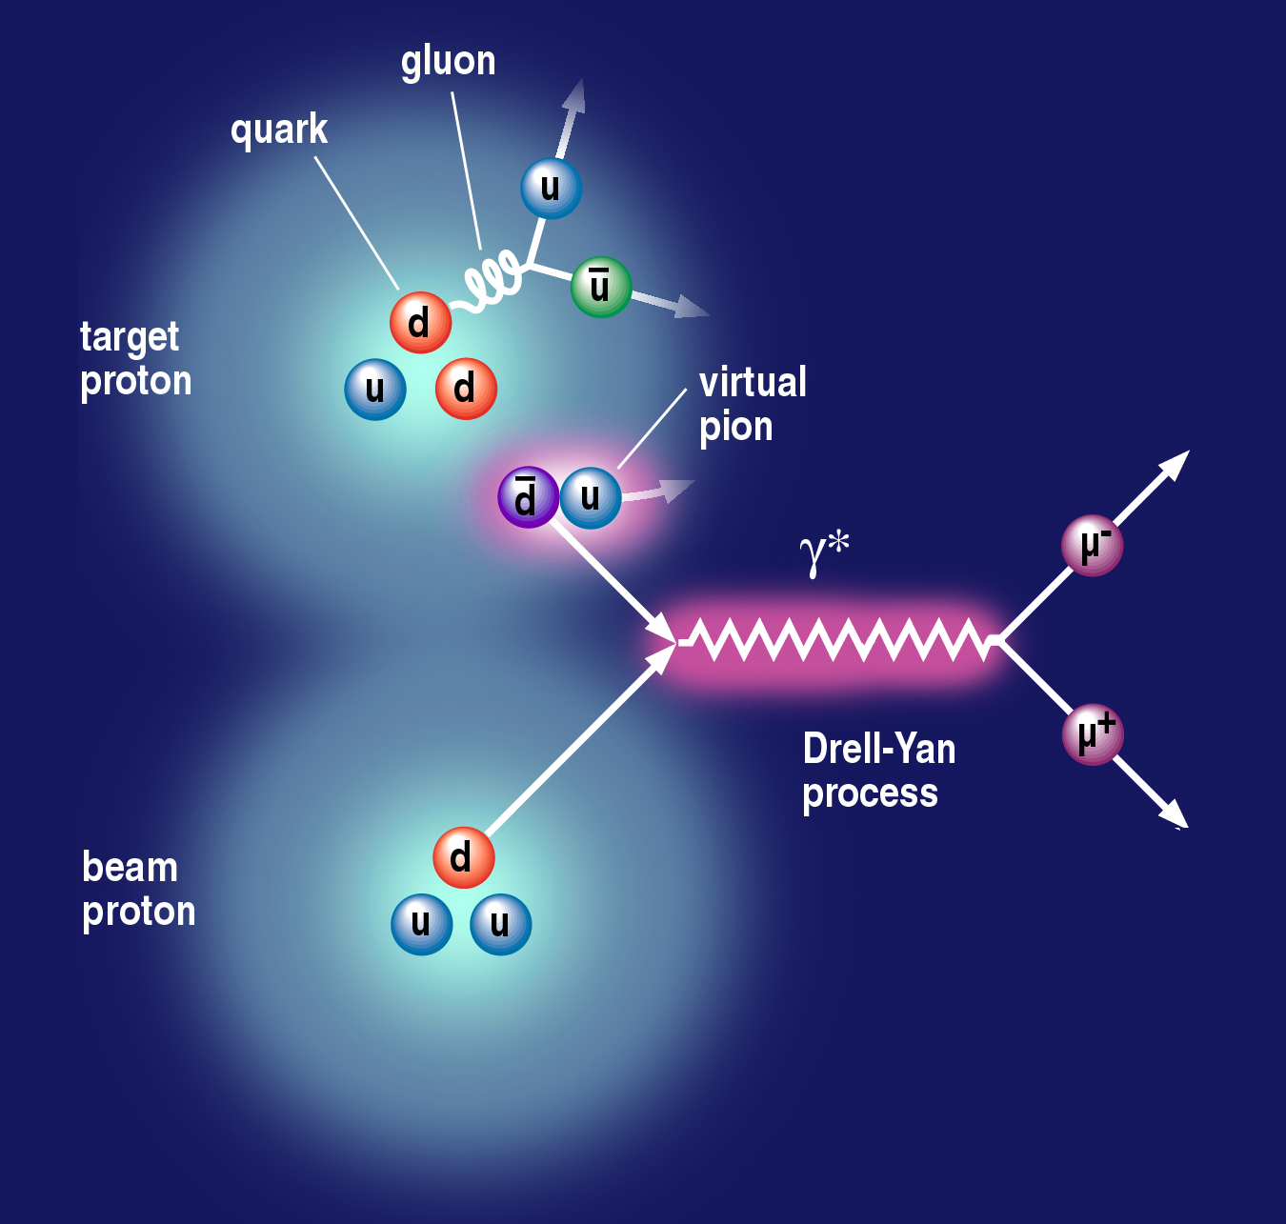
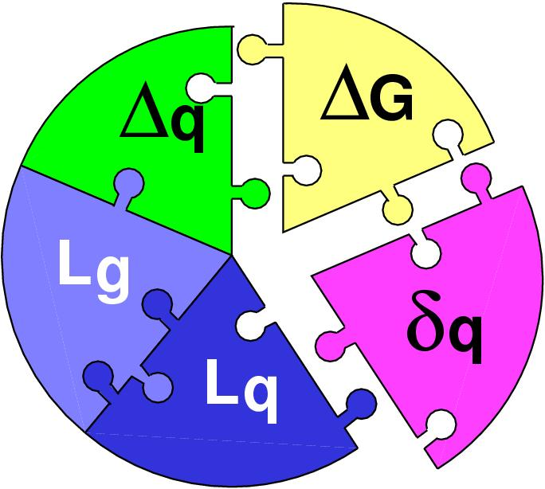
The Physics of Polarized Target Drell-Yan
(Sea-quark flavor asymmetry)
Sea-quark orbital angular motion and Sivers function at x = 0.0 ~ 0.3
Proton spin puzzle
E906 dbar/ubar projection
E906 Spect.
Monte Carlo
E906 Spect.
Monte Carlo
E906 Spect.
Monte Carlo

Slide 36
My efforts in next 5+ years
Completing PHENIX and E906 (2016~2020)
  DY and open charm TSSA
    Universality of QCD factorization
    Novel QCD dynamics/tri-gluon correlations
  J/Psi and Psi’ in p+A and AA
    Energy loss and Flow
    Parton-medium interactions
Dark photon and polarized Drell-Yan at Fermilab (2016 – 2020+)
  Direct dark photon/dark Higgs search
  Sea quark OAM via Drell-Yan TSSA
sPHENIX(f/sPHENIX) upgrade (2017 – 2023+)
  Low pT B-hadron/B-Jet R_AA and Flow
  MAPS pixel detector R&D
LHC-b? (2017+, LHC Run-III 2020-2022+)
  Small x gluon and sea-quark saturation, nPDF
  Dark photon search

Slide 37
LANL HI and ME Future Programs: the Big Picture
2015
2020
2025
2030
FVTX+MUON @RHIC
HI/CNM: heavy quark dE/dx, color screening,
limited small-x (10^-3) gluon saturation with D, B, J/Psi, Psi’, Upsilons and Drell-Yan
Spin: sea-quark/gluon transverse spin physics via Drell-Yan, D,B, J/Psi etc.
sPHENIX R&D
sPHENIX/fsPHENIX
ePHENIX/EIC
HI/CNM: QGP property and CNM with Jets, J/Psi, HQ, DY
Spin: Transverse spin physics with DY, jet, D, B and identified hadrons
E906, Pol. DY/Dark photon, Dark photon Phase-II ….............
HI/CNM: quark dE/dX
Spin: Polarized target Drell-Yan by LANL LDRD
BSM: dark photon and dark Higgs etc
Other facilities: LHC-b
HI/CNM: A+A,p+A,e+A, very small-x (10^-5) CGC physics, dE/dx
BSM: dark photon and dark Higgs etc

Slide 38
Detector Upgrades and Expected Signals
Dark photon trigger upgrade
  Add a fine-granularity scintillating strip based trigger/tracking to tag dimuons from the same decay Z-vertex
  A new trigger for events with displaced down-stream dimuons
Unique signals
  Displaced dimuon decay vertex for long-lived particles
  Invariant mass peak in dimuon mass spectrum
  Mostly from beam dump (target ~6% λ_{I}.)
Beam time
  Run parasitically with E1039 (2017-2019)
  Possible dedicated runs later with upgraded (e^{+/-}, h^{+/-})
-- 2.5%
-- 6.0%
Dimuon mass resolution
Z (meter)

Slide 39
Back up slides

Slide 40
First Study of Sea-quark’s Sivers Asymmetry and OAM with a polarized proton target at E906@Fermilab
LDRD/DR FY13-16
The first precise measurements of sea-quark Sivers distributions
@ x = 0.0~0.3 where significant Sivers asymmetry observed in pol. SIDIS; and also expect OAM effect from pion-cloud
A new probe to study the origins of sea-quark flavor asymmetry
E906 Spect.
Monte Carlo
Notes:
This is a continouation of E906, studying the same phenomea and nucleon structure with different probes!

Slide 41
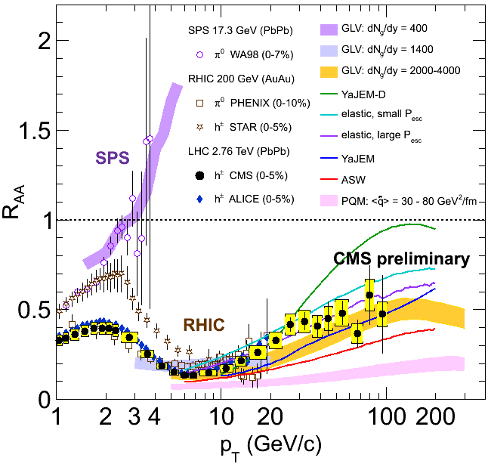
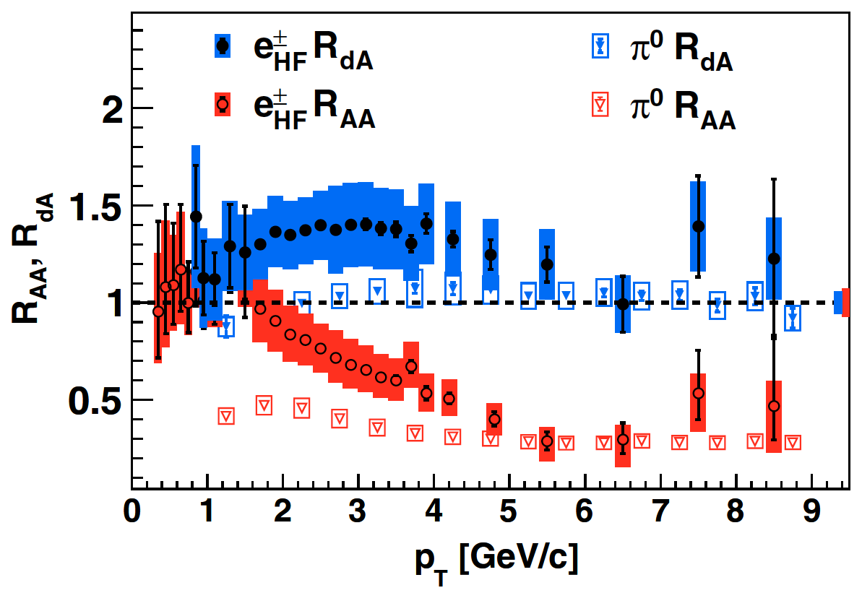
Mass Dependent Parton Energy Loss and Open Heavy Quark Production in d+Au and Au+Au @RHIC
Significant CNM/QGP effects observed in d+A and A+A
Lack of precision measurements
  Heavy flavor single electrons and muons, systematic limited
  A mix of leptons from D and B
Needs precision D,B measurements
Au
d
Light hadron suppression from SPS, RHIC to LHC
Heavy quarks in d+Au and Au+Au, PRL (2012)
Precision Study of single muons from Heavy Quarks, new muon capability w/ FVTX
Notes:
Move to back up
To better understand the jet supression and parton energy loss, we studies heavy quark supression in d+A and A+A, and there are surpriseds – heavy quark are almost equally suprresed as light and also significant CNM in d+A,
Not just the radiative dE/dx … maybe collisional dE/dx also plays a big role , however, more quantitative measurements are required to precisely distinguish various models .. Experimental data are systematically limited
Early inclusive heavy quark production in d+A and AA showed significant effects, data however are systemtic limited,
Need F/VTX to carry out precision measurements of D, B
One d+A alone doesn’t have the capability to distinguish various CNM effects …
Understanding the energy loss mechanisms is a challenging question for QGP physics ! Need a joint efforts of Exp + Theory efforts

