Slide 1

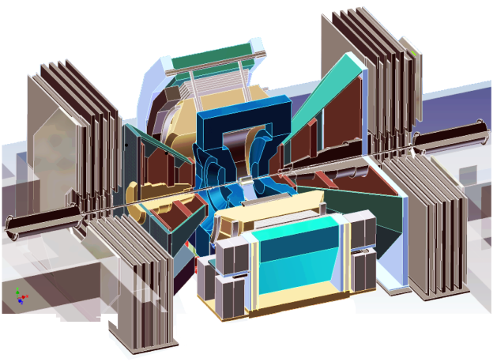
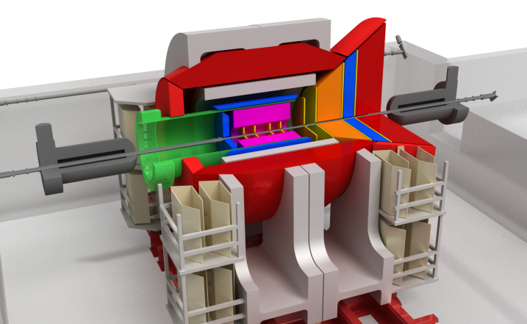
LANL Heavy Ion Physics Program at RHIC
With a long history of leading heavy flavor physics
PHENIX physics: 2000->2016+
Lead physics w/ muons
MuTr completed: 2002
FVTX completed: 2010
sPHENIX physics: 2023->2025+
Lead HF Physics w/MVTX
QGP, cold-QCD
EIC physics: ~2030
Lead HF Physics
Spin, gluon CGC/TMD
~2000
2016
~2025

Slide 2
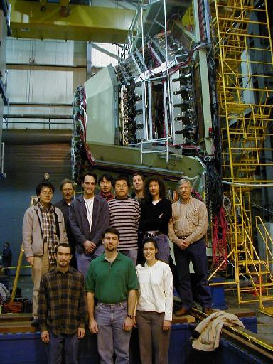
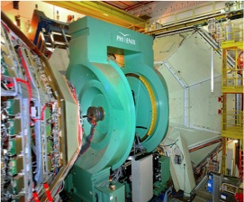
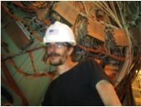
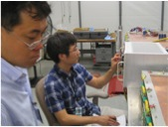
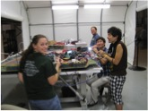
LANL-Led PHENIX Muon Trackers (20+ years, $20M)
Muon Tracker Contributions - Designed, built, installed, commissioned two muon tracker systems
Responsibilities - DC Member, coordinate and perform maintenance and improvement
Muon Tracker Analyses - Have provided much of the simulation and reconstruction software, as well as online QA software for
the Muon Trackers. Lead roles in most muon physics analyses (QGP, CNM & Spin)
Close collaboration with US, RIKEN/Japan and French Institutions
Year 2000, the first
South Muon Arm completed
North MuTr
South MuTr
2011
2010

Slide 3
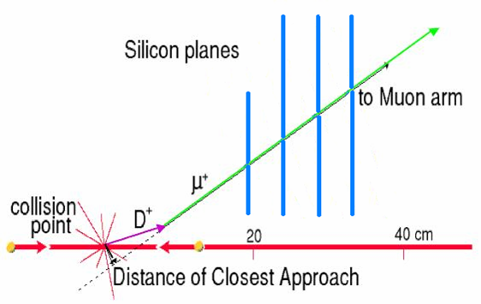
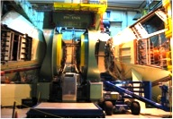
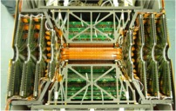
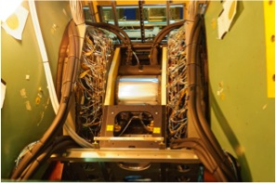
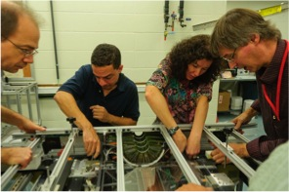
LANL-Led PHENIX FVTX Upgrade (10+ years,$10M)
Commissioned and Took First Data in 2012 Run
Started with LANL LDRD
Heavy Ion Physics - Heavy quark energy loss; QGP color screening; CNM effects
Spin Physics - Sea-quark and gluon polarizations; Transverse spin physics
Forward VerTeX Detector (FVTX)
Produced many key physics measurements
prompt
New Tools:
Open D, B
J/psi and Psi’
Drell-Yan
W^{+/-}
π→μ
(DCA)
2011@BNL
Notes:
j/psi + psi’ plot
Rolls

Slide 4
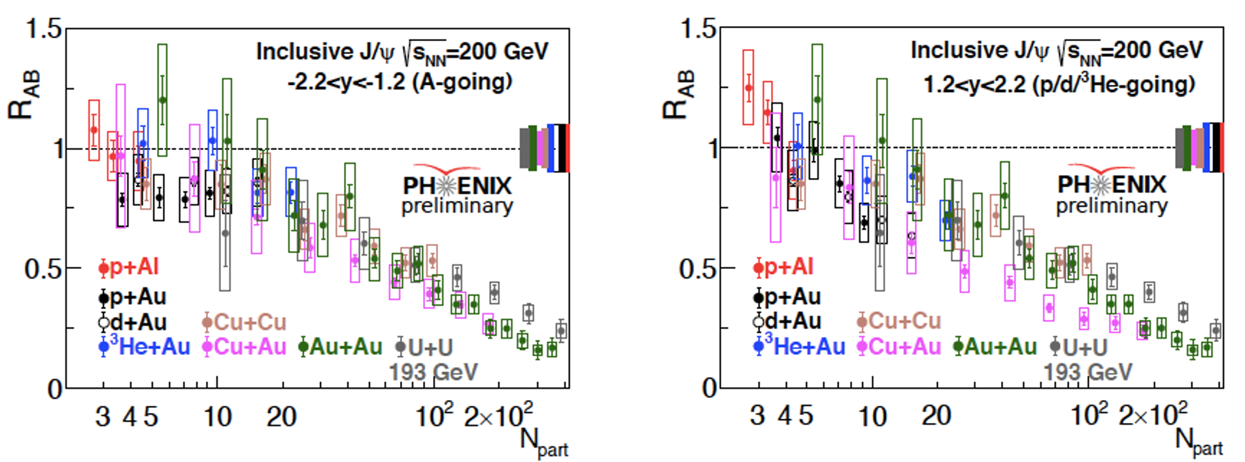
PHENIX Recent Highlights - I
Recent publications from muon analyses (LANL played major roles)
"Measurement of J/ψ at forward and backward rapidity in p+p, p+Al, p+Au, and 3He+Au collisions at √sNN=200 GeV”, PRC (2020)
"Nuclear modification factor of charged hadrons at forward and backward rapidity in p+Au and p+Al collisions at sqrt(s_NN)=200 GeV”, PRC (2019)
"J/Psi production at forward rapidity in pp collisions at sqrt(s)=510 GeV”, PRD (2019)
"Nuclear dependence of transverse single-spin asymmetry of charged hadrons at forward and backward rapidity in polarized $p+p$ and $p+$Au collisions at $\sqrt{s_{NN}}=200$ GeV”, PRL (2019)
"Measurements of mumu pairs from open heavy flavor and Drell-Yan in pp collisions at \sqrt{s}=200 GeV”, PRD (2019)
"Transverse Single-SpinAsymmetry in $J/\psi$ Production in Polarized $p+p$, $p+\rm{Al}$,and $p+\rm{Au}$ Collisions at $\sqrt{s}=200$GeV in PHENIX”, PRC (2018)
"B-meson production at forward and backward rapidity in p+p and Cu+Au collisions at sqrt{s_NN}=200 GeV”, PRC (2017)
"Cross section and transverse single-spin asymmetry of single muons from open heavy flavor decays in polarized $p+p$ collisions at $\sqrt{s}=200$ GeV”, PRD (2017)
"Fraction of B-meson decayed J/psi measured in p+p collisions at root-sNN=510 GeV”, PRD (2017)
"$J/\psi$ longitudinal double spin asymmetry measurement at forward rapidity in $p+p$ collisions at $\sqrt{s}=510$ GeV” (2016)
PHENIX completed data taking in 2016, but physics analysis continues
Latest J/Psi nuclear-modification-factor R_{AB}
From small p+p to large U+U collisions
Forward and backward rapidity
Observed strong nuclear dependence in R_{AB}

Slide 5
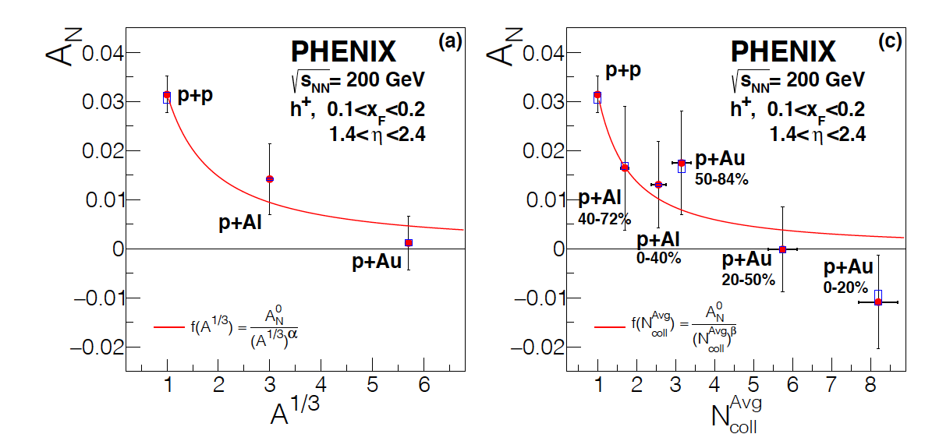
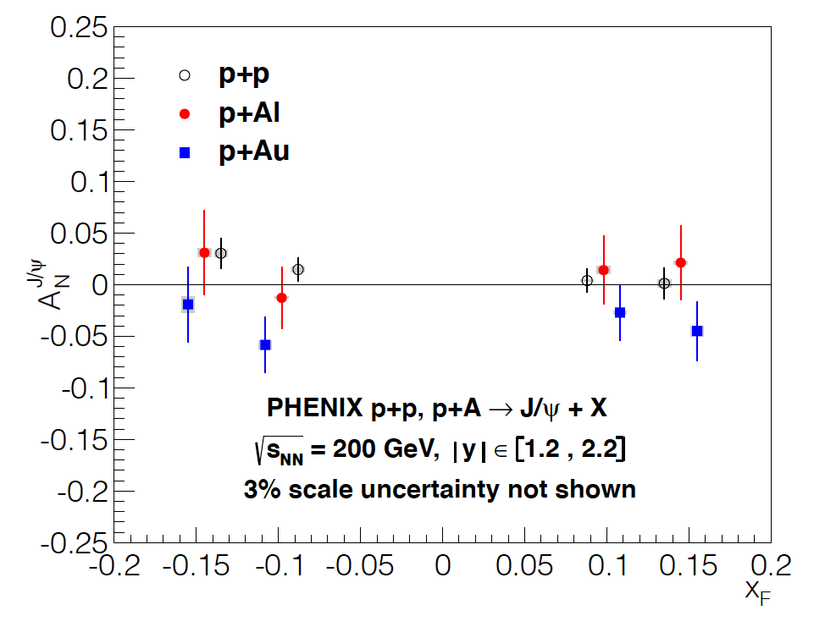
PHENIX Recent Highlights - II
Transvers spin to probe CNM in p+A
  Forward hadrons with muon spectromters
  Forward and backward J/Psi
  Observed strong nuclear dependence in A_{N}
News: 2 students coming to LANL to do analysis
FSU and Vanderbilt (DOE awarded)
PRL 123, 122001 (2019)
PRC (2020)

Slide 6
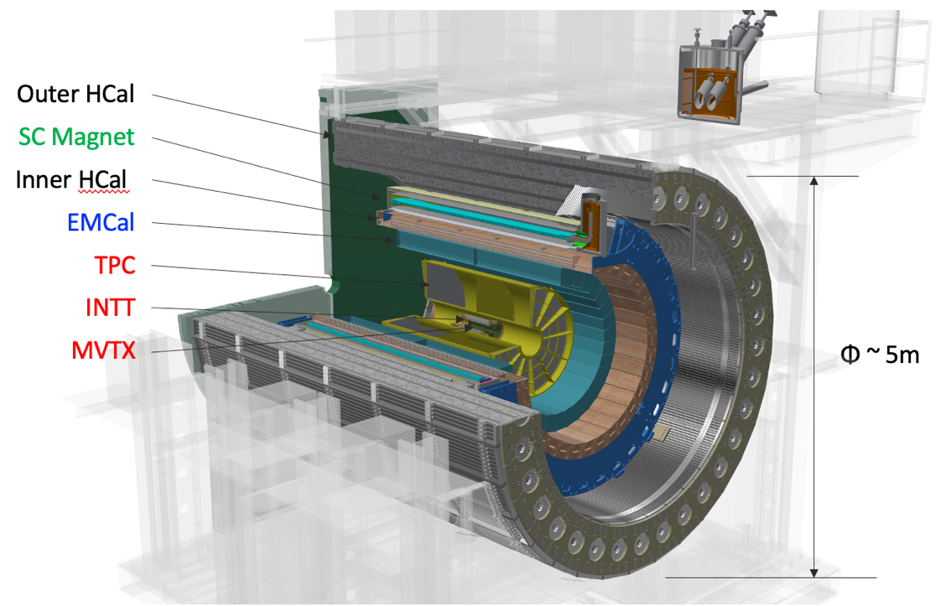
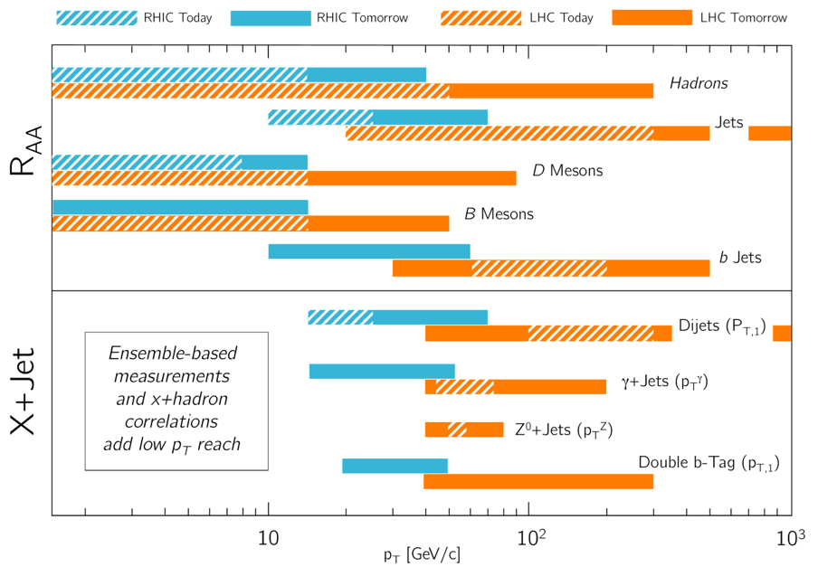
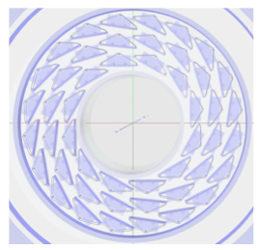
The sPHENIX Experiment: 2016 – 2025+
LANL’s focus: Heavy Flavor physics with Monolithic-active-pixel-sensor-based VerTex detector (MVTX) upgrade
sPHENIX projections:
Complementary: RHIC vs LHC
B=1.4T
MVTX beam view
R = 2.5 – 4.0 cm
Under construction, ready for day-1 physics 2023

Slide 7
LANL Led MVTX Detector Upgrade
Initiated by LANL LDRD ($5M, 2016-2019)
Technology selection & conceptual design
Key R&D on readout and integration
Physics program development
DOE/BNL project funding ($6.4M, 2019 – 2023)
Detector construction
Sensor and readout electronics
Integration & operation
To be installed in 2022, Day-1 physics 2023
Excellent track DCA resolutions in pp, pAu and AuAu

Slide 8

LANL LDRD R&D Highlights (2016-2019)
LDRD major achievements:
ALPIDE sensor evaluation (collaboration with CERN)
Prototype telescopes to demonstrate performance @Fermilab
MVTX conceptual design - from readout to mechanical system
Physics and detector simulations
Theoretical model development
Developed the MVTX proposal, and secured funding DOE/BNL
Significantly reduced the MVTX project technical and schedule risks
Fermilab Test Beam Results:
- Excellent spatial resolution: <5 um ;
- Track hit efficiency > 99%
Test beam @FNAL, 2019
Notes:
Several of LANL postdocs have made it possible , amazing job done! – just name a few, Dr. Sho Uemura, Alex T, Sanghoon, Mike McCumber, Darren McGlinch et al … and previous LANL postdoc/student, Jin Huang and Haiwang Yu of BNL,
there are all statt/faculty in other institutions; current postdoc Yasser Corrale, Cameron Dean et al , in collaboration with CERN ITS group and LANL AOT- div, Mark Prokop et al, UT-Austin ..
I have their photos in the backup slides

Slide 9

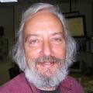
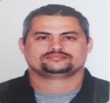




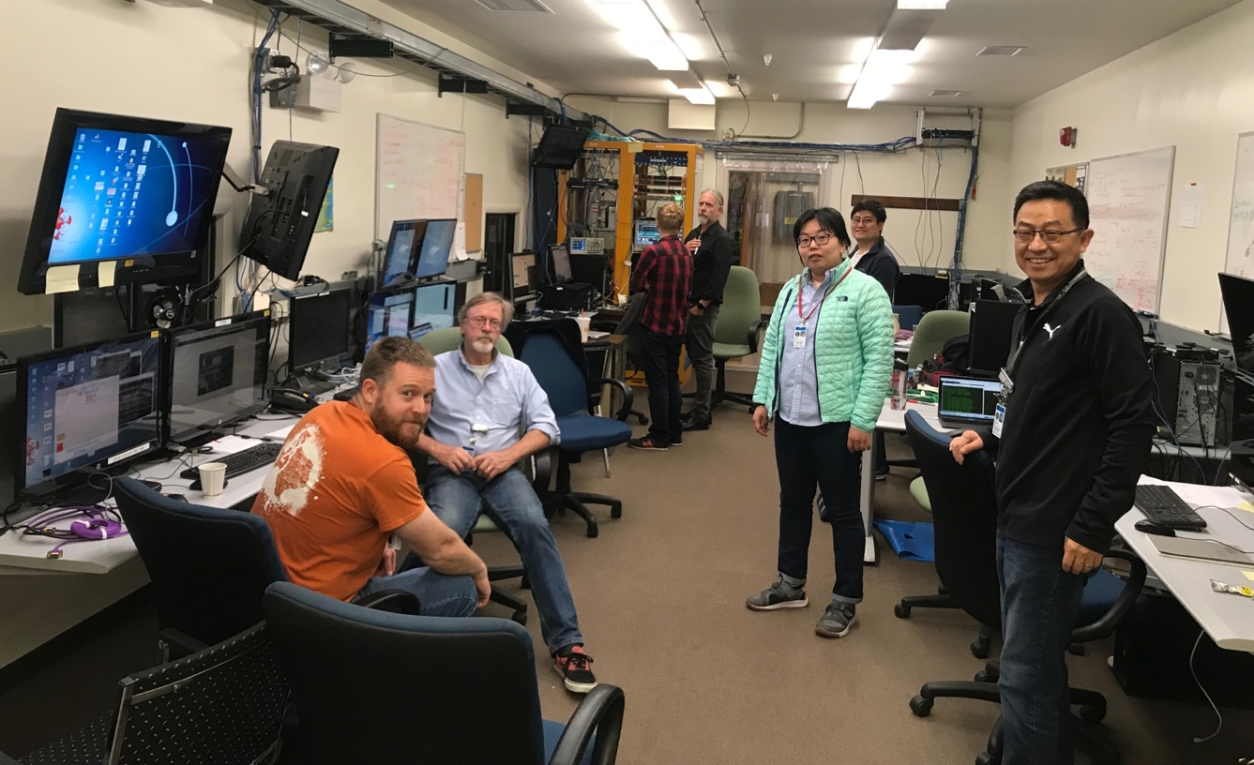
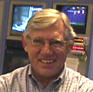


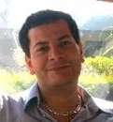
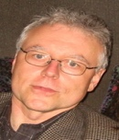

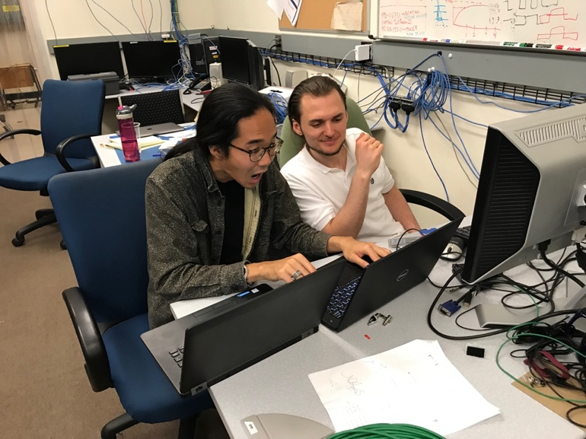
LANL LDRD’s Success -> MVTX Project Approval
MVTX Fermilab Test Beam in May-June 2019
Sho & Alex
Matt, Hubert, Cameron, Gerd, Zongze,
Xuan, Xiaochun(GSU)

Slide 10
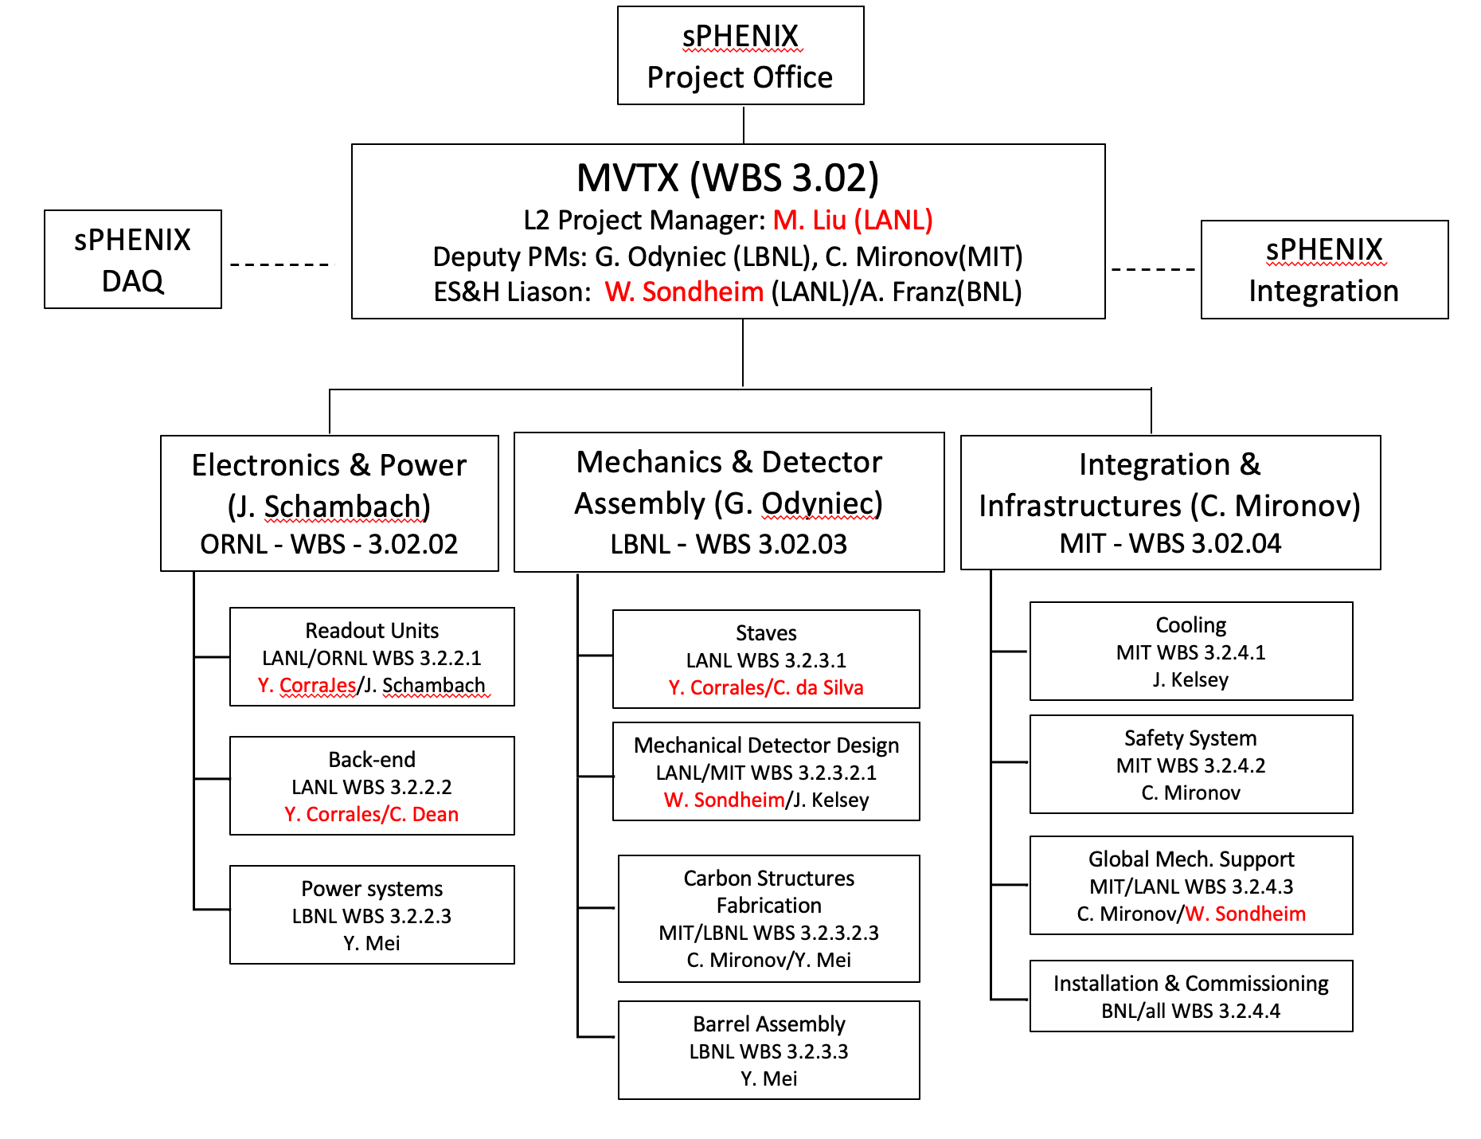

sPHENIX MVTX Project
MVTX Project
Org. Chart
MVTX detector upgrade for HF physics
  Tag heavy hadrons through displaced decay vertices
  Funded by DOE/BNL, under construction, 2019 – 2023
  Ready for the full sPHENIX physics, 2023-2025+
  In collaboration with LBNL, MIT, BNL et al., 20+ institutions
LANL plays major roles
  MVTX project management and oversee stave production at CERN
  Mechanical system design and readout integration
  MVTX detector geometry and response simulation
  B-hadron and b-jet physics study
LANL LDRD/DR (FY2016-2019) for the initial R&D
  Physics and detector R&D
  Pre-conceptual design
Software & Computing
MVTX simulation KF Particle TPC calibration
Y. Corrales C. Dean H. Pereira Da Cosata
Notes:
MVTX is considered as “upgrade” as it was NOT in the sPHENIX baseline design.
It all started with LANL LDRD/DR (of which I was the PI) with a feasibility study. Through LDRD, we carried out key R&D to establish the science case and also completed technology selection to realize the physics program.
In the meantime, we started to build a MVTX detector consortium to bring in new collaborators to our efforts, at the end, we have fomed collaboration with several other leading institutions, including LBNL, MIT, BNL et al and further developed a full physics program as well as the detector R&D and construction project …

Slide 11
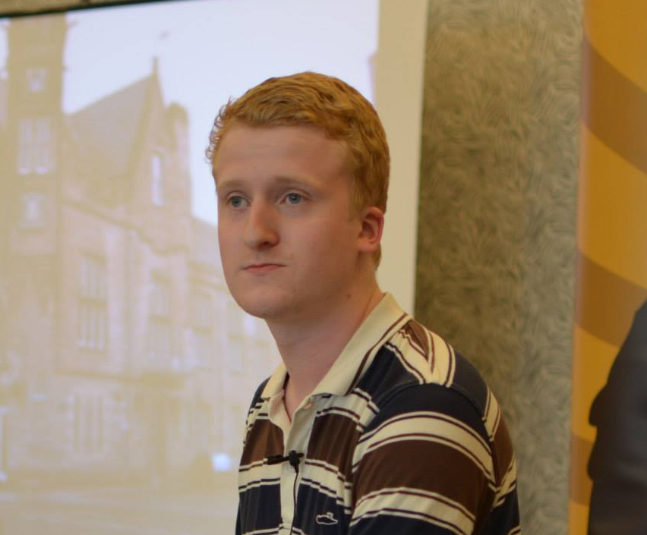
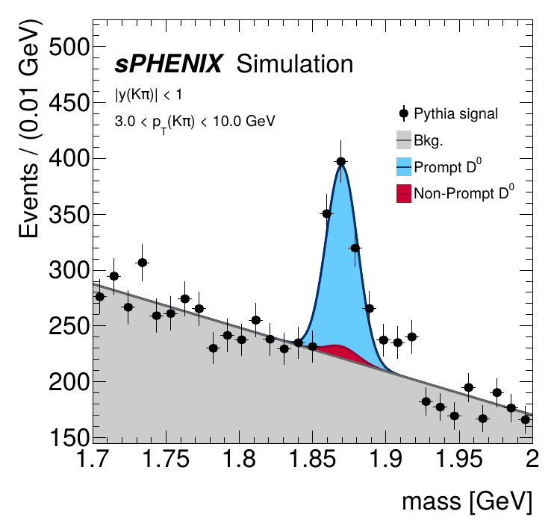
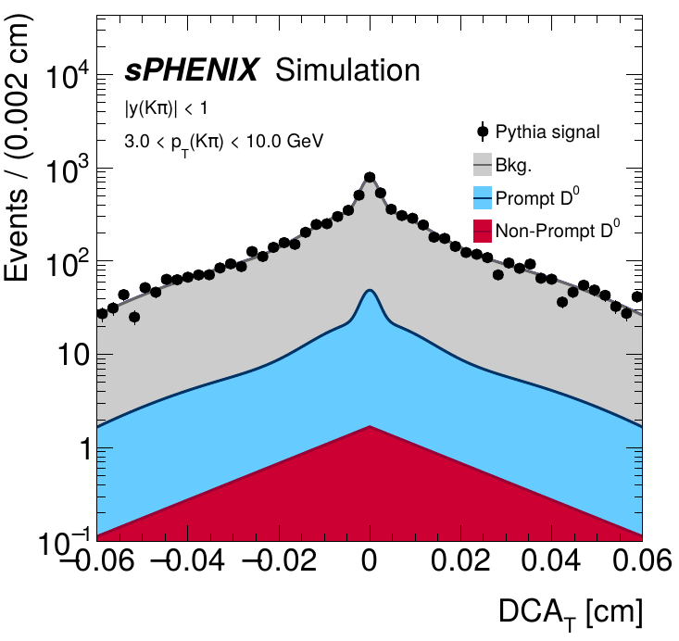
Getting Ready for Day-1 Physics
- Monte Carlo Data Challenge
PYTHIA 8 p+p with full
detector GEANT sim + reco
KFParticle package implemented for exclusive HF hadron reconstruction

Slide 12

Summary: LANL’s Physics Programs at RHIC
Continue producing unique physics from PHENIX
  CNM, QGP
  Spin physics
Leading MVTX upgrade for sPHENIX ( – 2023)
  LANL LDRD developed the program (FY17-19)
  R&D and construction, installation in fall 2022
  Heavy quark physics program development
sPHENIX Heavy Quark Physics (2023-2025+)
  Probe the inner workings of QGP with heavy quarks
  Study cold QCD matter, spin structure of nucleon, complimentary to EIC
Transition from sPHENIX to EIC (~2025+)
  EIC Physics and detector development - ECCE, EIC@IP6 proposals
  Ready for EIC physics ~2030
LANL has a good combination of physics leadership and technical capabilities to
carry out major scientific exploration at national and international level

Slide 14
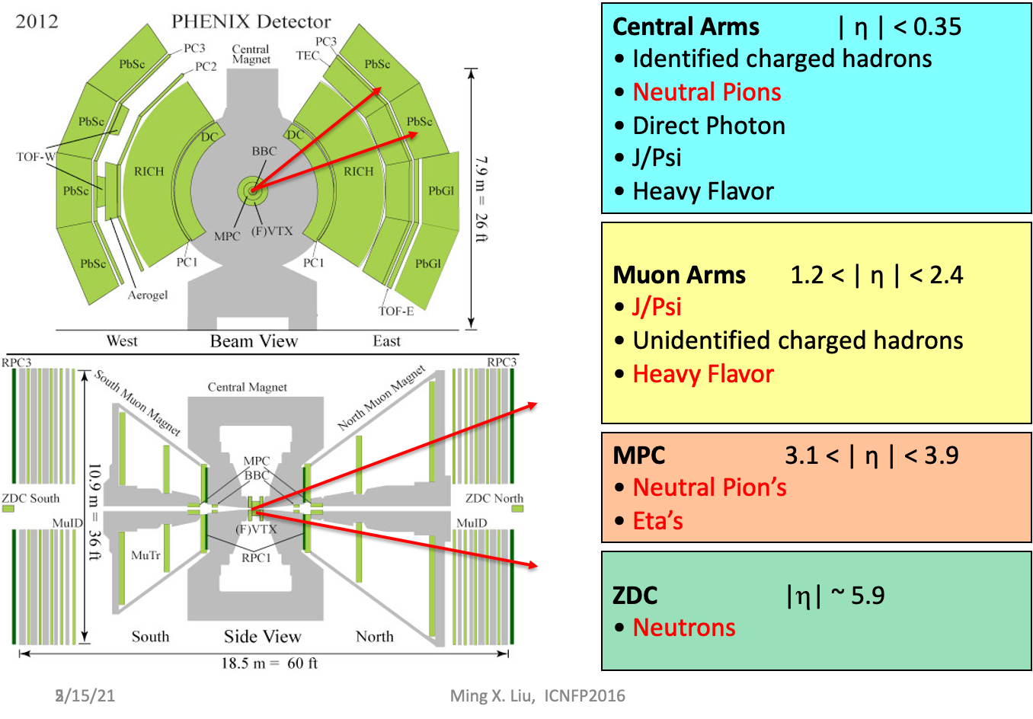
PHENIX Experiment: Last Data Taking 2016
LANL focus:
Finish unique physics with muon
measurements
J/Psi, dimuons
HF, singly muons
FVTX capability
  DCA
  Evt_Multiplicity
Run15 p+p,p+Au, p+Al
Run14: Au+Au
BBC ~ MPC: 3.1-3.9

Slide 15
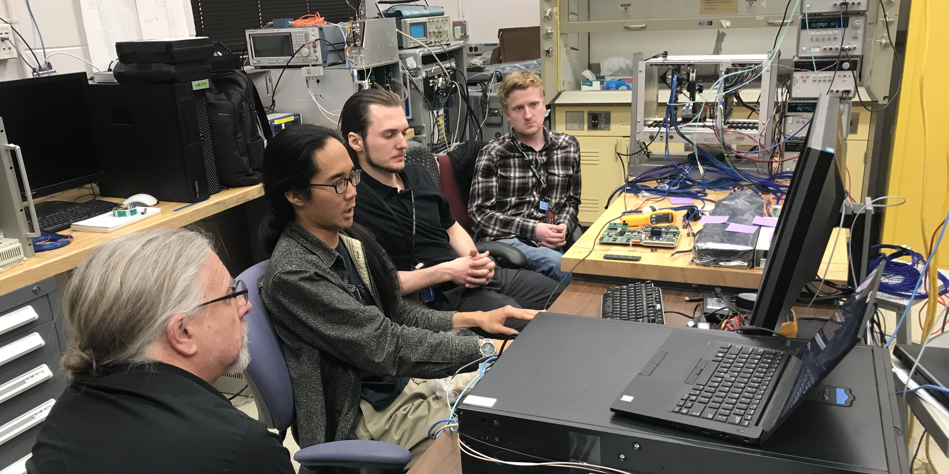
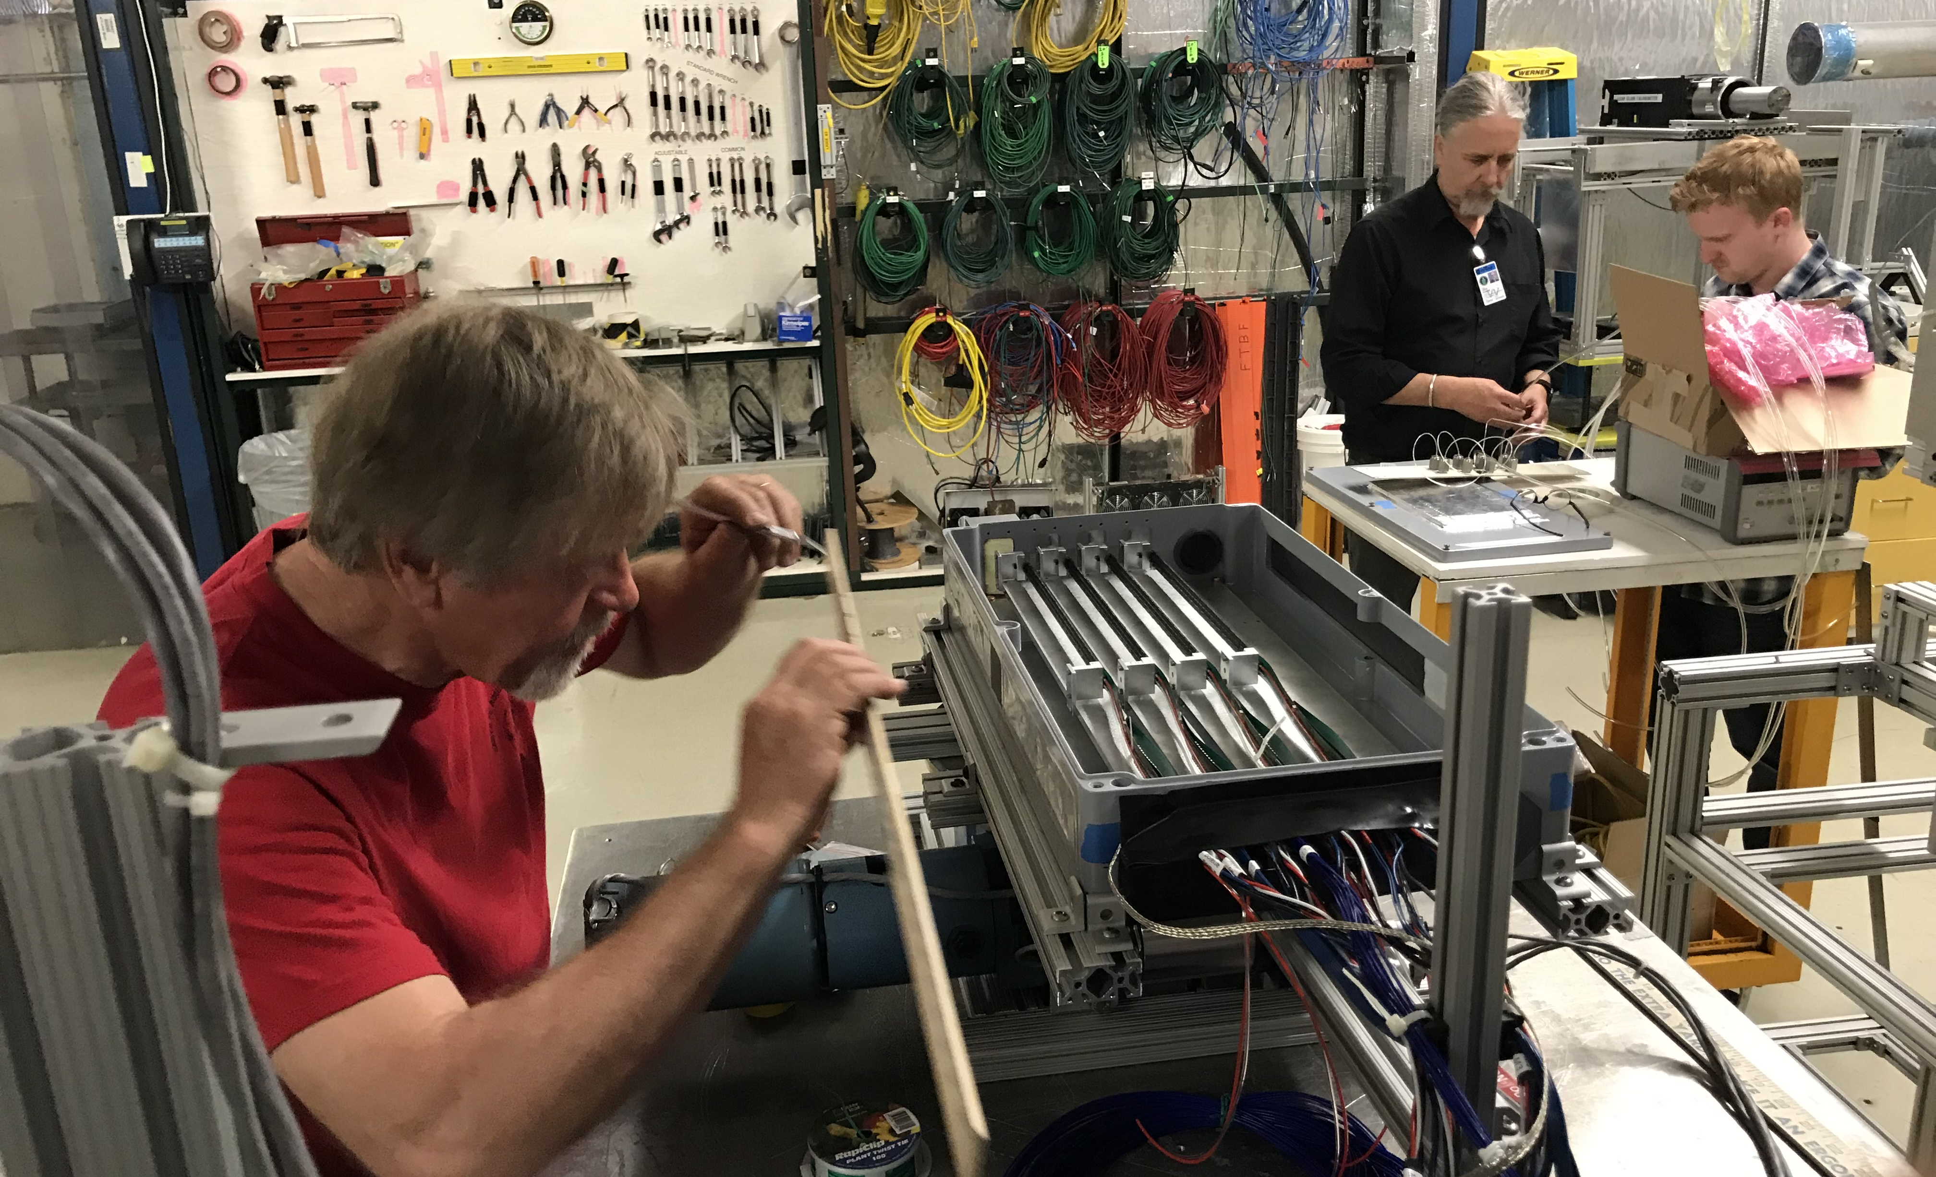
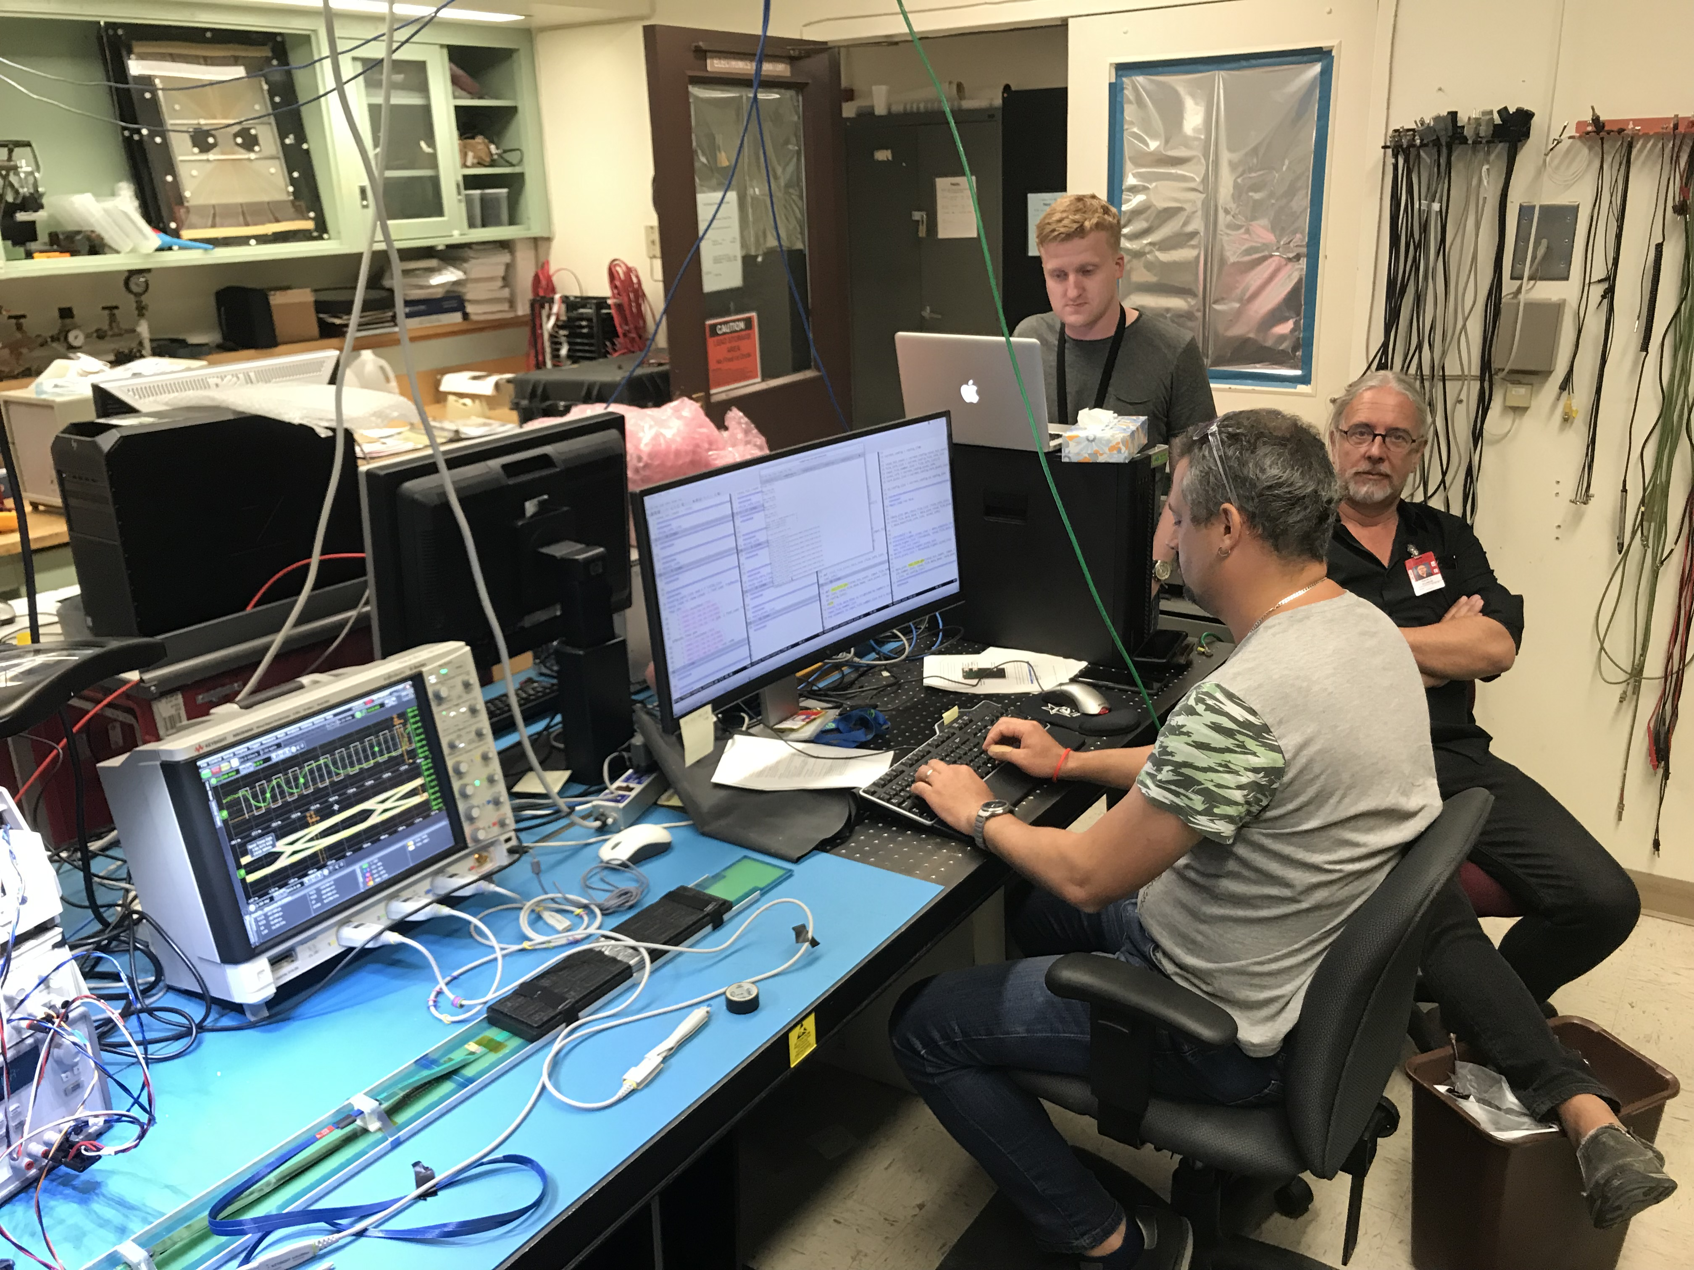
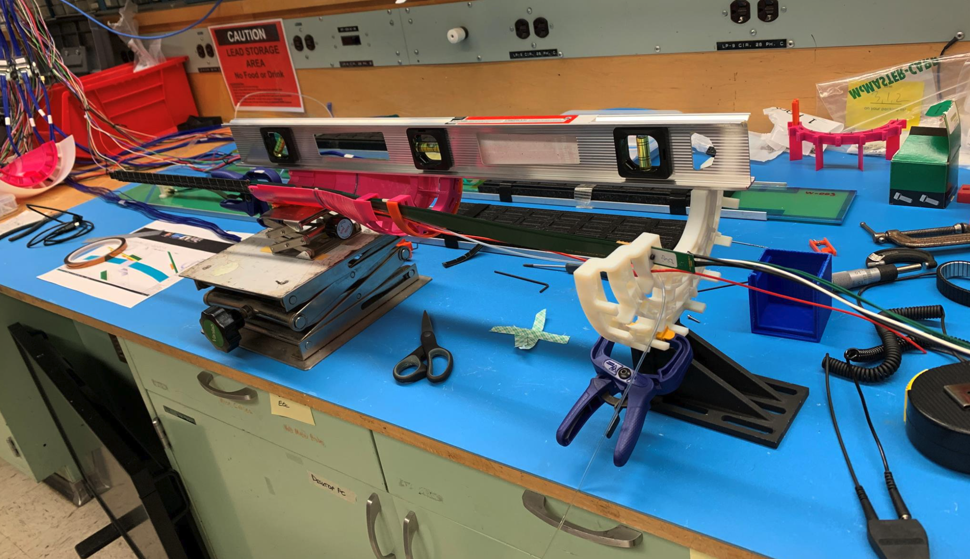
Readout test @LANL
Setup telescope @Fermilab
MVTX 3D Mockup @LANL
Readout test @LANL

Slide 16
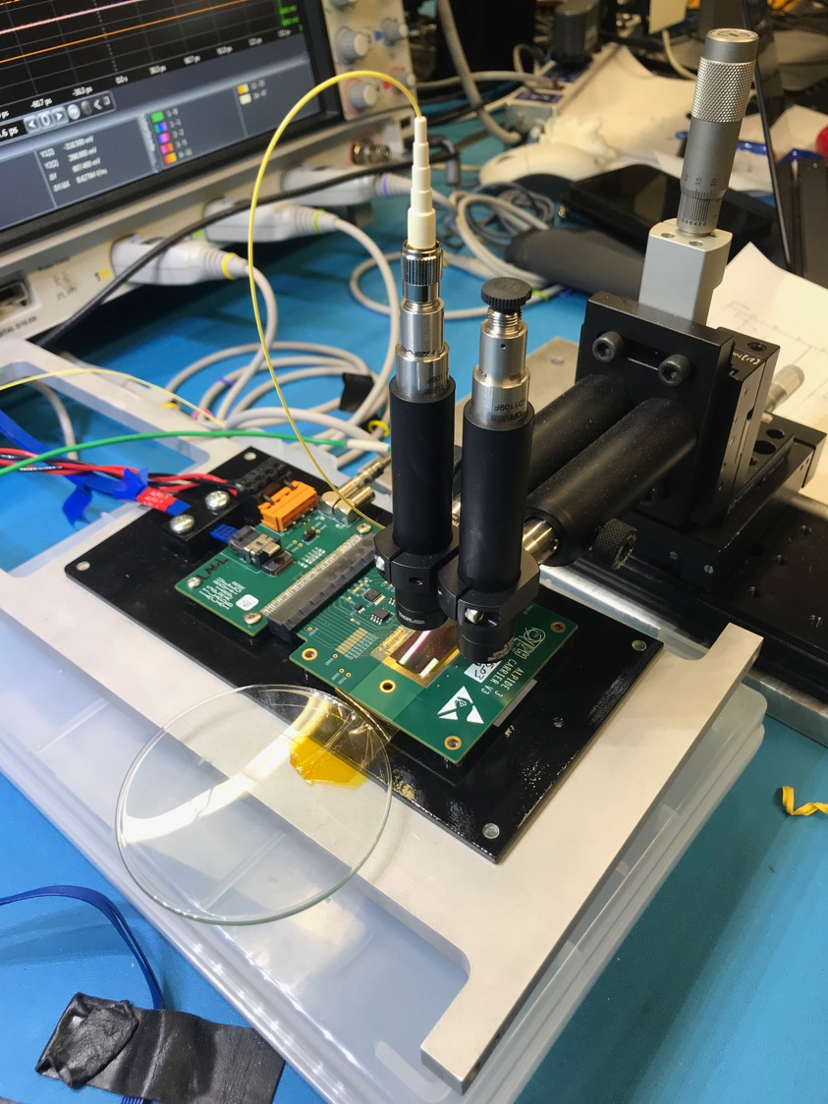
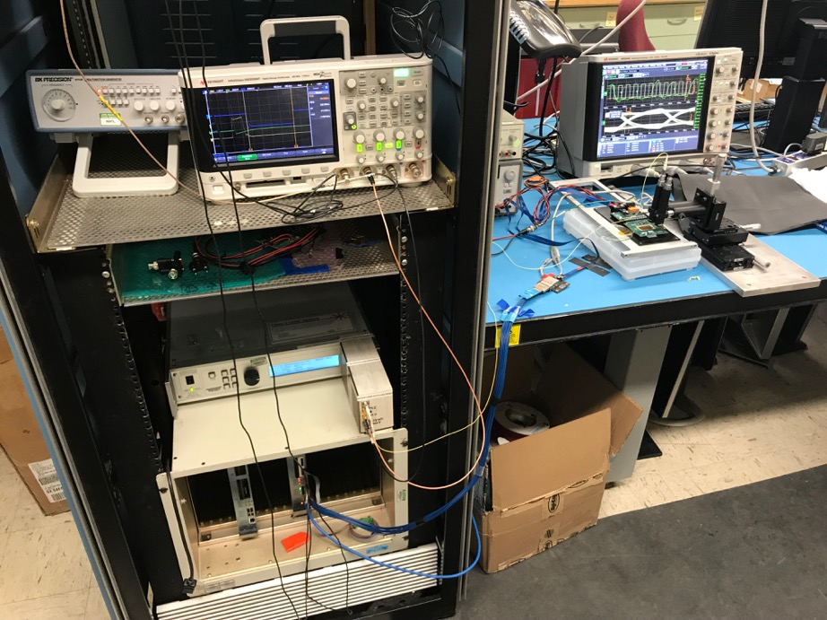
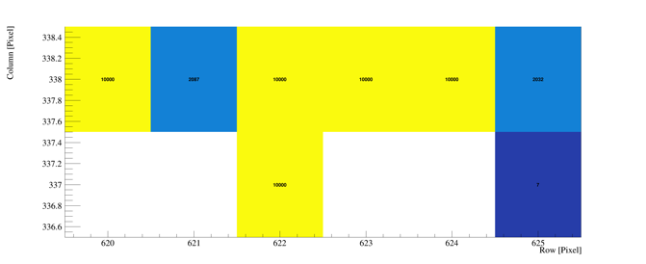
Study MAPS Performance with Pulsed Laser @LANL
Inject “MIP” signal, focused laser beam
  850 nm laser, 4ns wide pulse, ~1 MIP
  50kHz trigger
  Find optimal MAPS operating parameters
Laser system
MOSAIC Testbench
Pixel hits

Slide 17

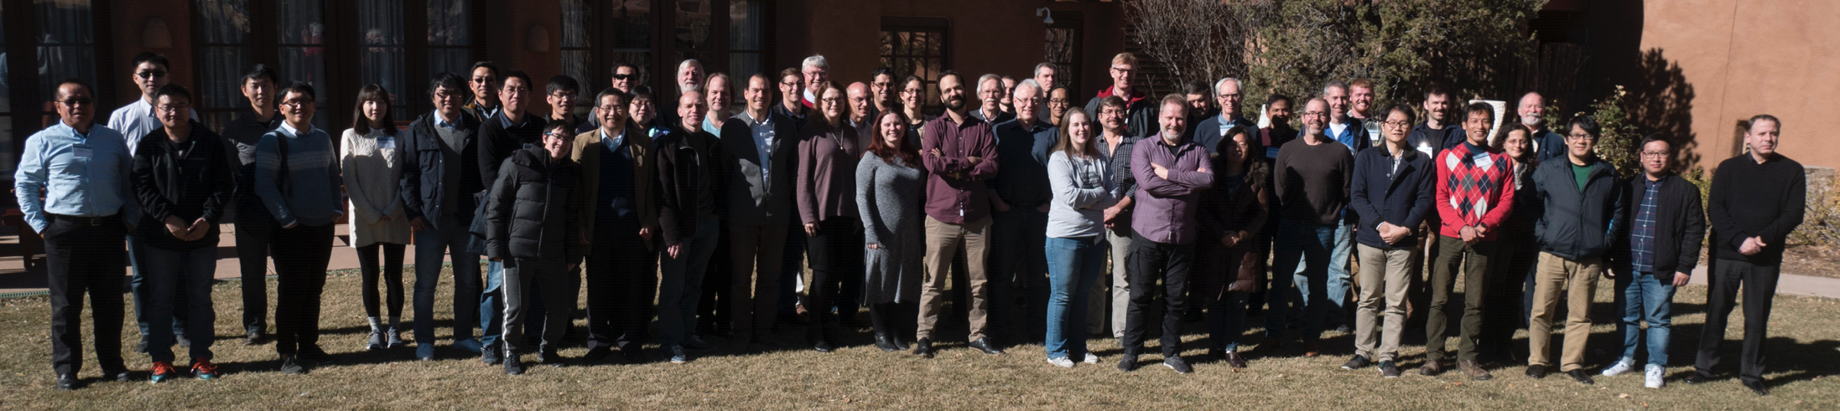
The Growing sPHENIX Collaboration
sPHENIX is a large international collaboration
  1st collaboration meeting, 12/2015
  80 institutions total (as of 3/2020), and growing
  25% non-US institutions
  MVTX upgrade group
  LANL+LBNL+MIT+BNL+UT-Austin…, 20+ institutions
sPHENIX Collaboration Meeting, Santa Fe, NM, 12/2017

Slide 18
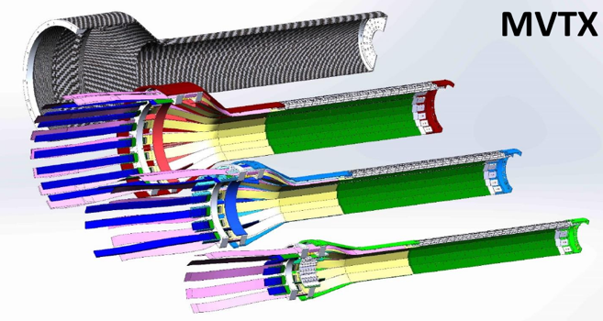
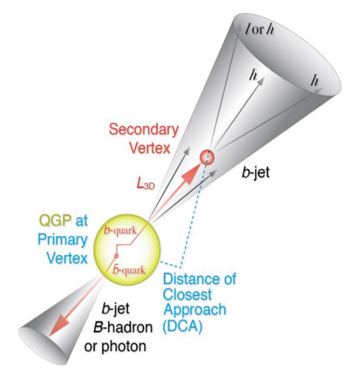
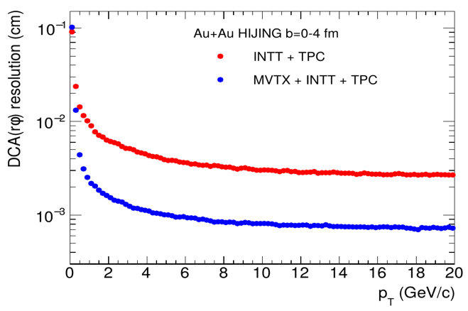
Open HF Tagging with MVTX Upgrade
- Monolithic-active-pixel-sensor based VerTeX detector
MVTX key parameters: (ALPIDE)
pixel size: 27um x 29 um
ultra-thin stave: 0.35%X₀
Integration time: ~5us
Multi-tracks w/ large DCA
2nd vertex mass
Exclusive hadron reconstruction
10um

Slide 19
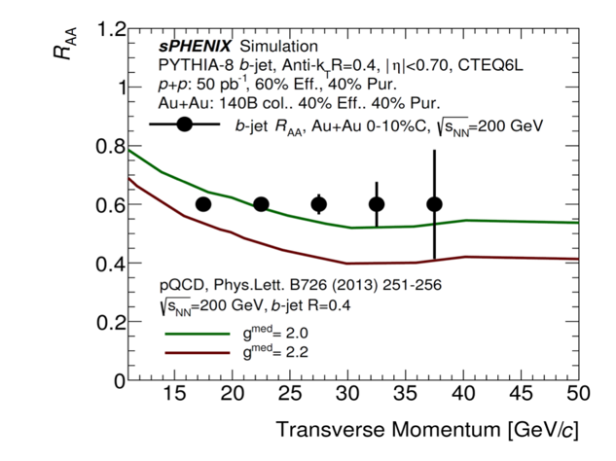

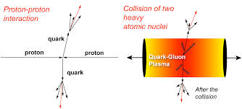
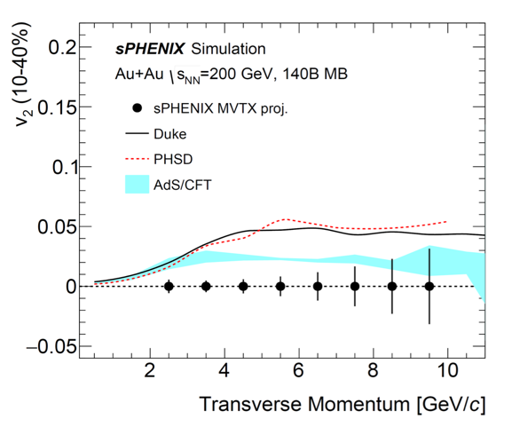
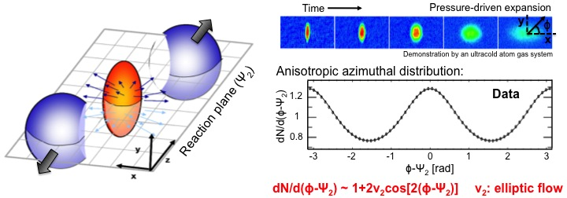
Open Heavy Flavor Physics Program – Key Observables
Nuclear modification of b-jets:
Radiative energy loss
Collisional energy loss
B-hadron azimuthal asymmetry - “Elliptic Flow” v2
Sensitive to b-QGP
coupling:
- if no-interaction, v₂=0
Notes:
LANL postdoc on jets – Mike/Ming , Sanghoon et al, Cameron/Ming on B-hadron;
The top plot from sPHENIX simulations – Mike, Sanghhon, Jin et al with theory input from Ivan et al
The bottom plot from sPHENIX simulations – LBNL (Xin + students) + LANL (Ming, PHSD and AdS/CFT) …
In the early days, I was pretty much overseeing both physics and detector development ….
sPHENIX HF Working Group (Jin and Xin) and (Jin and Hideki)… recently started to have a separate HF bi-weekly meetings as MVTX bi-weekly become more project oriented …

Slide 20
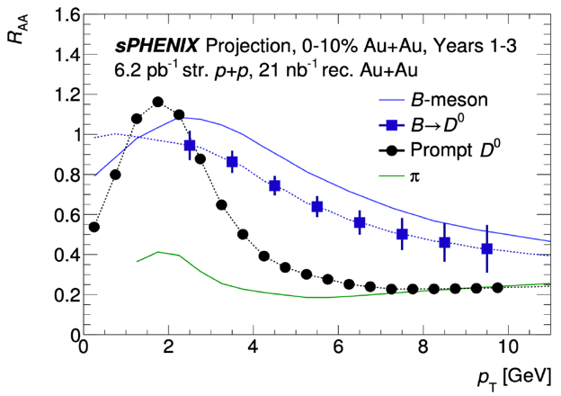
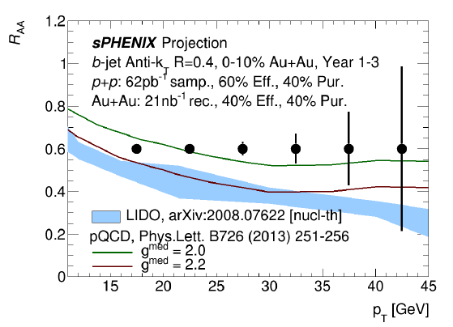
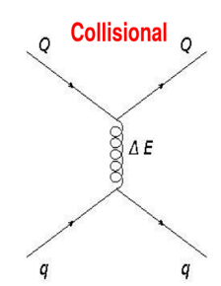
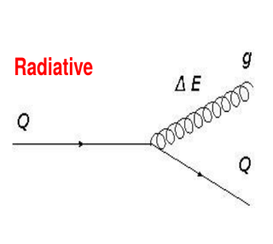
Precision HF Hadron and b-Jet R_{AA}
Many factors affect the HF hadron production:
Heavy quark energy loss in QGP: mass, pT dependence
Heavy quark diffusion in QGP
Heavy quark hadronization in QGP
Also other observables:
- di-b-jet, modification of HF jet structures etc.

Slide 21
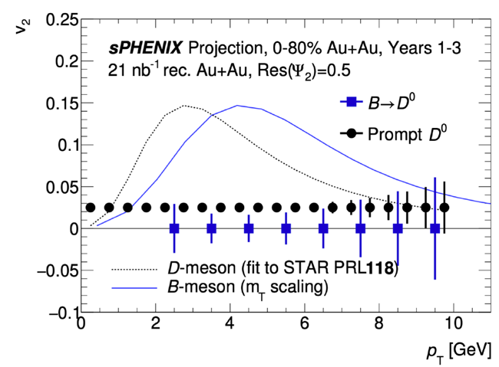


Precision “Flow” Measurements of B-hadron and b-Jets
STAR: D⁰ v2 m_{T} scaling observed
Many factors affect the HF hadron production:
Heavy quark energy loss in QGP
Heavy b-quark diffusion in QGP
Heavy quark hadronization in QGP
b-jet flow, pQCD:
- Energy loss induced v2?

