Slide 1
LANL’s sPHENIX Program at RHIC
Ming X. Liu, P-25
High Energy Nuclear Physics Team
03/30/2020

Slide 2

Summary: LANL’s sPHENIX Program
Near Term: lead MVTX upgrade ( now – 2022)
  MVTX project R&D, construction and installation in 2022
  Heavy quark physics program development
    QGP – baseline developed
    Spin physics and Cold Nuclear Matter - under development
Mid Term: lead sPHENIX MVTX Physics (2023-2025+)
  Heavy quarks and jets measurements
    QGP properties
  Heavy quark and jet probes for Cold QCD
    Nucleon structure and spin physics
    Cold Nuclear Matter
Transition from sPHENIX to EIC at RHIC (~2025+)
  EIC detector development and construction
  EIC physics program development
    Nucleon structure and spin physics
    Cold nuclear Matter
  EIC physics run as early as 2030
Heavy Ion physics in LHCb (2017+)
  Gluon saturation physics
  Heavy quarkonia and multiquark exotic states
  Forward magnet station tracker
QCD focus
- sPHENIX
- future EIC

Slide 3
LANL’s sPHENIX Program Well Aligned with National NP Priority
2015 US Nuclear Science Long Range Plan Highlights:
sPHENIX at RHIC
Matter at extreme condition: Understand the inner
workings of Quark-Gluon Plasma (QGP)
Future Electron Ion Collider (EIC)
Unlock the mysteries of the strong force that bind us all
Posters:
-Cesar da Silva, “LHCb Heavy Ion”
-Kun Liu, “E1039 Nucleon Spin”
QGP

Slide 4
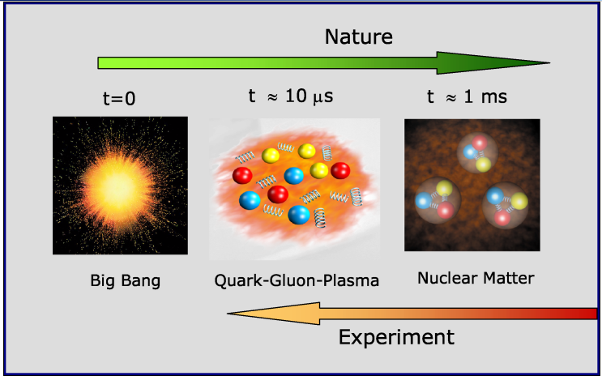
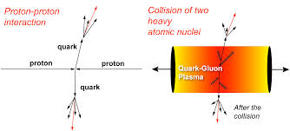
sPHENIX: Recreate a State of the Early Universe - QGP
QGP created in high energy heavy ion collisions
Extract QGP properties by comparing p+p vs A+A
Joint experimental and theoretical efforts!

Slide 5
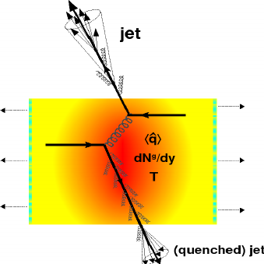
The sPHENIX Science Mission
- the next generation DOE flagship Heavy Ion Experiment (LRP2015)
“Probe the inner workings of QGP by resolving its properties at shorter and shorter length scales. The complementarity of [RHIC and the LHC] is essential to this goal, as is a state-of-the-art jet detector at RHIC, called sPHENIX.” (LRP2015)
3 sPHENIX Physics Pillars
Jet structure
vary momentum/angular
scale of probe
Quarkonium spectroscopy
vary size of probe
“QGP Debye screening”
Jets, Upsilons, Heavy Quarks
LANL led initiative:
Heavy quark probes
Parton interaction with QGP
vary mass/momentum of probe
“Medium interaction”
u,d,s
c
b

Slide 6
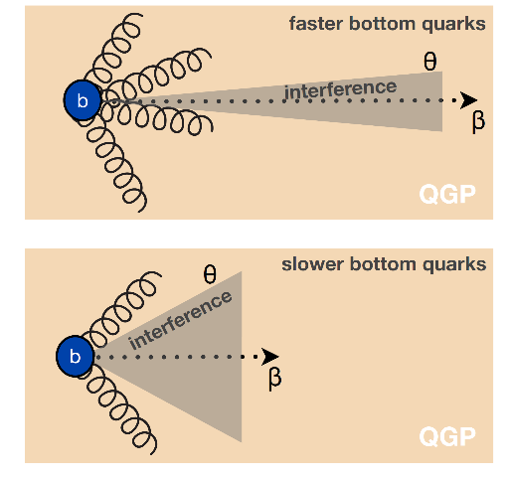
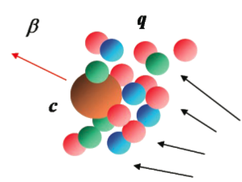
Heavy Quarks Provide Unique Probe of QGP
Mass dependent radiative energy loss
Study mass dependence
  Jet quenching: energy loss
  Flow: interaction with medium
Access QGP properties
  Transport coefficients, coupling to medium etc.
“dead cone”
Experimental measurements
+ Theoretical modeling
m_{u} m_{d}
m_{s}
Λ_{QCD}
m_{c}
m_{b}
1
10
10²
10³
10⁴
T_{c}
T_{QGP}
MeV

Slide 7
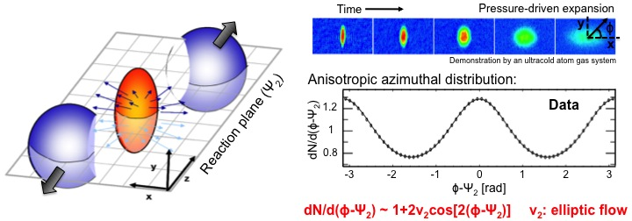
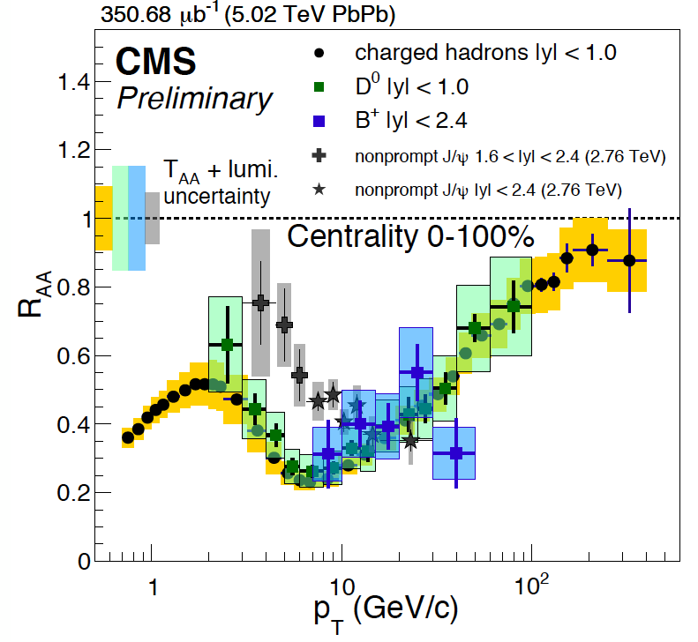

Heavy Quark “Charm” and Medium Interactions
- Surprising Observations from RHIC and LHC
RHIC
PRL 118 (2017) 212301
- Strong charm-medium interactions v₂ “flow” @RHIC
similar to light quarks - a big surprise!
- Large suppression of charmed hadron R_{AA} at high pT, @LHC
Mass effects not clearly shown in Charm sector
→ next “B-hadron & b-jet”, with MVTX upgrade in sPHENIX
Expected most significant at low pT ~ Mass (b)
dead-cone, collisional effects etc.
LHC

Slide 8
LANL Leads sPHENIX MVTX Upgrade at RHIC
Study “the inner workings” of Hot QCD (QGP) with heavy flavor hadrons and jets
  Cold QCD/Spin physics program under active development
Monolithic-active-pixel-sensor-based VerTeX detector (MVTX) upgrade
  Tag heavy hadrons through displaced decay vertices
  Funded by DOE, R&D and construction, 2019 – 2022
  Ready for sPHENIX physics, 2023-2025+
  In collaboration with LBNL, MIT, BNL et al. in sPHENIX
LANL’s major roles on MVTX upgrade
  MVTX project management and oversee stave production at CERN
  Mechanical system design and readout integration
  MVTX detector geometry and response simulation
  B-hadron and b-jet physics study
LANL LDRD (2016-2019) enabled the initial R&D
  Physics and detector R&D
sPHENIX 3 Physics Pillars
Jets
Upsilons
Heavy Quarks (w/ MVTX)
MVTX Project Org. Chart

Slide 9
sPHENIX MVTX Detector Upgrade
Detector construction: 2019-2020
Ready to install: 6/2022
Total cost: $4.8M + $1.6 M

Slide 10

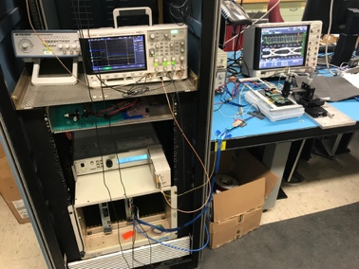

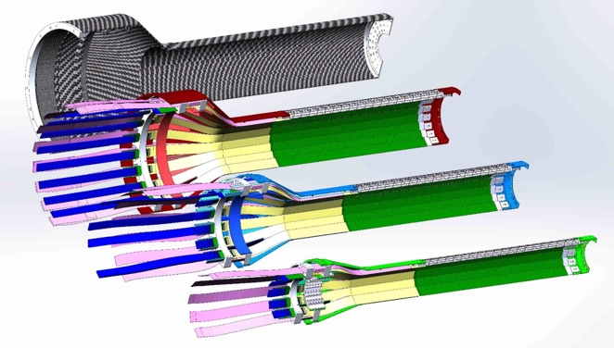
LANL LDRD Enabled Initial sPHENIX MVTX R&D
LDRD achievements:
ALPIDE sensor evaluation and optimization
MVTX readout hardware and software development & integration
MVTX mechanical conceptual design
Prototype telescopes to demonstrate performance
Physics and detector simulations
Theoretical model development
Developed the MVTX full proposal
ALICE Monolithic Active Pixel Sensor (ALPIDE)
Very fine pitch (27μm x 29μm), for superb spatial resolution
High efficiency (>99%) and low noise (<10⁻⁶), for excellent tracking
Time resolution, ~5 μS, for less pileup
Ultra-thin/low mass, 50μm (~0.3% X₀), for less multiple scatterings
0.5M channels with on-pixel digitization, for zero-suppression and fast readout
Low power dissipation, 40mW/cm², for minimal service materials
MVTX Full Proposal to DOE
(2018)
Fermilab Test Beam:
Tracking spatial resolution
achieved: <5 um
Sensor evaluation
with laser @LANL
MVTX detectors
~28 μm
Test beam @FNAL
An ideal pixel detector for QGP physics!

Slide 11






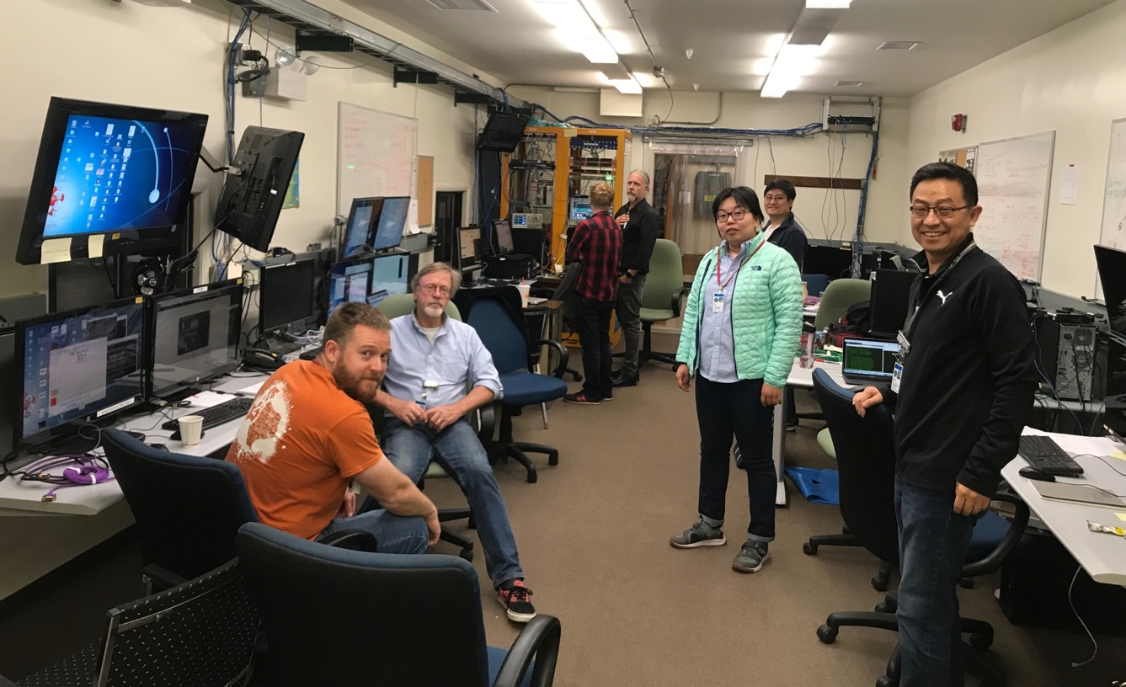






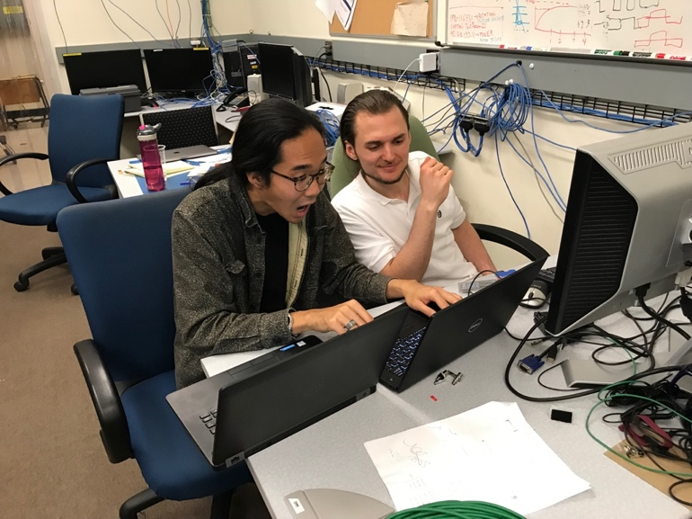
LANL LDRD Exp. Team in Action @Fermilab Test Beam
Two Photos by Ming @Fermilab Test Beam, May-June 2019
Others: Pat, Sanghoon, Walt, Mark, Yasser, Mike, Jo (UT-Austin), John(BNL),
Chris, Abel, Dave, Darren, Kun, Cesar, Martin(BNL), Jin (BNL), John (BNL) …
Sho & AleT
Matt, Hubert, Cameron, Gerd, Zongze,
Xuan, Xiaochun(GSU)

Slide 12
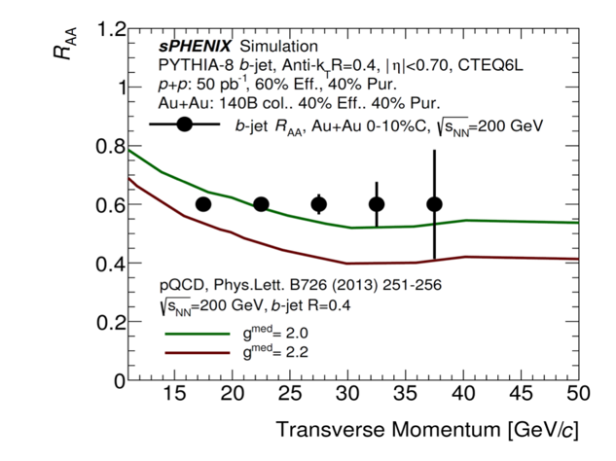
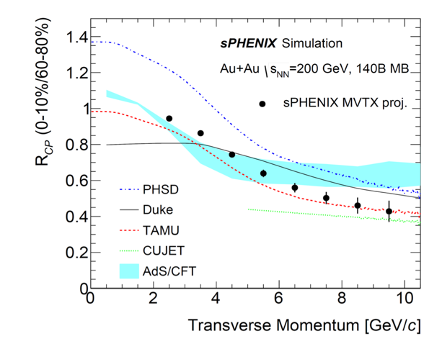
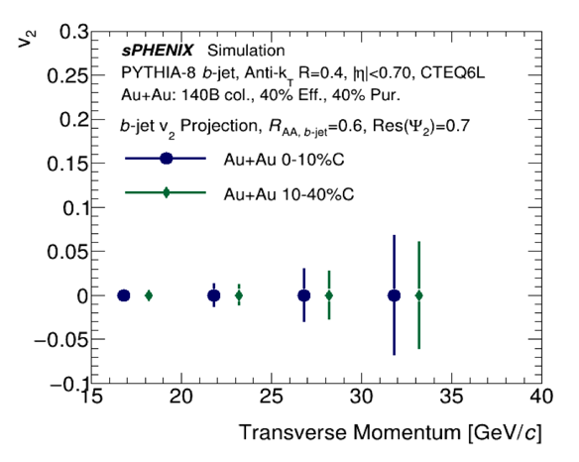
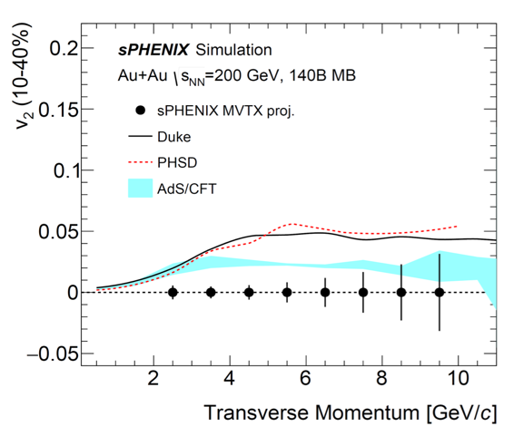
Established sPHENIX Open Heavy Flavor Physics Program
MVTX Physics Projections
B-tagging with MVTX:
displaced B-decay vertex
b-jets R_{AA} & V₂
B-Hadrons R_{CP} & V₂
sPHENIX detector & physics simulations

Slide 13
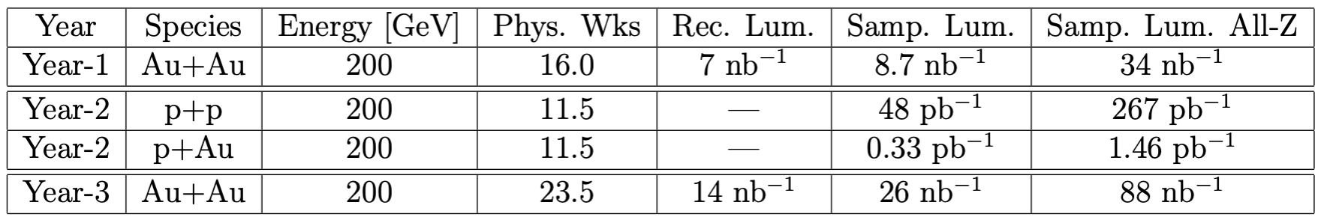
sPHENIX Run Plan
https://indico.bnl.gov/event/4788/attachments/19066/24594/sph-trg-000_06142018.pdf
Main Au+Au running mode:
- Year-1 (commissioning) + Year-2,3 (high statistics production):
- Consistent with BNL technically-driven timeline to the EIC
- Collaboration sees strong science case for additional running
- Improve uncertainties and respond to discoveries in first years

Slide 14

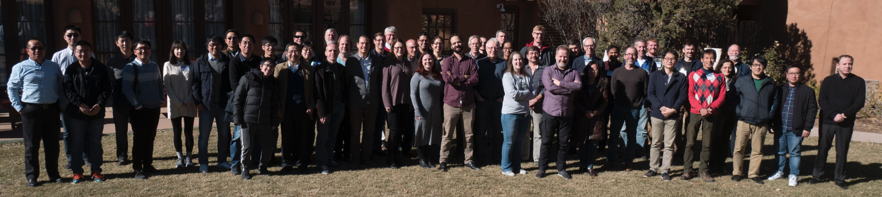
sPHENIX Collaboration
An international collaboration
  - 1st collaboration meeting, 12/2015
80 institutions total (as of 4/2020)
- About 25% non-US institutions
LANL hosted sPHENIX collaboration meeting in 2017
MVTX upgrade group:
LANL+LBNL+MIT+BNL + UT-Austion …, 20+ institutions
sPHENIX Collaboration Meeting, Santa Fe, NM, 12/2017

Slide 15
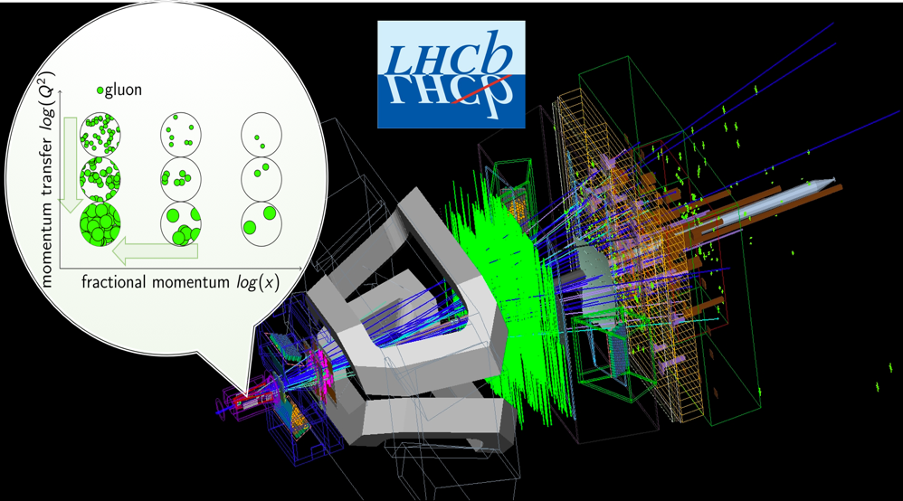
Heavy Ion Program at LHCb (2017+)
Full member with Collaboration
Co-leading the LHCb’s Nuclear Physics program and potentially bringing other US Institutions
SEARCH FOR THE GLUON SATURATED CONDENSATED REGIME.
We are in the verge of a historic discovery or strong constraints for its observation in the future electron-ion collider.
QUARKONIA AND EXOTIC SPECTROSCOPY.
Unprecedent number of quarkonia states observed in nuclear collisions. First observations of tetraquarks in proton-lead collisions. Unique laboratory for nuclear medium studies and characterization of novel multiquark mesons.
THE MAGNET STATION, A SOFT PARTICLE TRACKER.
LANL lead R&D project for a particle tracker which can access unprecedent QCD phase space and potential dark sector.
Strong support from LHCb and Polish Nuclear Physics Institutes. Other European and American Institutions interested.

Slide 16
Future Heavy Ion Physics Opportunity in LHCb
Median Term (next 3~5 years)
Development of a High-Level Trigger for isolated photons and jets to improve precision on the search for gluon saturated regimes.
Search of new multiquark exotic states in nuclear collisions.
Construction of the Magnet Station Tracker.
Exploration of high luminosity fixed target collisions
Long Term (next 5+ years)
Search for new physics in high luminosity Heavy Ion Collisions
  Exploration of super strong Magnetic Fields produced in HI collisions (~10¹⁴ T)
  Hadron genesis in strong colored fields present in Quark-Gluon Plasma (Big Bang like environment)
  QGP tomography with spherical harmonics and event engineering
  Development of fast machine learning FPGAs for online analysis of high-density environments
  First proof of principle applications of quantum devices for advance particle and QCD process identifications

Slide 17
Summary: LANL’s sPHENIX Program
Near Term: lead MVTX upgrade ( now – 2022)
  MVTX project R&D, construction and installation in 2022
  Heavy quark physics program development
    QGP – baseline developed
    Spin physics and Cold Nuclear Matter - under development
Mid Term: lead sPHENIX MVTX Physics (2023-2025+)
  Heavy quarks and jets measurements
    QGP properties
  Heavy quark and jet probes for Cold QCD
    Nucleon structure and spin physics
    Cold Nuclear Matter
Transition from sPHENIX to EIC at RHIC (~2025+)
  EIC detector development and construction
  EIC physics program development
    Nucleon structure and spin physics
    Cold nuclear Matter
  EIC physics run as early as 2030
Heavy Ion physics in LHCb (2017+)
  Gluon saturation physics
  Heavy quarkonia and multiquark exotic states
  Forward magnet station tracker
QCD focus
- sPHENIX
- future EIC

Slide 18
Backup Slides

Slide 19
sPHENIX Timeline

Slide 20
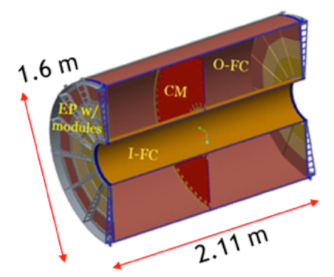
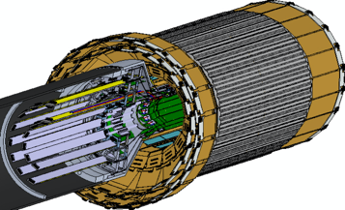
Th sPHENIX Detectors

Slide 21
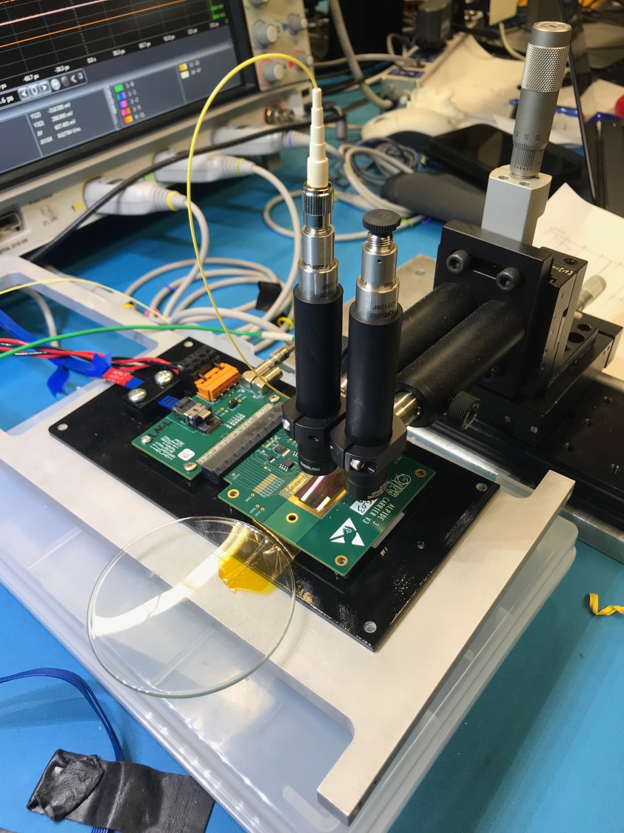
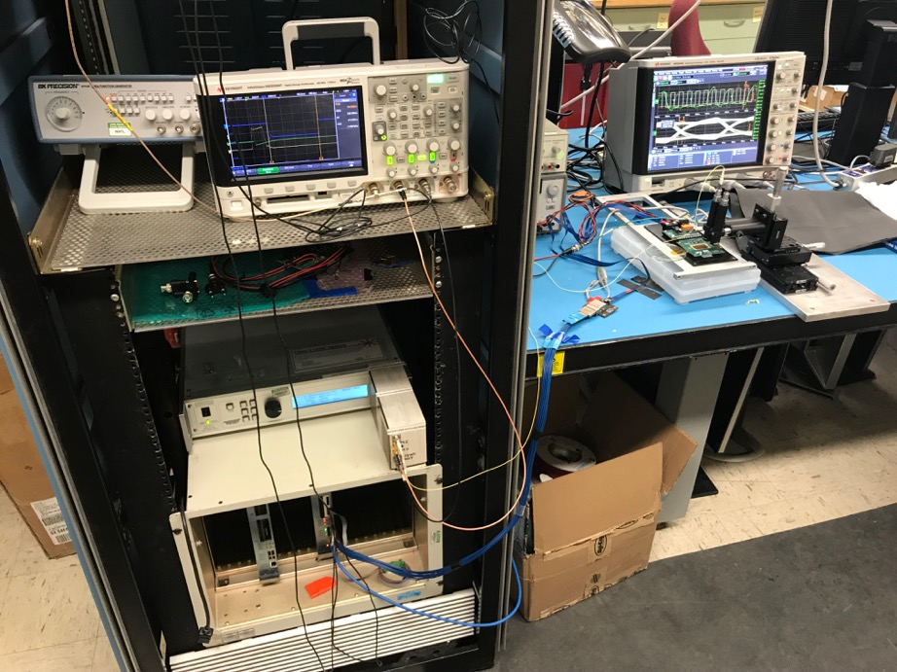
LDRD Detector R&D Highlights
MAPS sensor evaluation
MVTX full readout development
MVTX mechanical support design
Physics and detector simulations

Slide 22
MVTX Mechanical Syste, Desgin
3-D print mockup for MVTX + INTT/TPC
System integration

Slide 23
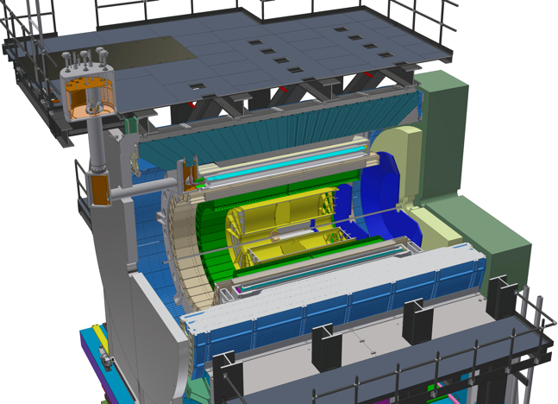


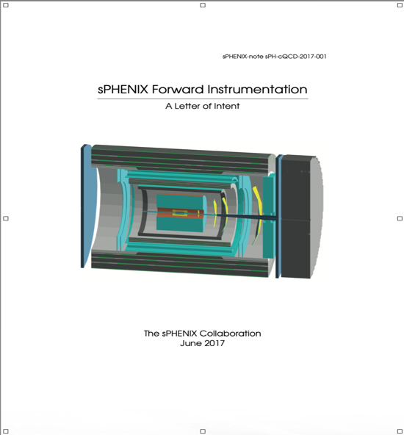
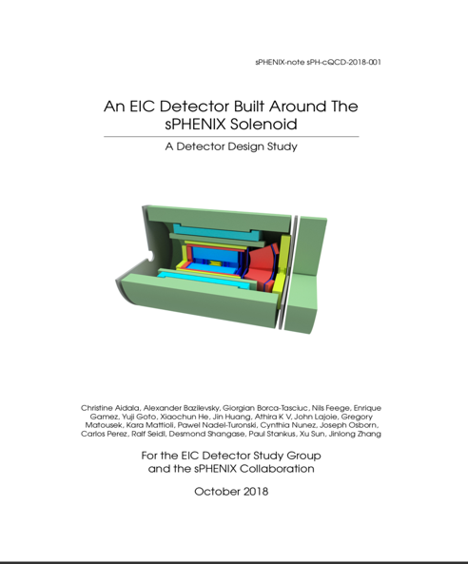
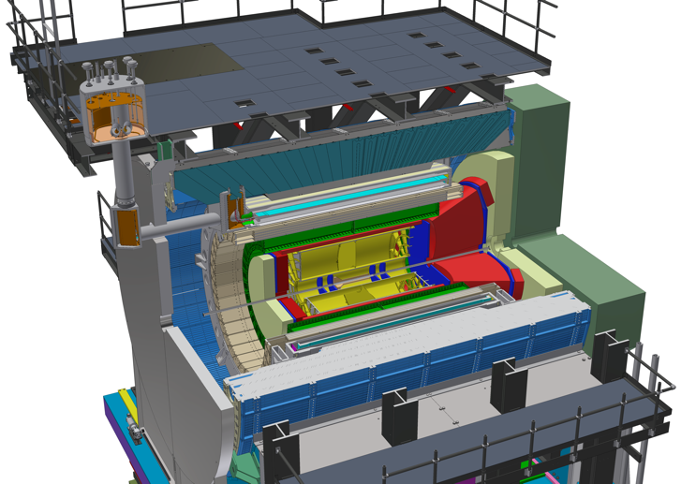
LANL Led Exploration of Cold QCD Opportunities with
Forward sPHENIX and ePHENIX/EIC
Jet TSSA singe change ?
Forward sPHENIX upgrade proposal
Forward Jet Transvers Single Spin Asymmetry (TSSA)
Drell-Yan TSSA
Forward detector design and simulation
An EIC Detector Built Around
the sPHENIX Solenoid (2018)

Slide 24

Electron-Ion-Collider at BNL
"The EIC promises to keep America in the forefront of nuclear physics research and particle accelerator technology, critical components of overall U.S. leadership in science,” said U.S. Secretary of Energy Dan Brouillette. “This facility will deepen our understanding of nature and is expected to be the source of insights ultimately leading to new technology and innovation.”

