Slide 1
LANL and the sPHENIX Experiment at the Relativistic Heavy Ion Collider at BNL
Ming X. Liu, P-25
March 30, 2020
LANL Capability Review

Slide 2
Outline
HENP recent achievements
sPHENIX at RHIC
MVTX Upgrade
LANL LDRD highlights
Future plan

Slide 3
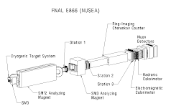
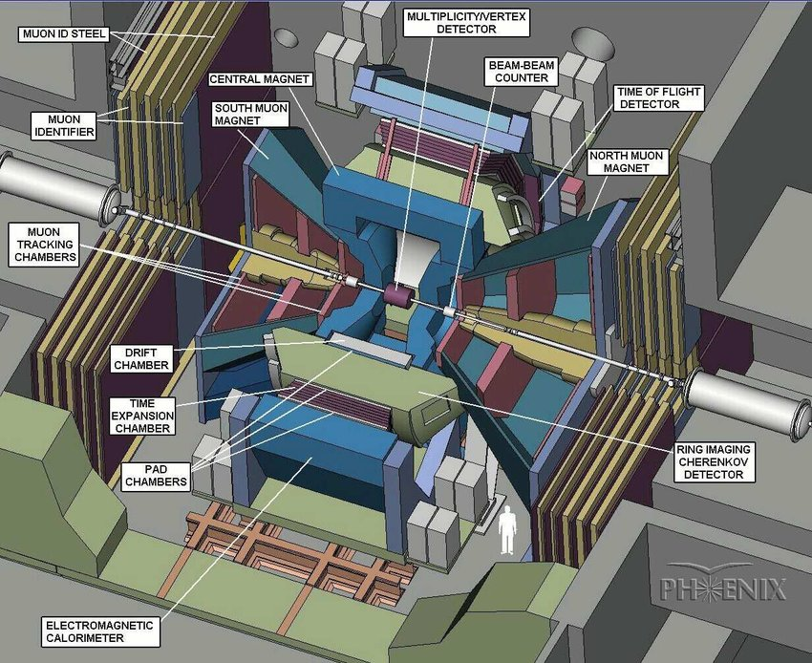
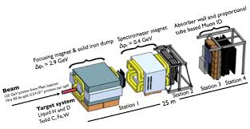
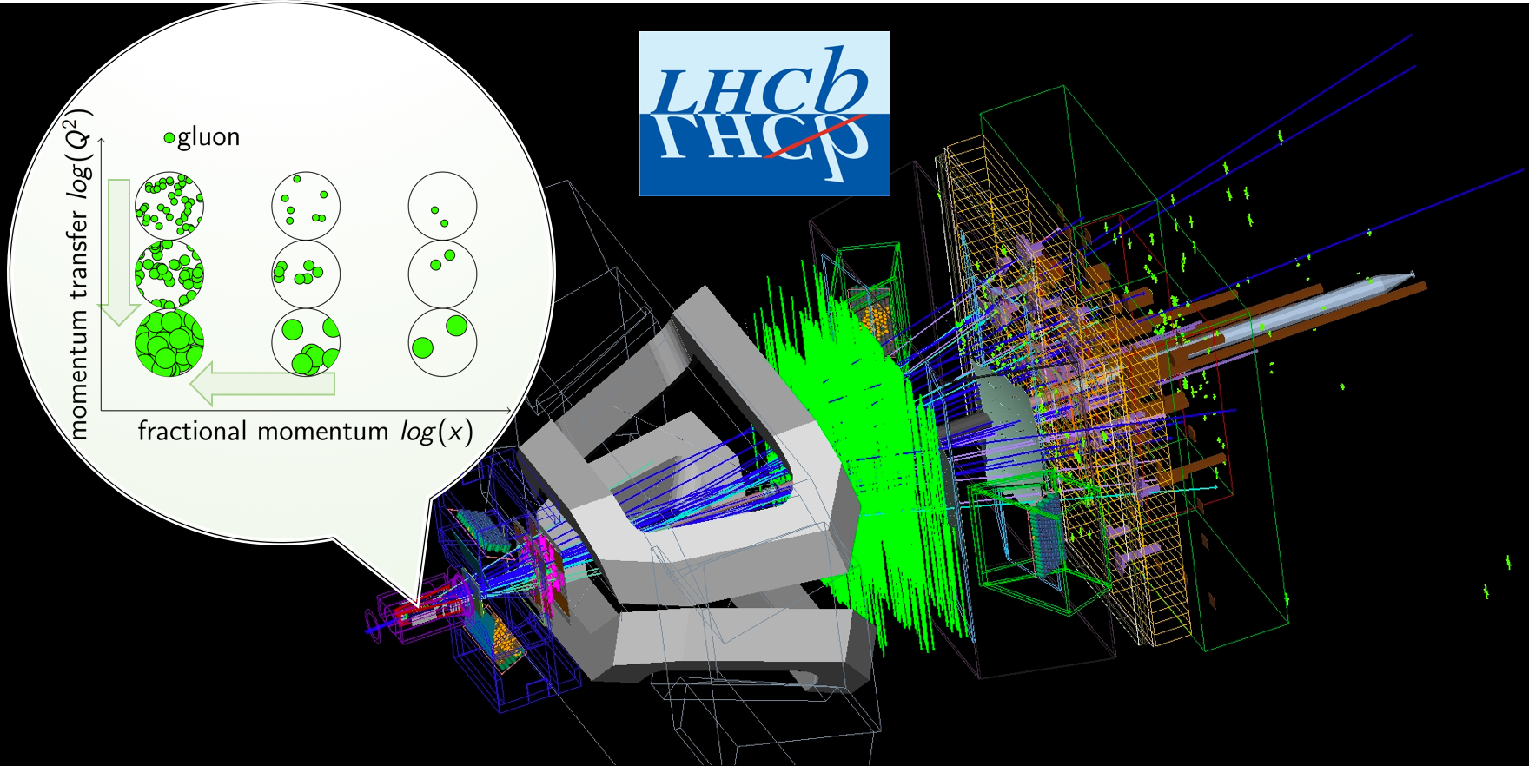
LANL’s Recent History of Leading Roles in Major High Energy Nuclear Physics Experiments in the US and Abroad
@Fermilab and CERN
@RHIC
PHENIX: 1996 – 2016+
- Froward muon trackers
Forward silicon strip detector
Heavy quark physics with muons
Hot QCD/QGP physics
Spin and Cold nuclear matter physics
E772/E789/E866 @Fermilab
1990 - 1999
Dimuon Drell-Yan experiments
Physics of sea quark
Quark energy loss
E906/E1039 @Fermilab
2010 – 2022+
Dimuon DY experiments
- Trcking detectors;
- polarized target
Quark energy loss
Physics of sea quark
sPHENIX: 2016 – 2025+
- MVTX silicon pixel detector
Heavy hadron and jet
QGP physics
Cold QCD physics
LHCB @CERN
2018 –
Forward magnet tracker
- Physics of gluon saturation

Slide 4
LANL’s Program Well Aligned with National Science Priority
- leading roles in several frontiers
Nuclear matter under extreme condition
  Quark Gluon Plasma
  Gluon saturation (condensate)
Nucleon structure, quarks and gluons and QCD dynamics
2015 US Nuclear Science
Long Range Plan:
sPHENIX at RHIC
Future Electron Ion Collider (EIC)

Slide 5
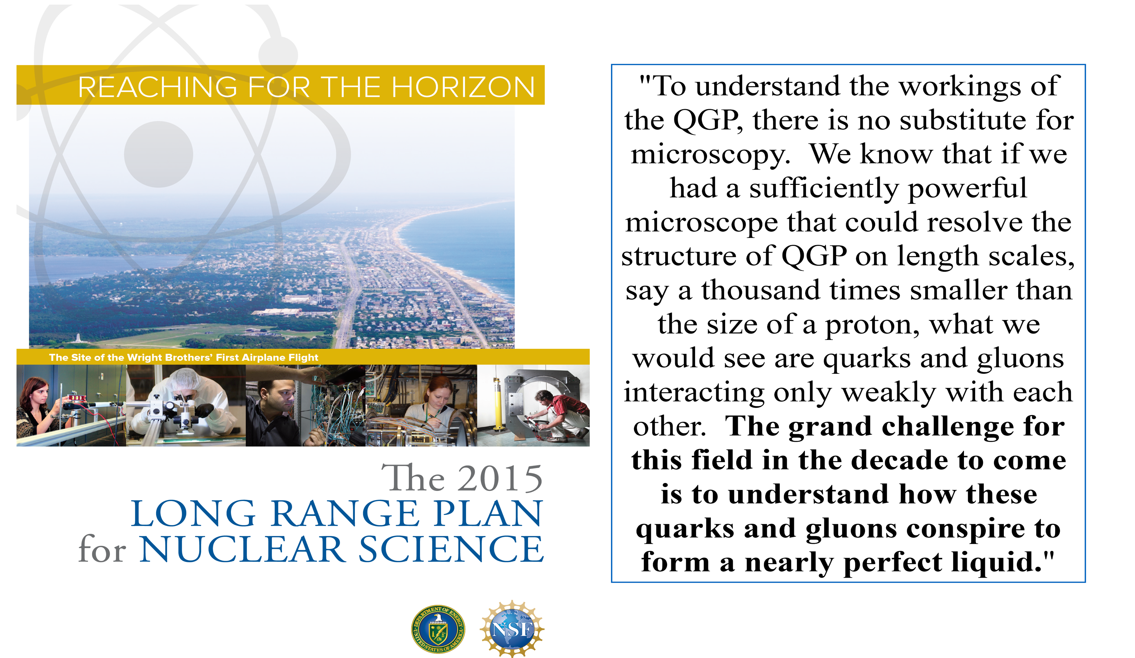
The sPHENIX Science Mission
- the next generation DOE flagship Heavy Ion Experiment (LRP2015)
sPHENIX at the Relativistic Heavy Ion Collider at BNL

Slide 6
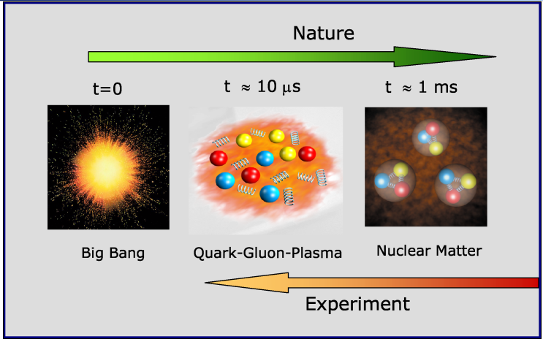
Recreate a state of the Early Universe: QGP

Slide 7
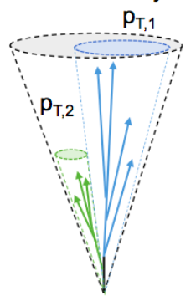
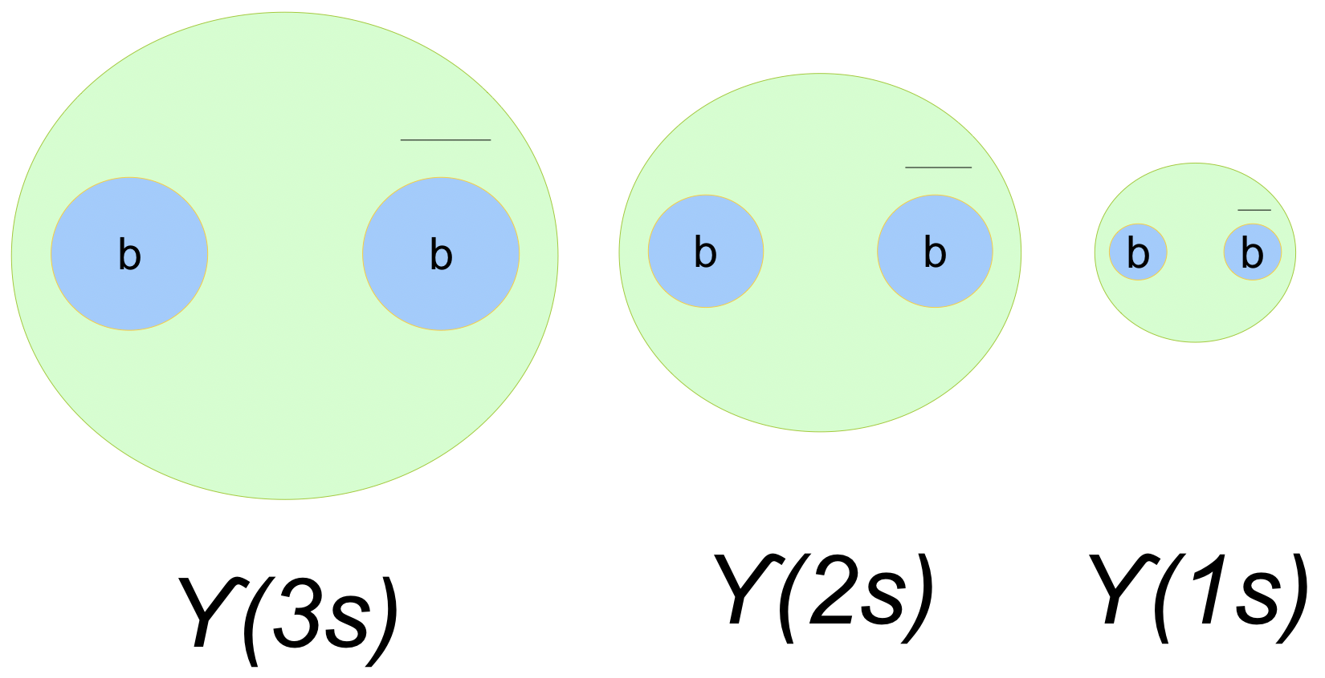
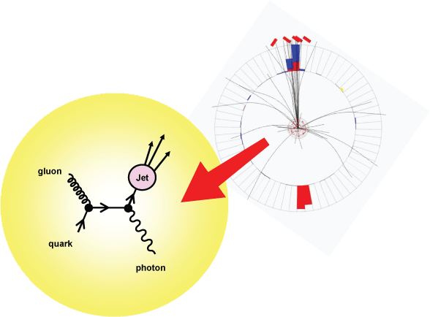
Probing Hot QCD – sPHENIX’s Approaches
“Probe the inner workings of QGP by resolving its properties at shorter and shorter length scales. The complementarity of [RHIC and the LHC] is essential to this goal, as is a state-of-the-art jet detector at RHIC, called sPHENIX.”
Jet structure
vary momentum/angular scale of probe
Quarkonium spectroscopy
vary size of probe
g
charm
Parton energy loss
vary mass/momentum of probe
u,d,s
bottom

Slide 8
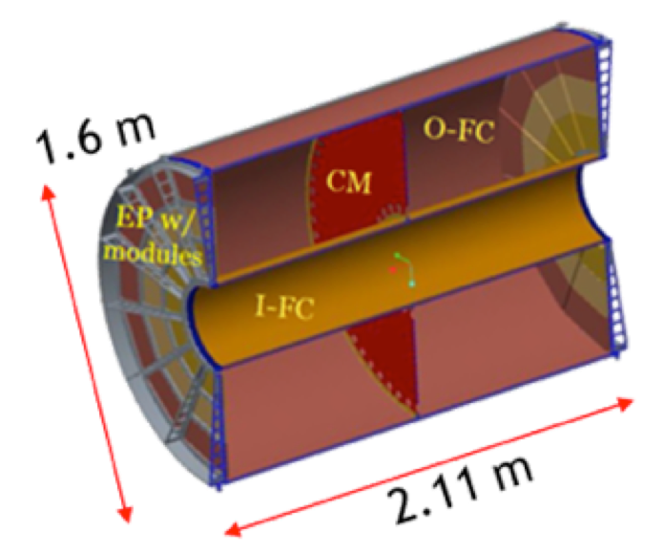
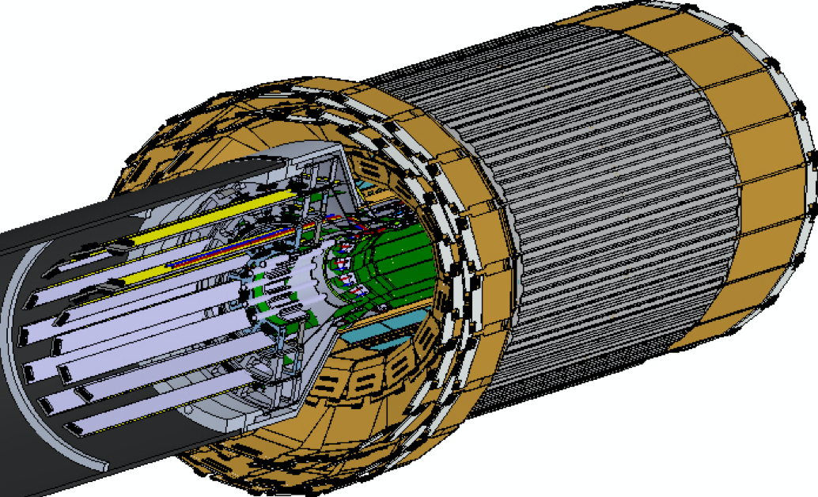
Th sPHENIX Detectors

Slide 9
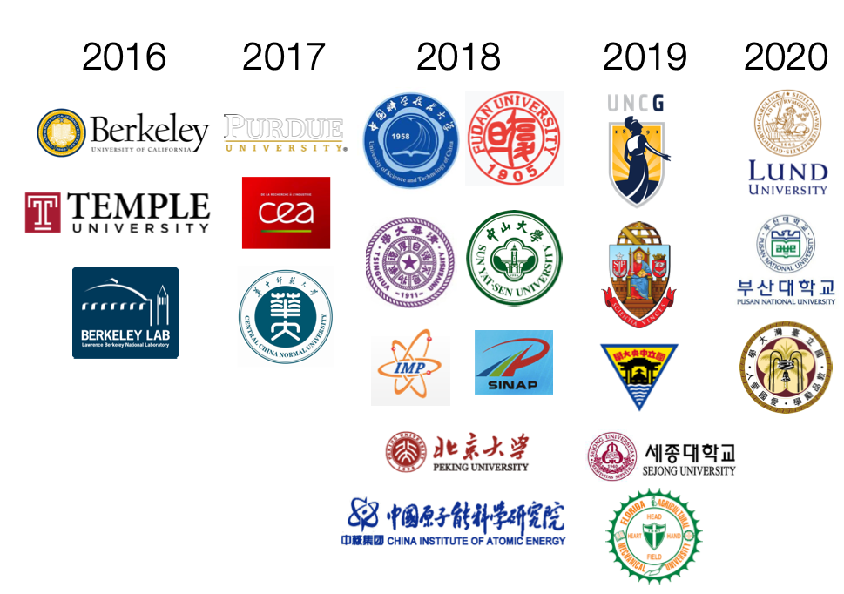
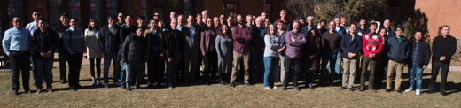
sPHENIX Collaboration
Formed in 12/2015
80 institutions total (as of 4/2020)
  About 25% non-US institutions
sPHENIX Collaboration Meeting, Santa Fe, NM, 12/2017

Slide 10
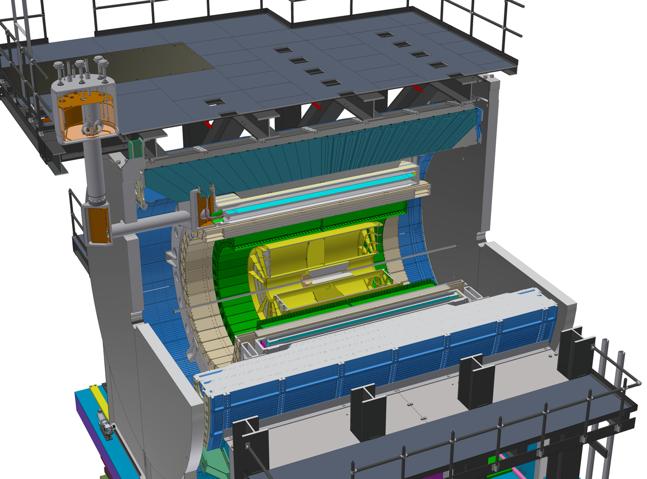

LANL Leads sPHENIX MVTX Upgrade at RHIC
Monolithic-active-pixel-sensor-based VerTeX detector (MVTX) upgrade
  Approved by DOE, supported by RHIC/BNL Operation Fund
  Detector R&D and construction, 2019 – 2022
  Ready for Day-1 physics with sPHENIX, 2023-2025+
Study “the inner workings” of Hot QCD (QGP) with heavy flavor hadrons and jets
  Cold QCD physics program under development
sPHENIX MVTX upgrade group
  LANL+LBNL+MIT+BNL + UT-Austin et al, 20+ institutes
LANL LDRD (2016-2019) supported the initial R&D
  Physics and detector development
sPHENIX 3 Physics Pillars
Jets
Upsilon
Heavy Flavor (w/ MVTX)
MVTX: a state of the art, inner most pixel tracking detector
- for precision heavy quark measurement, enables the 3rd physics pillar
MVTX
MVTX Service Barrel

Slide 11
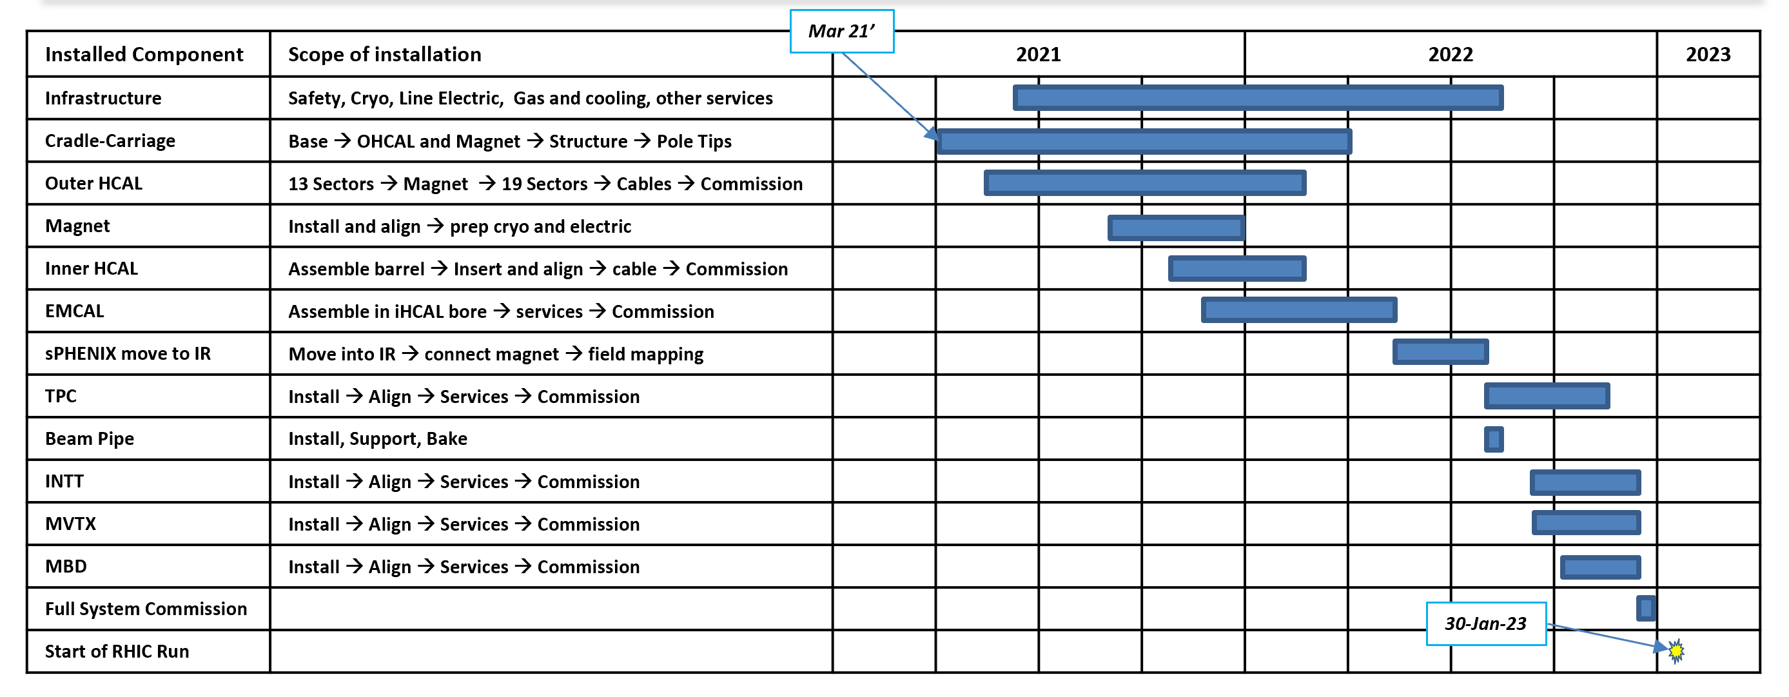
sPHENIX Timeline
2015
2016
2017
2018
2019
2020
2021
2022
2023
sPHENIX
science
collaboration
DOE CD-0
“Mission need”
approval
DOE CD-1/3A
Cost, schedule,
advance purchase
approval
BNL PD-2/3
Final project design approval, authorization to execute
Installation
and
commissioning
Start physics
data taking
Data taking:
2023-2025+
https://indico.bnl.gov/event/4788/attachments/19066/24594/sph-trg-000_06142018.pdf

Slide 12
Highlights of LANL’s Activities
LDRD
MVTX
Test beam runs

Slide 13
LANL’s sPHENIX Physics Program at RHIC
Near Term: MVTX upgrade ( now – 2022)
  MVTX detector construction and installation in sPHENIX by 2022
  Heavy quark physics program development
    QGP – baseline developed
    Spin physics and Cold Nuclear Matter - under development
Mid Term: sPHENIX Physics Runs (2023-2025+)
  Heavy quark and Jets physics for heavy ion
    QGP
  Heavy quark and jets physics for Cold QCD
    Spin physics
    Cold Nuclear Matter
Transition from sPHENIX to EIC at RHIC (~2025+)
  EIC detector development and construction
  EIC physics development
    Spin physics
    Cold nuclear Matter
  EIC physics run as early as 2030

Slide 14
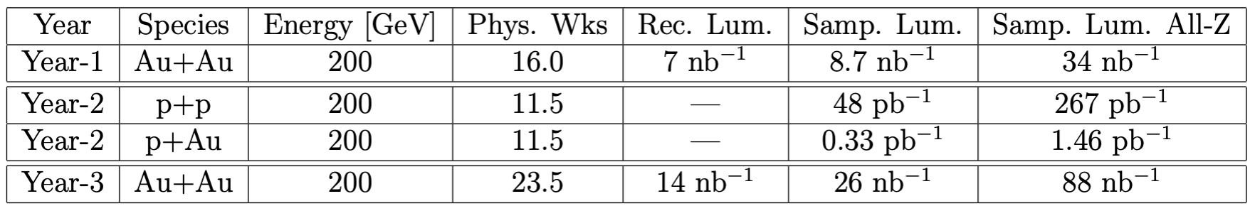
sPHENIX Run Plan
https://indico.bnl.gov/event/4788/attachments/19066/24594/sph-trg-000_06142018.pdf
Main Au+Au running mode: 15kHz min bias for |zvtx| < 10cm
Ongoing discussions with BNL’s Collider-Accelerator Dept. to optimize running conditions.
Year-1 (commissioning) + Year-2,3 (high statistics production): 145 billion Au+Au collisions
  cf. more than 20x STAR 2016 data set of 6.5 billion events (PAC 2017 presentation)
Consistent with BNL technically-driven timeline to an EIC
Collaboration sees strong science case for additional running
Improve uncertainties and respond to discoveries in first years

Slide 15
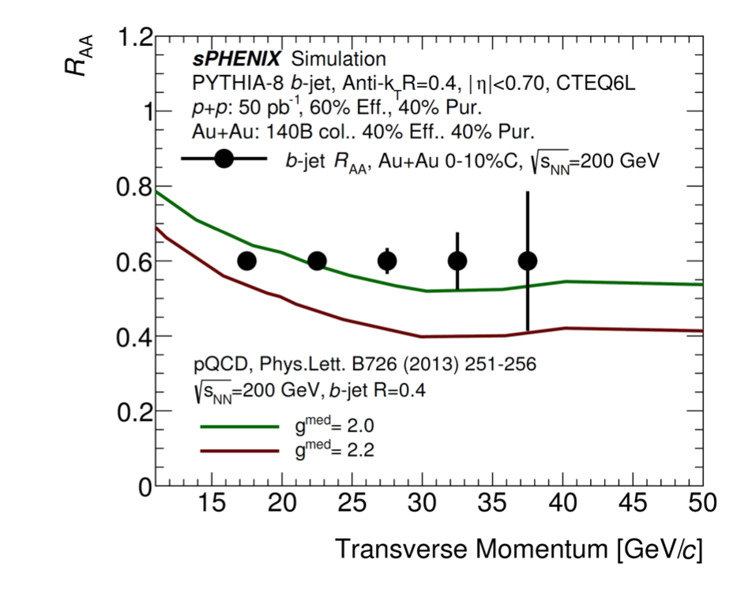
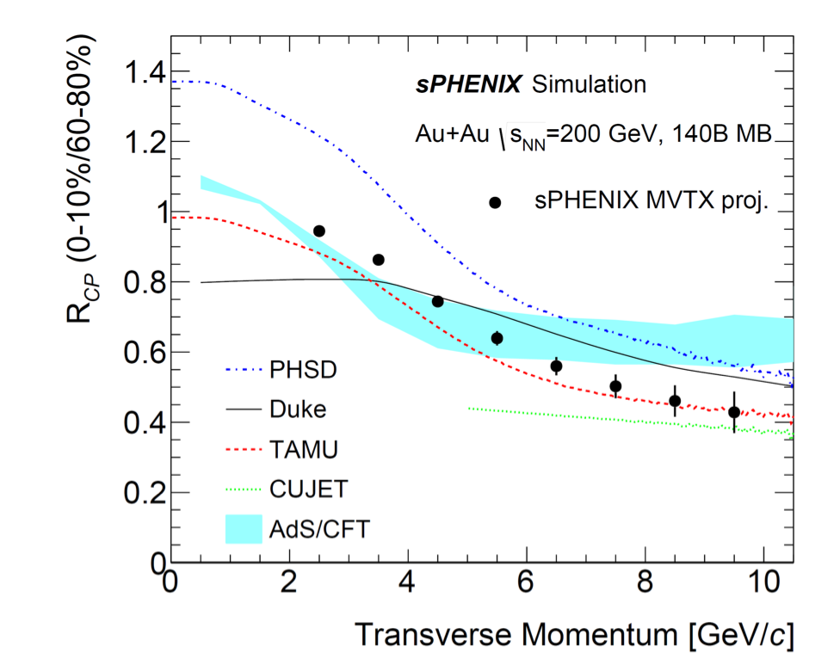
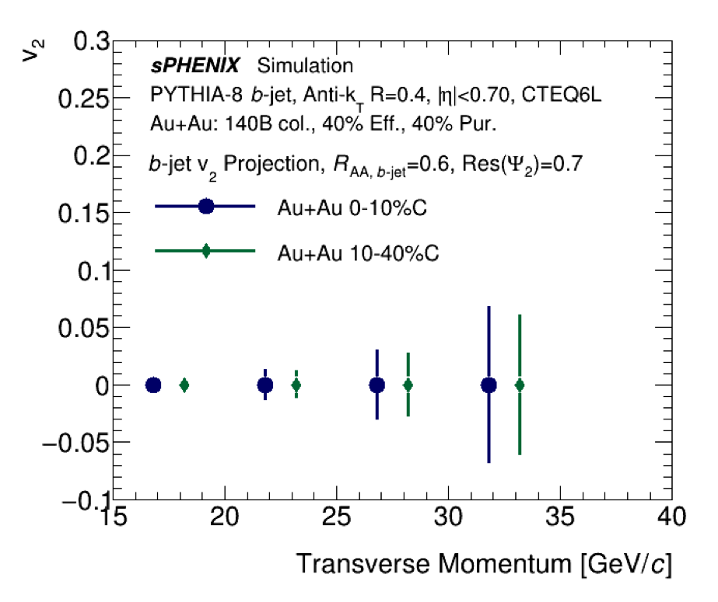
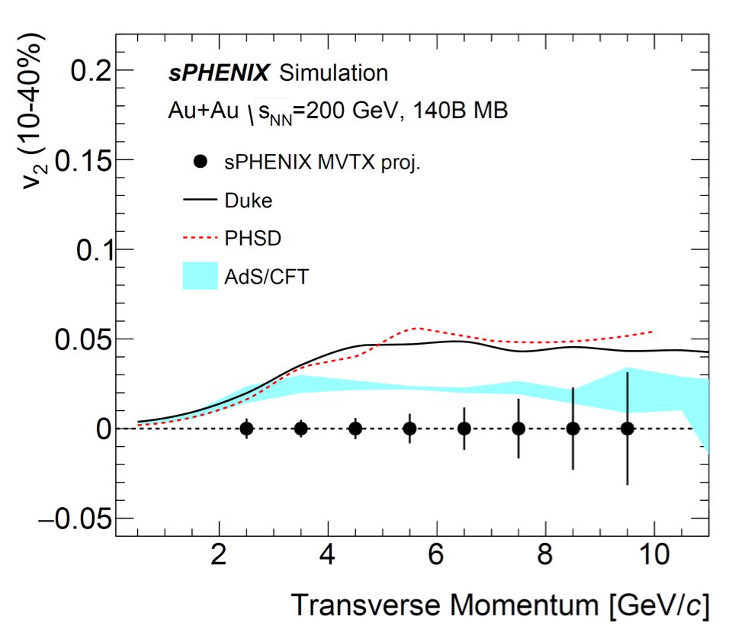
Open HF observables – b-tagged jets, B mesons
b-tagged
jet RAA
B-meson RCP
b-tagged
jet v2
B-meson v2

Slide 16
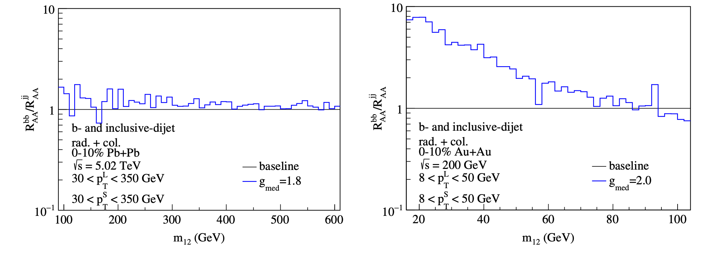
Sensitivity of novel heavy flavor jet observables
Z-B Kang, J Reiten, I Vitev, B Yoon, “Light and heavy flavor dijet production and dijet mass modification in heavy ion collisions”, Phys. Rev. D99 034006 (2019)
strong coupling to the medium near T_{c} ⇔ pronounced b-dijet effect at RHIC
LHC
RHIC

Slide 17
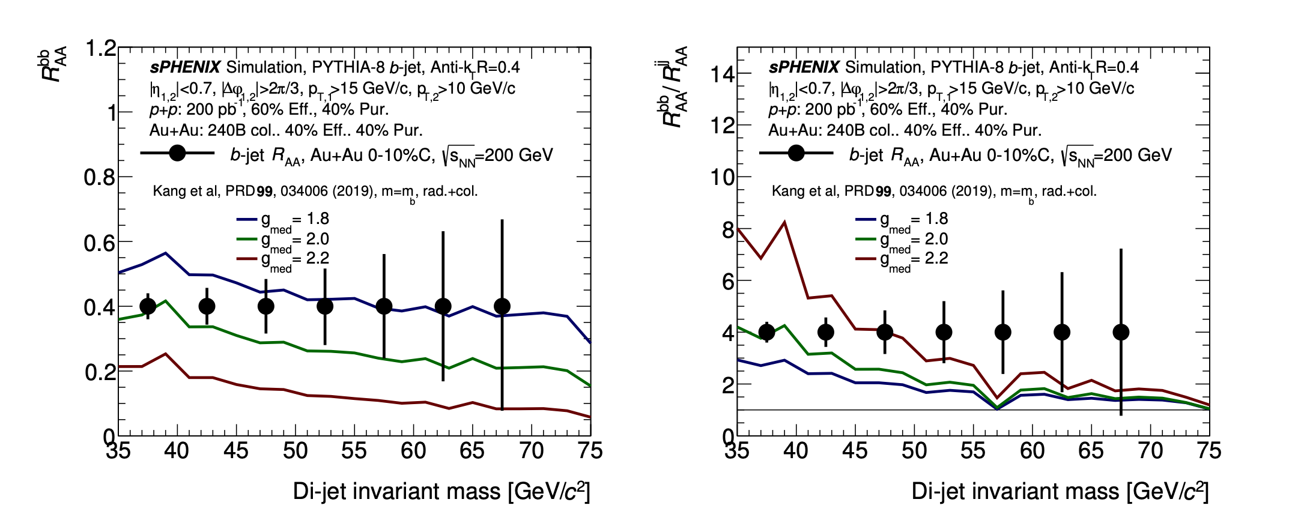
Sensitivity of novel heavy flavor jet observables
Z-B Kang, J Reiten, I Vitev, B Yoon, “Light and heavy flavor dijet production and dijet mass modification in heavy ion collisions”, Phys. Rev. D99 034006 (2019)
increasing gmed
increasing gmed
J. Reiten, private communication

Slide 18
backup

Slide 19
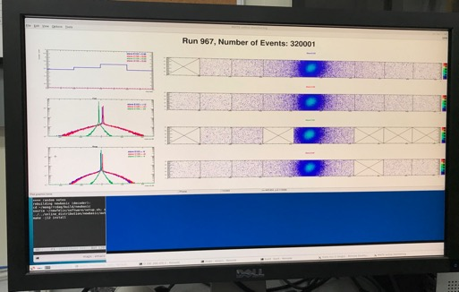
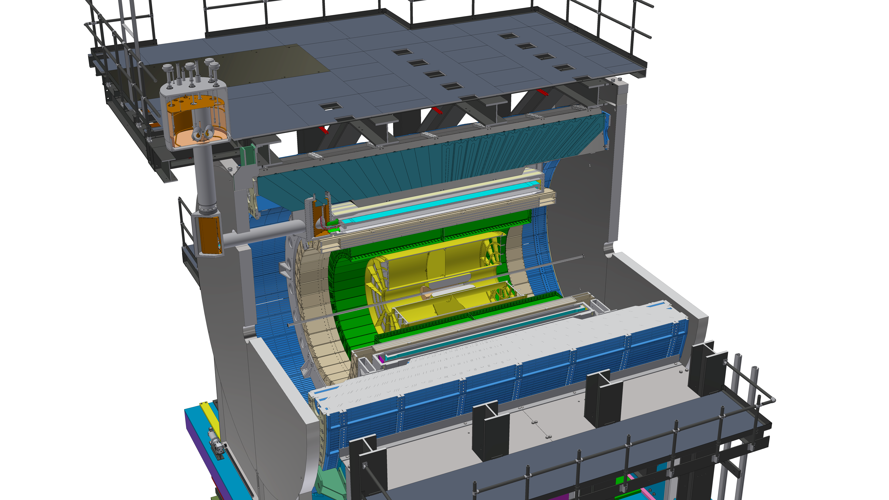

LANL Lead sPHENIX MVTX Upgrade at RHIC
Lead MVTX upgrade effort, 2016 – 2025+
  LANL+LBNL+MIT+BNL + UT-Austin et al, 20+ institutes
Monolithic-active-pixel-sensor-based VerTeX detector (MVTX) upgrade
  Detector R&D, construction and installation, 2019 – 2022
    Full readout chain tested at Fermilab in May 2019; sensors and electronics in production
    MVTX mechanical system preliminary design completed, FDR in January 2020
  Will be ready for Day-1 physics with sPHENIX, 2023-2025+
Study “the inner workings” of Hot QCD (QGP) with heavy flavor hadrons and jets
  Cold QCD physics program under development
LANL’s major roles on MVTX upgrade project, 2019 - 2023+
  Oversee MVTX project, MVTX stave production at CERN
  Mechanical system design and construction, readout integration
  MVTX detector geometry and simulation
  B-hadron and b-jet physics study
LANL LDRD (2016-2019) supported the initial MVTX R&D
  Identified key physics goals and completed detector conceptual design
120GeV p-beam
Trigger >30kHz
MVTX mechanical support design
MVTX Test Beam @Fermilab,May – June, 2019
MVTX sensor and readout
electronics fully qualified.
All 60 Readout Unit boards produced
Stave production on-going at CERN,
~20% done, complete end of 2020
MVTX
MVTX Service Barrel

Slide 20
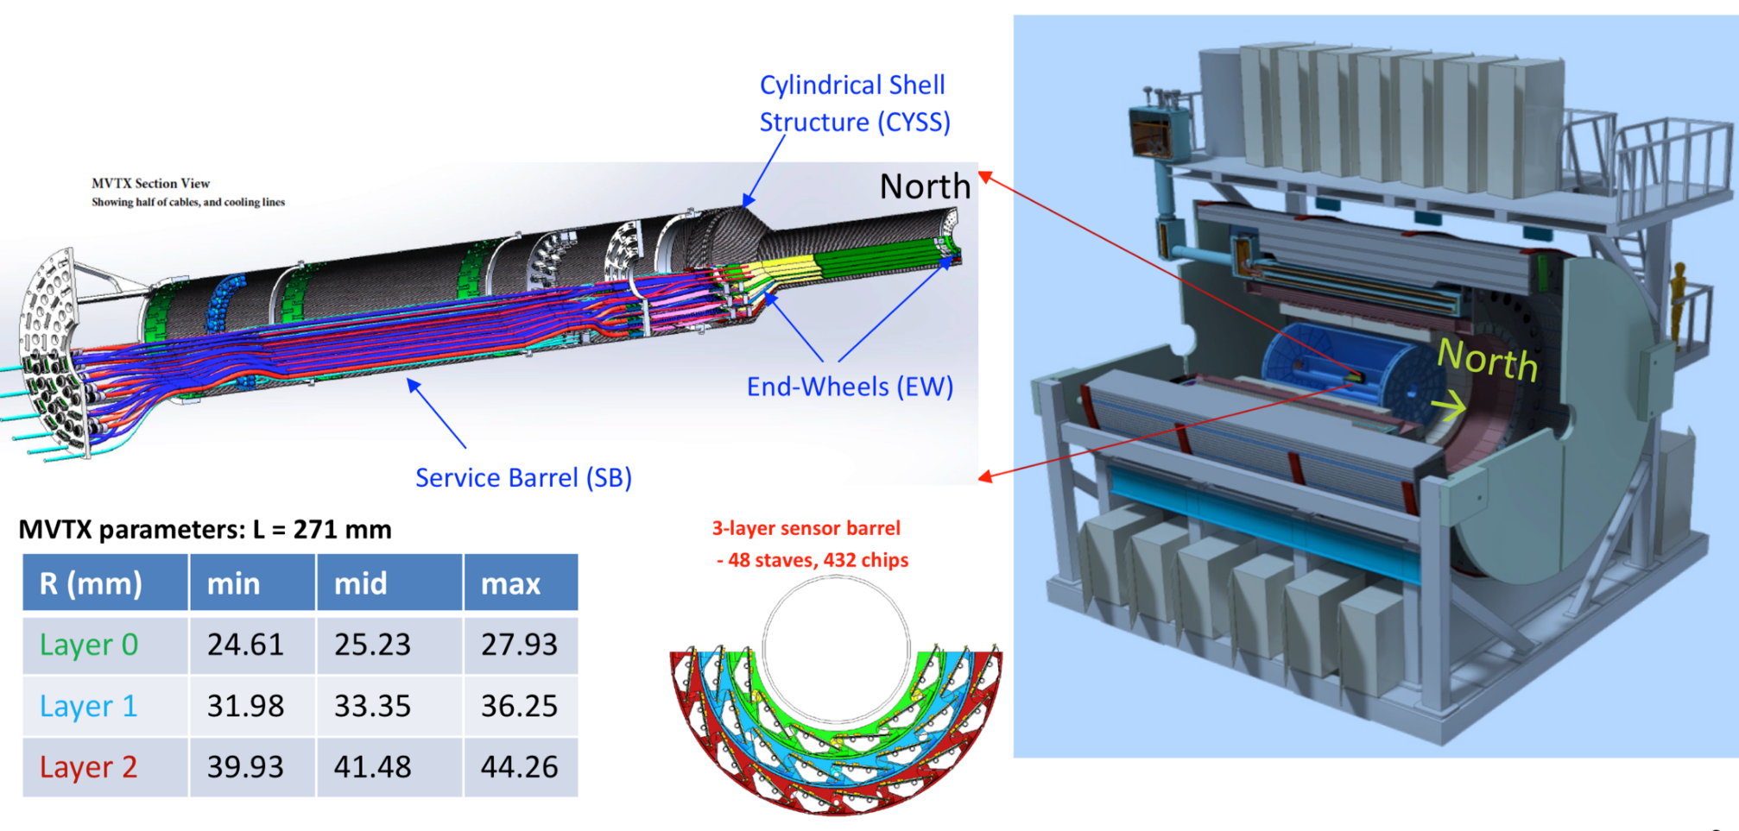
MVTX Detector –”Adapted” from ALICE ITS Design
Project Start: Dec 2019
Ready to install: June 2022
Total Project Cost $4,795k
sPHENIX

Slide 21
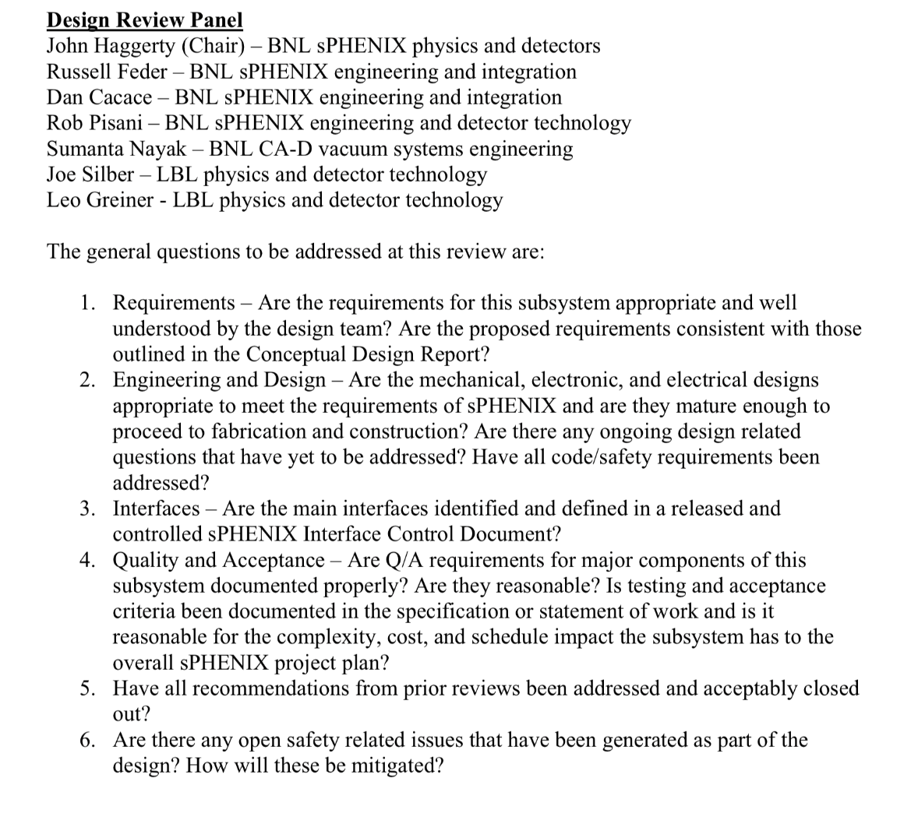
MVTX Design Review – Jan 29
https://indico.bnl.gov/event/7165/
Engineering Design is advanced thanks to:
Near complete adaptation of ALICE ITS design
LANL design studies funded by LANL LDRD
MIT and LBNL design studies funded by BNL R&D
Issues with beam pipe and MVTX insertion that need to be resolved over the next 1-3 months.
LBNL ready to receive staves once funding is available to begin shipping preparation

Slide 22
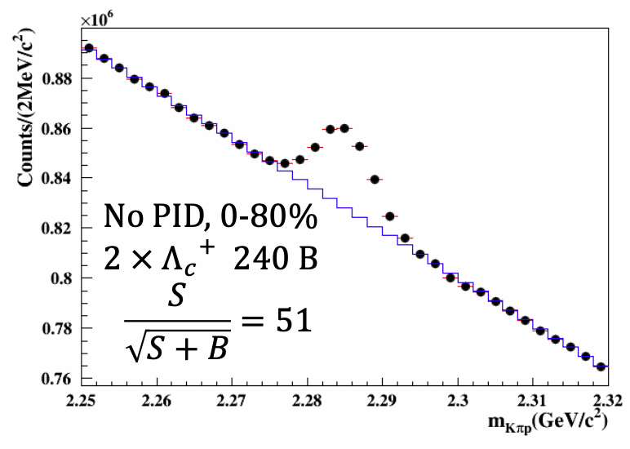
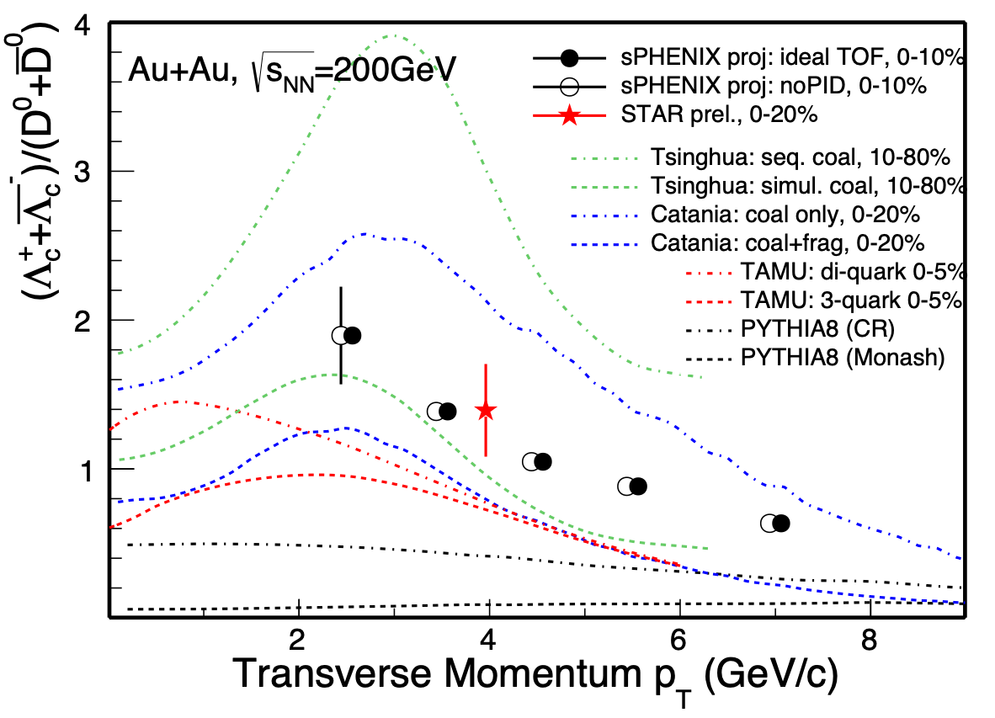
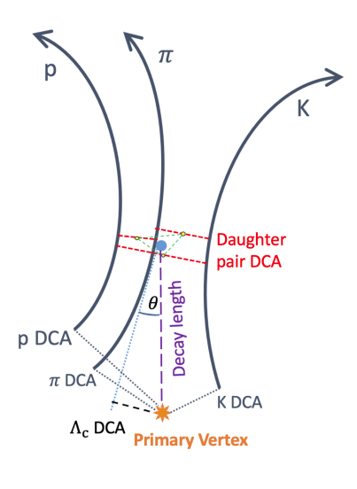
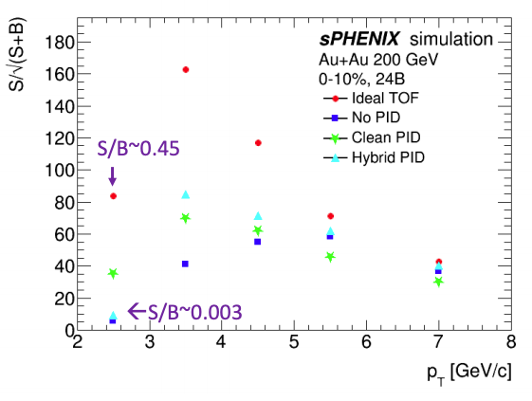
Λc - Hadronization
complex decay topologies enable high S/B in baseline sPHENIX
Yuanjing Ji (USTC/LBNL)

Slide 23

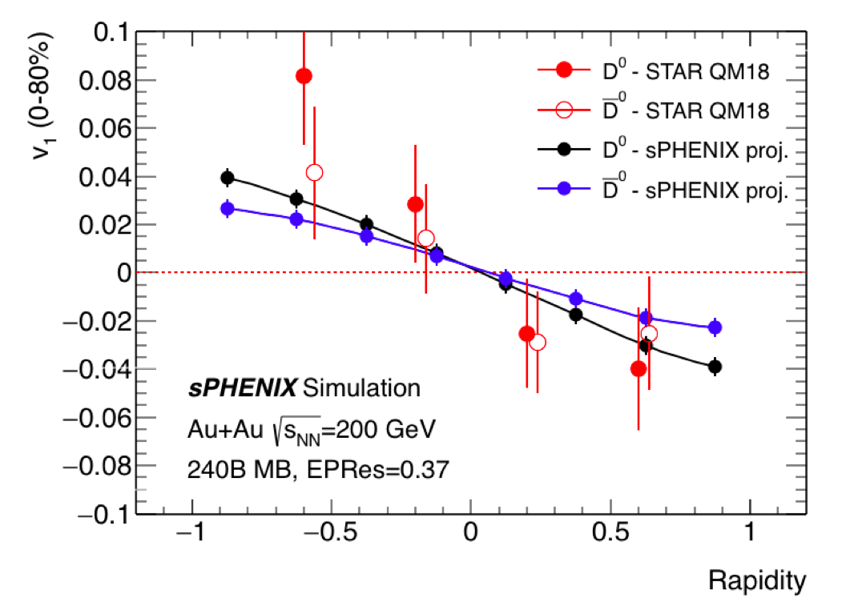
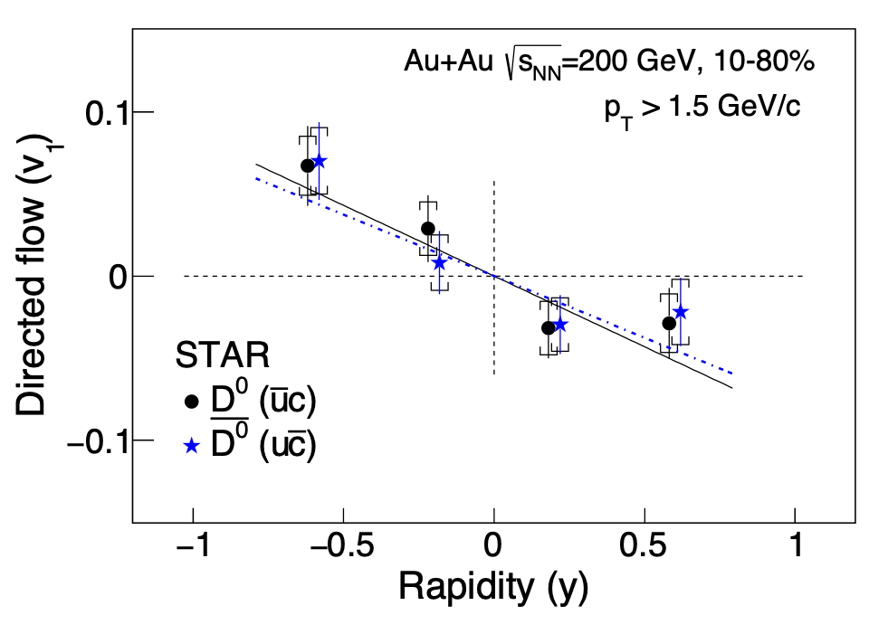
D⁰ v1 – direct access to initial B field
Phys. Rev. Lett. 123, 162301 (2019)
cf. Alex Jentsch’s talk from this morning

Slide 24
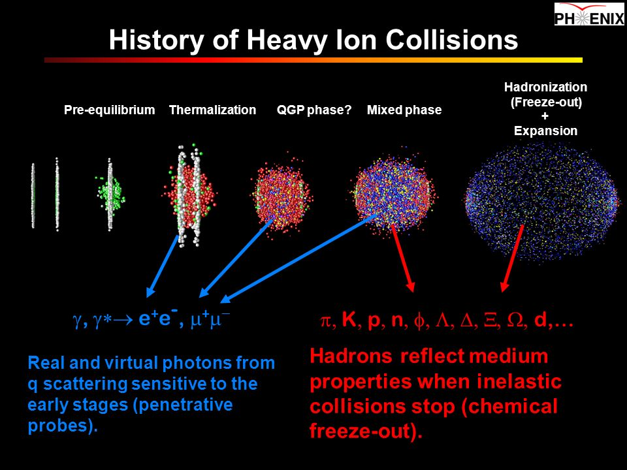
Particles Produced in Heavy Ion Collision

Slide 25
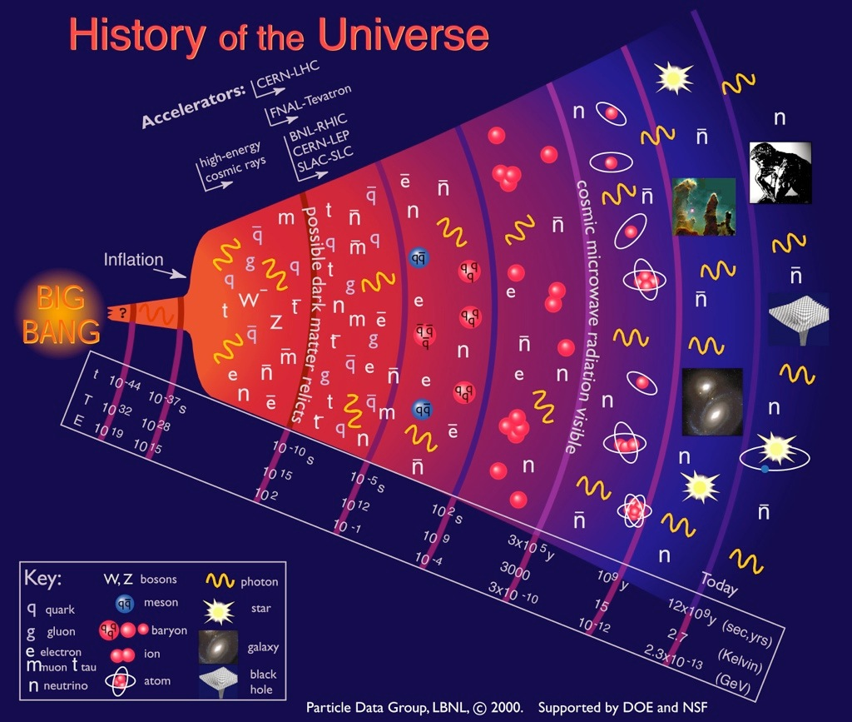
Fundamental particles and the evolution of the Universe
Quark-Gluon
Plasma (QGP)

Slide 26
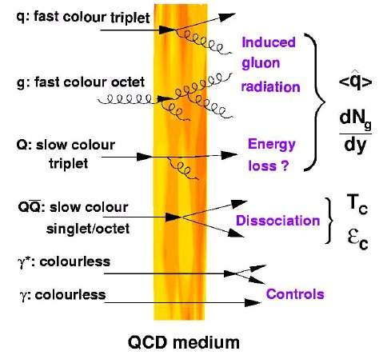
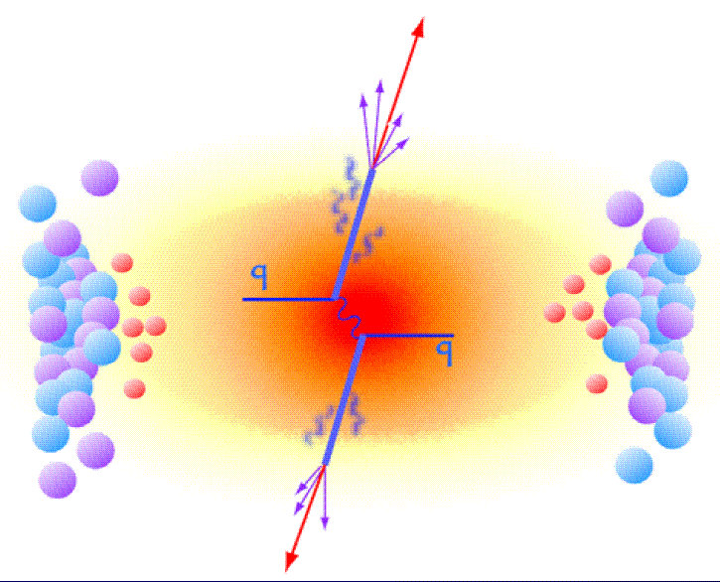
Topic-1: Probe the QGP Density with Jets
High density QGP medium created in
Heavy ion collisions:
~20x of normal nucleus

Slide 27
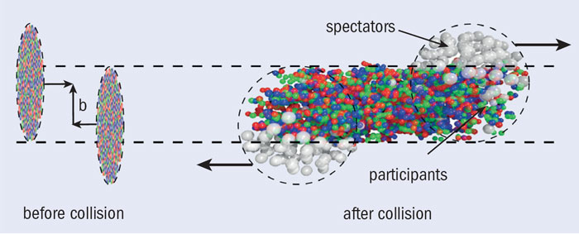
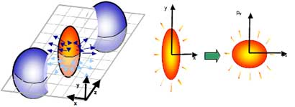
QGP Medium Behavior in non-Central Heavy Ion Collisions
Anisotropic flow

Slide 28
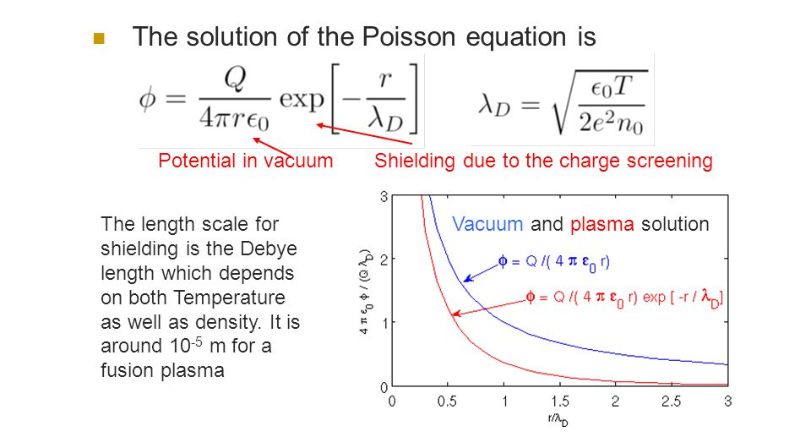
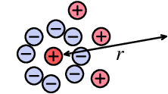
Debye Screening in Plasma

Slide 29
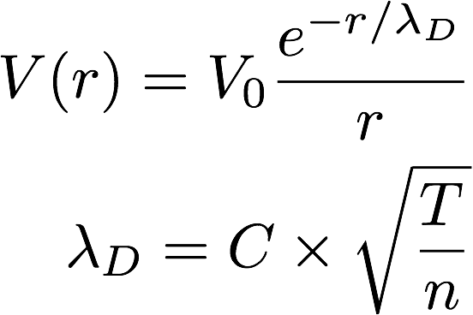
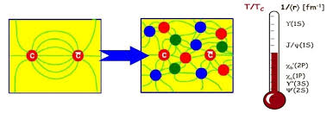
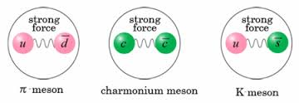
QGP “Color Charge” Screening
Plasma Debye Length:
The shorter the r_{D},
the stronger the screening
effects
Binding energy ~ a few 10² MeV, ~ QGP Temperatures

Slide 30
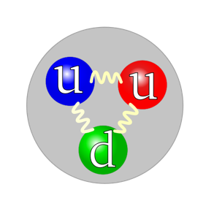
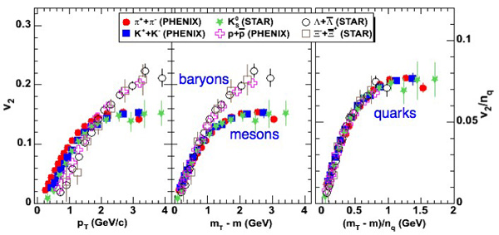
Quark Liquid!
baryons
mesons

Slide 31
Unlocking the Secret of the Early Universe

