Slide 1
Single muon V2 - ATLAS

Slide 2
STAR

Slide 3
Forward D0 in pA, CGC/nPDF - LHCb

Slide 4
Evidence of regeneration?

Slide 5
J/Psi v2 - ALICE

Slide 6
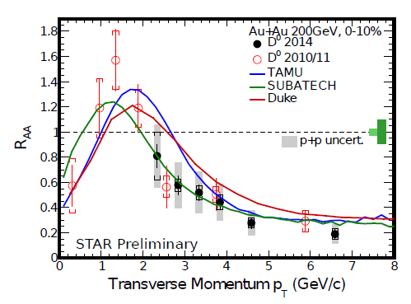
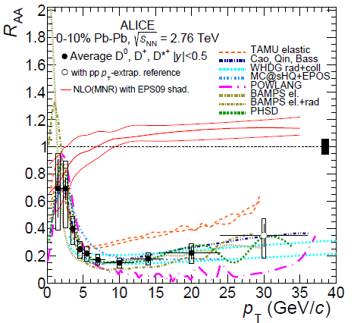
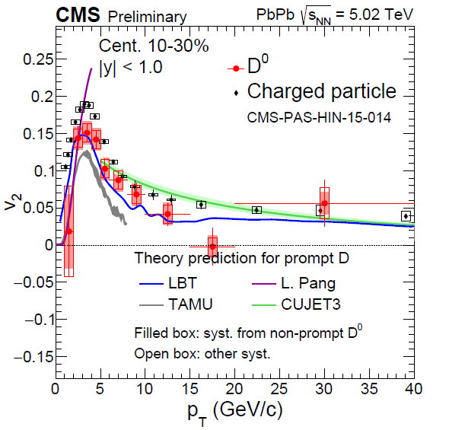
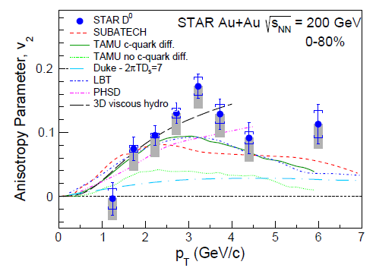
3.2 Heavy-Flavor Phenomemology at RHIC + LHC
Flow bump in R_{AA} + large v₂ ↔ strong coupling near T_{pc} (recombination)
Importance of T- + p-dependence of transport; D_{s}(2πT) ~ 2-4 near T_{pc}
High-precision v₂: transition from elastic to radiative regime

Slide 7
New models
Formation time and initial state dE/dX
J/Psi,
long-range matrix can be used to estimate formation time?
D, B
Coalesces with quarsi particles ~1GeV
Quasi particle model
Effective mass ~ 1GeV vs T/T_C
V2 on heavy flavor
For B calcualtion? V2?
B-bbar correlation
pT – Phi etc.
B-meson correlation
B-jet correlation
Diffusino coefficeient 2piTD and V2 ?
Experimentla test ?

Slide 8
Quasi-particles in QGP

Slide 9
Heavy quark inside QGP

Slide 10
Quasi-particle model

Slide 11
nPDF

