Slide 1
Run15 pp and pAu J/Psi A_N
A surprise!

Slide 2
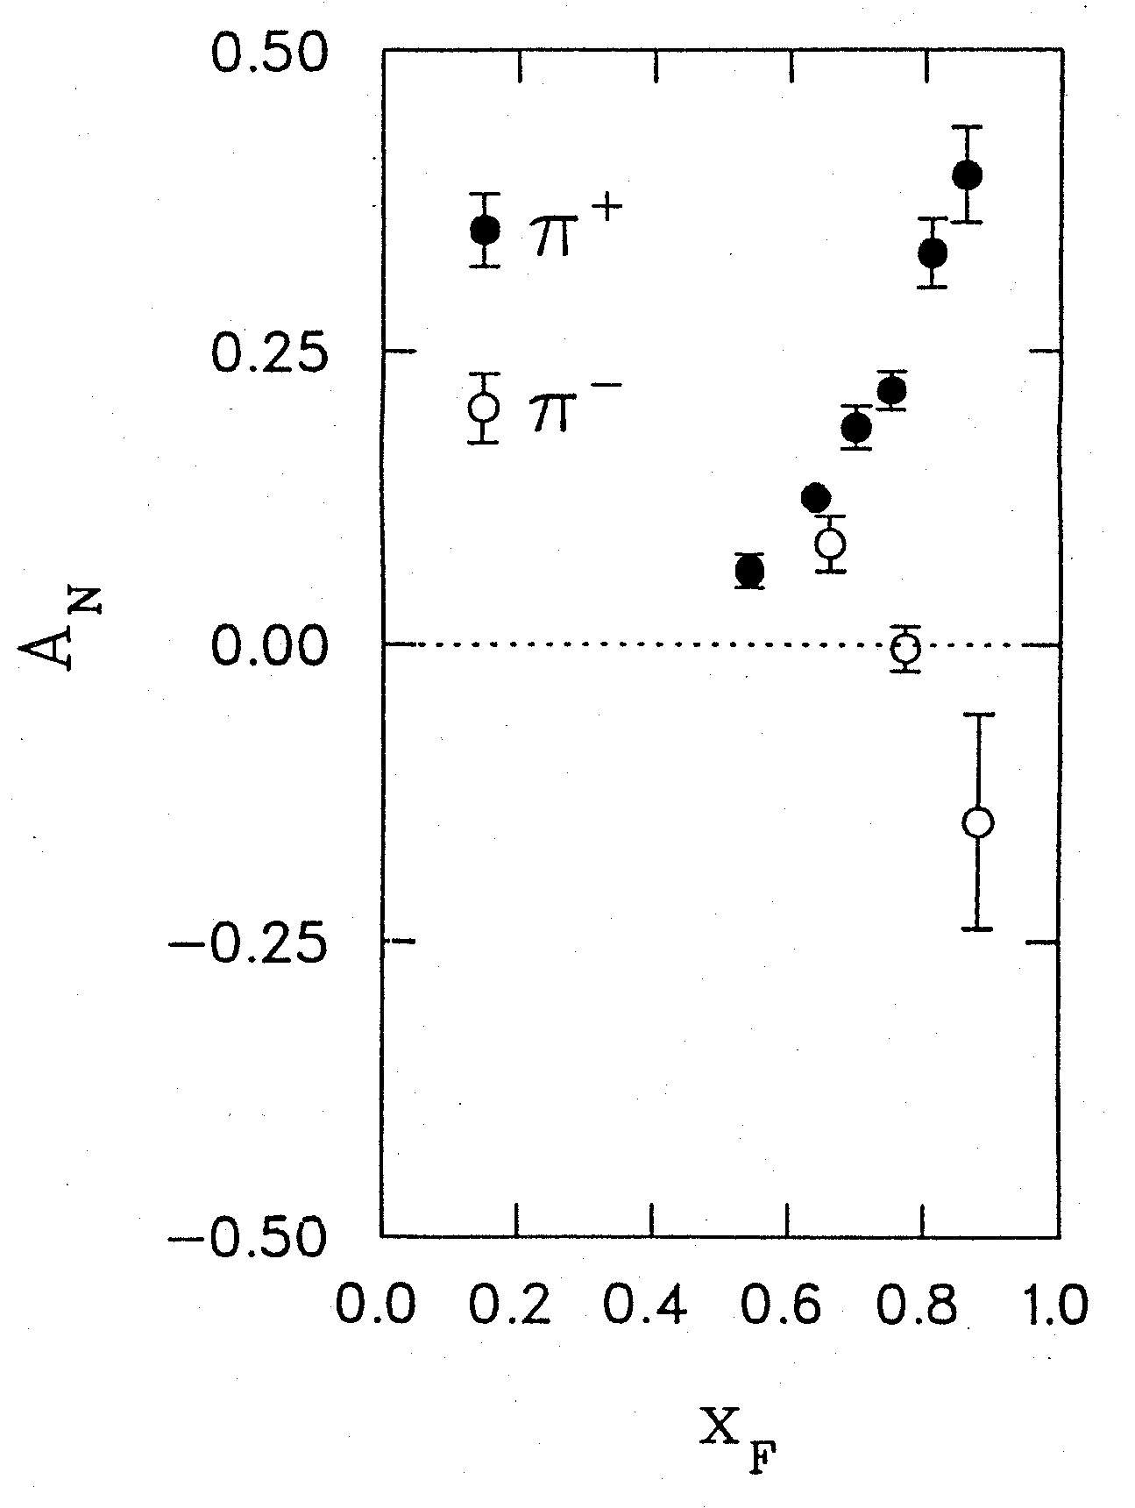
A_{N}^{J/psi} vs. x_{F}

Slide 3
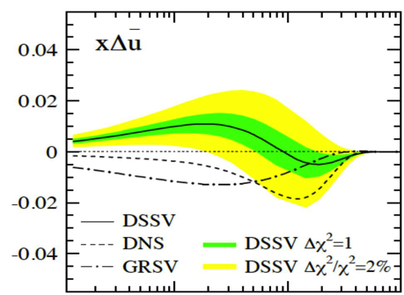
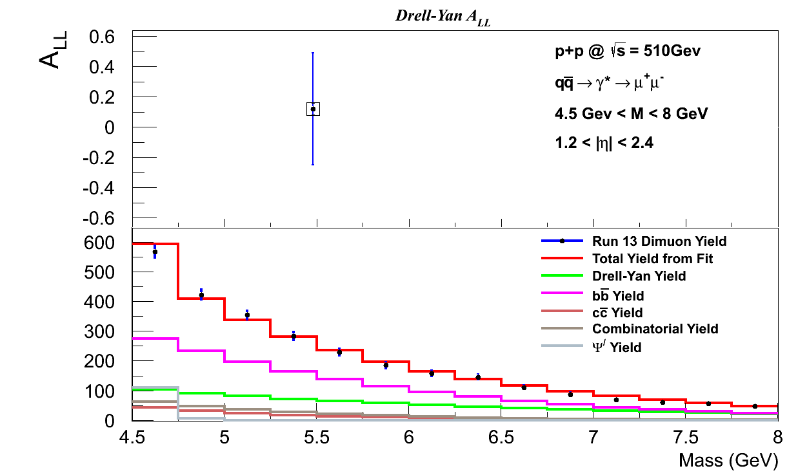
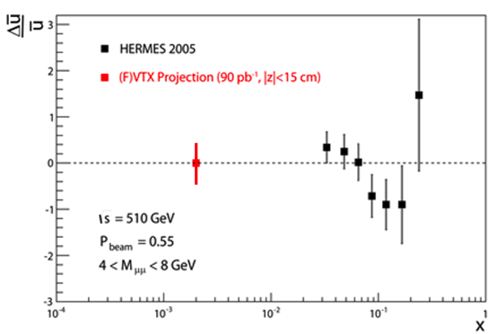
Drell-Yan Run13 pp510 A_LL
Drell-Yan fraction and ALL

Slide 4
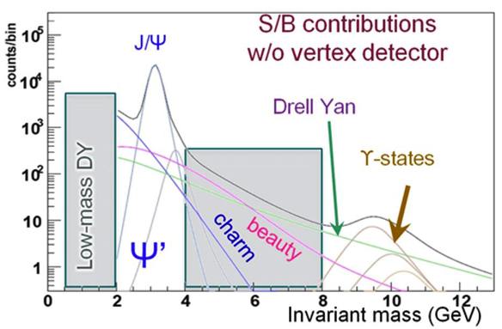
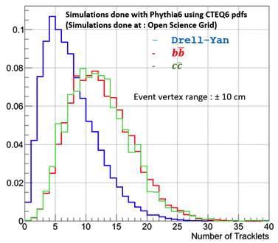
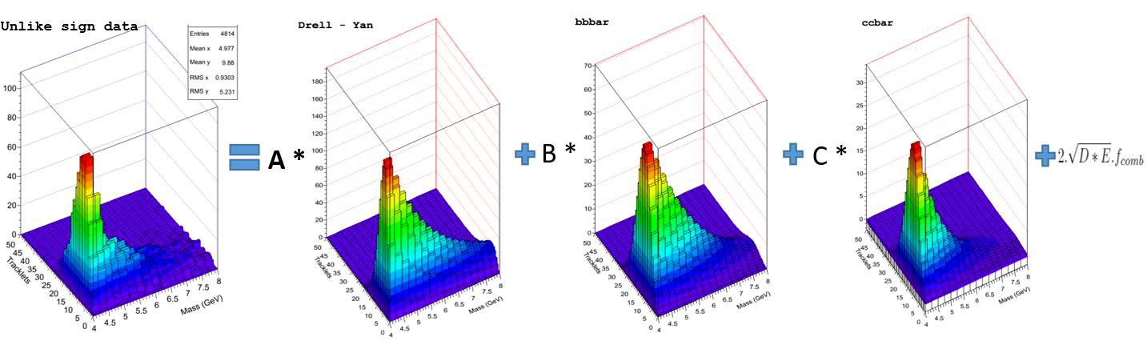
Drell-Yan Run13 pp510 A_LL
Drell-Yan & FVTX tracklets
PP200 simulations +Run6 dimuon fit

Slide 5
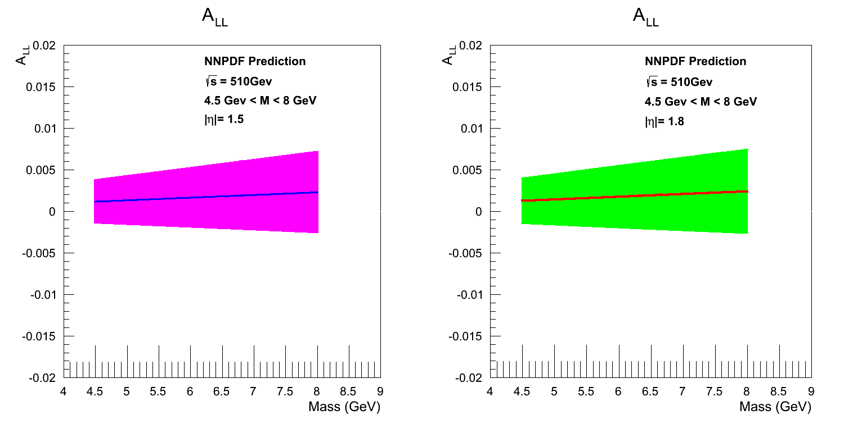
Pp510 A_LL: Model Predictions

