Slide 1
sPHENIX* and the Future of sQGP Physics
Strongly Interacting
Quark Gluon plasma
Richard Seto
LANL seminar
Jan 9, 2011
* In the era of the LHC
I will cover heavy ion physics
Other important topics: spin, cold nuclear matter
Disclaimer: These are my ideas and does not necessarily reflect the official view of the PHENIX Collaboration

Slide 2
The sQGP – what do we know?
Before RHIC turn on, what did we think we would find?
Weakly coupled quark gluon Plasma
We were wrong!
At RHIC/LHC the sQGP has been formed
Strongly interacting – low viscosity
Equilibrates rapidity τ< 1fm (even heavy quarks)
High energy probes (partons) loose energy traversing the sQGP
T₀>Tc (190 MeV)

Slide 3
Questions:
Are quarks strongly coupled to the quark-gluon plasma at all interaction distance scales?
What are the detailed mechanisms for parton-QGP interactions and responses? Are the interactions coherent over the entire medium length scale, what are the dominant energy loss mechanisms?
Are there quasi-particles in the medium? What are their masses and widths?
Is there a relevant color screening length in the quark-gluon plasma?
How is rapid equilibration and entropy production achieved?
What is the nature of color charge in large nuclei? What role does gluon saturation and the EMC effect play in nucleus-nucleus collisions? How do these modifications evolve?

Slide 4
Making progress
Requires close collaboration between theory and experiment to make progress
Very rewarding
Is RHIC relevant in the era of the LHC?
My answer: YES! - we are doing condensed matter physics of QCD
sPHENIX is fundamentally planned to be a jet detector
Ideas are a work in progress
RHIC – dedicated machine flexible combination of beam species and energies

Slide 5
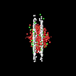
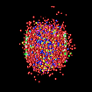
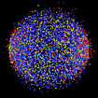
Stages of the collision Different Physics at each stage
Simulation and model
by K. Geiger, ….

Slide 6
Stages of the collision Different Physics at each stage
Pre-Collision
Saturated Gluon Fields
Characterized by Q_{sat} ~ 1-2 GeV

Slide 7
Stages of the collision Different Physics at each stage
Hard probes formed
Decoherence τ~1/Q_{sat} ~ 0.1-0.2 fm/c
Equilibration τ_{therm} ~ 0.3 – 1 fm/c

Slide 8
Stages of the collision Different Physics at each stage
sQGP
Hydrodynamics
Viscosity ~ $\frac{1}{4π}$
Energy loss of hard probes

Slide 9
Stages of the collision Different Physics at each stage
Hadrons form
Viscous Hydrodynamics

Slide 10
Stages of the collision Different Physics at each stage
Freezeout

Slide 11
Stages of the collision Different Physics at each stage
Free Stream
To detectors

Slide 12
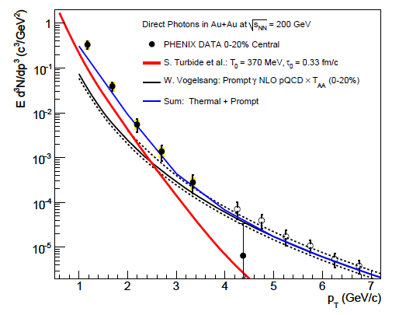
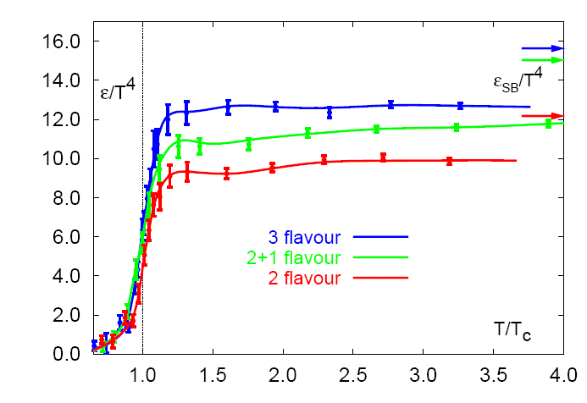
Lattice Predictions
Lattice: T_{C}~190 MeV (ε_{C} ~ 1 GeV/fm³)
Phase transition- fast cross over
to experimentalist: 1st order
T
Blackbody radiation
$$\frac{ε}{T^{4}}\sim NDOF$$
ε/T⁴
Fit to T=370 MeV
+PQCD
T/T_{C}
Rapid increase in NDPF
PHENIX – thermal direct photons

Slide 13
DOF/quasiparticles?
Are there quasi-particles in the medium?
What are their masses and widths?
Lattice: NDOF=37
Data: no meaningful
Answer yet
Low bound on energy density
Lower bound on NDOF
NDOF=$\frac{30}{π^{2}}\frac{ε}{T^{4}}$
Number of DOF?
Get better handle on ε, s(probably is OK), T₀
What are the DOF?
changes with time
Sound waves at early times, Quasiparticles later. What are they?
SPHENIX
Probe sQGP with high pt partons: quasiparticle(or not) characteristics, energy density
Look at quarkonia – get better handle on temperature
T
13

Slide 14
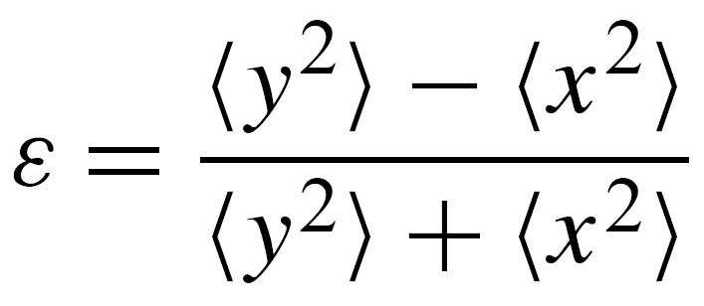
Flow: How explosive is the sQGP?
p_{y}
φ
pressure
p_{x}
z
y
x
Coordinate space:
initial asymmetry
Momentum space:
final asymmetry
dn/dφ ~ 1 + 2 v₂(p_{T}) cos (2 φ) + ...
pre-RHIC prejudice - weakly interacting QGP
⇨ weak flow signal

Slide 15
Strong flow Signal
Hydrodynamics works for p_{T}< 2 GeV
detailed hydro calculations (QGP+mixed+RG, zero viscosity)
τ₀ ~ 0.6 -1.0 fm/c
ε~15-25GeV/fm³
(ref: cold matter 0.16 GeV/fm³)
LHC consistent with RHIC
v₂

Slide 16
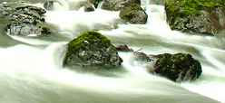
Throw a rock in a stream: Heavy quarks
Heavy quarks
Flow!
Rapid equilibration of heavy quarks
PRL 98, 172301 (2007)

Slide 17
Hydrodynamic models require small η/s (viscosity) to reproduce flow signal
Small viscosity ⇨ Strongly interacting
Can we calculate the viscosity (η)?
BIG problem, QCD in our regime
is a strongly coupled theory
Perturbative techniques do NOT work
“gauge-gravity duality”
aka string theory

Slide 18
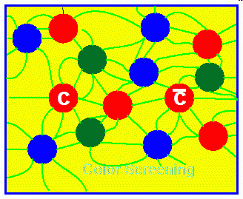
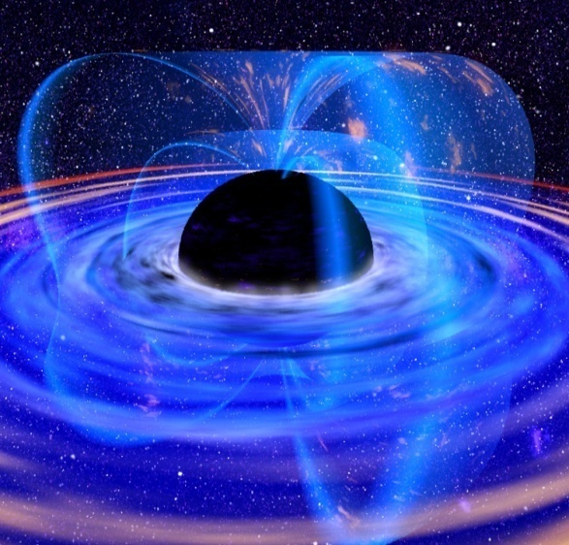
String theory: Extra Dimensions
“QCD” strong coupling
Complicated
4d
Boundary
(we live here)
An Analogy
What’s this?
dual
z
5d bulk theory
In 3D – Its easy to see
Its a Hologram
Gravity
Black hole
“Simple”
Possibility to solve a strongly coupled theory! (for the first time??)

Slide 19
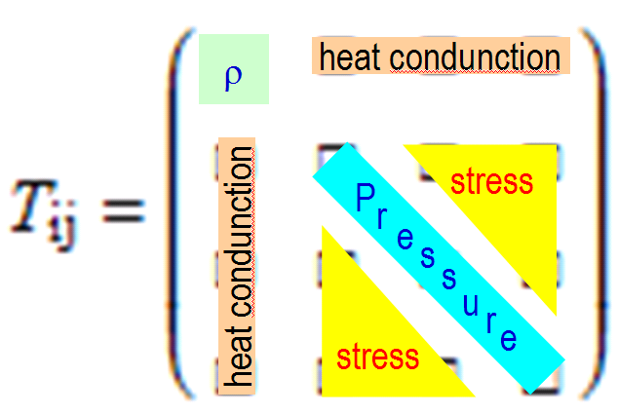
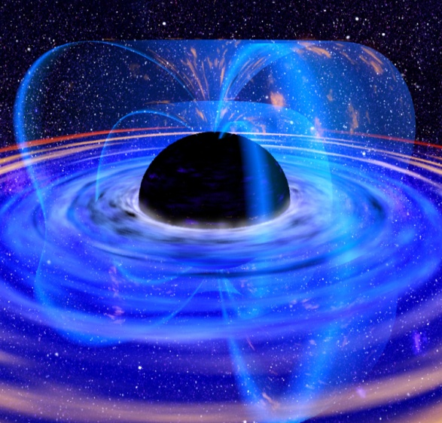
using gauge-string duality (AdS/CFT)
dual
σ(0)=area of black hole horizon
Viscosity
Strongly
coupled
theory
Area of
Black
hole
Theory

Slide 20
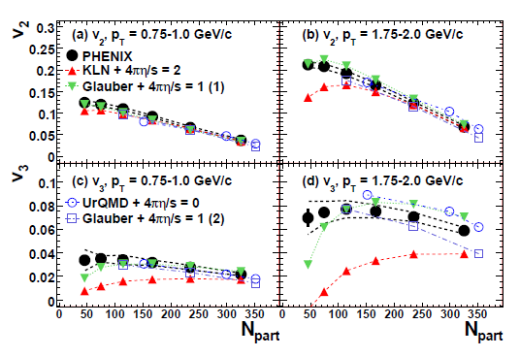
Recently v₃⇨η/s
V₂ measurement consistent
With η/s= 1/4π or 2/4π
Depending on assumed
Initial conditions
V₂
V₃ measurement breaks
This ambiguity
$$\frac{η}{s}=\frac{1}{4π}$$
V₃
$$\frac{η}{s}=\frac{2}{4π}$$
Data
PRL 107, 252301 (2011)

Slide 21
Flow and strongly interacting QGP
In conjunction with theory –
Possibility to ask detailed questions about a QCD system
we are making measurements of unprecedented accuracy
questions:
Are quarks strongly coupled to the quark-gluon plasma at all interaction distance scales?
How is rapid equilibration and entropy production achieved?
By the time sPHENIX starts (2017), probably most soft physics (e.g. flow) will be done – even heavy quarks
So

Slide 22
Jet quenching
colored quarks from hard scattering
Colorless
Hadrons
Hard probes formed
Energy lost
Colored
QGP
“Pre”-RHIC prejudices
Suppression due to bare color charges
Heavy Quarks “not” suppressed
Direct Photons should not be suppressed
⇨ Check of binary scaling
22

Slide 23
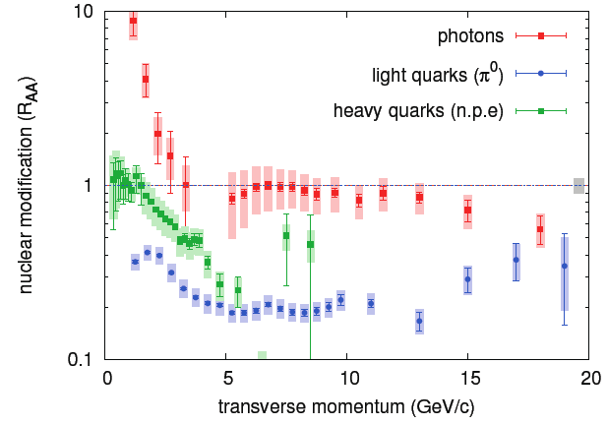
What do we know? Jet quenching
π⁰ suppressed by factor of 5!
Photons
binary scaling OK
Heavy quarks also suppressed!
LHC consistent with RHIC
Direct γ
Heavy Quarks
0.2
π⁰

Slide 24
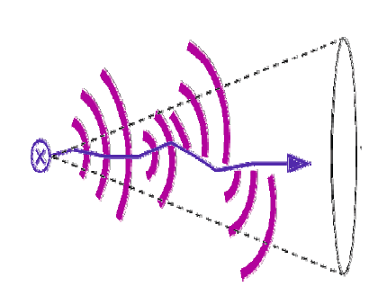
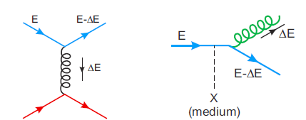
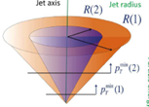
Mechanisms
PQCD inspired (weakly coupled)
Radiative energy loss
e.g. BDMPS, DGLV, AMY
Collisional energy loss
AdS/CFT
(strongly coupled)
Jet broadens
Radiated partons interaction with
medium is treated via AdS/CFT
These thermalize
Fragmentation inside or outside of sQGP ?

Slide 25
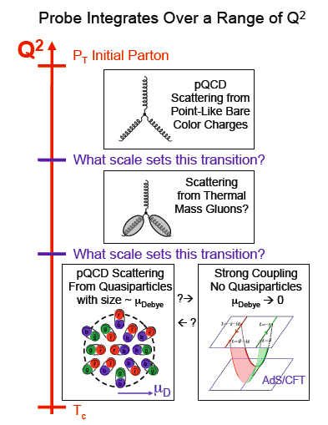
Jet measurements - Questions:
Are quarks strongly coupled to the quark-gluon plasma at all interaction distance scales?
What are the detailed mechanisms for parton-QGP interactions and responses? Are the interactions coherent over the entire medium length scale, what are the dominant energy loss mechanisms?
Are there quasi-particles in the medium? What are their masses and widths?

Slide 26
The future: sPHENIX – a jet detector
Is RHIC relevant in the LHC era?
YES !
⇨QCD Condensed matter physics
Jets become our “laser” with which to probe the medium
sPHENIX – a jet detector: 20-60 GeV
LHC: gluon jets (60 GeV+)
RHIC – quark jet dominated; LHC – gluon jet dominated
RHIC – a dedicated machine able to vary species and energy

Slide 27
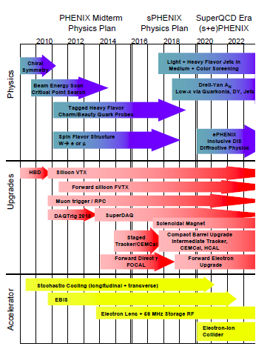
sPHENIX
Large acceptance
Hadronic calorimetry
Also
Good tracking
Good Photon/electron detection
Morph into ePHENIX
Fundamentally a
Jet detector

Slide 28
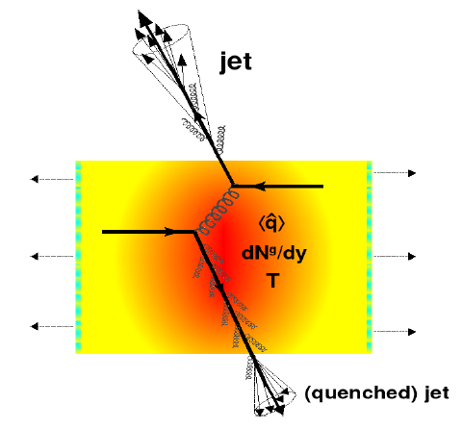
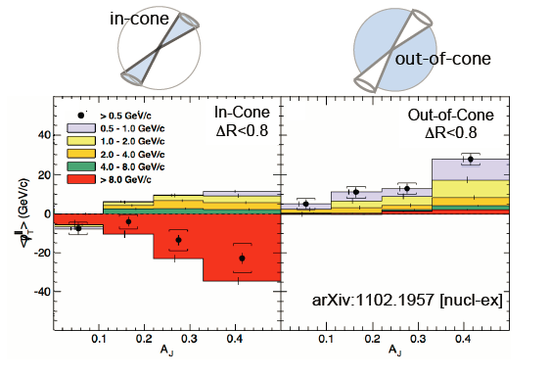
Why full jets?
Jet 1
$A_{J}=\frac{E_{T1}−E_{T2}}{E_{T1}+E_{T2}}$ $∆φ>\frac{π}{2}$
(Quenched) Jet 2
Low p_{T}
Low p_{T}
$$A_{J}$$
CMS
High p_{T}
Pattern of energy loss gives information about the medium

Slide 29
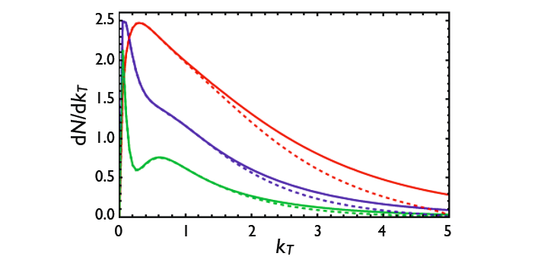
Are lower energy jets different?
DGLV
Distribution of radiated gluon k_{T}
Screening scale
0.25 GeV:green
0.50 GeV:blue
1.0 GeV:red
Solid – 40 GeV Jet
Dashed – 20 GeV

Slide 30
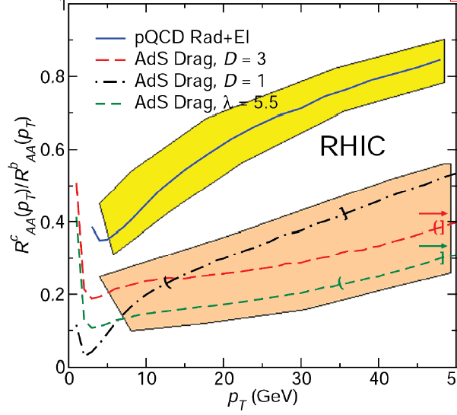
Strongly/weakly coupled?
pQCD
AdS
LHC can do this too but
is the sQGP at the LHC and RHIC the same?
Do the heavy quarks probe the same stage of the collision?

Slide 31
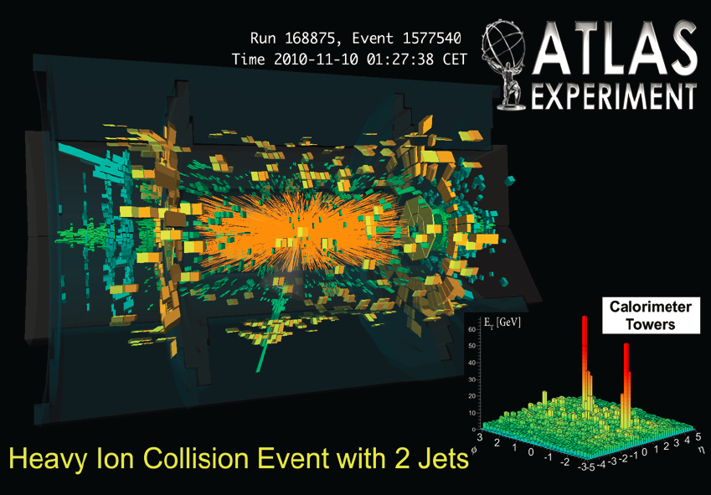
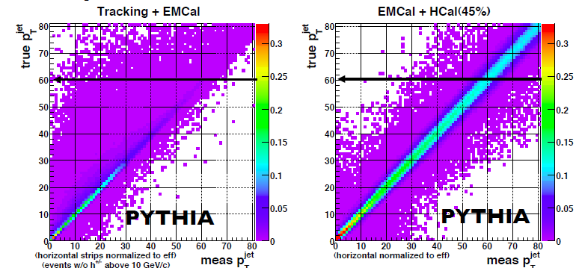
What do you need an HCAL for?
All heavy ion jet publications to date (i.e. ATLAS and CMS) come from hermetic calorimeter measurements !

Slide 34
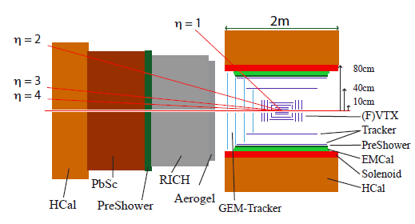

Slide 35
Already probably out of date

Slide 36
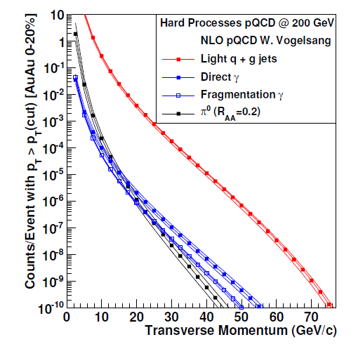
Can one really measure jets at RHIC?
50 billion Au+Au events (10 billion central)
10⁷ jets > 20 GeV
10⁶ jets > 30 GeV
10⁵ jets > 40 GeV
10⁴ jets > 50 GeV
More than 10⁴
direct photons
> 20 GeV

Slide 37
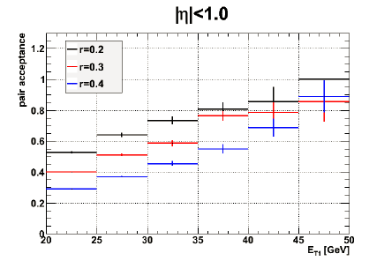
What about pairs of jets?
With two units of pseudorapidity coverage, complete containment more than 50% for di-jets (R=0.2)
Thus 10 million jets > 20 GeV, yields at least 5 million dijet pairs!
First ATLAS paper has ~ 1000 jets > 100 GeV.

Slide 38
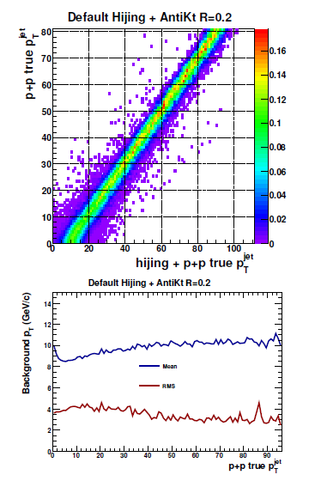
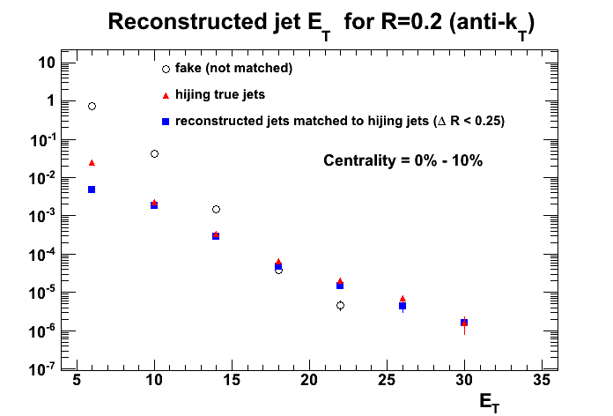
With the right detector and the right rates,
we can measure jets very well at RHIC!
PYTHIA Jet + HIJING
Initial fake jet rate study
Hanks, Sickles
Only ~ 3 GeV of RMS fluctuation on jets with R = 0.2 in central Au-Au
McCumber

Slide 40
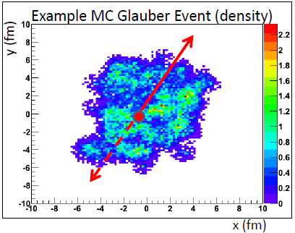
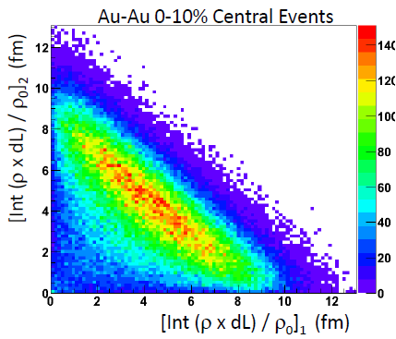
Jamie’s version of their calculation… real geometry and for LHC and RHIC
Simulate collision with fluctuations
Hard scattering proportional to density
Parton path length L is calculated
Gluons are radiated and lost to the medium
Plot A_{J}

Slide 42
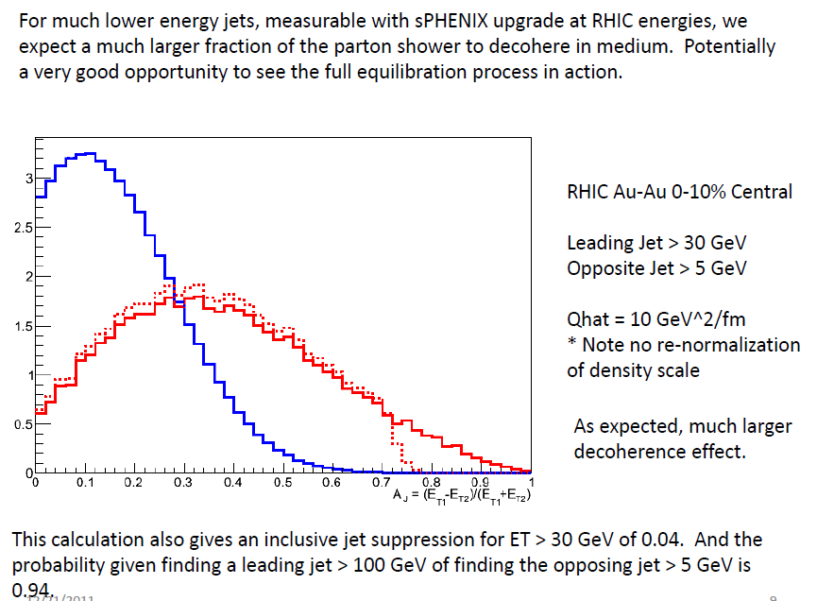

Slide 43
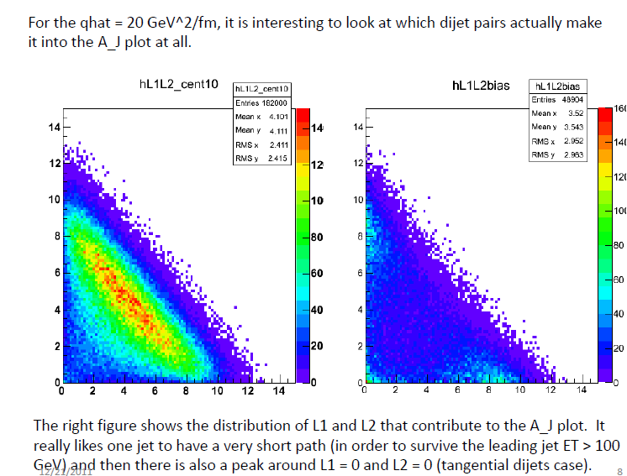
L₂
L₂
L₁
L₁
Equilibration process in action – Medium is opaque to most jets

Slide 44
sPHENIX and the JET Collaboration
We have started active work with the JET collaboration and they are putting calculations together relevant for RHIC energies.

Slide 45
And now for something Completely different (spin, CNM) Transverse Momentum dependent factorization in pA collisions
We usually collinear factorization in our calculations i.e. gluon distribution G(x) – i.e. depends only on x
Good for inclusive
For less inclusive – k_{T} important , TMD(Transverse momentum dependent) factorization
Use unintegrated (in terms of k_{T}) gluon distributions G(x,k_{T})
TMD factorization violated for dijet production in hadron+hadron collisions
Get back TMD factorization in case of small x partons at high density (“CGC regime”) – probed by quark, or photon
Equivalence between TMD and CGC approach in “CGC” regime
Connections to TMD’s in spin? A unification?

Slide 46
xG now comes in two flavors G₁ and G₂ in CGC limit – all CS can be described using G₁ and G₂
PRD 49, 2233, 3352
NPB 529, 451

Slide 47
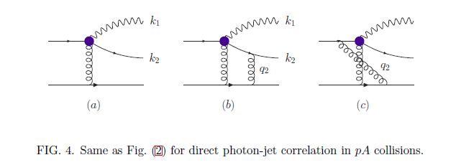
G₂ probed in pA→γ +X
“new” gluon pdf
Quark PDF
Hard scattering part
Au
p

Slide 48
What is unique at RHIC?
ability to probe
a broad range of scales
Varying geometries
ulta-high data rate
What do we what sPHENIX to be
known for 10 years from now?
Uncovering the connection between
the strongest coupled perfect fluid medium to weakly coupled probes and the medium structure.

Slide 49
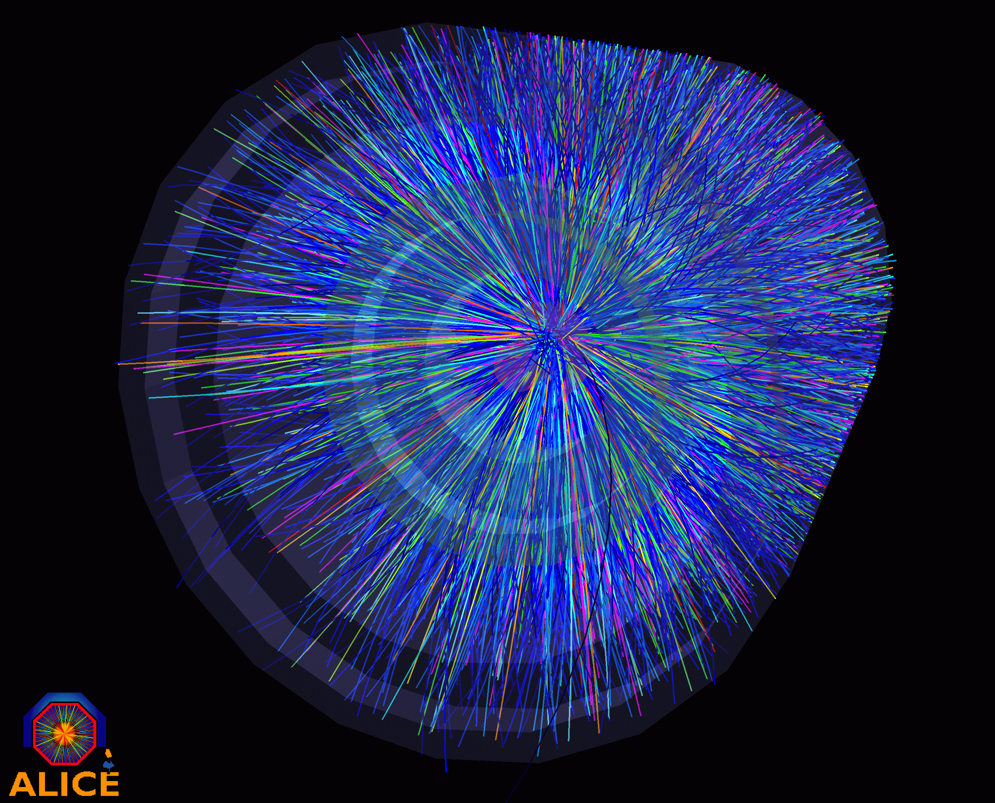
Where are we?
Like trying to study liquid water on a planet whose temperature was a couple hundred degrees below 0º C by shooting ice cubes at each other
Some dates
Thermo Otto von GuerickeOtto von Guericke 1650
Boyle’s law ~1660
Fluid dynamics Blaise Pascal (hydrostatics), Daniel Bernoulli (1700).
We are somewhere between 1660 and 1700
Our Task: move on to do QCD Condensed Matter Physics
big future ahead of us – but I have no idea where it will lead.
Perhaps sometime – far in the future, we will understand the world of the strong interaction, as well as we do the world of the electro-magnetic interaction

Slide 50
Questions:
Are quarks strongly coupled to the quark-gluon plasma at all interaction distance scales?
What are the detailed mechanisms for parton-QGP interactions and responses? Are the interactions coherent over the entire medium length scale, what are the dominant energy loss mechanisms?
Are there quasi-particles in the medium? What are their masses and widths?
Is there a relevant color screening length in the quark-gluon plasma?
How is rapid equilibration and entropy production achieved?
What is the nature of color charge in large nuclei? What role does gluon saturation and the EMC effect play in nucleus-nucleus collisions? How do these modifications evolve?

