Slide 1
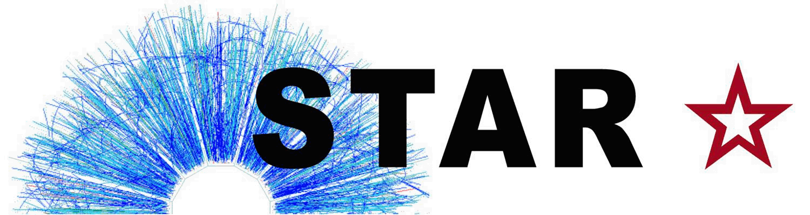

W Boson Production in Polarized p+p Collisions at th
Justin Stevens
LANL P-25 Seminar

Slide 2
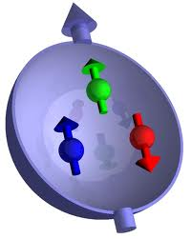
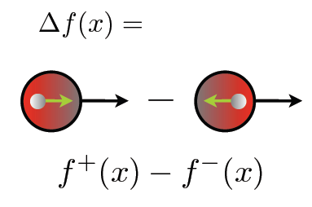
Proton Spin Puzzle
Constituent Quark Model
Integral of quark polarization is well measured in DIS to be only ~30%, but decomposition (especially sea) is not well understood
Helicity Distribution
2

Slide 3
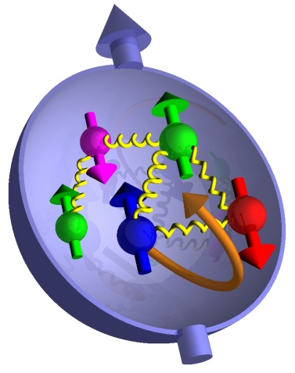
Proton Spin Puzzle
The observed spin of the proton can be decomposed into contributions from the intrinsic quark and gluon spin and orbital angular momentum
Integral of quark polarization is well measured in DIS to be only ~30%, but decomposition (especially sea) is not well understood
Helicity Distribution
Helicity Distribution: Δq, Δg
Not well constrained by DIS and a primary focus of the RHIC spin program
3

Slide 4
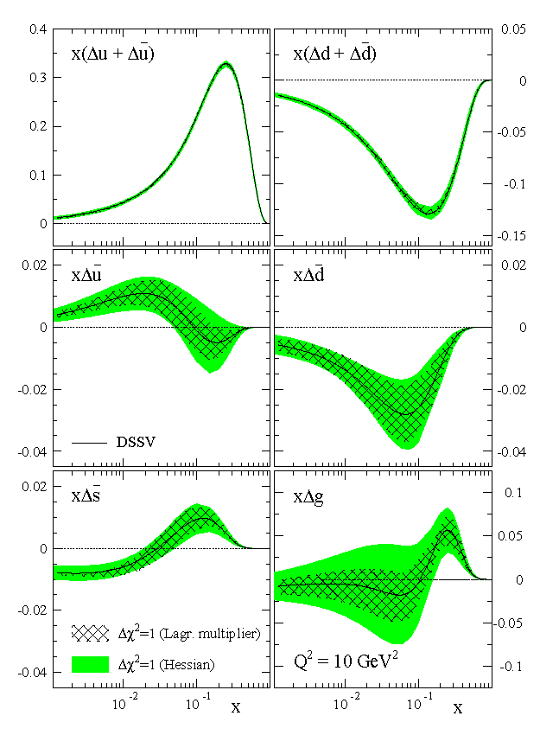
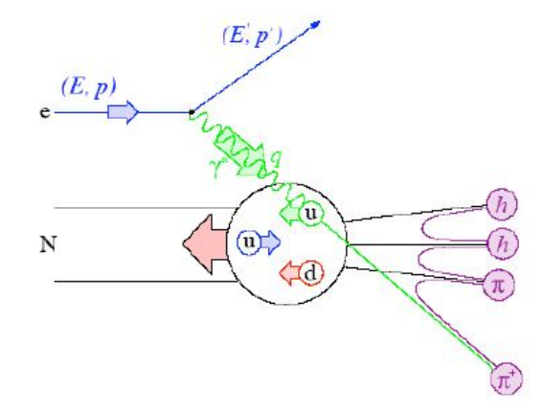
Constraints from Polarized DIS and SIDIS
Inclusive Polarized DIS
  Precise determination of
  Not sensitive to individual quark distributions
Semi-inclusive Polarized DIS
  Separate quark /antiquark distributions via detection of final-state hadron and use of fragmentation functions
4
Notes:
Need a few formulas to give context

Slide 5
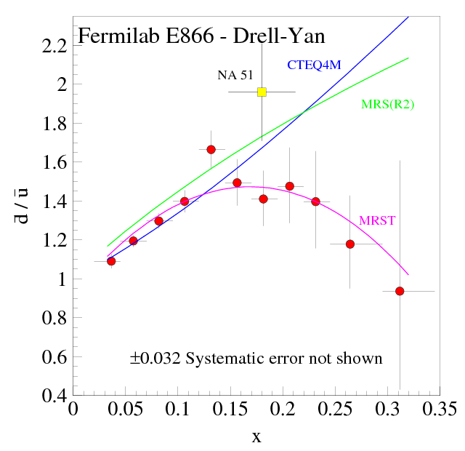
Flavor Asymmetry of the Sea
Unpolarized Flavor Asymmetry:
Quantitative calculation of Pauli blocking does not explain ratio
Non-perturbative processes may be needed in generating the sea
E866 results are qualitatively consistent with pion cloud models, chiral quark soliton models, instanton models, etc
PRL 80, 3715 (1998)
Q²=54GeV
u
d
u
¯
d
d
5

Slide 6
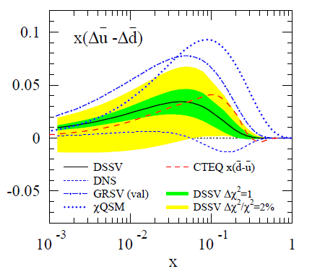
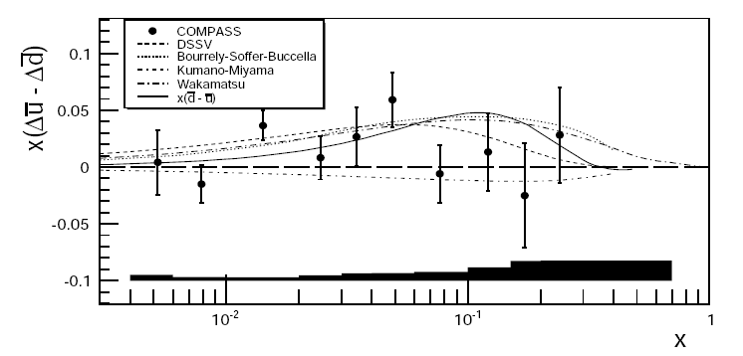
Studying the Sea Polarization
Polarized Flavor Asymmetry:
Valence u and d distributions are well determined from DIS
Polarized flavor asymmetry could help differentiate models
arxiv1007.4061
6
Notes:
Mention hermes points as well
BSC = Statistical Model
Wakamatsu = Chiral Quark Soliton
Kumano-Myama = Meson Cloud

Slide 7
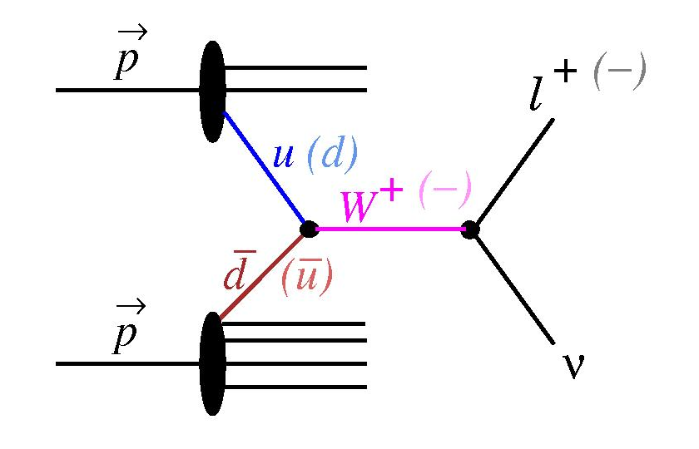
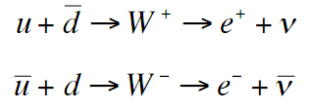
Probing the Sea Through W Production
Detect Ws through
e⁺/e⁻ decay channels
Measure parity-violating single-spin asymmetry:
(Helicity flip in one beam while averaging over the other)
7

Slide 8
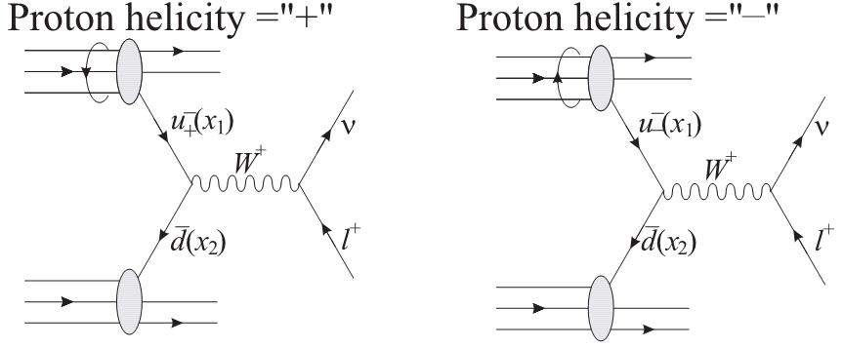
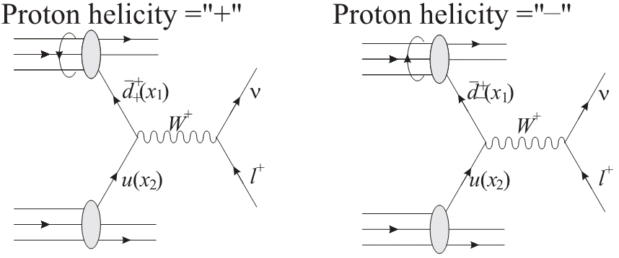
Parity-Violating Asymmetry: A_{L}
V-A coupling of the weak interaction leads to perfect spin separation
Only LH quarks and RH antiquarks
+
8

Slide 9
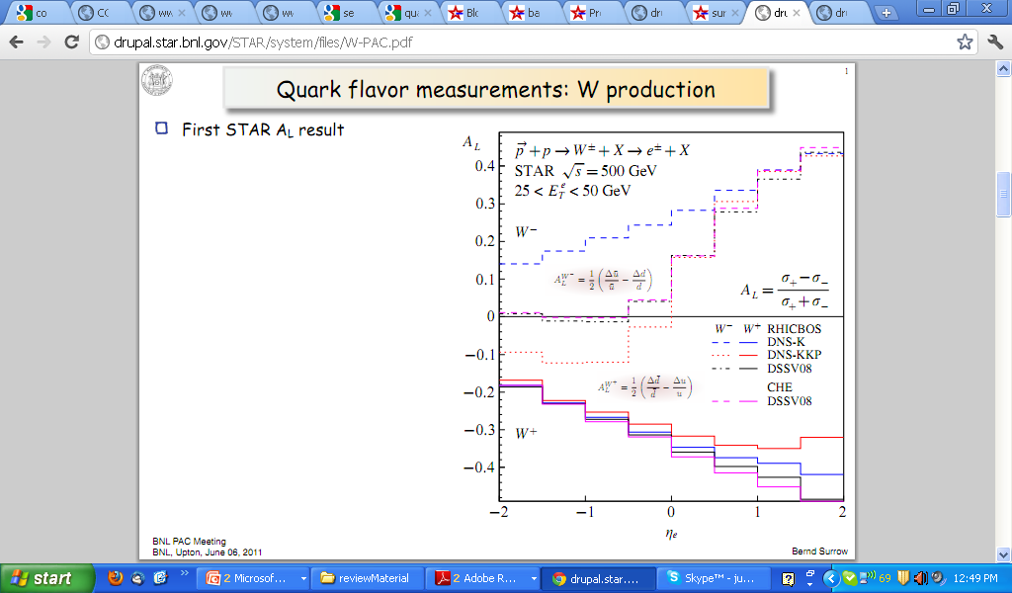


Expectations for A_{L}
Large parity-violating asymmetries expected
Simplified interp. at forward rapidity
Spread in curves gives qualitative feel for uncertainty in helicity distributions
9
Notes:
Mention forward/backward diff and refer to later…

Slide 10
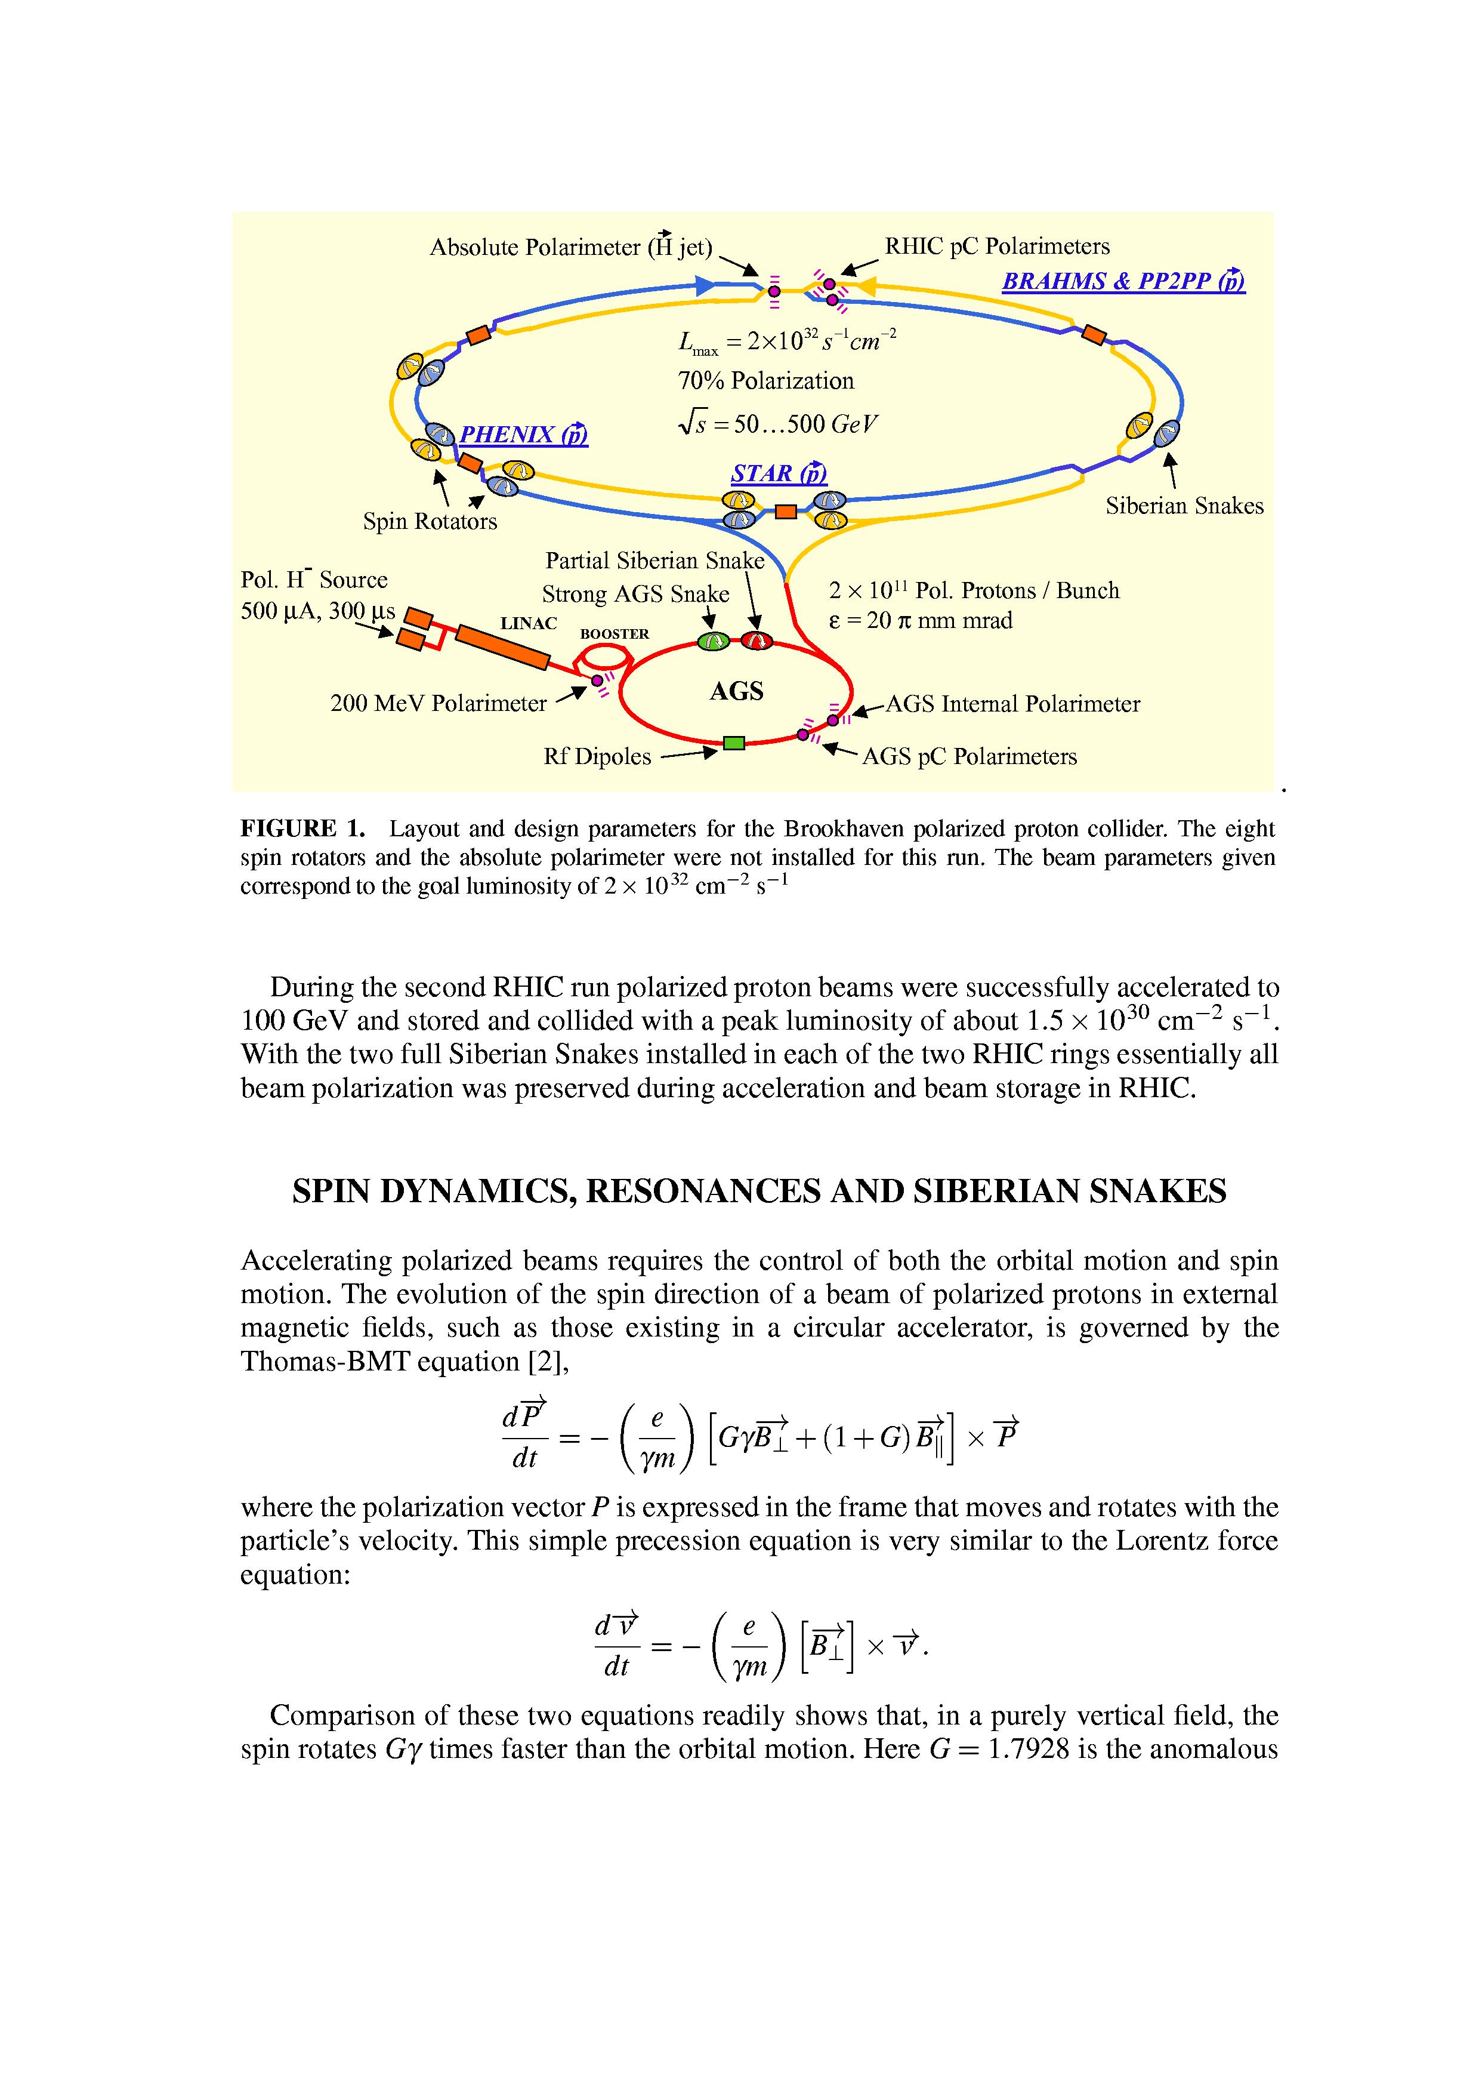
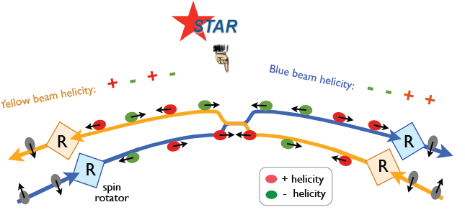
RHIC - First Polarized pp Collider
Spin Rotators at IR’s: transverse and longitudinal spin orientation possible
CNI polarimeters + H-Jet target: measure polarization
√s=200 GeV
  2006: P=58%, 2009: P=56%
√s=500 GeV
  2009: P=40%, 2011: P=50%
AGS Helical Partial Snake
10

Slide 11
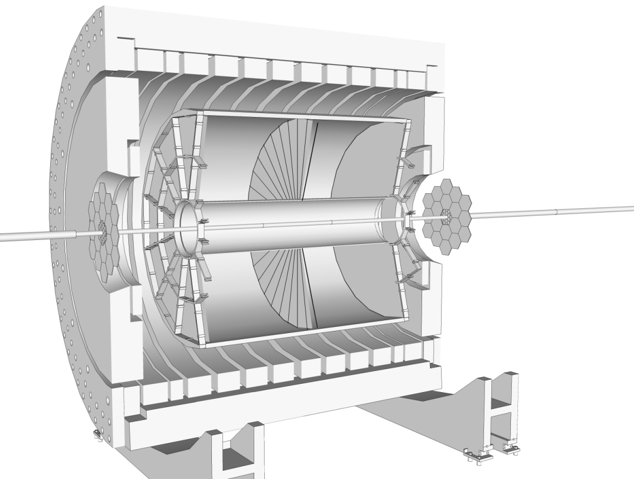
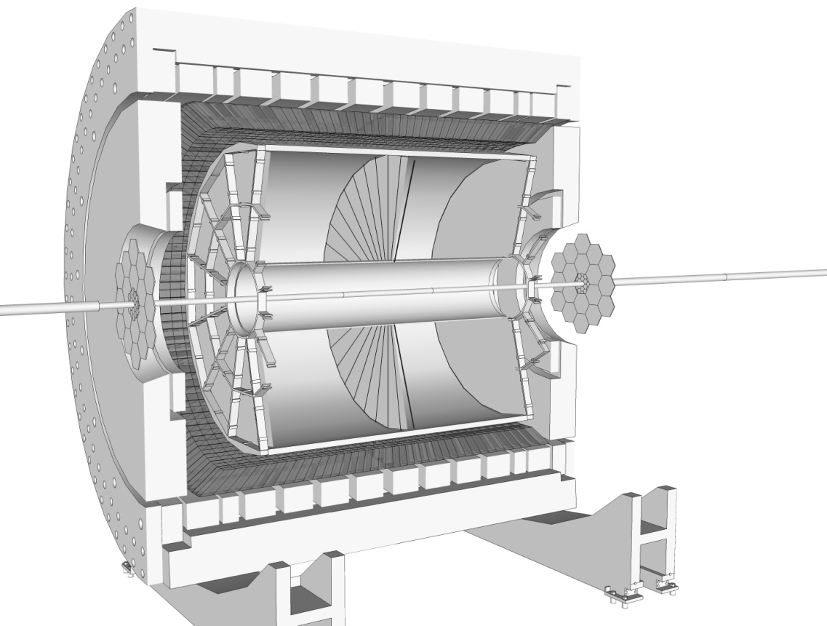
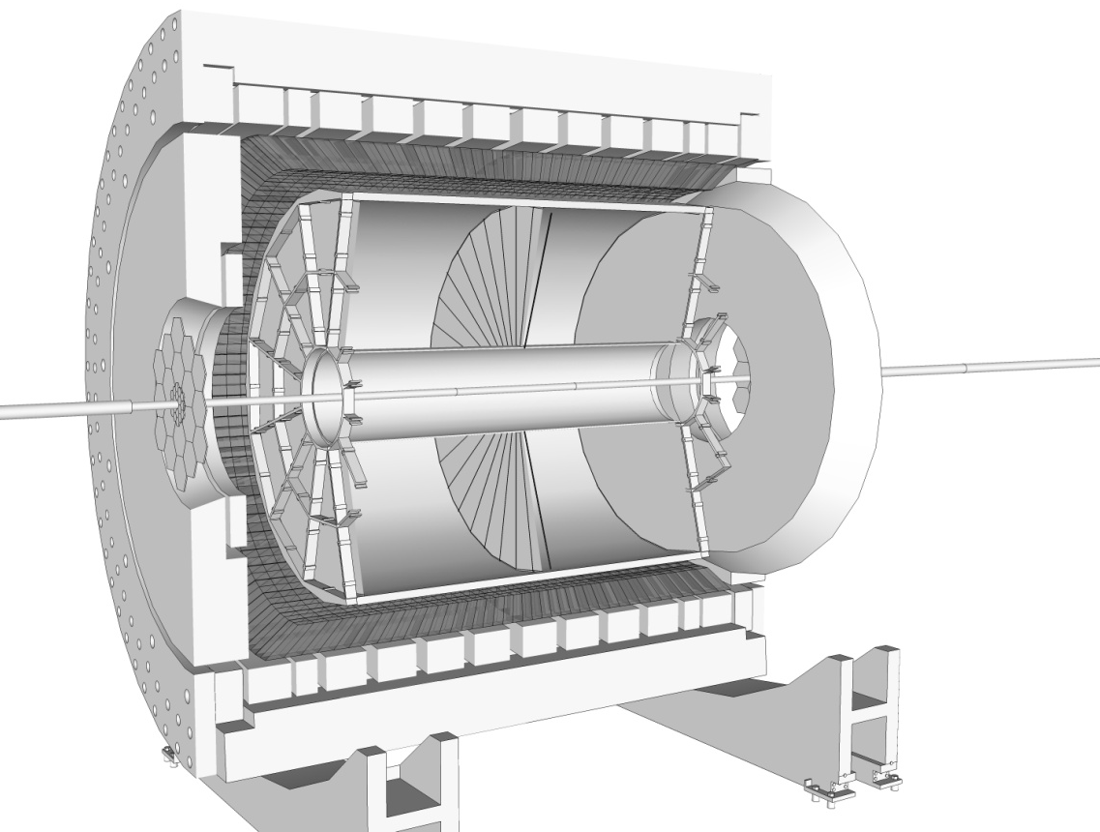
Detector Overview
0.5T Solenoidal Magnet
Triggering Barrel EM Calorimeter (BEMC): |η| < 1
Time Projection Chamber (TPC):
Charged particle tracking |η| < 1.3
Triggering Endcap EM Calorimeter (EEMC):
1.1 < η < 2
11
Notes:
Spend some time here:
-TPC: how does it work
-BEMC: explain tower and size 3 degrees in phi

Slide 12
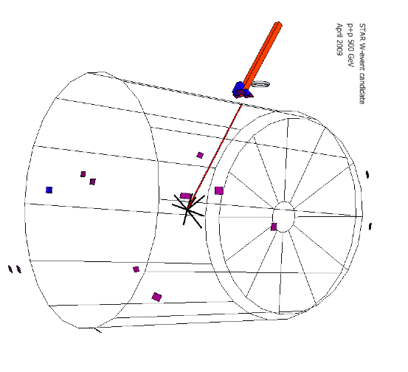
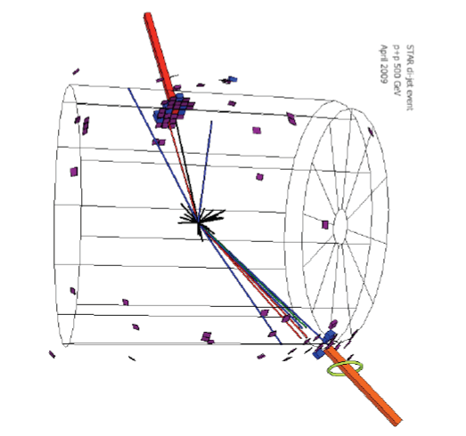
W → e + ν Candidate Event
Isolated track pointing to isolated EM deposit in calorimeter
Large “missing energy” opposite electron candidate
Di-jet Background Event
Several tracks pointing to EM deposit in calorimeter spread over a few towers
Vector pt sum is balanced by opposite jet, “missing energy” is small
12

Slide 13
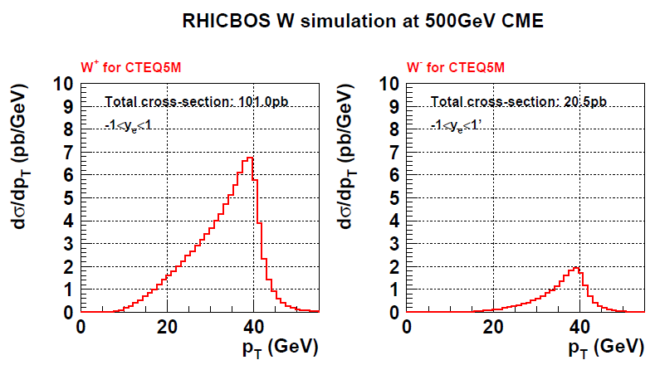
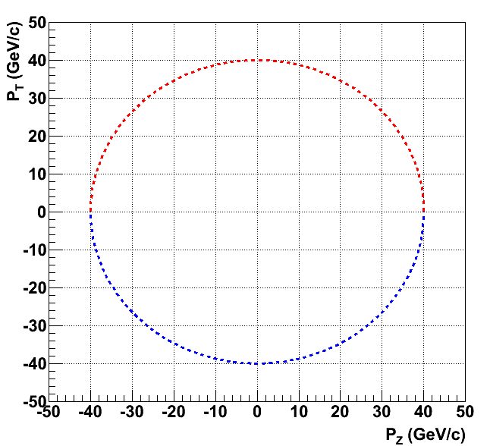
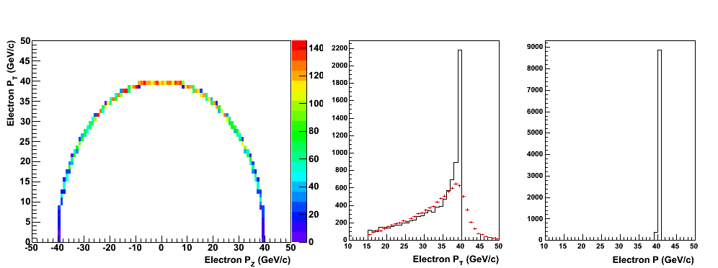
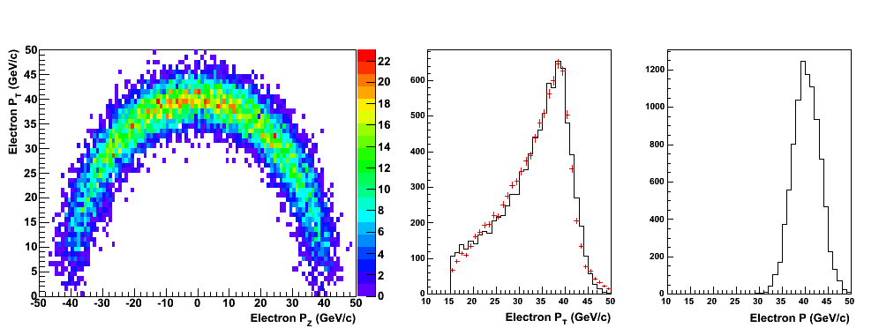
W Decay Kinematics: Jacobian Peak
Ideally reconstruct W mass to search for signal
  Not possible with neutrino in final state
  STAR isn’t hermetic so can’t reconstruct “missing E_{T}”
Instead use electron E_{T} distribution
  At mid-rapidity expect “Jacobian Peak” at ~M_{W}/2
Theory Cross Section
W Rest Frame
Electron
Add Smearing from W p_{T}
Model
Pythia
Model
Pythia
Neutrino
13

Slide 14
Analysis Philosophy
Expect a Jacobian peak in the electron E_{T} distribution
Expect a steeply falling background, but large compared to signal
~M_{W}/2
Yield
W Signal
Yield
QCD Background
E_{T}
E_{T}
~M_{W}/2
Yield
Look for excess in electron E_{T} spectrum at M_{W}/2
E_{T}
14

Slide 15
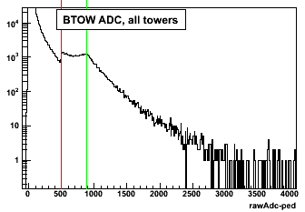
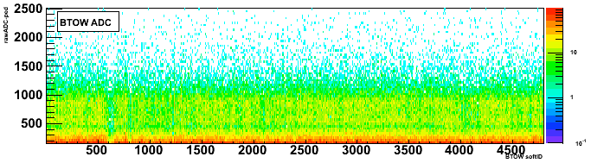
W→e+ν EMC Trigger
Trigger:
Level 0: BEMC Single High Tower Threshold (E_{T} > 7.3 GeV)
Level 2: BEMC 2x2 Cluster E_{T} Software Threshold (E_{T} > 13 GeV)
Ws out here
ADC ~ E_{T}
ADC ~ E_{T}
~97% of BEMC participate in trigger
15
Notes:
Figure of barrel towers in trigger (~97% in trigger… tribute to my work on BEMC?)

Slide 16
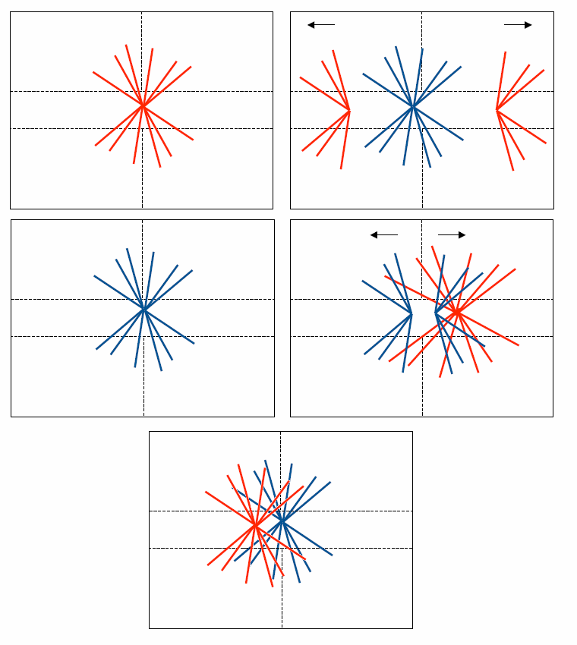
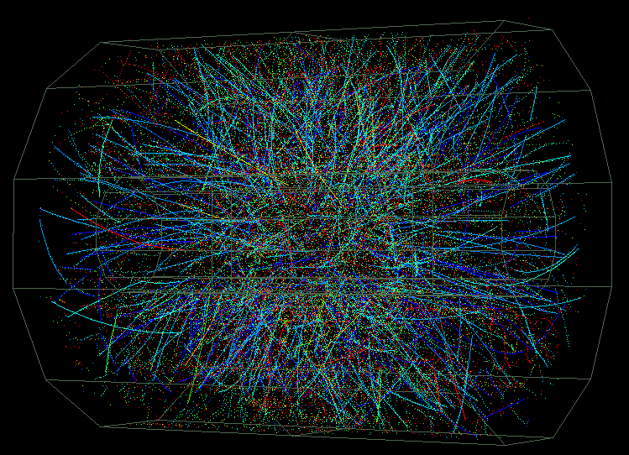
Experimental Challenges: I
Charged track “pileup” in the TPC
  Electronic charge takes ±38 μs to drift through TPC
  Bunch crossing period is 107 ns, so integrate over ~335 bunch crossings (ie. order ~30 MB collisions)
Earlier Bunch Crossing
Later Bunch Crossing
Same Bunch Crossing
Triggered Event
Pileup Collision
16

Slide 17
Experimental Challenges: II
High p_{T} charge sign separation in 0.5 T B-field with finite spatial resolution
  STAR tracking optimized for lower p_{T} in inclusive hadron Heavy Ion analyses
  TPC NIM states design for maximum momentum of 30 GeV and W decay e± at 40 GeV!
BEMC energy calibration at high energies
  Calibrations determined from relatively low p_{T} e±
  Well above energy scales of typical STAR analyses
  Scale verified with Zs and Jacobian peak “position”
17

Slide 18
Event Selection and
Cross Section
18

Slide 19
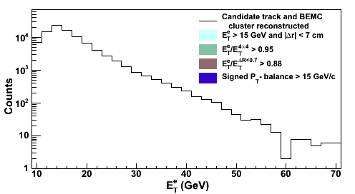
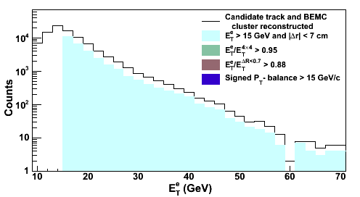
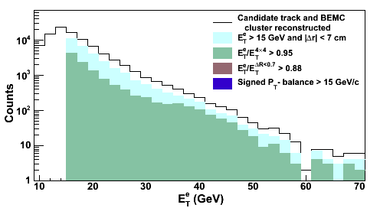
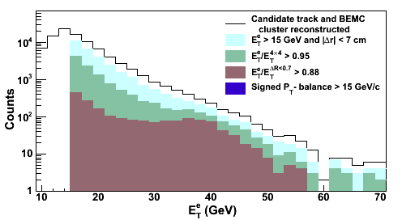
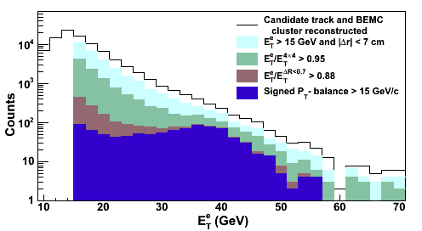
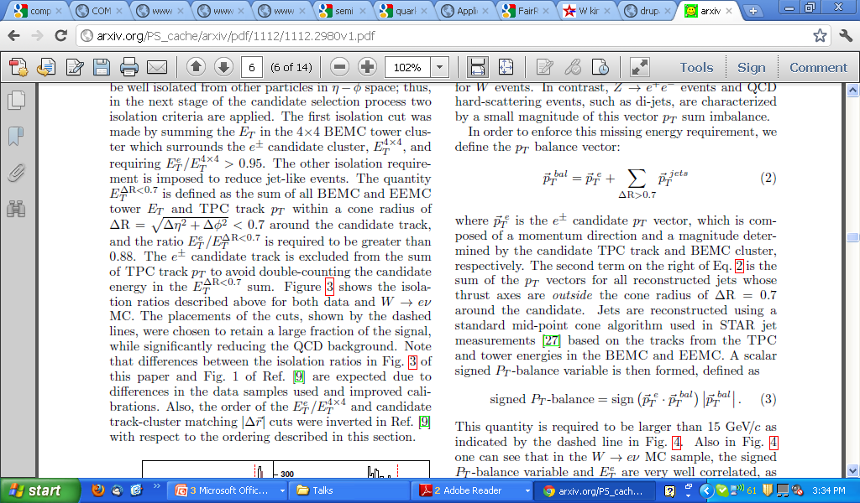
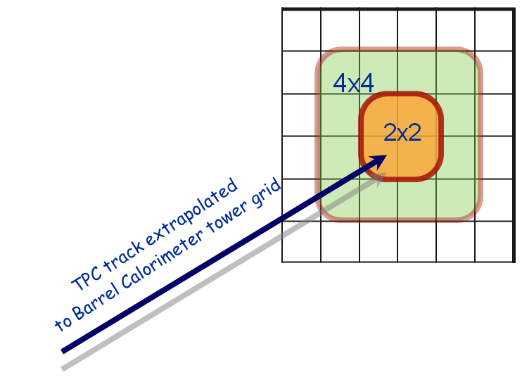
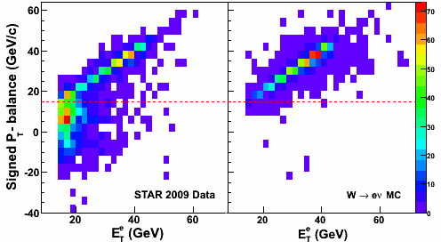
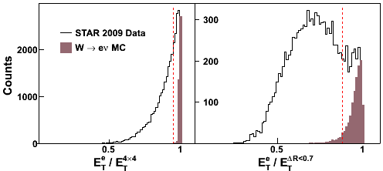
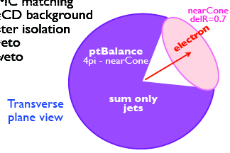
W Candidate Selection
Match high pT track to BEMC cluster
Isolation Ratios
Signed-Pt Balance
19
Notes:
Suppress jets with leading hadron
Near side jet-cone veto
Suppress di-jets and multi-jet events
Require an imbalance in p_{T} of the lepton cluster and any jets reconstructed outside the near side jet cone

Slide 20
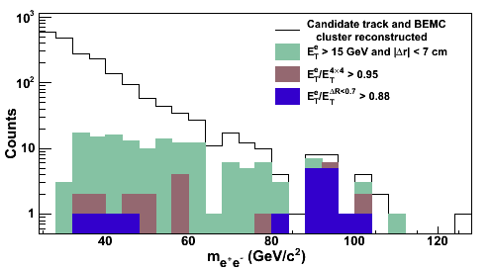
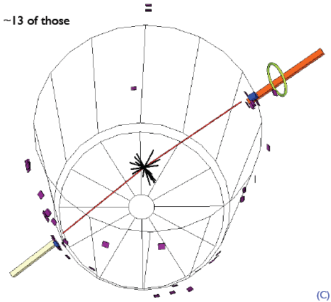
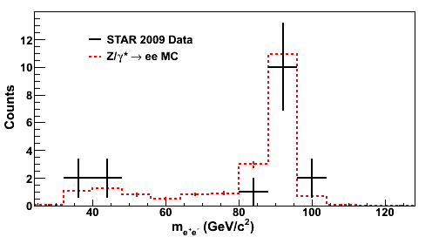
Z Candidate Selection
Similar isolated lepton requirements as W candidates
Good agreement between data and MC
Z Candidate Event
20

Slide 21
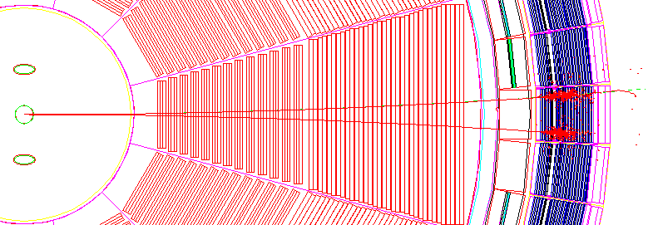
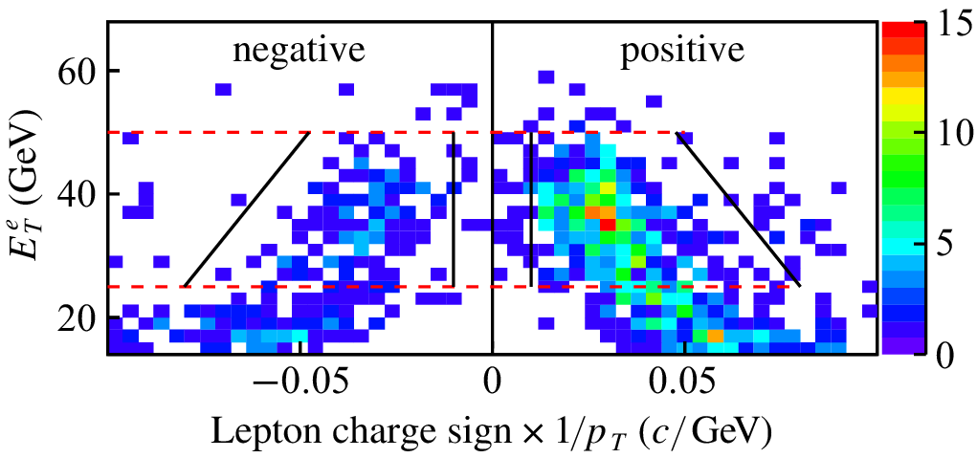
e⁺/e⁻ Charge Separation at High P_{T}
BEMC
TPC
TPC
TPC
vertex
positron P_{T} = 5 GeV
electron P_{T} = 5 GeV
+/- distance D ~ 1/P_{T}
P_{T}=5 GeV : D~15 cm
P_{T}=40 GeV : D ~2 cm
200 cm of tracking
21

Slide 22
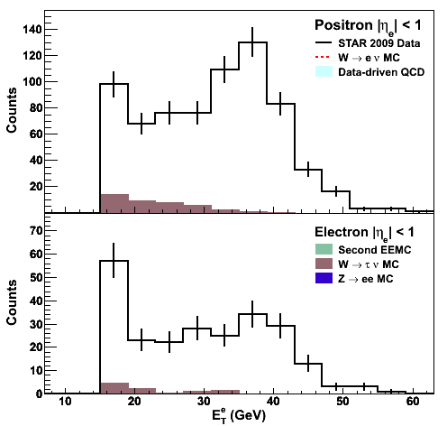
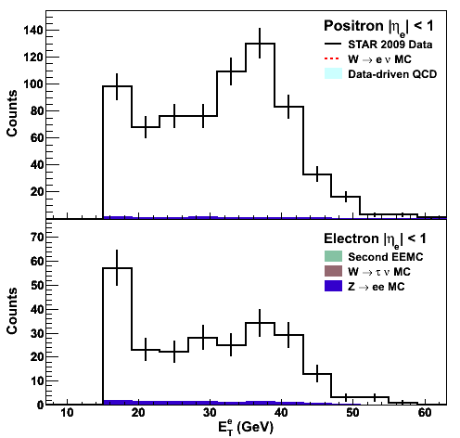
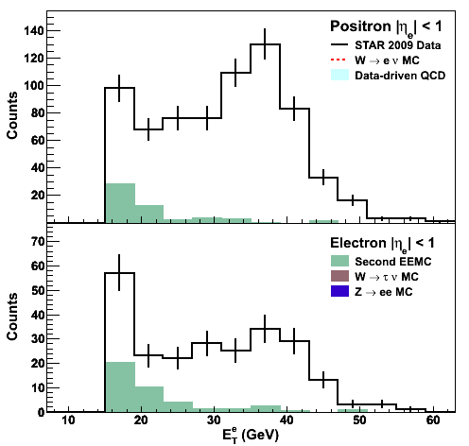
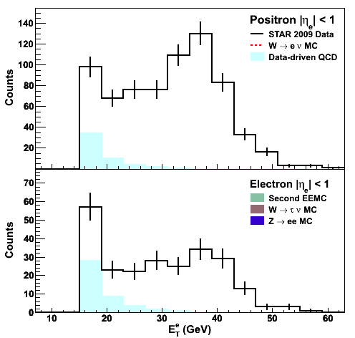
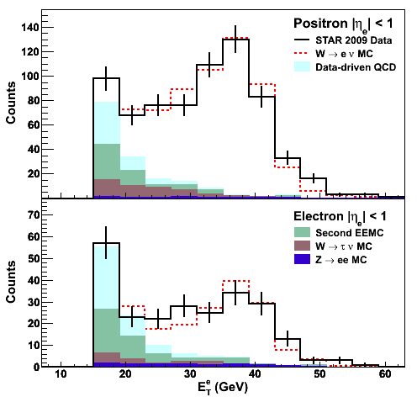
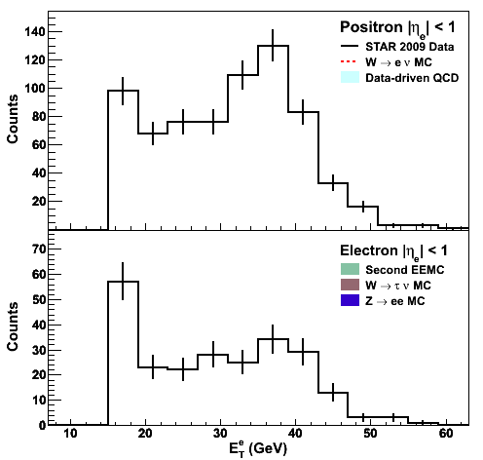

Background Estimation
Sources:
EWK: W→τ+ν, Z→e⁺e⁻
Second EEMC
Data-driven QCD
Good Data/MC agreement
22

Slide 23
Measured Cross Sections
Reconstruction efficiencies determined from MC
  PYTHIA W and Z events are embedded into “zerobias” events from data, simulating realistic pile-up effects
+
23

Slide 24
Measured Cross Sections
Reconstruction efficiencies determined from MC
  PYTHIA W and Z events are embedded into “zerobias” events from data, simulating realistic pile-up effects
Acceptance corrections determined from NLO calculation
  Significant uncertainty contribution from PDFs
Systematic Uncertainties
  Dominated by integrated luminosity measurement from Vernier Scan uncertainties (13%)
  Smaller contributions from background estimation, BEMC energy scale, track reco. effic. , and acceptance corrections
24

Slide 25


Measured Cross Sections
Good agreement between experiment and theory over wide kinematic range
Validates the use of an NLO theory framework to extract helicity distributions from the spin asymmetry A_{L}
arXiv:1112.2980
25

Slide 26

W Cross Section Ratio: R_{W}
Ratio of W+ to W- cross sections sensitive to unpolarized sea quark flavor asymmetry
Complementary to fixed-target DY and LHC collider measurements
arXiv:1112.2980
PRL 80, 3715 (1998)
26

Slide 27
Spin Asymmetry
27
Notes:
Note polarization important…?

Slide 28




Longitudinal Polarization at STAR
Yellow beam helicity:
+ - + -
Blue beam helicity:
- - + +
spin rotator
spin rotator
+ helicity
- helicity
(mostly) longitudinal polarization
transverse pol
transverse pol
STAR sees four helicity configurations
28

Slide 29

Relative Luminosity
Relative Luminosity monitor, E_{T}<20 GeV
arb. units
Integrated luminosity for the helicity configurations not necessarily the same
Use ratio of statistically independent background sample to normalize spin dependent yields
Spin dependent luminosity of four spin states monitored to ~1%
B - Y -
B - Y +
B + Y -
B + Y +
Helicities of
beams colliding at STAR
29

Slide 30

What Is Actually Measured?
P-V AL
( the goal )
ALL
30

Slide 31

Lots of Asymmetries
AL
ALL
Null test
31

Slide 32

Lots of Asymmetries (cont.)
W⁺
W⁻
ALL
Null test
P-V
AL
P-V
AL
ALL
Null test
32

Slide 33


STAR W A_{L}
STAR Run 9 Result
PRL 106, 062002 (2011)
33

Slide 34
Future Plans for A_{L}
34

Slide 35



W Decay Kinematics
Use lepton rapidity as a surrogate for W rapidity based on W decay kinematics
e⁻⁽⁺⁾ are emitted along (opposite) the W⁻⁽⁺⁾ direction
Fraction of events where polarized proton provides the anti-quark
q
q
polarized
unpolarized
35

Slide 36


Forward GEM Tracker (FGT) Upgrade
6 light-weight triple-GEM disks using industrially produced GEM foil
Provide tracking and charge sign ID at forward η
Partial Installation for 2012
η=1
η=2
FGT
36

Slide 37


FGT Installation
Cosmic ray “test stand” operating in STAR DAQ system
Analysis of cosmic ray data ongoing
Installation of 14/24 quarter sections complete
37

Slide 38


Future STAR W Measurements
Near term (2012)
  L ≈ 100 pb⁻¹
  P ≈ 50%
Multi-year program
  L ≈ 300 pb⁻¹
  P ≈ 70%
  Significant constraints on the polarized anti-quark sea PDFs
S/B = 5
38

Slide 39
A Possible New Direction:
W Production in Transversely
Polarized p +p Collisions
Left
Right
39

Slide 40



Transverse Single Spin Asymmetries
E704
PRL 97, 152302
Large transverse spin asymmetries consistent over an order of magnitude in √s up to 200 GeV
Cross sections measured at forward rapidity at RHIC are reasonably described by pQCD
Proposed pQCD mechanisms for large A_{N}:
  Sivers Effect: parton orbital motion
  Collins Effect: transversity + fragmentation
Left
Initial pQCD prediction
Right
40

Slide 41
Mechanism for Large Transverse Spin Effects
Sivers mechanism: asymmetry in production of jet, γ, W, etc.
Collins mechanism: asymmetry in the forward jet fragmentation
S_{P}
S_{P}
k_{T,q}
p
p
p
p
S_{q}
k_{T,π}
Sensitive to proton spin – parton transverse motion correlations
Sensitive to transversity
Need to go beyond inclusive hadron measurements
Possibilities include jets, direct photons, Drell-Yan, Ws, etc.
41
Notes:
Sivers=Initial State and Collins=Final State

Slide 42




Testing the Universality of the Sivers Function
Drell-Yan A_{N}
W A_{N}
  W production and DY share the same Sivers function
  Asymmetries are large in magnitude for Ws
  Lepton decay dilutes the effect
Sivers function measured in SIDIS vs DY expected to differ by a sign
Need DY results to verify the sign change: critical test of TMD approach
42

Slide 43
Summary and Outlook
The production of W bosons in polarized p+p collisions provide a new means of studying the spin and flavor asymmetries of the proton sea quark distributions
STAR’s first measurements of the parity-violating asymmetry A_{L} and cross sections are in good agreement with theoretical expectations
STAR has a bright future for continuing to explore nucleon spin structure through W production
  Improved statistical precision for A_{L} at mid-rapidity
  Forward rapidity measurements with the FGT upgrade
  Possible test of the universality of the Sivers function in transversely polarized collisions
43

Slide 44
Backup
44

Slide 45

Proton Spin Puzzle
Constituent Quark Model
In reality the proton is a “bag” of bound quarks and gluons interacting via QCD
  Contributions from spin and orbital angular momentum of quarks and gluons
p is made of 2u and 1d quark
S = ½ = Σ S_{q}
u
u
Explains magnetic moment of baryon octet
d
45

Slide 46


Full set of DSSV polarized distributions
de Florian et al, PRL 101, 072001
and arXiv:0904.3821
46

Slide 47
Probing the Sea Through W Production
Detect Ws through e⁺/e⁻ decay channels
V-A coupling leads to perfect spin separation
  LH quarks and RH anti-quarks
Neutrino helicity gives preferred direction in decay
Measure parity-violating single-spin asymmetry:
(Helicity flip in one beam while averaging over the other)
47

Slide 48
What About Forward Rapidity?
Run 9 and Run 11 results are limited to mid-rapidity (|η| < 1), where A_{L} is a mixture of quark and anti-quark polarization
At forward/backward rapidity a simplified interpretation emerges as the lepton rapidity can be used to help determine whether the polarized proton provided the quark or anti-quark
Fraction of events where polarized proton provides the anti-quark
q
q
polarized
unpolarized
Notes:
Need better description why large \eta_e gives good surrogate for \eta_W

Slide 49



Vernier Scan
49

Slide 50






Cross Section Summary Tables
Fiducial Cross Sections
Efficiency Corrections
Acceptance Corrections
50

Slide 51


Background Effects on Asymmetry
51

Slide 52


What does FGT Add?
eta~1
eta~2

Slide 53


What is a GEM Detector?
High gain (~10⁶)
Fast (<20 ns FWHM)
Low mass
Good spatial resolution
Inexpensive
Foils produced by CERN and Tech-etch
53

