Slide 1
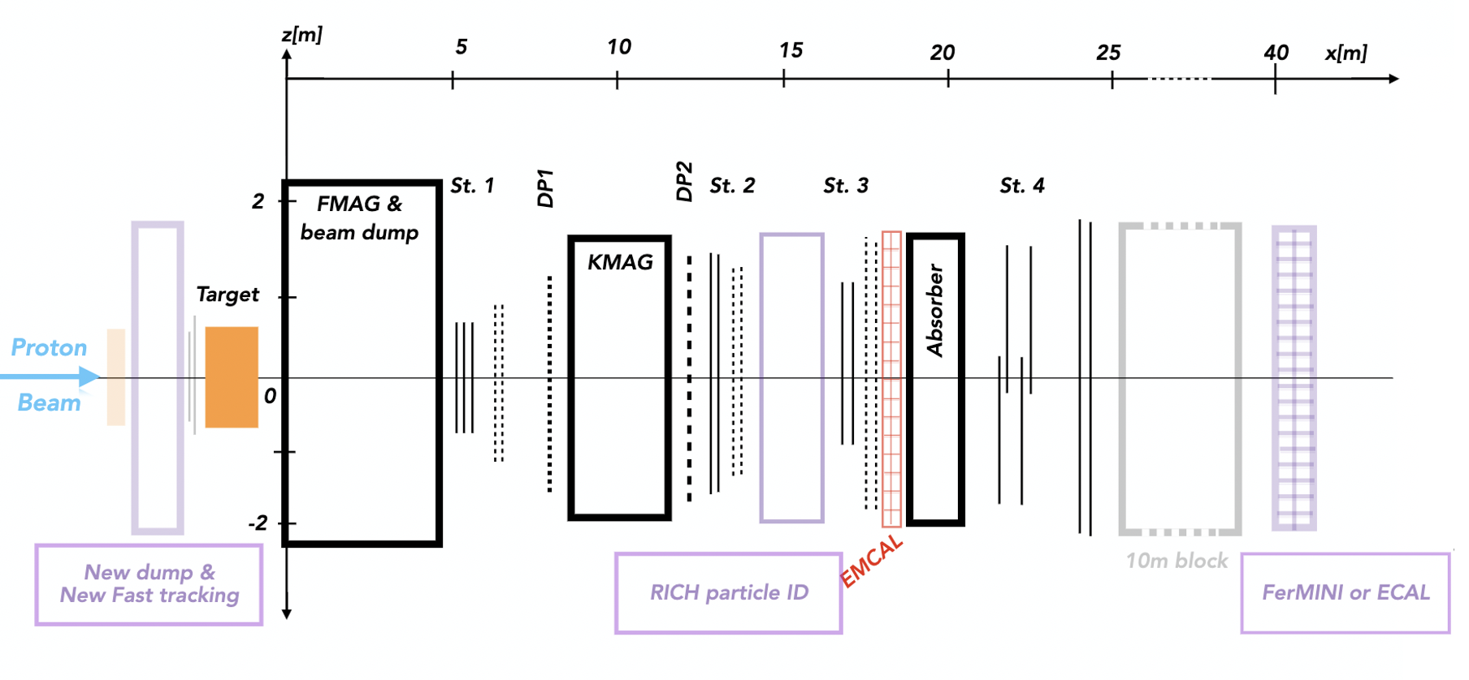
Tsai, de Niverville, Liu, 1908.07525, LongQuest
Dark-Sector Searches at Intensity Frontier & Towards New LANL Opportunities
Yu-Dai Tsai, Fermilab/U Chicago
[1] Dark photon, inelastic dark matter, muon g-2, and LongQuest (1908.07525)
[2] The FerMINI Experiment (1812.03998, PRD ‘19)
[3] Millicharged Particles (MCPs) in Neutrino Experiments (1806.03310, PRL ‘19)
[4] FORMOSA (2010.07941, NEW)

Slide 2
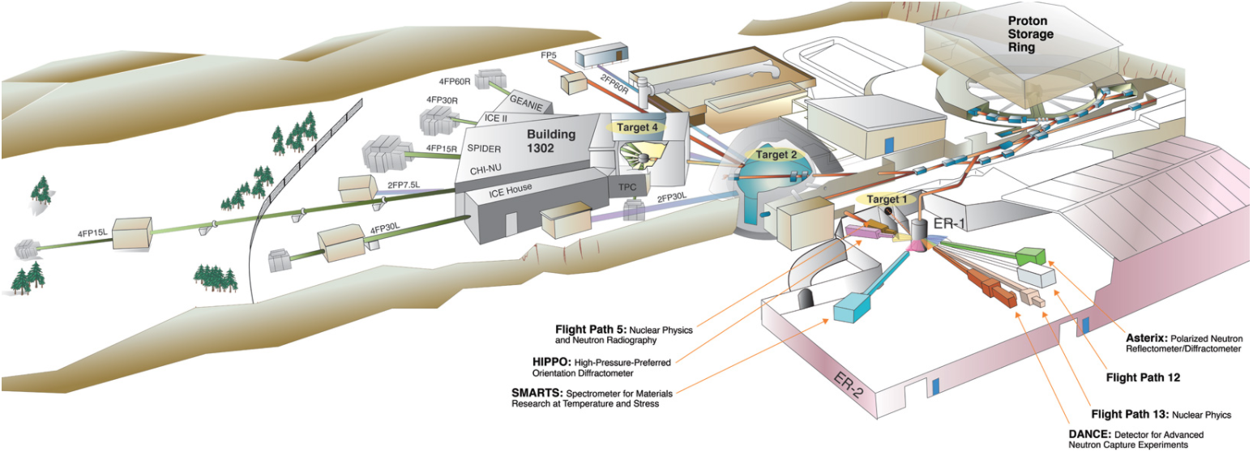
Lujan Center at LANSCE
https://lansce.lanl.gov/facilities/index.php
Proton Fixed-Target Experiments Decay vs Scattering Detectors
[5] Light Scalar & Dark Photon at BoreXino & LSND, 1706.00424, PLB ‘18 (proton-charge radius anomaly) w/ Pospelov
[6] Dipole Portal Heavy Neutral Lepton, 1803.03262, PRD ‘18
(LSND/MiniBooNE anomalies) w/ Magill, Plestid, Pospelov
[7] Dark Neutrino at Scattering Exps: CHARM-II & MINERvA, 1812.08768, PRL ‘19
(MiniBooNE Anomaly) w/ Argüelles, Hostert
Many relevant references listed in the end; Please let me know if there are missing refs.
Email: yt444@cornell.edu; arXiv: https://arxiv.org/a/tsai_y_1.html

Slide 3
Outline
Motivations: Why MeV – 10 GeV New Physics?
Decay vs Scattering Experimental Probes
Decay studies (e.g., dark photons) & the LongQuest proposal
Specialized millicharge experiment: FerMINI & FORMOSA
New LANL Opportunities! in addition to the CCM exp (congrats on the 1st DM result!)

Slide 4
Motivations
Yu-Dai Tsai, Fermilab, 2021

Slide 5
Exploration of Dark Sector
Ultralight DM, Axions, and ALPs
Dark-Sector Models for GC gamma-ray/AMS anti-p excess, 1912.08821
Neutrino!
Bramante, Linden, Tsai
PRD’17, 1706.05381
SIMPs/ELDERs
ELDER: Kuflik, Perelstein, Lorier, and Tsai PRL ‘16, 1512.04545; JHEP ’17, 1706.05381
US Cosmic Visions, 1707.04591
Astrophysical/cosmological observations: important to reveal the actual story of dark matter (DM).
Why fixed-target experiments? And why MeV – GeV+, in addition to the motivation of thermal dark matter
Notes:
40-70 GC / 46-94 anti-p

Slide 6
Why study MeV – GeV+ dark sectors? Signals of discoveries grow from anomalies Dark Matter & Standard Model connections
Yu-Dai Tsai, Fermilab, 2021

Slide 7
Some anomalies involving MeV - GeV+ Explanations
︙
Muon g-2 anomaly
EDGES result
LSND & MiniBooNE anomaly
︙
Below ~ MeV there are also strong astrophysical/cosmological bounds that are hard to avoid even with very relaxed assumptions

Slide 8
v Hopes for New Physics
EDGES 21-cm absorption spectrum anomaly
Millicharged Particles in Neutrino Experiments, Magill, Plestid, Pospelov & Tsai, PRL ‘19, 1806.03310
Cosmic-ray produced MCP in neutrino observatories, 2002.11732, PRD ‘20
Muon g-2 Anomaly Dark Photon, Inelastic Dark Matter, and Muon g-2 Windows in CHARM, NuCal, NA62, SeaQuest, and LongQuest, Tsai, de Niverville, Liu, 1908.07525
Happy to talk about these offline
︙

Slide 9
Accelerator Probes for New Physics
︙
LSND/MiniBooNE Anomalies
Dipole Portal Heavy Neutral Lepton, Magill, Plestid, Pospelov, Tsai, PRD ’18, 1803.03262
Dark Neutrino at Scattering Experiments: CHARM-II & MINERvA Argüelles, Hostert, Tsai, PRL ‘20, 1812.08768
Proton charge radius anomaly:
Light Scalar & Dark Photon at Borexino & LSND, Pospelov, Tsai, PLB ‘18, 1706.00424
︙

Slide 10
The Rise of Dark Sector: Sub-GeV DM
The Lee-Weinberg bound (1977’): below ~ 2 GeV, DM freeze-out through weak-Interaction (e.g. through Z-boson) would overclose the Universe.
Could consider ways to get around this but generally sub-GeV DM needs BSM mediators to freeze-out to proper relic abundance.
New mediator is needed: the rise of “dark sector” (DM + mediators + stuffs).
Another motivation to consider dark sector other than anomalies
Notes:
LDM ??

Slide 11
Advantages of Accelerator Experiments
Yu-Dai Tsai, Fermilab, 2021

Slide 12
Not all bounds are created with equal assumptions
Assumptions
Or, how likely is it that theorists would be able to argue our ways around them
Accelerator-based: Collider, Fixed-Target Experiments
Some other ground-based experiments
Astrophysical productions (not from ambient DM): energy loss/cooling, etc:
Rely on modeling/observations of (extreme/complicated/rare) systems
(SN1987A & neutron-star mergers)
Dark matter direct/indirect detection: abundance, velocity distribution, etc
Cosmology: assume cosmological history, species, etc
Reveal actual DM story
Yu-Dai Tsai, Fermilab, 2021

Slide 13
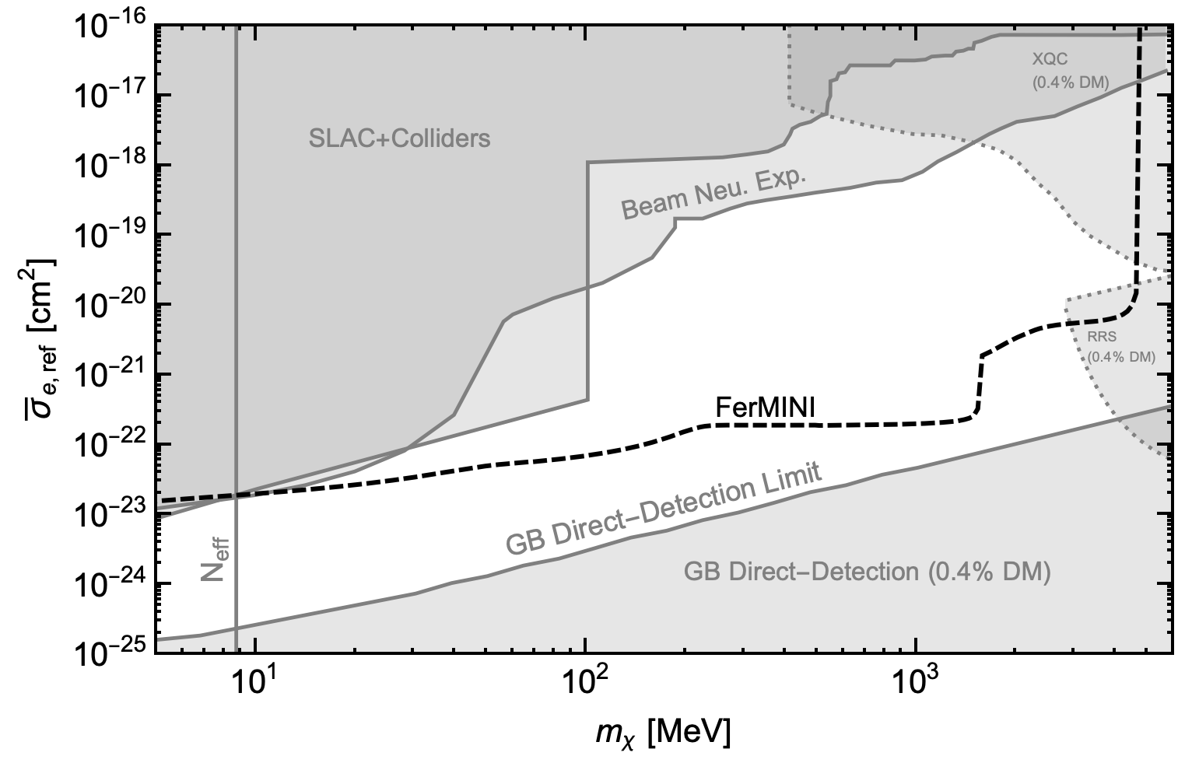
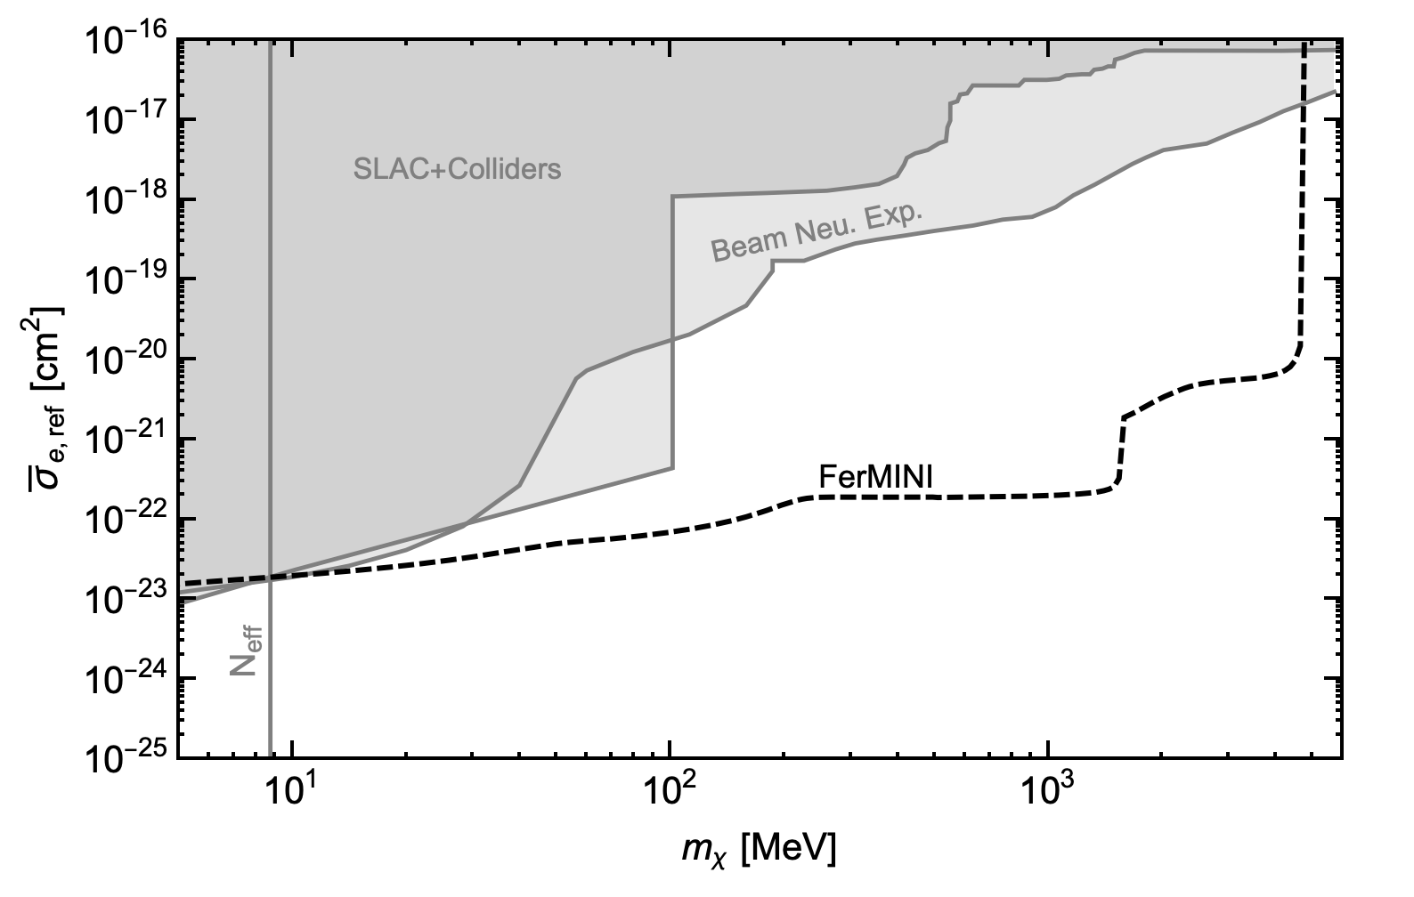
Not all bounds are created with equal assumptions Example: Constraints on Millicharged Dark Matter (mDM)
Accelerator
Accelerator
Direct-Det.
1812.03998 + 2002.11732
1812.03998 + 2002.11732 with just fixed-target probes
consider ambient dark matter
Produce dark particles in collisions
Same mass and interaction strength.
Different assumptions
Yu-Dai Tsai, Fermilab, 2021

Slide 14
Proton FT (& Neutrino) Experiments
High statistics, e.g., LSND has ${10}^{23}$ Protons on Target (POT)
Neutrinos are dark-sector particles.
Could have low to high energy proton beams on targets: O(1 – 400) GeV (I will compare Fermilab/CERN facilities)
Shielded/underground: lower background
Many of them existing and many to come: strength in numbers

Slide 15
Proton Facilities of Interest
Fermilab / CERN current & future facilities
Fermilab (undergoing a Proton Improvement Plan: PIP)
Booster Beam (BNB) | ~ ${10}^{20}$ POT/yr | 8 GeV | now
NuMI beam | 1 - 4 x ${10}^{20}$ POT/yr | 120 GeV | now
LBNF beam (future) | ~ ${10}^{21}$ POT/yr | 120 GeV | near-future
CERN - SPS beam
NA62 | up to 3 x ${10}^{18}$ POT/yr | 400 GeV | now
SHiP | up to ${10}^{19}$ POT/yr | 400 GeV | future
CERN – HL LHC | ${10}^{16}$ POT/yr | $√s$ = 13 TeV | near-future
Lujan Neutron Target (800 MeV protons, ~ ${10}^{22}$ POT/yr), now

Slide 16
Proton FT Experiment: Decay vs Scattering
Yu-Dai Tsai, Fermilab, 2021

Slide 17
Decay Experiments/Detectors
Including CHARM decay detector (DD), NuCAL, NA62 (see, arXiv:1908.07525)
Experiments optimized to study decaying particles, or simply two charged particle final states, e.g. from Drell-Yan (SeaQuest)
General features:
Large decay volume
Low density (likely vacuumed), low background
Simple design thus relatively low cost (tracking planes + ECal)
Often, there is external magnetic field (track separations/momentum reconstruction/filter-out soft SM radiation)
5. Usually studying long-lived particles (kaon rare decays, dark mediators, e.g., dark photons)

Slide 18
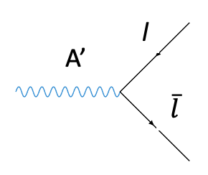
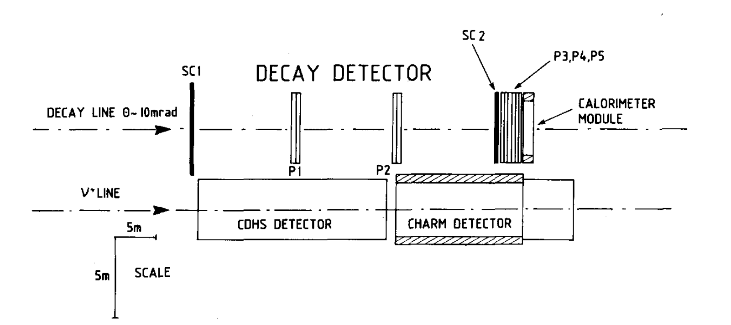
Decay Experiments/Detectors
CHARM Decay Detector
A’
CHARM Collaboration, PLB ‘93
CHARM: CERN HAmburg Rome Moscow

Slide 19
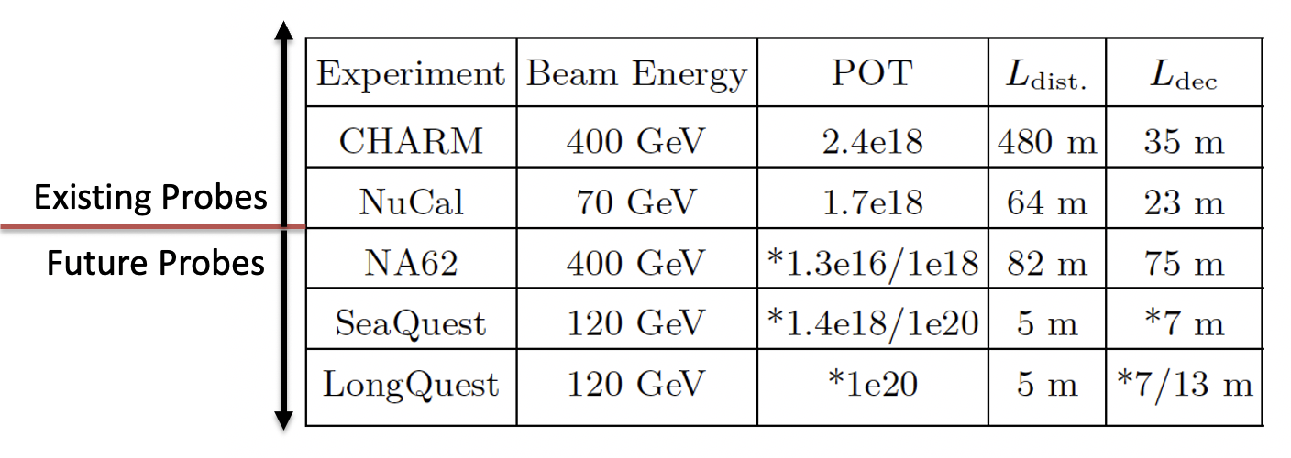
Legion of Decay Experiments
DUNE ND
120 GeV
1e21
500 m
*1m
LANL - CCM
800 MeV
2.25e22 (3yr)
20 m
1.2 m
$L_{dist.}$ = from target to detector (longer will lose short-lived particles)
$L_{dec}$= length of the decay region (the longer the better)
*means still to be determined
See, e.g., 1908.07525 for a systematic comparison
Conducting a comprehensive study for general & Snowmass purposes

Slide 20
Interesting Long-Lived Particles for Decay Studies
Yu-Dai Tsai, Fermilab, 2021

Slide 21
The Rise of Dark Sector: Sub-GeV DM
The Lee-Weinberg bound (1977’): below ~ 2 GeV, DM freeze-out through weak-Interaction (e.g. through Z-boson) would overclose the Universe.
Could consider ways to get around this but generally sub-GeV DM needs BSM mediators to freeze-out to proper relic abundance.
Mediator is needed for a proper freeze-out: the rise of “dark sector” (DM + mediators + stuffs).
Another motivation to consider dark sector other than anomalies

Slide 22
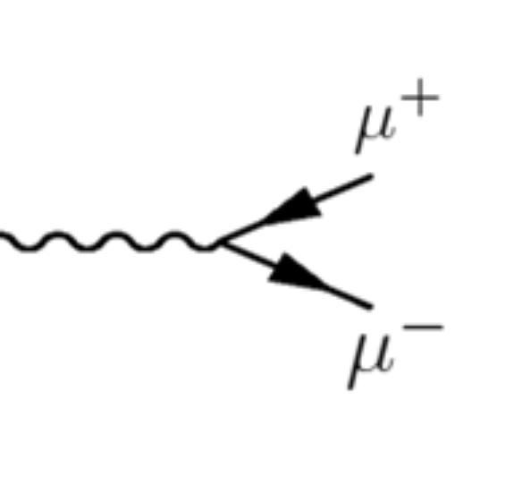
Renormalizable “Portals”
Dark sectors can include mediator particles coupled to the SM via the following renormalizable interactions.
High-Dim. axion portal is also popular
(Holdom, ‘85)
(See Dark-Sector 2016 report 1608.08632)
Low-energy effective interaction
$$ε$$
Mass from Dark Higgs or Stueckelberg
A’
Dark photon A’:
mass basis

Slide 23
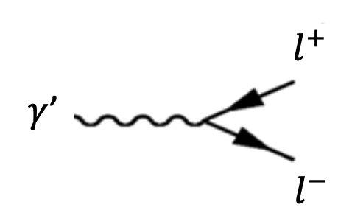
Dark-Sector Phenomenology Studying “dark photon” portal
“Dark Sector”: DM + “mediators” to SM
One of the three 4-dimentional “portals” to dark sectors
These “portals” help connect dark matter to SM and is essential for GeV or sub-GeV thermal dark matter (see, Lee-Weinberg Theorem, Lee, Weinberg, PRL 77)
$γ$*
X
kinetic mixing
Notes:
See my work on dark-sector searches in accelerators: add references

Slide 24
Details of LongQuest: A Multi-Purposed Detector
Yu-Dai Tsai, Fermilab, 2021

Slide 25
SpinQuest -> DarkQuest @ Fermilab
Yongbin Feng (Fermilab), for DarkQuest collaboration, PPC21
arXiv:1509.00050 (Gardner, Holt, Tadepalli); arXiv:1804.00661 (Berlin, Gori, Schuster, Toro) + …
DarkQuest is a proposal for EMCal installation after current SpinQuest run (Fall 2023)
Nhan Tran (Fermilab) was rewarded Fermilab LDRD funding and is leading detailed SeaQuest/DarkQuest study + Snowmass white paper.

Slide 26
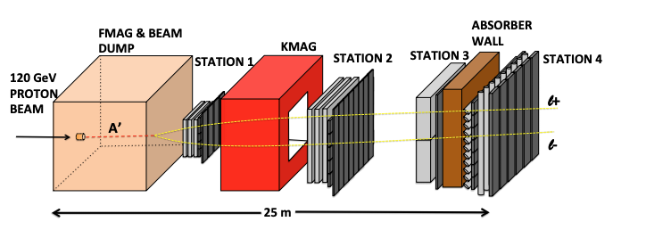
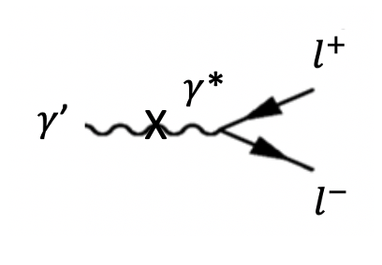
LongQuest: Three Part Upgrad of SpinQuest, as Dedicated Long-Lived Particle Experiment arXiv:1908.07525, Tsai, de Niverville, Liu ‘19
Modified from arXiv:1509.00050 (Gardner, Holt, Tadepalli)
Another ECAL
from PHENIX
New Dump
Fast Tracking
10m block
Ring Image Cherenkov Detector
LongQuest – Far Det.
Far Detectors: low bkg.
another ECAL, or Millicharge detector
LongQuest – Dump & Track
Front dump and fast tracking
LongQuest – Particle ID
Getting RICH (from PHENIX exp.) or HBD for particle id.
Yu-Dai Tsai, Fermilab, 2021

Slide 27
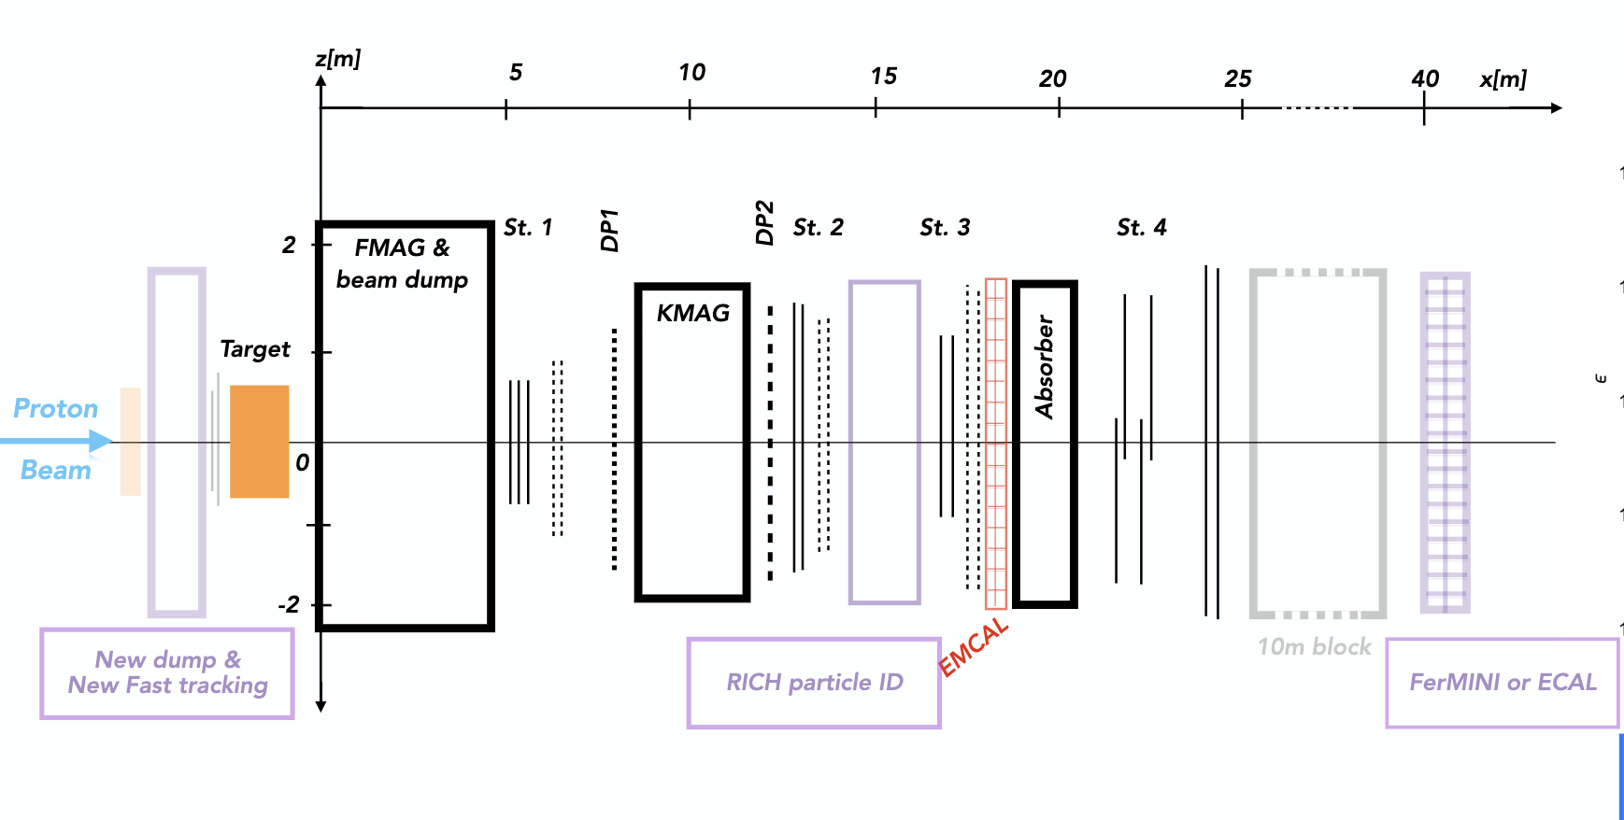
LongQuest Updated Configuration arXiv:1908.07525, Tsai, de Niverville, Liu ‘19
Yongbin Feng (Fermilab), for DarkQuest collaboration, PPC21

Slide 28
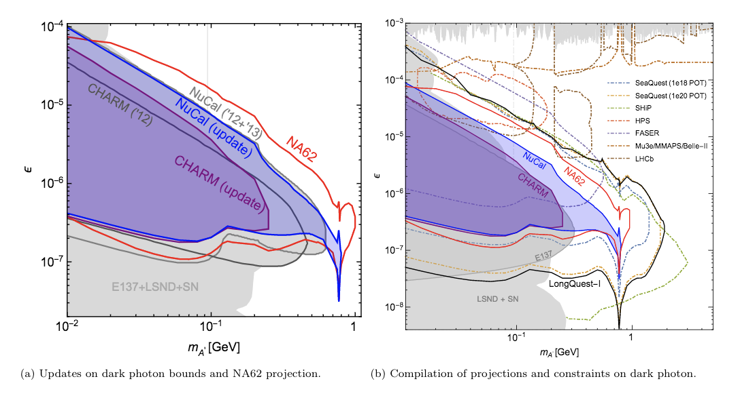
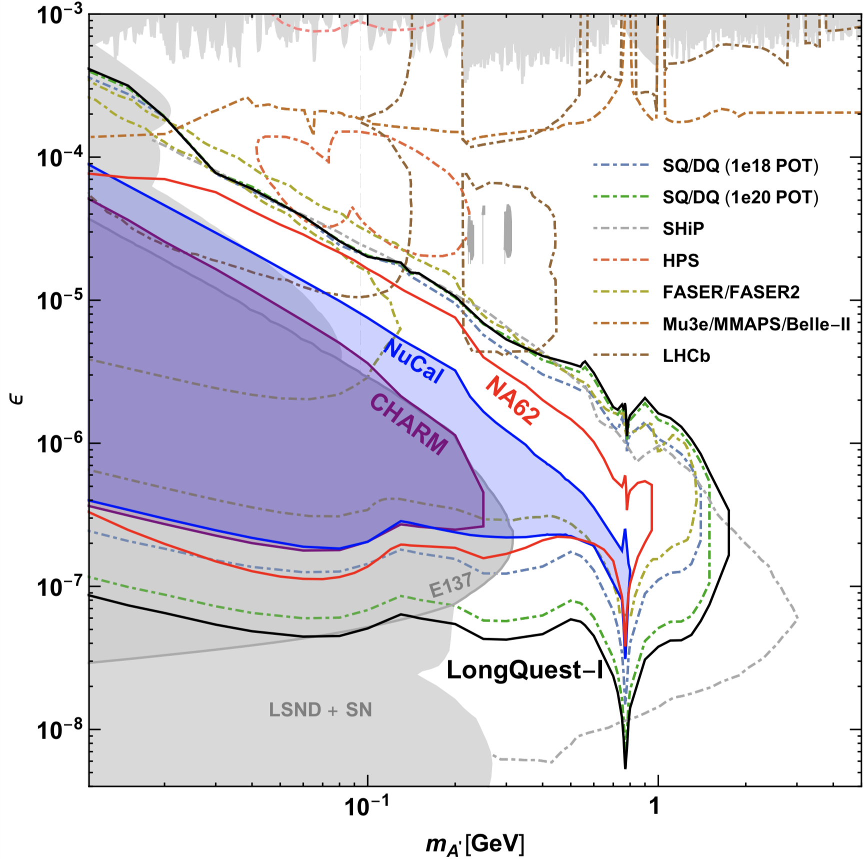
Legion of Probes on Dark Photon
Ilten, Soreq, Williams, and Xue 1801.04847 compilation of probes
1908.07525
Consider proton bremsstrahlung production properly
resonance from mixing with the ρ and ω mesons
New Projections from NA62 and LongQuest, Tsai, de Niverville, Liu, 1908.07525,
Many new projections since ‘19

Slide 29
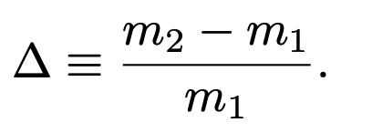
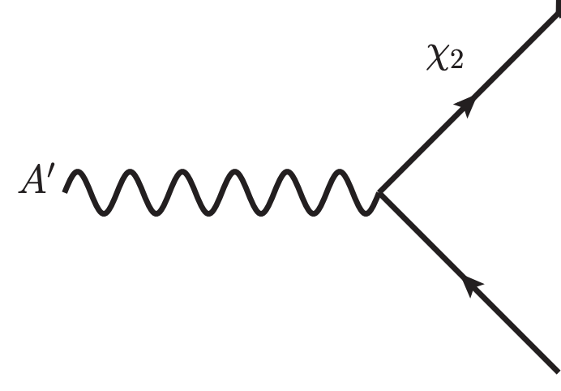
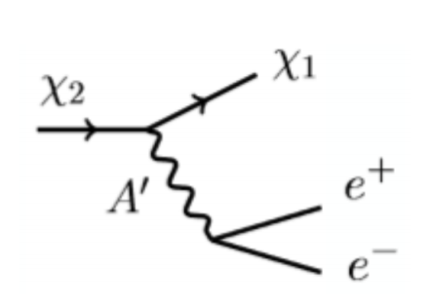
Inelastic Dark Matter
One of the few viable MeV – GeV thermal dark matter candidates
A “thermal target” for DM searches
Can explain g-2 and freeze-out to the right relic DM abundance
Smith, Weiner, arXiv:0101138, + many papers
$m_{A′}>m_{x1}+m_{x2}$.
1703.06881 (Izaguirre, Kahn, Krnjaic, Moschella)

Slide 30
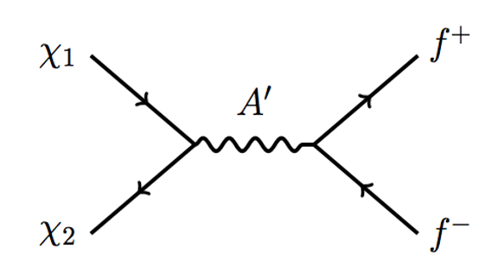
Inelastic Dark Matter (iDM)
Co-annihilation freeze out to right relic abundance but avoid CMB constraints
Suppressed at the CMB epoch
Considered thermal targets for newly proposed experiments
Suppressed at the CMB epoch
1703.06881 (Izaguirre, Kahn, Krnjaic, Moschella)
Collider: 1508.03050 (Izaguirre, Krnjaic, Shuve)
Fixed target:
1703.06881 (FT: Izaguirre, Kahn, Krnjaic, Moschella),
1804.00661 (SeaQuest: Berlin, Gori, Schuster, Toro)
1902.05075 (g-2: Mohlabeng)
1908.07525 (Strong bounds: Tsai, de Niverville, Liu)
1911.03176 (Belle II update, Duerr, Ferber, Hearty, Kahlhoefer, Schmidt-Hoberg, Tunney)
︙

Slide 31
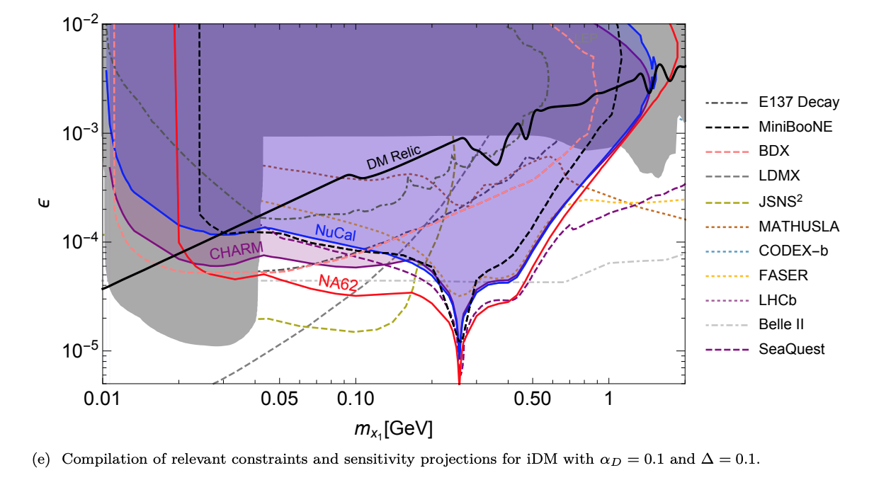
New Bounds on Inelastic Dark Matter
Inelastic Dark Matter:
1703.06881
(Izaguirre, Kahn, Krnjaic, Moschella),
Tsai, de Niverville, Liu, 1908.07525
$m_{A′}/m_{x1}$ = 3.
Tsai, de Niverville, Liu, 1908.07525
See, Duerr, Ferber, Hearty, Kahlhoefer, Schmidt-Hoberg, Tunney, 1911.03176, for Belle II update

Slide 32
Minimal
Explanation
Ruled out
Slides of Dr. Paolo Crivelli (ETH, Zurich)
More complicated models related to Dark Matter & Cosmology?

Slide 33
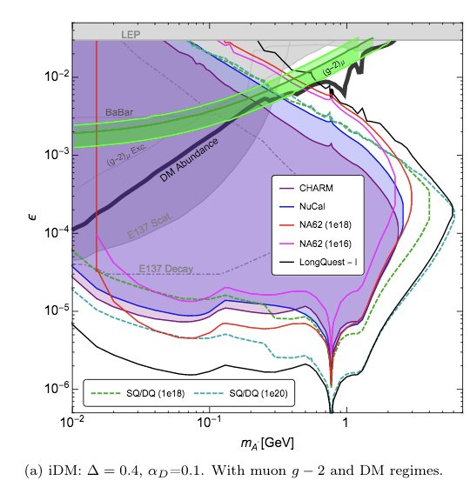
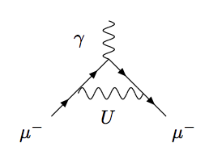
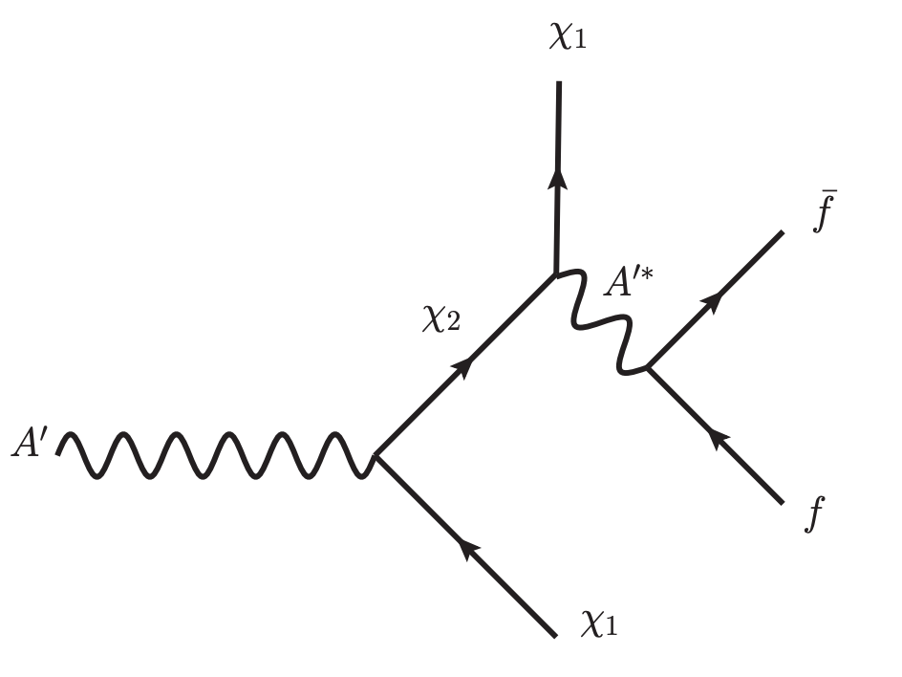
Inelastic Dark Matter & Muon g-2 explainer
A’
See, e.g., Fayet, 2007 (hep-ph/0702176)
1902.05075, Mohlabeng
1908.07525
1908.07525, Tsai, deNiverville, Liu
2012.08595, Duerr et al, detailed BaBar analysis may rule out the g-2 region
$m_{A′}/m_{x1}$ = 3.

Slide 34
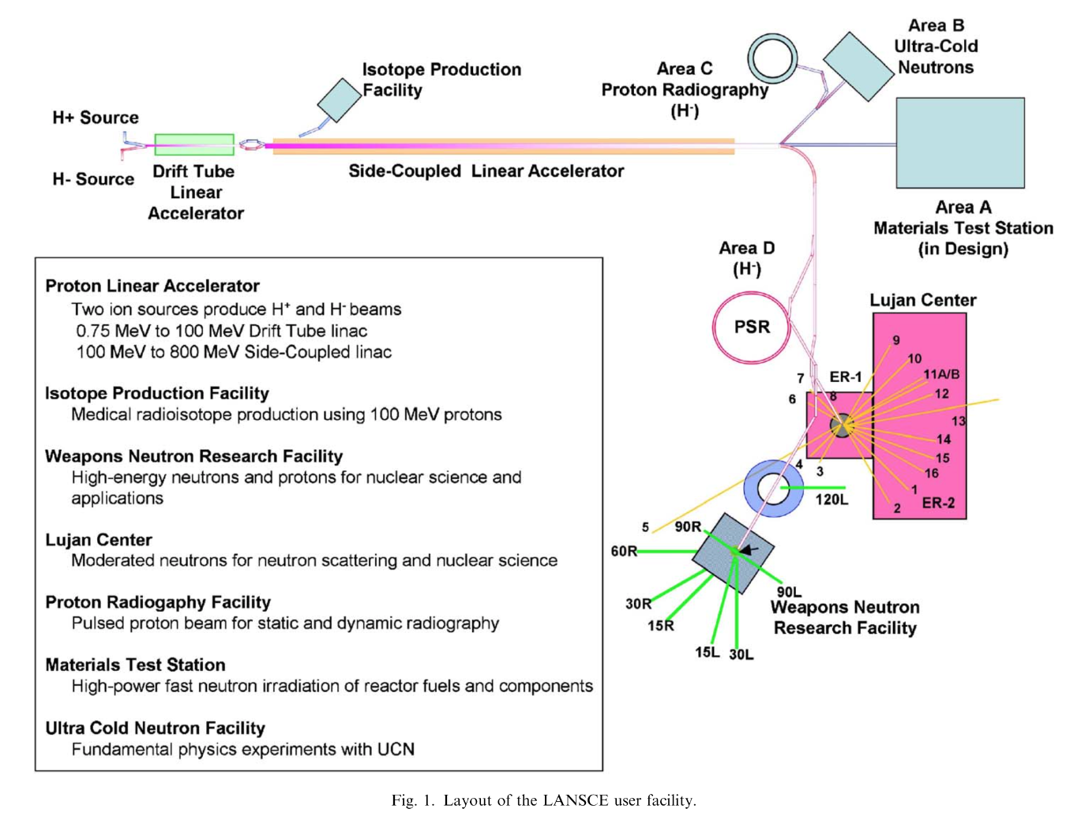
LANL-LLP Opportunity!
https://www.sciencedirect.com/science/article/pii/S0168900206003792

Slide 35
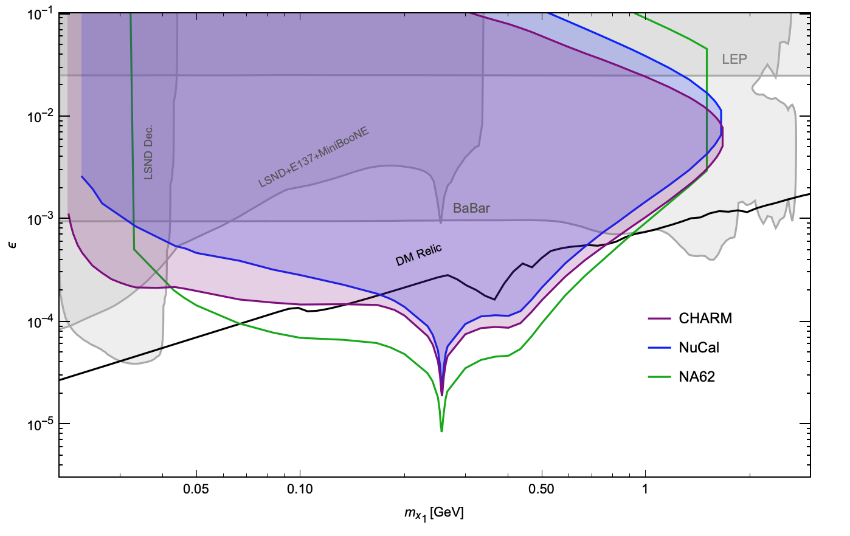
LANL-LLP Target: Inelastic Dark Matter
Inelastic Dark Matter:
$m_{A′}/m_{x1}$ = 3,
$Δ=0.05,$
$α_{D}=0.5$
LANL-LLP Target Region
LANL-LLP Study: deNiverville, Liu, Tsai, in preparation

Slide 36
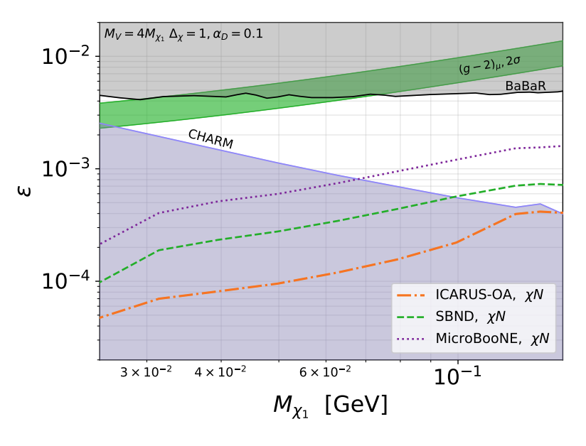
LANL-LLP Target: g-2 Motivated Models
LANL-CCM/LLP Region
LANL-LLP Target Region
Batell et al, arXiv:2106.04584
LANL-CCM/LLP Study: deNiverville, Tsai, in preparation
Notes:
Discuss with Patrick: not fixed to DM, just large Delta

Slide 37
Beyond Simple Dark-Sector Models
Can also look into
Strongly Self-Interaction DM (motivated by dark QCD)
Cosmology motivated models
New results in preparation!
Yu-Dai Tsai, Fermilab, 2021

Slide 38
Scattering Experiments
Yu-Dai Tsai, Fermilab, 2021

Slide 39
Scattering Detectors
MiniBooNE, SBND, MicroBooNE, MINERvA, DUNE LArTPC, Coherent Captain-Mills (CCM)
Primary goals to study neutrino scattering and/or neutrino oscillation
Features (comparing to decay detector):
higher density
complicated design compared to the decaying detector.
Smaller fiducial volume (for near-beam detectors); cost more.
Usually studying stable particles (neutrino, dark matter, millicharged particles)

Slide 40
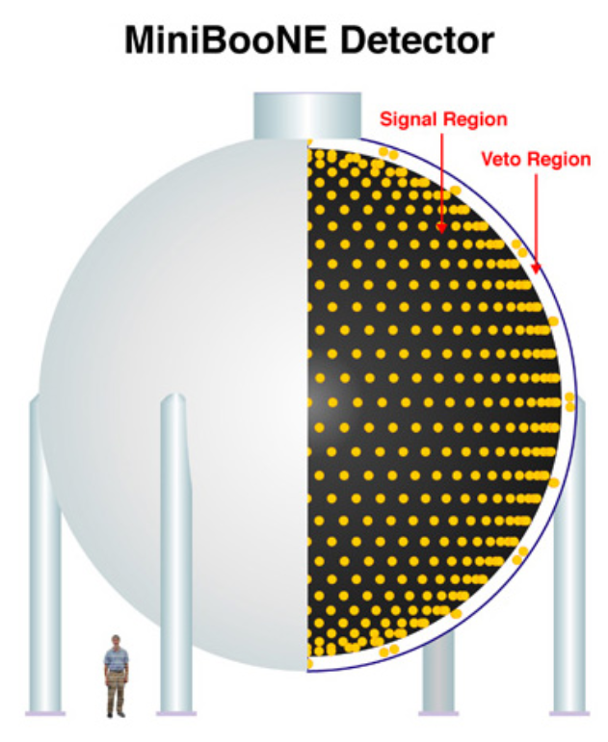
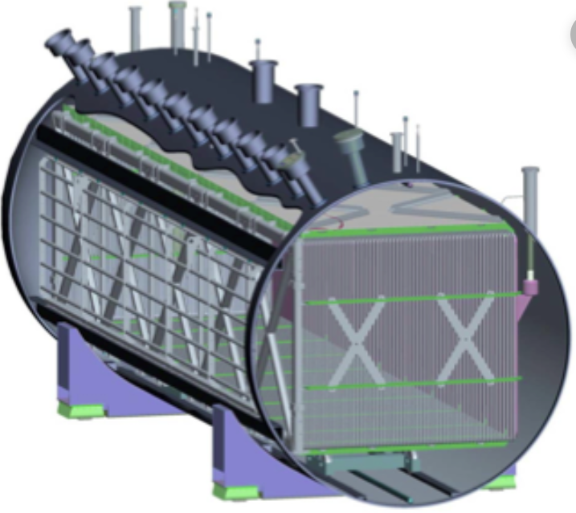
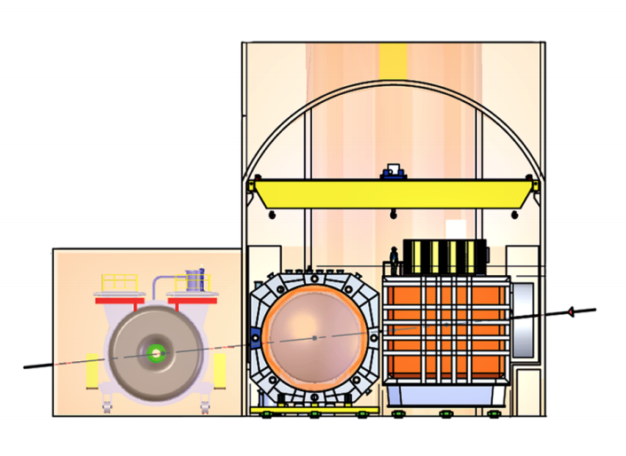
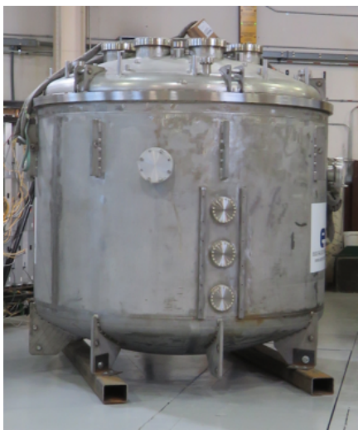
Scattering Detectors
MiniBooNE Detector
MicroBooNE Detector
arXiv:0806.4201 MiniBooNE collaboration
arXiv:1612.05824
MicroBooNE collaboration
- NuMI Beam
- BNB
- LBNF (future) One can do a lot of interesting new physics analyses based on scattering detectors
DUNE Near Detector
CCM
10-ton LAr (Ar40)
arXiv:2002.02967, DUNE TDR V - I
https://p25ext.lanl.gov/~lee/CaptainMills/
https://arxiv.org/abs/2105.14020

Slide 41
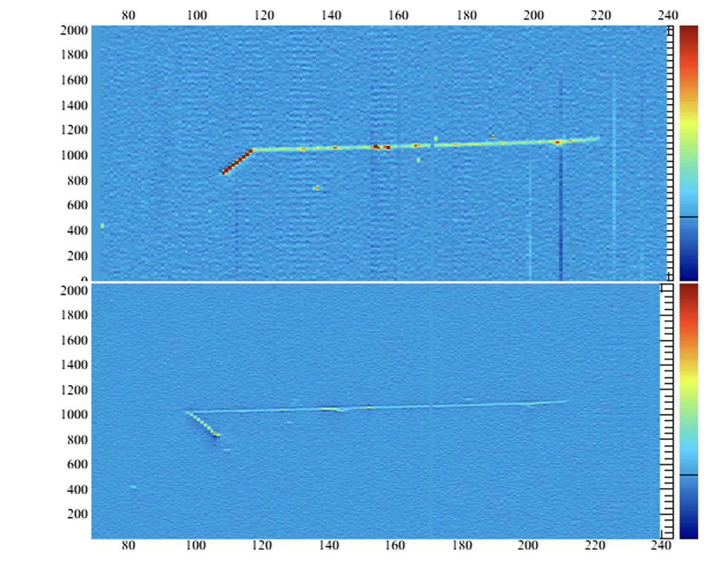
AI & Machine Learning at the Intensity Frontier
Low energy neutrino event in ArgoNeuT, from ArgoNeuT collaboration, PRD ‘19
https://lss.fnal.gov/archive/2018/pub/fermilab-pub-18-559-nd.pdf
Studying very faint signals (tracks) in DUNE, Proto-DUNE, CCM, and other Argonne Detectors, for MCP, DM, and other dark-sector signatures. New applications for well-developed techniques
Notes:
!!

Slide 42
Specialized “Scattering” Detectors
Low-cost / specialized detectors to add to the beam facilities?
Broaden the physics cases
- NuMI beam
- BNB
- LBNF (future)

Slide 43
FerMINI - Proton Fixed-Target Search for Millicharged Particle (MCP) & Millicharged Dark Matter (mDM) Kelly, Tsai, arXiv:1812.03998, PRD19
Yu-Dai Tsai, Fermilab, 2021

Slide 44
Finding Millicharge (Minicharge)
Electric charge quantized and why? A long-standing question!
SM U(1) allows arbitrarily small (any real number) charges. Why don’t we see them? Motivates Dirac quantization, Grand Unified Theory (GUT) (anomaly cancellations fix some SM ${U(1)}_{Y}$ charge assignments)
Link to string compactification and quantum gravity (Shiu, Soler, Ye, PRL ’13)
Testing if e/3 is the minimal charge
MCP could have natural link to dark sector (dark photon, etc)
Could account for dark matter (DM) abundance
Used for the cooling of gas temperature to explain the EDGES anomaly

Slide 45
MCP Model
A particle fractionally charged under SM U(1) hypercharge
Can just consider these Lagrangian terms by themselves (no extra mediator, i.e., dark photon). Completely legal! Naively violating the empirical charge quantization (cool!).
We are only probing MCP here! Minimal assumptions. Most robust constraints.
This could be from vector portal Kinetic Mixing (Holdom, ‘85) - a nice origin to the above term - help give rise to dark sectors - easily compatible with Grand Unification Theory

Slide 46
Kinetic Mixing and MCP Phase
Coupled to new dark fermion χ
(SM: Standard Model)
See, Holdom, 1985
New fermion χ charged under new gauge boson B’.
Millicharged particle (MCP) can be a low-energy consequence of massless dark photon (a new U(1) gauge boson) coupled to a new fermion (become MCP in a convenient basis.)

Slide 47
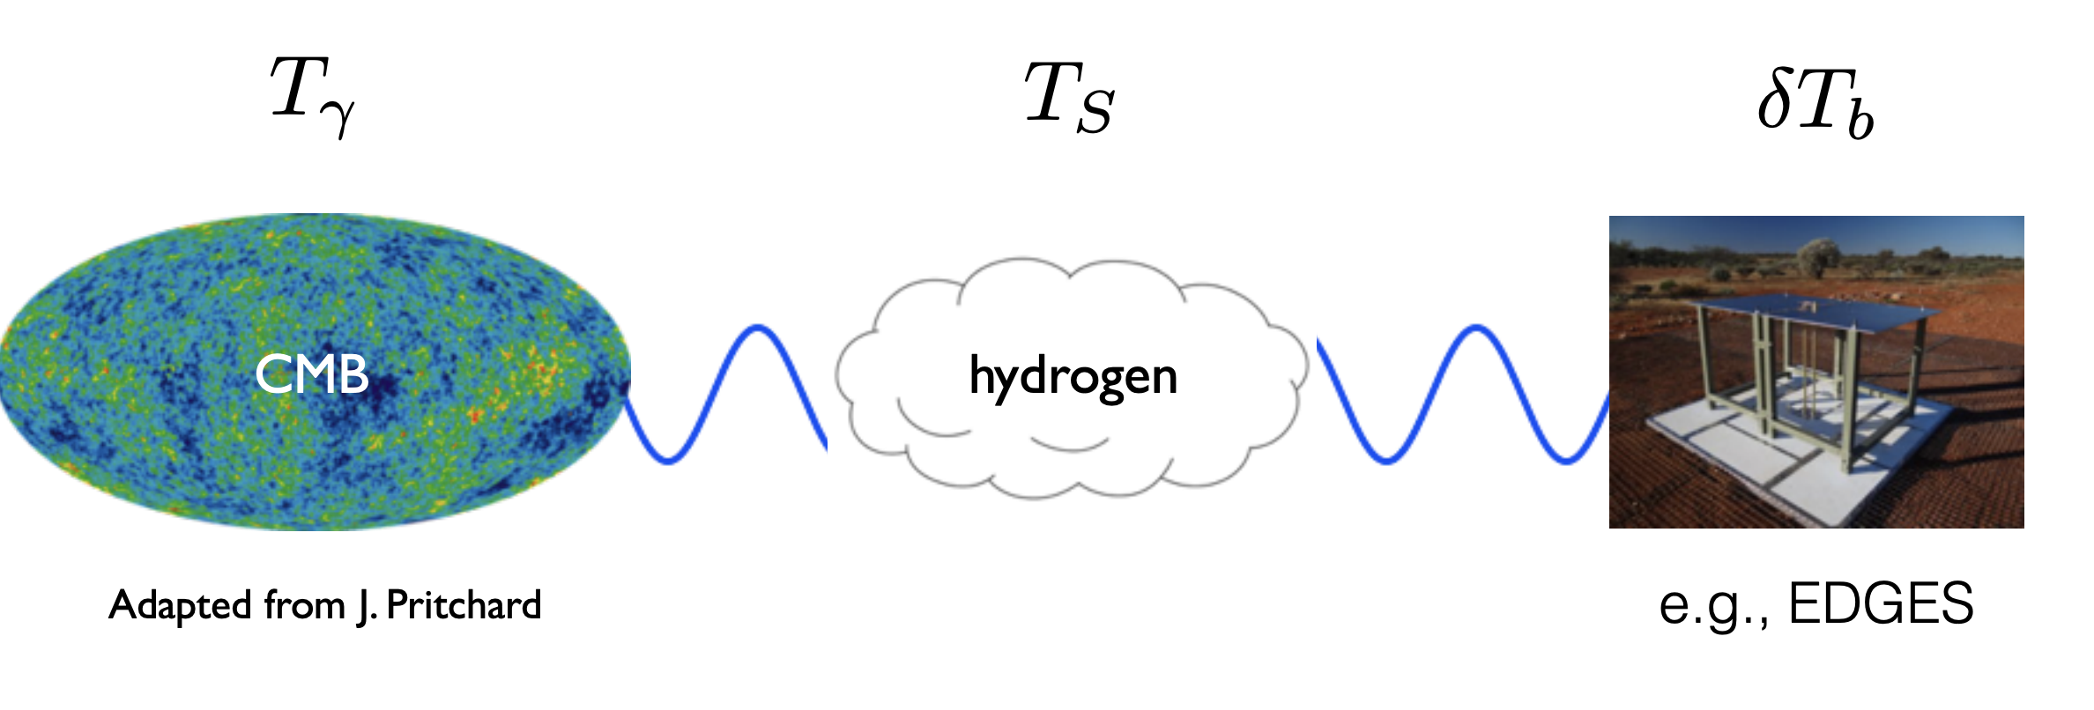
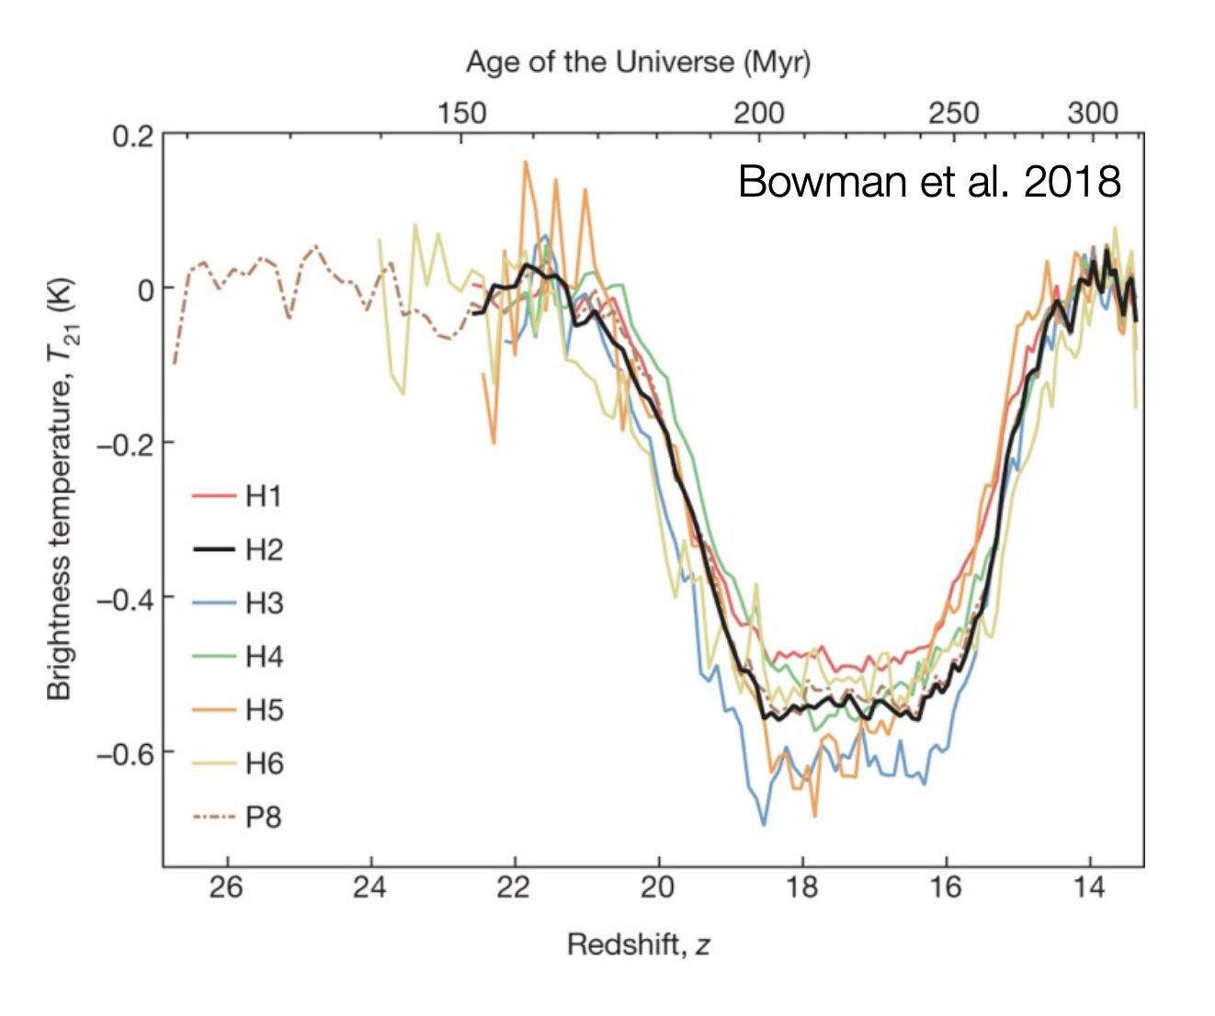
EDGES Measurement
Jordan Mirocha (UCLA)
EDGES collab., Nature, (2018); Barkana, Nature, (2018), more refs listed in the end

Slide 48
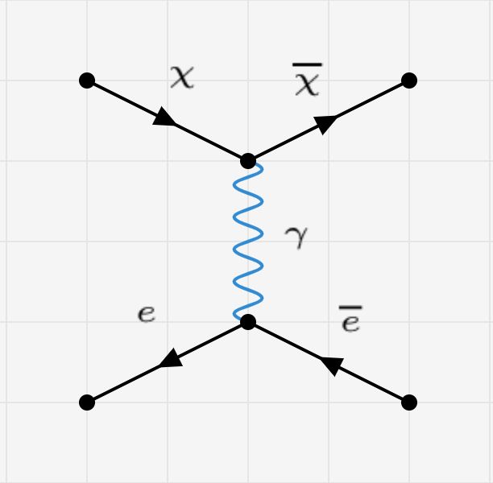
MCP Detection: “Hard” Scattering or Ionization
Ionization (eV-level): ~ very low-energy scattering: e.g., MilliQan: arXiv:1410.6816, Haas, Hill, Izaguirre, Yavin
“Hard” (MeV-level) electron elastic scattering: e.g., Magill, Plestid, Pospelov, Tsai, 1806.03310 (MCP in neutrino Experiments, MiniBooNE, MicroBooNE, SBND, DUNE, SHiP)

Slide 49
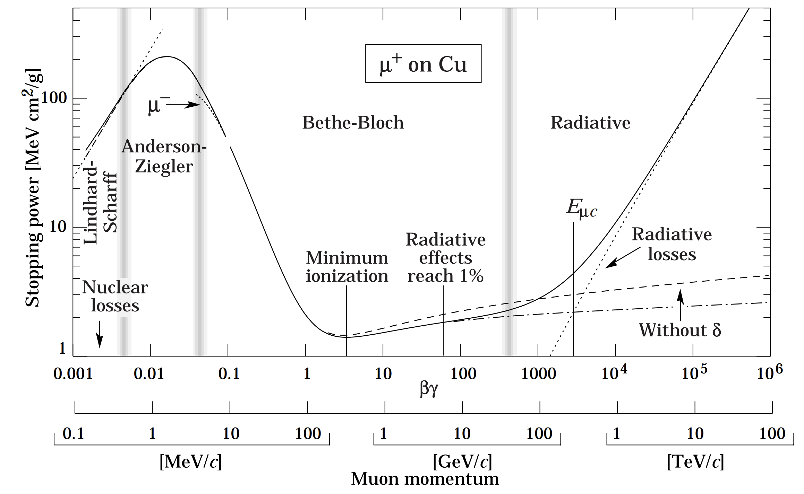
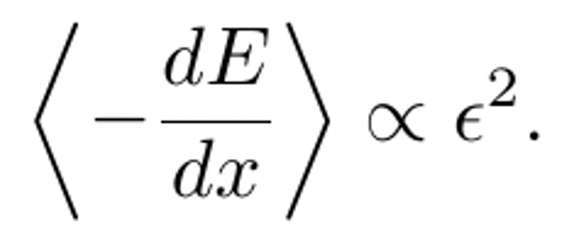
MCP Detection: Ionization
Want very low momentum transfer: ionization and scintillation signature
Signature proportional to - dE/dx of the MCP, referred to as energy loss/stopping power
Can be approximated with the Bethe-Bloch Formula (various modified versions and detailed considerations.)
intentionally make the plot small so we don’t get into too much details of this.
http://pdg.lbl.gov/2020/reviews

Slide 50
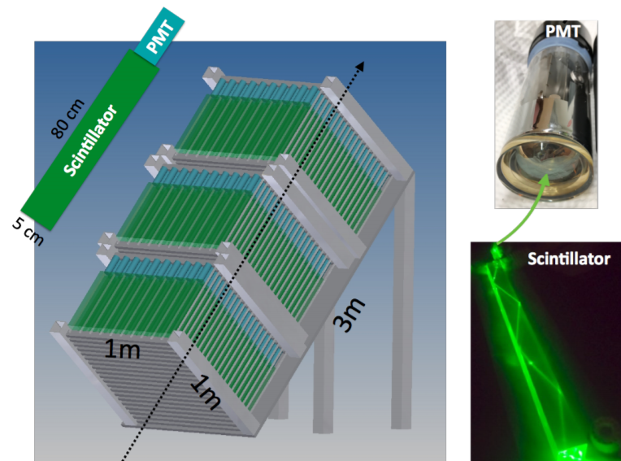
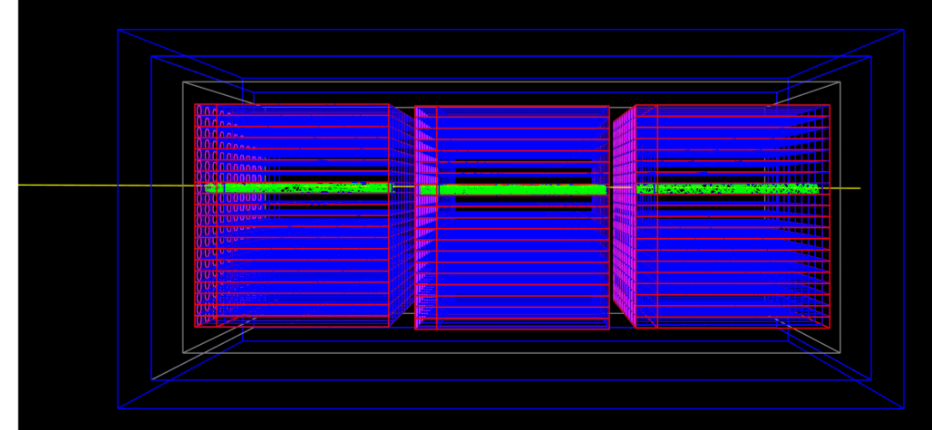
MilliQan: Detector Concept
ns
1607.04669, Ball, Brooke, Campagnari, De Roeck, Francis, Gastal, Golf, Goldstein, Haas, Hill, Izaguirre, Kaplan, Magill, Marsh, Miller, Prins, Shakeshaft, Stuart, Swiatlowski, Yavin

Slide 51
FerMINI: Fermilab Millicharge Search
Yu-Dai Tsai, Fermilab, ‘20

Slide 52
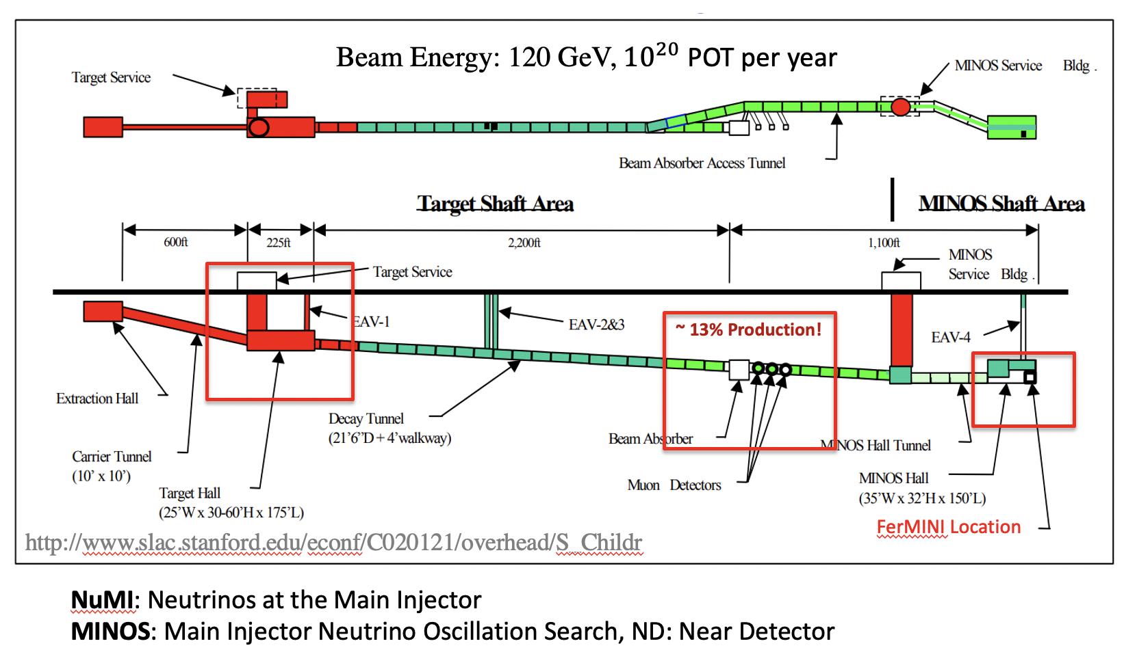
FerMINI Site 1: NuMI-MINOS Hall
Beam Energy: 120 GeV
Modified from Zarko Pavlovic’s figure
Yu-Dai Tsai Fermilab

Slide 53
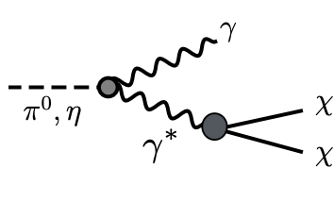
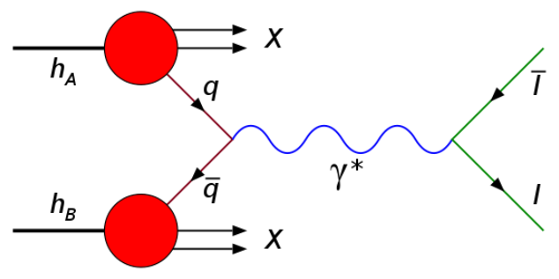
Production of MCP
Production: Meson Decays
Target
Figures replaced A’ with photon from 1703.06881 (Izaguirre, Kahn, Krnjaic, Moschella)
χ
Production: Drell-Yan
$$\overline{\text{χ}}$$
https://en.wikipedia.org/wiki/Drell%E2%80%93Yan_process
Heavy (vector) mesons are important for high-mass mCP’s in high-energy beams
BR(π⁰→2γ) = 0.99
BR(π⁰→γ$e^{−}e^{+}$) = 0.01
BR(π⁰→$e^{−}e^{+}$) = ${6∗10}^{−6}$
BR(J/ψ→$e^{−}e^{+}$) = 0.06

Slide 54
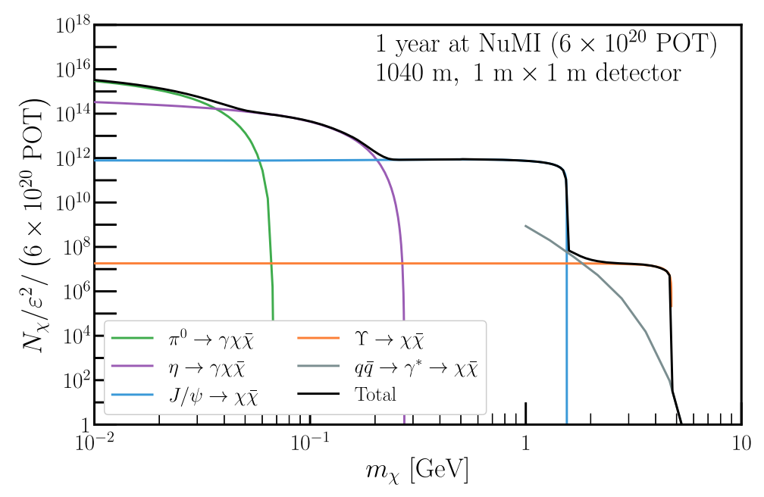
MCP Production/Flux
120 GeV proton beam on target (graphite)
det. area

Slide 55
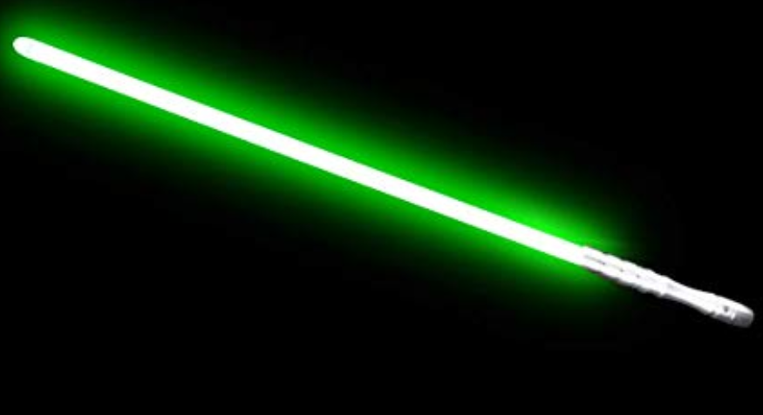
Photoelectrons (PE) from Scintillation
The averaged number of photoelectron (PE) seen by the detector from single MCP is:
One can use Bethe-Bloch Formula to get a good approximation
$N_{PE}$ ~ $ϵ^{2}$ x ${10}^{6}$ for 1 - meter plastic scintillation bar
$ϵ$ ~ ${10}^{−3}$ roughly gives one PE

Slide 56
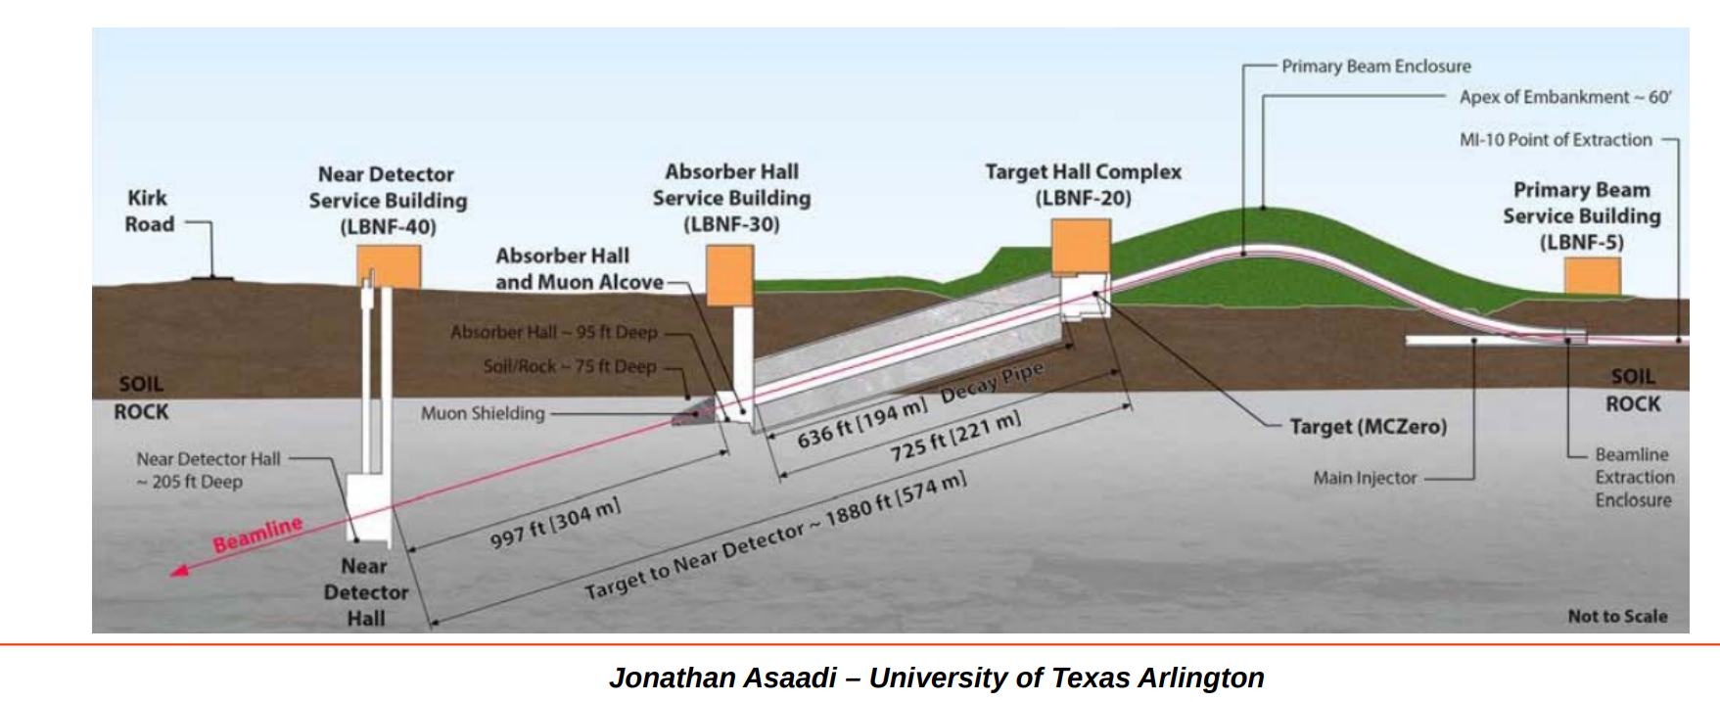
Site 2: LBNF Beam & DUNE ND Hall
Beam Energy: 120 GeV, ${10}^{21}$ POT/yr
https://indico.cern.ch/event/657167/contributions/2708015/attachments/1546684/2427866/DUNE_ND_Asaadi2017.pdf
LBNF: Long-Baseline Neutrino Facility
There are many other new physics opportunities
in the near detector hall!
Combine with DUNE PRISM?

Slide 57
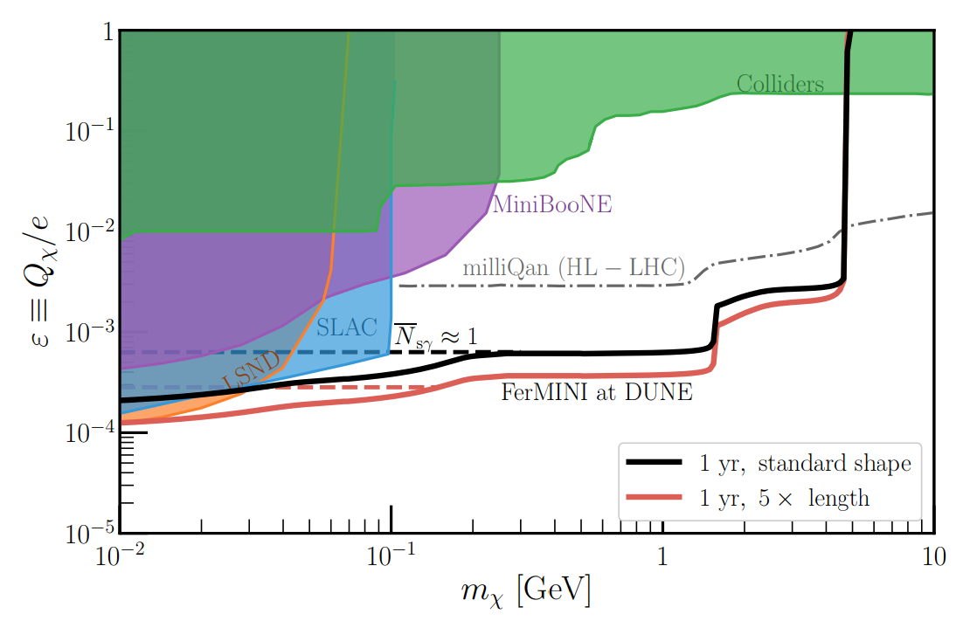
FerMINI @ DUNE
Kelly, Tsai, arXiv:1812.03998, PRD19
Yu-Dai Tsai, Fermilab
Can be improved by considering timing & just double-coincidence, instead of triple or quadruple coincidence, see SUBMET, Kim, Hwang, Yoo, arXiv:2102.11493, JHEP21

Slide 58
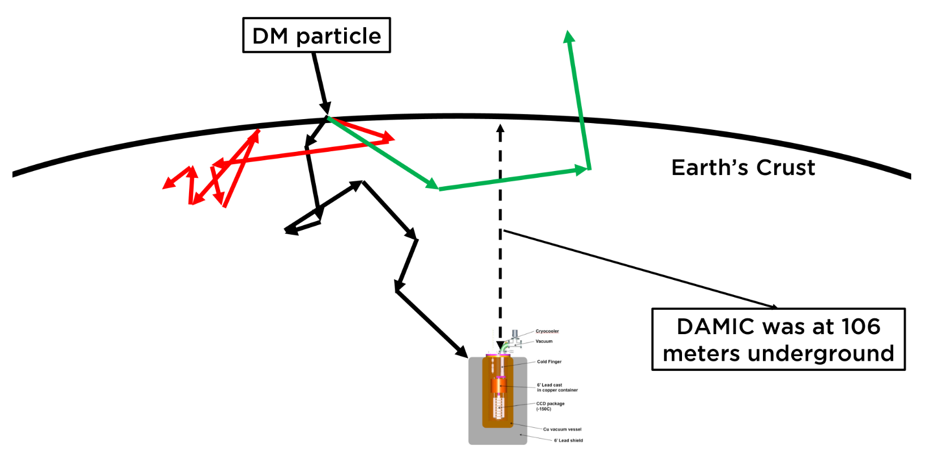
Strongly Interacting Dark Matter DM-SM Interaction too strong that attenuation stop the particles from reach the direct detection detector
DMATIS (Dark Matter ATtenuation Importance Sampling), Mahdawi & Farrar '17

Slide 59
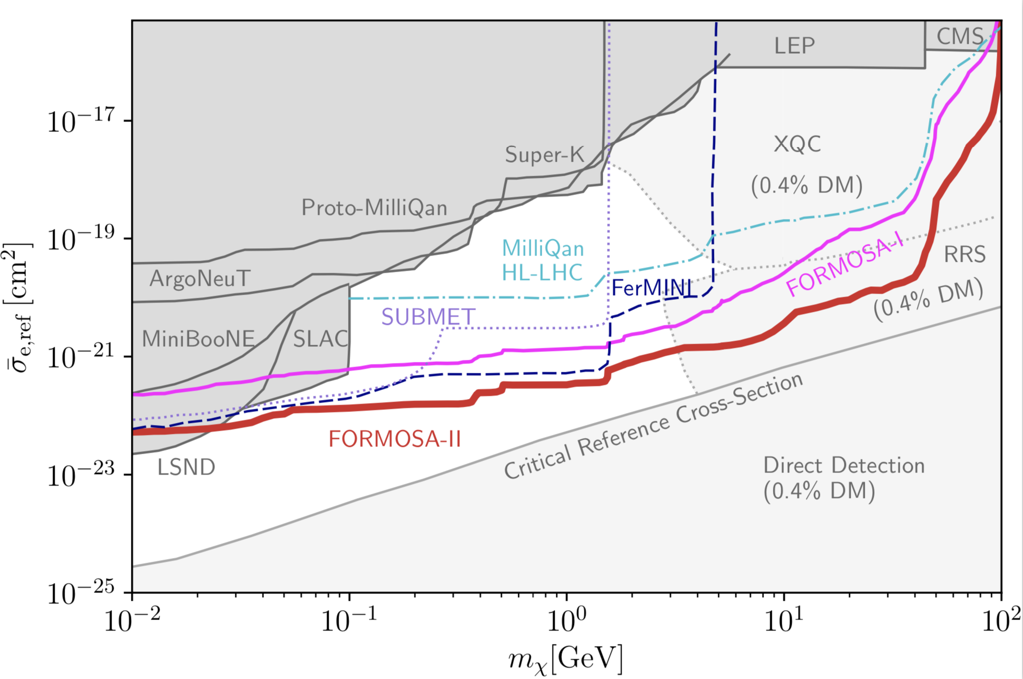
Probe of Millicharged Dark Matter
MCP / LDM with ultralight dark photon mediators
We will add this figure with all the projections to the appendix of the LOI
Saeid Foroughi, Felix Kling, Yu-Dai Tsai, arXiv:2010.07941
Here we plot the critical reference cross-section see 1905.06348 (Emken, Essig, Kouvaris, Sholapurkar)
Accelerator probes can help close the Millicharged SIDM window!
Cosmic-ray production & Super-K detection 2002.11732
Yu-Dai Tsai, Fermilab

Slide 60
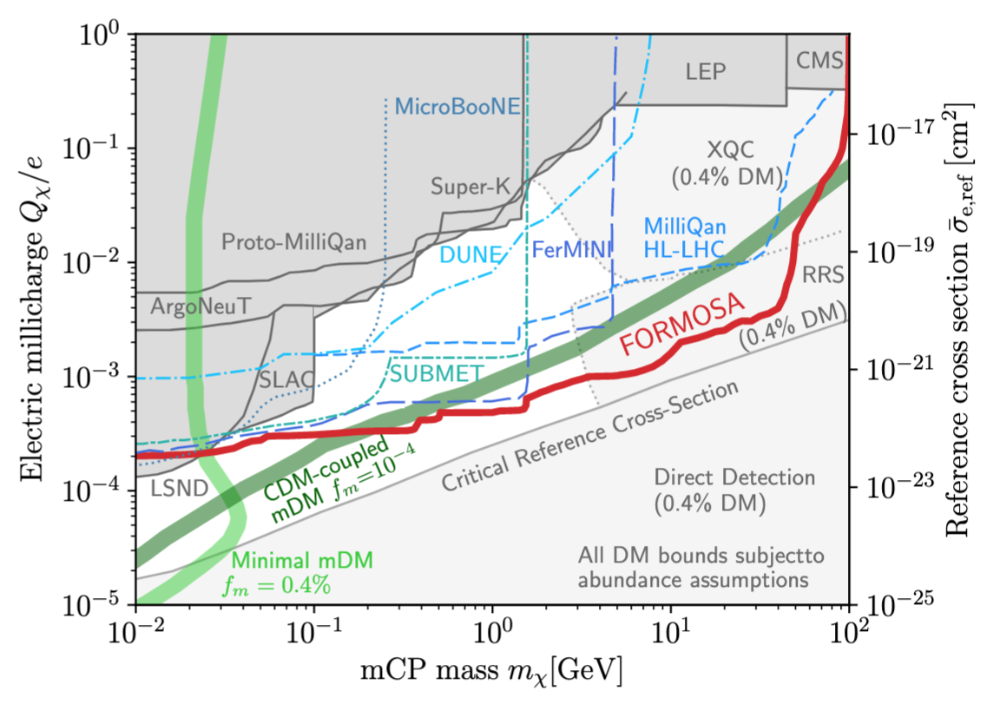
FerMINI Probes of EDGES DM
FORMOSA is similar to milliQan and FerMINI, but study MCP at LHC forward region
Notes:
Read SUBMET paper ??

Slide 61
LANL Millicharge Opportunity!
https://www.sciencedirect.com/science/article/pii/S0168900206003792

Slide 62
LANL-MCP Experiment
LANL-MCP Target Region
Foroughi, Liu, Tsai, in preparation

Slide 63
Legion of Decay Experiments
DUNE ND
120 GeV
1e21
500 m
*1m
LANL - CCM
800 MeV
2.25e22
20 m
1.2 m
LANL - MCP
800 MeV
~ 1e22
TBD
TBD
LANL - Decay
800 MeV
~ 1e22
TBD
TBD
$L_{dist.}$ = from target to detector (longer will lose short-lived particles)
$L_{dec}$= length of the decay region (the longer the better)
*means still to be determined
See, e.g., 1908.07525 for a systematic comparison
Conducting a comprehensive study for general & Snowmass purposes

Slide 64
Summary and Big Picture
Proton fixed-target/beam-dump experiments: very powerful searching for MeV-GeV DM and LLP, anomaly motivated
LANL can be the next center for dark sector search, building a research complex at the Lujan Center or Proton Radiography Facility (pRad)
Conduct LLP search like LongQuest (LANL-LLP), can do MCP search like FerMINI (LANL-MCP): low-cost new experiments!

Slide 65
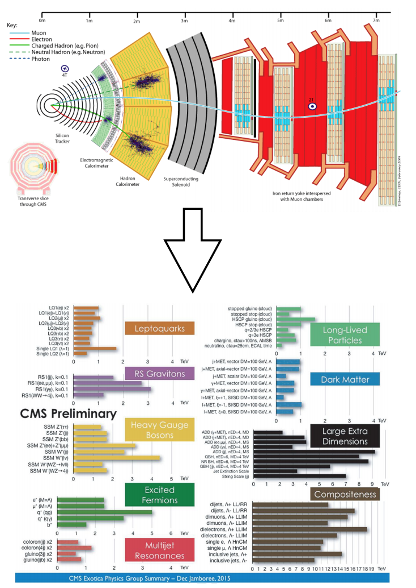
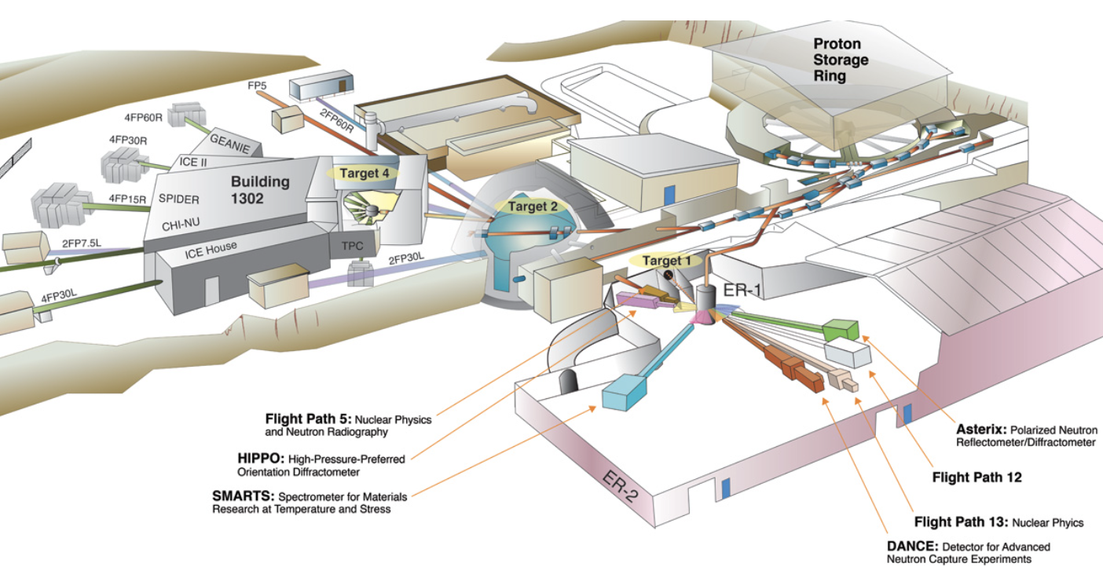
LHC vs LANL New-Physics Complex
High energy frontier
High intensity frontier
SAND
https://lansce.lanl.gov/facilities/index.php
New Physics Opportunities!
https://indico.fnal.gov/event/18430/session/8/contribution/17 From Roni Harnik
Yu-Dai Tsai, Fermilab, 2021

Slide 66
Thank you! There are many other exciting ideas to explore!
Yu-Dai Tsai, Fermilab, ‘21

Slide 67
Signature: Triple Coincidence
Based on Poisson distribution, zero event in each bar correspond to $P_{0}$ = $e^{−N_{PE}}$, so the probability of seeing triple incident of one or more photoelectrons is:
$N_{x, detection}$ = $N_{X, \text{going} \text{through} \text{detector}}$ x P.

Slide 68
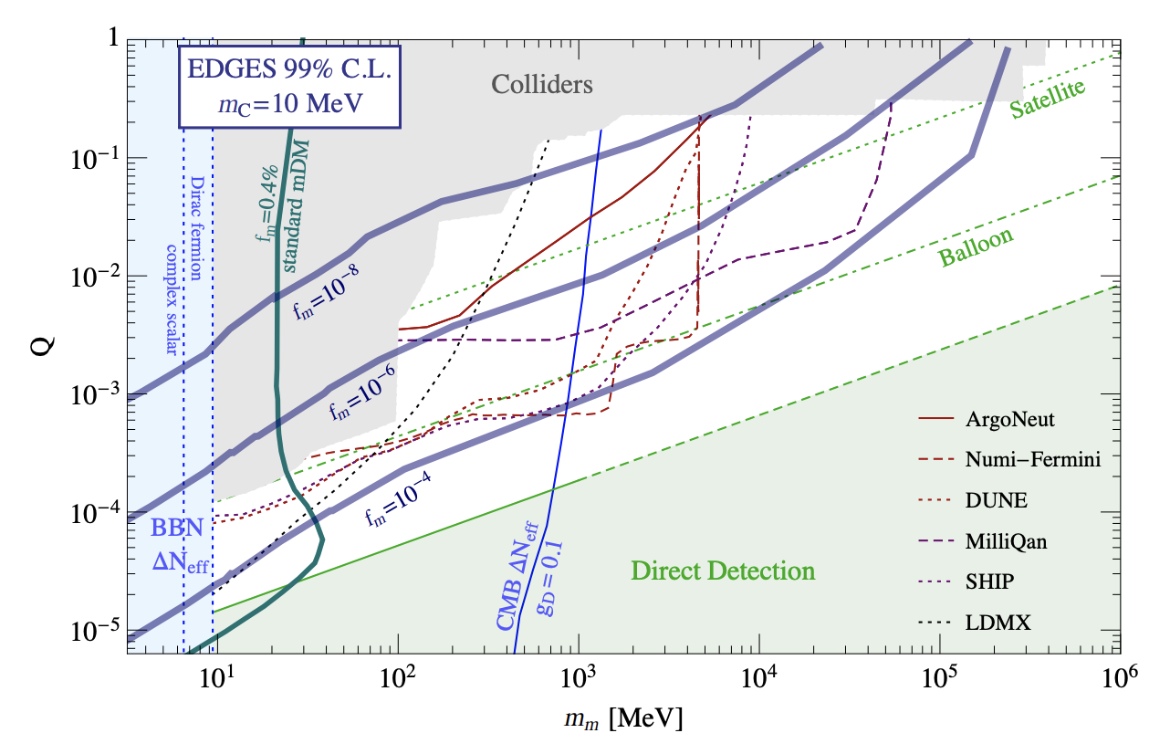
Millicharged DM for EDGES
(1 year)
(full run)
Liu, Outmezguine, Redigolo, Volansky, ’19
EDGES gives another hint of dark matter property, just like small-scale structure

Slide 69
Proton Facilities of Interest
Comparison of Various Facilities
LSND | ${\text{Total} \text{of} 10}^{23}$ POT | Beam: 800 MeV | King of POT
Fermilab (undergoing a Proton Improvement Plan: PIP)
Booster Beam (BNB) | ~ ${10}^{20}$ POT/yr | 8 GeV | now
NuMI beam | 1 - 4 x ${10}^{20}$ POT/yr | 120 GeV | now
LBNF beam (future) | ~ ${10}^{21}$ POT/yr | 120 GeV | near-future
CERN - SPS beam
NA62 | up to 3 x ${10}^{18}$ POT/yr | 400 GeV | now
SHiP | up to ${10}^{19}$ POT/yr | 400 GeV | future
CERN – HL LHC | ${10}^{16}$ POT/yr | $√s$ = 13 TeV | near-future

Slide 70
Lujan & CCM Information!
https://indico.fnal.gov/event/46020/contributions/202757/attachments/137980/172466/LANSCE-PSR-LOITalk-NF-09.pdf

Slide 71
Lee-Weinberg
The Lee-Weinberg bound (1977’): below ~ 2 GeV, DM freeze-out through weak-Interaction (e.g., through Z-boson) would overclose the Universe. Freeze-out too early
Could consider ways to get around this but generally sub-GeV DM needs BSM mediators to freeze-out to proper relic abundance.
New mediator is needed: the rise of “dark sector” (DM + mediators + stuffs).
Another motivation to consider dark sector other than anomalies

