Slide 1
STAR HFT upgrade and Heavy Flavor Program
Flemming Videbæk
Brookhaven National Lab

Slide 2
Overview
HFT motivation
Detector Overview, focused on PXL
  Alignment
  Performance
HF physics
  D⁰ spectra R_{AA} flow
  Charm cross sections, hadrochemistry
Summary

Slide 3
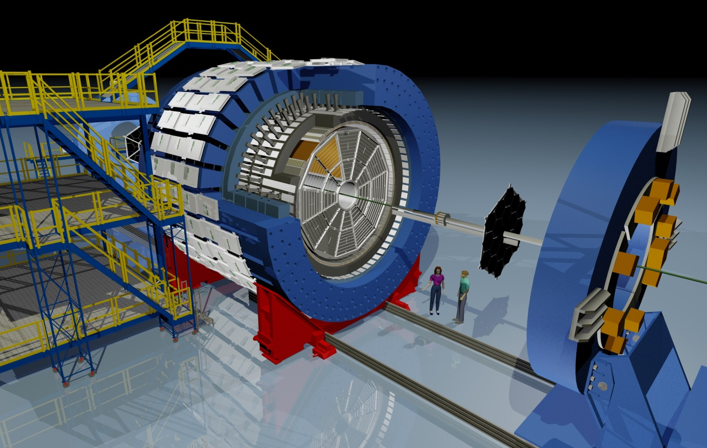
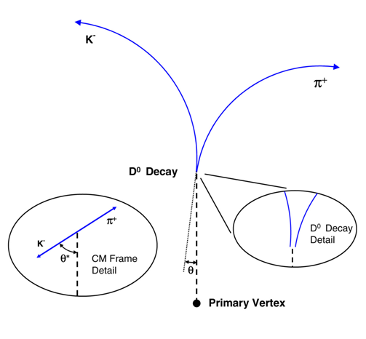

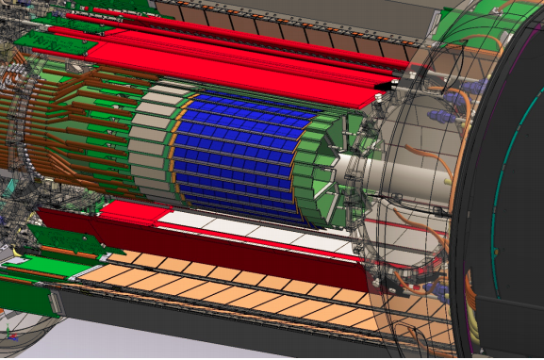
STAR HFT Physics Motivation
Extend the measurement capabilities in the heavy flavor domain, good probe to QGP:
Direct topological reconstruction of charm hadrons (small cτ decays, e.g. D⁰ → K π)
The STAR detector
@ RHIC
Method: Resolve displaced vertices (~120 μm)
200 GeV Au+Au collisions @ RHIC
dN_{ch}/dη ~ 700 in central events
HFT
Notes:
SV
Highlight detecting short lived particles –
you have heard about the physics in previous talks

Slide 4
Physics of the Heavy Flavor Tracker at STAR
Direct HF hadron measurements (p+p and Au+Au)
  (1) Heavy-quark cross sections: D^{0±}*, D_{S}, Λ_{C} , B, …
  (2) Both spectra (R_{AA}, R_{CP}) and v₂ in a wide p_{T} region: 0.5 - 10 GeV/c
  (3) Charm hadron correlation functions, heavy flavor jets
  (4) Full spectrum of the heavy quark hadron decay electrons
Physics
  (1) Measure heavy-quark hadron v₂, heavy-quark collectivity, to study the medium properties e.g. light-quark thermalization
  (2) Measure heavy-quark energy loss to study pQCD in hot/dense medium e.g. energy loss mechanism
  (3) Analyze hadro-chemistry including heavy flavors
Notes:
Need to go through formatting

Slide 5
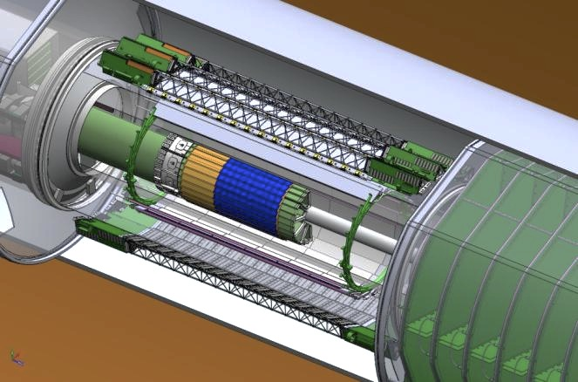
Heavy Flavor Tracker (HFT)
HFT
Detector | Radius (cm) | Hit Resolution R/ϕ - Z (μm - μm) | Radiation length
SSD | 22 | 20 / 740 | 1% X₀
IST | 14 | 170 / 1800 | <1.5 %X₀
PIXEL | 8 | 12/ 12 | ~0.4 %X₀
 | 2.5 | 12 / 12 | ~0.4% X₀
SSD
IST
PXL
PIXEL
two layers
18.4x18.4 μm pixel pitch
10 sectors, delivering ultimate Pointing resolution that allows for direct topological identification of charm.
Monolithic active pixel sensors (MAPS) technology
SSD
Existing single layer detector, double side strips (electronic upgrade)
IST One layer of silicon strips along the beam direction (r-φ) , guiding tracks from the SSD to PIXEL detector.

Slide 6
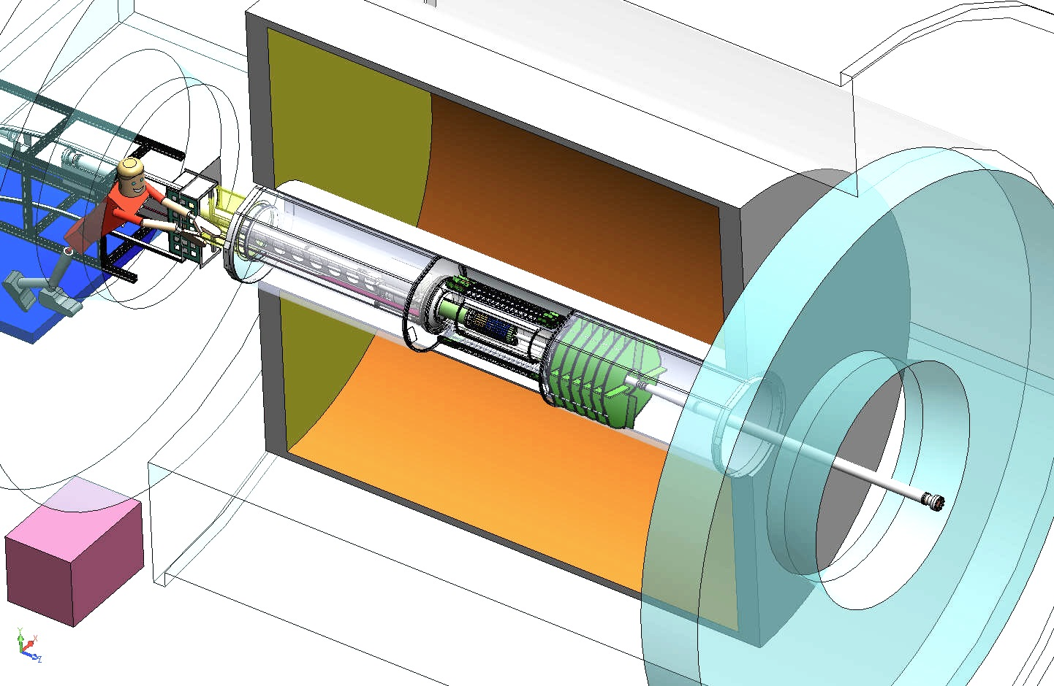
Heavy Flavor Tracker (HFT)
Inner Field Cage
Magnet
Return Iron
Outer Field Cage
FGT
TPC Volume
Solenoid
EAST
WEST

Slide 7
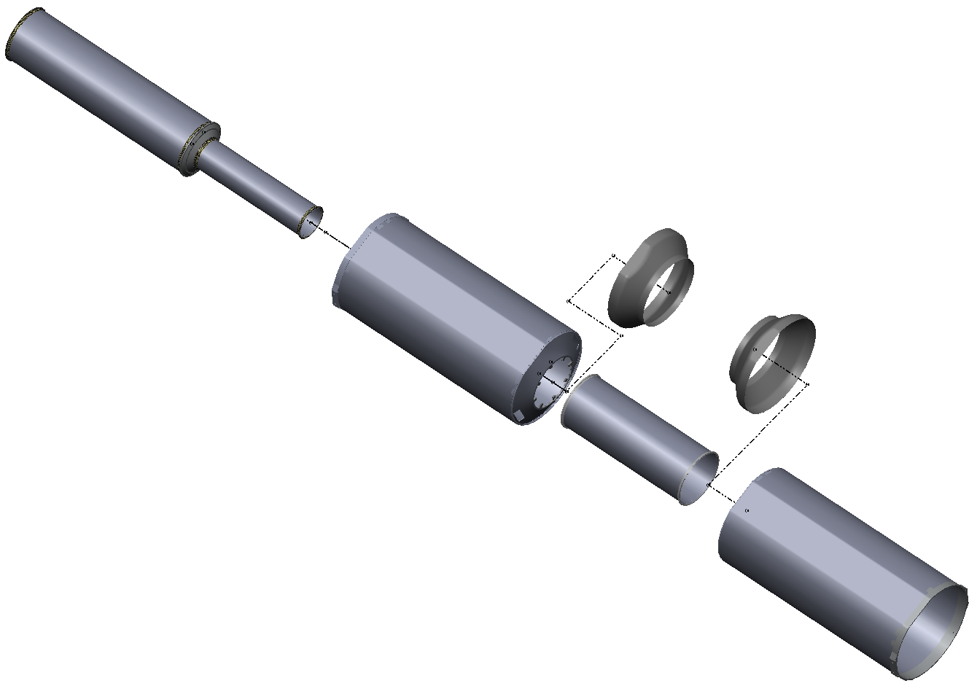
Inner Detector Support (IDS)
IDS
East Support Cylinder
Outer Support Cylinder
West Support Cylinder
PIT
Middle Support Cylinder
PST
MSC
Pixel Insertion Tube
Pixel Support Tube
ESC
Shrouds
Installed for Run-12
MSC installed for Run-13 for PXL
OSC
Carbon Fiber Structures provide support for 3 inner detector systems and FGT.
All systems are highly integrated into IDS.
Inner Detector Support
WSC

Slide 8
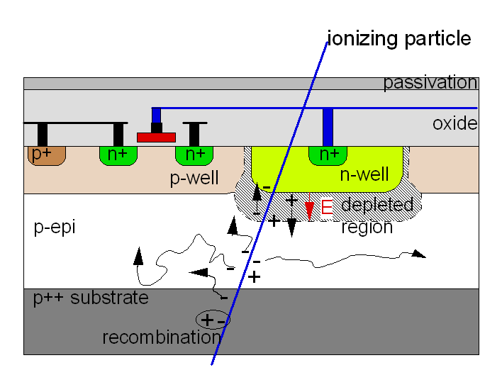
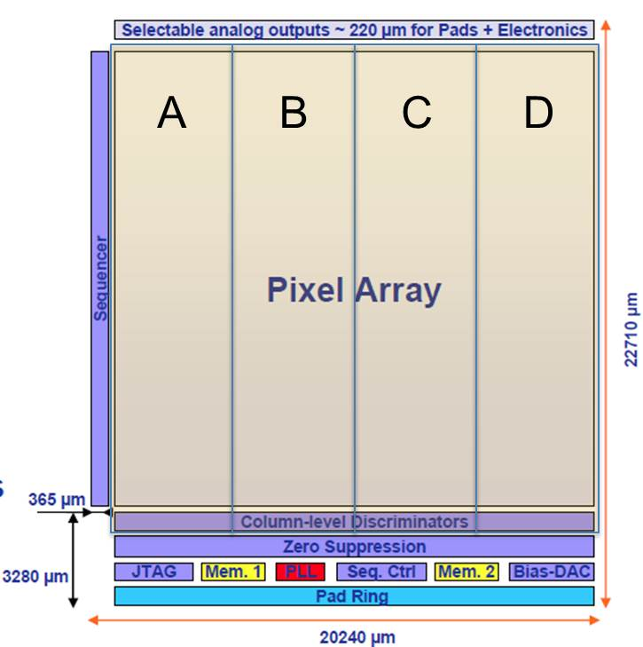
PXL Sensor
Monolithic Active Pixel Sensor technology
Ultimate-2: third generation sensor developed for the PXL detector by the PICSEL group of IPHC, Strasbourg
High resistivity p-epi layer
  Reduced charge collection time
  Improved radiation hardness
    20 to 90 kRad / year - 2*10¹¹ to 10¹² 1MeV n eq/cm²
S/N ~ 30
MIP Signal ~ 1000 e⁻
928 rows * 960 columns = ~1M pixel
Rolling-shutter readout
  connects row by row to end-of-column discriminators
  185.6 μs integration time
  ~170 mW/cm² power dissipation
  Configurable via JTAG
  2 LVDS data outputs @ 160 MHz

Slide 9
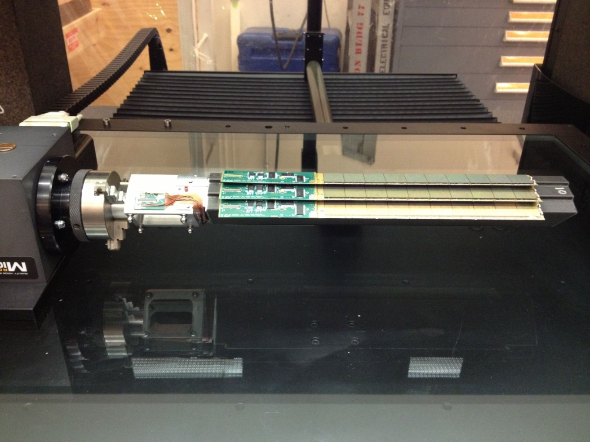
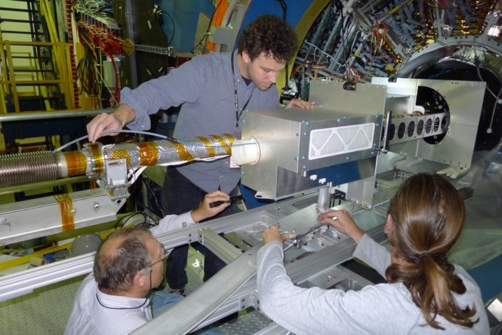
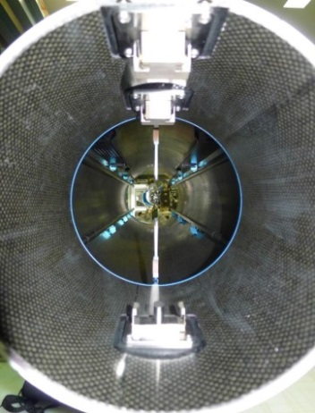
PXL Hit Position Resolution
Ultimate-2 sensor geometry
  pixel size: 20.7 μm X 20.7 μm ~6 μm geometrical resolution
  3-pixel av. cluster size ~3.7 μm resolution on center-of-mass
Position stability
  Vibration at air cooling full flow: ~5 μm RMS
  Stable displacement at full air flow: ~30 μm
  Stable displacement at power on: ~5 μm
Global hit resolution: Δx ~ 6.2 μm
Δx ~ 6.2 μm
r₁ = 2.8 cm
r₂ = 8 cm
HFT DCA pointing resolution:
( 10 ⊕ 24/p) μm
Sector in the metrology setup
Metrology survey
  3D pixel positions fully mapped and related to kinematic mounts
Novel insertion approach
  Inserted along rails and locked into a kinematic mount inside the support structure
  Capability to fully replace PXL within 12 hour
PXL insertion
Kinematic mounts

Slide 10
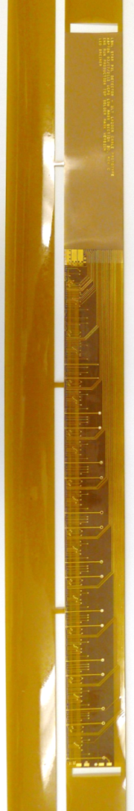
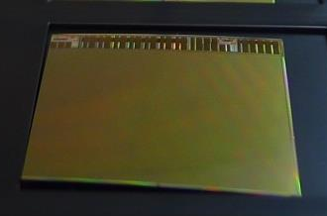
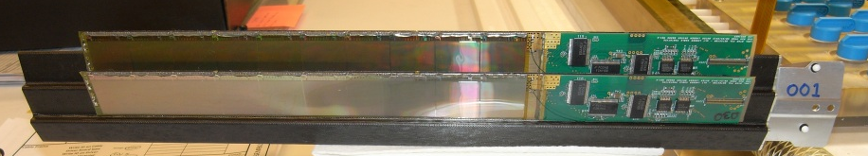
PXL Material Budget
Curved sensor
40-60% yield after thinning, dicing and probe testing
Thinned Sensor
  50 μm
  0.068% X₀
Flex Cable
  Aluminum-Kapton
  two 32 μm-thick Al layers
  0.128% X₀
    Copper version → 0.232% X₀
Carbon fiber supports
  125 μm stiffener
  250 μm sector tube
  0.193% X₀
Cooling
  Air cooling: negligible contribution
Total material budget on inner layer: 0.388% X₀
  (0.492% X₀ for the Cu conductor version)
HFT DCA pointing resolution:
( 10 ⊕ 24/p) μm

Slide 11
Info on PXL detector mechanics and construction
NIM Article
  arXiv 1710.02176
  NIM A97(2018) 60
Howard Wieman
  HFT PXL mechanics
  Forum on Tracking Detector Mechanics
  30 June-2 July 2014 at DESY, Hamburg
  https://indico.cern.ch/event/287285/contributions/1640694/attachments/534386/736809/PXL_mechanics.pdf

Slide 12
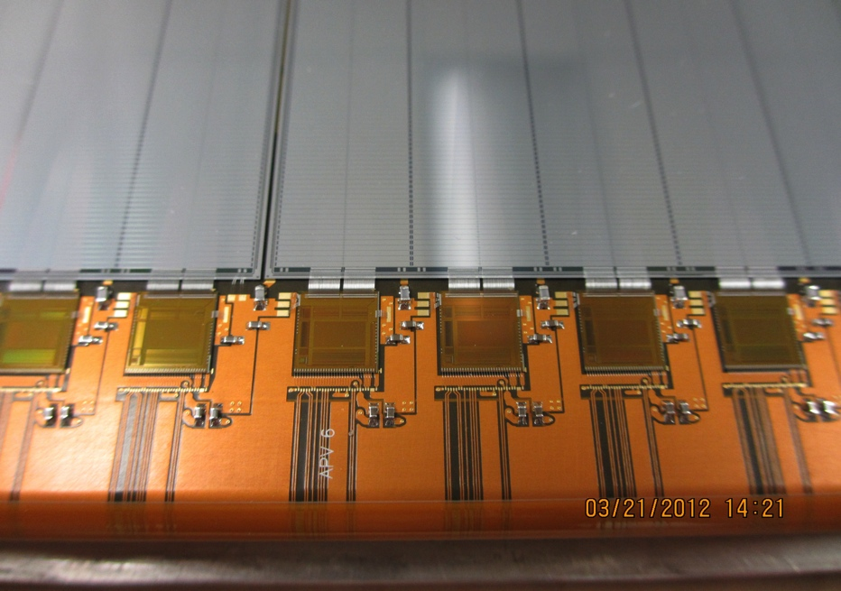
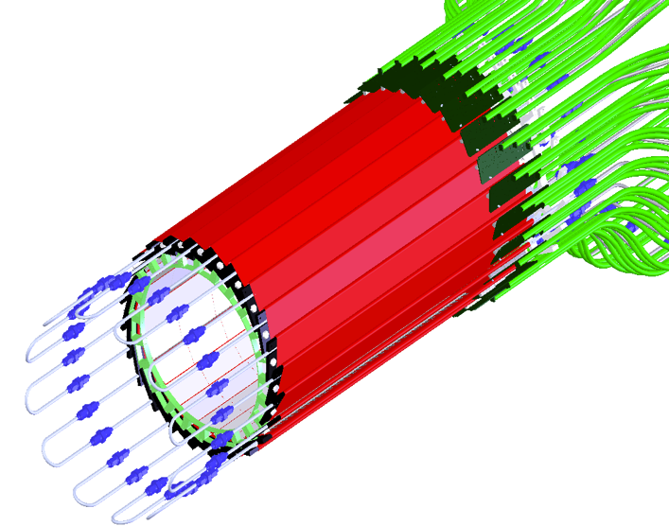
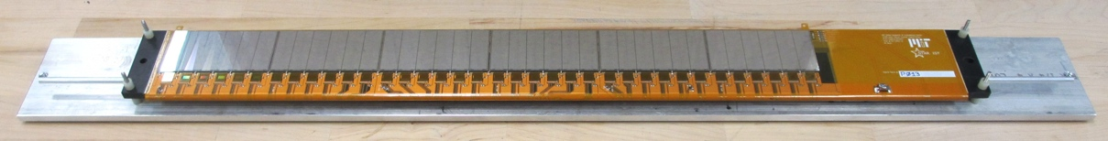
Intermediate Si Tracker
24 ladders, liquid cooling
Details of wire bonding
Prototype Ladder
S:N > 20:1
>99.9% live and functioning channels
People:
Gerrit van Nieuwenhuizen, MIT -> ATLAS Phase II
Zhenuy Ye, UIC – STAR forward Upgrade

Slide 13
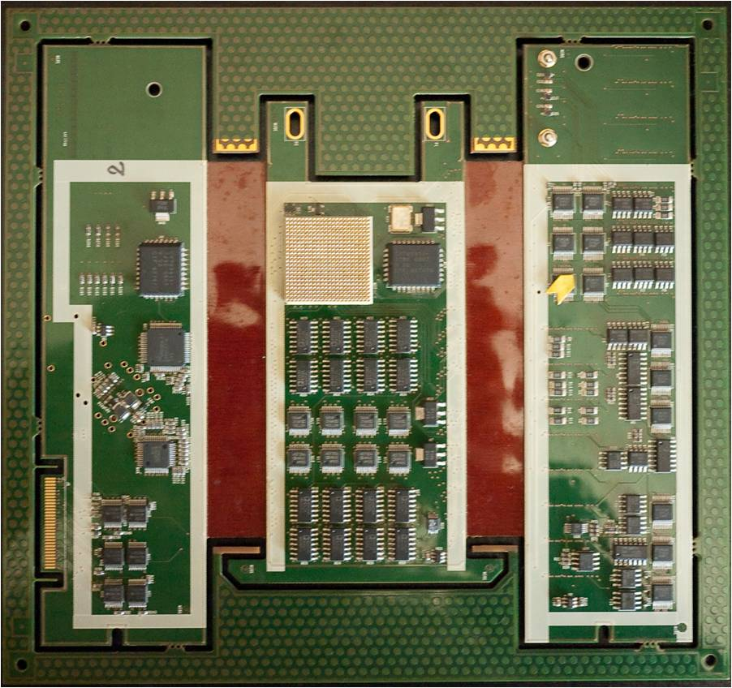
Silicon Strip Detector (SSD)
20 Ladders
Ladder Cards
Add pictures
The ladders and Si-sensors was from existing detector
Upgrade readout system with new ladder cards on detector, RDO cards, and cooling system

Slide 14
Timeline
R&D 2003- LBL with IHPC, Strasbourg for MAPS sensors
2008 Project start ; 2010-2014 construction
2013 Commissioning run
2014-16 Physics
  14: AuAu
  15: pp
  16: AuAu dAu
2017 Removed from STAR and in storage

Slide 15
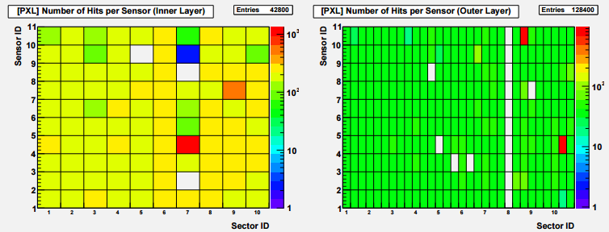
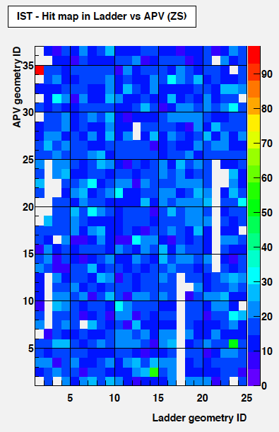
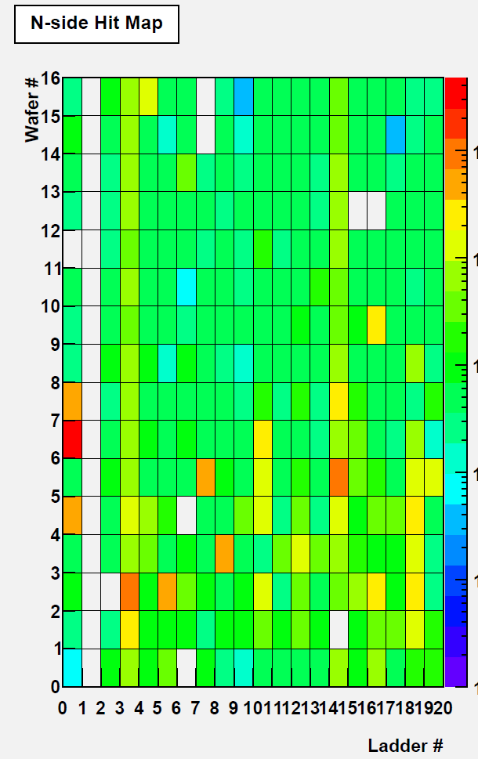
HFT Status in 2014 - 2016 Run
    Typical trigger rate of ~0.8kHz with dead time <5%
    Limit interaction rate due to 186microsec pileup
Sub-detector active fraction
  PXL
    > 99% operational at the delivery
    2015 Run ended with 5% dead sensors (6 damaged sensors + 1 outer ladder off)
  IST
    95% channels operational, stable
  SSD
    80% channels operational (one ladder off)
PXL1
PXL2
IST
SSD
Notes:
Need something on Run 16!!

Slide 16
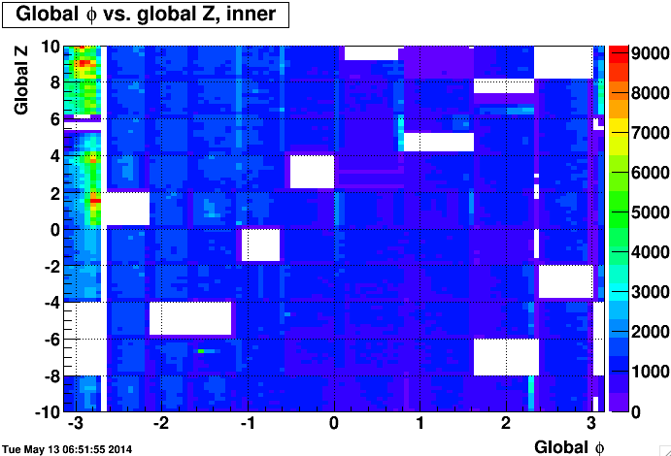
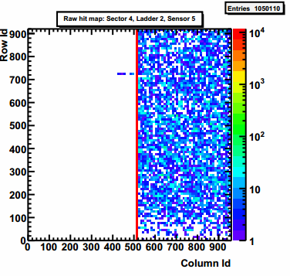
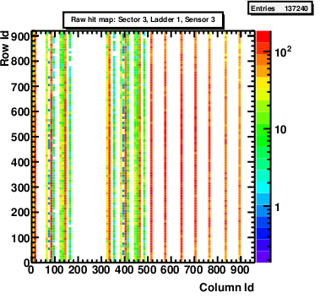
Lessons learned: Latch-up damage on PXL
Inner layer damage: 14%
Unexpected damage seen on 15 ladders in the STAR radiation environment in 2014 Run first 2 weeks
  Digital power current increase
  Sensor data corruption
  Hotspots in sensor digital section
  Related to latch-up events
Latch-up tests at BASE facility (LBL) to measure latch-up cross‑section and reproduce damage
  50 μm & 700 μm thick, low and high resistivity sensors; PXL ladders
  Irradiation with heavy-ions and protons
Results and observations
  Current limited latch-up states observed (typically ~300 mA)
  Damage reproduced only with HI on PXL 50 μm thinned sensors
Safe operations envelope implemented
  Latch-up protection at 80 mA above operating current
  Periodic detector reset
Latch-up phenomenon:
Self feeding short circuit caused by single event upset
Can only be stopped by removing the power

Slide 17
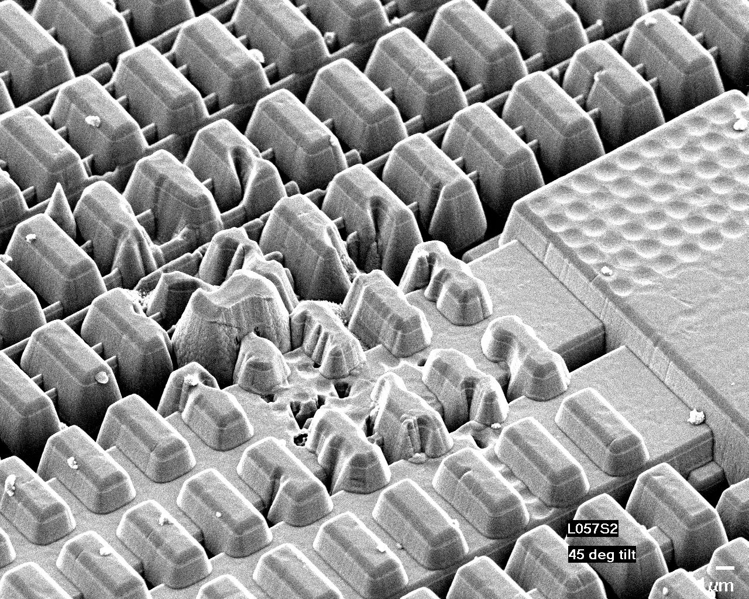
Latch-up damage: Sensor Deconstruction
Deconstructing damaged sensor through a plasma etching technique
The metal layer appears to be melted
Pixel sensor layers etched and viewed with scanning electron microscope
1 μm

Slide 18
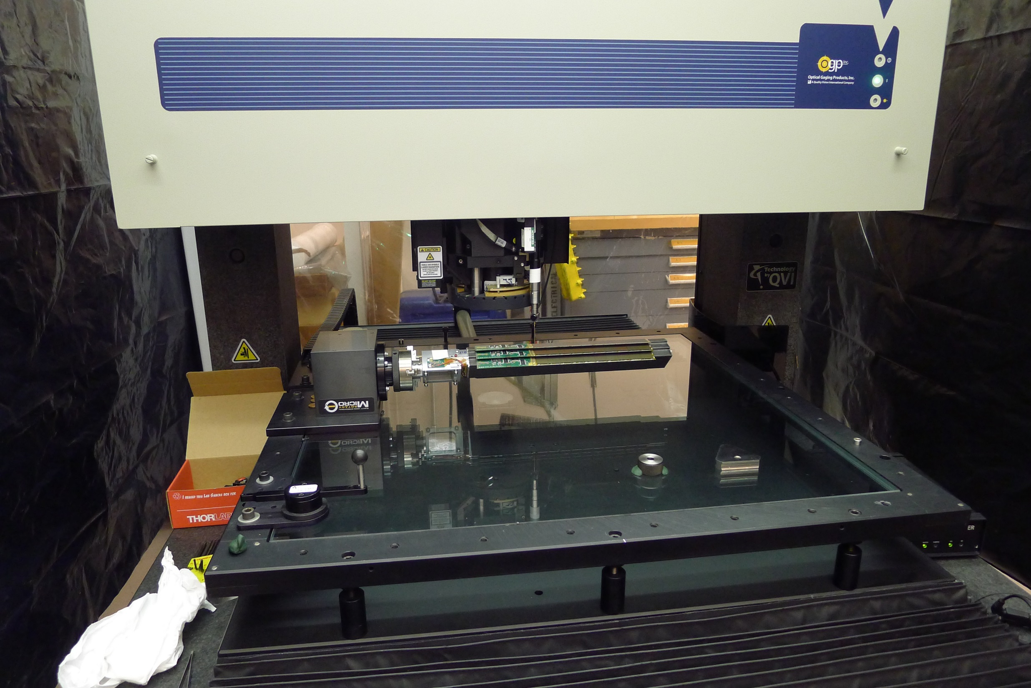
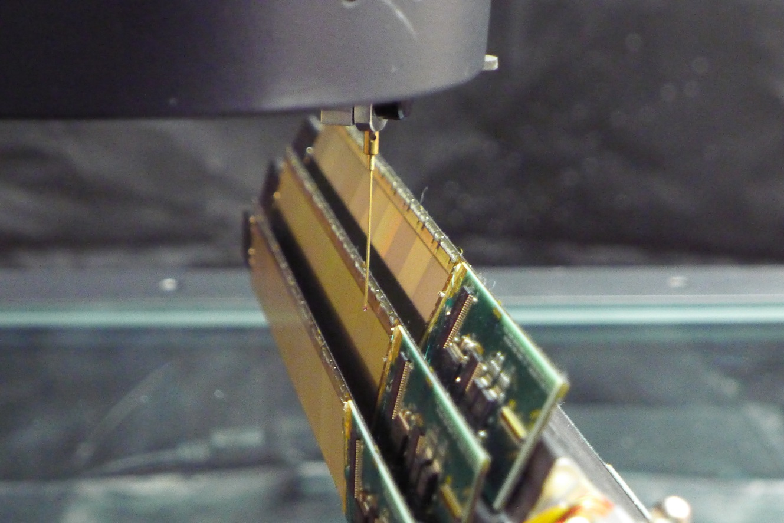
Spatial mapping of the pixels
Pixel locations determined with CMM equipment to within 10 μm prior to installation in STAR
Programmed CMM Measurement method#:
All pixels located on a sector with respect to 3 sector tooling balls
  2 Lithography points on the chips measured with optical head
  Chip surface profile measured with 11 x 11 point pattern using a Feather Probe∗. Using a touch probe permits picking up over hung surfaces
PXL sensor surface profile from survey: ± 30 μm > PXL hit error,
and the chip to chip surface deviation along the ladder surface is still larger, but all of this is then corrected with the spatial map
Parametriuzed by 5*5 spline fct
Full sector measurement takes ~ 8 hours

Slide 19
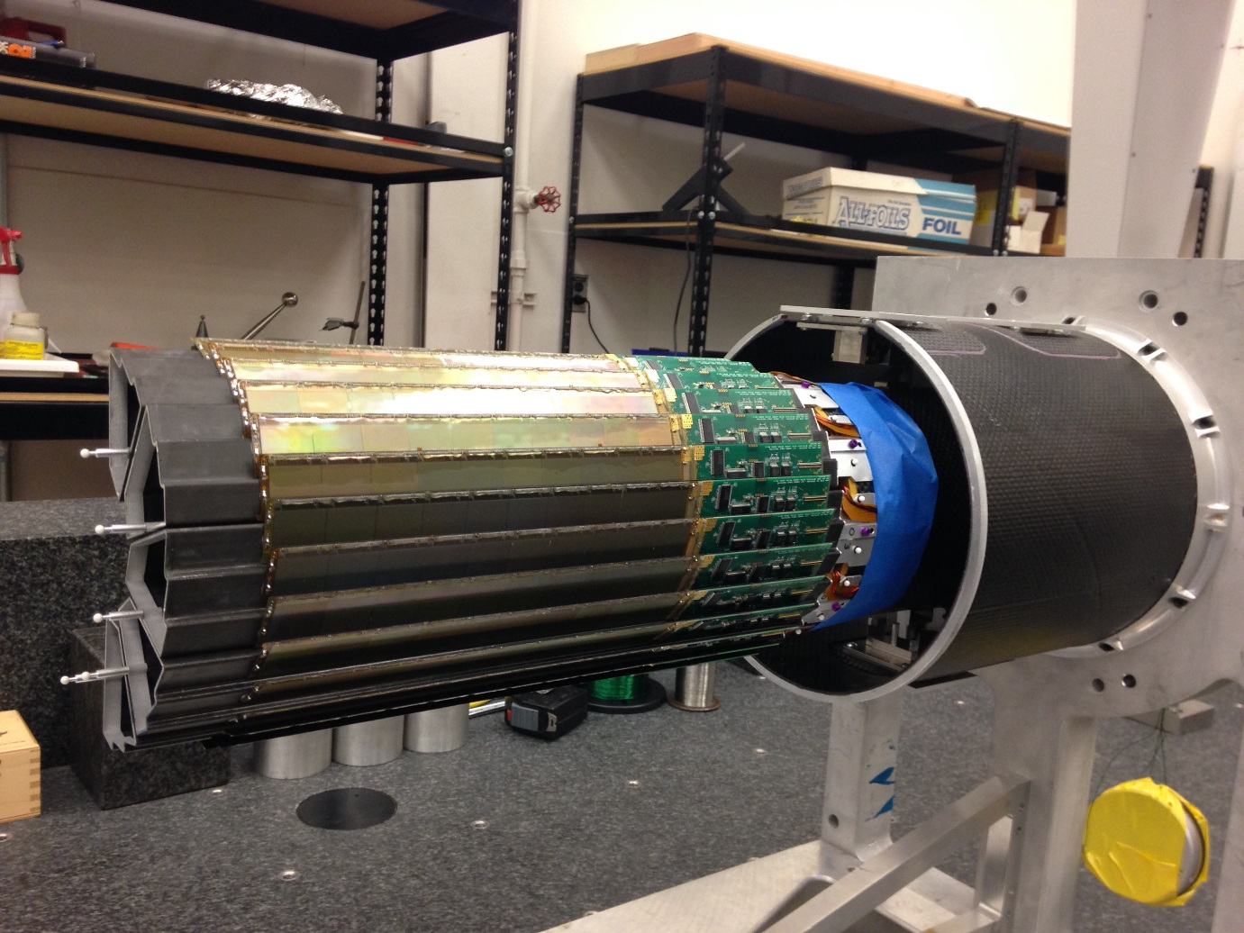
After assembling sectors in a half shell sector tooling balls measured with touch probe relative to kinematic mount coordinate frame
Since the shells are supported the same way in the CMM and in the STAR installation the relative pixel position mapping is not disturbed
duplicate, truncated PXL support tube with kinematic mounts

Slide 20
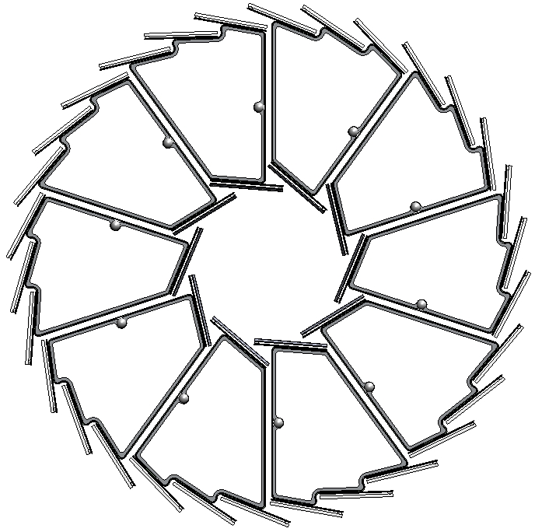
Final operating pointing performance in STAR
Cosmic ray result
Excellent half to half pointing, sub 30 μm
But after half to half alignment which was required to correct poor reproducibility of kinematic mount seating
Check alignment with very low luminosity AuAu also
X
X
X
X
X
X

Slide 21
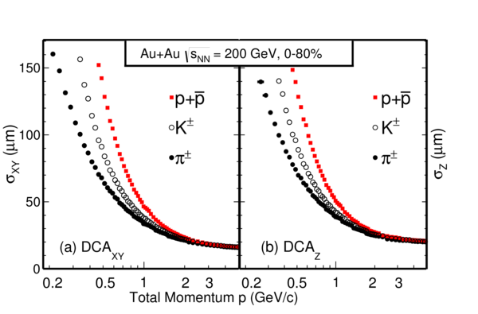
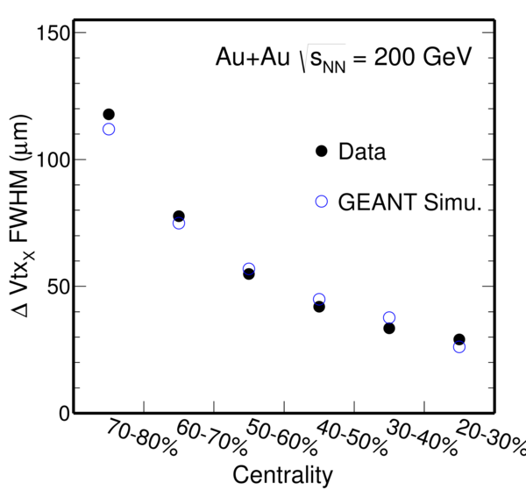
HFT performance
Pointing resolution was determined in Au+Au collisions at 200 GeV in transverse plane and longitudinal. Measurements are in agreement with expectations.
Important also to take into account the vertex resolution vs. centrality, particular for the most peripheral collisions

Slide 22
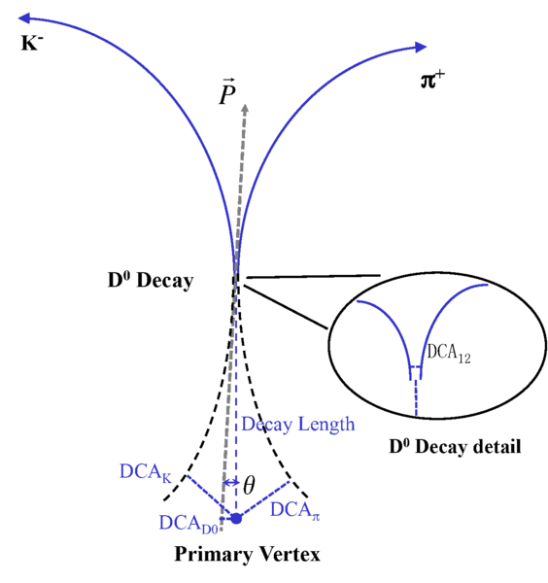
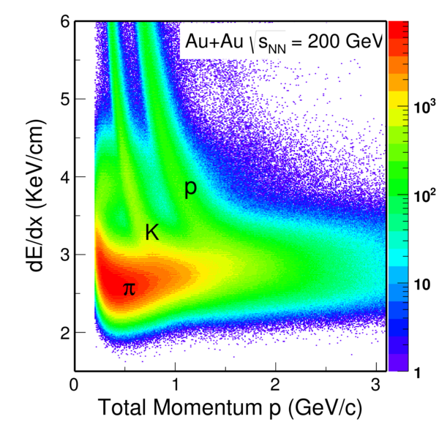
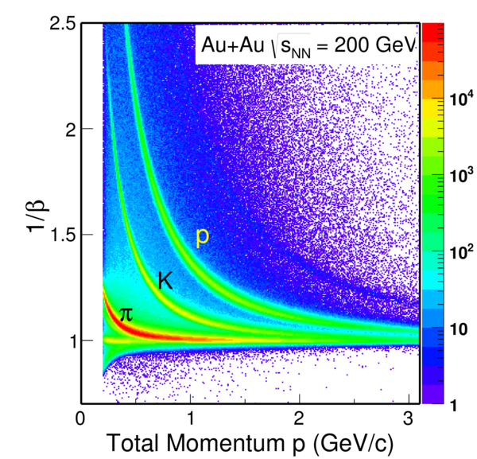
D⁰ reconstruction
Use topological variables
Use particle ID

Slide 23
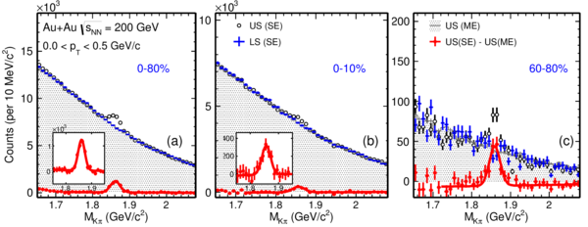
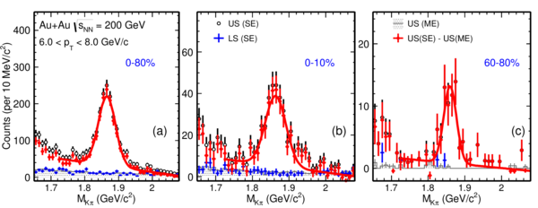
D⁰ spectra
We have achieved very good significance for D⁰
Low p_{T} is difficult due to the pileup and miss matched hit points
Notes:
Of course bot d0 and d0-bar

Slide 24
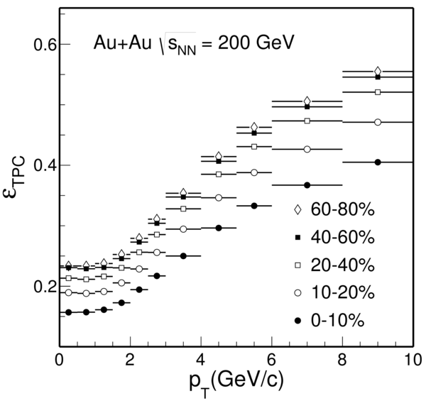
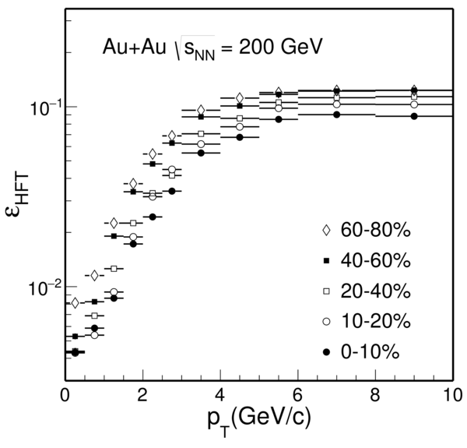
Some words on efficiency
We have applied two methods to evaluate efficiencies
Fast simulation data driven to replicate multi dimensional basic observables
Geant embedding with displaced geometries
Methods agrees well

Slide 25
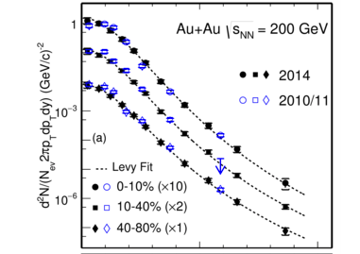
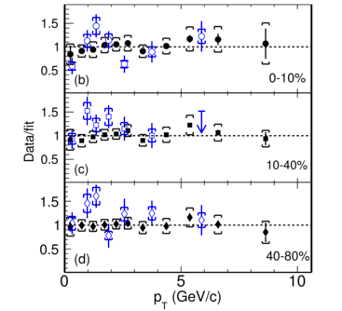
D⁰ spectra
Precise measurements extends to low p_{T} and non-central collisions. Data from 2014
Results consistent with 2010/11 TPC only analysis
Data from submitted paper: arXiv 1812.10224

Slide 26
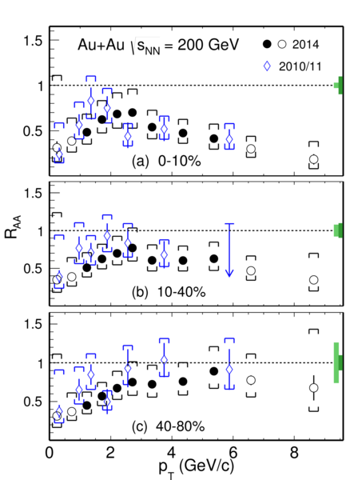
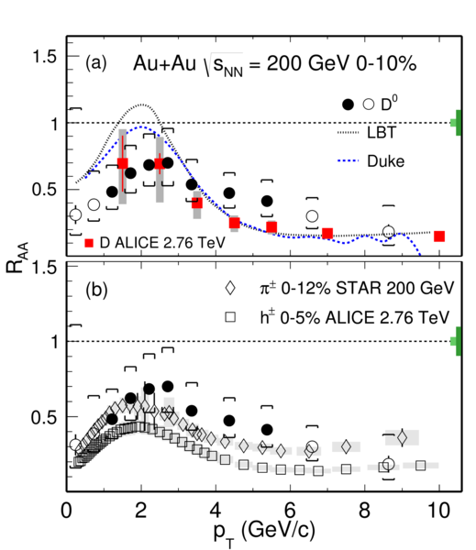
D⁰ R_{AA}
R_{AA} < 1 for 0-10% for all p_{T}
Suppression at high p_{T} increases for more central collisions
Same trends as at LHC and for light mesons
Notes:
Add references

Slide 27
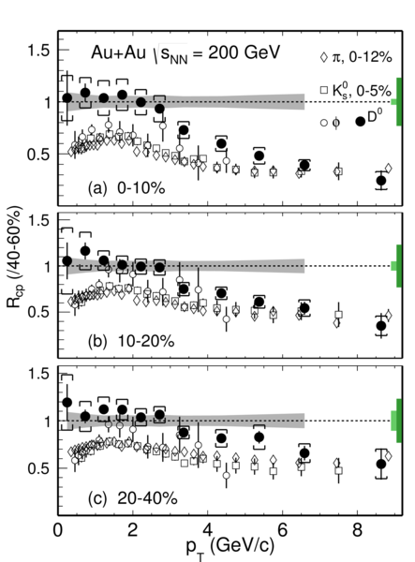
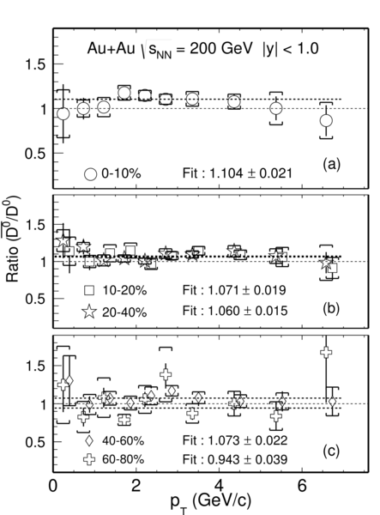
D⁰ R_{CP}
Significant suppression at high p_{T}
Matches theoretical calculations
D⁰-bar/D⁰ slightly greater than one
  Possible due to slight baryon asymmetry at RHIC

Slide 28
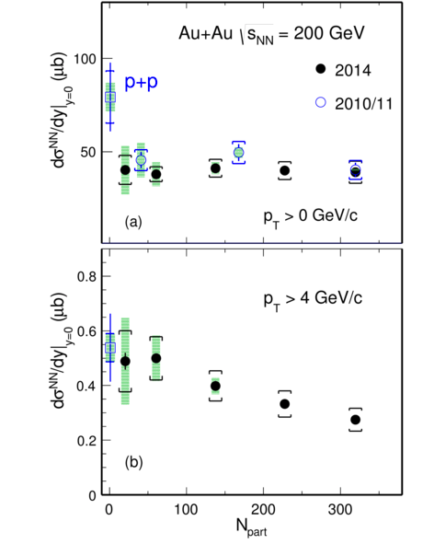
D⁰ cross section
Total D⁰ cross section is nearly independent of centrality, and smaller than in p+p. For p_{T} > 4 GeV/c it decreases with centrality

Slide 29
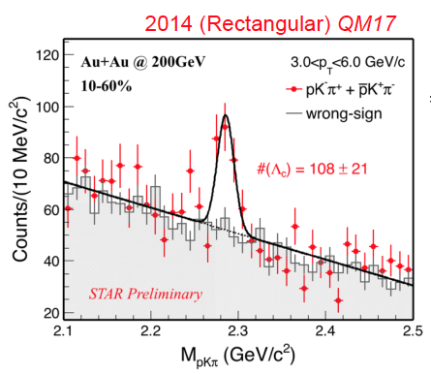
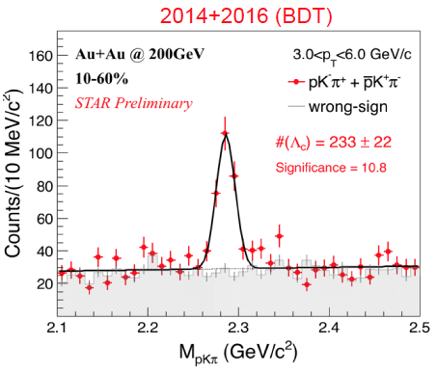
Λ_{c} reconstruction
More than 50% improvement in signal significance with TMVA methods
Includes 2016 dataset

Slide 30
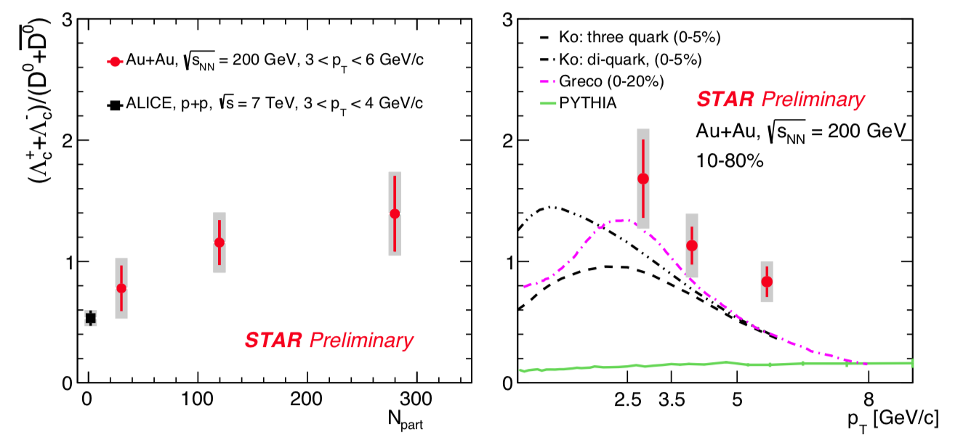
Λ_{c}/D⁰ centrality dependence
Λ_{c} enhancement increases towards more central Au+Au collisions
Large contribution to total charm cross sections in HI

Slide 31
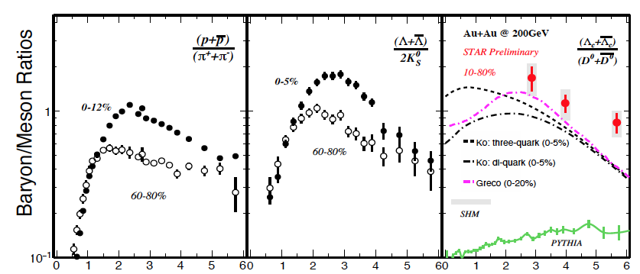
Λ_{c}/D⁰ p_{T} dependence
Significant enhancement of Λ_{c}/D⁰ compared to p+p.
Comparable with light flavor B-to-M ratios
Consistent with charm quark hadronization via coalescence
Notes:
Ko PRC79(2009) 044905.
Greco Eur.Phys.JC(2018) 78:348
SHM PRC79(2009( 044905

Slide 32
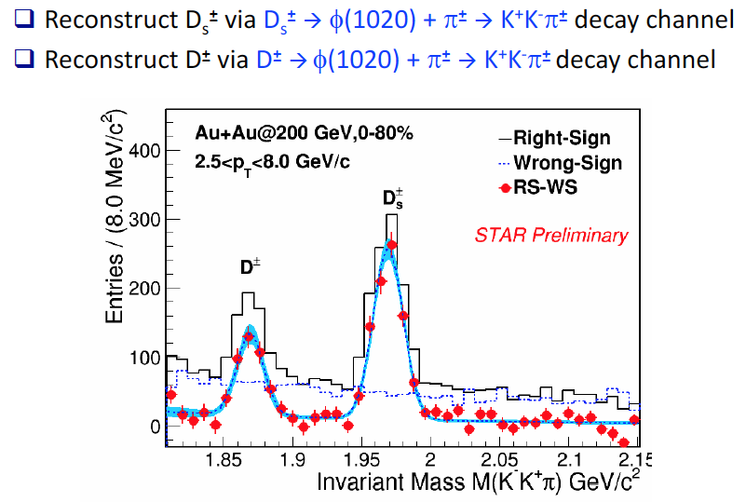
Strange Charmed quarks

Slide 33

Total charm cross section
D⁰ yields measured down to p_{T}=0 GeV/c
For D⁺⁻, D_{s} Levy fits to measured spectra for extrapolation
For Λ_{c} three model fits to data are used and included in systematics
Total charm cross section is consistent with p+p values
Redistributed on meson and baryons

Slide 34


D_{s}, D⁰ enhancement
Strong enhancement of D_{s}/D⁰ observed in central A+A w.r.t fragmentation baseline
->Strangeness enhancement and coalescence
Enhancement larger than model, particular at high p_{T}

Slide 35


Non prompt D⁰, B-decay
Strong interaction of charm with the medium.
What about bottom?
R_{AA} of non-prompt D⁰ extracted.
Improved signal significance using BDT
Will get results form combined data set

Slide 36


B study from different channels

Slide 37


D⁰ Elliptic Flow
Published D⁰ v₂ from 2014 dataset
Clear mass ordering for p_{T} < 2 GeV/c
Follows NCQ scaling in mid-central (10-40%) collisions
Phys.Rev.Lett 118, 212301 (2017)

Slide 38

D⁰ Elliptic Flow
D⁰ v₂ measurements extended to 0-10% centrality with combined 2014 and 2016 data set
Significant flow observed

Slide 39



Slide 40


Slide 41

D⁰ directed flow (v₁)
First evidence for non-zero v1 for D’s
Much larger than K+-K-
May imply effect of strong EM fields in collision system

Slide 42



Slide 43



Slide 44
Summary
The HFT upgrade was overall successfully and has hopefully lead the way for future high resolution vertex detectors (ITS, sPHENIX, EIC)
Strong Modification of charm hadron spectra and hadro chemistry in AA collisions as witnessed by the different observations
  Total charm cross section is conserved.
  Substantial energy loss , coalescence
  Gain significant flow & may have achieved thermal equilibrium in medium (v₂)
  Observed non-zero directed flow
Indication for suppression at high p_{T} for B->D⁰ ,… measurements
Thanks to the many STAR collaborators that has work on HFT construction and analysis over the years

Slide 45


The STAR Upgrades and BES Phase II
i
TPC
Major improvements for BES-II
Endcap TOF
E
EPD Upgrade:
Allows a better and independent reaction plane measurement critical to BES physics
Improves trigger
iTPC Upgrade:
Rebuilds the inner sectors of the TPC
Continuous Spatial Coverage
Improves dE/dx
Extends η coverage from 1.0 to 1.5
Lowers p_{T} cut-in from 125 MeV/c to 60 MeV/c
EndCap TOF Upgrade:
PID at η = 1.1 to 1.5
Provided by CBM-FAIR Phase-0

Slide 46


All detectors now in place for BES II

Slide 47
Backups

Slide 48
Figs from D0 long paper

Slide 49


STAR Heavy Flavor Tracker (HFT)
TPC – Time Projection Chamber (main tracking detector in STAR)
HFT – Heavy Flavor Tracker
SSD – Silicon Strip Detector
IST – Intermediate Silicon Tracker
PXL – Pixel Detector
Tracking inwards with gradually improved resolution:
R (cm)
σ = ~1 mm
Acceptance coverage:
-1< η < 1
0 < φ < 2π
SSD r = 22
IST r = 14
PXL r₂ = 8
  r₁ = 2.8
σ = ~300 μm
σ = ~250 μm
σ = <30 μm

Slide 50

6-9

Slide 51



10-

Slide 52



13-

Slide 53



Slide 56


PXL Detector Mechanical Design
Mechanical support with kinematic mounts (insertion side)
carbon fibre sector tubes (~ 200µm thick)
Insertion from one side
2 layers
5 sectors / half (10 sectors total)
4 ladders / sector
Ladder with 10 MAPS sensors (~ 2×2 cm each)
Aluminum conductor Ladder Flex Cable
20 cm

Slide 57



