Slide 1

The sPHENIX Experiment at RHIC
Ming X. Liu
Los Alamos National Laboratory
(for the sPHENIX Collaboration)
September 9-13, 2019, Santa Fe, NM

Slide 2

US Nuclear Physics Long Range Plan (2015) sPHENIX – to understand “Inner Workings of QGP”

Slide 3
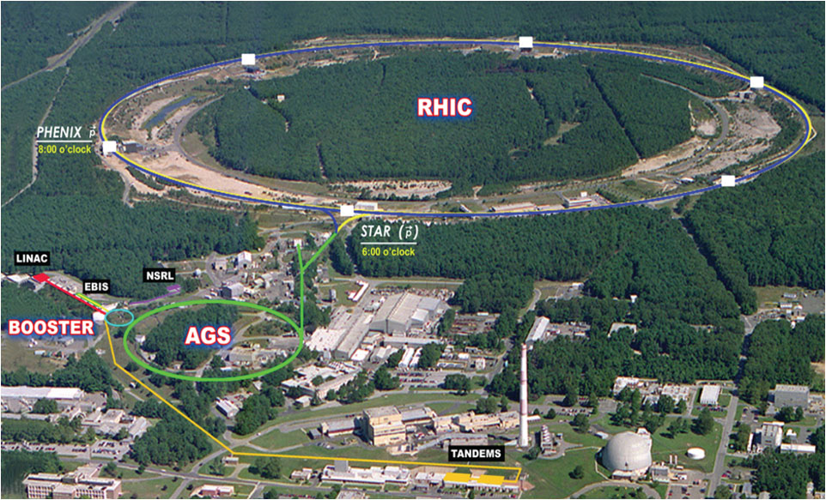
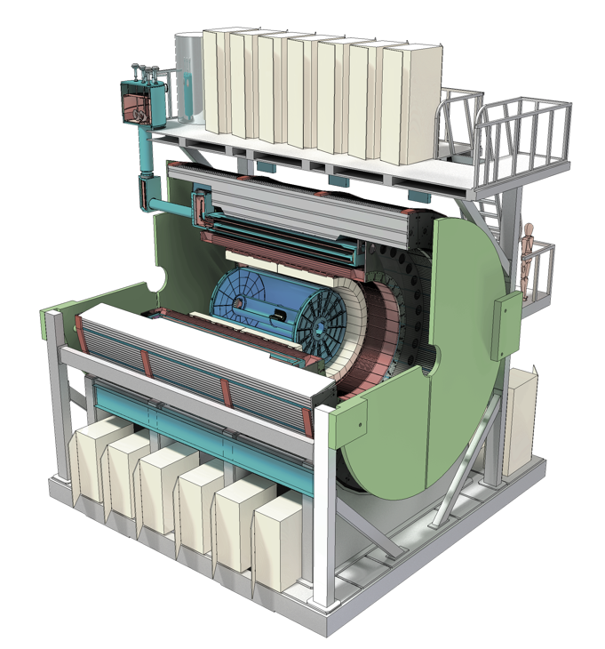


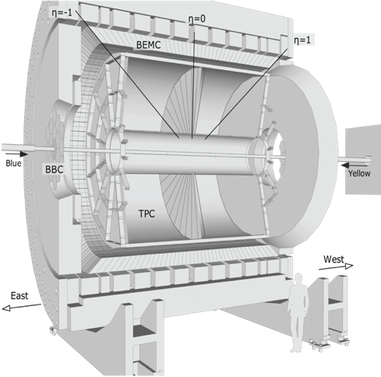
sPHENIX Upgrade at RHIC the next generation Heavy Ion Physics experiment in the US
Φ 1.2km

Slide 4
Outline
sPHENIX detector and HI physics
  Jets and photons
  Upsilons
  Open heavy flavors
Cold-QCD physics opportunity
  Spin, TMD, nPDF
  Forward upgrade
Outlook

Slide 5
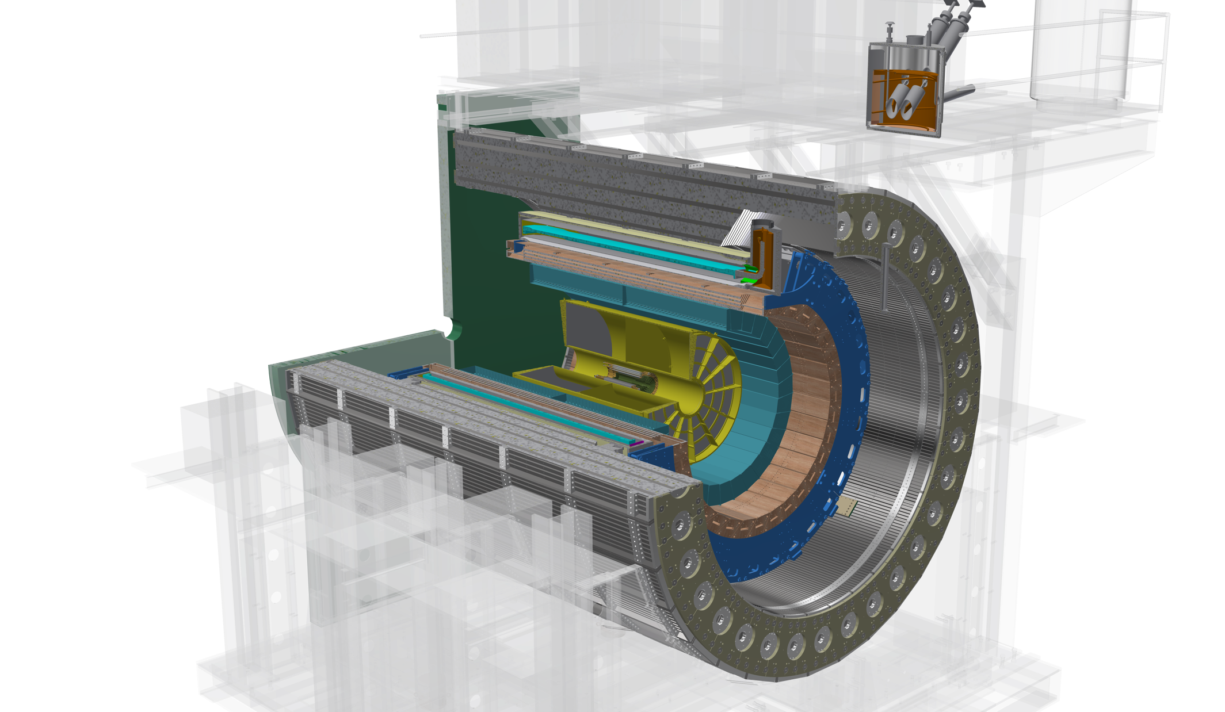
The sPHENIX Detector
A high rate and large acceptance detector for heavy ion physics at RHIC
Outer HCal
SC Magnet
(Inner Hcal)
EMCal
TPC
INTT
MVTX
Φ ~ 5m
|eta| < 1.1
B: 1.4 T
15 kHz trigger
>10 GB/s data
MBD
Notes:
15kHz matched to collision rate.

Slide 6
Probing the Inner Workings of QGP in sPHENIX
- Key Capabilities

Slide 7
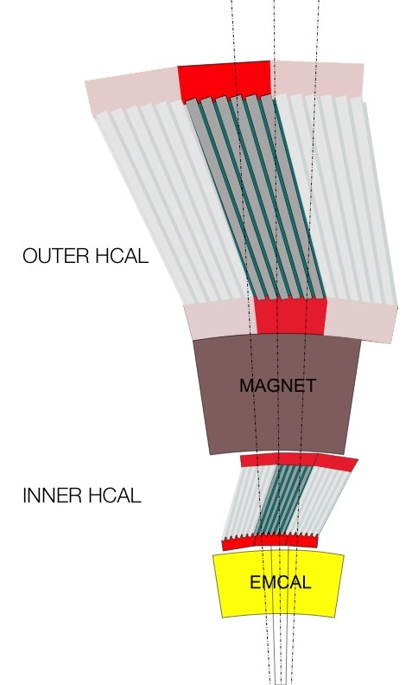
sPHENIX Detector Sub-Systems
Outer HCAL ≈3.5λ_{I}
Magnet ≈1.4X₀
Inner HCAL ≈1λ_{I}
EMCAL ≈18X₀ (≈1λ_{I})
MVTX (based on ALICE ITS/IB):
3-layer MAPS vertex tracker
Excellent 3-D DCA resolution, < 25 μm @ p_{T} > 1 GeV/c
INTT:
2-layer Si strip
TPC:
48 layer, continuous readout, R = 20-78 cm
Excellent momentum resolution p_{T} = 0.2-40 GeV/c
EMCal: Scintillating fibers embedded in W powder
Δη×Δφ = 0.024×0.024
σ_{E}/E = 16%/√E ⊕ 5%
HCal: Plastic scintillating tiles + tilted Steel/Al plates
Δη×Δφ = 0.1×0.1
σ_{E}/E = 100%/√E

Slide 8
Detector Performance: Tracking and Jets
GEANT simulations verified with test beam data

Slide 9
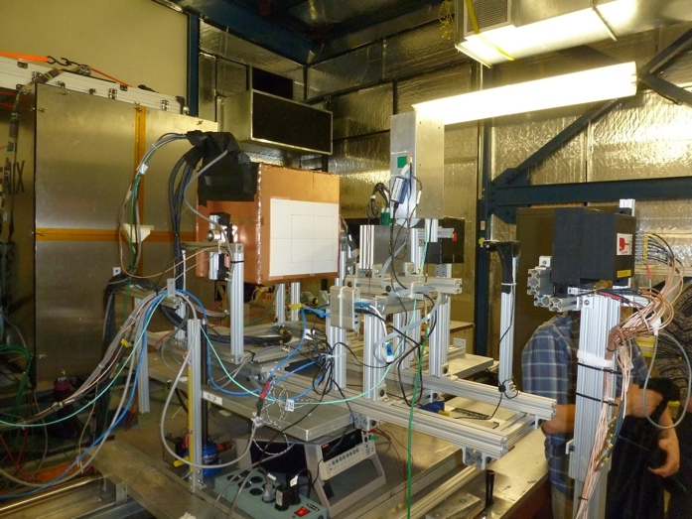
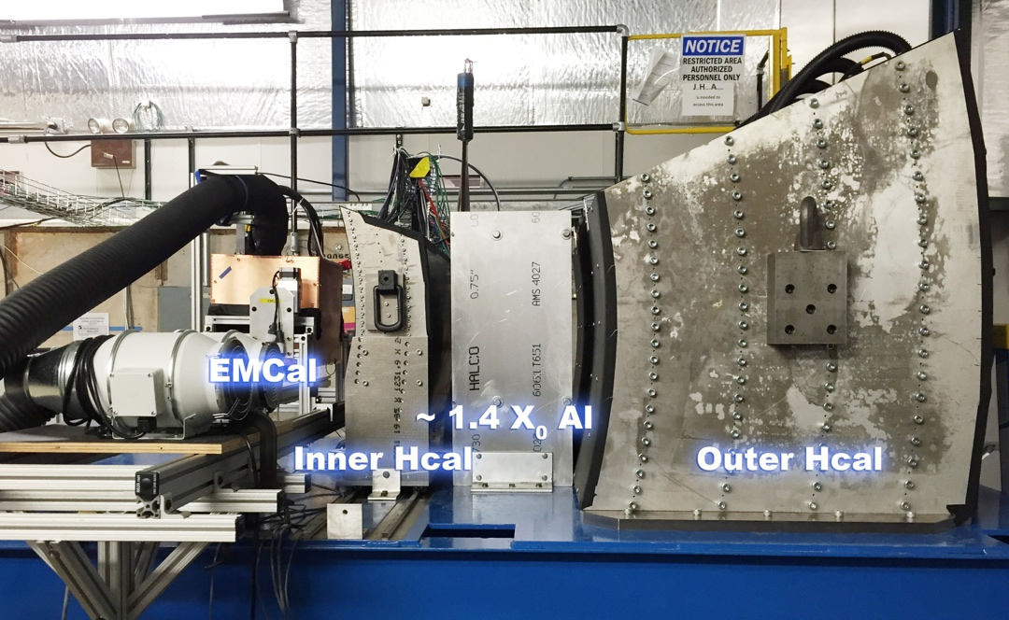
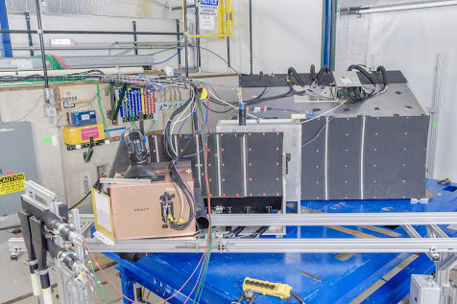
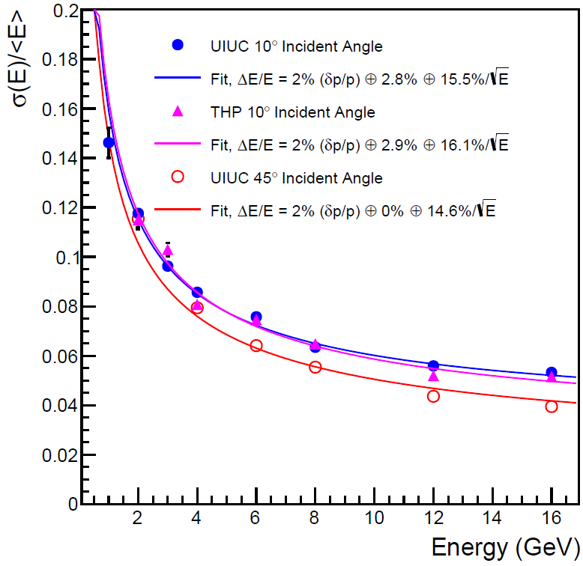
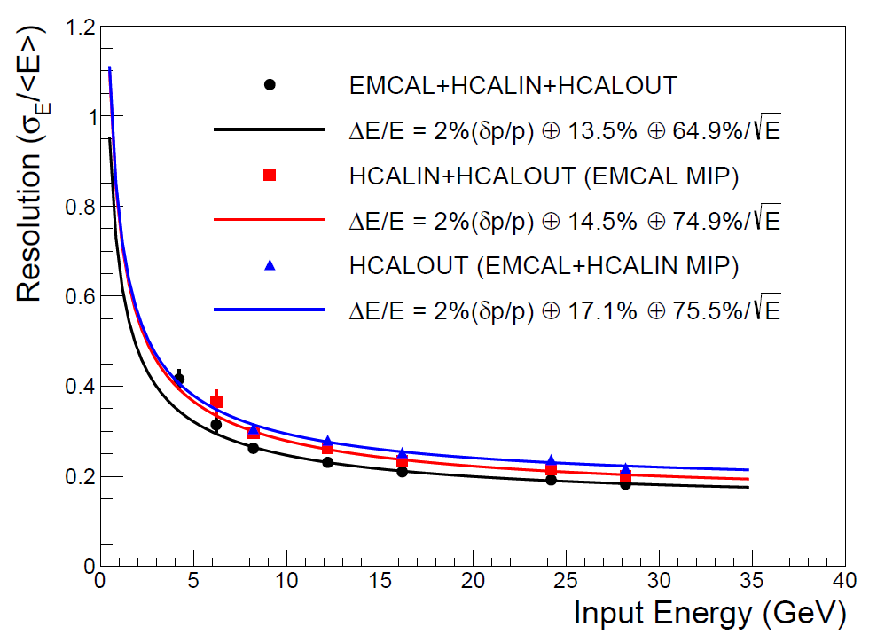
Calorimeters Beam Tests
February 2014
Proof of principle
February 2016: η~0 prototype
February 2017: η~0.9 prototype
sPHENIX beam test data
sPHENIX beam test data
Electron
Energy resolution
arXiv:1704.01461
Pion
Energy resolution
arXiv:1704.01461

Slide 10
Monolithic-Active-Pixel-Sensor based Precision Vertex Detector
-- for Open Heavy Quark Measurements

Slide 11
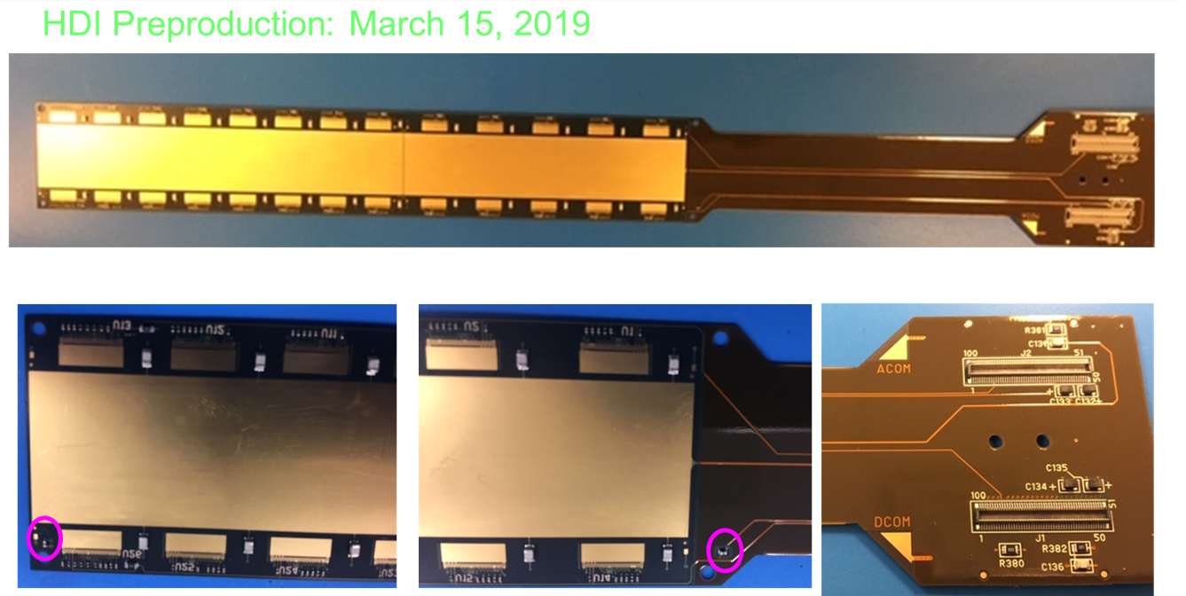
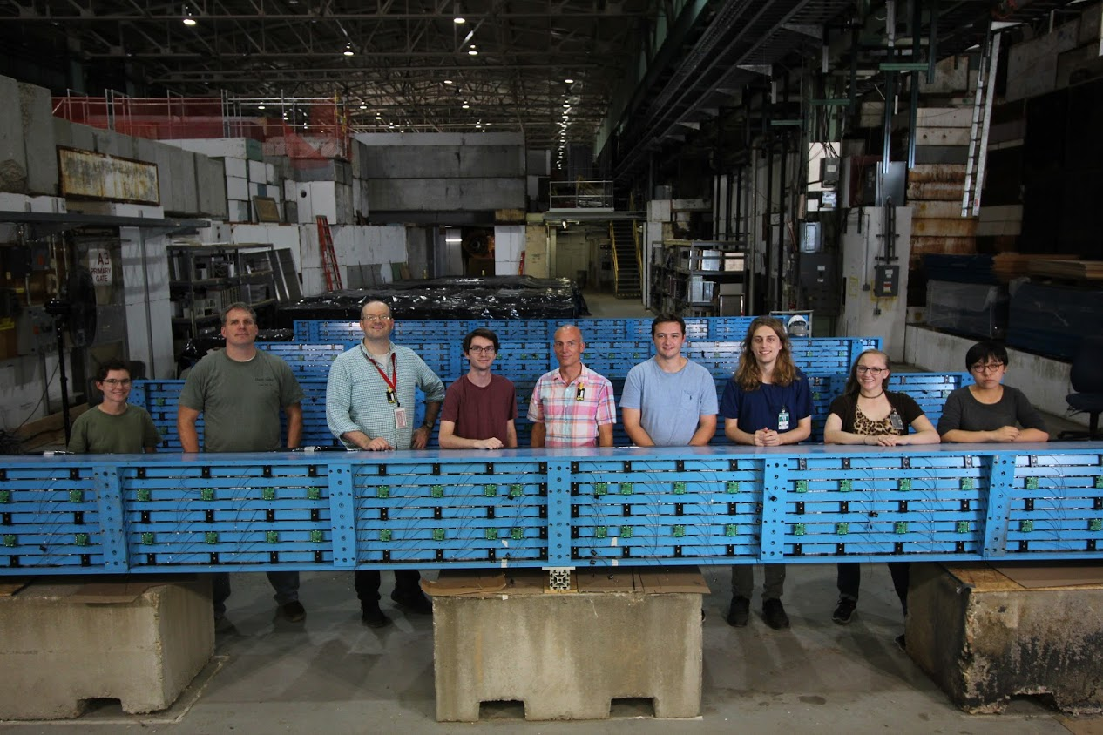
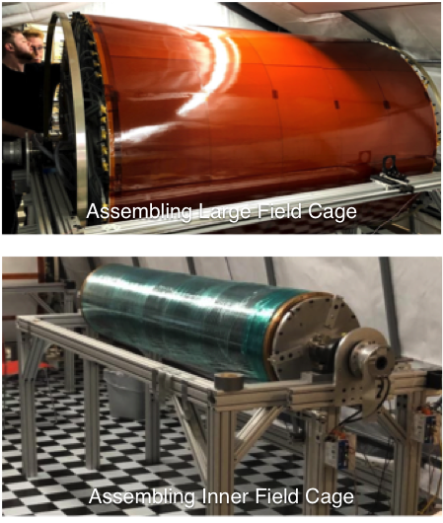
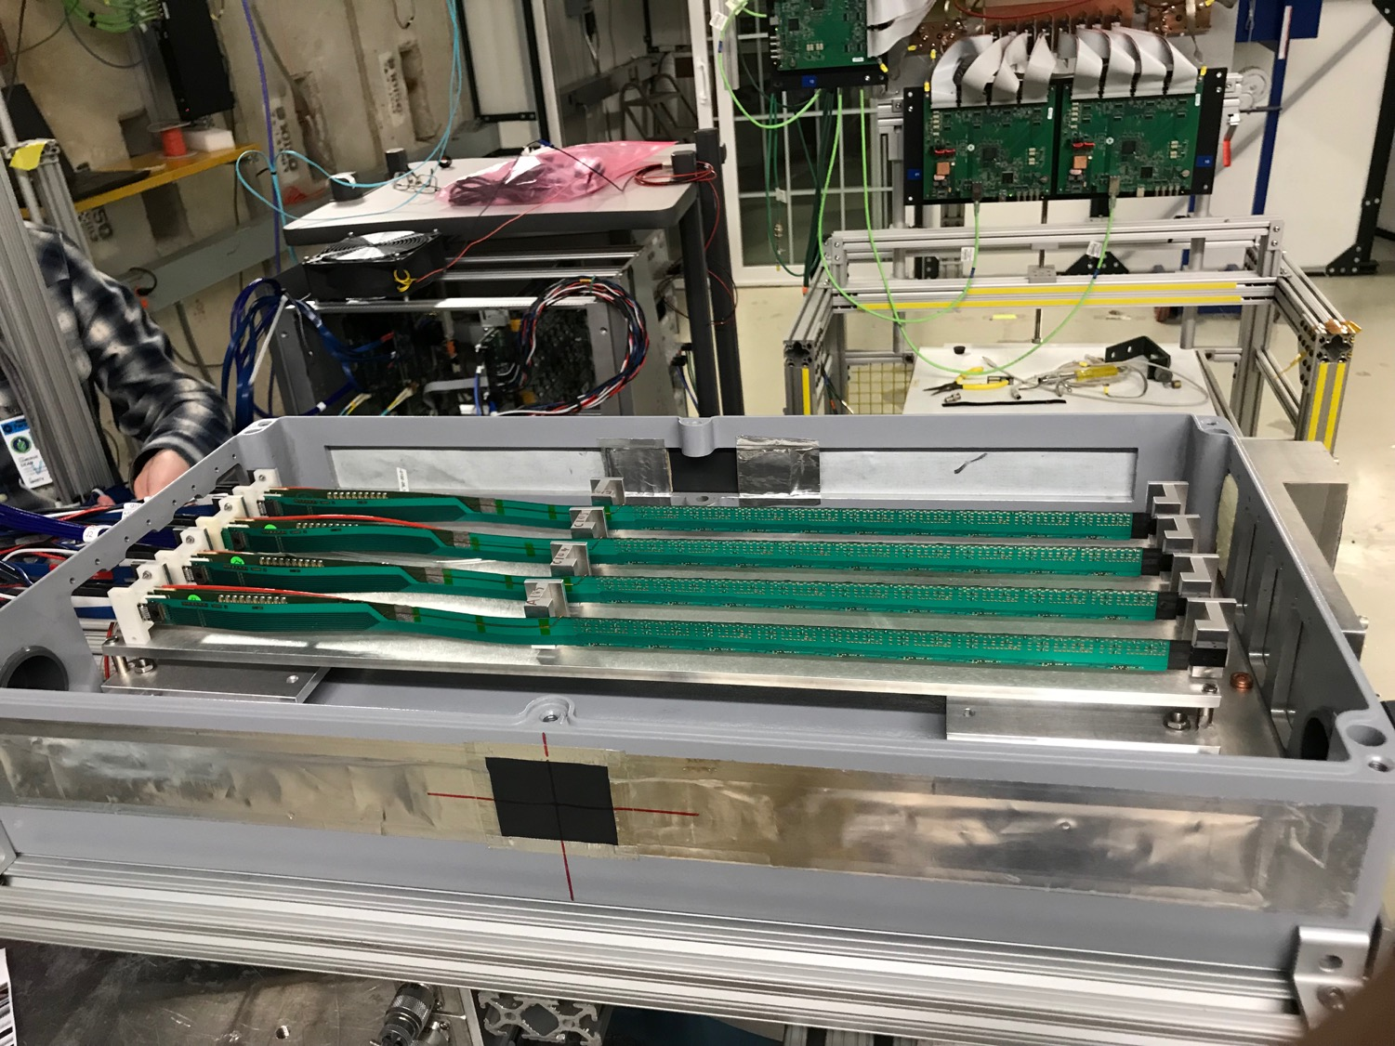
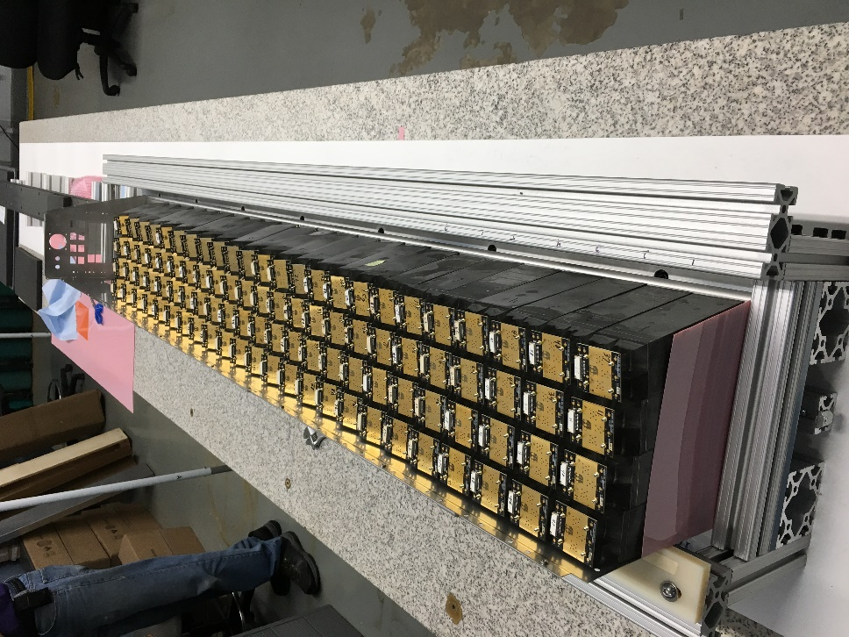
Detector Status and Highlights
All 32 oHCAL sectors received at BNL
EMCAL sector 0 assembled
TPC GEM pre-production started
MVTX sensor staves and Readout Units being produced
Successful MVTX, INTT, TPC beam tests at FNAL
INTT
HCal
EMCal
TPC
MVTX

Slide 12
Evolving sPHENIX Run Plan
1st campaign
2nd campaign
Guidance from ALD to think in terms of a multi-year run plan
Consistent with language in DOE CD-0 “mission need” document
Incorporates BNL C-AD guidance on luminosity evolution
Incorporates commissioning time in first year
Minimum bias Au+Au at 15 kHz for |z| < 10 cm:
47 billion (Year-1) + 96 billion (Year-3) + 96 billion (Year-5) = Total 239 billion events

Slide 13
sPHENIX 3 Physics Pillars
Jets
Upsilons
Heavy Quarks

Slide 14
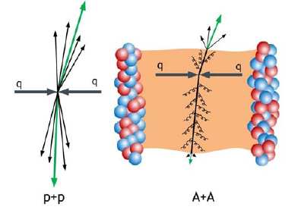
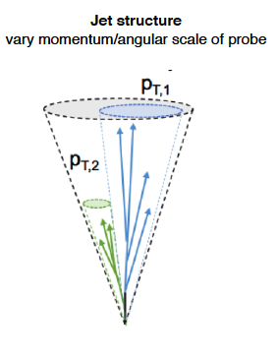
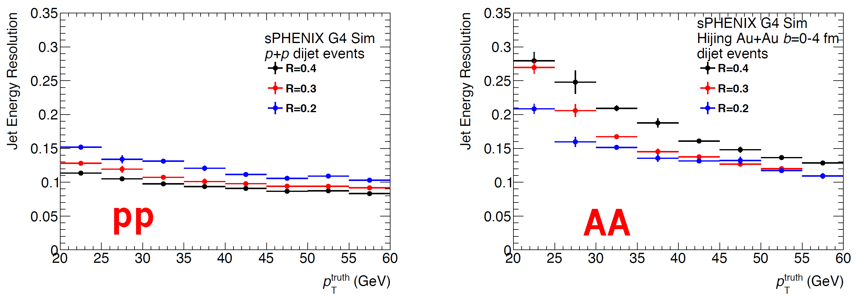
(I) Precision Calorimetry for Jets and Photons
Calorimeter jets + precision tracking: jet reconstruction and jet structure - New era in RHIC HI jet physics!

Slide 15
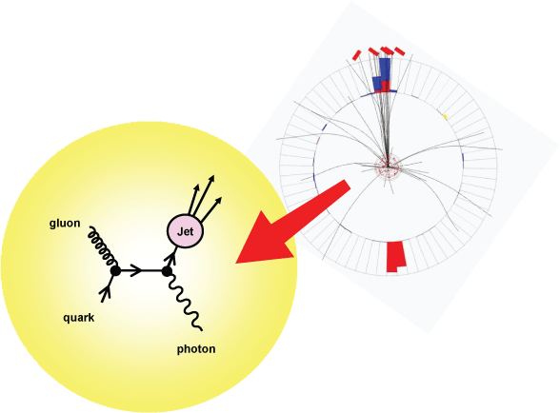
Key Observable: Direct Photon Tagged Jets
Jets by HCal +EMCal
γ+Jet momentum balance
Jet fragmentation in QGP
Photons by EMCal
Jet shape modification
Mostly quark jets: ~80%

Slide 16
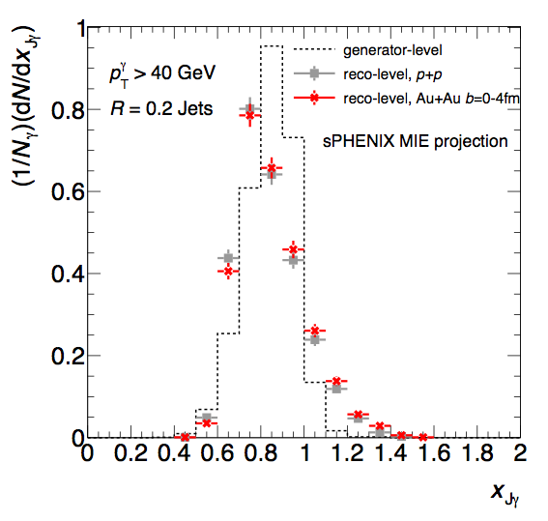
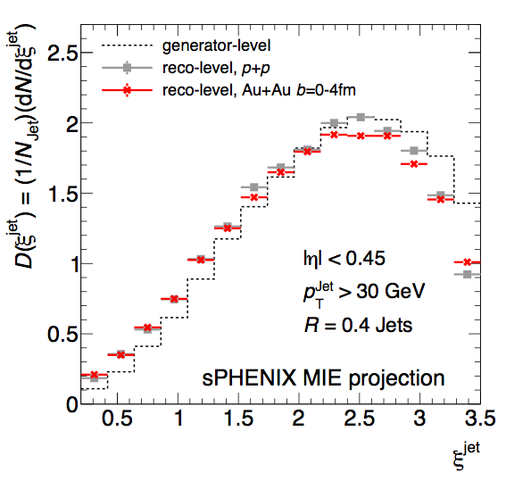
Modification of Photon-tagged Jets
γ+Jet momentum balance
γ+Jet fragmentation function
sPHENIX projection 100B Au+Au
Study parton energy loss in QGP
Modification of parton shower in QGP

Slide 17
Di-Jets Modification: LHC vs RHIC
Increased coupling at low energy to the medium near T_{c}
stronger di-jet suppression expected at RHIC
LHC
RHIC
Z-B Kang, J Reiten, I Vitev, B Yoon, “Light and heavy flavor dijet production and dijet mass modification in heavy ion collisions”, Phys. Rev. D99 034006 (2019) Partly supported by LANL LDRD motivated by and connected to sPHENIX

Slide 18
sPHENIX 3 Physics Pillars
Jets
Upsilons
Heavy Quarks

Slide 19
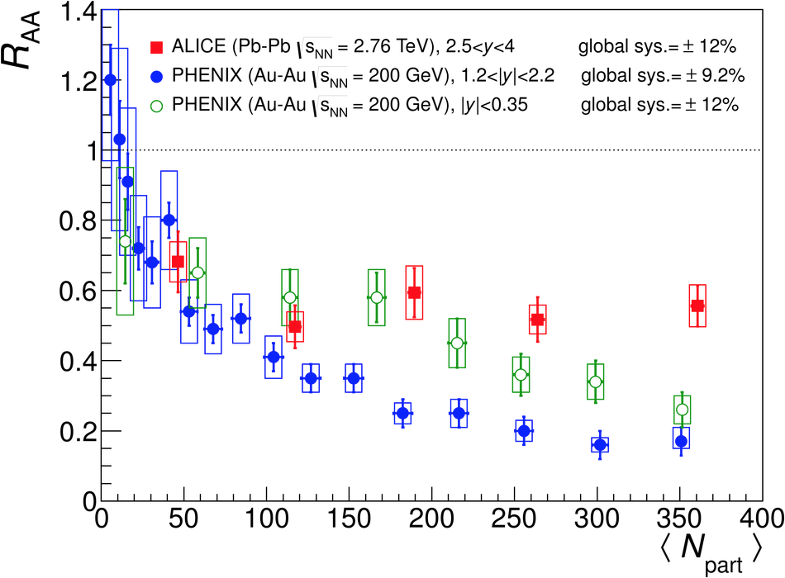
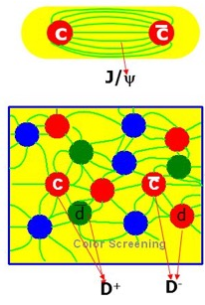
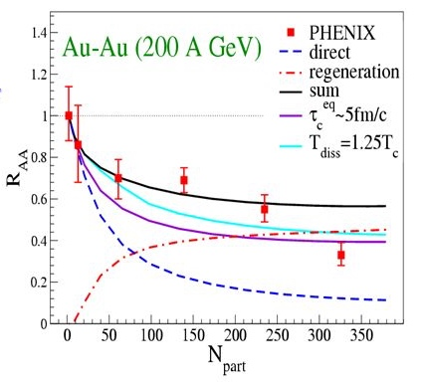
(II) J/Psi Suppression Observed, w/ Surprises, @RHIC and LHC
QGP Suppression
  Color screening
  Breakup w/ “co-movers”
Regeneration
  Coalescence of many c-cbar pairs produced in A+A
Upsilons! – focus of sPHENIX
  No regeneration
Zhuang et al.

Slide 20
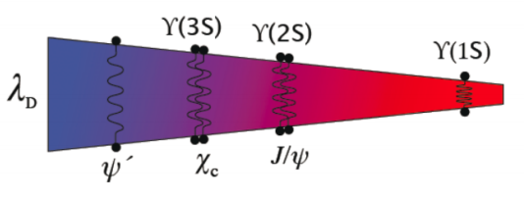
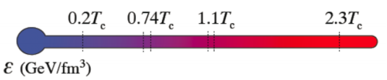
Upsilon Spectroscopy at RHIC
ϒ(3s)-0.78fm
ϒ(2s) – 0.56fm
ϒ(1s) – 0.28fm
sPHENIX: Thermometer of QGP via clean separation of three Upsilon states
CMS data:
min. bias PbPb

Slide 21
sPHENIX 3 Physics Pillars
Jets
Upsilons
Heavy Quarks

Slide 22
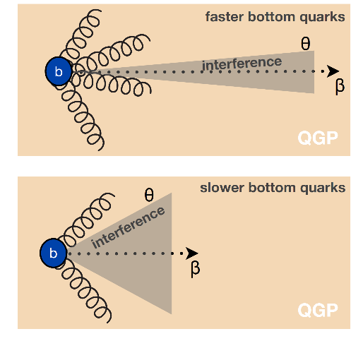
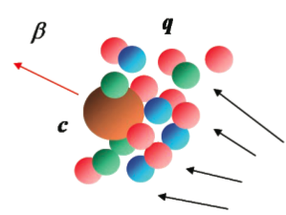
(III) Heavy Quarks - Unique Probe of QGP
Study mass dependence
  Jet quenching
  “Flow” – interaction with medium
Access QGP properties
Mass dependent
radiation dE/dx
m_{u} m_{d}
m_{s}
Λ_{QCD}
m_{c}
m_{b}
MeV
1
10
10²
10³
10⁴
T_{c}
T_{QGP}

Slide 23
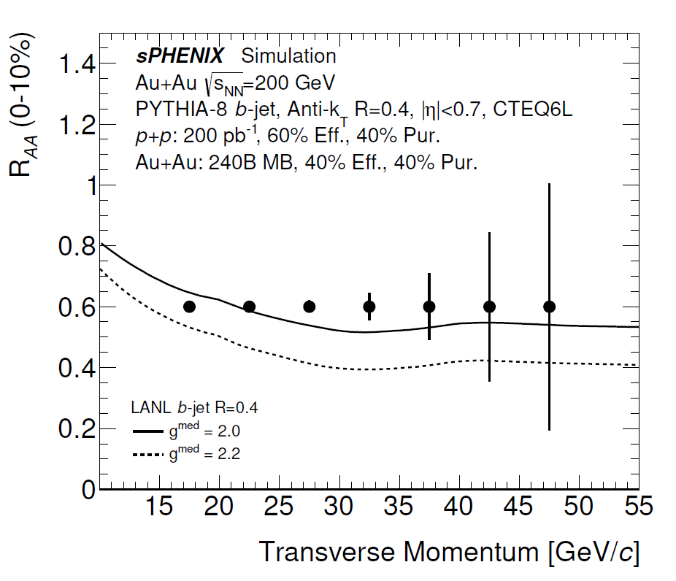
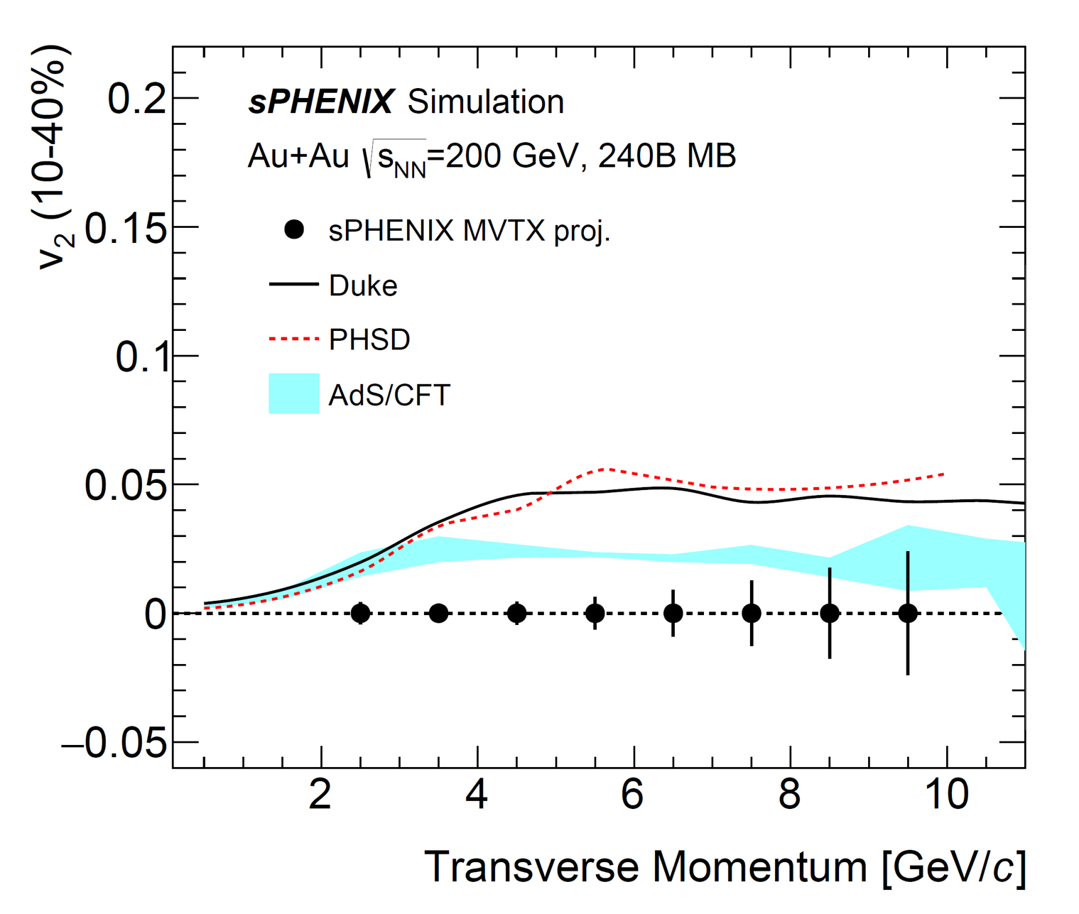
B-Hadron and b-jet Projections
Inclusive B-hadron/b-jet suppression and v₂ at RHIC
Strong constraints on energy loss model of high energy probe in QGP
Determine the bottom quark collectivity → clean access to D_{HQ} at RHIC energy
Inclusive b-jet R_{AA}
non-prompt D-meson and predictions for sPHENIX

Slide 24
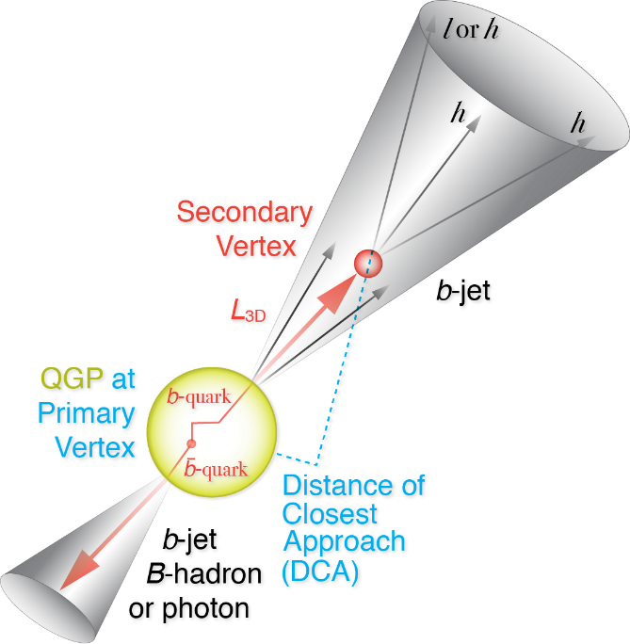
b-Di-Jet Modifications
Jared’s talk
Z-B Kang, J Reiten, I Vitev, B Yoon, “Light and heavy flavor dijet production and dijet mass modification in heavy ion collisions”, Phys. Rev. D99 034006 (2019) Partly supported by LANL LDRD motivated by and connected to sPHENIX

Slide 25
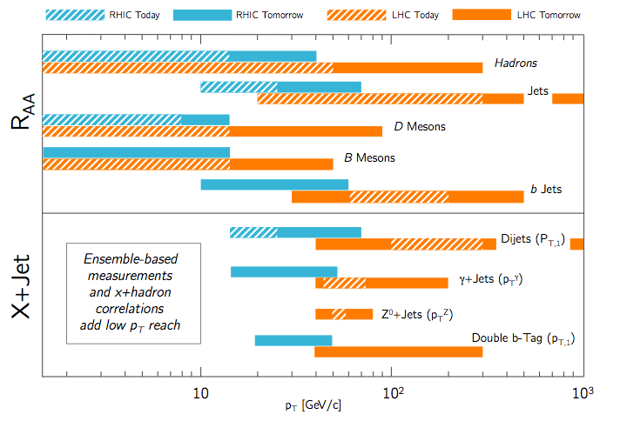
sPHENIX Complements LHC Measurements
Excellent coverage at low-medium pT
Precision measurements with high statistics
Larger QGP effects at RHIC for many observables at low pT
Same probes at RHIC and LHC

Slide 26
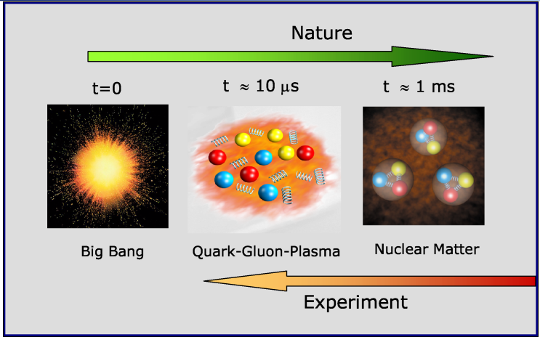
A Broad Physics Program with sPHENIX
Nuclear matter under extreme condition, “QGP”
Nucleon and nuclear structures, novel QCD dynamics, “Cold QCD”
“Hot” QGP physics
“Cold” QCD physics

Slide 27
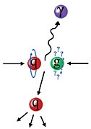

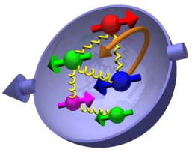
Study Gluon Polarization
Jets, hadrons, direct photons and more

Slide 28
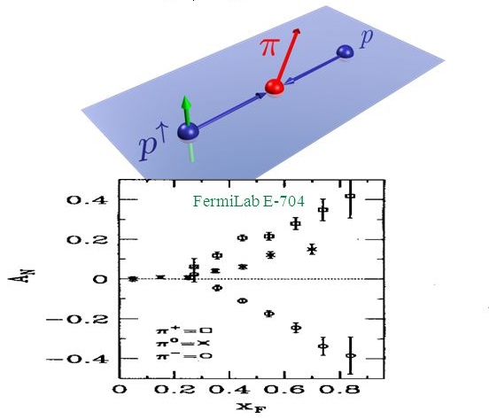
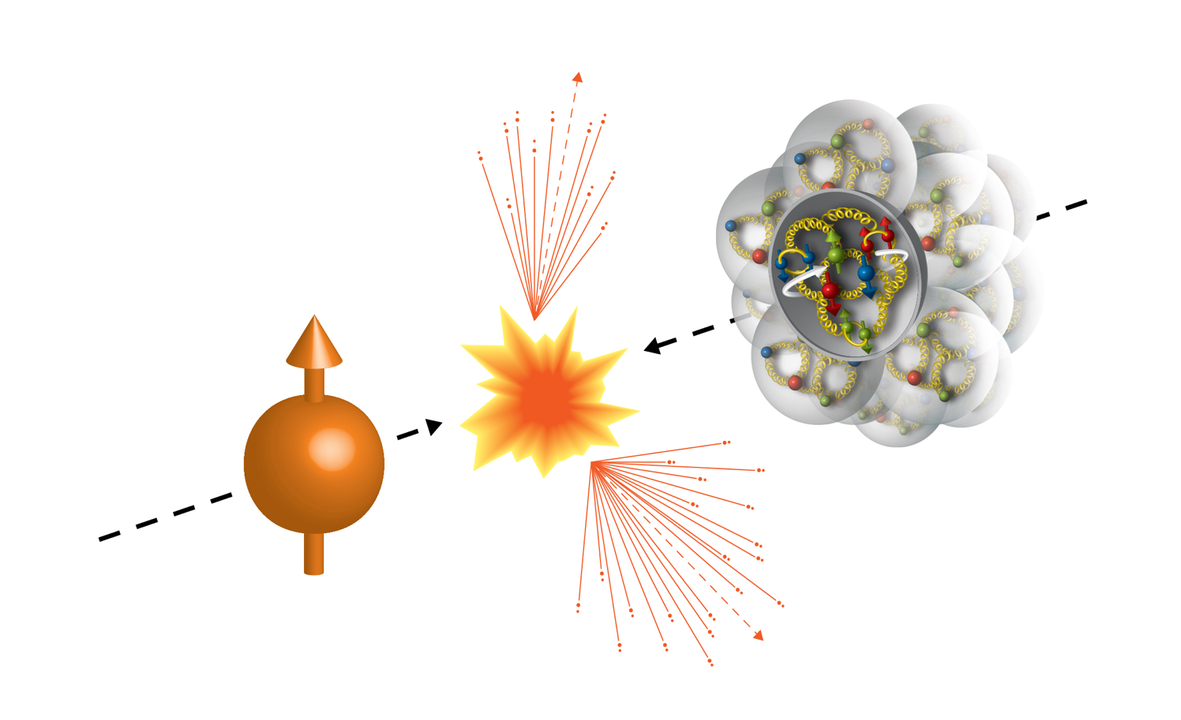
Physics with Transversely Polarized p+p/A Collisions at RHIC
100GeV/nucleon
100GeV
Au
Transversely Polarized Proton

Slide 29
Probe the Underlying Physics via Hard Scatterings
TMD, Collinear Twist-3 Factorizations
(i) Sivers mechanism:
correlation proton spin & parton k_{T}
(ii) Collins mechanism: Transversity × spin-dep fragmentation
SIDIS:
S_{P}
Phys Rev D41 (1990) 83; 43 (1991) 261
S_{P}
Nucl Phys B396 (1993) 161
S_{q}
p
k_{T,q}
p
p
p
S_{q}
k_{T,π}
p+p/A:
Collinear Twist-3 (RHIC): quark-gluon/gluon-gluon correlations

Slide 30
Access Sivers and Collins with Jet and Hadron Azimuthal Distributions in Transversely Polarized p+p Collisions
Feng Yuan, PRL 100, 032003 (2008)
Umberto D’Alesio et al PRD 83 034021 (2011)
→ “Sivers-like” (Jet)
→ “Collins-like” (hadron)

Slide 31
Forward Upgrade Proposal
Forward upgrade will bring in new physics capability – TMD, small-x physics, QGP over broader kinematics etc.
sPHENIX Barrel Detectors:
MVTX, INTT, TPC
EMCal, HCal
sPHENIX Forward Upgrade
EMCal, Hcal, Tracking

Slide 32
sPHENIX at Electron Ion Collider (EIC)
A Day-1 EIC Detector based on sPHENIX

Slide 33
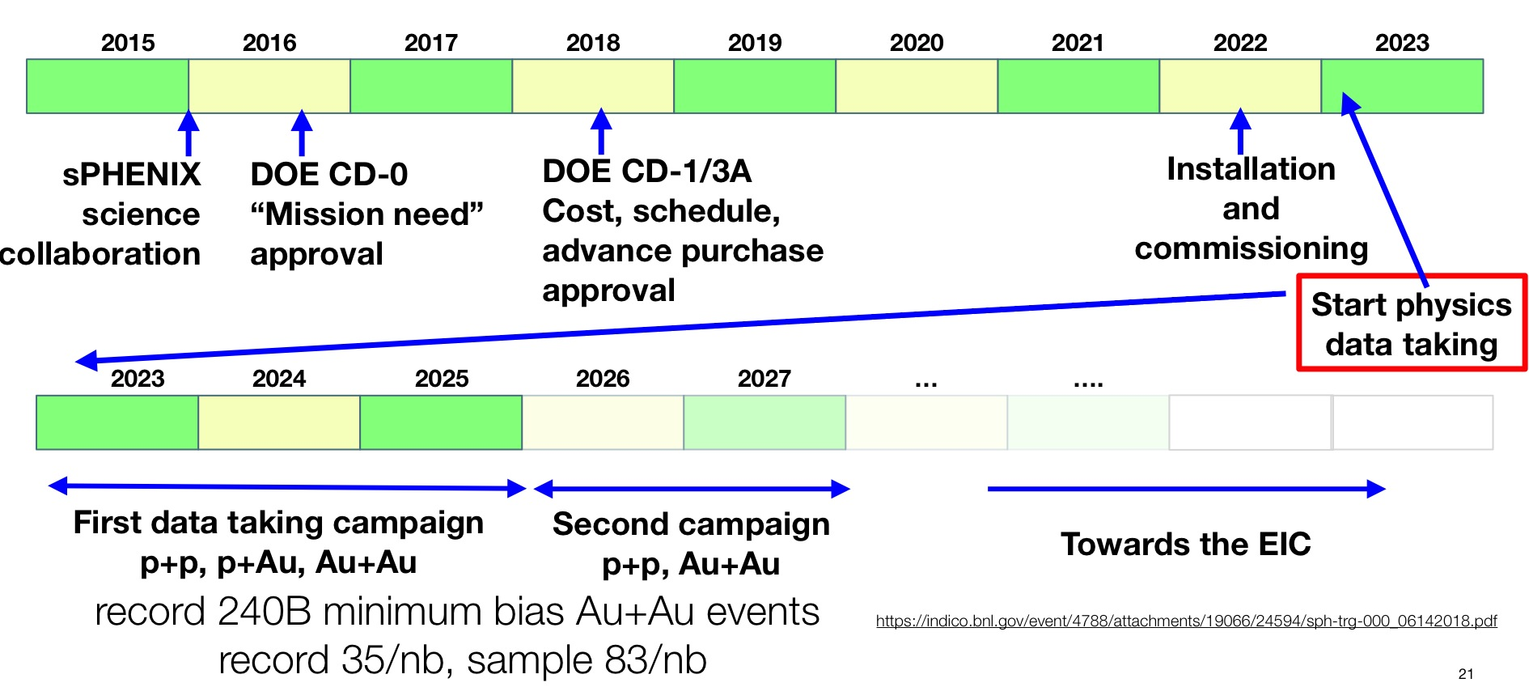
sPHENIX Timeline
PD-2/3 Reviewed;
Expect approval soon

Slide 34
Summary and Outlook

Slide 35
The Growing sPHENIX Collaboration
77 institutions – 17 since formation of collaboration in December 2015
Augustana University
Banaras Hindu University
Baruch College, CUNY
Brookhaven National Laboratory
China Institute for Atomic Energy
CEA Saclay
Central China Normal University
Chonbuk National University
Columbia University
Eötvös University
Florida State University
Fudan University
Georgia State University
Howard University
Hungarian sPHENIX Consortium
Insititut de physique nucléaire d’Orsay
Institute for High Energy Physics, Protvino
Institute of Nuclear Research, Russian Academy of Sciences, Moscow
Institute of Physics, University of Tsukuba
Institute of Modern Physics, China
Iowa State University
Japan Atomic Energy Agency
Charles University (CUNI), Prague
Czech Technical University in Prague (CTU)
Korea University
Lawrence Berkeley National Laboratory
Lawrence Livermore National Laboratory
Lehigh University
Los Alamos National Laboratory
Massachusetts Institute of Technology
Muhlenberg College
Nara Women’s University
National Central University
National Research Centre "Kurchatov Institute"
National Research Nuclear University "MEPhI"
New Mexico State University
Oak Ridge National Laboratory
Ohio University
Peking University
Petersburg Nuclear Physics Institute
Purdue University
Rice University
RIKEN
RIKEN BNL Research Center
Rikkyo University
Rutgers University
Saint‐Petersburg Polytechnic University
Sejong University
Shanghai Institute for Applied Physics
Stony Brook University
Sun Yat Sen University
Temple University
Tokyo Institute of Technology
Tsinghua University
Universidad Técnica Federico Santa María
University of California, Berkeley
University of California, Los Angeles
University of California, Riverside
University of Colorado, Boulder
University of Debrecen
University of Houston
University of Illinois, Urbana-Champaign
University of Jammu
University of Maryland
University of Michigan
University of New Mexico
University of North Carolina at Greensboro
University of Sao Paolo
University of Tennessee, Knoxville
University of Texas, Austin
University of Tokyo
University of Science and Technology, China
Vanderbilt University
Wayne State University
Weizmann Institute
Yale University
Yonsei University
9/10/19
The sPHENIX Experiment at RHIC

Slide 36
Backup slides

Slide 37
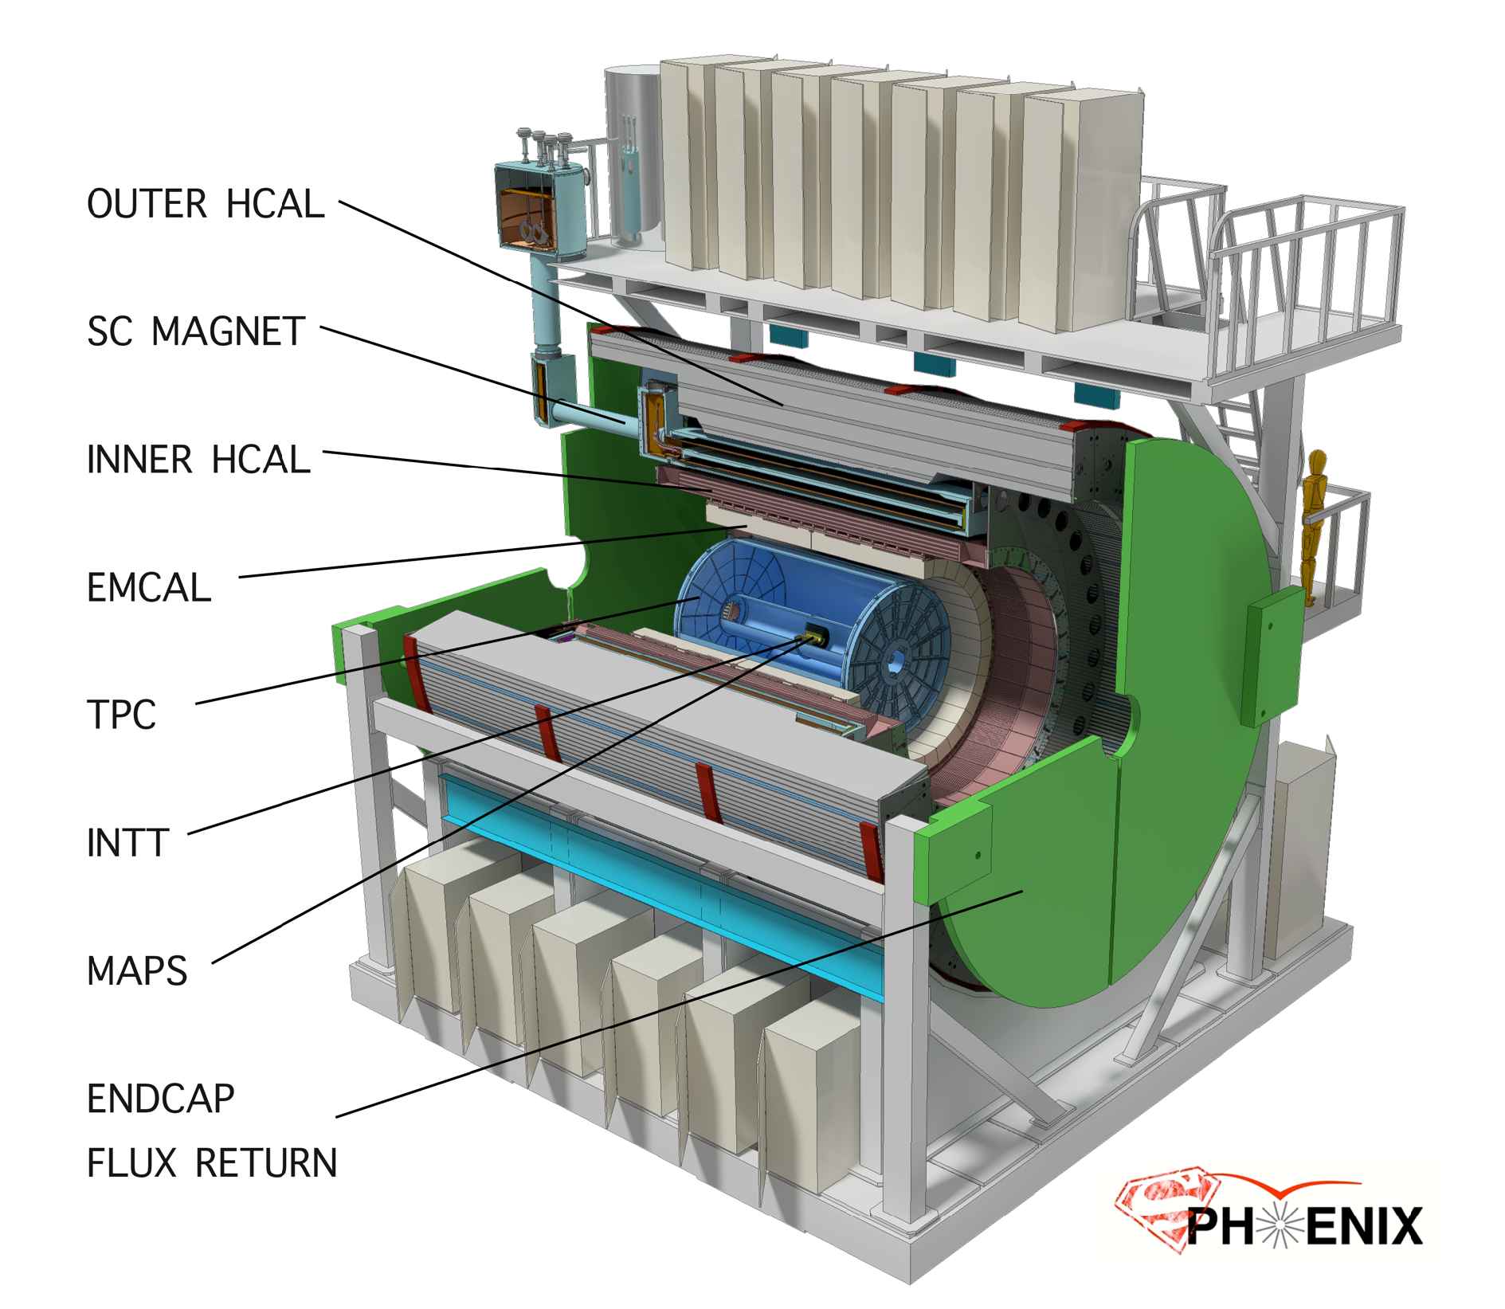
sPHENIX: a State of the Art Detector for Heavy Ion Physics at RHIC
CD-0/Science Case Sept 2016
Construction Phase Jul 2018 -22
Ready for Beam Jan 2023
Space preserve for
future Particle ID
MVTX

Slide 38
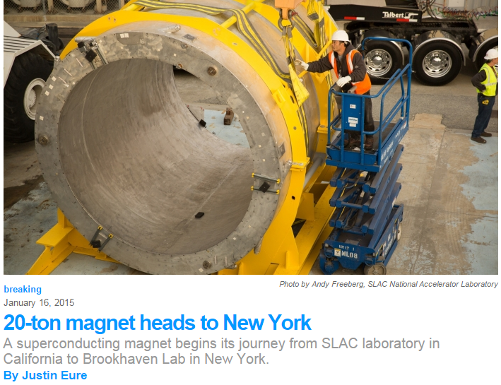
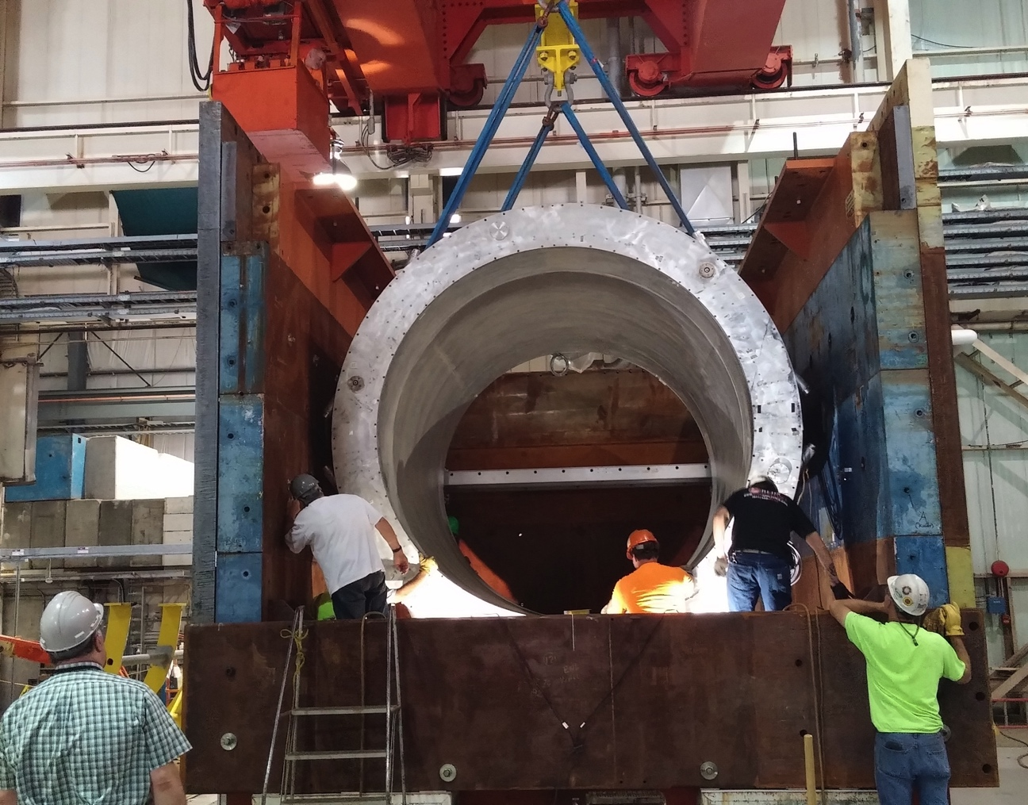

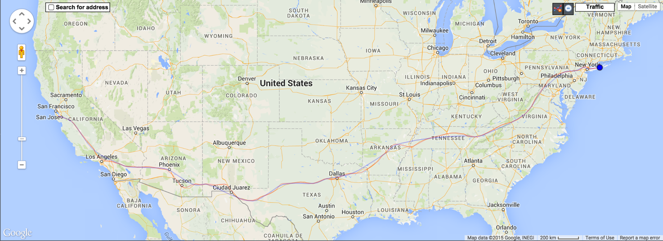

Super conducting magnet
1.4 Tesla magnet, Ф = 2.8 m, L = 3.8 m Previously used in BaBar @ SLAC
Moved to BNL in Feb 2015
Successful cold low field test in 2016
Full field test in 2018
Preparing full field test @ BNL

Slide 39
Assembly of EMCal Sector 0
Sector 0 cooling system
Sector 0 assembly continues to make good progress at BNL.
Fit-up of the Sector electronics cooling system underway
Sector 1 block construction ongoing at UIUC
Assembly of Sector 0 at BNL

Slide 40
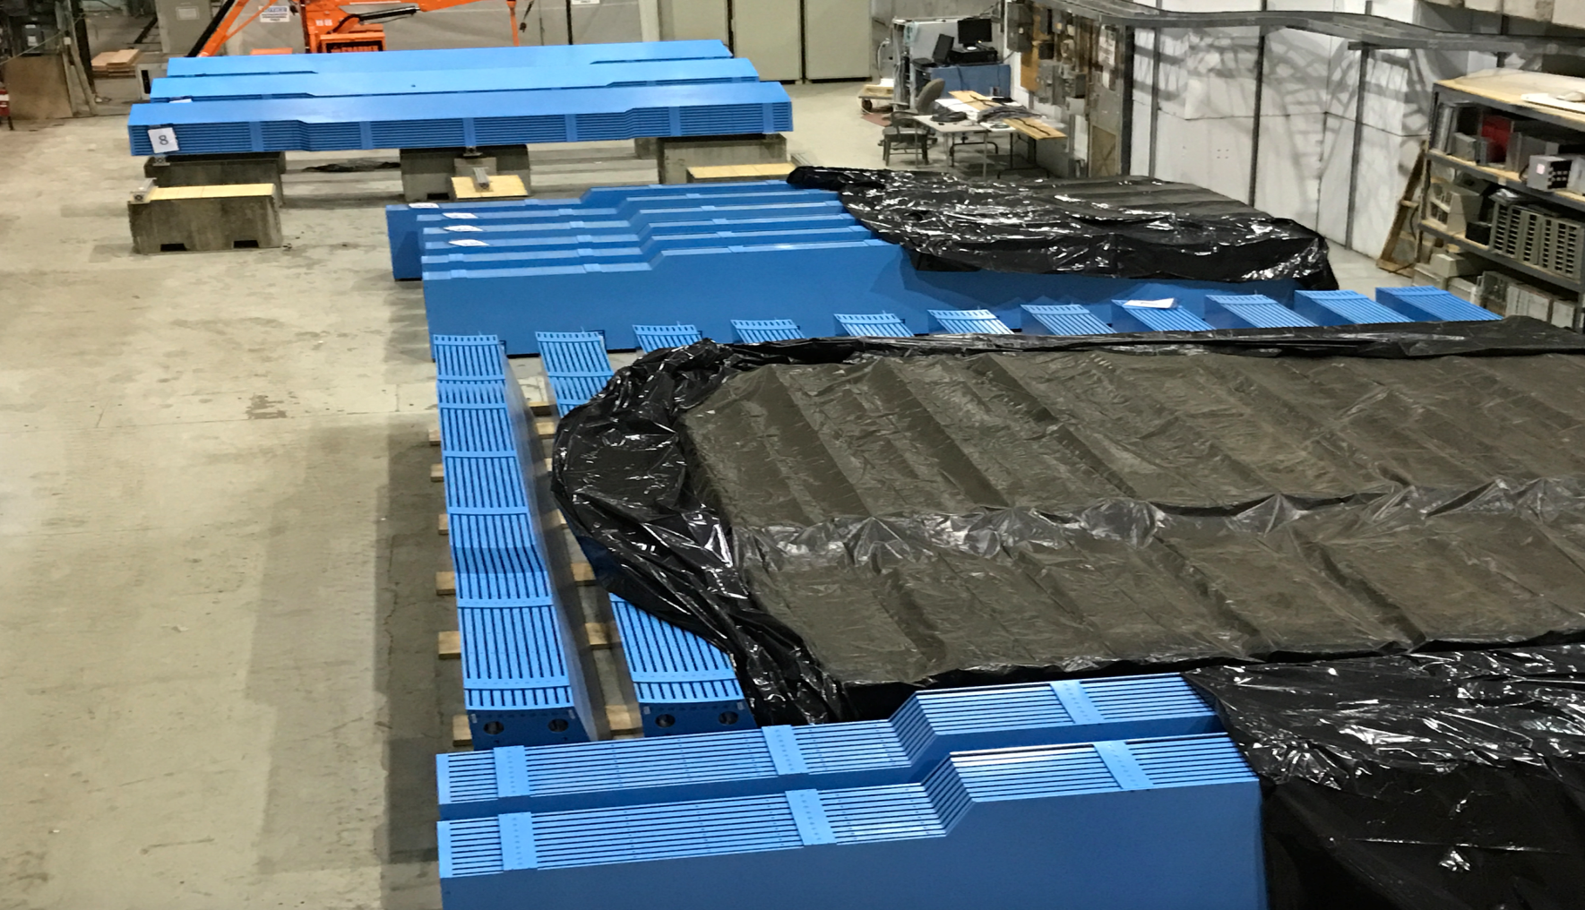
All 32 Barrel Magnet Steel Sectors at BNL

Slide 41
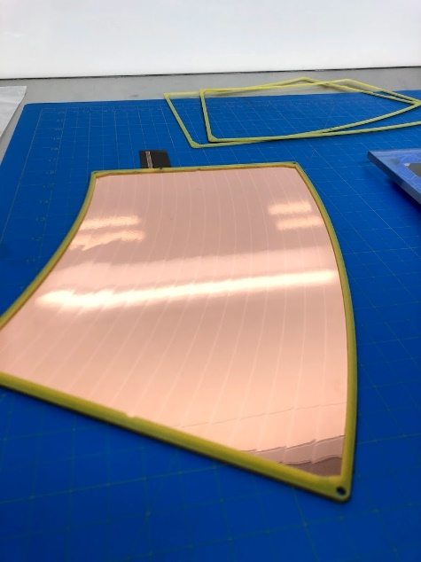
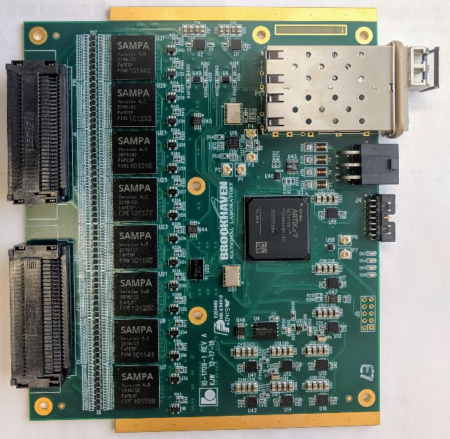
TPC Preproduction Components
Left: TPC R2 module four-layer GEM stack used in the test beam. Right: Preproduction TPC FEE cards carrying eight SAMPA version 4 chips, an Artix-7 FPGA, and double SFP+ links.

Slide 42

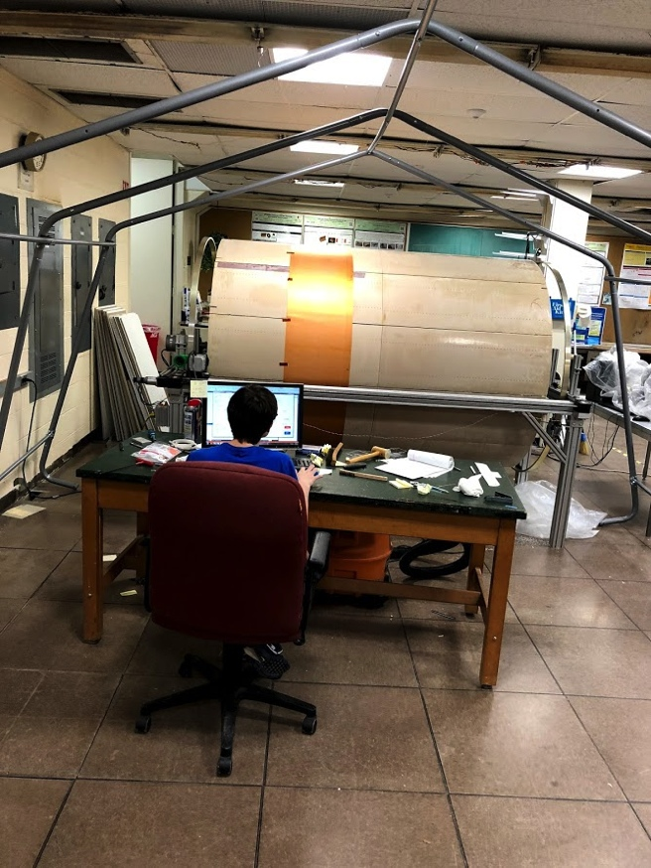
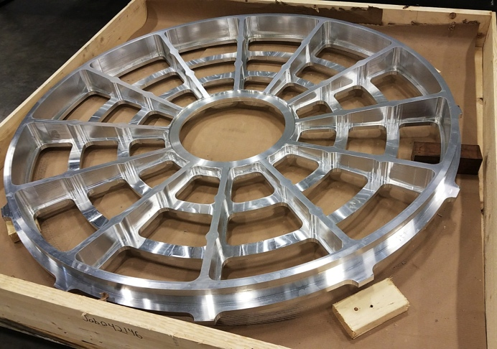
TPC
Initial analysis of small prototype test beam data shows resolution as good predicted resolution
Wagon wheel
Outer Field Cage
Inner Field Cage
The TPC position resolution in the r-φ (bend) direction measured to be 114 μm averaged over the full drift length

Slide 43
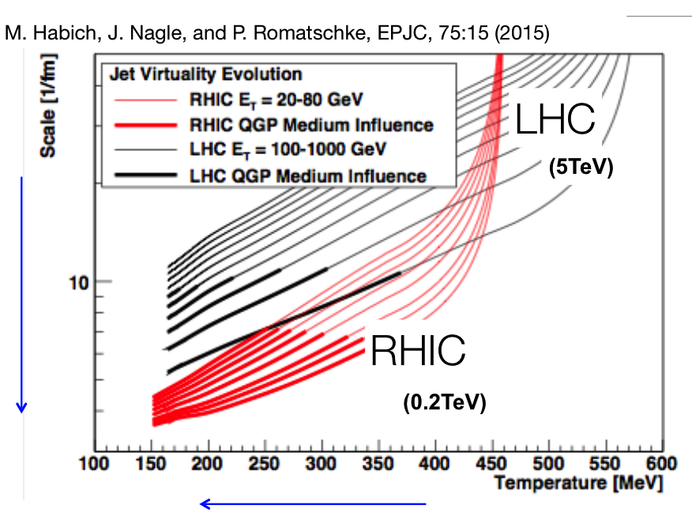
Jet Evolution @ RHIC
QGP@RHIC → Closer to transition temperature
Better access to strong coupling regime
Larger fraction of jet evolution dominated by QGP medium @RHIC

Slide 44
Core sPHENIX Science Program

Slide 45
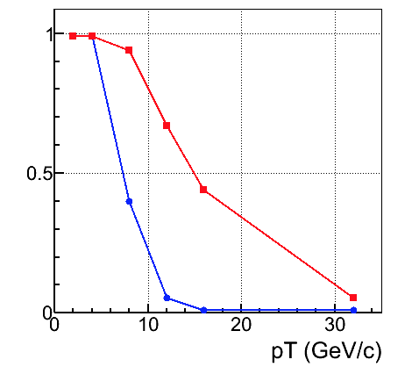
γ – Jet Correlations
For 20 GeV γ
S/B is 20x larger at RHIC than LHC
UE 2.5x smaller
π⁰ eff vs p_{T}
Clustering
+ shower profile
Allows for γ/π⁰ discrimination up to ~20 GeV/c

Slide 46
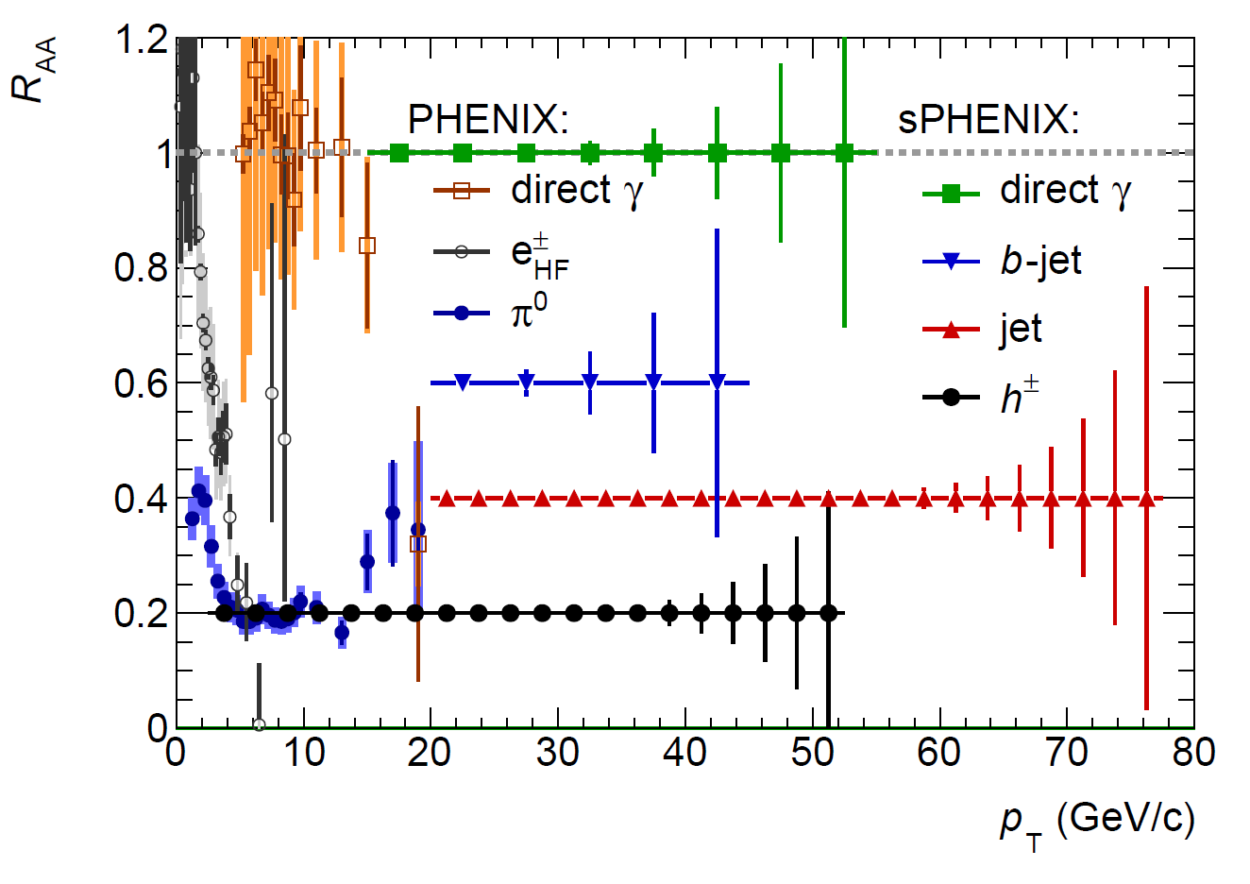
A Broad Physics Program with Jets @sPHENIX
Parton Mass and Flavor Dependence of Jet Suppression and more

Slide 47


Slide 48

Upsilons at sPHENIX and LHC
CMS data
min. bias PbPb
sPHENIX Y(1S) simulation
top 10% central AuAu
+ 50 kHz pileup
Y(ns) → μ⁺+μ⁻
Y(ns) → e⁺+e⁻
Observable: differential suppression of Y(nS) Physics:
temperature dependence of QGP Debye screening length

Slide 49

Precision Vertex and Open HF Observables
Precision vertex tracker + high rate capability
→ Precision open charm and bottom over wide scales
10um
Notes:
D_s plot … ?
Shanshan - A multi-scale approach is required for the full picture

Slide 50




B-jet tagging
Multi-tracks w/ large DCA
2nd vertex mass reco’d
CMS work-point, Phys. Rev. Lett. 113, 132301 (2014)

Slide 51

B-meson Projections
High precision non-prompt-D suppression and flow to RHIC
Determine the bottom quark collectivity
→ clean access to D_{HQ} at RHIC energy
non-prompt D-meson and predictions for sPHENIX
Notes:
Exploring B->J/psi (and maybe B->e high pT) channels

Slide 52

b-jet Projections
Inclusive b-jet suppression and v₂ to RHIC
Strong constraints on energy loss model of high energy probe in QGP
Inclusive b-jet R_{AA}
Inclusive b-jet v₂

Slide 53


Charm Chemistry - Introduction
Charm baryon vs meson
Heavy quarks transport in
QGP and hadronic phase of the medium
Charm quark hadronization via coalescence

Slide 54




Reconstruction of $Λ_{c }$
$Λ_{c}$→K⁻pπ⁺
Daughters p_{T} > 0.6GeV
Daughters DCA < 50 µm
p DCA > 75 µm,
K DCA > 96 µm,
π DCA > 65 µm
Decay length Lc > 200 µm
DCA Lc < 100 µm
Hybrid PID
0-10%
2<p_{T}<3 GeV/c
Centrality | Running events |  | Scaled events
 | signal | Background
0-10% | 5B | 2B | 24B
10-20% | 3B | 1B | 24B
20-40% | 3B | 1B | 48B
40-60% | 3B | 1B | 48B
60-80% | 5B | 8B | 48B

Slide 55


Forward EMCal Simulations and Calibration
Cosmics energy response determined with vertical muons down into fEMC stack in standard G4 setup (3% sampling):
Full simulation setup exists in G4:
30 GeV photon
shower in G4
deposited energy (GeV)
MPV is 26.6 MeV
~3 pixels/0.0266 GeV =
113 SiPM pixels/GeV
NIM A 406 (1998) 227-258:
136 +/- 5 p.e. /GeV
(BCF-10, cosmics)
217 +/- 68 p.e. /GeV
(BCF-12, laser)

Slide 56
Forward Hadronic Calorimeter R&D
Essential for forward jet reconstruction, hadron energy measurement, and triggering
Collaboration with UCLA group for STAR upgrade and EIC detector R&D

Slide 57
HCal Prototype Test Beam Results

