Slide 1

The sPHENIX Experiment at RHIC
Ming X. Liu
Los Alamos National Laboratory
(for the sPHENIX Collaboration)
September 9-13, 2019, Santa Fe, NM

Slide 2
Outline
sPHENIX physics and detectors
  Jets and photons
  Upsilons
  Open heavy flavors
A new Cold-QCD physics opportunity
  Spin, TMD, nPDF
  Forward upgrade
Outlook

Slide 3

US Nuclear Physics Long Range Plan (2015) sPHENIX – to understand “Inner Workings of QGP”

Slide 4
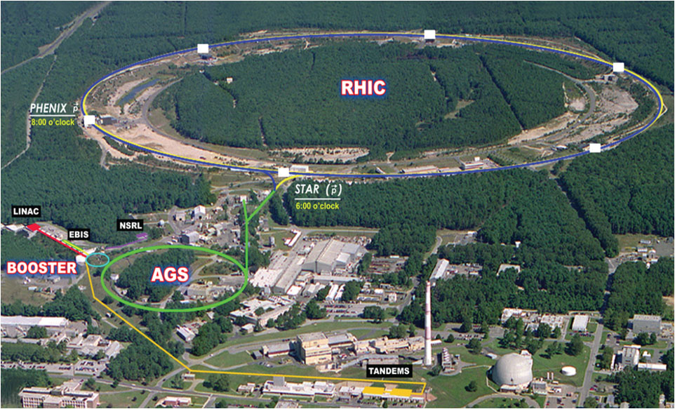
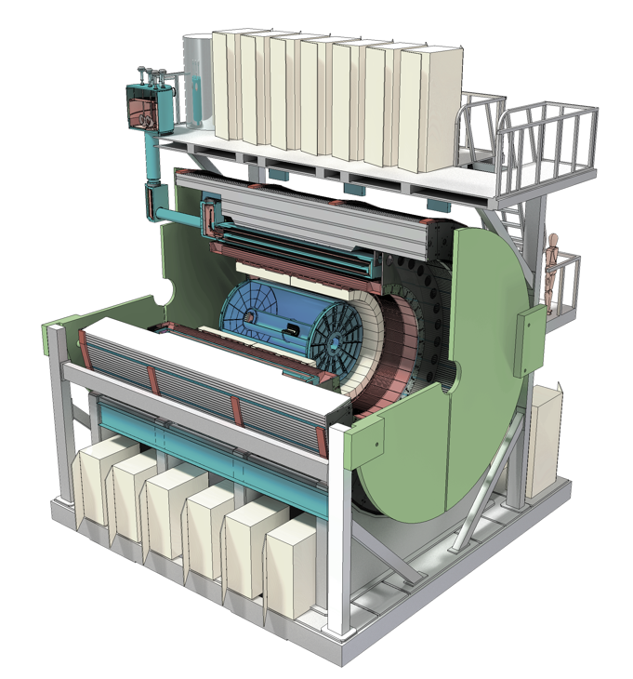


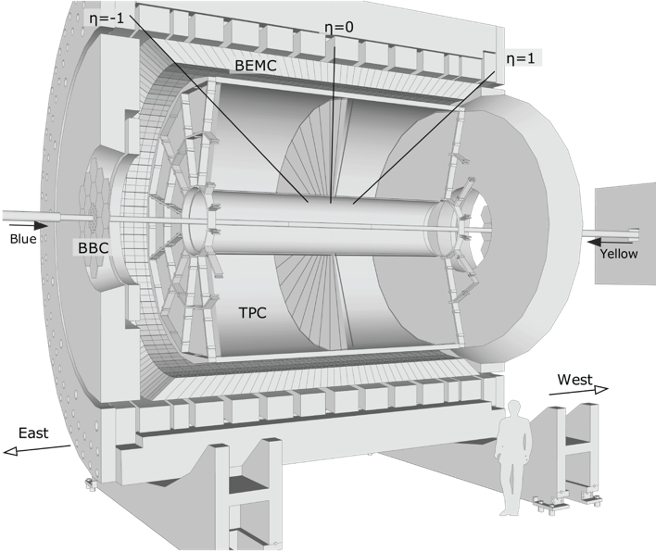
sPHENIX Upgrade at RHIC the next generation Heavy Ion Physics experiment in the US
sPHENIX:
- A large acceptance, high-rate
Φ 1.2km

Slide 5
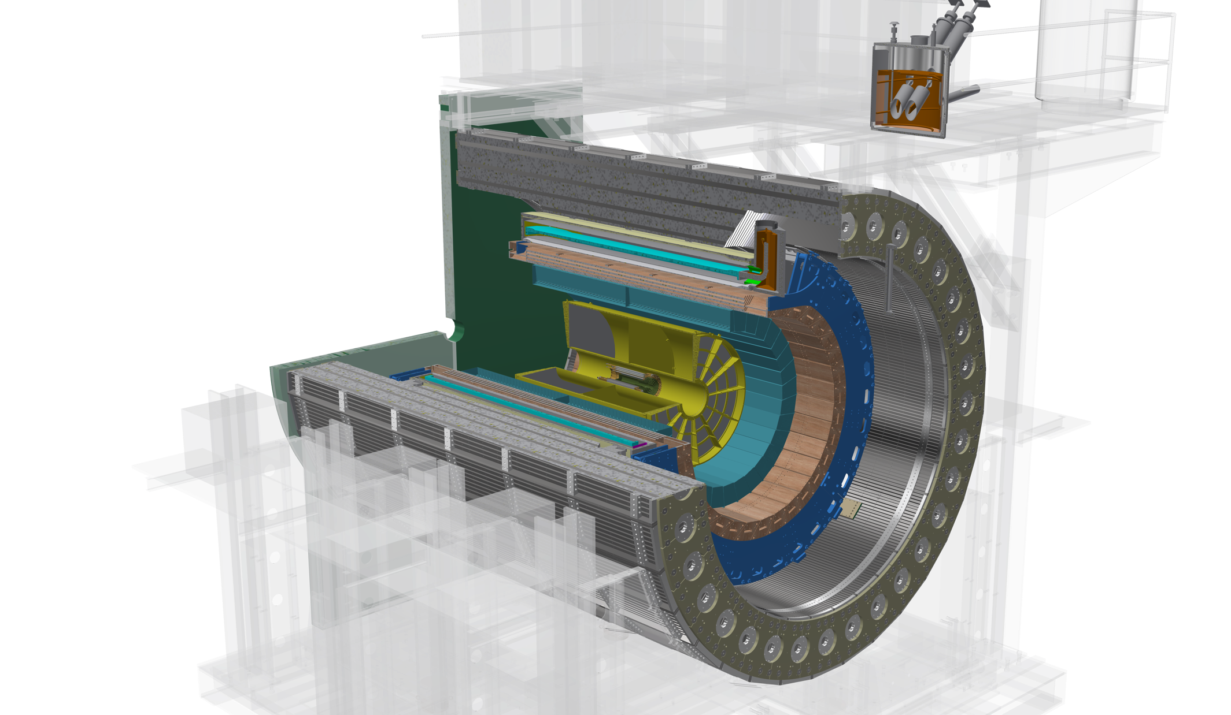
The sPHENIX Detector
A high rate and large acceptance detector for heavy ion physics at RHIC
Outer HCal
SC Magnet
(Inner Hcal)
EMCal
TPC
INTT
MVTX
Φ ~ 5m
|eta| < 1.1
B: 1.4 T
15 kHz trigger
>10 GB/s data
MBD
Notes:
15kHz matched to collision rate.

Slide 6
Probing the Inner Workings of QGP in sPHENIX
- Key Capabilities

Slide 7
sPHENIX Detector Sub-Systems

Slide 8
Detector Performance: Tracking and Jets
GEANT simulations verified with test beam data

Slide 9
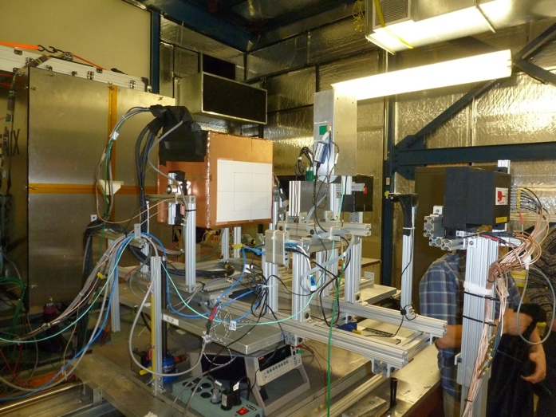
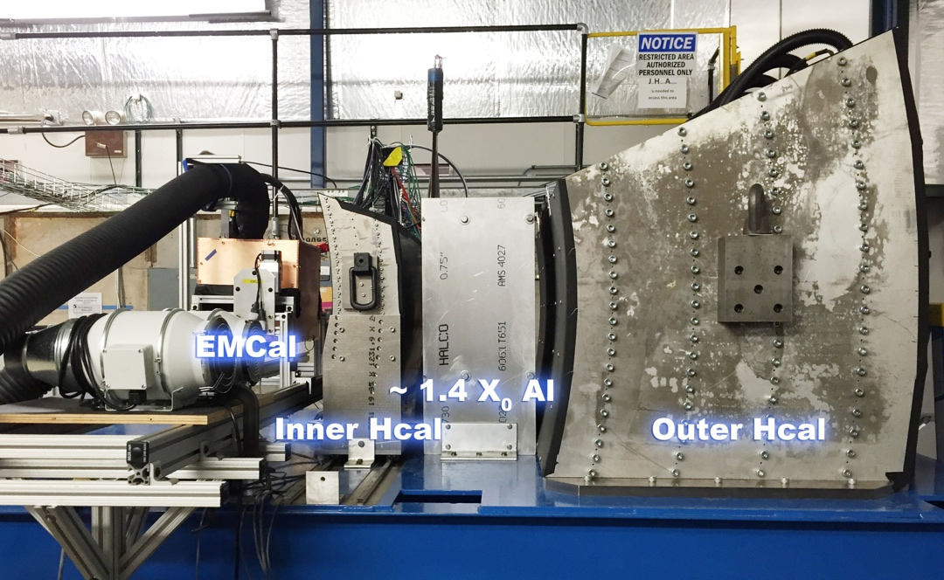
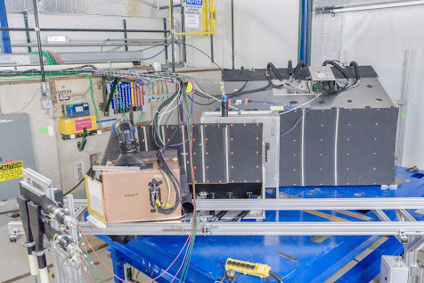
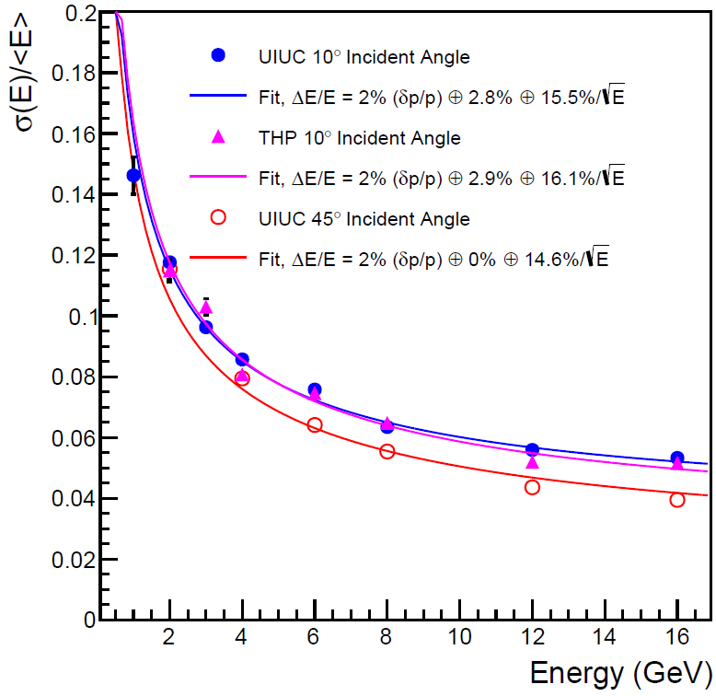
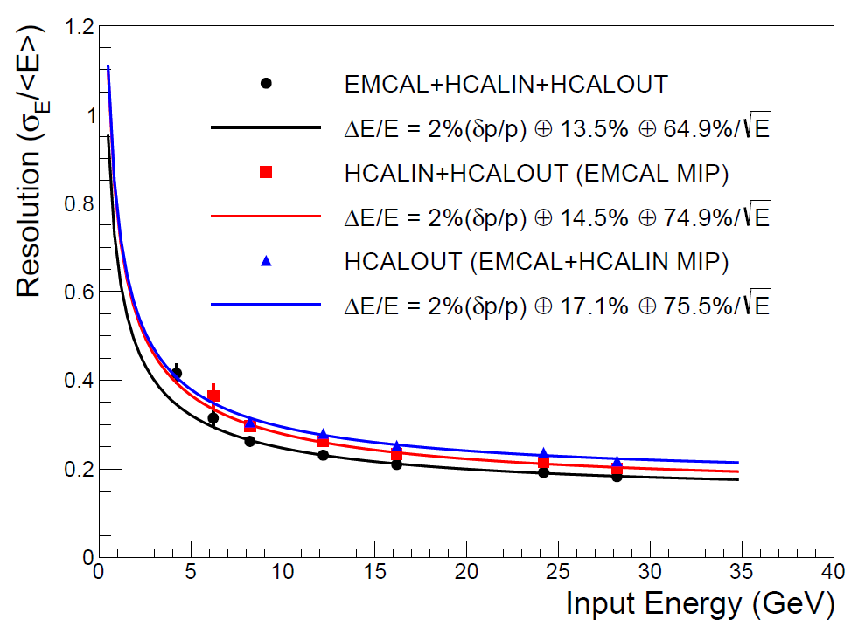
Calorimeters Beam Tests
February 2014
Proof of principle
February 2016: η~0 prototype
February 2017: η~0.9 prototype
Electron
Energy resolution
arXiv:1704.01461
Pion
Energy resolution
arXiv:1704.01461
sPHENIX beam test data
sPHENIX beam test data

Slide 10
Monolithic-Active-Pixel-Sensor based Precision Vertex Detector
-- for Open Heavy Quark Measurements

Slide 11
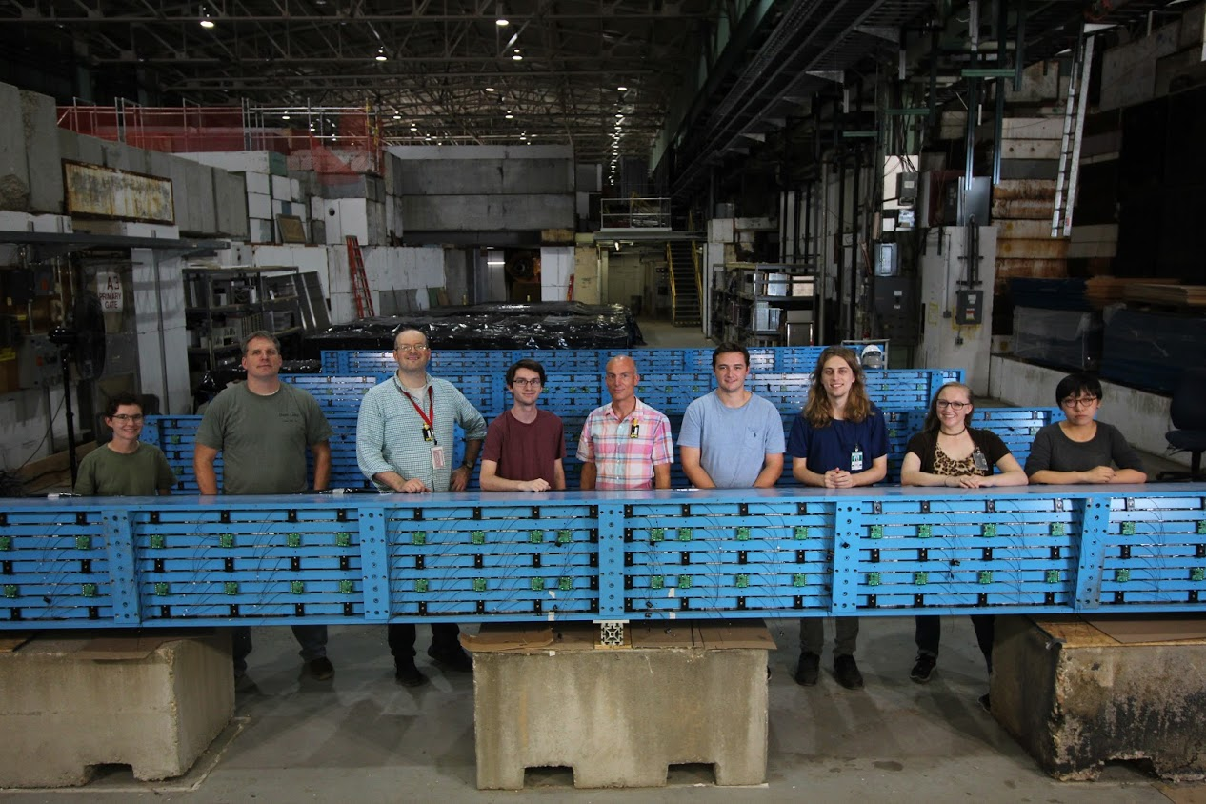
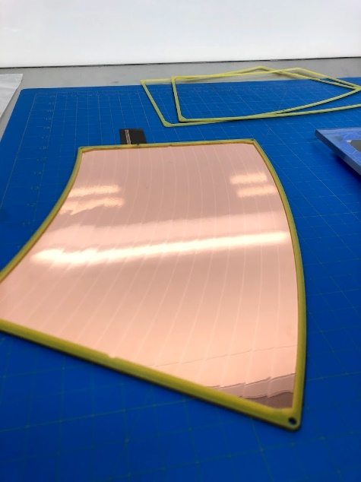
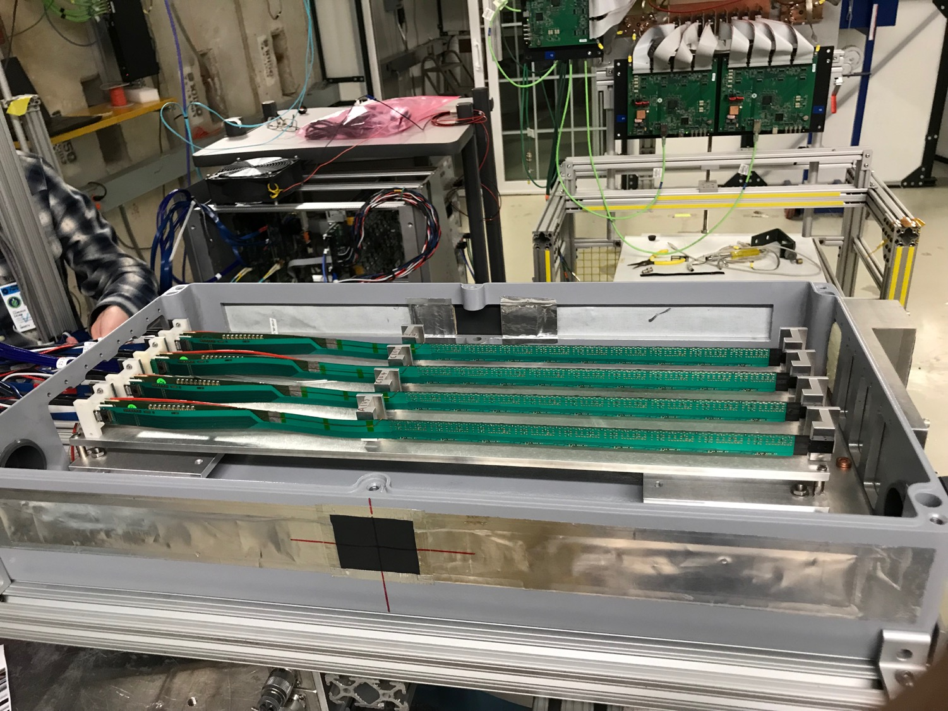
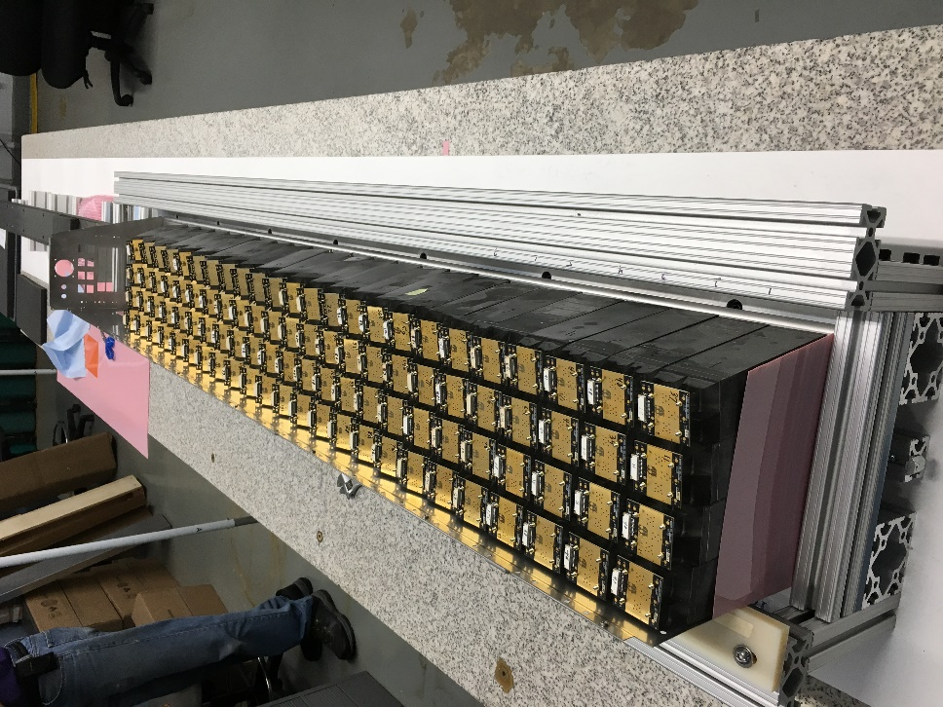
Detector Status and Highlights
All 32 oHCAL sectors received at BNL
EMCAL sector 0 assembled
TPC GEM pre-production started
MVTX sensor staves and Readout Units being produced
Successful MVTX, INTT, TPC beam tests at FNAL

Slide 12
Evolving sPHENIX Run Plan
1st campaign
2nd campaign
Guidance from ALD to think in terms of a multi-year run plan
Consistent with language in DOE CD-0 “mission need” document
Incorporates BNL C-AD guidance on luminosity evolution
Incorporates commissioning time in first year
Minimum bias Au+Au at 15 kHz for |z| < 10 cm:
47 billion (Year-1) + 96 billion (Year-3) + 96 billion (Year-5) = Total 239 billion events

Slide 13
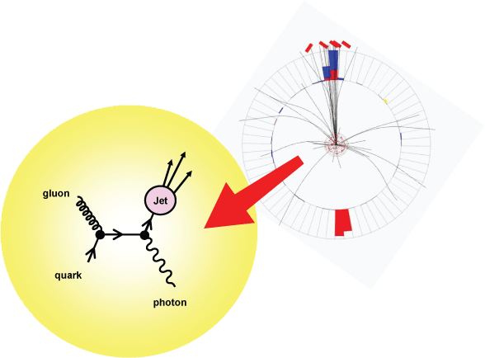
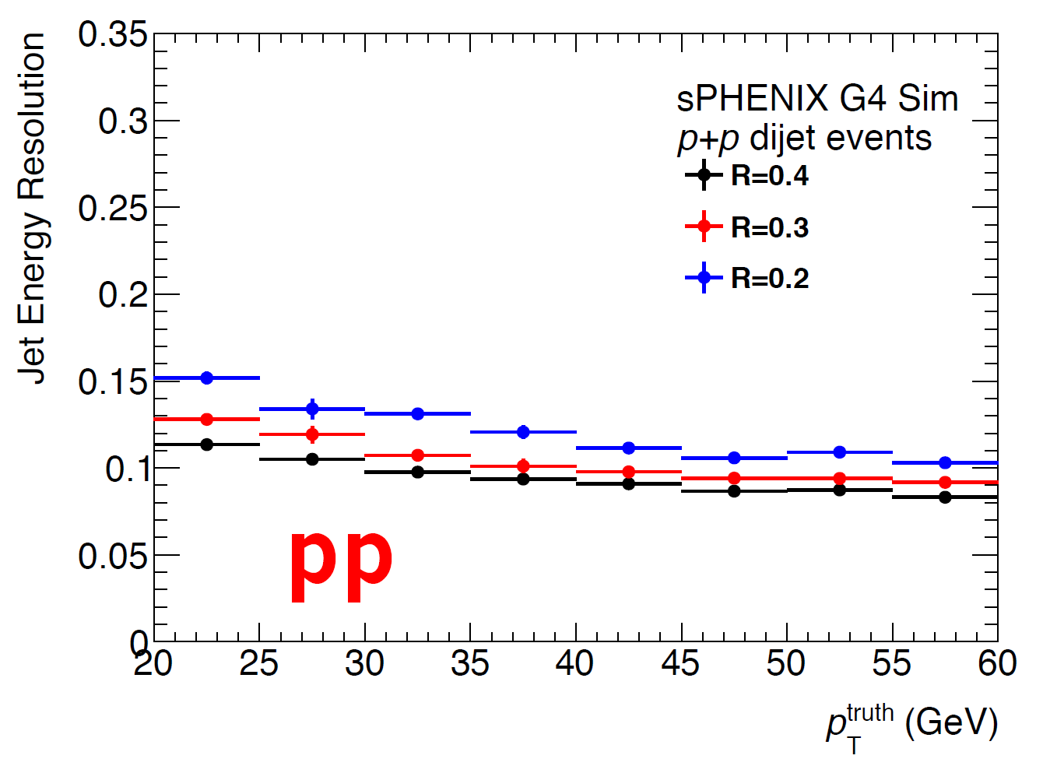
Precision Calorimetry for Jets and Photons
Jets by EMCal+HCal
Excellent jet resolution in both p+p and A+A
Photons by EMCal

Slide 14
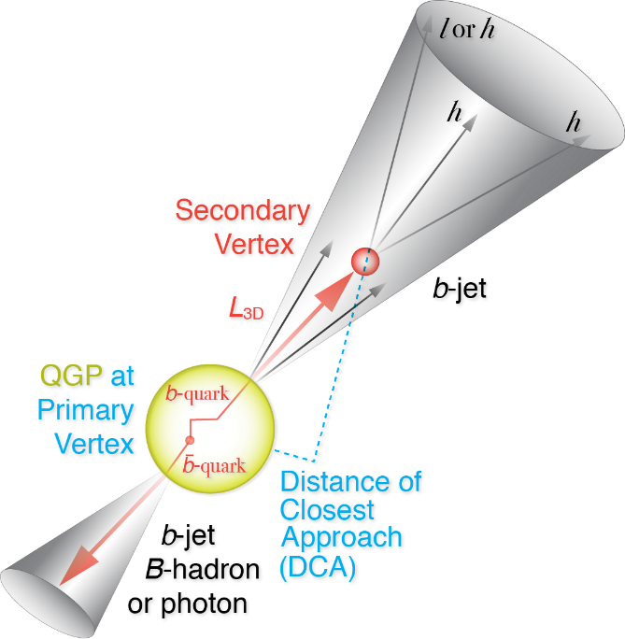
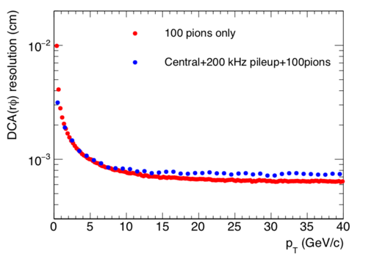
Precision Vertex and Open HF Observables
Precision vertex tracker + high rate capability
→ Precision open charm and bottom over wide scales
10um
Notes:
D_s plot … ?
Shanshan - A multi-scale approach is required for the full picture

Slide 15
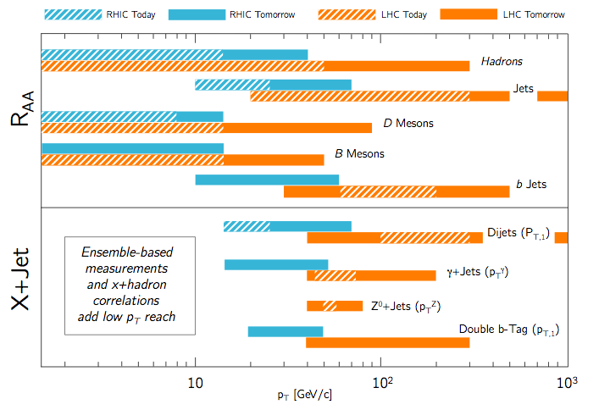
sPHENIX Complements LHC Measurements
- Excellent coverage at low-medium pT
- Precision with high statistics
Larger QGP effects
but difficult to trigger:
low p_{T}, highly quenched jets
low p_{T} charm and beauty

Slide 16
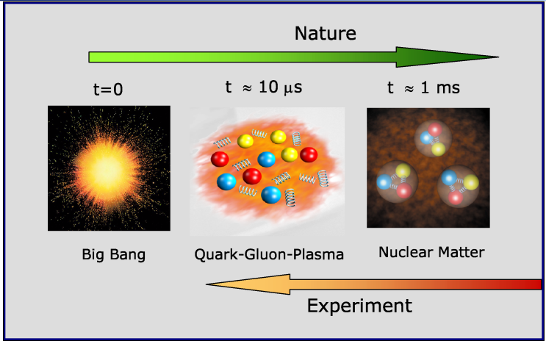
A Broad Physics Program with sPHENIX
Nuclear matter under extreme condition, “QGP”
Nucleon and nuclear structures, novel QCD dynamics, “Cold QCD”
“Hot” QGP physics
“Cold” QCD physics

Slide 17
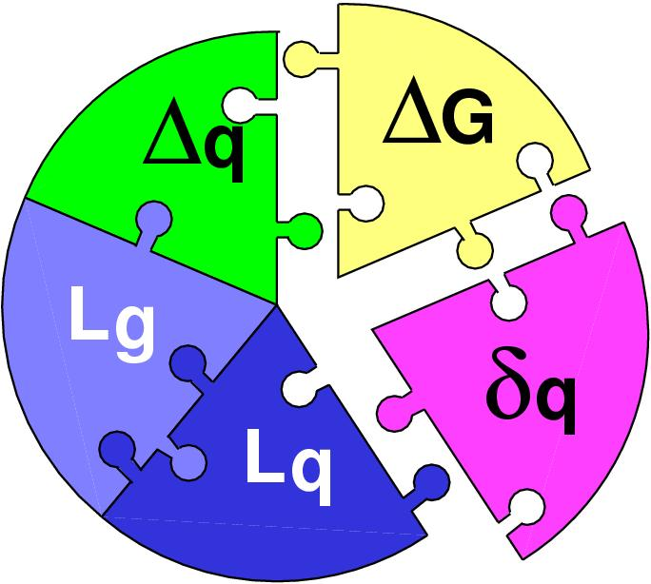
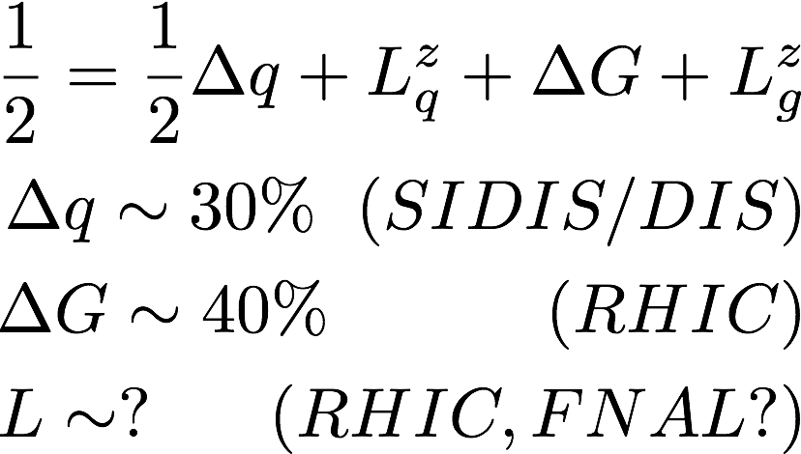
Three Decades of the Proton Spin Puzzle
Early expectation: large gluon polarization
 | Quark Spin | Gluon Spin
SLAC -> 2000 | (E80 – E155)
CERN ongoing | (EMC), (SMC), COMPASS
DESY ->2007 | (HERMES)
JLab ongoing | Hall A,B,C
RHIC ongoing | (BRAHMS), (PHENIX), STAR
Axial anomaly
Cheng & Li, PRL (1989)
EMC, 1980s
 | SIDIS/DIS
 | Polarized p+p
/hadrons

Slide 18

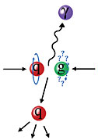
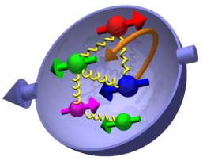
Study Gluon Polarization
Jets, hadrons, direct photons and more
Ref: RHIC 2015 pp200
Recorded lumi ~50pb⁻¹

Slide 19
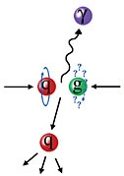
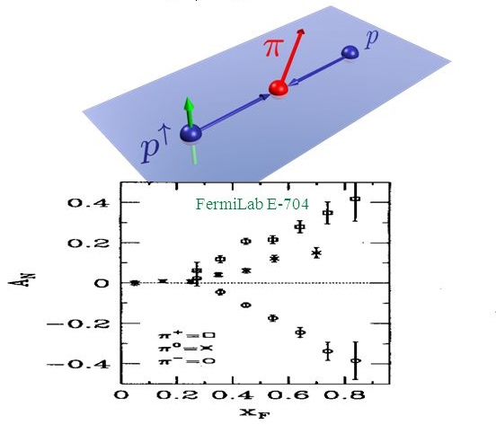
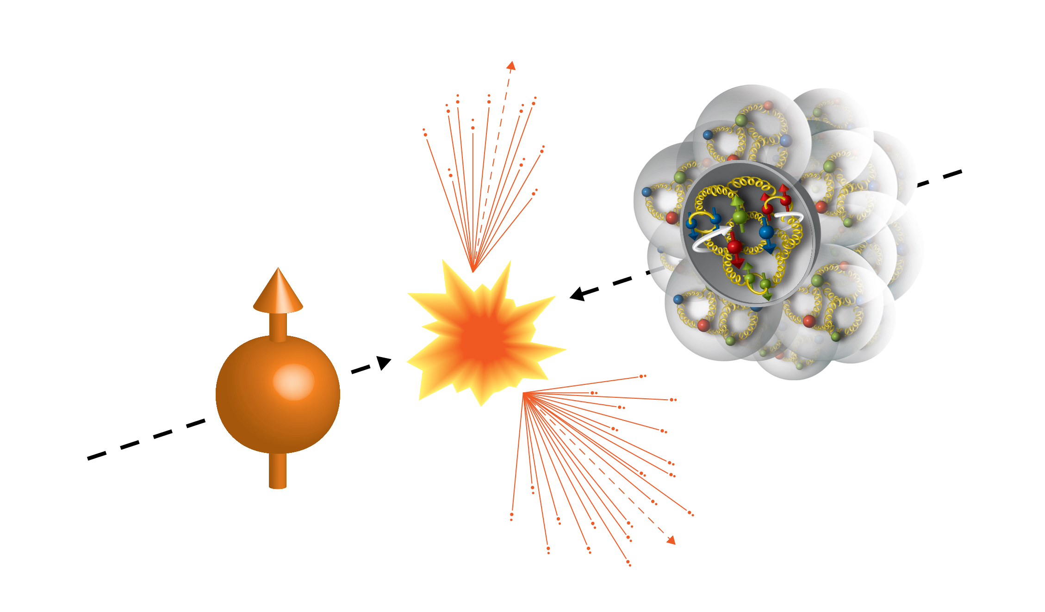
Physics with Transversely Polarized p+p/A Collisions at RHIC
100GeV/nucleon
100GeV
Au
Transversely Polarized Proton

Slide 20
Probe the Underlying Physics via Hard Scatterings
TMD, Collinear Twist-3 Factorizations
(i) Sivers mechanism:
correlation proton spin & parton k_{T}
(ii) Collins mechanism: Transversity × spin-dep fragmentation
SIDIS:
S_{P}
Phys Rev D41 (1990) 83; 43 (1991) 261
S_{P}
Nucl Phys B396 (1993) 161
S_{q}
p
k_{T,q}
p
p
p
S_{q}
k_{T,π}
pp:
Collinear Twist-3 (RHIC): quark-gluon/gluon-gluon correlations

Slide 21
Access Sivers and Collins with Jet and Hadron Azimuthal Distributions in Transversely Polarized p+p Collisions
Feng Yuan, PRL 100, 032003 (2008)
Umberto D’Alesio et al PRD 83 034021 (2011)
→ “Sivers-like” (Jet)
→ “Collins-like” (hadron)

Slide 22
Forward Upgrade Proposal
Forward upgrade will bring in new physics capability – TMD, small-x physics, QGP over broader kinematics etc.
sPHENIX Barrel Detectors:
MVTX, INTT, TPC
EMCal, HCal
sPHENIX Forward Upgrade
EMCal, Hcal, Tracking

Slide 23
sPHENIX at Electron Ion Collider (EIC)
A Day-1 EIC Detector based on sPHENIX

Slide 24
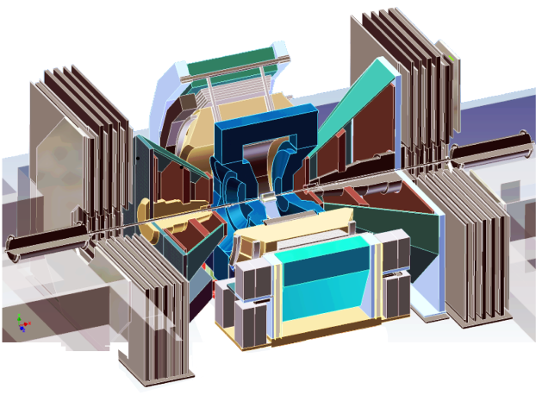
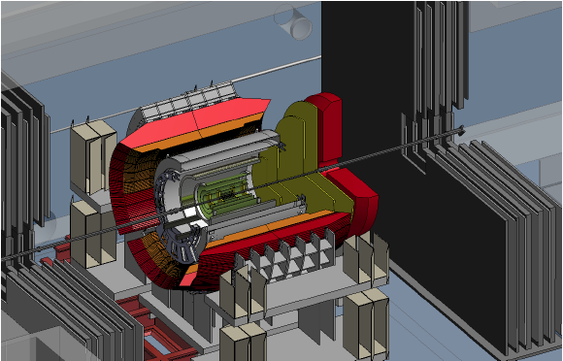
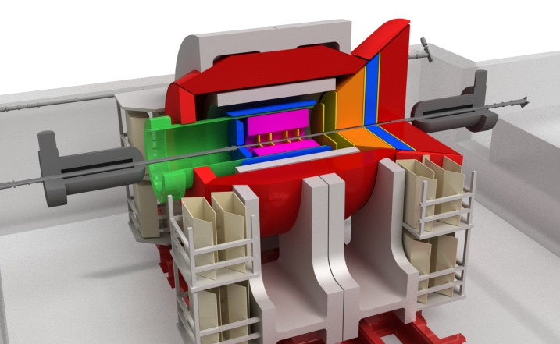
Evolution of the PHENIX Interaction Region at RHIC
PHENIX experiment
An EIC detector
16y+ operation
Broad spectrum of physics
(QGP, Hadron Physics, Dark Matter)
170+ physics papers with 24k citations
Last run in this form 2016
Comprehensive central upgrade base on BaBar magnet
Jet, heavy flavor and beauty quarkonia physics program
→ nature of QGP
Possible forward tracking and calorimeter upgrade → Spin, CNM
Path of PHENIX upgrade leads to a capable EIC detector
Large coverage of tracking, calorimetry and PID
Open for new collaboration/new ideas
arXiv:1501.06197 [nucl-ex]
arXiv:1402.1209 [nucl-ex]
2000-2016
2017→2022; Physics: 2023+
>2025+
Time
RHIC: A+A, spin-polarized p+p, spin-polarized p+A
EIC: e+p, e+A

Slide 25
The Growing sPHENIX Collaboration

Slide 26
Backup slides

Slide 27
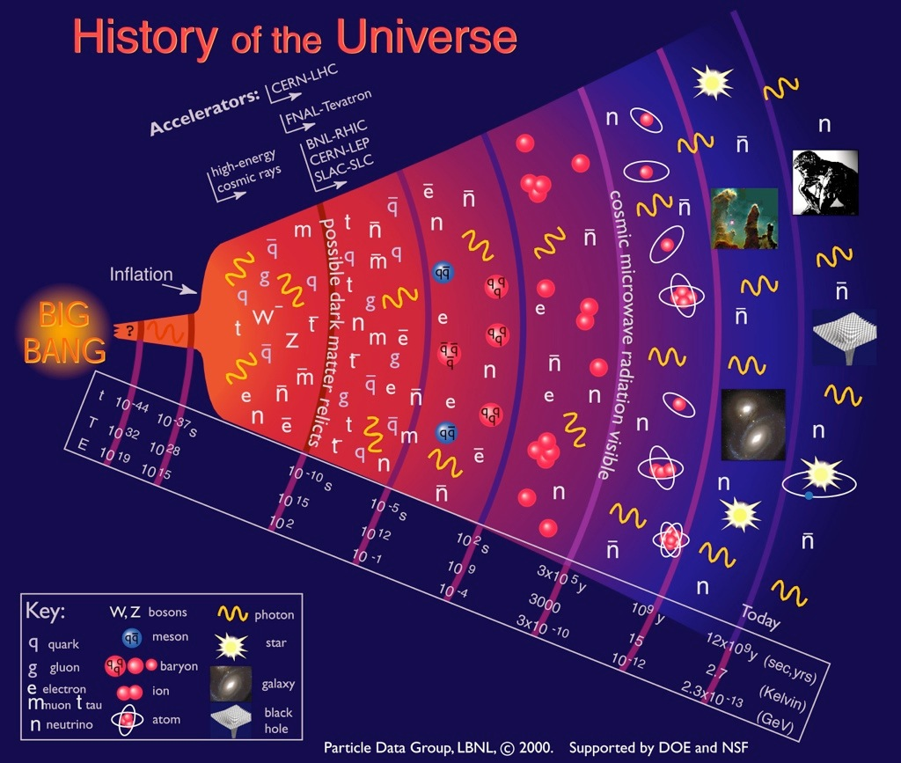
Quark-Gluon
Plasma (QGP)

Slide 28
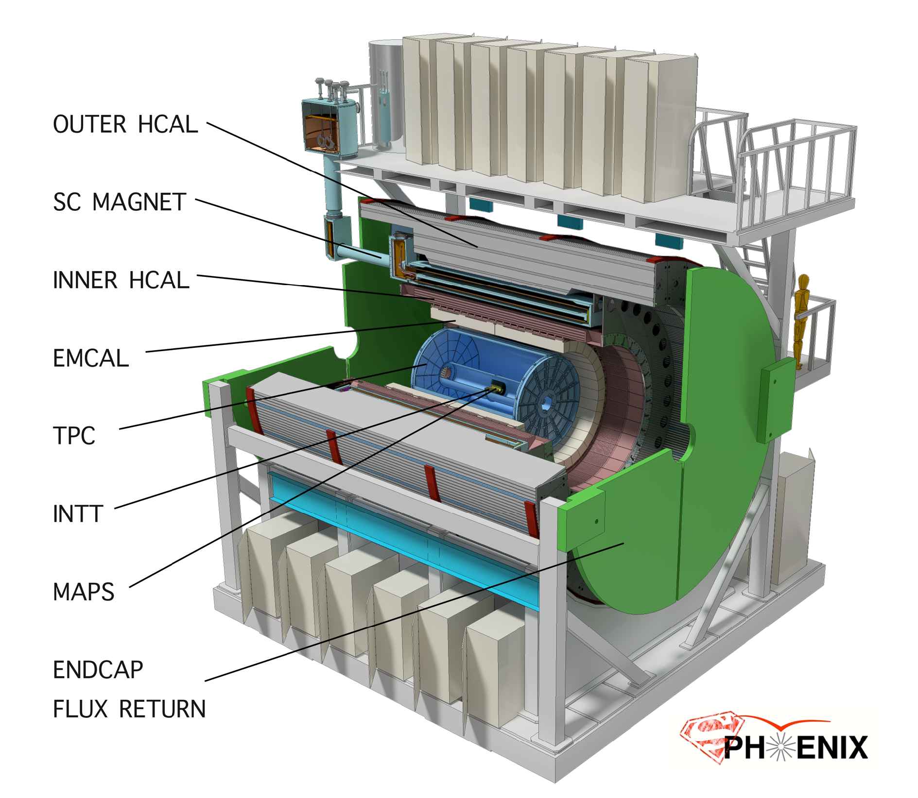
sPHENIX: a State of the Art Detector for Heavy Ion Physics at RHIC
CD-0/Science Case Sept 2016
Construction Phase Jul 2018 -22
Ready for Beam Jan 2023
Space preserve for
future Particle ID
MVTX

Slide 29
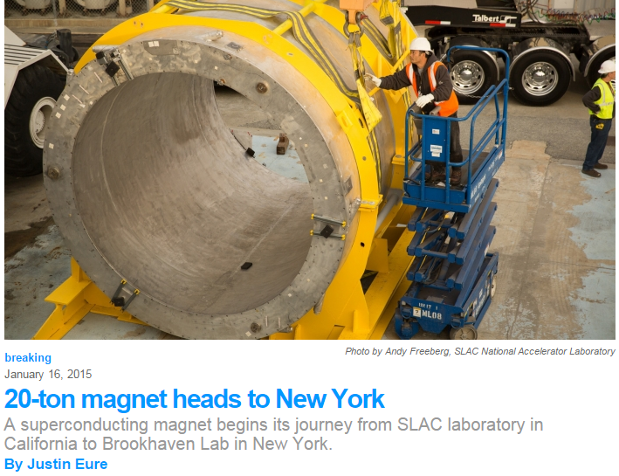
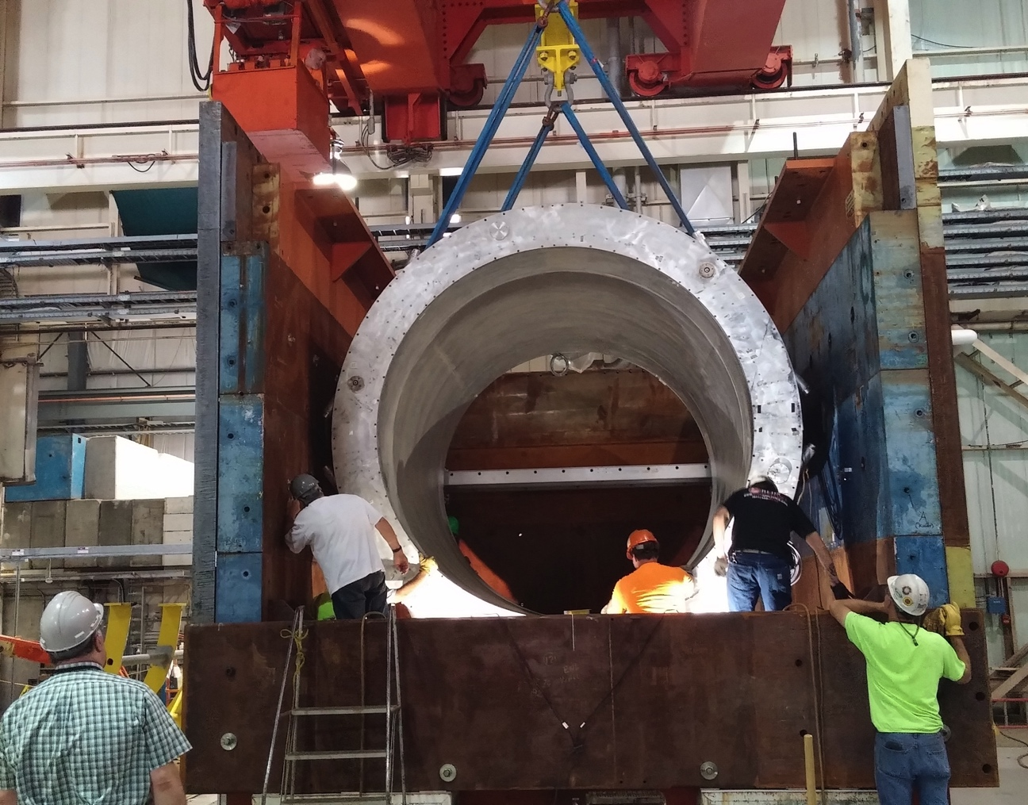

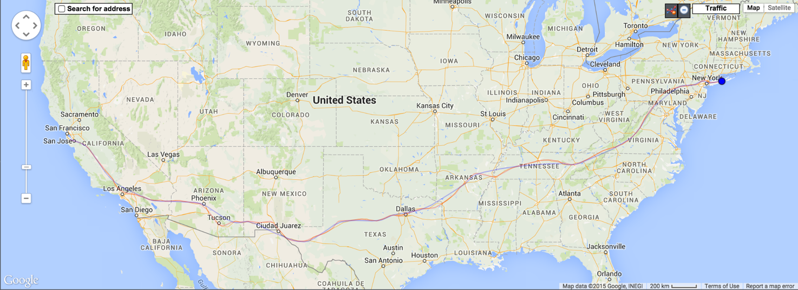

Super conducting magnet
1.4 Tesla magnet, Ф = 2.8 m, L = 3.8 m Previously used in BaBar @ SLAC
Moved to BNL in Feb 2015
Successful cold low field test in 2016
Full field test in 2018
Preparing full field test @ BNL

Slide 30
Assembly of EMCal Sector 0
Sector 0 cooling system
Sector 0 assembly continues to make good progress at BNL.
Fit-up of the Sector electronics cooling system underway
Sector 1 block construction ongoing at UIUC
Assembly of Sector 0 at BNL

Slide 31
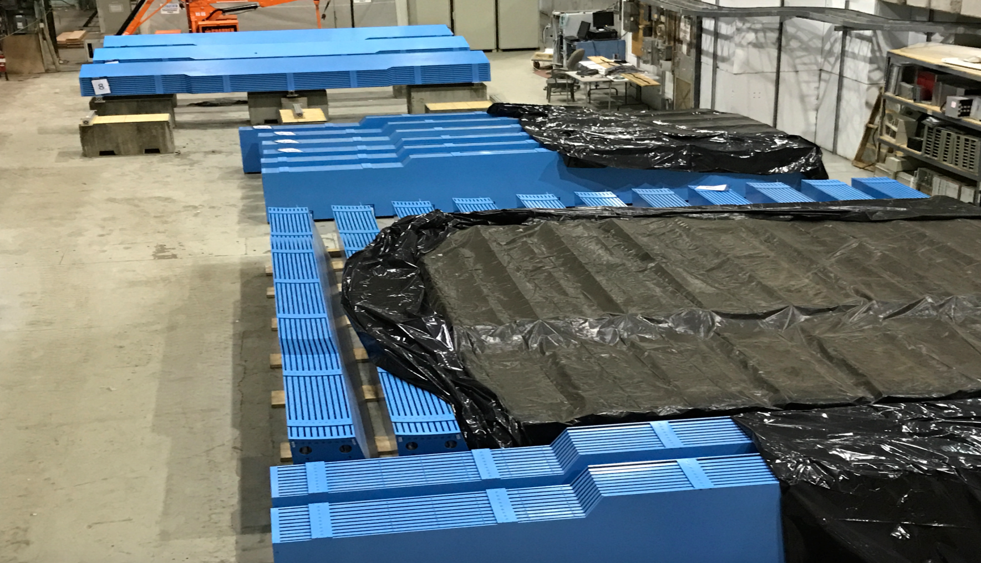
All 32 Barrel Magnet Steel Sectors at BNL

Slide 32
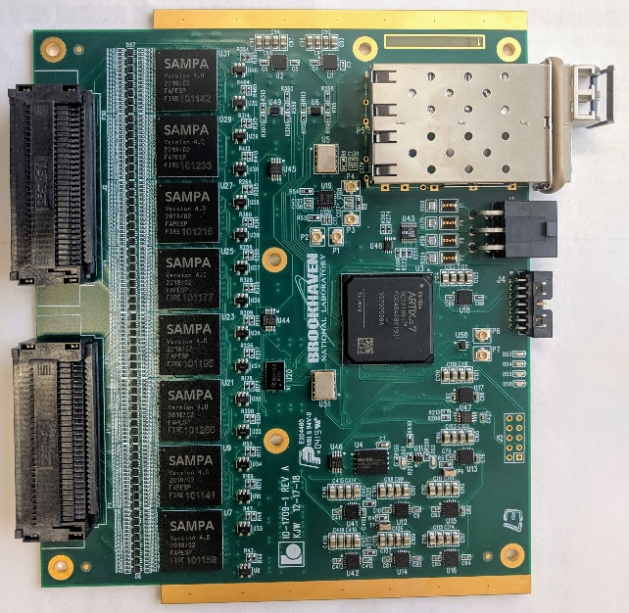
TPC Preproduction Components
Left: TPC R2 module four-layer GEM stack used in the test beam. Right: Preproduction TPC FEE cards carrying eight SAMPA version 4 chips, an Artix-7 FPGA, and double SFP+ links.

Slide 33
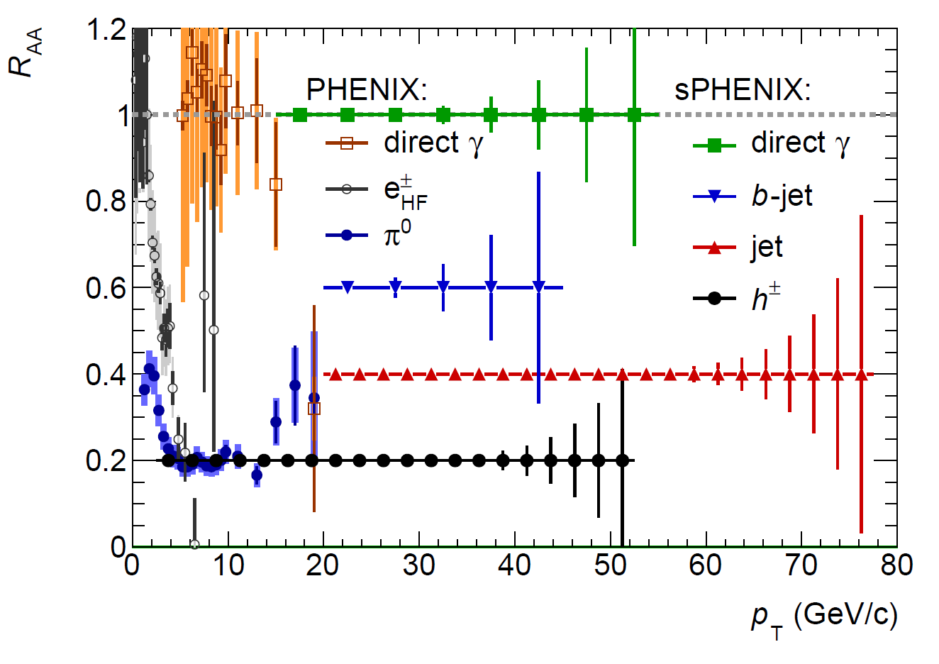
A Broad Physics Program with Jets @sPHENIX
Parton Mass and Flavor Dependence of Jet Suppression and more

Slide 34
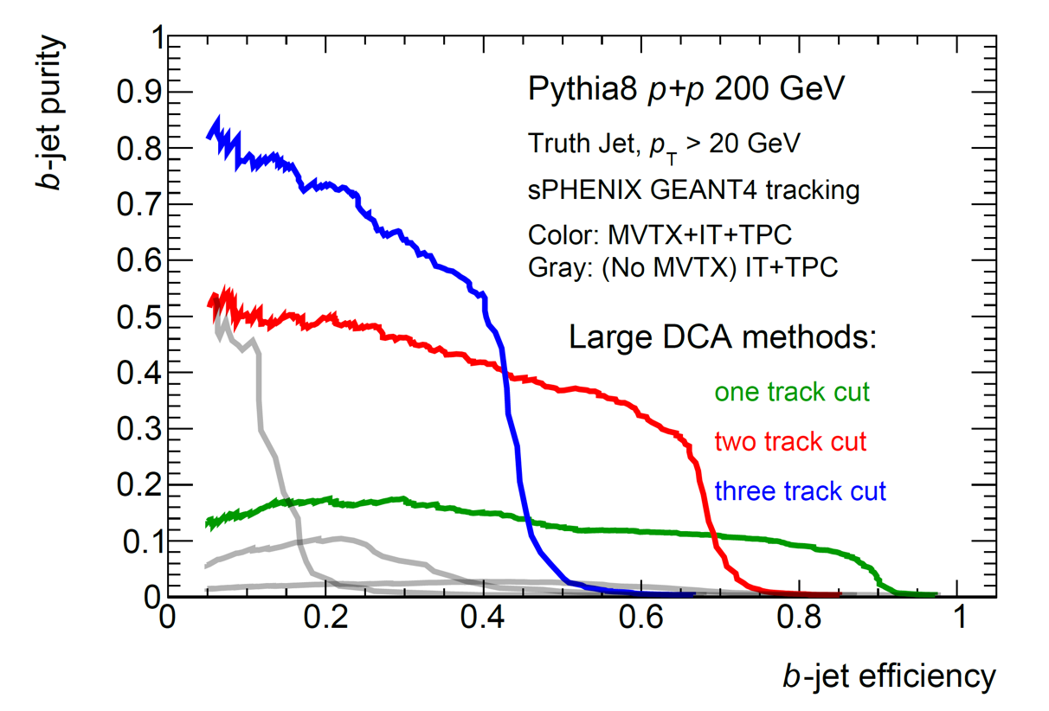
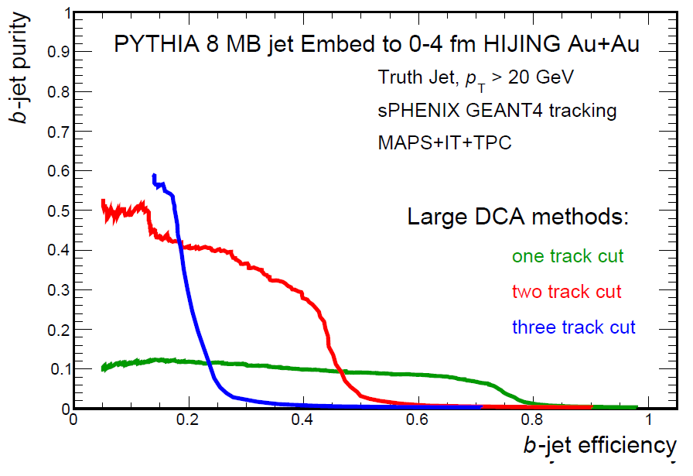
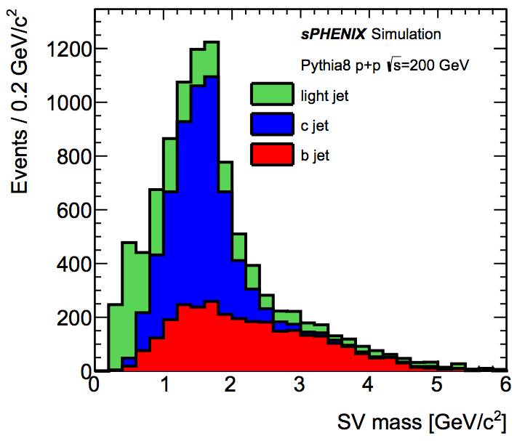

B-jet tagging
Multi-tracks w/ large DCA
2nd vertex mass reco’d
CMS work-point, Phys. Rev. Lett. 113, 132301 (2014)

Slide 35
Summary and Outlook
A great opportunity for new collaborators to join the sPHENIX effort!
Baseline detectors
Forward upgrade
An EIC detector

Slide 36
Drell-Yan in the Forward Rapidity: p+A

Slide 37
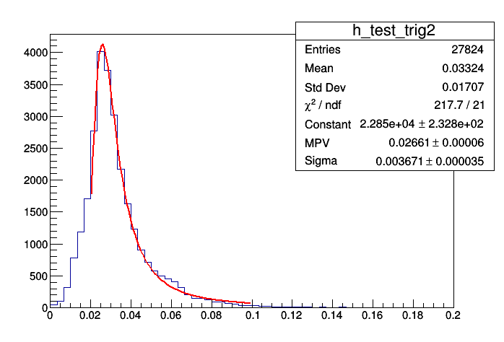
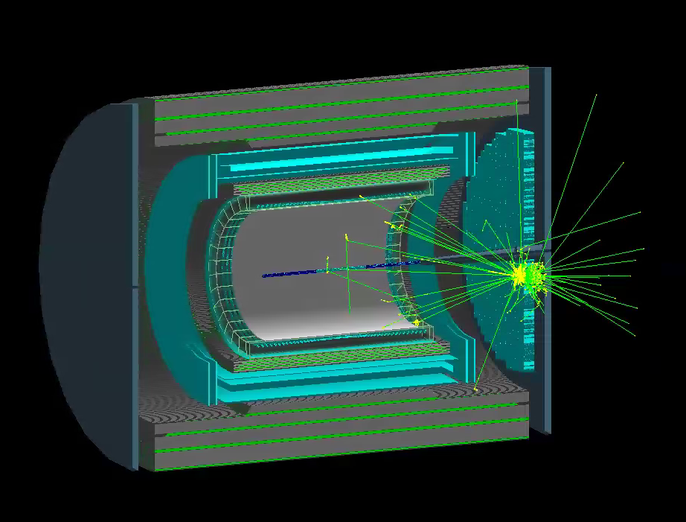
Forward EMCal Simulations and Calibration
Cosmics energy response determined with vertical muons down into fEMC stack in standard G4 setup (3% sampling):
Full simulation setup exists in G4:
30 GeV photon
shower in G4
deposited energy (GeV)
MPV is 26.6 MeV
~3 pixels/0.0266 GeV =
113 SiPM pixels/GeV
NIM A 406 (1998) 227-258:
136 +/- 5 p.e. /GeV
(BCF-10, cosmics)
217 +/- 68 p.e. /GeV
(BCF-12, laser)

Slide 38
Forward Hadronic Calorimeter R&D
Essential for forward jet reconstruction, hadron energy measurement, and triggering
Collaboration with UCLA group for STAR upgrade and EIC detector R&D

Slide 39
HCal Prototype Test Beam Results

