Slide 1

Overview of PHENIX Spin
Physics Program
Ming Liu
Los Alamos National Laboratory

Slide 2
Outline
PHENIX experiment at RHIC
Longitudinal spin program
Transverse spin program
Outlook

Slide 3
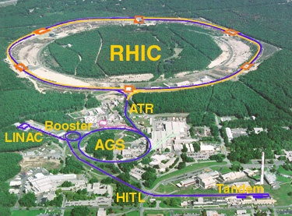
Polarized Proton Collider at RHIC
Absolute Polarimeter (H↑ jet)
RHIC pC Polarimeters
PHOBOS
polarized p+p collisions
62 ≤ √s ≤ 500 GeV
Siberian Snakes
BRAHMS
Siberian Snakes
PHENIX
STAR
Spin Rotators
(longitudinal polarization)
Spin Rotators
(longitudinal polarization)
Pol. H⁻ Source
LINAC
BOOSTER
Helical Partial Siberian Snake
200 MeV Polarimeter
AGS
AGS pC Polarimeter
Strong AGS Snake

Slide 4
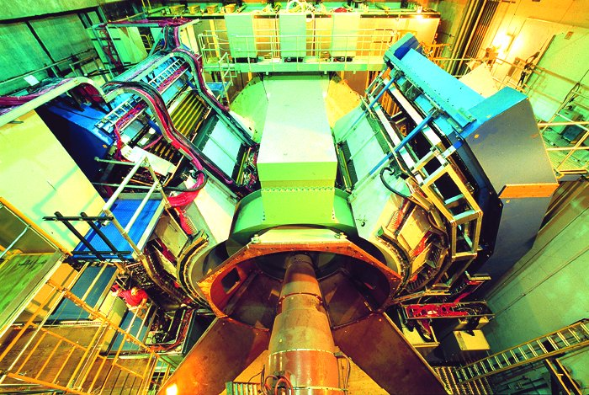
PHENIX Detector

Slide 5
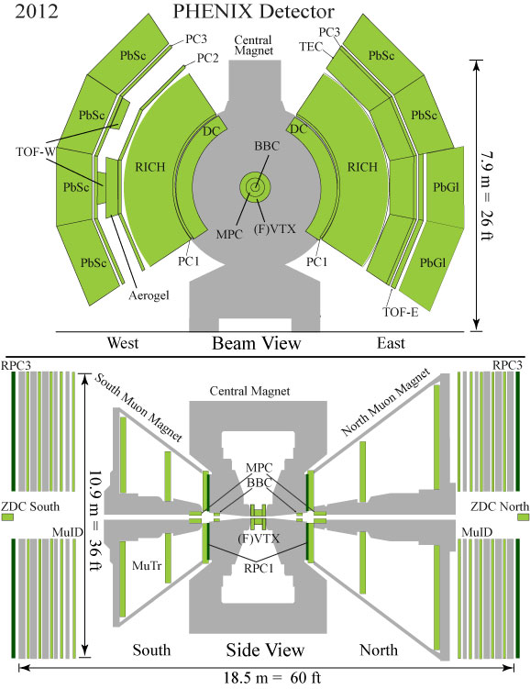
PHENIX Detector at RHIC
Central Arms | η | < 0.35
Identified charged hadrons
Neutral Pions
Direct Photon
J/Psi
Heavy Flavor
Muon Arms 1.2 < | η | < 2.4
J/Psi
Unidentified charged hadrons
Heavy Flavor
MPC 3.1 < | η | < 3.9
Neutral Pion’s
Eta’s
ZDC |η| ~ 5.9
Neutrons
Notes:
5

Slide 6
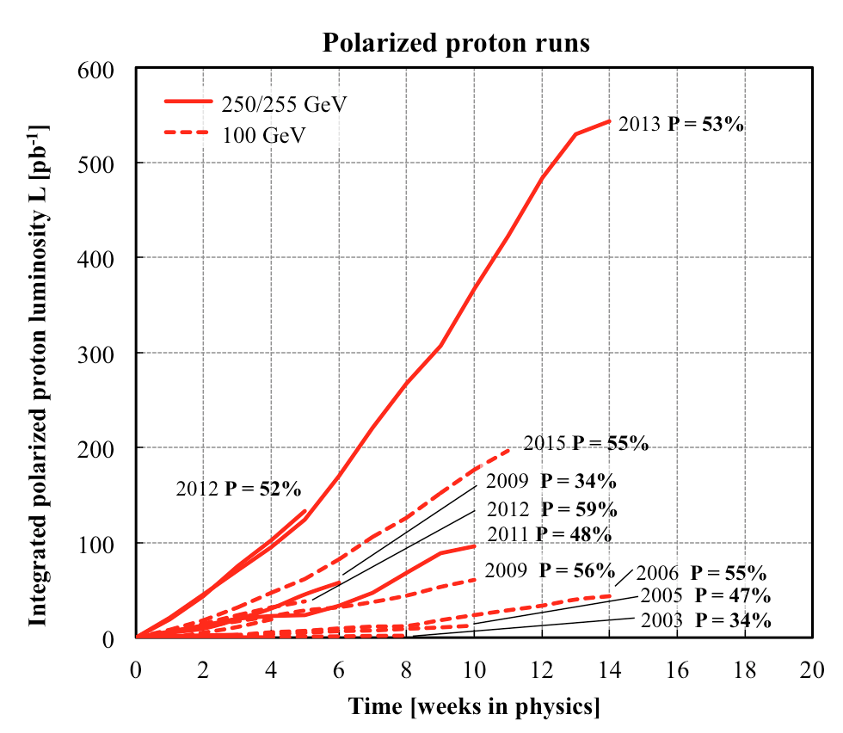
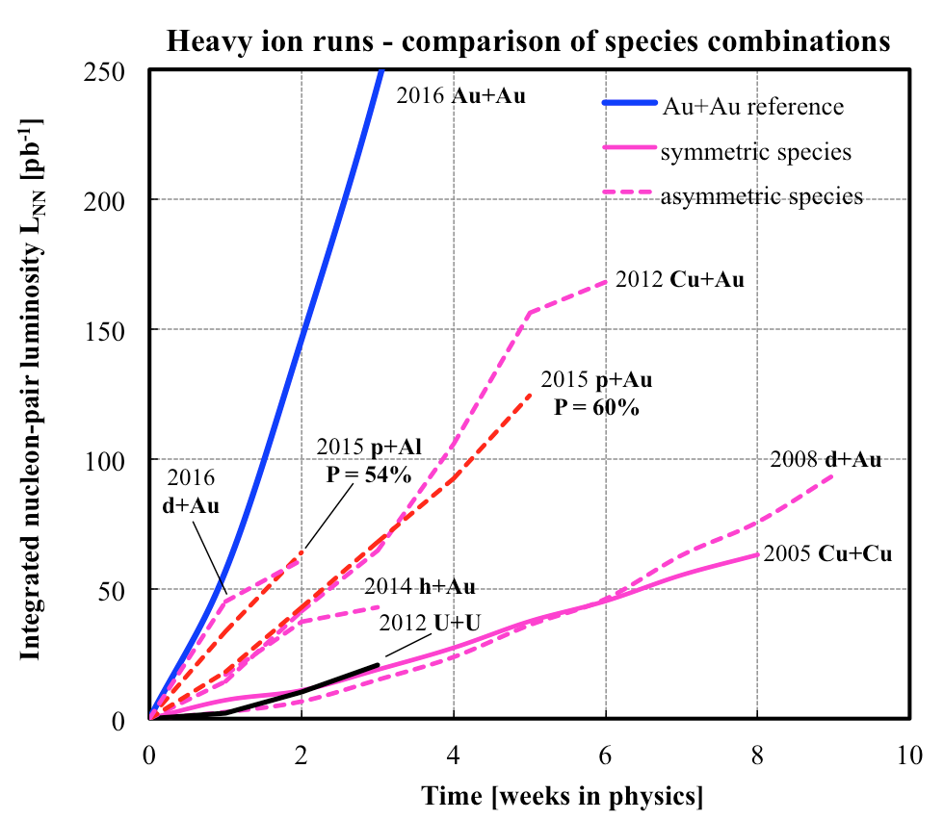
History of RHIC Spin Runs
RHIC is capable of delivering the polarized p+p/A for precision spin physics
A very challenging task to deliver polarized p+p, excellent performance from 2012+
Outstanding Heavy Ion machine performance from the beginning
Polarized p+p, p+Au and p+Al
10/13/14
Notes:
Our physics analysis efforts are closely tied to the RHIC beams operations
Took “BNL” 10 years to reach the mechine performanvec goals ..
6

Slide 7
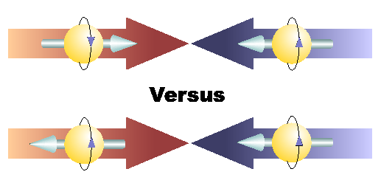
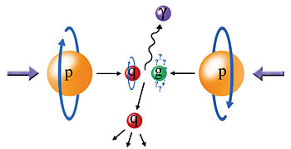
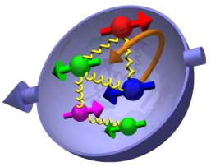
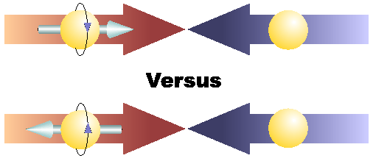
Physics with Longitudinally
Polarized p+p Collisions

Slide 8
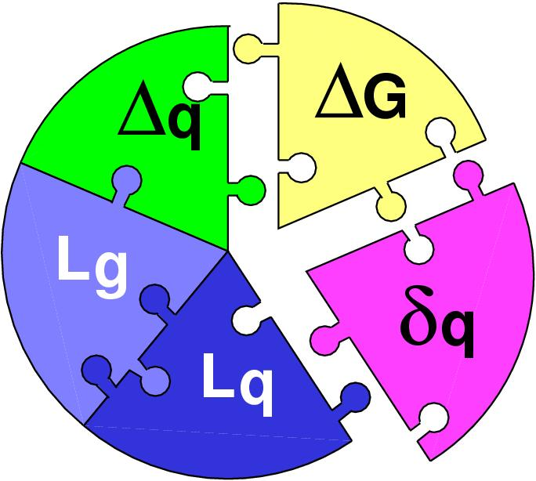
Three Decades of the Proton Spin Puzzle
Early expectation: large gluon polarization
 | Quark Spin | Gluon Spin
SLAC -> 2000 | E80 – E155
CERN ongoing | EMC, SMC, COMPASS
DESY ->2007 | HERMES
JLab ongoing | Hall A,B,C
RHIC ongoing | (BRAHMS), (PHENIX), STAR
Axial anomaly
Cheng & Li, PRL (1989)
EMC, 1980s
 | SIDIS/DIS
 | Polarized p+p

Slide 9
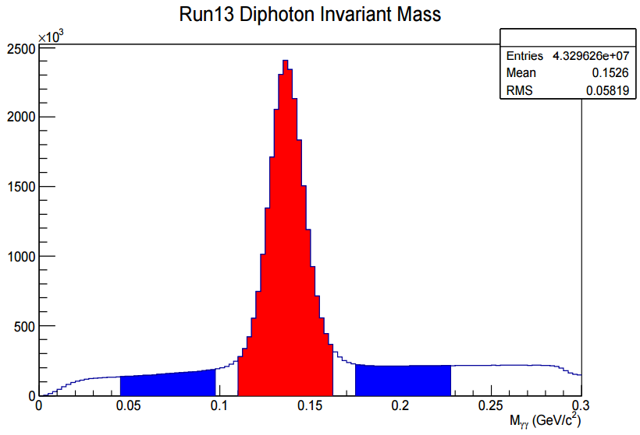
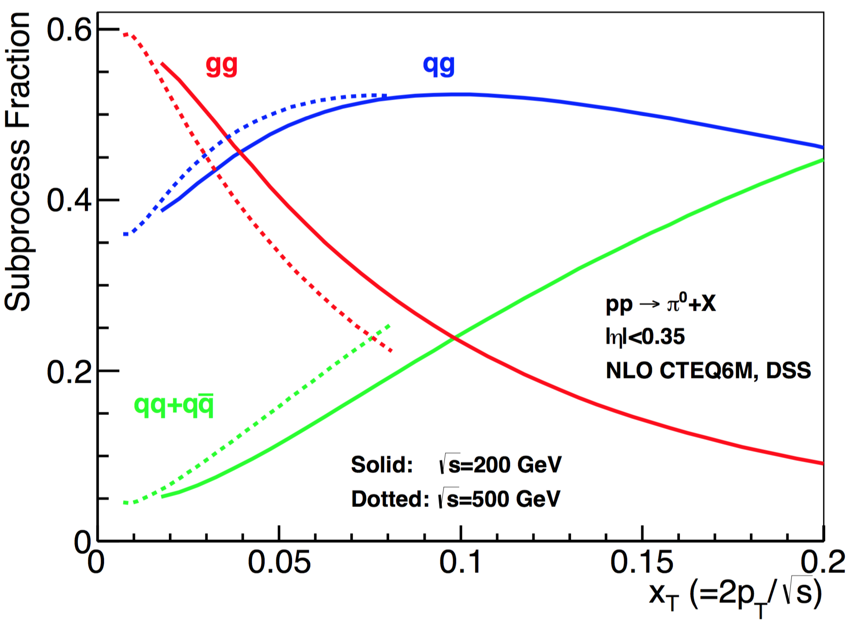

Gluon Polarization and 𝜋⁰ A_{LL}
A_{LL}=(N⁺⁺-N⁺⁻)/(N⁺⁺+N⁺⁻)
    -- Parton distribution functions
    -- Partonic hard scattering rates
    -- Fragmentation functions
DIS
?
pQCD
e+e-
Relative fractions
Di-photon mass: 𝜋⁰ peak

Slide 10
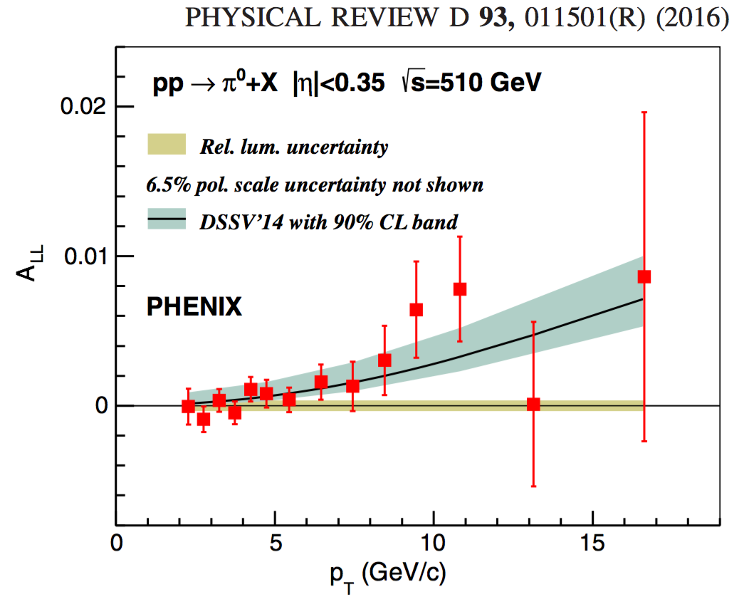
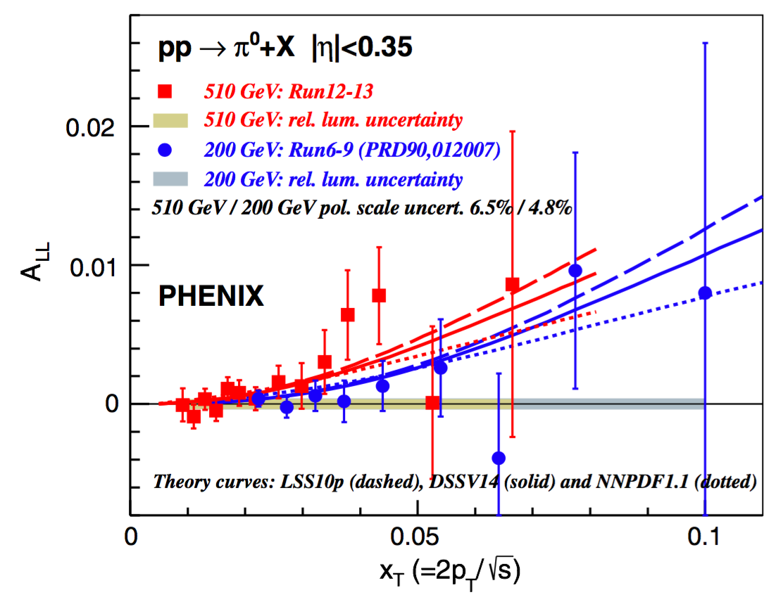
𝜋⁰ A_{LL} at central rapidity (|𝜂|<0.35)
Latest PHENIX publication PRD 93, 011501(R), (2016)
Positive gluon polarization at moderate x ~ 0.05 - 0.2
PHENIX+STAR data:

Slide 11
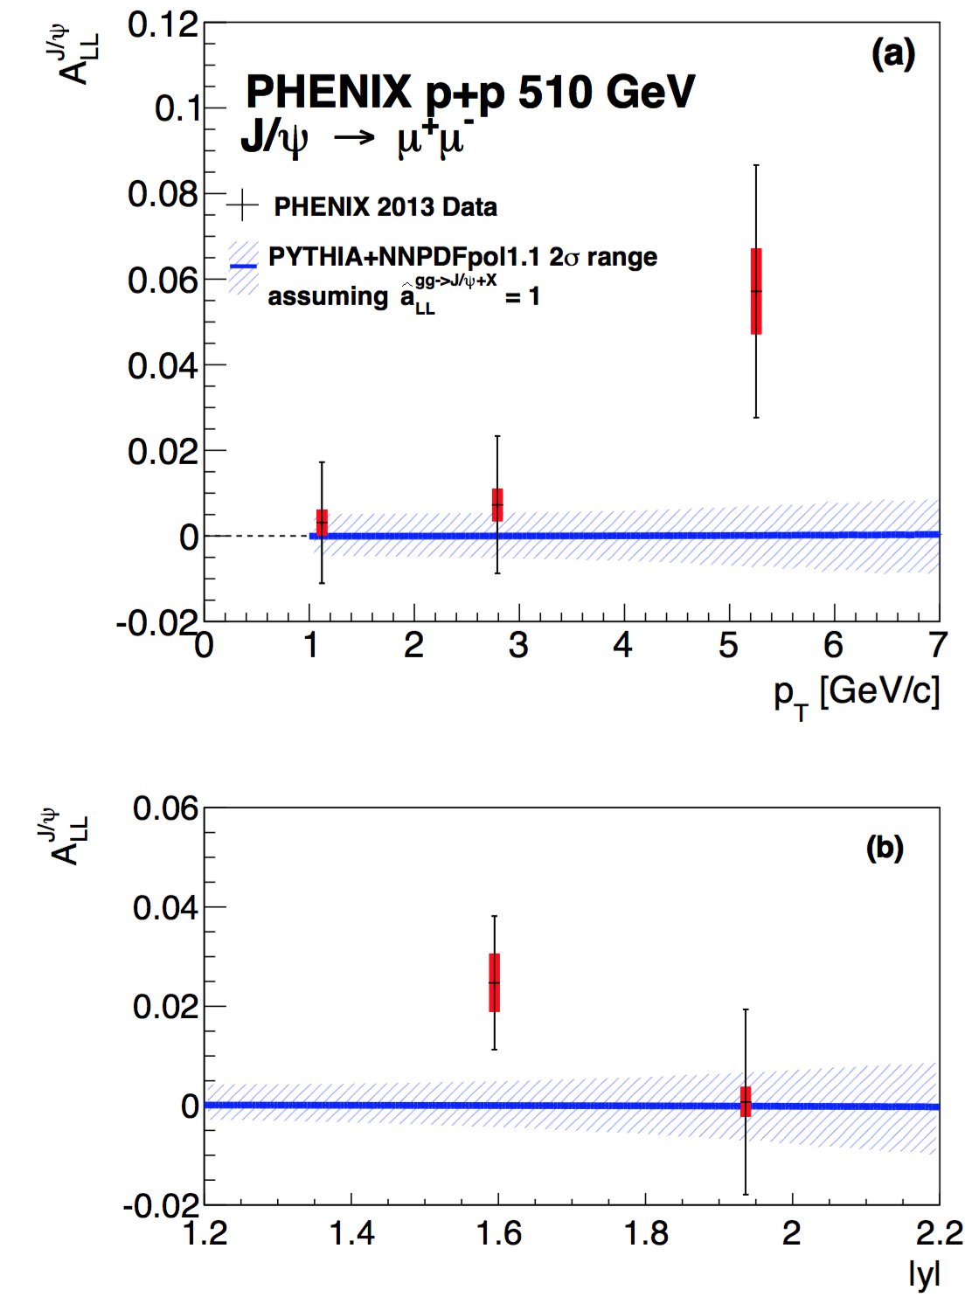
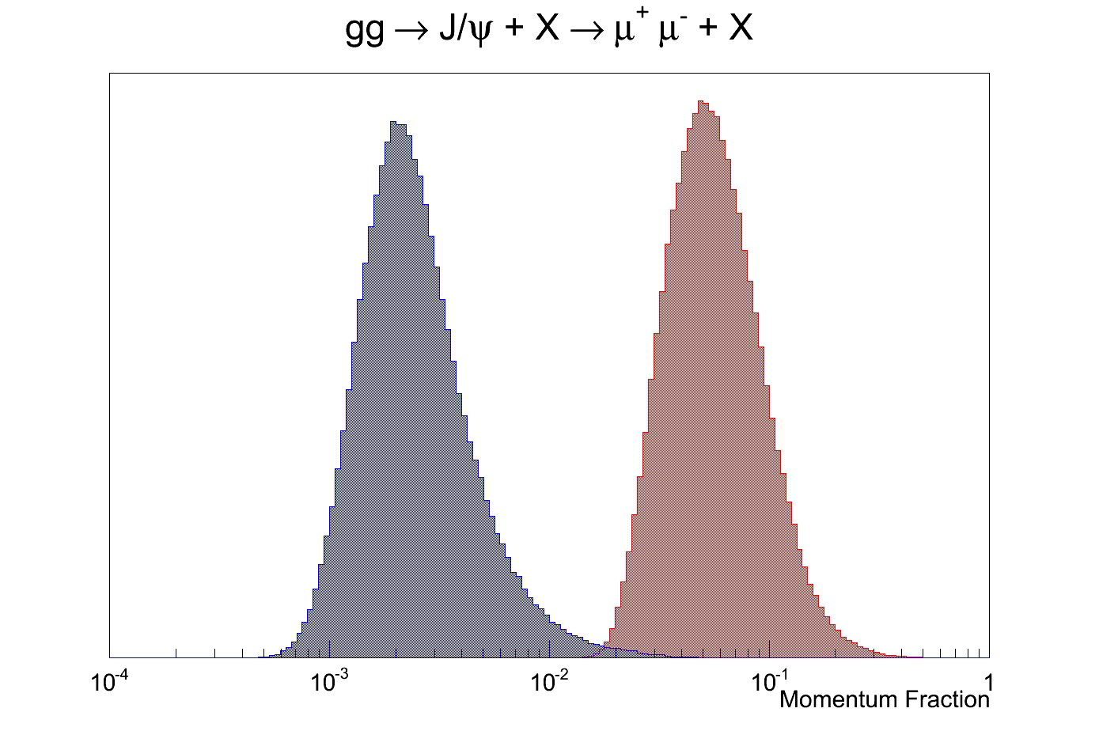
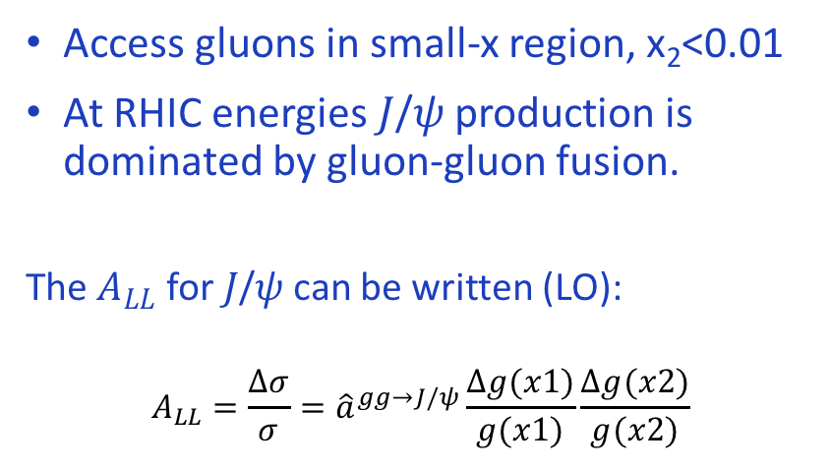
𝐽/𝜓 A_{LL} at Forward Rapidity
Access gluons in small-x region, x₂<0.01
At RHIC energies 𝐽/𝜓 production is dominated by gluon-gluon fusion.
The $A_{LL}$ for 𝐽/𝜓 can be written (LO):
$$A_{LL}=\frac{Δσ}{σ}={\hat{a}}^{gg→J/ψ}\frac{Δg(x1)}{g(x1)}\frac{Δg(x2)}{g(x2)}$$
x₂
x₁

Slide 12
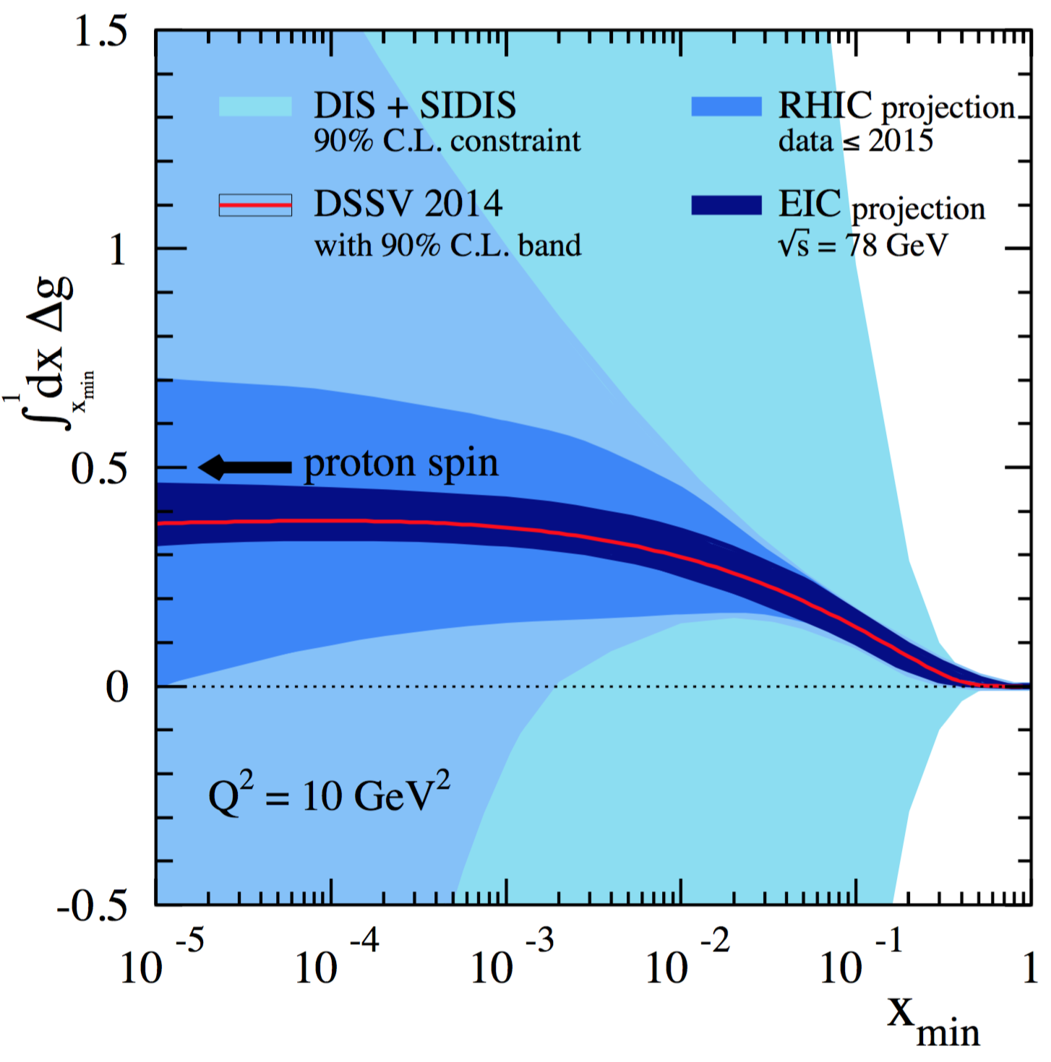
Impact of RHIC data on Gluon Polarization
arXiv:1602.03922
Favors positive gluon polarization
  Published/Submitted:
  Run9 200GeV Central 𝜋⁰ A_{LL}
  Run13 510GeV Central 𝜋⁰ A_{LL}
  Run13 510GeV Forward 𝐽/𝜓 A_{LL}
  Ongoing analyses
  Run11 500GeV Forward 𝜋⁰ A_{LL}
  Run13 510GeV Forward 𝜋⁰ A_{LL}
  Run13 510GeV Central 𝜋±
  Run13 510GeV Central direct photon
  Run9, 11 di-𝜋⁰ A_{LL}
Proposed EIC, 2025+

Slide 13
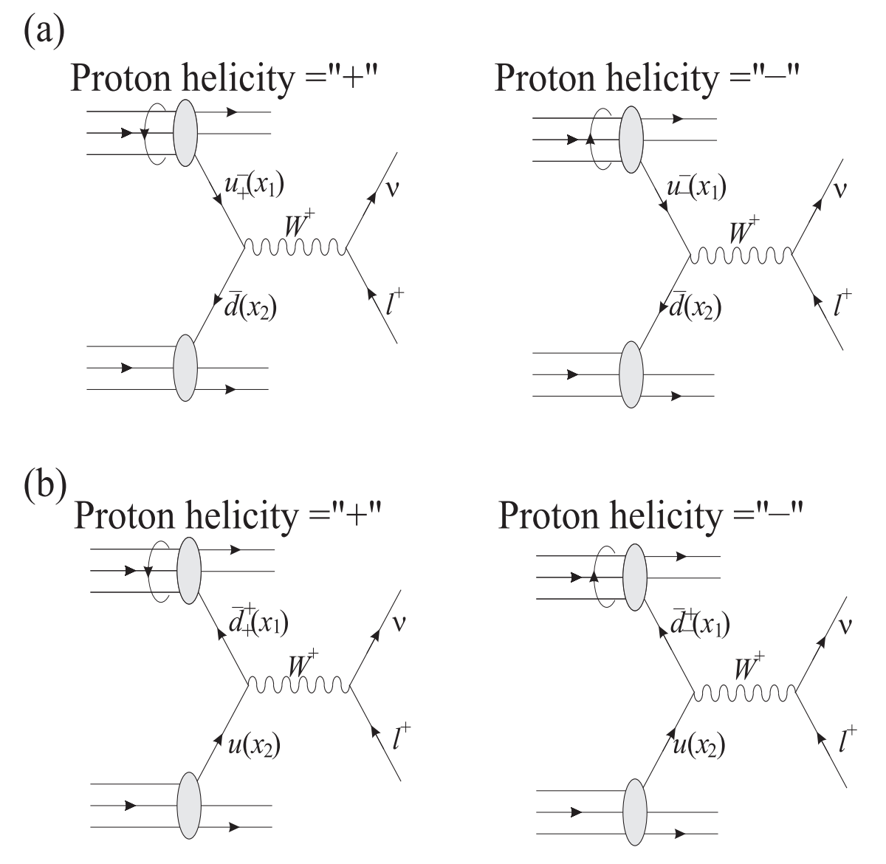
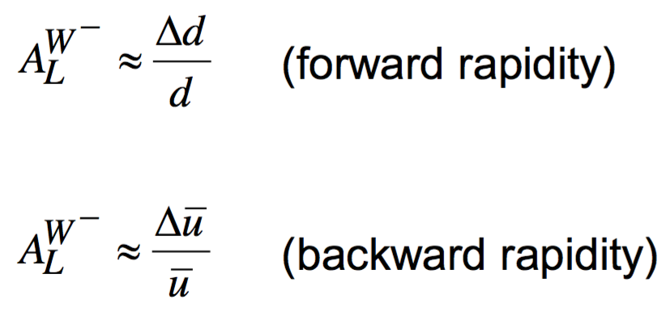
Flavor Identified Sea Quark Polarization
Δ𝑢 (𝑥), Δ𝑑(𝑥)
Could sea-quark contribute significantly the total proton spin?
  Polarized sea-quark distributions poorly known, SIDIS has limited sensitivity
RHIC has unique access to flavor identified sea-quarks via W^{+/-}
A_{L}=(N⁺-N⁻)/(N⁺+N⁻)
Ann. Rev. Nucl. Sci.50:525-585, (2000)

Slide 14
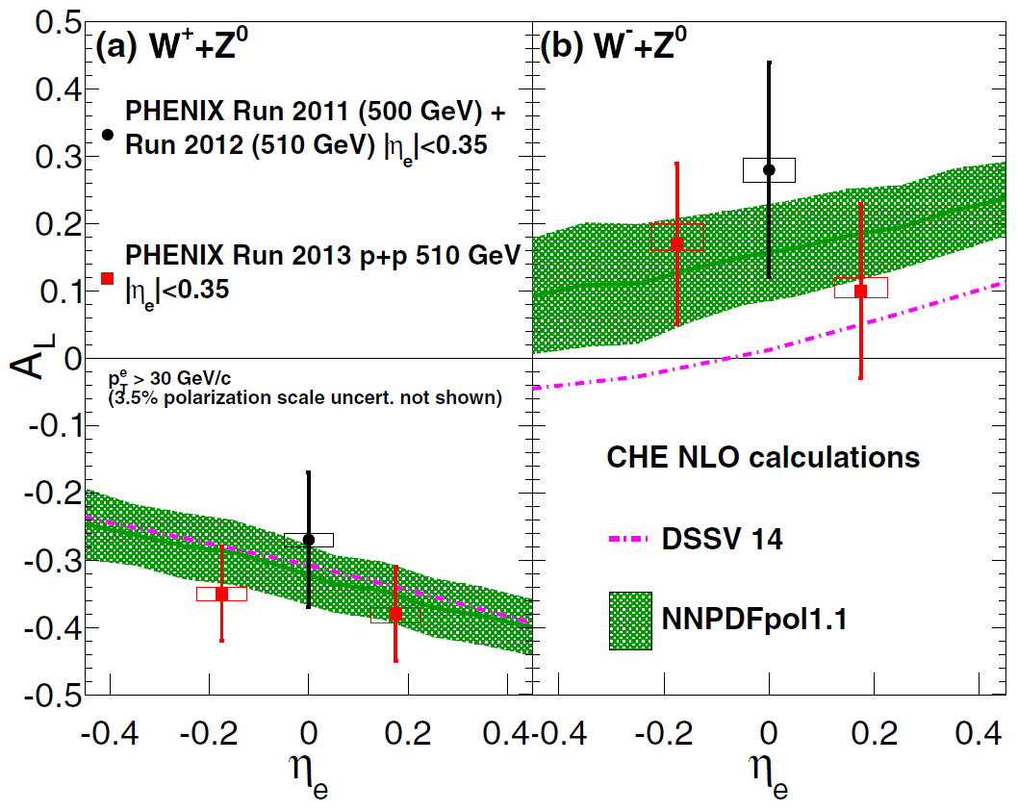
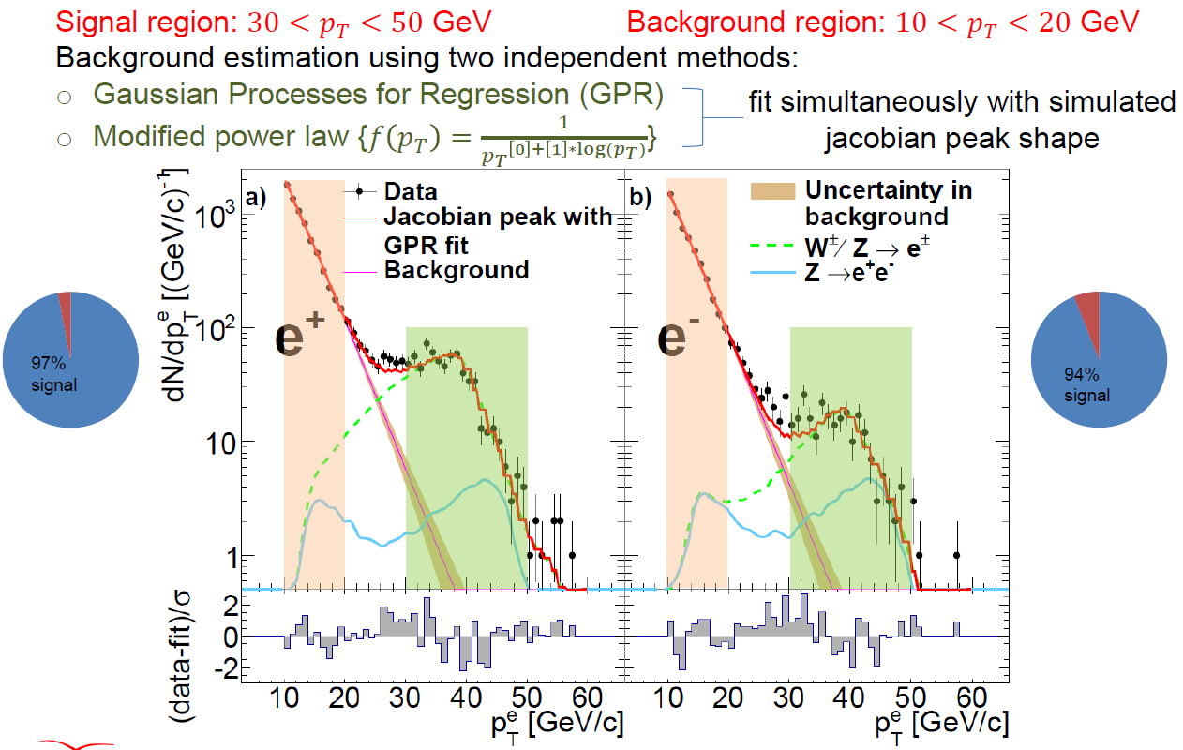
Run13 pp510GeV 𝑊± → 𝑒± A_{L}
Latest PHENIX publication: PRD 93, 051103(R)(2016)
High pT electrons from
W^{+/-} decays

Slide 15
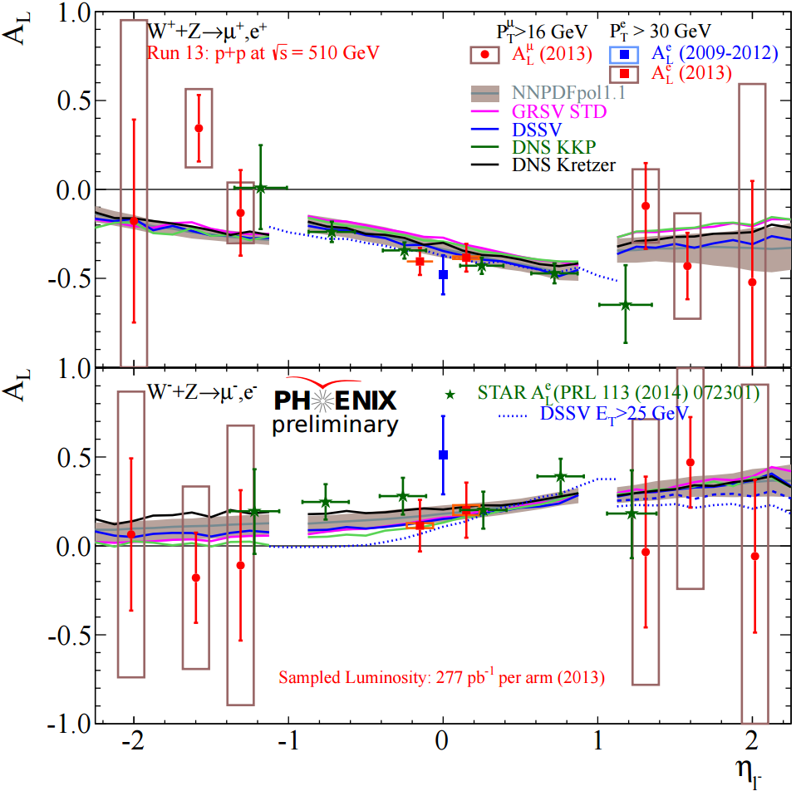
Add Forward 𝑊± → 𝜇± A_{L}
Forward Muons

Slide 16
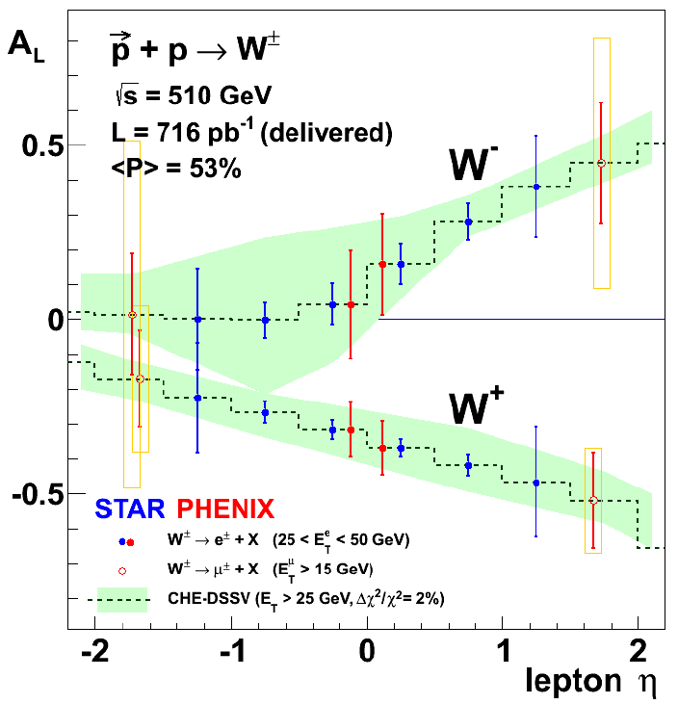
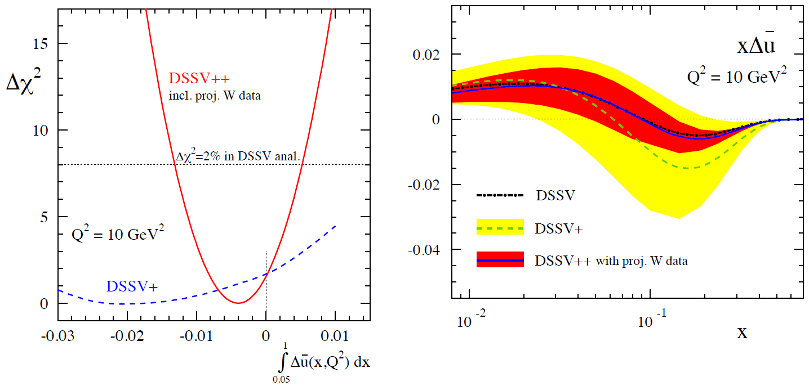
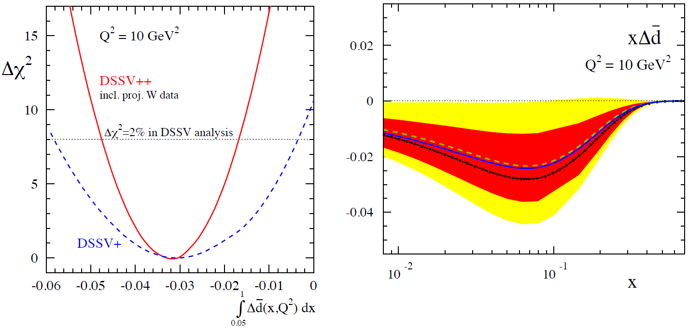
RHIC 𝑊± → 𝑙± data Impact on
Sea Quark Polarization
Expect significant improvement of flavor identified sea quark polarization
arXiv: 1501.01220

Slide 17
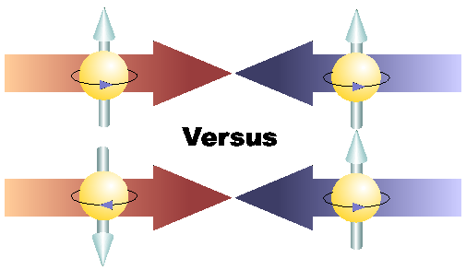
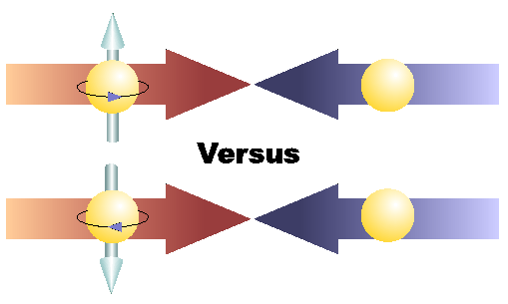
Physics with Transversely
Polarized p+p Collisions

Slide 18
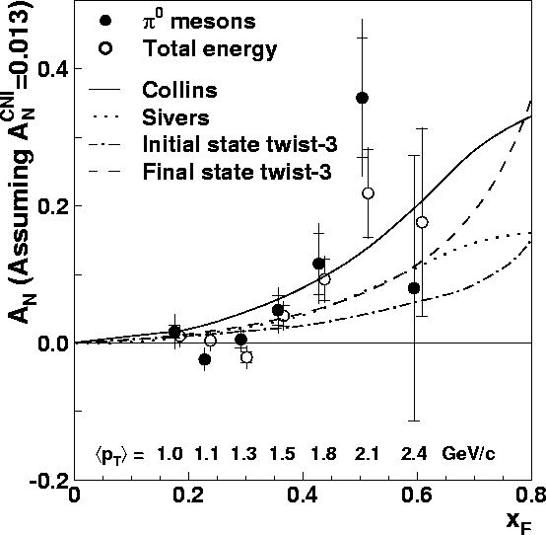
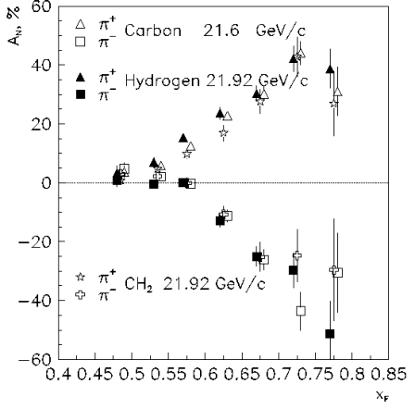
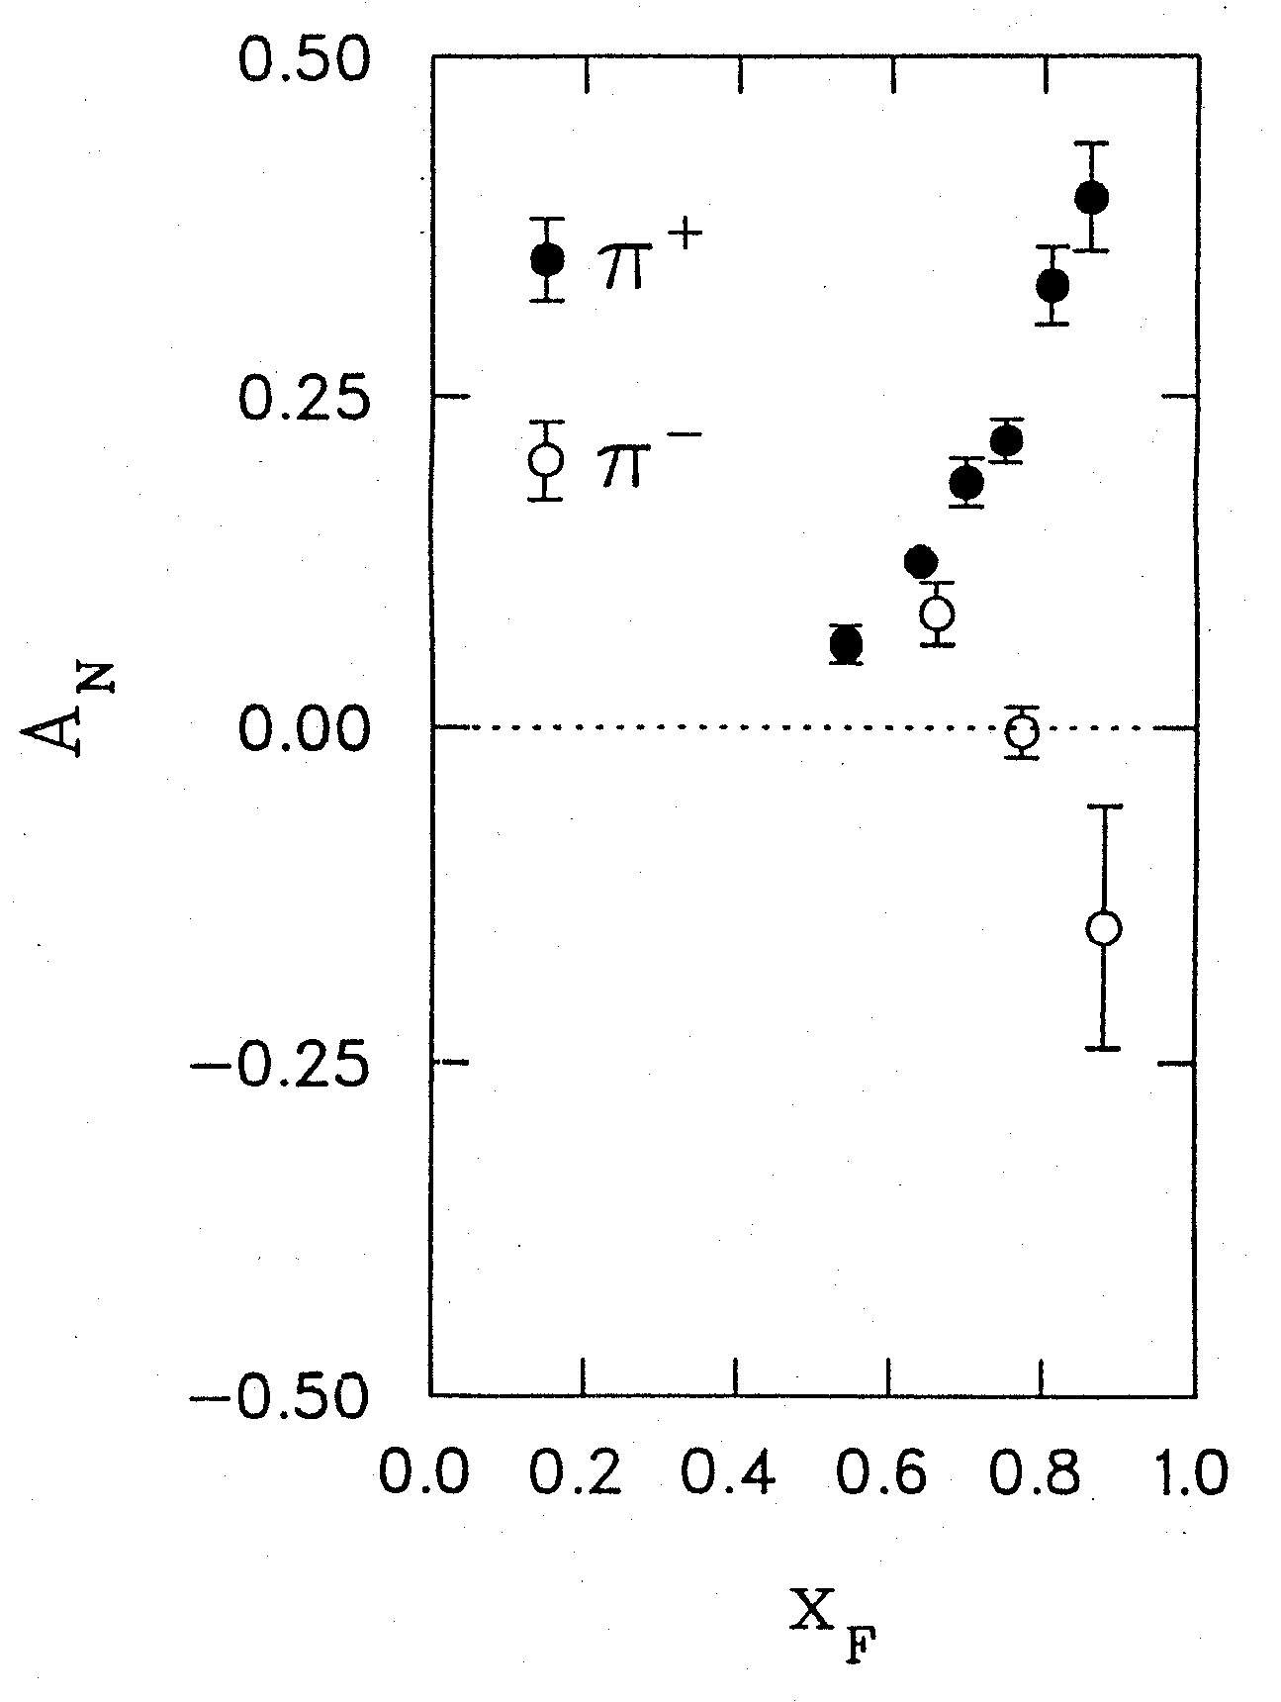
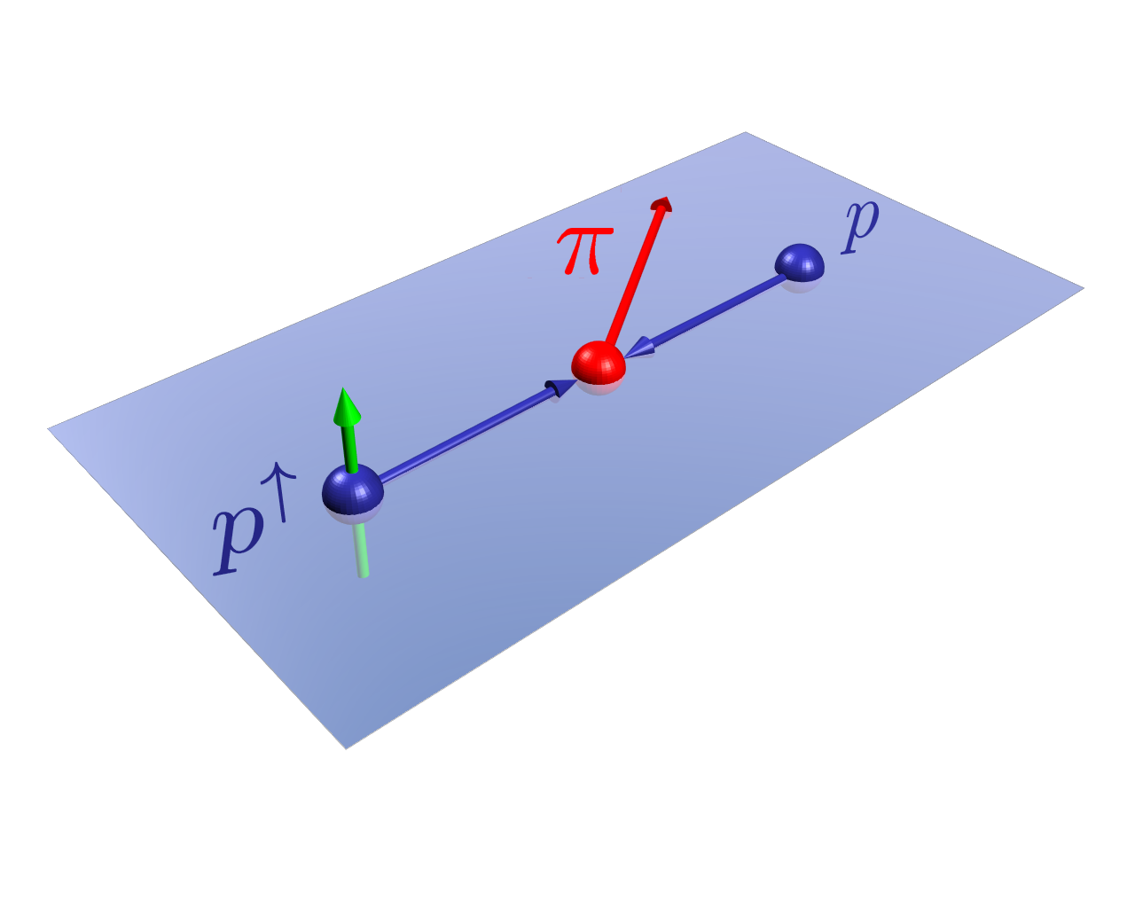
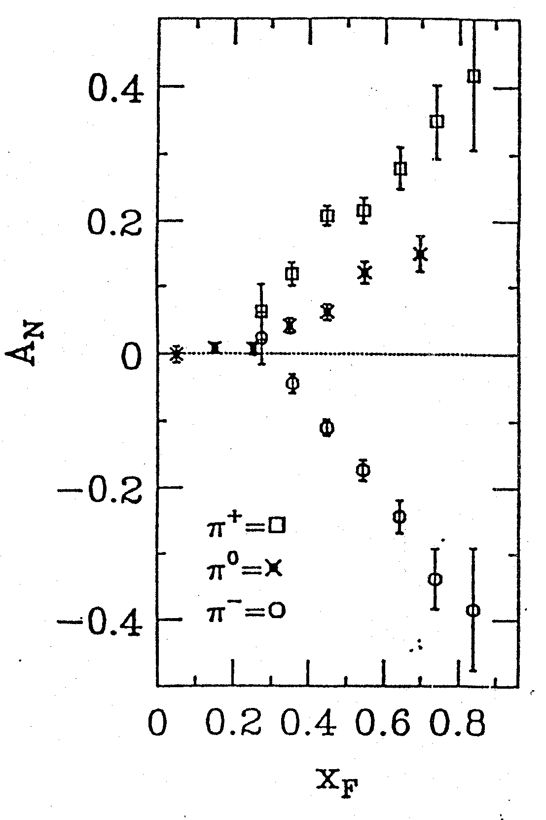
Do We Understand the Physics?
RHIC 200 GeV CMS
Large Transverse Single Spin Asymmetry (TSSA) in forward hadron production persists up to RHIC energy.
FNAL 200 GeV beam
AGS 22 GeV beam
ZGS 12 GeV beam
PRL (2004)
PLB261, 201 (1991)
PLB264, 462 (1991)
PRD65, 092008 (2002)
PRL36, 929 (1976)
Sivers, Collins, Twist-3 ….
Non-Perturbative cross section
Perturbative cross section

Slide 19
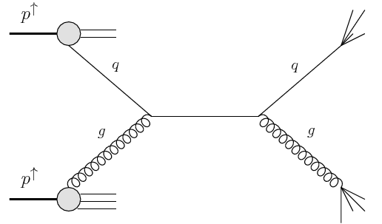
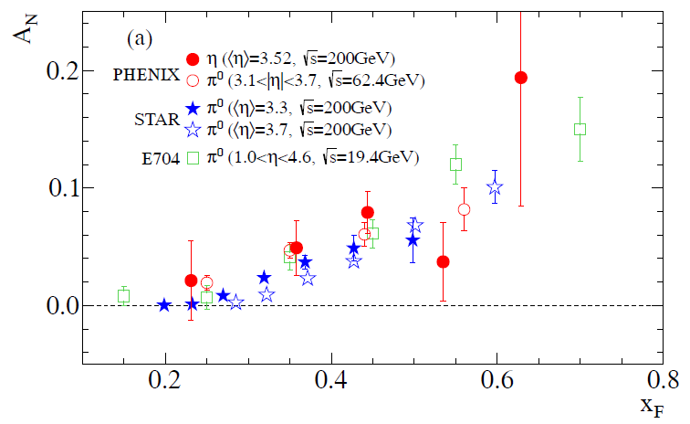
Large TSSA observed at Forward-Rapidity: π⁰ and η
Production well described by pQCD
A_{N} is independent of collision energy
  xF scaling?
Similar for Pion and eta
  No mass dependence?
x₁
Valance quark effect ?
arXiv:1406.3541
x₁>>x₂
x₂

Slide 20
Probe the Underlying Physics via Hard Scatterings
TMD vs Collinear Twist-3 Factorizations
(i) Sivers mechanism:
correlation proton spin & parton k_{T}
(ii) Collins mechanism: Transversity × spin-dep fragmentation
S_{P}
Phys Rev D41 (1990) 83; 43 (1991) 261
S_{P}
Nucl Phys B396 (1993) 161
S_{q}
p
k_{T,q}
p
p
p
S_{q}
k_{T,π}
Collinear Twist-3 (RHIC):
quark-gluon/gluon-gluon correlation

Slide 21
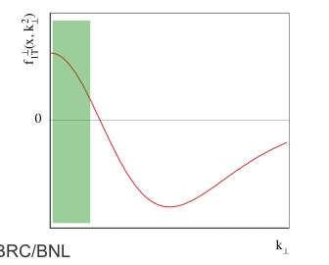
A Surprise: A_{N} Sign Mismatch?
First attempt to check the “Universality of QCD description of TSSA”
- Kang, Qiu, Vogelsang, Yuan PRD 2011
Twist-3 (RHIC) v.s. Sivers (SIDIS)
A possible solution? Kang, Prokudin PRD (2012)
SIDIS Data
unknown

Slide 22
Hadron TSSA in Twist-3 Framework
Qiu & Sterman PRD 59 (1998)
1st term: twsit-3 correlation functions, “Sivers”
2nd term: twist-2 transversity * twist-3 from unpol beam (expected small)
3rd term: twist-2 transversity * twist-3 FF, “Collins”
Need new direct measurements of Sivers and Collins TSSA in p+p!
Forward sPHENIX Upgrade Proposal
22

Slide 23
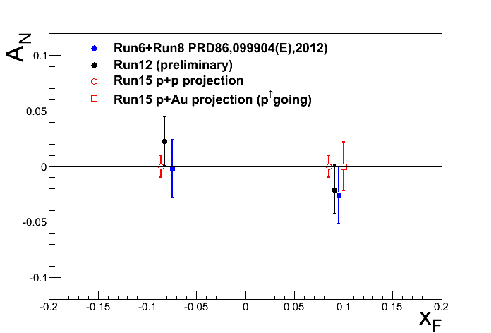
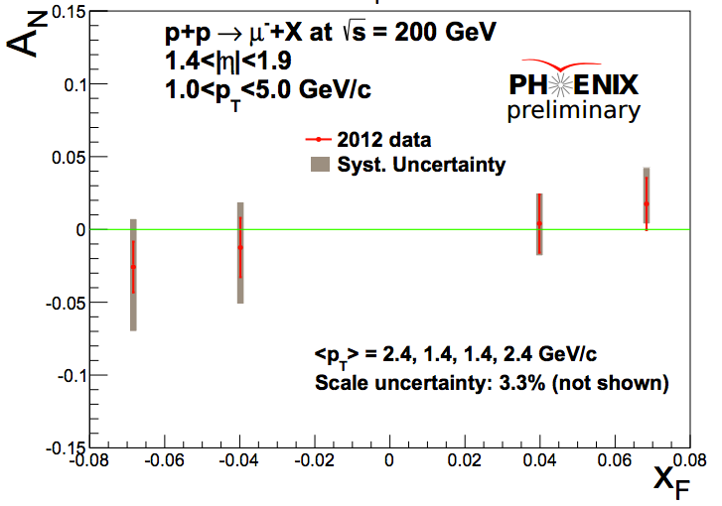
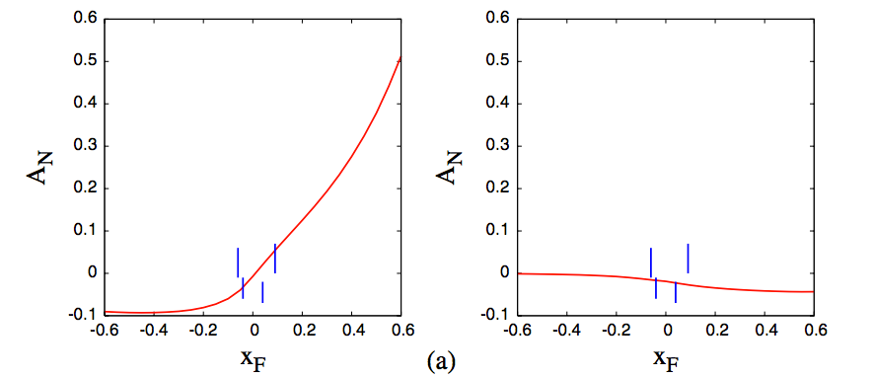
Gluons?: Forward Heavy Flavor A_{N}
Heavy Flavor production is an ideal tool to investigate gluon distributions.
J/ψ A_{N}
We expect much improved result from ongoing Run15 p+p analysis (>5x statistics) as well as J/ψ A_{N} result in Run15 p↑+A
  Y. Koike, S. Yoshida PRD84:014026 (2011)
D⁺
D⁻

Slide 24
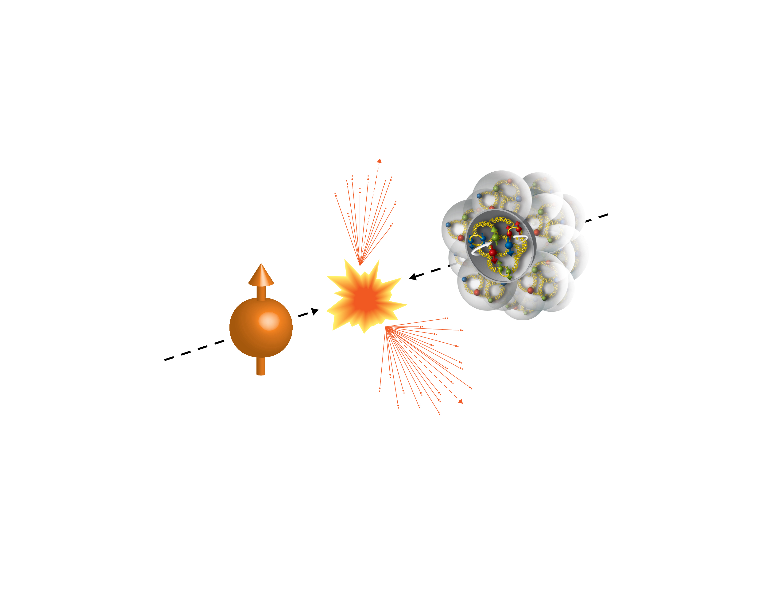
First Polarized p+A at RHIC
Run15 (2015)
100GeV/nucleon
Au, Al
100GeV
Polarized Proton
 | # of proton | # of neutron
p | 1 | 0
Al | 13 | 14
Au | 79 | 118

Slide 25
Run15 p+Au: a Surprise!
Itaru Nakagawa’s
talk, July 13
Unexpected pAu and pAl asymmetries observed compared to that of pp
A
BBC Veto
𝛾*
𝜋⁺
p
↑
n
A
BBC
BBC Tag
?
↑
p
n
BBC

Slide 26
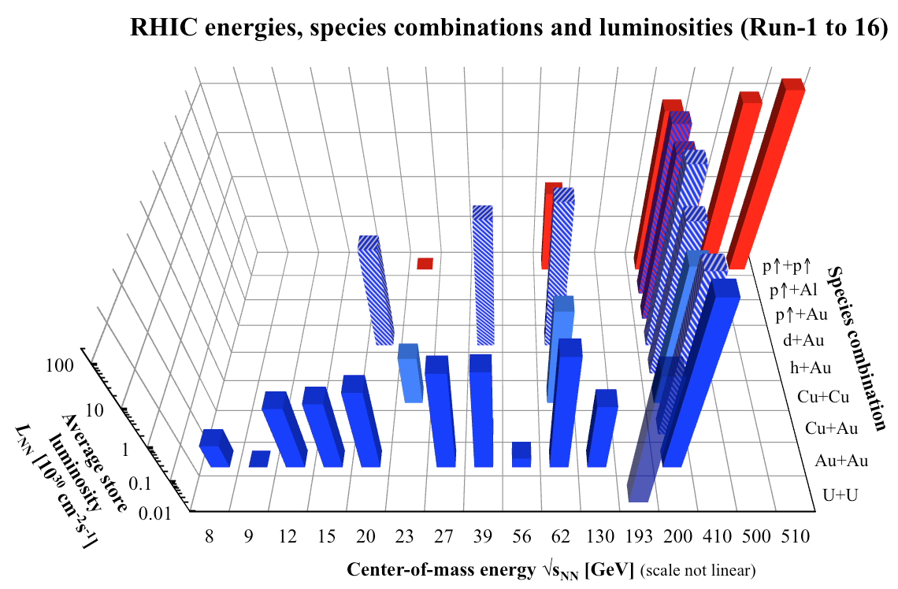
Summary of PHENIX Runs: 2000-2016

Slide 27
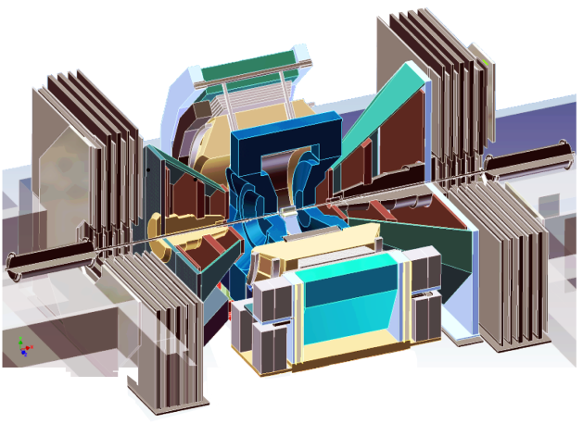
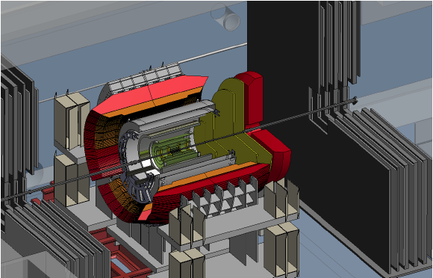
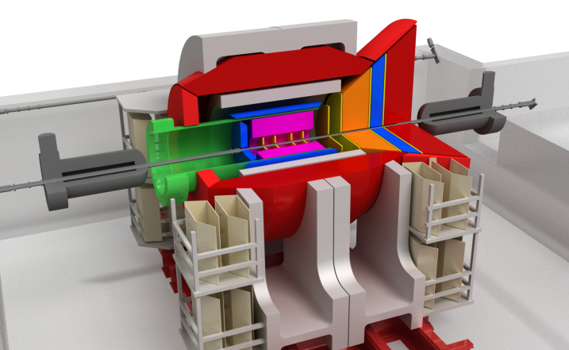
Outlook: PHENIX -> Forward/sPHENIX->ePHENIX
Documented: http://www.phenix.bnl.gov/plans.html
Current PHENIX
f/sPHENIX
An EIC detector
PHENIX completed 2016
16y+ work
100+M$ investment
130+ published papers to date
Comprehensive central upgrade based on BaBar magnet
fsPHENIX: forward tracking, HCal and muon ID
Key study of transverse spin
New collaboration/new ideas
Path of PHENIX upgrade leads to a capable EIC detector
Large coverage of tracking, calorimetry and PID
New collaboration/new ideas
~2000
2017→2020
~2025
Time
RHIC: A+A, polarized p+p, polarized p+A
eRHIC: e+p, e+A

Slide 28
backup

Slide 29
Initial Success of TMD and Twist-3
Both describe pp data well, from fixed-target to RHIC
E704

Slide 30
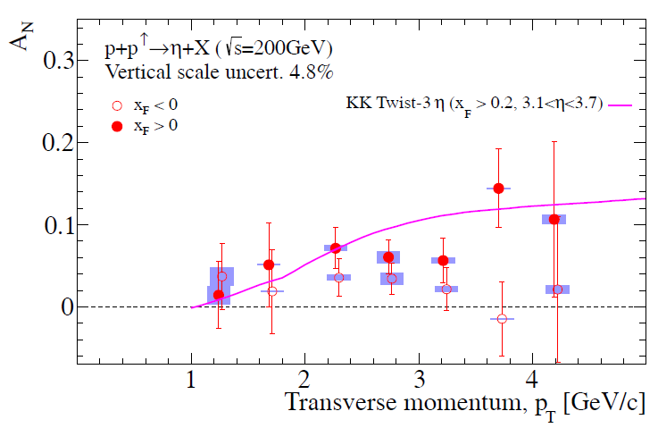
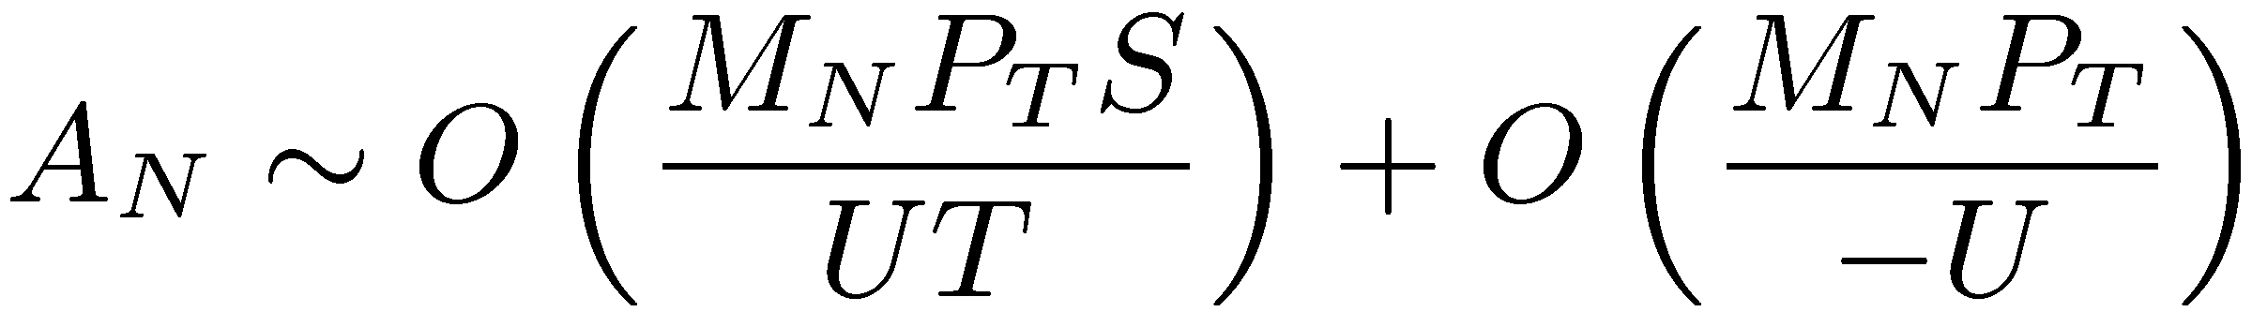
“Weak” p_{T} Dependence
arXiv:1406.3541
Naïve expectation at high pT
Recent work, Twist-3, Kanazawa & Koike
10/17/2014
Ming Liu

Slide 31
Access Sivers and Collins with Jet and Hadron Azimuthal Distributions in Transversely Polarized p+p Collisions
Feng Yuan, PRL 100, 032003 (2008)
Umberto D’Alesio et al PRD 83 034021 (2011)
Experimental variables:
Jet P_{j,} xF
Hadron P_{h} , PID
Beam polarization
→ “Sivers-like”
→ “Collins-like”

Slide 32
fsPHENIX Projected Jet Sivers Asymmetries
Test the universality of QCD description of TSSA: pp vs SIDIS
Naïve direct mapping
from SIDIS Sivers (GPM)
- “u-quark jet” A_{N} >0
Sivers, SIDIS fit
With process-dep
from SIDIS Sivers (Twist-3)
- “u-quark jet” A_{N} < 0

Slide 33
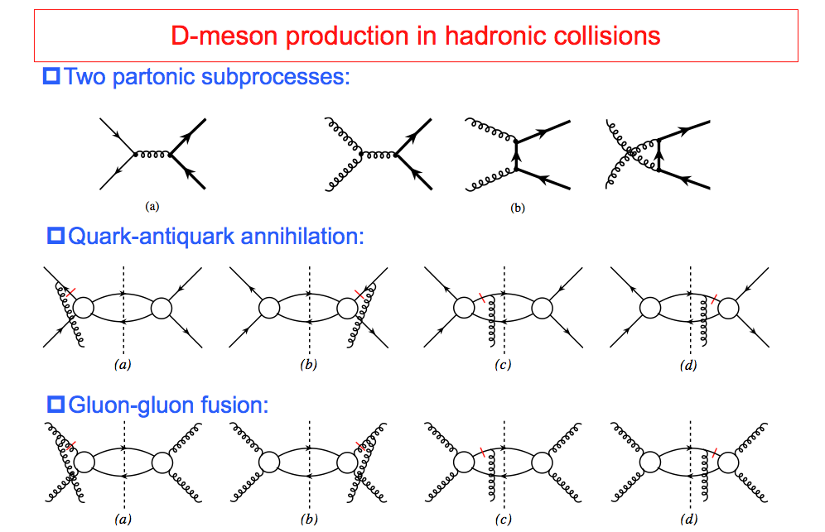
TSSA in Heavy Quark Production in p+p
Kang, Qiu, Vogelsang, Yuan, PRD 2008

Slide 34
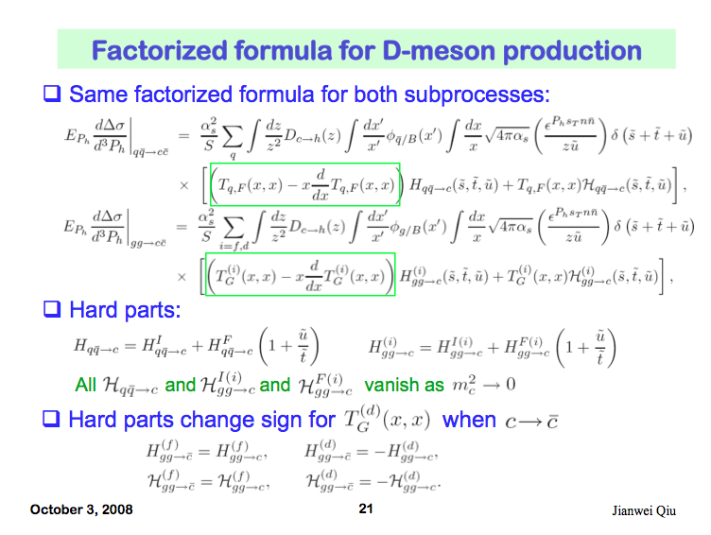
Open Charm TSSA in Twist-3 Approach
Qiu, 2010

Slide 35
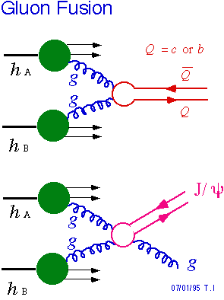
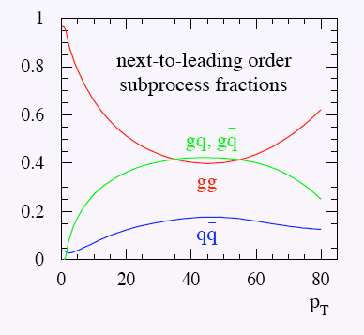
Heavy Flavor to Access Gluons
Sensitive to gluon Sivers function
* probe gluon’s orbital angular momentum?
-- Minimize Collins’ effects
* heavy flavor production dominated by gluon gluon fusion at RHIC energy
Pythia 6.1 simulation (LO)
* gluon has zero transversity
Tri-gluon correlation functions
Also sensitive to J/ψ production mechanisms and QCD dynamics
Open Charm
Johann Riedl, SPIN2008
Notes:
What about gluon

Slide 36



Expectation from Run 2015 p+p & p+A with F/VTX
Drell-Yan
prompt
π→μ
Expect much improved results from Run 15
  110 pb⁻¹, Pol = 57% (Run15)
  10x FOM(Run12)
GTMD model
Twist-3 Approach

