Slide 1
New Opportunities of “High” Energy QCD Hadron Physics with Drell-Yan at Fermilab
Ming X. Liu (Los Alamos)
Jen-Chieh Peng (UIUC)
Study novel strong interaction phenomena (parton model)
New Fundamental tests of QCD

Slide 2
Outline
A brief review of Drell-Yan experiments: Hadron Physics @Fermilab
High energy (parton) QCD hadron physics – recent development
  Nucleon parton model and novel QCD dynamics
  Transverse Momentum Dependent PDF & FF functions (TMD)
  Drell-Yan TSSA and “sign change”
    New opportunities of QCD physics at Fermilab
  Drell-Yan, Open charm, Lambda …
    anti-protons @8GeV, (120GeV?)
    Proton @120GeV
  Polarized Program?!
    QCD color-charge flow and transverse spin effect in hard scatterings

Slide 3
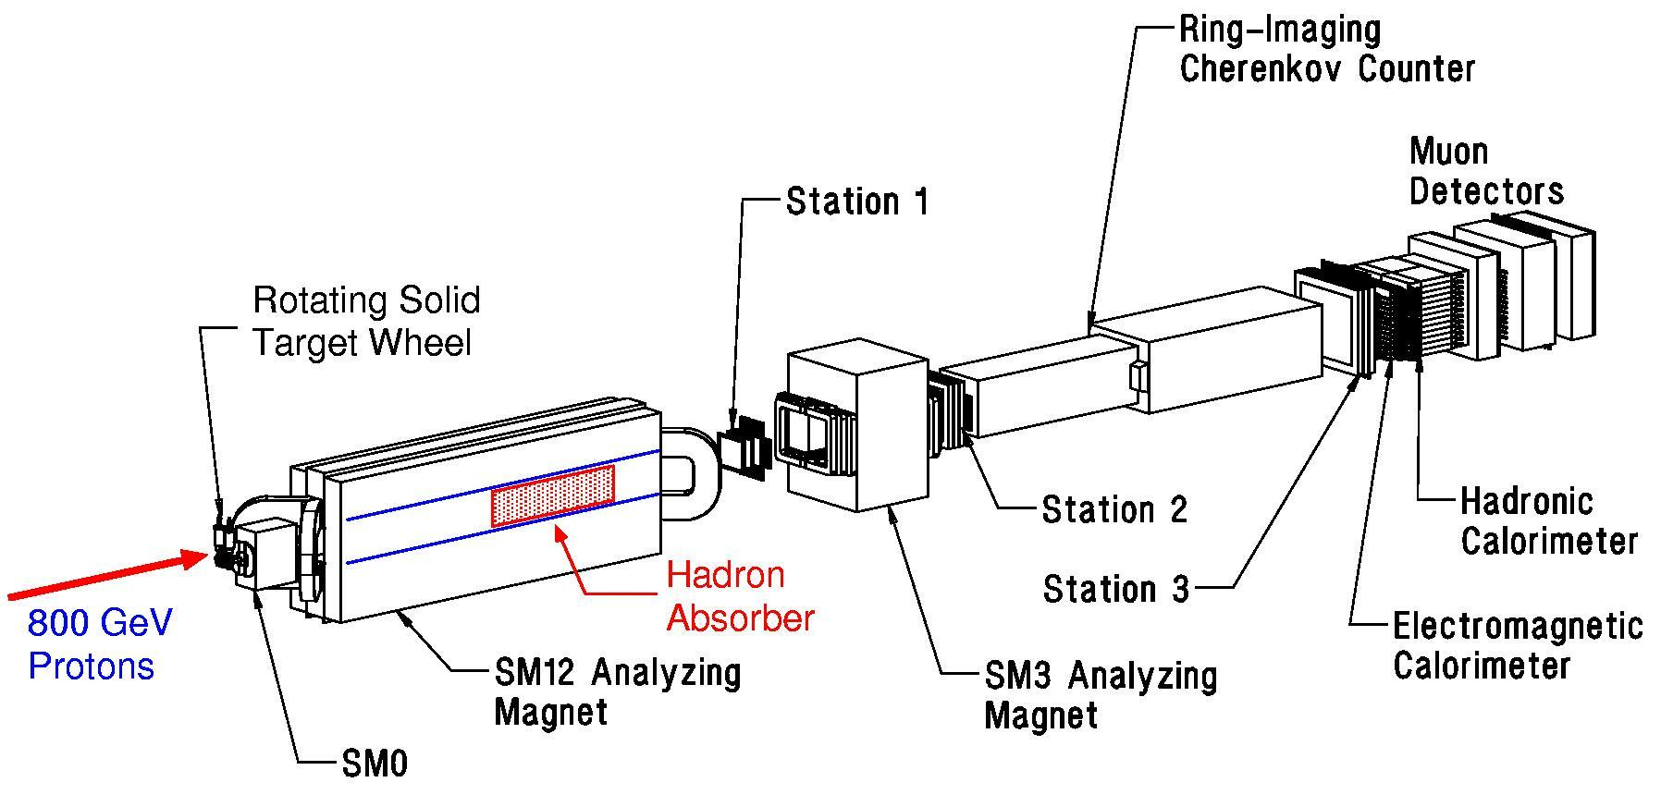
Fermilab Dimuon Spectrometer: Fixed Target Drell-Yan
(E605 / 772 / 789 / 866 / 906)
Polarized Drell-Yan at Fermilab after E906?

Slide 4
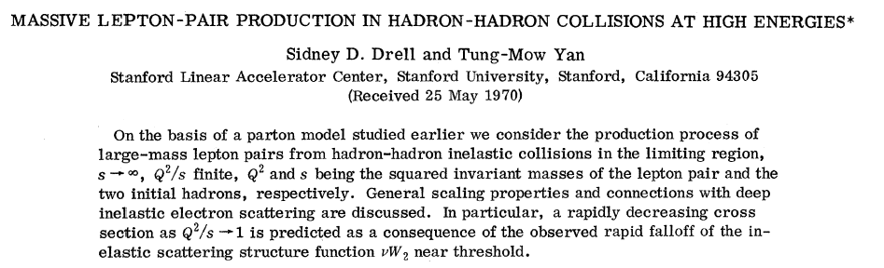
The Drell-Yan Process
E866@Fermilab
p
μ⁺
p
μ⁻

Slide 5
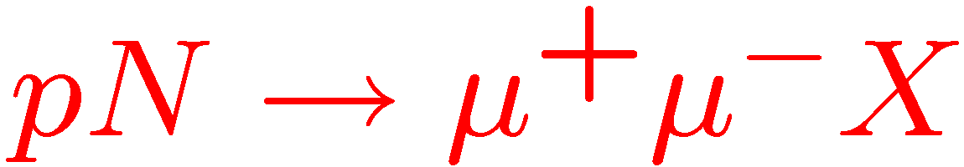
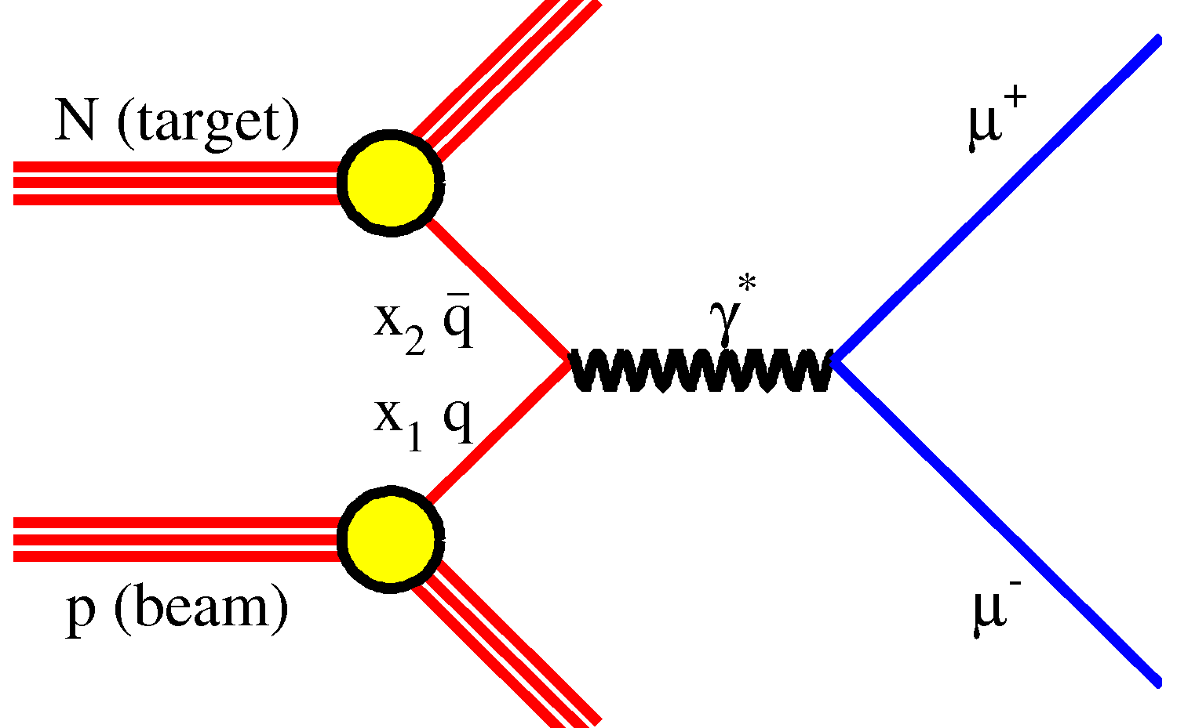
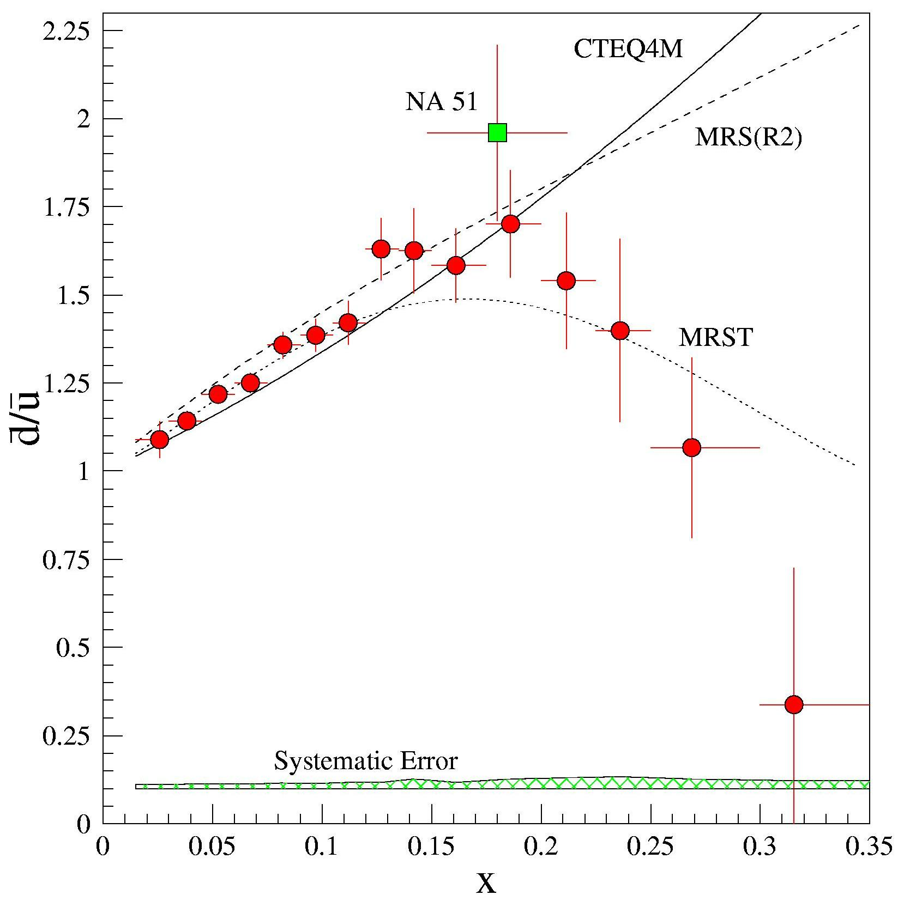
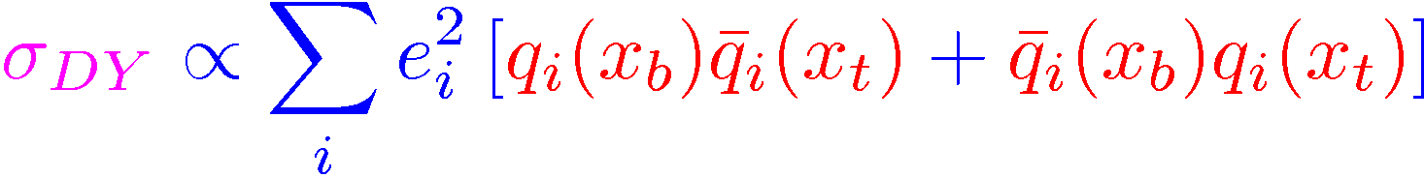
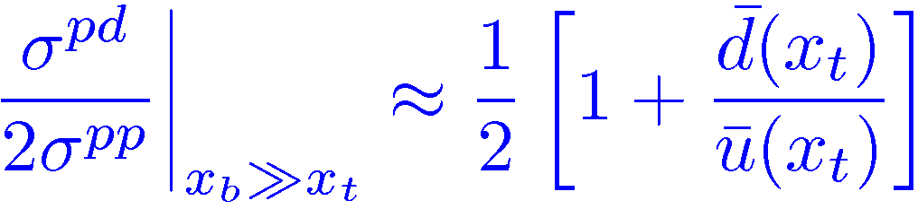
Fermilab E866 Highlight: sea quark asymmetry
E866, Phys.Rev. D64 (2001) 052002
FermiLab/E866
Sea Asymmetry probed by Drell-Yan

Slide 6
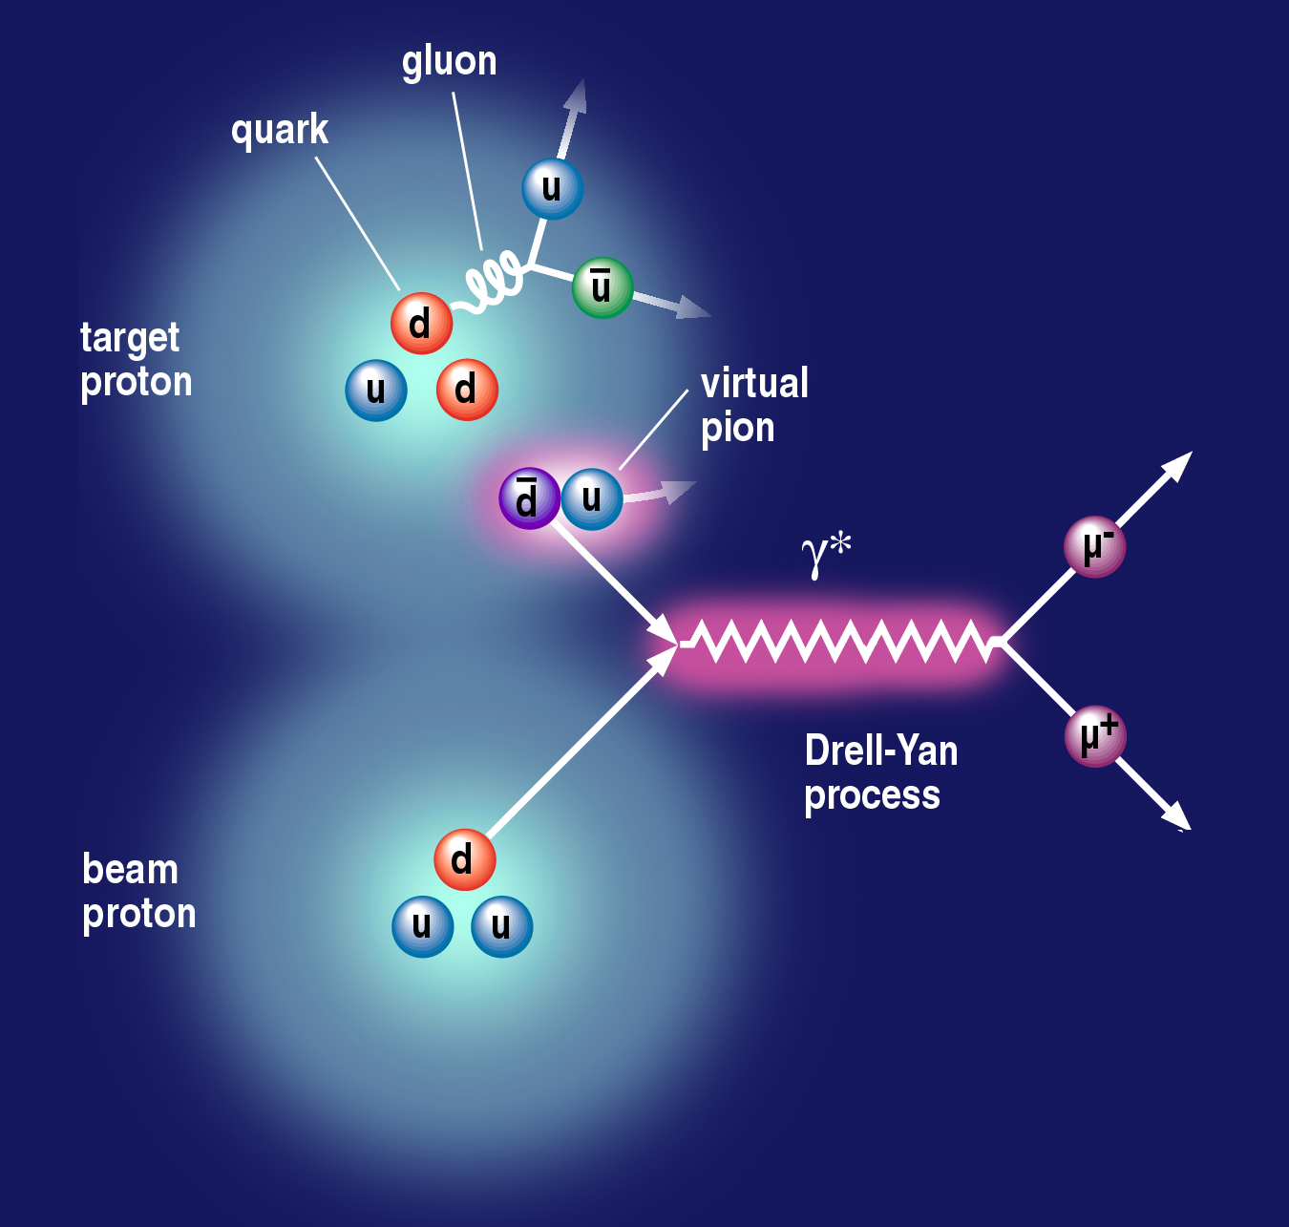
Nucleon Structure and Vacuum Quantum Fluctuation
Notes:
Use the nice picture to show that if sea quarks are only from gluon splitting, one will expect dbar = ubar; but if include pion cloud fluctuation, the symmetry is broken. → and E866 showed that is the case. So proton is a very complex system.
So it is interesting to see what happens to polarized case.
It is also a model killer – some predict even larger asymmetry for polarized case.
So understanding the details of nucleon structure will help us better understand the confinement.
So we want to explore the flavor decomposed sea quark distributions.

Slide 7
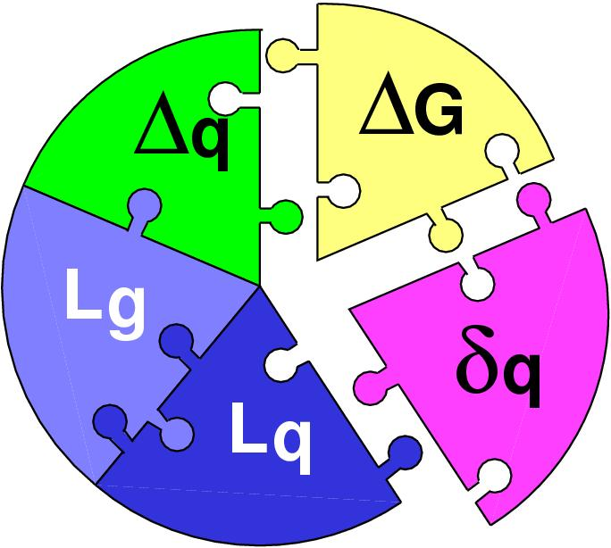
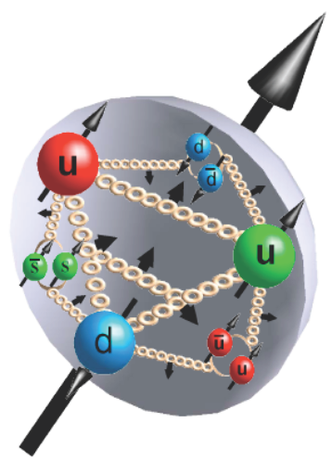
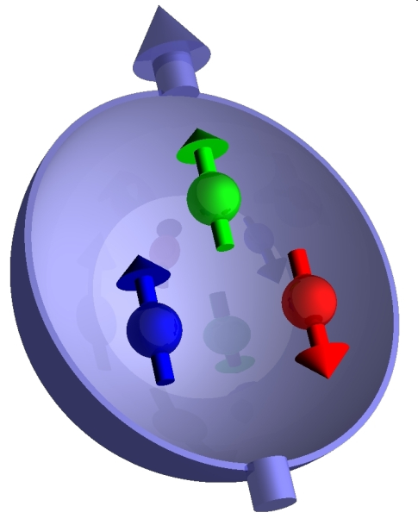
Surprises in Hadron (Spin) Physics (I) the QCD challenge of “Too Small”
Proton Spin Puzzle
Spin Physics @RHIC, J-Lab, CERN, JPARC …
  Gluon polarization
  Quark polarization
  Orbital angular mom.?

Slide 8
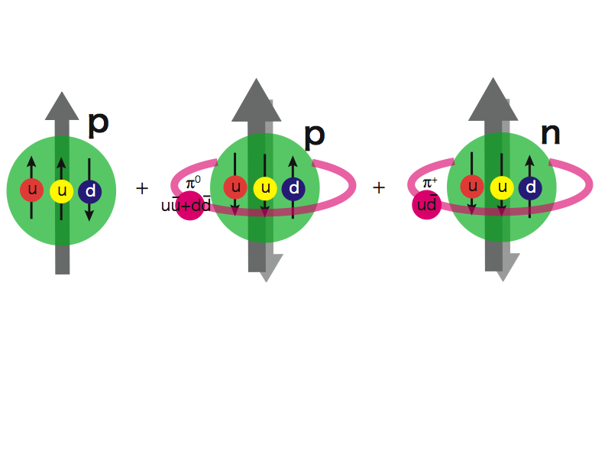
Pion Cloud Model and the
Orbital Angular Momentum?!
Extra dbar in proton
Sea Quarks Carry Major Orbital Angular Momentum Component?

Slide 9
Pion Cloud and Orbital Angular Momentum
“Proton spin puzzle”, sea quark flavor asymmetry and L_{Z}
G. Garvey, PRC81:055212,2010.

Slide 10
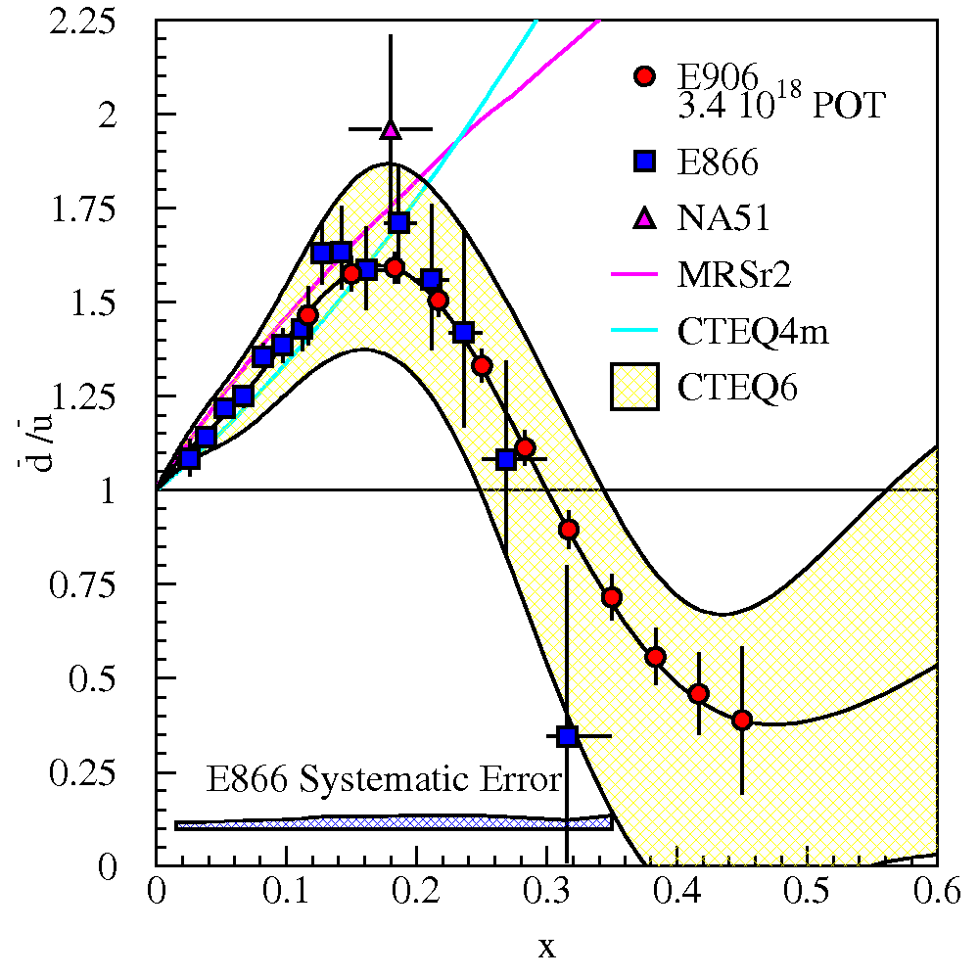
E906 Projections for d-bar/u-bar Ratio
SeaQuest will extend these measurements and reduce statistical uncertainty
SeaQuest expects systematic uncertainty to remain at ≈1% in cross section ratio
5 s slow extraction spill each minute
Intensity:
  2 x 10¹² protons/s
  1 x 10¹³ protons/spill

Slide 11
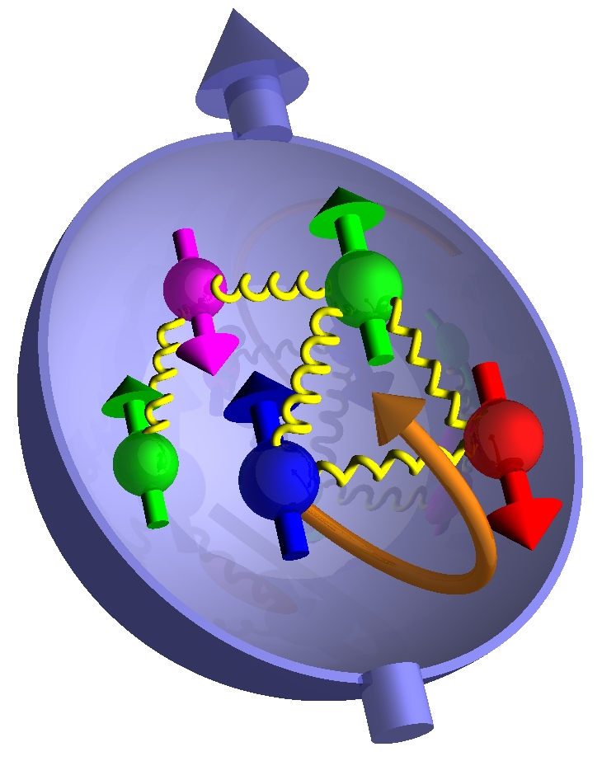
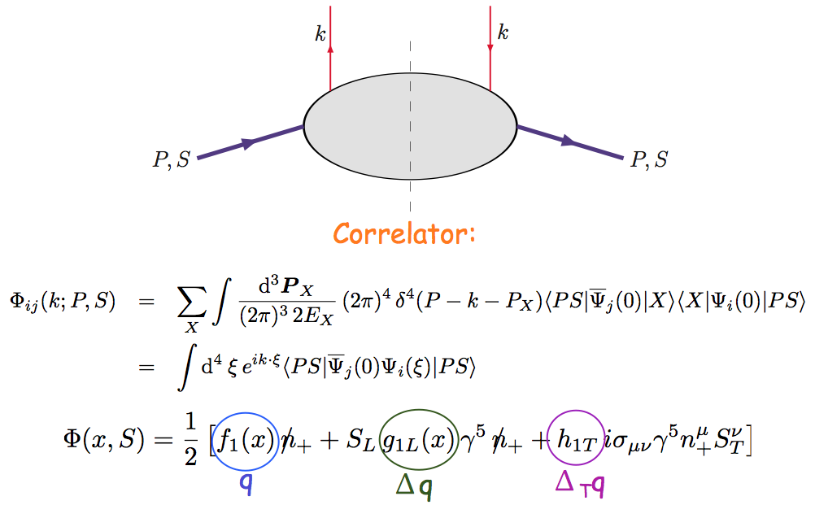
Nucleon Quark Structure, TMD
Beyond Leading-Twist Collinear Approximation
- Partonic interpretation of hard scatterings
- Universal functions

Slide 12
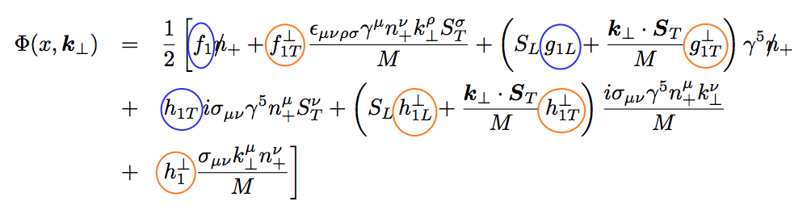
Including k_{T} … TMDs
No K┴ dependence
K┴ - dependent
T-even
K┴ - dependent
T-odd

Slide 13
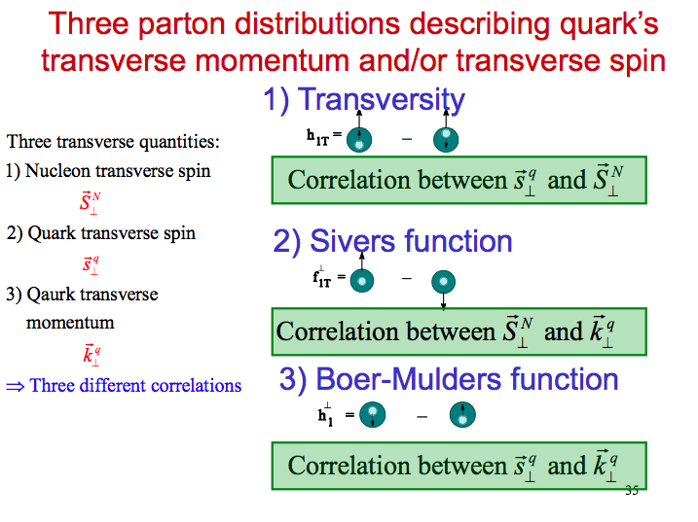

Slide 14
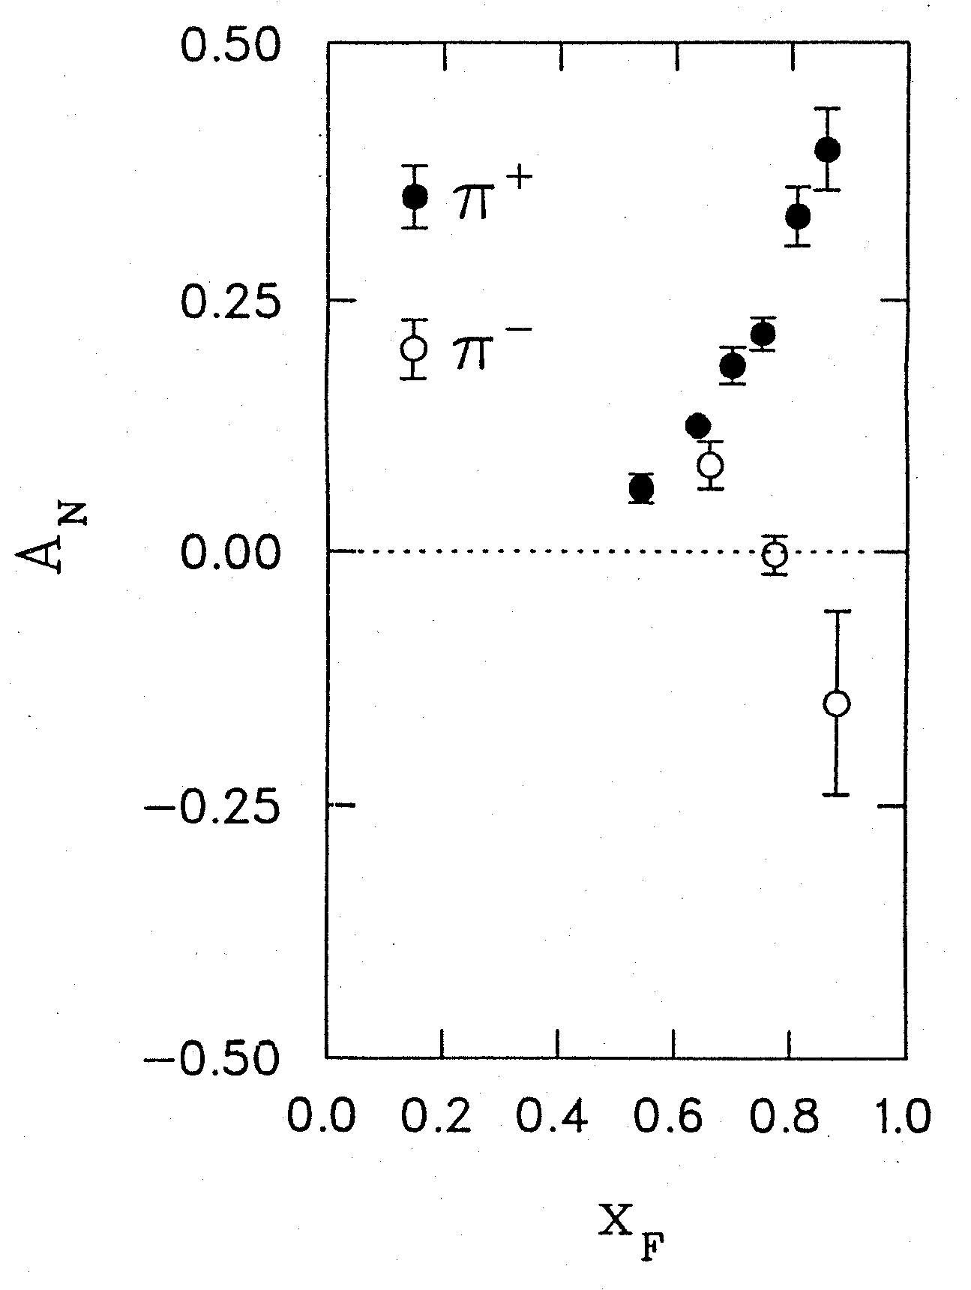
Surprises in Hadron (Spin) Physics (II) the QCD challenge of “Too Large”
Transverse Single Spin Asymmetries A_{N}
Left
Argonne ZGS, p_{beam} = 12 GeV/c
Right
Theory Expectation:
Small asymmetries at high energies
(Kane, Pumplin, Repko, PRL 41, 1689–1692 (1978) )
A_{N}
A_{N} ~ O(10⁻⁴) theory
Experiments:
ZGS, AGS, FERMILAB to RHIC
A_{N} ~ O(10⁻¹) observed
W.H. Dragoset et al., PRL36, 929 (1976)
11/19/11
14

Slide 15
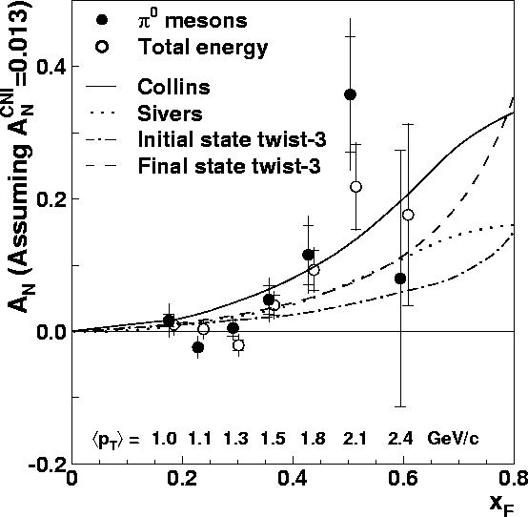
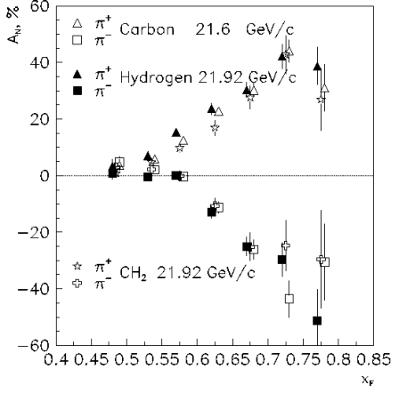
Transverse SSA’s from low to high energies
RHIC 20,000 GeV beam
FNAL 200 GeV beam
AGS 22 GeV beam
ZGS 12 GeV beam
PRL (2004)
PLB261, 201 (1991)
PLB264, 462 (1991)
PRD65, 092008 (2002)
PRL36, 929 (1976)
Non-Perturbative cross section
Perturbative cross section

Slide 16
Possible Mechanisms …
Sivers mechanism: Correlation between nucleon spin and parton k_{T}
Collins mechanism: Transversity (quark polarization) * asymmetry in the jet fragmentation
Phys Rev D41 (1990) 83; 43 (1991) 261
Nucl Phys B396 (1993) 161
S_{P}
S_{P}
S_{q}
p
k_{T,q}
p
p
p
S_{q}
k_{T,π}
Orbital Angular Momentum?

Slide 17
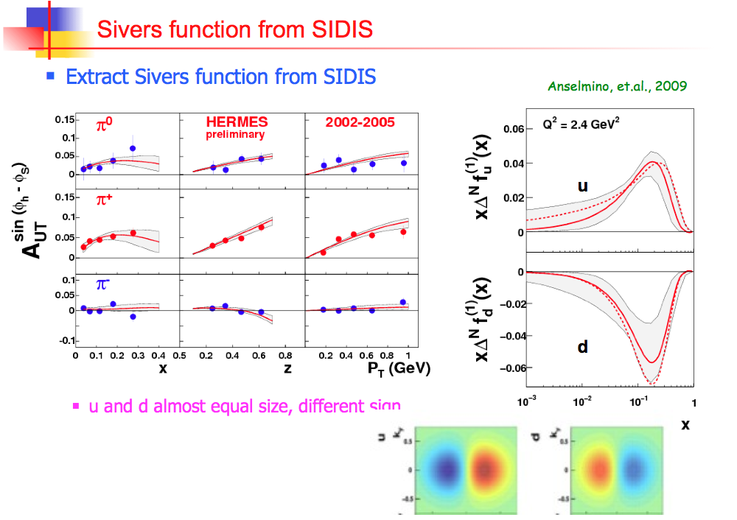

Slide 18
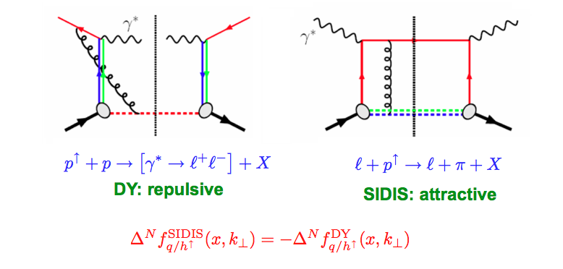
Sivers Functions in DY and DIS
The sign change – a new fundamental test of color gauge formalism
Collins ‘02
Twist-3: sign change from gluonic-pole in hard parts
In the overlapped region – consistent description
Ji, Qiu, Vogelsang, Yuan ‘06
Bacchetta, Boer, Diehl, Mulders ‘08

Slide 19
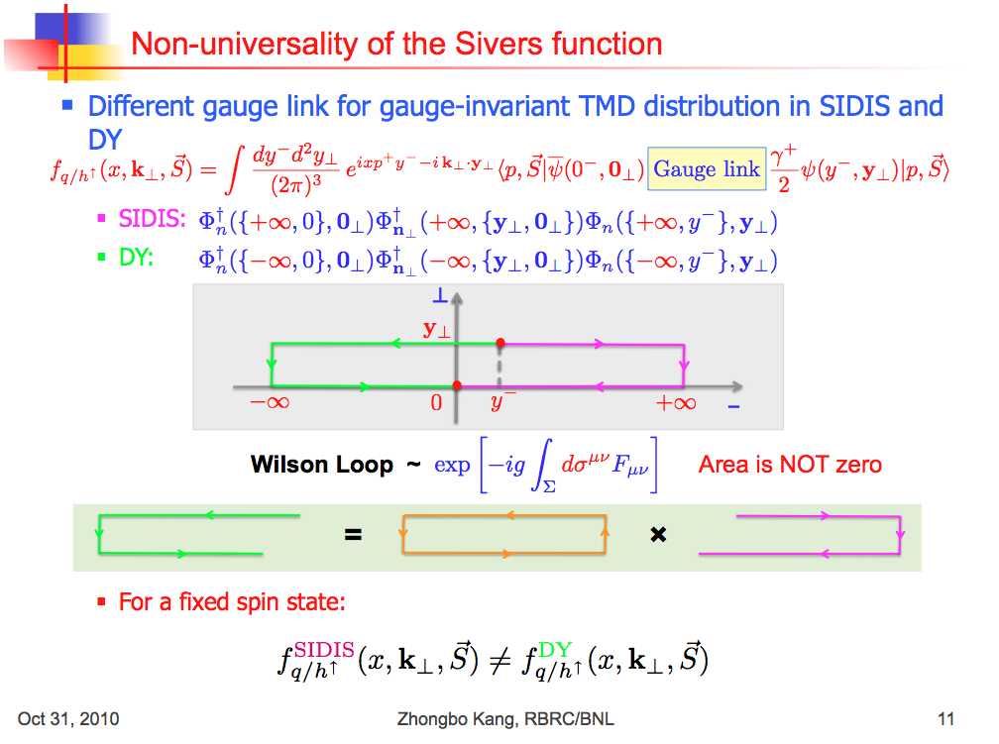

Slide 20
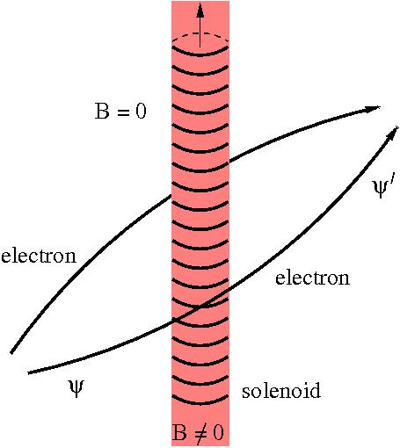
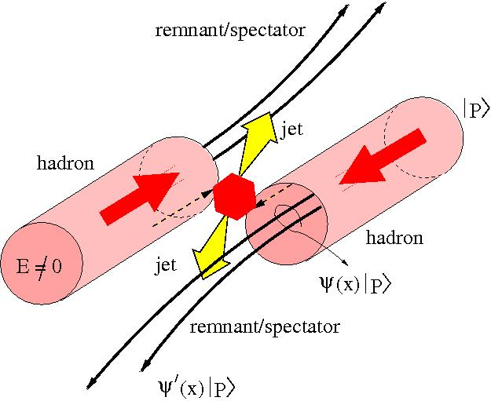
Featuring: phases in gauge theories
Piet Mulders 2010
GAUGE THEORIES

Slide 21
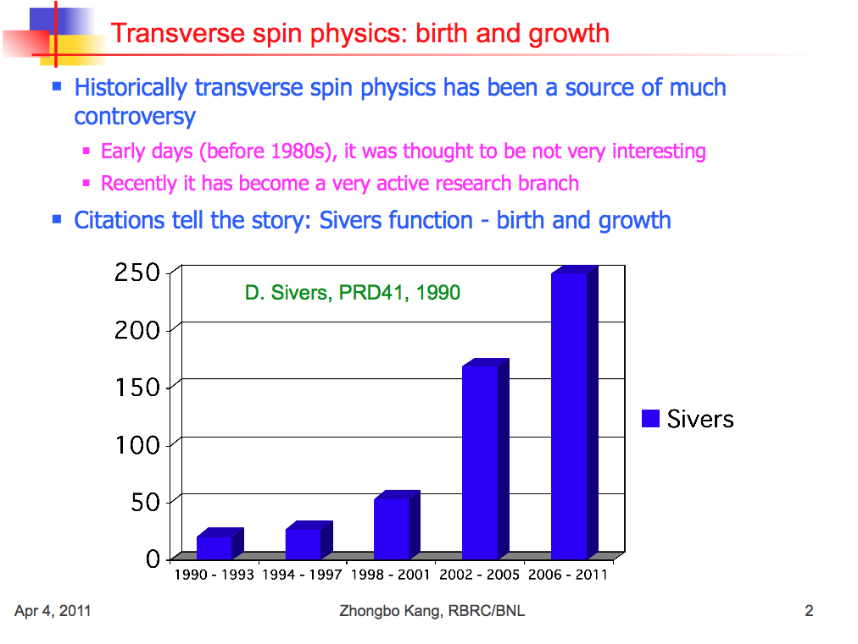
=> Probe Sivers Functions via Polarized DY!

Slide 22
Transversity and TMDs can be probed via DY

Slide 23
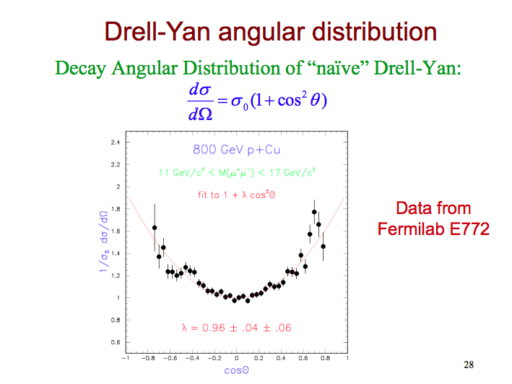

Slide 24
Drell-Yan Decay Angular Distributions
Θ and Φ are the decay polar and azimuthal angles of the μ⁺ in the dilepton rest-frame
Collins-Soper frame
A general expression for Drell-Yan decay angular distributions:

Slide 25
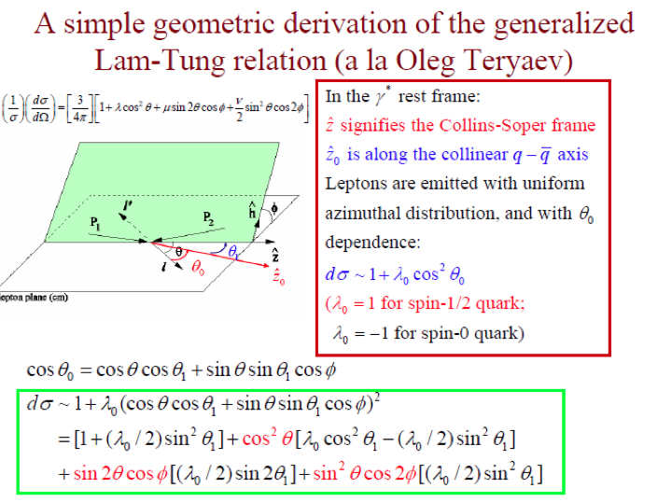

Slide 26
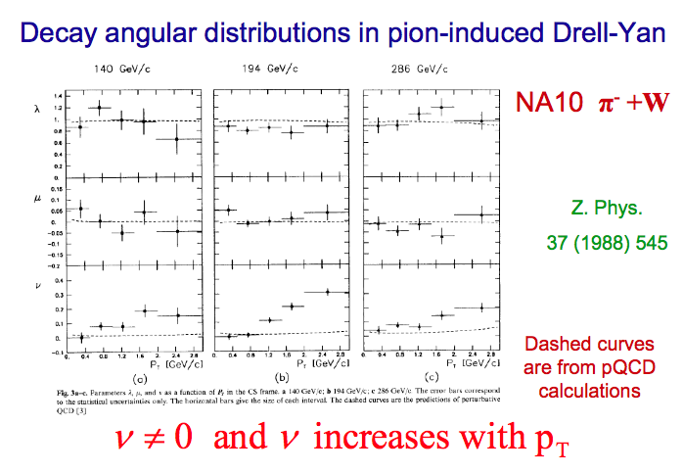

Slide 27
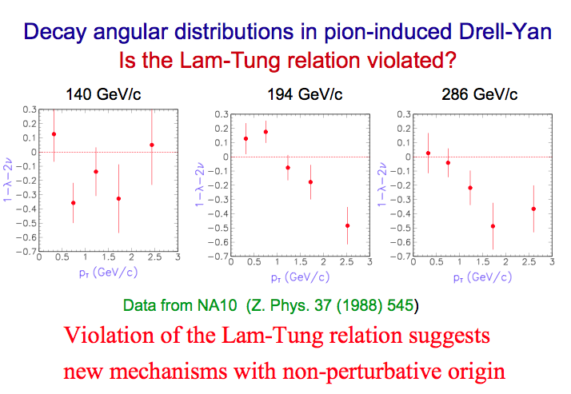

Slide 28
Unpolarized Beam DY and Boer-Mulders Function h₁┴
● Observation of large cos(2Φ) dependence in Drell-Yan with pion beam
194 GeV/c π + W
Boer, PRD 60 (1999) 014012

Slide 29
Azimuthal cos2Φ Distribution in π+W and p+d Drell-Yan
E866 Collab., Lingyan Zhu et al.,
PRL 99 (2007) 082301; PRL 102 (2009) 182001
Smallνis observed for p+d D-Y
With Boer-Mulders function h₁┴:
ν(π⁻W→µ⁺µ⁻X)~ [valence h₁┴(π)] * [valence h₁┴(p)]
ν(pd→µ+µ-X)~ [valence h₁┴(p)] * [sea h₁┴(p)]
More data expected
from E906 soon!
Sea-quark BM functions are much smaller than valence quarks
29

Slide 30
Drell-Yan with anti-protons at Fermilab
pbar-p:
  (valence – valence) interaction!
Expect large TMD effects
  Possible “strong violation” of Lam-Tung relation?
  Quark Boer-Mulder functions in p and pbar

Slide 31
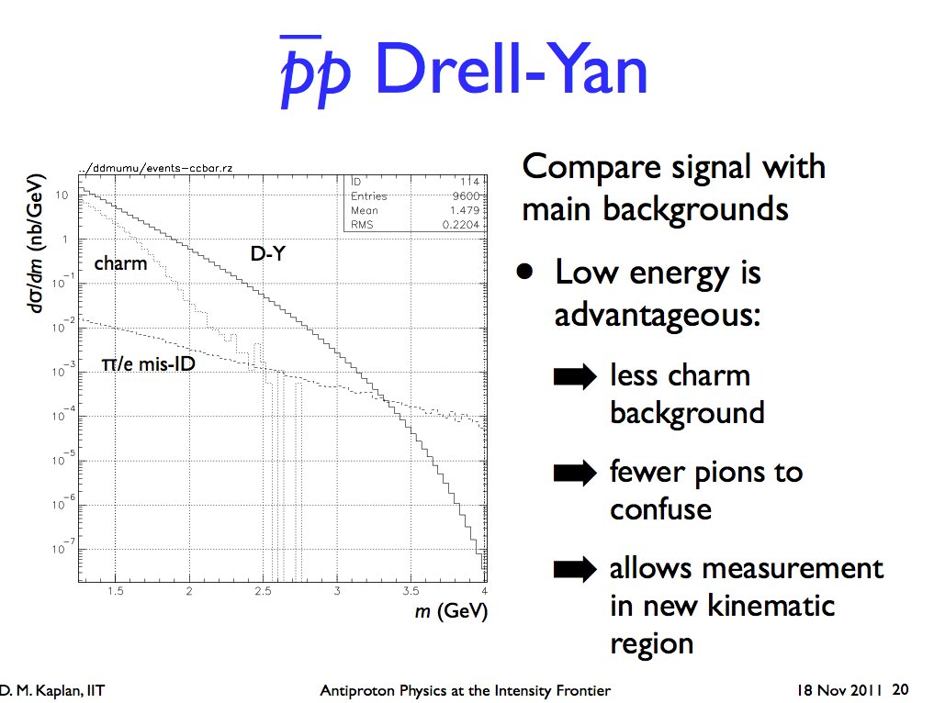

Slide 32
New Opportunities for Polarized Program at Fermilab
Anti-proton on polarized proton target – Transverse Single Spin Asymmetry
  Possible with polarized frozen proton target (BNL, J-Lab etc.)
  Drell-Yan TSSA sign change!
  Open charm TSSA: charm vs anti-Charm!
  Lambda polarization
High density polarized proton target (NH3)
  Polarized Drell-Yan with E906 spectrometer
    120GeV (polarized) proton beam
  Antiproton beams 120GeV?

Slide 33
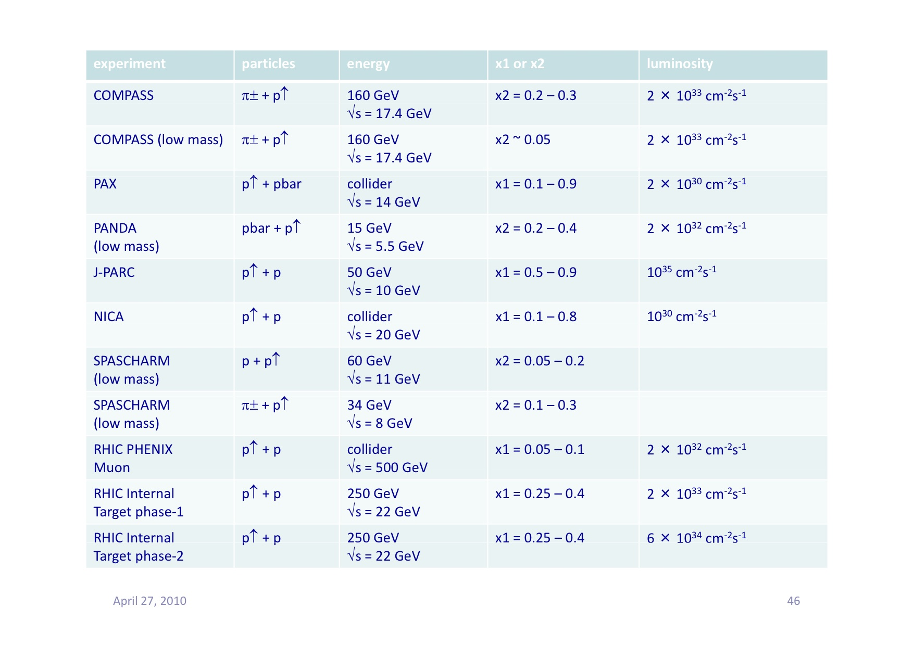
Proposed Future Polarized DY Exp’s
Y. Goto 4/2010 CERN DY
Polarized DY Dimuon Exp. at Fermilab Main Injector: 120GeV
RHIC fixed target possibility: 250 GeV

Slide 34
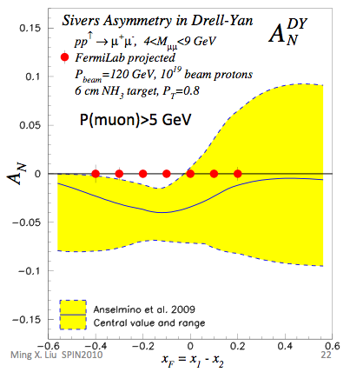
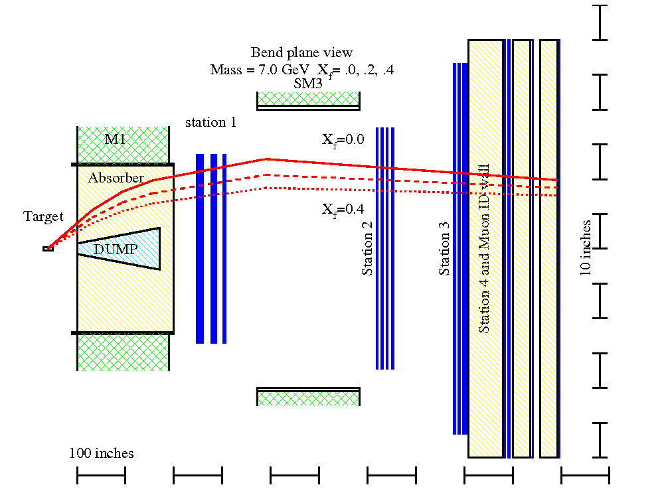
Polarized Drell-Yan @Fermilab?
- Polarized Target?
  6 cm NH₃
  10¹⁹ proton
Polarized beam?

Slide 35
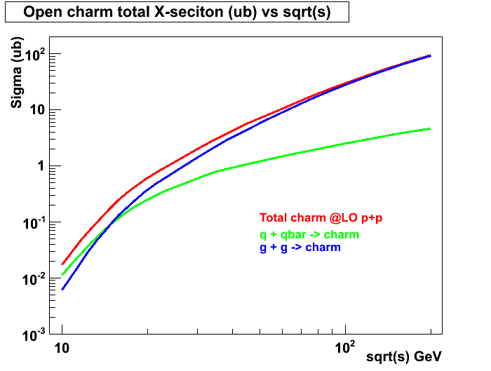
Open Charm Production in p+p with PYTHIA (LO)
RHIC 200 GeV
RHIC 62GeV
E906
JAPRC

Slide 36
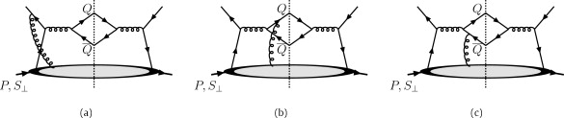
Heavy Quark TSSA pbar-p @Fermilab
Twist-3 quark-gluon correlation fun.
Different color factors for charm and anti-charm A_{N}
F. Yuan and J. Zhou PLB 668 (2008) 216-220
Initial state
Charm
anti-Charm

Slide 37
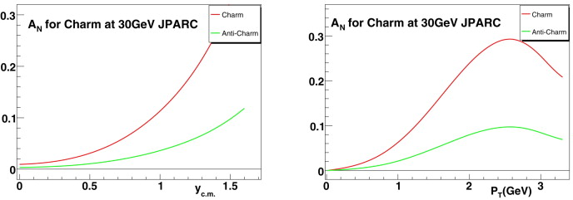
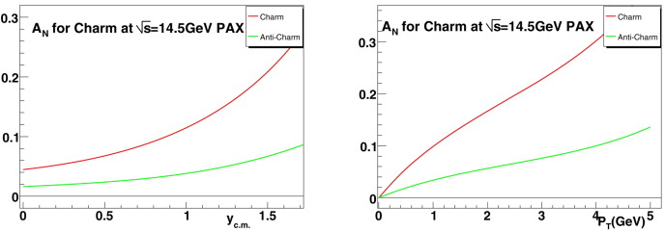
JPARC p+p
GSI: p+pbar

Slide 38
Summary and Outlook
Drell-Yan with (anti)proton beams at Fermilab will provide unique and timely opportunity to study critical issues in understanding of QCD dynamics in hadronic interactions
  TMDs: Boer-Mulders, Lam-Tung relations…
  Novel QCD dynamics
Polarized Drell-Yan program could further advance our understanding of strong interactions and novel spin related phenomena
  TSSAs in Drell-Yan,
  open (anti)charm
  Lambda …
A new fundamental test of QCD color gauge formalism
  TSSA sign change (or not) in Boer-Mulders and Sivers functions in p(bar)-p compared to what observed in polarized DIS
  QCD A-B effect

Slide 39
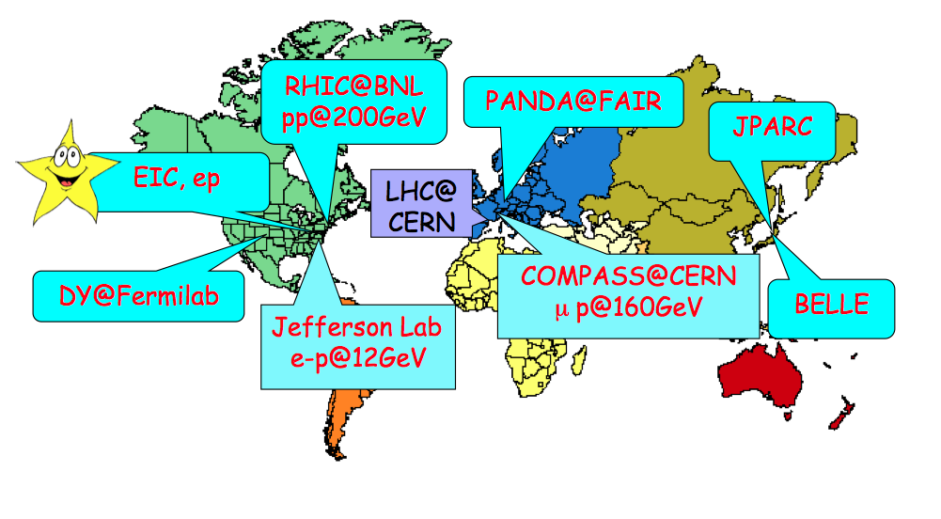
World Map of QCD Facilities

Slide 40
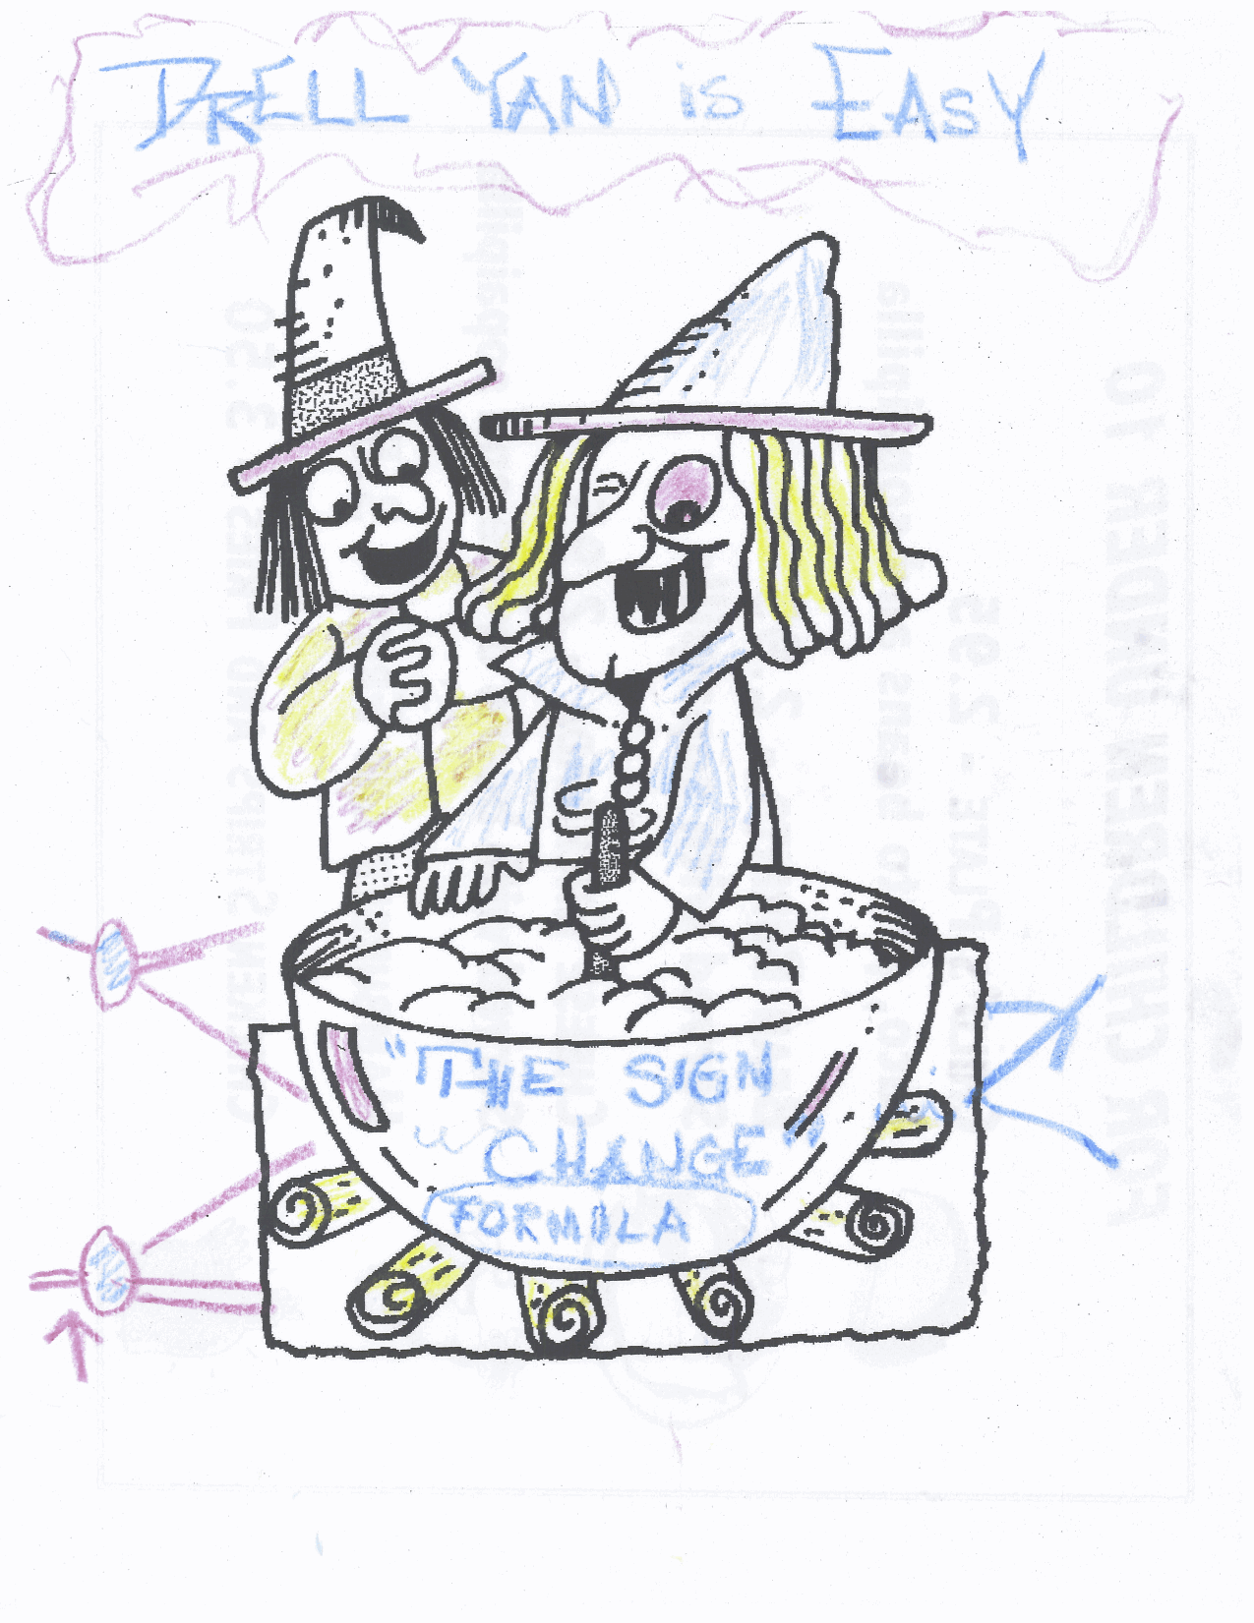

The magic of
sign change
Drawing from D. Sivers @Santa Fe Polarized Drell-Yan Workshop 10/31-11/1, 2010

Slide 41
Backup slides

Slide 42
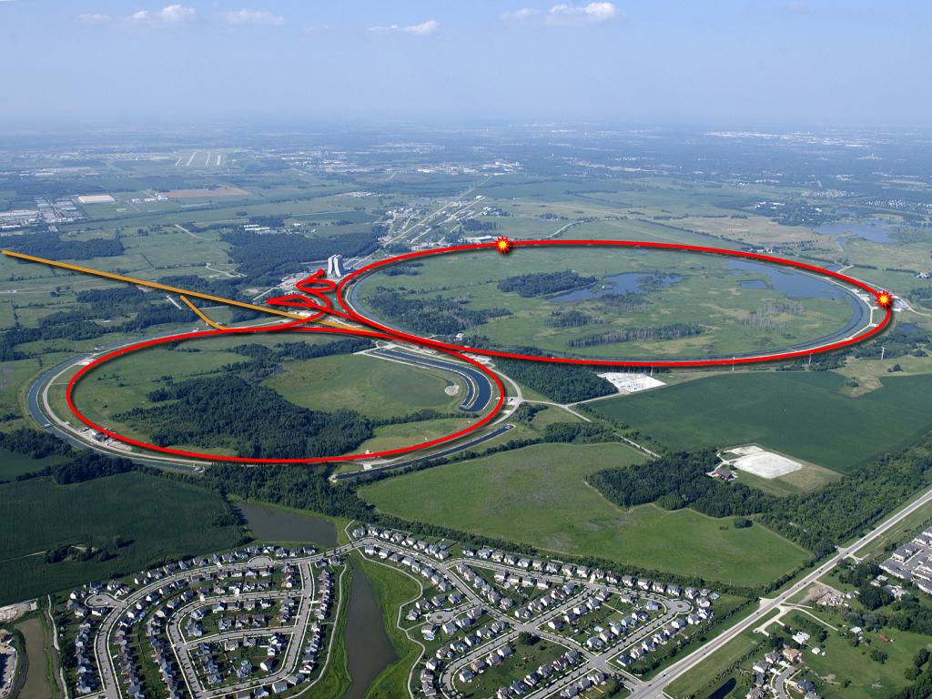
The Intensity Frontier
17 kW at 8 GeV
for neutrinos
Soudan
MiniBooNE
SciBooNE
MINOS
Tevatron Collider
250 kW at 120 GeV
for neutrinos
42
Young-Kee Kim: Ten Year Plan (Science and Resources), PAC Meeting 2009-03-05

Slide 43
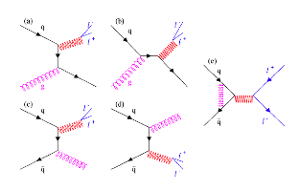

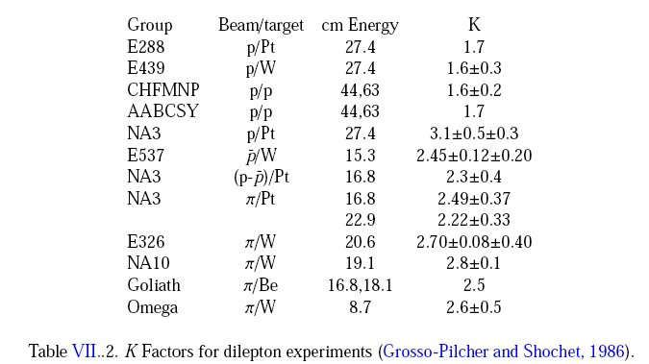
QCD Correction
K factor collection

Slide 44
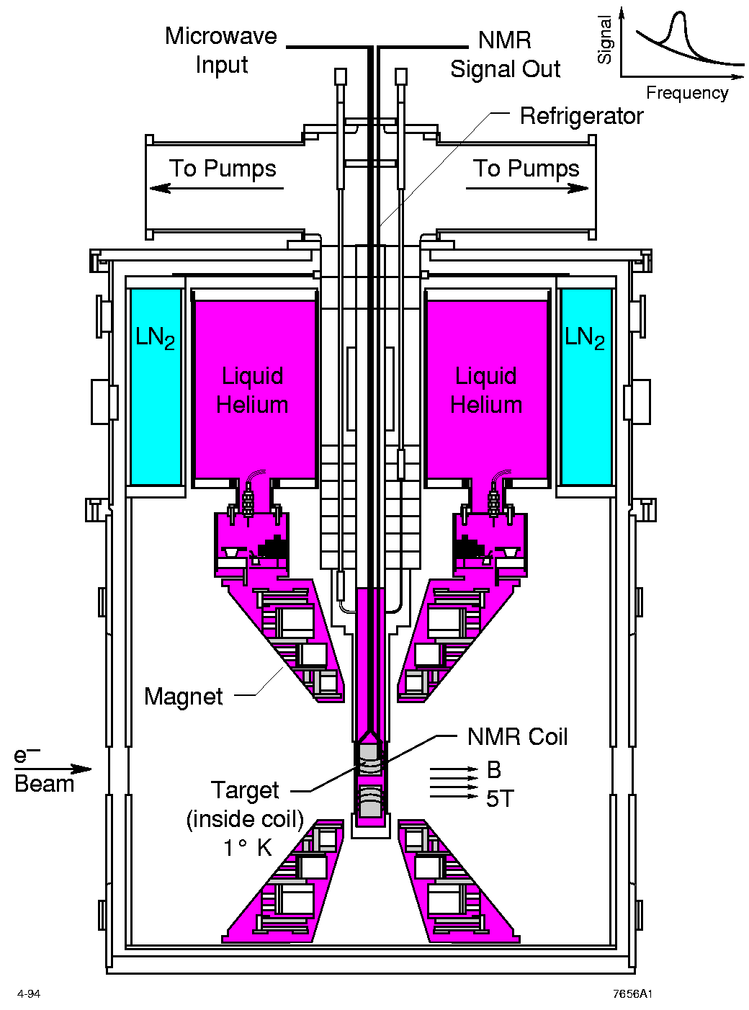
UVA/J-Lab/SLAC Polarized proton/deuteron target
D. Crabb MENU10
Polarized NH₃/ND₃ targets
Dynamical Nuclear Polarization
Operate at 5 T and 1 K. Pol ~ B/T
Used with high beam intensities – up to ~100 nA
Large capacity pumps
Polarizations:
  p > 90%,
  d ~ 50%
Able to handle high luminosity
  up to ~ 10³⁵ (Hall C)
~ 10³⁴ (Hall B)

Slide 45
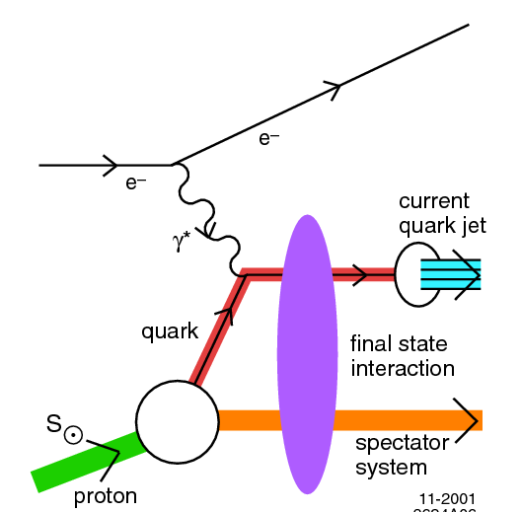
Theory: K_{T} vs Collinear Factorization
f_{a}
h
Tran. Mom. Dep. Funs
  Sivers Fun
  Collins Fun
Twist-3 collinear
  Quark-gluon correl.
  Gluon-gluon correl.
q
FF_{q}
σ
f_{b}
X’
A_{N}
TMD
Collinear/Twist-3
pT

Slide 46
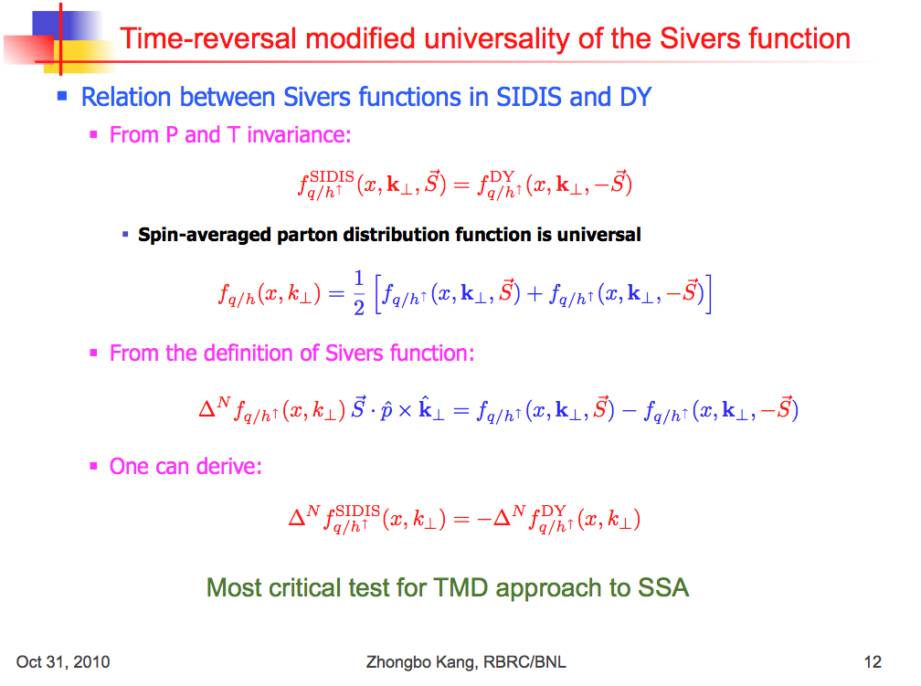

Slide 47
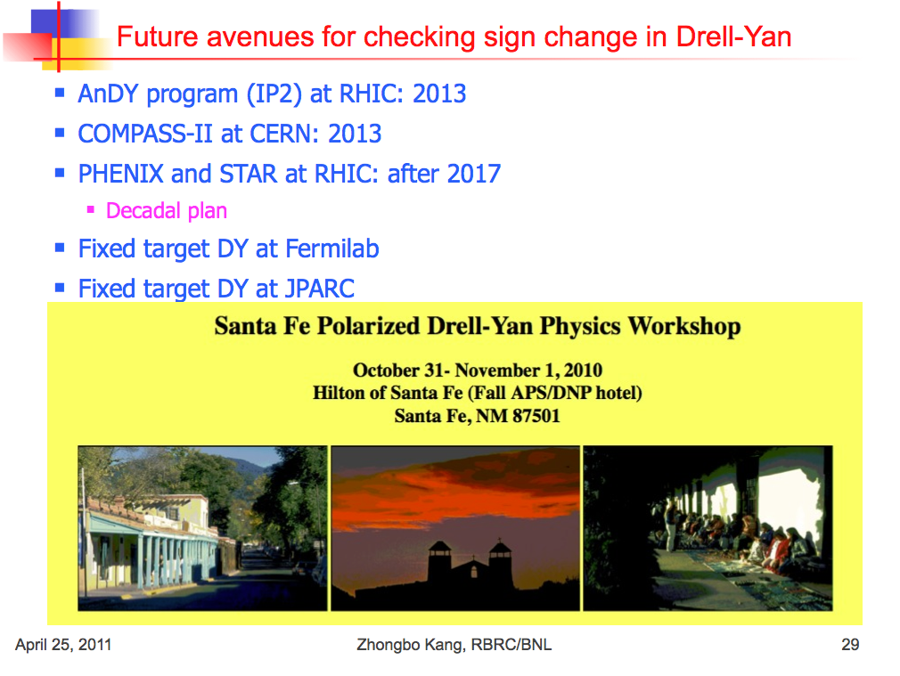

Slide 48
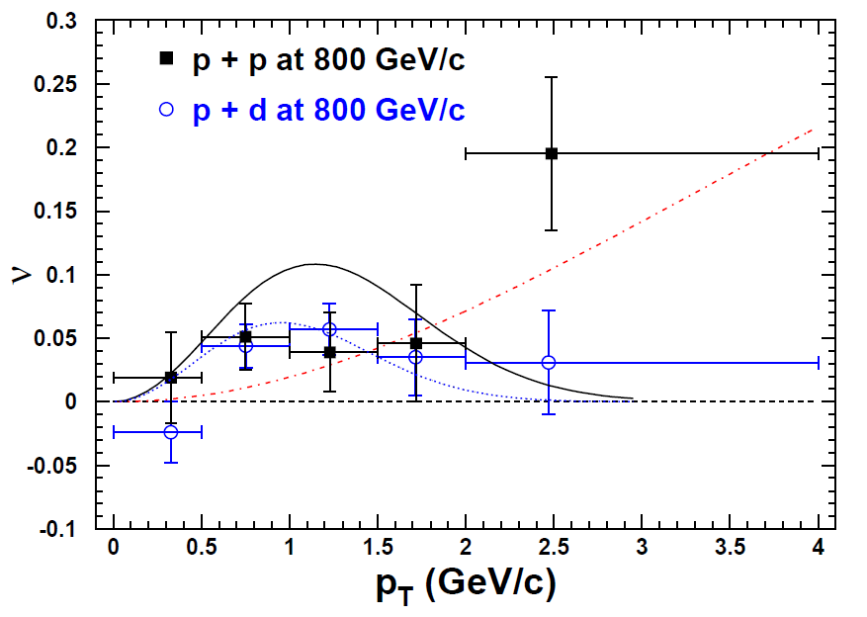
Results on cos2Φ Distribution in p+p Drell-Yan
L. Zhu, J.C. Peng, et al., PRL 102 (2009) 182001
p+p
pQCD
(Boer, Vogelsang; Berger, Qiu, Rodriguez-Pedraza)
p+d
Combined analysis of SIDIS and D-Y by Melis et al.
More data are anticipated from Fermilab E906

Slide 49
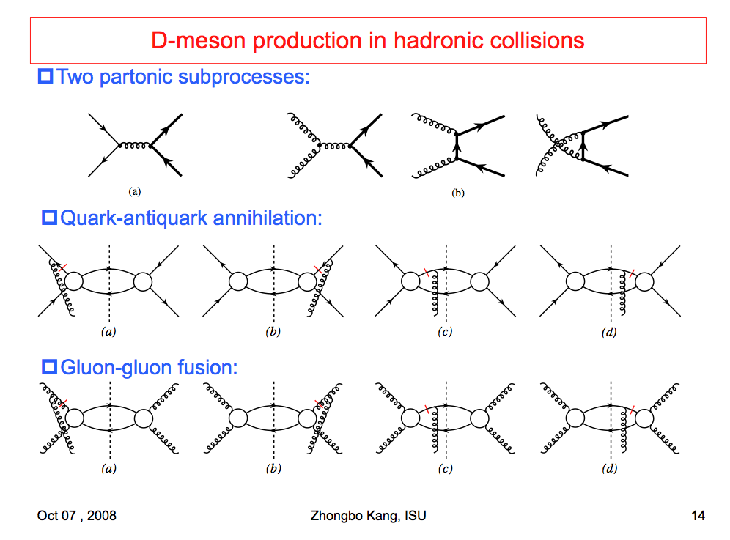
TSSA in Heavy Quark Production
Kang, Qiu, Vogelsang, Yuan, PRD 2008

