Slide 1


Study of Multiplicity Dependent J/Psi Yield in p+p and p+Au Collisions at PHENIX
Ming Liu, LANL
For the PHENIX Collaboration
Oct. 13,2021
DNP2021 (Online)

Slide 2
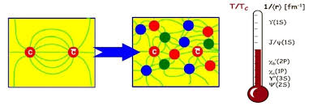

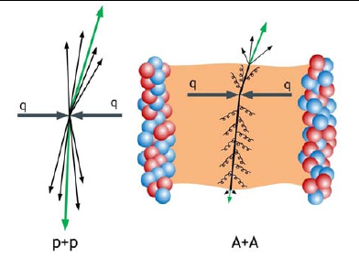
Physics Motivation
J/Psi production in HI collisions
  Initial charm-pair production
    Single hard scattering per N+N collision
  J/Psi formation
    Color screening in QGP
    Recombination from many <c, cbar> in A+A
    Hadronization, final state interactions
Event multiplicity in small system
  Multi-Parton-Interaction (MPI) important at high energy, increased production rate
  Strong final state interactions, break-up
Questions to think about:
  QGP formation and MPI
  “Centrality” in small systems
“Single hard scattering per N+N collisions”

Slide 3
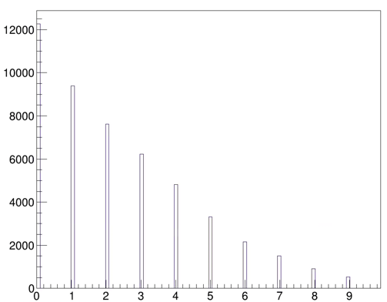
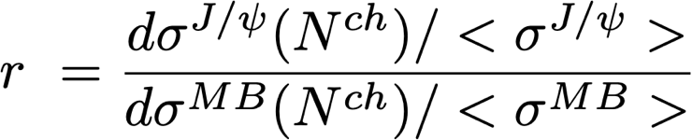
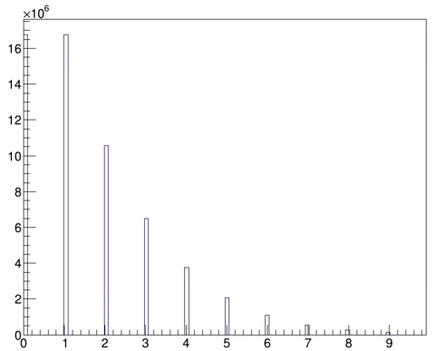
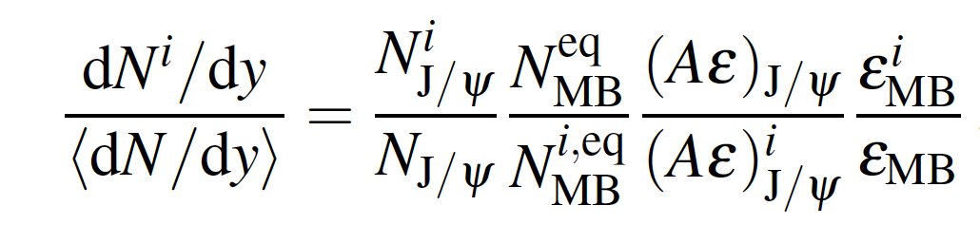
J/Psi Yields vs Event Multiplicity N^{ch}
J/Psi event
multiplicity
Normalized J/Psi event multiplicity differential ratio “r”:
R =
MB event multiplicity
Or relative yield for each multiplicity bin:
Evt_Mult (N^{ch})

Slide 4
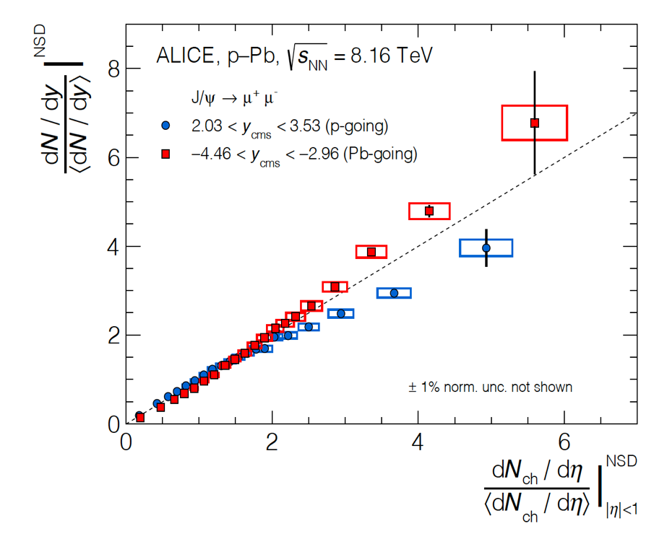
Recent Studies of Small Systems at LHC and RHIC
ALICE@LHC, JHEP 2009 (2020) 162
STAR @RHIC
Consistent with incoherent multi-parton interactions;
MPI and formation of QGP droplets

Slide 5
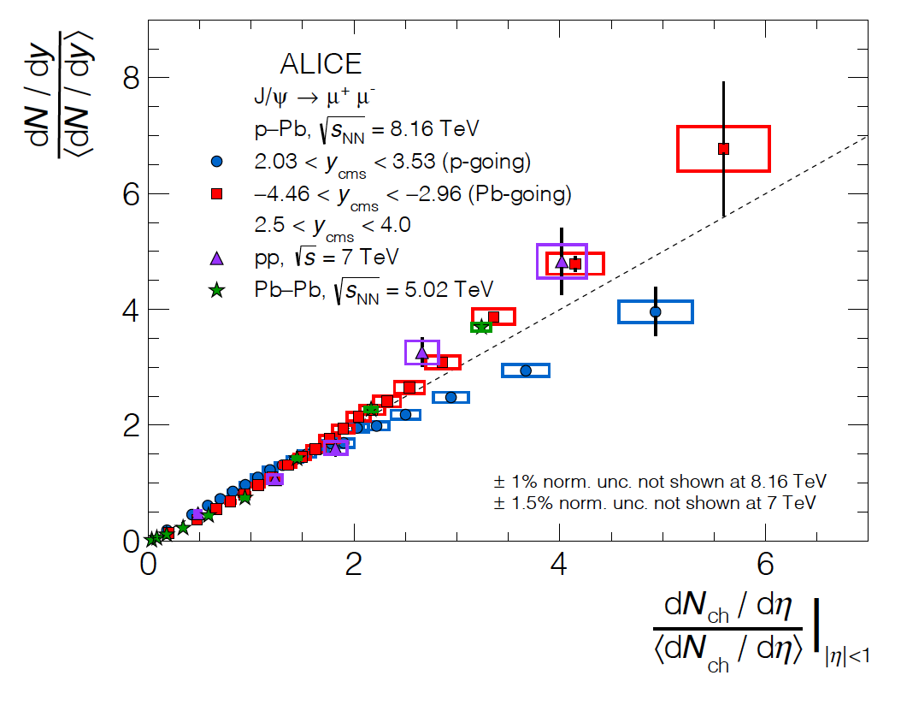
And it seems universal …
J/Psi: pp, pPb, PbPb
D-mesons: p-Pb

Slide 6
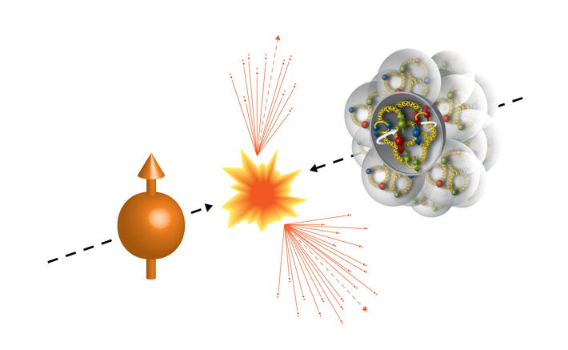
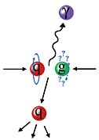
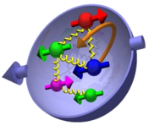
PHENIX Experiment in 2015 Run, 200GeV pp and pA
Transversely polarized p+p and p+Au/Al collisions at RHIC
  p+p: L_{NN} ~ 200 pb⁻¹
  p+Au: L_{NN} ~ 130 pb⁻¹
Run15 (2015)
100GeV/nucleon
100GeV
Au, Al
Polarized Proton

Slide 7
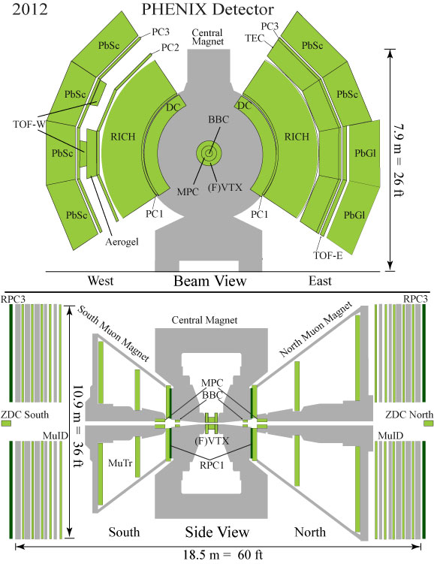
PHENIX Detector at RHIC
Central Arms | η | < 0.35
Identified charged hadrons
Neutral Pions
Direct Photon
J/Psi
Heavy Flavor
Evt_Multiplicity:
SVX:
| η | < 1
Muon Arms 1.2 < | η | < 2.4
J/Psi
Unidentified charged hadrons
Heavy Flavor
FVTX:
1.2< | η | < 2.4
BBC/MPC 3.1 < | η | < 3.9
Neutral Pion’s
Eta’s
BBC:
3.1< | η | < 3.9
ZDC |η| ~ 5.9
Neutrons
Notes:
7

Slide 8
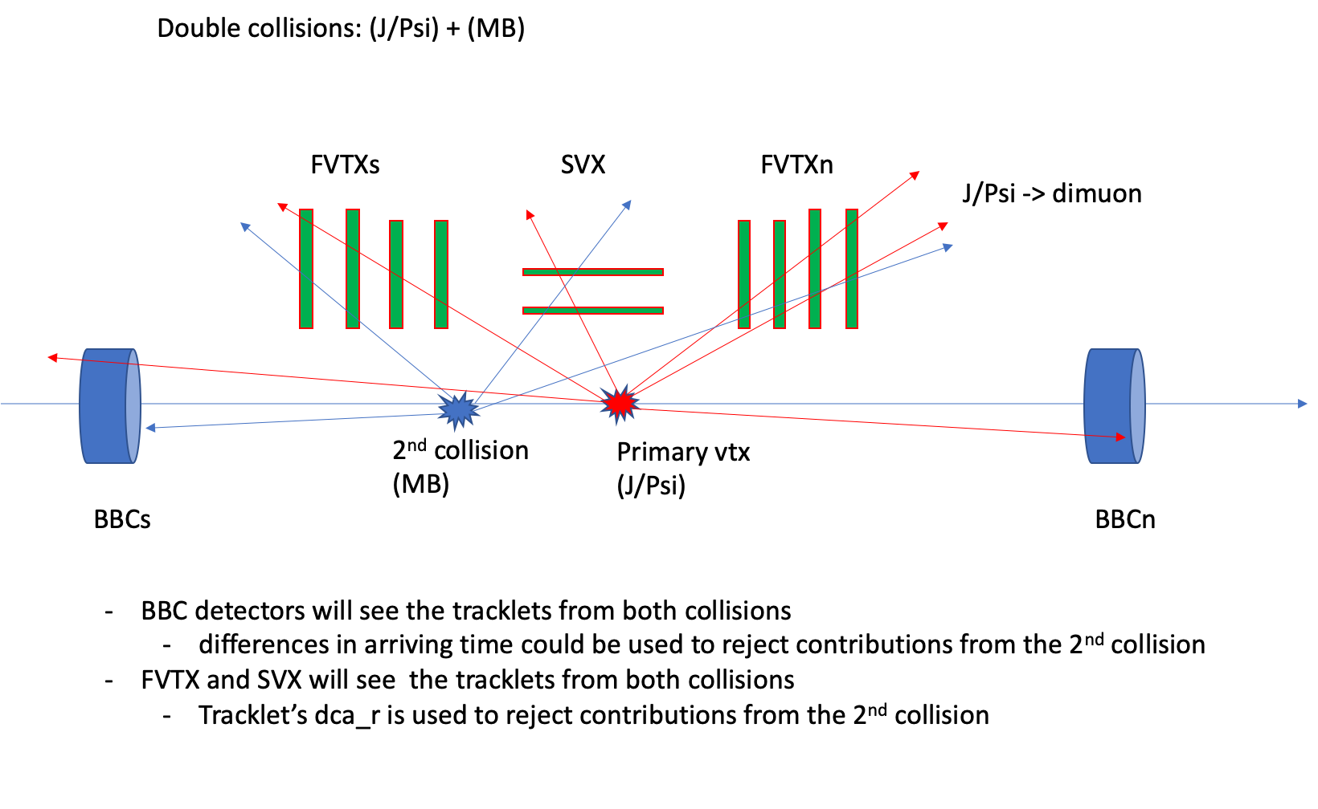
J/Psi and Event Multiplicity Measurements in PHENIX
1.2<|eta| < 2.4
|eta| < 1
J/Psi: 1.2<|eta| < 2.4
3.1<|eta| < 3.9
FVTX and SVX see the tracklets from both collisions
- Tracklet’s impact distance to vertex used to remove multiple collisions
BBC detectors see the tracklets from both collisions
- Difference in hits arriving time used to reject multiple collisions

Slide 9
J/Psi Yields vs Evt_Mult Topology
Co-mover breakup?
Collision energy density?
Evt_Multi
Evt_Multi
Evt_Multi

Slide 10
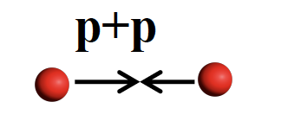
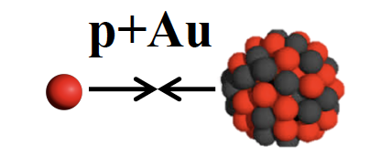
J/Psi Production in pp and pAu Collisions at PHENIX

Slide 11
J/Psi Yields vs Evt_Mult Projections for 200GeV p+p

Slide 12

Summary and Outlook
Small system provides new insights to J/Psi production mechanisms in HI collisions
  Various initial and final state effects
  MPI important for understanding QGP formation in small system
PHENIX has unique coverage to explore this physics
  Event multiplicity determined over wide rapidity ranges
Stay tunned!

Slide 13
Backup

Slide 14
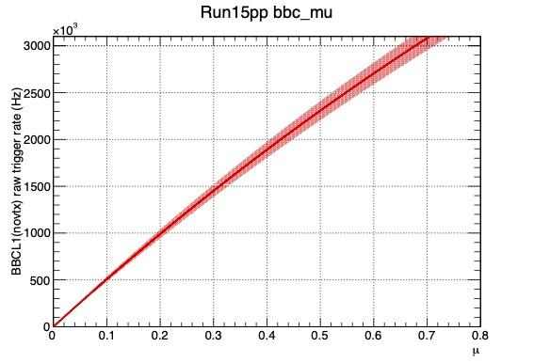
Multiple Collision Probability Table
BBCLL1_Eff = 55 +/ 5 % for run15 pp MB; 79 +/-2 % for hard scattering
BBC Rate kHz | Mean_Mu | Prob. to have 2+ collisions
250 | 0.05 | 0.12%
500 | 0.1 | 0.47% <pAu>
1,000 | 0.2 | 1.8% <pp>
1,500 | 0.31 | 3.9%
2,000 | 0.43 | 6.9%
2,500 | 0.55 | 10%

Slide 15
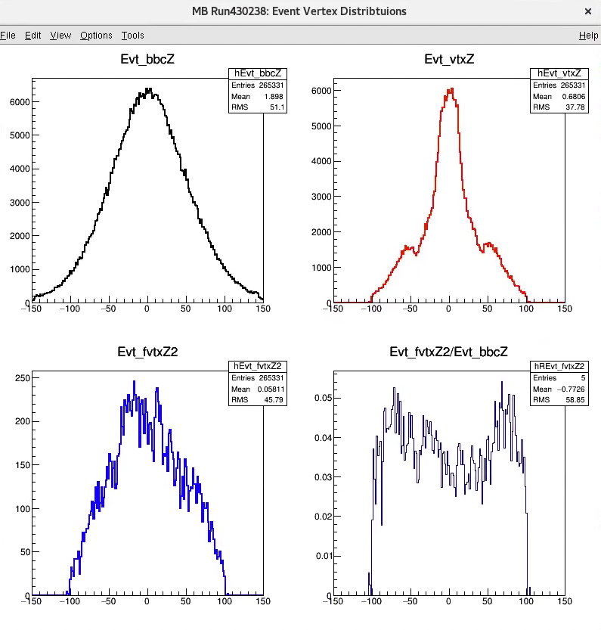
Cross Check Event Vertex Distributions:
Precision event
vertex:
|Evt_vtxZ|<10 cm
Z_Sigma = 51cm
BBC_Rate = 1.24 MHz
@1.2 MHz, mu = 0.24,
prob 2.7 % having double collision
For |Evt_vtxZ| < 10cm events
Double collusion fraction ~3%, very close to the 2.7% estimated double collision fraction
2nd vtxZ distribution ~ BBC_Z
All Collision Z-Vertex
|Evt_vtxZ|<10 cm
2nd Evt_vtxZ2

Slide 16
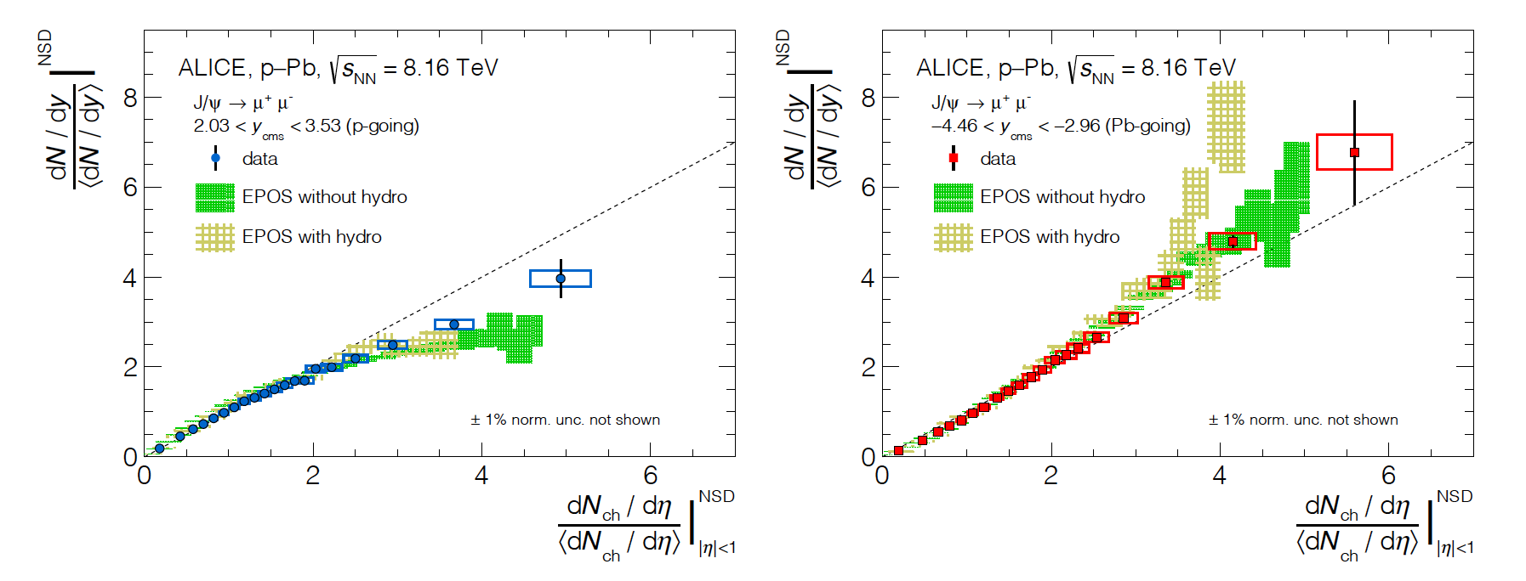
What could contribute to this?
ALICE@LHC, JHEP 2009 (2020) 162
J/Psi production: from incoherent superposition of parton-parton collisions in pp and p+A (MPI)
Consistent with two-particle correlation in multiplicity dependence, jet-like peak invariant with evt_mult, particles being produced via incoherent fragmentation of MPI
Possible formation of small QGP droplets from MPI

Slide 17
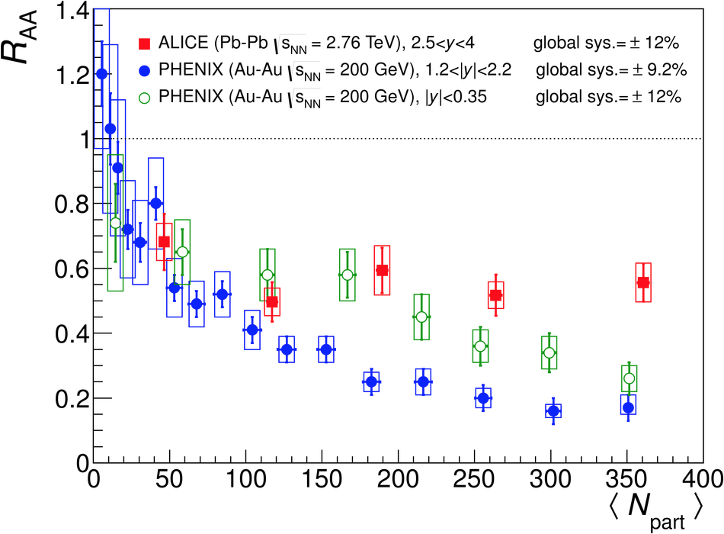
J/Psi Suppression Observed

Slide 18
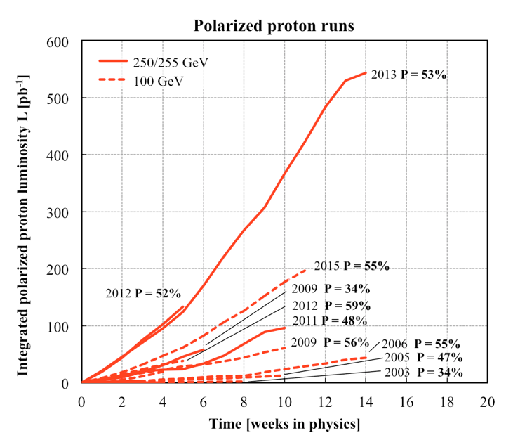
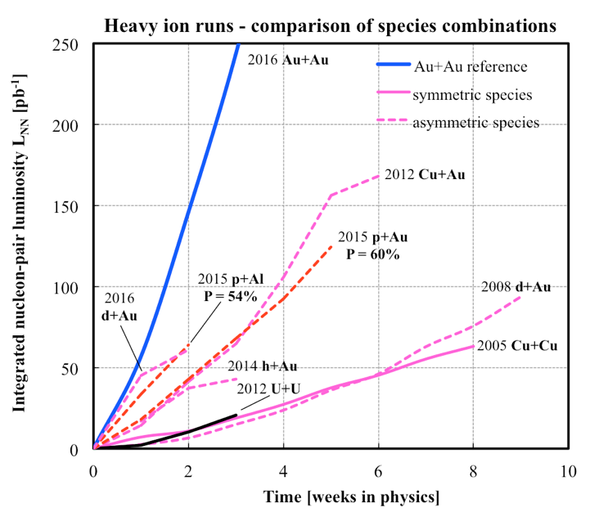
History of RHIC Runs
10/13/14
Notes:
Our physics analysis efforts are closely tied to the RHIC beams operations
Took “BNL” 10 years to reach the mechine performanvec goals ..
18

Slide 19
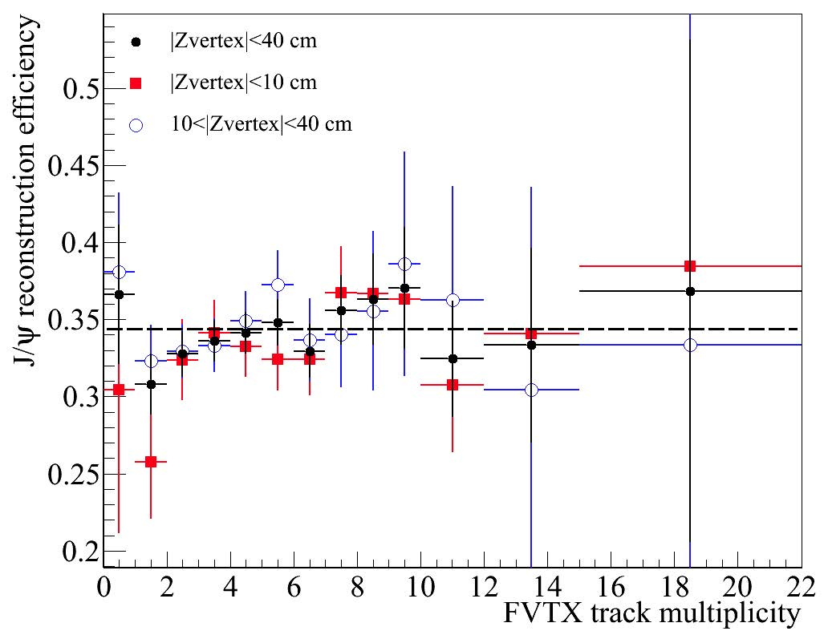
J/Psi Reconstruction Efficiency vs Multiplicity

Slide 20
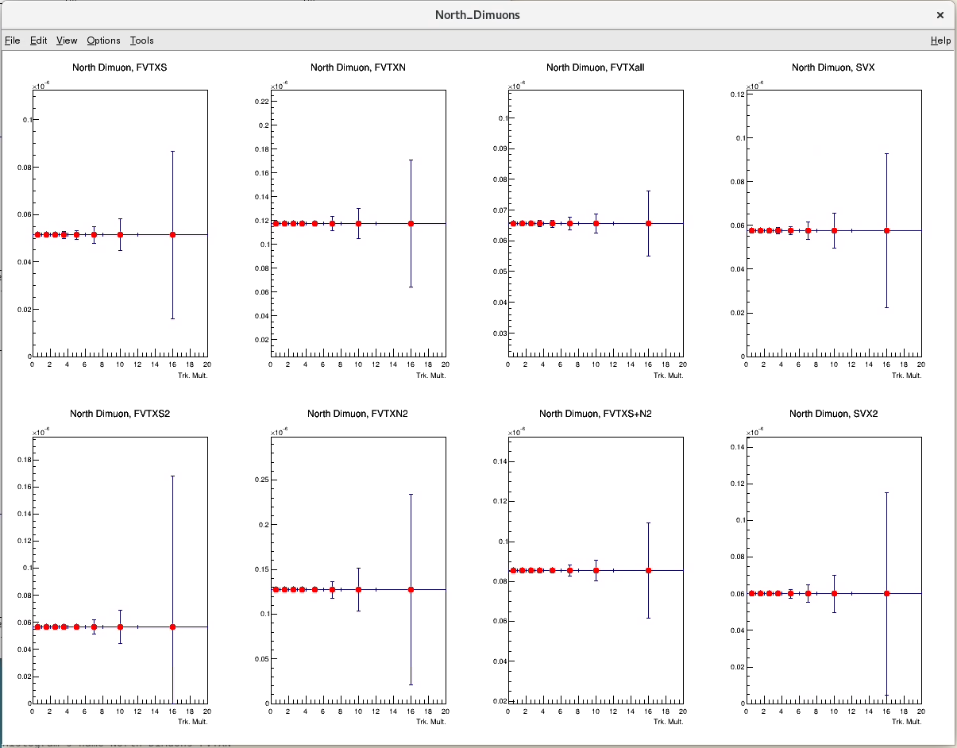
Raw Relative J/Psi Yields per MB vs Evt_Multiplicity

