Slide 1
Quark Energy Loss in p+A Collisions
Benchmark Energy Loss Model Calculations
Ming X. Liu
Los Alamos National Lab
(E906/SeaQuest Collaboration)

Slide 2
Energy Loss in Electrodynamics widely used to probe matter
Bethe-Bloch formula:
Collisional energy loss
(ionization and atomic
excitation)
H. A. Bethe, Ann. d. Physik 5, 325, (1930)
Radiative energy loss
(photon bremsstrahlung)
In QCD
PDG, Phys.Lett. B 592, 1-4 (2004)

Slide 3
Energy Loss in the QGP
- Significant parton energy loss has been discovered at RHIC,
- Can we use it to qunatify properties of QGP?
Single Hadron Tomography
jet
g
g
T
T
g
X. Wang, M. Gyulassy, PRL68(1992)1480
Notes:
As is well known, an interesting property of QCD is confinement, which means that in nature quarks and gluons are confined in hadrons, and we cannot see free quarks and gluons. If we accelerate two heavy nuclei to very high energy and make them collide with each other, we can deposit a huge amount of energy in the colliding center and the confined quarks and gluons may be deconfined to form a new kind of matter: Quark-gluon-plasma, or QGP.
jet quenching is widely regarded as one of the best one to probe the hot/dense matter. Jet quenching tells that when an energetic parton passing through hot and dense nuclear matter, it may suffer multiple scattering with other partons in hot medium and lose a lot of energy. One can get the information of the medium by the lost energy of jets. It is very similar to X-rays tomography used in hospital to detect the intern structure of human body. Jet quenching theory predicted strong suppressions in single hadron production and di-hadron correlation in the hot QGP medium. In single hadron production, because the jet will lose a large amount of energy when propagating in the QGP, when the jet is fragmentated into hadrons, the hadron yield will be significantly suppressed. In di-hadron prod., when a pair of jet produced. There are usually back-to-back. If they are produced near the surface of the QGP, the jet near the surface will travel very short distance in the QGP and lose few energy. Whereas another jet may travel a longer distance and lose a large amount of energy before fragmentation. Therefore If the leading hadron of this jet is chosen as triggered particle, in the opposite direction, the yield of the hadron from another jet will be highly suppressed.

Slide 4
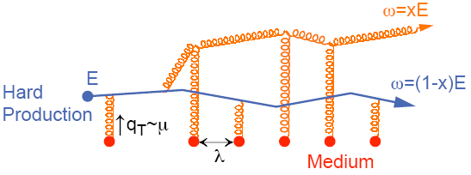
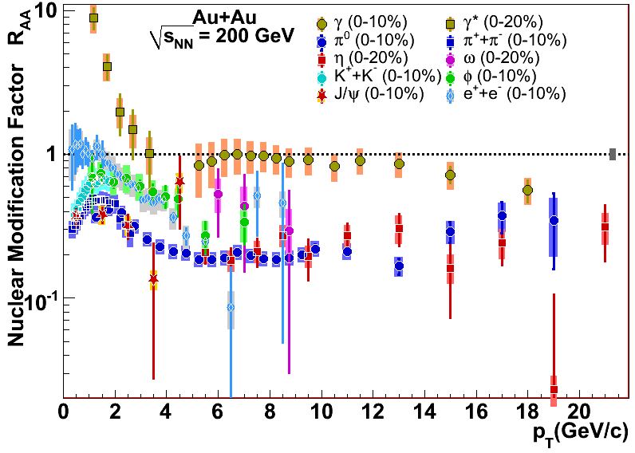
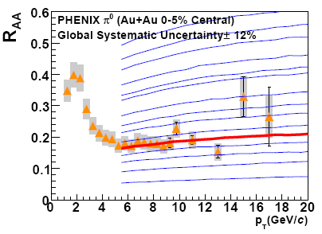
R_{AA} and Jet Quenching at RHIC
Energy loss of partons from hard scattering through re-scattering in the hot & dense medium
  nuclear modification factor R_{AA} << 1 at high p_{T}
  Access medium properties through statistical analysis
    example: transport coefficient in PQM model
    Very much model dependent
A. Adare et al., PRC 77(2008)064907
PQM
Huge opacity of the medium
→

Slide 5
e± R_{AA}: a Challenge for Models
Wicks et al., NPA 784(2007)426
Testing ground for various parton energy loss (ΔE) models
  radiative ΔE only
    Djordjevic et al., PLB 632(2006)81
    Armesto et al., PLB 637(2006)362)
  collisional ΔE included
    Wicks et al., NPA 784(2007)426
    van Hees & Rapp, PRC 73(2006)034913)
Alternative approaches to interpret the suppression
  collisional dissociation of heavy mesons (charm and bottom!)
    Adil & Vitev, PLB 649(2007)139
  contribution from baryon enhancement
    Sorensen & Dong, PRC 74(2006)024902
Adil & Vitev, PLB 649(2007)139

Slide 6
Stopping Power of Nuclear Matter for High Energy Quarks
Stopping power of matter (radiative energy loss)
Fundamental probe of the matter properties
 | Large Nuclei | Electromagnetic
Theory | Competing theories | Established theory
Phenomenology | Poorly known | Extremely successful
Experiment | Single attempt | Plentiful quality data
Need for improvement | Urgent!!! | Almost NONE

Slide 7
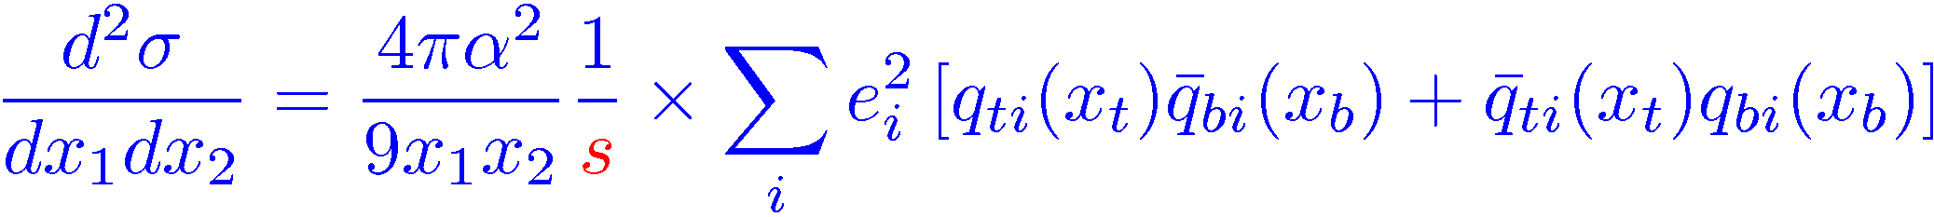
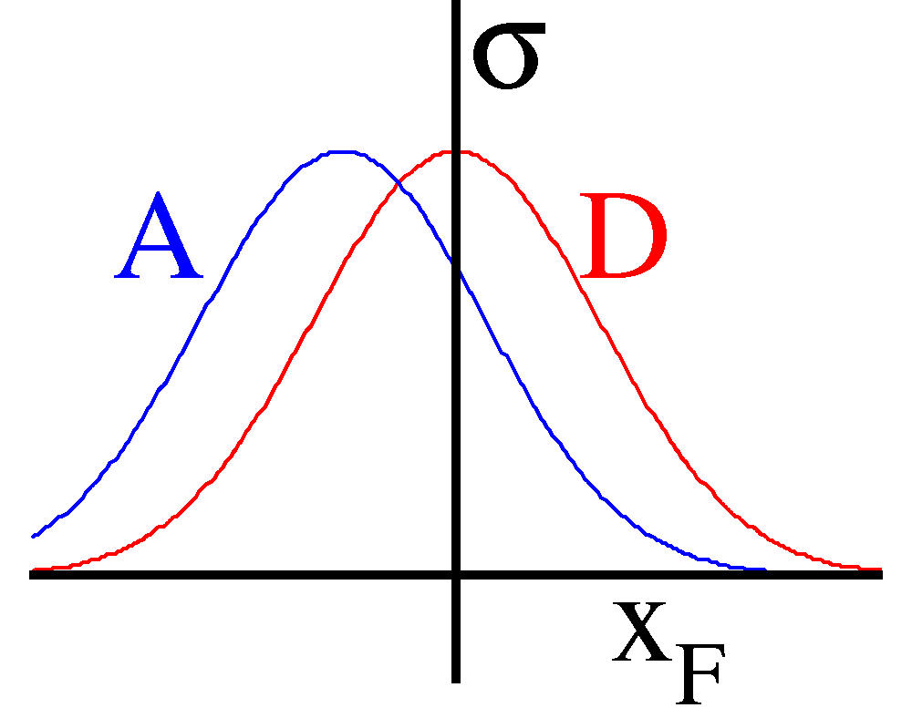
The Basic Idea of Initial-State Energy Loss in p+A
Benchmark Energy Loss Calculations
(Drell-Yan Process)
Minimal final-state interactions of the detected particles.
q, g
R=A/D
X_{F}

Slide 8
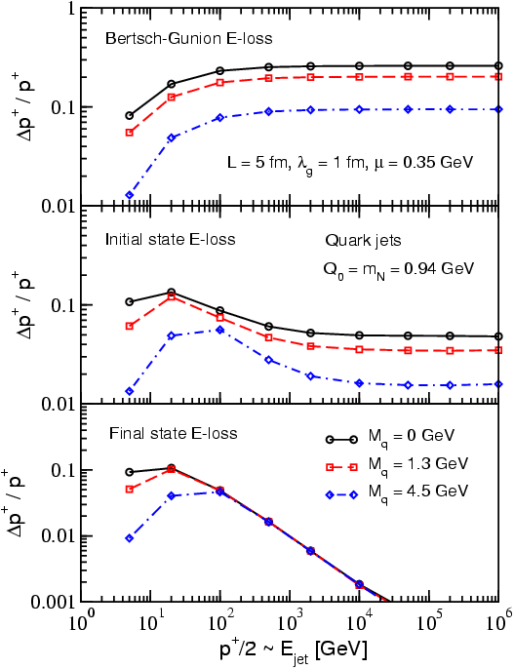
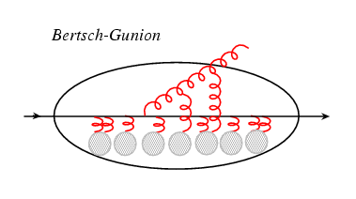
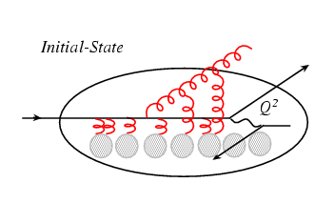
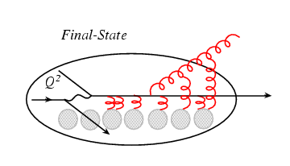
Recent Progress in Parton Energy Loss Calc.
Think of the parton (quark) energy in the
nuclear rest frame:
I. Vitev PRC 75, 064906 (2007)
Ideal case
DY
DIS
Initial-state E-loss is large and much larger than final-state energy loss for cold nuclei
RHIC
E906
In Drell-Yan we don’t have final-state interactions

Slide 9

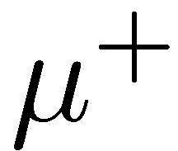

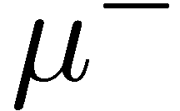
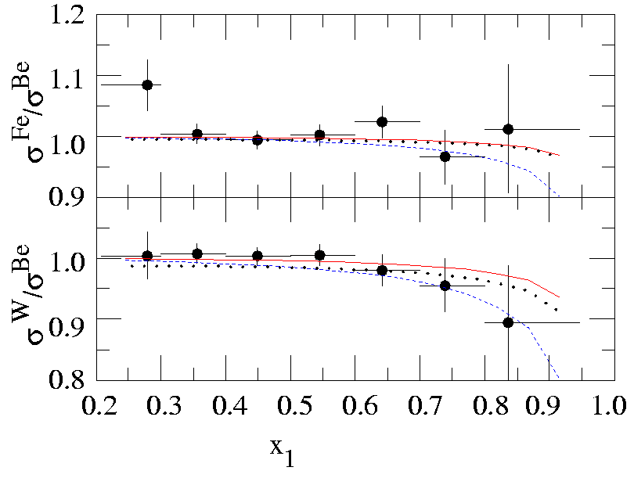
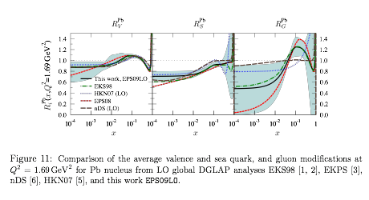
Early Data from E866 @800GeV p+A
Energy loss vs shadowing
  Correction must be made for shadowing effects, x₂ < 0.05
    Garvey & Peng PRL 90 (2003) 9
  No partonic energy loss if all effects from shadowing
    Vasiliev et al., PRL 83,(1999) 2304
  Significant parton energy loss, ~[2~5]GeV/fm if all from energy loss
    Johnson et al. Phys. Rev. C 65, 025203 (2002).
arXiv:0802.0139
New Approach: minimize Shadowing

Slide 10
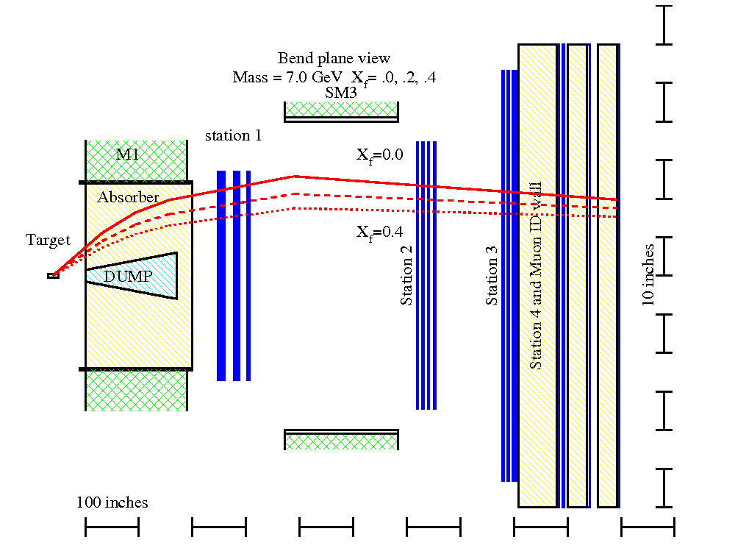
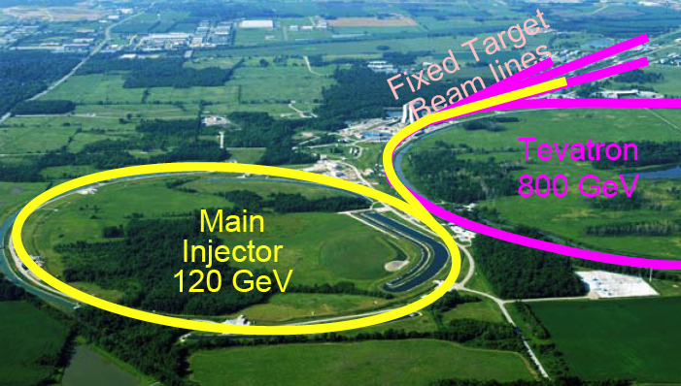
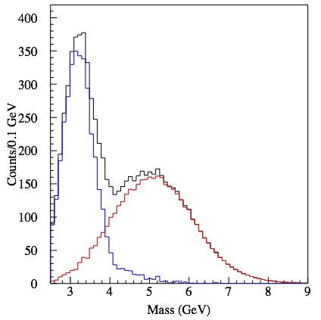
E906/SeaQuest Dimuon Drell-Yan@Fermilab
120GeV proton beam from Main Injector
p, d, and other A-targets
detect very forward particles
expect to start Exp. late 2010

Slide 11
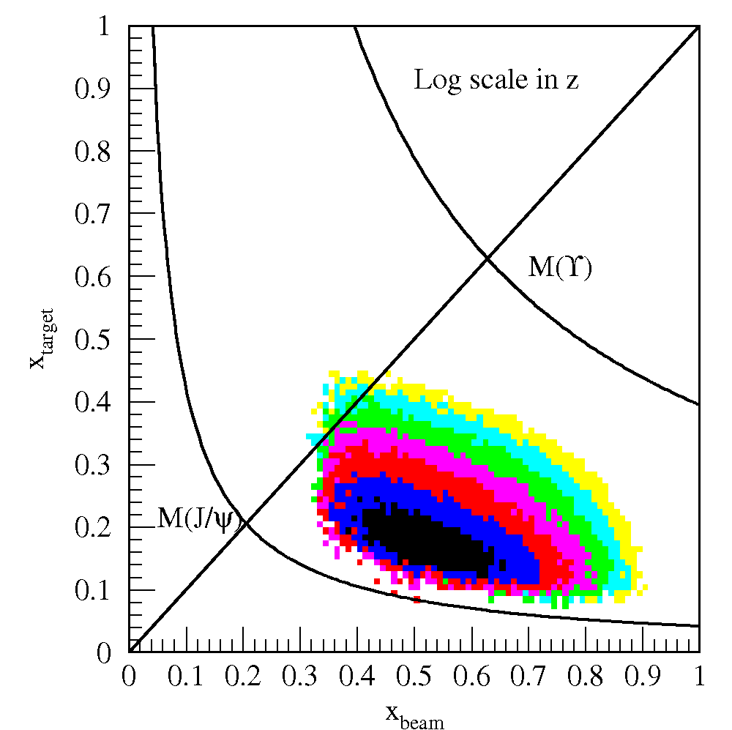
dE/dx Measurement in p+A @E906
(Drell-Yan Process)
Maximal initial state energy loss and Minimal final-state interactions of the detected particles.
Eliminated shadowing effects
q, g
E_{quark} = 30~100GeV

Slide 12
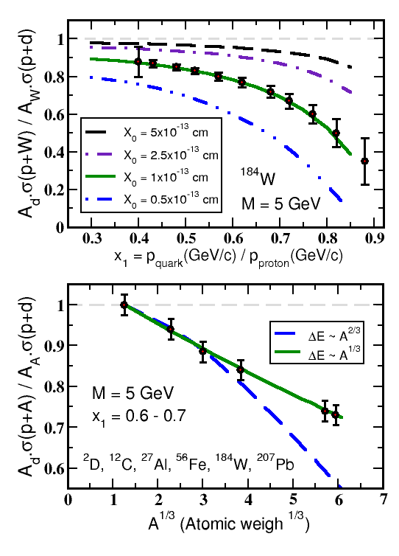
Experimental Sensitivity to Quark Energy Loss
For radiation lengths X₀ = 1 x 10⁻¹³ m achieve sensitivity ~ 20%
Clearly distinguish between leading models for L dependence of E-loss (5σ)
Theory guided optimization of the E906 p+A program:
Quark energy loss only
Need 2~3 targets (²⁷Al,¹⁸⁴W ) / high statistics versus many targets / low statistics
I. Vitev & B.W. Zhang

Slide 13
Conclusions and Outlook
There is pressing need for a benchmark determination of the energy loss of quarks in large nuclei
We now have theoretical tools and computational power to carry out the technically challenging pQCD calculations
Experiment E906 will provide the ideal platform for high energy quark energy loss benchmark measurements (Initial State).
  parton initial energy E= 30~100 GeV
  Relevant to RHIC and LHC parton energy (HI program)
Also critical for the interpretation of the data from current and future heavy ion experiments
Personal note: like to have DIS to benchmark Final State energy loss calculation, eRHIC?
Expt. Funded
Magnet Design Experiment
And construction Construction
Experiment
Runs
J-PARC
Proposed
Jan. 2007
2008
2009
2010
2011
2012
Publications

Slide 14
Back up

Slide 15
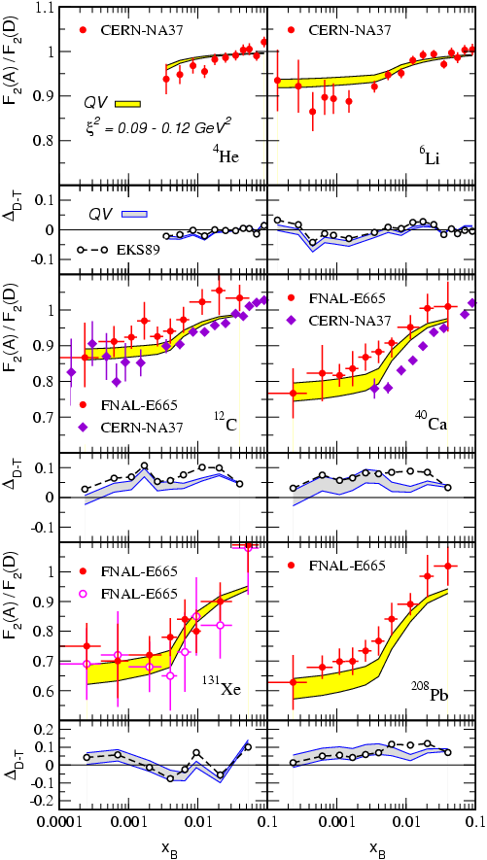
Key: Minimize Shadowing Effects
Uncertainty of the nuclear shadowing
20 – 30% effect comparable in magnitude to the effect of energy loss that we want to study
M. B. Johnson et al., Phys. Rev. Lett. 86 (2001)
Sufficiently low C.M. energy outside of the shadowing region
J.W.Qiu, I.Vitev., PRL 93 (2004)

Slide 16
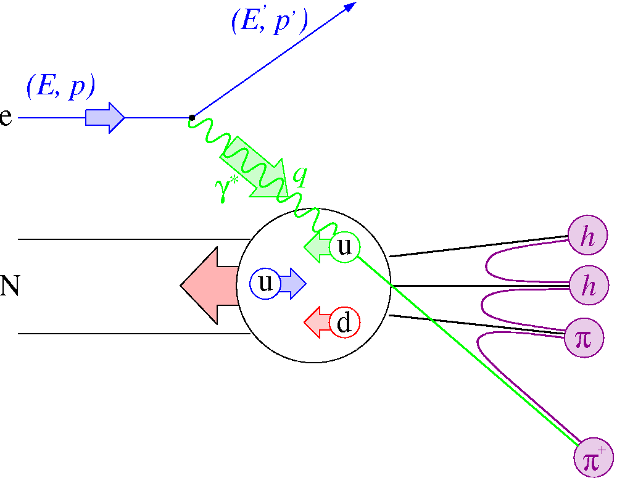
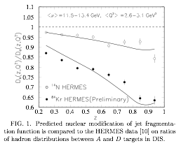
Parton Energy Loss SIDIS @HERMES
Out going quarks
  HERMES A-dep Fragmentation Functions
  Must understand nuclear–dependent fragmentation
  Wang & Wang
    Assume all from quark energy loss
    dE/dL=0.5GeV/fm
    @E =10 GeV for Au.
Wang & Wang PRL 89 (2002) 162301

Slide 17
E906/Drell-Yan timeline
P. Reimer
Fermilab PAC approved the experiment in 2001, but experiment was not scheduled due to concerns about “proton economics”
Spectrometer upgrade funded by DOE/Office of Nuclear Physics (already received $538k in FY07)
Fermilab PAC reaffirms earlier decision in Fall 2006
Scheduled to run in 2010 for 2 years of data collection
Apparatus available for future program at J-PARC
  Significant interest from collaboration for continued program here
Expt. Funded
Magnet Design Experiment
And construction Construction
Experiment
Runs
J-PARC
Proposed
Jan. 2007
2008
2009
2010
2011
2012
Publications

