Slide 1
Low Mass Vector Mesons Nuclear Modification Factors in d+Au Collisions @ 200GeV
Lei Guo
Los Alamos National Laboratory
PHENIX Collaboration
(Presented by Ming Liu)

Slide 2
Motivation
Cold Nuclear Matter Effect on Low Mass Vector Meson production
Nuclear suppression at forward rapidity has been observed for J/Ψ, and other hadrons.
Low mass vector mesons only studied in Mid-Rapidity
Intial State Effect vs Final State Effect
partonic scatterings with nucleons
hadronic interaction with cold nuclear matter
Cronin Effect
Enhancement at moderate p_{T}
First measurement of R_{CP}
for φ,ρ+ω at forward rapidity
Vector Meson
q
Final State
Effect
d
Initial State Effect

Slide 3
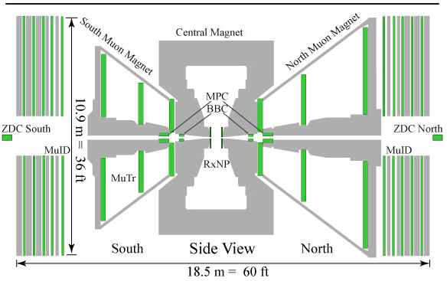
Experimental Setup and Raw Mass Spectrum
μ⁺
μ⁻
Au
d
Background at low mass range
challenging to describe
Backward
rapidity
Forward
rapidity

Slide 4
Basic Data and Analysis Information
Data set:
Run 8 d+Au @ 200 GeV, 2008 @ PHENIX, RHIC
Detecting two muons
Luminosity = 81nb⁻¹
160 Billion Collisions Sampled, 437TB
Basic Analysis Cuts used:
|V_{z}| < 30 cm (Determined by BBC)
di-muon p_{T} > 0.9 GeV
Rapidity range: 1.2 < |y| < 2.4
Require two muons come from event vertex

Slide 5
Background Estimation Challenge
y<0, Centrality: 20-40
Correlated background
A new data-driven background estimation method developed
Use di-muon pairs with large χ2_{vtx} to estimate the background
Addresses the issue of correlated hadrons that decays to μ^{+/−}
Achieved good background description at all mass range

Slide 6
Concept of a new method of data-driven background estimation: decomposition of χ²_{vtx} distributions
Assumptions:
Background dominated by muons from pion/Kaon decay, and have
wider χ²_{vtx} distribution than vector meson signals
Events outside χ²_{vtx} cut can be used to predict background under the signal
Like-sign events can be used to derive the normalization factor

Slide 7
Background estimation example
Procedure:
Divide the normalized like sign
events distribution with χ ² <5
by that with χ ² >5
Resulting ratio is fitted with
a second order polynomial
function from 0.5-2.5 GeV
This normalization function is
multiplied to the unlike-sign
events distribution with χ ² >5,
giving the background
++,--
mass
+-

Slide 8
Yield Extraction Examples
Fitting function: Two Gaussian (φ/ω) + One Relativistc BW (ρ) +Background (Defined by estimated shape)
φ yields stable when fitting procedure changes
ρ+ω yields using background subtraction (large uncertainty)
y>0, Centrality: 40-60
y>0, Centrality: 40-60
Estimated background
ρ φ
ω
ρ φ
ω
Smaller fitting range:0.5-2.5 GeV
Larger parameter range
Larger fitting range:0.4-2.6GeV
Smaller parameter range

Slide 9
Results of Nuclear Modification Factor R_{CP}: φ
Nuclear Modification Factor R_{CP} for φ
Backward rapidity
forward rapidity
Yield Ratio normalized by N_{coll}
(average number of binary collisions)

Slide 10
Results of Nuclear Modification Factor R_{CP}: ρ+ω
Nuclear modification factor R_{CP} for ρ+ω
Backward rapidity
forward rapidity
Large uncertainty due to background subtraction:
N_{ρ+ω}=N_{Total}-N_{bg}-N_{φ,} d²N_{ρ+ω}=d²N_{Total}+d²N_{bg}+d²N_{φ}

Slide 11
Comparison of Vector Meson R_{CP}
Comparing Nuclear Modification Factor R_{CP} for ρ+ω, φ, and J/Ψ
Backward rapidity
forward rapidity
Caution is needed when interpreting the difference, due to
different p_{T} coverage, mass and production-mechanism dependent

Slide 12
R_{CP} Ratio: (ρ+ω) to φ
Ratios: R_{CP} of (ρ+ω) to R_{CP} of φ
Backward rapidity
forward rapidity
Systematic uncertainties due to N_{coll}, trigger efficiency correction, and reconstruction efficiency correction, are cancelled

Slide 13
Summary and discussion
Significant suppression in forward rapidity
Stronger suppression for ρ/ω than φ and J/Ψ
Due to lighter quark content, and/or different production mechanisms?
φ suppression consistent J/Ψ within uncertainties
Future plan:
R_{dA} results
Rapidity and p_{T} bins

Slide 14
Backup Slides

Slide 15
p_{T} coverage bias when comparing R_{CP}
ρ/ω/φ
J/Ψ
Cronin effect: enhancement at high p_{T}
Muon arm p_{T} coverage in the lower range: J/Ψ > φ > ρ/ω
Actual difference between R_{CP} of φ(J/Ψ) and ρ/ω could be higher

Slide 16
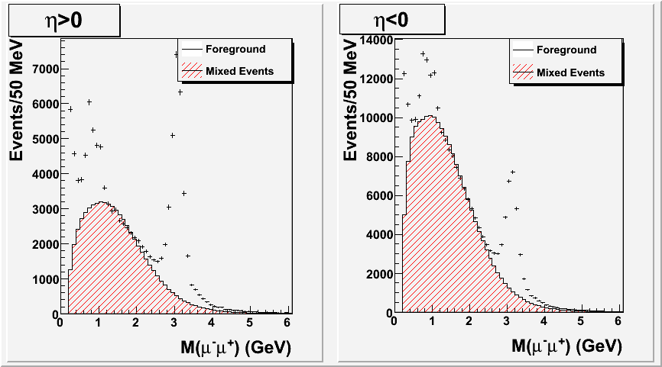
Mixed-Events technique for BG estimation
What were the main issues in the analysis
Background estimation below 1.5 GeV
y<0
y>0
Low mass dimuon pairs could have contamination of correlated pion pairs
Neither mixed events or like-sign-pair method describes low mass region

Slide 17
Data χ²_{vtx} distrubtions
Spectra shown normalized to N_{total}
In unlike-sign signal region, χ²_{vtx} distribution is narrower
Tail in the signal region is due to background contamination
In like-sign events, χ²_{vtx} is slightly mass-dependent
Normalization function for background is mass-dependent

Slide 18
Non-resonant region χ²_{vtx} distributions and background formula
Non-resonant region: 1.5-2.5 GeV
Like-sign events matches well
the unlike-sign events
The small mis-match would lead
to an overall normalization factor
Background formula:
Overall normalization factor C (close to 1) is only necessary if using
like-sign events to derive the normalization function
Unlike-sign events can also be used to derive the normalization function,
then there is no need for the factor C.

Slide 19
Procedure of yield extraction
Fitting function: polynomial background (defined by estimated shape)+ two gaussian (φ,ω) and one relativistic BW (ρ)
Fitting parameters:
Free within predefined errors:
Within 2(4)σ: M(φ), σ(φ), M(ω), σ(ω), M(ρ), Γ(ρ) (Total:6, from simulation)
Within 1(3)σ: Polynomials: up to 7 (6/5) parameters (6th /4th/3rd, order)
Free parameter:
N(φ), N(ω), N(ρ)/N(ω) (Total: 3)
N(ρ)/N(ω): 0.25-4 (Model-dependent, but has small effect on φ yield)
Fixed without change
L: Orbital Angular momentum quantum number for ρ Breit-Wigner shape
R: Interaction Radius for ρ Breit-Wigner shape
Total number of parameters: 18 (6th polynomial)
Variation of fits: two fitting ranges (0.4-2.6, 0.5-2.5 GeV)
two sets of fitting parameters ranges
18 values for each bin, systematic error due to yield extraction extracted from RMS

Slide 20
Systematics Study
Three main systematics Errors are included
Uncertainty in N_{coll} and centrality-dependent trigger efficiency correction factor (~10%)
Uncertainty in yield extraction (18 fits for each bin, 4-10%)
Three sets of fits
Nominal fitting procedure
Wider range of variation for fitting parameters (4/3 σ instead of 2/1 σ)
Wider fitting range (0.4-2.6 GeV, instead of 0.5-2.6 GeV)
Three different orders of polynomial for background parameterization
Two types of normalization
Uncertainty extracted from the RMS of 18 values for each bin
Uncertainty in south arm reconstruction efficiency
Using global uncertainty of 15%
Will be determined later from embedded simulation

Slide 21
Obtaining final φ R_{CP} values
Final values R_{cp} :Mean
Systematic error due to
yield extraction: RMS
Final statistical error:
Mean

Slide 22
Cuts defined by simulation
p_{T}
DG0
DDG0
y

Slide 23
x coverage from simulation

