Slide 1

Study of Forward J/ψ Production vs Event Multiplicity in p+p Collisions at PHENIX
Ming X. Liu
Los Alamos National Laboratory
(for the PHENIX Collaboration)

Slide 2
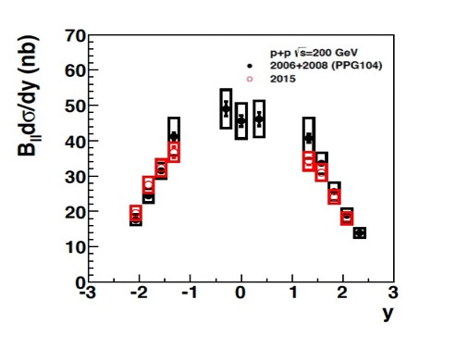
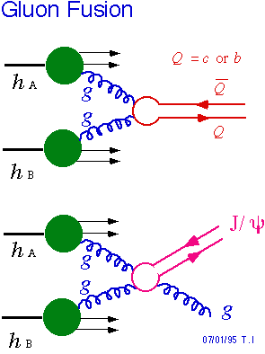
J/ψ Production in High Energy Collisions
How J/Psi are produced?
Perturbative + Non-perturbative
- J/Psi (c-cbar), a simplest QCD system
“c-cbar” pair from hard scattering
  pQCD:
    Single hard scattering
    Multiple semi-hard parton interactions (MPI)
  NRQCD models:
    Color Singlet (CS)
    Color Octet (CO)
  Jet fragmentation
“c-cbar” hadronization to J/Psi
  Color neutralization
  Interactions with QCD medium
PHENIX, PRC 102, 014902 (2020)
CS:
CO:

Slide 3

J/ψ Yields vs Event Multiplicity - Topology
MPI, co-mover/FSI
MPI, collision energy local density?
Evt_Multi
Evt_Multi
MPI, collision energy local density?
MPI, co-mover/FSI, all
Evt_Multi

Slide 4
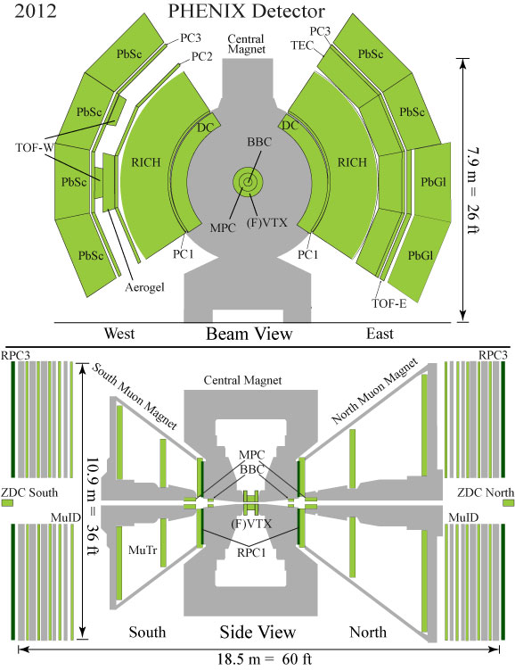
PHENIX Detector at RHIC
Central Arms | η | < 0.35
Identified charged hadrons
Neutral Pions
Direct Photon
J/Psi
Heavy Flavor
Evt_Multiplicity:
SVX:
| η | < 1
Muon Arms 1.2 < | η | < 2.4
J/Psi
Unidentified charged hadrons
Heavy Flavor
FVTX:
1.2< | η | < 2.4
BBC/MPC 3.1 < | η | < 3.9
Neutral Pion’s
Eta’s
BBC: MB Trigger
3.1< | η | < 3.9
ZDC |η| ~ 5.9
Neutrons
Notes:
4

Slide 5
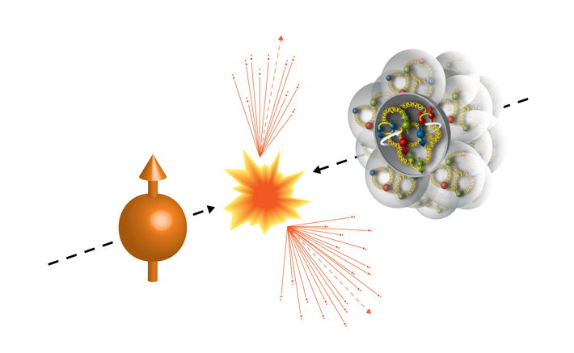
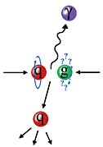
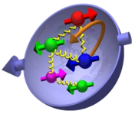
PHENIX Experiment in 2015 Run, 200GeV pp and pA
Transversely polarized p+p and p+Au/Al collisions at RHIC
  p+p: L_{NN} ~ 200 pb⁻¹
  p+Au: L_{NN} ~ 130 pb⁻¹
Run15 (2015)
100GeV/nucleon
100GeV
Au, Al
Polarized Proton

Slide 6
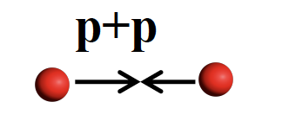
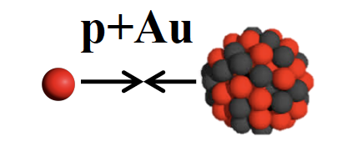
J/ψ Production in pp and pAu Collisions at PHENIX

Slide 7
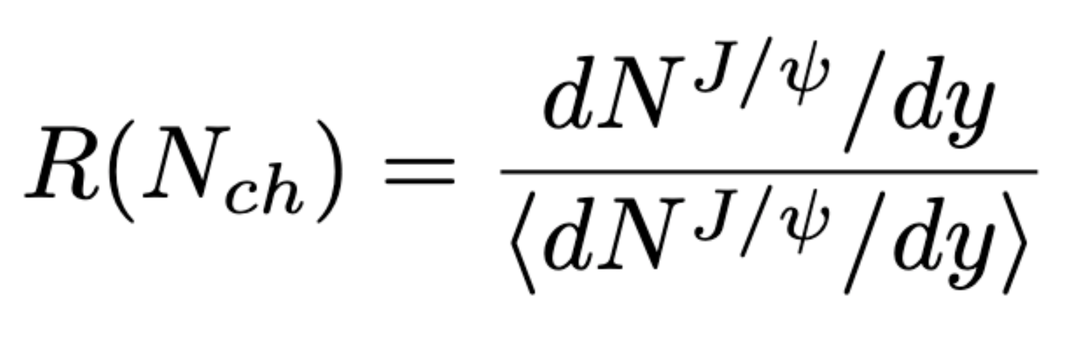
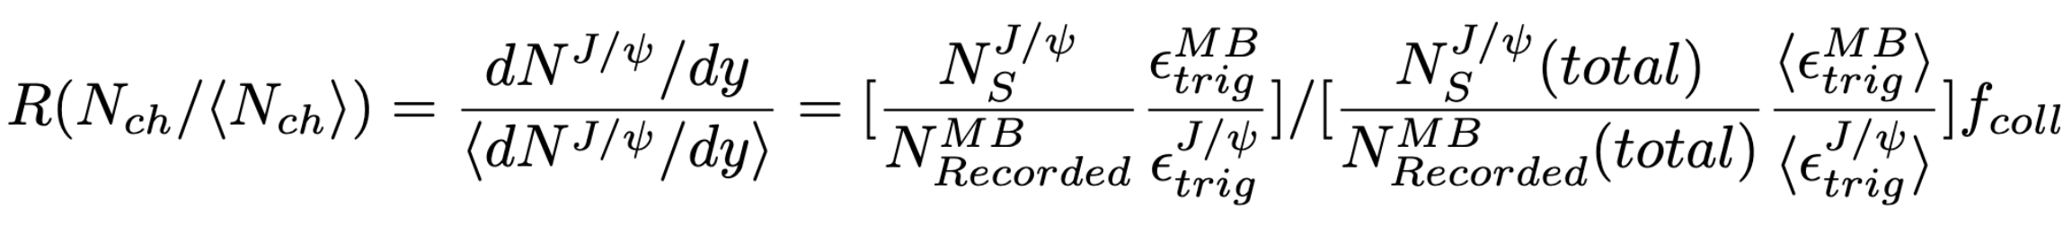
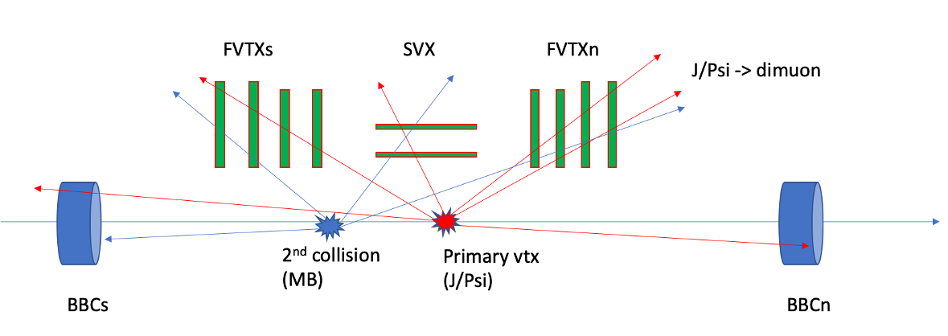
Our Measurements at PHENIX
J/ψ Relative Yields vs Event Multiplicity from FVTX and SVX

Slide 8
J/ψ Production: same kinematic region
RED = Tracklets (1.2 < eta < 2.4)
Green = North (J/Psi: 1.2 < y < 2.2)
Multiplicity ~ MPI contribution to the forward J/Psi production?

Slide 9
J/ψ Production vs Multiplicity at Midrapidity
RED = Tracklets (|eta|<1)
Green = North (J/Psi: 1.2 < y < 2.2)
~ less co-mover type FSI at high multiplicity

Slide 10
J/ψ Production: far-off kinematic region
RED = Tracklets (-2.4 < eta < -1.2)
Green = North (J/Psi: 1.2 < y < 2.2)
~ much less co-mover type FSI at high multiplicity

Slide 11
J/ψ Yields vs Event Multiplicity
RED = Tracklets (1.2 < eta < 2.4)
Green = North (J/Psi: 1.2 < y < 2.2)
Light Blue = South (J/Psi: -2.2 < y < -1.2)

Slide 12
J/ψ Yields vs Event Multiplicity
- subtract J/Psi dimuon contributions (I)
RED’ = Tracklets (1.2 < eta < 2.4),
[dimuon subtracted]
Green = North (J/Psi: 1.2 < y < 2.2)

Slide 13
J/ψ Yields vs Event Multiplicity
- subtract J/Psi dimuon contributions (II)
RED’ = Tracklets (1.2 < eta < 2.4),
[dimuon subtracted]
Green = North (J/Psi: 1.2 < y < 2.2)
[inclusive tracklets]
(Before)
(After)

Slide 14
Consistency Check: North vs South Arms (I)
RED = Tracklets (1.2 < |eta| < 2.4)
Green = North (J/Psi: 1.2 < y < 2.2)
Light Blue = South (J/Psi: -2.2 < y < -1.2)

Slide 15
Consistency Check: North vs South Arms (II)
RED = Tracklets (1.2 < |eta| < 2.4)
Green = North (J/Psi: 1.2 < y < 2.2)
Light Blue = South (J/Psi: -2.2 < y < -1.2)

Slide 16
Consistency Check: North vs South Arms
RED = Tracklets (1.2 < eta < 2.4)
Green = North (J/Psi: 1.2 < y < 2.2)
Light Blue = South (J/Psi: -2.2 < y < -1.2)

Slide 17
J/ψ Yields vs Event Multiplicity: All Together
RED = Tracklets (1.2 < eta < 2.4)
[dimuon subtracted]
Green = North (J/Psi: 1.2 < y < 2.2)
[inclusive tracklets]
Light Blue = South (J/Psi: -2.2 < y < -1.2)
- Less MPI contribution to the forward J/Psi production?

Slide 18
Comparation with other Results (I)
ALICE:
STAR:
PHENIX:

Slide 19
Comparation with other Results (II)
ALICE:
STAR:
PHENIX:

Slide 20
Summary and Outlook
First measurements of the relative J/ψ yields in the forward rapidity vs normalized event charged particle multiplicity in pp at 200GeV
  Strong N_{ch} dependence observed when signal and Evt_Mult in the same kinematics
  N_{ch} dependence reduced significantly if remove the dimuon contribution to Evt_Mult
  Dimuon subtracted N_{ch} dependence similar to the ones from Evt_Mult determined in a far kinematic region from the signal
Physics discussions
  J/ψ mostly from g+g interactions at RHIC
  “c-cbar” favors CS state, at low pT?
  Less MPI contributions at RHIC?
p+Au analysis in progress, expect preliminary results soon

Slide 21


Slide 22
Backup slides

Slide 23
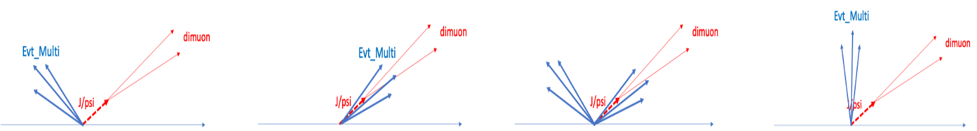
J/Psi Production and QCD Underlying Events

Slide 24
Comparation with other Results (III)
ALICE:
STAR:
PHENIX:

Slide 25
J/ψ Yields vs Event Multiplicity: All Together
RED = Tracklets (1.2 < eta < 2.4)
[dimuon subtracted]
Green = North (J/Psi: 1.2 < y < 2.2)
[inclusive tracklets]
Light Blue = South (J/Psi: -2.2 < y < -1.2)
- Less MPI contribution to the forward J/Psi production?

Slide 26
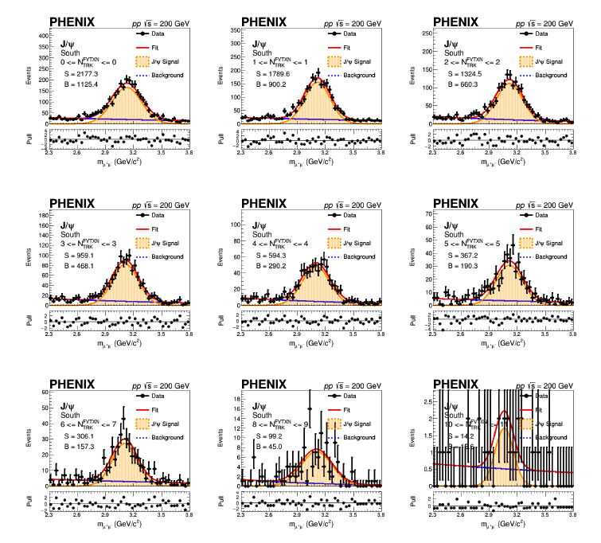
J/ψ Dimuon Mass Fits

Slide 27
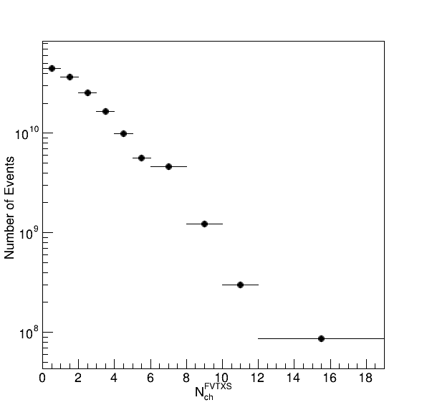

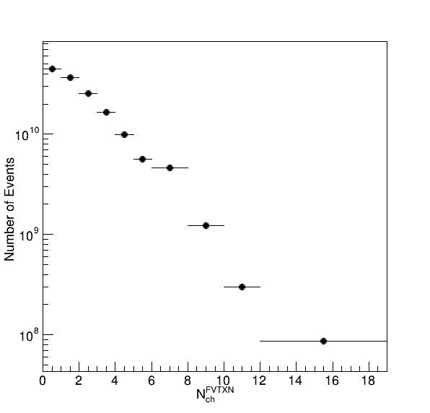
MB Events’ FVTX and SVX Tracklet Raw Distributions

Slide 28
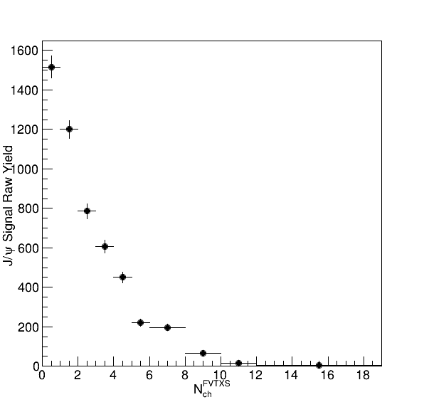
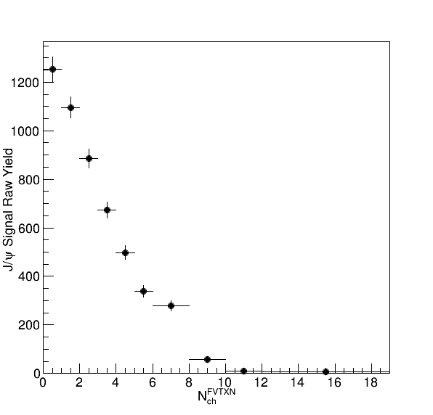
Raw J/ψ Counts vs FVTX and SVX
FVTXS
VTX
FVTXN

Slide 29
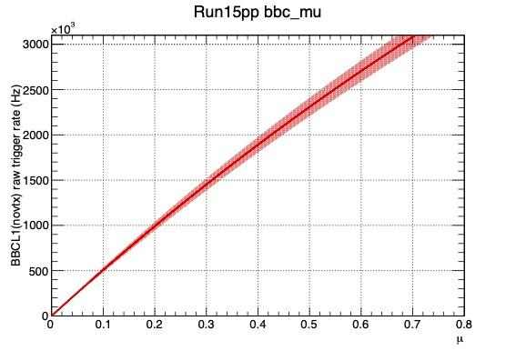
Multiple Collision Probability Table
BBCLL1_Eff = 55 +/ 5 % for run15 pp MB; 79 +/-2 % for hard scattering
BBC Rate kHz | Mean_Mu | Prob. to have 2+ collisions
250 | 0.05 | 0.12%
500 | 0.1 | 0.47% <pAu>
1,000 | 0.2 | 1.8% <pp>
1,500 | 0.31 | 3.9%
2,000 | 0.43 | 6.9%
2,500 | 0.55 | 10%

Slide 30
FVTX Track Multiplicity Correlations

Slide 31
FVTX Track Multiplicity Correlations: MB
FVTXS_MB
SVX_MB

Slide 32
FVTX Track Multiplicity Correlations: MB
FVTXS_MB, SVX>4
FVTXS_MB, SVX>6
FVTXS_MB, SVX>2

Slide 33
DIS2022
Summary of J/Psi results from STAR and ALICE

Slide 34


STAR: J/Psi multiplicity at mid-rapidity
MB: non-single diffractive p+p collisions
  VPD: 4.4 < eta < 4.9
  BBC: 3.3 < eta < 5.0
J/Psi:
  |y|<1, e+e-,
  BEMC triggered
  1<pT<1.5; 1.5 < pT<4, 4< pT<14

Slide 35
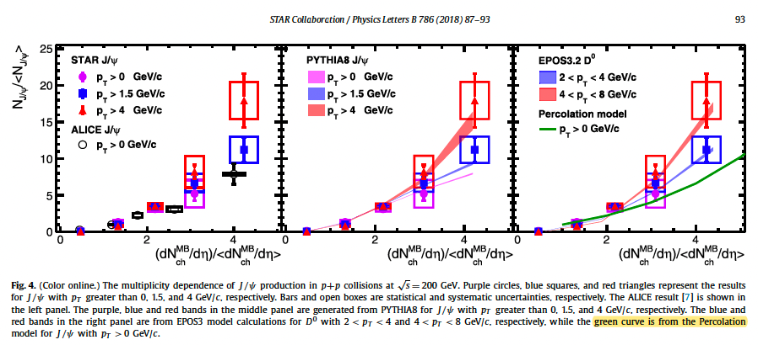
STAR
My note: possible more “color singlet” contributions at low pT [Blue],
and more ”color-octet” at high pT [Red]?

Slide 36
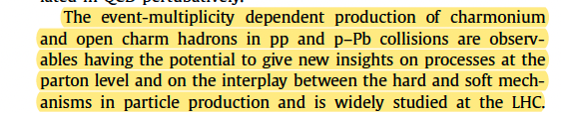
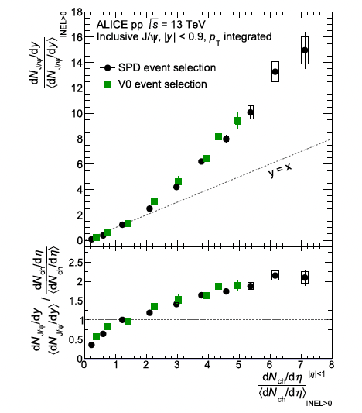
ALICE p+p: 7, 13 TeV
Pp 7 TeV
  Mid and forward rapidity
Pp 13 TeV
  |y|<0.9
  Nch: |eta|<1;
  -3.7 < eta < -1.7
  2.8 < eta < 5.1
  INEL > 0: Nch>0 at |eta|<1
  Didn’t subtract the di-eletron from N_ch?!

Slide 37
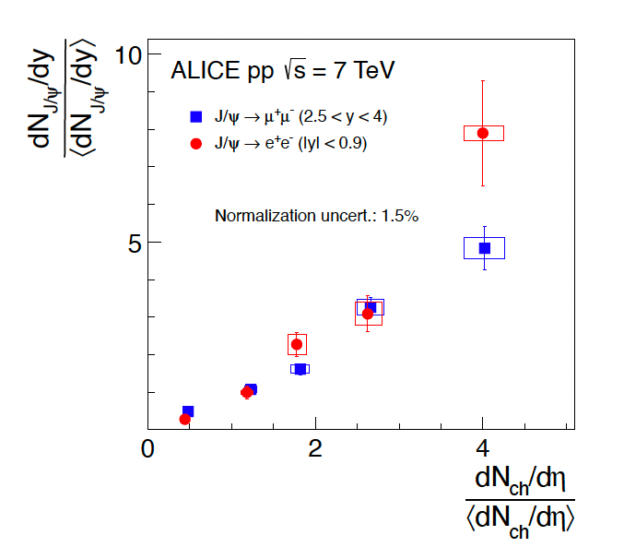
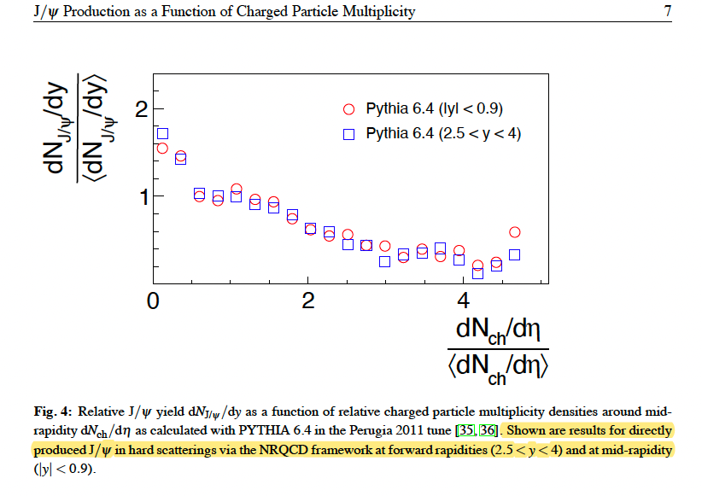
ALICE pp 7TeV: Pythia 6.4, without MPI

Slide 38
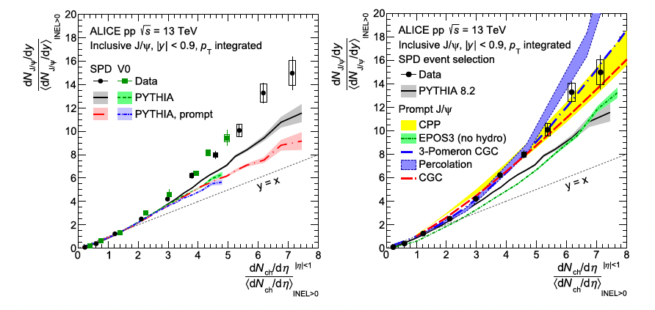
ALICE 13TeV: |y|< 0.9

Slide 39
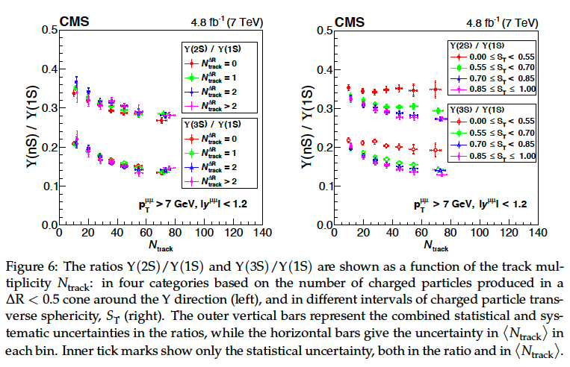
CMS Upsilons: pp

Slide 40
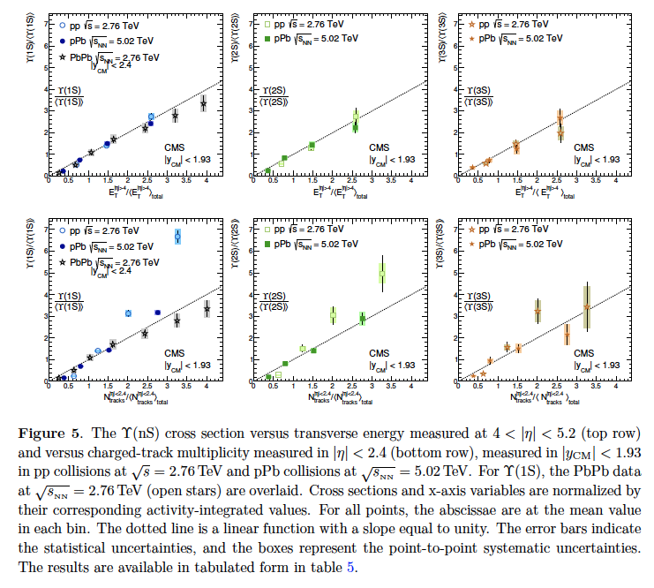
CMS (2013)

Slide 41
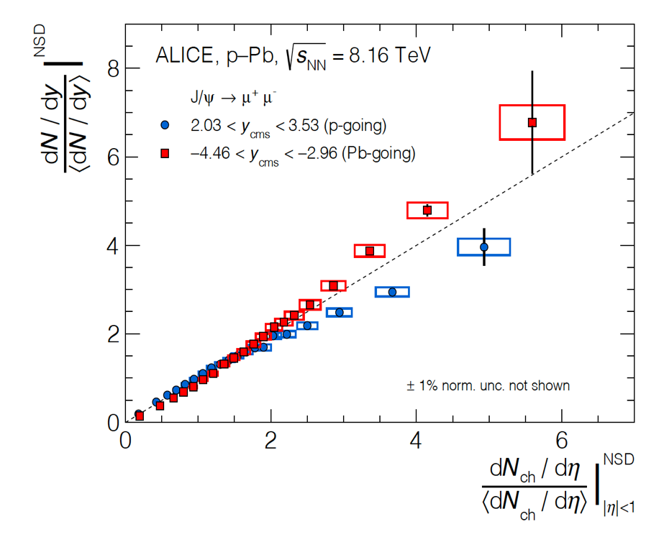
Recent Studies of Small Systems at LHC and RHIC
ALICE@LHC, JHEP 2009 (2020) 162
STAR @RHIC
Consistent with incoherent multi-parton interactions;
MPI and formation of QGP droplets

Slide 42
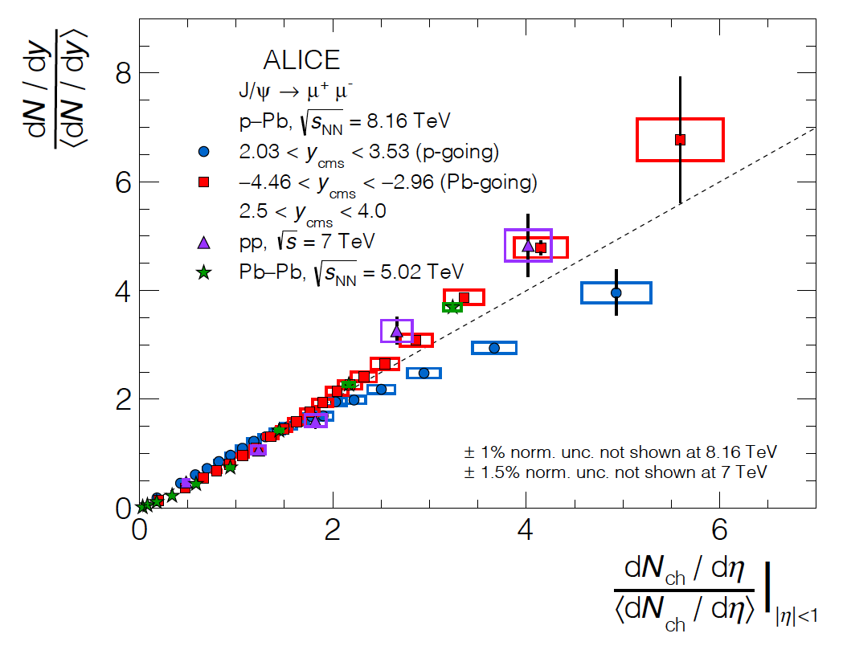
And it seems universal …
J/Psi: pp, pPb, PbPb
D-mesons: p-Pb

Slide 43
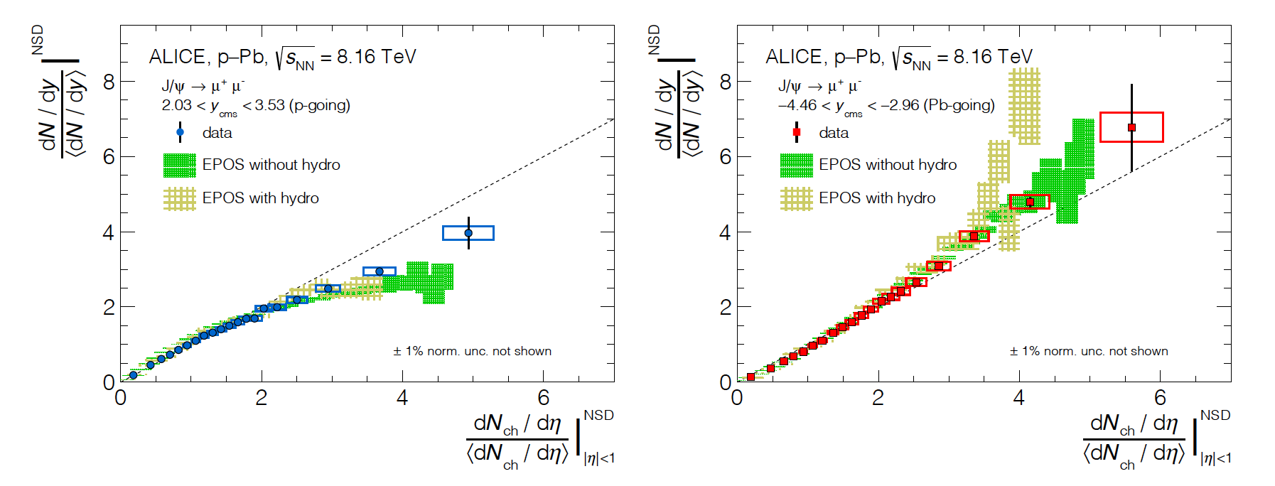
What could contribute to this?
ALICE@LHC, JHEP 2009 (2020) 162
J/Psi production: from incoherent superposition of parton-parton collisions in pp and p+A (MPI)
Consistent with two-particle correlation in multiplicity dependence, jet-like peak invariant with evt_mult, particles being produced via incoherent fragmentation of MPI
Possible formation of small QGP droplets from MPI

