Slide 1
Forward J/Psi Production vs Event Multiplicity in p+p Collisions
Ming X. Liu
Los Alamos National Laboratory
for the PHENIX Collaboration

Slide 2
J/Psi Production in Hadronic Interaction
How hadron particles are produced in high energy collisions?
From quark/gluon to hadrons

Slide 3
Our Measurements J/ψ Relative Yields vs Event Multiplicity from FVTX and SVX

Slide 4
DIS2022
Summary of J/Psi results from STAR and ALICE

Slide 5
STAR: J/Psi multiplicity at mid-rapidity
MB: non-single diffractive p+p collisions
VPD: 4.4 < eta < 4.9
BBC: 3.3 < eta < 5.0
J/Psi:
|y|<1, e+e-,
BEMC triggered
1<pT<1.5; 1.5 < pT<4, 4< pT<14

Slide 6
STAR

Slide 7
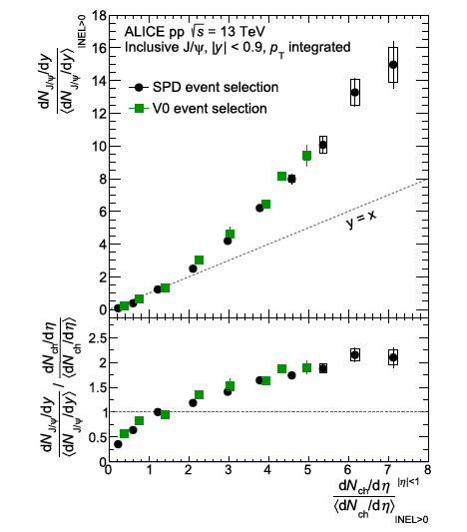
ALICE p+p: 7, 13 TeV
Pp 7 TeV
Mid and forward rapidity
Pp 13 TeV
|y|<0.9
Nch: |eta|<1;
-3.7 < eta < -1.7
2.8 < eta < 5.1
INEL > 0: Nch>0 at |eta|<1
Didn’t subtract the di-eletron from N_ch?!

Slide 8
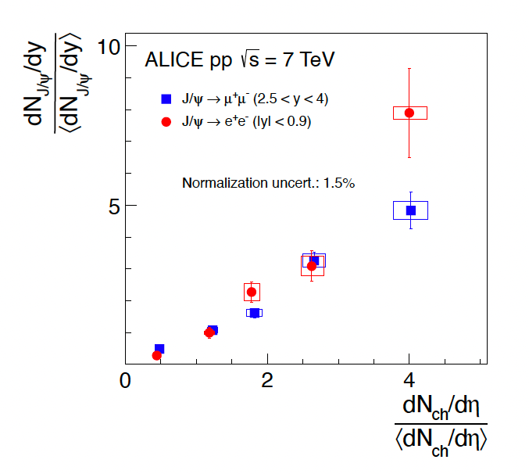
Pp 7TeV: Pythia 6.4

Slide 9
ALICE 13TeV: |y|< 0.9

Slide 10
CMS Upsilons: pp

Slide 11
CMS (2013)

